Slide 1
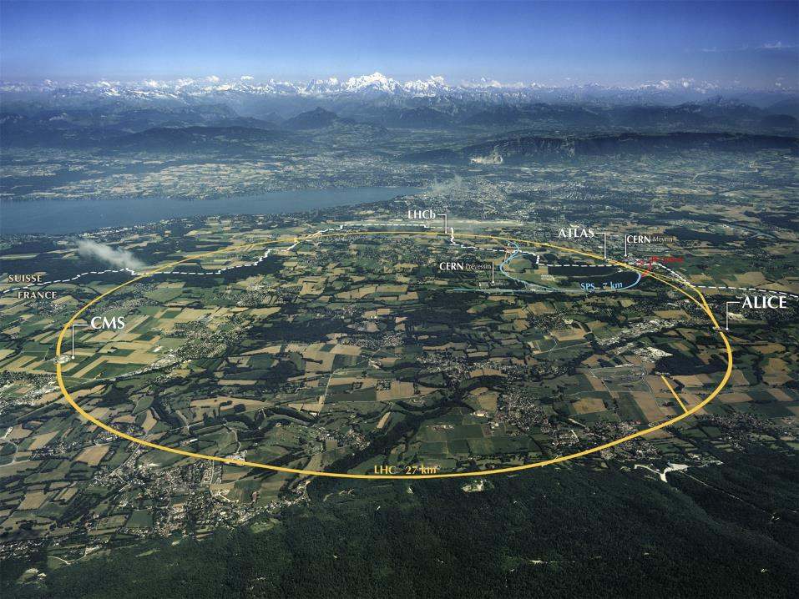
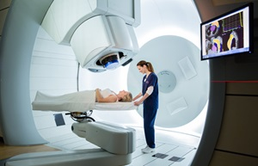

The technology of helium synchrotron: technology readiness and research needed
Maurizio Vretenar
CERN, ATS/DO Accelerator and Technology Projects and Studies
25 May 2023
Particle therapy - future for the Baltic States?

Slide 2
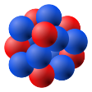
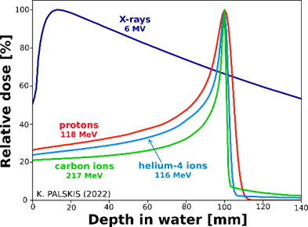

Treating cancer with radiation (photons and ions)
Photon (X-ray)
no mass
Proton
mass: 1 m₀
Helium ion
mass: 4 m₀
Carbon ion
mass: 12 m₀
m₀= 1.67 × 10⁻²⁷ kilograms
Linear Energy Transfer (LET) increases with the mass of the particle →
the higher the particle mass, the higher will be the energy at entrance required to reach a deep-seated tumour (30-35 cm)
Examples from plot above:
Photons (X-rays): 6 MeV
Protons: 118 MeV
Helium ions: 116 MeV
Carbon ions: 217 MeV
In general, the higher the energy the larger (and more expensive) the particle accelerator

Slide 3
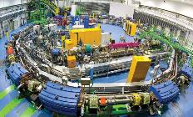
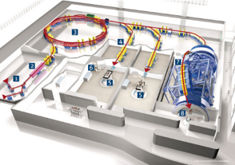
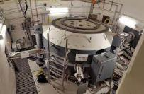
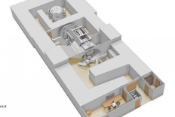
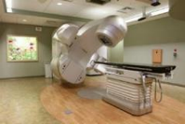

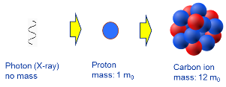
Comparing accelerator designs
Ions deliver more energy to the tissues but need more energy to enter the body → factor 2.8 in accelerator diameter going from protons to carbon
courtesy IBA
Synchrotron, carbon ions
~5,000 m²
>200 M€
Cyclotron, protons
~500 m²
~few 10 M€
Linac, X-rays
~50 m²
~few M€
Anything in between?

Slide 4
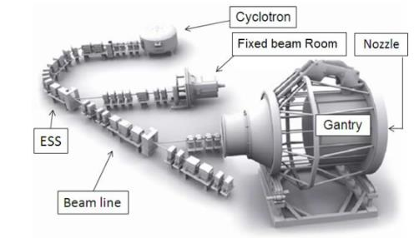
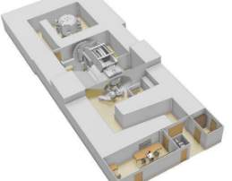
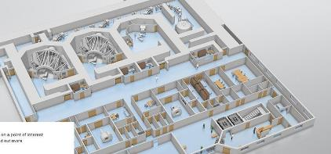
Proton therapy accelerators: cyclotrons
At present, the cyclotron is the best accelerator to provide proton therapy reliably and at low cost (3 vendors on the market).
Critical issues with cyclotrons:
Energy modulation (required to adjust the depth and scan the tumour) is obtained with slow sliding plates that become rapidly radioactive → need large shielding.
Very effective for protons, becomes complex and expensive for heavier particles.
ProteusOne and ProteusPlus turn-key proton therapy solutions from IBA (Belgium)

Slide 5


The CERN Next Ion Medical Machine Study
Proton therapy is now commercial, and CERN, as an international organisation, cannot interfere with a mature commercial market.
Heavy ion therapy is still in an early phase despite its advantages. Its diffusion is limited mainly by:
  Size and cost of the accelerator;
  Lack of experimental data.
New demands from the medical community and new opportunities from recent research can be integrated in a newly designed ion therapy facility.
Approval in 2019 of the Next Ion Medical Machine Study (NIMMS) in the frame of the CERN Knowledge Transfer for Medical Applications.
In line with CERN mission, the goal of NIMMS is to build on CERN expertise to develop a portfolio of technologies that can be used in a next generation facility, more than developing a single design (NIMMS as a «toolbox»).

Slide 6


NIMMS Collaborations - 2023
Basic requirements of a next
generation cancer therapy accelerator:
Operation with multiple ions: protons, helium, carbon, oxygen, etc.
Lower cost and dimensions, compared to present;
Faster dose delivery with higher beam intensity and new delivery schemes (FLASH and mini-beams).
A gantry device to precisely deliver the dose to the tumour.
Parallel operation for biomedical research and treatment.
SEEIIST (South East Europe Int. Inst. for Sustainable Technologies)
TERA Foundation (Italy)
GSI (Germany)
INFN (Italy)
CIEMAT (Spain)
Cockcroft Institute (UK)
University of Manchester (UK)
CNAO (Italy)
Imperial College (UK)
MedAustron (Austria)
U. Melbourne (Australia)
ESS-Bilbao (Spain)
Riga Technical University (Latvia)
Thessaloniki University (Greece)
Sarajevo University (Bosnia &H.)
PARTREC Groningen (NL)
TENMAK (Turkey)
CNPEM (Brazil)
Partners can use the NIMMS technologies to assemble their own optimized facility

Slide 7
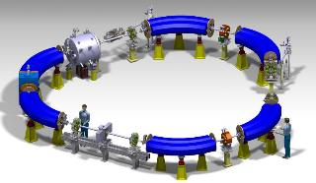
Main features of an accelerator for the Baltics
As discussed within the CERN Baltic Group:
An advanced accelerator capable of cancer treatment with modern techniques in parallel with a robust experimental programme (in-vitro and in-vivo).
Main synchrotron parameters:
maximum magnetic rigidity 4.5 T/m (220 MeV/u for 4He, penetration 30 cm in water).
4 x 10¹⁰ ions extracted, to irradiate a 1 litre tumour with 2 Gy.
Synchrotron because of size, flexibility, cost, available expertise at CERN and elsewhere:
Designed for helium ions, can accelerate protons at treatment energy;
Can use protons at higher energy for full body on-line radiography;
Can accelerate other ions (e.g. carbon) for biophysics experiments.
Can be equipped with modern FLASH extraction and can produce mini-beams.
The linac injector can be used in parallel for production of radioisotopes (e.g. 211At) using helium ions or protons.
Based on CERN experience in small synchrotrons (LEAR, LEIR, ELENA)
Preliminary circumference 33 m

Slide 8

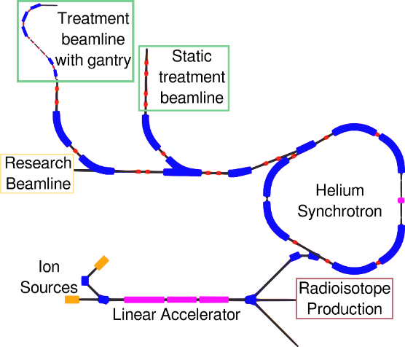

Layout of a facility for treatment and research with helium and proton beams
Two beamlines for treatment, one for research.
Rotating superconducting gantry.
Injector with parallel radioisotope production
Surface ~2,000 m2
NIMMS Collaboration, IPAC22 Conference
10 m
Small triangle-shaped synchrotron with FLASH extraction capability

Slide 9
Part by E. Benedetto

Slide 10
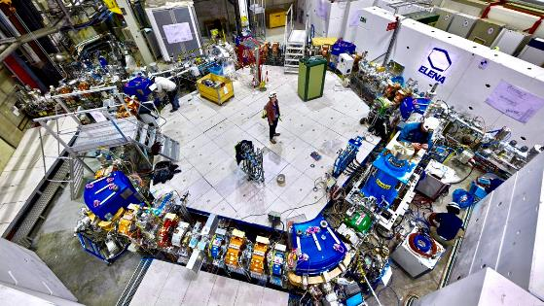
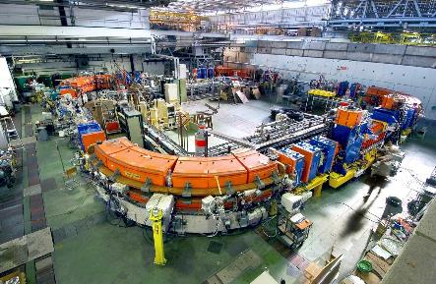
Small synchrotrons for research – CERN expertise
The ELENA synchrotron at CERN (antiproton decelerator)
6 magnets for 60deg each, 30 m circumference (same symmetry and size as He synchrotron).
Built at CERN (using industrial and home-made components) between June 2011 (approval by CERN Council) and November 2017 (first antiproton beam).
Part of the team that built this accelerator is still available and is collaborating with the design of the helium synchrotron for cancer therapy (e.g. 3D drawings)
The LEIR synchrotron at CERN (heavy ion accumulator)
4 magnets for 90deg each, 80 m “circumference”.
Built at CERN in 1978-82, refurbished in 2003-06, still operating.
Team with huge competences in low-energy ion beams.

Slide 11
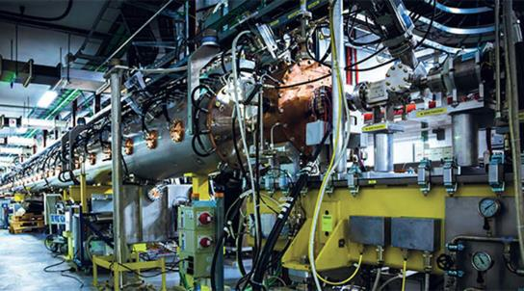
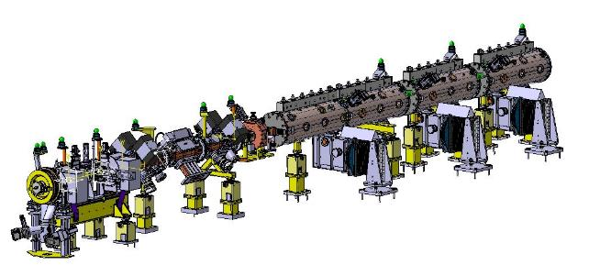
The linac injector
The Injector Linac is based on the design of Linac4 at CERN
86-m long linear accelerator built in 2008-17 at CERN, using components from industry or provided by other laboratories.
The He-synchrotron injector can use the same design.
6 m
He-synchrotron injector
Linac4

Slide 12

Technology Readiness Level – by component
Component | Technological Level | Status | Procurement
Magnets | Standard | Being designed | Build in industry
Injection | Improved from existing | Being designed | Build on CERN drawings
Slow extraction | Improved from existing | Septa being designed | Build on CERN drawings
FLASH extraction | New (TRL 5) | Being studied | Build in industry
Radio-Frequency | Standard | Drawings at CERN | Build in industry
Beam instrumentation | Standard | CERN drawings or commercial | Build or procure in industry
Injector linac | Standard | Adapt CERN drawings | Assemble in house
RFQ injector | Standard |  | Procure or assemble
Ion sources | Standard | Commercial | Build in industry
Dosimetry | Standard, new for FLASH | Partly to be designed
Beam lines | Standard | Commercial | Build in industry
Controls | Standard (to adapt) | Commercial | Build with industry

Slide 13
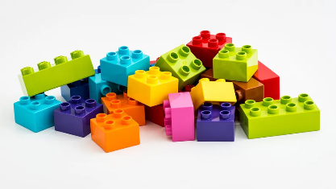
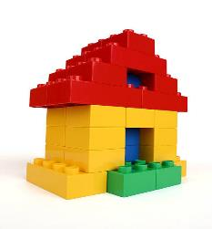
A few comments and caveats
All components are quite standard, apart from new features as FLASH.
R&D is ongoing on some components (injection and extraction magnets) to reduce electrical consumption and possibly cost.
Construction consists in integrating parts made in industry, taking responsibility for the overall design, integration, and performance.
Some initial design can be made at CERN, then finalised in another institution or in industry.
Because of final medical licensing, medical QA has to be respected from the initial design!

Slide 14
Research plans and goals
Goal: complete a Technical Design Report (CERN-NIMMS deliverable) by June 2025. The TDR will be public and available to anyone willing to build the facility.
Plan to achieve this deliverable:
1. Continue the R&D on FLASH extraction, dosimetry and delivery to patient (1 PhD student starting end 2023), coming to a coherent conceptual design.
2. Analyse the lattice (2023, Technical Student + expert), the septa (2023/24, Technical student + expert), design the magnets (2023/24, Technical student + expert), analyse and complete the design of missing elements (injection, diagnostics, RF, dosimetry, 2024/25, PhD student + experts).
The Technical Design Report will be coordinated by CERN and should receive a small CERN grant for 2024/25. External contributions via NIMMS are welcome and will accelerate the process and increase the amount of detail of the TDR. Note that while the linac will be part of it, the gantry will not be included in this study.

Slide 15
Medical licensing, construction/commissioning plan
An important point is that the machine will have to be licensed for treatment – this might be even easier for helium ions than for protons for which commercial companies are already on the market. Contribution from an expert in medical licensing (consultant, company) connected with the final user and its rules and procedures will be of paramount importance.
Timeline: after TDR, final design phase, construction, commissioning.
Commissioning can be done in stages:
Helium and proton beam from linac injector, for radioisotopes.
Helium and proton beam from synchrotron, to experimental area.
Proton beam to fixed beam treatment room, medical certification.
Helium beam to fixed beam treatment room, medical certification (of accelerator, the particle is assumed will be done by other therapy centres)
Proton and helium beam to gantry treatment room.

Slide 16
Available expertise and construction strategy
Confirmed contributions to the Technical Design Report are expected to come from:
CERN: part-time contributions from experts, supervision of students, student grants, overall coordination.
TERA Foundation(s): contribution from synchrotron expert, general design, supervision of students (and possibly one grant).
Riga Technical University: contributions on medical physics, gantry design, other.
Lower level contributions expected from GSI and DKFZ (Germany), CNAO (Italy), etc.
Note that CERN is not going to take responsibility for the final design, construction and commissioning of the facility.
After completion of the TDR, an agreement can possibly be negotiated with the CERN management for support with final design and procurement of the components, against a financial contribution (MedAustron model).

Slide 17
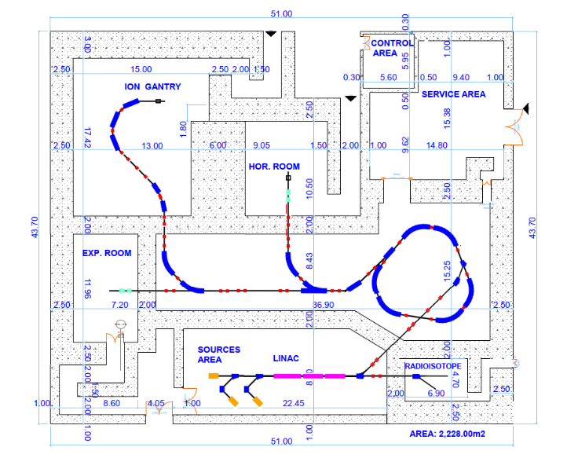
Main features of the proposed facility
Dual use, patient treatment and research.
Modular design, options can be added/removed (radioisotopes, gantry, treatment rooms, experimental rooms).
Flexible operation with protons and/or helium. Operation (and medical certification) can be adapted to future medical requirements.

