Slide 1

PRISMAP Questionnaire
The European
Medical Radionuclide Program
MAIJA RADZINA, Edgars Mamis, Laura Saule, Elina Pajuste, Marika Kalnina, Thomas Cocolios, Zeynep Talip, Mikael Jensen, Ulli Köster, Thierry Stora

Slide 2
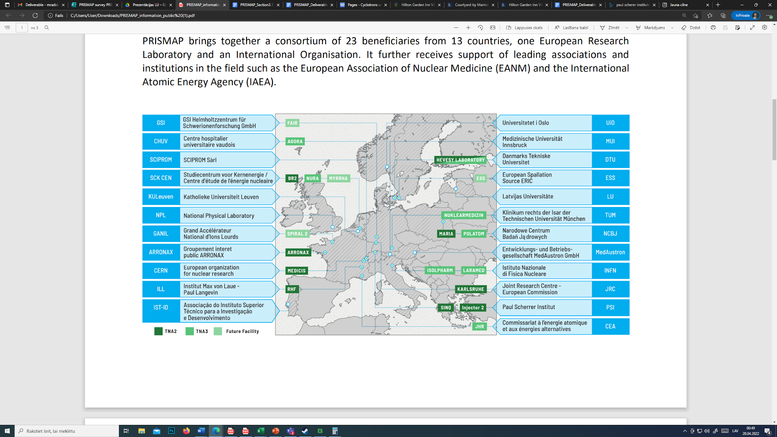
PRISMAP 23 partners, 13 countries
Slide 2/19
Maija Radzina, Riga, Latvia
www.prismap.eu
25th of May, 2023

Slide 3
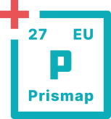
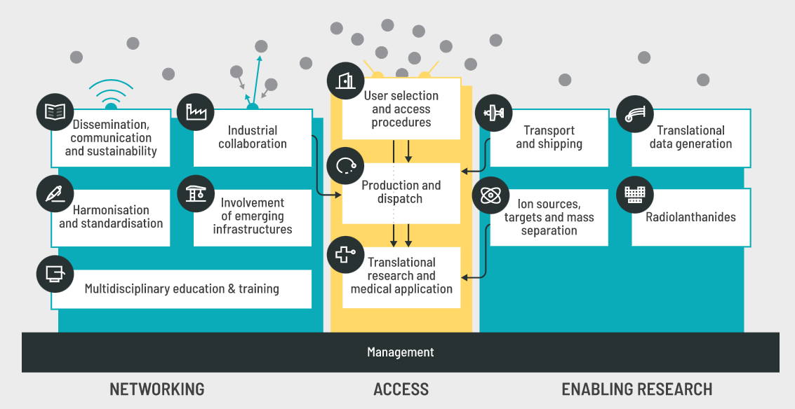
Slide 3/19
Maija Radzina, Riga, Latvia
www.prismap.eu
25th of May, 2023

Slide 4

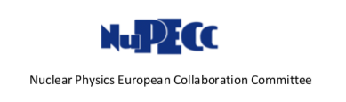
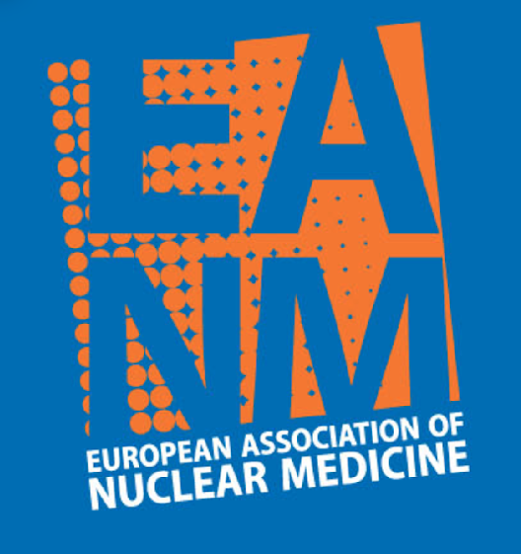
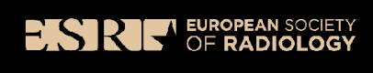
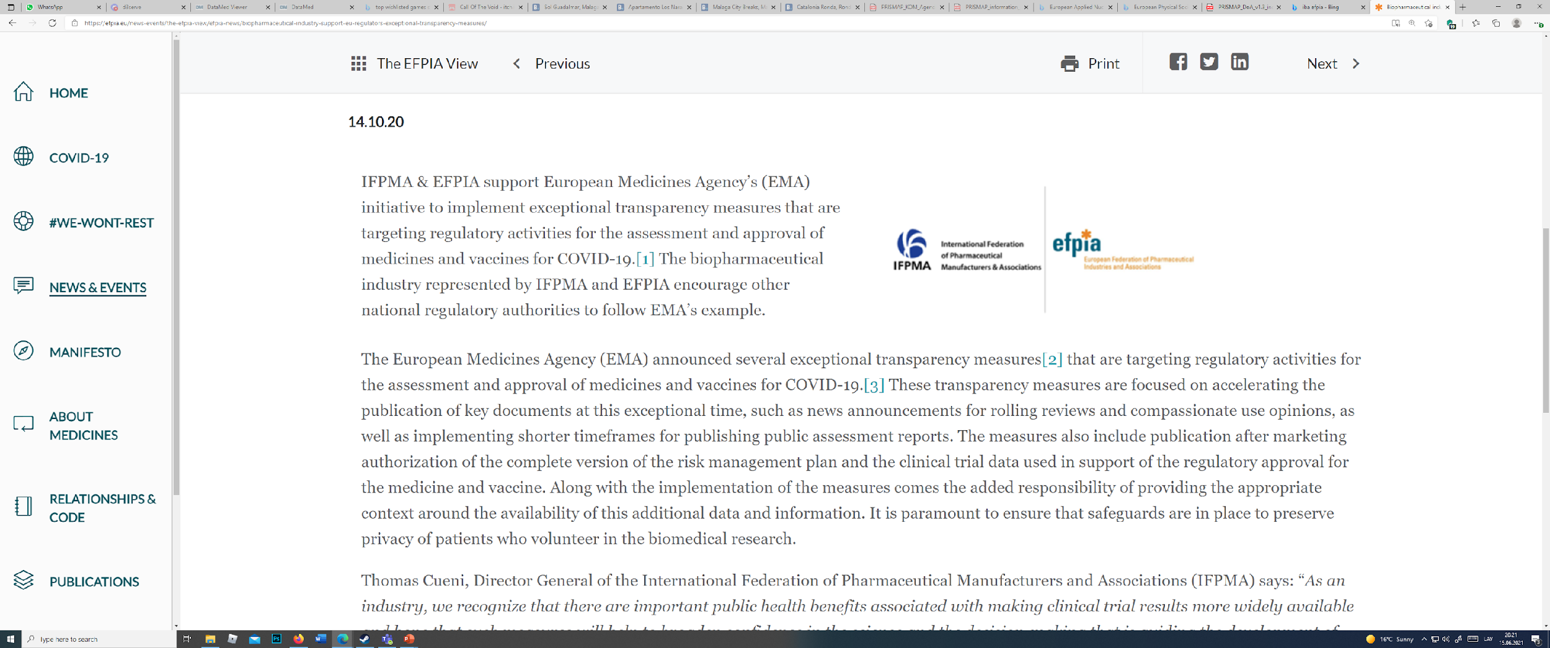
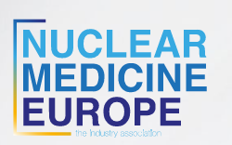
NETWORKING
Universities
University hospitals
Reasearch Laboratories, Institutes – radiopharma, radiochemistry, radiophysics
International professional organizations (EANM, ESR, ESHI etc.)
International authorities - IAEA, NuPECC etc.
Industrial authorities (NMEU, EFPIA, IBA, ITM etc.)
  Cyclotron and RPH equipment manufacturers
  Nuclear reactor facilities
  Radiopharmaceutical companies
  Detector manufacturers
End users – nuclear medicine, molecular imaging and radioisotope specialists, researchers, students
Slide 4/19
Maija Radzina, Riga, Latvia
www.prismap.eu
25th of May, 2023

Slide 5
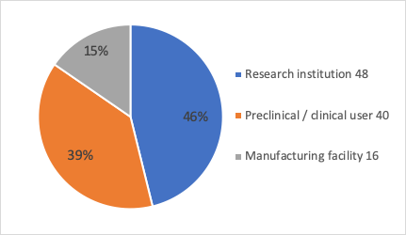
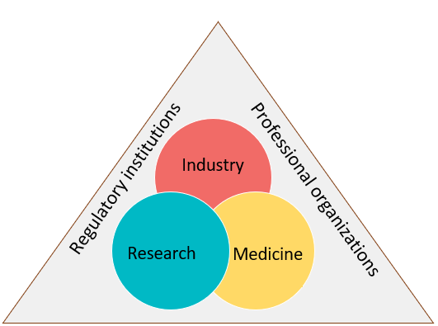
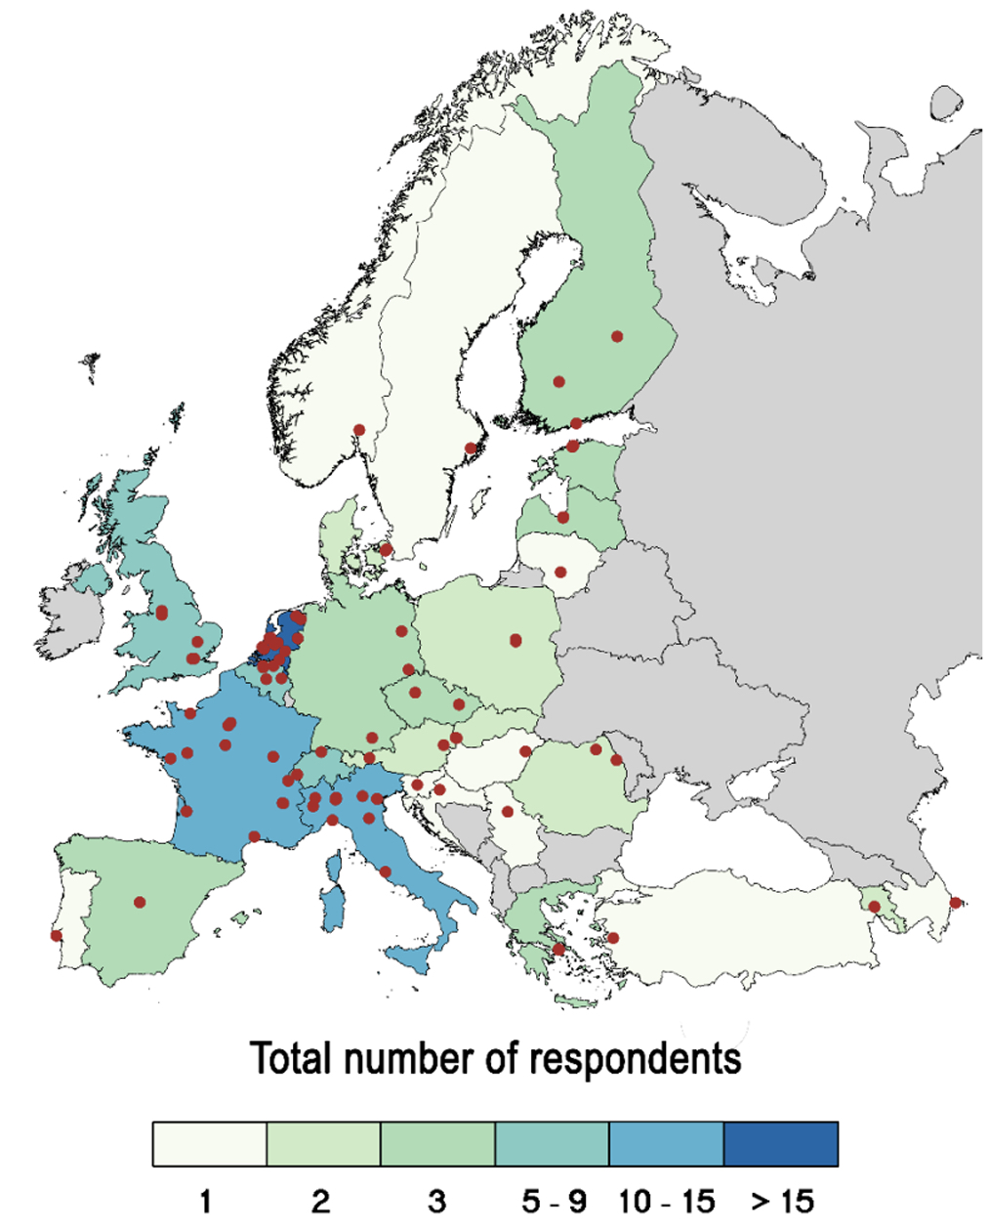
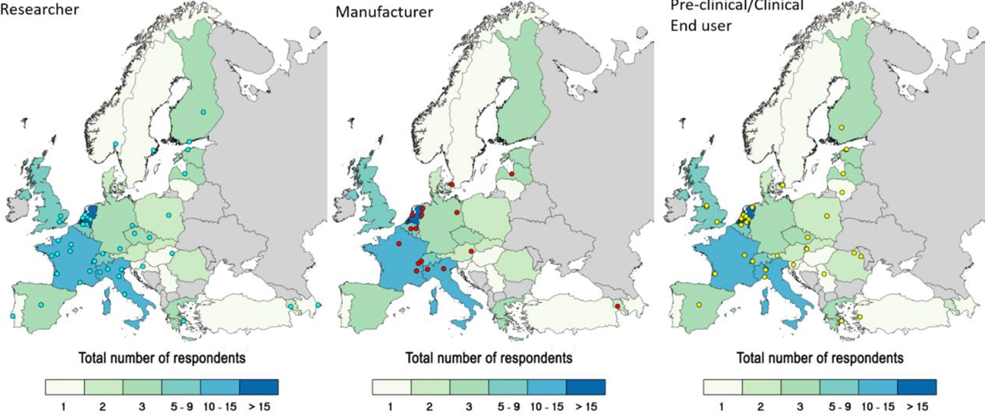
Questionnaire
114 respondents
30 countries
104 different institutions
Year 2022
Actual data: 20.05.2023, graphs by K. Palskis
Slide 5/19
Maija Radzina, Riga, Latvia
www.prismap.eu
25th of May, 2023

Slide 6
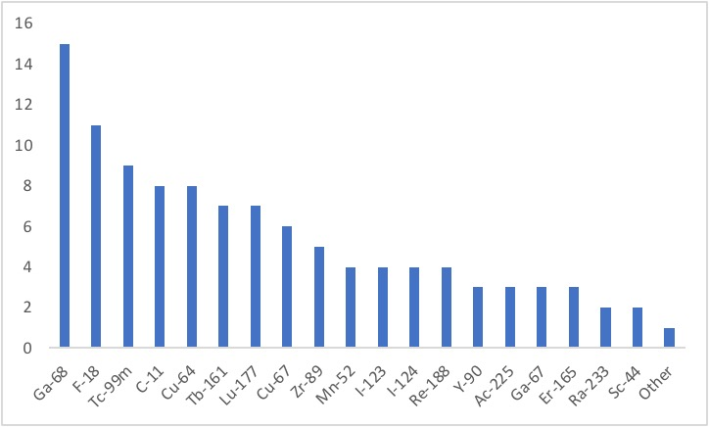
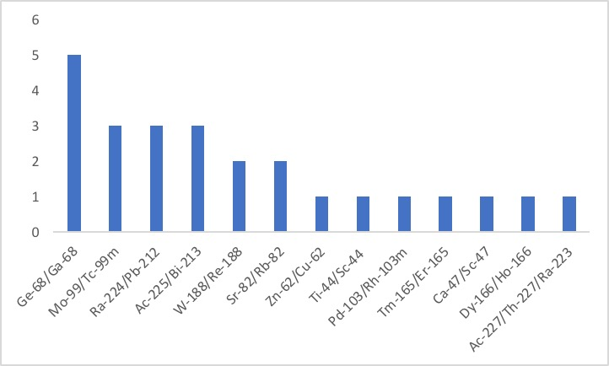
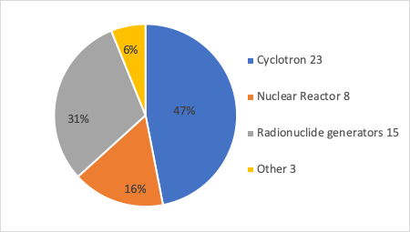
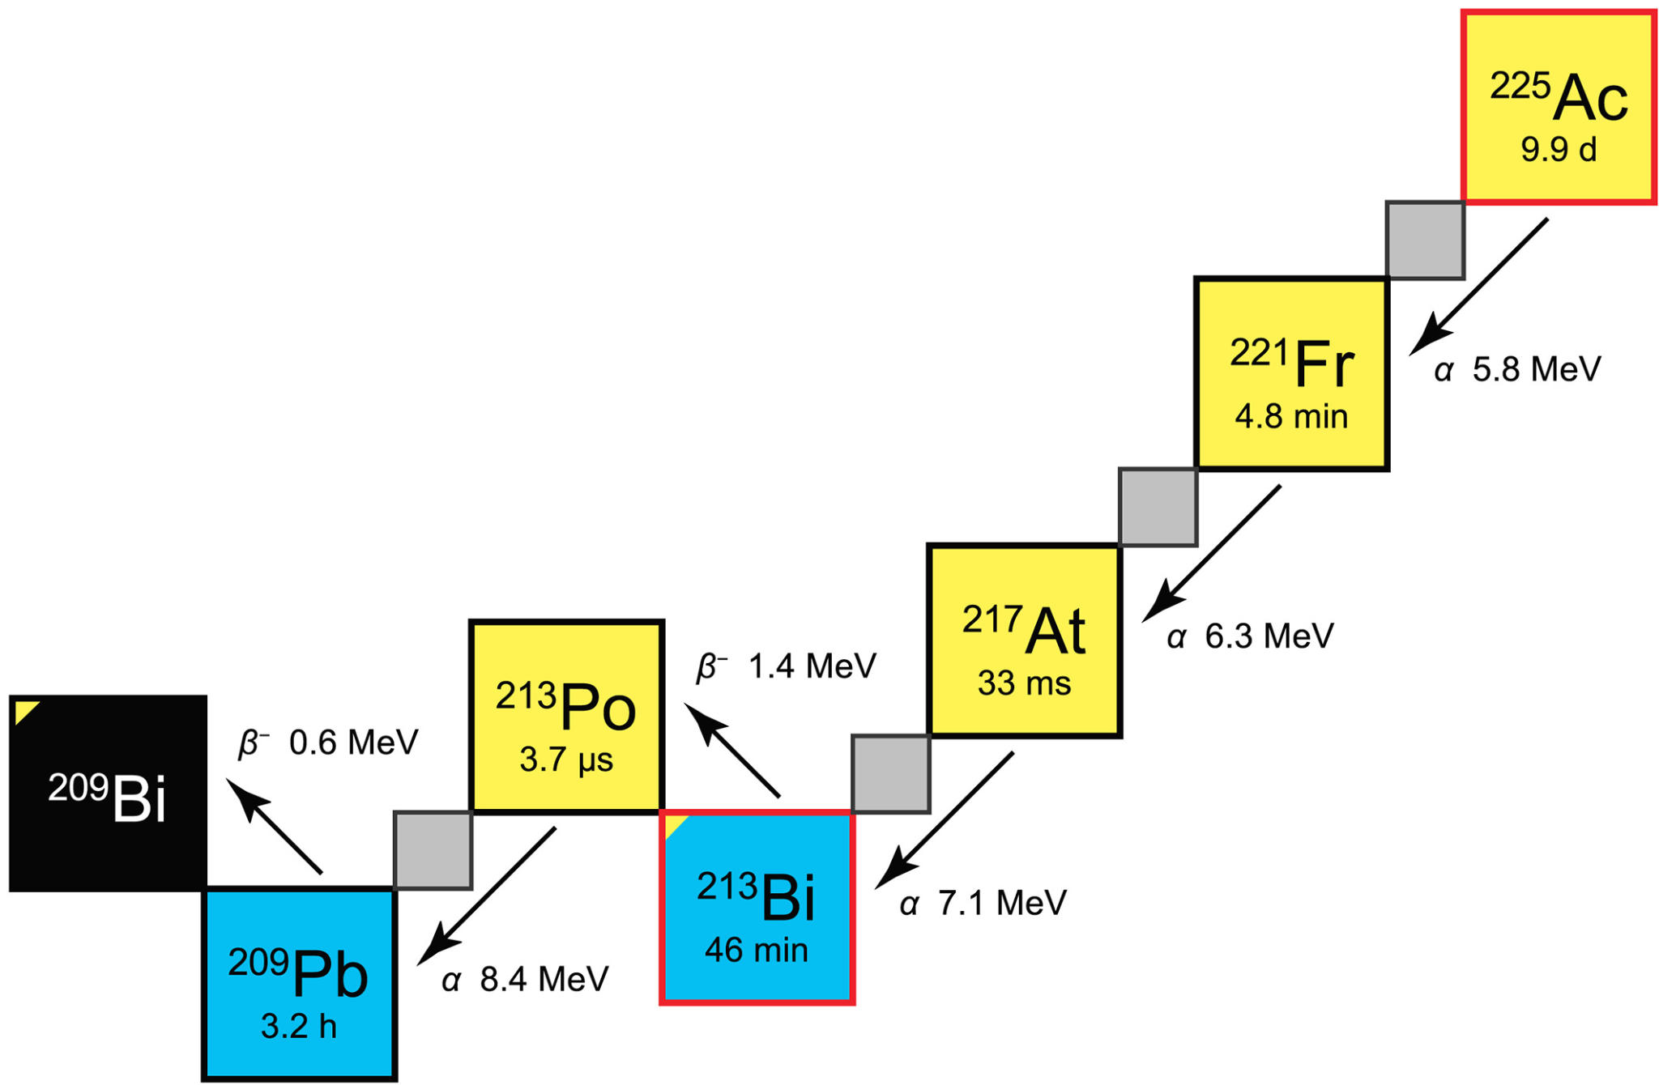
PRODUCTION + RESEARCH OF RADIONUCLIDES
Radionuclides produced by the manufacturing and research institutions
Radionuclide generators produced (and) studied
Other: ^{155,161}Tb, ¹⁸⁸W, ^{195m}Pt, ²¹¹At, ¹³⁵La, ^{53,54}Mn, ⁴⁷Sc, ¹⁰³Pd, ¹⁰³Ru, ¹¹¹Ag, ^{129m}Xe, ^{131m}Xe, ¹⁴³Pr, ¹⁴⁹Pm, ¹⁵³Sm, ¹⁶⁵Er, ¹²⁸Ba, ²¹²Pb
Out of 64 respondents from research institutions and manufacturing facilities, 31 respondent companies or Research institutions produce radionuclides (~30% of respondents)
Increasing demand for the alpha emitting radionuclide ²²⁵Ac
The aim is to indicate more sites that would offer such increasing interest radionuclides is still an open objective with high importance
Ac-225
T_{1/2} = 9.92 d
Slide 6/19
Maija Radzina, Riga, Latvia
www.prismap.eu
25th of May, 2023

Slide 7
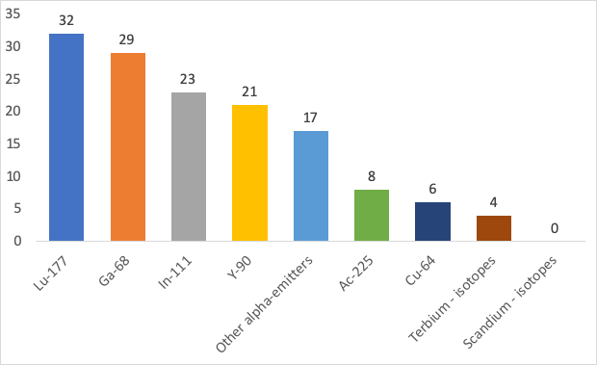
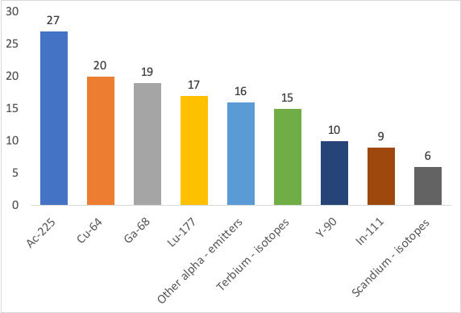
RADIONUCLIDES USED BY END USERS
NOW
2-5 years
None (except for iodine radiopharmaceuticals) of the current responder institutions yet are interested in possibilities of “matched pair” RPH's such as Tb, Y, Cu and Sc radionuclides in the near future, this probably reflect the still insufficient pre-clinical data and/or availability of such radionuclides
¹²³I-¹³¹I as Iodine (23 resp.)
[⁶⁸Ga]Ga-DOTA-peptides - [¹⁷⁷Lu]Lu-DOTA-peptides (22 resp.)
[⁶⁴Cu]Cu-peptides- [¹⁷⁷Lu]Lu-peptides (20 resp.)
^{99m}Tc- [²²³Ra]RaCl₂ (19 resp.)
[¹⁸F] PSMA - [¹⁷⁷Lu] Lu-PSMA (17 resp.)
[¹²³I] mIBG – [¹³¹I]-mIBG (11 resp.)
[⁶⁴Cu]Cu-peptides-[¹⁷⁷Lu] Lu-peptides (17 resp.)
[¹⁸F] PSMA - [¹⁷⁷Lu] Lu-PSMA (16 resp.)
[⁶⁸Ga]Ga-DOTA-peptides - [¹⁷⁷Lu]Lu-DOTA-peptides (14 resp.)
[⁶⁸Ga] Ga-PSMA - [¹⁷⁷Lu] Lu-PSMA (13 resp.)
[¹⁸F]NaF – [²²³Ra]RaCl₂ (8 resp.)
Theranostic pairs
Slide 7/19
Maija Radzina, Riga, Latvia
www.prismap.eu
25th of May, 2023

Slide 8
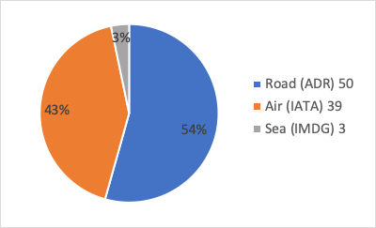
DISTRIBUTION OF RADIONUCLIDES
24 respondent companies/institutions distribute RN to national external research institutes, radiopharmaceutical producers or users
½ of the responders who distribute already have national and international distribution routes and methods established, including intercontinental
The most often mentioned RN suppliers:
ITM in Garching (ITG)
Curium
Mallinckrodt
Polatom
SCK-CEN
IRCCS
GE
Eckert & Ziegler
Arronax
Novartis
IBA
Oncoinvent
Bayer
The main limitations or transportation constraints:
regulatory limitations/customs clearance
lack of harmonised import/export legalisation
need for complex supply chains
licensing
Necessity to transfer patients to other countries for specified Nuclear Medicine examinations and/or treatment procedures were required in up to 70 % of end-user respondents for following reasons: unavailable radiopharmaceutical access, unavailable radionuclide or no reimbursement by the national healthcare system
Majority is transported by road
Slide 8/19
Maija Radzina, Riga, Latvia
www.prismap.eu
25th of May, 2023

Slide 9
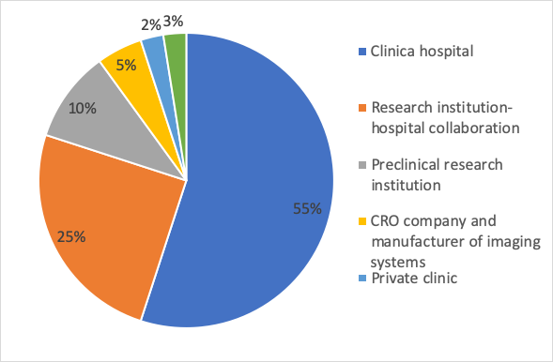
END USER QUESTIONNAIRE
Total 40 respondents
End users are interested in new radionuclides and pharmaceuticals for research and preclinical/clinical purposes as well as technology advancements that shows their interest in development
Main research interests:
oncology
cardiology
infection and inflammation
endocrinology
neurology
animal PET/CT or PET/MR with experimental long term animal facilities for radionuclide therapy studies
Slide 9/19
Maija Radzina, Riga, Latvia
www.prismap.eu
25th of May, 2023

Slide 10
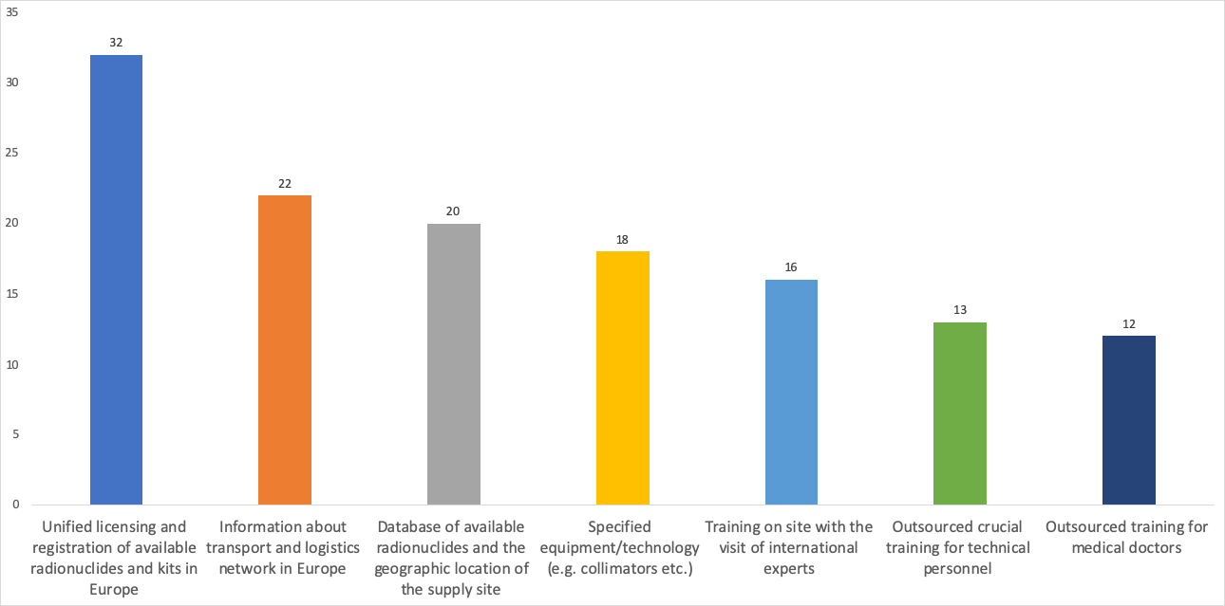
PRE-CLINICAL/CLINICAL USER NEEDS FOR DAILY PRACTICE
Slide 10/19
Maija Radzina, Riga, Latvia
www.prismap.eu
25th May 2023

Slide 11
RESEARCH AND DEVELOPMENT ACTIVITIES
80% of respondents indicated that their R&D activities would benefit from collaboration/cooperation, offered by efforts of the PRISMAP consortium already at this stage
Equipment for research purpose in nuclear pre-clinical and clinical environment:
Animal SPECT/CT or SPECT/MR (32 resp.)
Animal PET/CT or PET/MR (30 resp.)
Experimental long term animal facilities after radiation exposure (20 resp.)
PET, PET/CT or PET/MR (17 resp.)
SPECT, SPECT/CT or SPECT/MR (17 resp.)
There is an interest in collaborating with PRISMAP consortium members to foster or use radionuclides and expertise offered for pre-clinical and clinical applications and studies
Main radionuclides of interest for research in following years:
¹⁴⁹Tb, ¹⁵²Tb, ¹⁵⁵Tb, ¹⁶¹Tb, ²²⁵Ac, ⁸⁹Zr, ⁶⁷Cu, ⁶⁴Cu, ¹⁶⁵Er/¹⁶⁹Er, ⁴⁷Sc, ⁴⁴Sc, ¹⁷⁷Lu, ²¹¹At, ¹⁸⁸Re
Slide 11/19
Maija Radzina, Riga, Latvia
www.prismap.eu
25th of May, 2023

Slide 12

FOCUS ON THE BALTIC STATES
7 respondents from the region ( LV – 3, EE – 3 and LT – 1):
2 research institutions
4 clinical/pre-clinical users
1 manufacturing facility – Nucleo Ltd. (LV)
East Tallinn central
North Estonia medical centre
Tallinn university of Technology
Riga Technical University
Nucleo
ARS
Kaunas University Hospital
Additional data about NM diagnostic equipment availability (ART study, 2022)
Single Photon Emission Computed Tomography (SPECT)
LV – 2 (3 as of now), EE – 3 and LT – 8 14 units in total
Positron Emission Tomography (PET)
LV - 3, EE – 3 and LT – 2 8 units in total
Gamma cameras – not included in the study
Slide 12/19
Maija Radzina, Riga, Latvia
www.prismap.eu
25th of May, 2023

Slide 13
THE BALTIC STATES: RADIONUCLIDES USED CLINICALLY
THERAPY / THERANOSTICS
3 out of 4: Lutetium-177
Radium-223 (TAT)
2 centers: Iodine-131
East Tallinn central hospital:
Yttrium-90
Rhenium-186
Strontium-89
Samarium-153
DIAGNOSTICS
All facilities: ¹⁸F
Most of the facilities: ^{99m}Tc
2 centers: Iodine-123
THERANOSTIC PAIRS
[¹⁸F]PSMA-[¹⁷⁷Lu]Lu-PSMA ¹²³I-¹³¹I [¹²³I]mIBG-[¹³¹I]-mIBG ^{99m}Tc-²²³RaCl others: [^{99m}Tc]-peptides - [¹⁷⁷Lu]-DOTA-peptides
Slide 13/19
Maija Radzina, Riga, Latvia
www.prismap.eu
25th of May, 2023

Slide 14
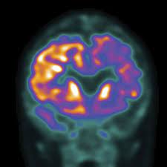
THE BALTIC STATES: APPLICATIONS
NOW
Oncology
Cardiology
Neurology
Infection and inflammatory response diagnostics
Endocrinology
Traumatology
Nephrology
Pulmonology
Gastroenterology (LT)
In 2-5 years
Most of the clinical facilities have indicated the goal to extend applications
for oncologic indications
Slide 14/19
Maija Radzina, Riga, Latvia
www.prismap.eu
25th of May, 2023

Slide 15
THE BALTIC STATES: RADIONUCLIDES OF THE FUTURE
Interests are common for most of the clinical Baltic facilities
¹⁷⁷Lu (more-widespread usage), ⁶⁸Ga, ⁶⁴Cu, Actinium-225 and Terbium isotopes
A large interest on Gallium – Lutetium theranostic pair has been reported
[⁶⁸Ga]Ga-DOTA-peptides-[¹⁷⁷Lu]Lu-DOTA-peptides
[⁶⁸Ga]Ga-PSMA- [¹⁷⁷Lu]Lu-PSMA
Cu-64 stands as a very good alternative to Ga-68 in these theranostic pairs due to increased half-life and decreased positron emission energy (increased spatial resolution)
Slide 15/19
Maija Radzina, Riga, Latvia
www.prismap.eu
25th of May, 2023

Slide 16
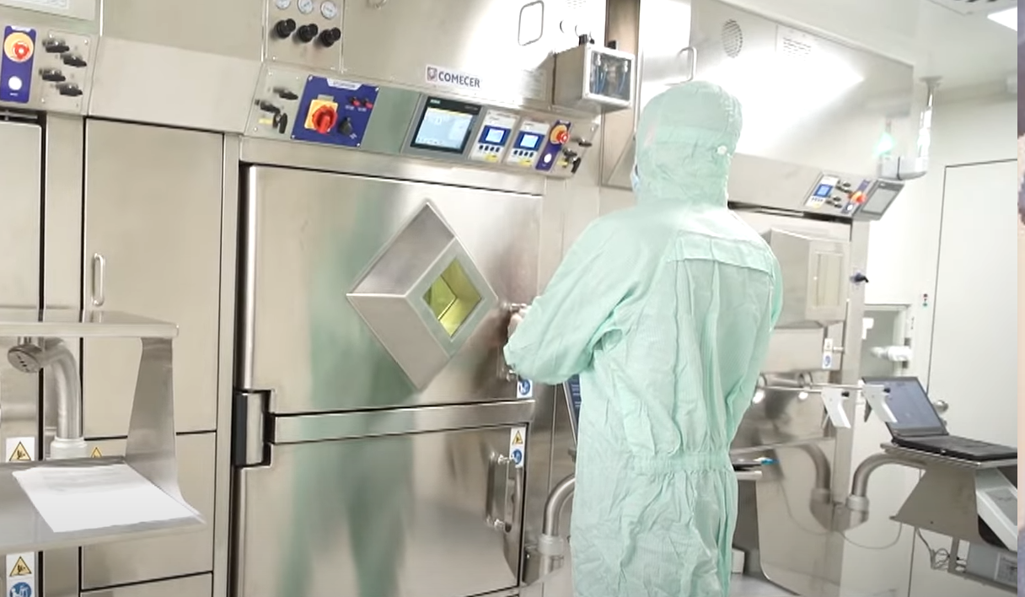
THE BALTIC STATES: MANUFACTURING PERSPECTIVE
Nucleo, Ltd.
In near future: Kauno Klinikos
Commercial 18 MeV IBA cyclotron
Radionuclides to be produced:
¹⁸F and short lived PET radionuclides (¹⁵O, ¹¹C)
⁶⁸Ga – via generator
Future plans: Scandium-44 and Scandium-47
further plans: ⁶⁴Cu and ⁶⁷Cu, isotopes from Terbium “family”
Commercial cyclotron (14-19 MeV)
Radionuclides to be produced:
¹⁸F and short lived PET radionuclides (¹⁵O, ¹¹C, ¹³N). ⁶⁸Ga
Future plans: Scandium-44 and Scandium-47
further plans: ⁶⁴Cu and ⁶⁷Cu, from terbium “family”: ¹⁵¹Tb and ¹⁵⁵Tb
Parallel isotope production would be the most beneficial as complementary, not competitive
Isotope production in the proposed facility – conventional PET isotopes limited to quantities necessary for radiotherapy treatment planning and studies (hypoxia markers, response assessment etc.) with the main focus on non-conventional, complementary isotopes of interest in the community
Slide 16/19
Maija Radzina, Riga, Latvia
www.prismap.eu
25th of May, 2023

Slide 17
THE BALTIC STATES: Research institutions
Research institution from Latvia (university)
Main research area - nanodosimetry
Level of training that institution provide - PhD programs; Academic bachelor and master study programs; Professional higher education programs; Professional further education courses; Workshops and seminars; Scientific visits
Riga Technical university
Research institution from Latvia (university)
Main research area - nanodosimetry
Level of training that institution provide - PhD programs; Academic bachelor and master study programs; Professional higher education programs; Professional further education courses; Workshops and seminars; Scientific visits
Tallinn University of Technology
Research institution from Estonia (university)
Main research area - safety culture; clinical audit of medical exposures; dose measurements and modelling
Level of training that institution provide - PhD programs; Academic bachelor and master study programs; Professional higher education programs; Professional further education courses; Workshops and seminars; Scientific fellowships; Scientific visits
Slide 17/19
Maija Radzina
25th of May, 2023

Slide 18
Potential benefits from collaboration/cooperation in obtaining emerging radionuclides with centralized and harmonized procedures and legislation, offered by efforts of the PRISMAP consortium:
Research and clinical use interest
Supply of medical Sc radionuclides for labeling studies
To assure availability of full spectrum of radionuclides and radiopharmaceuticals for institution needs
Dose calculations and dose modelling of emerging radionuclides
Slide 18/19
Maija Radzina
25th of May, 2023

Slide 19
Needs for improvement for daily practice of end users:
Database of available radionuclides and geographic location
Specified equipment/technology (e.g. collimators etc.)
Unified licensing and registration of available radionuclides and kits in Europe
Information about transport and logistics network in Europe
Training on site with the visit of international experts
Outsourced training for medical doctors
Outsourced training for other medical personnel
Outsourced training for technical personnel
Slide 19/19
Maija Radzina
25th of May, 2023

Slide 20


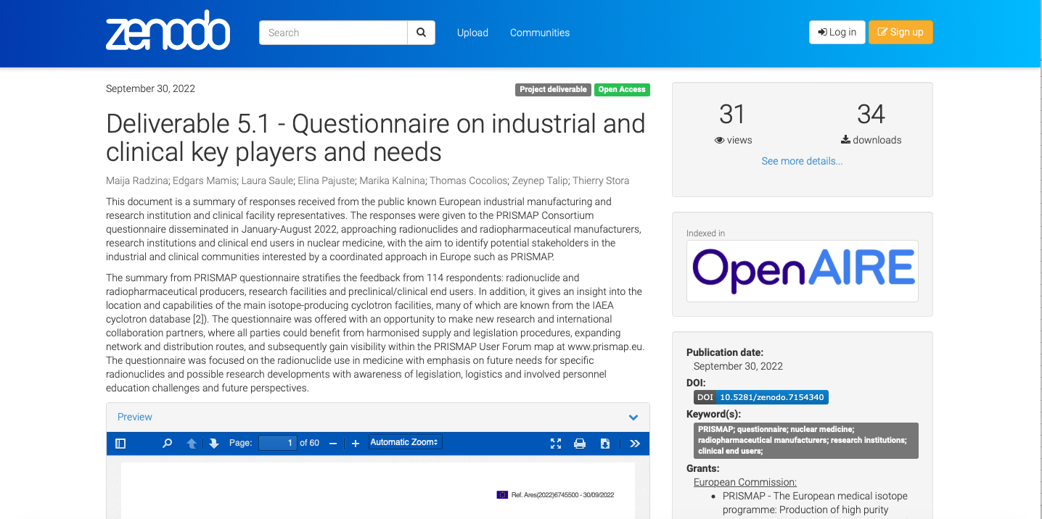





DELIVERABLE 5.1 - Questionnaire
https://zenodo.org/record/7154340#.Y39OaHZBw2w
Slide 20/19
Maija Radzina, Riga, Latvia
www.prismap.eu
25th of May, 2023

Slide 21
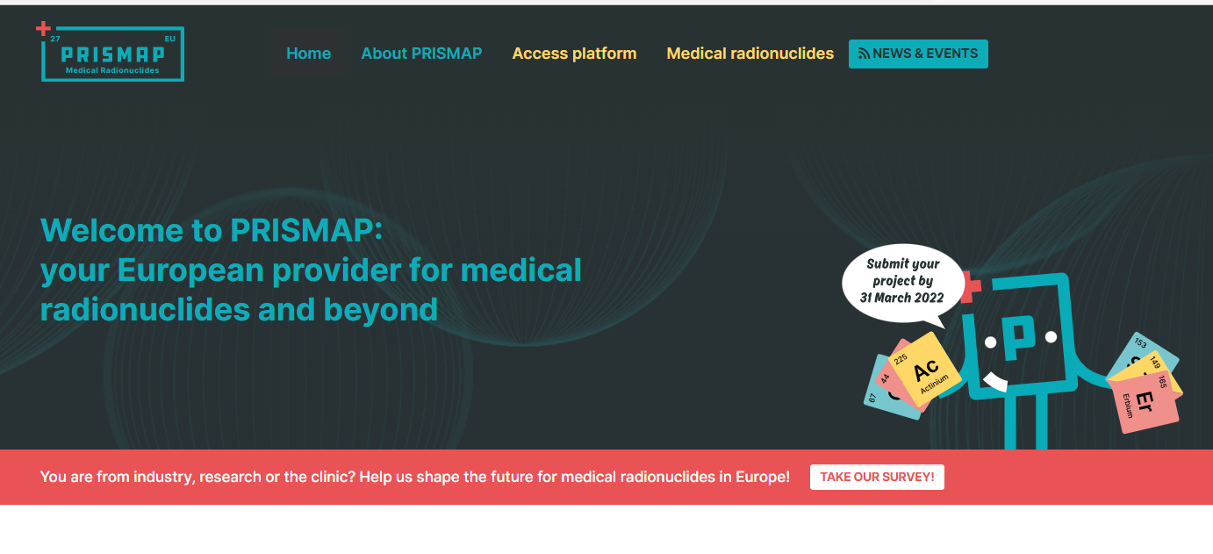
QUESTIONNAIRE IS STILL OPEN!
Slide 21/19
Maija Radzina, Riga, Latvia
www.prismap.eu
25th of May, 2023

Slide 22

FUTURE COLLABORATION
Provide access to new radionuclides and new purity grades for the medical research
New Applicants for PRISMAP Project calls in partnership with Industry
Create a common entry port and web interface to the starting research/user community
Enhance clarity and regulatory procedures to foster the radiopharmaceuticals research
Improve the delivered radionuclide data and regulation, along with biomedical research capacity
Ensure long-term sustainability of PRISMAP - Pre-clinical/clinical partnership
www.prismap.eu
This project has received funding from the European Union’s Horizon 2020 research
and innovation programme under grant agreement No 101008571 (PRISMAP)
Slide 22/19
Maija Radzina, Riga, Latvia
www.prismap.eu
25th of May, 2023
Notes:
New Applicants for PRISMAP Project calls in partnership with Industry
Industry meets Academia meetings/ joint Workshops
Industrial partner’s visibility on PRISMAP map
Pre-clinical/clinical partnership

