Slide 1


Radionuclide production and translational research
Edgars Mamis
University of Latvia, CERN
25/05/2023

Slide 2
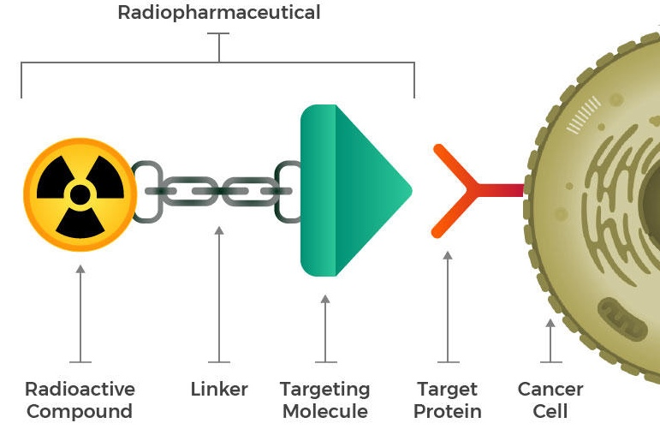
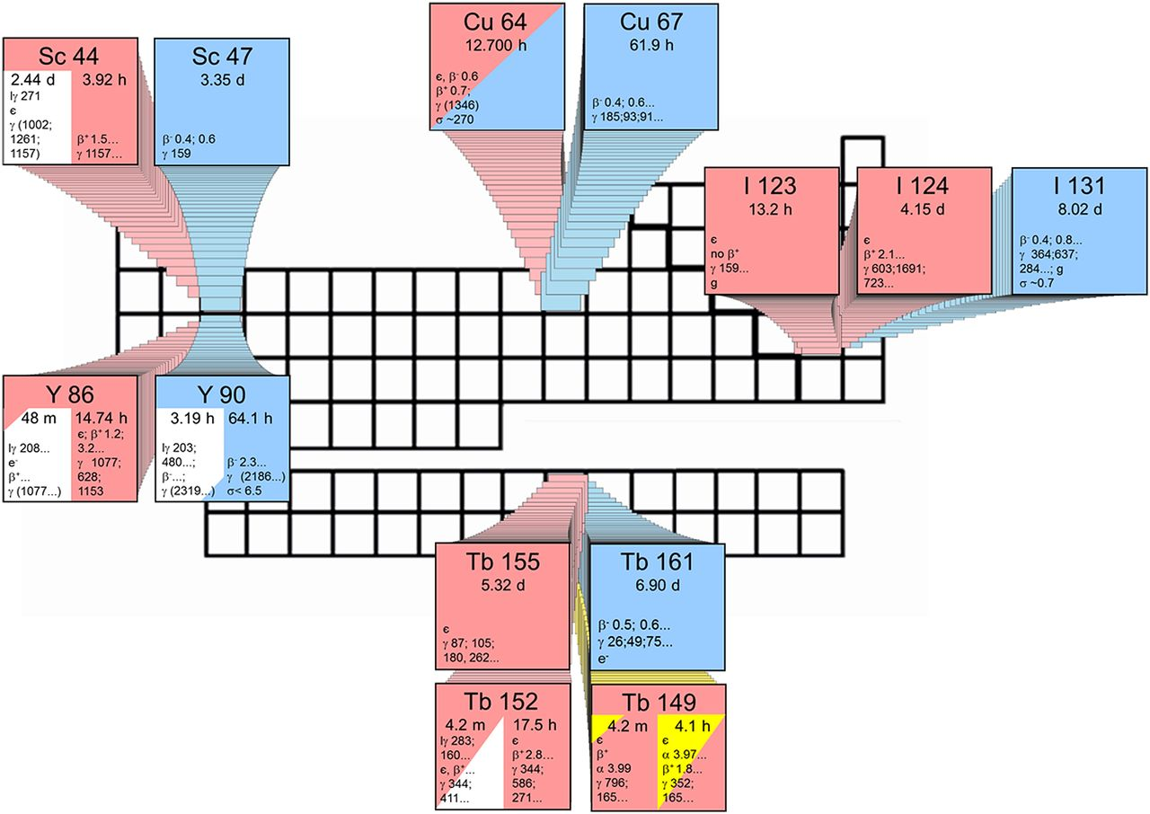
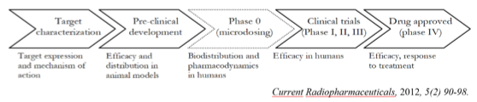

Radiopharmaceuticals and theranostics
Radiopharmaceuticals - group of pharmaceutical drugs containing radioactive isotopes used for:
  SPECT – Single Photon Emission Computed Tomography;
  PET/CT – Positron Emission Tomography/Computed Tomography;
  Radionuclide therapy.
Biological molecules or sometimes artificial building blocks for specific targets, labelled with radioactive positron (β⁺)/gamma or alpha and β⁻ emitters;
Theranostics – Therapy and Diagnostics
  Radiolabelled drugs for both purposes
  “Matched pair” theranostic agents
Sc 43 ??
Fig. 2 Illustrative structure of a ligand radiopharmaceuticalradiopharmaceutical and its cell binding
Fig. 1. Theragnostic principle: matched pairs of radionuclides for PET and SPECT imaging and for therapeutic application in nuclear medicine.
Fig. 3. Illustrative structure of drug develoment

Slide 3
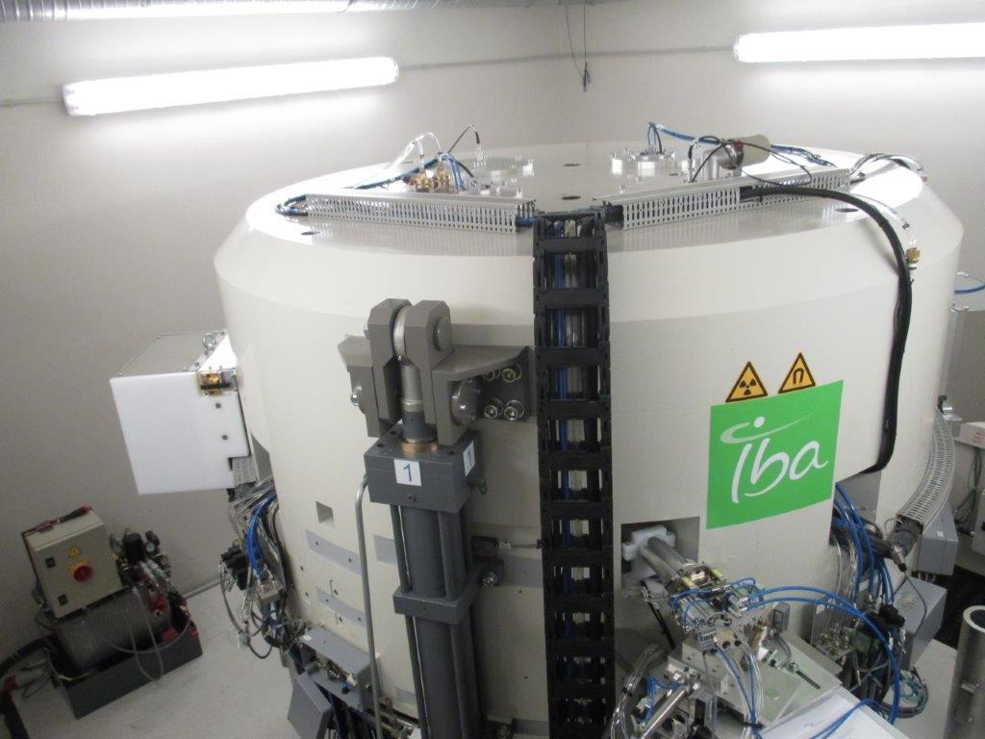
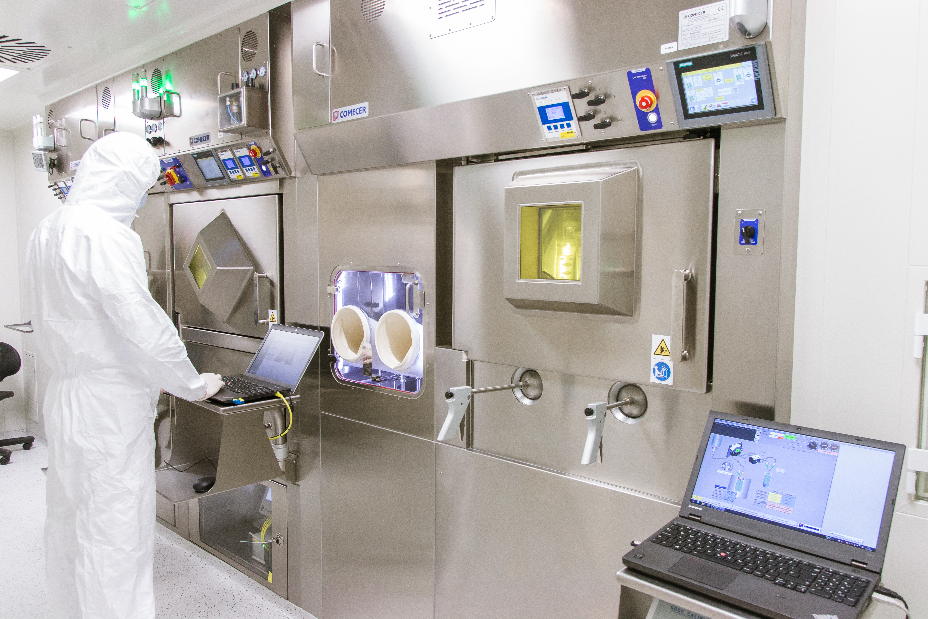
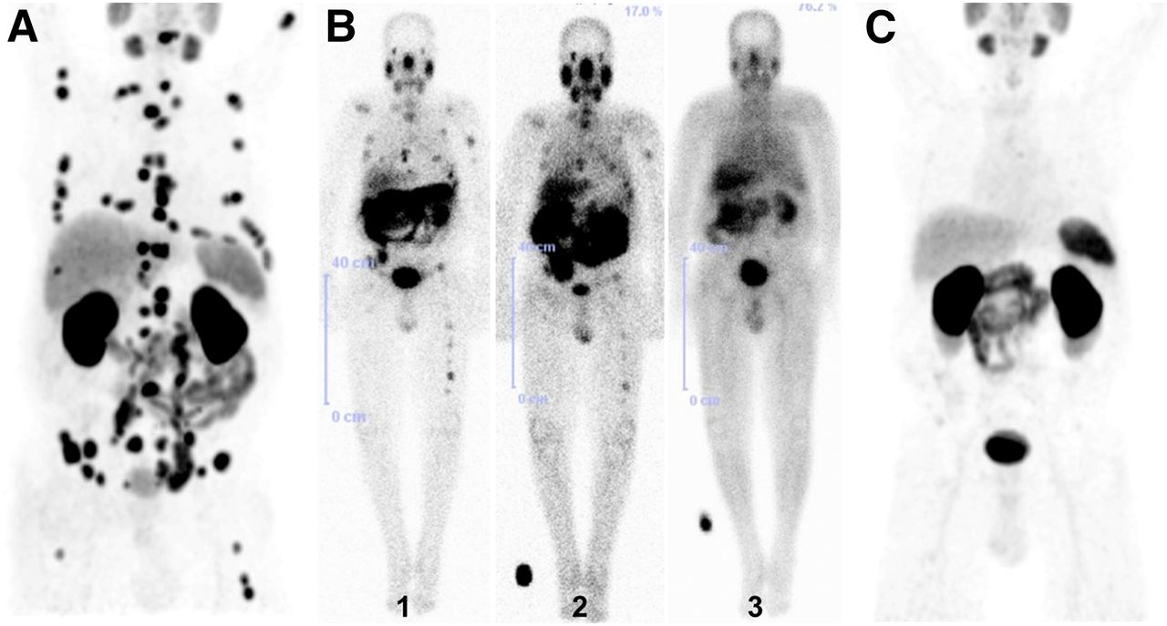
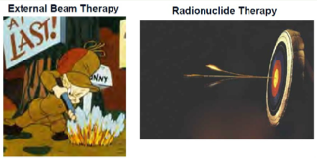
Theragnostics = Diagnostics + Therapy
Radiopharmaceuticals – radioactive drugs
PET/CT – a standard in cancer diagnostics.
  First PET/CT scan in 2016 in Latvia
“Treat what You see” method
  First Lu-177 treatment in 2019 in Latvia
25/05/2023

Slide 4
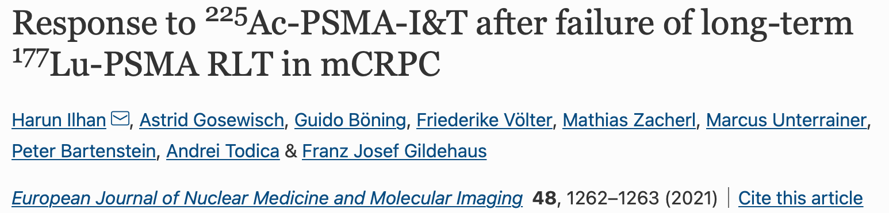
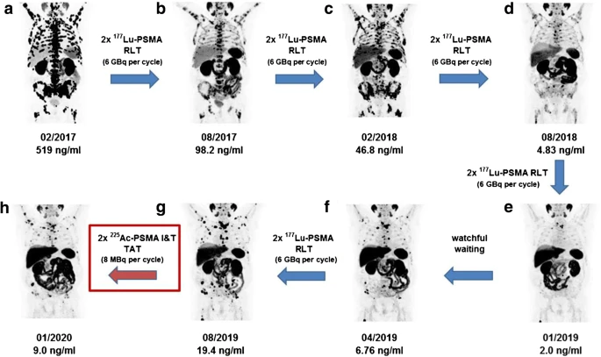
Targeted (α and β-) therapy

Slide 5
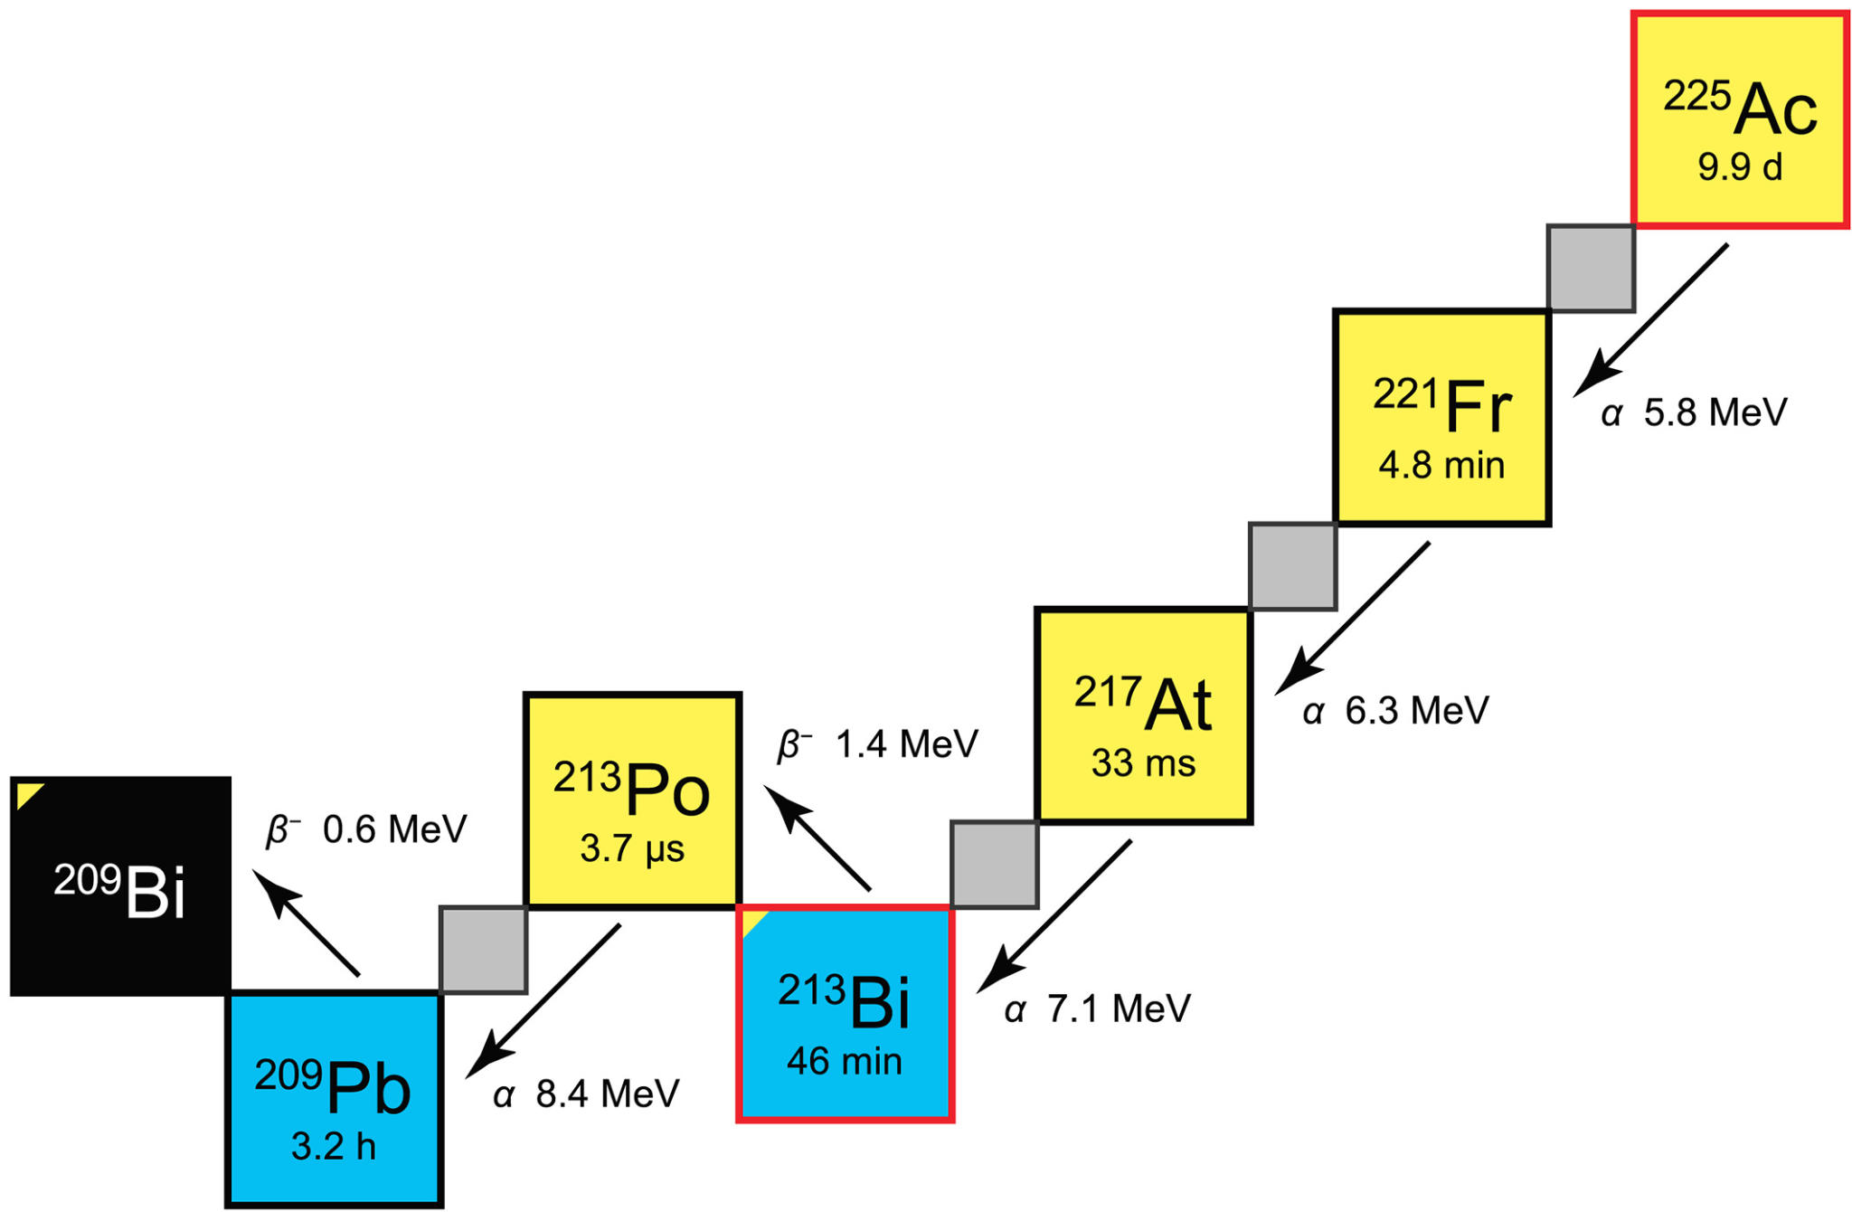
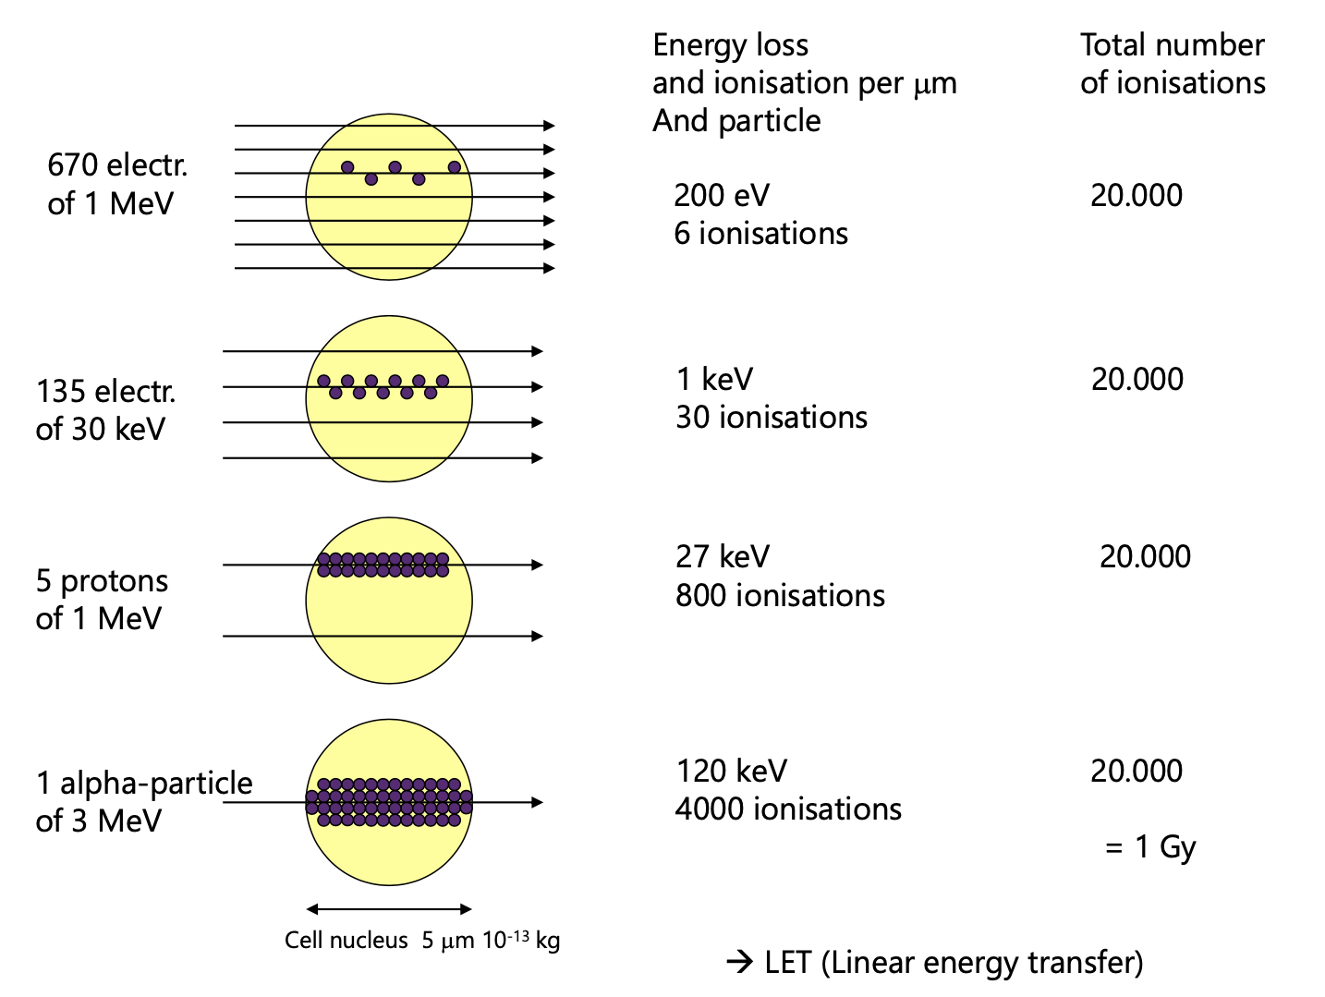
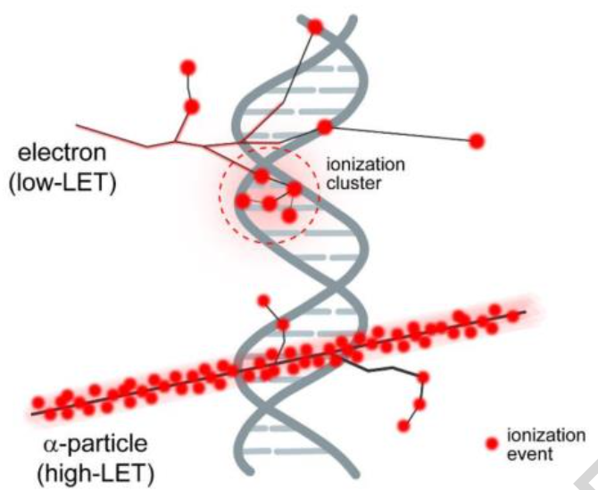
Linear energy transfer
Ac-225
T_{1/2} = 9.92 d
Alpha decay RN labelled with PSMA are very aggressive to salivary glands

Slide 6
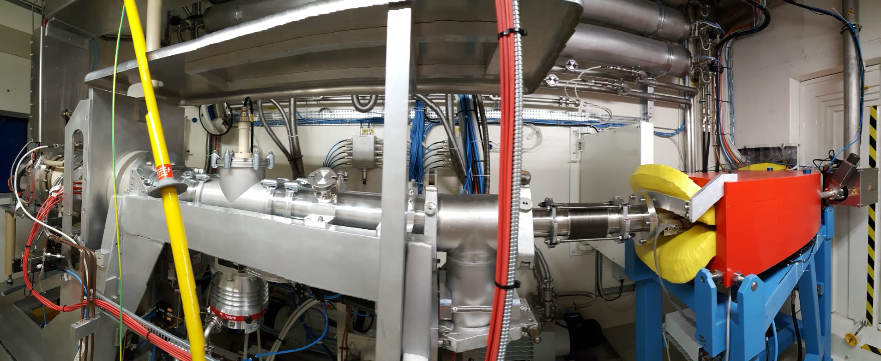
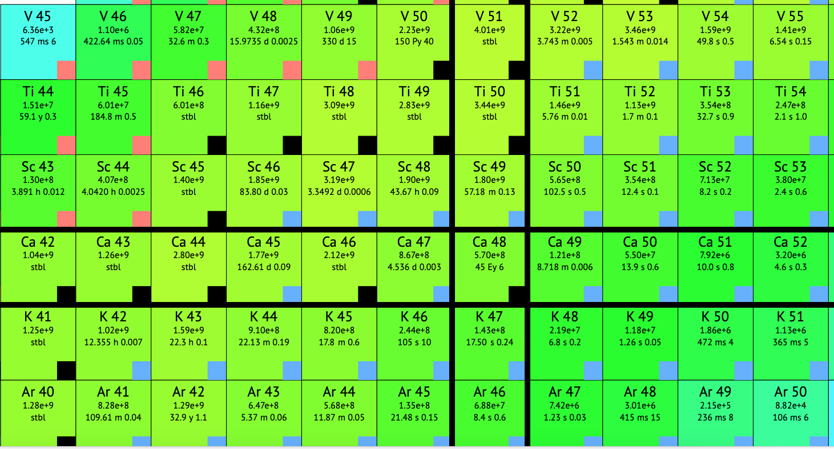
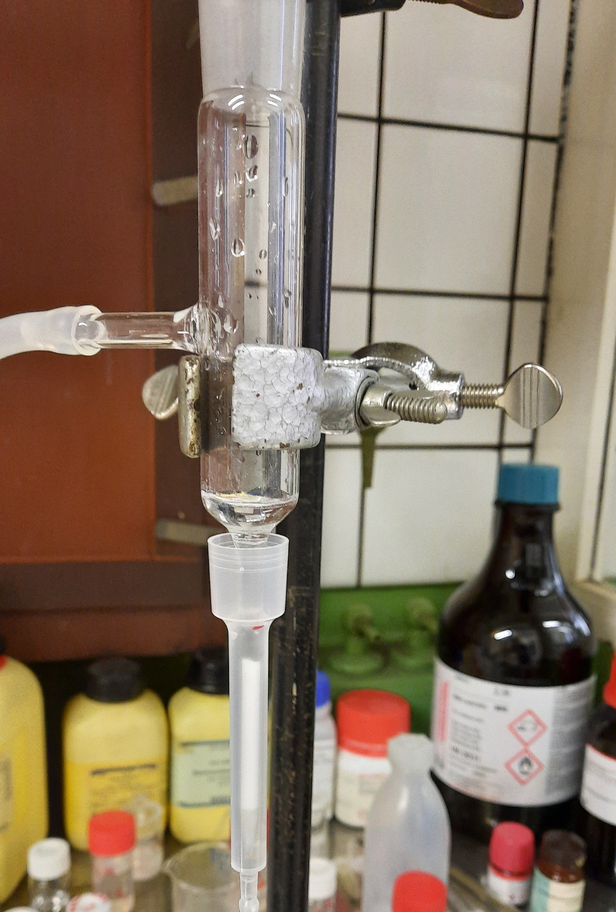
Pure radionuclides for medical applications
Isotopically pure target material (e.g. Ca-44 20k Eur/g, Ni-64 80k Eur/g) or …
Mass-separator
CERN-MEDICIS mass-separator to obtain isotopically pure medical radionuclides.
Chemically pure radionuclides are obtained through radiochemical separation
Fig. 4. MEDICIS mass-separator
Radiochemistry (…or lasers)
Fig. 5. Column for chemical separation
25/05/2023

Slide 7
Nat-Ti and nat-V as target material for ^{xx}Sc production
Relatively cheap metals titanium and vanadium are light, corrosion resistant, refractory and non-toxic;
Natural titanium has five stable isotopes with different percentages,
i.e. ⁴⁶Ti (8.25%), ⁴⁷Ti (7.44%), ⁴⁸Ti (73.72%), ⁴⁹Ti (5.41%), and ⁵⁰Ti (5.18%);
^{nat}V consists of 2 stable isotopes
(⁵¹V: 99.750%, ⁵⁰V: 0.250%)
Melting point:
  Vanadium - 1910 ºC
  Titanium – 1668 ºC
Fig. 3. Excitation function of ^{nat}Ti(p,x)^{xx}Sc reaction by the TALYS-1.9 code
A. Jafari, et. All. Cyclotron-based production of the theranostic radionuclide scandium-47 from titanium target, Nuclear Inst. and Methods in Physics Research, vol. 961, no. Elsevier B.V., 2020
Table 1. Data of the ^{nat}V(p,x)⁴⁷Sc,⁴⁶Sc nuclear cross sections and the values of the IAEA reference cross sections used.
Gaia Pupillo, et.all. Production of 47Sc with natural vanadium targets: results of the PASTA project, Journal of Radioanalytical and Nuclear Chemistry, 2019, https://doi.org/10.1007/s10967-019-06844-8
During medical Sc radionuclide production contaminants such as ⁴⁶Sc (t_{1/2}=83d; E𝛾= 889 keV; 1120 keV) or ⁴⁴Sc (t_{1/2}=4.04h; E𝛾= 1157 keV) in ⁴³Sc production mostly cannot be avoided, even with highly enriched target materials;
  Such high contaminant energy is bad for shielding and patient dosimetry;
  Mass-separation step therefore is mandatory

Slide 8

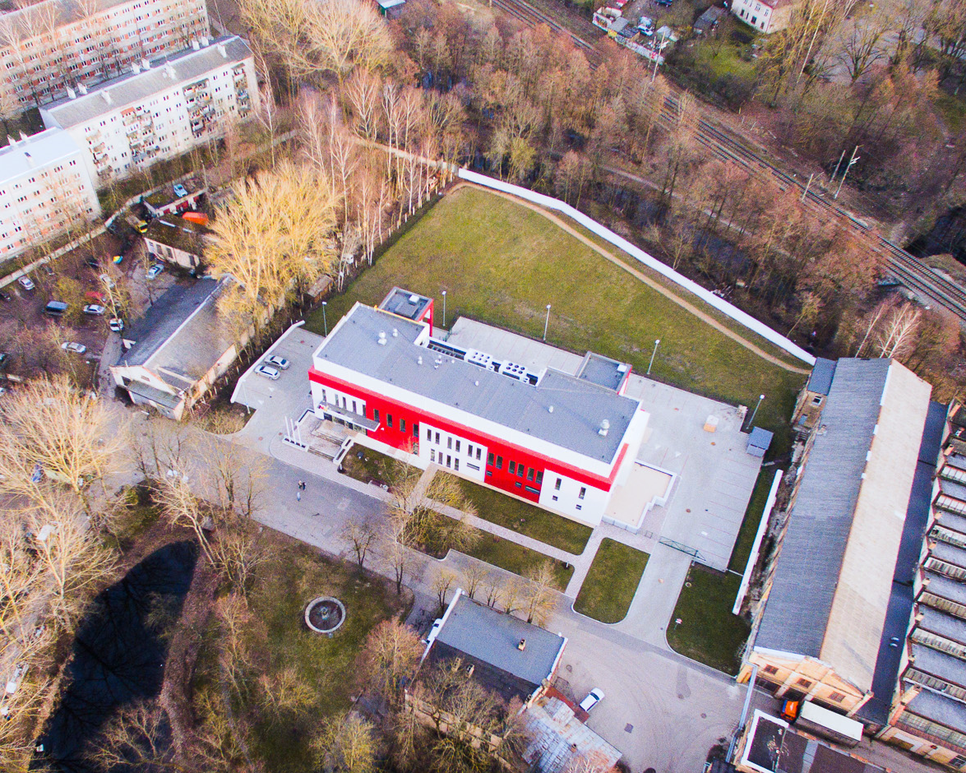
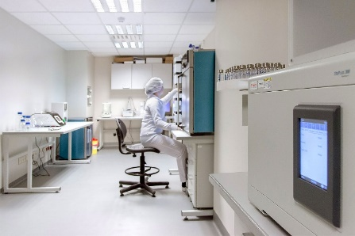
SIA NUCLEO (Riga, Latvia)

Slide 9
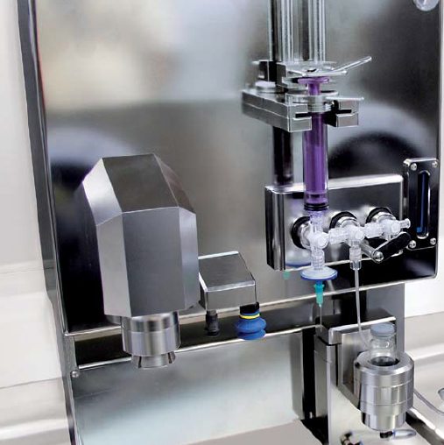
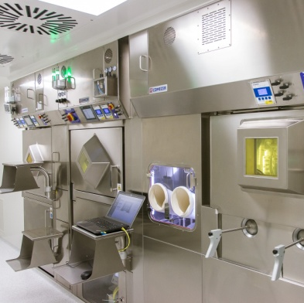
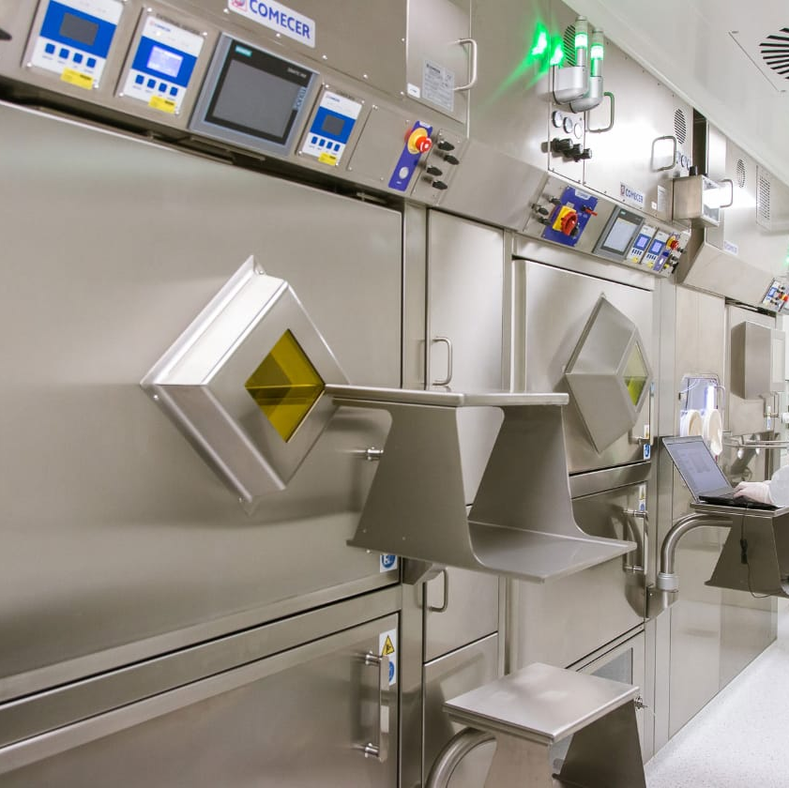
Equipment
6 hot-cells located in Class C clean rooms of whom:
  4 dedicated for active ingredient synthesis
  2 for sterile dispensing
  1 additional dedicated for radiometal labelling - underway
2x semi-automatic sterile open-vial dispensers
25/05/2023

Slide 10
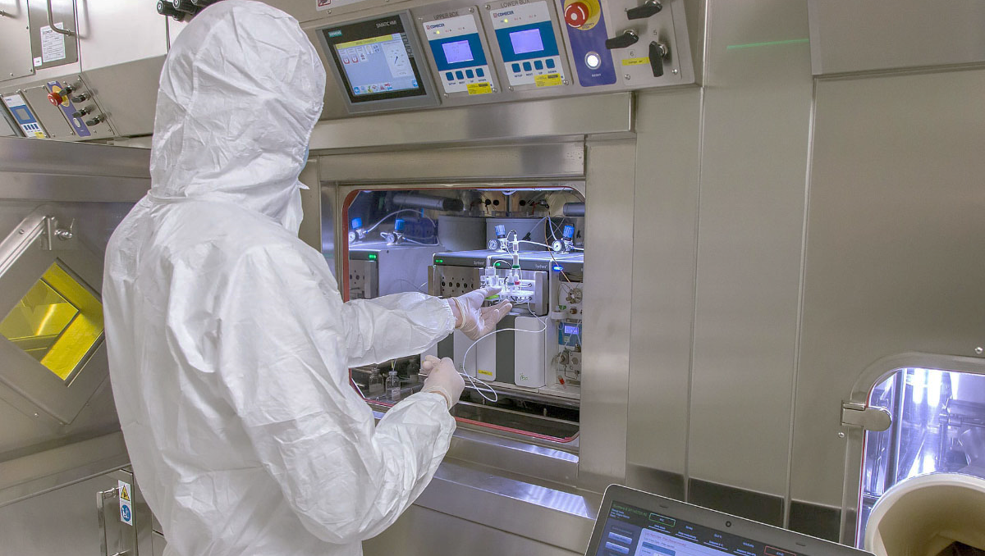
Expertise and infrastructure in radiopharmaceutical production and quality control:
[¹⁸F]-FDG
[¹⁸F]-NaF
[¹⁸F]-FLT
[¹⁸F]-F-Choline
[¹⁸F]-FPSMA-1007
[⁶⁸Ga]-PSMA-11
[¹⁷⁷Lu]-PSMA-I&T
[⁶⁸Ga]-DOTA-TOC;NOC;TATE
Other possibilities:
[¹¹C]-Met and PiB
[¹⁸F]-FDOPA
[¹⁸F]-FMISO
[^{64;67}Cu] labelled compounds
…

Slide 11
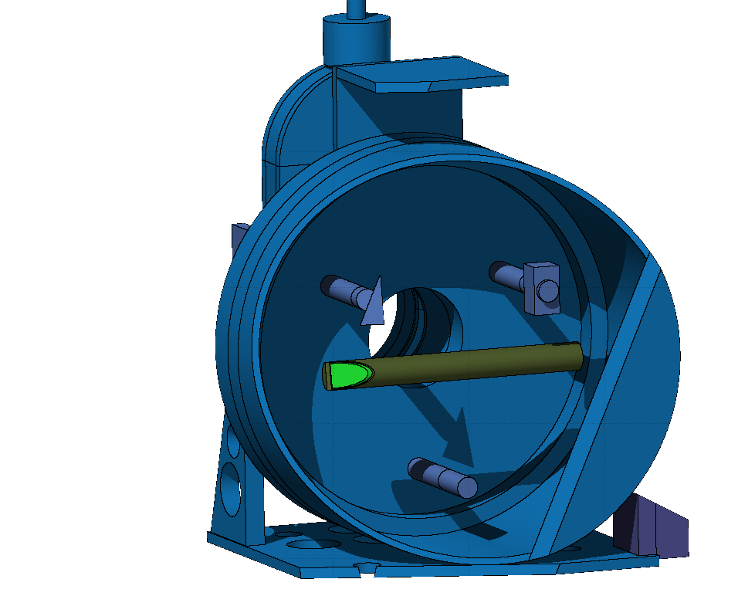
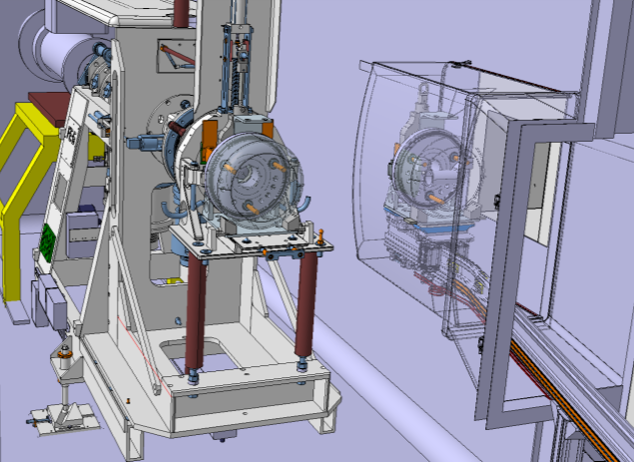

CERN-MEDICIS
MEDICIS - MEDical Isotopes Collected from Isolde;
ISOLDE - Isotope mass Separator On-Line facility;
Production of non-conventional radionuclides for R&D in cancer imaging, diagnostics and radiation therapy done at partner institutes;
1.4 GeV
1 uA
MEDICIS Target
ISOLDE Target
Isotopes for ISOLDE
Beam dump
Protons 1.4 GeV
Fig. 6. CERN-MEDICIS in CERN accelerator complex
Fig. 7. 3D model of the ISOLDE-MEDICIS facility in 2017.
Located after the PS Booster, it receives protons with an energy of 1.4 (possibly 1.7 or 2 GeV in upgrade scenarios).
Fig. 8. ISOLDE and MEDICIS irradiation point

Slide 12
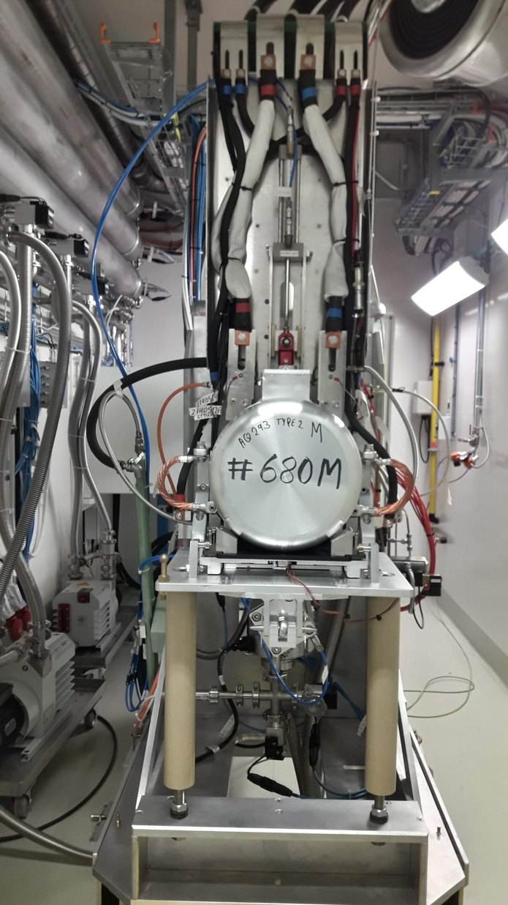
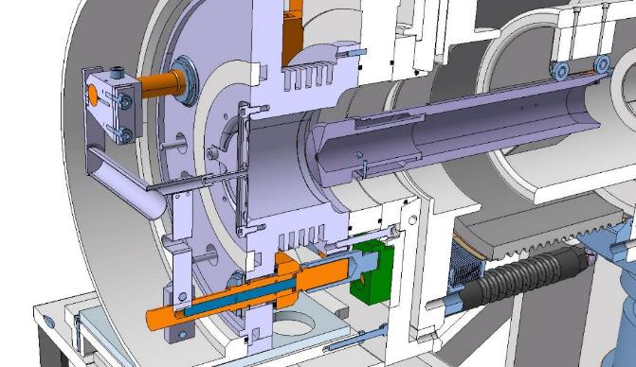
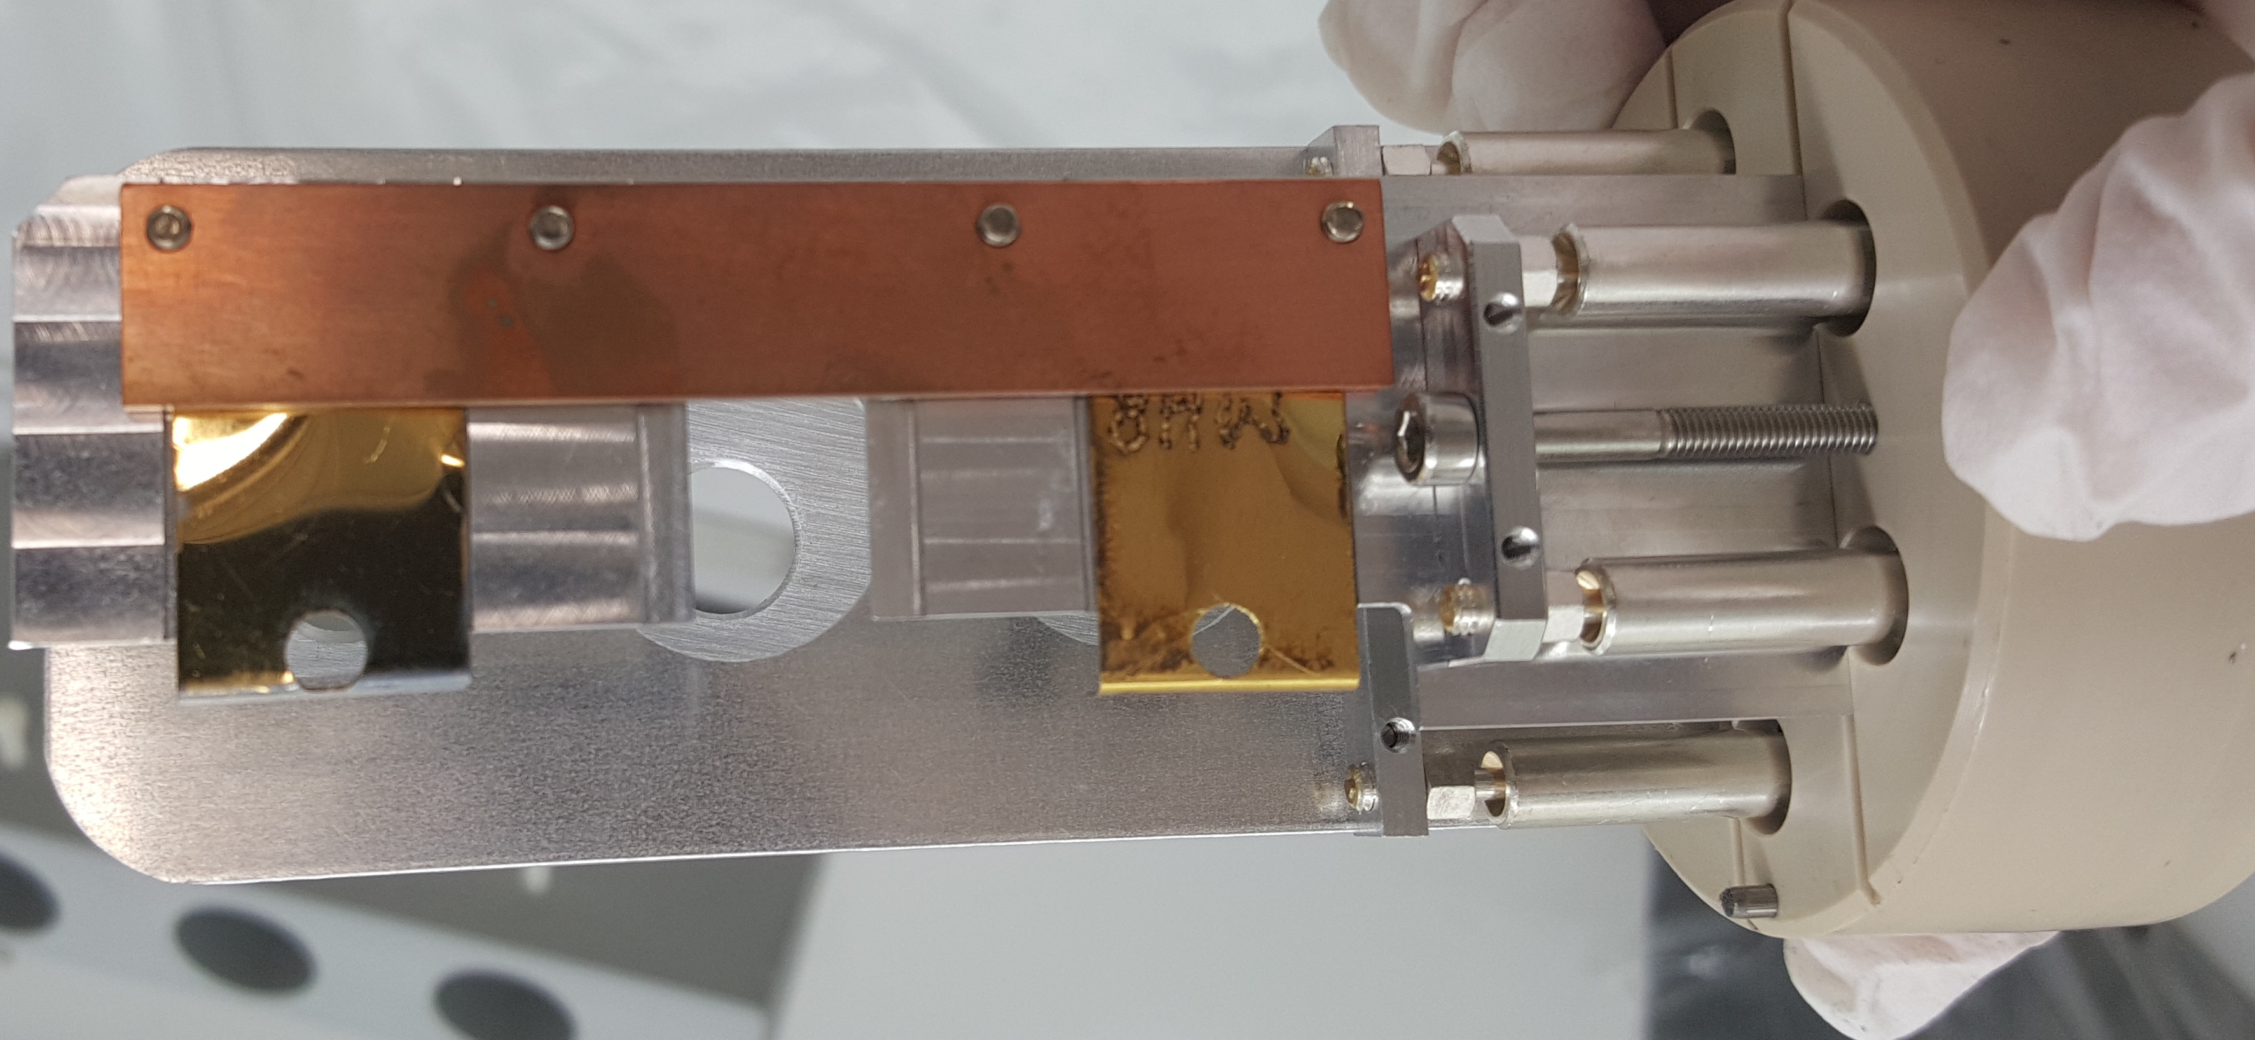
CERN-MEDICIS principle – view inside the bunker
Radioisotopes
Ions
Vacuum
Air
Fig. 9. Animated MEDICIS mass-separator radionuclide extraction principle
Courtesy of C. Duchemin

Slide 13
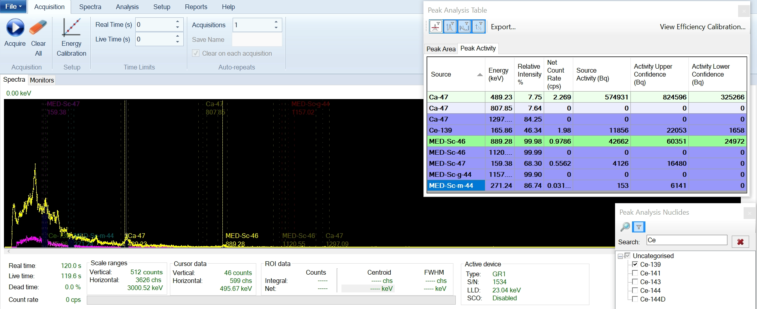
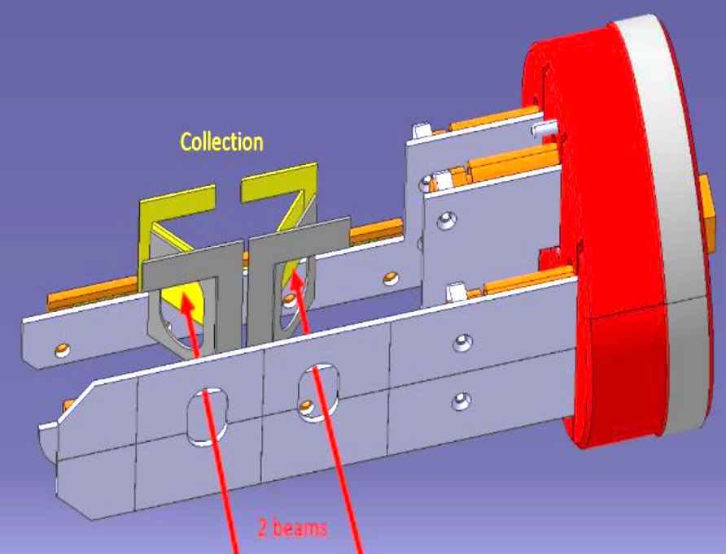
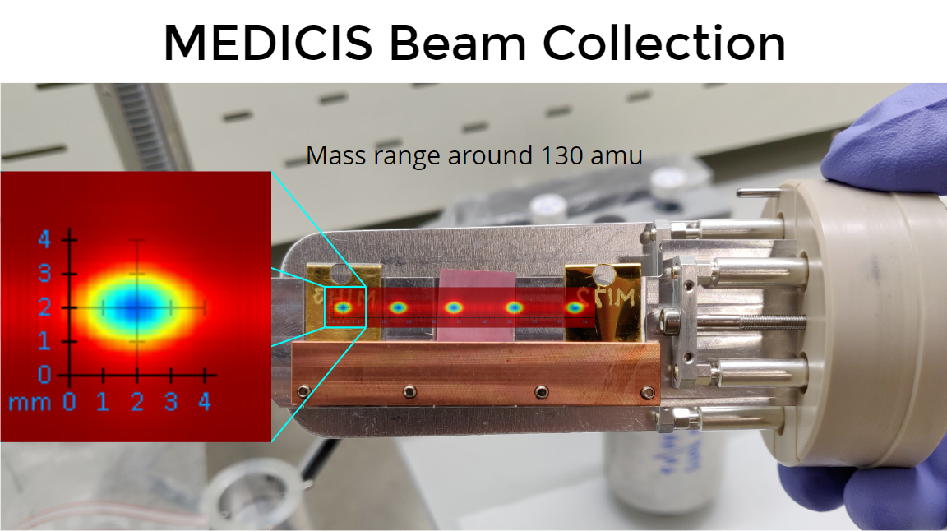
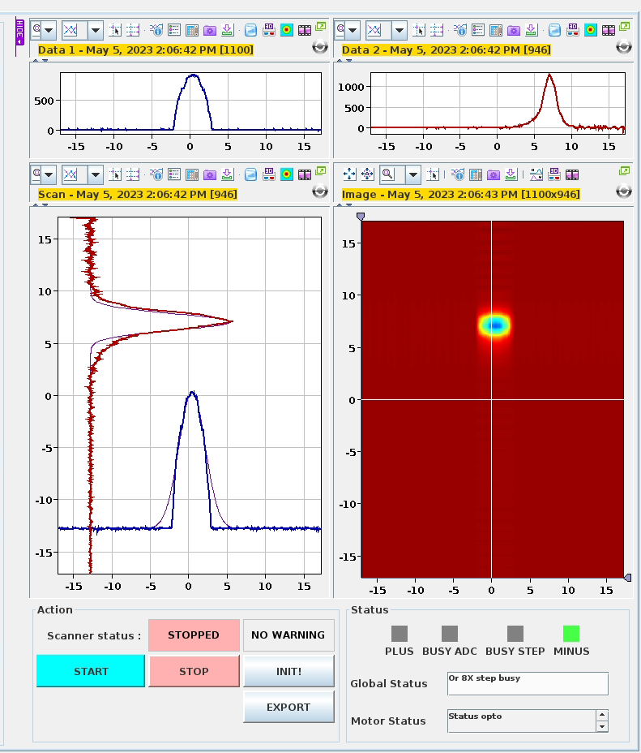
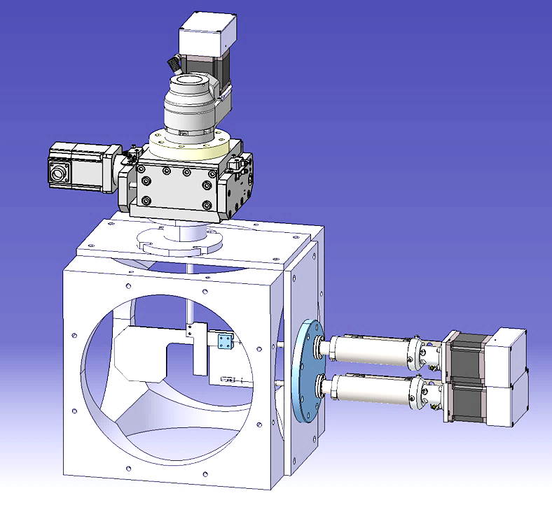
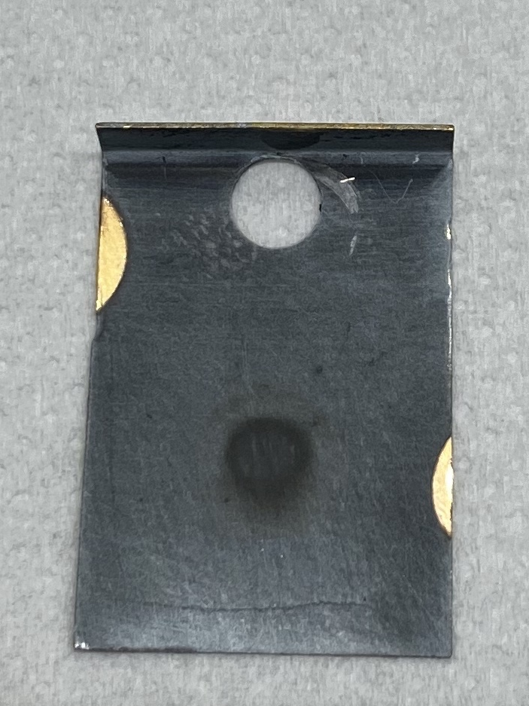
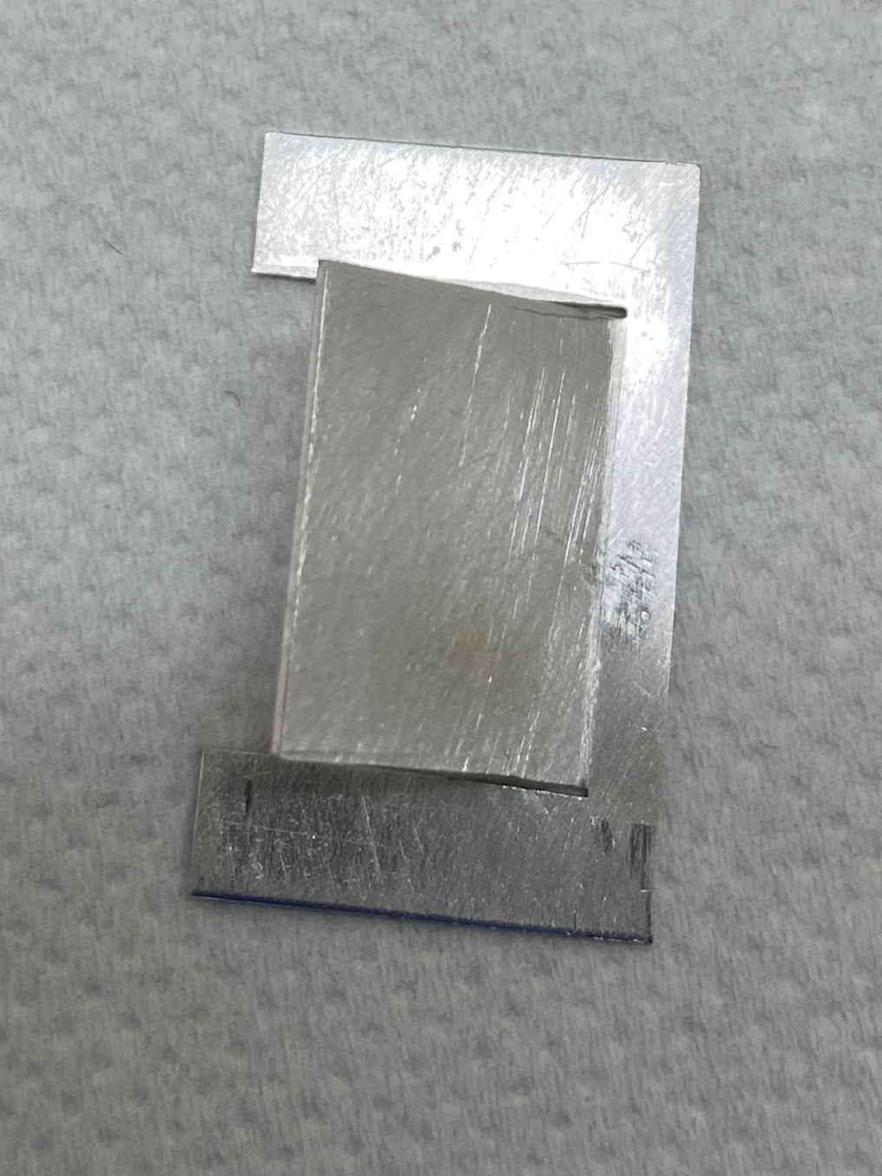

MEDICIS mass separator collection chamber
Double collection slit system and sample holder to collect 2 close mass beams at the same time;
Sample holder with tilted foils suport to reduce sputtering and foil cross-contamination;
Kromek on-line gamma spectrum measurement to monitor implanted radionuclide activity and implantation rate.
Fig. 10 Kromek gamma spectrometer software
Fig. 12. MEDICIS separated isotope collection foils
Fig. 11 MEDICIS mass-separator double collection slit system, separated beam and double collection, tilted foil sample holder
Fig. 13. Implanted foil retrieval
Courtesy of S. Marzari and R.E.Rossel
13

Slide 14
MEDICIS (and PRISMAP) radionuclides produced/separated
Year of operation | Mode of operation | Radionuclides of interest | Weeks of operation/ collection | Total activity collected (MBq) | Institutes received the radionuclides
2019 | External sources (LS2) | Tb-155, Er-169, Yb-175, Pt-195m | 15 | 870 | KU Leuven (BE), PSI (CH), HUG (CH), NPL (UK)
2020 | External sources (LS2) | Sm-153, Tb-155, Tm-167, Ac-225 | 17 | 540 | KU Leuven (BE), SCK CEN (BE), PSI (CH), NPL (UK)
2021 | CERN PSB Beam External sources | Sc-44,47, Ba-128/Cs-128, Sm-153, Tb-155, Tm-167, Pt-191, Yb-175, Ac-225 | 25 | 1300 | KU Leuven (BE), SCK CEN (BE), PSI (CH), CHUV (CH), NPL (UK), PAEC (PK)
2022 | CERN PSB Beam External sources | Sc-44,47, Ba-128/Cs-128, Sm-153, Tb-155, Tm-165, Tm-167, Pt-195m, Ac-225,227 | 26 | 840 | KU Leuven (BE), SCK CEN (BE), PSI (CH), CHUV (CH), NPL (UK)

Slide 15
Radionuclides and their respective characteristics considered by NIMMS project for production with linear accelerator
Radionuclide | Usage of radionuclide | Particle beam used for production | Necessary target material | Decay half-life
Sc-43 | Diagnostic – PET | α | Calcium-40 | 3.9 h
Sc-44 | Diagnostic – PET | Deuteron | Calcium-44 | 4 h
Co-57 | Diagnostic – SPECT | α | Manganese-55 | 272 days
Cu-64 | Theranostic (β-) | Deuteron | Nickel-64 | 12.7 h
Cu-67 | Theranostic (β-) | α | Nickel-64 | 61.9 h
In-111 | Diagnostic – SPECT | α | Silver-109 | 67.2 h
Sn-117m | Theranostic (β-) | α | Cadmium-114 to Cadmium-116 | 14 days
Sm-153 (c.a.) | Theranostic (β-) | α | Neodymium-150 | 2 days
Re-186 | Theranostic (β-) | Deuteron | Tungsten-182 to Tungsten-183 | 90.6 h
At-211 | Therapeutic (α) | α | Bismuth-209 | 7.2 h
Courtesy of K. Paļskis and T. Torims

Slide 16
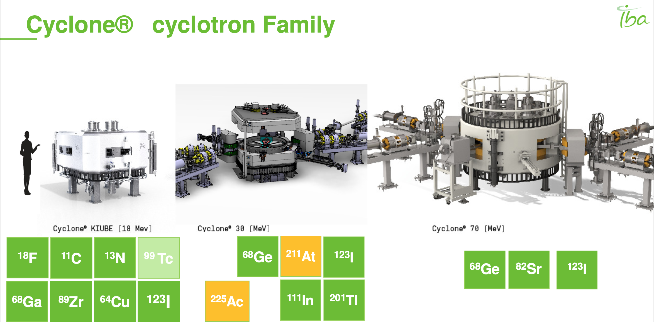
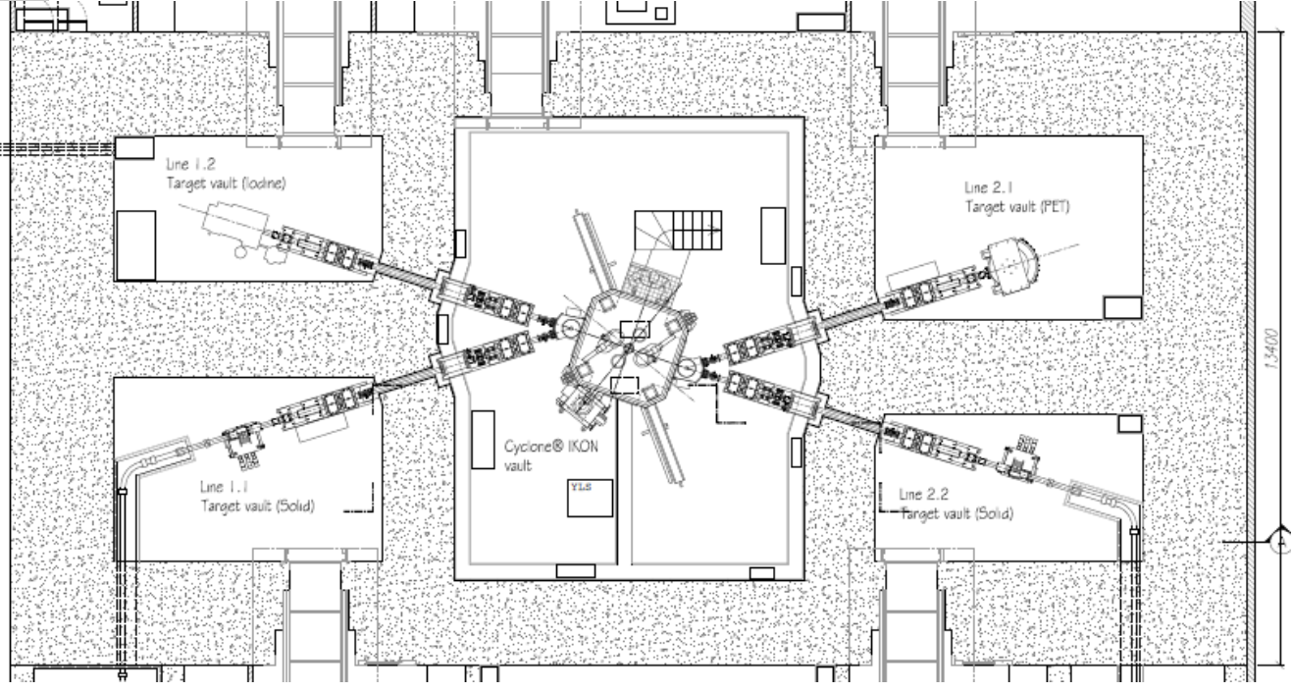
Cyclotron production
Need of specialized vaults and infrastructure built

Slide 17
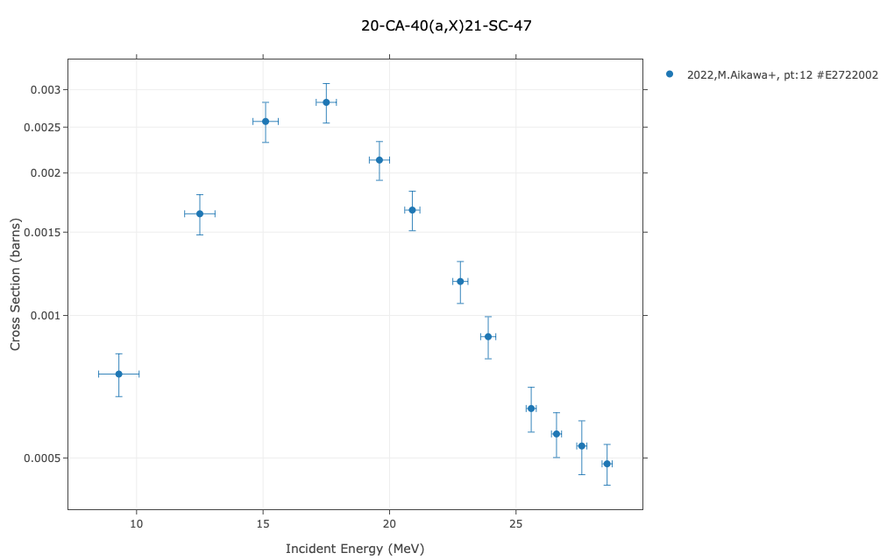
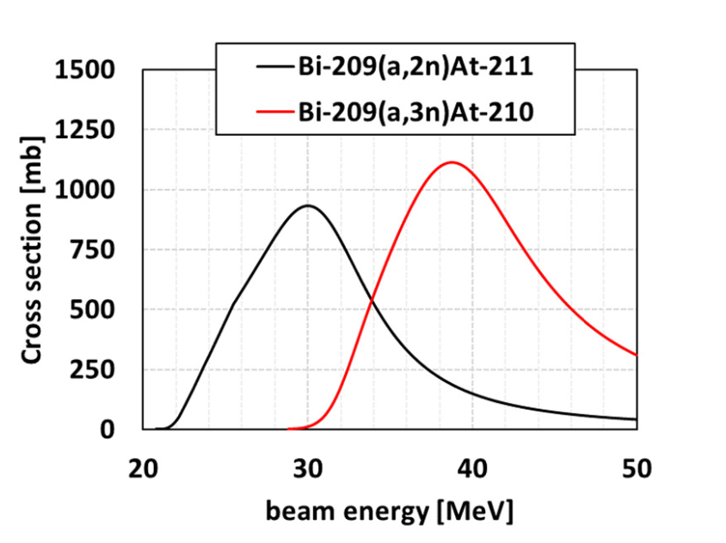
Alpha particles for radionuclide production
Ca-40 for Sc-47 production
Ca-40 abundancy = 97%
Ca-46 abundancy = 0.004 % and thermal neutrons needed

Slide 18
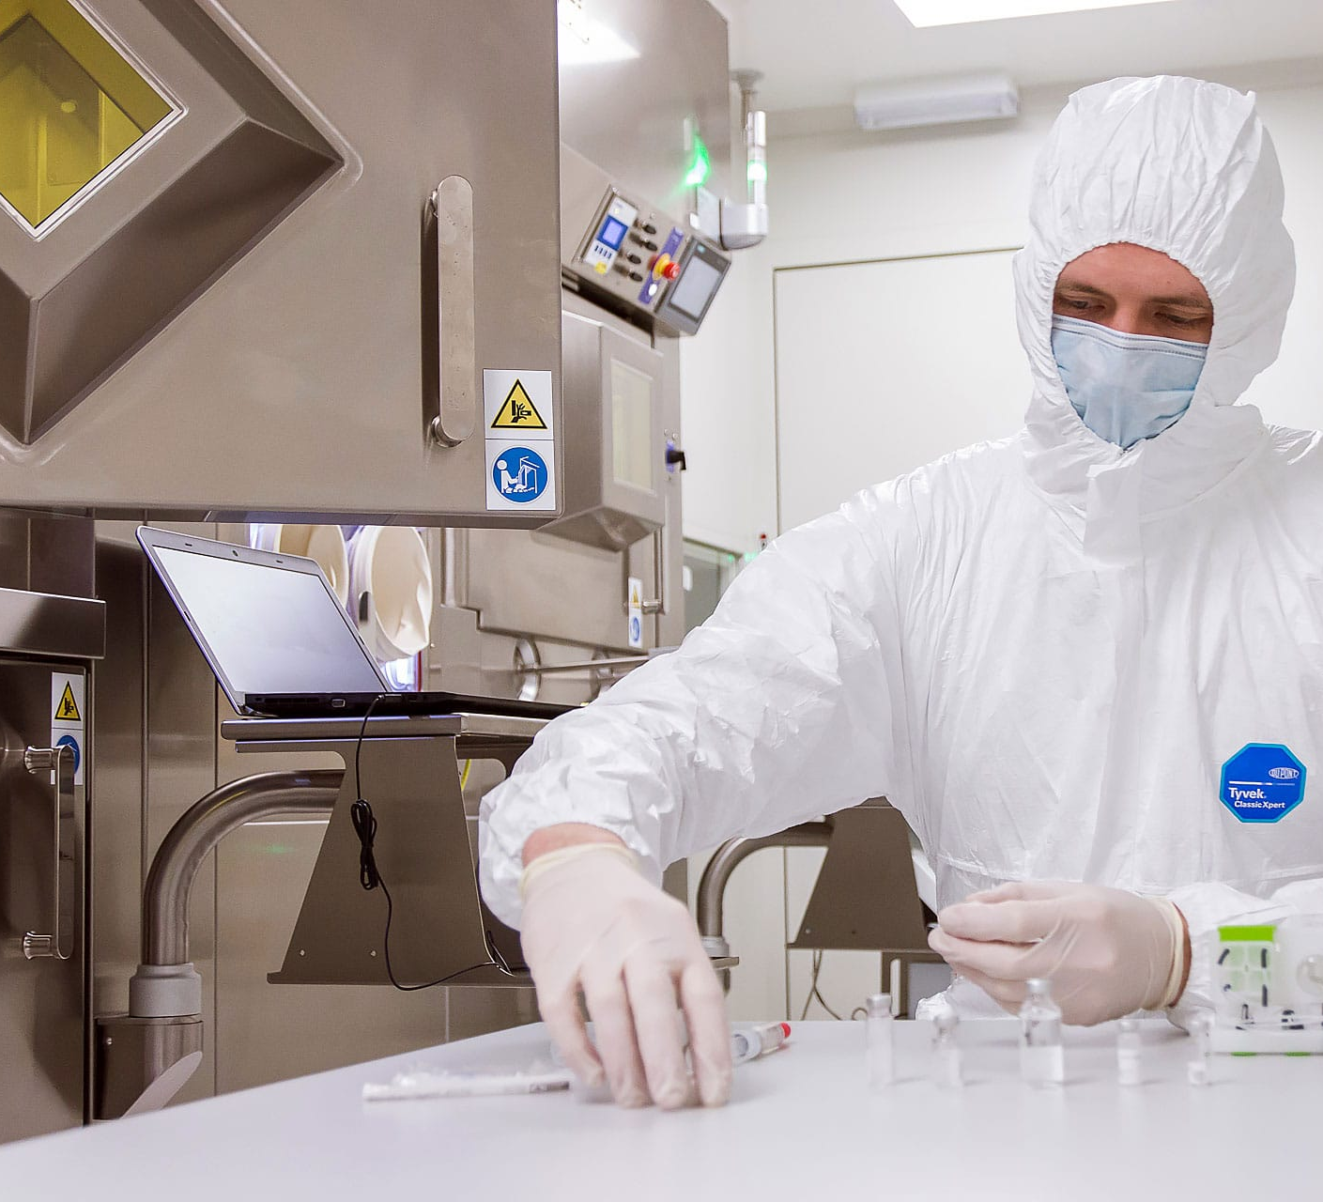

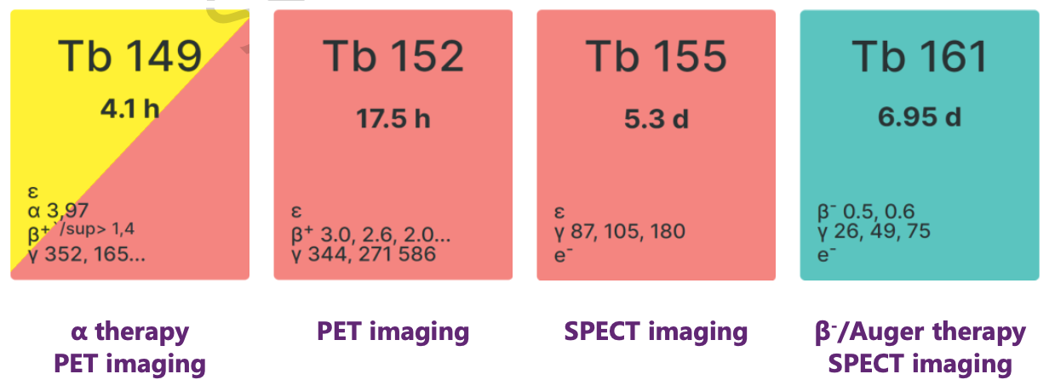
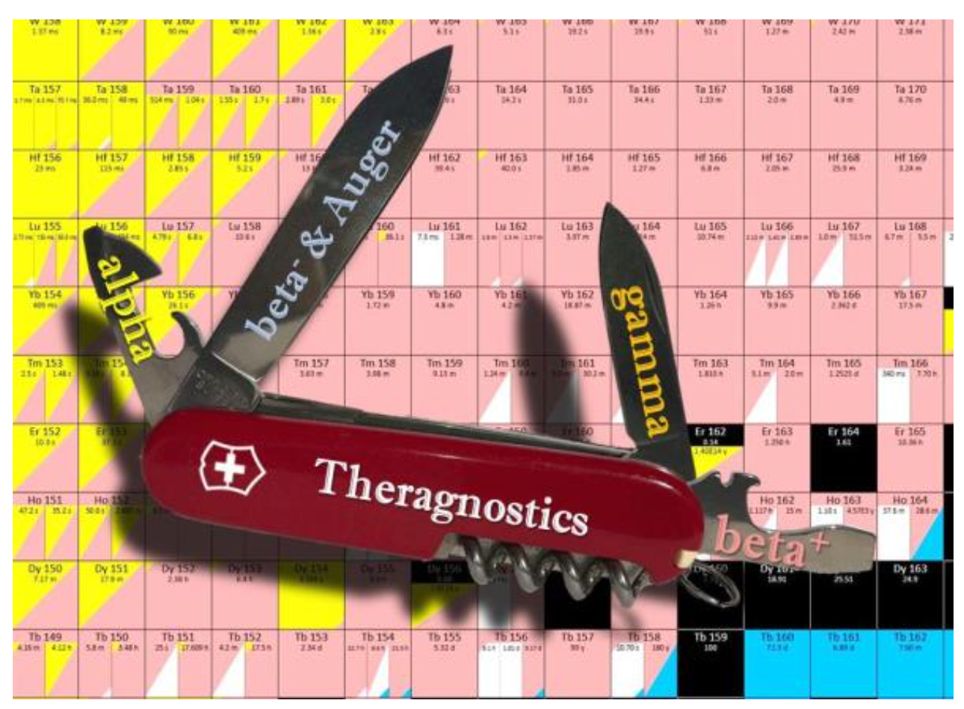
What else ?
Radionuclides of interest
Scandium - 43 | Gallium - 68
Scandium - 44 | Terbium – 149
Calcium - 47 | Terbium – 152
Scandium - 47 | Terbium – 155
Titanium - 44 | Terbium – 161
Copper - 64 | Lutetium - 177
Copper - 67 | Actinium - 225
25/05/2023

Slide 19
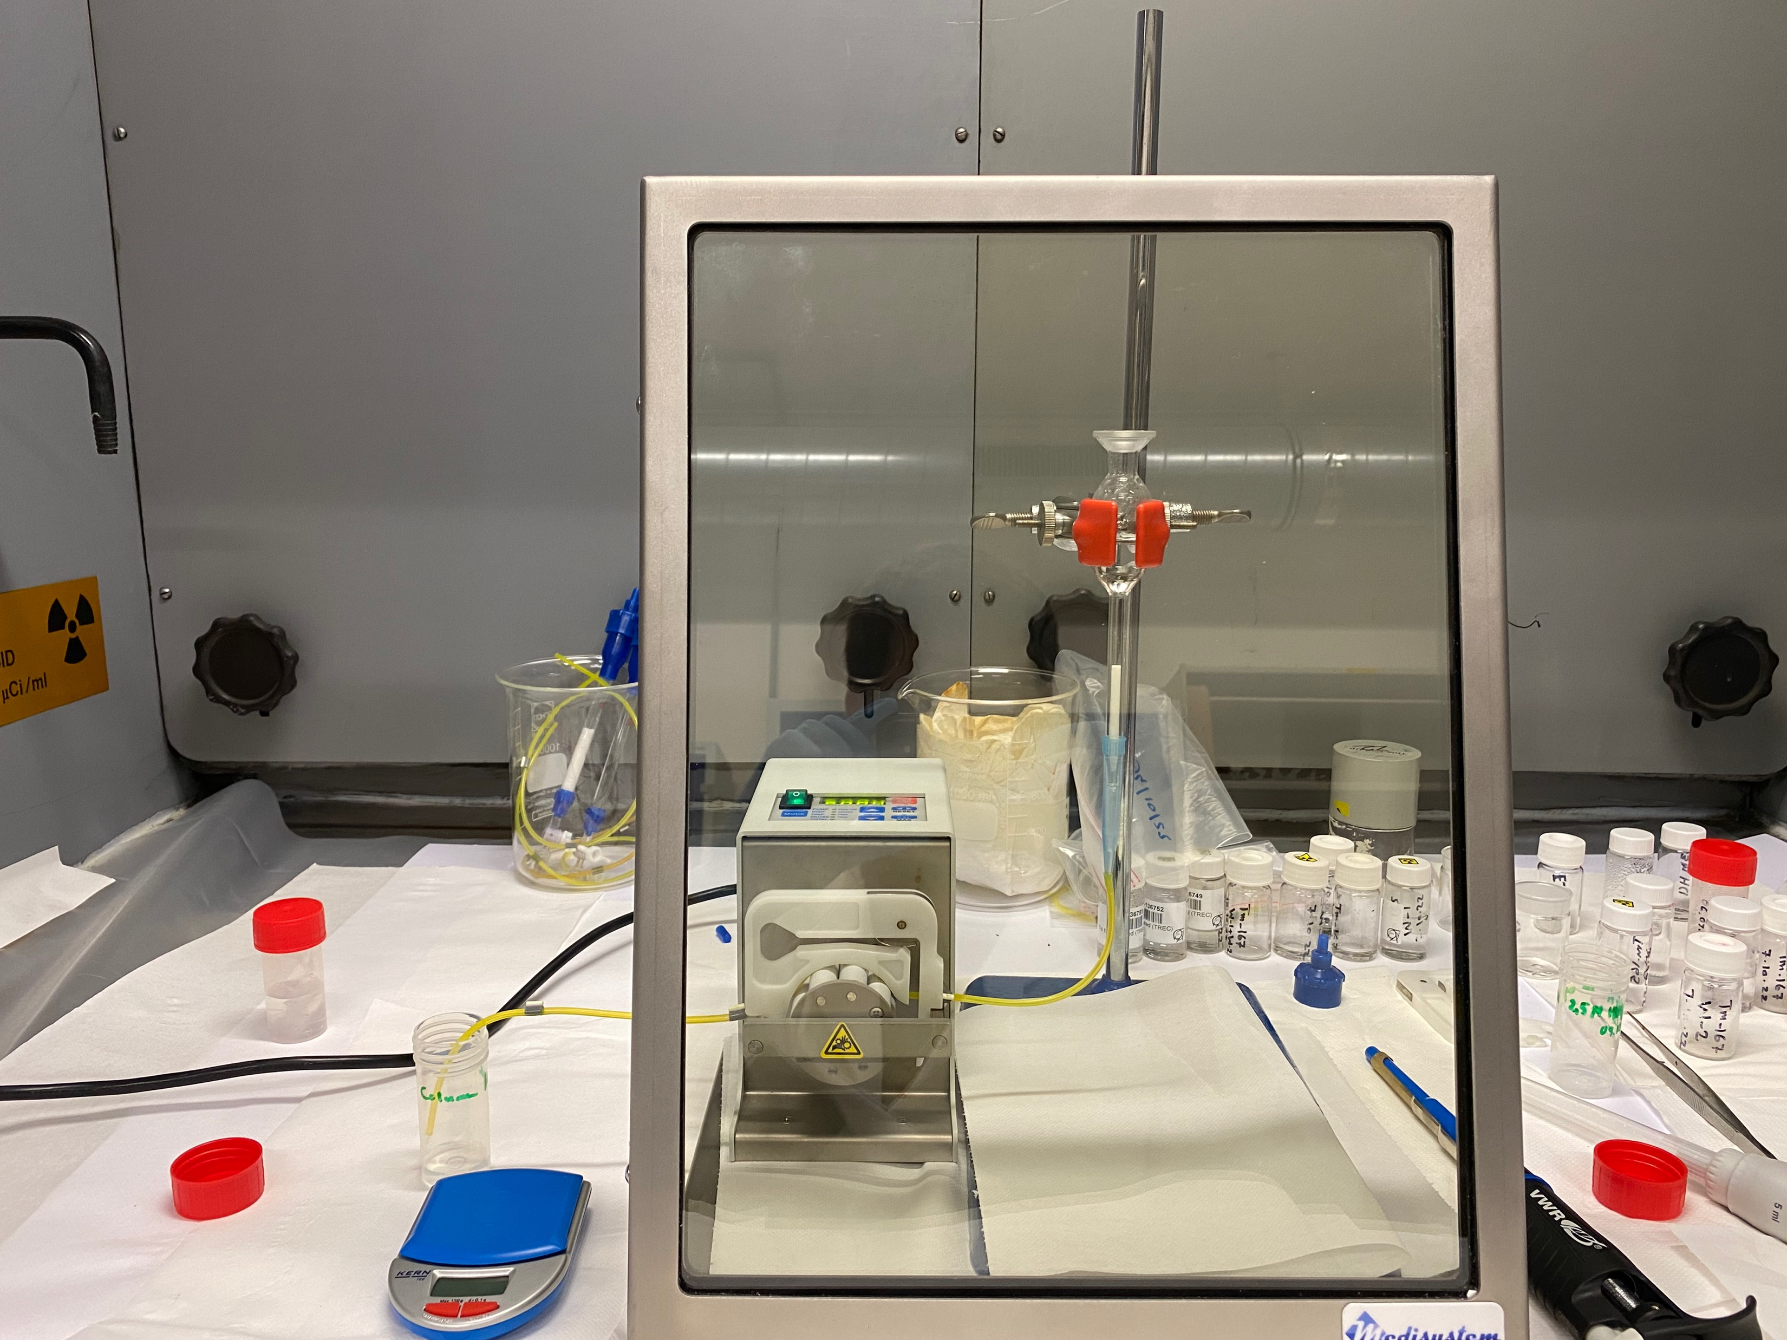
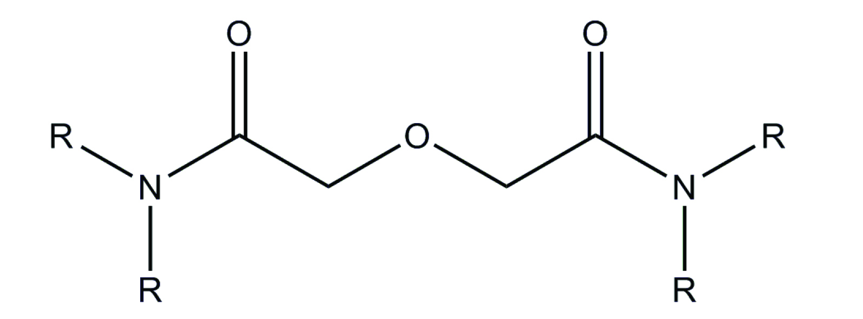
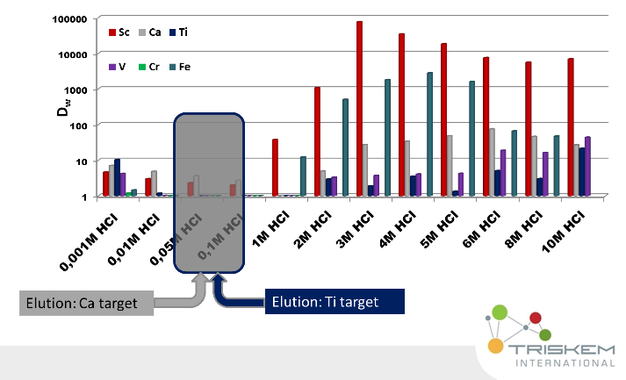
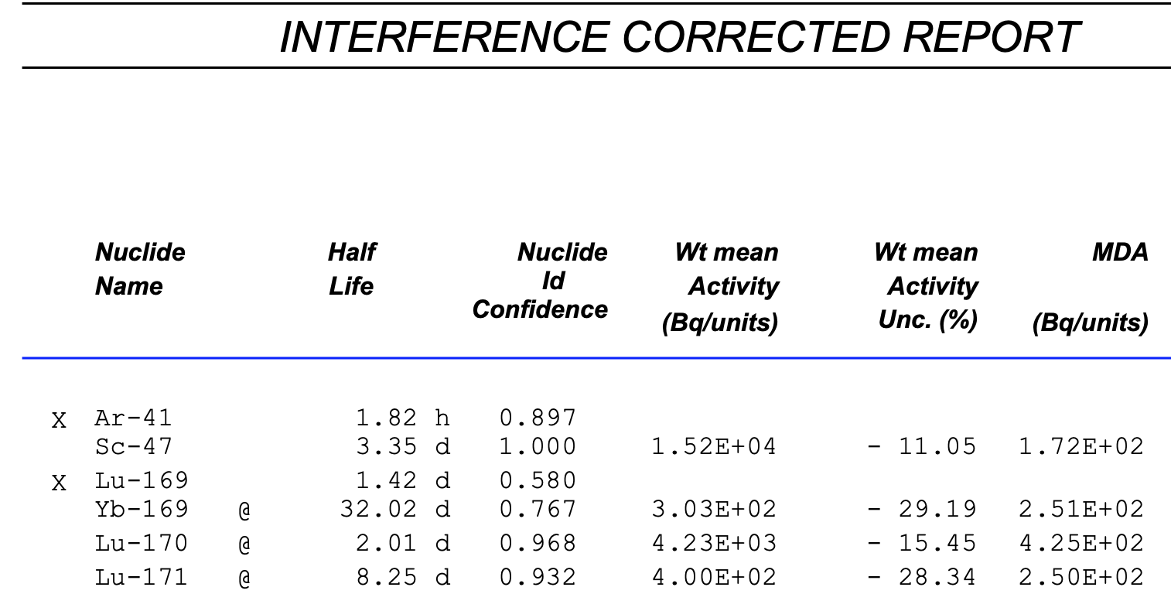
Radiochemistry
Radiochemistry lab setup at UoL
Radionuclide chemical puridfication
Labelling studies with chelators for drug development
Optimization of methods and synthesis
Analythical methods
Fig. 38. Setup for radiochemical Sc-47 separation from collection foil
Table 10. Gamma spectroscopy results of radiochemically separated Sc-47 sample from mass separation
Courtesy of P. Kalniņa

Slide 20
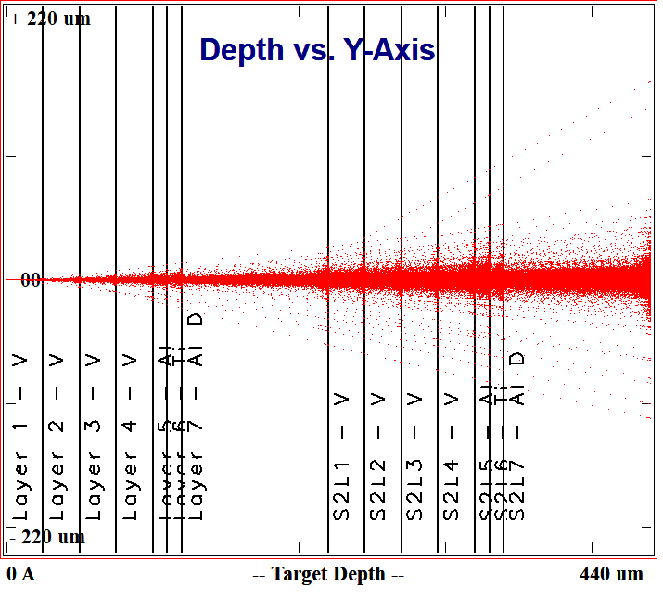
Cross-section measurements
Refined or new nuclear reaction cross-section data for target materials
  E.g. stacked foil technique
  (deuterons on V material)
Unique opportunity to use He ions
Nuclear physicist involvement
  Chemical and nuclear engineers for targets

Slide 21
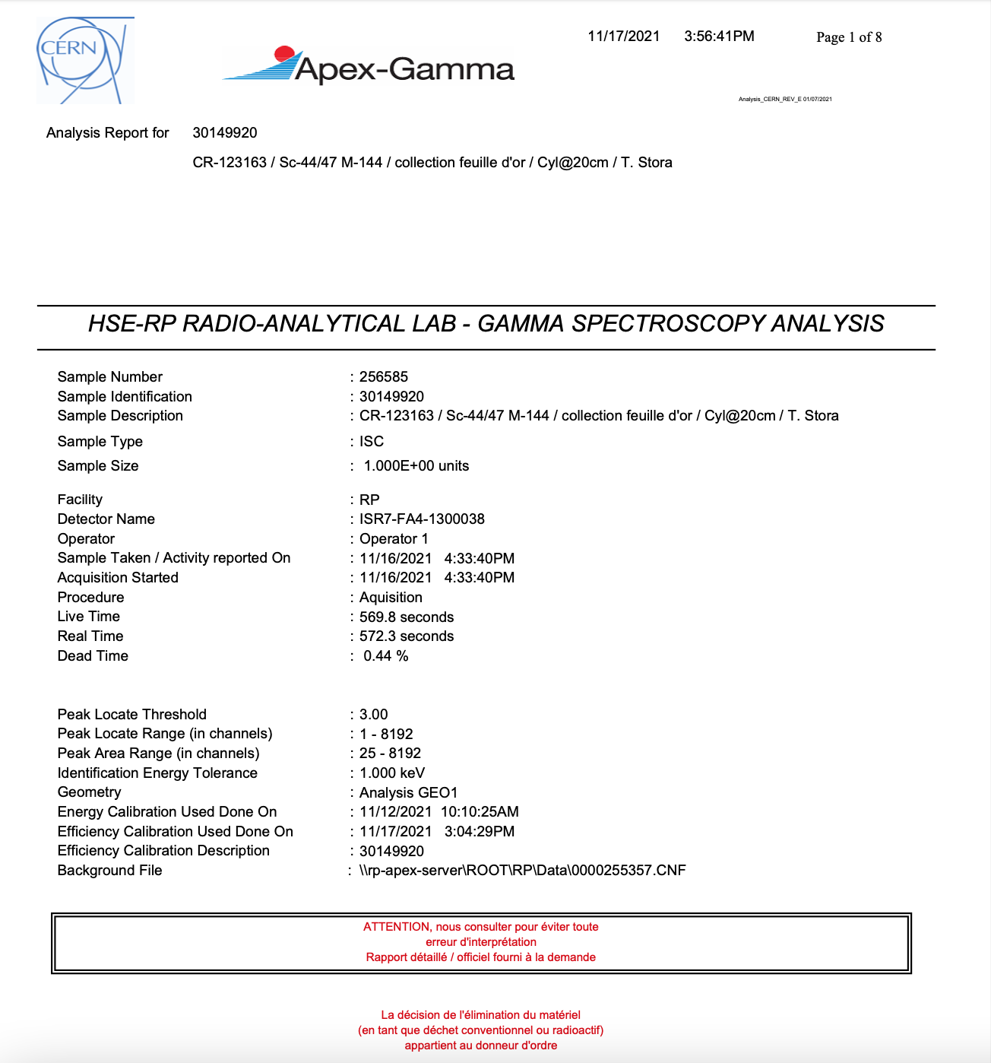
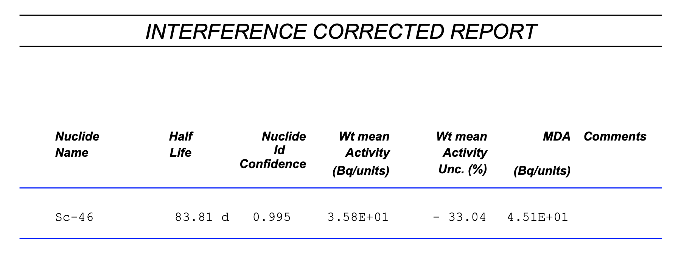
Activity and radiochemical purity
𝛾 and β spectroscopy studies on produced radionuclides
Half-life measurements and result refinement
  E.g. Sc-43 could not be produced without Sc-44 contaminants

Slide 22
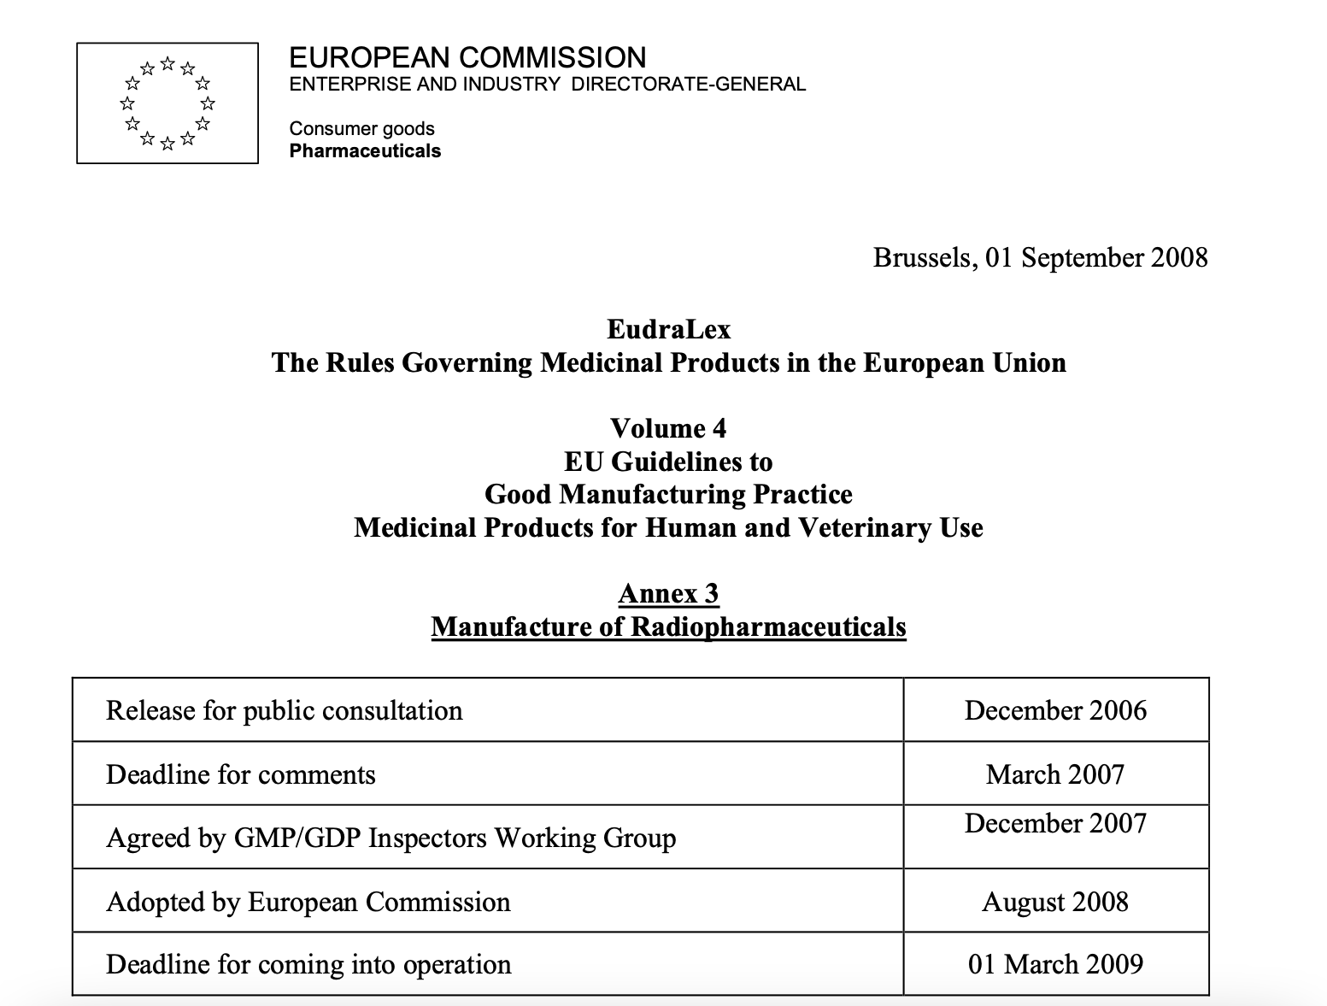
Looking beyond – some GMP principles undertaken
Radiopharmaceuticals intended for use in clinical trials as investigational medicinal products should in addition be produced in accordance with the principles in Eudralex Volume 4, annex 13.
Type of manufacture | Non - GMP * | GMP part II & I (Increasing) including relevant annexes
Radiopharmaceuticals PET Radiopharmaceuticals Radioactive Precursors | Reactor/ Cyclotron Production | Chemical synthesis | Purification steps | Processing, formulation and dispensing | Aseptic or final sterilization
Radionuclide Generators | Reactor/ Cyclotron Production | Processing
* Target and transfer system from cyclotron to synthesis rig may be considered as the first step of active substance manufacture.
QC: A written procedure detailing the assessment of production and analytical data, which should be considered before the batch is dispatched, should be established.
  Traceability of radionuclide production and separation

Slide 23
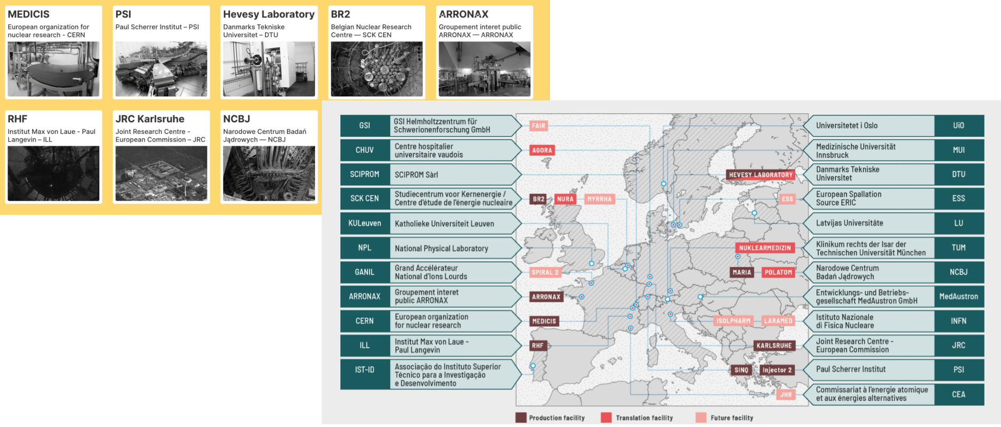

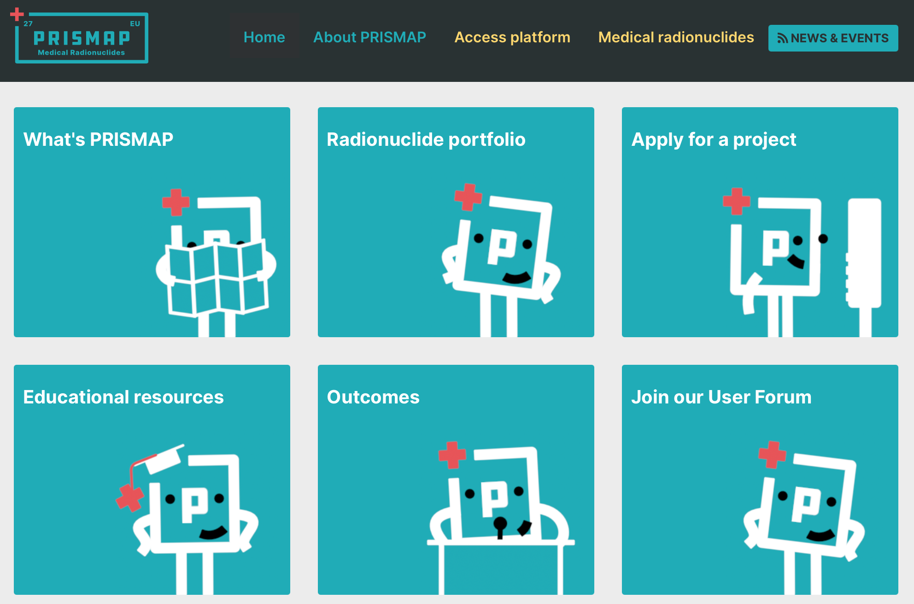

Baltics, MEDICIS and PRISMAP
MEDICIS Website: https://medicis.cern/
Pre-clinical and biomedical facilities available for project implementation.
PRISMAP Website: https://www.prismap.eu
PRISMAP will create a single-entry point for a fragmented user community distributed amongst universities, research centres, industry and hospitals.
No projects submitted from Baltics!
Courtesy of C. Duchemin and T. Stora

Slide 24


Step forward
Proof-of-concept:
High molar activity has been achieved with mass-separation:
7.0 GBq/mg to 1.5 TBq/mg
Up to 280 MBq in a single collection

Slide 25


