Slide 1
Beam Loss & Machine Protection
Lecture – Interactions of Radiation with Matter
William A. Barletta
Director, United States Particle Accelerator School, Fermilab
Dept. of Physics, MIT & UCLA
Economics Faculty - University of Ljubljana

Slide 2
Outline:
Beam material interaction, heating, activation
Beam material interactions
  From MeV to TeV, different particle types, …
  Bethe-Bloch description
Shower development & energy loss
Beam interaction with thin structures (e.g. windows) & components
Long term damage mechanisms, radiation damage, displacement per atom, point defects, clustering etc., shielding
Activation of material & equipment
Tools for calculation (e.g. FLUKA, MARS, EGS, …)
Beam losses into electronics, single event upsets

Slide 3
Beam-matter interactions:
Two questions
Individual particles carry minute amounts of energy
Accelerators generate beams of particles for research, medicine, and industrial applications process materials
How do particles impart energy to the materials being processed?
  Fundamental electromagnetic, atomic & nuclear interactions
How does the passage of a beam through matter affect the characteristics of the beam?
  Changes in current, particle energy, and beam emittance
Full simulation of interactions & consequences must account for both effects

Slide 4
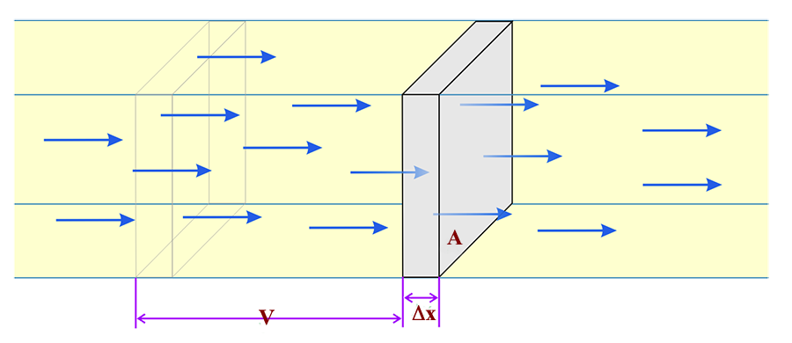
Beam-target interaction rates
Start with a monoenergetic beam of particles impinging on a thin target of thickness Δx, area A, & number density N
The beam flux (number of particles per cm2/sec): I = nv
  n = particle density density (number per cm³) & v =βc
# of interactions (s⁻¹) = σ(E) I N(A Δx)
  where σ(E) is the energy dependent cross-section of the process

Slide 5
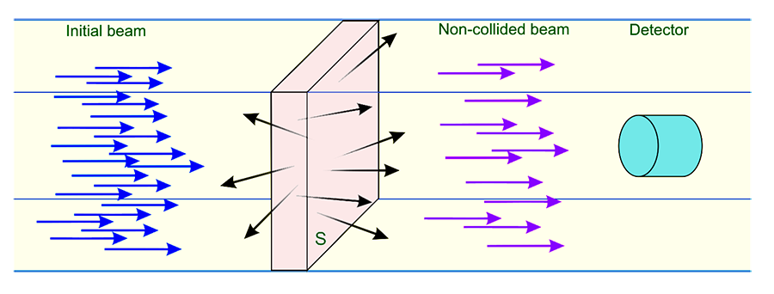
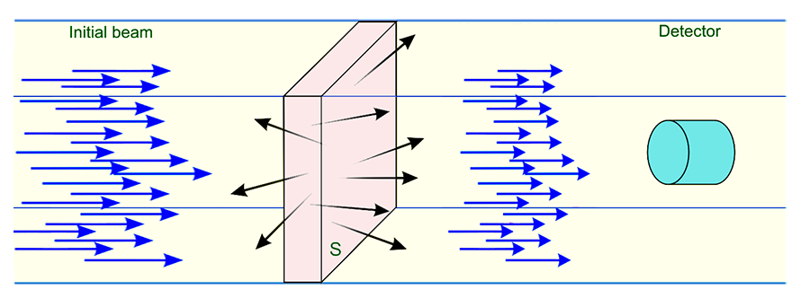
How the beam changes
Beam attenuates
Beam loses energy and the energy spreads (straggling)

Slide 6
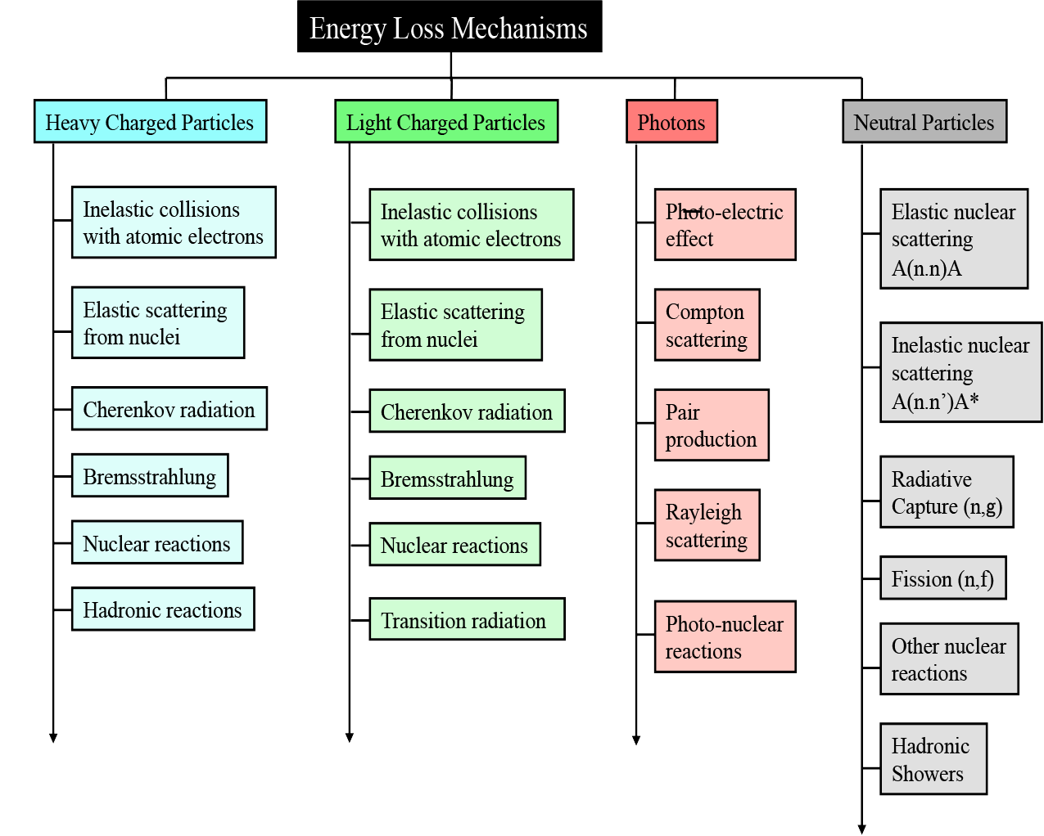
Source: S H Conell

Slide 7


How the beam changes
Beam generates electromagnetic and / or hadronic shower
Beam loses energy and the energy spreads (straggling)

Slide 8
Interactions of particles with matter
Dominant interaction for lower energy particles used in industrial applications (generally <10 MeV) is due to Coulomb (electromagnetic) interactions
  Inelastic collisions between incident electrons & orbital electrons of absorber atoms
  Elastic collisions between the incident electron & nuclei of absorber atoms
The ionization & excitation of atomic electrons (inelastic) in target material are the most common processes
X-ray emission can become important, particularly for electrons in high Z materials
  Nuclear interactions play a less significant role

Slide 9
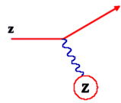
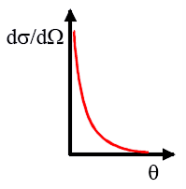
Elastic Scattering
Incoming particle: charge z
Target nucleus: charge Z
Elastic cross section:
(valid: spin 0, small angles  low ; note that σ diverges for <> = 0.
For very small angles (large impact b), get screening:
At = 0 cross section => constant
Rutherford Scattering Formula
Notes:
Fernow p. 64,65, section 2.6. Cross section for angles less than Theta_min will be very small. At theta = 0, cross section goes to constant.

Slide 10
Elastic Scattering Cross Section
To estimate θmin localize incident trajectory to Δx ~ atomic radius ra
Uncertainty in incident momentum &
Rutherford scattering breaks down when Δx ~ rn, (nucleus size)
Integrating the differential cross-section yields
Notes:
Fernow p. 64,65, section 2.6. Cross section for angles less than Theta_min will be very small. At theta = 0, cross section goes to constant.

Slide 11
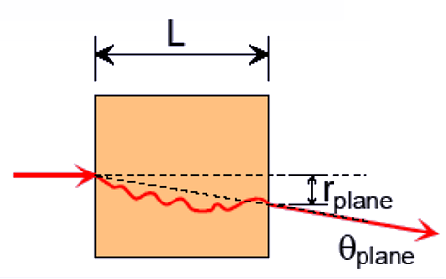
Multiple small angle scattering
For any observed scatter the particle could have scattered once or many time at small angles
Given σscatter the probability of scattering through a total angle  in traveling through a length L can be found.
Expected value of θ:
Notes:
11
Except for lightest elements, multiple scattering dominated by Coulomb scattering off nuclei.

Slide 12
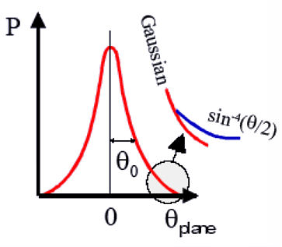
Multiple small angle scattering
Expected value of θ:
X0 = “radiation length”
Notes:
Except for lightest elements, multiple scattering dominated by Coulomb scattering off nuclei.

Slide 13
Bremsstrahlung & pair production
High-energy electrons (> “critical energy”) predominantly lose energy in matter by Bremsstrahlung
  The energy loss by Bremsstrahlung is exponential
High-energy photons predominantly lose energy by e⁺e⁻ pair production
X_{o} = mean distance over which an electron’s energy is reduced by a factor of 1/e due to radiation losses only
  Also, X_{o} = 7/9 of mean free path for pair production

Slide 14
Radiation length
The characteristic amount of matter traversed for both of these loses is the radiation length X_{o}, [ g-cm⁻² ]
Radiation loss is approximately independent of material when thickness expressed in terms of X₀
Critical energy is the energy at which losses due to ionization are equal to losses by radiation

Slide 15
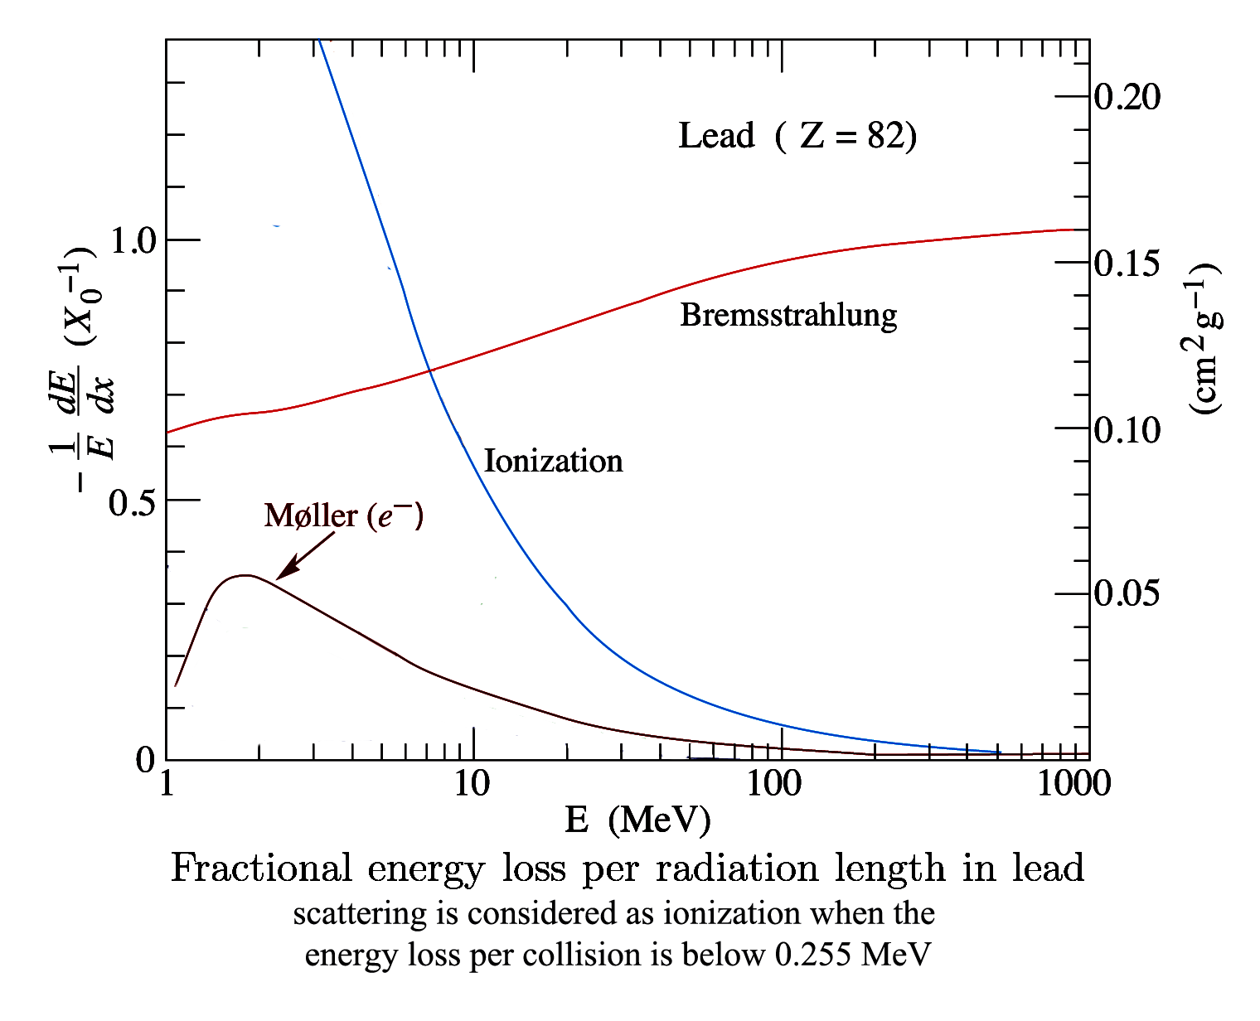
Fractional energy loss mechanism for electrons
Ecrit
Source: LBNL Particle Data Group

Slide 16
Moliere radius, R_{M}
The Moliere radius gives the average lateral deflection of critical energy electrons after traversing 1 X_{o}
It can be parameterized as
This also characterizes the spread of a beam of electrons traversing matter

Slide 17
Bremsstrahung dose
To estimate the dose at 1 meter from a thick (~1 X_{o} target)
D ≈ 2000 I_{beam} E_{o}^{2.8} (rad/hr)/(kW-m²) for E < E_{o}20 MeV
and
D ≈ 30000 I_{beam} E_{o}² (rad/hr)/(kW-m²) for E > E_{o}20 MeV
The angular spread of the radiation cone is

Slide 18
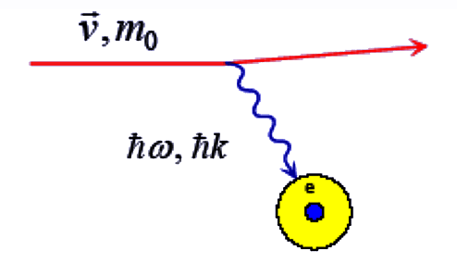
Energy deposition in matter by electrons
Via discrete collisions with the atomic electrons of the absorber particles deposit energy into matter
  For electrons, collisions with nuclei not so important (me<<mN) for energy loss
where Ne = electron density
Large enough => ionization.

Slide 19
Classical energy loss (dE/dx)
Charged particles passing through matter collide with nuclei & electrons
For an incident particle of mass M, charge z1e, velocity v1. colliding with a particle of mass m, charge z2e:
If m = me and z2=1 for e,
M = Amp and z2=Z for n:
(For Z electrons in
an atom with A~2Z)

Slide 20
Energy loss and stopping power (cont’d)
Total energy lost by incident particle per unit length:
where
  This classical form is an approximation.
Energy loss for a minimum ionizing particles,
(E_{o} > 2m_{particle}c²)
averaged over its entire range, is ~2 MeVcm²/g
  ~2 MeV/cm in water & water-like tissues
 characteristic orbital frequency for the atomic electron

Slide 21
Range of Particles
When Coulomb scattering dominates the energy loss, a pure beam of charged particles travel roughly the same range R in matter
Example: 1 GeV/c protons have a range of about 20 g/cm² in lead (17.6 cm)
The number of heavy charged particles in a beam decreases with depth into the material
Most ionization loss occurs near the end of the path, where velocities are small => Bragg peak: increase in energy loss at end of path
Mean Range depth at which 1/2 the particles remain.
Notes:
E_0 is ~9.3 MeV for protons in air (n=1.8).

Slide 22
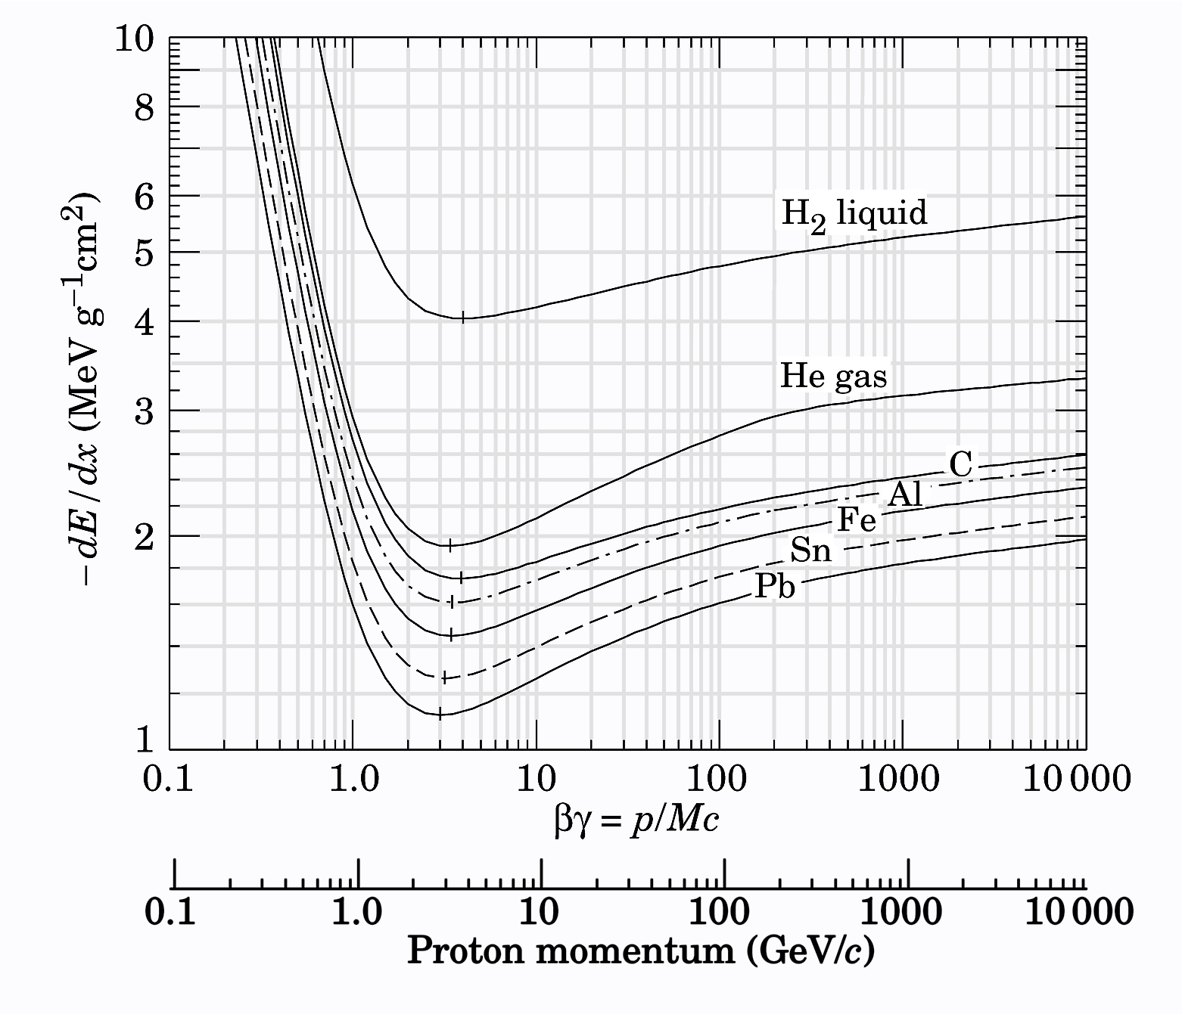
Real Ionization Energy Loss
Full Bethe-Block formula
Number of encounters is proportional
to electron density in medium:
Notes:
I = Ionization potential of medium, Tmax = maximum kinetic energy,
delta = density effect correction parameter.
For dense materials w/ interatomic spacing small, the upper limit on allowed impact parameters may encompass many atoms.
“dielectric screening”.

Slide 23
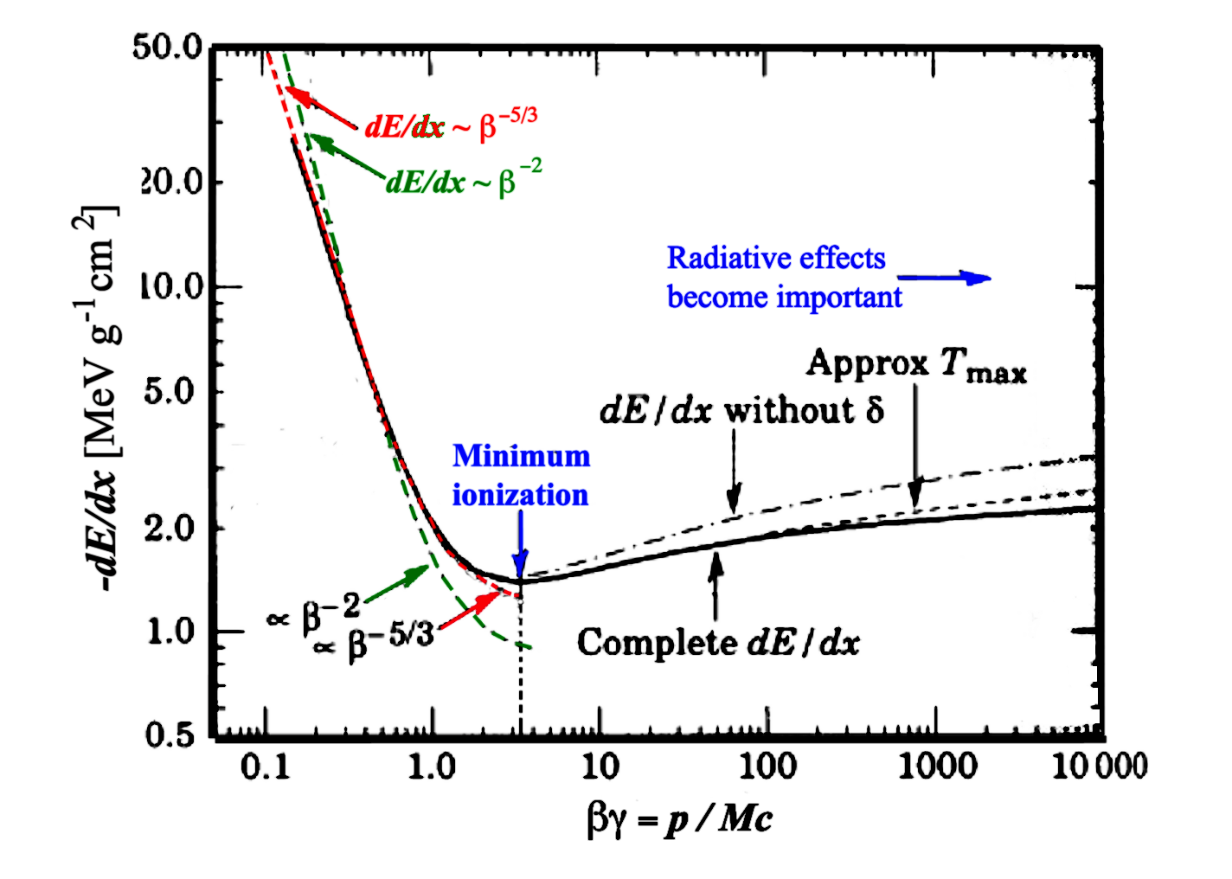
Features of Bethe-Bloch
Minimum ionizing particles
(MIP) at βγ ~ 3 – 4
At low energy dE/dx falls ~ β⁻²
At high energy dE/dx rises as ln(βγ)²
(relativistic effect)
At very high energy dE/dx saturates
(due to density effect)

Slide 24
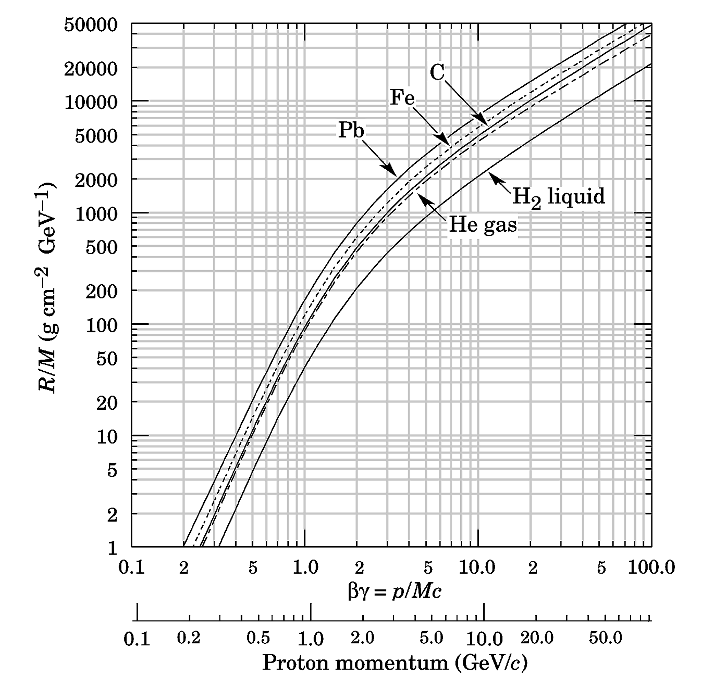
Range of ions
(for polymers and silicon use C curve)
Source: Particle data group

Slide 25
End-of-range deposition: Bragg peak
Energy deposition profile Carbon - 292.7 MeV/n
  (Bragg peak used as "range")
  Range is measured in high density poly (r=0.97 g/cm³)
  LET (in H₂O) = 12.89 KeV/μm
Data source:
NASA Space Radiation Laboratory @BNL
cm

Slide 26
Anatomy of the Bragg peak
1/r² and transverse size set peak to entrance ratio
overall shape from increase of dE/dx as proton slows
width from range straggling and beam energy spread
nuclear buildup or low energy contamination
nuclear reactions take away from the peak and add to this region
depth from beam energy

Slide 27
Beam interactions with absorbing medium
Inelastic collisions with orbital electrons of target atoms
  Loss of incident electron’s kinetic energy through ionization & excitation of target atoms
Two types of ionization collisions:
  Hard collisions - ejected orbital electron gains enough energy to be able to ionize atoms on its own (called delta rays)
  Soft collisions - ejected orbital electron gains an insufficient amount of energy to be able to ionize matter on its own
Elastic collisions between incident particles & target nuclei
  Incident electrons lose kinetic energy through a cumulative action of multiple scattering events
  Each event characterized by a small energy loss

Slide 28
Range of incident particles
Eventually, the incident particle loses all its energy & stops at a certain depth in the absorber - called the particle range
In most encounters between the incident particles and absorber atoms the energy loss is minute ==> is convenient to think of the incident particles as losing energy gradually in a Continuous Slowing Down Approximation (Berger and Selzer)
The mean path length of an particle of initial energy E₀ can be found by integrating the reciprocal of the total mass stopping power over the energy from E₀ to 0

Slide 29
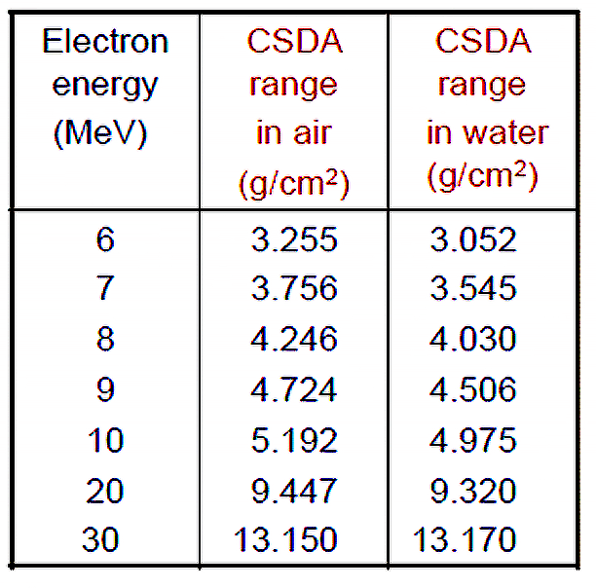
CDSA ranges of electrons in water and air
The CSDA range is a calculated quantity that represents the mean path length along the electron’s trajectory
The CSDA range is not the the depth of penetration along a defined direction
Source: IAEA

Slide 30
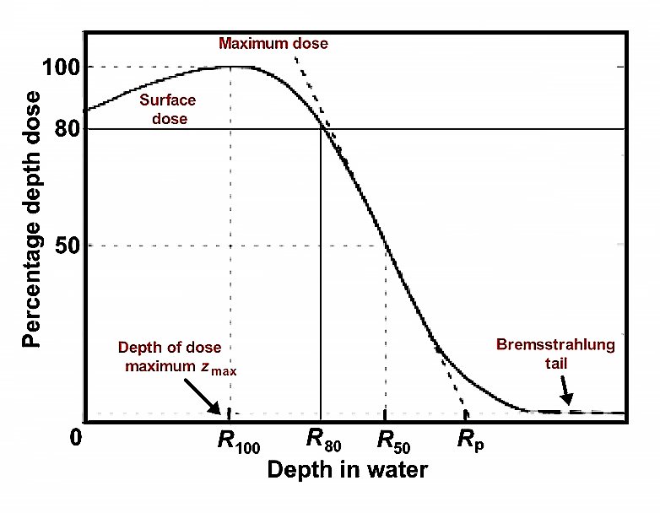
Dose–depth distribution for electrons
Electron beam percentage depth dose curve along the beam axis exhibits the following characteristics:
Surface dose is relatively high (of the order of 80 % – 100 %)
Maximum dose occurs at a certain depth referred to as the depth of dose maximum zmax
Beyond zmax the dose drops off rapidly and levels off at a small low level dose called the bremsstrahlung tail (of the order of a few per cent).

Slide 31
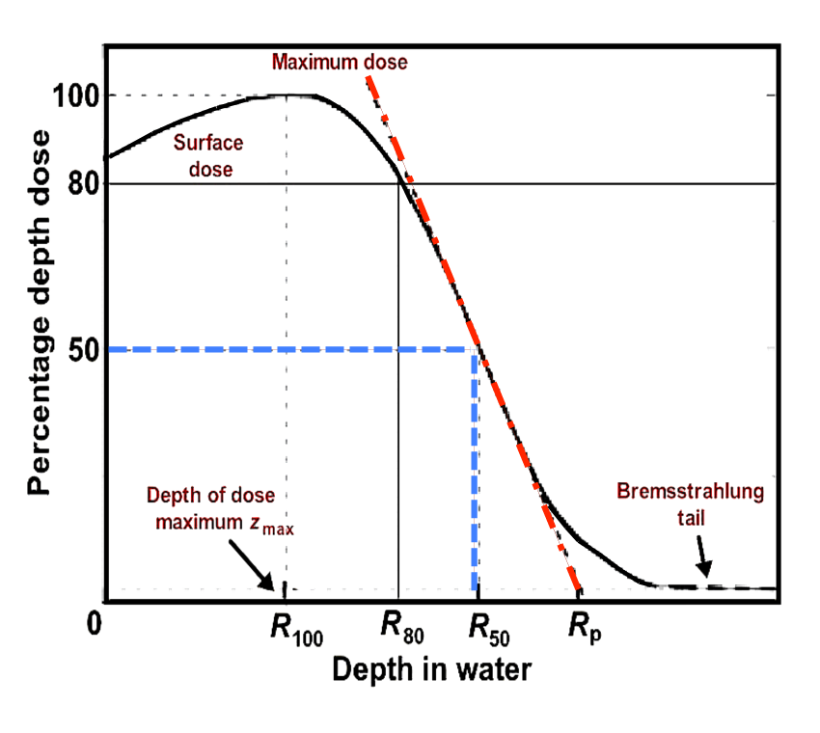
Dose–depth distribution for electrons
Electron beam range definitions
Maximum range Rmax
  Largest penetration depth of electrons in the target
Practical range Rp
Therapeutic range R80
Depth R50
Dose gradient is the slope in red

Slide 32
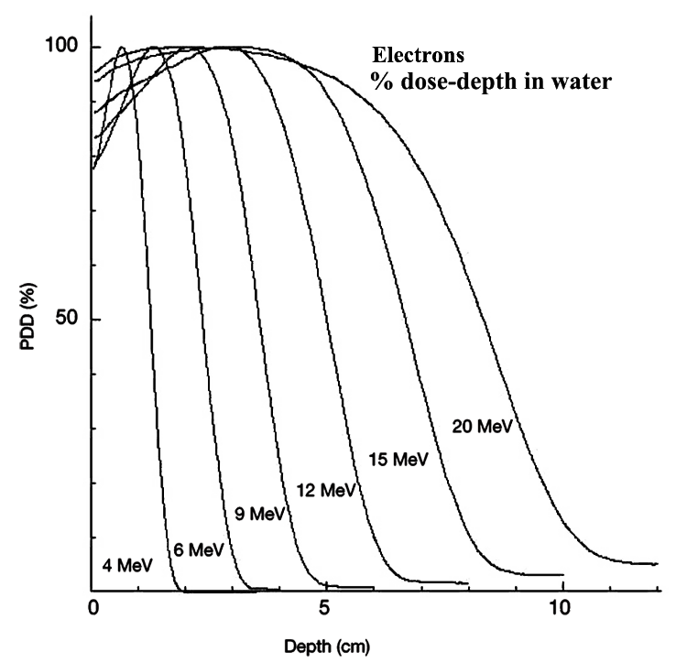
Dose buildup with depth
Buildup region for electron beams, is the depth region between the target surface & the depth of dose maximum z_{max}
Buildup occurs because multiple scattering increases average angle of electron trajectories with increasing depth
Surface dose for MeV electron beams is relatively large (typically 75 % - 95 %)
The percentage surface dose increases with increasing electron beam energy

Slide 33
Interactions of photons
For three major types of interaction play a role in photon transport:
  Photoelectric absorption
  Compton scattering
  Pair production

Slide 34
Photoelectric Absorption
The photon transfers all of its energy to a bound electron
  The electron is ejected as a photoelectron
  This interaction is not possible with a free electron due to momentum conservation.
The photoelectron appears with an energy: E_{e-} = hν - E_{b}
Photoelectron emission creates a vacancy in a bound shell of electrons
The vacancy is quickly filled by an electron from a higher shell
As a result one or more characteristic X‐rays may emitted.
  These X‐rays are generally reabsorbed close to the original site
  In some cases an Auger electron is emitted instead of the X‐ray

Slide 35
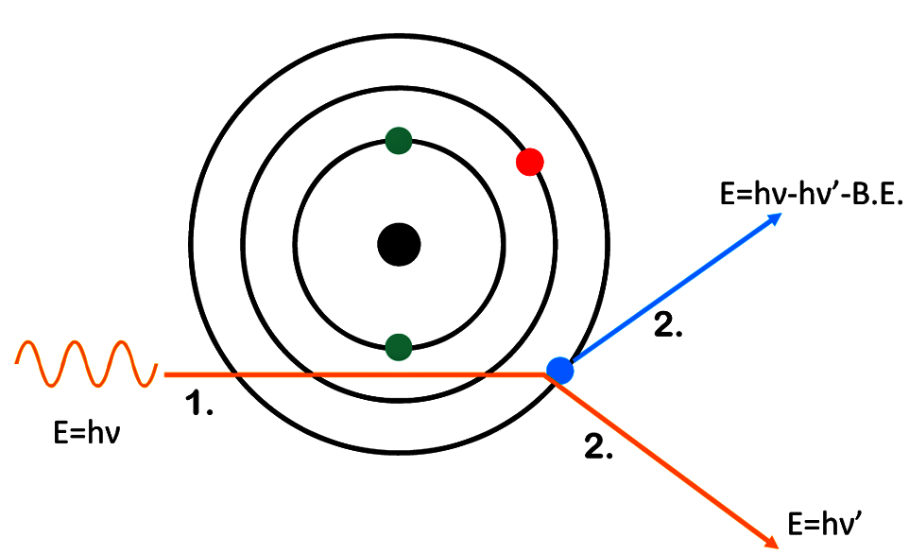
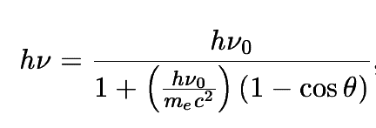
Compton scattering of photons
Compton scattering is the predominant interaction for gamma rays with energies < a few MeV
The incident gamma scatters from a loosely bound or free electron in the absorbing material
  The incoming photon transfers a portion of its energy to the electron depends on the scattering angle
  The photon is deflected at an angle Θ & the electron is emitted as a recoil

Slide 36
Pair production is possible if E_{γ} > 2 m_{e-}
The gamma ray is replaced by an e⁺e⁻ pair
To conserve energy & momentum, pair productions must take place in the coulomb field of a nucleus
The photon energy in excess of 2 m_{e-} (1.02 MeV) is converted into kinetic energy shared between the e⁺ & e⁻
The e⁺ subsequently slows down in the medium & annihilates with another electron, releasing two 511 keV photons in the process.
The pair production probability remains very low until the gamma ray energy approaches several MeV.
  The probability varies approximately with Z² of the absorber
    No simple expression exits for this relation.

Slide 37
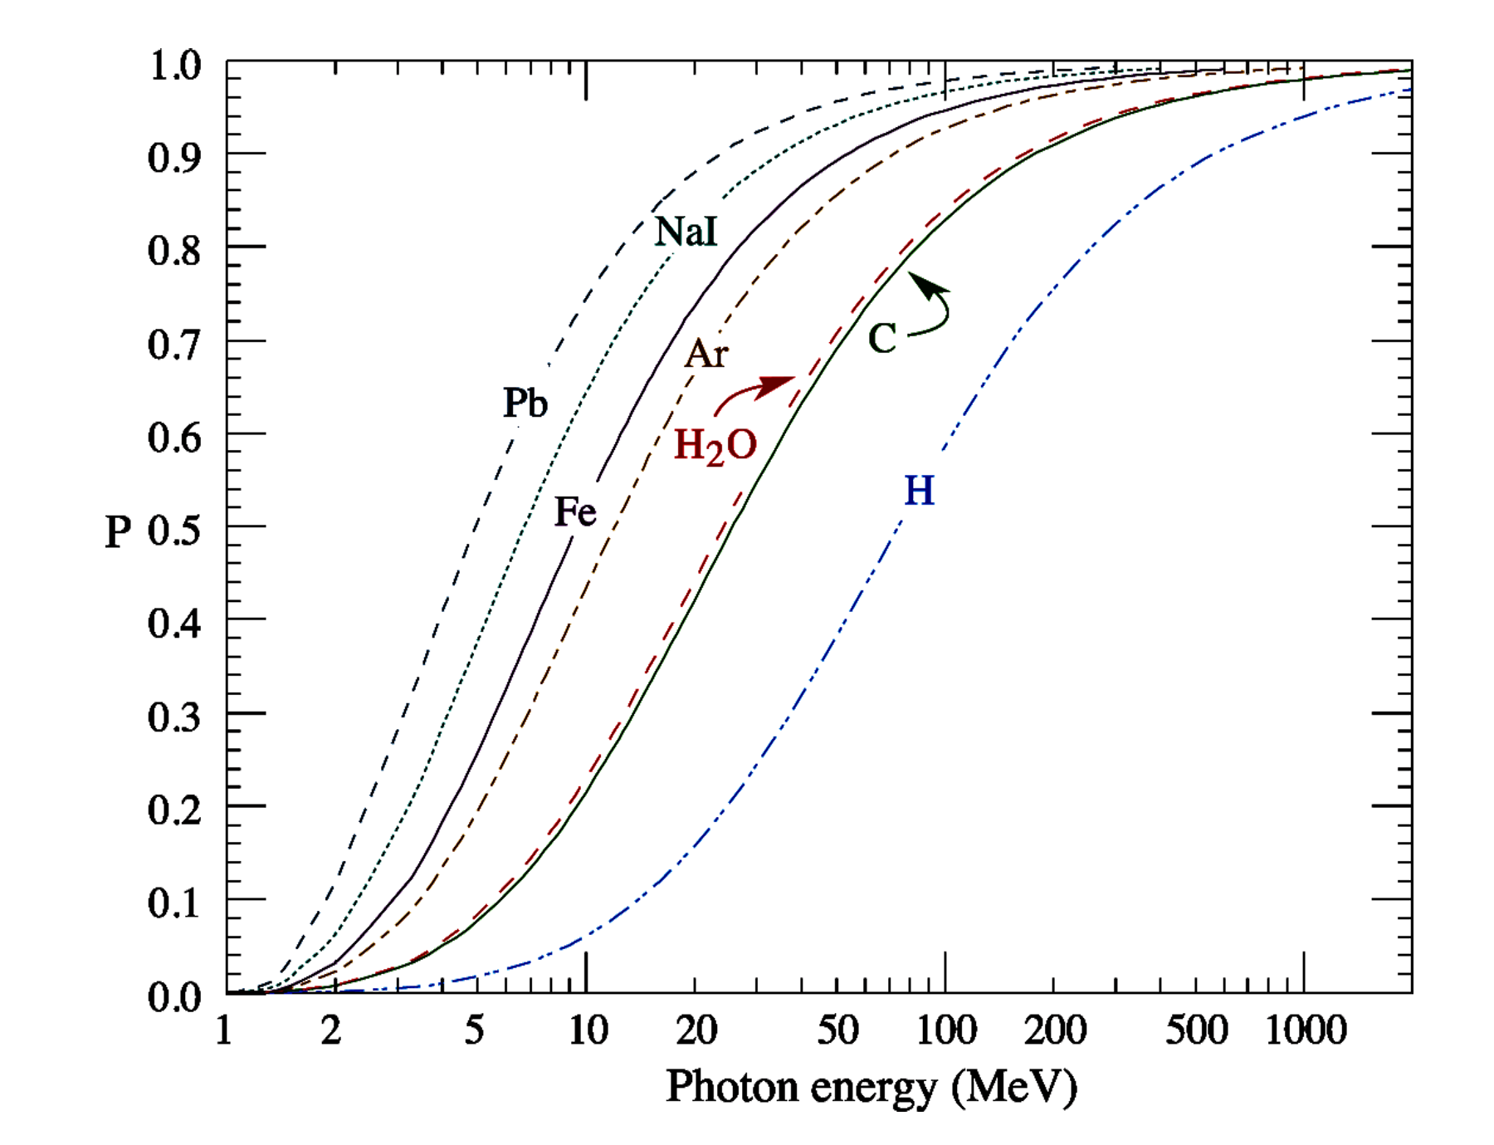
Photon transport through matter:
Probability of pair production

Slide 38
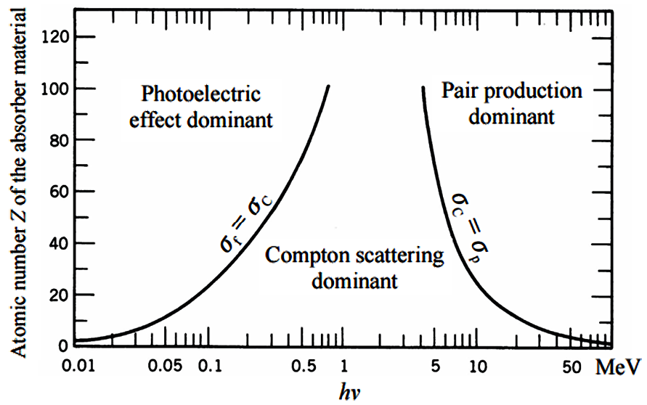
Regimes of gamma transport
The lines show values of Z and hν for which the two neighboring effects are just equal
Source: Knoll, G. F., Radiation Detection and Measurement, 4th Edition, John Wiley (2010)

Slide 39
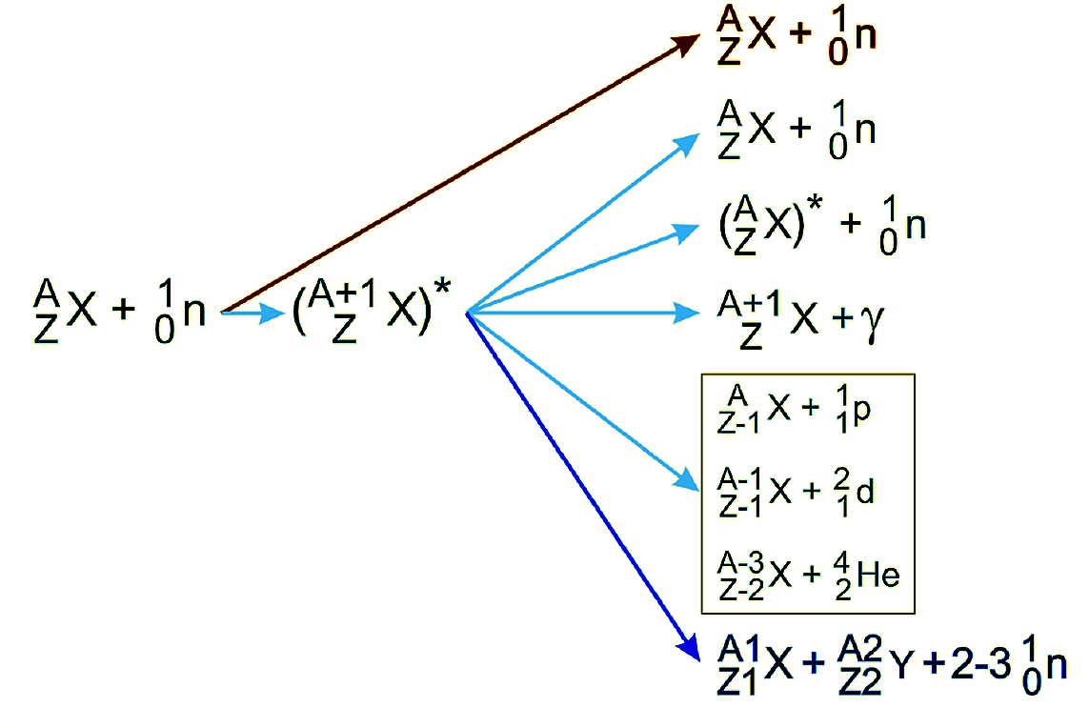
Interactions of neutrons with matter
Neutron beams pass through matter until each undergoes a collision at random & is removed from the beam.
Neutrons are scattered by nuclei not electrons
  They leave a portion of their energy until they are thermalized & absorbed.
Elastic scattering
Resonant elastic scattering
Inelastic scatterig
Radiative capture
Production of charged particles
Fission

Slide 40

Interactions of neutron with matter
Neutron beams pass through matter until each undergoes a collision at random & is removed from the beam.
Neutrons are scattered by nuclei not electrons
  They leave a portion of their energy until they are thermalized & absorbed.
Beam intensity drops continuously drop as it propagates through the material
  mean kinetic energy of the neutrons also generally decreases
Beam intensity follows an exponential attenuation law
  Characterized by an attenuation length

Slide 41
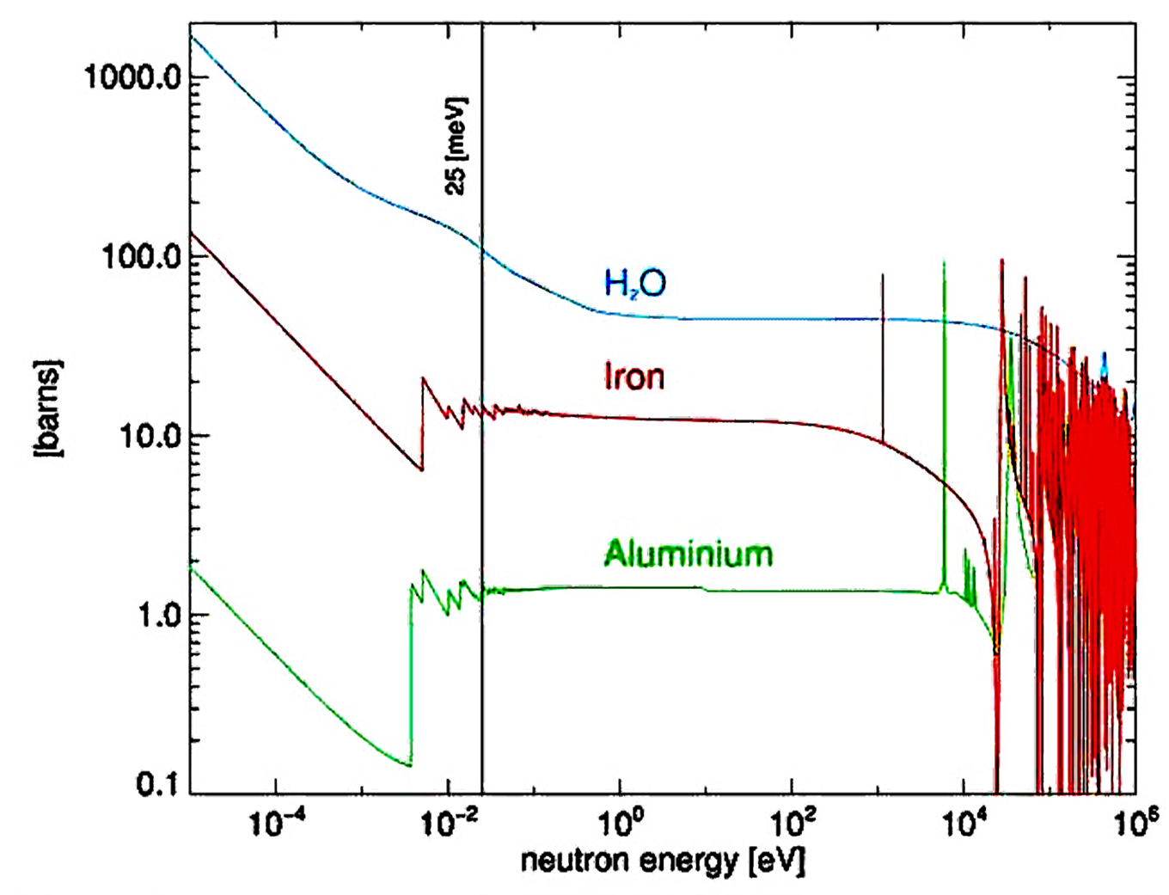
Neutron interaction cross-sections (<1 MeV)
For e-beam processing we want to avoid neutron production
Source: PSI

Slide 42
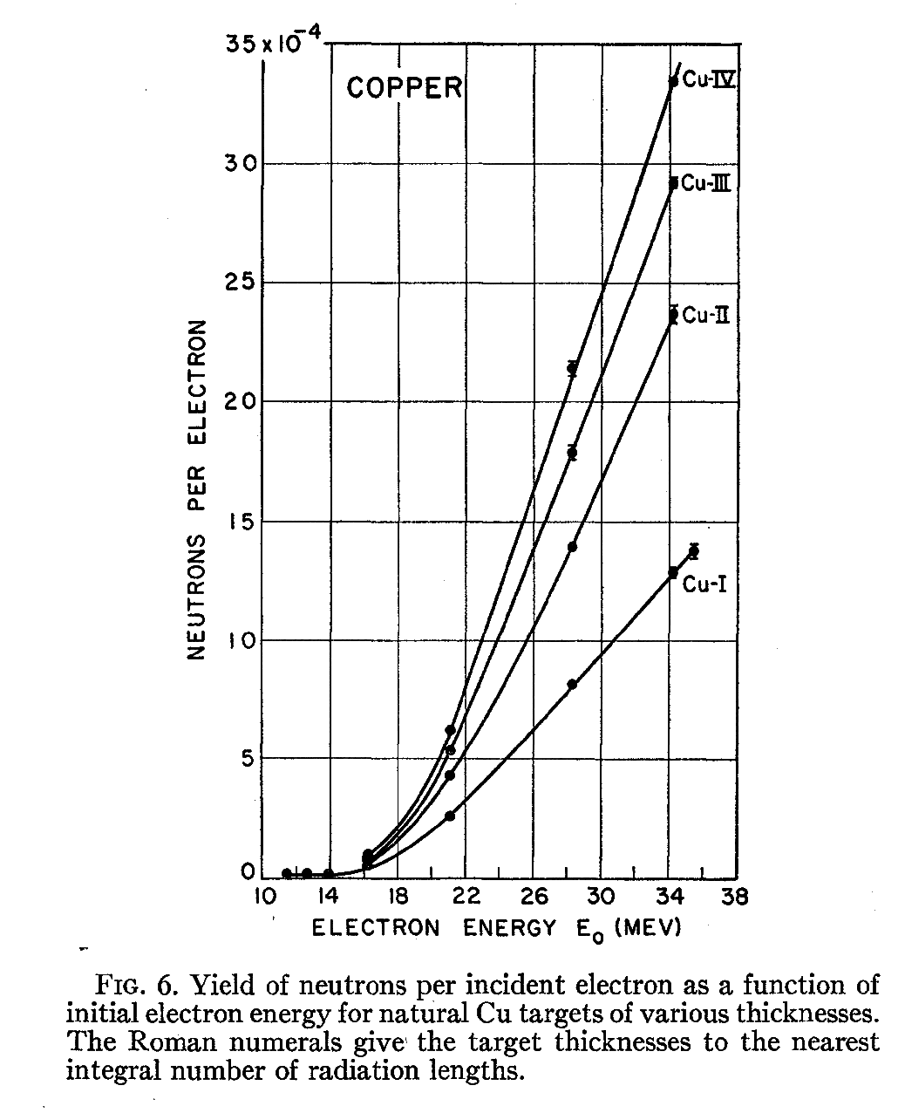
Photo-Neutron threshold = Nuclear binding energy
Thick target yield of photoneutrons
Y(E_{o},Pb,∞ ) ≈ 2X10⁻⁴E_{o}(MeV) (n/e⁻)
A conservative value for shielding estimates is
Y(E_{o}) ≈ 10⁻³ E_{o}(MeV) (n/e⁻)
Source: Barber and George, Phys. Rev 116, 4(1959):

Slide 43
Interactions at high energy
E_{particle} >> m_{particle}
Characteristic feature:
Hadronic cascades & electromagnetic showers (EMS)
due to multi-particle production
in strong nuclear & electromagnetic interactions.

Slide 44
Cascades and showers
By consecutive multiplication, the interaction avalanche rapidly grows, passes its maximum and then attenuates
  Due to energy dissipation between the cascade particles & ionization energy loss
Energetic particles are concentrated around the projectile axis forming the shower core
Neutral particles (mainly neutrons) & photons dominate cascade development when energy drops below a few hundred MeV.

Slide 45
Electromagnetic shower
e
PbW04 CMS, X0=0.89 cm
After t generations
At the shower maximum < E > ~ E_{critical}
After shower maximum, the remaining energy is carried away by photons ==> exponential falloff

Slide 46
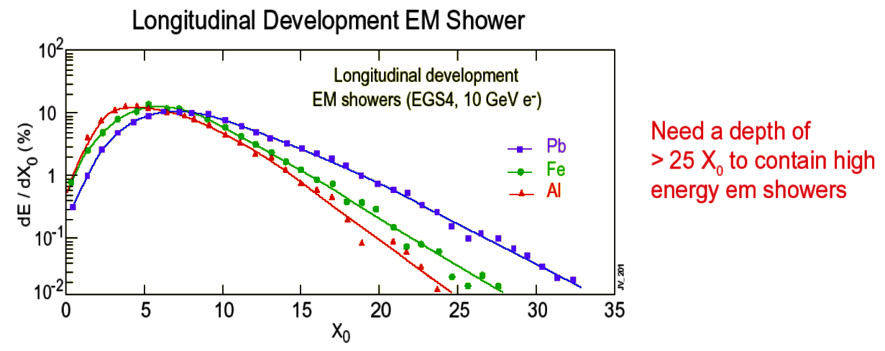
Electromagnetic shower sizes
EM showers scale length is a radiation length
  (X_{o} = 1.76 cm in Fe)
Longitudinal dimension of EM showers is (10-30) X_{o}
Transversely, the effective radius of an EM showers is ~2R_{M}
  where R_{M} is a Moliere radius = 0.0265 X_{o} (Z + 1.2)

Slide 47
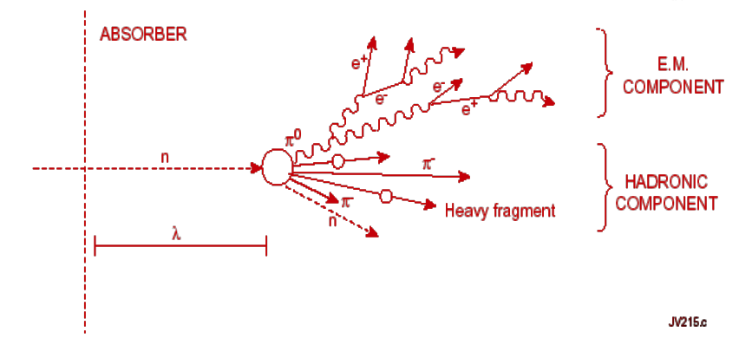
Hadronic cascade basics
Strong interaction is responsible for shower development
  Analogy with EM showers
A high energy hadron striking absorber ==> multi-particle production consisting of mesons (e.g. π±, πº,K etc.)
  These in turn interact with further nuclei
Breakup of nuclei leads to spallation neutrons
Multiplication continues until energies reach π production threshold

Slide 48
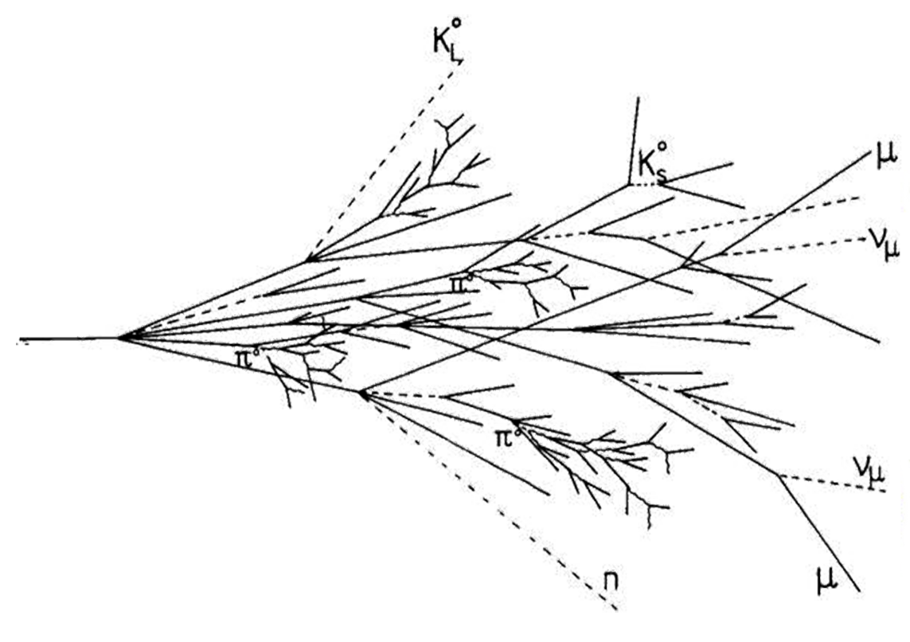
Hadronic cascade
More complex than EM showers
  Visible EM O(50%)
    e±, γ, πº → γγ
  Visible non-EM O(25%)
    Ionization of π±, p, µ±
  Invisible O(25%)
    Nuclear break-up
    Nuclear excitation
  Escape O(2%)

Slide 49
Nuclear interaction length
Simple model treats interaction on a black disc of radius R
In fact,
Define nuclear interaction length, λ₁
Cascade particles have a limited transverse momentum

Slide 50
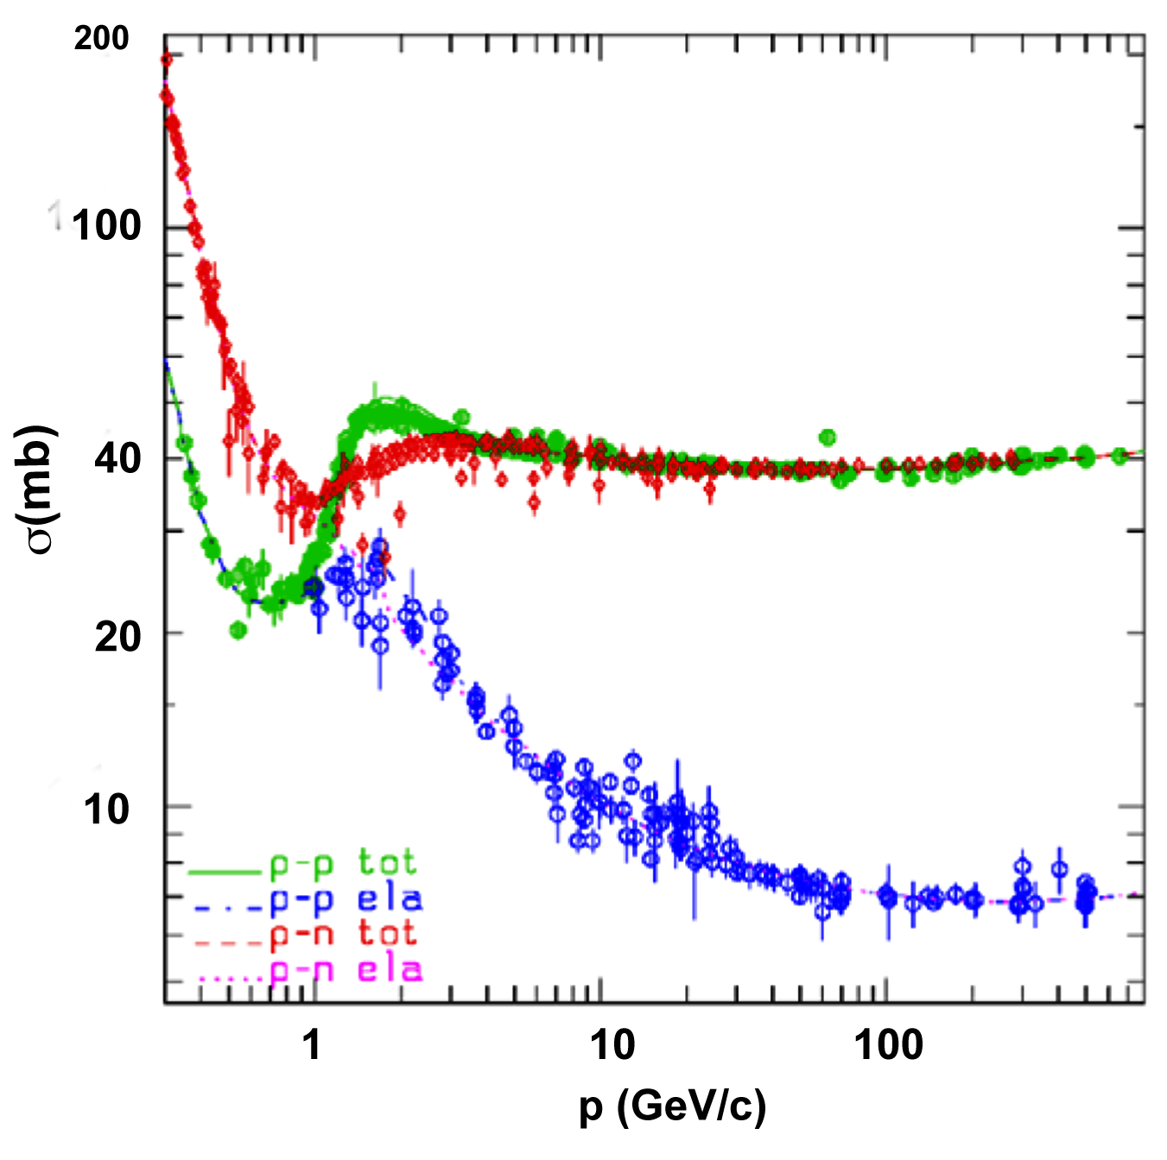
Total p=p & n-p cross-sections

Slide 51
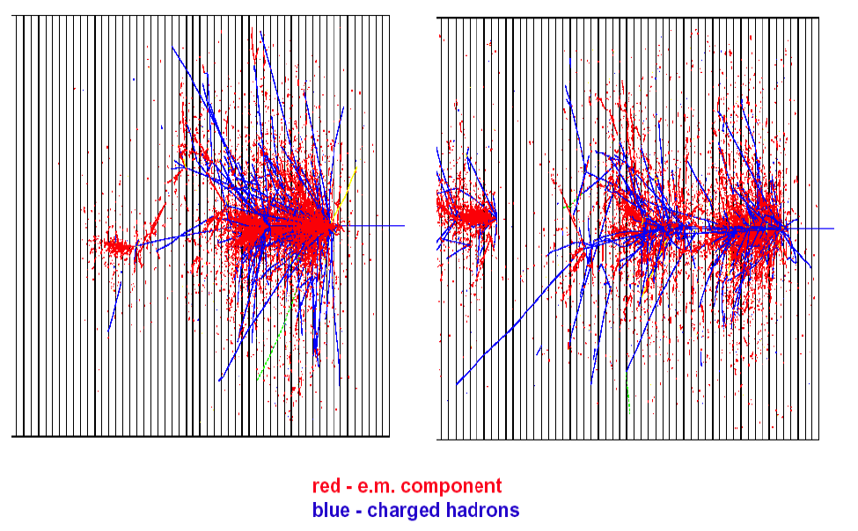
150 GeV pion showers in Copper

Slide 52
Shower sizes
Hadronic cascade scale length is a nuclear interaction length, λ₁ (16.8 cm in Fe)
  EM showers it is a radiation length X_{o} (1.76 cm in Fe)
  Interaction lengths scale as ln E
Longitudinal dimension of hadronic cascades = (5-10) λ₁
  In EM showers it is (10-30) X_{o}
Transversely, the effective radius of a hadronic cascade is about λ₁
  For EM showers it is about 2R_{M}
    where R_{M} is a Moliere radius = 0.0265 X_{o} (Z + 1.2)

Slide 53
Effects on Materials

Slide 54
Effects on materials
Component damage (lifetime):
  Thermal shocks & quasi-instantaneous damage
  Insulation property deterioration due to dose buildup
  Radiation damage to inorganic materials due to atomic displacements (DPA) and helium production
Operational (performance):
  Superconducting magnet quench or failure
  Single-event effects in electronics
  Detector performance deterioration
  Radio-activation, prompt dose & impact on environment
Effects depend on material, energy density deposited & time structure of dose

Slide 55
Effects in organic materials: three-step process
Production of free radicals by radiation
a) A free radical can be an atom, molecule, or ion, but along with its normal paired electrons, it must also have a single, unpaired electron
2. Reaction of free radicals:
a) Crosslinking, chain scission, formation of unsaturated bonds (C=C, etc.), oxidation, & gas evolution
3. Change of molecular structure:
a) Modification & degradation affected by irradiation temperature & atmosphere as well as by presence of additives
  degradation is enhanced at high temperatures
  radiation oxidation in the presence of oxygen accelerates degradation
  additives can improve radiation resistance

Slide 56
Effects in inorganic matter
Thermal shock ==> fast ablation & slower structural changes
  Short pulses depositing energy density in hydrodynamic regime
    From 200 J/g (W), 600 J/g (Cu), ~1 kJ/g (Ni, Inconel) to ~15 kJ/g
    Energy density of high explosive ~ 4 kJ/g
Radiation defects induced by cumulative nuclear radiation, in particular high energy ( E ≥ 0.1MeV ) neutrons
  Regions with displaced atoms, vacancies, self interstitials [Frenkel pairs] produced by Primary Knock-on Atoms (PKA)
    PKA: A lattice atom that is knocked off or displaced from its lattice position by intense radiation & comes to rest in an interstitial position far from the vacant site created
  Injection of helium, hydrogen & transmuted atoms
  Thermal spikes: regions with atoms in high energy states

Slide 57
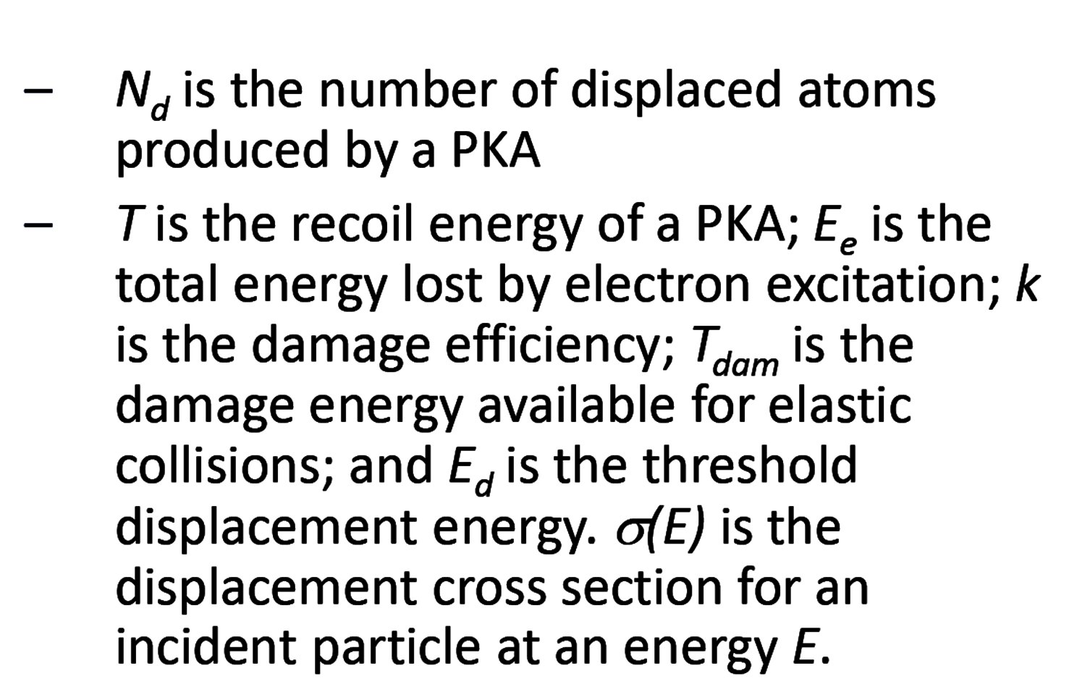
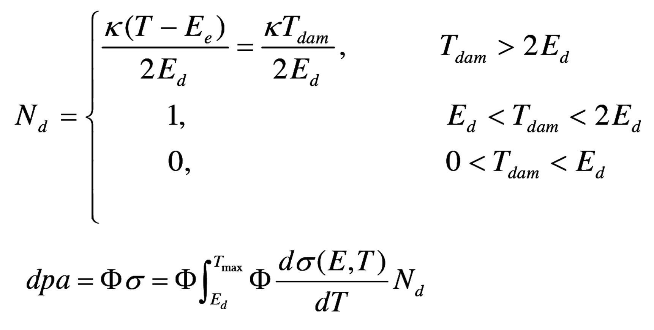
Calculation of Displacements Per Atom (DPA)
Evaluating radiation damage requires a fundamental parameter that characterizes lattice displacement events
DPA compares radiation damage by different radiation sources.
  DPA is a damage‐based exposure unit & represents the number of atoms displaced from their normal lattice sites due to energetic particle bombardment
Calculation of DPA values

Slide 58
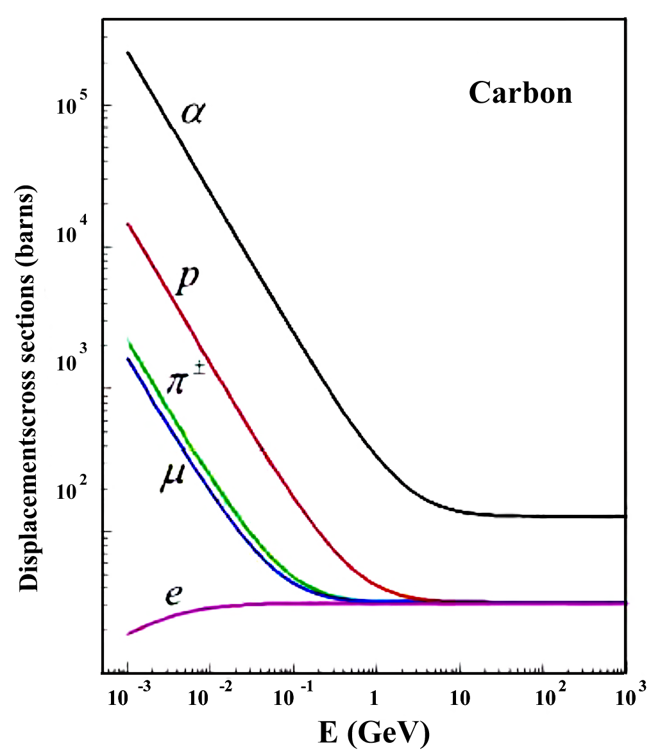
Displacement cross section
Products of elastic & inelastic nuclear interactions as well as Coulomb elastic scattering of transported charged particles (hadrons, electrons, muons & heavy ions) from 1 keV to 10 TeV contribute to DPA in this model
  For Coulomb scattering, Rutherford cross section with Mott corrections and nuclear form factors are used

Slide 59
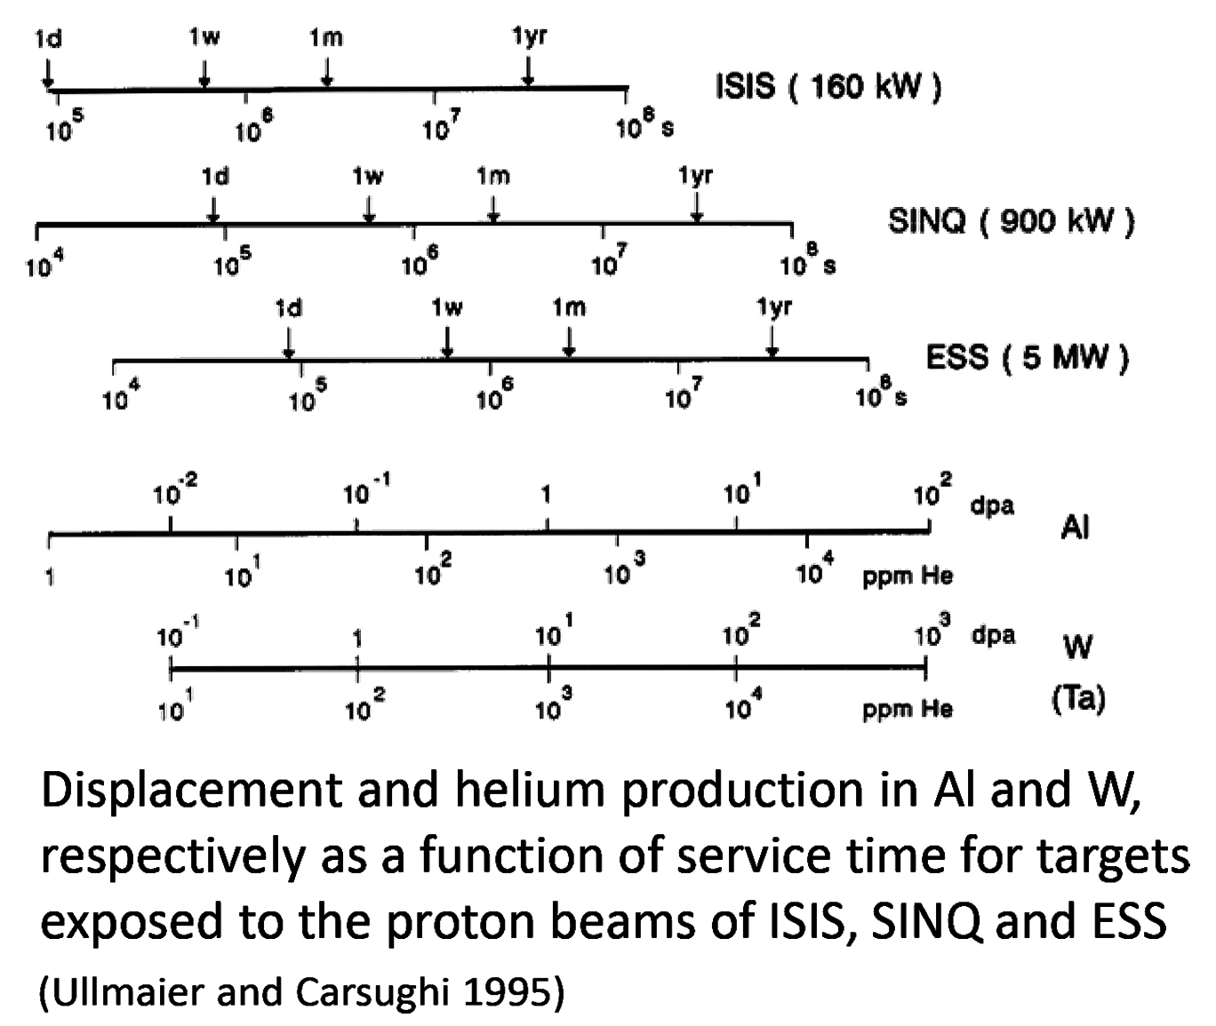
Transmutation Effects
Nuclear transmutation reactions occur, producing solid transmutation products & He and H gas atoms
  He & H gas atoms can have pronounced effect on materials performance even at low concentrations
  Production rates of He, H (He/dpa, H/dpa) can vary in different radiation environments.

Slide 60
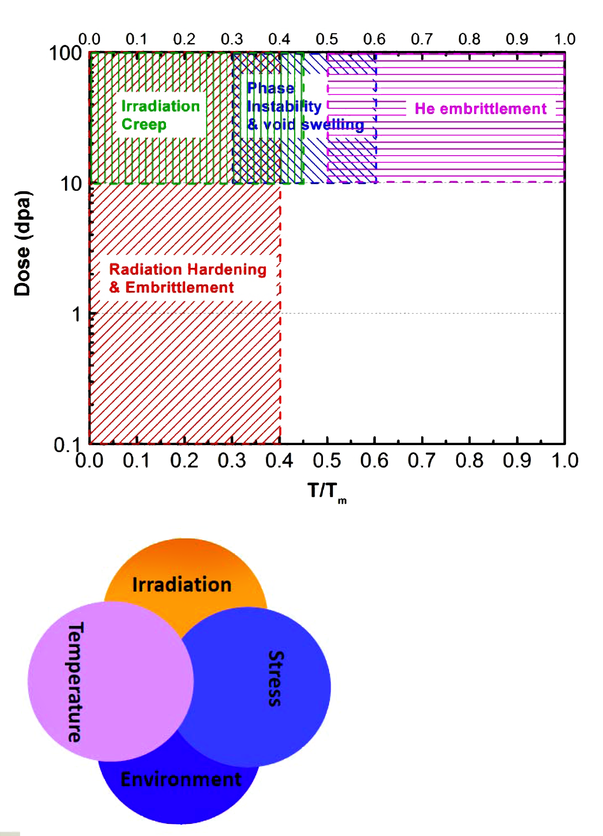
Radiation-induced property changes
Radiation‐induced microstructural changes significantly degrade materials’ properties
  Degradation of physical properties (increase in electrical resistivity, decrease in thermal conductivity, etc.)
  Radiation hardening & embrittlement
  Irradiation creep
  Void swelling
  High temperature He embrittlement
  Reduction in fatigue performance, irradiation‐assisted stress corrosion cracking

Slide 61
Simulation Tools
The modern approach for accelerator complexes is to build a realistic model of the whole machine for beam loss, energy deposition, activation & radiation shielding studies

Slide 62
Simulation tools
The challenge: detailed & accurate (to a % level) modeling of all particle interactions with 3-D system components
  Up to tens of kilometers of the accelerator lattice)
  Energy region spanning up to 20 decades
  Basis of accelerator, detector & shielding designs & evaluation of their performance
Five general-purpose, all-particle Monte Carlo codes are capable of this: FLUKA, GEANT4, MARS15, MCNP6, & PHITS
  Used in combination with lattice codes (MADX), geometry generator codes, & tracking codes
  Results of energy deposition are computed in ANSYS codes
All the aspects of Monte-Carlo simulations benchmarked - wherever possible - with dedicated beam tests
Source: N. Mokhov

Slide 63
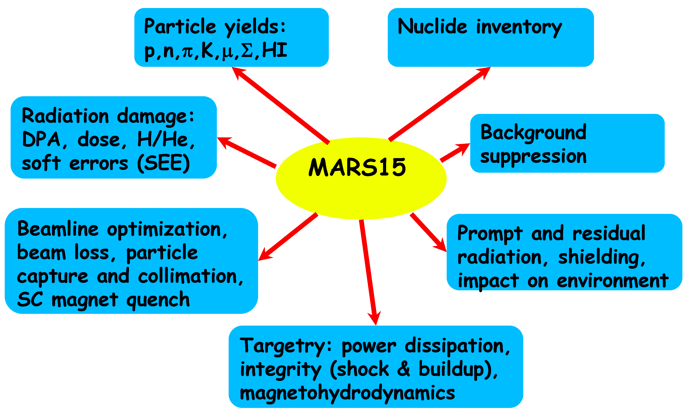
Example: MARS15
Source: N. Mokhov

Slide 64
Particle Production in Nuclear Interactions
Origin of the majority of beam-induced deleterious effects
  In accelerator, detector, beamlines, targets, collimators, absorbers & environment
Models are okay at E_{part} < 1-3 GeV & E_{part} > 8-10 GeV
At intermediate energies: some theoretical difficulties; experimental data contradict each other
  Main problem is low-energy pion production
Recent improvements: Los Alamos Quark-Gluon String Model
  New & better approximations for elementary total, elastic, and inelastic cross sections for NN and πN interactions
Source: N. Mokhov

Slide 65
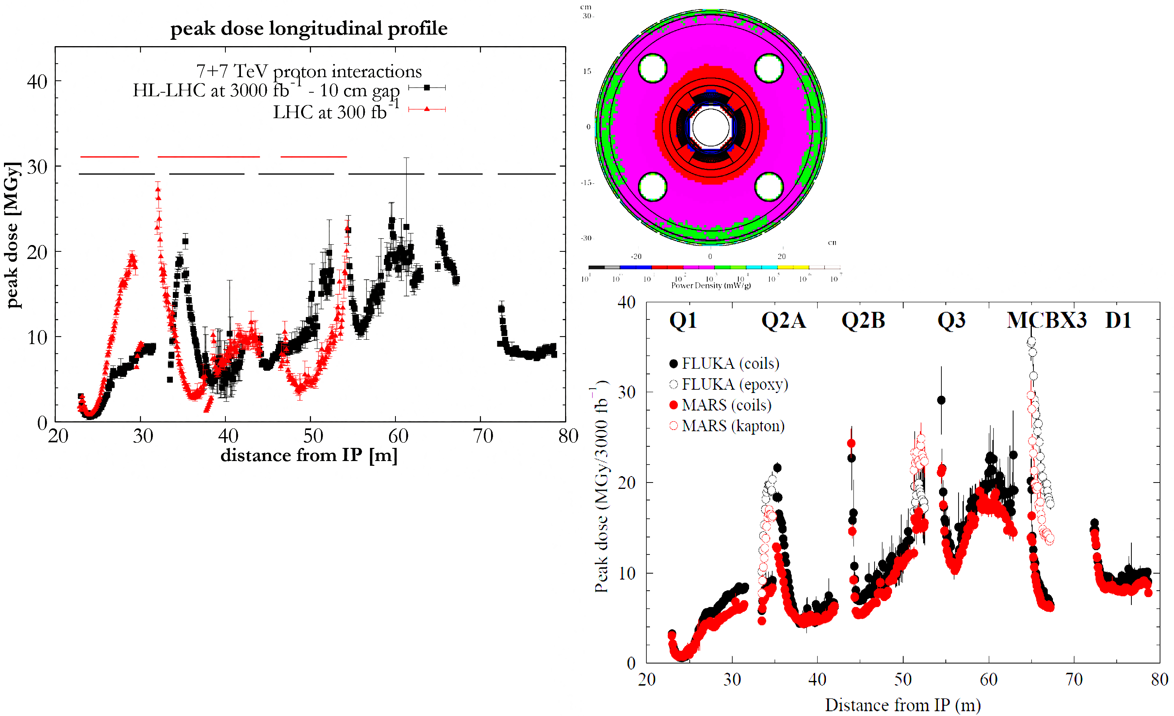
Example: Hi-Lumi LHC Upgrade
Beam Loss and Accelerator Protection
FLUKA & MARS
correlated studies:
design goals achieved
With proposed protection system,
peak dose (i.e. lifetime) in HL-LHC
magnets at 3000 fb-1 is the same as
in LHC magnets at 300 fb-1
Source: N. Mokhov

Slide 66
Effects on electronics
Damage from the total ionizing dose
Displacement damage
  Similar to damage of other inorganic materials
Single-event upset
  Due to single ionizing particle injecting charge into a sensitive node in the electronic device
  Stochastic failure events
    Characterized by probability for a given level of total dose
    Effects range from single-event transients to possible destructive latch-ups, destructive gate ruptures or burn-outs
A prevention strategy must be implemented from the outset
  Entails availability of protected areas, dedicated shielding, & adoption of radiation-tolerant and radiation-hardened electronics.

