Slide 1

Reliability and Availability for
Particle Accelerators
A. Apollonio (RESHAPE)
andrea.apollonio@reshape.systems
USPAS – 01/02/2023
Acknowledgements: C. Peters, R. Schmidt, B. Todd, J. Wenninger
Notes:
<number>

Slide 2
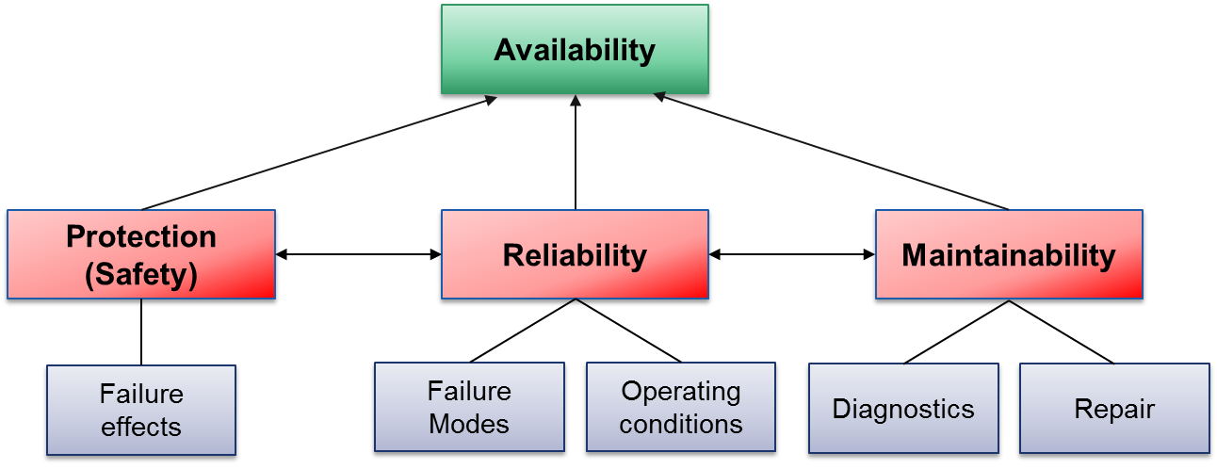
RAMS/Outline
NB: in the context of particle accelerators, we speak about ‘Protection’ rather than ‘Safety’, if no personnel is involved
Notes:
<number>

Slide 3
Basic Definitions
Reliability (0-1) is the probability that a system does not fail during a defined period of time under given functional and environmental conditions
  Example of reliability specification: “An accelerator must have a reliability of 60 % after 100 h in operation, at a current of 40 mA”
Availability (0-1) is the probability that a system in a functional state at given point in time
  Example of availability specification: “An accelerator must ensure beam delivery to a target for 90 % of the scheduled time for operation”
Clearly we want highly available and highly reliable accelerators → questions to be answered in this lecture:
What are the factors that limit their reliability and availability?
How can these be quantified systematically?
Notes:
<number>

Slide 4
Metrics
Availability
Reliability
Protection
Low Importance
Relative Importance
High Importance
Notes:
<number>

Slide 5
Large-Scale Colliders
Synchrotron Light Sources
Availability
Availability
Protection
Reliability
Protection
Reliability
Notes:
<number>

Slide 6
Spallation Neutron Sources
Accelerator Driven Systems
Availability
Availability
Reliability
Reliability
Protection
Protection
Notes:
<number>

Slide 7
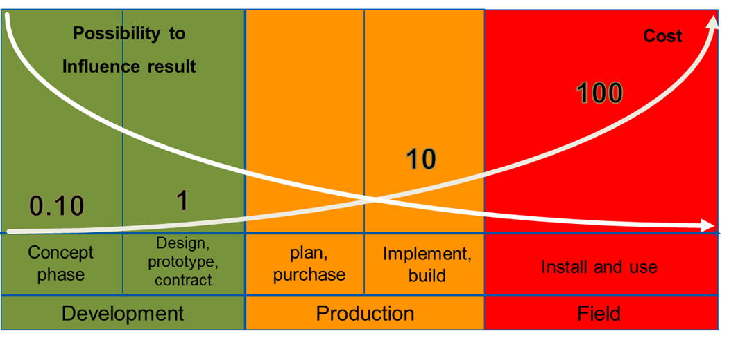
Importance of Reliability Analyses
Prof. Dr. B. Bertsche, Dr. P. Zeiler, T. Herzig, IMA, Universität Stuttgart, CERN Reliability Training, 2016
Product/Accelerator Lifecycle
The earlier reliability constraints are included in the design, the more effective the resulting measures will be
Notes:
<number>

Slide 8
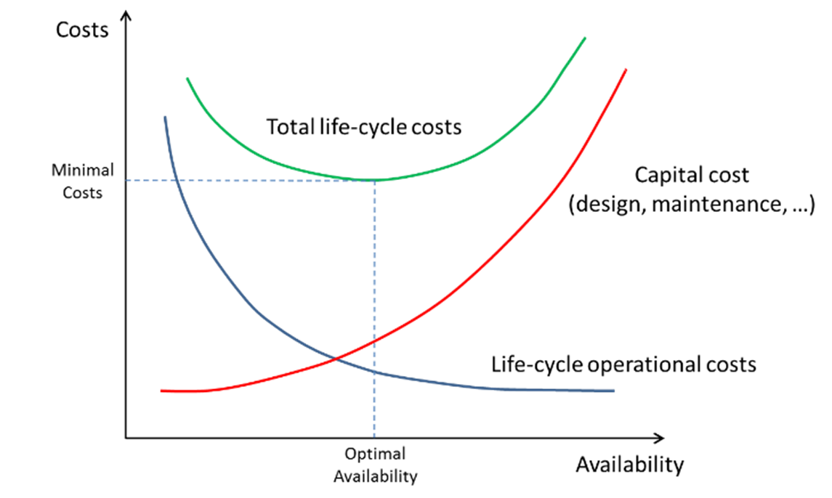
Importance of Reliability Analyses
Given a target performance reach (neutron fluence, number of patients treated, luminosity production, …), an optimal balance between capital costs and operation costs must be found
Notes:
<number>

Slide 9
Today: Dependability Studies
Technology Feasibility Assessment
Concept Phase
Technology Definition and Implementation
Design Phase
Exploitation Phase
Technology Field Use & Optimization
Reliability Studies
New Technology Definition and Implementation
Upgrade Phase
Notes:
<number>

Slide 10
Future: Dependability Studies
Technology Feasibility Assessment
Concept Phase
Reliability Studies
Technology Definition and Implementation
Design Phase
Exploitation Phase
Technology Field Use & Optimization
New Technology Definition and Implementation
Upgrade Phase
Notes:
<number>

Slide 11
Risk
Notes:
<number>

Slide 12

Risks for Particle Accelerators
Not to complete the construction of the accelerator
  Happened to other projects, the most expensive was the Superconducting Super Collider in Texas / USA with a length of ~80 km
  Cost increase from 4.4 Billion US$ to 12 Billion US$, US congress stopped the project in 1993 after having invested more the 2 Billion US$
Not to be able to operate the accelerator
Damage to the accelerator beyond repair due to an accident
SSC
Notes:
<number>

Slide 13
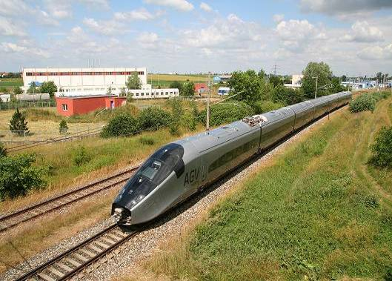

Energy stored in the LHC
Picture source: http://en.wikipedia.org/wiki/File:Alstom_AGV_Cerhenice_img_0365.jpg
Shared as: http://creativecommons.org/licenses/by-sa/3.0/deed.en
Picture source: http://militarytimes.com/blogs/scoopdeck/2010/07/07/the-airstrike-that-never-happened/
Shared as: public domain
3⋅10¹⁴ protons in each beam
Kinetic Energy of 200 m Train at 155 km/h ≈ 360 MJoule
Stored energy per beam is 360 MJ
Stored energy in the magnet circuits is 9 GJoule
Kinetic Energy of Aircraft Carrier at 50 km/h ≈ 9 GJoule
….can melt 14 tons of copper
[11]
Notes:
<number>

Slide 14
Risk Assessment (1/2)
B. Todd, M. Kwiatkowski, “Risk and Machine Protection for Stored Magnetic and Beam Energies”
Risk is the product of the probability of occurrence of an undesired event x its impact (financial, reputation, downtime,…)
‘Acceptable’ or ‘Unacceptable’ risk depends on the context!
Different for user-oriented facilities, medical accelerators, fundamental research,…
Notes:
<number>

Slide 15
Risk Assessment: Example (2/2)
IMPACT
FREQUENCY
Notes:
<number>

Slide 16
Risk Assessment: Example (2/2)
IMPACT
 | Per year | Catastrophic | Major | Moderate | Low
Frequent | 1
Probable | 0.1
Occasional | 0.01
Remote | 0.001
Improbable | 0.0001
Not credible | 0.00001
Cost [MCHF] |  | > 50 | 1-50 | 0.1-1 | 0-0.1
Downtime [days] |  | > 180 | 20-180 | 3-20 | 0-3
FREQUENCY
Notes:
<number>

Slide 17
Risk Assessment: Example (2/2)
IMPACT
 | Per year | Catastrophic | Major | Moderate | Low
Frequent | 1
Probable | 0.1
Occasional | 0.01
Remote | 0.001
Improbable | 0.0001
Not credible | 0.00001
Cost [MCHF] |  | > 50 | 1-50 | 0.1-1 | 0-0.1
Downtime [days] |  | > 180 | 20-180 | 3-20 | 0-3
FREQUENCY
Notes:
<number>

Slide 18
Risk Assessment: Example (2/2)
IMPACT
 | Per year | Catastrophic | Major | Moderate | Low
Frequent | 1
Probable | 0.1
Occasional | 0.01
Remote | 0.001
Improbable | 0.0001
Not credible | 0.00001
Cost [MCHF] |  | > 50 | 1-50 | 0.1-1 | 0-0.1
Downtime [days] |  | > 180 | 20-180 | 3-20 | 0-3
FREQUENCY
Assessment of the required level of risk reduction (1-4) for different failure scenarios
Notes:
<number>

Slide 19
Risk Assessment: Example (2/2)
IMPACT
 | Per year | Catastrophic | Major | Moderate | Low
Frequent | 1
Probable | 0.1
Occasional | 0.01
Remote | 0.001
Improbable | 0.0001
Not credible | 0.00001 |  |  |  | 0
Cost [MCHF] |  | > 50 | 1-50 | 0.1-1 | 0-0.1
Downtime [days] |  | > 180 | 20-180 | 3-20 | 0-3
FREQUENCY
Assessment of the required level of risk reduction (1-4) for different failure scenarios
Notes:
<number>

Slide 20
Risk Assessment: Example (2/2)
IMPACT
 | Per year | Catastrophic | Major | Moderate | Low
Frequent | 1 | 4
Probable | 0.1
Occasional | 0.01
Remote | 0.001
Improbable | 0.0001
Not credible | 0.00001 |  |  |  | 0
Cost [MCHF] |  | > 50 | 1-50 | 0.1-1 | 0-0.1
Downtime [days] |  | > 180 | 20-180 | 3-20 | 0-3
FREQUENCY
Assessment of the required level of risk reduction (1-4) for different failure scenarios
Notes:
<number>

Slide 21
Risk Assessment: Example (2/2)
Machine Protection Concern
Availability Concern
IMPACT
 | Per year | Catastrophic | Major | Moderate | Low
Frequent | 1 | 4 | 3 | 3 | 2
Probable | 0.1 | 3 | 3 | 3 | 2
Occasional | 0.01 | 3 | 3 | 2 | 1
Remote | 0.001 | 3 | 2 | 2 | 1
Improbable | 0.0001 | 3 | 2 | 1 | 0
Not credible | 0.00001 | 2 | 1 | 0 | 0
Cost [MCHF] |  | > 50 | 1-50 | 0.1-1 | 0-0.1
Downtime [days] |  | > 180 | 20-180 | 3-20 | 0-3
FREQUENCY
Assessment of the required level of risk reduction (0-4) for different failure scenarios
Notes:
<number>

Slide 22
Risk Assessment: Example (2/2)
Machine Protection Concern
Availability Concern
IMPACT
 | Per year | Catastrophic | Major | Moderate | Low
Frequent | 1 | 4 | 3 | 3 | 2
Probable | 0.1 | 3 | 3 | 3 | 2
Occasional | 0.01 | 3 | 3 | 2 | 1
Remote | 0.001 | 3 | 2 | 2 | 1
Improbable | 0.0001 | 3 | 2 | 1 | 0
Not credible | 0.00001 | 2 | 1 | 0 | 0
Cost [MCHF] |  | > 50 | 1-50 | 0.1-1 | 0-0.1
Downtime [days] |  | > 180 | 20-180 | 3-20 | 0-3
FREQUENCY
New approach: ‘Data-driven risk matrices for CERN’s accelerators’, IPAC’21
Notes:
<number>

Slide 23
Failure Frequency
Notes:
<number>

Slide 24
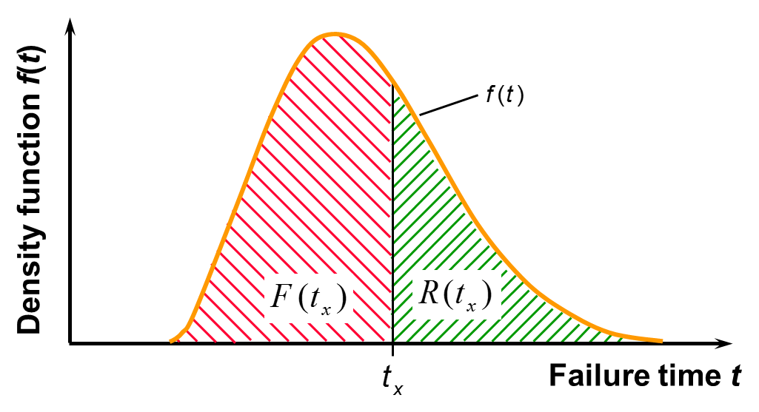
Failure Behaviour of Components
Prof. Dr. B. Bertsche, Dr. P. Zeiler, T. Herzig, IMA, Universität Stuttgart, CERN Reliability Training, 2016
F: Failure Probability
R: Reliability
The failure behaviour of a component is described by a density function
Its integral over a certain time tx gives the failure probability
Reliability is the complement to 1 of the Failure Probability (‘Survival’ Probability)
Notes:
<number>

Slide 25
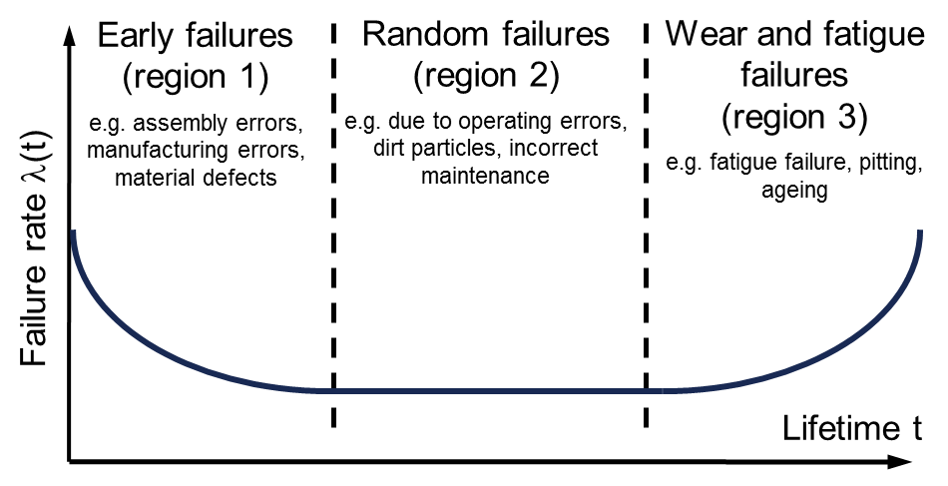
Failure Rate and Bathtub Curve
In practice, it is often assumed that failures occur randomly, i.e. they are described by an exponential density function → constant failure rate λ
Only in the latter case Mean Time Between Failures (MTBF) = 1/λ
Clearly a simplification in some cases…
Prof. Dr. B. Bertsche, Dr. P. Zeiler, T. Herzig, IMA, Universität Stuttgart, CERN Reliability Training, 2016
Notes:
<number>

Slide 26
Component Failure Rate Estimates
TESTS
EXPERT ESTIMATES
STANDARDS
Accurate results
Cost + Time
Accelerated lifetime tests (if applicable)
Big uncertainties on boundary conditions
Good for known technologies
Good for preliminary estimates
Very systematic
Boundary conditions taken into account
Technology advancements
IMPORTANT: The power of reliability analysis methods is not in the accuracy of failure rate estimates, but in the possibility to compare architectures and show the sensitivity of system performance on reliability figures
Notes:
<number>

Slide 27
Description of System Failure Behaviour
Functional Block Diagram
Component 1.A
Component 2
Component 1.B
Component 4
Component 3
Notes:
<number>

Slide 28
Description of System Failure Behaviour
Example: Redundant magnet powering with current regulation:
Function: provide stable current to the magnet, based on the feedback of the current measurement. Each power converter can supply all the current to the magnet
Power Converter A
Magnet
Power Converter B
Current Regulation System
Current Measurement System
Notes:
<number>

Slide 29
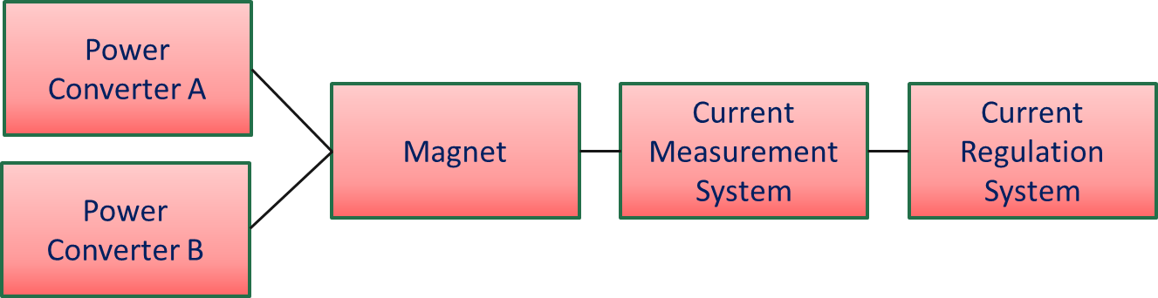
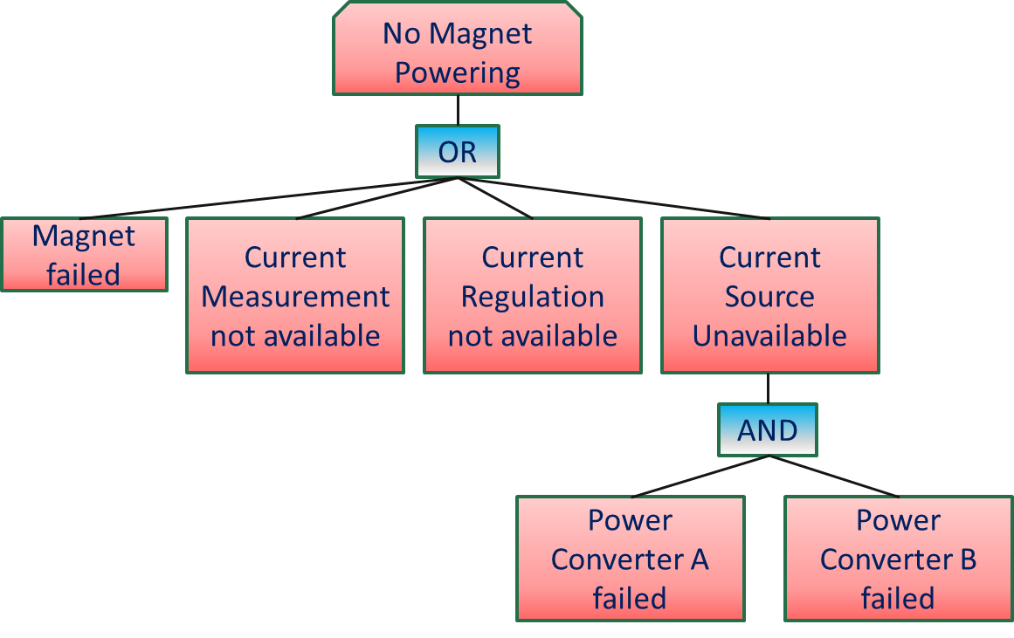
Description of System Failure Behaviour
Reliability Block Diagram:
Question: what is the minimum set of components that allows fulfilling the system functionality?
A
B
Fault Tree:
Question: what are the combinations of failures that lead to a system failure?
Boolean Algebra allows calculating system reliability from component reliability
Notes:
<number>

Slide 30
Redundancy
Source
LEBT
RFQ
MEBT
Switching Magnet
SC Cavities
Source
LEBT
RFQ
MEBT
The switching magnet becomes the reliability bottleneck in this architecture
  It should be designed for high reliability
  How should it be operated? (only when required, at predefined times,…)
A strategy has to be defined on how to operate the ‘spare’ Linac:
  Continuously running – ‘hot spare’ (quantify operation costs)
  When required (consider additional time to recover nominal operation)
When introducing redundancy, think about remaining single points of failure!
Notes:
<number>

Slide 31
Failure Impact
Notes:
<number>

Slide 32
Impact on Accelerator Operation
Failures of accelerator components can lead to:
  Damage of the accelerator (if no suitable protection is in place)
  Requires significant interventions on the accelerator to restore operating conditions, typically involving experts from different fields
  Order of magnitude: Several weeks/months
  Downtime of the accelerator (no damage thanks to machine protection systems, but impossibility to operate the accelerator)
  Requires a corrective action to restore operating conditions (Maintenance), typically only involving experts of the failed equipment
  Order of magnitude: Hours/days
Notes:
<number>

Slide 33
Failure Impact: Damage
Notes:
<number>

Slide 34
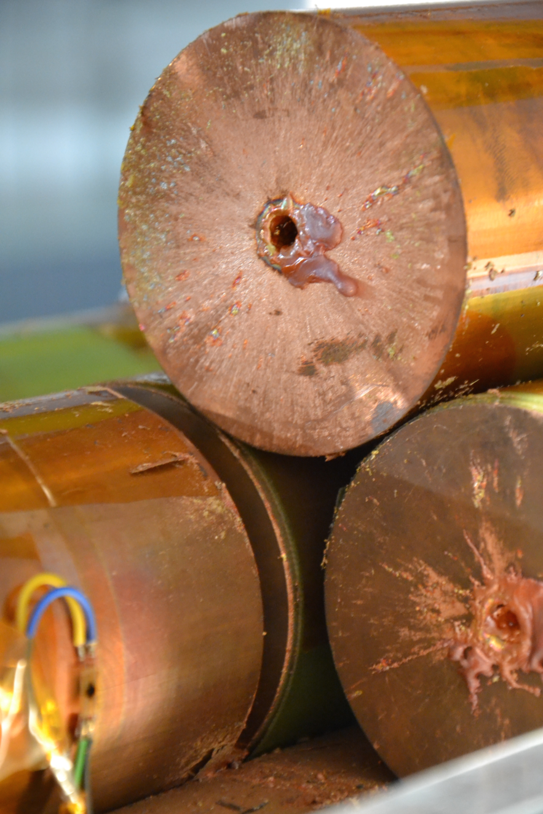
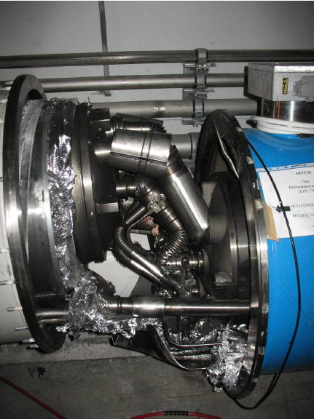
Damage in High-Power Accelerators
Notes:
<number>

Slide 35
Failure Impact: Downtime
Notes:
<number>

Slide 36
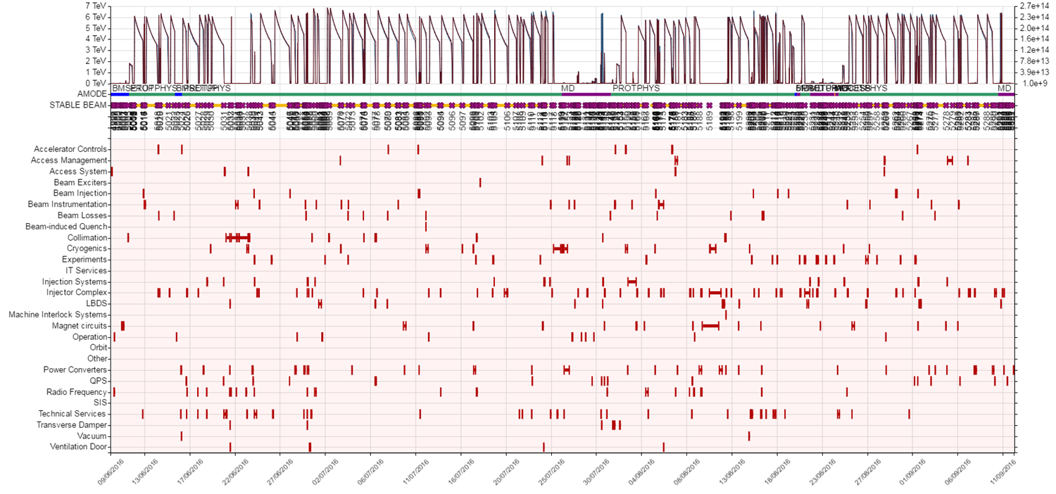
Accelerator Downtime
Systematic follow-up of failures → learn from experience → possible reduction of recovery times (faster diagnostics, faster repairs, management of spare parts,…)
Notes:
<number>

Slide 37
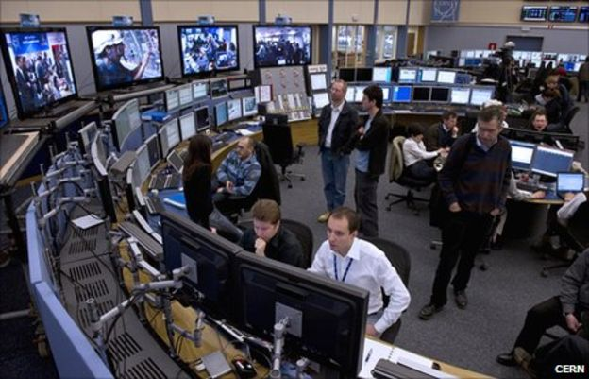
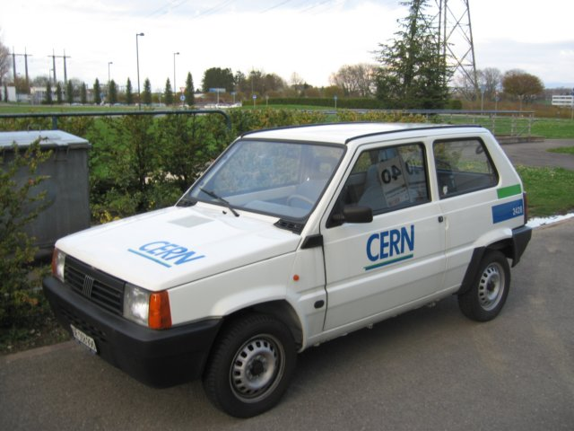

Failure Duration
Failure Duration
Identification
Diagnostics
Logistics
Repair
Mean Time to Repair (MTTR): the average time required to repair a failed component or device.
In addition, some time might be required to recover nominal operating conditions (e.g. beam-recommissioning, source stabilization, magnetic pre-cycles,…)
Notes:
<number>

Slide 38
Definitions
Maintenance signifies methods for the determination and evaluation of the current status as well as for the preservation and reestablishment of the nominal status of facilities, machines and components.
Corrective maintenance methods are required for partial and total failures of facilities, devices and components. Such methods serve to the reestablishment of the nominal condition.
Preventive maintenance deals with maintenance methods which are carried out preventively, that is, at a predetermined time or periodically after a certain amount of operational hours.
Condition-based maintenance avoids exact inspection and overhauling intervals and thus avoids the periodical renewal of fully functional components and assemblies.
Prof. Dr. B. Bertsche, Dr. P. Zeiler, T. Herzig, IMA, Universität Stuttgart, CERN Reliability Training, 2016
Notes:
<number>

Slide 39
Maintenance and Operability
Maintenance and operability should be considered from early design phases of the accelerator
System architectures can strongly influence maintainability
Modular designs help optimizing maintenance tasks and commissioning
Accessibility of equipment (when possible) ensures faster recoveries after failures
Advanced diagnostics capabilities help identifying – and possibly anticipate – failures → invest in machine learning for failure prediction
Important: reliability analyses provide the means for spare part management
Notes:
<number>

Slide 40
Trade-Off
A complex engineering problem...
Reliability
Availability
Protection
Complexity
Costs
Maintainability
For each application, the optimal working point has to be chosen!
Notes:
<number>

Slide 41
Thanks a lot for your attention!!
Notes:
<number>

