Slide 1
Controls and Interlocks
Doug Curry
USPAS, January 2023

Slide 2
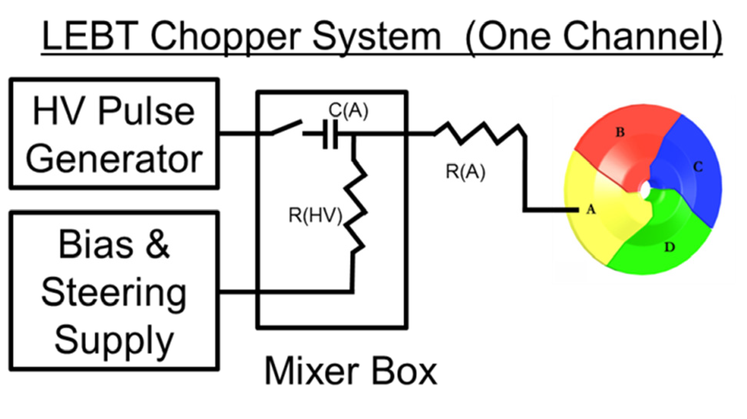
Terminating beam
Methods for terminating beam in a Linac
  Choppers
  Faraday Cups
  Shutters
  Kickers
  Terminate cavity and source RF
A pulsed machine like SNS it is easy to “steal” 7-10 cycles – then return to full power
Facilities with CW beam and cryogenic targets may not be so lucky – a slow ramp can be required to establish “production” beam again
MPS Interface
Source
RF
RFQ

Slide 3
The “Machine Cycle”
60 Hz beam pulses
  16.67ms defines 1 cycle
  A Turn is dependent on beam energy
    973 ns @ 850 MeV
    911 ns @ 1.3 GeV
Cycle Start is t = 0
Kick the beam out of the Ring
Ring Extract is t = 5050
Beam production stops at End of Inject, t = 5048
Beam is extracted from the Ring at turn 5050
Beam size grows towards Cycle Start
Start of each machine cycle
Every 16.67 ms

Slide 4
The machine cycle
RF, source and diagnostic events
Beam On notifies subsystems, “this cycle is a beam cycle”
Power grid line synchronization was terminated after commissioning
  Caused neutron smearing at the instruments because the Neutron Choppers couldn’t keep up with the load demands at the power plants
Not good for Neutron Choppers
Beam On Event
The Event Link is a biphase mark coded bit stream that is derived from the ring clock.
  This allows CDR (Clock and Data Recovery) circuits to create a local copy of the ring clock at the subsystem nodes for synchronization

Slide 5
Beam controls
Normal beam operations
“Beam On”
Operate source and RFQ during non-beam cycles
  Maintain thermal stability
  DO NOT generate beam
    “Blanking cycles”
      i.e. < 60 Hz
    MPS “faulted” states
  Shift gates in time
    Pulsed machine
  Kickers/shutters
    CW machine
Source operates while the RFQ is active, beam is accelerated through the RFQ and into the Linac
Source shifted operations
”Beam Off”
End of Inject:
Timing Event that determines the “end” of an SNS Machine Cycle
Source operates almost 3 ms after the RFQ is active, beam is not accelerated and is lost in the RFQ structure

Slide 6
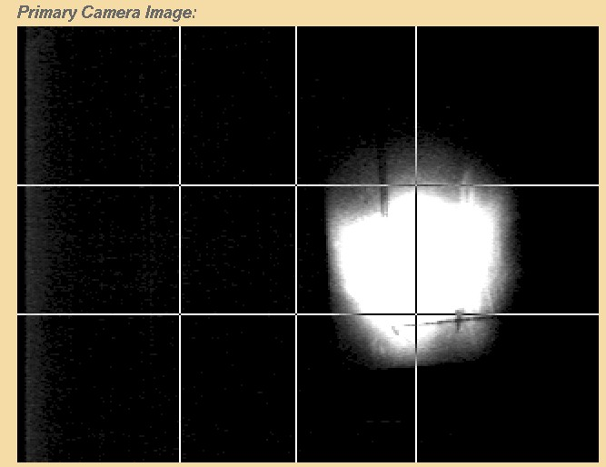
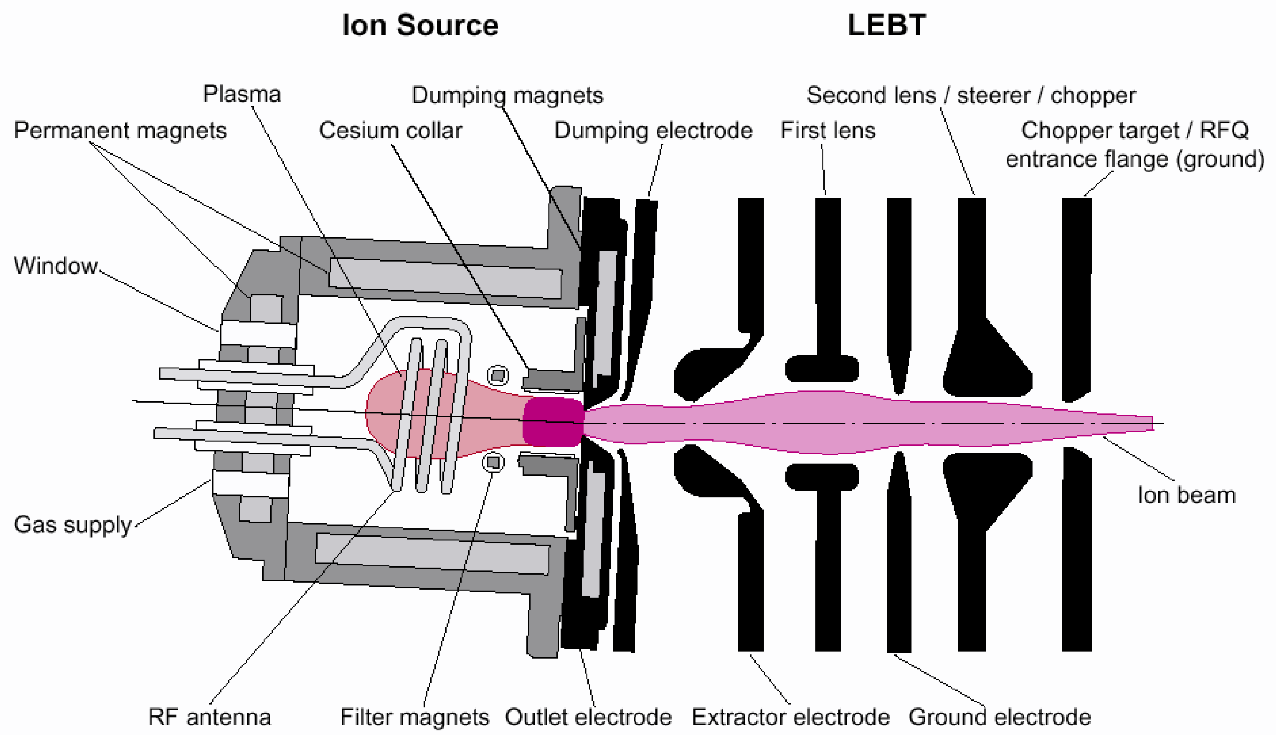
Beam controls
DTL1 180° phase shift
  Mitigate accelerating low leakage currents in the Linac, ~3 uA while the RFQ is on
  Reduces heating in the SCL cavities
  Eliminated in the 1st warm RF structure
Dark current seen using a view screen
~300 W 13.56 MHz continuous RF generates a low power plasma
High beam current pulses are generated by a 50-70 kW 2MHz RF amplifier

Slide 7
Beam controls
Set Chopper to ”full chop” during beam blanking cycles
  Use the LEBT Chopper to “blank” out shifted Ion Source pulses, up to 20 Hz
    >20 Hz increases the likelihood of damaging LEBT Chopper Target with increased heat load
  Reduce contamination of the RFQ
MPS Interface
Source
RF
RFQ

Slide 8
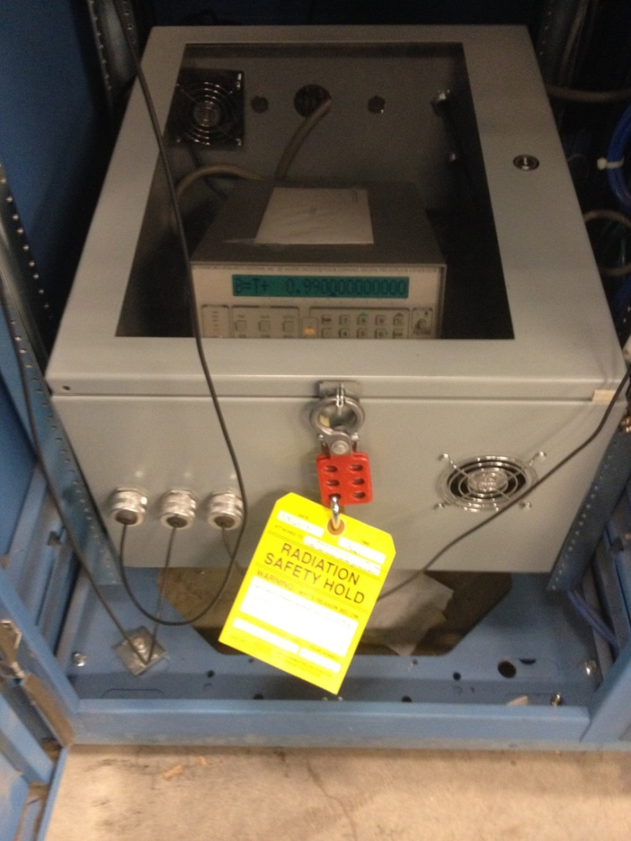
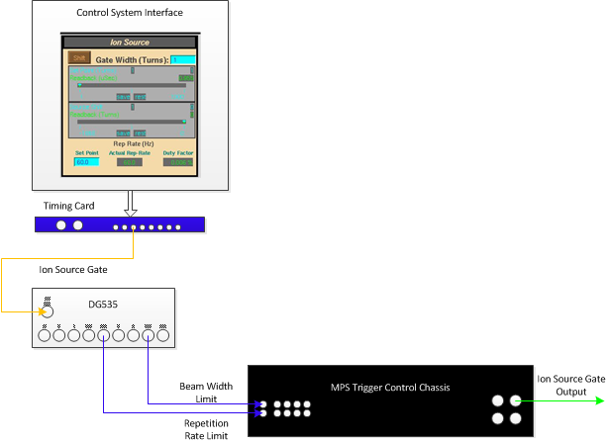
Protection by equipment lock-down
DG535
Rep rate
and
Pulse width
limits
Another method to limit beam pulse is to lock down certain control parameters
At SNS, operations staff manually set a gate generator in the Front-end building to limit the ion source beam pulse length
  The pulse can be < but not > than this setting, truncated by the DG535
Radiation Safety
RS-Hold

Slide 9
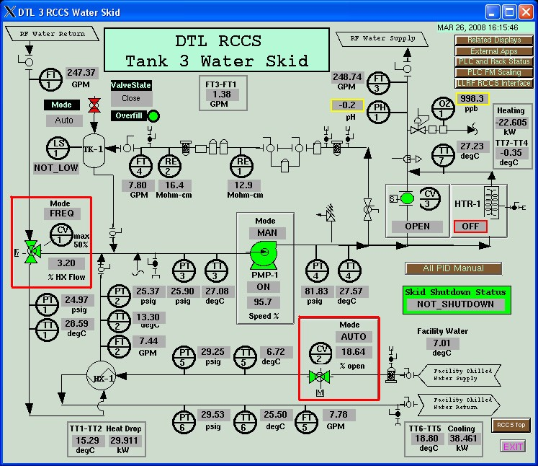
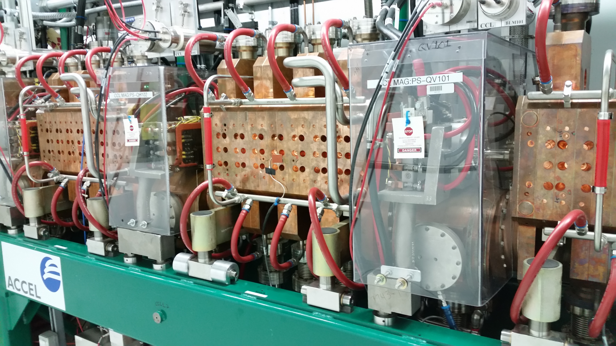
Beam Controls
Warm Linac Resonance Control Cooling System (RCCS)
Provide thermal stability for resonance control to reduce beam losses
10 system, one for each set of warm cavities
  6 DTL
  4 CCL
Hot and cold flow valves
SNS
CCLs

Slide 10
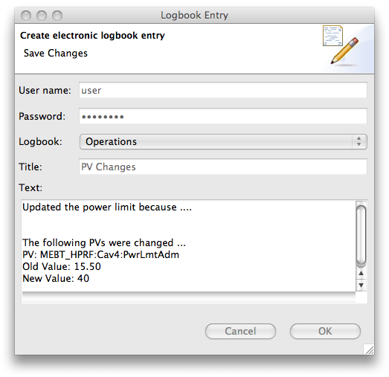
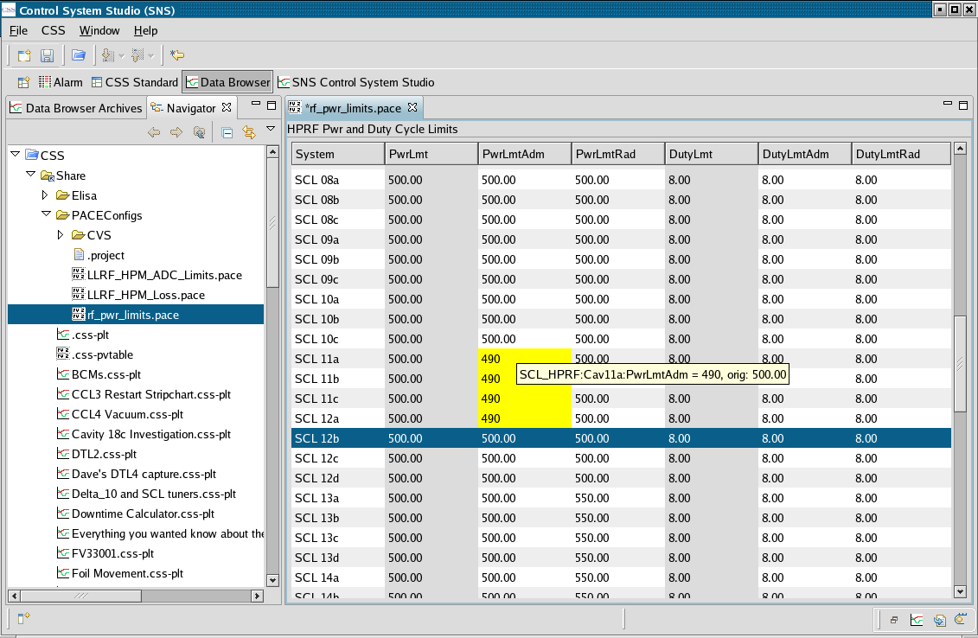
PACE
PACE (PV Adjust Confirm E-log)
  EPICS (Experimental Physics and Industrial Control System)
  Applied to critical control parameters
manual
automatic

Slide 11
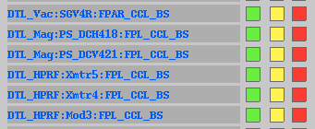
Configuration control
Channel status
Device
Sector Gate Valve
Intended for 2 MW
SNS Beam Modes
  50, 100, 1mS, Full Power, Off and Standby
SNS Machine Modes
  MEBT BS, CCL BS, L-Dump, I-Dump, E-Dump and Target
Configured via MPS PLC
  Located in the main Control Room
  Read by the Timing Master and broadcast to each node at 60 Hz
  Verified against database before every machine cycle
“Mode Mask” indication
Color is dependent on setting
Physical input status
from field device

Slide 12
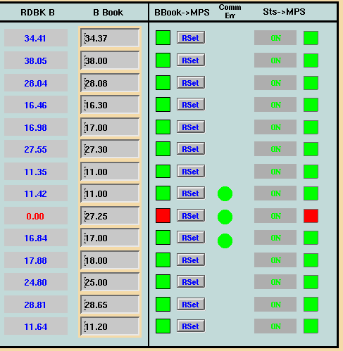
Software interlocks
Magnets
Power Supplies
  HV levels for BLMs
  Power supply settings
Chatter Fault limits
  Auto recovery → manual recovery
Dump Power limits
  Combined with administrative controls
  Injection Dump uses fast protect hardware “Nano-coulomb detector”
    Soft interlocks are too slow in the event of a Primary Stripper foil failure

Slide 13
Protection by alarms
Control system can monitor many parameters, and alert operators when these parameters stray outside of pre-defined limits
These are separate from the automatic interlocks.
Alarms do not automatically turn off the beam.
Alarms may be set to alert operators before parameters reach the interlock limits, or may be set on some less rigorous parameters

Slide 14
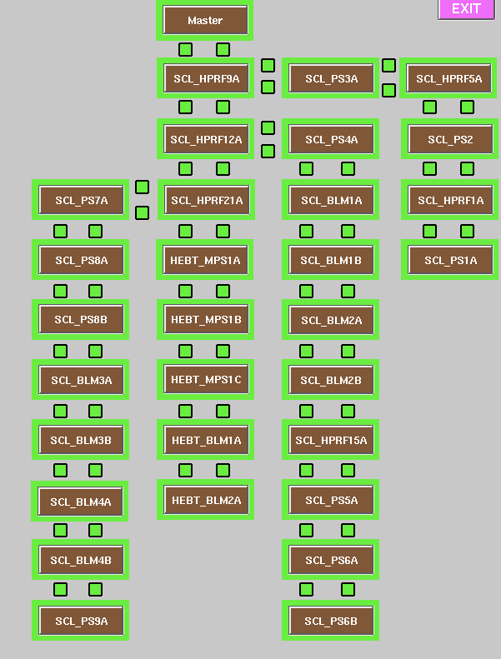
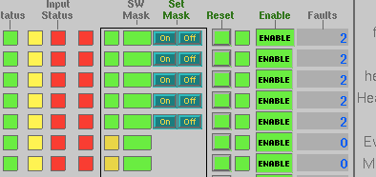
User screens
Overview of
the SCL
Approximately 110 nodes at SNS
  Without interface screens, it would be difficult to know which system reported the fault
  Also allows operations to establish bypass settings
The input status
reflects faulted
Input channel
Bypass
Enable/disable
Fault
counters
The channel status
is green because
the Machine Mode is
upstream of this location

Slide 15
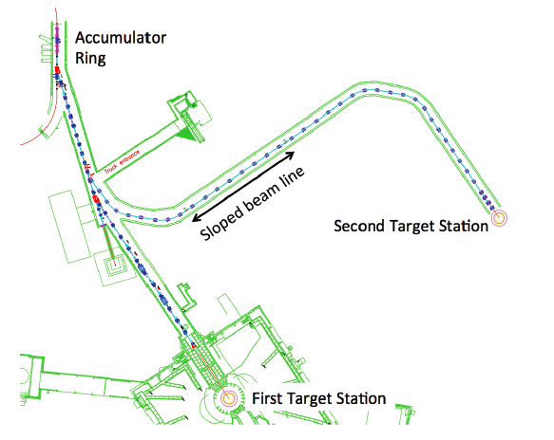
Moving forward STS
Extraction
Septum
Second Target Station (STS)
Single pulse configuration
  Two pulse configuration for STS (Second Target Station)
  STS 10-20 Hz
    47 kJ per pulse
Kicker magnet interface
  Beam must go to STS
Kicker
Magnets
R2T2
Dipole
Example: What level of effort should be spent protecting the FTS beam when a fault occurs on the STS beamline?
  A fault occurs in the R2T2 transport line or target. It is desirable to not disrupt beam to the FTS. This requires coordination between the Timing System and MPS to ensure only STS cycles are disrupted.

Slide 16
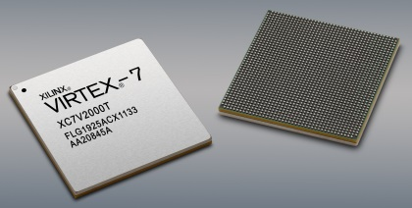

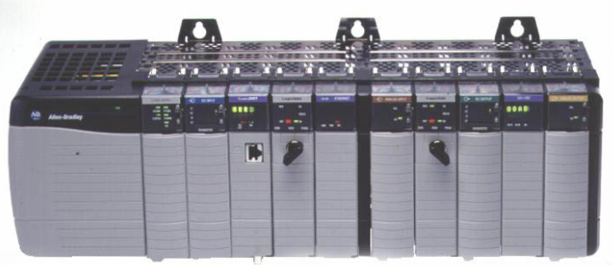
Implementing interlocks
Microcontroller design
  PLCs “Slow Interlocks,” milliseconds
  Software “Soft Interlocks,” seconds
Discrete Components, microseconds
  ICs
  FPGAs
  CPLDs
Varying levels of reliability
  Failure methods plague all types
Discrete components
PLC
software
microseconds
milliseconds
seconds

Slide 17
The Magic FPGA
??????
FPGA
👿
😎
problem
solution
FPGA
(Field Programmable Gate Array)

Slide 18
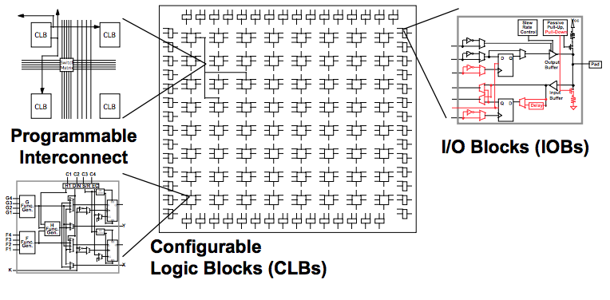
FPGA “basic” SRAM architecture
Logic Blocks
  4 input LUT (look up table)
Programmable Interconnect
  Routing configurable resources together
I/O pins
  Configurable and fixed types
Internal RAM
External Flash
  Device program storage
SRAM type, most common
Anti-fuse/Internal Flash, heavy in defense and aerospace
Basic Xilinx layout

Slide 19
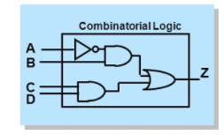
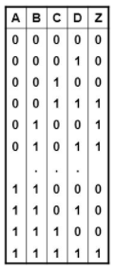
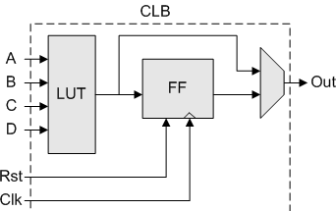
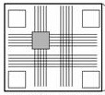
FPGA architecture
Size metrics
  Flip Flops (registers, bit storage)
  LUTs
  RAM blocks
No logic gates internally
  Functions are translated into Look Up Tables
LUT (Look Up Table)
  DFF (D-type Flip Flop)
  Mux
Entire resource is consumed if any of its elements are used
**This is no longer true in modern day devices
Interconnect
Xilinx simplistic view of LUT configuration

Slide 20
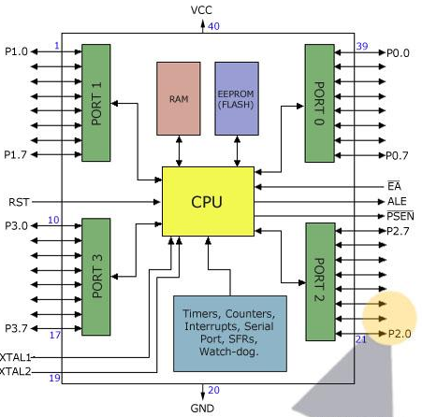
Microcontroller “basic” architecture
CPU
  Central Processing Unit
Shared bus(es)
RAM and Flash
  Boot-up Instruction storage
  Program storage
External I/O
Instruction/Data Cache
Other interfaces
Intel and PowerPC
Atmel AT89S52

Slide 21
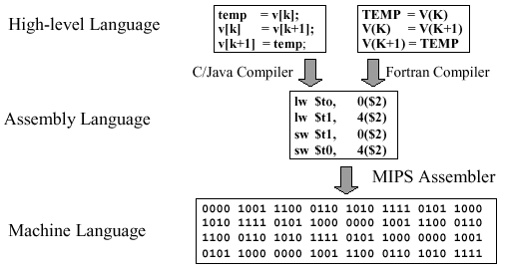
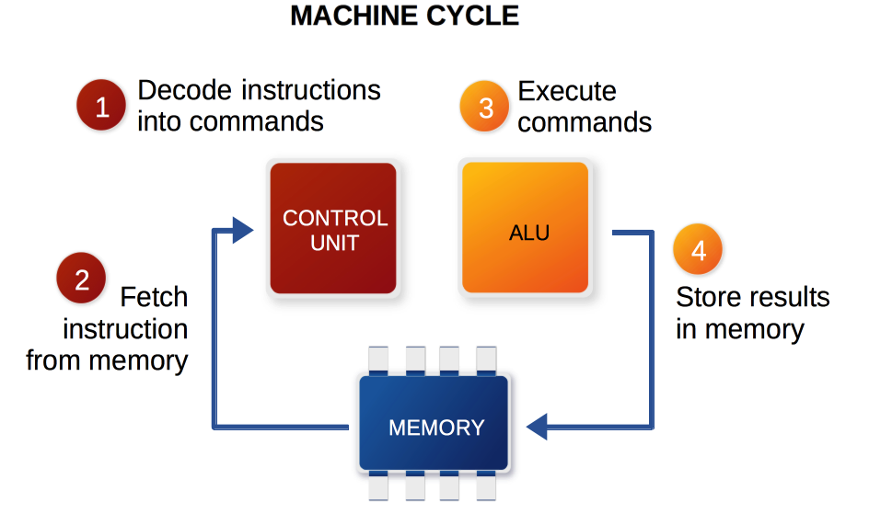
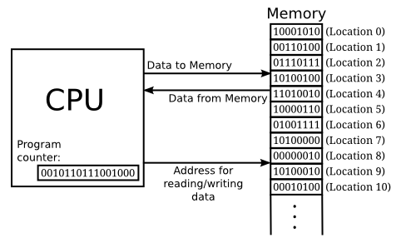
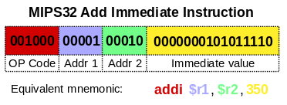
Basic CPU example
1GHz clock
Perform 1 step per clock cycle
  Intel
“Execute commands” occur at 250 MHz!!!
Add the immediate value to the value stored in address location 2 and store that result in address location 1

Slide 22
Basic similarities
Flash to store programs
  uC typically local, FPGA typically external
  On Power up, programming functions are loaded
Clocking resources (synchronous devices)
User Configurable, one to many times, flash dependent not device dependent
Susceptible to ”event upsets”
  SEU, MEU, … several classifications depending on the failure type
Radiation hardened devices
  Level of ”hardening” varies significantly
Modern day devices are highly complex architectures

Slide 23
Basic differences
Microcontroller
FPGA
Single process execution (time slicing)
GHz clocking speeds
Dynamic program configuration
Operating Systems
Broad user community
  Plethora of programming languages
  Compile and go…
Massive Parallel Processing
MHz clocking speeds
Fixed program configuration
Direct programming
Limited user community
  Concurrent programming languages
  Timing constraints, PLL configuration, …

Slide 24
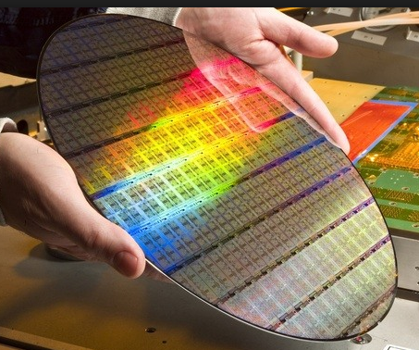
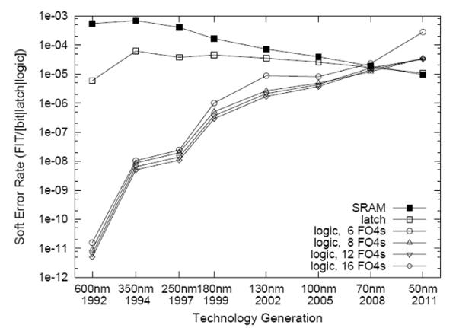
Single Event Effects (SEE)
  SEU, MEU (Multi) Single Event Upste
  SEFI – Single Event Functional Interrupt
    Can be repairable in real-time, depending on location and device
  SEL – Single Event Latch Up
    Fixed by power cycling the device
  SEB – Single Event Burnout
    Permanent damage, non-repairable
SER
Soft Error Rate
*2017*
14 nm
Moor’s Law
transistors double per unit area every 2 years
*2022*
7 nm

Slide 25
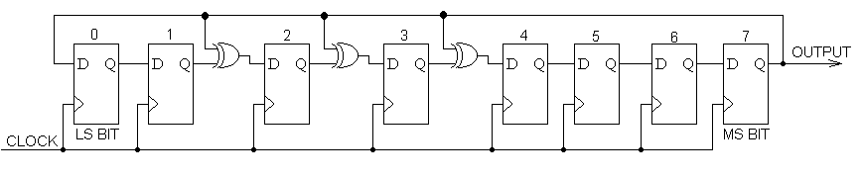
Error detection
SReg
FSM (Finite State Machine)
  Encode “one-hot”
  Run the State Register through an XOR gate
CRC (Cyclic Redundancy Check)
  CRC “Sum” is transmitted with data
TMR (Triple Modular Redundancy)
  Can be implemented internal to an FPGA
  Multiple devices feeding a PLC
  Etc…
XOR
Output will always be ‘1’
Single bit error detection method
M
What if the failure occurs in the voting scheme?
V
M
M
TMR
CRC

Slide 26


CPU SEU example
ADDI “Add Immediate” becomes ANDI ”logical AND Immediate”
This example applies to address or value registers as well
What if this was a branch or jump command?
New instruction
Expected instruction
001100
Could be any of these!!!!

Slide 27
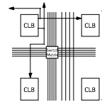

FPGA SEU example
x
x
0
Programmable switch matrix
Utilize CRC capabilities of programmable devices
Usually requires partial to full reconfiguration of the device
  This can be an automated process
  For Interlocks, it will likely be better to notify and take no immediate action

Slide 28
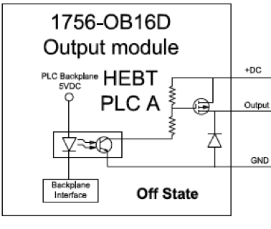
Other failure modes
Stuck at ‘1’/‘0’ (high/low)
  Doubled Digital I/O as SNS for PLC interfaces (SA1) ”MPS Good”
    SNS Vacuum Interface
    Electrical overload during maintenance created permanent damage to the output gate
  Gated Clock “MPS Good”
    SNS MPS Hardware failure
    Firmware doesn’t match final design requirements
      Does your organization consider firmware software or hardware?
      Are firmware changes subject to DCN (Design Change Notification) process?
        What if it’s part of an interlock system???
SA’1’
Backplane interface

Slide 29
Protection system grounding error
April 2013 - Modification to add redundant power supplies to increase availability
  Inter-segment handshaking not tested as part of installation QA or post modification tests
Error found July 31, 2013 during annual certification testing
  Under certain conditions, PPS would not have shut off the front end for a downstream fault
  Common mode error affected both of the redundant chains
  Unintended result of modification to PPS systems to add redundant power supplies
  Beam Operations halted until mitigating measures in place
    It took 9 days before receiving a letter of resumption from DOE
  Failure mode identified and replicated on bench
    Very complicated failure mode

Slide 30
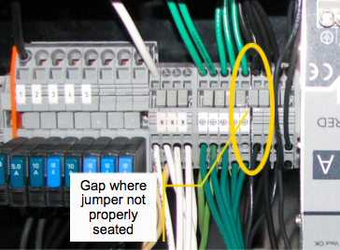
Accelerator PPS grounding error
  Power supply modification required a common ground between A and B divisions
  Improperly installed jumper "floated" linac PPS ground, creating a sneak circuit
  Sneak circuit defeated segment to segment handshaking if enough PLC outputs were ON

Slide 31
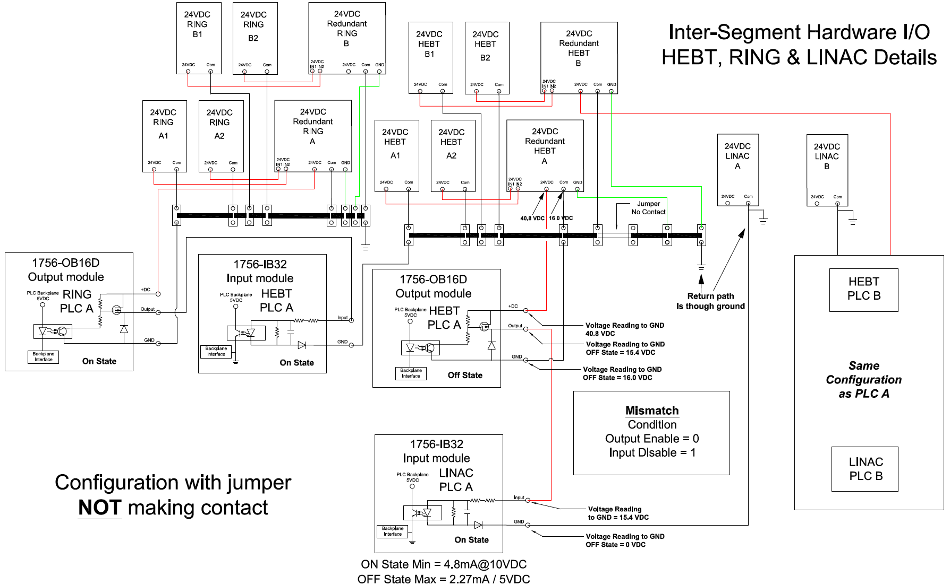
Biased input “good condition”
Inputs
Biased ON

Slide 32
Sneak circuit – outputs bias inputs

Slide 33
Questions

