Slide 1
Machine Protection in Plasma Machines
Doug Curry
USPAS, January 2023

Slide 2
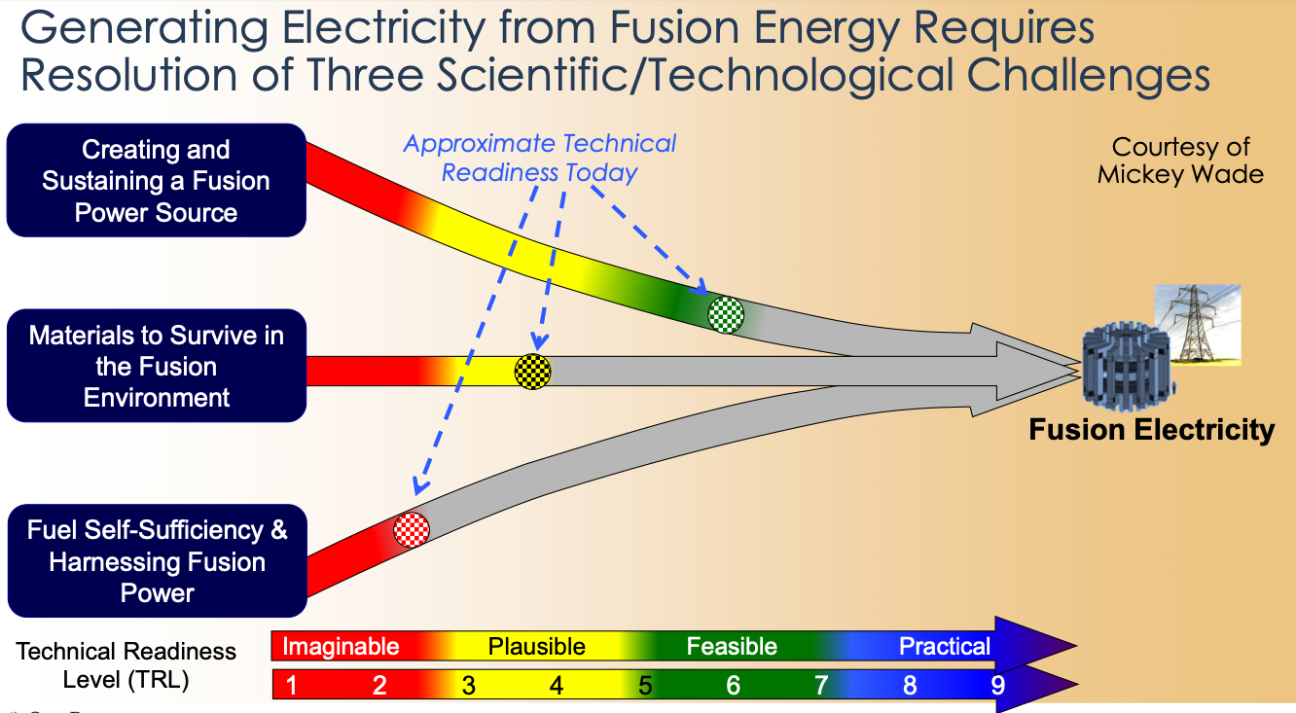

Slide 3
National Ignition Facility (NIF)
Laser-based Inertial Confinement Fusion (ICF)
  “squeeze a small amount of fuel to reach pressure and temperature necessary for fusion”
Lawrence Livermore National Laboratory
On December 5, 2022 achieved the first scientific breakeven controlled experiment with an energy gain of 1.5

Slide 4
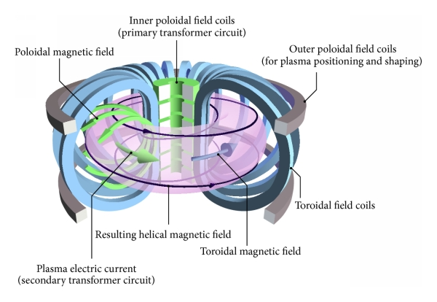
What is a tokamak?
A tokamak:
uses a powerful magnetic field to confine a hot plasma in the shape of a torus
is one of several types of magnetic confinement devices being developed to produce controlled fusion power
is currently the leading candidate for a practical fusion reactor
Figure from: S. Li, H. Jiang, Z. Ren, C. Xu - S. Li et. al. "Optimal Tracking for a Divergent-Type Parabolic PDE System in Current Profile Control" , Abstract and Applied Analysis doi:10.1155/2014/940965, CC BY 4.0, https://commons.wikimedia.org/w/index.php?curid=74679708

Slide 5
The lifetime of the divertor will determine the availability of a tokamak-based fusion power system
Coolant manifold
(permanent)
Toroidal field coils
Upper ports
(modules and coolant)
Blanket modules
5-6 year lifetime
Central ports
(modules)
Vacuum vessel
70 cm
(permanent)
Cool shield
30 cm
(permanent)
Divertor plates
2-year lifetime goal
Lower ports
(divertor)
Main driver of scheduled maintenance: the divertor

Slide 6
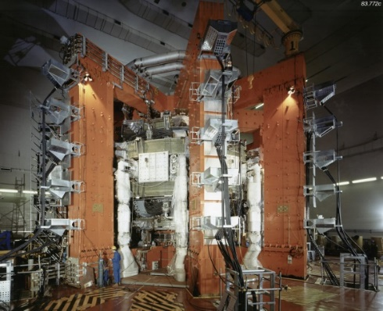
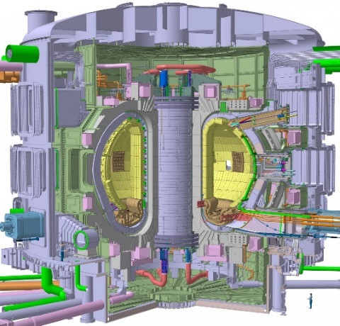
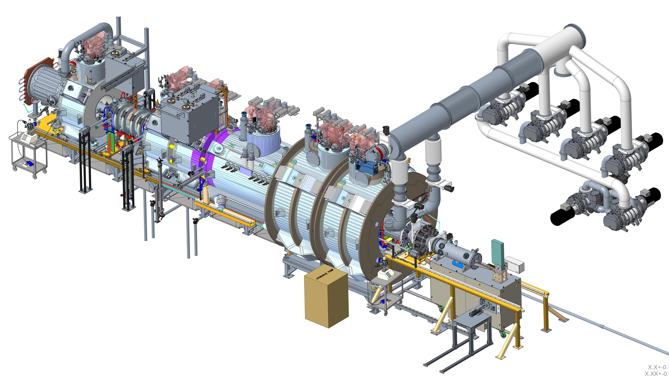
The Materials Plasma Exposure Experiment (MPEX) is a tool for understanding challenges for divertor plasma facing components
JET ITER Fusion Reactor
5000x ion fluence
10⁶x neutron fluence
5x ion fluence
100x neutron fluence
Human figure
Human figure
ITER divertor plasma parameters
Plasma Density ~ 10²⁰ - 10²¹ m⁻³
Temperature ~ 1 - 15 eV (11000 - 150000 K)
Ion fluxes ~ 10²³ - 10²⁴ m⁻²s⁻¹
Power fluxes ~ 10 MW/m²
-> inaccessible in present tokamaks and materials test facilities
MPEX will address this regime
MPEX will advance plasma facing materials up to end of lifetime studies

Slide 7
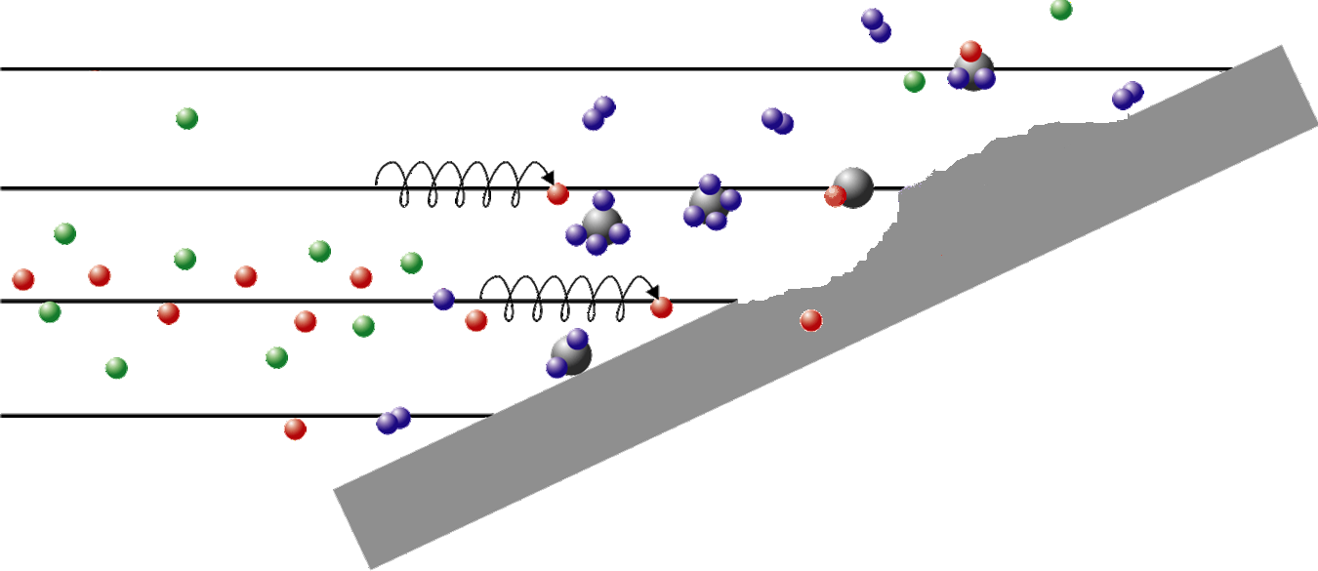
Plasma Material Interactions (PMI) in a fusion reactor limits the lifetime of materials including the divertor
Re-deposition
Co-deposition of
hydrogen
Erosion
(chemical and physical)
Ablation
Melting (metals)
Implantation
Calculated worst case erosion rate ~ m/year neglecting redeposition
carbon target
Strongly Coupled regime:
Eroded material is trapped in the plasma near the target and re-deposited on the surface
Long exposure to damaging plasma flux ⇒ thick layers of re-deposited material
Every surface atom is displaced ~ 10⁷ times in a divertor lifetime
Material in a reactor divertor is NOT what was installed
Need a way to create and test plasma-reformed surfaces

Slide 8
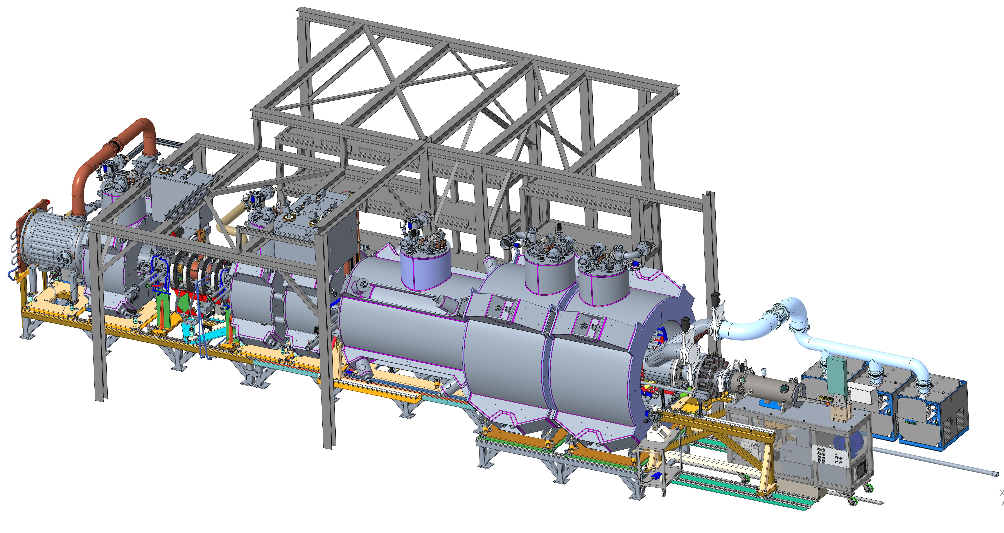
MPEX – magnets shown
The device is 15.4 m (~50 ft) in length
Notes:
The “eye test” – progress in PDR

Slide 9
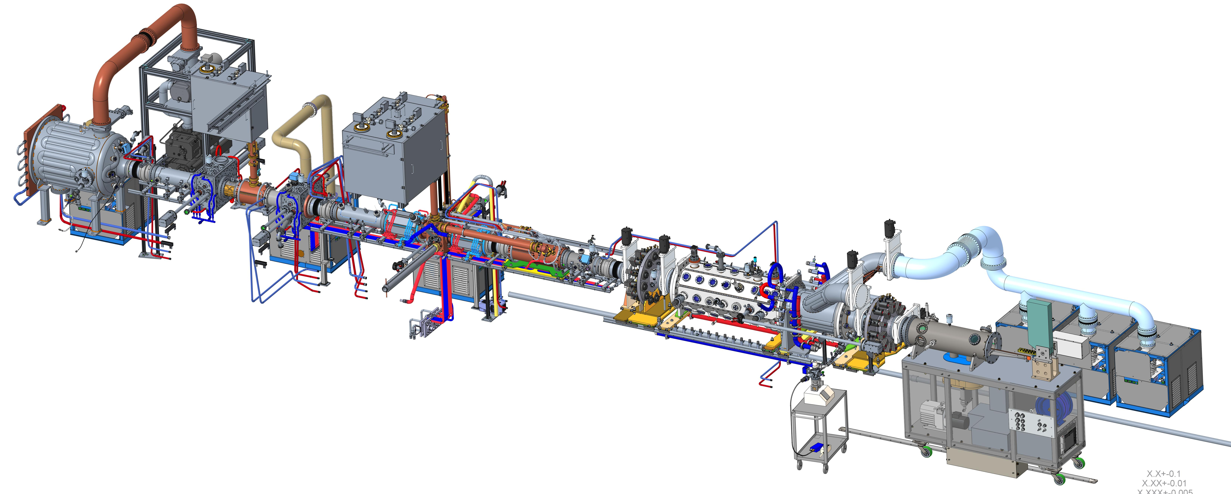
MPEX – magnets removed
RF-tuning controls
Vacuum pumping
Gate Valves
Pump skids are magnetically shielded
Vacuum chamber

Slide 10
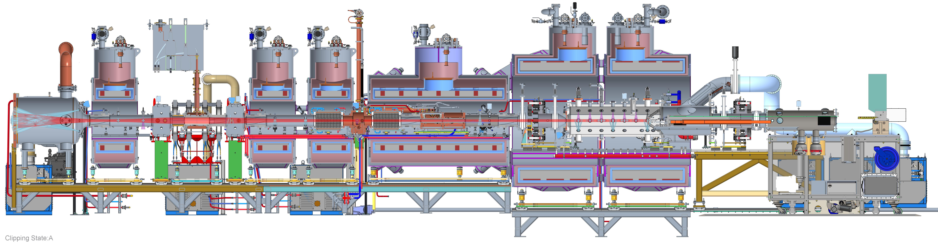
MPEX systems – cross section
4 – Normal Conducting Magnets
19 – Super Conducting Magnets
Dump Chamber
plasma terminates upstream
EC Heating
400 kW microwave electron heating
IC Heating
310 kW radio frequency ion heating
Helicon Source
175 kW plasma source
PMI Chamber
plasma terminates downstream
Target Exchange Chamber
transports target
13.56 MHz
70 GHz,
105 GHz
3 - 9 MHz
Plasma Material Interaction
Notes:
Another view – cross-section, can get a sense for the plasma size

Slide 11
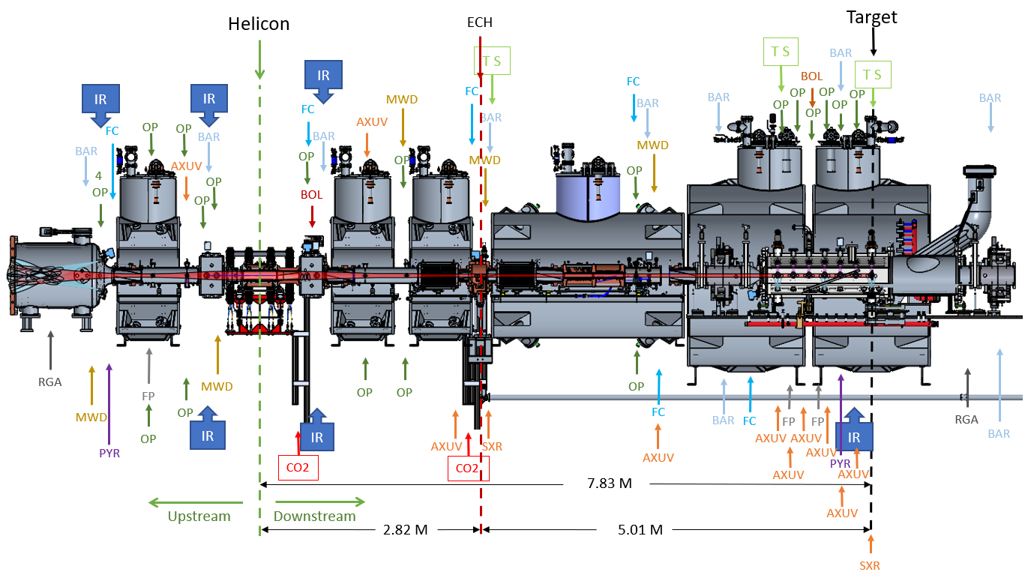
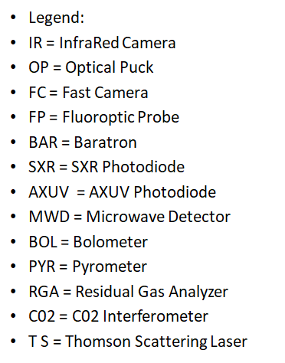
MPEX Diagnostics Locations – IR Cameras
TALIF

Slide 12
MPEX – Plasma Modes
Plasma discharges
  Helicon only
Basic plasma discharges
  Helicon + (ICH + ECH < 50%)
Full Power
  Helicon + (ICH + ECH > 50% to 100%)
No machine mode settings for plasma operations
  various configurations will be set for RF maintenance operations
IC Heating
Helicon Source
EC Heating

Slide 13
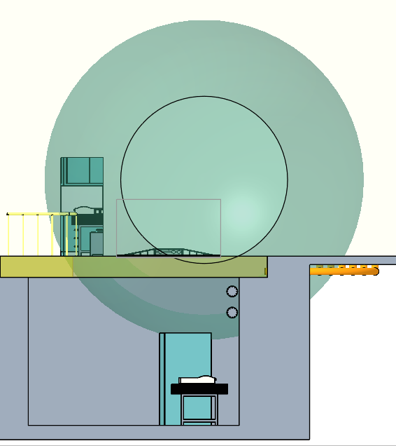
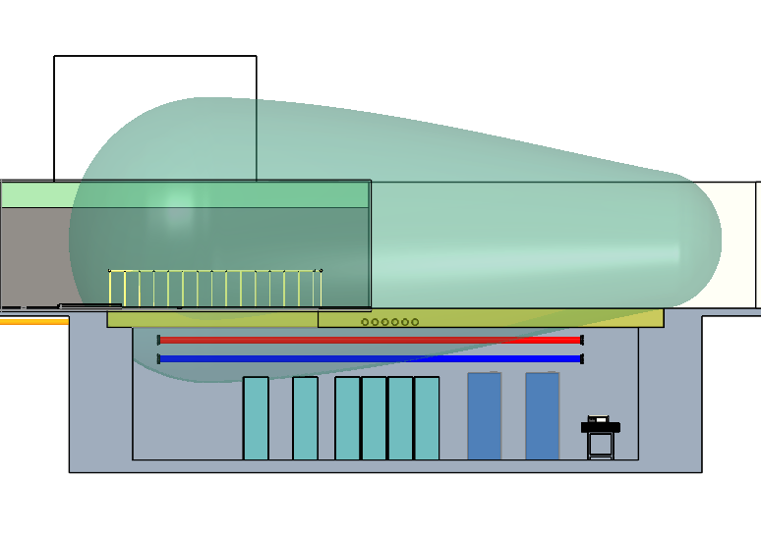
Magnetic fields
150 gauss lines
Area of interest for I&C
Cabinet top to bottom of 150 gauss line is just under 6 inches

Slide 14
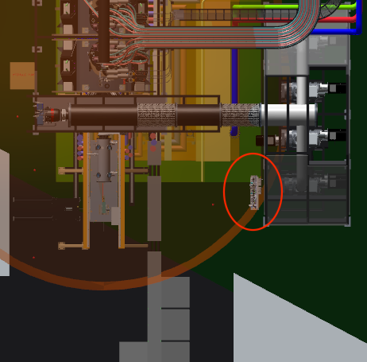
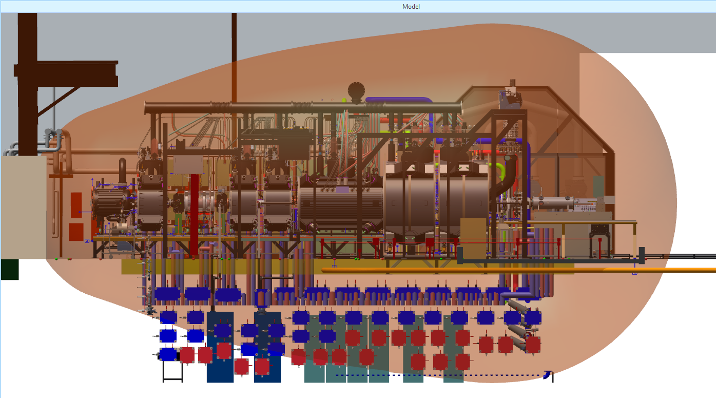
Magnetic fields
50-gauss line
50 gauss field in most of the pit area
Relocated PMI gas panel outside of 50 gauss line

Slide 15
Machine Interlocks
Similarities with common accelerators methods
  RF systems, arc detection, vacuum, water flow/temp, gate valve position, etc…
Differences with common accelerator methods
  Fast surface temperature measurements – detection
    IR Camera
  RGAs - detection
  Shattered Pellet Injection (SPI) – mitigation

Slide 16

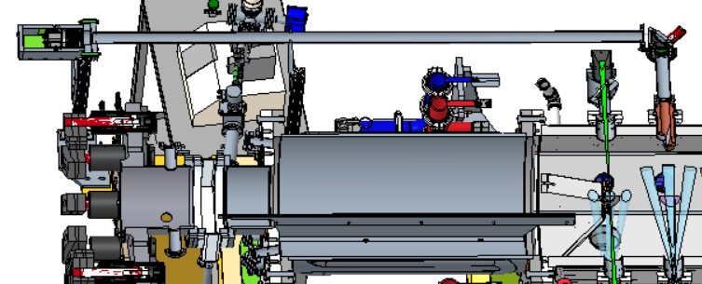
IR (Infrared) cameras
Measures: T_{surf}, q (surface temperature, heat flux)
  6 IR cameras viewing high heat flux (HHF) internal components of MPEX
Commercial off-the-shelf (COTS)
  Same design (camera + stand) used for all 6 cameras
  Vary optics to achieve desired field of view of HHF components
Design Highlights
  IR cameras are shielded from external magnetic fields and moved away from coils
FLIR A700-PRO
Specifications (off-the-shelf)
640 x 480 pixels
7.5 – 14 μm (uncooled microbolometer)
30 Hz frame rate, 16-bit
Integrated visible camera
IR Camera in PMI Chamber

Slide 17
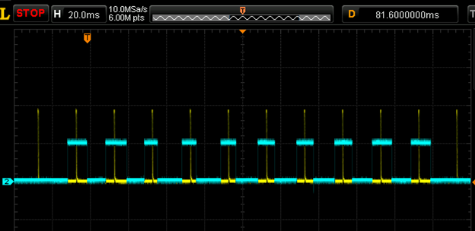
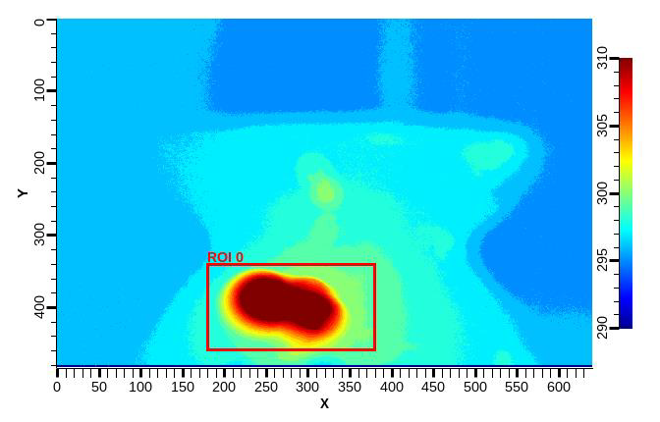
IR Camera
Start/end of video frame
CIS requirement (Central Interlock System) – MPS
  Detect fault and respond < 50 ms
    “T0” when the MPS system receives the frame
    transmit frame ~4-5 ms before the end of frame, finish 6-8 ms after the end of frame
    ~ 5 ms @ the IOC to calculate statistics (Std, Min, Max) and respond
    ~ 30-35 ms of float, ~65-70 ms after start of acquisition
  Faults can be generated on the entire image or ROI (region of interest)
Transmit frame
Faster response times can be accomplished via FPGA processing if requested

Slide 18
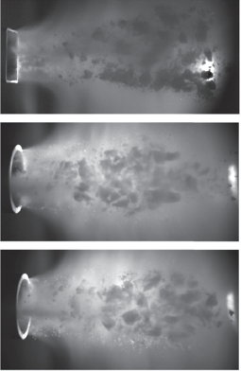
Shattered Pellet Injection (SPI)
Baseline technology for the disruption mitigation system for the International Thermonuclear Experimental Reactor (ITER)
Cryogenic pellets in a pipe-gun for injection of material to mitigate disruptions
Protection Function
  Thermal and quench mitigation
  Suppression and dissipation on runaway electrons – potential to seriously damage the walls of the device

Slide 19
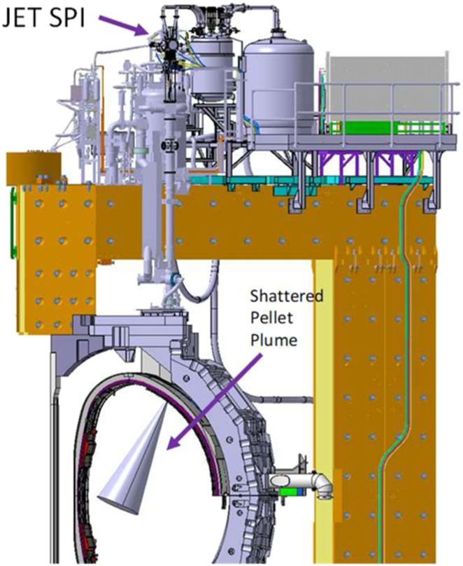
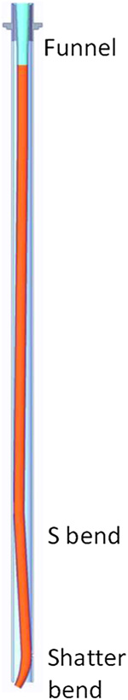
Joint European Torus (JET) SPI system
Mounted on top of the machine
Shatter tube is 1.6 meters long with a final 20-degree bend with a 15 cm bend radius at the exit of the tube
“Design and performance of shattered pellet injection systems for JET and KSTAR disruption mitigation research in support of ITER,” 2021, Nuclear Fusion 61
L.R. Baylor, et al

Slide 20
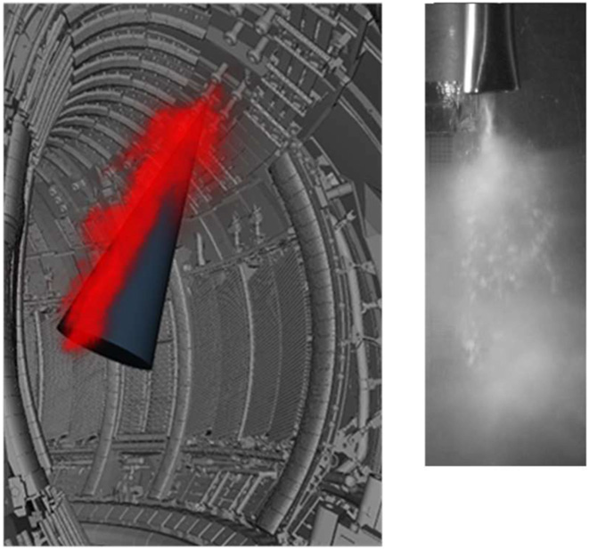
Pellet fragment injection
Neon fragments entering the plasma showing the plume and expected 15-degree dispersion cone
Pellet cycle time is typically between 30 and 40 minutes
Use multi-barrel designs

Slide 21
ITER SPI
24 SPIs to thermally radiate the plasma energy, reduce the electromagnetic loads on the machine and components, and suppress the formation of runaway electrons
3 SPIs to control the current quench decay time
28.5 mm diameter pellets
  12.5 mm diameter on JET
“Recent progress in shattered pellet injection technology in support of the ITER disruption mitigation system” 2021, Nuclear Fusion 61
T.E. Gebhart, et al

Slide 22
Questions

