Slide 1
Cryogenics for Cold Powering system
Budget consideration
V. Gahier, TE-CRG
CERN, 20 October 2022

Slide 2
Outline
Tunnel system
  Interfaces definition
  Scope for Cryo
  Budget proposition /distribution
  Bypass cryoline and alupex optionnal scope
String system
Conclusion / Way forward

Slide 3
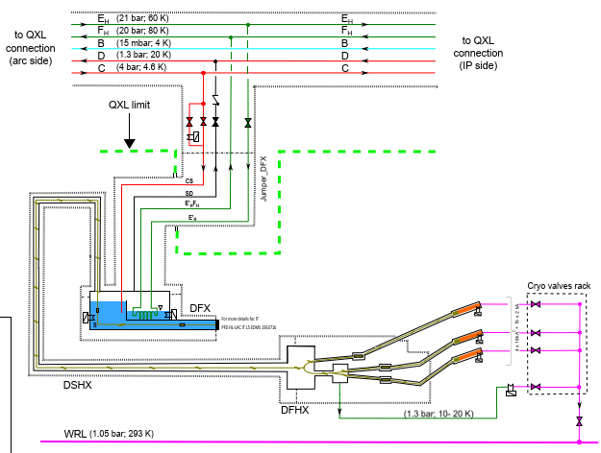
Mechanical Interfaces
Three mechanical interfaces to WP9 for the Cold Powering System :
Interface A to the QXL
Interface B between the GMS and WRL,
Interface C between the DFHX and GMS.
  Interface C₁ : at DFHX level
  Interface C₂ : at GMS level : current interface considered for budget/scope evaluation.
Zone C₁-C₂ comprises :
the Alupex line from the current leads to the GMS control valves
The bypass cryoline from DFHX to the GMS heater
Zone C1/C2 can be treated as a optional scope
Interface A
Interface C₂
Interface C₁
Interface B
Interface C₂
Quantity | Ref | Function | Interface & Label | Size* | Type of Connection
1 | Bypass Heater | Bypass heater | Interface C – bypass heater | DN 32 | Bayonet
4 | CL 18 kA | Current lead 18 kA outlet | Interface C – CL 18 kA | DN 20 | TBC
15 | CL 2 kA | Current lead 2 kA outlet | Interface C – CL 2 kA | DN 15 | TBC
Interface B
Ref | Function | Interface & Label | Size | Type of Connection
WRL | Warm helium return | Interface B - WRL | DN 65 Min PN 6 | Flange

Slide 4
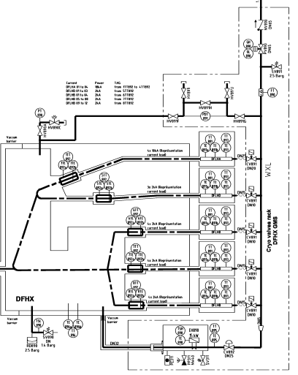
Mechanical Interfaces
Interface B
Mechanical interfaces will be geographically at the GMS level.
Connection responsibilities by WP6A.
Interface B
Ref | Function | Interface & Label | Size | Type of Connection
WRL | Warm helium return | Interface B - WRL | DN 65 Min PN 6 | Flange
Interface C₂
Quantity | Ref | Function | Interface & Label | Size* | Type of Connection
1 | Bypass Heater | Bypass heater | Interface C – bypass heater | DN 32 | Bayonet
4 | CL 18 kA | Current lead 18 kA outlet | Interface C – CL 18 kA | DN 20 | TBC
15 | CL 2 kA | Current lead 2 kA outlet | Interface C – CL 2 kA | DN 15 | TBC
1 | PDT | Connection of GMS PDT | Interface C – PDT | 3/8 | TBC
Interface C₁
Interface C₂
Extract of LHCLSQLJ0031

Slide 5
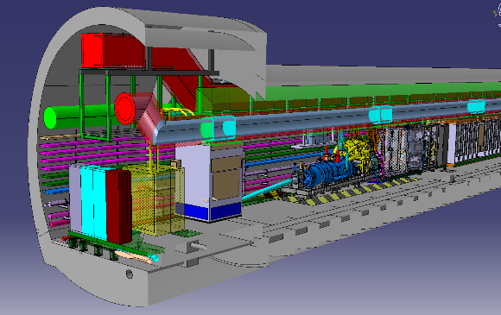
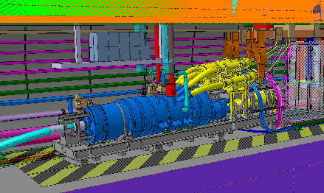
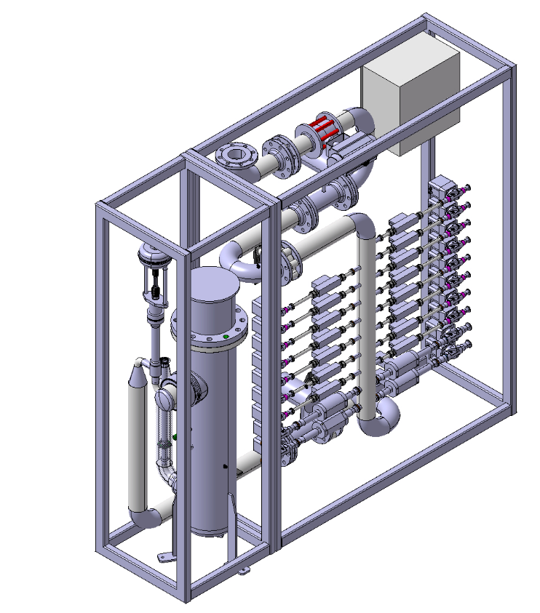
Mechanical Interfaces
Alupex and bypass cryoline are routed by the top.
For the moment, only a space reservation in the 3D model.
Distance DFHX-GMS ~ 14 m
Distance DFHM-GMS ~ 17 m
Courtesy R. Betemps
Courtesy R. Betemps
Alupex lines in enclosed protected area
GMS
Interface C₂
Bypass cryoline
DFHX
Interface C₁
2200 mm x 600mm x 2000mm

Slide 6
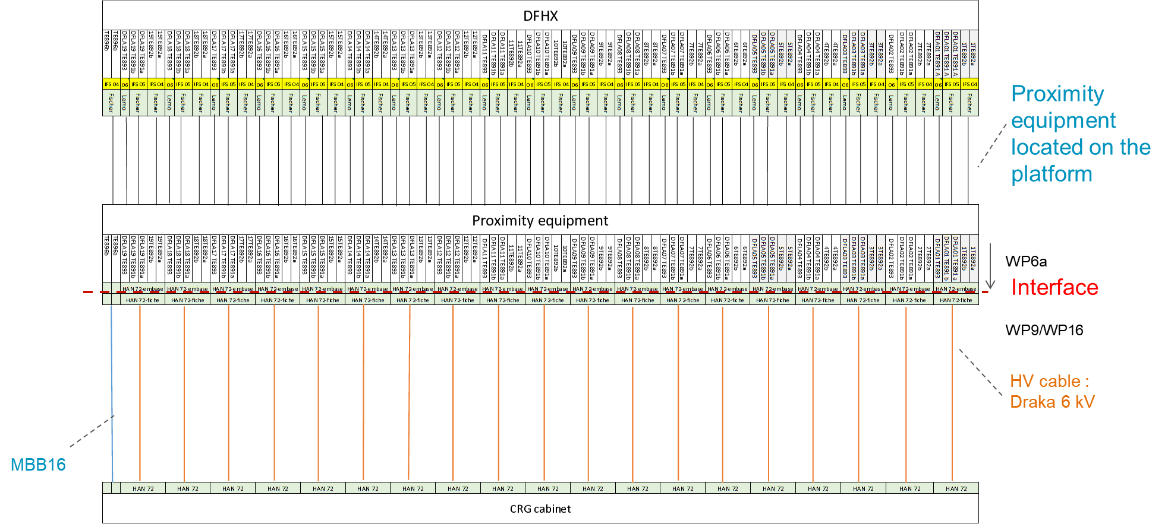
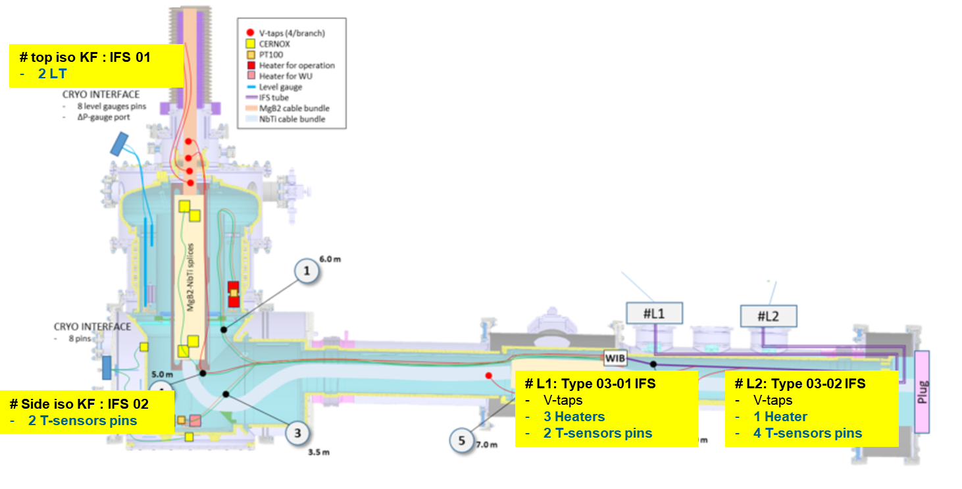
Electrical Interface
For DFX signals, Electrical interface will be at connector level
For DFHM signals, Interface will be at the proximity equipment level.
DFHM electrical interface
DFX electrical interface

Slide 7
Proposed Responsibility Matrix for work execution
 | Material | Design / specification | Procurement | Installation | Remark
DFX | Temperature probes | CRG | CRG | MSC
 | HEATERs | CRG | CRG | MSC
 | Level GAUGES | CRG | CRG | MSC
 | Pressure transducerS | CRG | CRG | MSC
DFHX | Temperature probeS | CRG | CRG | MSC | Value engineering in progress regarding splices temperature probes
 | Pressure transducerS | CRG | CRG | MSC
Current Leads DFLH | Temperature sensors (TT 891 / TT 893) | MSC | MSC | MSC | Data acquisition required
Gas Management System (DFHX GMS) | BYPASS HEATER | CRG | CRG | CRG
 | control valves | CRG | CRG | CRG
 | Rack | CRG | CRG | CRG
 | Other Instrumentation | CRG | CRG | CRG
 | LOCAL FIELD BOX | CRG | CRG | CRG
 | Piping between GMS and WRL | CRG | CRG | CRG | Refer to proposed mechanical interface
Zone C1-C2 | vacuum insulated line between DFHX and heater | MSC | MSC | MSC | Design /specification / Fabrication/ Installation could taken by CRG – refer to next slide for option pricing
 | ALUPEX LINES | MSC | MSC | MSC | Alupex connection currently in the protected DFHX zone
NB : the proposed responsibility matric is only for Work execution – budget funding are not covered.

Slide 8
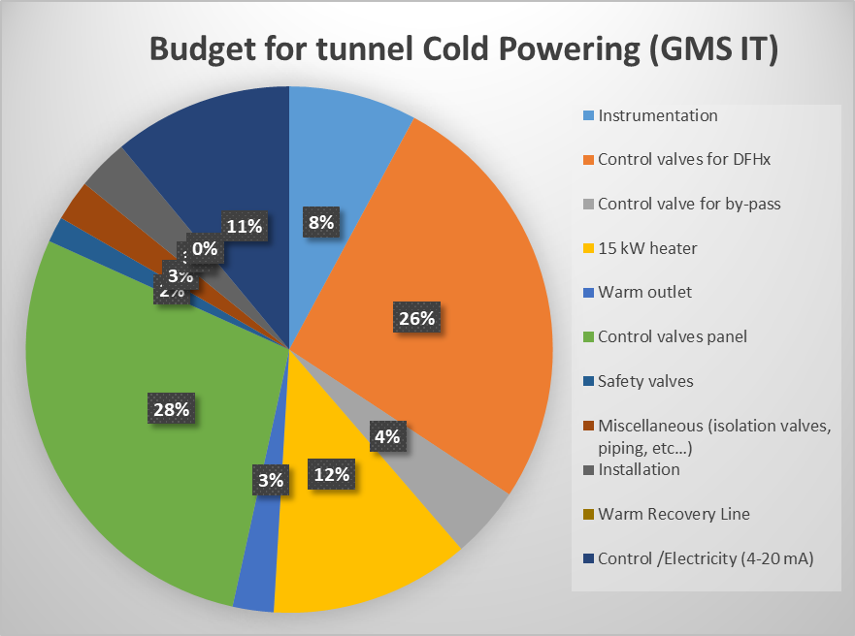
GMS Tunnel Budget
 |  | GMS For IT 2022 | GMS For MS 2022
1 | Cryogenic Distribution System | CHF 159,000 | CHF 137,500 | comments
1.1 | Gas Management System | CHF 141,500 | CHF 120,000
1.1.1 | Instrumentation | CHF 12,500 | CHF 12,500
1.1.2 | Control valves for DFHx | CHF 42,000 | CHF 22,000 | considering cryogenic valve "Weka or Velan"
1.1.3 | Control valve for by-pass | CHF 7,000 | CHF 7,000
1.1.4 | 15 kW heater | CHF 19,500 | CHF 19,500
1.1.5 | Warm outlet | CHF 4,000 | CHF 4,000
1.1.6 | Control valves panel (design, manufacture, documentation) | CHF 45,000 | CHF 45,000 | considering REX of Test bench F2
1.1.7 | Safety valves | CHF 2,500 | CHF 2,500
1.1.8 | Miscellaneous (isolation valves, piping, etc…) | CHF 4,000 | CHF 4,000
1.1.9 | Installation | CHF 5,000 | CHF 3,500
1.2 | Warm Recovery Line | CHF - | CHF -
2 | Control /Electricity (4-20 mA) | CHF 17,500 | CHF 17,500 | Local field box, PLC card
 | Grand total | CHF 159,000 | CHF 137,500
GMS is estimated to :
  159 kCHF for the one item of the IT version (GMSX)
  137.5 kCHF for one item of the MS version (GMSM)
In total, there are :
  4 GMS for IT
  4 GMS for MS
NB :
  Cryo signals data acquisition (PLC, crate…) is in WP9 budget
  Cabling from interface to electrical WP9 budget.
  Cryo- instrumentation in WP9 budget

Slide 9
Budget distribution for GMS Tunnel configuration
The proposed distribution is as follows :
  WP9 : control valves; instrumentation, heater , warm outlet….
  WP6A : control valve panel, safety valve, installation..
WP9 budget is overall estimated to 740 kCHF.
WP6A budget is overall estimated to 446 kCHF.
Total overall 8 GMS cost : 1186 kCHF
WP9 | CHF 102,500 | CHF 82,500
WP6a | CHF 56,500 | CHF 55,000
for split FSU/Installation refer slide 14.

Slide 10
Zone C1/C2 option – cryogenic lines budget estimation
Estimation revised for the cryogenic lines - valid for 8 units produced together and taking into account the simplified configuration : 276 kCHF as a budget estimation for the Zone C1/C2 bypass cryoline.
Two options considered - overall cost identical at 276 kCHF for both options.
  Production of the line segments by industry – In this case, components produced by industry, specification and installation by CERN/FSU.
  Production of the cryolines by CERN.
NB : The Alupex lines from DFHX (Interface C1) is currently in the DFHX protected area : it is proposed that this scope is kept by WP6A.
Leak tests of the Alupex lines will require discussion between WP9 and WP6A.
Detailed cost estimate – FSU cost detailed for the different phases

Slide 11
String
It was agreed to use the GMSX #1 for the String. Schedule of installation/de-installation to be defined.
The supplementary cost (13-43 kCHF) related to the following items is imputed to the String – provisionnal cost is shown in yellow.
Additional costs due to lack of scale savings
Installation and de-installation
Material re-qualification before tunnel re-installation
Potential reconfiguration to match tunnel final GMS design.
1 | Cryogenic Distribution System
1.1 | Gas Management System
1.1.1 | Instrumentation | CHF 10,200 | PT/PDT not compatible with the Tunnel
1.1.2 | Control valves for DFHx | CHF 8,000 | Counts for supplementary cost for Weka Valve (4 valves)
1.1.3 | Control valve for by-pass | CHF 2,000 | Counts for supplementary cost for Weka Valve (1 valves)
1.1.4 | 15 kW heater | CHF 1,071 | electrical Connection of the heater
1.1.5 | Warm outlet | CHF -
1.1.6 | Control valves panel | CHF 1,750 | Pressure and leak test
1.1.7 | Safety valves | - | requalification of safety valve
1.1.8 | Miscellaneous (isolation valves, piping, etc…) | CHF -
1.1.9 | Installation | CHF 5,000 | FSU cost
 | Control valve for by-pass | CHF 10,000 | reconfiguration (potential) for reinstallation
 | qualification for tunnel re-installation | CHF 5,250 | electronic + mechanical
 | Grand total | CHF 43,271

Slide 12
Conclusion and way forward
Thorough exercise for the cost estimate of the GMS.
Total Cost estimate for the 8 GMS is 1186 kCHF. Interface is defined at the GMS level (interface C₂ and Interface B) for the fore-mentioned cost.
The proposed budget distribution between WP6A and WP9 is as follows :
  Budget to be taken by WP9 is estimated to 740 kCHF (62% of total GMS cost)
  Budget to be taken by WP6A is estimated to 446 kCHF (38% of total GMS cost)
Vacuum insulated cryogenic line between DFHX and heater can be optionally designed/ manufactured/ installed by CRG. The total cost for the 8 units has been estimated to 276 kCHF.
It is proposed that the Alupex lines remains out of CRG scope due to their connection in the restricted enclosure area of the DFHX.
GMS serie X1 can be used for the String. Supplementary costs related to the early installation and material requalification (13-43kCHF) shall be imputed to the WP16.

Slide 13
Detailed list of components of GMS X
Item | Nominal mass flow [g/s] | Model considered | Connection size / Characteristics | Number
18 kA CL control valve | 1 | Weka / Velan | Kv = 3.2 m³/h | 4
2 kA CL control valve | 0.1 | Burkert | G 1/2 | 15
 |  |  | Kv = m3/h
Bypass control valve | Up to 10 | Weka /Velan | DN 25 | 1
 |  |  | Kv =14.7 m³/h
Electrical heater | Up to 10 | Cetal | 15 kW | 1
Thermometers - heater outlet | - | PT100 | - | 1
Differential pressure transmitter | - | Rosemount 3051C - TBC | 0-62 mbar | 1
Outlet shut-off valve | 5 | Worcester | DN65 | 1
Outlet non-return valve | 5 | TBC | DN65 | 1
Outlet flowmeter | Up to 10 | Bronkhorst | DN65 | 1
 |  |  | 0-10 g/s
 |  |  | Δp_{max} < 10 mbar
Safety valve | TBD | Circle seal | TBD | 1

Slide 14
WP6a GMS budget split
GMS budget split as required by WP6a is shown below detailing :
  Drawing by FSU in green
  Installation in green
Cost is indicated per GMS.
No tooling cost identified.

Slide 15
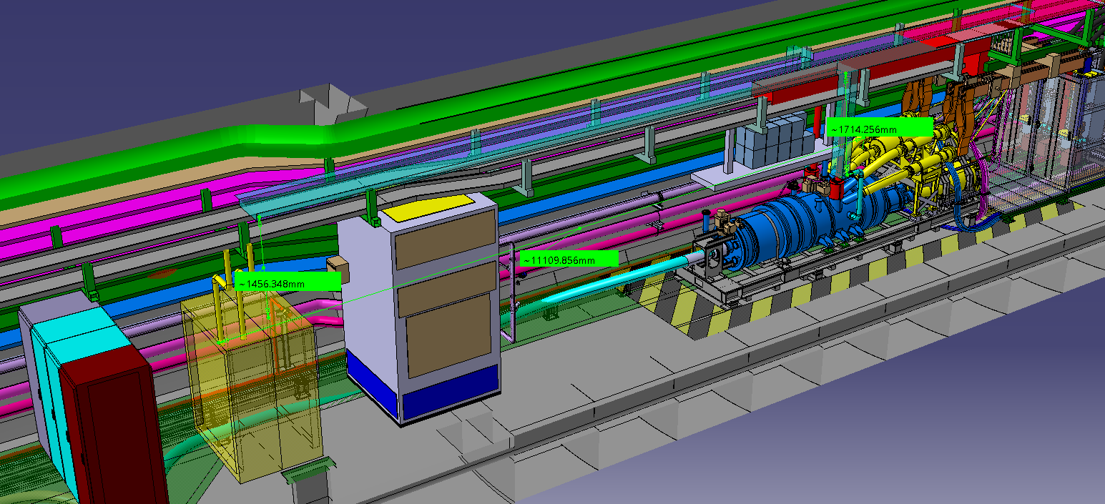
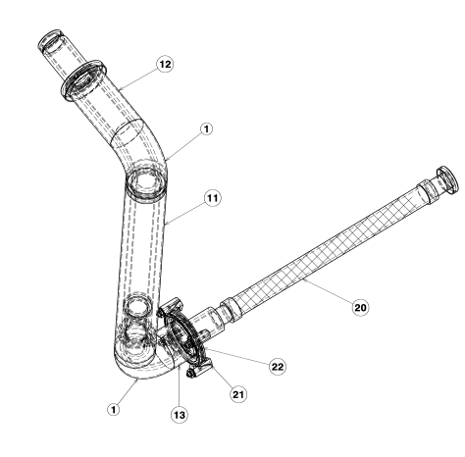
Bypass line Simple routing DHFX
Straight line 6m?
welding
Elbow
welding
Elbow
Drawing LHCDFX_0026
Elbow
Bayonet + flexible
Fixed point
Interface
Bypass in DN32
Length ~14.26 m

Slide 16
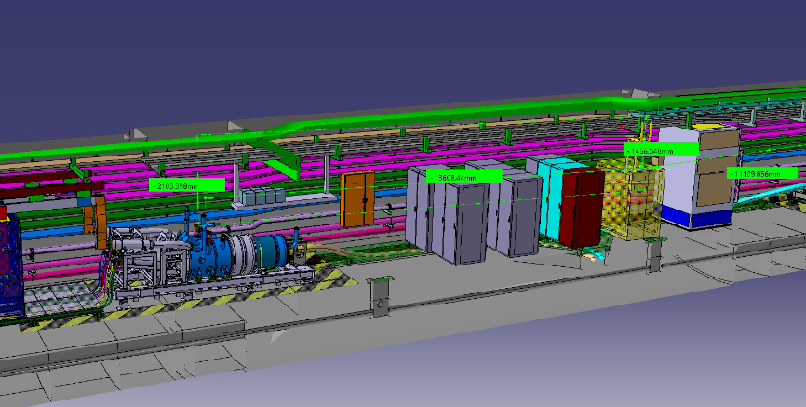
Bypass line simple routing DFHM
Straight line 6m?
welding
Straight line 6m?
welding
Elbow
welding
Elbow
Bypass in DN32
Length ~17.15 m

