Slide 1

Introduction to Doing Business with CERN for Republic of Ireland
Chris Hartley – Head of Industry, Procurement and Knowledge Transfer Department
13/02/2023

Slide 2
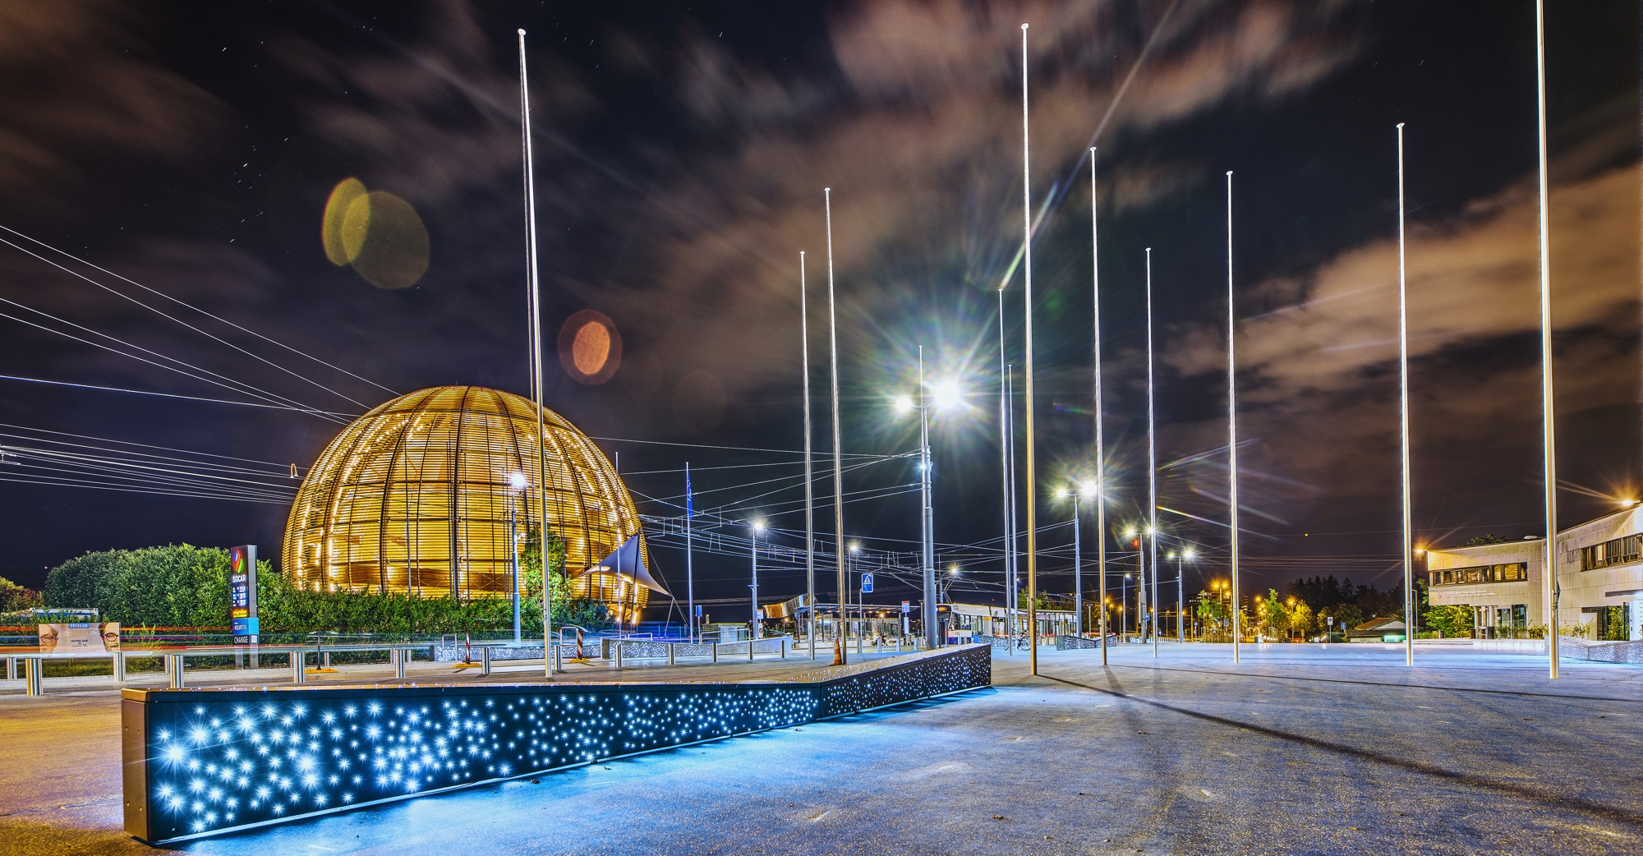
AGENDA
Introduction
How Do We Buy?
How Much DO We Spend?
Procurement @ CERN - the rules
Impact of
Doing business with CERN
Procurement website

Slide 3

INTRODUCTION

Slide 4
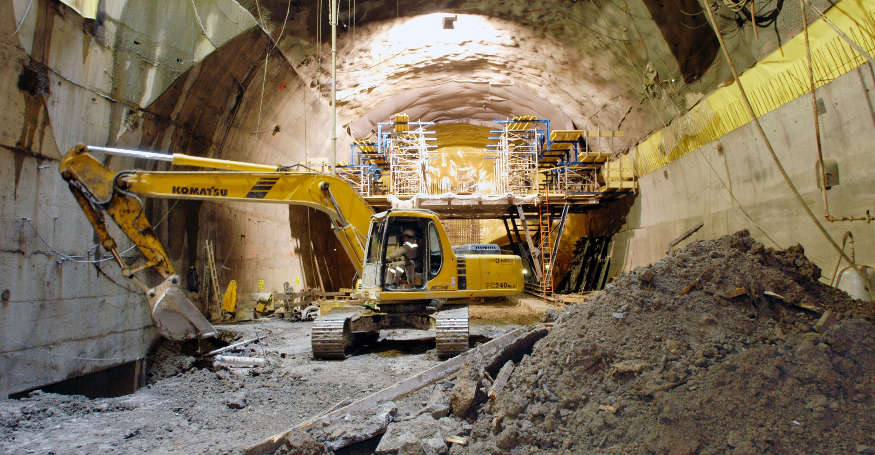
CERN needs
Civil engineering:
  Construction
  Renovation of buildings
  Metallic structures
  Earthworks
  Roads
Cooling and ventilation
equipment

Slide 5
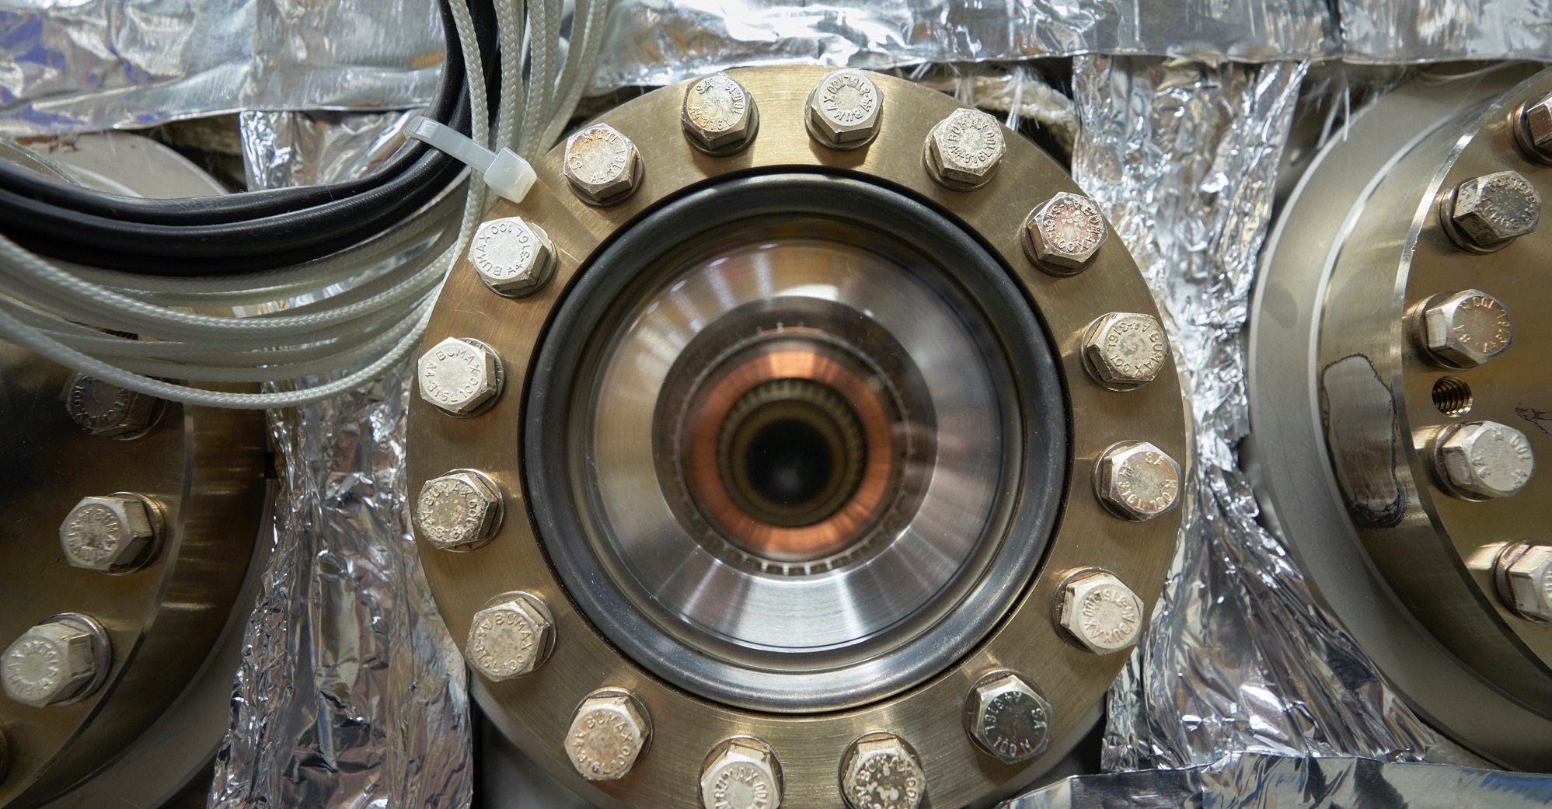
CERN needs
Electical engineering and magnets
  Transformers
  Switchboards and switchgear
  Cables
  Automation
  Power supplies
  Magnets

Slide 6
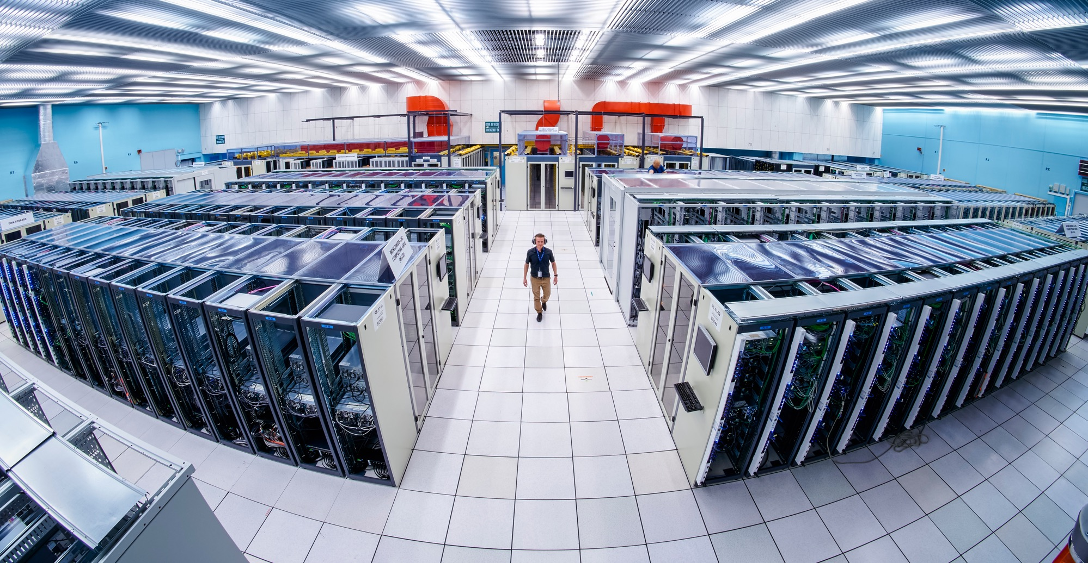
CERN needs
Information Technology
  Computing systems
  Servers
  Software
  Network equipment
  Personal computer equipment

Slide 7
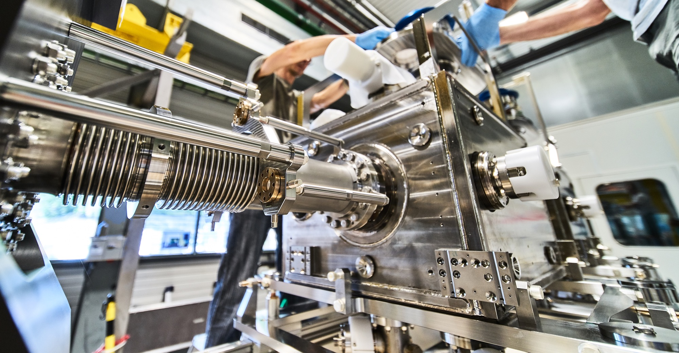
CERN needs
Mechanical engineering and raw materials:
  Machining
  Sheet metal work and arc welding
  Special fabrication techniques
  Raw materials, finished and semi-finished products (plates, pipes, etc.)
  Offsite engineering and testing

Slide 8
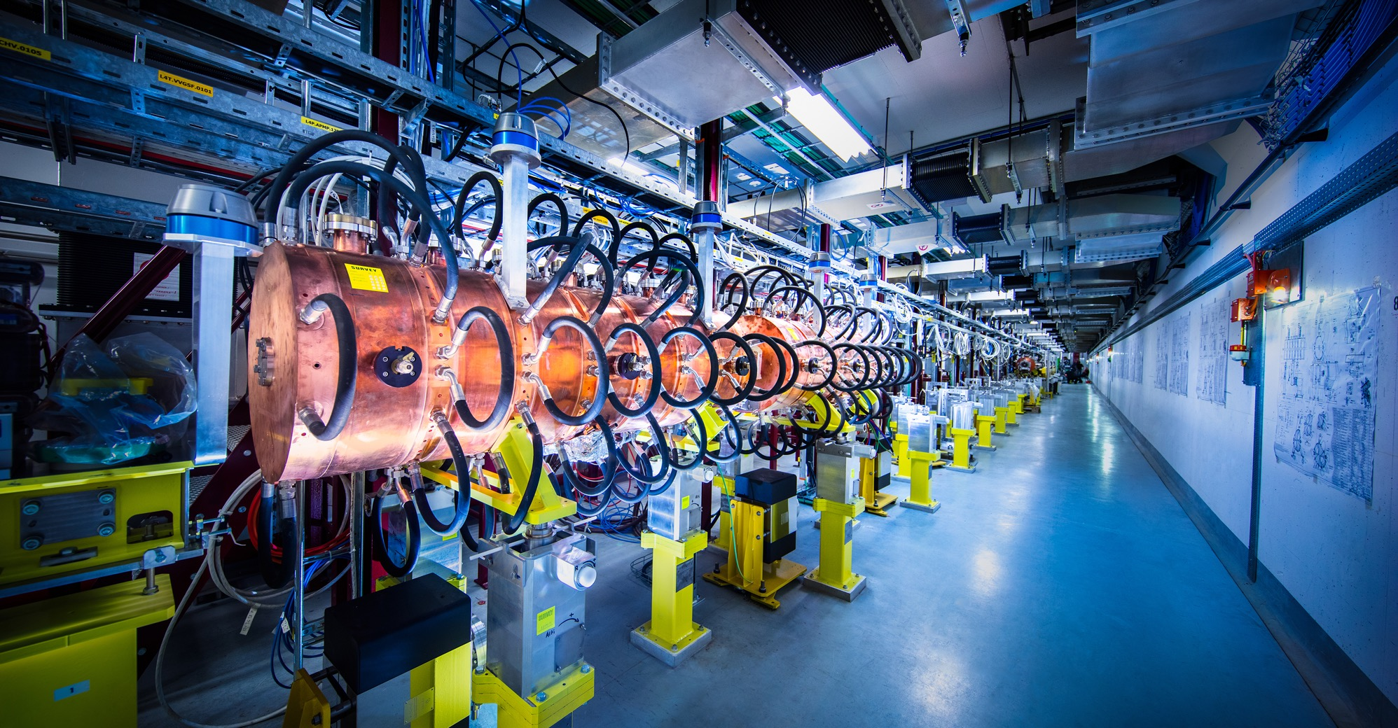
CERN needs
Electronics and radiofrequency:
  Electronic components (active, passive)
  PCBs and assembled boards
  LV and HV power supplies
  Radiofrequency plants
  Amplifiers

Slide 9
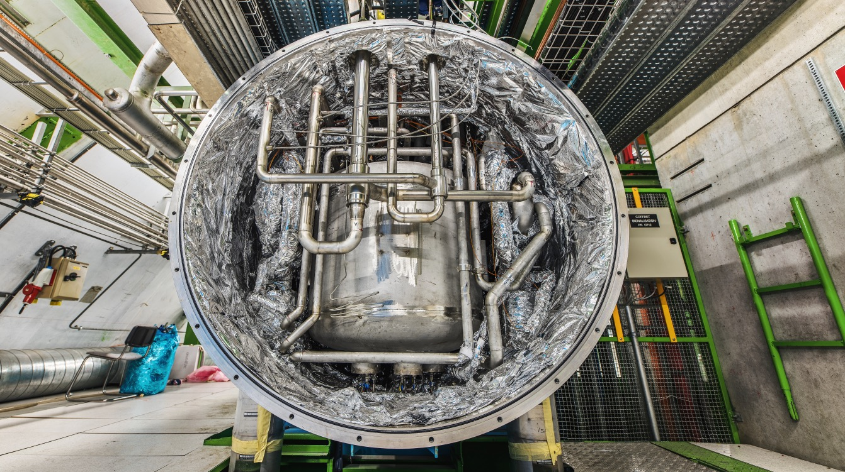
CERN needs
As well as:
  Cryogenic and vacuum equipment
  Optics and photonics
  Particle and photon detectors
  Health and safety equipment,
  Transport and handling equipment
  Office supply, furniture
  Industrial services on the CERN site

Slide 10

How do we buy?
  Service Contracts are for the provision of services to be performed on the CERN site.
Supply Contracts are anything which are not service contracts

Slide 11
How does CERN buy?
  Off-the shelf or non-standard products which can be produced with existing manufacturing techniques or technologies:
  Functional specification
  Non-standard products where industry has neither the required know-how nor the interest to develop and design the products:
  Build-to-Print specification
Prototypes and or Pre-series might be required.

Slide 12
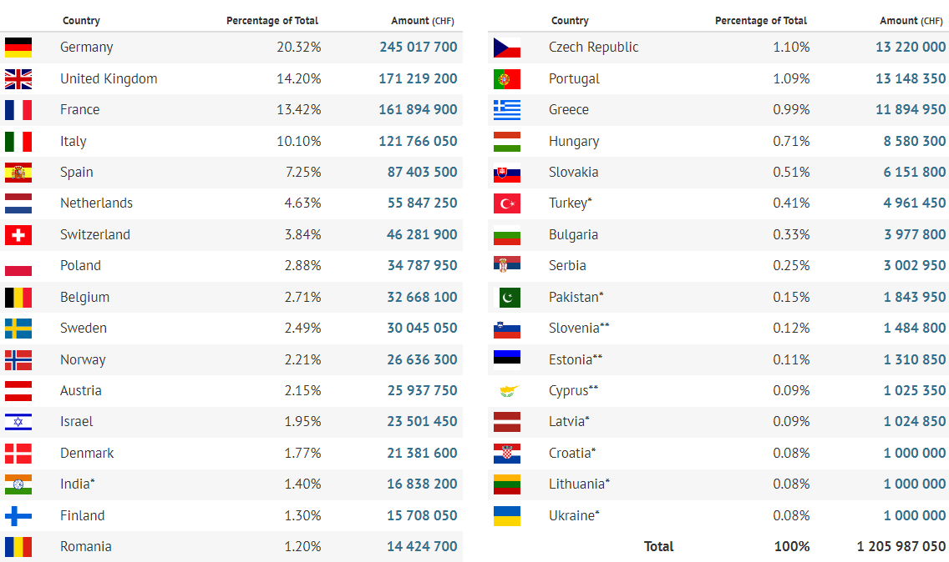
Yearly Budget (contributions 2022)

Slide 13
Procurement Expenditure

Slide 14
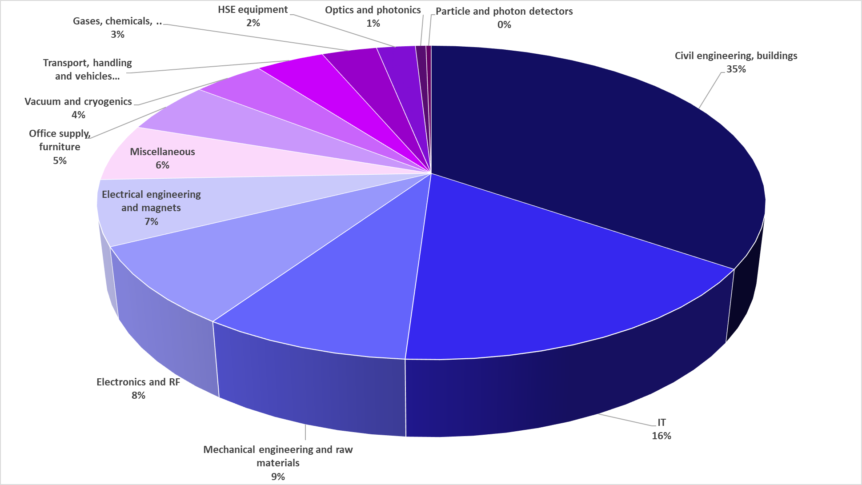
Supplies (229MCHF spent in 2021 – CERN budget only)

Slide 15

CERN is entitled to establish its own internal rules necessary for its proper functioning, including:
Procurement Rules
Safety Rules
Staff Regulation of its own personnel

Slide 16
The Procurement Service
Mission
The Procurement Service (PS) procures all supplies and services for CERN
Meeting the specified and contractual technical, delivery
and performance requirements
At the lowest possible overall cost
While achieving balanced industrial return for CERN Member States
Respecting CERN
Procurement Rules

Slide 17
Principles of the Procurement Rules (1/4)
1
Transparency and Impartiality
2
Tenders open to Member States and Associate Member States only
3
Objectivity and equal treatment: tendering packages are objective and impartial

Slide 18
Principles of the Procurement Rules (2/4)
Selective tendering procedures: CERN’s tendering procedures are not open to any interested firms
Confidentiality: Opening and evaluation of bids as well as negotiations are not public

Slide 19
Principles of the Procurement Rules (3/4)
Award for supplies (and services, exceptionally) based on:
Lowest compliant bid
Technical
Financial
2
Best Value for Money is currently rarely used and requires prior approval of the Finance Committee
Delivery

Slide 20
Principles of the Procurement Rules (4/4)
Award for industrial services based on:
Best Value For Money
2
No alignment rule

Slide 21

Procedures Based On Estimated Cost
The procedure followed depends on the estimated cost
Increasing value = increasing scrutiny and approval
Increasing value = increasing response times
Member States have visibility of mid value price enquiries
Member States approve all high value contracts and derogrations from the rules

Slide 22
Country of origin
SUPPLIES
“Country(ies) where the supplies (including their components and sub-assemblies) are manufactured or undergo the last major transformation by the contractor or its sub-contractor”
If at least 60% of the total amount of the bid comes from a poorly balanced MS, then the whole bid will be treated as that from a bidder in a poorly balanced MS.
SERVICES
“Country(ies) in which the bidder is established.”
If at least 40% of the total amount of the bid comes from a poorly balanced MS, then the whole bid will be treated as that from a bidder in a poorly balanced MS.

Slide 23

Industrial return coefficient
Industrial return
coefficient
Over a 4-year period:
Very poorly balanced : < 0.40
Poorly balanced (PB) : 0.40 ≥ x < 1
Well balanced (WB): ≥ 1
For Supply contracts and for a
12-month period starting on
1st March, defined as:
“The ratio between a Member State's percentage share of the value of all Supply contracts and that Member State's percentage contribution to the CERN Budget over the same period”.
Status definition
% expenditure in the MS
Return Coef.=
% contribution to CERN budget for this MS

Slide 24
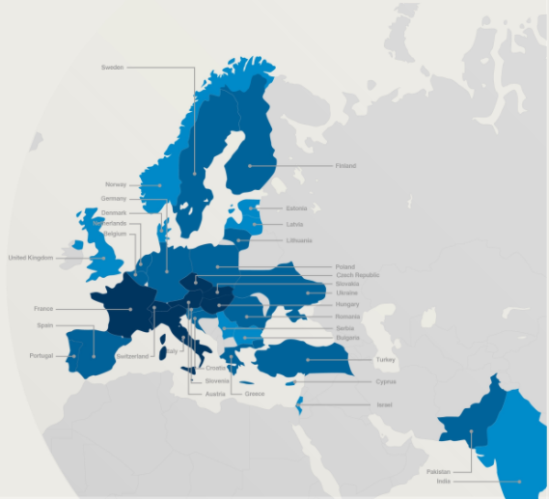

Poorly balanced Member States (Supplies)
(1st March 2022 – 28 February 2023, based on the previous 4 calendar years):
Well Balanced | Poorly Balanced | Very Poorly Balanced
Austria Czech Republic France Hungary Italy Slovakia Switzerland | Belgium Croatia* Cyprus* Finland Germany Greece Lithuania* Netherlands Pakistan* Poland Portugal Romania Slovenia* Spain Sweden Turkey* Ukraine* | Bulgaria Denmark Estonia* India* Israel Latvia* Norway Serbia United Kingdom
*Associate Member States

Slide 25
Active Steps to Improve Balance
The Member States wish to see an improvement in balance for Supplies
Services are less of a concern – recognised as local in nature
KPI of 3 VPBMS by 2025
Tools/mechanisms in the rules on Alignment and Limited Tendering
Regular data monitoring to target use of tools
Outreach to potential bidders – early information on larger procurements
Training and support

Slide 26
Alignment rule
Applicable for:
1
Contracts awarded on the lowest
compliant basis (mainly supply contracts)
2
With a total amount exceeding
100’000 CHF.
Under certain conditions as defined in CERN Procurement Rules, a bidder offering goods originating* in poorly balanced Member States is allowed to align its price to that of the
lowest bidder and thereby be awarded the contract.
RULE
* At least 60% for supply contracts or; at least 40% for service contracts awarded on the lowest compliant basis.

Slide 27
Limited tendering
« Limited tendering is foreseen by the CERN Procurement Rules to improve the industrial return of very poorly balanced Member States. »
Conditions
Firms established in very poorly balanced Member States only (industrial return <0.4);
ILO can ask to add firms, provided they are established in very poorly Member States.
Used in case where there is sufficient competition;

Slide 28

How Ireland Could Support Industry To Win Work At CERN

Slide 29
Starting Industrial Relationships With CERN
Outreach and training
Synergies with academia
Identification of realistic opportunities and industrial match
Managing expectations

Slide 30
Contact in your country
ILO: Industrial Liaison Officer
Who to contact in your Country
    Industrial Liaison Officers (ILO's) are appointed by CERN's Member States to facilitate the flow of communication between CERN and its suppliers. ILO's can provide advice on the opportunities available for doing business with CERN and the support available to firms
    in their local regions.

Slide 31
Impact of
Doing business with CERN

Slide 32
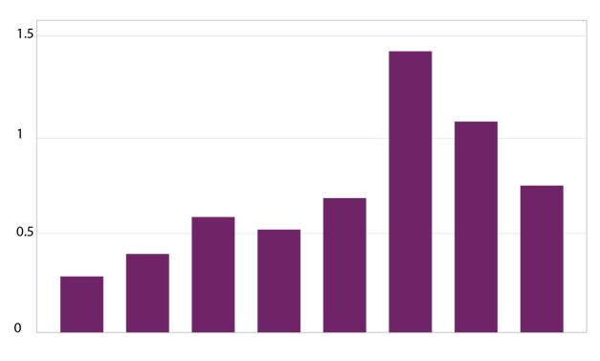
The economical impact of CERN Procurement on supplier’s performance (Castelnovo et al, 2018)
Empirical studies (by the analysis of financial data from 1995 to 2008 from 365 CERN suppliers for the LHC) show that after working with CERN on high-tech contracts, CERN suppliers
out-perform their peers by:
Investing more in R&D and filing more patents
Higher productivity, revenue and profitability
Order/contract received from CERN
Increase in R&D
Innovation
Productivity growth
increase revenues & profitability
Patents per firm
More than
2 years before
2-1 years before
Date of order
1,2 years later
3,4 years later
5,6 years later
7,8 years later
More than
8 years later
Notes:
Average number of patents filed before and after the beginning of the procurement relationship with CERN
The X-axis shows the «relative years», that are the difference between a given year and the year the first order is received. Therefore, CERN(0) is, for each company, the year of beginning of the procurement relationship.

Slide 33
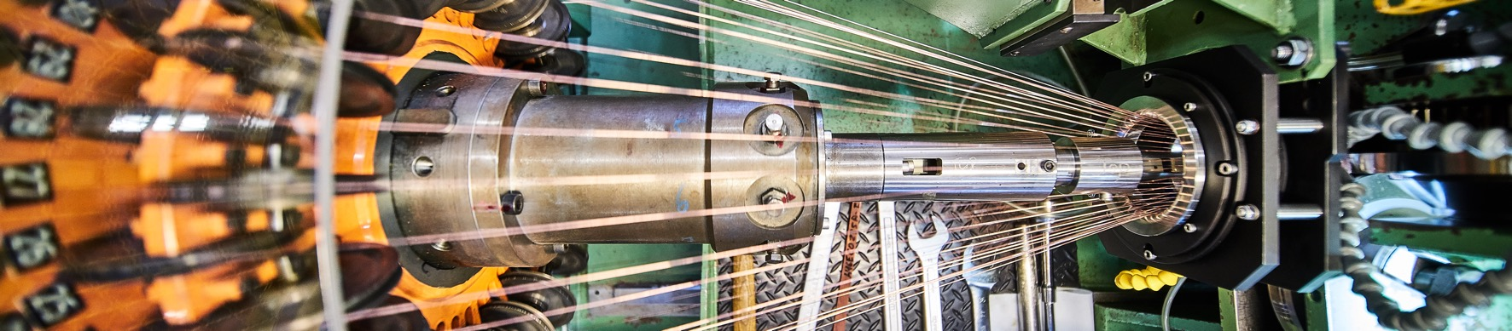
Doing business with CERN: the facts
Supplier survey (669 suppliers in 33 countries, 2017):
48%
improved products and services
42%
developed new products
55%
improved technical knowledge
in their field
18%
found or opened a new market to address
62%
used CERN as a marketing reference
Notes:
The key message here is that CERN is an open institution: open to its neighbours, and open to citizens from across the globe. We welcome them to CERN and go out to meet them
This slides summarises the outreach activities carried out by CERN.
It also includes a mention of CERN’s fundraising activities, for projects that are not part of CERN’s core activity. These fall into three categories: education & outreach, culture and creativity, innovation and knowledge exchange

Slide 34
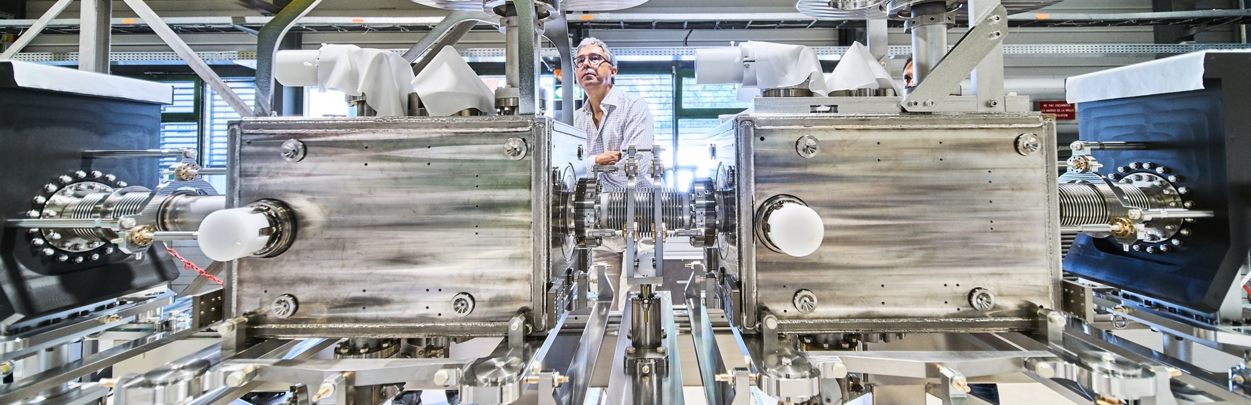
Doing business with CERN: the facts
Using CERN as a marketing reference improve
the reputation as suppliers

Slide 35
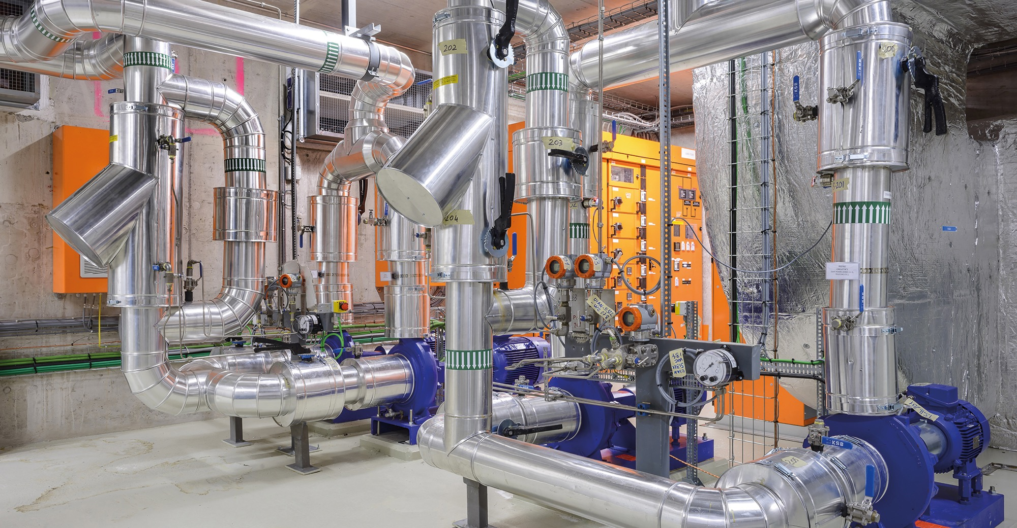
Social
Cost-Benefit Analysis (CBA) calculated by the University of Milan
“Each CHF invested in
HL-LHC project pays back approximately 1.8 CHF on societal benefits, including scientific, economic and cultural value (development of innovative technologies, industrial spillovers, skills acquired by students, etc.).”

Slide 36

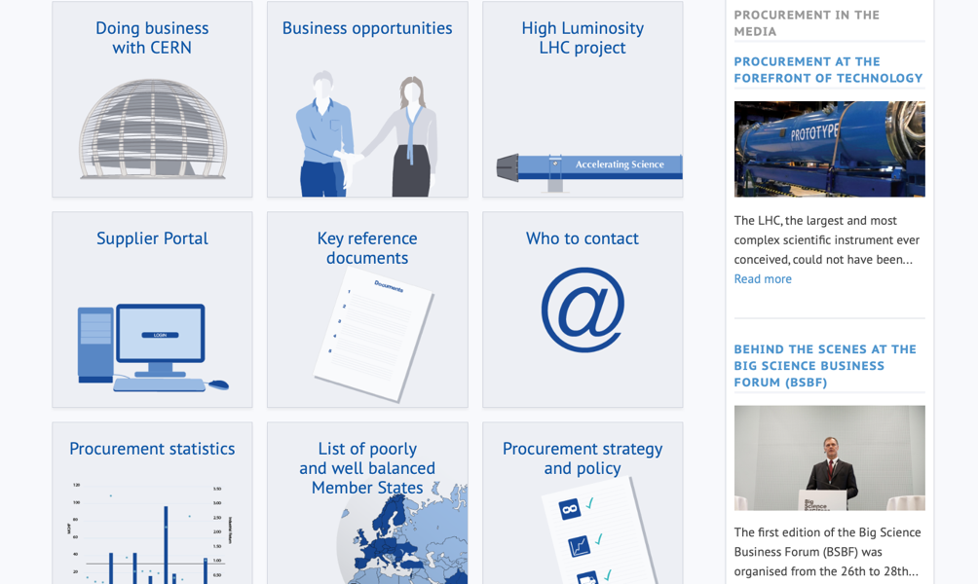
Procurement
website

Slide 37
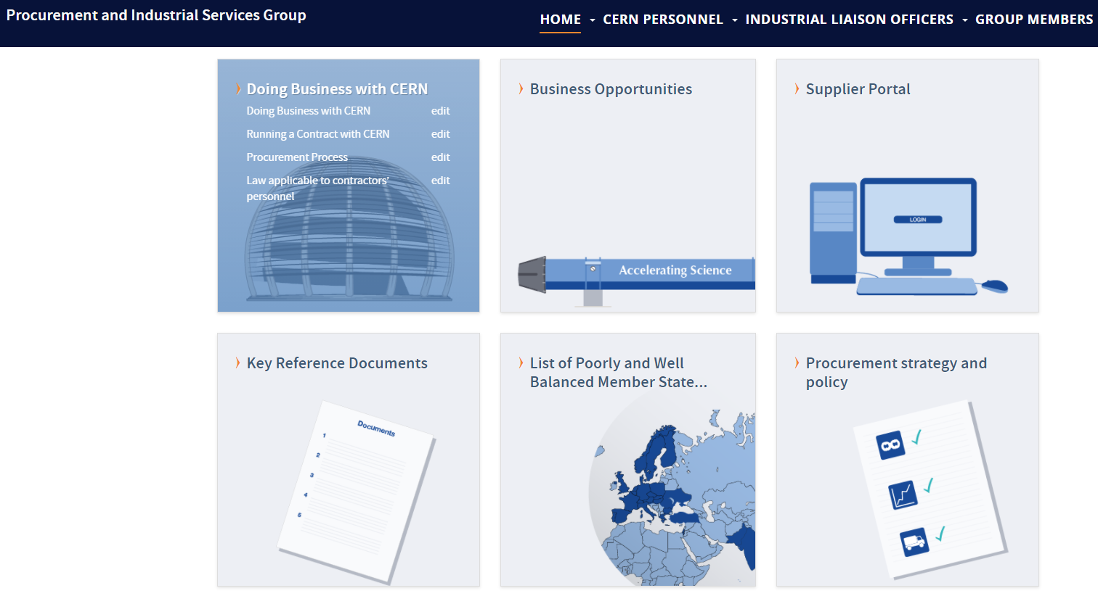
Website of the Procurement Service
http://procurement.web.cern.ch

Slide 38
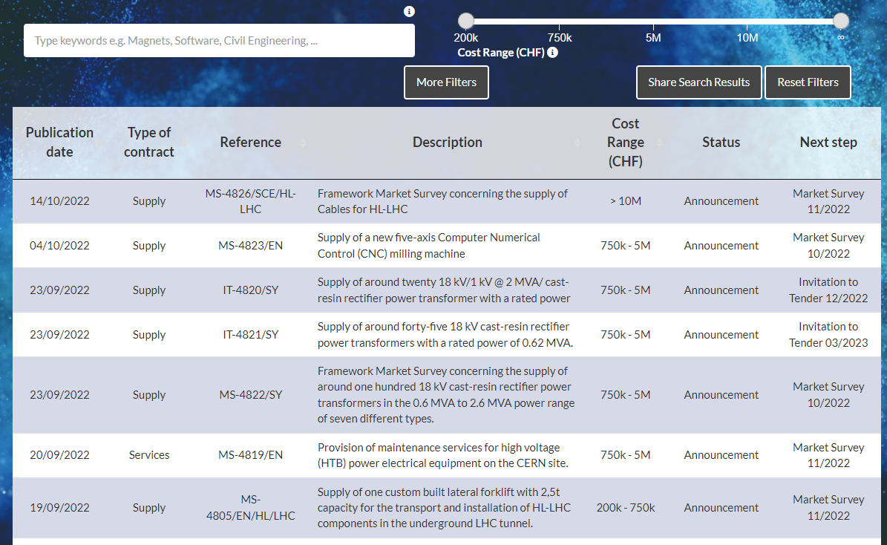
CERN Shopping List
https://forthcoming-ms.app.cern.ch/#!/

Slide 39
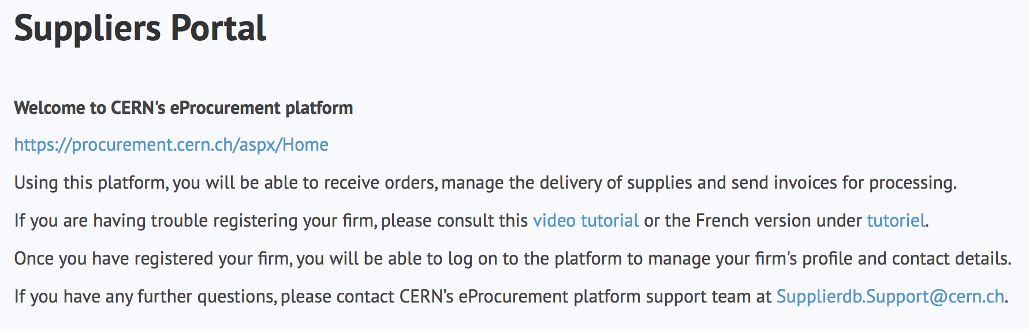
Register in the Suppliers Portal
for all exchanges with CERN, in particular to:
Be visible for future opportunities
(with the procurement codes you have indicated),
Receive and follow-up orders,
Send invoices.
MANDATORY

Slide 40
Thank you

