Slide 1
CERN Civil Engineering Future Studies Section and Opportunities
John Osborne, Vanessa Di Murro, Martin Cull, Aohui Ouyang
SCE-DOD-FS
13/02/2023

Slide 2



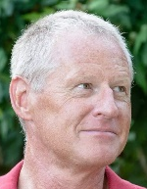



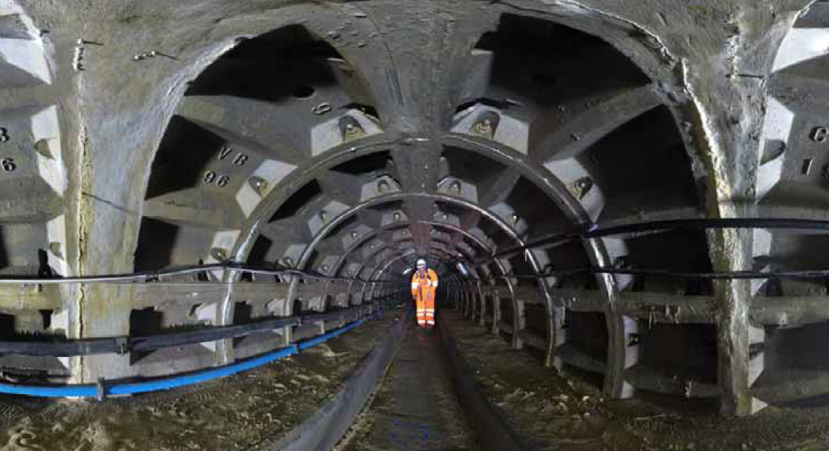
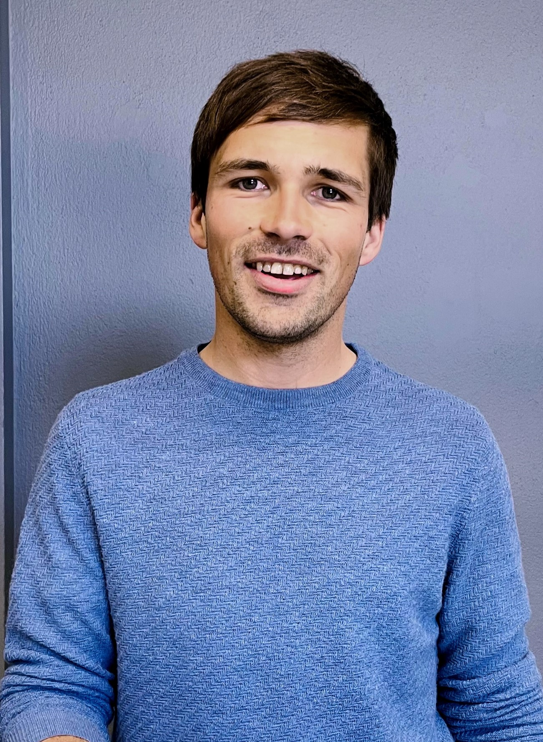
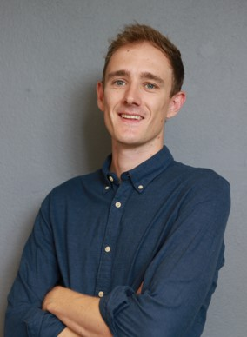


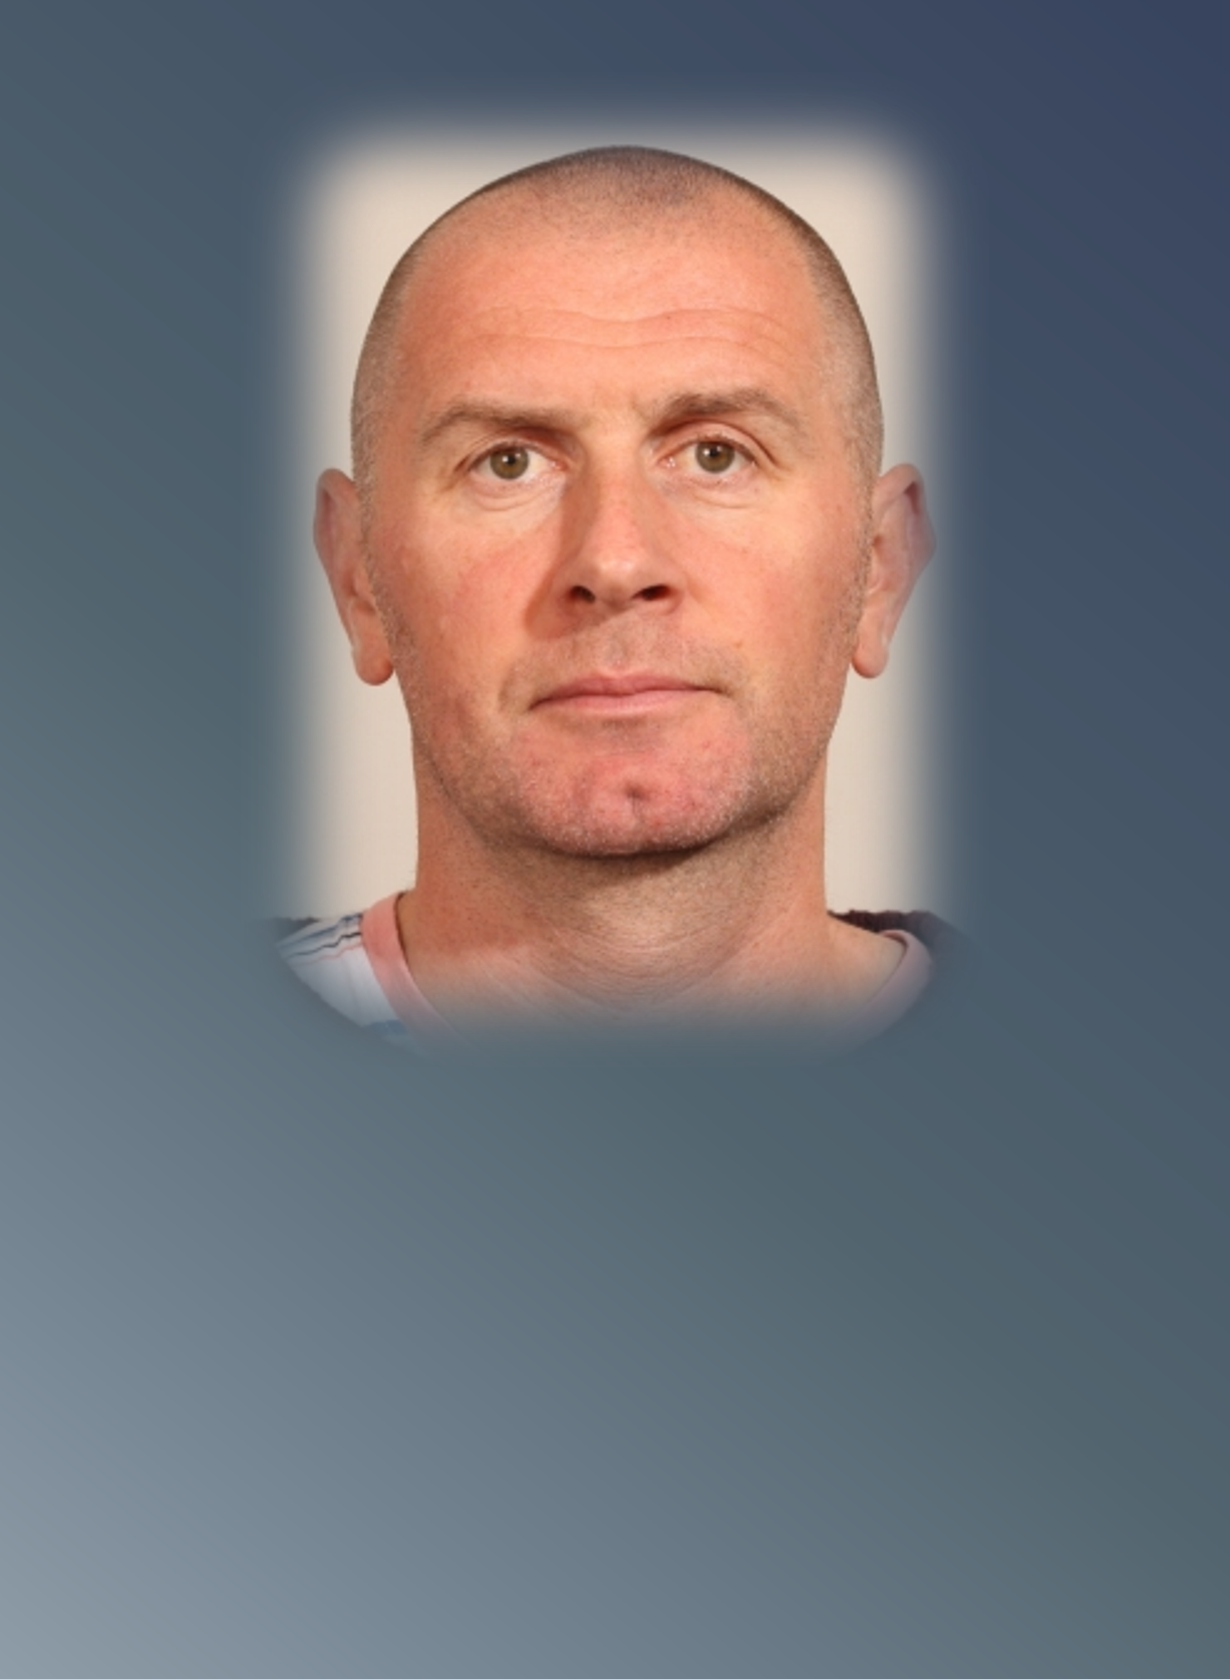

SCE-DOD-FS Section
Future Accelerator Studies
[FS]
SL: John Osborne
DL: Mar Capeans
International Linear Collider ,CLIC, Muon Collider, LHeC
External Reviews e.g. ESS, XFEL, DUNE etc.
Future Circular Collider (FCC) Underground Studies and Site Investigations
Physics Beyond Colliders (PBC)
Tunnel Asset Management (TAM)
Tunnel R&D Photogrammetry/Fibre Optic Studies
Roddy Cunningham
Liam
Bromiley
Kincső
Pál
Vanessa
Di Murro
Martin
Cull
Aohui
Ouyang

Slide 3
SCE-DOD-FS Mandate
Co-ordination of the civil engineering and infrastructure studies for large-scale physics projects. These include the Future Circular Collider (FCC), Linear Colliders (LC), Muon Colliders, Physics Beyond Colliders and ISOLDE studies.
Lead of the studies in conjunction with other SCE groups from conception, feasibility and technical design towards construction preparation.
Inspections and monitoring of all existing underground assets within the ‘Tunnel Asset Management’ unit, including some research and development for monitoring technologies like photogrammetry and fibre optic monitoring

Slide 4
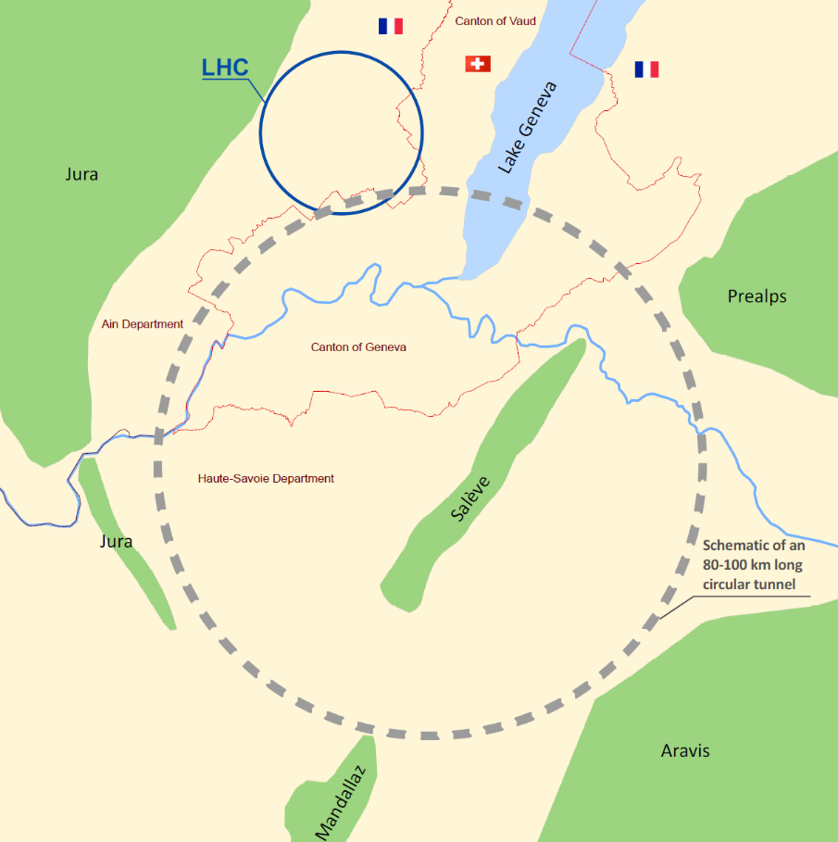
The Future Circular Collider Study (FCC)
Collision energy:
  100TeV
Circumference:
  80km-100km
Physics considerations:
  Enable connection to the LHC (or SPS)
Construction:
  c.2029-35
Cost:
  Civil Engineering 6BCHF
Aims of the civil engineering feasibility study:
  Is 80km-100km feasible in the Geneva basin?
  Can we go bigger?
  What is the ‘optimal’ size?
  What is the optimal position?

Slide 5
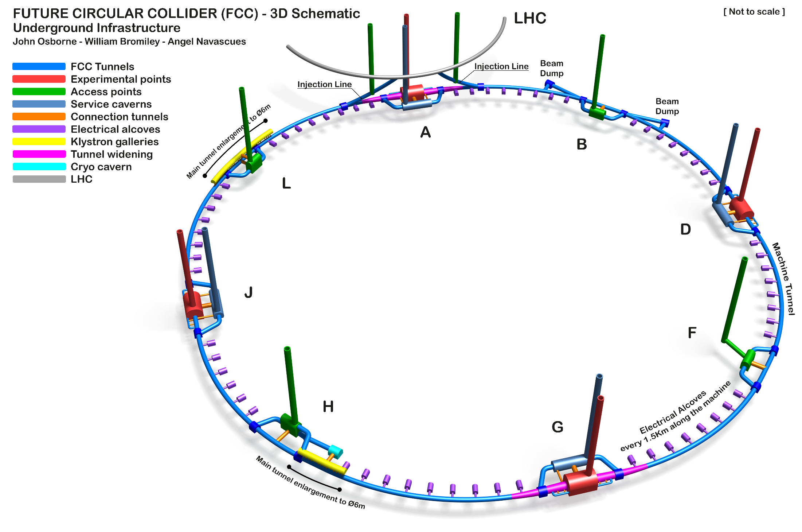
FCC Baseline Schematic: Single Tunnel

Slide 6
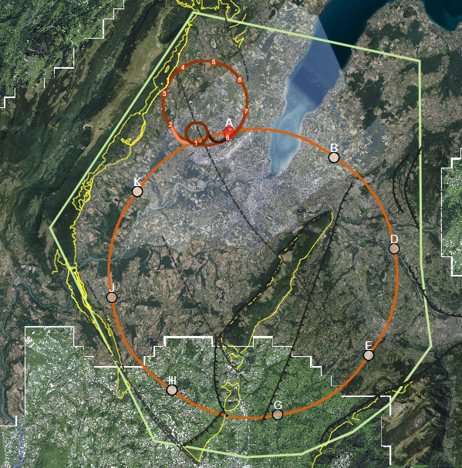
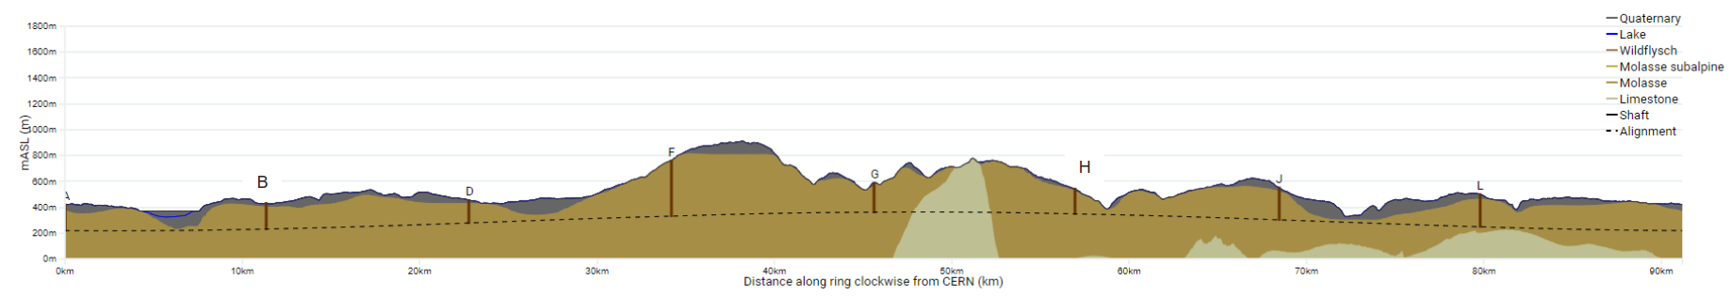
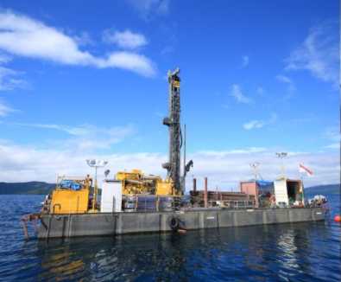
FCC: Areas with highest geological uncertainty
Good knowledge of the ground (e.g information near to CERN from LEP/LHC projects)
Good confidence that the tunnel alignment is in molasse
Lac Léman
Moraine/molasse interface uncertain
Soils and rock properties uncertain
High uncertainty in the hydrogeological conditions and water pressure
Jura
Limestone/molasse interface uncertain.
Risk of karts and high water pressures
A
B
Vallée de l‘Arve
Moraine/molasse interface uncertain.
Lack of reliable boreholes
L
Le Rhône
Moraine/molasse interface not certain.
Proximity to protected area
D
Bornes
Insufficient deep boreholes information
Complex faulted region, thrust zone.
Quality of molasse is uncertain. High overburden. Large span experimental caverns should be constructed in good molasse.
Vuache
Limestone/molasse interface not certain.
Risk of karts and high water pressures
Proximity to main active fault
J
J
F
H
Les Usses
Moraine/molasse interface not certain.
Low tunnel rock cover
G
Mandallaz
Fractured limestone formations, characteristics and locations of karsts unknown.
High water pressures
Vallée de l‘Arve
Bornes
Les Usses
Lac Léman
Mandallaz
Le Rhône
On-site investigation works 2024-25
Planned start of civil works mid 2030’s

Slide 7
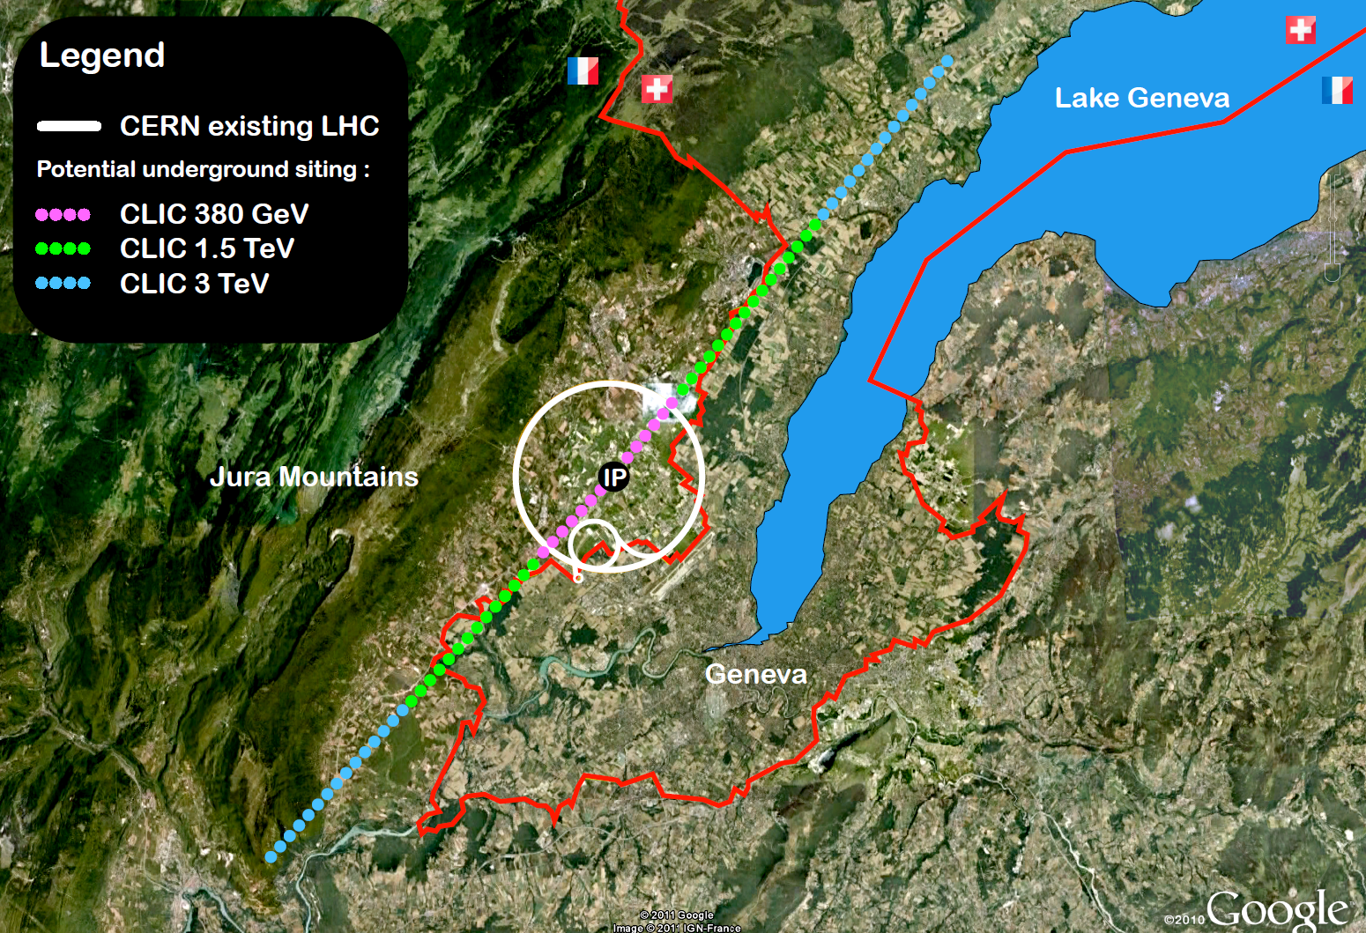
Compact Linear Collider (CLIC) Studies at CERN
9

Slide 8

Physics Beyond Colliders (PBC)
  PBC is a programme aimed at exploiting the full scientific potential of CERN's accelerator complex and its scientific infrastructure through projects complementary to the LHC, HL-LHC and other possible future colliders.
Main studies:
  Beam Dump Facility (BDF)
  Forward Physics Facility (FPF)
  electrons in the SPS (eSPS)
  ForwArd Search ExpeRiment (FASER)
  Neutrinos from STORed Muons (nuSTORM)
  Plasma Electron Proton/Ion Collider (PEPIC)
  Advanced Proton driven Plasma Wakefield Experiment (AWAKE)++
  Electric Dipole Moments (EDM) Storage Ring
  MAssive Timing Hodoscope for Ultra Stable neutraL pArticles (MATHUSLA)

Slide 9


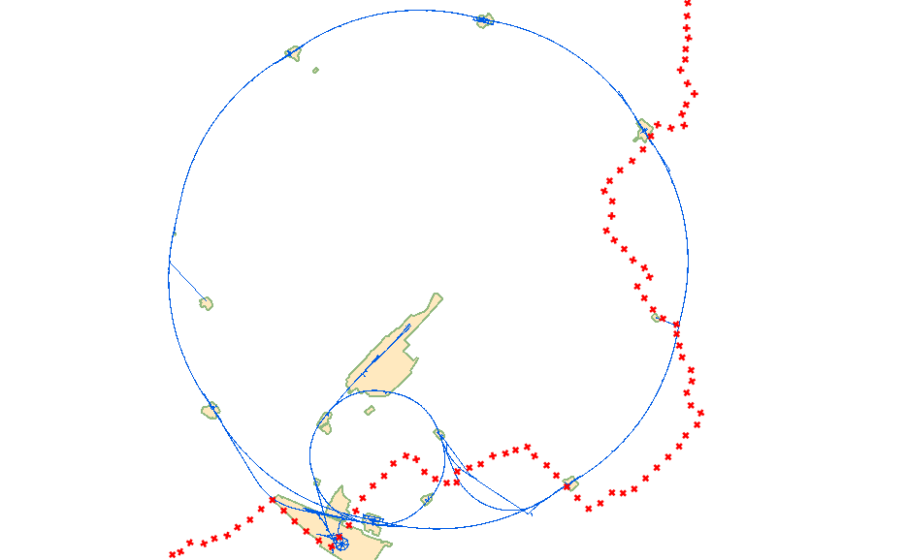
PBC Studies & Locations
AION-100 @IP4 LHC
LHC
MATHUSLA
Oliver Buchmuller (Imperial College) & Jonathan Ellis (King’s College/ CERN)
Charlie Young (SLAC) & Henry J. Lubatti (University of Washington)
Beam Dump Facility
Matthew Fraser (CERN) & Richard Jacobsson(CERN)
Forward Physics Facility
nuStorm
Jaime Boyd (CERN) & Jonathan Feng(UC Irvine)
SPS
Kenneth Long (Imperial College)
FASER
Jaime Boyd (CERN) & Jonathan Feng(UC Irvine)

Slide 10


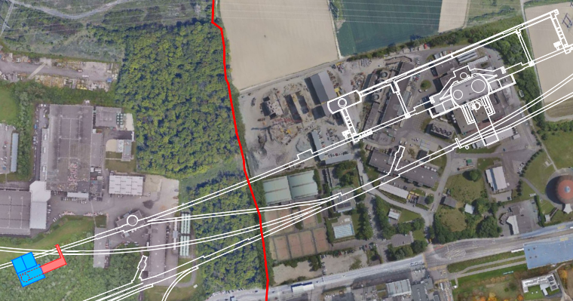
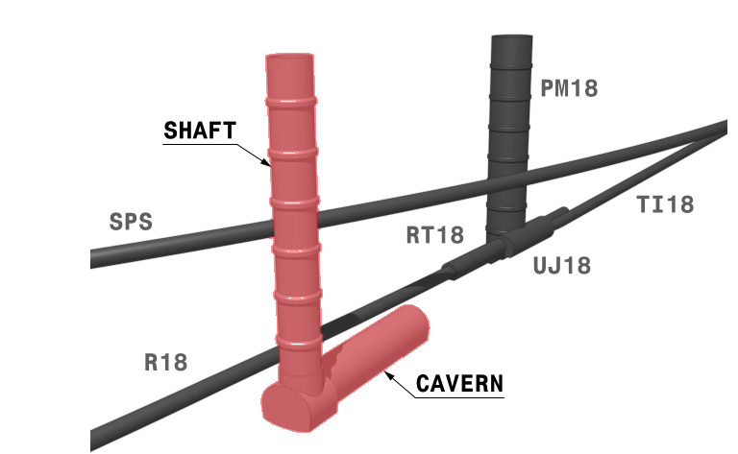
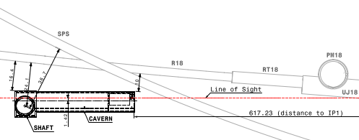
Forward Physics Facility
Location approx. 617m from IP1 on the French side of CERN land, 10 m away from the LHC tunnel
Design includes
  A 65m long experimental cavern, experiments centralised on the line of sight (LoS)
  An 88m deep access shaft
  Support buildings and infrastructure
  Site previously used as spoil disposal area for LEP, ground levels approx. 7m above the surrounding area
  Significant volume of excavation due to the existing conditions
IP1 ATLAS
LHC
New proposed facility

Slide 11
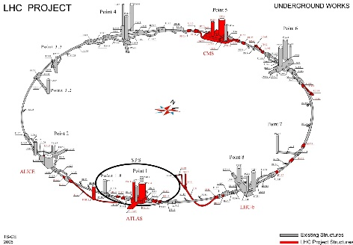
Civil Engineering companies
Large Hadron Collider (LHC) CE Contracts approx. EUR 600m
Package | Consultants | Contractors
POINT1 ATLAS | EDF (F) KNIGHT & PIESOLD (GB) | TEERAG-ASDAG (A) BARESEL (D) LOCHER (CH)
POINT 5 CMS | Joint Venture: GIBB (NOW JACOBS) (GB) GEOCONSULT (AT) SGI (CHH) | DRAGADOS (E) SELI (I)
Other points | BROWN & ROOT (GB) INTECSA (E) HYDROTECHNICA (P) | TAYLOR-WOODROW (GB) AMEC (GB) SPIE-BATIGNOLLES (F)
TI 8 | DITO | LOSINGER (CH)

Slide 12
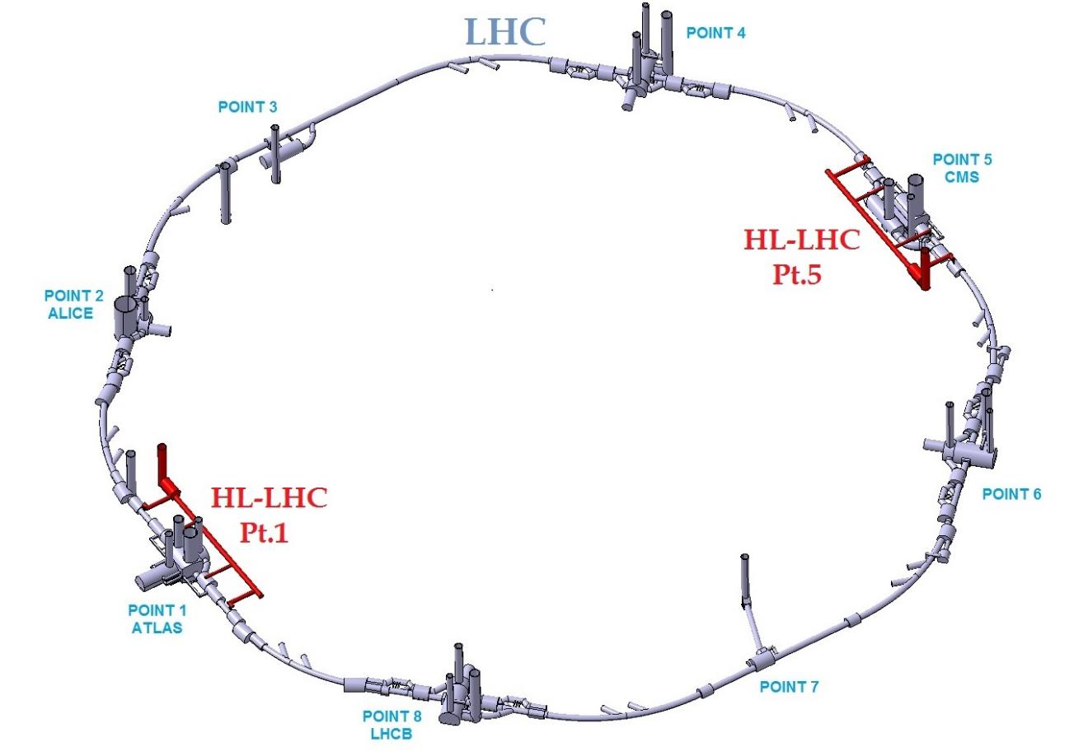
Civil Engineering companies
High Luminosity LHC Project (HL-LHC) CE Contracts approx. EUR 200m
Package | Consultants | Contractors
POINT1 | Consortium ORIGIN: SETEC (F) CSD ENGINEERS (CH) ROCKSOIL (I) | Joint Venture Marti Meyrin: MARTI TUNNELBAU (CH) MARTI DEUTSCHLAND (DE) MARTI ÖSTRERREICH (A)
POINT 5 | Consortium LAP LOMBARDI (CH) ARTELIA (F) PINI SWISS ENGINEERS (CH) | Consortium CIB: IMPLENIA (CH/ F) BARESEL (DE)
Building Permit | DELTA ARCHITECTS ASS ARCHITECTS

Slide 13

Civil Engineering companies
Future Circular Collider (FCC)
Package | Consultants | Contractors
PRE-DESIGN | ILF (A) GADZ (CH) ARUP (UK) AMBERG (CH)
Permitting GiS suppport | SETEC (FR) SETEC (FR) & ARUP (UK)
PRELIM SITE INVESTIGATION | EGIS (F) BG (CH)

Slide 14
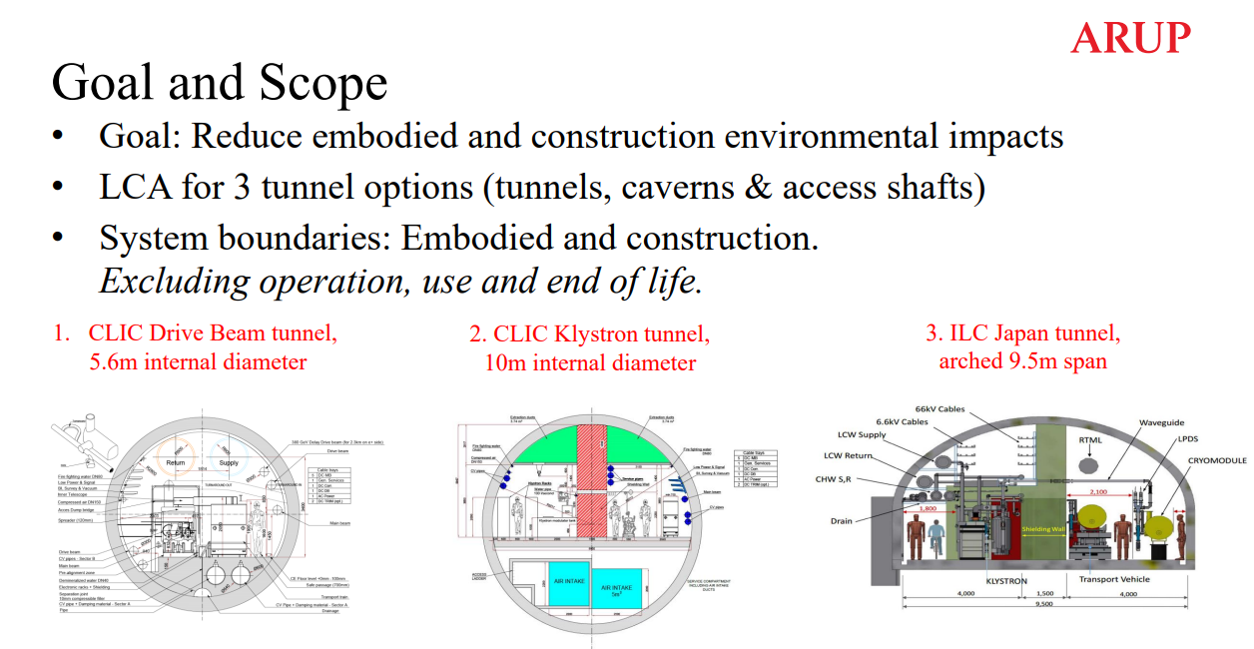
Life Cycle Assessment – Future Tunnels

Slide 15

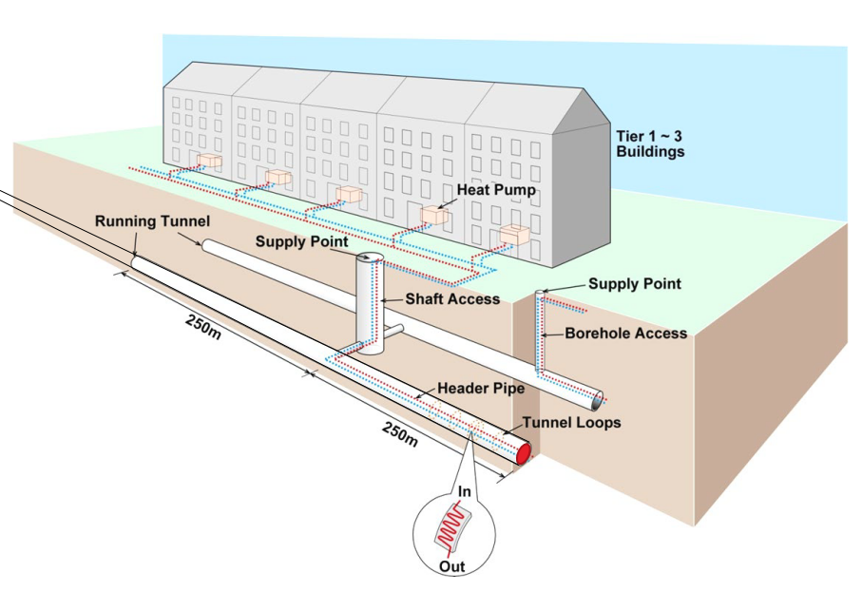
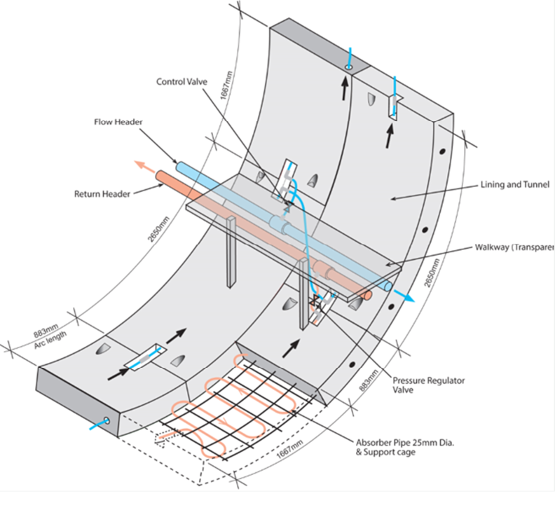
Heat Recovery Study - 2022

Slide 16




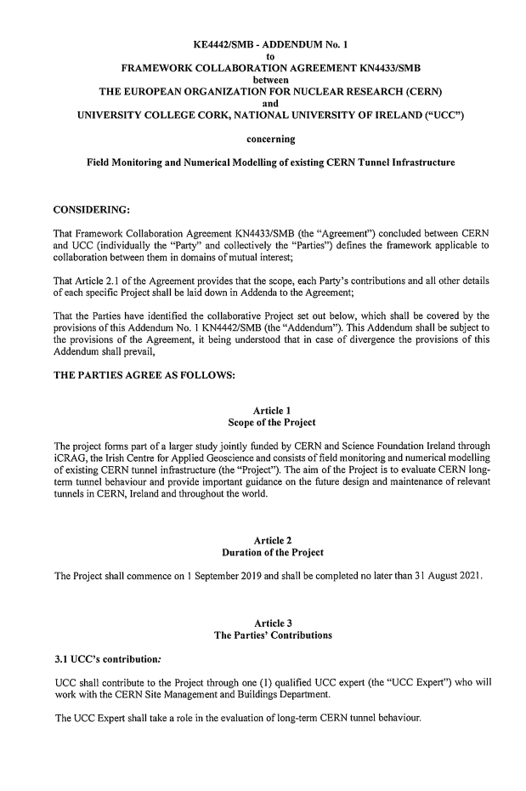
CERN & University College Cork Collaboration
In 2014, CERN established a collaboration with CSIC University of Cambridge (UK) in 2014
Since 2019, a Collaboration between CERN & University College Cork (UCC) was established by Dr Zili Li on Tunnel Asset Management on three research projects:
          2019-2020: Post-doc Zhipeng Xiao
          Long-term ageing tunnel structural behaviour at CERN and probabilistic risk assessment
            2020-2021: Master Student Darragh O'Brian
            Automated crack classification for underground tunnel infrastructure using deep learning
          2022-2024: PhD student Aohui Ouyang
      Deep learning-based photogrammetric analysis of ageing underground infrastructure (in progress)
Collaboration Agreement

Slide 17
Tunnel Asset Management
The TAM team within the SCE-DOD-FAS section is responsible for the coordination and research & development of tools that enables to assess the status of our underground infrastructure in order to operate it safely and efficiently. The use of Smart monitoring technologies will help to predict where maintenance is required and, hence, optimize future tunnel constructions.
Main Objectives
Reduce inspection time
Increase objectivity of inspection
Increase quantitative data
Reduce personnel presence in tunnels by using remote monitoring technologies
Develop a technology for future inspection to be implemented in new underground infrastructures (eg. FCC, Linear Colliders)

Slide 18
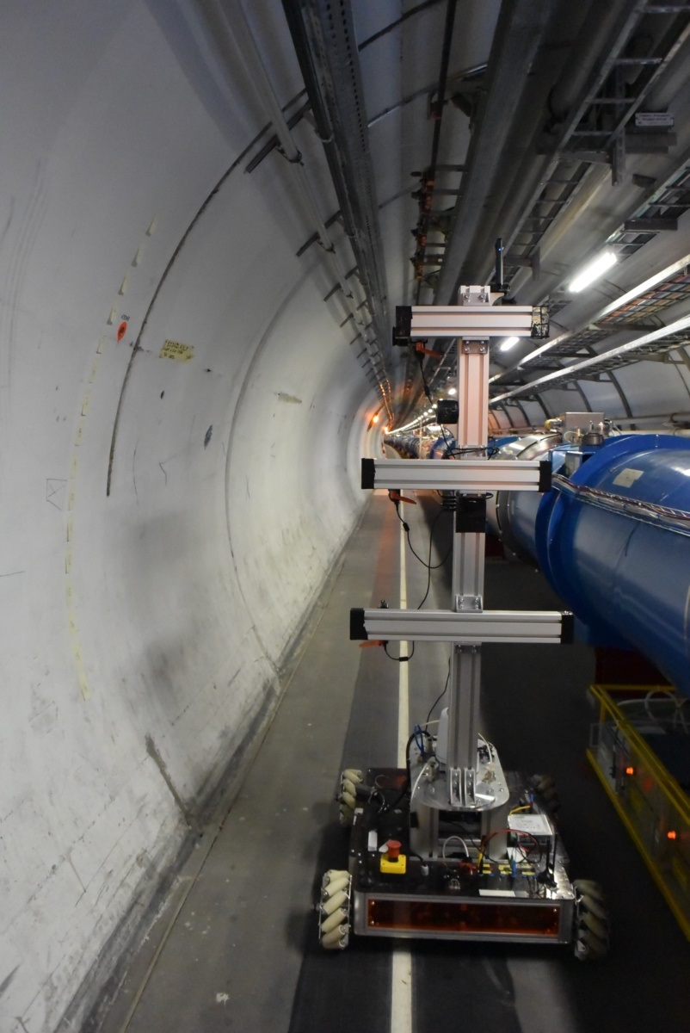
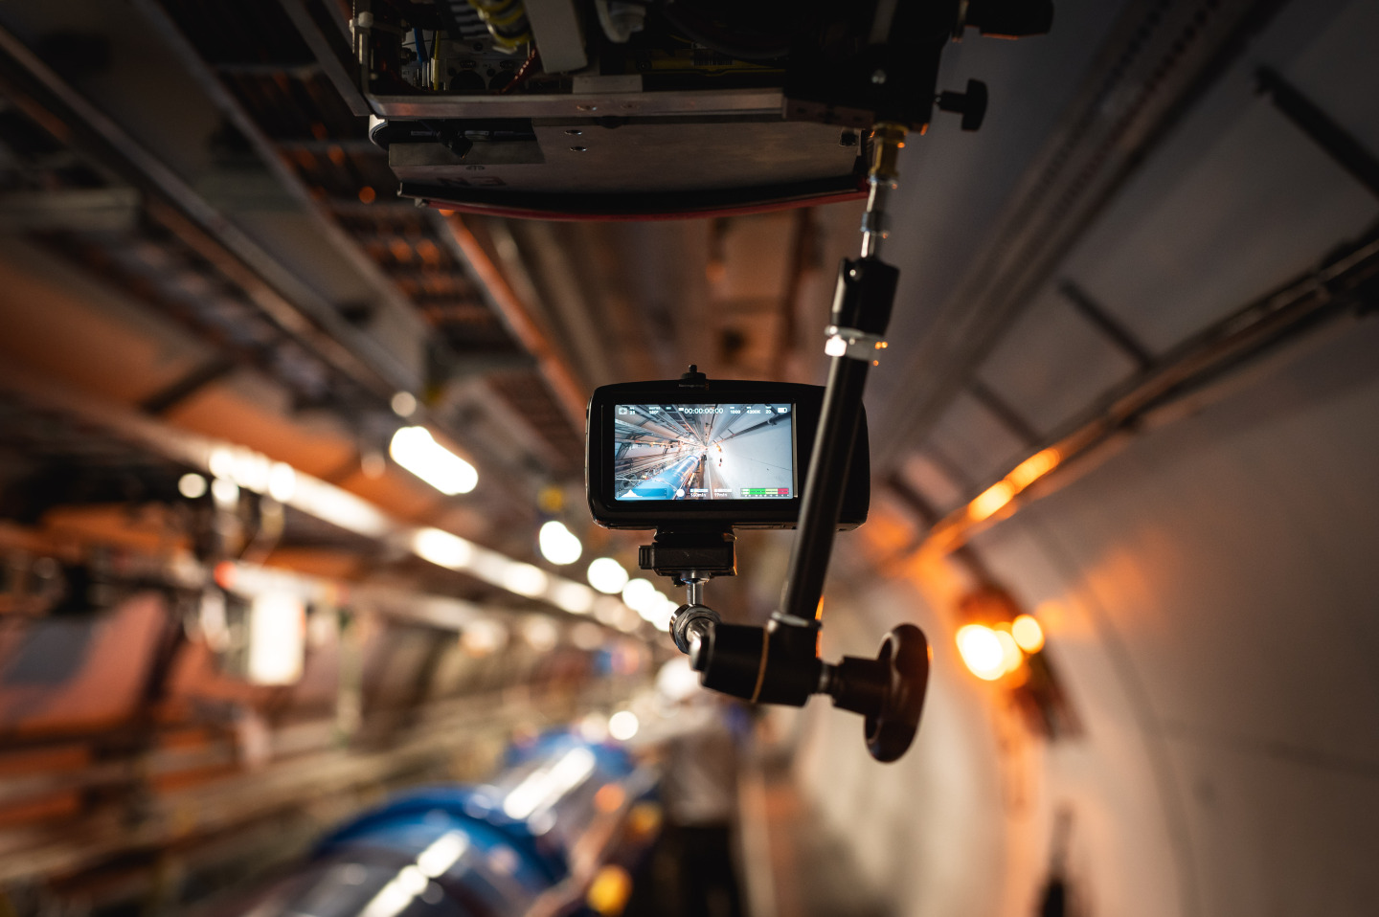
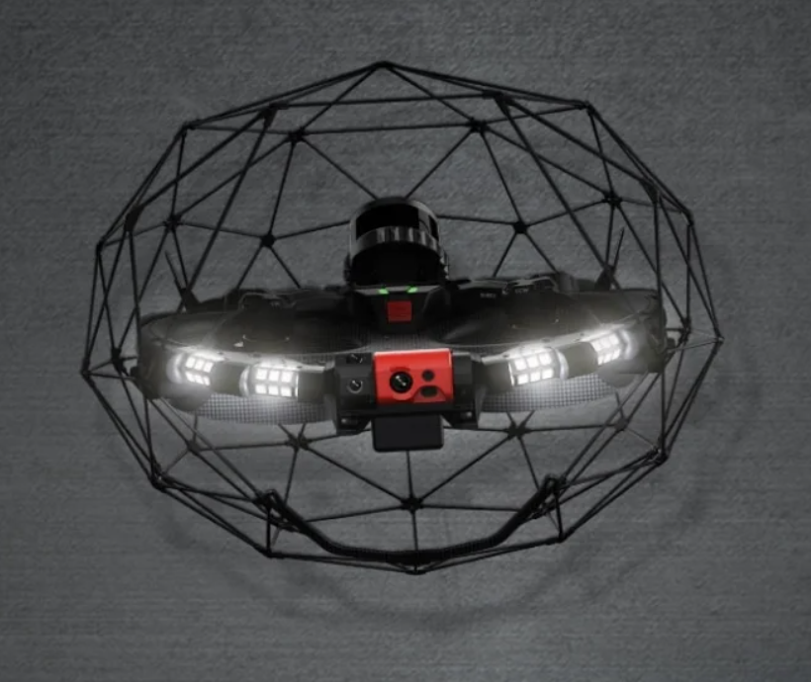

Tunnel Monitoring
Collaboration with BE-CEM Robotics team by using advanced robotics solutions (CERNbot & TIM) for remote monitoring of CERN underground
R&D for photogrammetry for crack detection and quantification (machine learning and structure from motion)
R&D for Distributed Fibre Optic Sensors (DFOS) monitoring for tunnel lining deformation detection
Other Monitoring technologies
  Drone ie. Flyability Elios 3
  Laser scanning (Point cloud system)

Slide 19
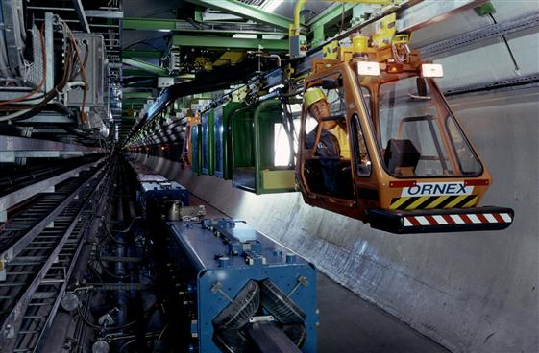
Train Inspection Monorail – TIM
Currently two TIM units are running in the LHC
Used for real-time monitoring of the LHC machine: the tunnel structure, the oxygen percentage, communication bandwidth and the temperature
Provides visual and infrared imaging of LHC tunnel
Can move up to 6km/h and can also pull small wagons for specific tasks

Slide 20


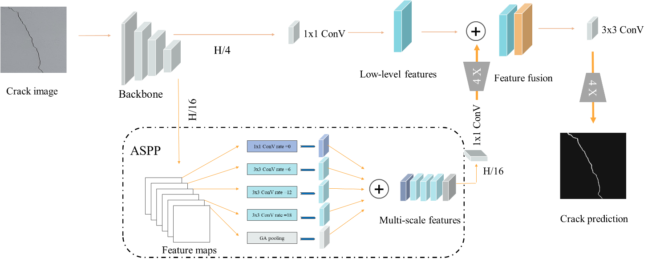
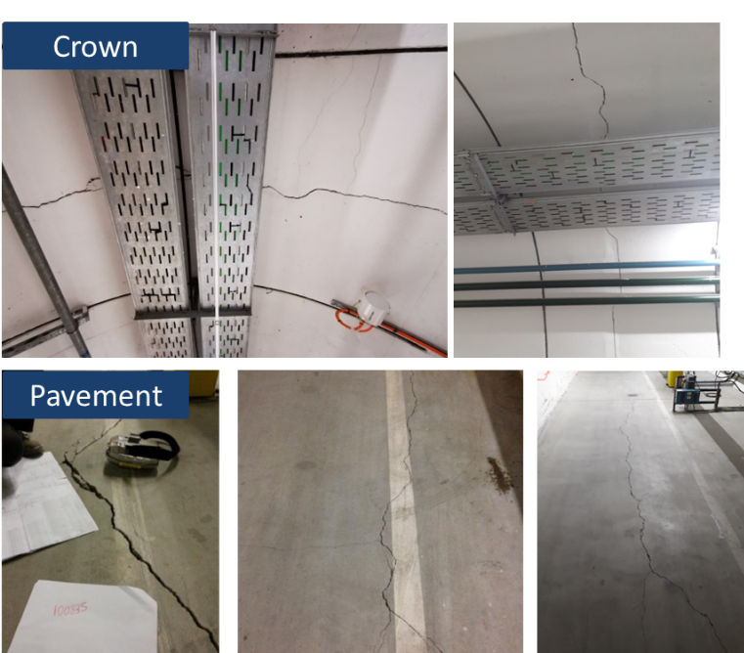
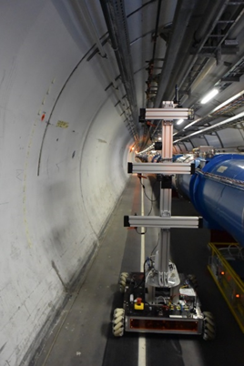
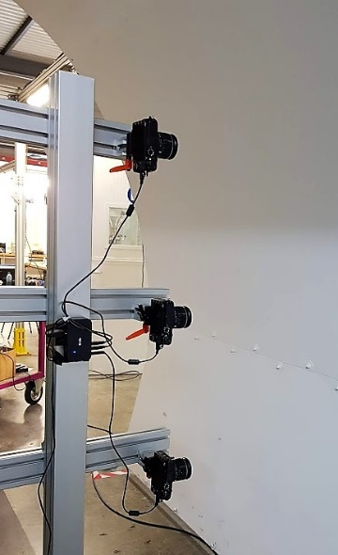
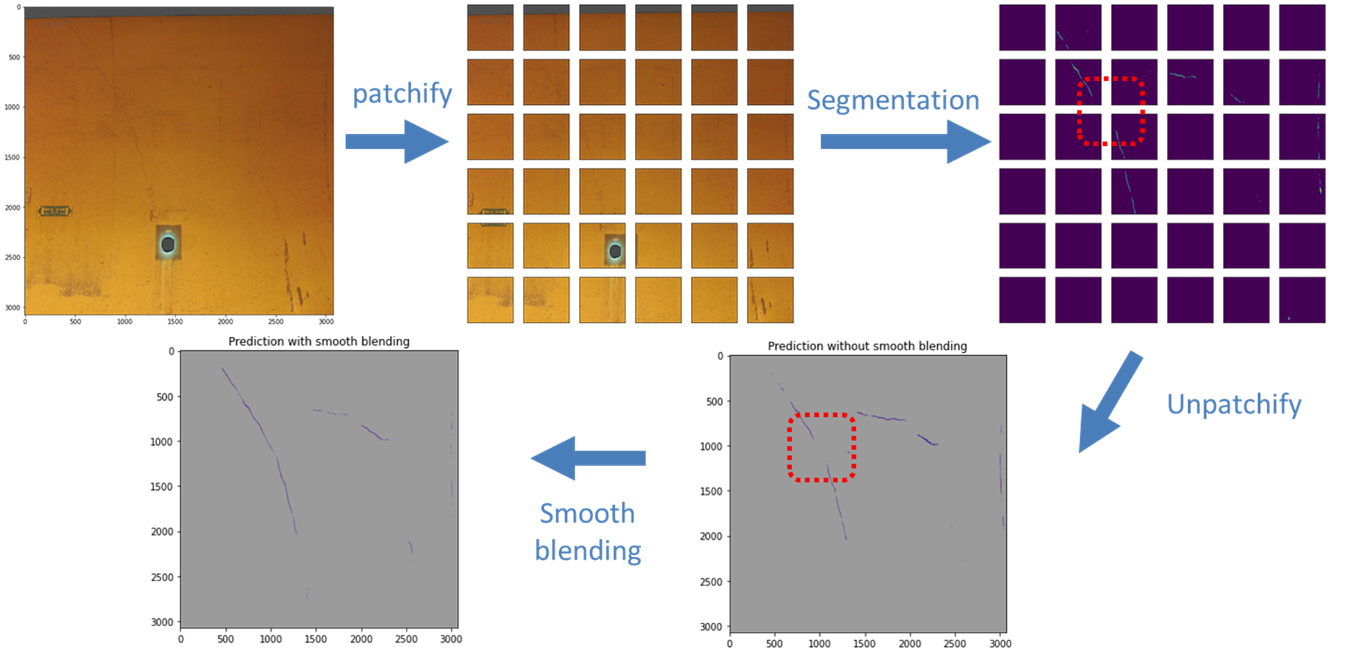
Deep learning-based photogrammetric analysis of ageing underground infrastructure
Methodology
CERN owns 83 km-long underground infrastructure and cracks appear as the dominant ageing defect
Deep learning-based automated crack detection
Observed cracks
CERNBot for data collection
Objectives:
Achieve remote tunnel visual inspection in a radioactive environment
Achieve automated crack detection and quantification
Analyzing crack patterns for understanding long-term structural behavior
Prediction of high-resolution images
Automatic tunnel inspection

Slide 21
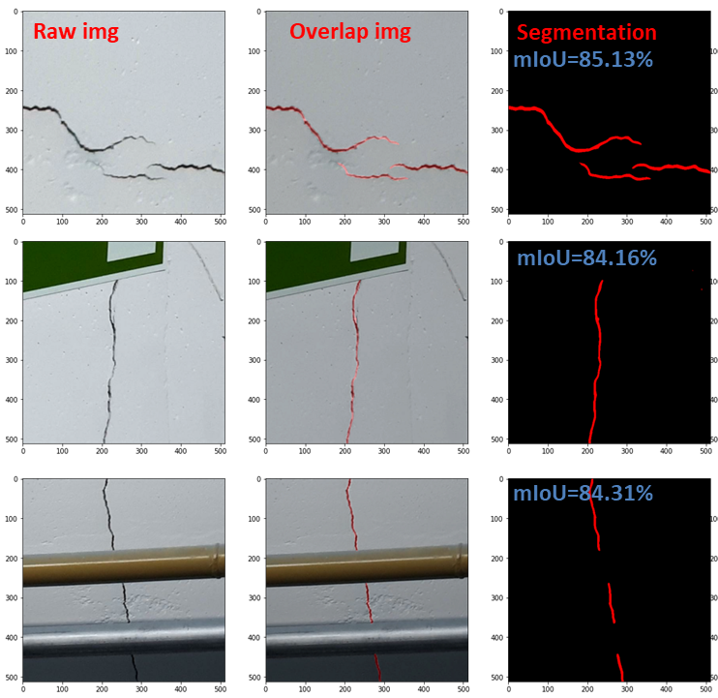
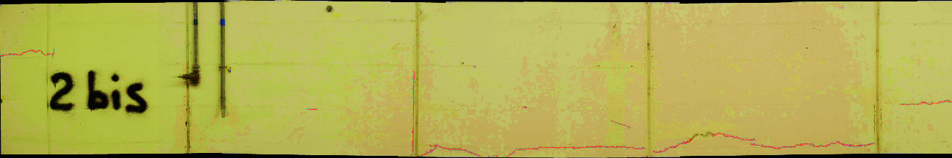
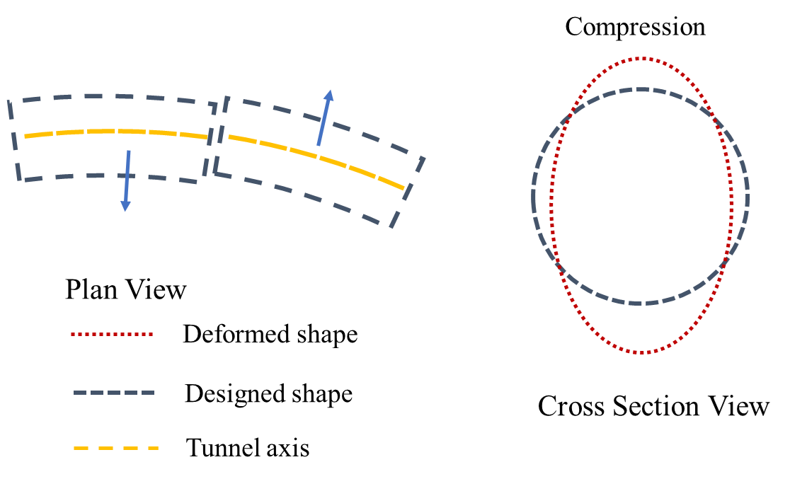
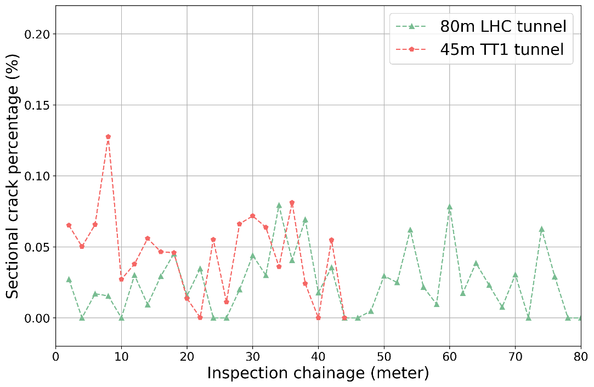
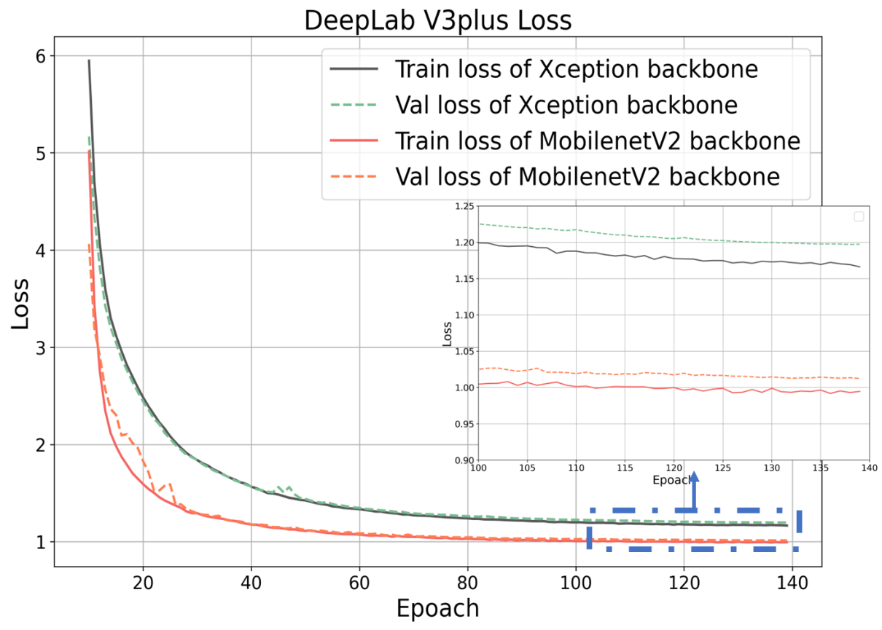
Deep learning-based photogrammetric analysis of ageing underground infrastructure
Model performance
Identified crack spatial patterns
Deformation mechanisms of LHC and TT1 Tunnel
Crack distribution

Slide 22




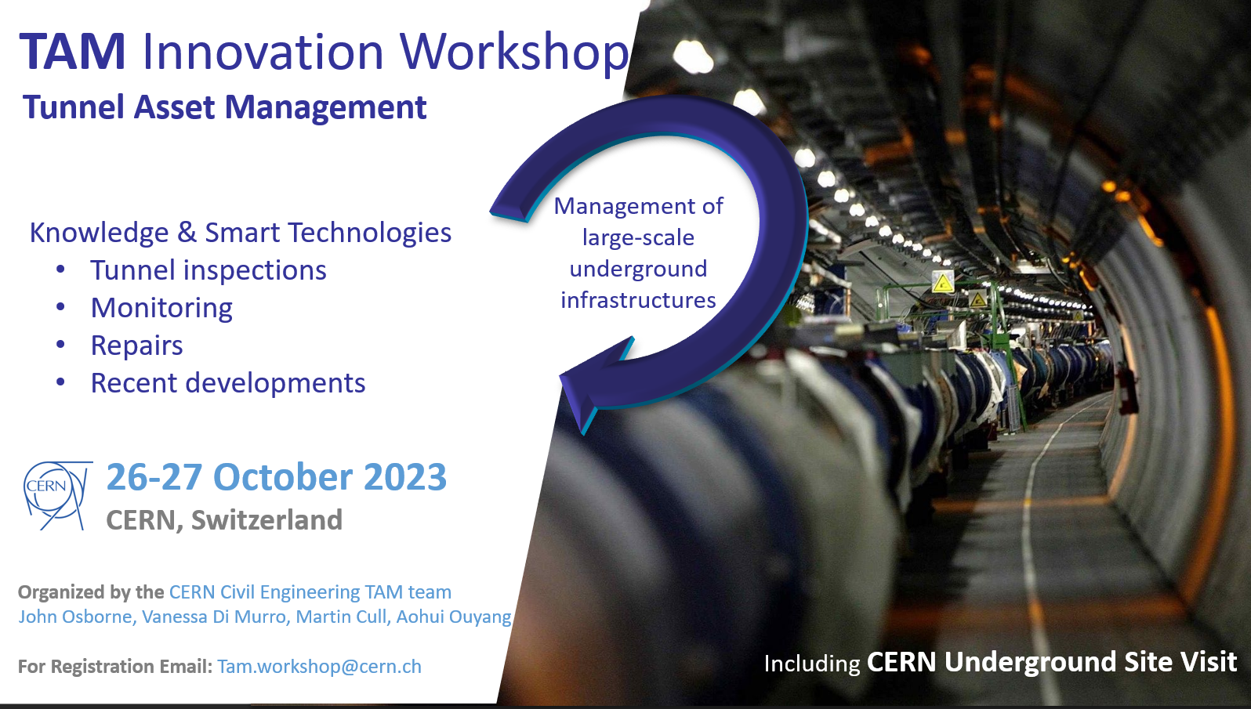
Future TAM Events
4th International Symposium of Machine learning and Big Data in Geoscience ISMLG2023
29th August - 1st September 2023 at University College Cork
Tunnel Asset Management Workshop on the 26-27th October 2023 at CERN

Slide 23
Thank you!

