Slide 1
AD electron cooler
New High Voltage Platform
A. Frassier
SY-BI-XEI
07 Feb 2023
01

Slide 2
Outline
Brief Reminder : High Voltage for E-Cooler
AD EC (Electron Cooler) existing HV facility
New HV installation
Conclusion
A.Frassier – new AD EC HV platform
02

Slide 3
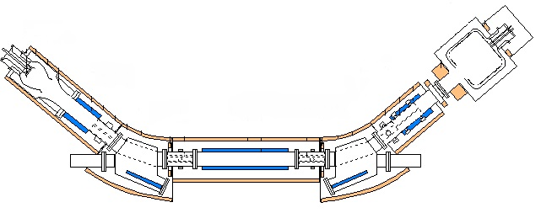
High Voltage for Electron Cooler
Collector supply
e- Intensity
e-
e-
Collector
e-Gun
e-
e-
Cathode supply
e- Energy
Pbar
Pbar
Drift
Toroid
Toroid
A.Frassier – new AD EC HV platform
03

Slide 4
HV Ecooler Power supplies functionnality
Cathode supply give eBeam energy (eV)
Collector supply give eBeam intensity (A)
Grid supply (or switch) modulate the intensity I=u.(Vk-Vg) p(3/2) (u=perveance)
Repeller supply repels secondary electron ( generated by the interaction between the eBeam and the surface of the collector)
Clearance electrode supplies to dump ionized particles (generated by the interaction between the eBeam and the residual vacuum gas)
A.Frassier – new AD EC HV platform
04

Slide 5
HV Platform
Most of HV supplies are referenced at the cathode voltage.
Advantage to be “referenced” at the cathode voltage :
  Standard HV power supplies
  I_loss protection
Need to use insulating transformer and High Voltage (Faraday) cage .
Also need ROSS relay, divider and safety interlocks …
A.Frassier – new AD EC HV platform
05

Slide 6
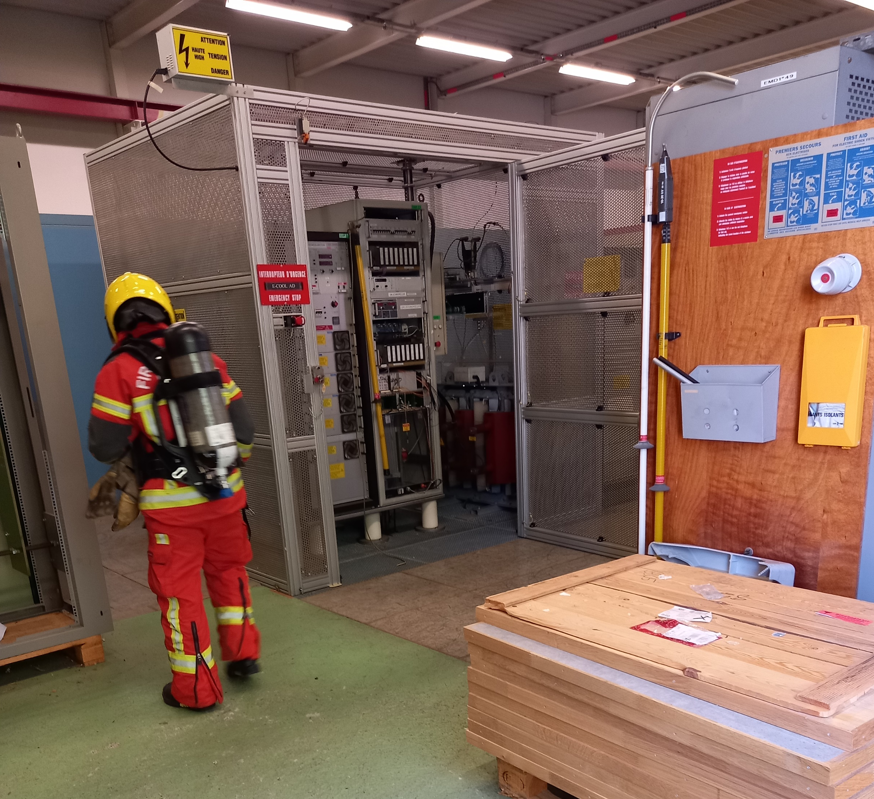
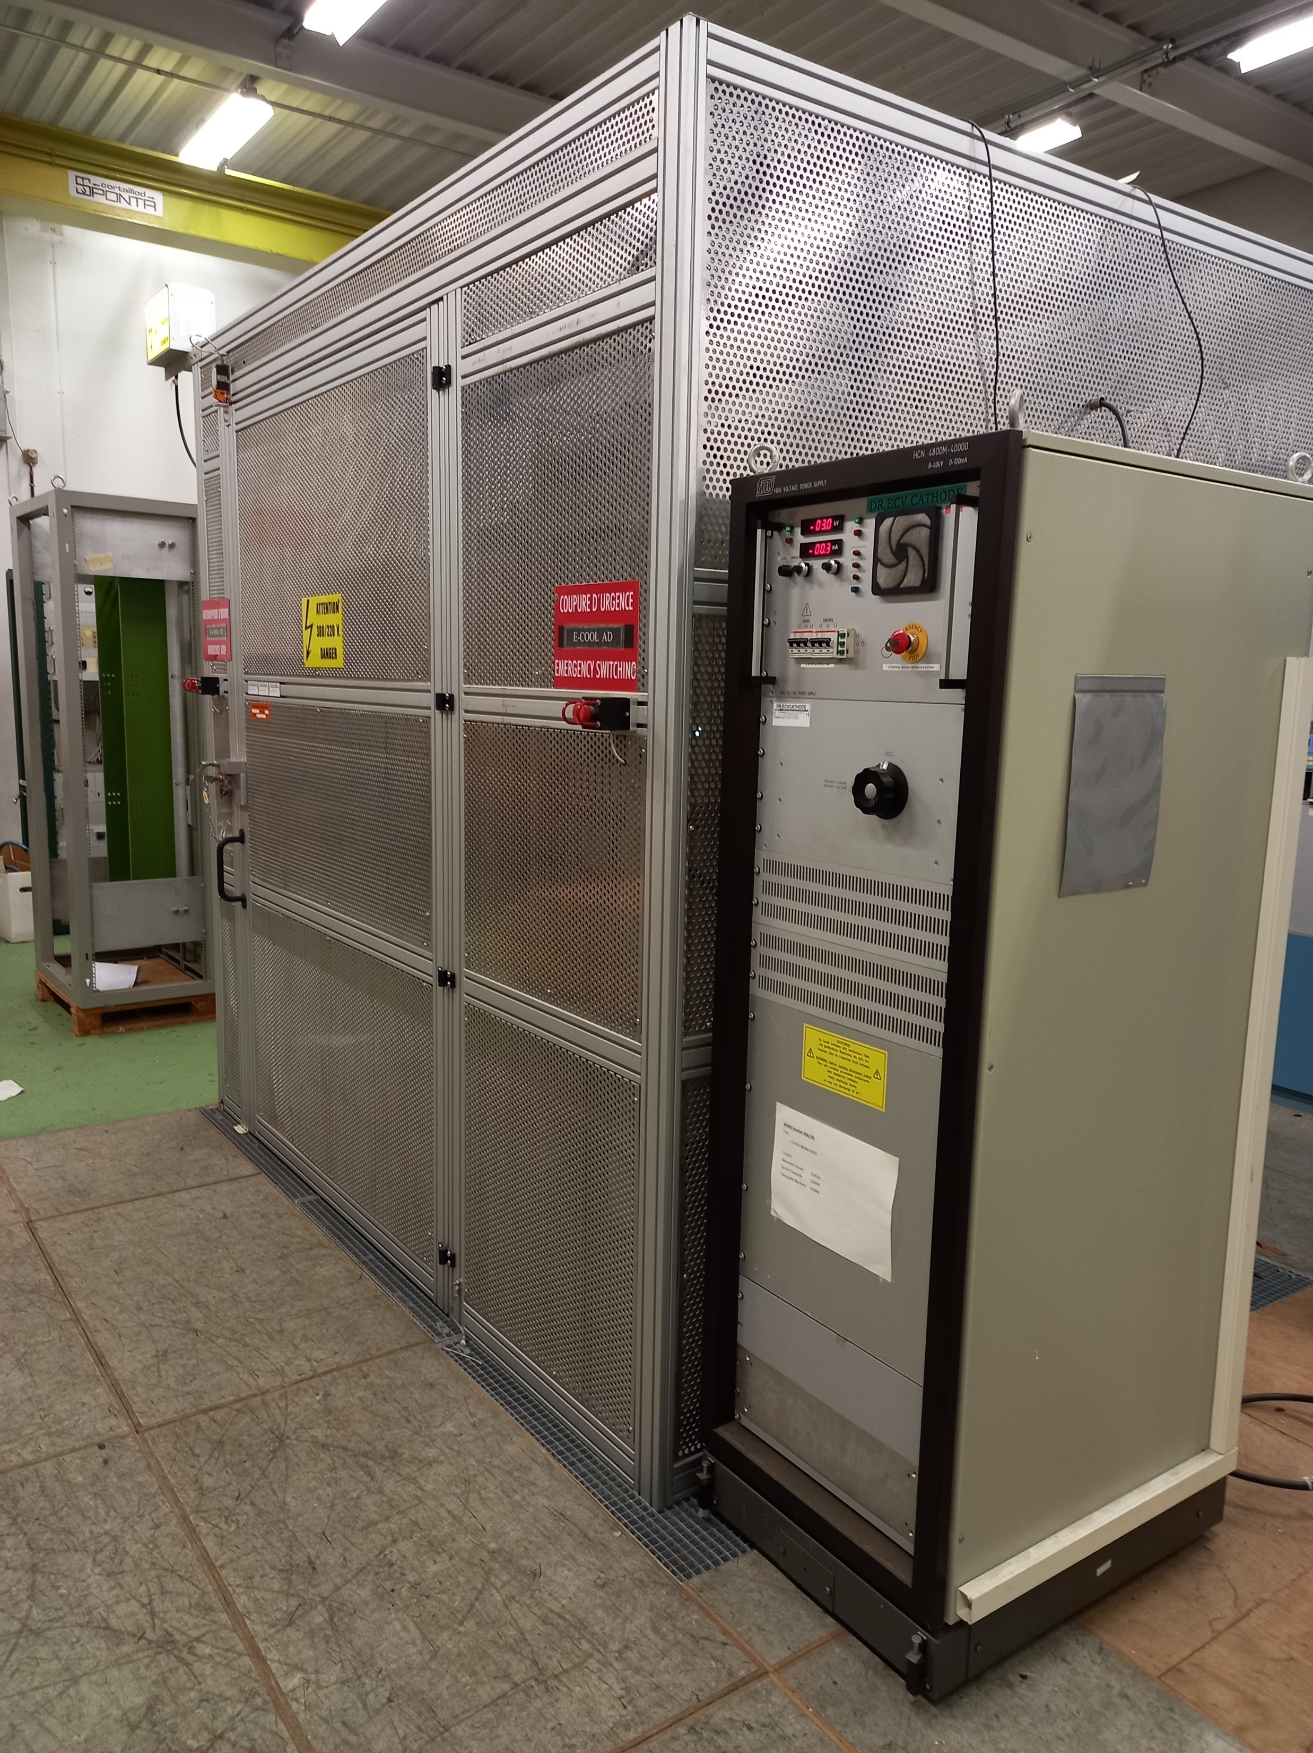
AD EC HV Existing facility
HV CAGE
HV CAGE + Cathode supply
A.Frassier – new AD EC HV platform
06

Slide 7
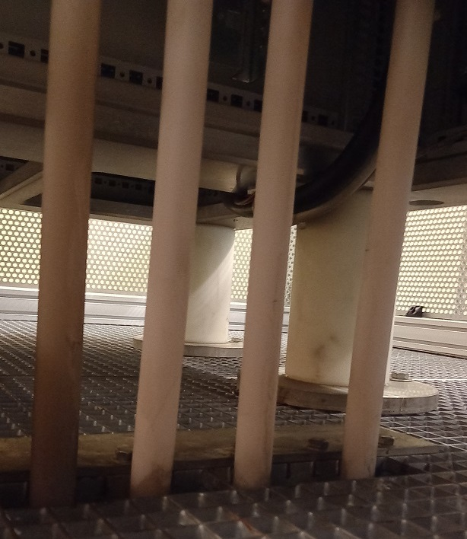
AD EC HV Existing facility : Operation & improvements
Operation of a HV facility or AD E-Cooler in general can be tricky due to a mix of high intensity beam, ultra vacuum, magnetic field and high voltage
In the last few years there have been failure with important consequences such as fire or vacuum leak
There are obvious improvements like a better protection of the high voltage elements
Almost all equipment start to be aging
Others improvement as better diagnostic tools will be a good help
Dust deposit
A.Frassier – new AD EC HV platform
07

Slide 8
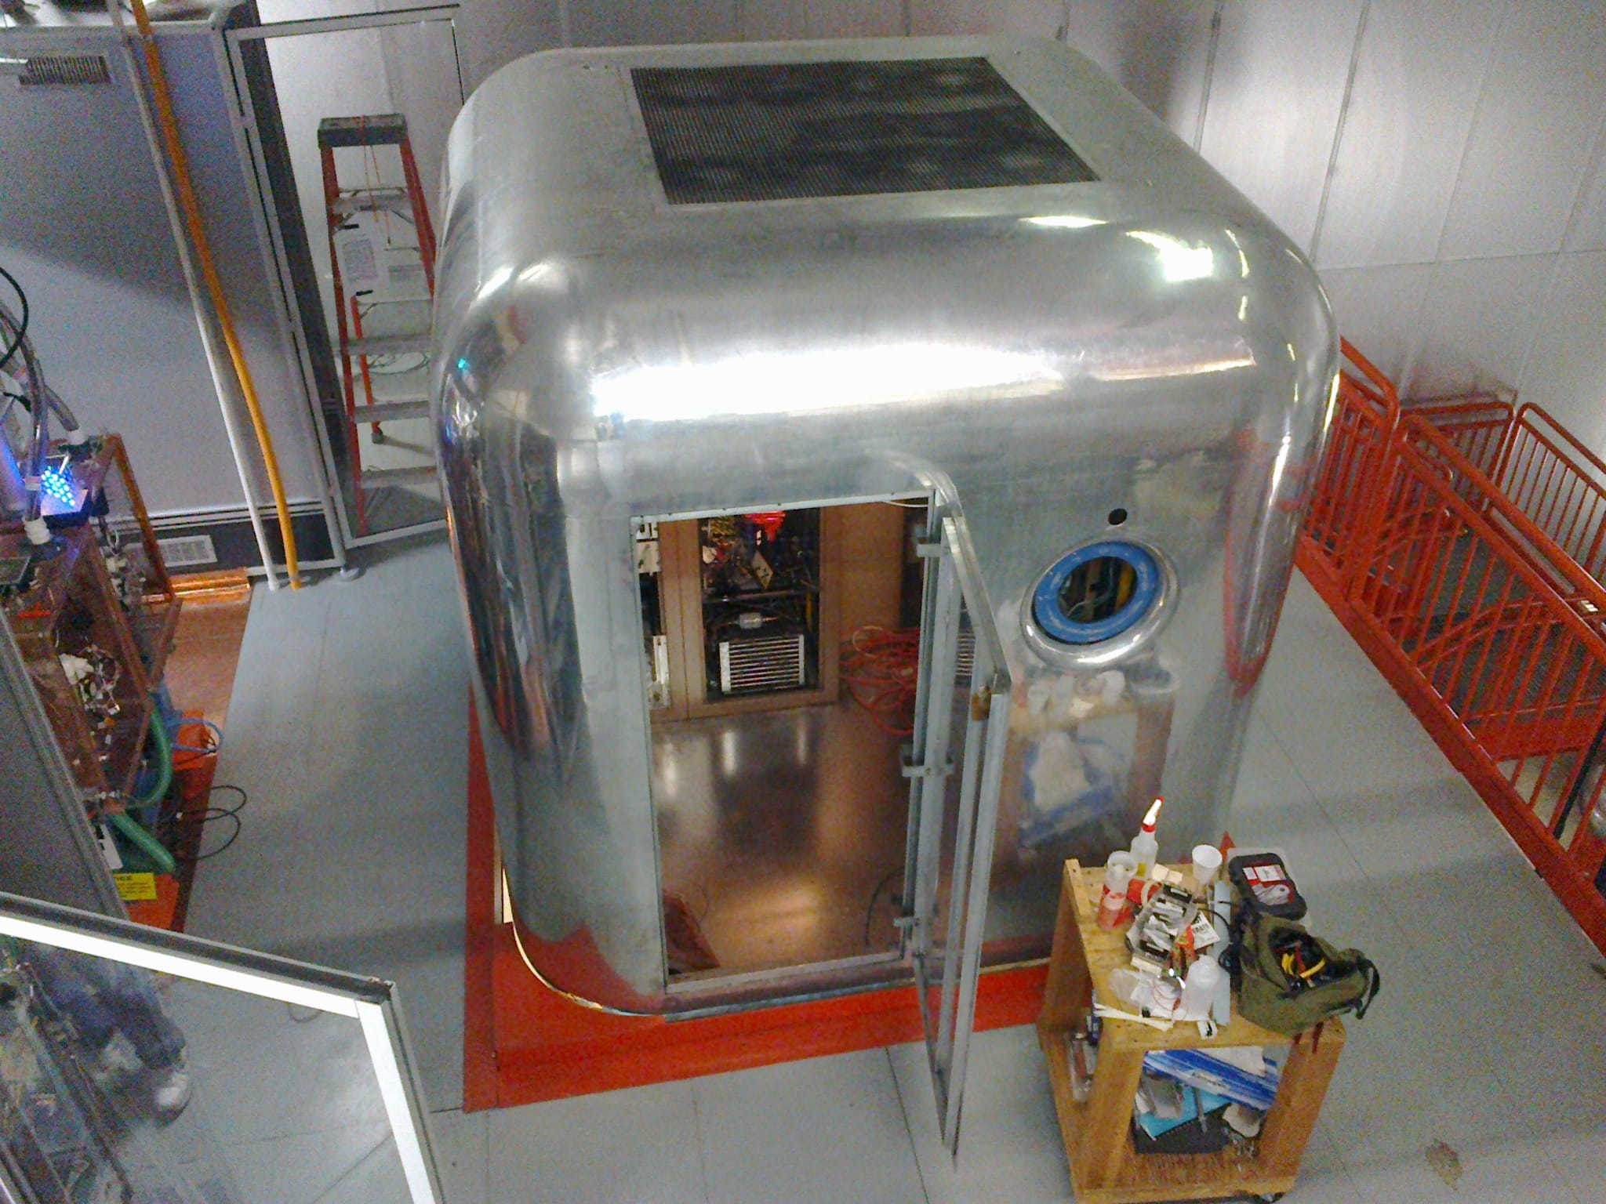
New HV Installation
New AD EC HV installation will be a mix between equipment tested at the 236 test-stand and precaution to take from the feedback of E-Cooler in operation.
A completely closed HV Faraday cage with filtered and pulsed air
Cage as closed as possible of the E-Cooler
  Electrical integrity (capacitance )
  Reduce drastically cost cabling (short cable) and supply powering
Integration of E-Beam switching (push-pull), modulator & rf amplifier for the e-beam position (BPM) and additional diagnostic tools ( DVM, CT ..)
A.Frassier – new AD EC HV platform
08

Slide 9
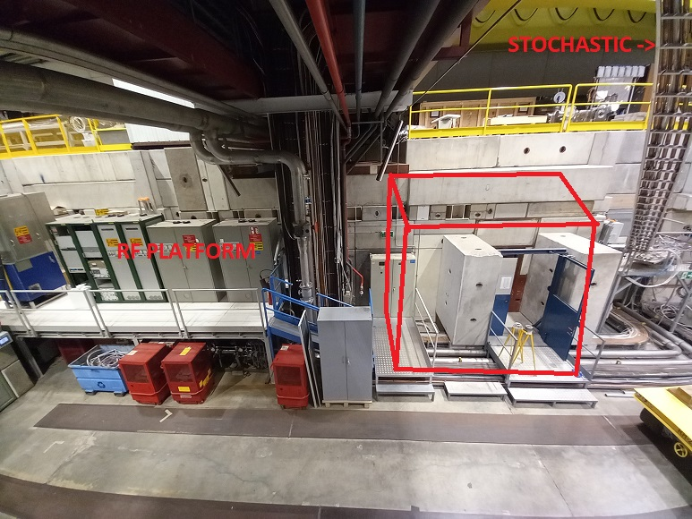
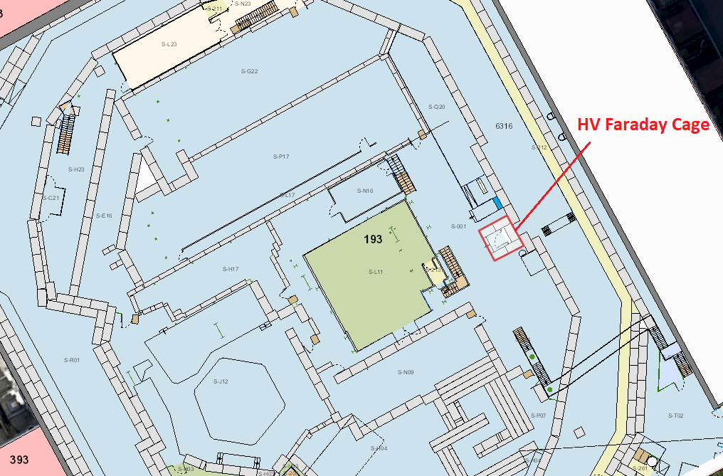
HV installation : Location
AD HALL overview
new location
A.Frassier – new AD EC HV platform
09

Slide 10
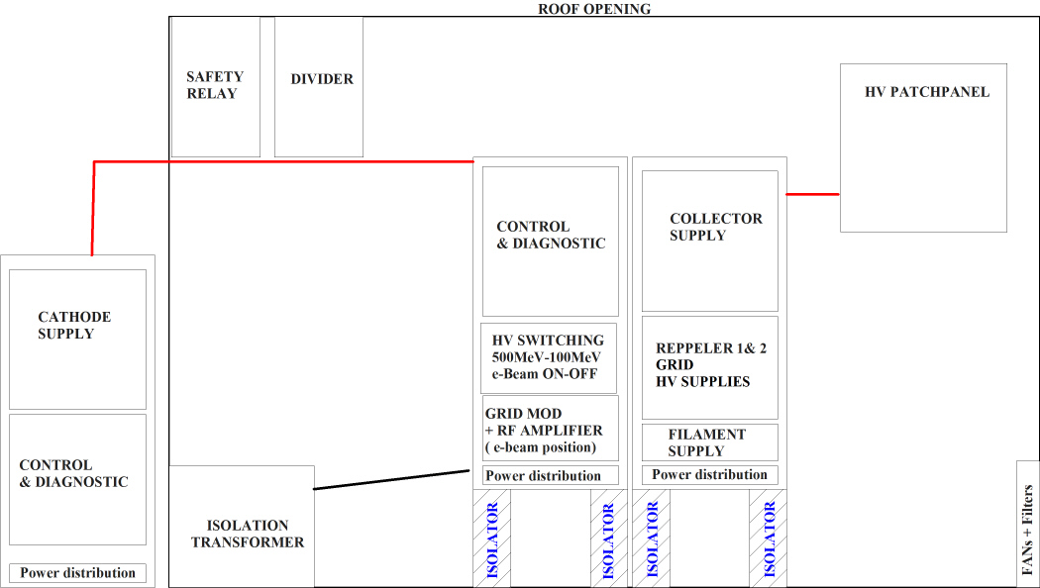
HV installation : HV cage
A.Frassier – new AD EC HV platform
10

Slide 11
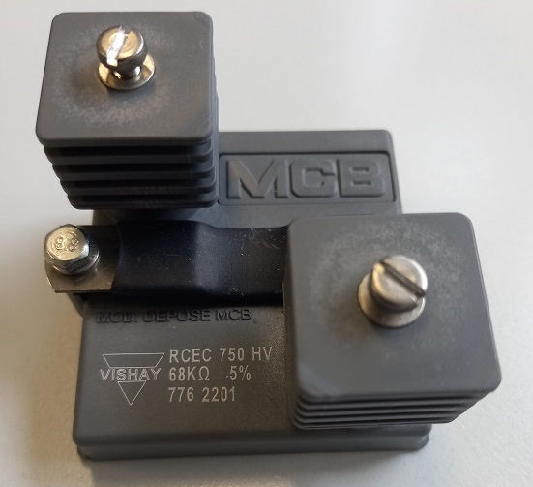
HV Installation: Planning
Last year :
  ECR : removal of the electrical cupboard (https://edms.cern.ch/document/2722644/0.1 )
This year :
  ECR : removal of the electrical cupboard (https://edms.cern.ch/document/2722644/0.1 )
  ECR : Installation of the new cage
YETS 2023/2024 :
  Removal of the electrical cupboard by EN/EL
2024 :
  HV cage installation
2025 :
  HV test in situ ( Dummy load )
YETS 2025/2026 :
  connection to AD E-Cooler (27keV)
2026 :
  E-Cooler (27keV) run with the new HV cage
  Dismount old HV cage for magnetic supplies ?
LS3 :
  Commissionning with the new E-Cooler (27keV or 68keV)
A.Frassier – new AD EC HV platform
11

Slide 12
Conclusion
The new HV installation for AD E-Cooler can be seen as a necessary renovation of current HV facility as well as the new HV facility for a new AD E-Cooler at higher energy
New cage on a new location allows us to carry out a smooth renovation of the HV platform
Not a big challenge to make a “bigger” cage for supporting higher voltage, it is just a bigger cage.
HV platform as close as possible of the ecooler is an improvement
Could have a strong impact on reliability and performance of the ad ecooler
Close collaboration with others services especially with SY-EPC
As soon as we have the green light for the location spotted in AD HALL with removal of the electrical cupboard we can start the ECR for the implementation of the cage
A.Frassier – new AD EC HV platform
12

Slide 13
EC @ 68keV : Main HV & power components
Circuit | HV max (kV) | Power (kW)
Transformer | -80 | 30 | Isolating 3P- 400VAC
Cathode | -70 | 1 | E-Beam energy
Collector | +5 | 20 | E-Beam intensity
Grid ON | +17 | 0.2 | E-gun beam ON
Grid OFF | -10 | 0.1 | E-gun beam OFF
Decelerator | +0.8 | 0.01 | Slow down e- to col
Reppeler | +5 | 0.05 | Return e- from col
Filament | 0.013 | 0.2 | Heating cathode
Push-pull BEHLKE | +30 | NA | E-Beam switching
Collector cooling | -80 | 20 | De ionizing water
Divider | -80 | NA | HV divider
Safety Relay | -80 | NA | ROSS
Can be decrease ?
A.Frassier – new AD EC HV platform

