Slide 1
Working Group on Medical Applications
M. Vretenar
23rd Meeting of the TIARA Collaboration Council, 23.02.2023

Slide 2
Motivation
Increasing interest in Medical Applications of Accelerators: NIMMS initiative at CERN, FLASH with electrons and VHEE, radioisotope production schemes (theragnostics, Tc, etc.), robust radiotherapy, BNCT, etc.
Momentum on ion therapy generated by the HITRIplus project: gathered a community of physicians and scientists around new ion therapy treatments, but will likely not continue beyond 2025.
Interest for collaboration & coordination of new ion therapy initiatives: ITRF (UK, multiple ions), SEEIIST (international, carbon), Advanced Particle Therapy Center for the Baltic States (international, helium), interest in Greece (Macedonia region).

Slide 3
Perimeter
Proton therapy is industrial (IBA, Hitachi)
FLASH electrons is being developed in collaboration with industry (CERN/CHUV/THERYQ and Curie/Thales).
Radioisotope production and BNCT involve small mature systems partially or totally industrialised.
The TIARA Working Group should (for the moment) only support ion therapy initiatives.

Slide 4
Mandate (tentative)
Disseminate information on ongoing initiatives for ion therapy, including outreach events and material.
Favour synergies and exchange of information and personnel between the initiatives.
Provide expert advice on specific topics related to ion therapy accelerators.
Explore and if required coordinate the preparation of proposals for ion therapy acceleration to the EC calls.
Explore ways to industrialise ion therapy technologies.

Slide 5
Composition
Coordinator
1 representative for each ion therapy centre (HIT, CNAO, MedAustron).
1 representative for each new initiative (total of 4).
1 medical doctor or expert in radiation therapy.
1 or 2 experts nominated by TIARA
Medical associations

Slide 6
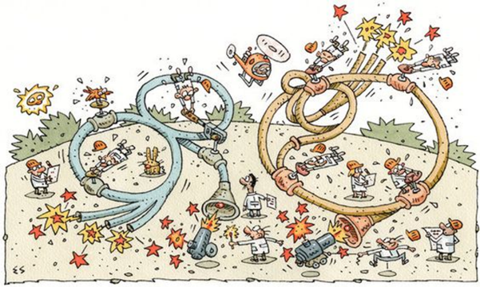
Thank you for your attention!
Image credit: Elwood H. Smith, The New York Times

