Slide 1

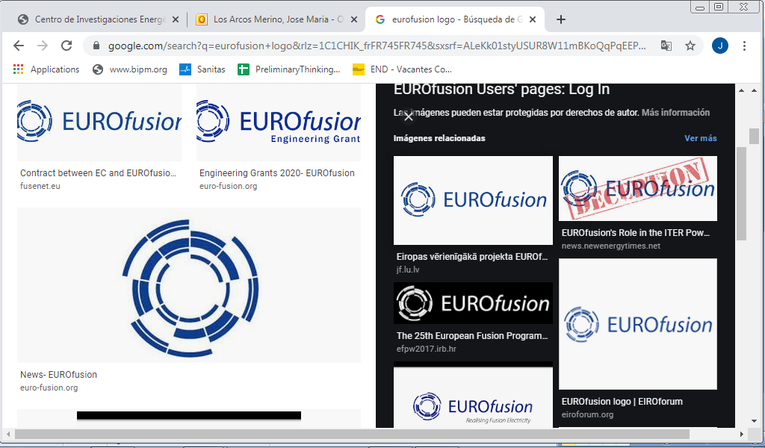
















Status of DONES Project
TIARA Collaboration Council Mtg
CERN, February 21th 2023
A. Ibarra (IFMIF-DONES España & CIEMAT)

Slide 2
Outline
What is DONES? Why?
Design status
Implementation
Summary

Slide 3
Outline
What is DONES? Why?
Design status
Implementation
Summary

Slide 4
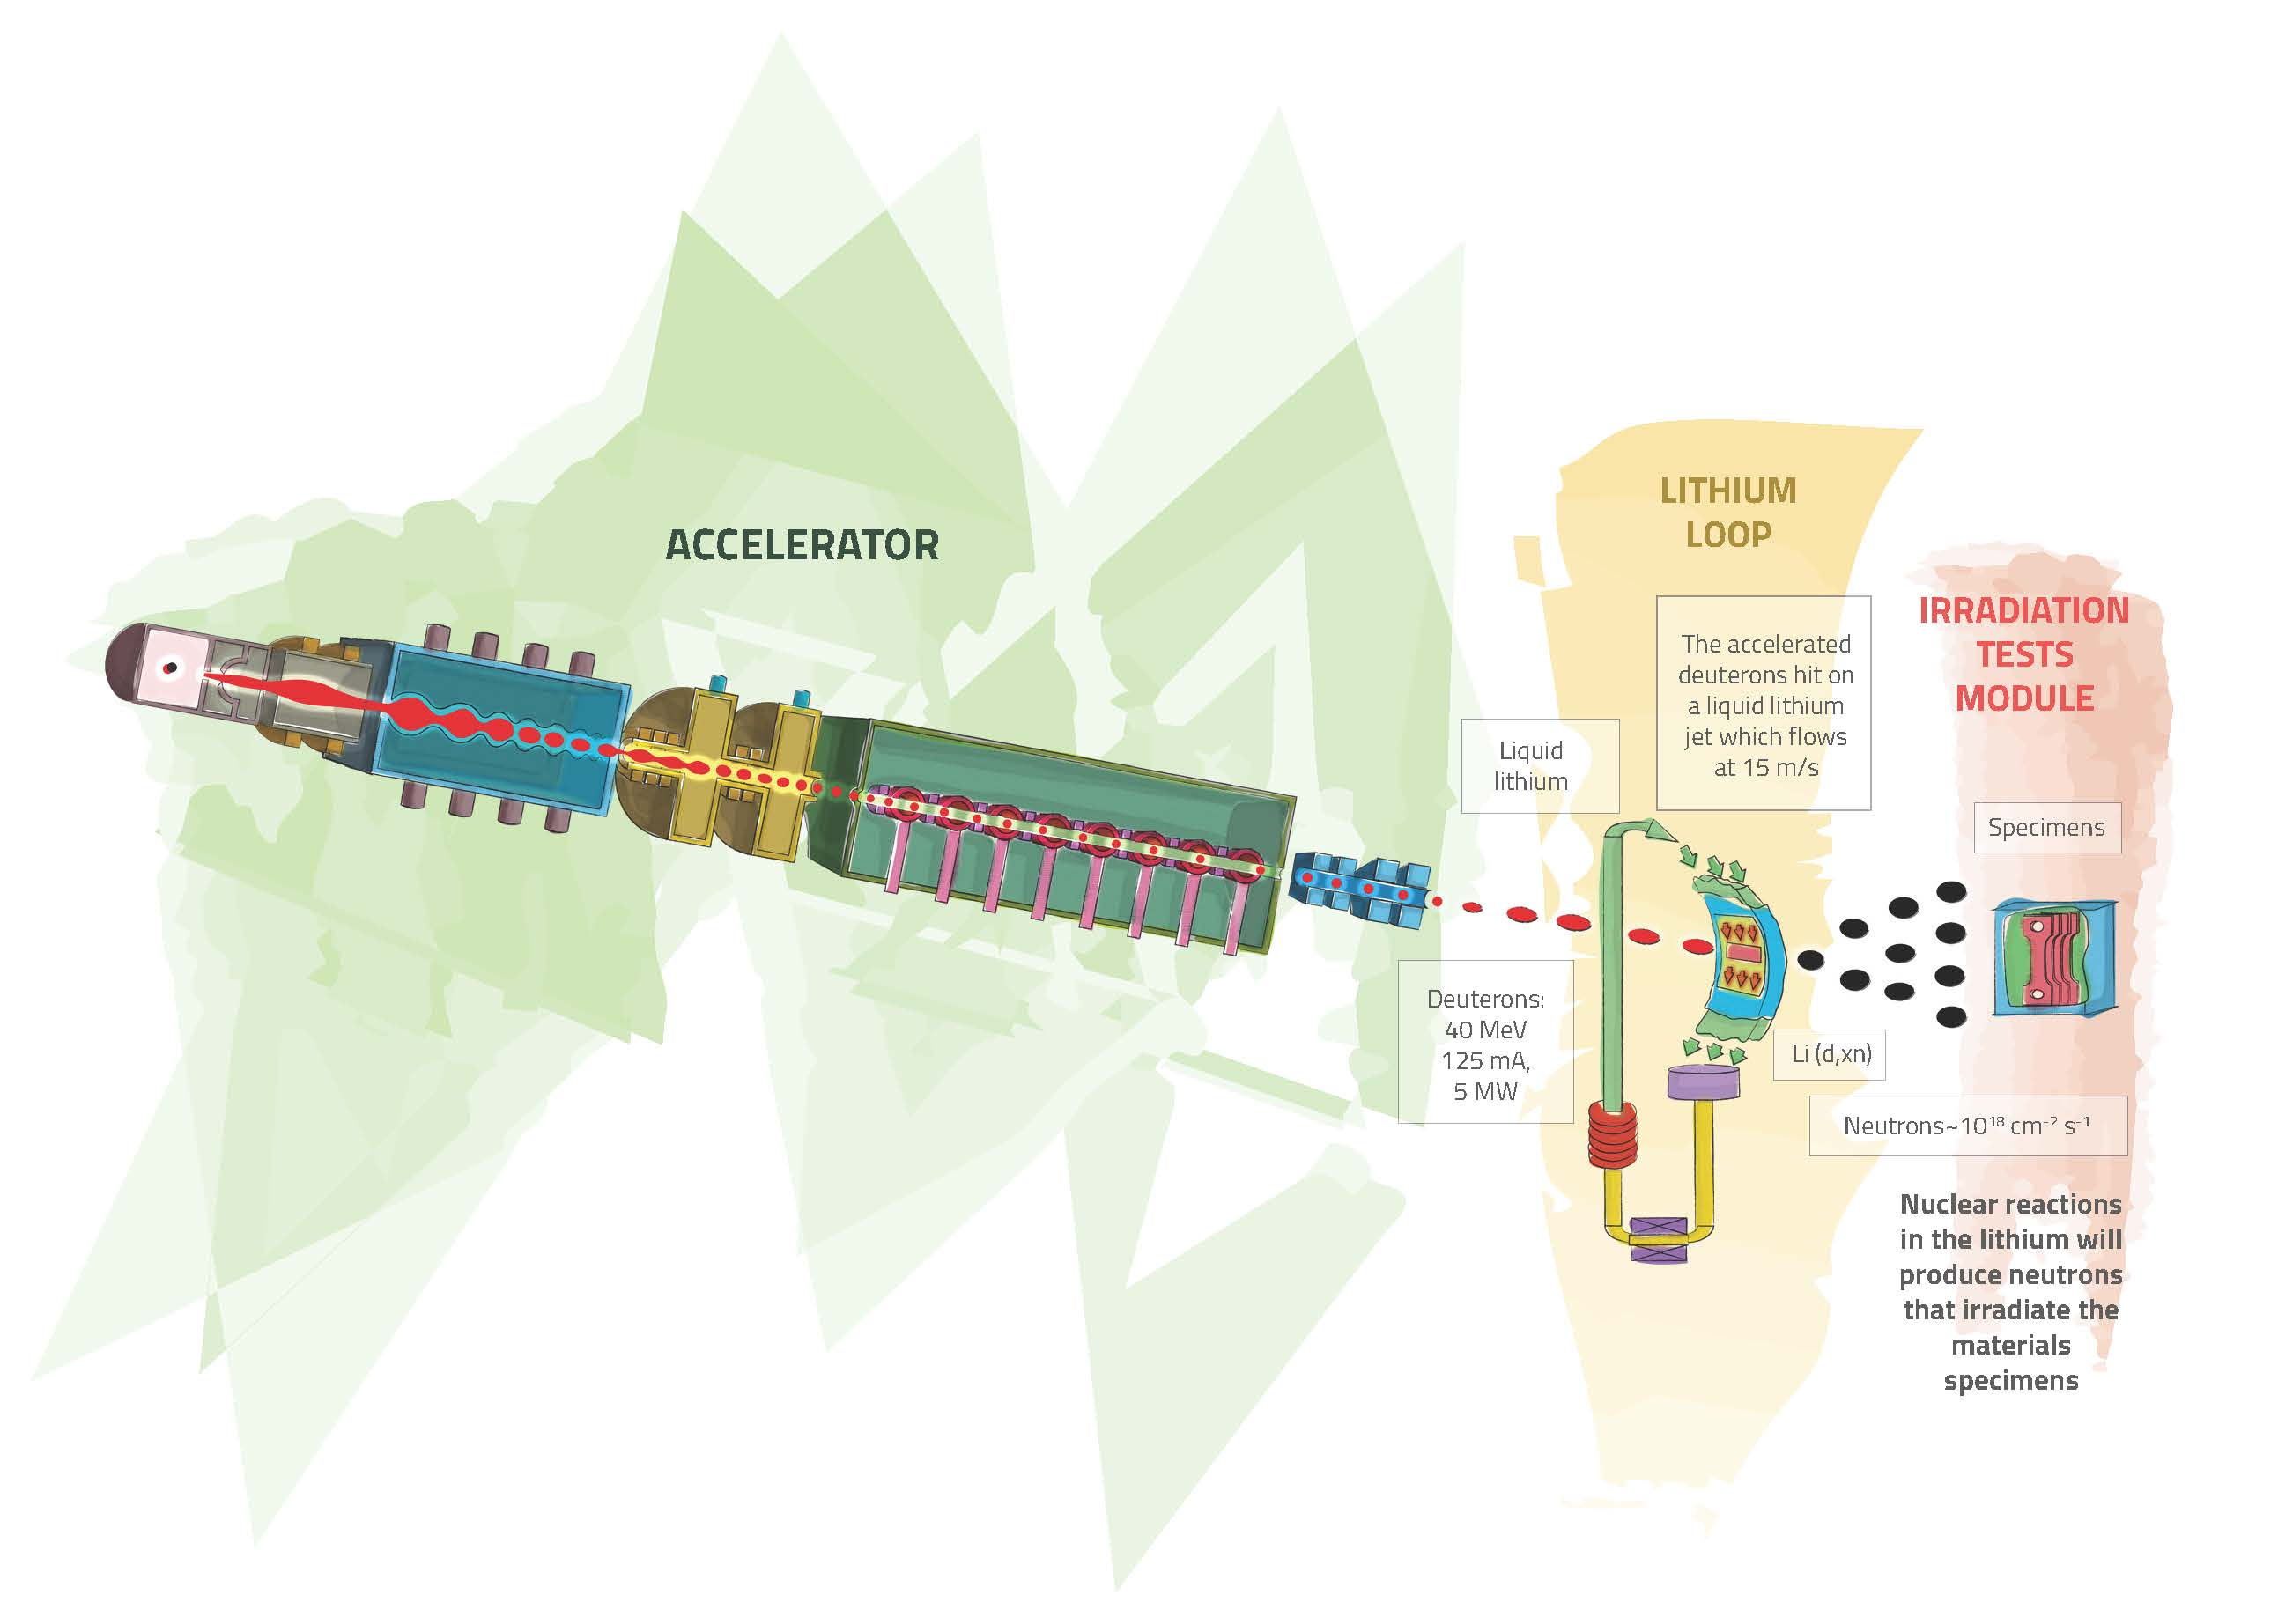
What is IFMIF-DONES?
An accelerator based fusion-like neutron source to be used for
the qualification of the materials to be used in the DEMO Reactor
A neutron flux of ~ 10¹⁵ n/cm²/s is generated with a neutron spectrum up to 55 MeV energy
High Flux Test Module:
20 dpa/fpy in 100 cm³ of material
Controlled Temperature:
250 < T < 550 ºC
Stripping reaction
15
Heat removal by high velocity Li flux
Identified as high priority in the EU Fusion Roadmap
Included in the ESFRI Roadmap as a EU strategic facility
A. Ibarra| Status of DONES| TIARA Council| February 21th 2023| Page 4

Slide 5
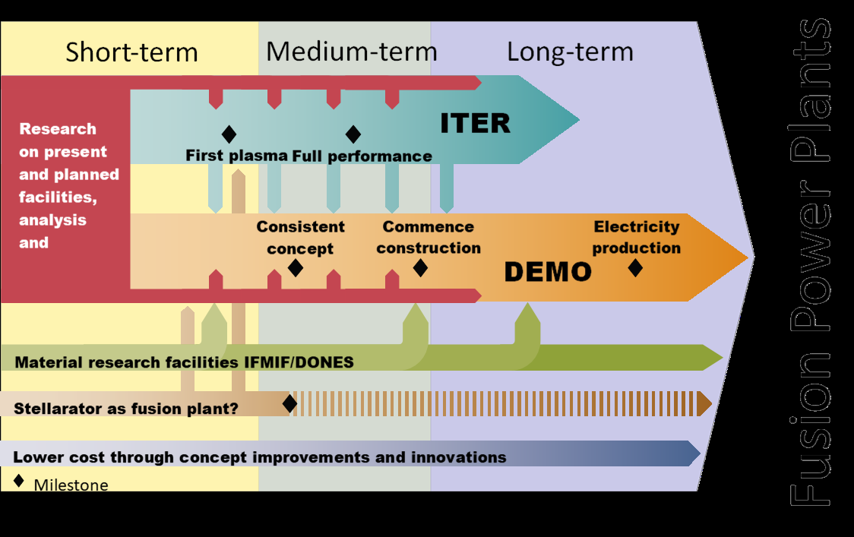
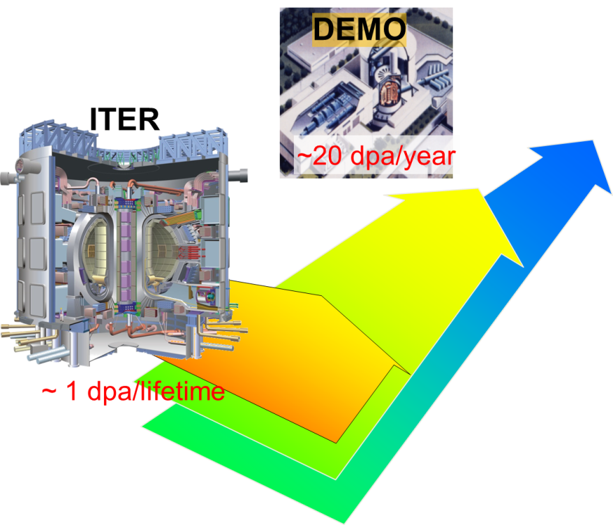
Why DONES?
One of the main differences between ITER and DEMO is the radiation dose: at DEMO more that two orders of magnitude higher
EU Fusion Roadmap
A. Ibarra| Status of DONES| TIARA Council| February 21th 2023| Page 5

Slide 6
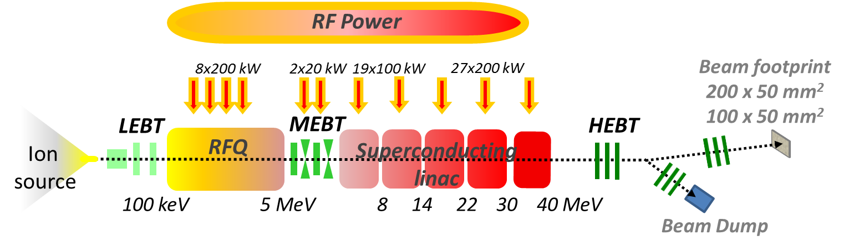
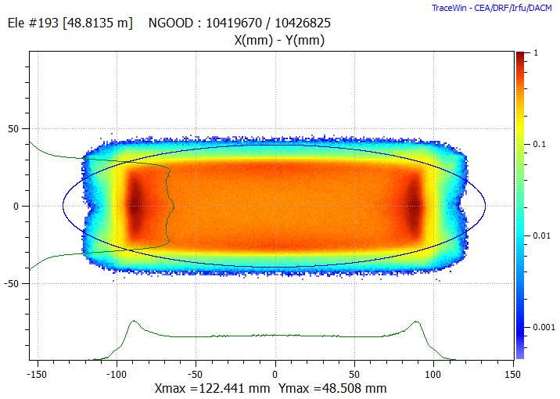
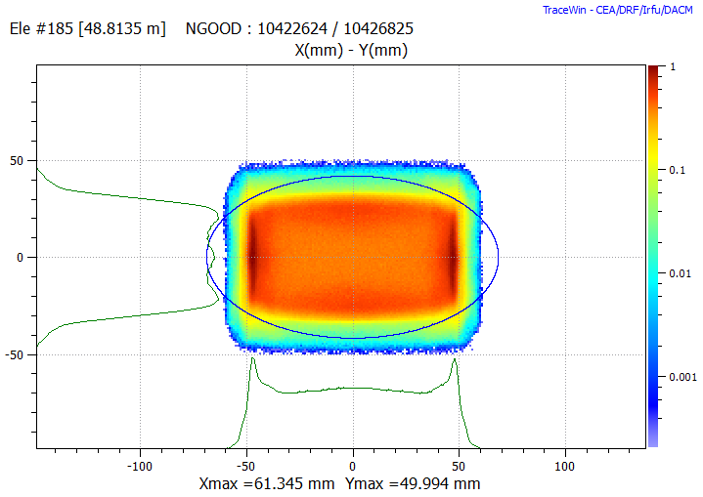
IFMIF-DONES: Accelerator
175 MHz Solid State RF source
Beam footprint @ target
Auxiliaries
Vacuum, Cryogenics, Water cooling, Gas and electric distribution…
20x5 cm² footprint
(reference)
10x5 cm² footprint
(optional)
D+ CW 175 MHz SC LINAC
125 mA / 40 MeV → 5 MW
Total length of ~100 m
Windowless liquid Li target
Hands-on maintenance (<1 W/m)
RH @ several components
Safety system with nuclear credit
Staged comissioning in five years (Injector CW / RFQ @10-20%
/SRF LINAC @ 1% / HEBT@ Target)
CW operation with 87% availability
A. Ibarra| Status of DONES| TIARA Council| February 21th 2023| Page 6

Slide 7
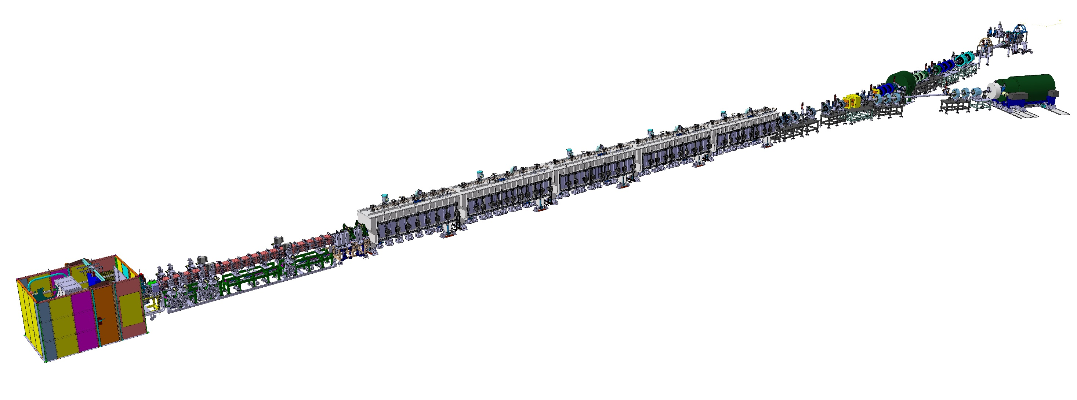
IFMIF-DONES: Accelerator Systems Layout
MEBT
Operating frequency | 175 MHz
Input energy / Output energy | 2.5 / 2.5 MeV/u
Particle type | D⁺,H⁺
Nominal beam peak current | 125 mA
Nominal duty cycle | 100 %
Beam dynamics length | 235 cm
Re-buncher cavities E₀LT | 350 kV
Coupler maximum transmitted power | 15 kW
Quadrupole magnetic field gradient | 25 T/m
Steerers strength (horizontal and vertical) | 25 G·m
Crucial validation results from LIPAc which is currently under commissioning at Rokkasho as part of IFMIF/EVEDA activities
INJECTOR
Ion type | D+
Output Beam current | 140 mA
Output Beam energy | 100 keV
Species fraction D+ | 99%
Beam current noise | 1% rms
Duty factor | 100%
Beam turn-off time | <10 µs
HEBT
Requirement | Target value
Beam energy | 40 MeV
Beam emittance | 0.3π·mm·mrad
Nominal beam peak current | 125 mA
Nominal duty cycle | Up to 100%
Achromatic bending | 9°
Beam footprint at Li Target | Tuneable:10x5 to 20x5 cm
(BDTL) Dipole | 30°
BD average power (DC<1%) | < 50 kW
SRF LINAC
 |  | CM#1 / #2 | CM#3 / #4 / #5
Cavity | βoptimal | 0.115 | 0.175
 | Quantity | 8 / 11 | 9 / 9 / 9
 | Nominal Accelerating Field (Eacc_nom) | 4.5 MV/m | 4.5 MV/m
 | Q0 @ Eacc_nom | 5x10⁸ | 10⁹
 | Beam Aperture | 40 mm | 50 mm
 | Maximum power dissipation @ Eacc_nom | 7 W | 7.4 W
 | Frequency at cold during vertical test (cavity untuned, no power coupler) | 175.016 - 175.060 MHz | 175.016 - 175.060 MHz
 | Tuning Range | - 50 kHz | - 50 kHz
 | Loaded cavity bandwidth | 2.7 kHz | -
 | Working Temperature | 4.45 K | 4.45 K
Power Coupler | Transmitted Power | 100 kW CW | 200 kW CW
 | Qext | 6.3x104 | -
Solenoid | Magnetic field Bz on axis | 6 T | 6 T
 | Sterrers Field | 3.5 mT.m | 3.5 mT.m
 | Quantity | 8 / 6 | 5 / 5 / 5
 | Working Temperature | 4.45 K | 4.45 K
RFQ
Requirement | Target value
Input energy | 100 keV
Output energy 5 MeV | 5 MeV
Input D+ current | 130 mA
Output D+ current | 125 mA
RF Frequency | 175 MHz
Max surface field | < 25.2 MV/m
Output rms emittance (norm.) transv. | < 0.30 π mm mrad
Output rms emittance longitudinal | <0.2 MeV deg
Duty factor | 100%
Transverse zero current phase advance RFQ end | < 220 deg/m
Longitudinal zero current phase advance RFQ end | < 90 deg/m

Slide 8
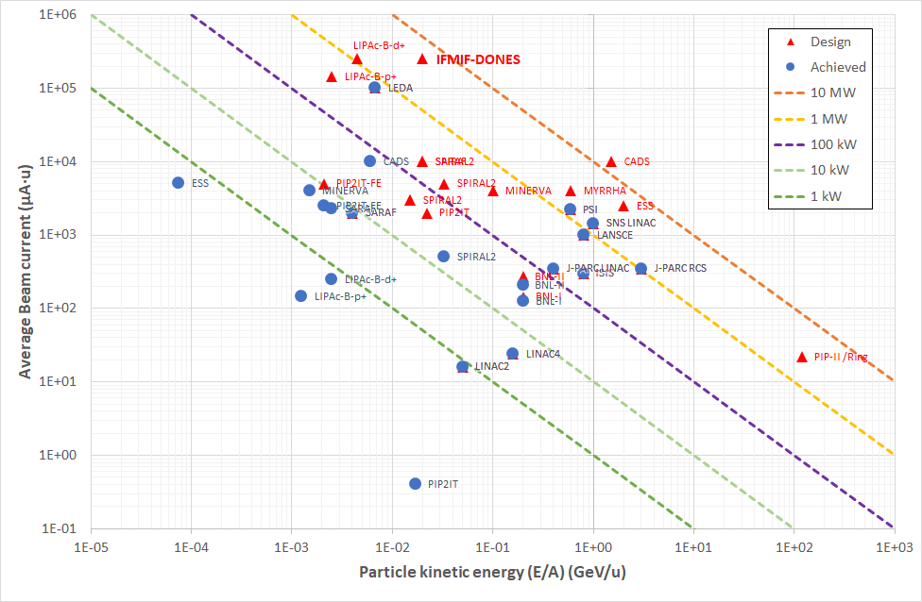
IFMIF-DONES: Accelerator
Very challenging due to the high 125 mA beam current and very high 5 MW beam power in the HEBT and on target but also:
highest current linac D⁺ in CW
top H⁺&D⁺ injector performance
longest RFQ
record of light hadrons current through SC cavities
highest beam perveance
A. Ibarra| Status of DONES| TIARA Council| February 21th 2023| Page 8

Slide 9
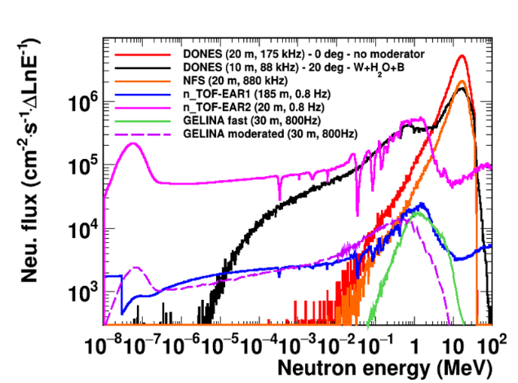
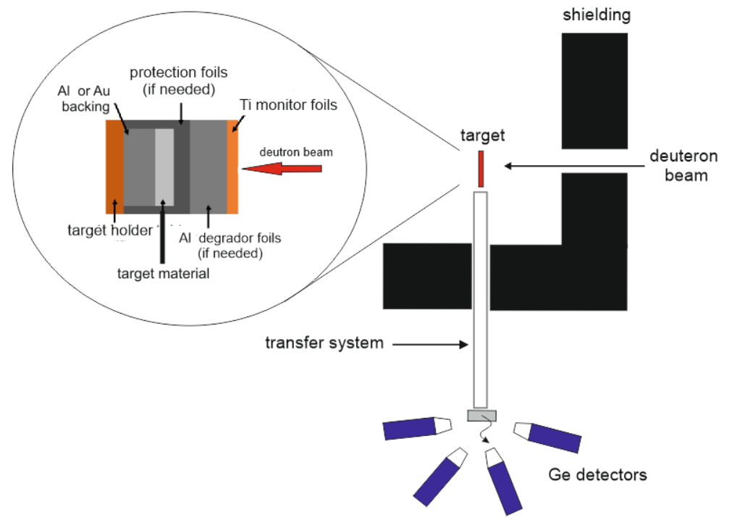
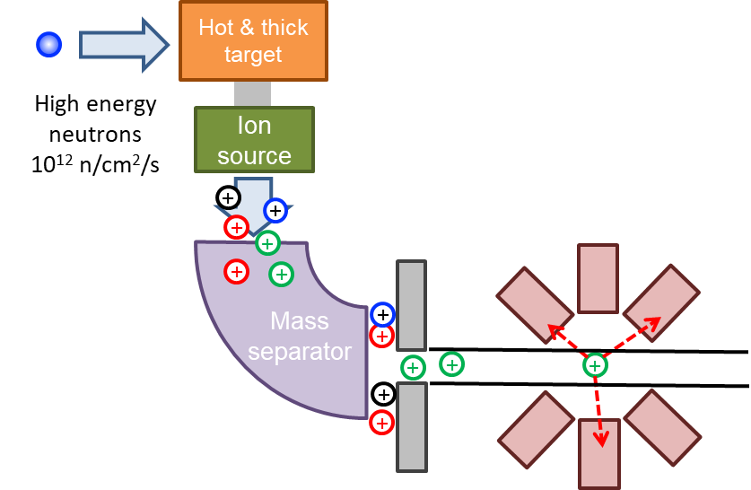
Complementary experiments
It will allow the construction of:
        the most intense deuteron TOF facility for nuclear physics studies
        a first class facility for techniques using fast neutrons
        the production of radioisotopes of medical interest
A. Ibarra| Status of DONES| TIARA Council| February 21th 2023| Page 9

Slide 10
Outline
What is DONES? Why?
Design status
Implementation
Summary

Slide 11
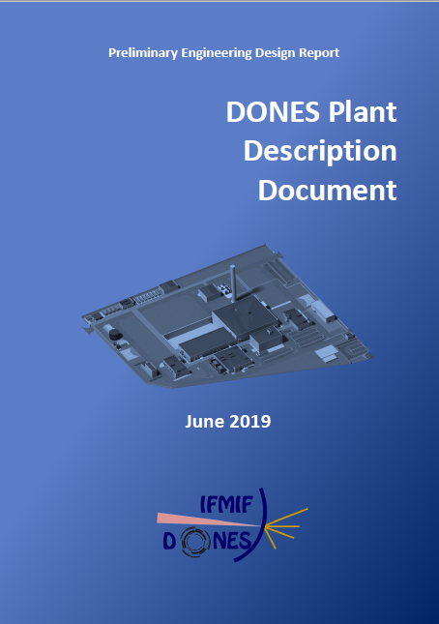
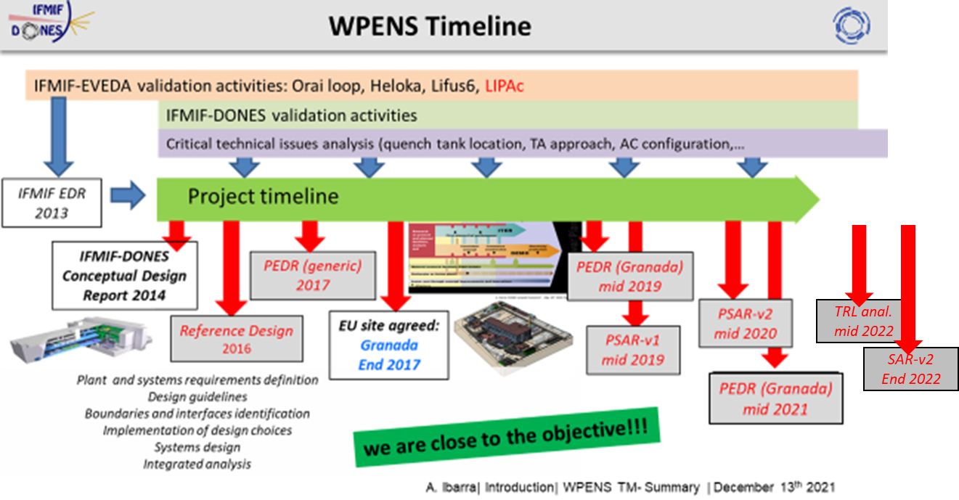
DONES Design Status
Engineering design
  Developed for IFMIF (and a generic site) up to 2013 in the framework IEA and BA (IFMIF/EVEDA)
  Developed for IFMIF-DONES from 2015 in the framework of the ENS WP of EUROfusion (+ FWC)
Site specific!
Ready to start the construction and manufacturing phase
A. Ibarra| Status of DONES| TIARA Council| February 21th 2023| Page 11

Slide 12
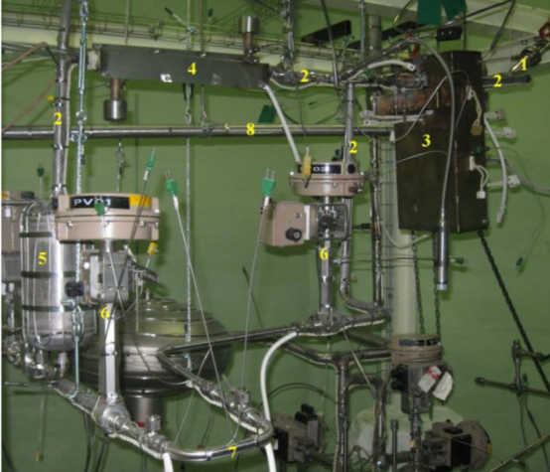
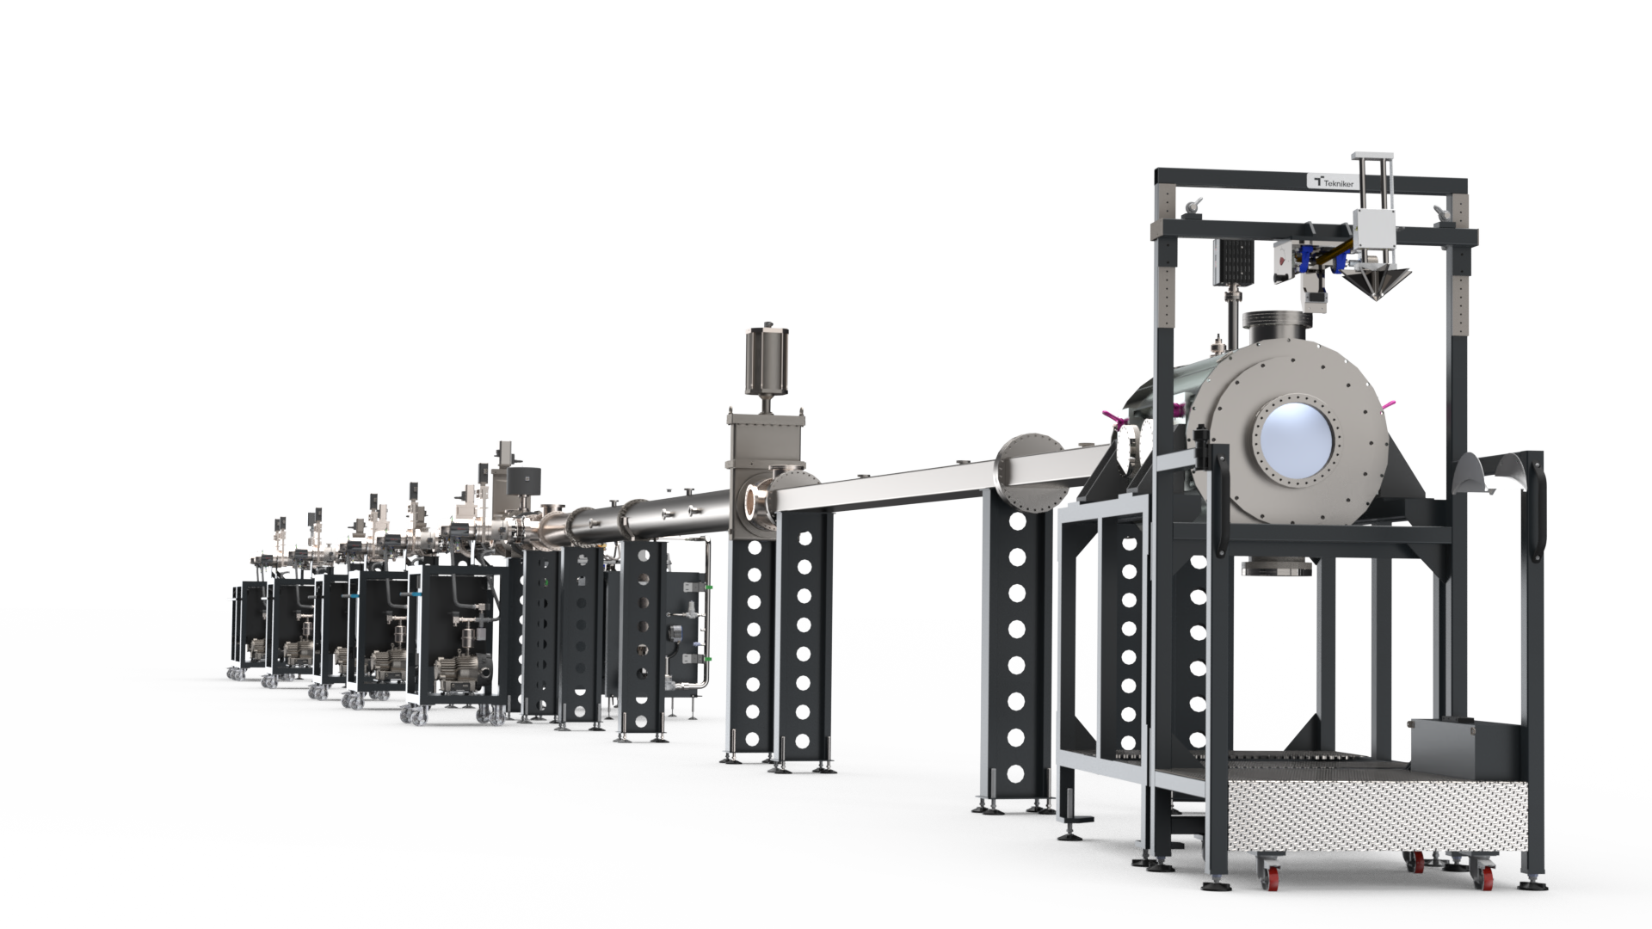
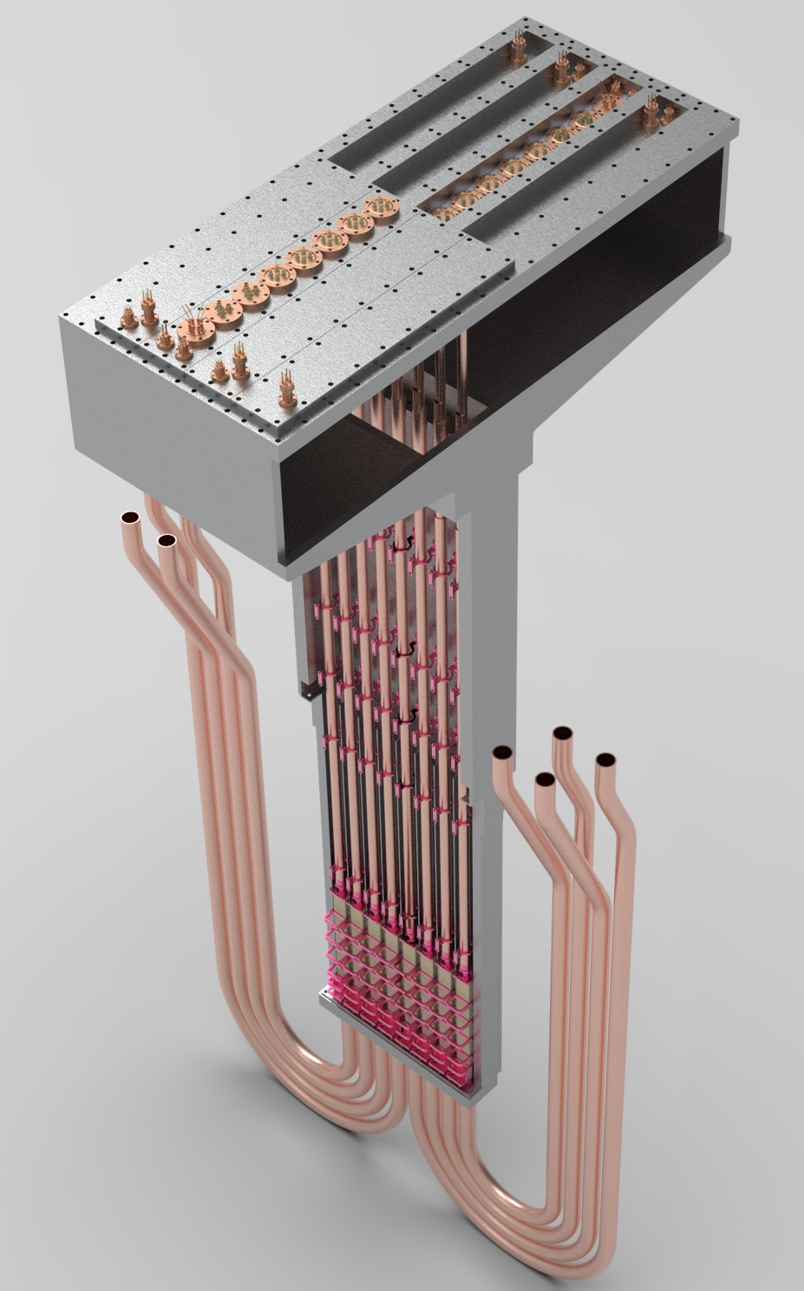
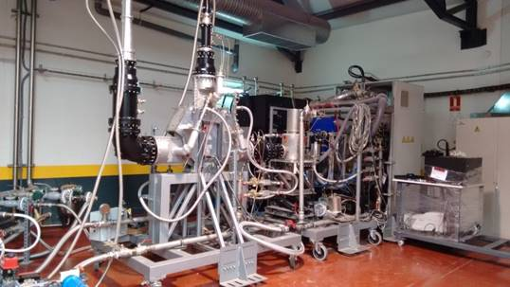
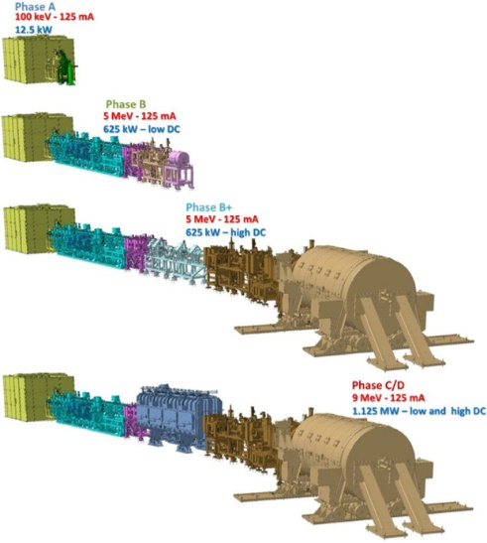
DONES Design Status
Engineering design
  Developed for IFMIF (and a generic site) up to 2013 in the framework IEA and BA (IFMIF/EVEDA)
  Developed for IFMIF-DONES from 2015 in the framework of the ENS WP of EUROfusion (+ FWC)
Prototyping and validation
  Being developed for IFMIF (and a generic site) in the framework of BA (IFMIF/EVEDA)
  Developed for IFMIF-DONES from 2015 in the framework of the ENS WP of EUROfusion
  Other additional national projects
Start-Up Monitoring Module (STUMM). Irradiation module to used during the commissioning phase in order to fully characterize radiation map
Quick Disconnecting System (QDS). To validate RH conection system
Multipurpose VaCuum accidental scenarios (MuVaCas). To analyze different posible accidental scenarios
Electromagnetic Pump prototype. To characterize pump performance
Li purification prototipe loop (LITEC) to test impurities control technology
LIFIRE facility to study Lithium fire risks
High Beta cavity & RF coupler
Meander-type beam extraction system
SSPA @175 MHz 200 kW CW
Shielding benchmarking using a 35 MeV (p, Be) neutron source
LIPAc (Rokkasho)
A. Ibarra| Status of DONES| TIARA Council| February 21th 2023| Page 12

Slide 13
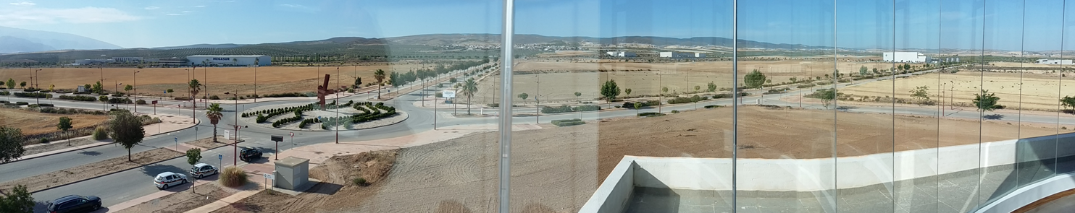
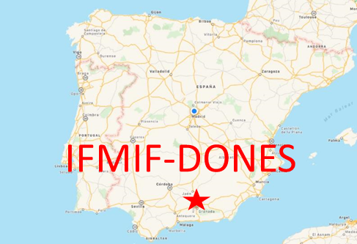
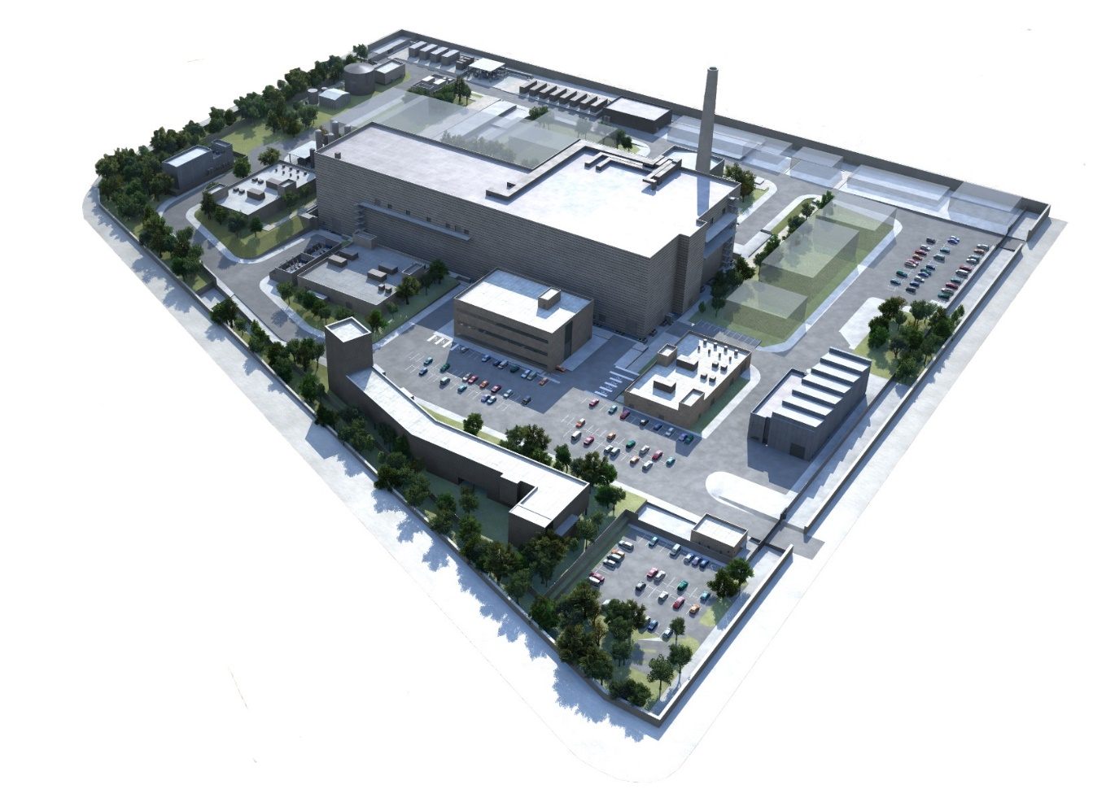
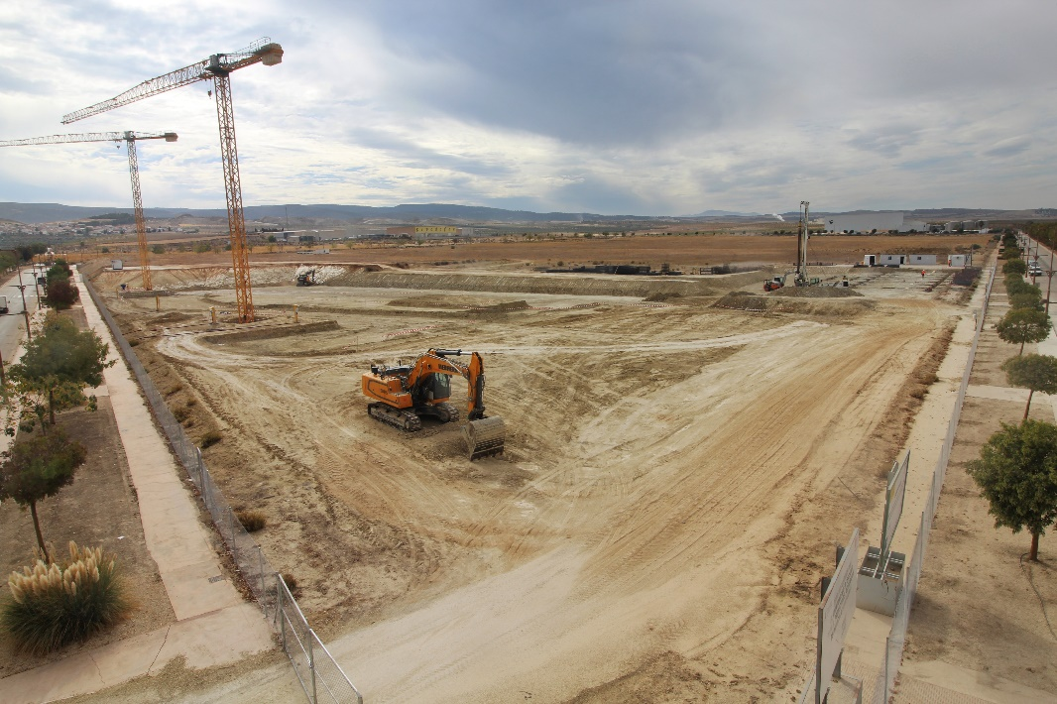
Site
Well characterized from the geotechnical, seismic,radiological and meteorological point of view
(some further detailed studies presently going on)
Work on-site already started!!!
A. Ibarra| Status of DONES| TIARA Council| February 21th 2023| Page 13

Slide 14
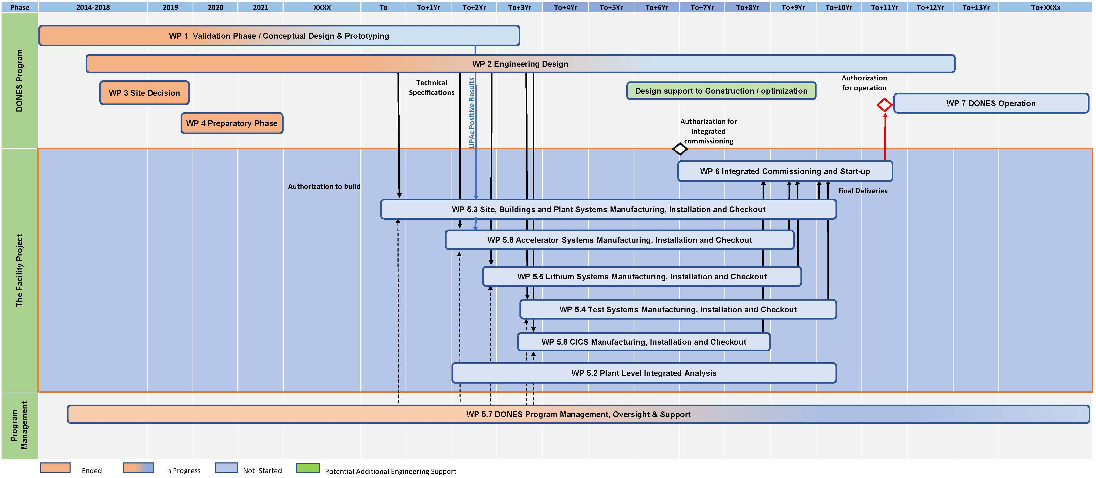
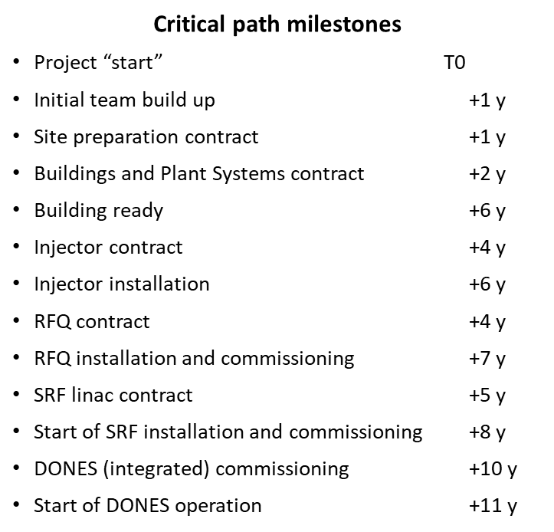
Master Schedule – DONES Programme
+1-2 years of irradiation and +1-2 years of PIE
First materials data around T0+(13-15)y
A. Ibarra| Status of DONES| TIARA Council| February 21th 2023| Page 14

Slide 15
Outline
What is DONES? Why?
Design status
Implementation
Summary

Slide 16
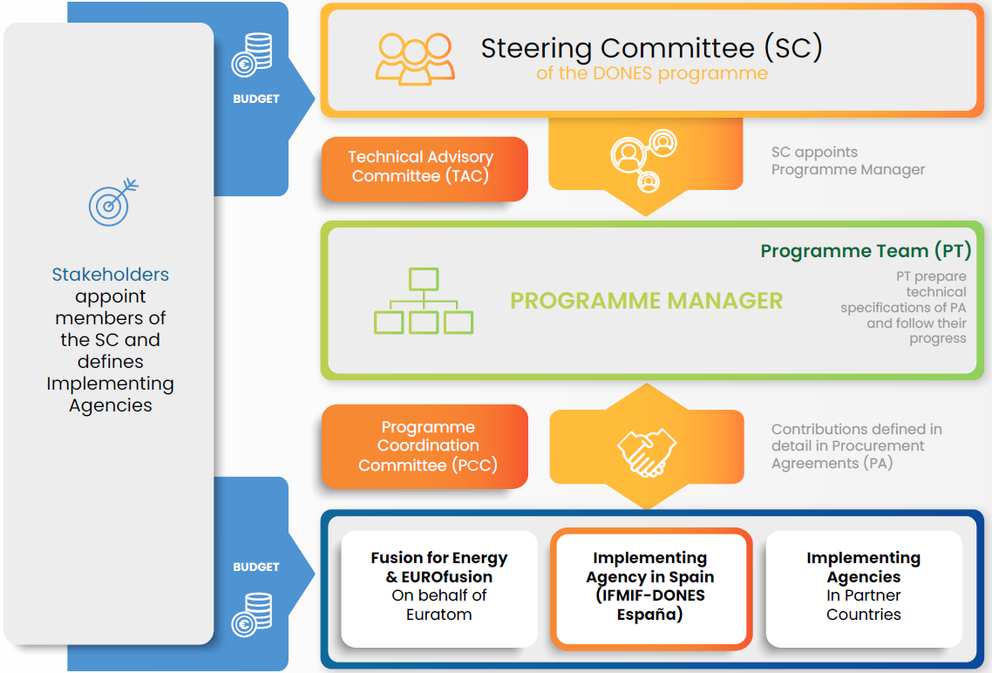
Governance and Management
Programme will run by flexible Programme Team and relying on In-Kind Contributions from different partners​
Design Authority in the Programme Team​
Owner/Operator responsibility on the Spanish Legal Entity​
Contributions will be agreed in a qualitative way
between the stakeholders and in detail by Procurement Arrangements between Implementing Agencies​
​
​
Contributions would consist of:​
In-kind components for IFMIF-DONES Facility construction, and/or​
Staff to the Programme Team, and/or​
Cash for Common Expenses and Reserve Fund, and/or​
Use of Support Facilities in contributing countries, and/or​
Participation in the DONES Programme exploitation​
​
​
Model similar to the one used in the Broader Approach project
A. Ibarra| Status of DONES| TIARA Council| February 21th 2023| Page 16

Slide 17
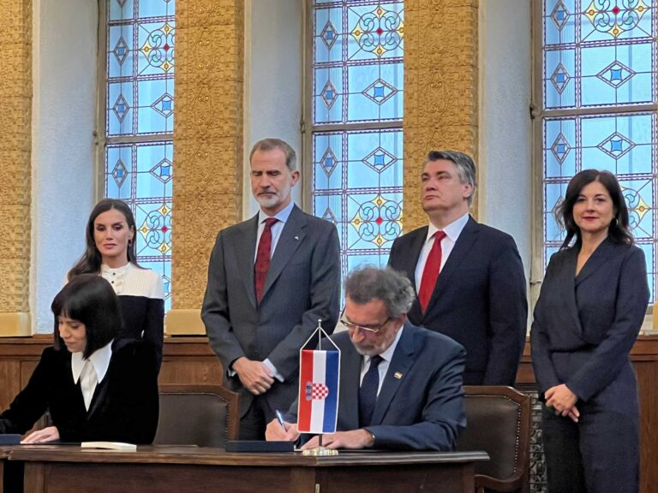
Status of DONES Program implementation
Spanish commitment: 50% of Construction costs + 10% operation costs
Croatian commitment: Recent signature of a MoU between Spain and Croatia defining the Croatian in-kind contributions to the Facility (around 5% of the construction costs).
Recent interchange of letters between Spain and EU Energy Commissioner: ”… the European Commission is committed to support your proposal in full respect of its responsibilities and those of the Governing Board of F4E.”
  F4E (around 20% construction costs -130 M€- included in the presently planned long-term budget). To be further elaborated
Discussions on going with a number of other EU countries and JA (working group already stablish) in order to define their possible contributions to the project
Around 75% of the construction Budget is assured (close to)
The DONES-Steering Committee will be stablish next March 16th (also including Observers)
(and that means the “official” start of the DONES construction Phase)
A. Ibarra| Status of DONES| TIARA Council| February 21th 2023| Page 17

Slide 18
Outline
What is DONES? Why?
Design status
Implementation
Summary

Slide 19
Summary
    Ready to move on!!!
A. Ibarra| Status of DONES| TIARA Council| February 21th 2023| Page 19

Slide 20
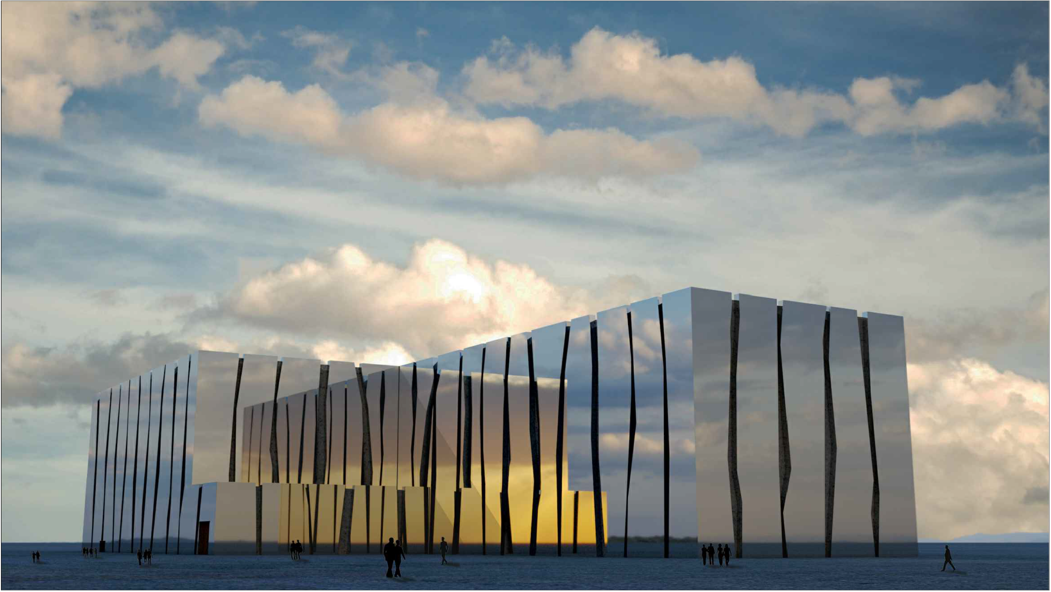






Slide 21
Neutron source requirements
Requirements based on EU DEMO needs
The requirements are to produce fusion-like neutrons
  Intensity large enough to allow moderate accelerated testing,
  Damage level above the expected operational lifetime,
  Irradiation volume large enough to allow the characterization of the macroscopic properties of the materials of interest required for the engineering design of DEMO (and the Power Plant)
> 10 dpa(Fe)/fpy
20 dpa(Fe) in 1.5y
50 dpa(Fe) in 3.5y
300 cm3
The most feasible approach based on Li(d,xn) sources
The DONES project!!!
The IFMIF project since 90´s
Managed under IEA and JP-EU BA, each more than a decade
A. Ibarra| Status of DONES| TIARA Council| February 21th 2023| Page 21

