Slide 1
HL-LHC Integration meeting
Ancillaries around CRAB-DQW cryomodule 2.0
Status Update!
10/02/2023
G. Aparicio
J. Dequaire
10/06/2022

Slide 2
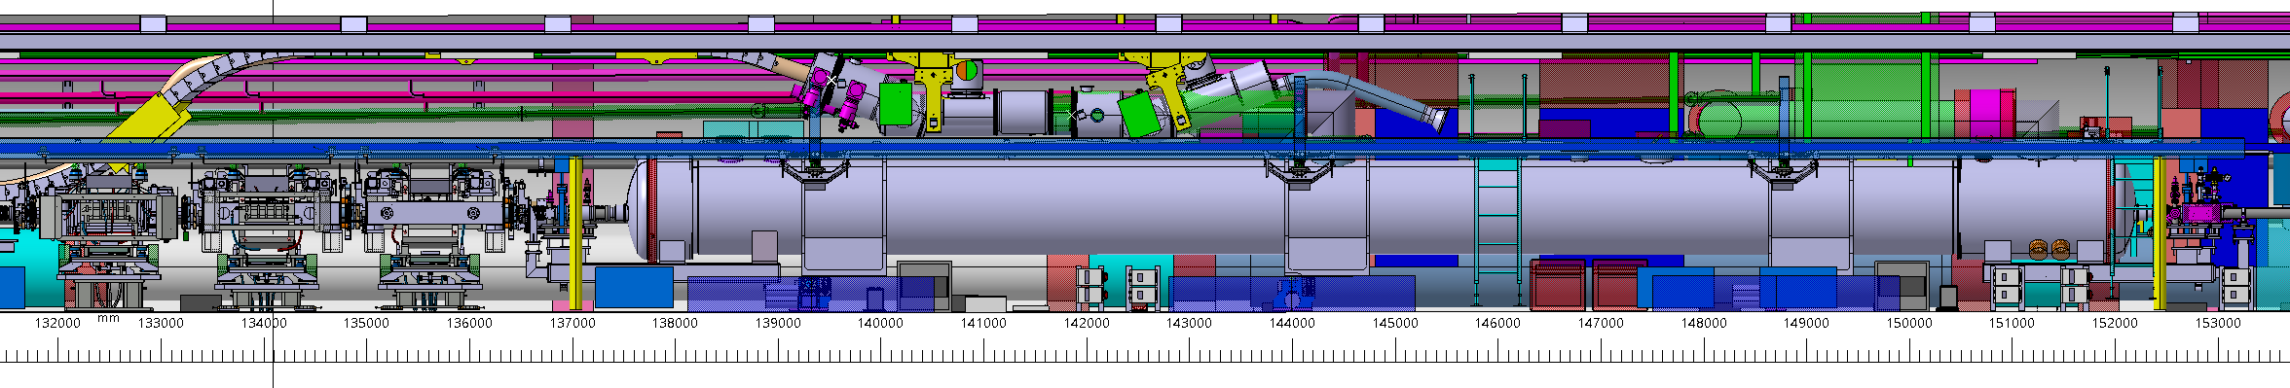
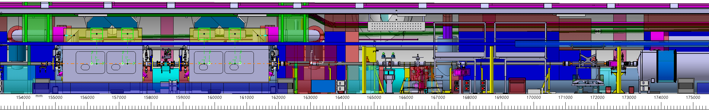
CRAB DQW – IP5 right area
Integration
June 2022
CRAB DQW in IP5 left
Should be a translation or symmetry of IP5 right configuration
CRAB RFD in IP1 area
Integration study after IP5
Should be a copy of IP5 configuration
Small adaptations to match RFD dimensions
Proposed configuration for IP5R ; View from transport area ST1516873_01

Slide 3
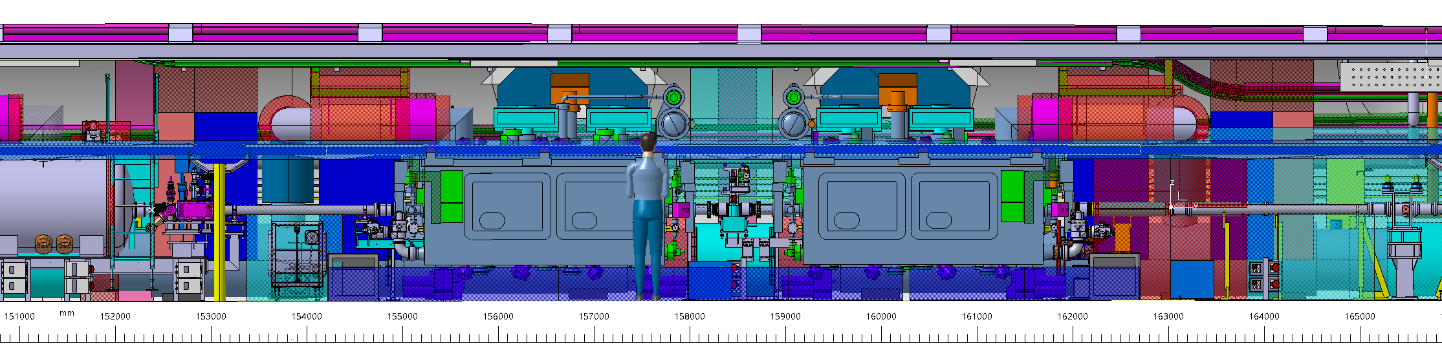
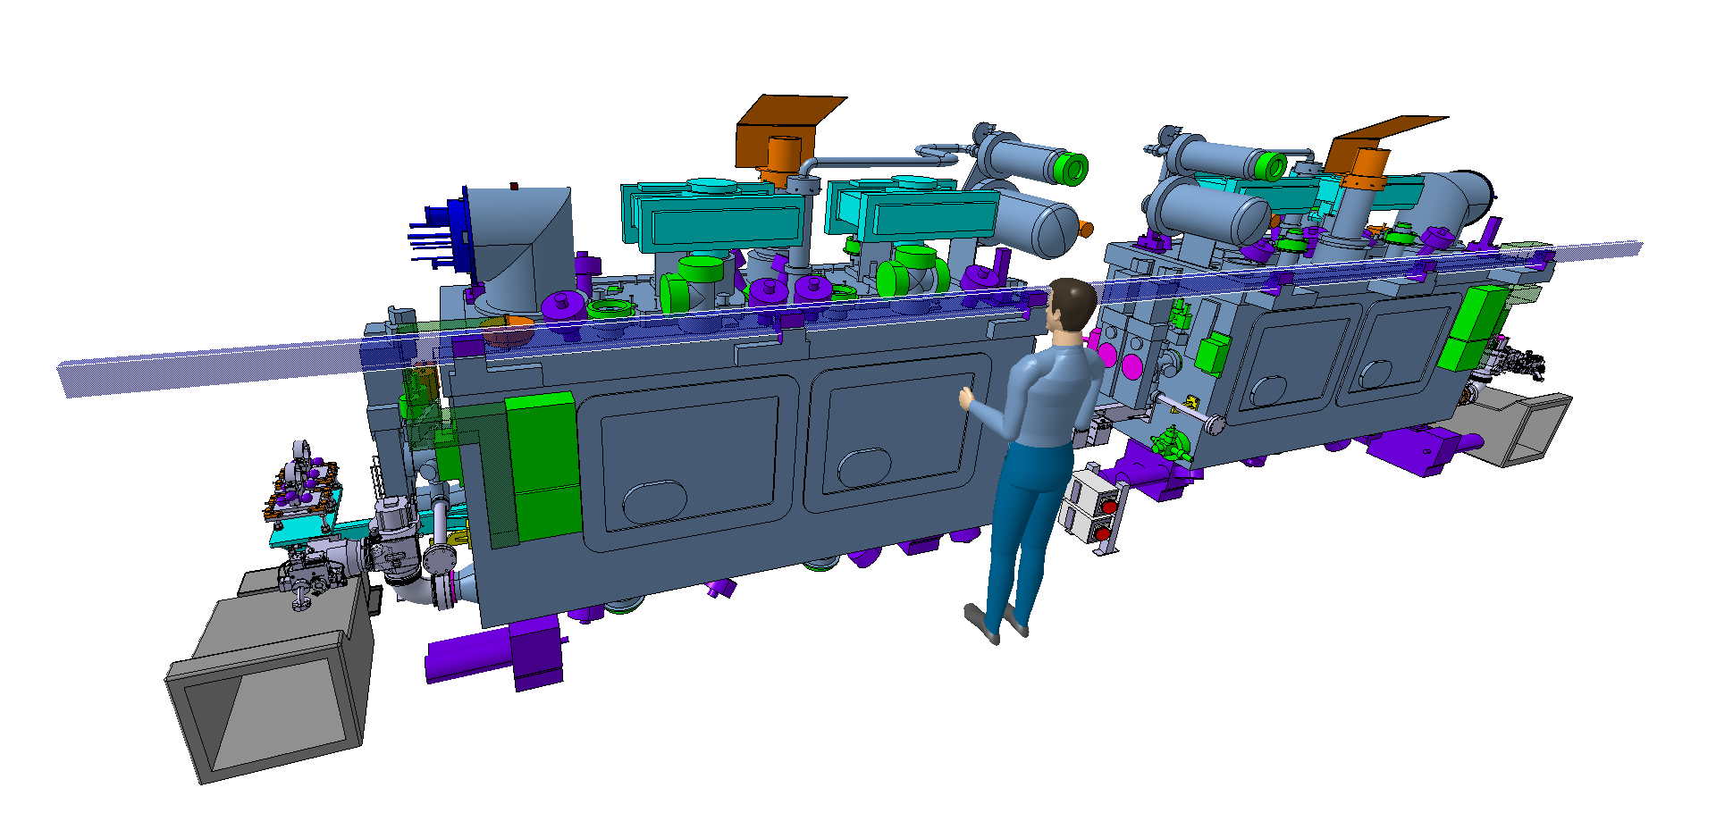
CRAB DQW – IP5 right area
Present Integration
CRAB DQW in IP5 left
Should be a translation or symmetry of IP5 right configuration → still to be done
CRAB RFD in IP1 area
Integration study after IP5
Should be a copy of IP5 configuration
Small adaptations to match RFD dimensions
Proposed configuration for IP5R ; View from transport area ST1516873_01

Slide 4
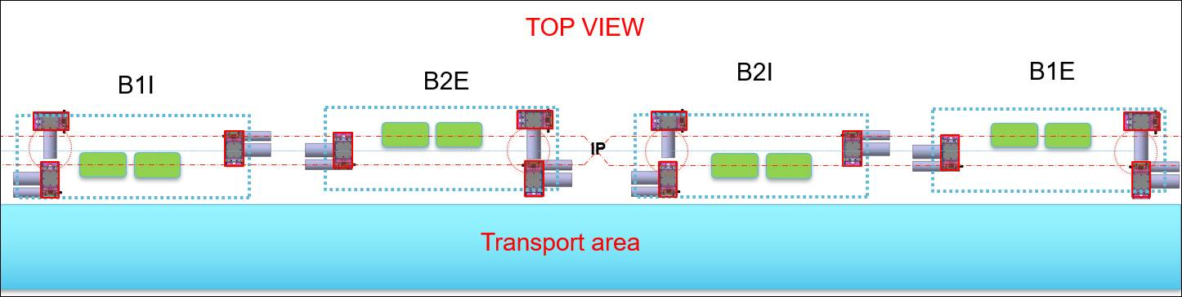
Equipment below CRAB-DQW
Integration
June 2022
Jacks positions
2 jacks located on the jumper side and 1 on the opposite
Ease the FSI integration
More available space between the cryomodules
Less interfaces needed on the cryomodules
FSI lower ports
All FSI lower ports should be located below the cryomodule
Feasibility to be checked on the jumper side
NEED VALIDATION
LEVEL 1
Jacks and FSI patch panels
2 Relocated below D2 and 1 between CRAB and the Q4, under the passerelle

Slide 5
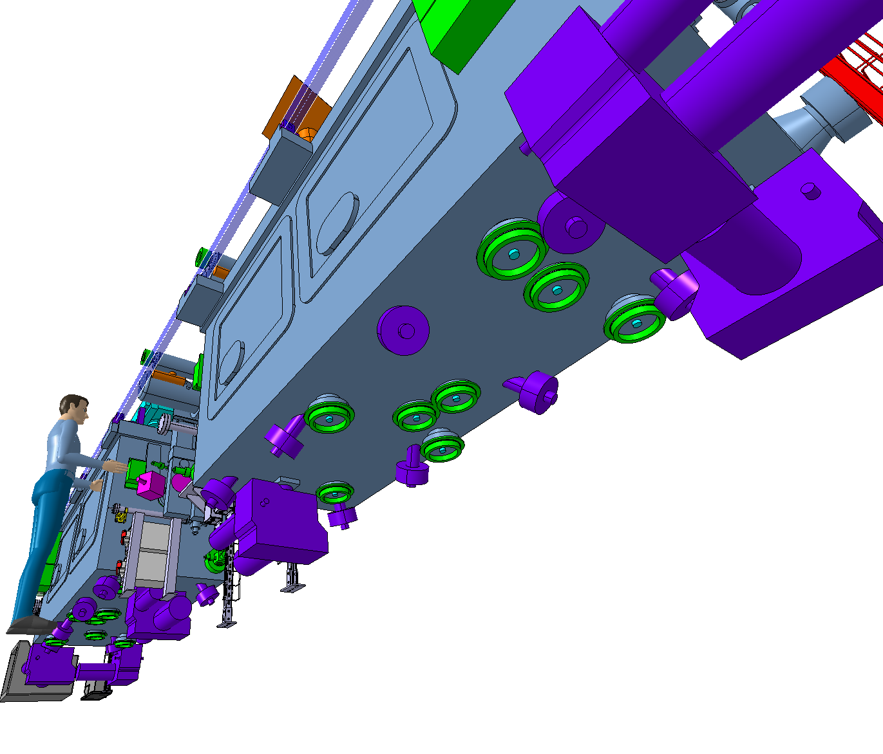
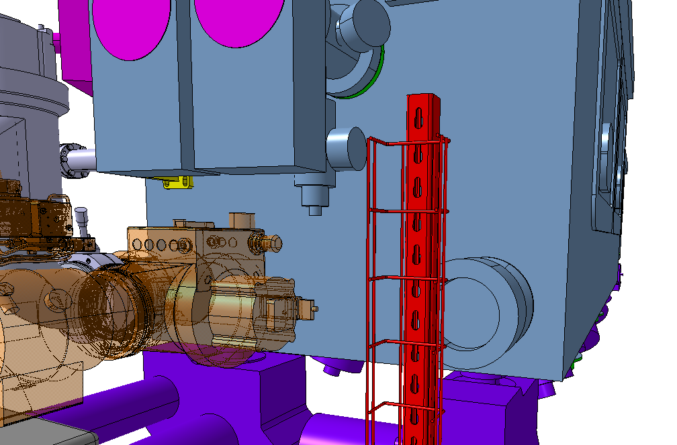
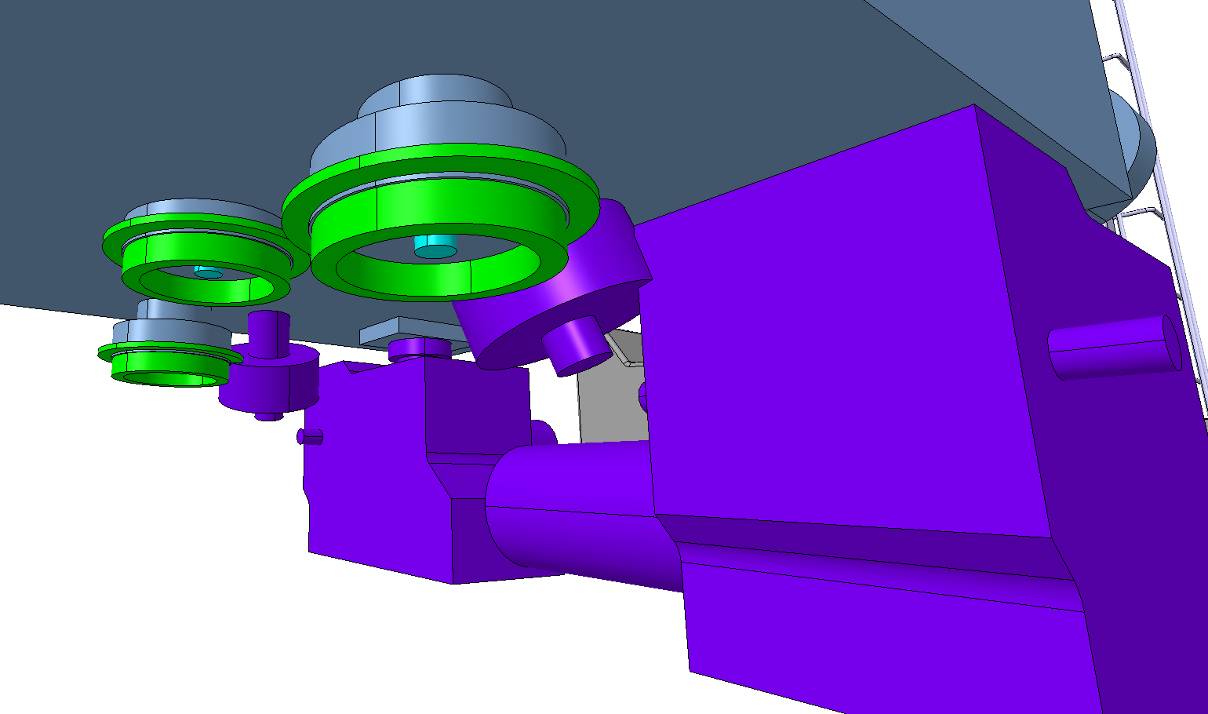
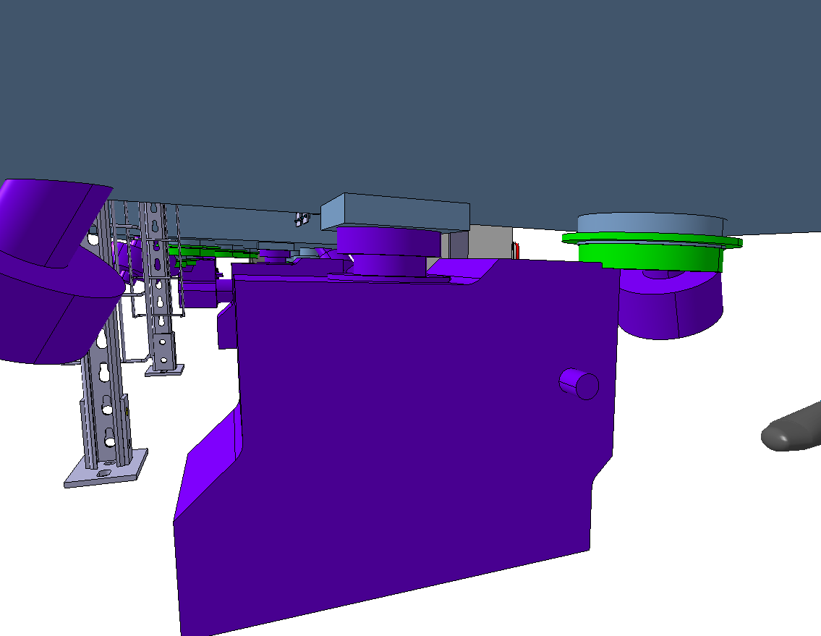
Equipment below CRAB-DQW
Present Integration
Jacks positions
2 jacks located on the jumper side and 1 on the opposite
Ease the FSI integration
More available space between the cryomodules
Less interfaces needed on the cryomodules
FSI lower ports
All FSI lower ports should be located below the cryomodule
Feasibility to be checked on the jumper side
Already relocated by WP4
and validated by BE/GM
Released EDMS 2511764
NEED VALIDATION
LEVEL 1
Already relocated by WP15
Jacks and FSI patch panels
2 Relocated below D2 and 1 between CRAB and the Q4, under the passerelle
BUT some interferences between the equipment and the jacks were found

Slide 6
Equipment below CRAB-DQW
Integration
June 2022
Primary pump
Located on the jumper side close to the insulation pump
Mini-racks for vacuum
Located on the jumper side close to the primary pump
Insulation pumps
Located on the jumper sides
Possibility to relocate the insulation pumps in the inter-cryomodule area
Small clashes between insulation pump and Beam vacuum extension roughing
Possibility to add more length on the cryomodule dedicated ports and / or rotate the pump’s upper equipment ?
NEED VALIDATION
LEVEL 2
Rotation possible ?

Slide 7
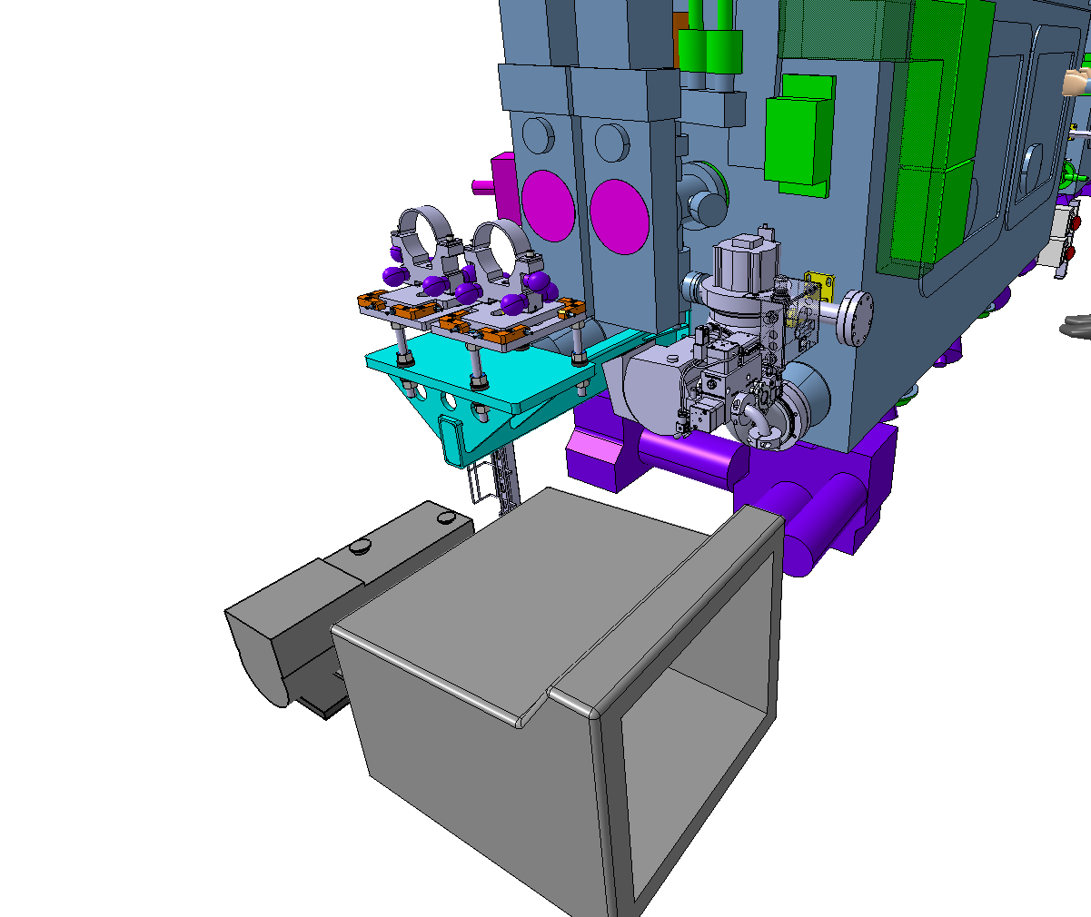
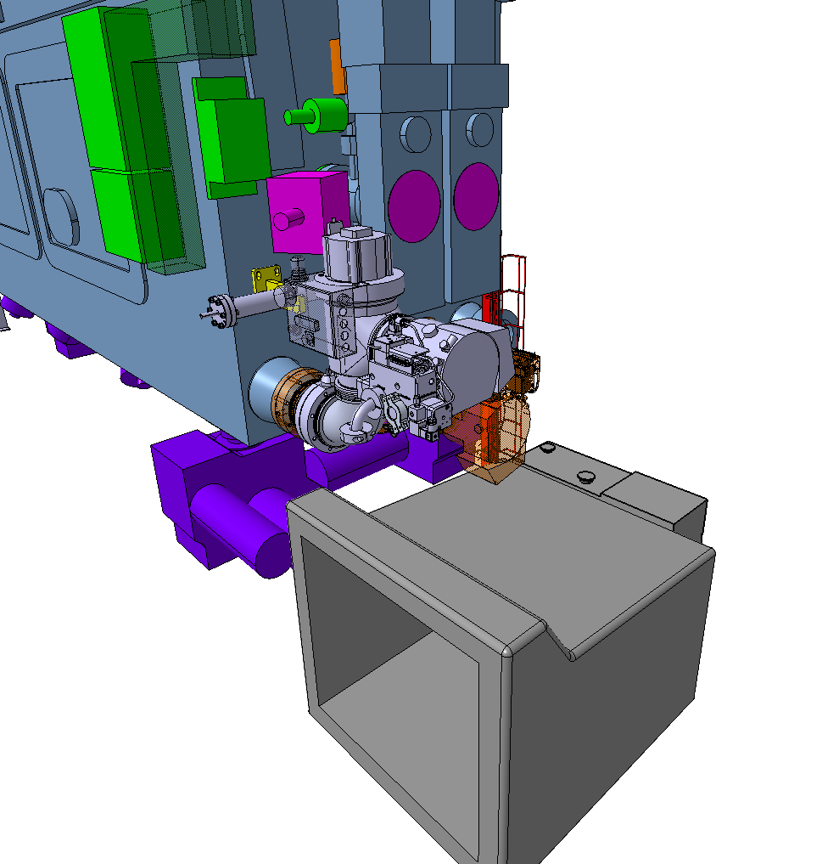
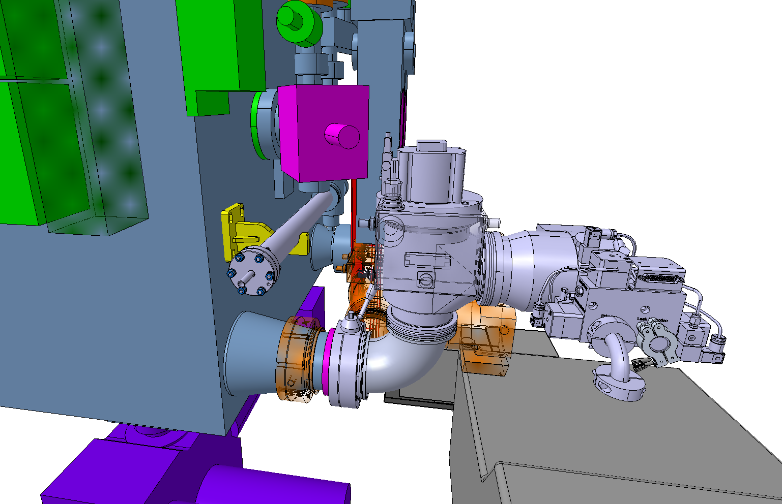
Equipment below CRAB-DQW
Present Integration
ONGOING DISCUSSION (BE/GM, WP12) about the possibility of rotating the primary pump looking down depending on the new radial motor dimensions
Primary pump
Located on the jumper side close to the insulation pump
Mini-racks for vacuum
Located on the jumper side close to the primary pump
Insulation pumps
Located on the jumper sides
Possibility to relocate the insulation pumps in the inter-cryomodule area
Not considered for the moment
No news since June 2022
Small clashes between insulation pump and Beam vacuum extension roughing
Possibility to add more length on the cryomodule dedicated ports and / or rotate the pump’s upper equipment ?
SOLVED by WP4 with the integration of an elbow connection interface
STILL to validate by WP12
NEED VALIDATION
LEVEL 2
Rotation possible ?

Slide 8
Equipment below CRAB-DQW
Integration
June 2022
Double beam chambers supports
Fixed on the cryomodules
Cryo-instrumentation feedboxes
Located between the cavities
Compressed air tank for beam gate valves
3 tanks located 1 in each jumper side + 1 between the cryomodule
Possibility to have less tank ?
Mismatch between double beam support and cryomodule interfaces of Z100 mm
Possible clash between FSI and double beam support
Possibility to modify the double beam support to match the cryomodule interfaces ?
Big clash between the feedboxes and the inter cryomodule beam chambers
Relocation above the beam chambers
Relocation on the cryomodules has the advantage of pre-cabling on surface but limits the access on the QXL side in tunnel
NEED VALIDATION
LOWER PRIORITY

Slide 9
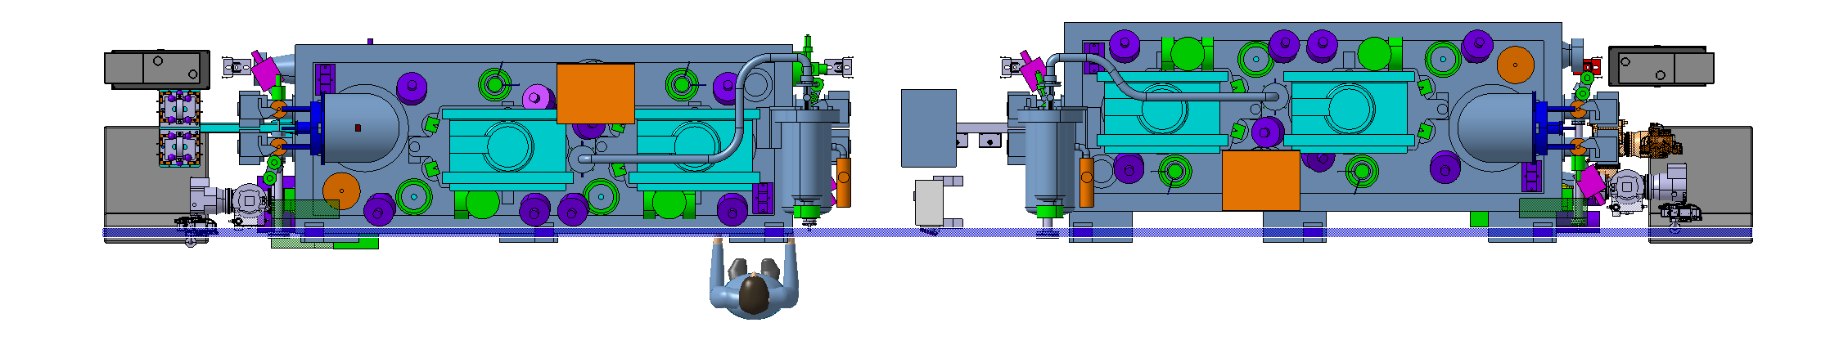
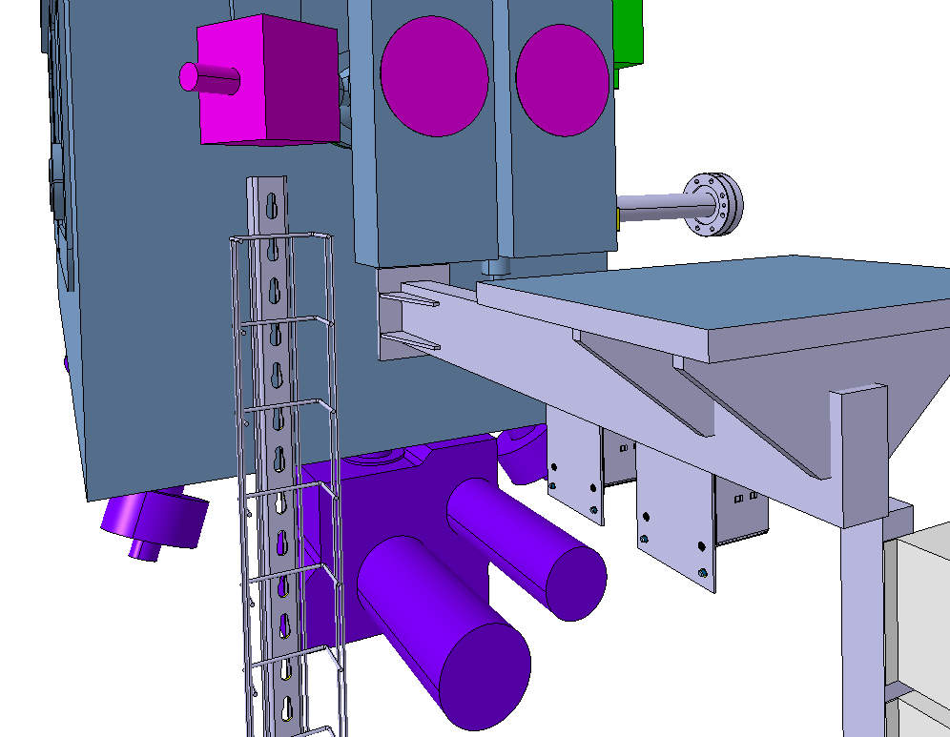
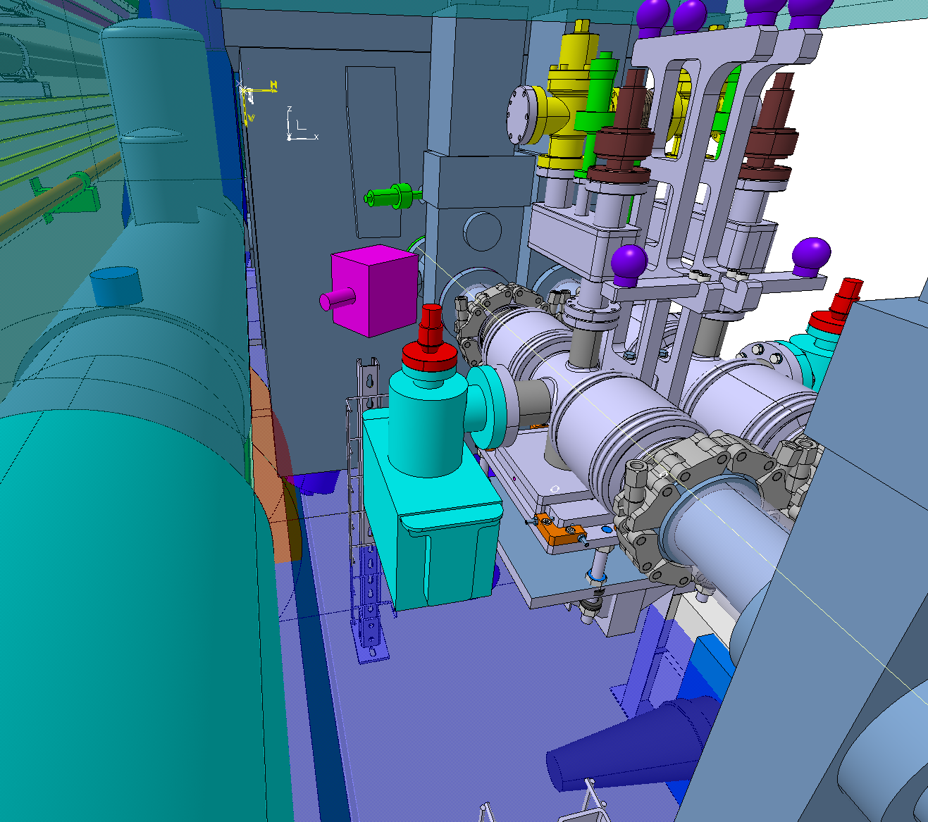
Equipment below CRAB-DQW
Present Integration
Double beam chambers supports
Fixed on the cryomodules
Cryo-instrumentation feedboxes
Located between the cavities
Compressed air tank for beam gate valves
3 tanks located 1 in each jumper side + 1 between the cryomodule
Possibility to have less tank ?
Relocated by WP4 to the transport side
No need for them anymore,
confirmed by WP12
Mismatch between double beam support and cryomodule interfaces of Z100 mm
Possible clash between FSI and double beam support
Possibility to modify the double beam support to match the cryomodule interfaces ?
Big clash between the feedboxes and the inter cryomodule beam chambers
Relocation above the beam chambers
Relocation on the cryomodules has the advantage of pre-cabling on surface but limits the access on the QXL side in tunnel
SOLVED by WP4 with the relocation of the FSI below the crabs
SOLVED by WP4 with the relocation of the cryo instrumentation
NEED VALIDATION
LOWER PRIORITY

Slide 10
Equipment around CRAB-DQW
Integration
June 2022
Electrical junction boxes VPI
3 boxes per cryomodule located on the sides, fixed on the cryomodule
Add interfaces on the cryomodule
Electrical coffrets
Located between the cryomodule
Possibility to move it elsewhere ?
NEED VALIDATION
LOWER PRIORITY
DQW cryogenic safety line
Located on the top of the cryomodule
Clash between the safety line and the RF waveguides
The safety line will be relocated between the waveguides

Slide 11
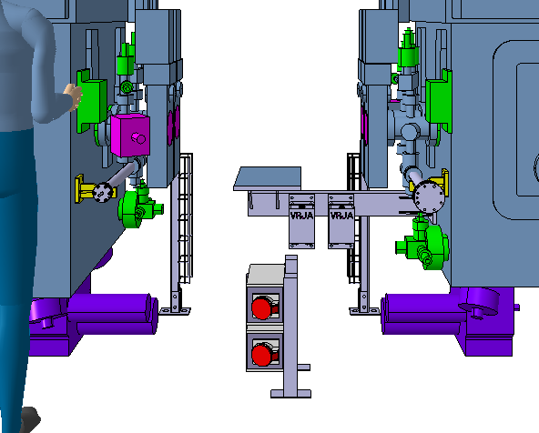
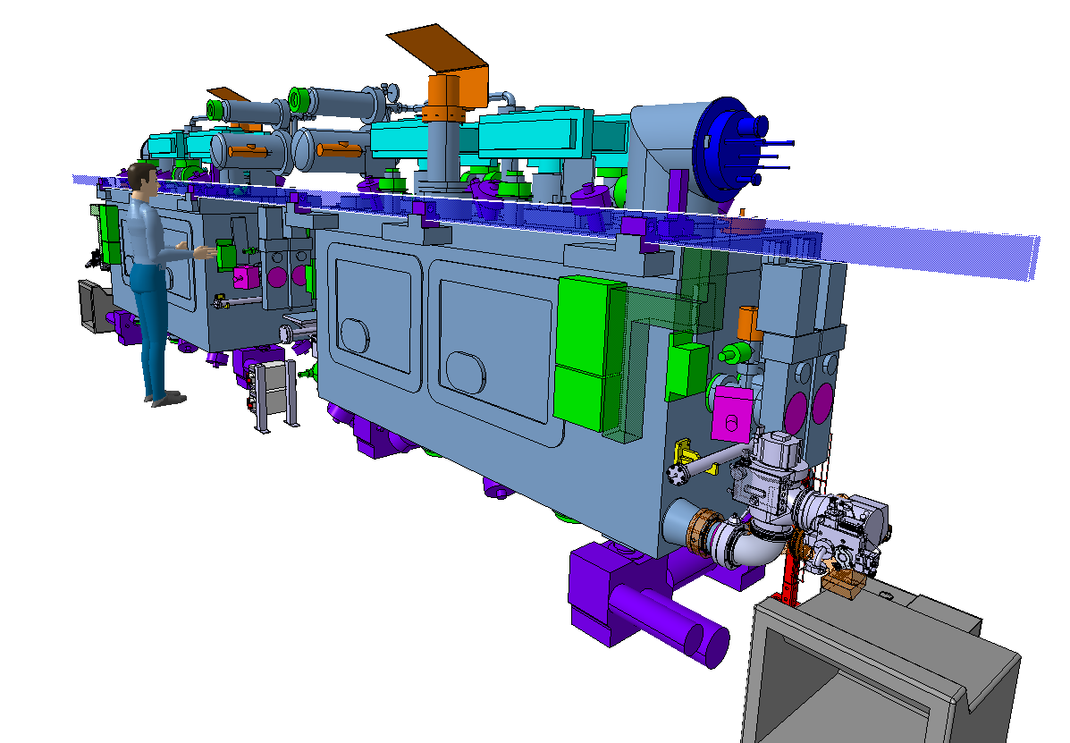
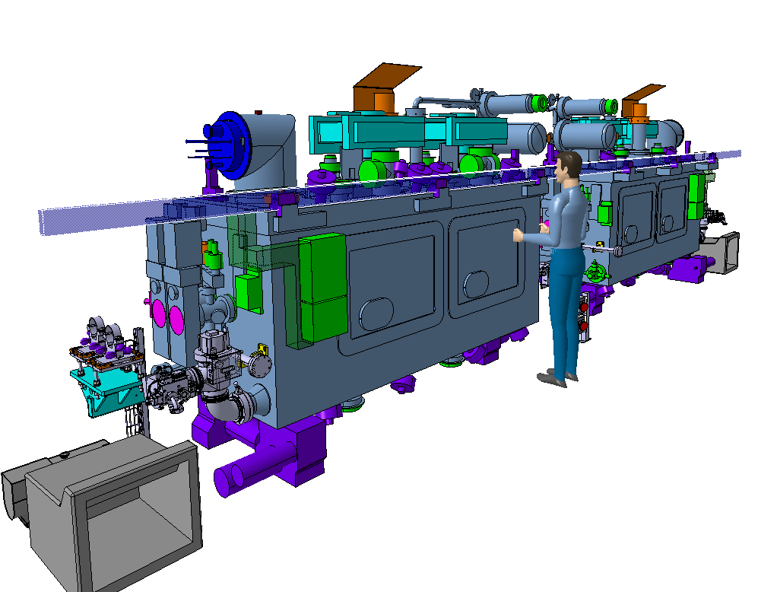
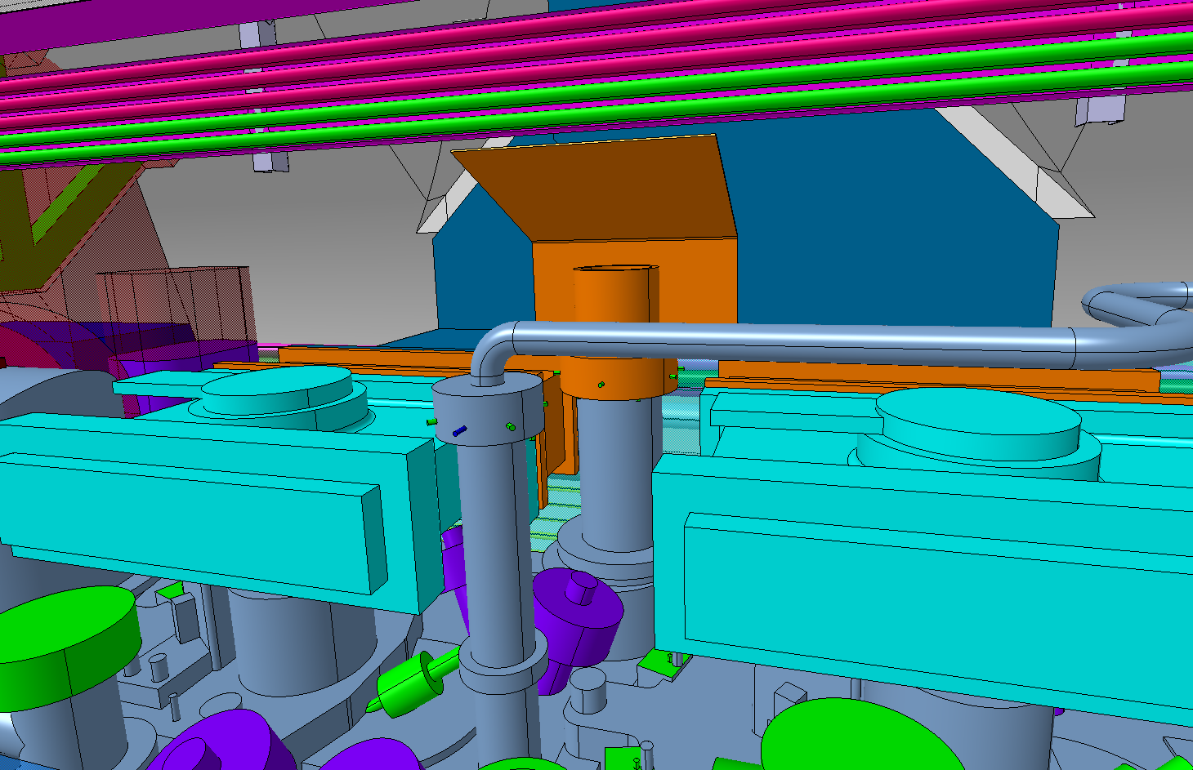
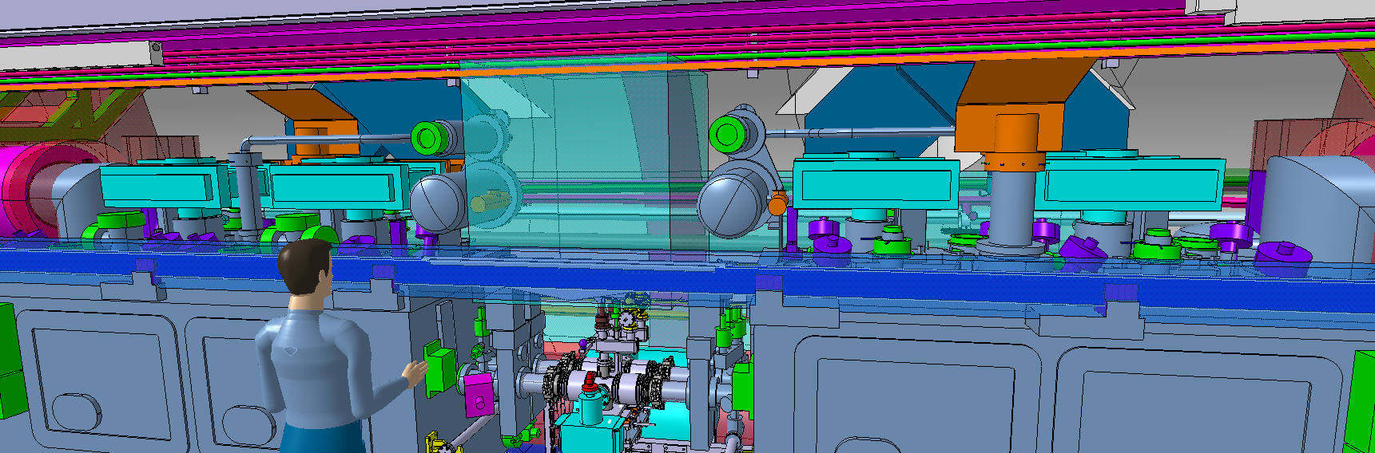
Equipment around CRAB-DQW
Present Integration
Electrical junction boxes VPI
3 boxes per cryomodule located on the sides, fixed on the cryomodule
Add interfaces on the cryomodule
Electrical coffrets
Located between the cryomodule
Possibility to move it elsewhere ?
NEED VALIDATION
LOWER PRIORITY
Orientation rotated by 90º looking to the transport side
2 VRJA boxes per cryomodule (instead of 3)
DQW cryogenic safety line
Located on the top of the cryomodule
Clash between the safety line and the RF waveguides
The safety line will be relocated between the waveguides
SOLVED by WP4 with the displacement of the safety line
Cable trays already protected

Slide 12
Equipment above CRAB-DQW
Integration
June 2022
WPS supports
3 supports per cryomodule located on the transport sides of the cryomodule
NEED VALIDATION
LOWER PRIORITY
Inclinometers
2 items per cryomodule located on the sides
Clash between the WPS supports and cryomodule
Possibility to adapt the supports ?
Clash between the inclinometers supports and cryomodule
Possibility to move the inclinometers ?

Slide 13
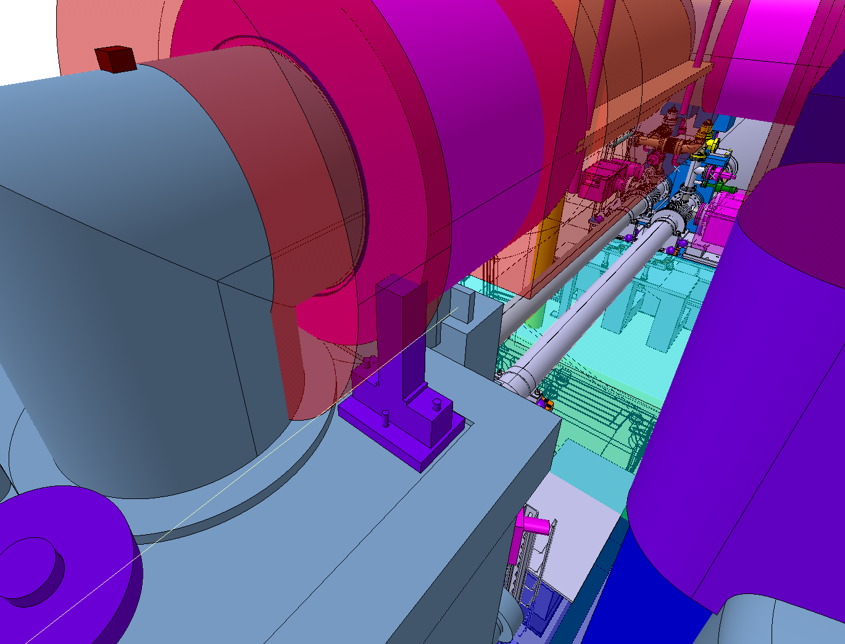
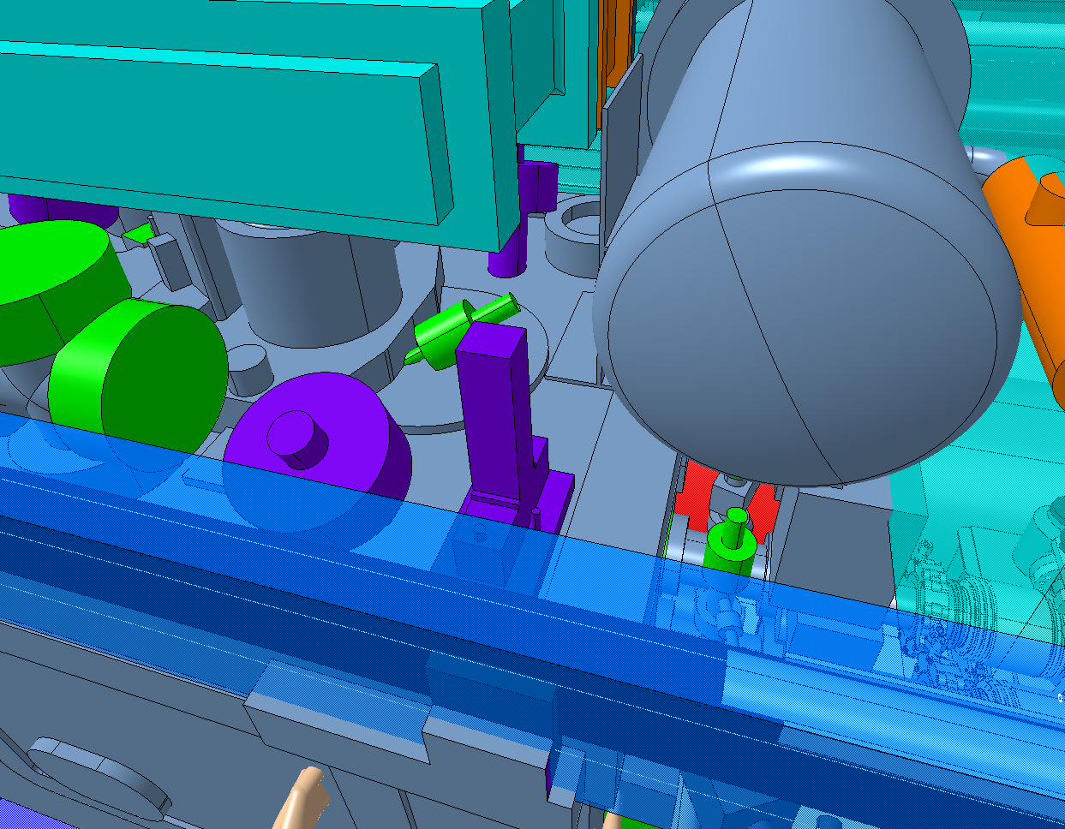
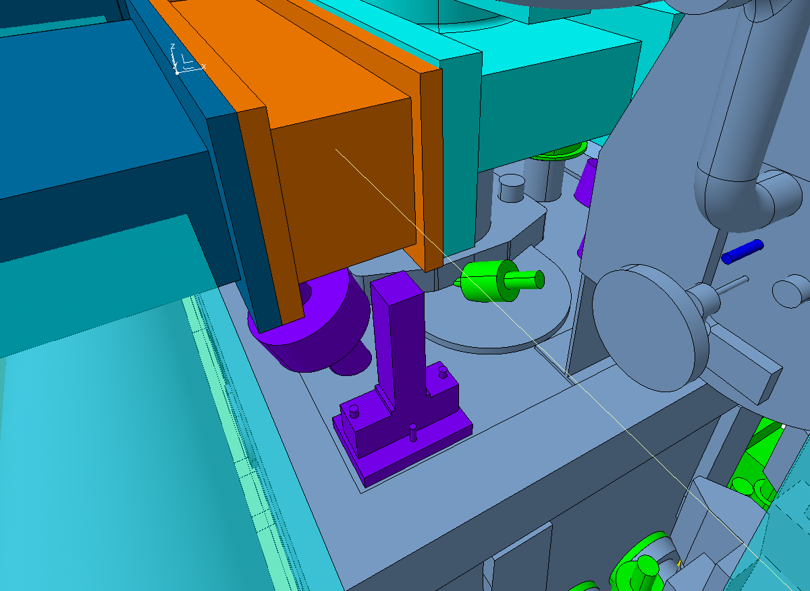
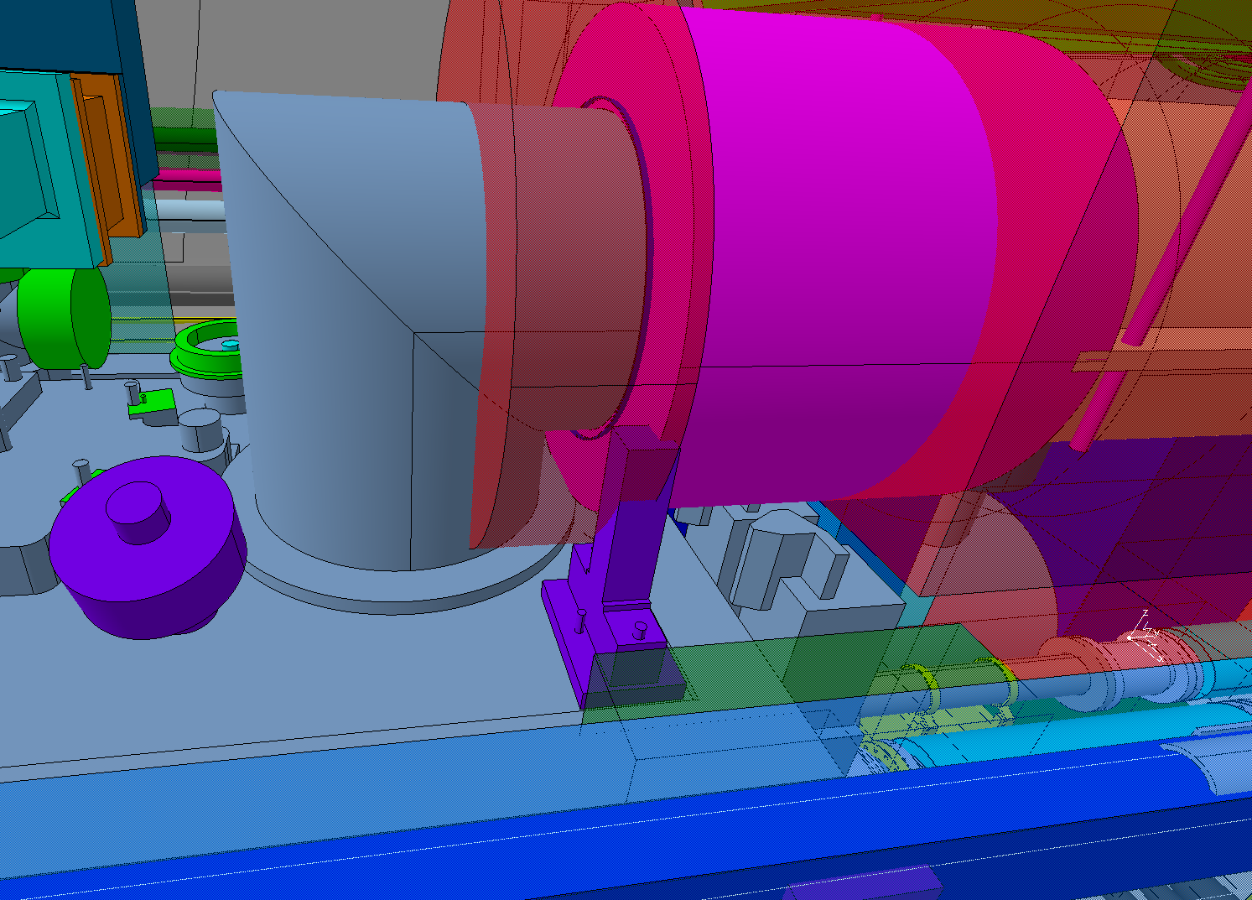
Equipment above CRAB-DQW
Present Integration
WPS supports
3 supports per cryomodule located on the transport sides of the cryomodule
NEED VALIDATION
LOWER PRIORITY
Inclinometers
2 items per cryomodule located on the sides
Ongoing
(together with BE/GM)
relocated by WP4 BUT interferences found between the jumper-side inclinometer and the jumper connection
Clash between the WPS supports and cryomodule
Possibility to adapt the supports ?

Slide 14
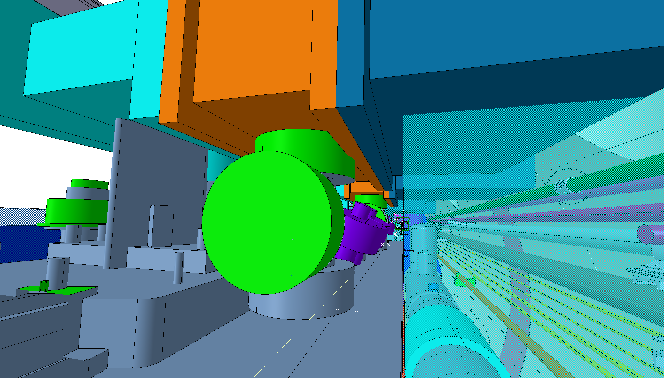
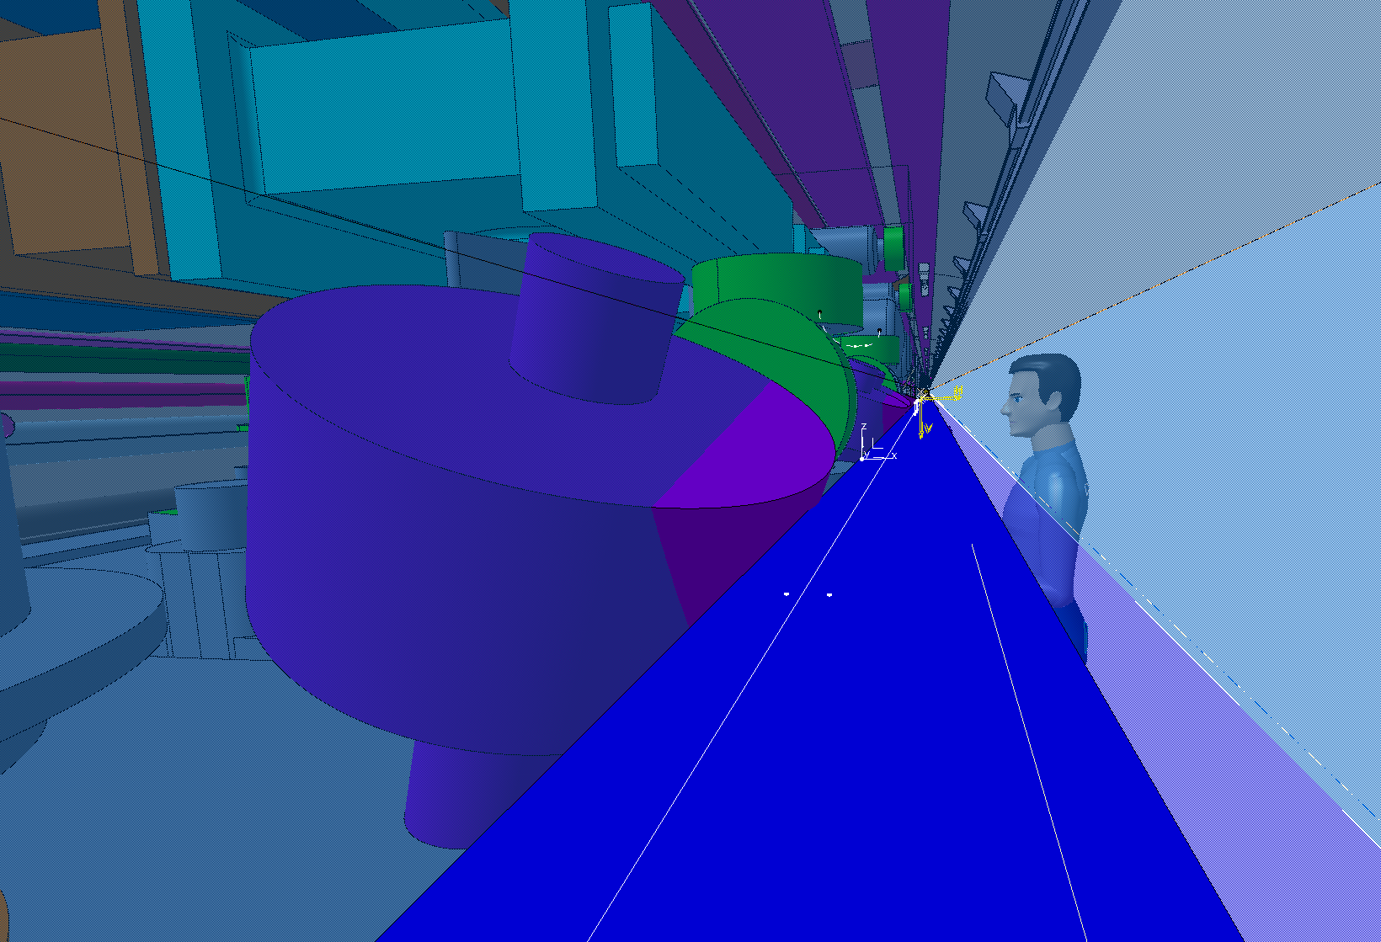
Equipment above CRAB-DQW
NEW FINDINGS
Interference between the electrical feedthrough and the RF wave guide connections on the non-IP crab.
Interference between the WPS space reservation and FSIs on top of the IP crab.

Slide 15
Thank you for your attention

