Slide 1
Thoughts on Polarization and Energy calibration experiments in KARA
refering to Bastian Harer’s slides at EPOl wkshp II and 9Feb23 EPOL meeting
Two cases:
1. Polarization is measured only with Touschek effect
2. (presumably longer term) polarization is measured with ‘FCC-ee-like polarimeter’

Slide 2
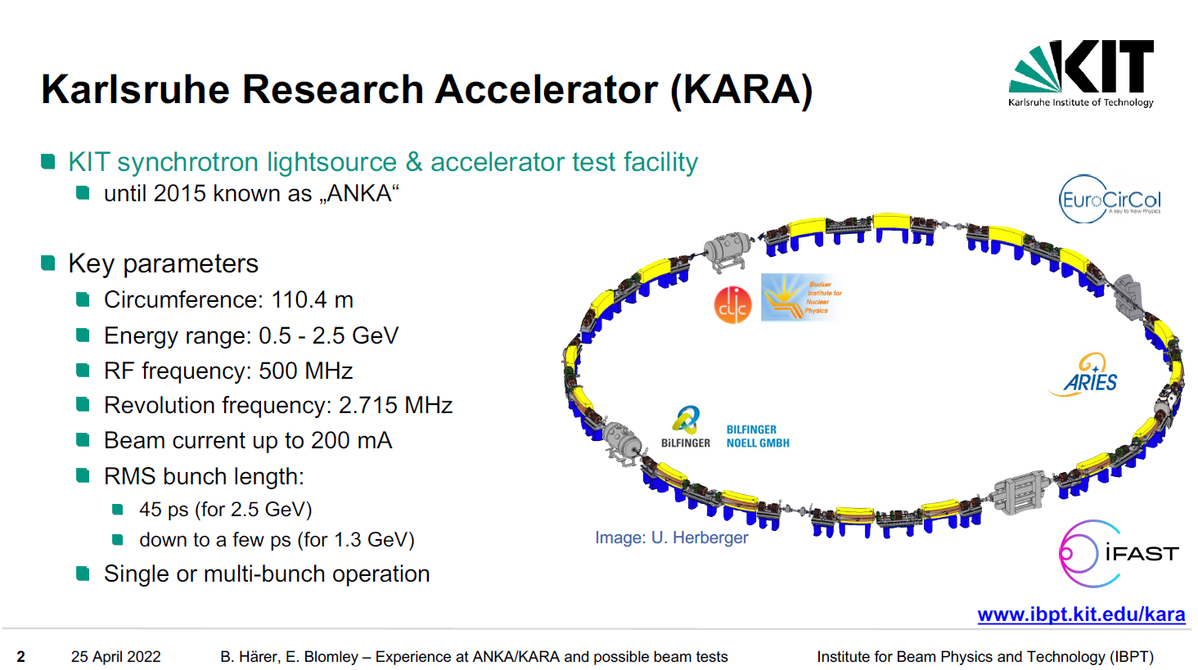
spin tune 1.1 – 5.7

Slide 4
2.5 10-5 precision here would
give 1.5 10-6 precision at FCCee-Z
(~100 keV)
independent of absolute level
of Touschek emission
→ probably insensitive to static
imperfections and knobs
polarization level and spin resonance from fit to time-dependent Touschek loss rate
QUESTIONS : How precise is τ_{d} measurement?
Assumptions on relationship between σ_{d} and energy measurement precision?
(Would precision increase by repeating the measurement?)

Slide 5
Important!
what can be controlled
-- vertical emittance
-- Touschek emission as function of time and function of kicker frequency.
-- Touschek emission depends on polarization of the beam
-- but isn’t sensitive to orientation of polarization
➔ cannot do a spin precession experiment
-- variation with time during depolarization
-- not a precise measurement of polarization level per se.
-- Touschek emission is sensitive to other effects (electron density)
-- beam charge, emittance etc.
-- these are static effects once beam parameters are set
should be straightforward to distinguish from

Slide 6
What can and can’t be done with Touschek meast
-- No spin orientation ➔ No spin precession study
this would require a compton polarimeter with 3D measurement (as FCC-ee) possible (space!)
-- Optimization of polarization level difficult
since spin knobs also change emittance
-- study of strong static depolarization possible
-- study of relationship between resonant depolarization frequency and spin resonances in lattice

Slide 7
Personal conclusions
definitely interesting to practice the resonant depolarization measurement in a situation where polarization time is 10 minutes!
2. It is impossible to perform the spin precession measaurement unless a 3D compton polarimeter is implemented (interesting, long term proposal)
3. It is difficult (to be studied further) to measure the polarization level precisely in view of optimizing it.
4. it should be feasible to study the implementation of spin knobs and
-- use them to measure the polarization and depolarization rate in a controlled way
-- thus possibly extract the absolute polarization level
-- use them to search for impact of spin resonances on the relationship between
resonant depolarization frequency and beam energy
5. Procedures
-- it is of great importance to simulate these experiments , at least conceptually, before executing them! -- understanding of the assignment of uncertainties is crucial!

