Slide 1
Material for discussion
Aurélien MARTENS (IJCLab Orsay)

Slide 2
Location of polarimeter(s)
Two locations were mentioned by Oide-san and M. Hofer:
  Upstream IP:
    Sigma_x=300um;sigma_y=30um;dispersion=12mm; 4.3mm bunch length
  Upstream RF section :
    Sigma_x=525um;sigma_y=12um (colliding);dispersion=32mm; 4.3mm bunch length
Pilot bunch charge: assume 1.6nC (as given by Oide some time ago)

Slide 3
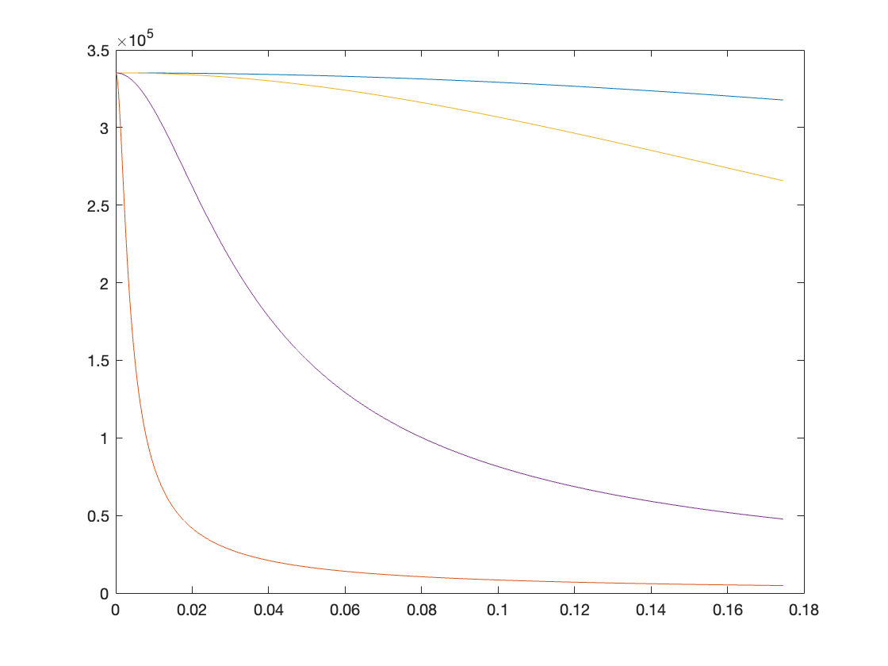
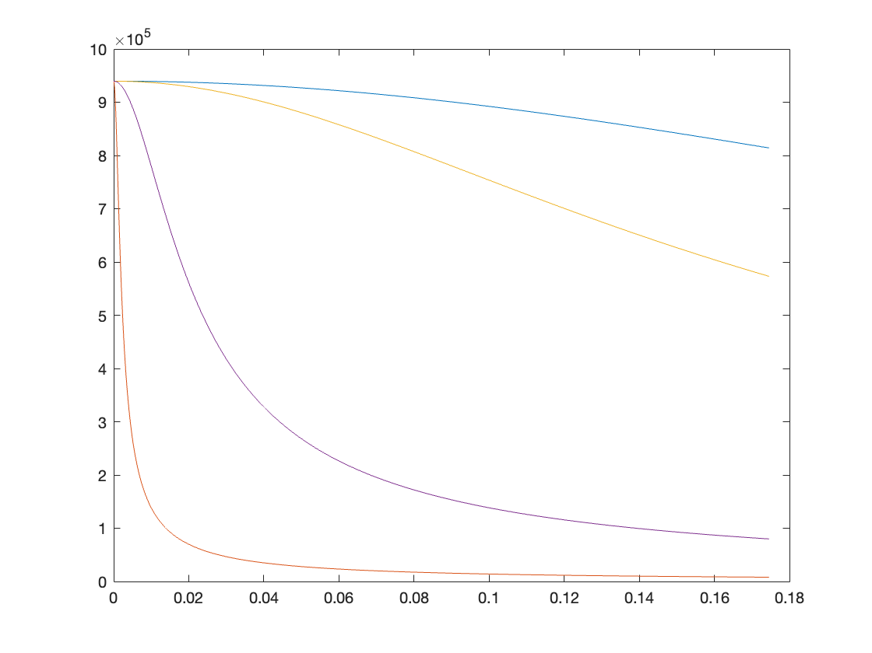
Estimated rates (pilot bunch)
Gaussian beam approx
Upstream RF, laser sigma=1mm
Upstream IP, laser sigma=600um
Laser Sigma_t = 3ps
3ps
30ps
30ps
Scattering rate (/s)
Scattering rate (/s)
300ps
300ps
3ns
3ns
Crossing angle (radians)
Crossing angle (radians)
NB: luminosity and scattering rates are sensitive to angular jitters
Assuming 100urad jitter → 3%/0.2%/0.03%/0.006% relative variation for 3ns/300ps/30ps/3ps case
Position jitters also induce lumi variations ~ (dX/sigma_X)^2~0.1% ? (assuming 3% jitter wrt size)
These are important to be considered when dealing with detector asymmetries when flip/flopping laser helicity

Slide 4
Some possible laser systems
NB: e-beam size now about 500um
Laser-beam size ~1mm
Nikolai’s baseline
Laser param. | 1 pilot (1.6nC) | 1 pilot v2 (1.6nC) | colliding bunches (38nC, at Z)
Repetition rate | 3 kHz | 3 kHz | 30 kHz
Pulse energy | 1 mJ | 1 mJ | 10x0.5mJ
Pulse duration | 5 ns | 5 ps ^{(**)} | 5 ps ^{(**)}
Average power | 3 W | 3 W ^{(***)} | 150 W
Scattering rate | 2x10⁵/s ^{(*)} | 3x10⁵/s ^{(****)} | 4x10⁸/s ^{(****)}
Scattering rate per bunch | 2x10⁵/s ^{(*)} | 3x10⁵/s | 4x10⁶/s
Same oscillator may be used but two different amplification schemes
Scheme for colliding can be adapted to a different configuration playing to some extent with rep-rate and/or number of pulses/burst
^{(*)} Large piwinski contribution, nearly scales as crossing angle, very dependent on laser beam size (was 2x10⁶/s in ref. paper)
^{(**)} Short pulse duration → broader laser spectrum, energy measurement from threshold more difficult
^{(***)} Can be increased to typically ~100W (nowadays) but requires operational validation, management of thermal effects…
^{(****)} not limited by Piwinski contribution → significantly increases when decreasing laser beam size

Slide 5
On laser spectrum/pulse duration
How stable is the laser wavelength central value, spectral width ?
  May limit the reproductibility of energy measurement of polarimeter. What do we actually need ? What can we actually do (laser metrology ?)
  Modelock Yb frequency comb can be locked to frequency standards (REFIMEVE+ network) with some €uros.
What is spectral width ←→ pulse duration (Fourier) ?
  Can be compared to e-beam (relative) energy spread ~0.5-1e-3
  3ps gaussian at Fourier limit is ok in that respect (similar as e-beam energy spread)

Slide 6
On crossing angle plane
Mitigation of synchrotron radiation on optics suggest that crossing in horizontal plane is not ideal
  There must be optics on both injection and ejection side.
Proposed idea would be to have crossing angle in both (horizontal and vertical) planes

Slide 7
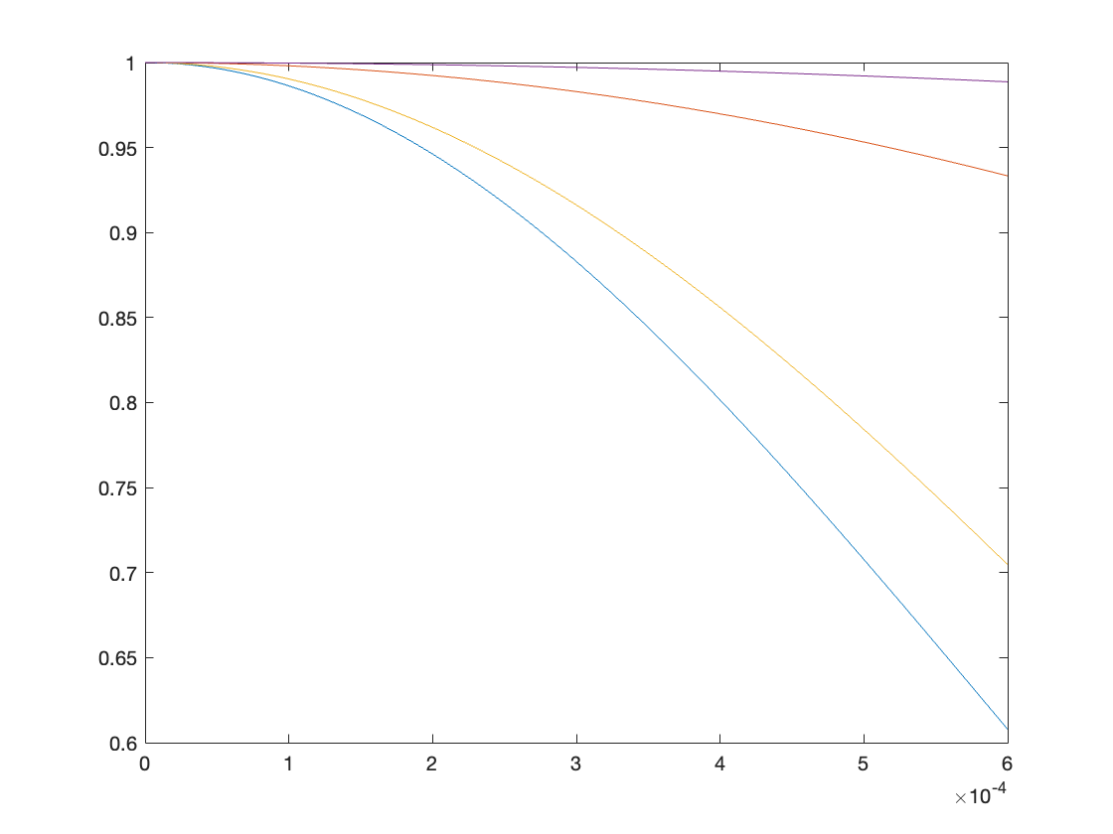
On beam size/ beam shape
What is the needed ratio between gaussian beam shapes of laser and electron beam ?
  Nickolai:” All electrons of the bunch should have the same probability of scattering on the laser target.
  The fulfillment of this condition means that we will be able to measure the correctly averaged polarization and energy, as well as the correct transverse dimensions and positions of the beam. Here I mean the measurements done by the polarimeter itself.
  That is, we do not have to think, for example, about the chromatism of spin motion, etc.
  Failure to comply with this condition, however, will make it possible to observe the (de)polarization process(es) and measure the energy by the depolarization method. »
What can we tolerate for the variation of interaction probability for electrons located say 2-sigma away from the beam center ?
Trade-off between luminosity and interaction probability variation ?
Do we actually ’need’ that or rather treat it as systematics and scan the laser through the beam ?
600um laser beam
300ps, 3degree
3ns,2mrad
30ps,3degree
Relative interaction probability
3ps,3degree
Distance to beam center (m)

