Slide 1


How to standardize experiments within HEARTS?
The GSI perspective
Online, 08.02.2023
related to:
WP4 Task 4.4 and D4.4
WP6 Task 6.1 and D6.1
WP8 Task 8.1 and D8.1
Christoph Schuy, Tim Wagner, Uli Weber and Marco Durante
GSI Biophysics
This project has received funding from the European Union’s Horizon Europe Research and Innovation programme under GA No 101082402.

Slide 2
Disclaimer / Consideration
The goal of this presentation is start a discussion. All ideas/proposed solutions are up for discussion.
The discussion is tailored for the GSI part of the project but significant parts can be directly used for CERN as well.
NSRL is our internal benchmark, but it is important to understand that there are significant differences e.g.
  NSRL is a pure user facility. Everybody working at NSRL is either doing beamline development or user service
  GSI is rather a science facility.
  The level of direct support we can offer will most likely be smaller
Beam time is very limited and must be used very efficiently, thus universal, simple and practical interfaces are needed
The “standard” we try to find doesn’t need to fit all possible experiments, only most. Non-standard experiments will, of course, still be possible if necessary.

Slide 3
Topics / Flow
Part 2
Part 1
Proposed workflow
first contact point of users via webpage
  user guide
  FAQ
  contact/beam request
assignment of liaison scientist
experiment scheduling / planning
on-site dry-run
beam exposure
test report
Technical parameters
Beam parameters
Variable shielding / range shifter
Target station

Slide 4
Part 1
Beam parameters
Note:
Every change to the accelerator settings during beamtime take at least 30 min and can take up to hours
Ions are not offered at the same time
 | GSI | comments
Energies | 80-1000 MeV/u | Typically 2-3 energies
Ions | H to U | typically C, Fe, U *
Intensity range | 500 – 10⁹ per spill | Depends (a bit) on the ion species
Extraction | Slow 1-10 s (quadrupole resonance) | Optional slow RF-KO (1 – 10 s), Fast kick out extraction (<1µs)
Spill length | 0.2 – 10s
Spill pause | < 2s | Variable duty cycle
Delivery | Scanning | Arbitrary shapes
Max area | Up to 20 x 20 cm² | < 5 x 5 cm² for uranium
Uniformity | Better than +-5%
Beam microstructure | Important? | Can be improved with RF-KO
beam on
Proposal:
One high energy → Shoot through/Bio
One low → BP scanning
One high intensity > 10⁶ per spill
One low intensity ≈ 5000 per spill
Spill
beam off
source
* additional ions like protons, helium might be available

Slide 5
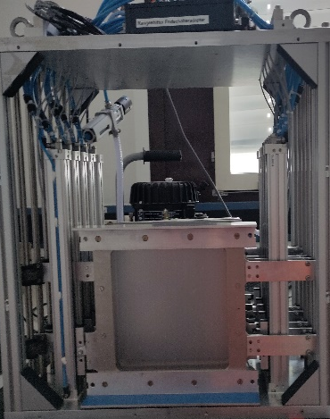
Part 1
Variable shielding handler/ Variable depth Bragg Peak Range shifter
modular version of the cave A binary range shifter
4 modules → 8 plates
  module
    2 plates, two sets of pneumatic linear motors
    max size 20 x 20 cm²
    max weight ≈ 10 kg
modules can be used individually or combined
standardized frames for “fast” plate exchange
  CAD available for users in case of non-standard configuration
Standard plate-sets for
  shielding (aluminum, PE) → thicker
  peak finding for electronics → binary, thinner
Note:
NSRL uses 2 target wheels which offers some geometrical benefits but is far less flexible/useful for different settings
“Old” binary Range shifter

Slide 6
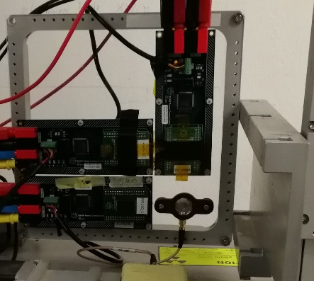
Part 1
Target station / Target station interface
Based on linear axes with hybrid steppers
  every point within the frame reachable via scanner and/or motor
Distortion corrected and calibrated target camera (OpenCV)
  Front or back
Distortion corrected Target laser
Remote movement (z → beam direction)
  x / y → standard
  + 1D-Rotation optional
One frame per “experiment”
Frame design based on CERN holder
  Inner opening > 20 x 20 cm² (RADEF and GANIL allow for up to 25 x 25cm² boards)
  Laser markers (back and/or front)
  Material: aluminum or reinforced plastic
Note: Entering the cave takes a minimum of ≈ 10 min
CERN target station and holder

Slide 7
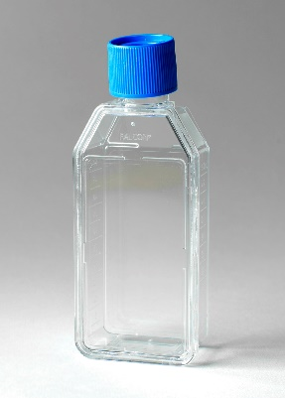
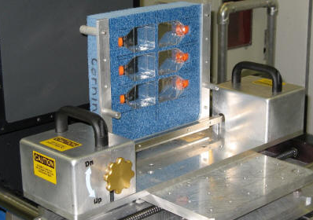
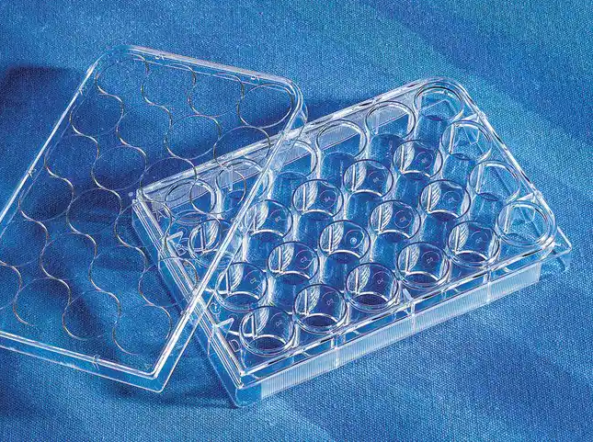
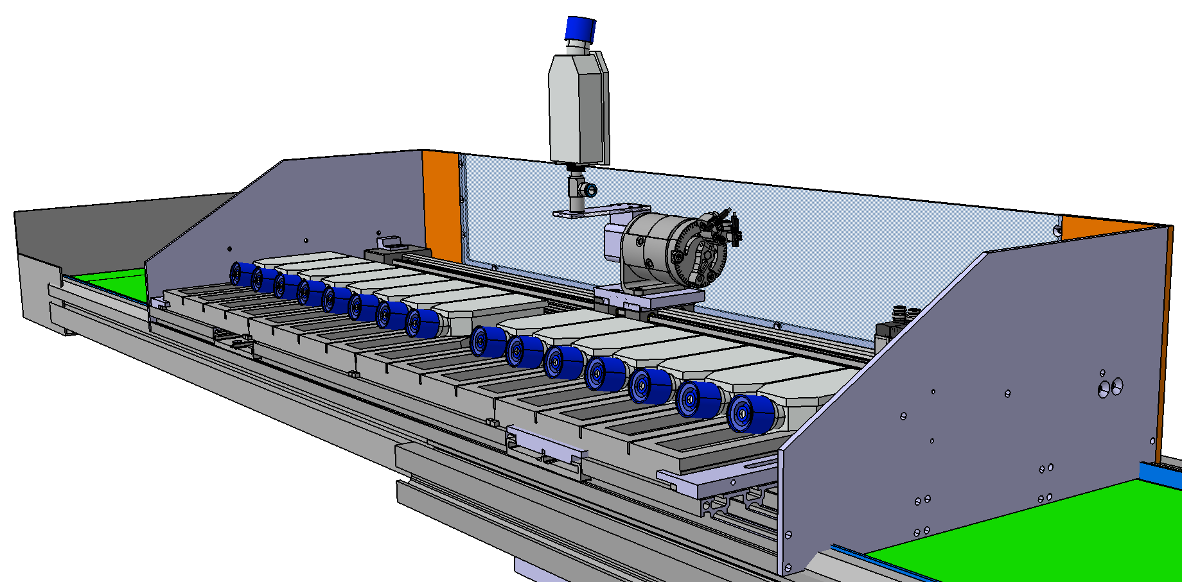
Part 1
Target station / Target station interface Bio
Biology irradiations typically use:
  T25 or T12.5 Flasks in sets of three or six per dose
  Well plates
Cells inside the flasks prefer to stay inside the medium
  Fill the flasks completely
  Only position them upright for a short time (<20min, depends on the experiment)
T25 Flask
Possible to integrate into a target station
Proposal:
Utilize a system, which flips flasks into an upright position only for irradiation and positions them horizontally otherwise (based on the GSI flask exchanger).
System should accept at least three, better six, T25 flasks at the same time and also be compatible with well plates
NSRL remote sample flipper
Well plate
More complicated to integrate into a target station, prototype exists at GSI already
GSI Flask exchanger

Slide 8
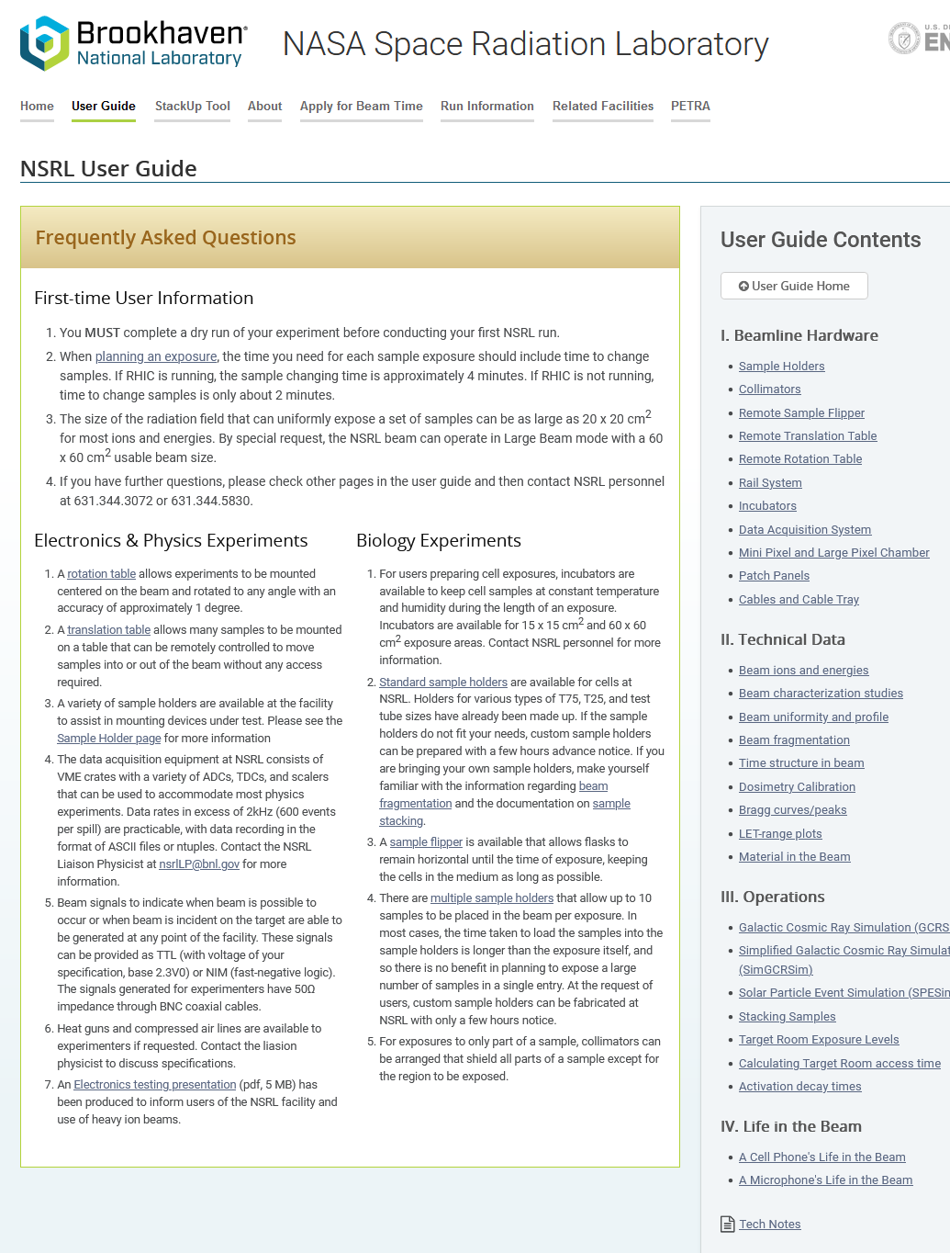
Part 2
HEARTS website – facility user guide
Similar to the NSRL user guide (https://www.bnl.gov/nsrl/userguide/)
Short explanation of basic physics with relevant examples
  Scattering/fragmentation/etc.
  Shared GSI/CERN
Explanation of irradiation room + CAD
  Space, cables, etc.
Explanation of beamline + CAD
Explanation of dosimetry/beam monitoring
Explanation of Shielding exchanger + interface CAD
Explanation of target station + interface CAD
  In case of bio → standardized flasks/etc.
Explanation of preparation/dry run
Resource/tools (Lise++, etc.)
  Shared GSI/CERN

Slide 9
Part 2
Liaison scientist
How much support is necessary/wanted by industry?
Possibilities for support
Regulatory requirements (e.g. radiation protection, biological lab safety, required GSI instructions, etc.)
Experimental planning?
MC simulations or other forms of calculations
Non-standard holders etc.
Fully perform the testing (no industry partner) on-site
Use of GSI/FAIR experimental equipment e.g. power supplies
Note: Beam exposure, etc. will always be performed by GSI/FAIR staff

Slide 10
Part 2
Requirements to access GSI
Workflow for onsite access for experimenters
Apply for guest status at GSI
  Fill online registration forms
  Sign Home institute declaration
  Perform general GSI safety instructions online
If access to the cave is needed:
  Further online safety instructions
  Medical certificate
  Apply for TLD dosimeter (or Barcode if neutron sensitive dosimeter is available)
  Safety instructions on site
Possibly apply for access to the Internet* or even to the GSI network / clusters
The application for a guest status process is required for everyone coming to GSI
The rules for getting access to the cave follow German radiation protection laws and cannot be changed.
Guides for all registration processes are available on the GSI webpages
* in case the user cannot access eduroam

Slide 11
Part 2
Experiment scheduling / planning
Available at https://www.gsi.de/fileadmin/beamtime/2022/BTS2022_v042.pdf
Influencing when a specific beamtime block is scheduled is really difficult
Specific user wishes for dates are essentially impossible
Scheduling within a specific beamtime block is up to us → degree of flexibility
The beam time block is fixed and the time slots must be accepted by the users

Slide 12
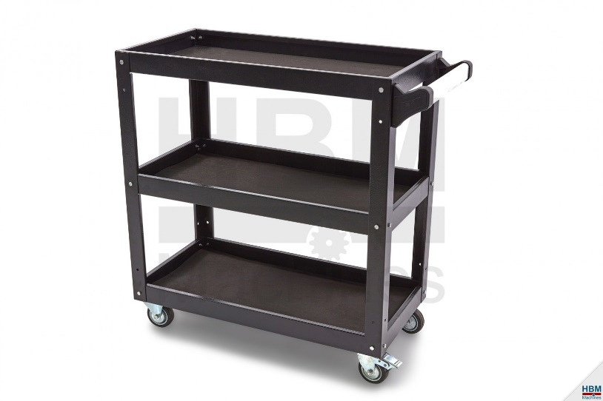
Part 2
On-site dry run / Target preparation
Goal: time optimization
Minimizing the setup time (likely, there are other experiments right before and afterwards)
Every experiment gets one cart to place electronics
If possible, every experiment should perform a dry run outside of the cave
Proposed process
  Prepare experiment on cart
  Test outside of cave
  Move fully tested experiment to cave
  Irradiate
  Bulk remove
example

Slide 13
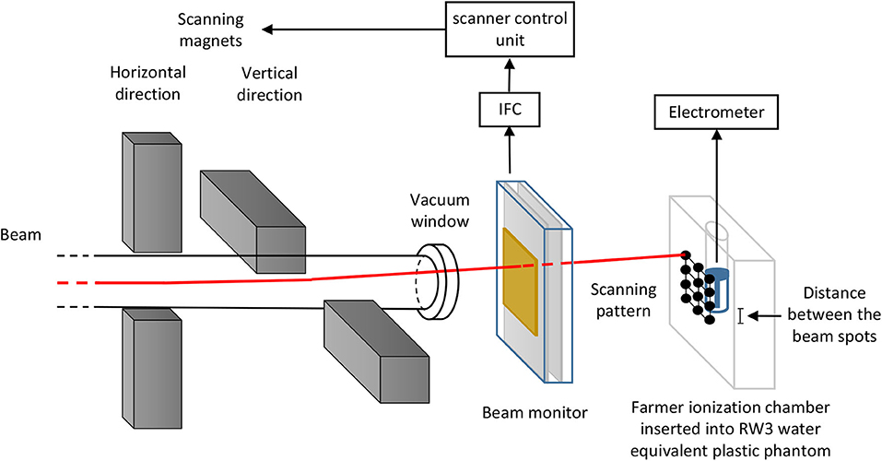
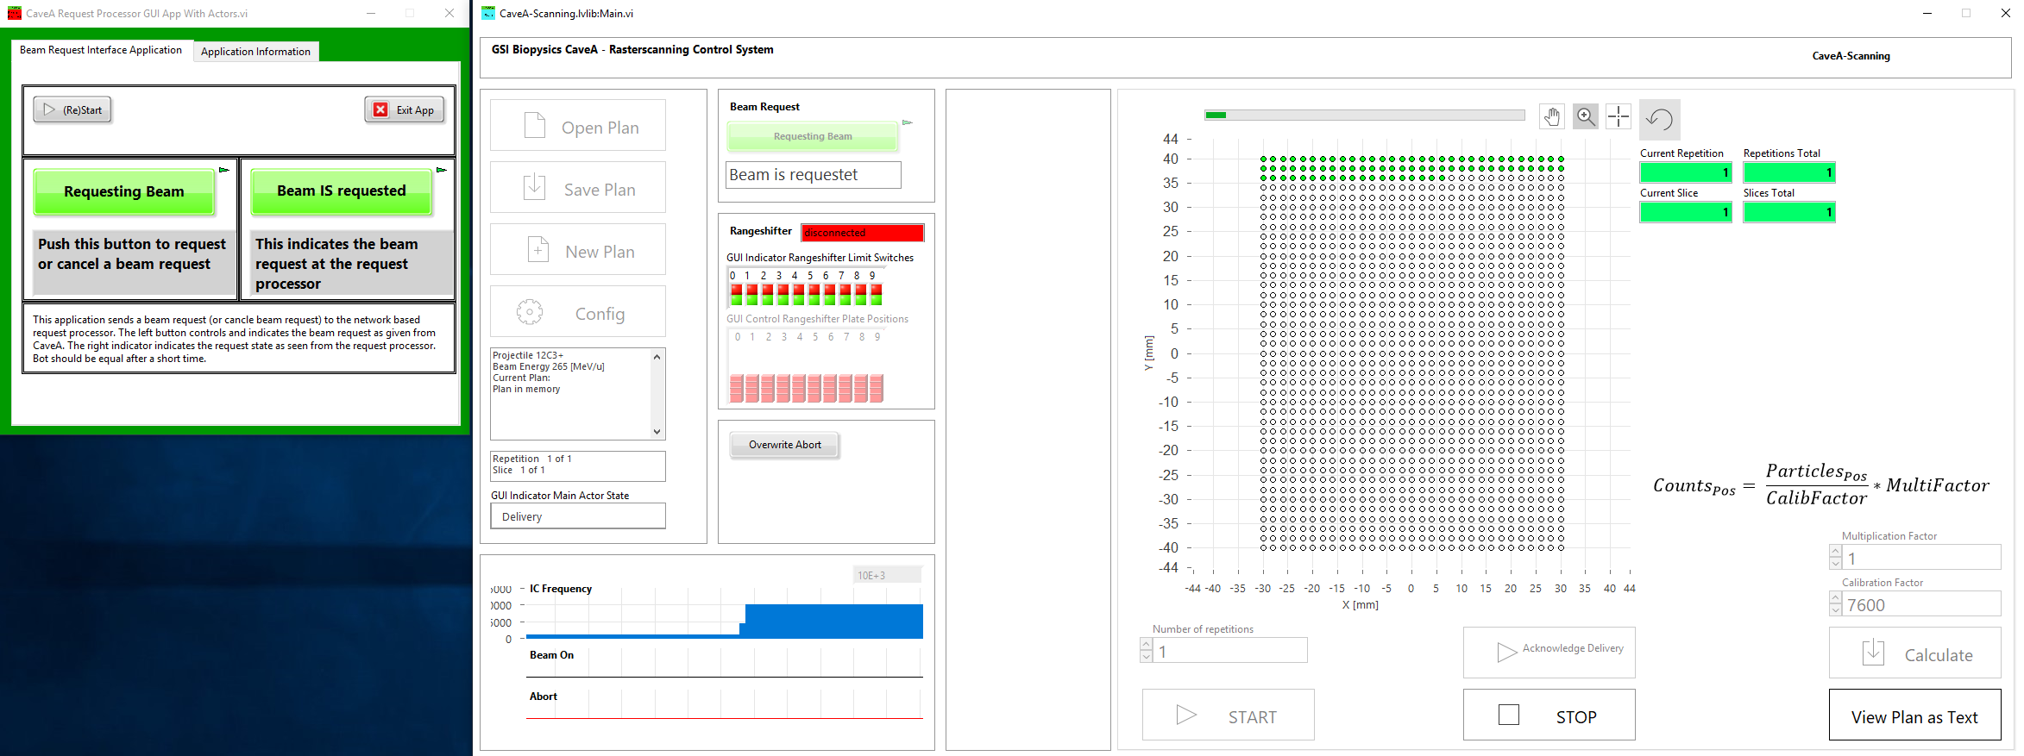
Part 2
Beam exposure
Information, which has to be supplied for the irradiation process
Desired beam intensity
  Can also be adjusted during the experiment, but takes time (larger steps take more time)
Irradiation areas (positions on the DUT and sizes)
Cave A Scanning system
  Used for setting up the scanning system
  Easily adjustable during the experiment in case more or less are needed
Desired total number of ions / cm² (for each irradiation area)
  Easily adjustable during the experiment in case more or less are needed
Cave A Scanning system GUI

Slide 14
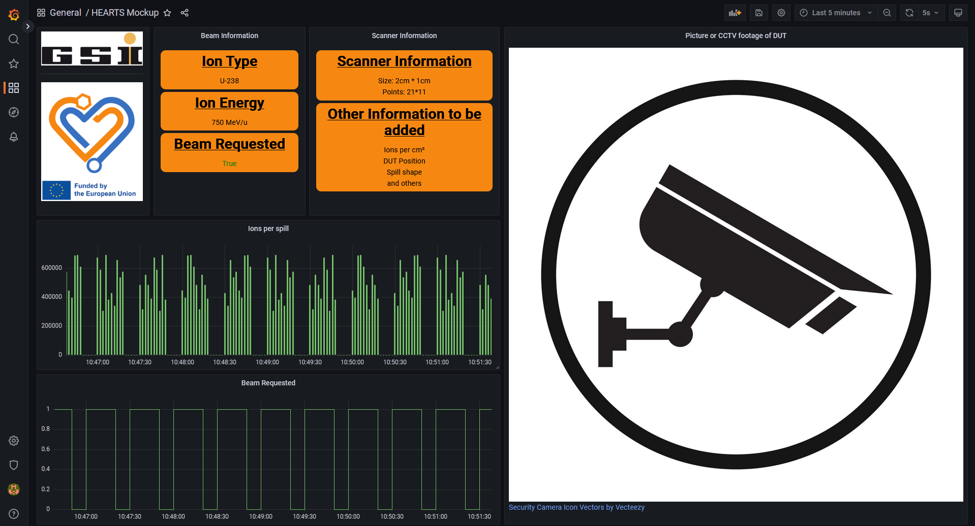
Part 2
Online information for users
Goal: Supply information to users
Show live data about the irradiation
Beam type & energy
Status / Progress of the beam application via scanning
Ions / spill, avg. # Ions for last N spills, Ions / cm² / s, etc.
DUT positioning picture
Target station data (X & Y position, etc.)
Information about other instrumentation (e.g. shielding)
What other kind of data would be needed here?

Slide 15
Part 2
Beam exposure – additional signals for users during exposure
Note: The amount of recorded information in different systems of the irradiation room/accelerator is extremely high
E.g. time resolved pulses of the beam monitoring detectors
What standard? NIM/TTL 5V/24V
Will these signals recorded by the user or by us and we only provide a timestamp or a synchronization pulse?
Define a set of information of interest for most experiments

Slide 16
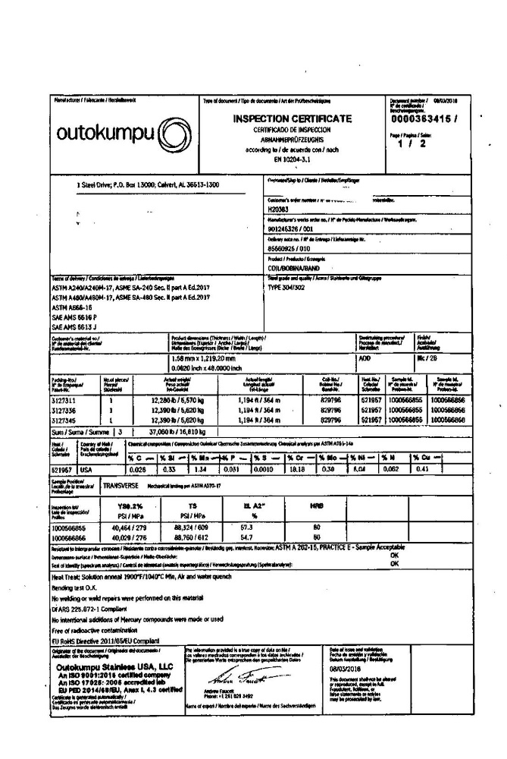
Part 2
Test/Summary sheet/Logbook
Note: The amount of recorded information in different systems of the irradiation room/accelerator is extremely high
Possible options:
Standardized test report per sample
Scan of Logbook
E-Log
Possible information
  Beamspot
  Field
  Planned exposure
  …
Define a set of information of interest for most experiments

Slide 17
Did we miss any crucial points?

