Slide 1
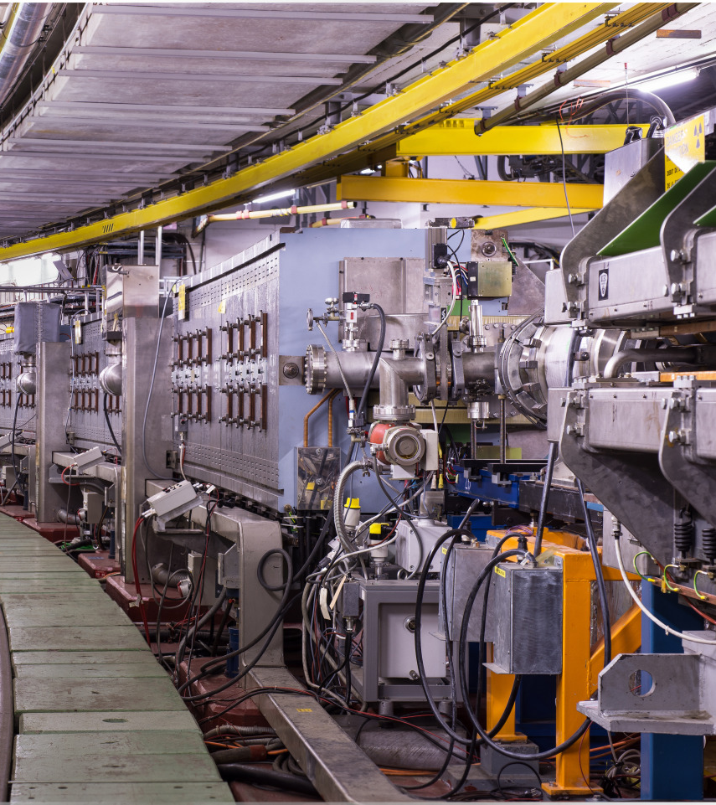

PS to SPS transfer: for a better understanding of the different observables and difficulties
A. Huschauer, K. Li

Slide 2


Overview & disclaimer
Handing over beam from the PS to the SPS – can be tricky at times
Several prerequisites need to be met and the needs to be a common understanding of beam quality
Even then, bad beams can still secretly sneak into the downstream machine, i.e., the SPS!
Here we would like to discuss some of the observables in place and how we could make use of them to optimize the PS 2 SPS beam transfer and the associated beam quality?

Slide 3
PS beam production basics

Slide 4
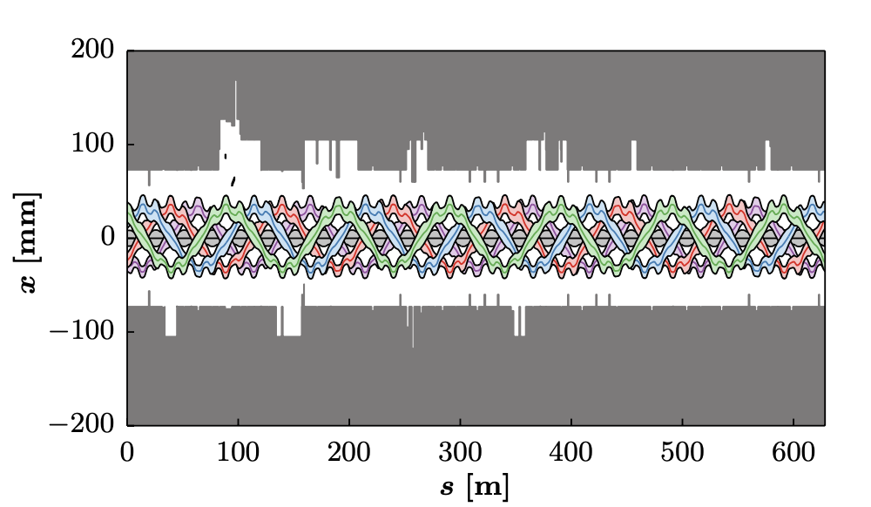
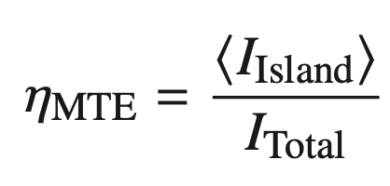
PS SFTPRO beam production in a nutshell
Main requirement: extract a 5-turn spill at constant intensity from the PS to fill
10/11 of the SPS in two consecutive shots
  Achieved using the Multi-Turn Extraction (MTE)
  Magnetic splitting to separate the beam in the
  horizontal phase space into 4 islands and one core
    Reduction of losses on the magnetic septum
    SMH16 and around the ring
    Intensity sharing quantified using the
    MTE efficiency (average intensity in one island
    over the total intensity, ideally 0.2):
simulation
septum blade in
particle-free space
Challenging in terms
of aperture!

Slide 5
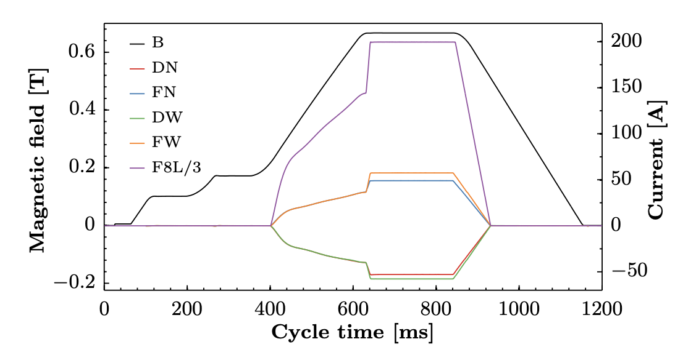
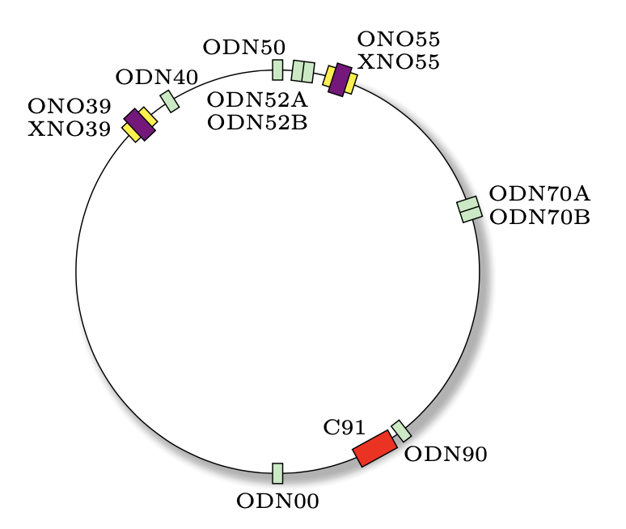
PS SFTPRO beam production in a nutshell
Fundamentals of the SFTPRO cycle
  Extraction at 14 GeV/c to optimize SPS duty cycle
  Working point setup with PFW to
    achieve tunes of Q_{x}=6.245 and Q_{y}=6.30 on the flat top to cross
    Q_{x}=6.25 from below
    Set slightly positive chromaticities to avoid head-tail instabilities and reduce
    chromatic tune spread
  Excitation of the stable fourth order resonance 4Q_{x}=25 with dedicated sextupoles (XNO) and octupoles (ONO, ODN)
    Strengths of these elements defines position and size of the islands
    XNOs also used for chromaticity adjustment
  Ramp on the horizontal tune to cross resonance 4Qx =25 and create the islands
    Done with the low energy quadrupoles (LEQ)
    Amplitude of the islands is directly proportional to the horizontal tune
      tune change of ~1E-3 at extraction corresponds to movement of the islands by
      dx~5mm

Slide 6
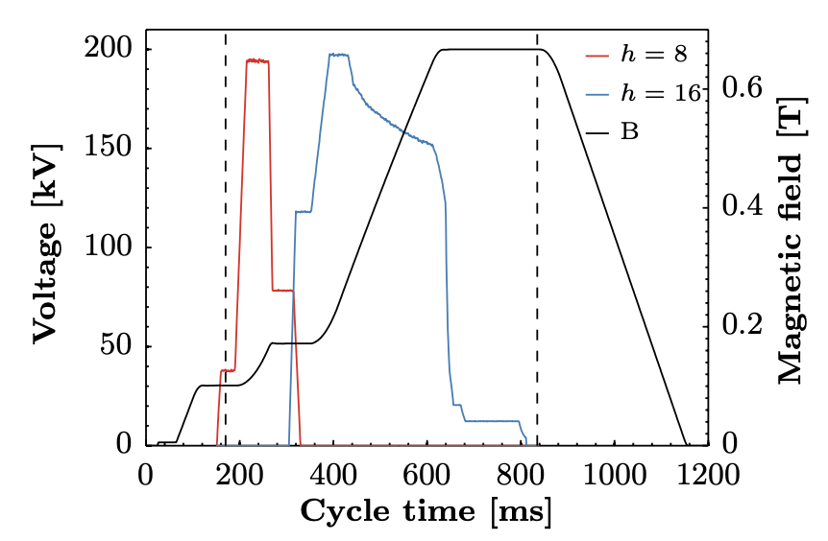
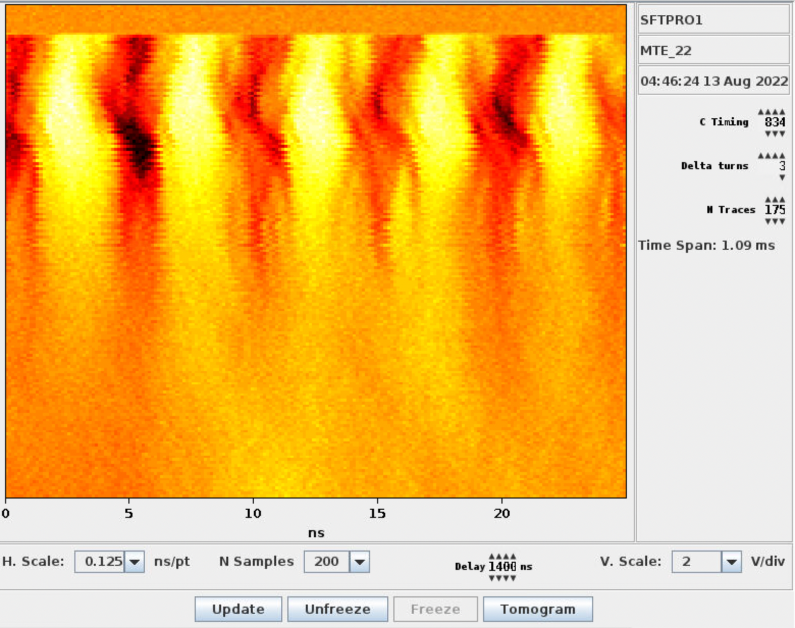
PS SFTPRO beam production in a nutshell
Fundamentals of the SFTPRO cycle
  Transverse damper in excitation/blow-up mode during the early part of the magnetic splitting
    Helps to push particles into the islands and achieve proper intensity sharing
  Low RF voltage to decrease horizontal tune spread followed by debunching
    Single 10MHz RF cavity (usually C10.91) operating at 12 kV
  Imprinting a 200 MHz modulation on the debunched beam for
  improved capture in the SPS
    Non-barrier bucket extraction:
    200 MHz amplitude on the
    beam adjusted using the radial
    position before extraction as
    part of energy matching,
    rarely ever touched afterwards
Synchronisation with barrier bucket covered in an upcoming lecture by Mihaly Vadai

Slide 7
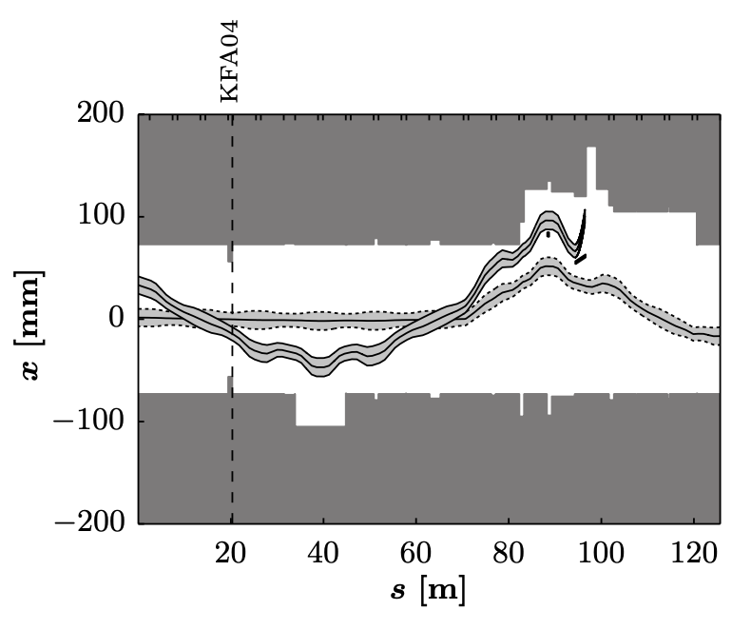
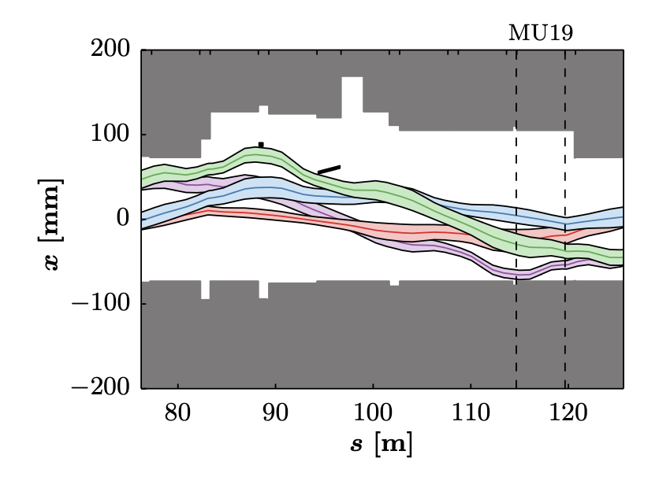
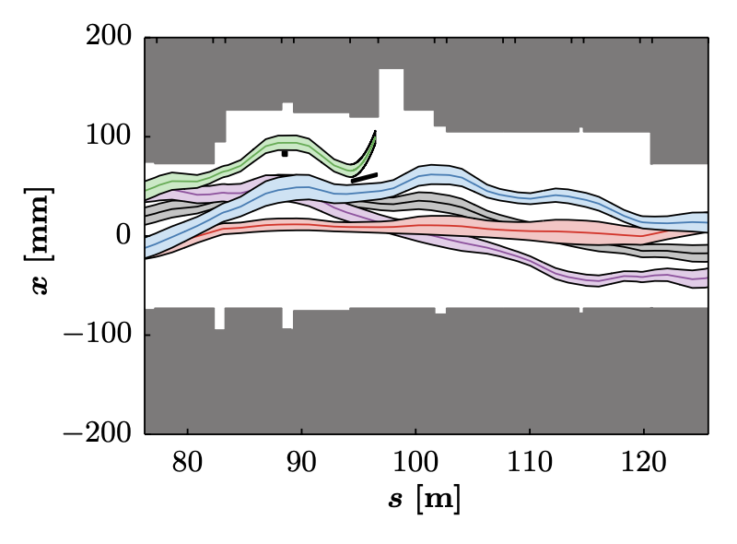
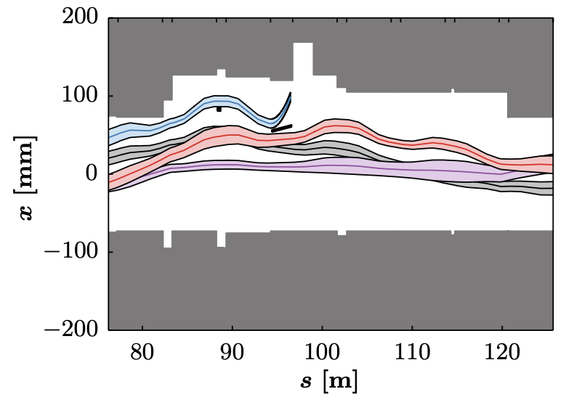
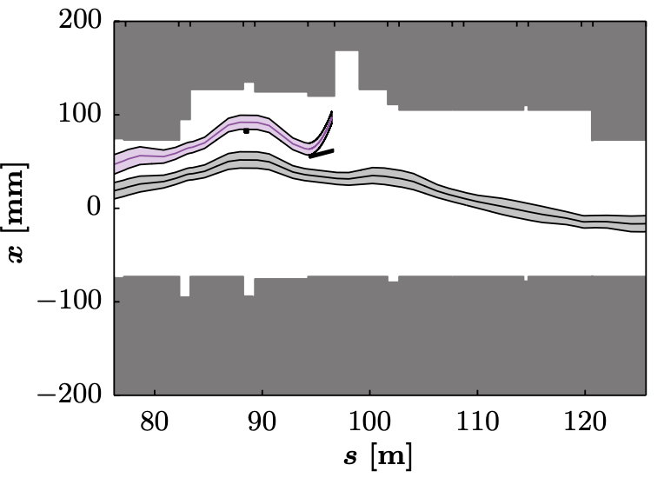
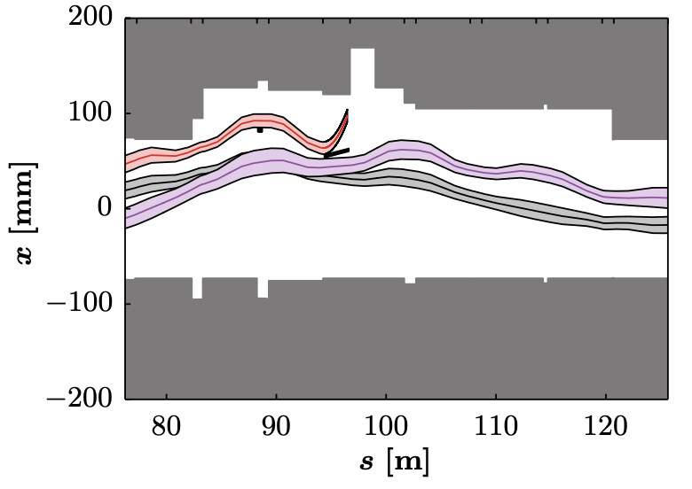
PS SFTPRO beam production in a nutshell
Fundamentals of the SFTPRO cycle
  Extraction over 5 turns
    Slow bump using four dipole magnets BSW12, 14, 20 and 22 to approach the extraction septum (increase in 6 ms)
    Fast bump with KFA13 and 21 (lasting 5 turns) to extract the islands
      Each islands extracted with ~ identical position and angle
    KFA4, BFA9 and KFA71 to extract core during the last turn
SMH16

Slide 8
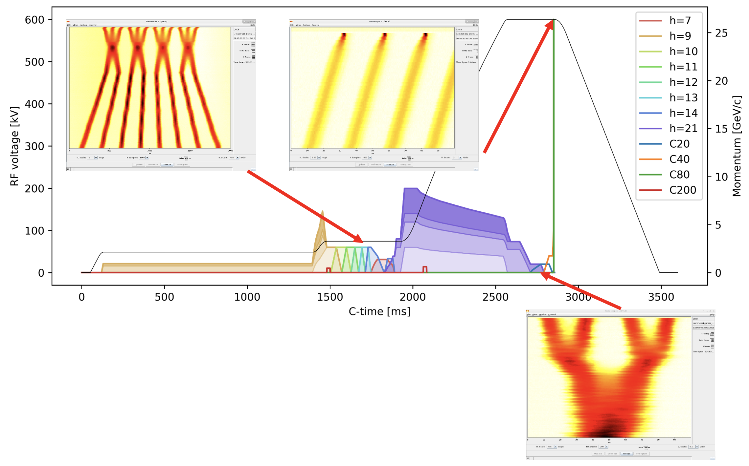
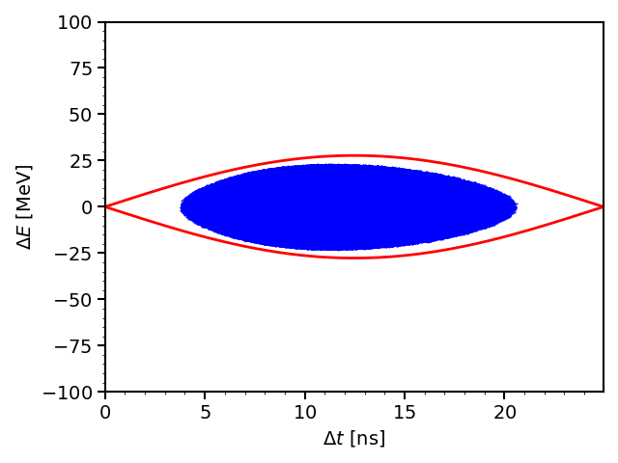
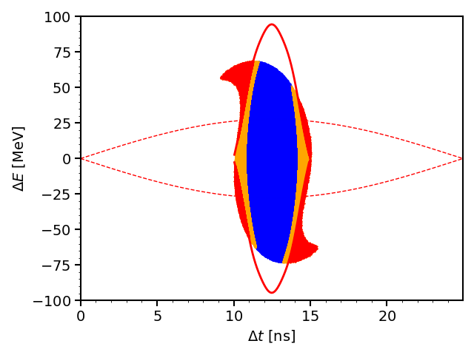
PS LHC beam production in a nutshell
Example of the BCMS beam
  8 bunches injected from PSB
  Merging into 4 bunches and then triple-splitting into 12 on intermediate plateau → 10 MHz cavities
  Quadruple splitting on the flat top to establish
  25 ns spacing → 20, 40 MHz cavities
  Bunch rotation before extraction to “fit” into
  SPS bucket → 2x40, 2x80 MHz cavities
  Synchronised
  transfer to SPS
!! not for single
bunches !!
A. Lasheen, OP Shutdown lectures 2020

Slide 9
PS 2 SPS – beam quality & transmission for SFTPRO

Slide 10
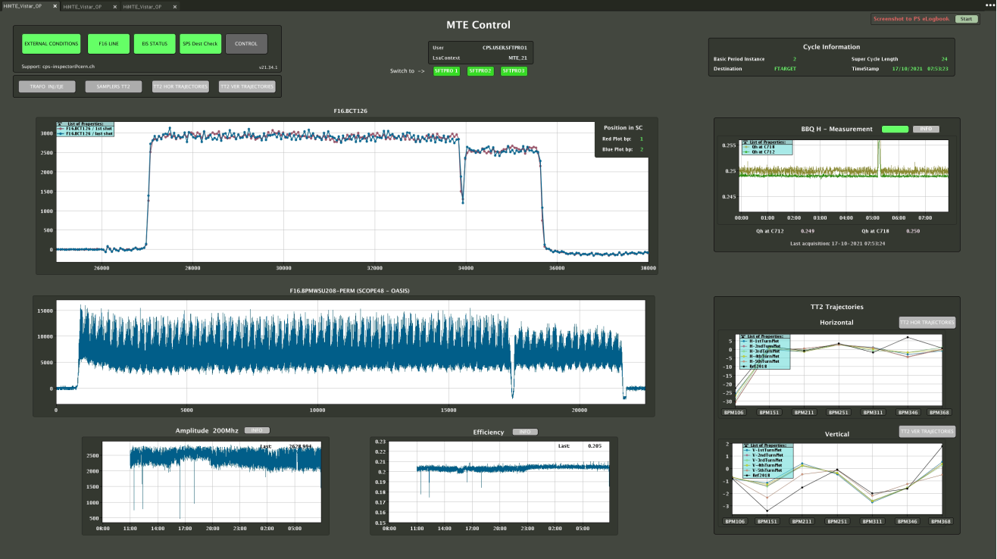
PS cycle – quality control
Most important signal to quantify the MTE splitting - sum signal of F16.BPMW208
Used to calculate:
MTE efficiency
200 MHz modulation amplitude (peak amplitude of FFT at 200 MHz)
Evolution of 200 MHz amplitude
Evolution of MTE efficiency

Slide 11
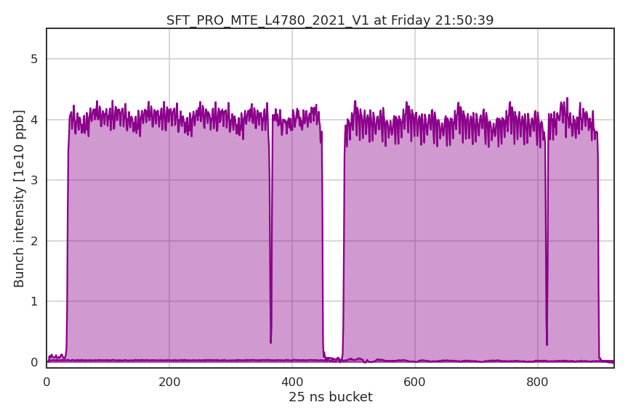
PS cycle – quality control
1st injection
Good spill
2nd injection
4 Islands
Core

Slide 12
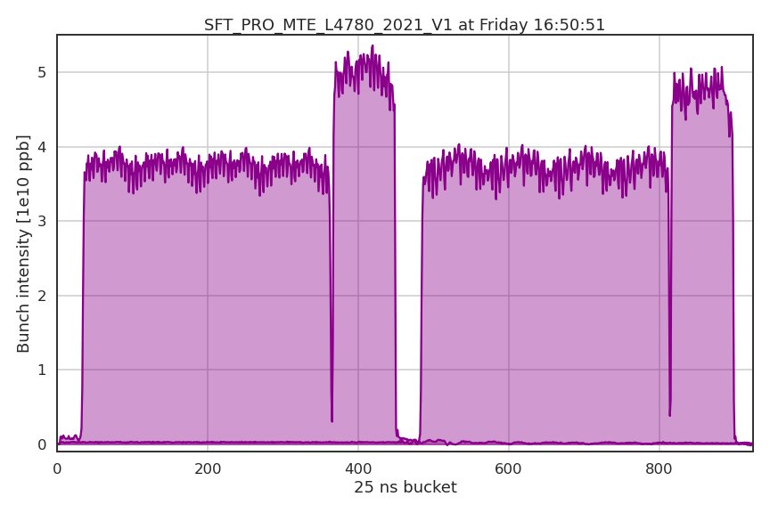
PS cycle – quality control
1st injection
Not so good spill…
2nd injection
4 Islands
Core

Slide 13
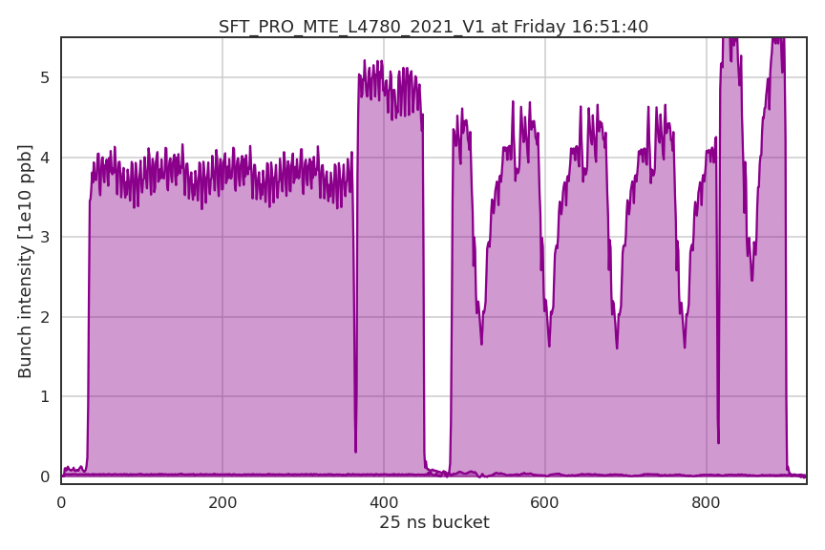
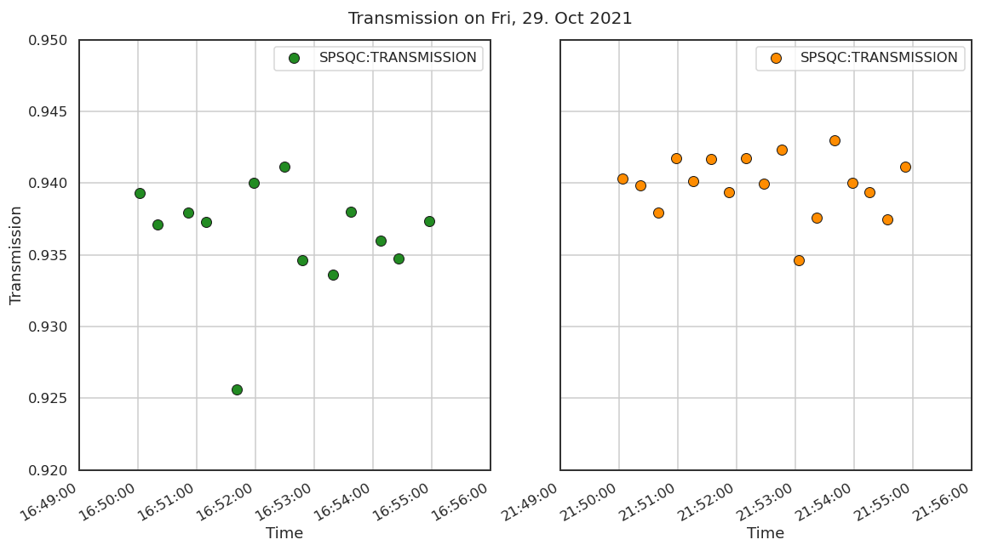
PS cycle – quality control
1st injection
Thank God it’s the upstream machine → PSB at fault!
2nd injection
→ Bad beam quality had an immediate impact on the SPS transmission and thus, the spill quality
Correction knobs:
Relative phases between h8 and h16
Horizontal tune, transverse damper frequency and amplitude
DFAs – using two kickers
Radial steering (normally only during commissioning as part of energy matching, then stable)
Beam quality:
Long. splitting symmetry (no online monitoring – but very robust)
Tune before splitting
MTE efficiency (roughly around 0.2)
Uniformity of island and core trajectories
Magnitude of 200 MHz component for SPS recapture (roughly between 2000 and 3000 – intensity dependent)
corrected
4 Islands
Core
églises

Slide 14

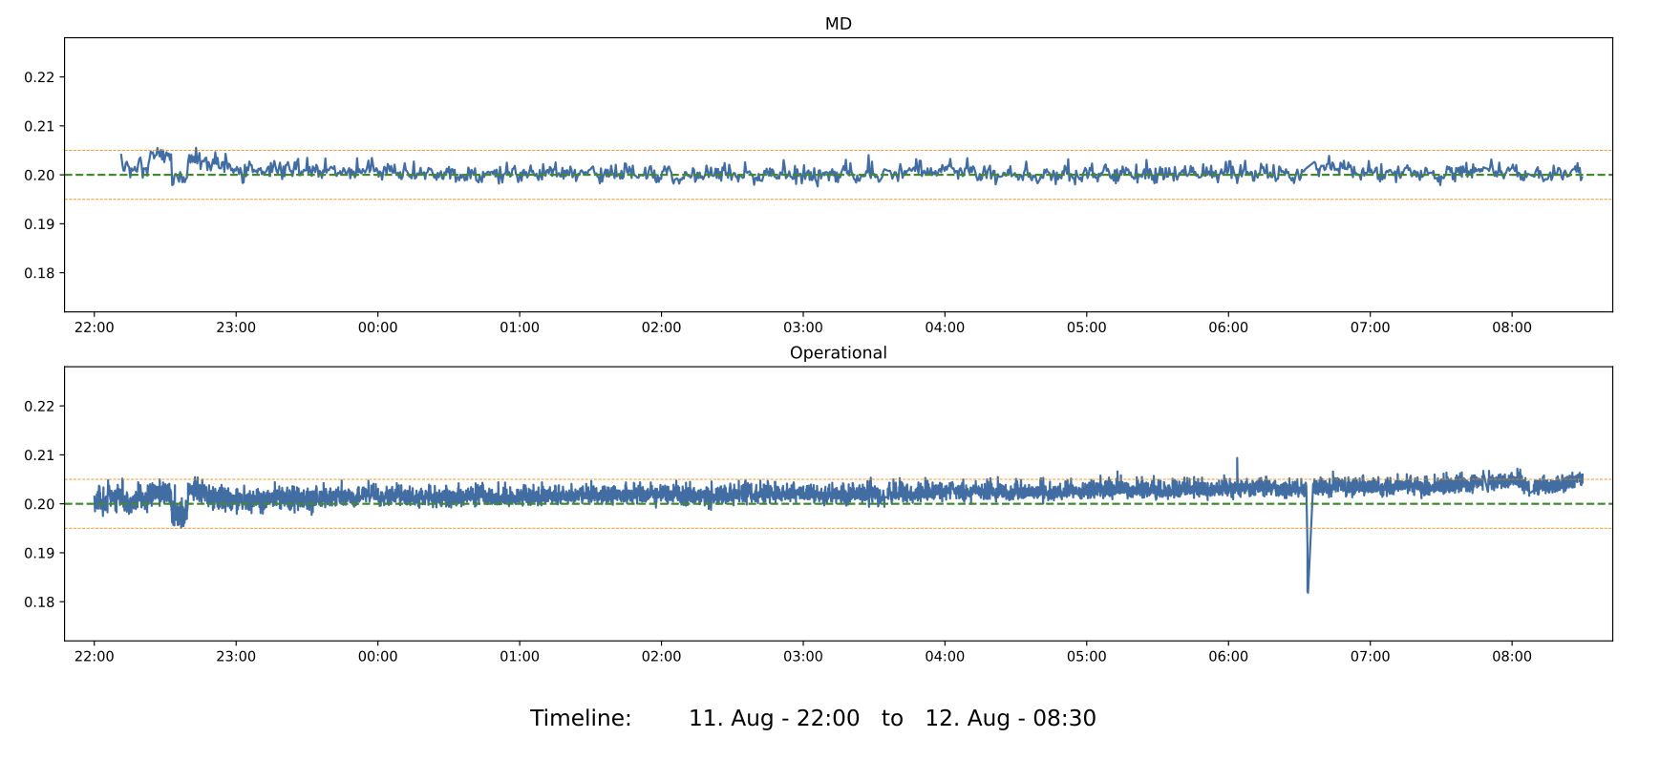
PS cycle – most important correction knobs
Three very effective knobs to adjust MTE efficiency:
  Horizontal tune during the splitting
  Frequency of the transverse damper excitation
  Amplitude of the transverse damper excitation
    increases horizontal size of the core if too high!
Excellent prospect for real-time control using
the Extremum Seeking (ES) algorithm
  See work by Cédric Uden
KFA4 and KFA71 to adjust core trajectories
MD cycle controlled by ES
Drift on operational cycle without ES

Slide 15
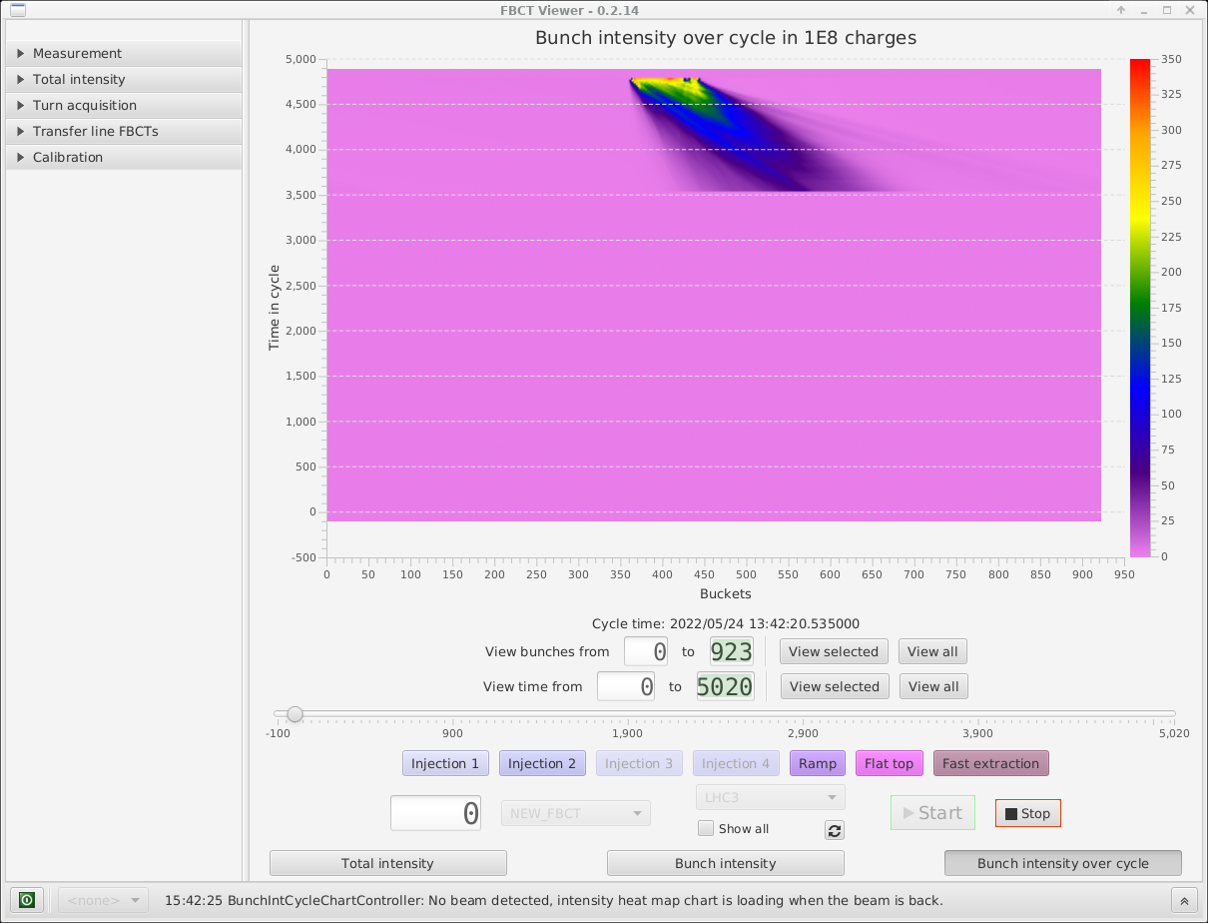
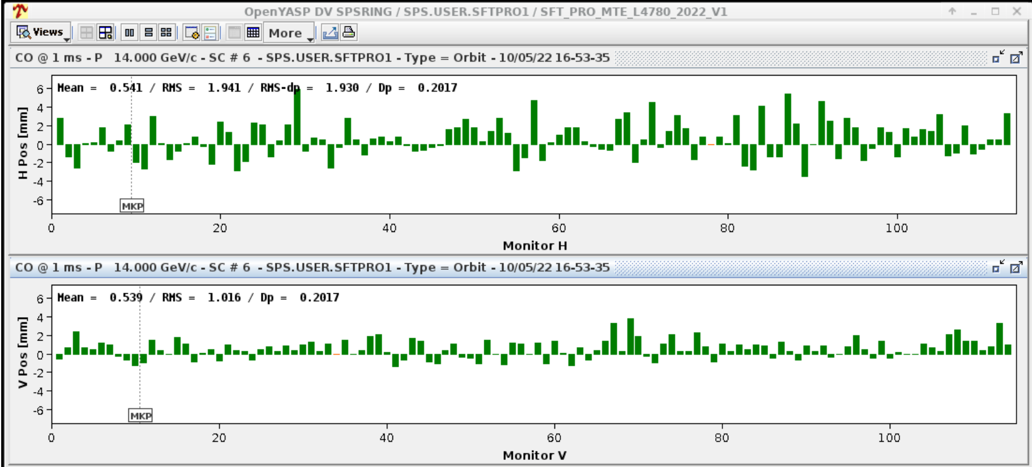
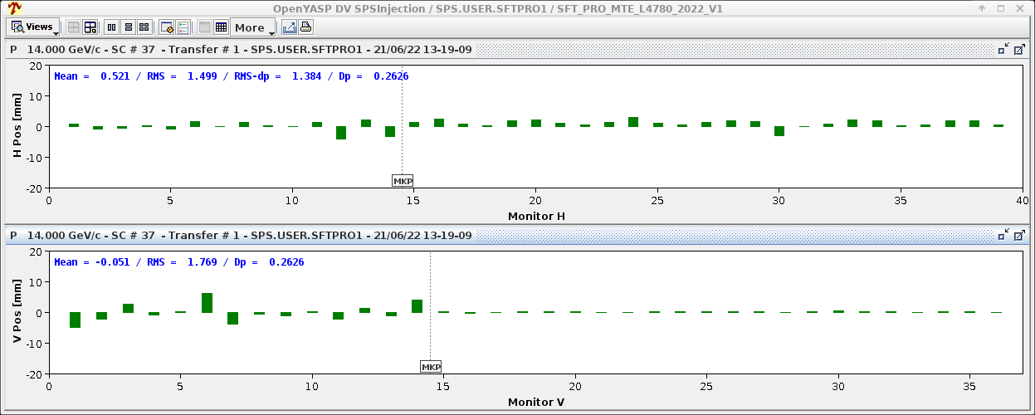
SFTPRO beam injection – SPS observables
Impacts transfer and transmission and is important for capture
Usually done when setting up new beams (beam commissioning)
Diagnosed using FBCT and MR as well as injection trajectories and orbit
This year, being monitored in the SPSQC to understand drift patterns
More info see OP shutdown lecture by S. Cettour Cave
Energy matching:
  Important prerequisite for optimal injection
  Diagnostics:
    Fast BCT
    Mountain range
    Synchro loop error
    First turn
    Beam orbit after ~50 ms

Slide 16
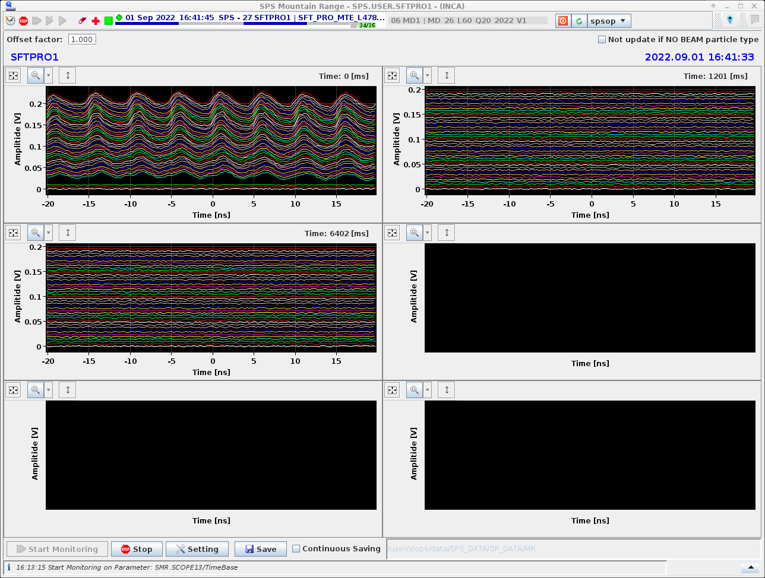
SFTPRO beam injection – SPS observables
Is often realized when SPS doesn’t capture and all beam is lost at start ramp
Diagnosed using Mountain range – very qualitatively
PS has their own measure of 200 MHz amplitude
We need to get a common quantitative measure of this parameter!
Longitudinal structure:
  200 MHz structure important for capture
  in the SPS
  Diagnostics:
    Mountain range

Slide 17
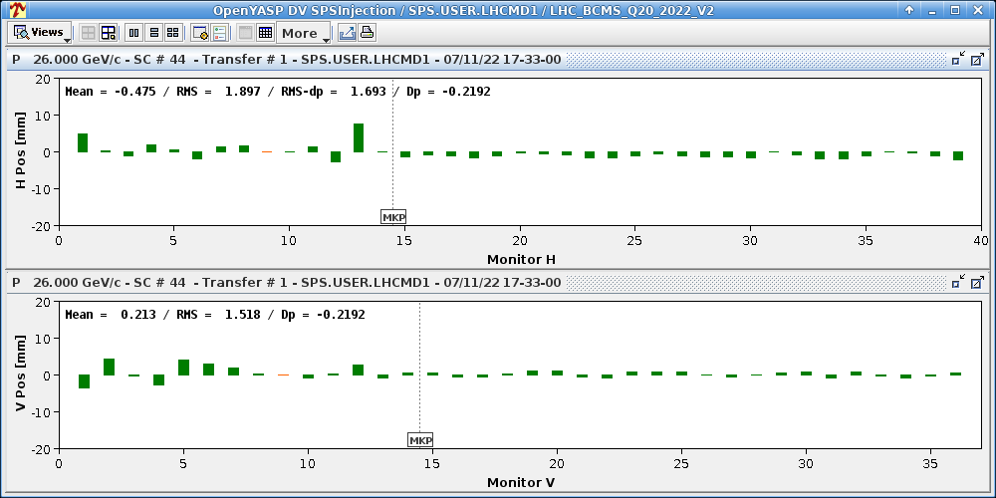
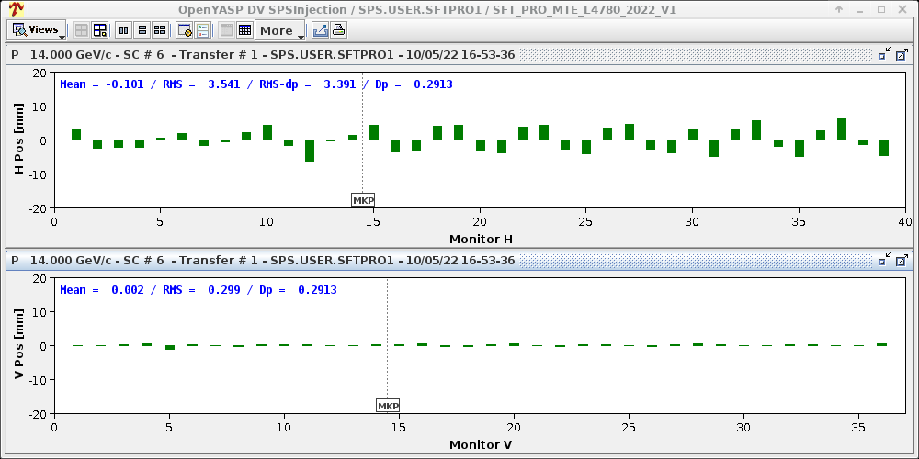
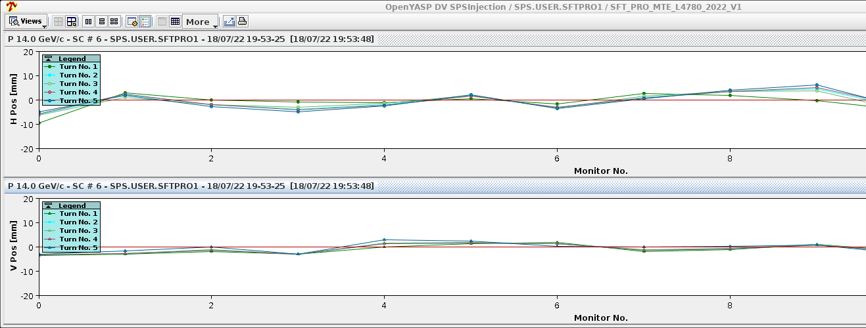
SFTPRO beam injection – SPS observables
Is often realized when there are large injection losses
Diagnosed using YASP – signature rather clear
PS used to have to be on their “Golden”
With new stitched model we can imagine to have an Injection Autopilot continuously monitoring and correcting for both machines
Injection steering:
  Important prerequisite for optimal injection
  Turn-by-turn trajectory adjustment with DFAs
  done from PS side using stitched model
  Diagnostics:
    YASP – using TT2 – TT10 stitched model
    YASP – using turn-by-turn acquisition

Slide 18
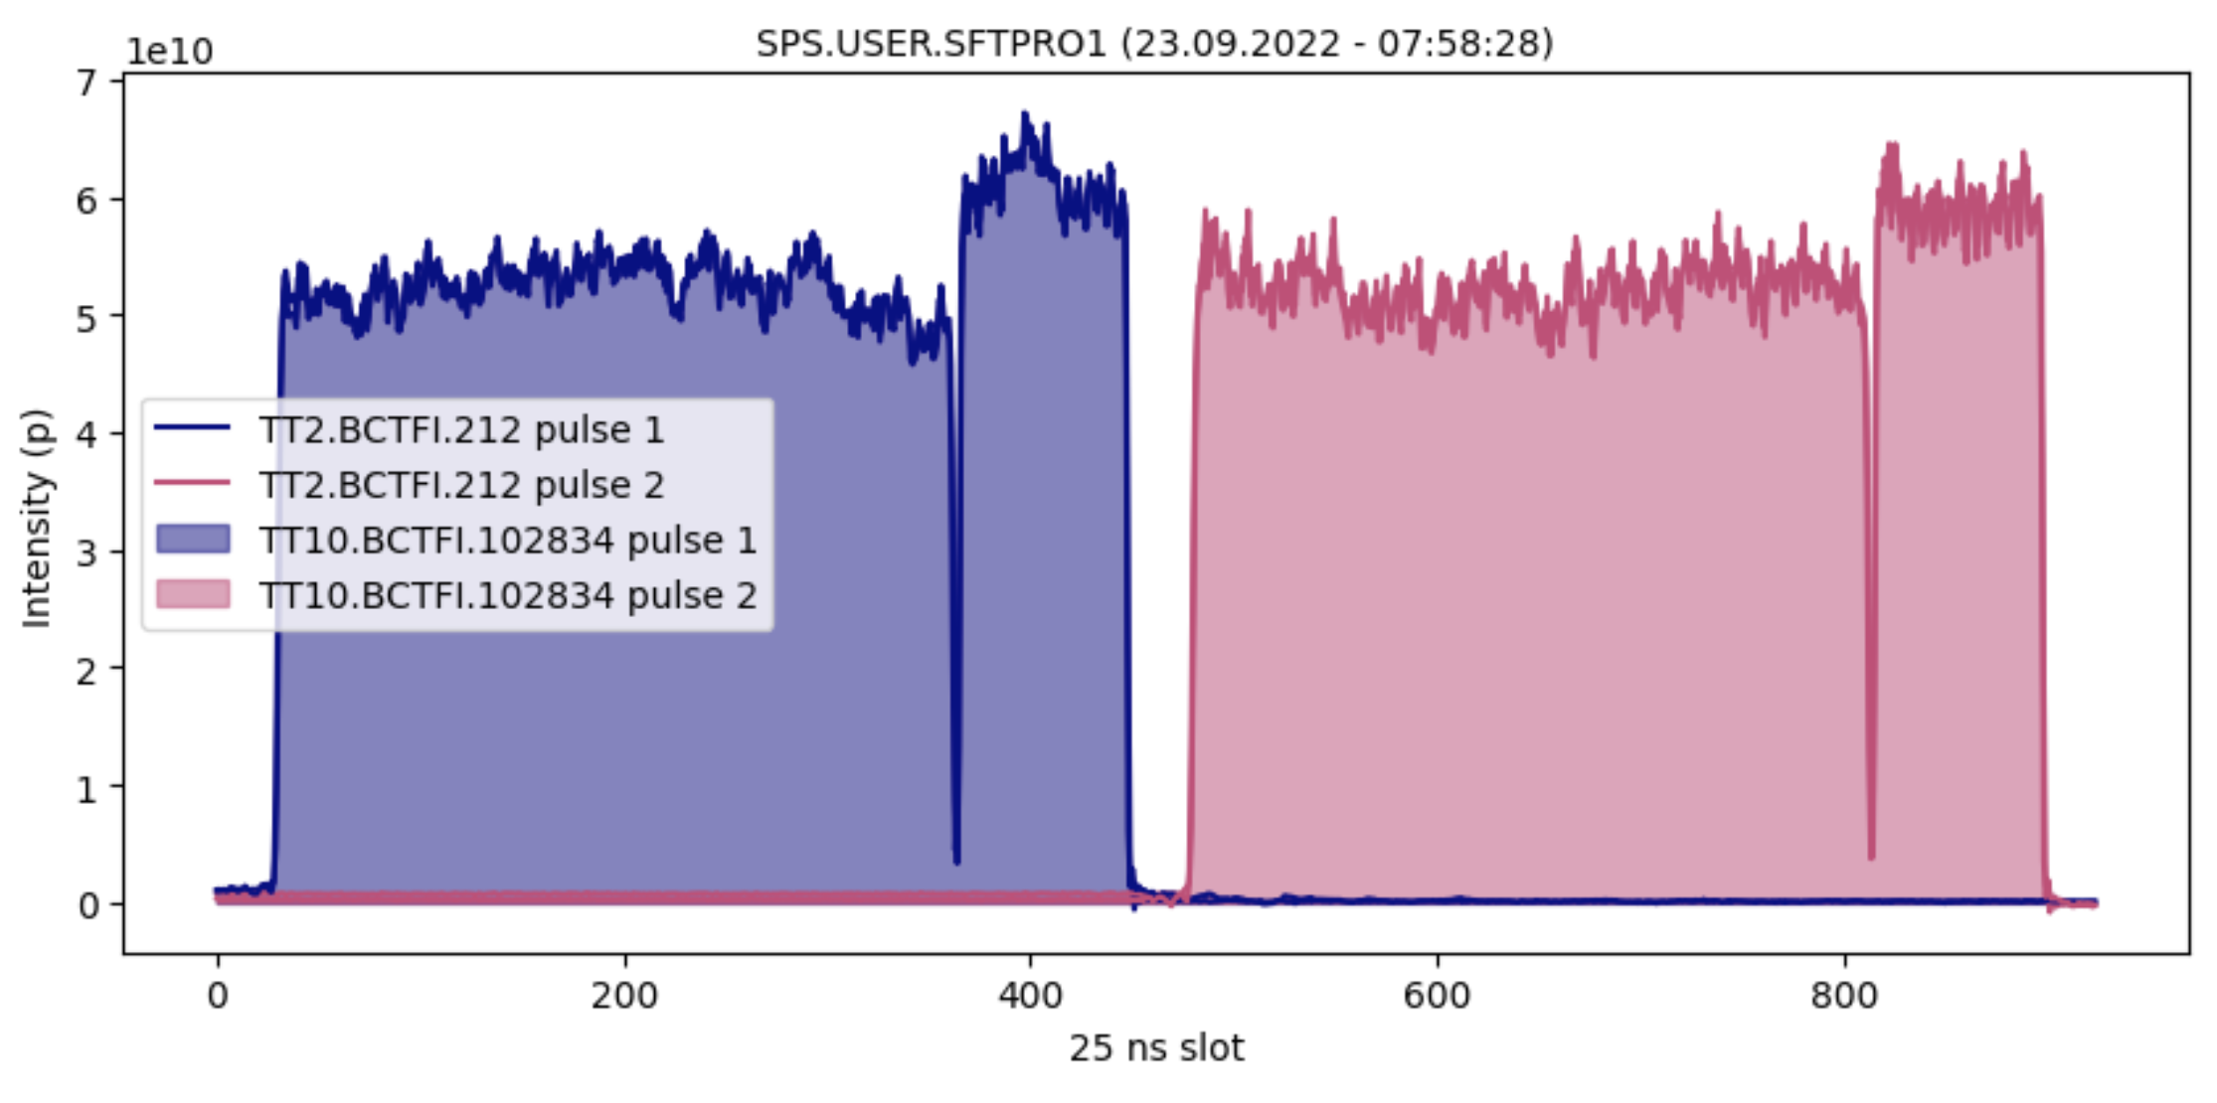
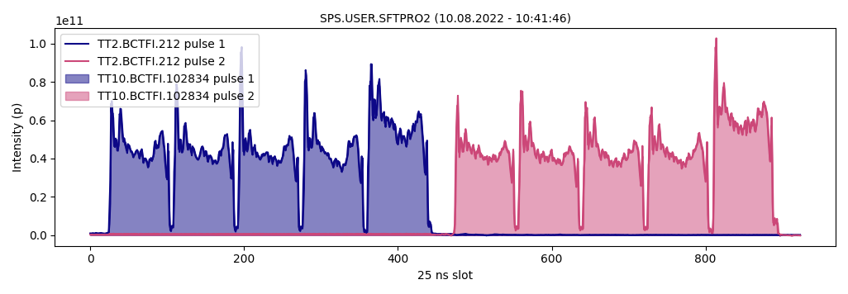
SFTPRO beam injection – SPS observables
Is often realized when there are large losses in the SPS
Diagnosed using fast BCTs – signature rather clear – but quantification not at all!
PS needs to adjust their splitting efficiency
Development of a new Vistar ongoing to monitor the important quantities in an obvious, constant and common way in the two machines using the same data sources
Intensity distribution and balance:
  Important prerequisite for good transmission
  Diagnostics:
    Fast BCTs transfer lines
    Fast BCTs ring

Slide 19
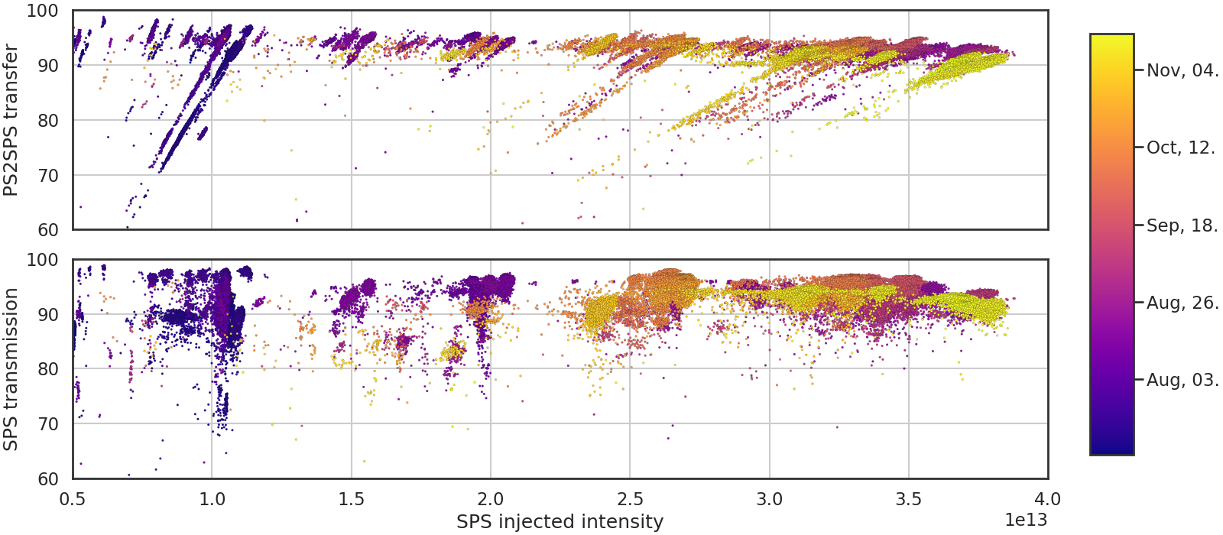
PS2SPS transfer in 2021
Several parameters and performance indicators are crucial for optimal beam preparation and transfer for the SPS
Intensity effect: loss of ~1.5% per 1e13 ppb
Better transmission for lower intensities – and bad towards end of the year

Slide 20
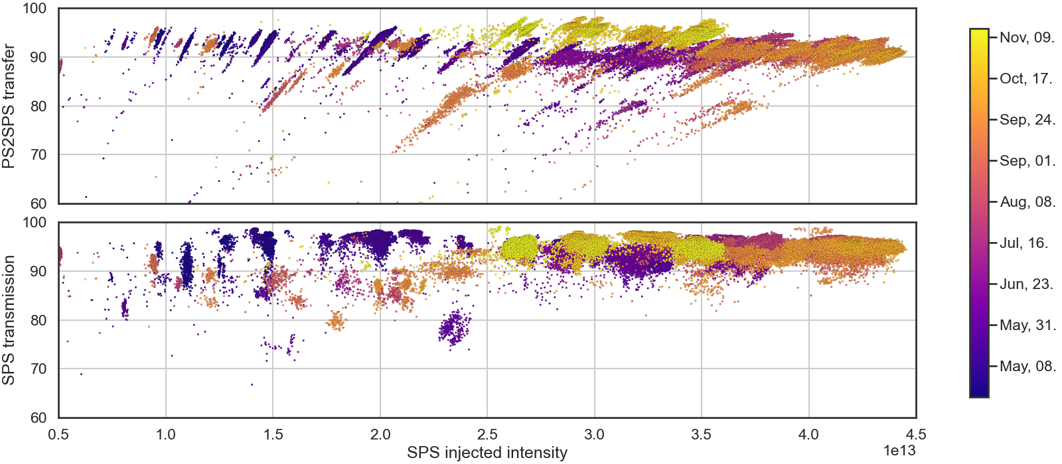
PS2SPS transfer in 2022
Intensity dependence very similar to last year – though higher intensities reached overall!
Intensity effect: loss of ~1.5% per 1e13 ppb – similar to last year
Much better transmission towards end of the year… what has happened?

Slide 21
PS 2 SPS – beam quality & transmission for LHC

Slide 22
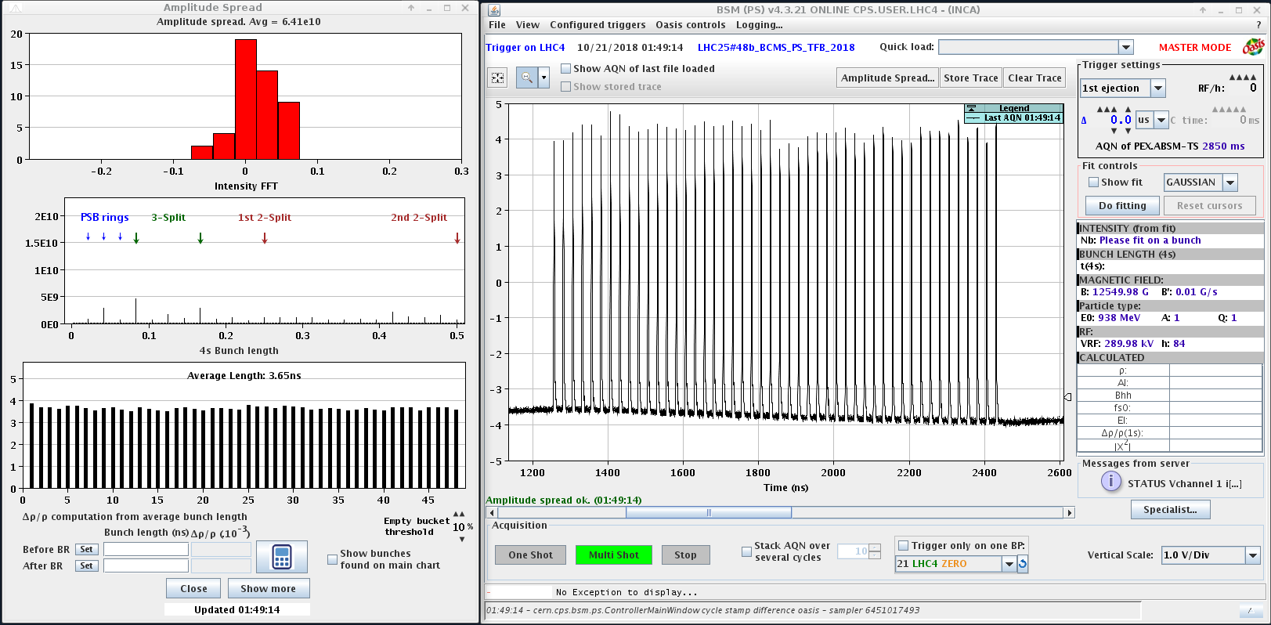
LHC beam – PS observables
Quality of longitudinal splittings
  Based on the WCM-acquisition of the last turn with the Bunch Shape Measurement (BSM) application or new last-turn logging in UCAP
    Extracting information on bunch length and bunch intensity variation along the batch
    FFT of the intensity variation allows to identify if splitting needs to be adjusted and/or intensity from PSB

Slide 23
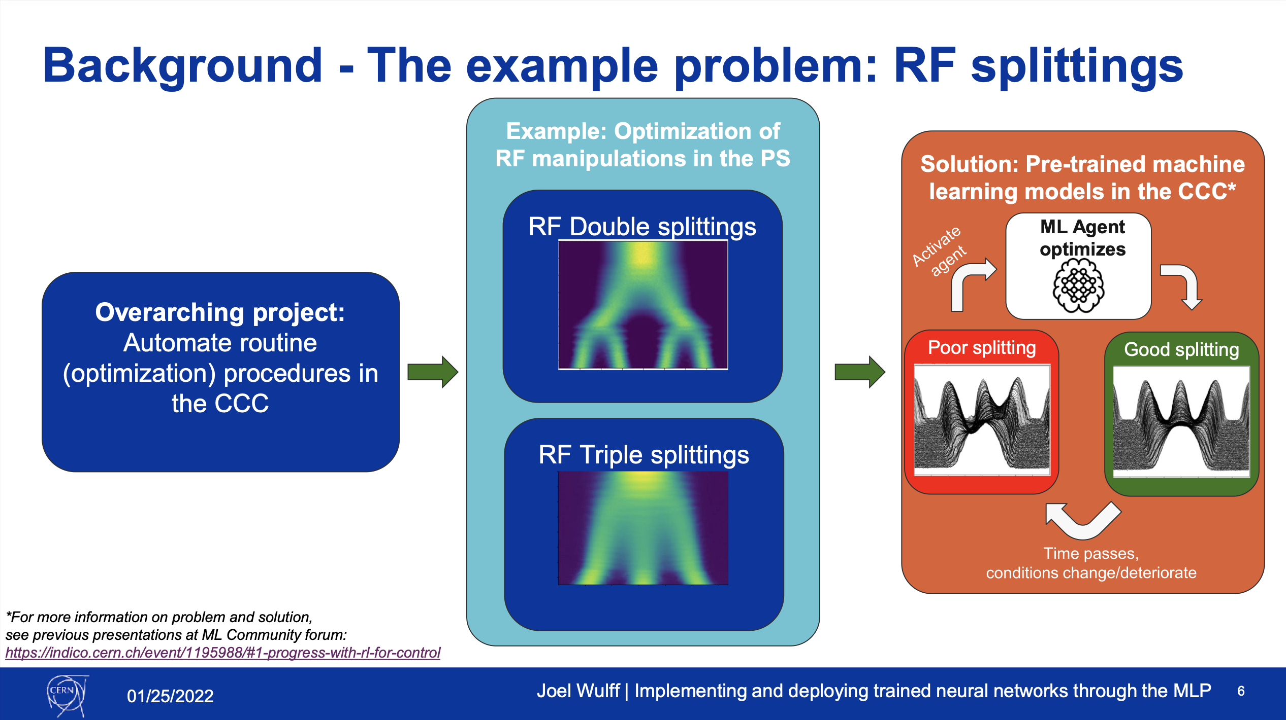
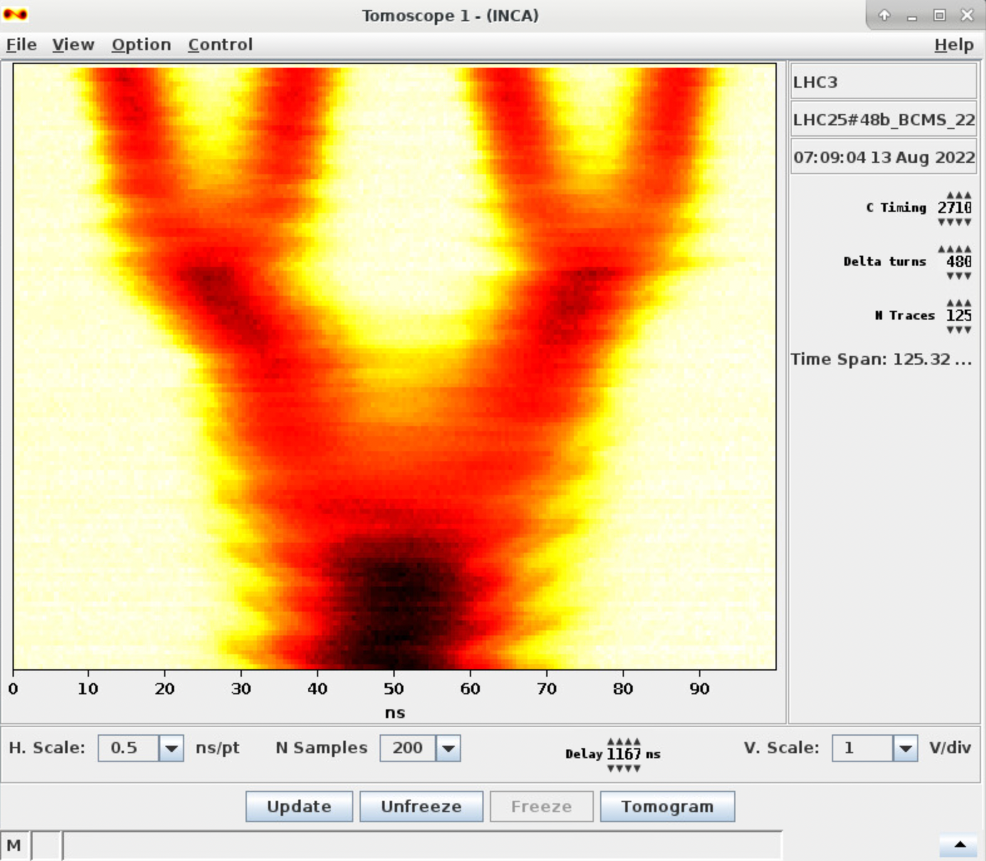
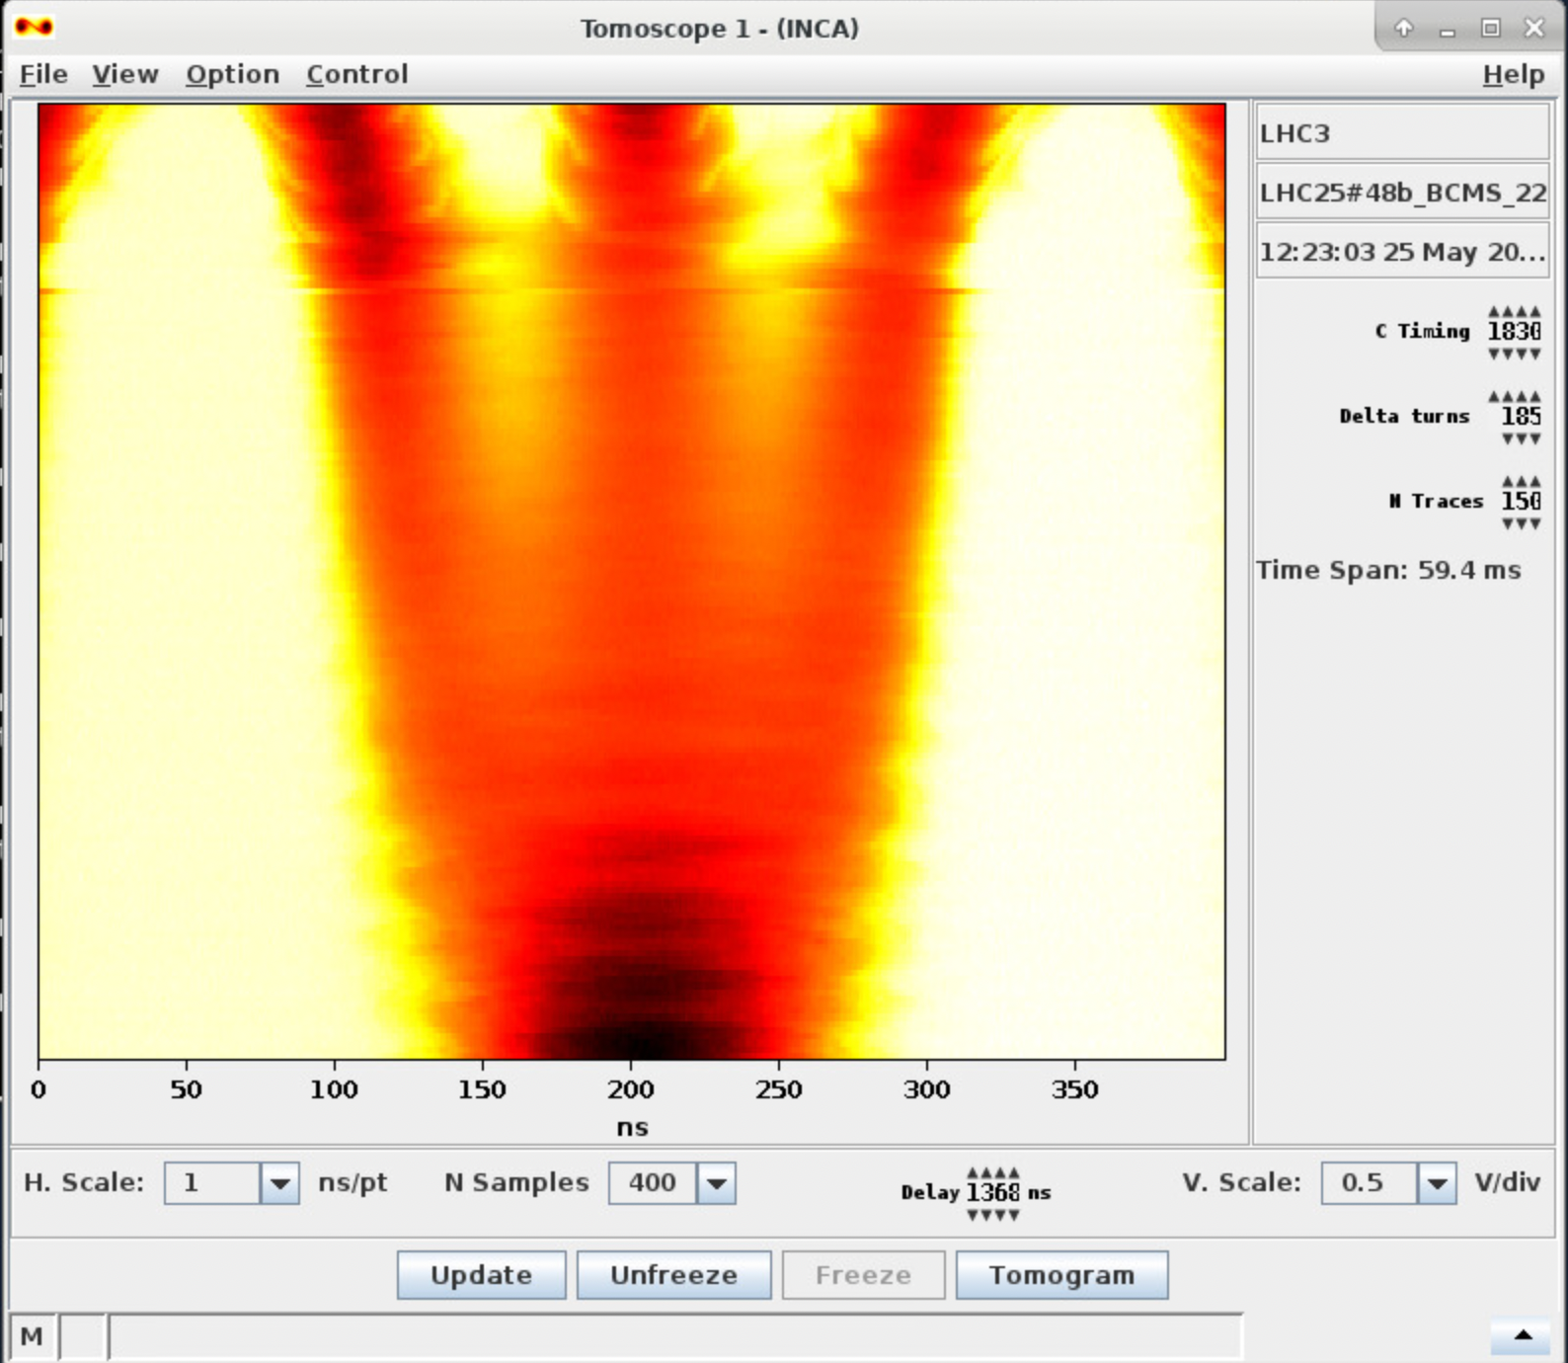
LHC beam – PS observables
Splitting correction today either done manually or using a RL agent developed by Joel Wulff
  Currently launched by the operator from the Tomoscope application
  Check AlexL’s Shutdown lecture for corresponding adjustment knobs
Common metric to be established to quantify splittings
  Identify which parameters are most
  critical for the transfer and SPS
  performance
  Establish clear limits on what is
  considered “good enough”

Slide 24
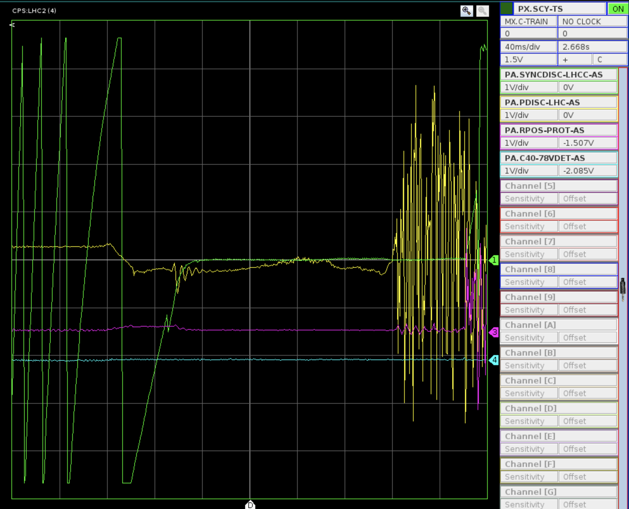
LHC beam – PS observables
PS-SPS synchronization
  Observation of synchro locking on OASIS
    Next step: make signal available via a sampler to post-process it and raise a flag if synchro isn’t working
  PS extraction scope for proper alignment of the first bunch wrt reference
    Installed in central building, streamed to CCC Vistar

Slide 25
LHC beam injection – SPS observables
Impacts transfer and transmission and is important for capture
Usually done when setting up new beams (beam commissioning)
Diagnosed using FBCT and MR as well as injection trajectories and orbit
This year, being monitored in the SPSQC to understand drift patterns
More info see OP shutdown lecture by S. Cettour Cave
Energy matching:
  Important prerequisite for optimal injection
  Diagnostics:
    Fast BCT
    Mountain range
    Synchro loop error
    First turn
    Beam orbit after ~50 ms
Now done identically between PS and SPS for both MTE- and LHC-type beams → easier and more streamlined in terms of procedures!

Slide 26
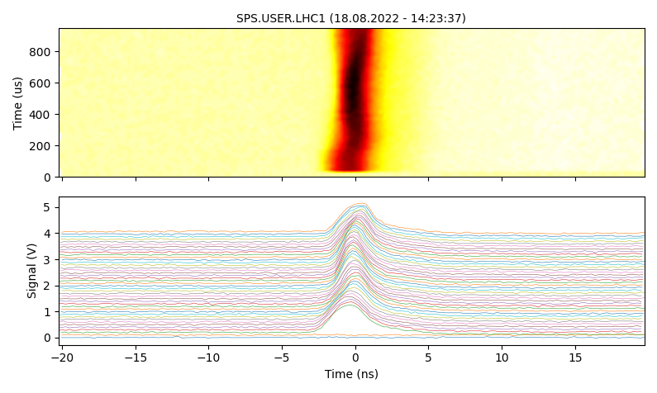
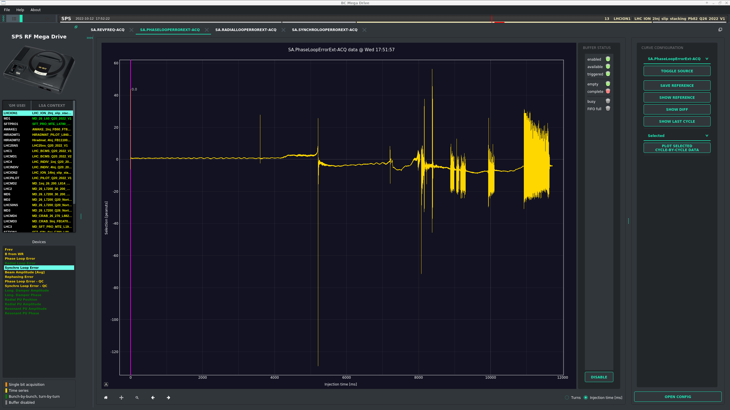
LHC beam injection – SPS observables
Longitudinal structure:
  Only an issue if PS high-frequency cavities are
  off and beam arrives debunched
    PS needs to extract proper bunch length nevertheless
  Diagnostics:
    Mountain range
Injection phase and injection phase correction are important!
Diagnosed using Mountain range and phase loop error
Correction is managed purely in the SPS
Thinkable to have this monitored and adjusted in an Autopilot kind of manner in the future

Slide 27
LHC beam injection – SPS observables
Is often realized when there are large injection losses
Diagnosed using YASP – signature rather clear
PS used to have to be on their “Golden”
With new stitched model we can imagine to have an Injection Autopilot continuously monitoring and correcting for both machines
Injection steering:
  Important prerequisite for optimal injection
  Diagnostics:
    YASP – using TT2 – TT10 stitched model

Slide 28
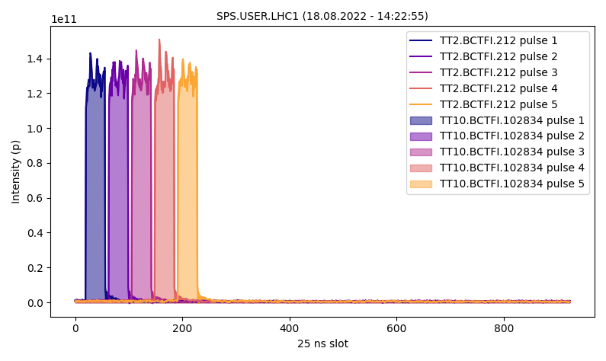
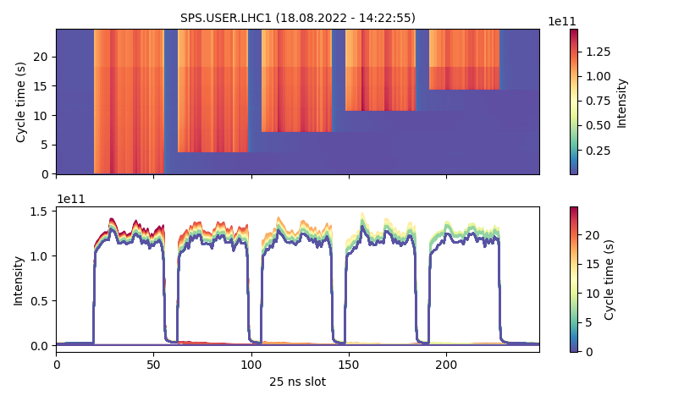
LHC beam injection – SPS observables
Is often realized when there are large losses in the SPS
Diagnosed using fast BCTs – signature rather clear – but quantification not at all!
PS needs to adjust their splitting
Development of a new Vistar ongoing to monitor the important quantities in an obvious, constant and common way in the two machines using the same data sources
Intensity distribution and balance:
  Important prerequisite for good transmission
  Diagnostics:
    Fast BCTs transfer lines
    Fast BCTs ring

Slide 29
PS 2 SPS – outlook and plans / ideas for the future

Slide 30
Outlook
SFTPRO
  ES algorithm to be implemented on a server for continuous online correction of MTE efficiency
  Online measurements with BGI to quantify horizontal core emittance
  Intensity distribution along the spill with barrier bucket to be further studied
LHC
  Online implementation of RL agent for longitudinal splitting control
    Requires improved longitudinal observation system
Generic
  Ongoing developments:
    Trajectory autopilot using stitched models
      requires PPM definition of reference trajectories
    PS Performance Monitoring System to expose many important parameters
      covers equipment and beam quality monitoring for all PS destinations (proof-of-concept ongoing for TOF)
      aiming at a prototype for online longitudinal observation this year
  Use coherent set of information to quantify important parameters and equipment status
    Improved communication via common Vistars

Slide 31
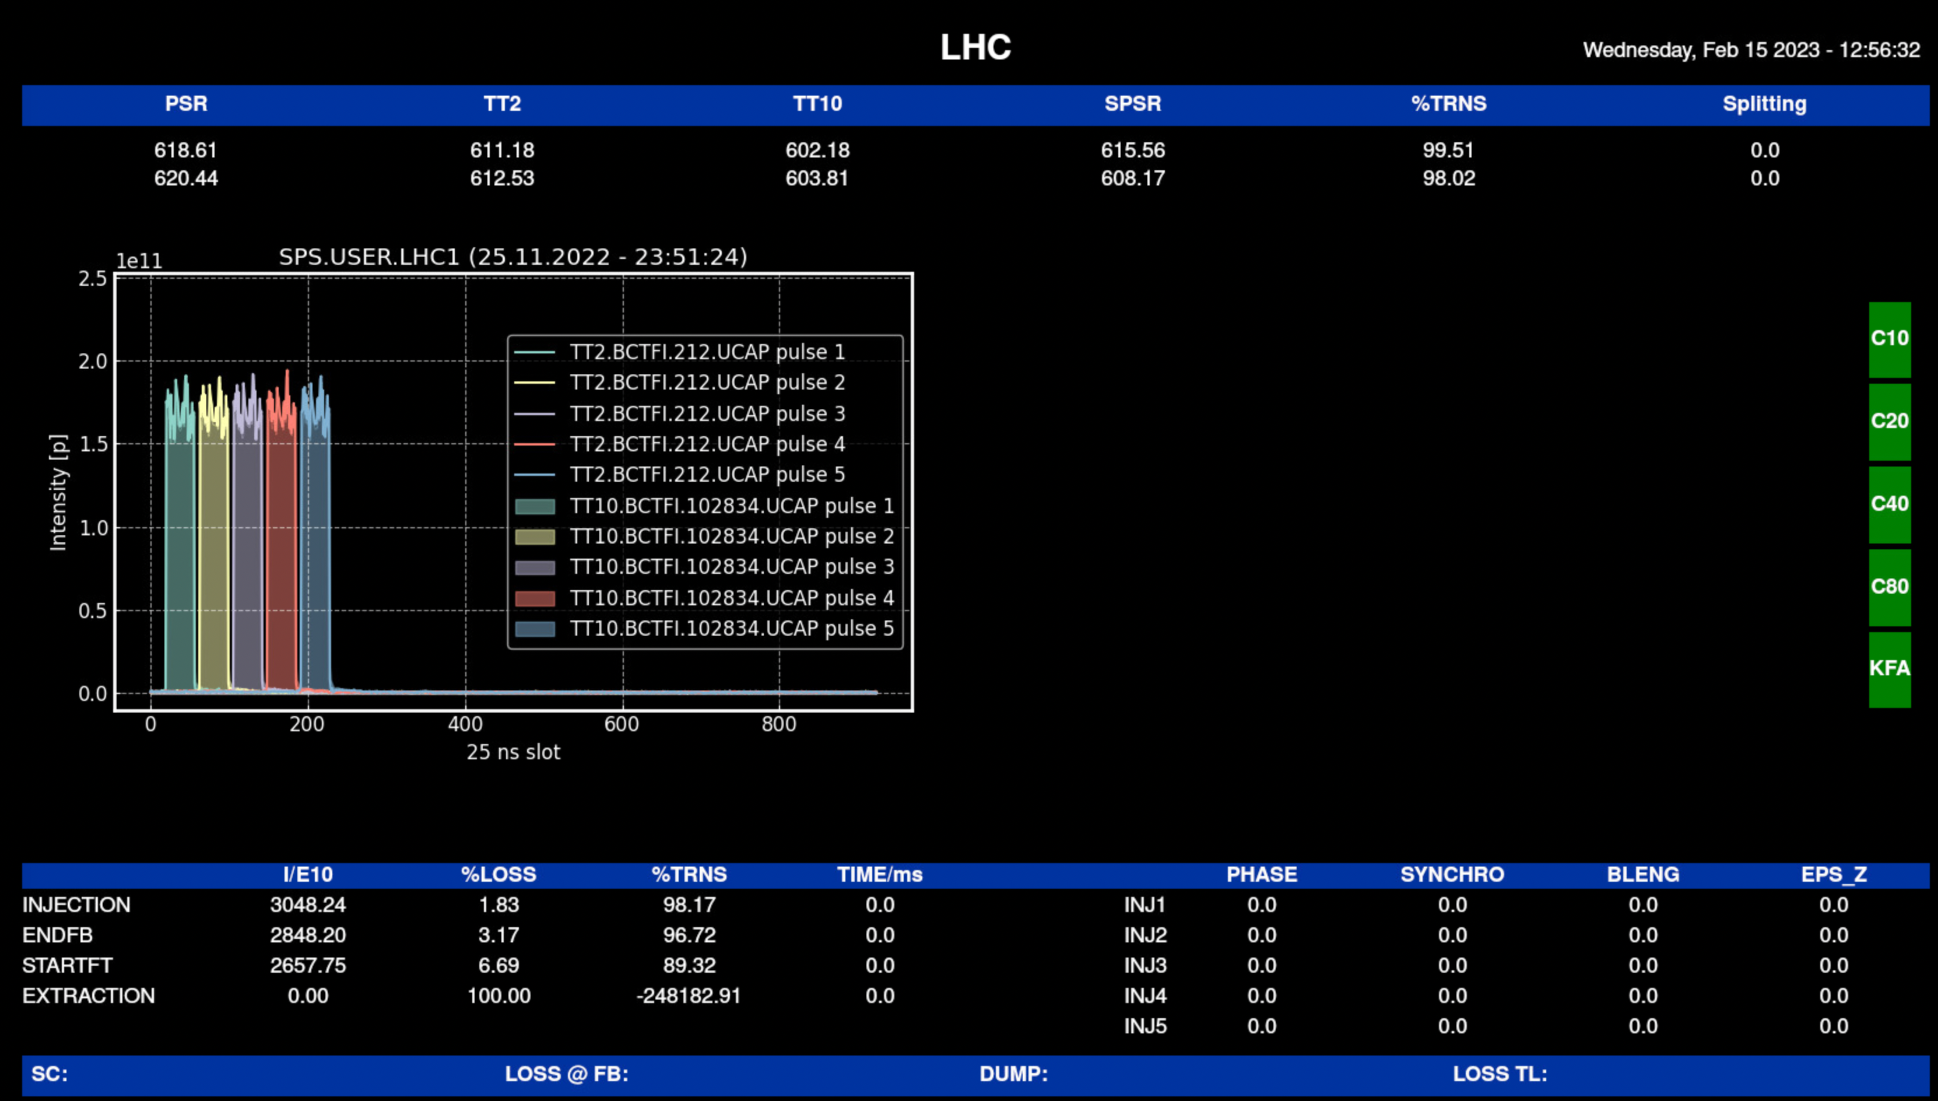
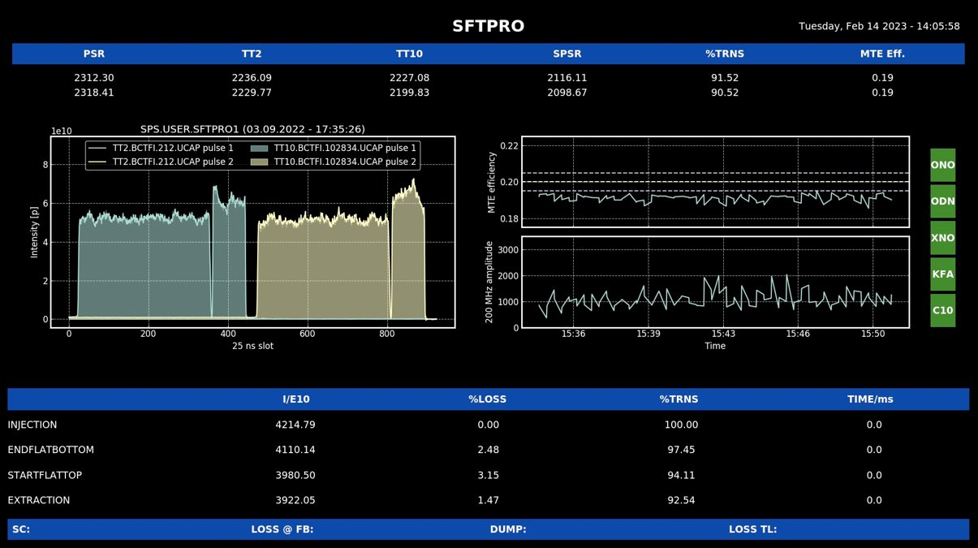
New Vistars

