Slide 1
Simulation Tools for Future Colliders
L. van Riesen-Haupt¹, T. Pieloni¹, G. Iadarola², P. Kicsiny¹, R. De Maria², X. Buffat²
¹EPF Lausanne; ² CERN

Slide 2
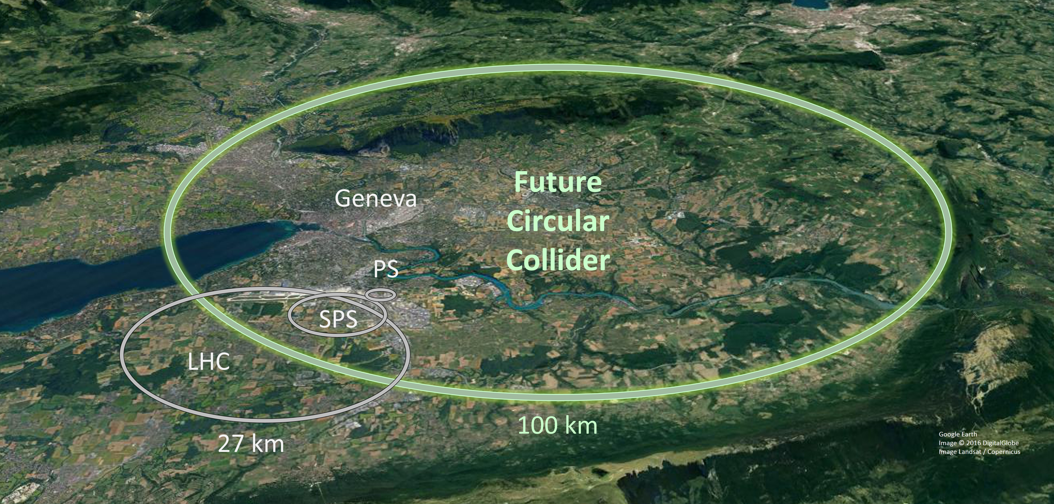
Motivation
Challenges set out by Future Circular electron-positron Collider (FCC-ee)
  Large and complex machine with many components
  Challenging collision parameters and insertion region design
  Tight alignment, manufacturing and correction tolerances
Challenges unique to lepton colliders
  E.g. synchrotron radiation effects
  Recent focus in CERN on hadron machines
Work with experts in the community to create tools for the broader community

Slide 3
Jungle of Simulations
Many different types of simulations including different effects and specialised codes
Types of simulations largely differ in
  Number of particles simulated
  Time/distance over which particles are simulated
  Inclusion of interactions with other particles, beams, components of the machine
Often interplay of different effects and simulations is essential
  Get a full and accurate picture of machine behaviour
  Requires interfacing between simulations
  Efficient propagation of design changes to all codes

Slide 4
Examples of Simulations
Simulation type | Description | Purpose
Optics | Fast linear approximation of the motion of beam centroid | Lattice design and optimisaiton
Dynamic Aperture | Tracking large number of particles over many turns | Establishing the dynamically stable regime
Beam-Beam | Interaction of particles in opposite colliding beams | Study of the perturbation due collisions
Collimation | Interaction of particles with matter and energy deposition | Machine protection and experimental background
Electron Cloud | Interaction of beam and electrons emitted from beam pipe | Determining beam stability
Collective effects | Interaction between particles in beams and bunches | Understand collective instabilities and behaviour

Slide 5
Examples of Simulations
Simulation type | Number of Particles | Turns/Distance | Interaction with
Optics | Single particle | Single or few turns | Magnets, (RF cavities)
Dynamic Aperture | Thousands | Thousands of turns | Magnets, (RF cavities)
Beam-Beam | Thousands | Interaction point (short) | Particles in the colliding beam
Collimation | Thousands | Large number of turns | Magnets, solid matter, secondary particles
Electron Cloud | Large number of macroparticles | Along bunch, thousands of turns | Beam pipe, emitted electrons
Collective effects | Large number of particles | Within bunch/beam, over entire machine/many turns | Particles in the same beam

Slide 6
Jungle of Codes used for FCC-ee
Domain | Organisation | Codes
Optics and Tracking | CERN | MAD-X, MAD-X PTC, SixTrack, SixTrackLib, Xsuite, MAD-NG, Placet, CPyMAD
 | KEK | SAD
 | ESRF | PyAT
 | Cornell | BMAD
 | Manchester | MERLIN++
 | ANL | Elegant
Beam-Beam | CERN | GUINEA PIG, COMBI
 | LBNL | BeamBeam3D
 | KEK | BBSS
 | IHEP | IBB
 | BINP | LifeTrac
Collective Effects | CERN | pyHEADTAIL, TRAIN, DELPHI
Impedance Modeling | CERN | IW2D
 | Dassault systems | CST Studio
Ecloud Simulations | CERN | PyECLOUD
Vaccum | CERN | Synrad+
Energy Deposition | CERN | FLUKA, MDISIM
 | Royal Holloway | BDSIM

Slide 7
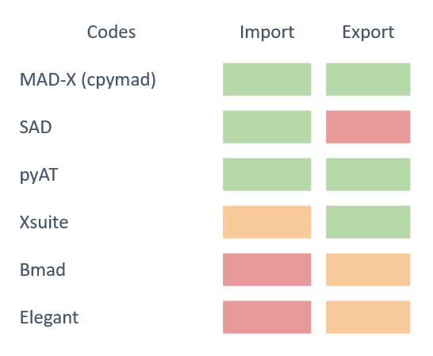

Sequence Converter and Manager
Sequence manager and converter developed by EPFL
  Efficient interfacing and conversion between codes
XConverter
  Convert to and from different codes
  Modular approach via XSequence
XSequence
  Python based sequence manager
  Backbone of XConverter
  Allows for code independent lattice management and modification
XSequence

Slide 8
Swiss Army Knife - XSuite
Identified XSuite a software as cornerstone for software framework
  Aims to cover a large range of functionality
  Written in python for easier interfacing
  Large and growing CERN community
Aim to provide direct input relevant for FCC-ee study by
  Implementing features
  Benchmarking new features
  Being first time users and inputting needs
Conversions still relevant to convert to and from XSuite and all legacy codes
  Also for benchmark studies
Use software for meaningful contributions to FCC study

Slide 9
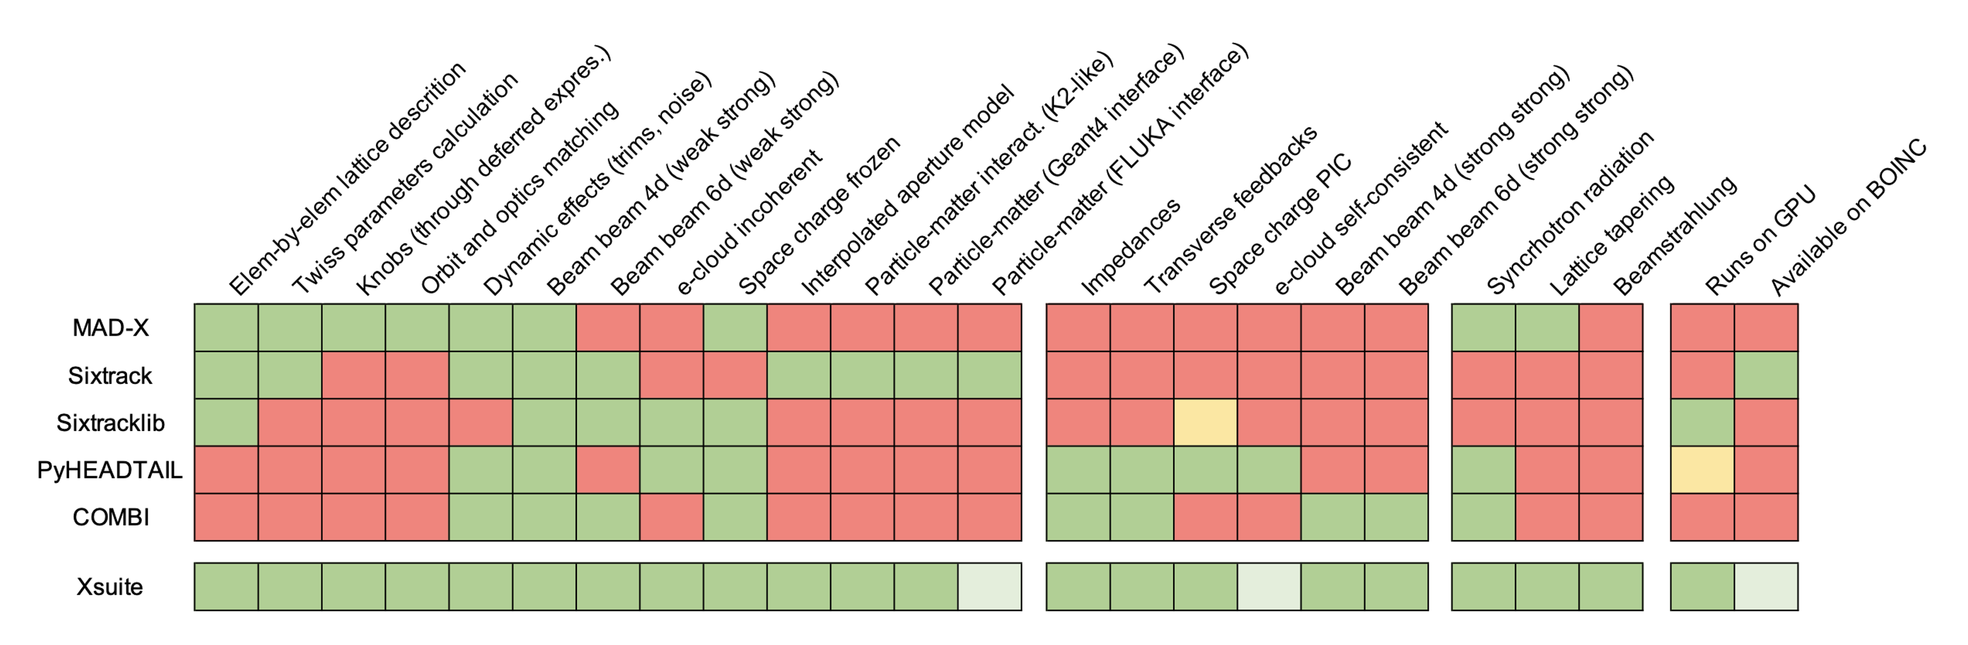



XSuite
Polarization and SPIN tracking
ML for DA optimization
Xsequence,
Xconverter
(F. Carlier)
SITROS
SAD
Y. Wu,
F. Carlier,
T. Pieloni
EPOL team
BMAD
PyAT
D. Di Croce,
G. Iadarola,
F. Vanderveken,
T. Pieloni,
SDSC
MADX
X. Buffat, R. Soos
P. Kicsiny,
X. Buffat,
D. Schulte
P. Kicsiny, X. Buffat, T.Pieloni
P. Kicsiny, X. Buffat
G. Simon, R. De Maria, G. Iadarola
L. Sabato, L. Mether,
G. Iadarola
Tapering
F. Carlier, L. van Riesen-Haupt, G. Simon, S. White

Slide 10
Great Progress
Polarization and SPIN tracking
ML for DA optimization
Xsequence,
Xconverter
(F. Carlier)
SITROS
SAD
Y. Wu,
F. Carlier,
T. Pieloni
EPOL team
BMAD
PyAT
D. Di Croce,
G. Iadarola,
F. Vanderveken,
T. Pieloni,
SDSC
MADX
X. Buffat, R. Soos
P. Kicsiny,
X. Buffat,
D. Schulte
P. Kicsiny, X. Buffat, T.Pieloni
P. Kicsiny, X. Buffat
G. Simon, R. De Maria, G. Iadarola
L. Sabato, L. Mether,
G. Iadarola
Tapering
F. Carlier, L. van Riesen-Haupt, G. Simon, S. White

Slide 11
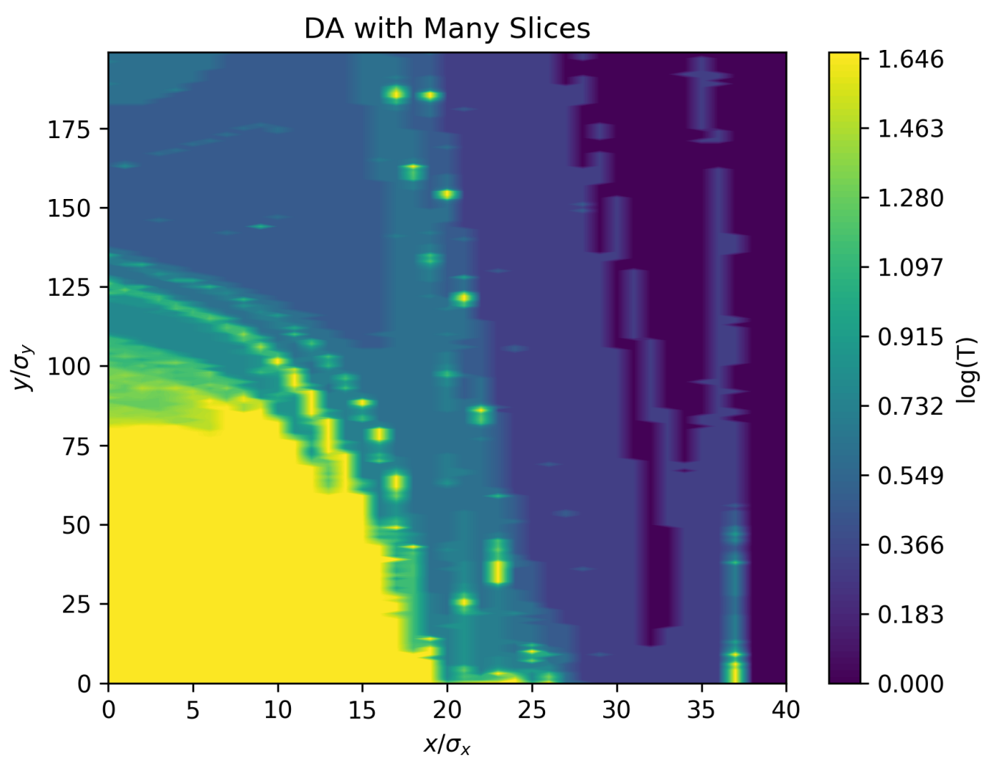
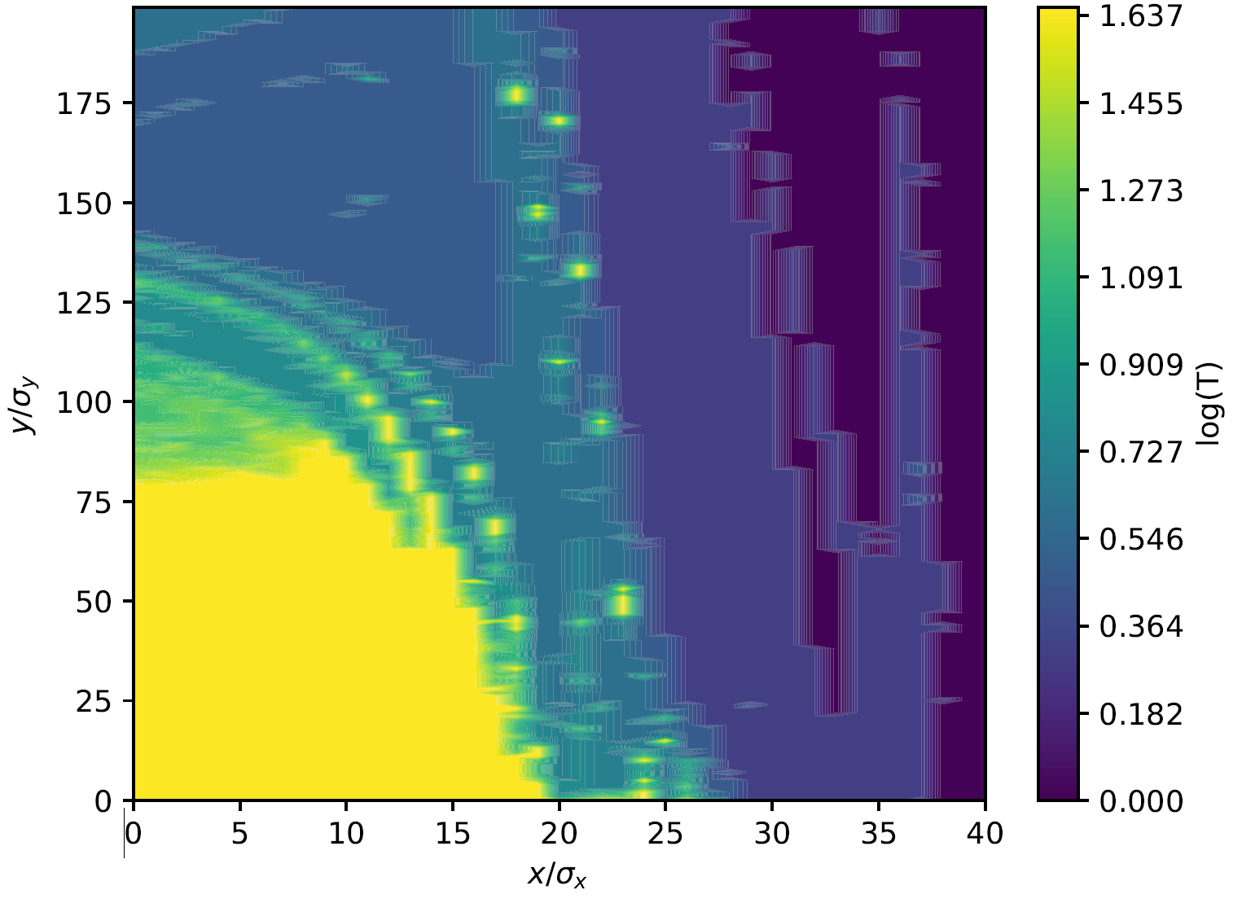
Consistency - Benchmarking
Important to benchmark new tools with existing codes
  Simple examples before multiple effects
  Understand possible inconsistencies
Extensive study benchmarking XSuite since this is a primary tool
  Optics with radiation and tapering compared to optics codes (MADX,SAD)
  Dynamic aperture with and without radiation (MADX, SAD, MADX-PTC)
  Emittance from tracking
    Compared to other tracking codes
    Compared to matrix methods
  Radiated photon spectrum
FCC-ee survival plot with radiation using SAD (top) and Xtrack (bottom)

Slide 12
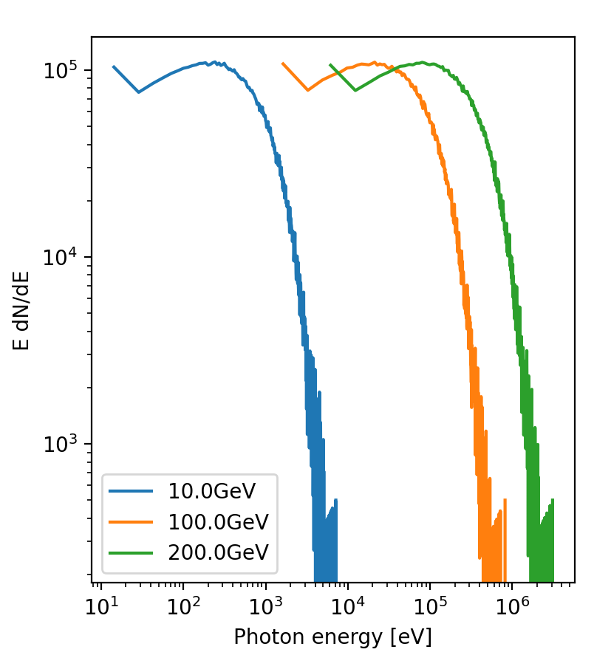
Consistency - Benchmarking
Important to benchmark new tools with existing codes
  Simple examples before multiple effects
  Understand possible inconsistencies
Extensive study benchmarking XSuite since this is a primary tool
  Optics with radiation and tapering compared to optics codes (MADX,SAD)
  Dynamic aperture with and without radiation (MADX, SAD, MADX-PTC)
  Emittance from tracking
    Compared to other tracking codes
    Compared to matrix methods
  Radiated photon spectrum
Power spectrum of photons emitted in 2T dipole at different energies in XSuite

Slide 13
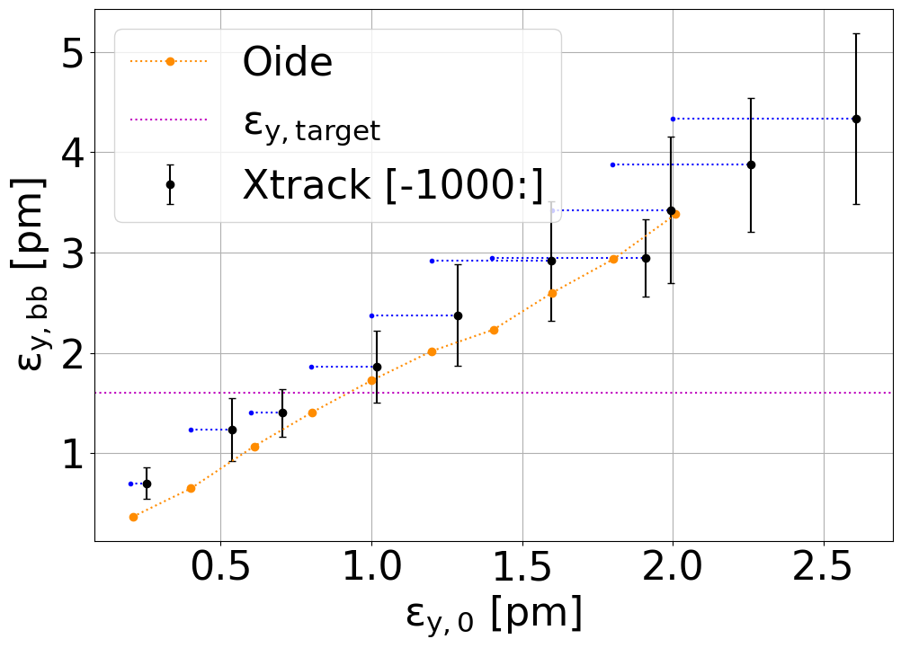
First Results: Optics, Beam-Beam and Emittance
SAD
First example of “bringing it together”
  Optimising optics of the machine
  Including beam-beam effects
  Tracking in lattice for emittance and beam-beam
Full benchmarking with previous studies
Many upcoming studies for FCC-ee
  Tune spread of particles in beam
  Dynamic aperture
  Emittance evolution
Emittance increase due to beam-beam from tracking in XSuite for various lattice emittances compared to SAD results. (Preliminary)

Slide 14
Conclusion
Large amount of different software used for FCC-ee and accelerators in general
  Many different unique purposes
  Dependent on specialised development and knowledge of few experts/labs
Improved interoperability by
  Facilitating conversion and model management
  Contribute to the development of modern broader tools
    Steer towards and use for FCC-ee purposes
    Benchmark against established codes
    Many meaningful contributions by CHART colleagues
First studies using new tools underway contributing to the FCC-ee study

