Slide 1
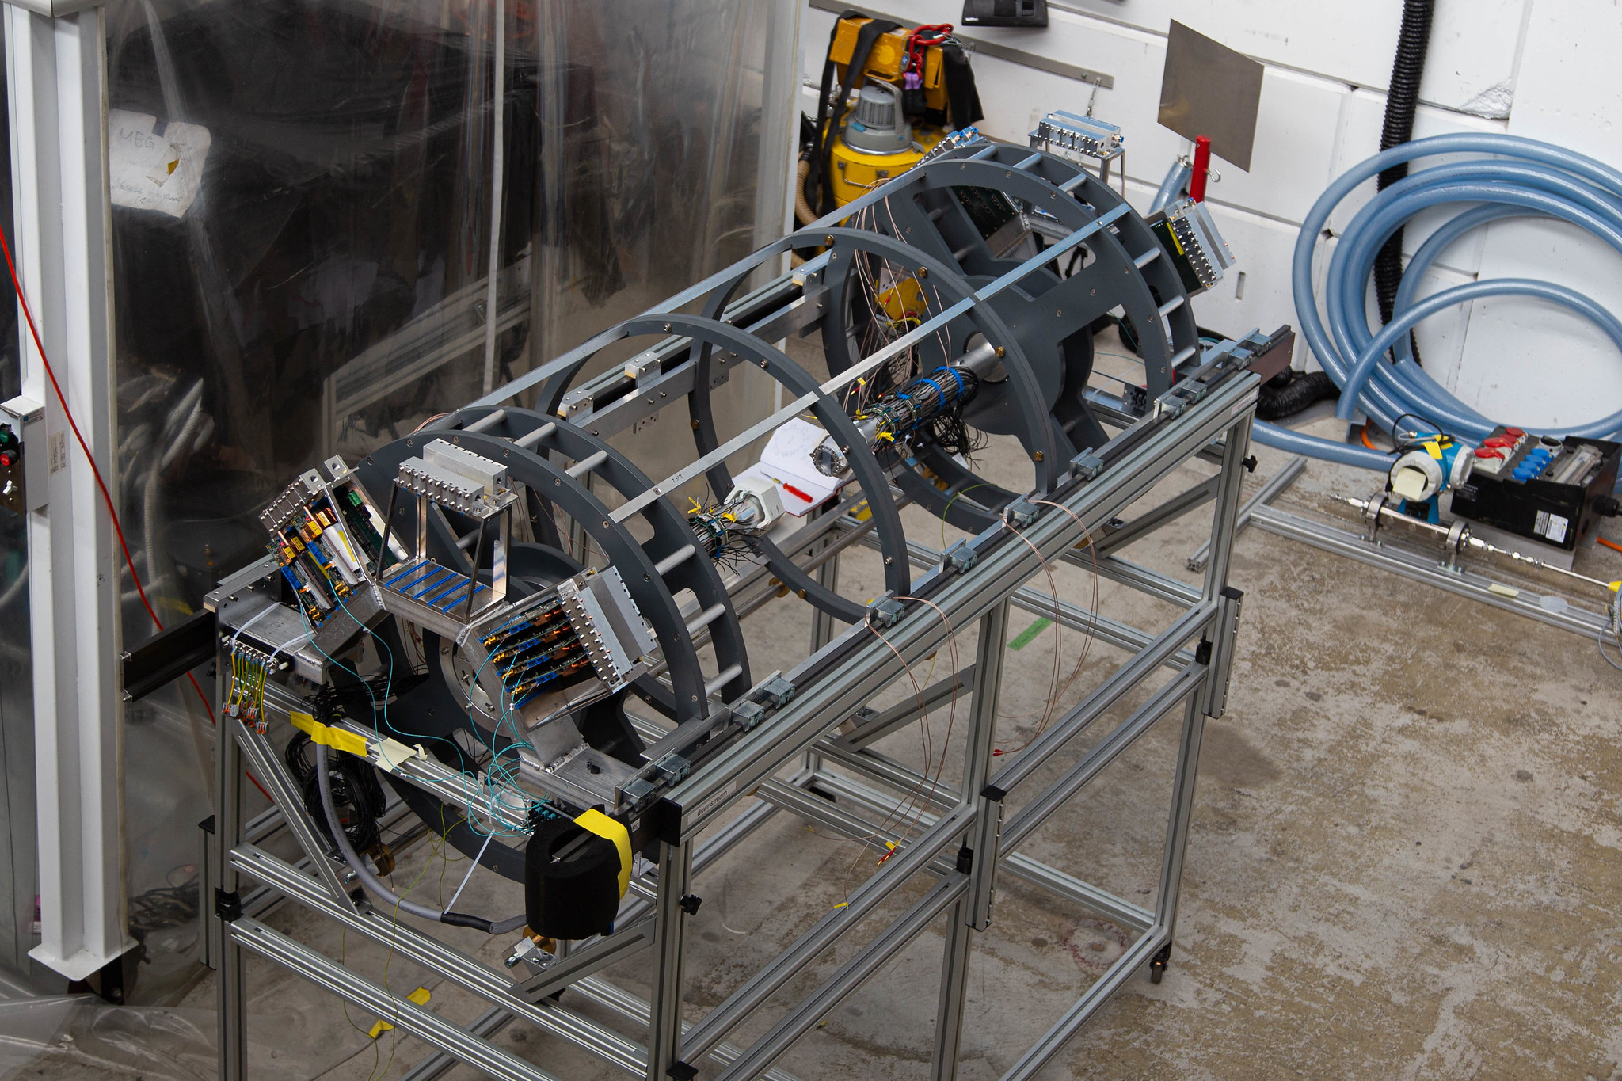
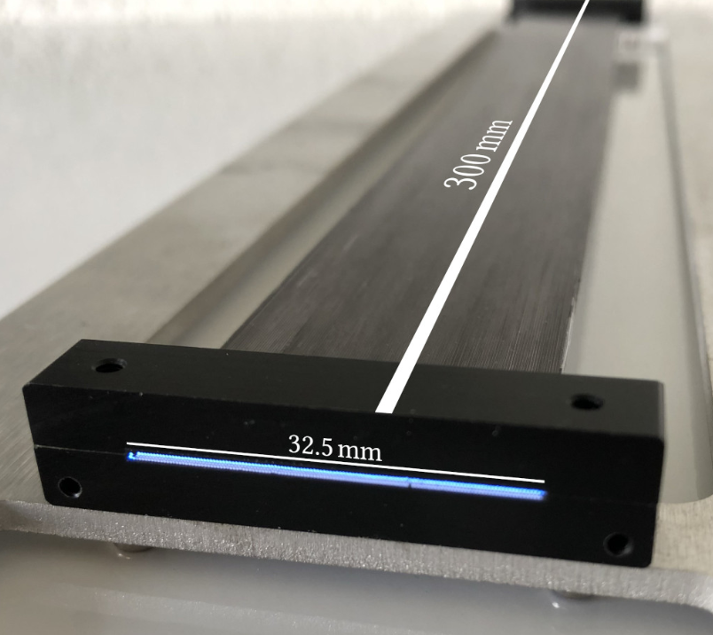
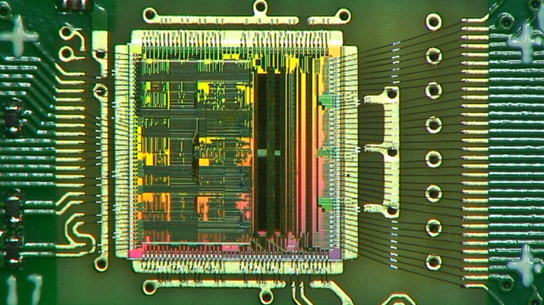
The DAQ system of the Mu3e SciFi detector
Joint Annual Meeting of the Swiss Physical Society and Austrian Physical Society
Yifeng Wang
on behalf of the Mu3e Collaboration
6.9.2023
Notes:
20′ long (+ 3′ for discussion)
0

Slide 2
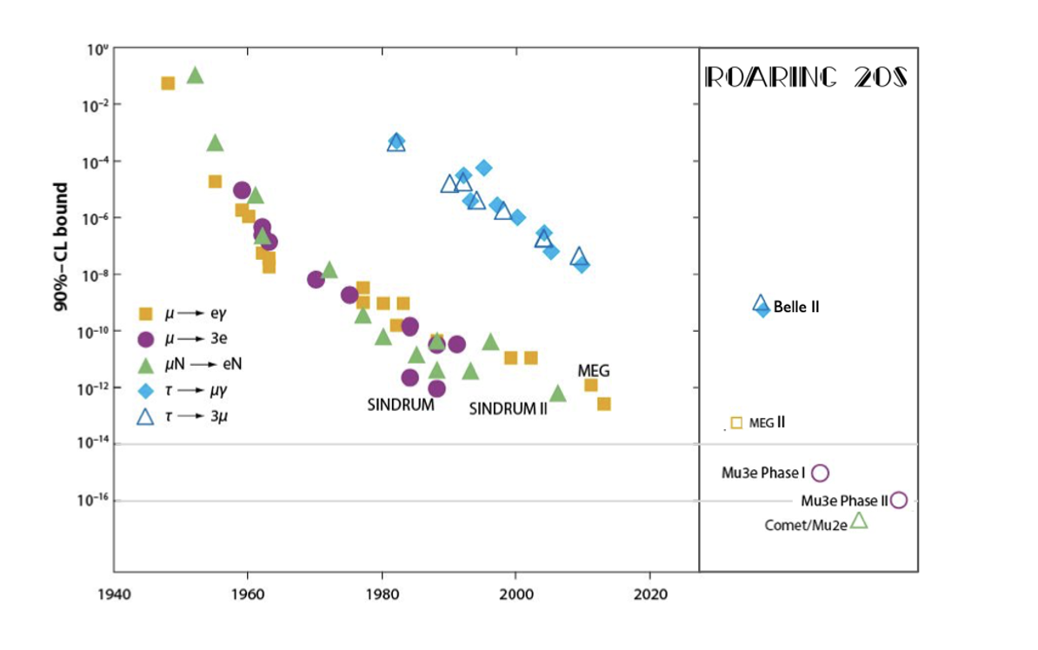
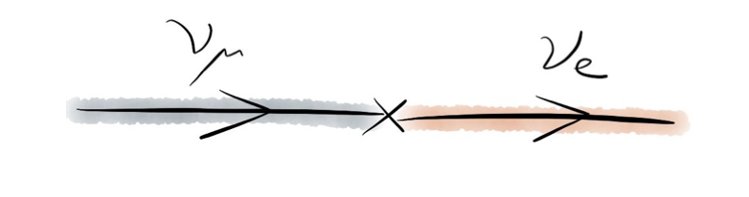
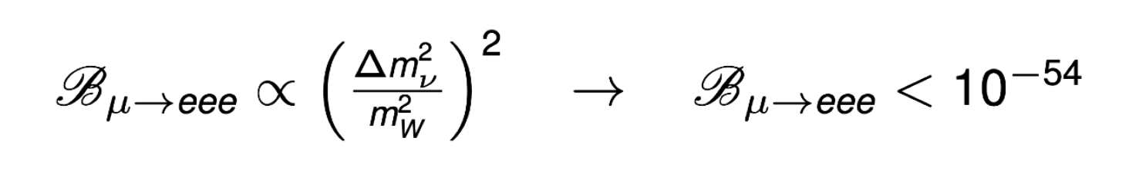
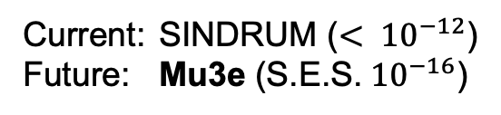
Physics goal: Lepton flavor violation (LFV)
Motivation: Lepton flavor violation has been observed in neutrino sector
  SM extension for nLFV, i.e. PMNS-matrix
  Lepton flavor violation (cLFV) has never been observed in charge lepton sector
Benefit: Free of SM background
Status: current limit in cLFV searches (mu->eee)
Worldwide status of muon decay search for charged LFV
SM suggested decay
Current: SINDRUM ($< {10}^{−12}$)
Future: Mu3e ($\text{S}\text{.}\text{E}\text{.}\text{S}\text{.}{ 10}^{−16}$)
1
Notes:
Limits and data from other

Slide 3

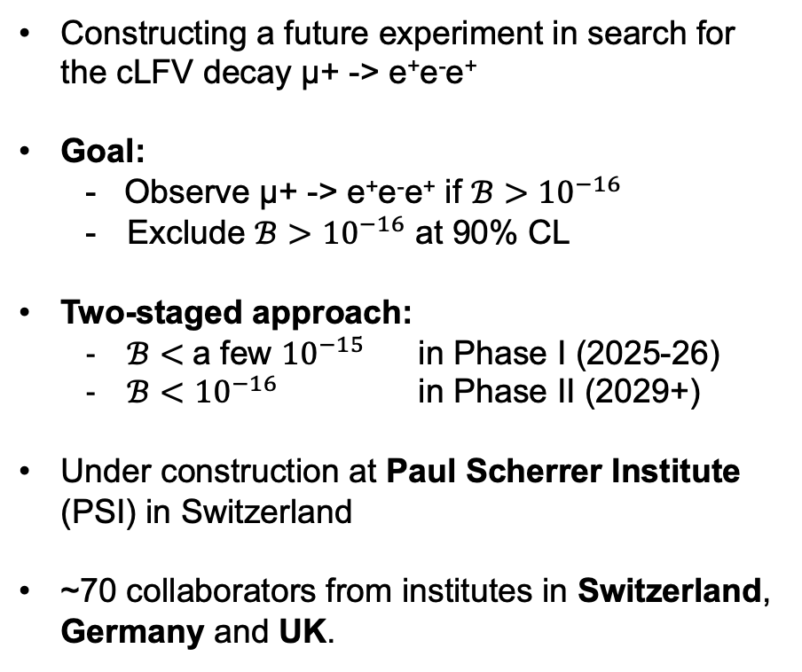
Introduction of Mu3e Collaboration
Constructing a future experiment in search for the cLFV decay µ+ -> e⁺e⁻e⁺
Goal:
  - Observe µ+ -> e⁺e⁻e⁺ if $ℬ>{10}^{−16}$
  Exclude $ℬ>{10}^{−16}$ at 90% CL
Two-staged approach:
  $ℬ<$a few ${10}^{−15}$ in Phase I (2025-26)
  $ℬ<{10}^{−16}$ in Phase II (2029+)
Under construction at Paul Scherrer Institute (PSI) in Switzerland
~70 collaborators from institutes in Switzerland, Germany and UK.
Ref:adapted from New Frontiers in Lepton Flavor
by Cristina Martin Perez
2

Slide 4
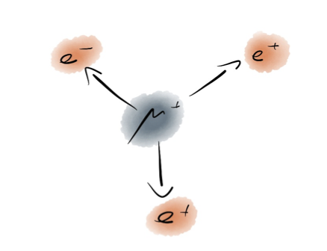
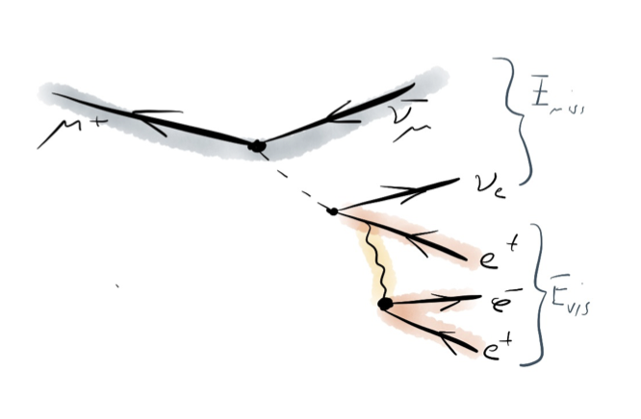
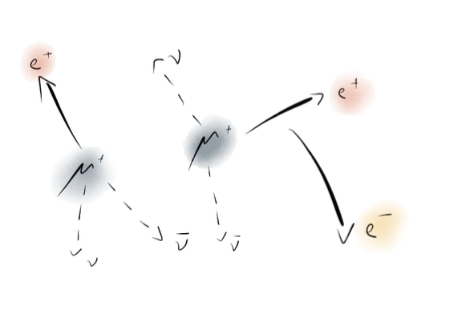
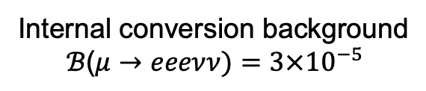
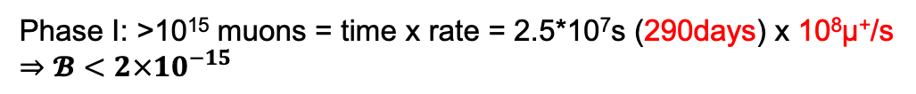
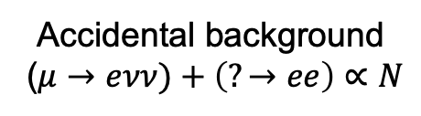




Searching for cLFV at Mu3e
Phase I: >10¹⁵ muons = time x rate = 2.5*10⁷s (290days) x 10⁸µ⁺/s
$⇒𝓑<2×{10}^{−15}$
Signal:
Background:
($μ^{+}→e^{+}e^{−}e^{+}$) signature
Internal conversion background
$$ℬ\text{(}μ→eeeνν)=3×{10}^{−5}$$
Accidental background
($μ→eνν)+\left(?→ee\right)$ $∝N$
Rejected with excellent energy and momentum resolution
Rejected with excellent timing and vertex resolution
Same vertex and time coincidence
.
Same vertex and time coincidence
.
Different vertex and time coincidence
.
$$\left(E,\vec{p}\right)=(m_{µ},0)$$
$$\left(E,\vec{p}\right)≠(m_{µ},0)$$
$$\left(E,\vec{p}\right)≠(m_{µ},0)$$
3
Yifeng Wang – ETH Zürich

Slide 5
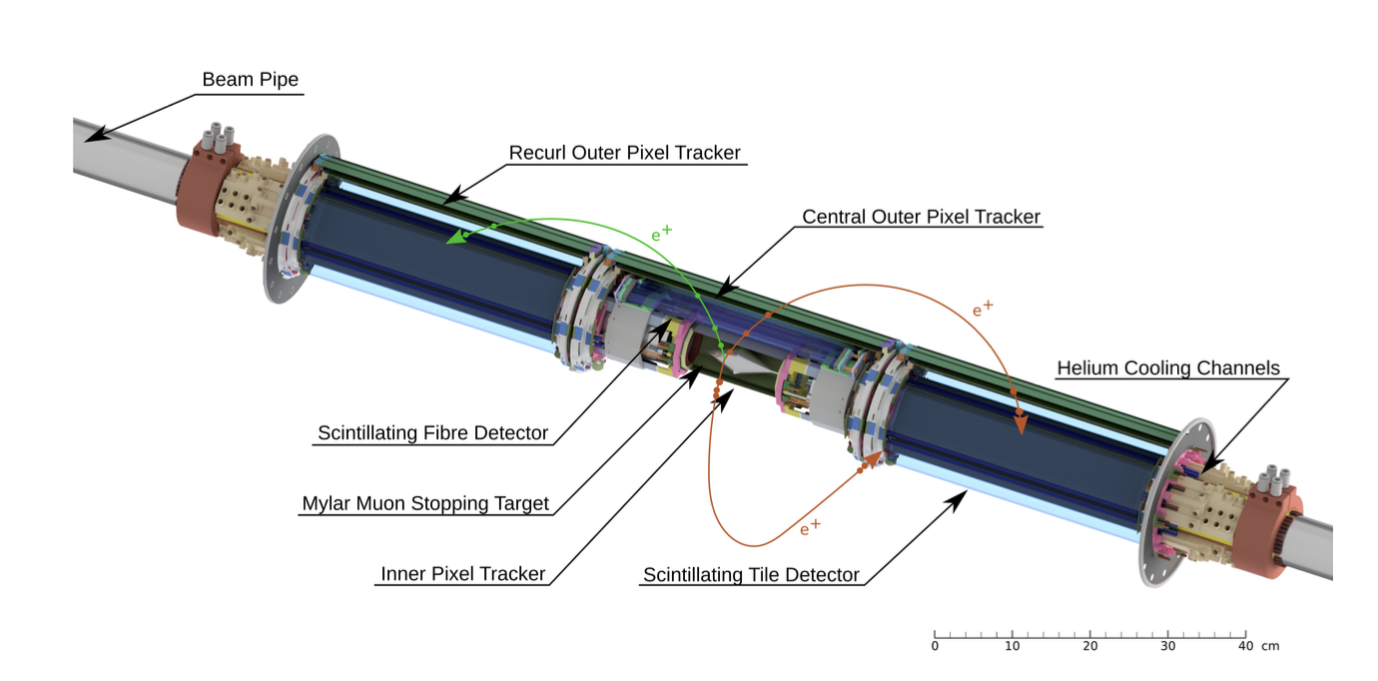
Mu3e design challenges
Unknown cLFV kinematics
High and continuous muon rate
Internal conversion
Accidental background
Multiple scattering
Large solid angle and kinematics acceptance
Fast and small dead-time readout electronics
Excellent momentum resolution (<1 MeV)
Excellent timing and vertex resolution (<100 ps and <0.5 mm)
Ultra-low material budget (<0.2% X₀ SciFi layer, ~0.1% X₀ per Pixel layer)
4

Slide 6
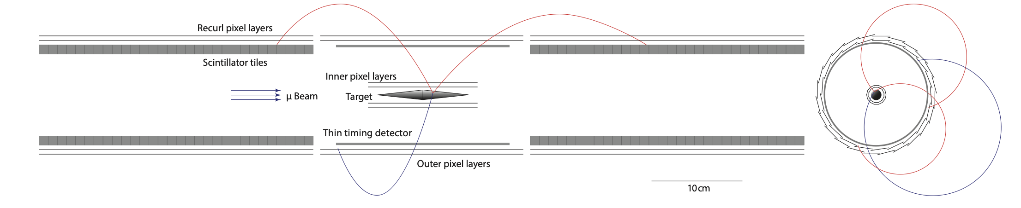
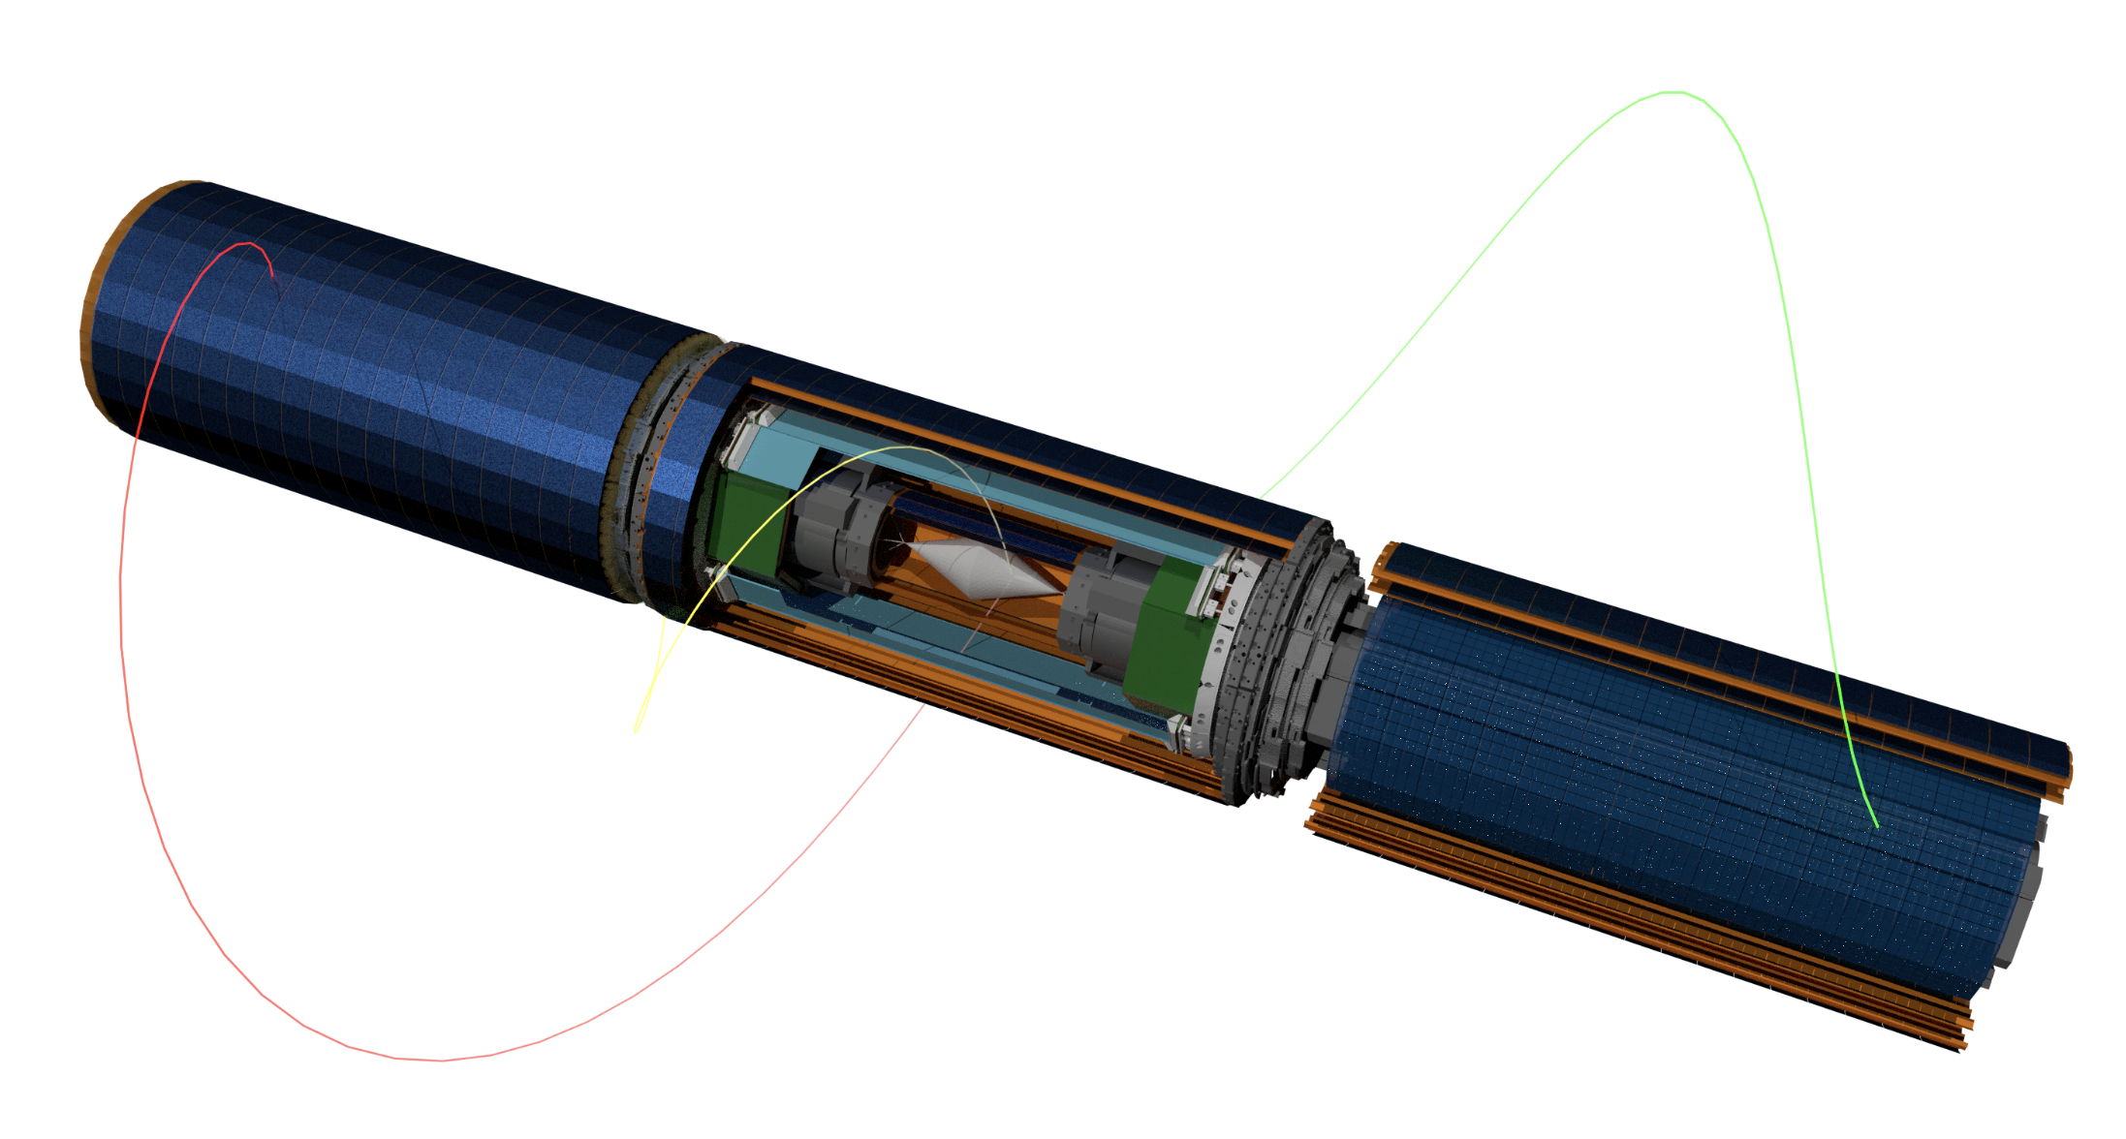
Timing layers in Mu3e
SciTile
SciFi
Goals of timing layers: time coincidence of tracks, charge identification and global event recons.
timing resolution: SciFi<200ps, SciTile<50ps, Pixel<26ns
5

Slide 7
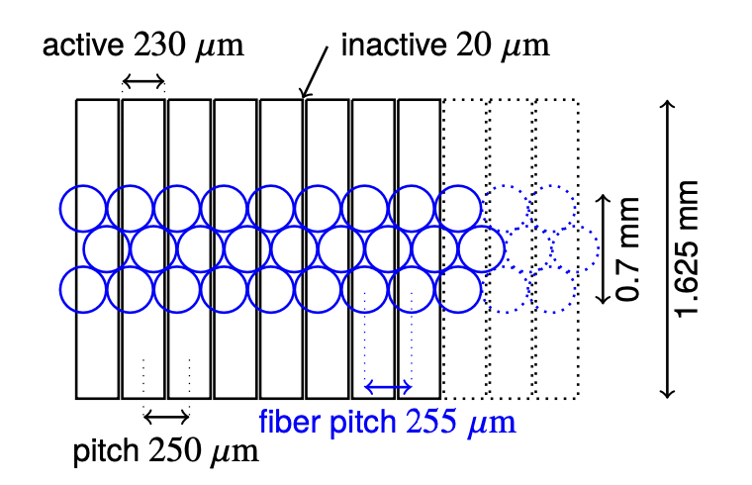
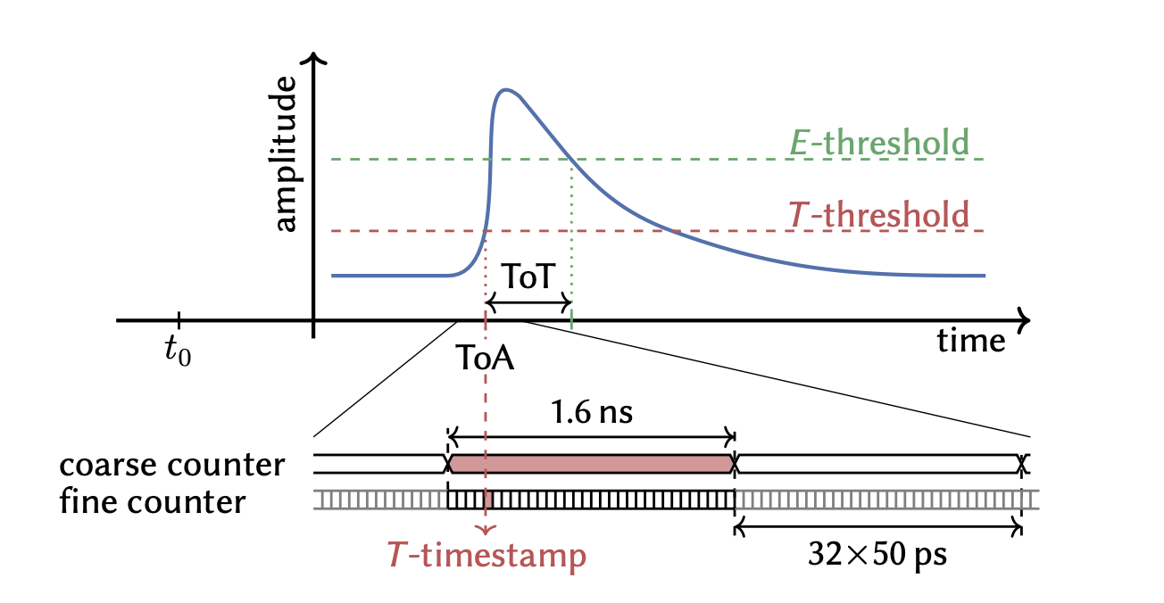
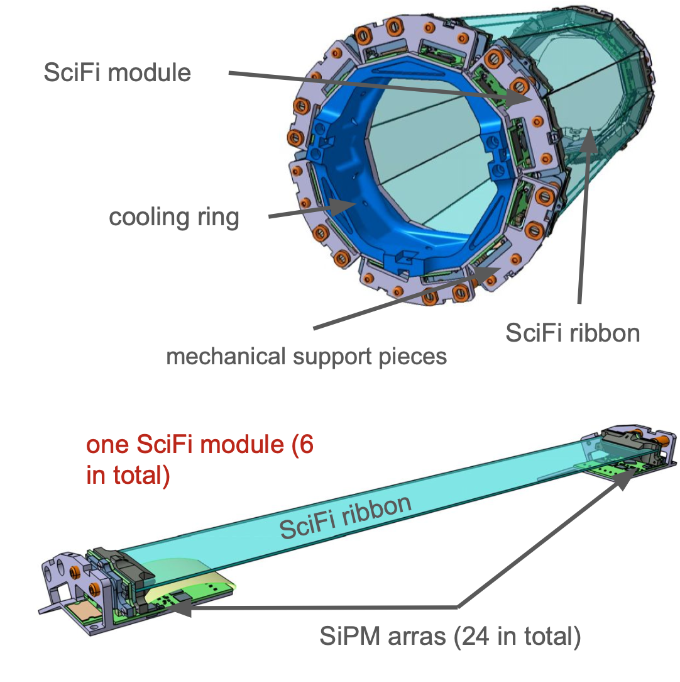
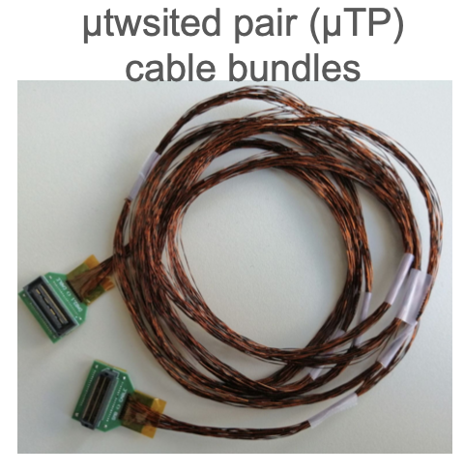
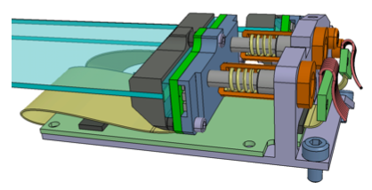
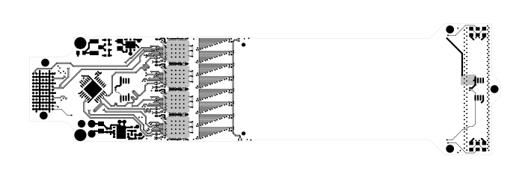
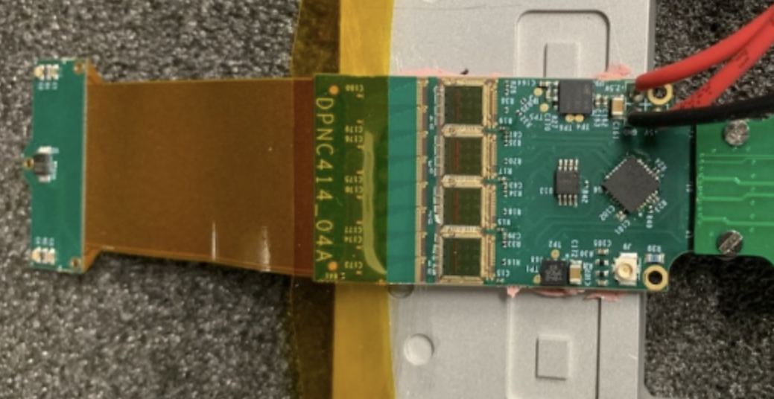
SciFi detector - construction
Fiber and SiPM array attached
SiPM readout waveform
on one end of the fiber ribbon
Ref: 2208.09906
Fill factor >60%
SiPM
MuTRiG x4
interposer
one SciFi super-module (6 in total)
To FPGA
SMB (SciFi Module Board)
SiPM arrays (24 in total)
Ref: Y. Demets, BVR 2023
6

Slide 8
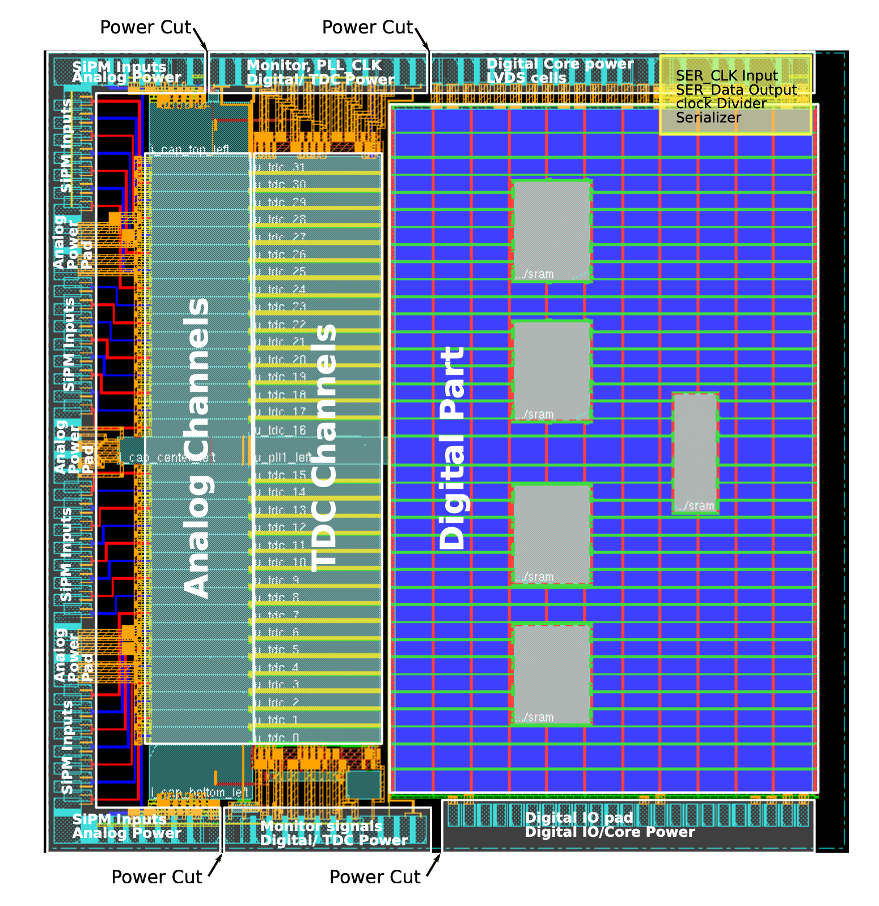
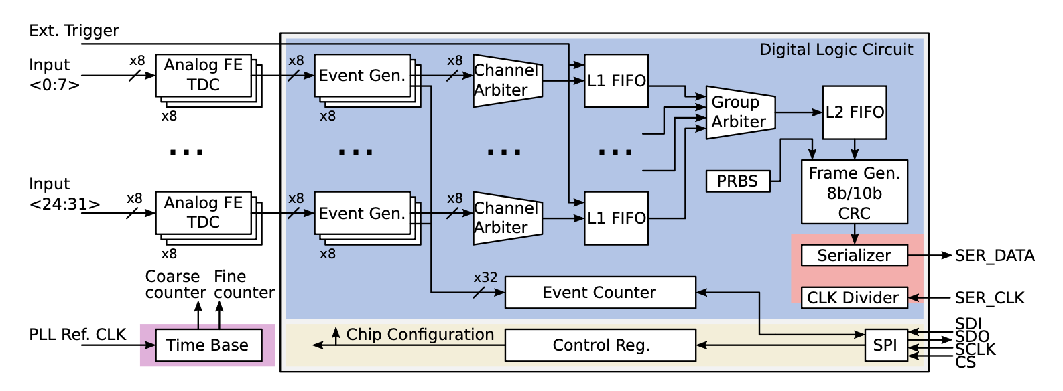
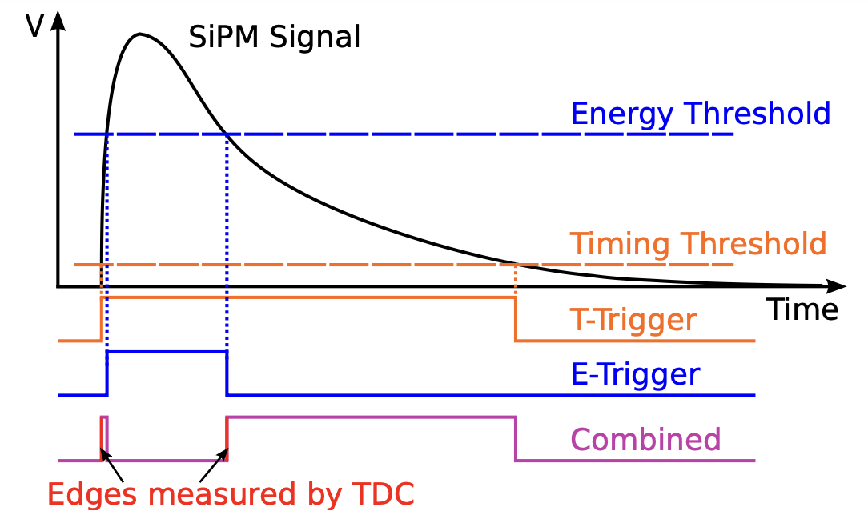
Specialized timing chip - MuTRiG
MuTRiG floorplan
MuTRiG (Muon Timing Resolver including Gigabit-link)
Data link | 1.25 Gbps LVDS
IO ports | Fully differential
Analog channels count | 32
Wafer | UMC 180 nm
Size | 5 mm x 5 mm
Clock speed (nominal) | 625MHz
Event rate > 25 MHz
50 ps time resolution
On-die hit validation hardware algorithm
  Rejecting 50%+ of DCR
Analog FE digitization
Functional block diagram of MuTRiG
MuTRiG bonded
Analog
to SiPM
Digital
to DAQ
bare die version in picture for SciFi
BGA packaging used for SciTile
7

Slide 9
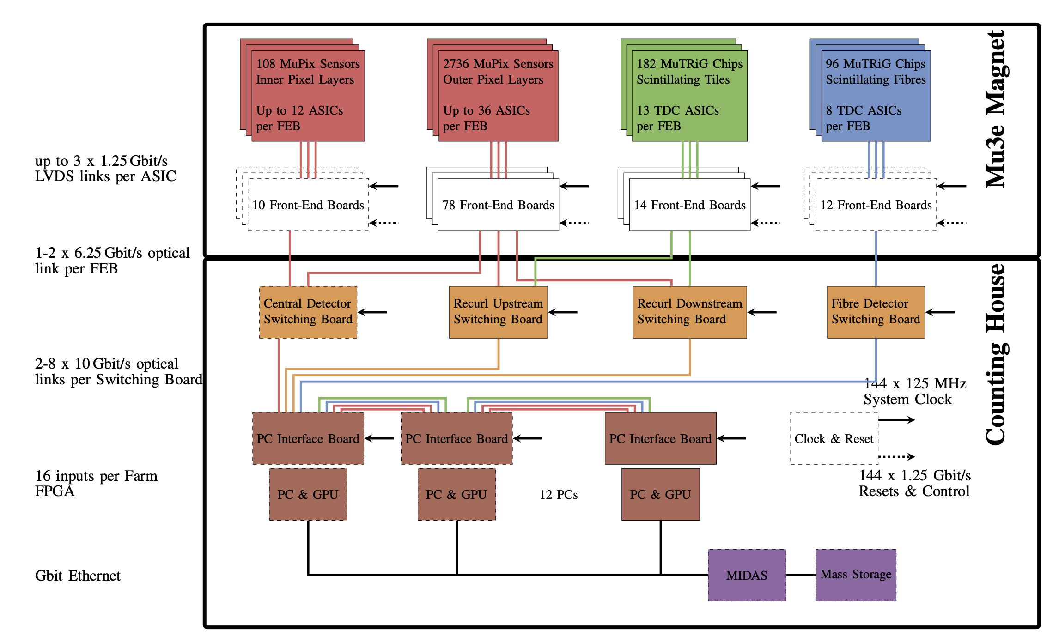
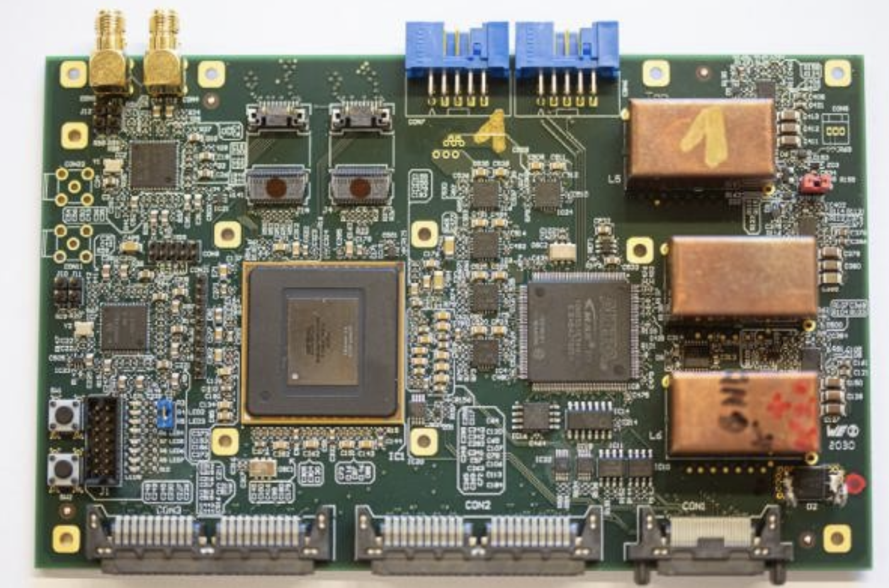
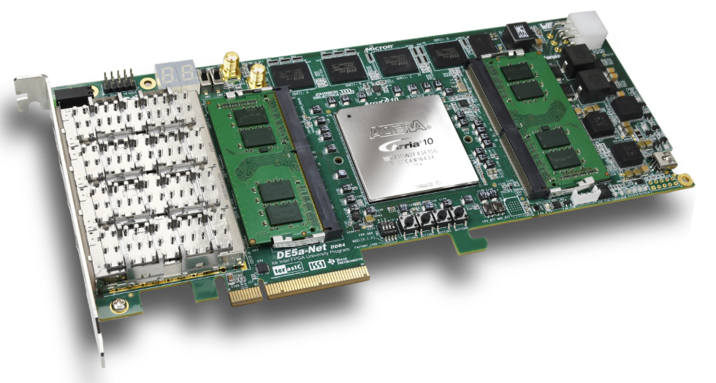
Triggerless Data acquisition (DAQ) system
Mu3e DAQ architecture
Intel(Altera) FPGAs and GPU farm
Link bottleneck bandwidth
(maximum allowed data rate) of SciFi
120 Gbps
144 Gbps
Front-end Board - Customized Arria V board - 8 XCVR
38 Gbps
a few Gbps (whole mu3e)
Farm Board – Dev kit Arria 10 – Customized PCIe DMA controller
8

Slide 10
System Design (FPGA DAQ)
To SWB
(fiber)
Protocols:
Streaming Data
Slow Control
Front-end Board
Optical Firefly® Transceiver
MAX 10
CFG
Arria V
ch 4-7 omitted
ch 0-3
Timestamp
Decoder and Aligner
ch 0-3
LVDS Receiver
Frame Parser
TS Sorter
Data Packer
MuTRiG
MM
MM
MM
MM
MM
ch 0-3
Dummy
MuTRiG Frame Generator
Data/SC select
Error flags
Bypass select
Rate statistics
MM
CFG
CFG
System Design
Data/control plane
Integrated design vs traditional HDL
IP-core lib for Mu3e
MM
MM
MuTRiG Configure SPI Master
Slow Control Master
Memory-Mapped
Interface
MM
:
: entity (functional block)
CFG: configure
: Arria V firmware (2 copies)
: Arbiter
: ASIC data frame
Yifeng Wang – ETH Zürich
9

Slide 11
System Design (FPGA DAQ)
To SWB
(fiber)
Protocols:
Streaming Data
Slow Control
Front-end Board
Optical Firefly® Transceiver
MAX 10
CFG
Arria V
ch 4-7 omitted
ch 0-3
Timestamp
Decoder and Aligner
ch 0-3
LVDS Receiver
Frame Parser
TS Sorter
Data Packer
MuTRiG
MM
MM
MM
MM
MM
ch 0-3
Dummy
MuTRiG Frame Generator
Data/SC select
Stream data
Low latency
High throughput
Fixed topology
Error flags
Bypass select
Rate statistics
MM
CFG
CFG
MM
MM
MuTRiG Configure SPI Master
Slow Control Master
Memory-Mapped
Interface
MM
:
: entity (functional block)
CFG: configure
: Arria V firmware (2 copies)
: Arbiter
: ASIC data frame
Yifeng Wang – ETH Zürich
10

Slide 12
System Design (FPGA DAQ)
To SWB
(fiber)
Protocols:
Streaming Data
Slow Control
Front-end Board
Optical Firefly® Transceiver
MAX 10
CFG
Arria V
ch 4-7 omitted
ch 0-3
Timestamp
Decoder and Aligner
ch 0-3
LVDS Receiver
Frame Parser
TS Sorter
Data Packer
MuTRiG
MM
MM
MM
MM
MM
ch 0-3
Dummy
MuTRiG Frame Generator
Data/SC select
Error flags
Bypass select
Rate statistics
MM
CFG
CFG
Slow Control
Versatile topology
Large addressable space
Crossing clock domains
MM
MM
MuTRiG Configure SPI Master
Slow Control Master
Memory-Mapped
Interface
MM
:
: entity (functional block)
CFG: configure
: Arria V firmware (2 copies)
: Arbiter
: ASIC data frame
Yifeng Wang – ETH Zürich
11

Slide 13
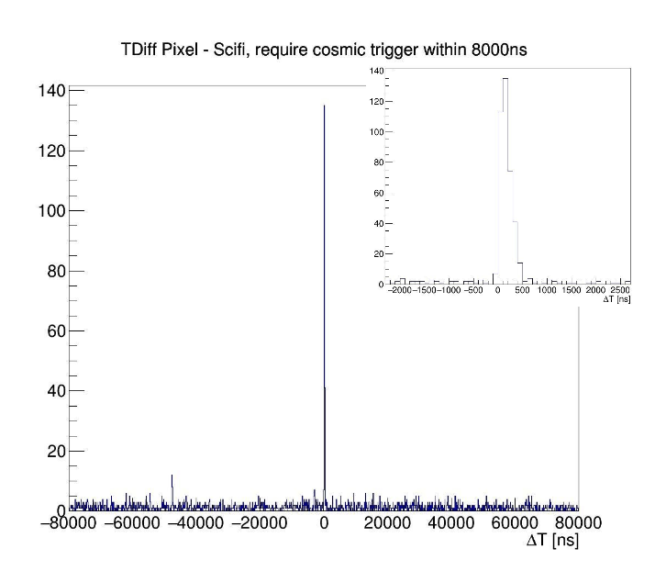
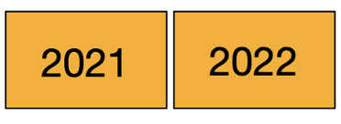
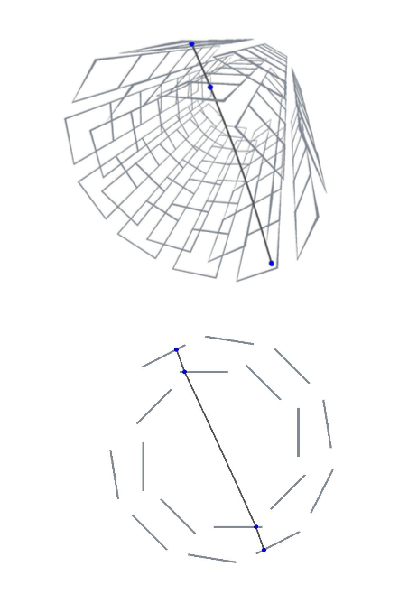
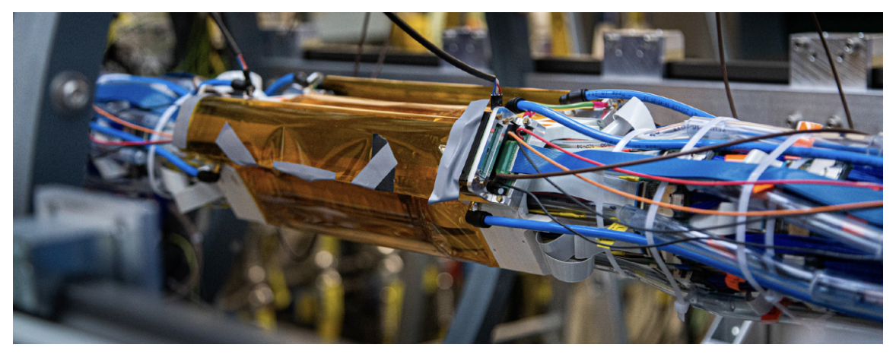
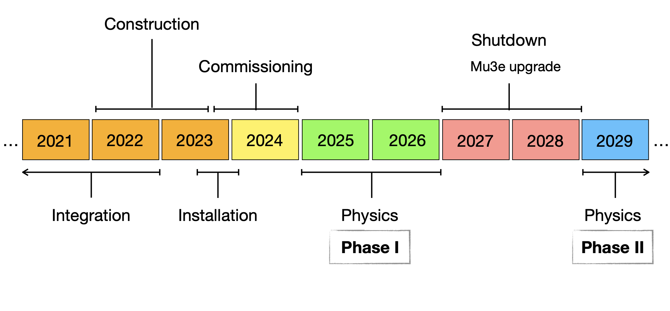

Conclusion
Integration runs
Two-phase physics plan
  $ℬ<$a few ${10}^{−15}$ in Phase I (2025-26)
  $ℬ<{10}^{−16}$ in Phase II (2029+)
Mu3e searching for cLFV violation decay mu->eee
Technical challenges in SciFi (timing, high data-rate, …)
FPGA-based DAQ system (low latency, high throughput, IP-packaging, …)
12

Slide 14
Backup slides

Slide 15
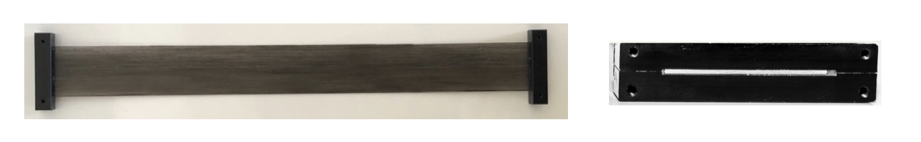
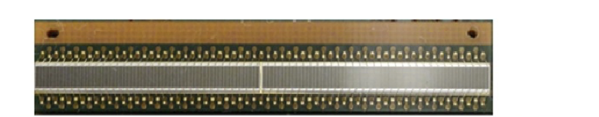
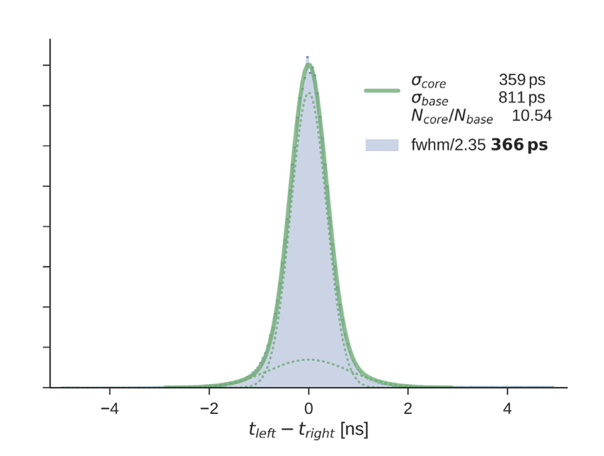
SciFi detector – light detection
Top view 300 mm
e⁻ or e⁺
Side view 32.5 mm
Induced light
Induced light
fiber ribbon (3 layer 250 µm round black epoxy coated rods)
(Kuraray SCSF-78MJ)
Attaching
SiPM readout waveform
~32 mm
1.625 mm
SiPM Array
(Hamamatsu S13552-HRQ)
SiPM pulse time resolution
measured with DRS4 (ADC, timing resolution 200 ps)
To be measured with MuTRiG (TDC, timing resolution 50 ps)
Fiber and SiPM array attached

Slide 16
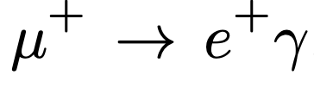
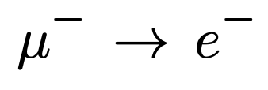
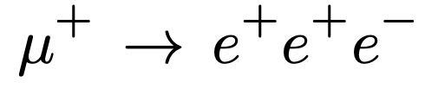
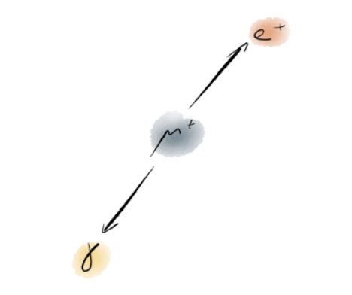
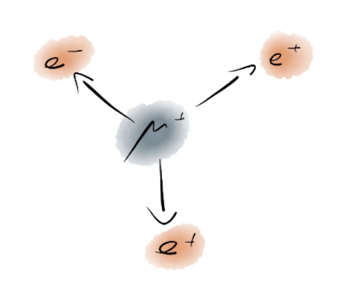
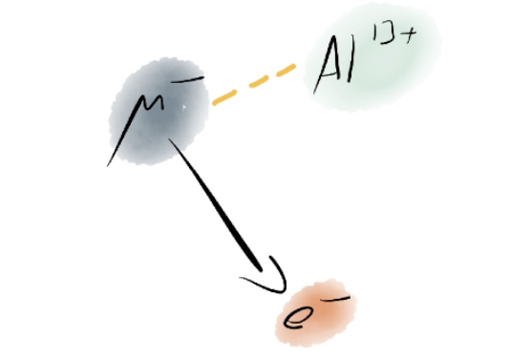


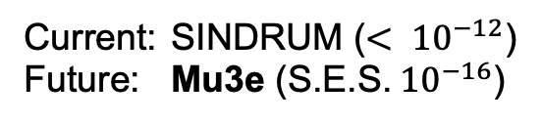
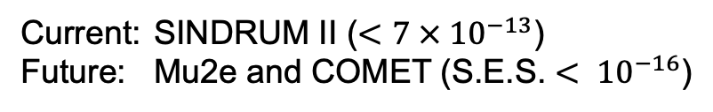
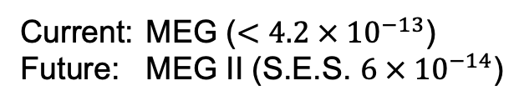
Worldwide status of muon decay search for charged LFV
(within nuclei)
Current: MEG ($<4.2 × {10}^{−13}$)
Future: MEG II (S.E.S. $6 × {10}^{−14}$)
Current: SINDRUM II ($<7 × {10}^{−13}$)
Future: Mu2e and COMET (S.E.S. $< {10}^{−16}$)
Current: SINDRUM ($< {10}^{−12}$)
Future: Mu3e ($\text{S}\text{.}\text{E}\text{.}\text{S}\text{.}{ 10}^{−16}$)

Slide 17
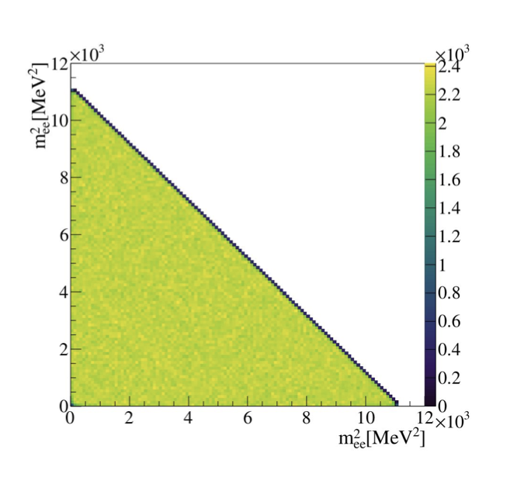
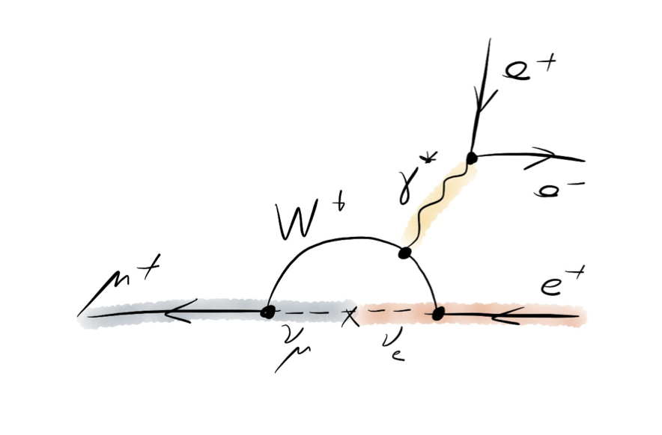




Why $μ→eee$ is a golden channel?
2. Full 3-body decay kinematics $⟹$ large kinematic space coverage
Phase space decay (Dalitz plot)
1. Strongly suppressed by SM $⟹$ very clean channel
consider acceptance of detector
SM suggested decay
BSM suggested decay

Slide 18



Beam and target
Double-cone hollow target
Distribute muon stops over large surface
Made in Mylar
Muon stopping ratio: 95.5%
100 mm long, 38 mm diameter,
Delivered by HIPA proton accelerator at PSI
Proton -> pions -> “surface” muon
~28 MeV DC muon beam
πE5 / CMBL shared by MEG II and Mu3e
7.5 x 10⁷ muons/s on target
Notes:
surface muon has 28MeV. move it up

Slide 19




Magnet and track recurl
1T Magnet: Maximize the acceptance of recurler
Momentum resolution increases as material budget decreases
Solenoid magnet with 1.0 T nominal field
Delivered at PSI, operational
Recurl helps on reducing multiple scattering uncertainties
Notes:
explain the recurl more
maximumize the acceptance of recurler

Slide 20

Pixel tracker in Mu3e
Outer pixel (recurl)
Inner pixel (vertex)
Goal of tracker: vertex and tracking
Granularity: Pixel=80µm*80µm, ScFi fiber=250µm*300mm, Tile 5mm*5mm
Notes:
Explain first the event
bit cut
ref is in pic
rotate the CAD
why tracking vertex

Slide 21



MuPix (HV-MAPS tech.)
- high voltage, monolithic, fast charge collection, smart diode
General Operating Scheme of
High-Voltage Monolithic Active Pixel Sensors
Block diagram of signal flow
Integration of diode sensor and detector circuit into one-die
World-most thin HV-MAPS, 50 µm (~0.1% X₀) version taped-out
Pixel size: 80 x 80 µm²
Pixel matrix: 256 x 250 pixels
Active region: 85.5% of the whole chip
Link type: 1.25 Gbps LVDS
Active region
Digital/Analog Chip bottom
Floorplan of MuPix
Notes:
just highlight bullet points
world-most thin

Slide 22





MuPix performance
Innovative gaseous helium cooling solution with 2g/s, sensor < 70˚C
spTAB bonding for High-Density Interconnects
Raw timing resolution
(w/o time-walk and delay correction)
Timing resolution
MIP detection efficiency
MuPix11 (100µm)
Measured temperature difference of dummy load
(at ~ 215 mW/cm2)
Max. temperature difference < 35 K (215 mW/cm2)
Max. temperature difference < 54 K (350 mW/cm2)
Notes:
backup
just mention helium cooling

Slide 23





Scintillating Tiles detector
Consists of size of 6 x 6 x 5 mm³ scintillating tiles
Readout with 3 x 3 mm² SiPM (MPPC S13360-3050VE)
Digitized by MuTRiG (TDC)
Efficiency > 99%, time resolution ~40ps
Tile Matrix
(top) w/ scintillator
(bottom) w/o scintillator
Tile Subdetector
Tile-shape scintillator
Notes:
why thick more material not in center
TODO: What is this figure?

Slide 24



MuTRiG
Raw waveform
MuTRiG Event Table
Frame Parser
8b/10b symbols
MM
LVDS Receiver
MM

Slide 25

Filter farm
Triggerless, continuous reconstruction
Track reconstruction in central pixel detector and vertex finding on GPUs
Events with μ → eee candidates are send off to mass storage
Data reduction by a factor of 80
Notes:
GPU highlight
Own scheme

Slide 26
Past integration runs
Integrated runs and testbeam of DAQ, helium/water cooling, magnet
Reconstructed cosmic muons and recurl electrons
Track reconstruction and coincidence found to validate the prototype
Pixel-SciFi and Pixel SciTile combined coincidence search
Notes:
re-do this plot quality

Slide 27


Simulation for Phase I physics
Phase space
Sensitivity
Vertex resolution ~0.3 mm (<0.5 mm)
Momentum resolution ~0.9 MeV (<1 MeV)
Notes:
more time on this slides

Slide 28




MuPix assemble to pixel ladder
Mock-ups of cabling and assembly performed for innermost pixel layers
Extreme space constrains for cabling, flex and uTP cable used
Assembling steps
1:4
Notes:
show only some pictures

Slide 29

Lepton flavor violation (LFV)
Lepton flavor violation has been observed in neutrino sector (nLFV)
=> SM extension for nLFV, i.e. PMNS-matrix
Lepton flavor violation has never been observed in charge lepton sector (cLFV)
Standard Model particles
Notes:
u->e not e->u
Highlight information: cLFV

Slide 30


Mu3e physics with kinematics
All decayed tracks have momemtum <53MeV

Slide 31

physics sensitivity, simulations

Slide 32



More about beam

Slide 33



construction and commissioning status, staging-setup, etc

Slide 34


IP-core library of Mu3e experiment
Instantiation tab
Created Mu3e-specific IP category
Avalon-MM
Slave
Exportable across system (FEB or SWB)
Integration with NIOS or System Console
One-click instantiation
Zero-debugging effort from user side
User Friendly GUI
Auto-interconnection with Avalon-Memory Mapped interface
Display floating-point 32 reading
Support parasitic powering (with 500 Ohm pull-up resistor)
Support rolling or one-time readout
Yifeng Wang – ETH Zürich

Slide 35

Slides from Frederik Wauters in CLFV2023
Yifeng Wang – ETH Zürich

Slide 36

Slides from Frederik Wauters in CLFV2023
Yifeng Wang – ETH Zürich

Slide 37

Conceptual design for gamma conversion at Mu3e
Slides from Frederik Wauters in CLFV2023
Yifeng Wang – ETH Zürich

Slide 38


Connector boards
uTP cable
Yifeng Wang – ETH Zürich

Slide 39




How do we test charge injection without final DAB
Normal data reading
SMB
Backplane
Charge injection port
FEB
+ -
Analog pulse
CMOS 2.5V
CMOS 2.5V
Charge Injection Evaluation Board
DAB 2.1

Slide 40
Yifeng Wang
D-​PHYS
yifenwan@phys.ethz.ch
ETH Zürich
Inst. f. Teilchen-​ und Astrophysik
HPK E 25
Otto-​Stern-Weg 5
8093 Zürich Switzerland

