Slide 1



Towards the first demonstration of gravitational quantum states of atoms with a cryogenic hydrogen beam
06.09.2023
Carina Killian¹, Philipp Blumer², Katharina Schreiner² ,Pauline Yzombard³, Otto Hanski⁴,
François Nez³, Valery Nesvizhevsky⁵, ‪Sergey Vasiliev⁴, Paolo Crivelli², Eberhard Widmann¹
¹ Stefan Meyer Institute for Subatomic Physics, Austrian Academy of Sciences, Kegelgasse 27, A-1030 Wien, Austria
² ETH, Zurich, Institute for Particle Physics and Astrophysics, 8093 Zurich, Switzerland
³ Laboratoire Kastler Brossel, Sorbonne Université, CNRS, ENS-PSL Université, Collège de France, 75252, Paris, France
⁴ Department of Physics and Astronomy, University of Turku, Turku, Finland, FI-20014
⁵ Institut Max von Laue - Paul Langevin, 71 avenue des Martyrs, Grenoble, France, F-38042

Slide 2
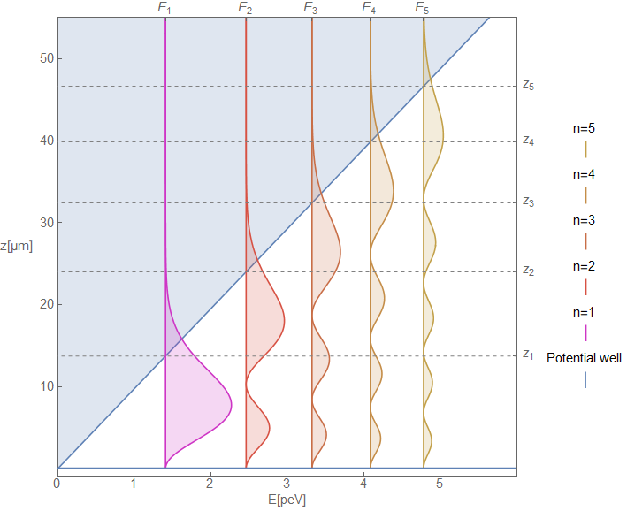
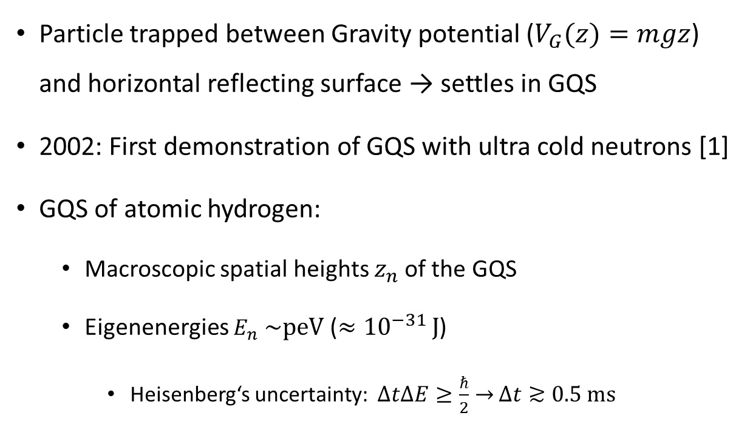
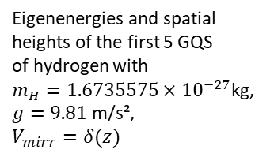

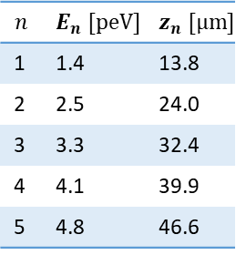
Gravitational Quantum States (GQS)
Particle trapped between Gravity potential ($V_{G}(z)=mgz$) and horizontal reflecting surface → settles in GQS
  2002: First demonstration of GQS with ultra cold neutrons [1]
  GQS of atomic hydrogen:
    Macroscopic spatial heights $z_{n}$of the GQS
    Eigenenergies $E_{n}$ $\sim$peV ($≈{10}^{−31 }J$)
      Heisenberg‘s uncertainty: $∆t∆E≥\frac{ℏ}{2}→$ $∆t≳0.5 ms$
$$\overset{⃑}{g}$$
$$n$$ | $$E_{n} [peV]$$ | $$z_{n} [µm]$$
1 | 1.4 | 13.8
2 | 2.5 | 24.0
3 | 3.3 | 32.4
4 | 4.1 | 39.9
5 | 4.8 | 46.6
Eigenenergies and spatial heights of the first 5 GQS
of hydrogen with
$m_{H}=1.6735575×{10}^{−27}$kg,
$g=9.81$m/s²,
$$V_{mirr}=δ(z)$$
[1] V. Nesvizhevsky et al., Quantum states of neutrons in the Earth's gravitational field. Nature 415, 297–299 (2002). https://doi.org/10.1038/415297a

Slide 3
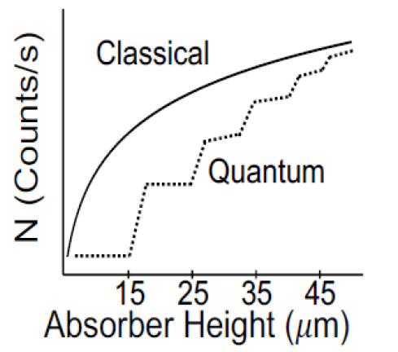
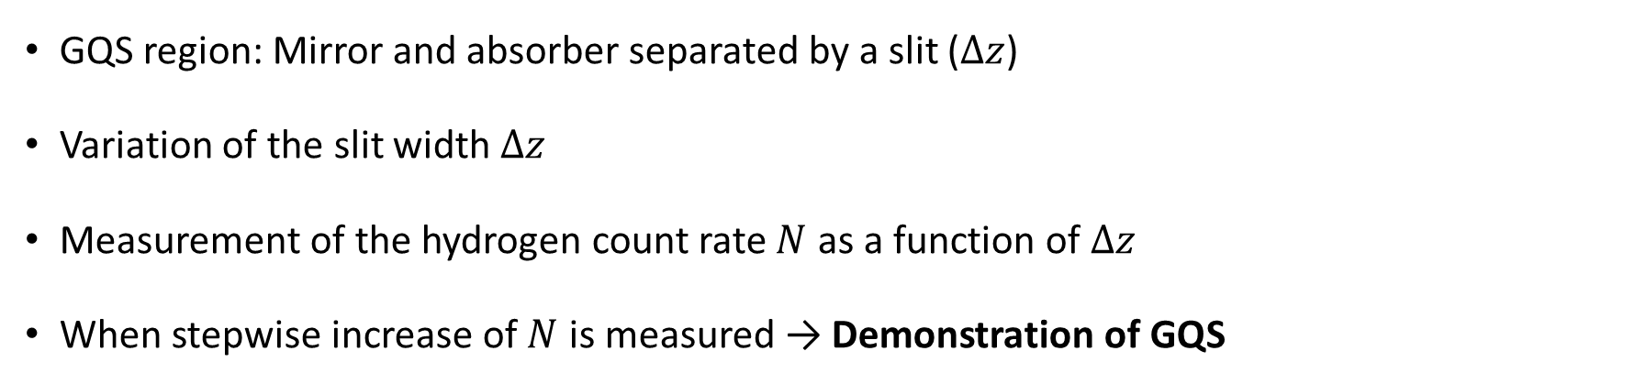






Measurement principle
GQS region: Mirror and absorber separated by a slit ($∆z$)
Variation of the slit width $∆z$
Measurement of the hydrogen count rate $N$ as a function of $∆z$
When stepwise increase of $N$ is measured → Demonstration of GQS
$$∆z=z_{2}$$
$$∆z=z_{3}$$
Cryogenic
H-Beam
Absorber
$$∆z<z_{1}$$
$$∆z=z_{1}$$
$$∆z<z_{1}$$
$$∆z$$
H-Detection
Mirror
Notes:
region for the gqs measurement will consist of a Hydrogen-Mirror and an absorber.
The mirror will reflect the Hydrogen atoms and the absorber will scatter the atoms that are high enough to reach it.
separated by the slit width delta z which is changed during the measurement.
in the presence of gqs, the mirror-absorber-system will only become transparent
when the slit width reaches the height of the first gqs, so approximately 15 µm.
Then, all of the atoms in the gravitational quantum groundstate will pass
and all of the others will still be reflected.
Until delta z reaches the height of the second state. Then, also the second state will pass, and so on.
Classically, a continuous dependence is expected.
So if we measure this stepwise behavior predicted by gqs, we demonstrate gqs for hydrogen!

Slide 4
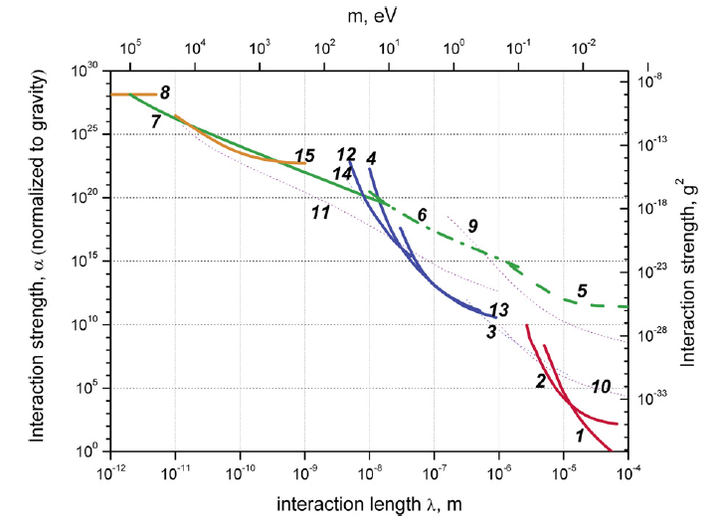
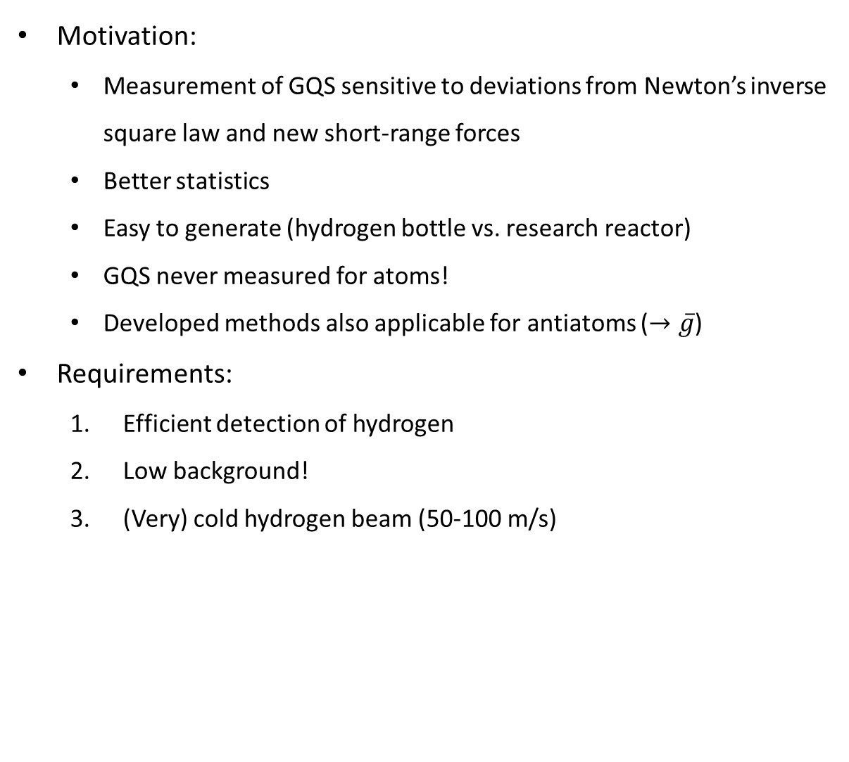
Measurement of GQS with hydrogen
  Motivation:
    Measurement of GQS sensitive to deviations from Newton’s inverse square law and new short-range forces
    Better statistics
    Easy to generate (hydrogen bottle vs. research reactor)
    GQS never measured for atoms!
    Developed methods also applicable for antiatoms ($→\overline{g}$)
Requirements:
  Efficient detection of hydrogen
  Low background!
  (Very) cold hydrogen beam (50-100 m/s)
UCN GQS
Exclusion plot for new spin-independent interactions [2]
1,2: short-range gravity in torsion balance
4,12,13: Extra forces on top of Casimir and v.d.W interactions
5: neutron Gravitational Quantum States (GQS)
6: neutron whispering gallery effects
7: neutron scattering on nuclei
8: precision measurements of exotic atoms
15: low mass bosons from the sun in a high-purity germanium detector
[2] Antoniadis, Ignatios & Baessler, S. & Büchner, M. & Fedorov, Valery & Hoedl, Seth & Lambrecht, Astrid & Nesvizhevsky, V.V. & Pignol, Guillaume & Protasov, K. & Reynaud, Serge & Sobolev, Yu. (2010). Short-range fundamental forces. Forces fondamentales à courte portée.

Slide 5
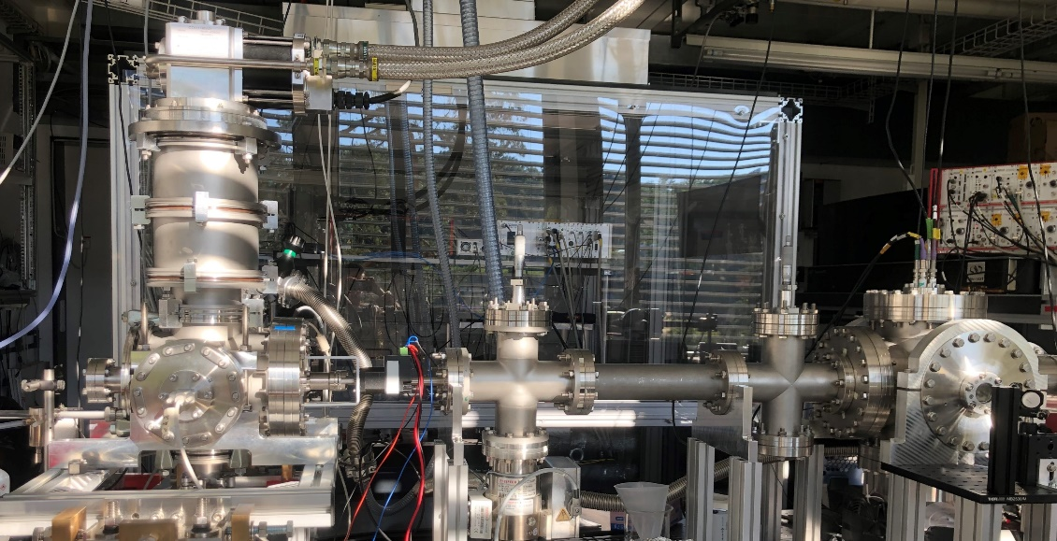
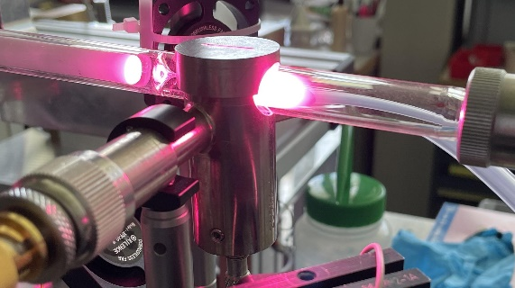
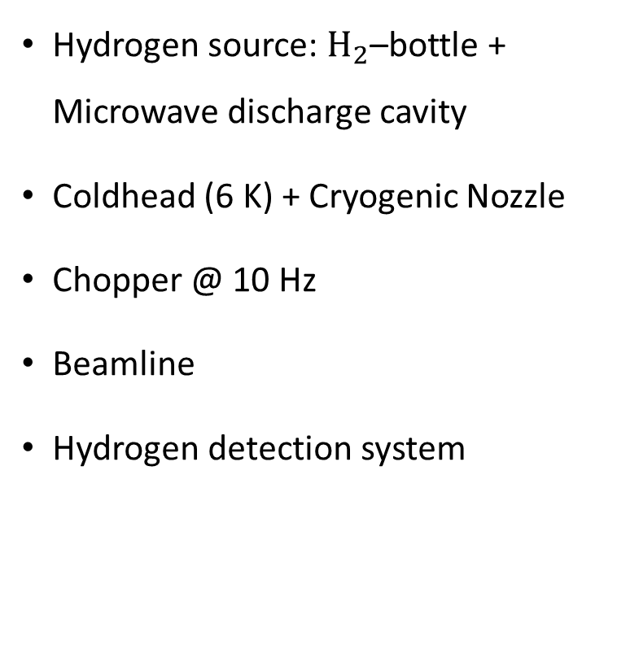
Hydrogen beam – Experimental setup
Hydrogen source: $H_{2}$–bottle + Microwave discharge cavity
Coldhead (6 K) + Cryogenic Nozzle
Chopper @ 10 Hz
Beamline
Hydrogen detection system
Coldhead
Chopper
Detection
chamber
H-Bottle
MW
discharge
cavity

Slide 6
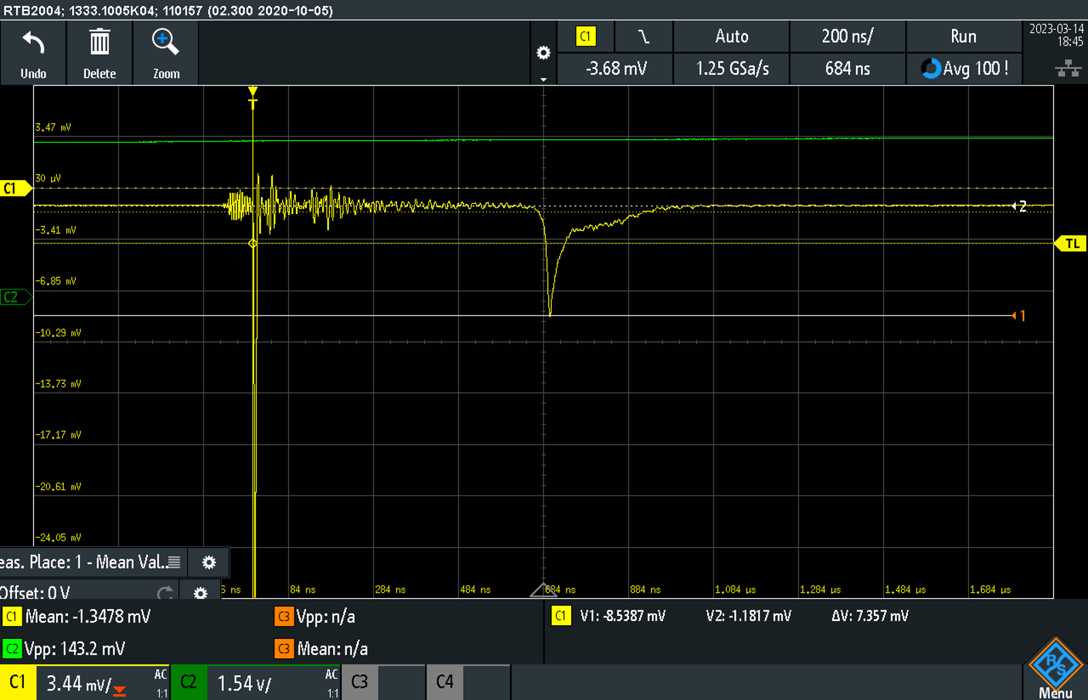
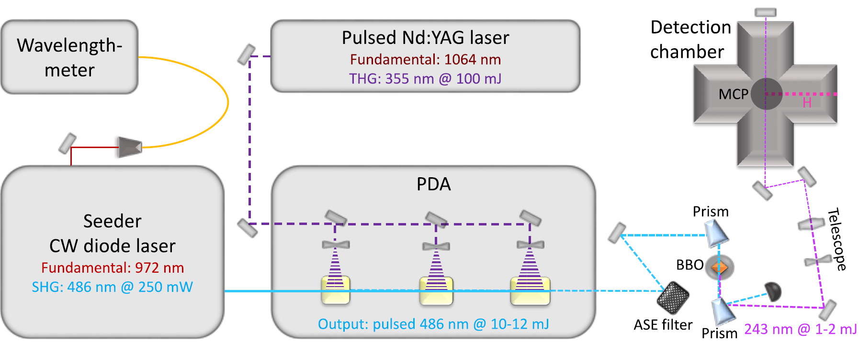
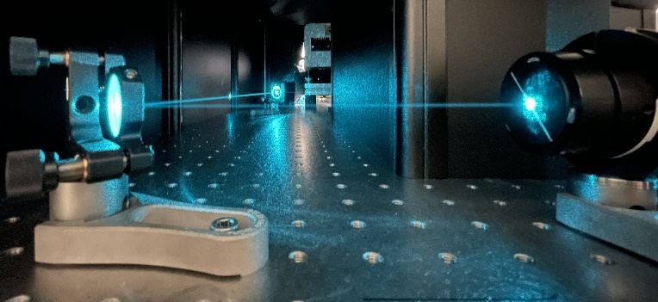



Requirement #1:
Efficient detection of hydrogen
Ionization Potential
Ionization of $H$ with a pulsed UV-Laser ($λ=243$nm)
  $H→H^{+}+e^{−}$
  2 photon excitation (1S-2S) + 1 photon ionization
Detection of $H^{+}$ with an MCP
Integrated MCP-Signal $∝H$- count rate
2s
$$λ=243nm$$
$$∆E=10.2eV→f≈246THz→λ≈121.8nm$$
1s

Slide 7
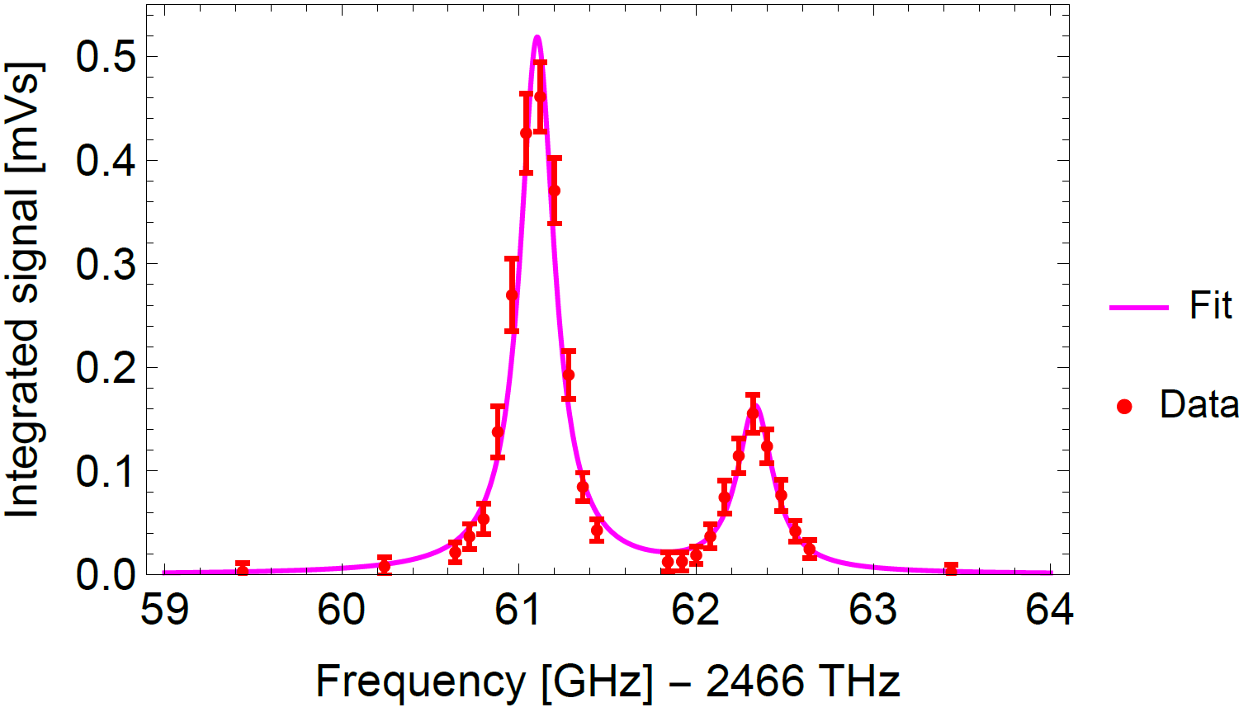
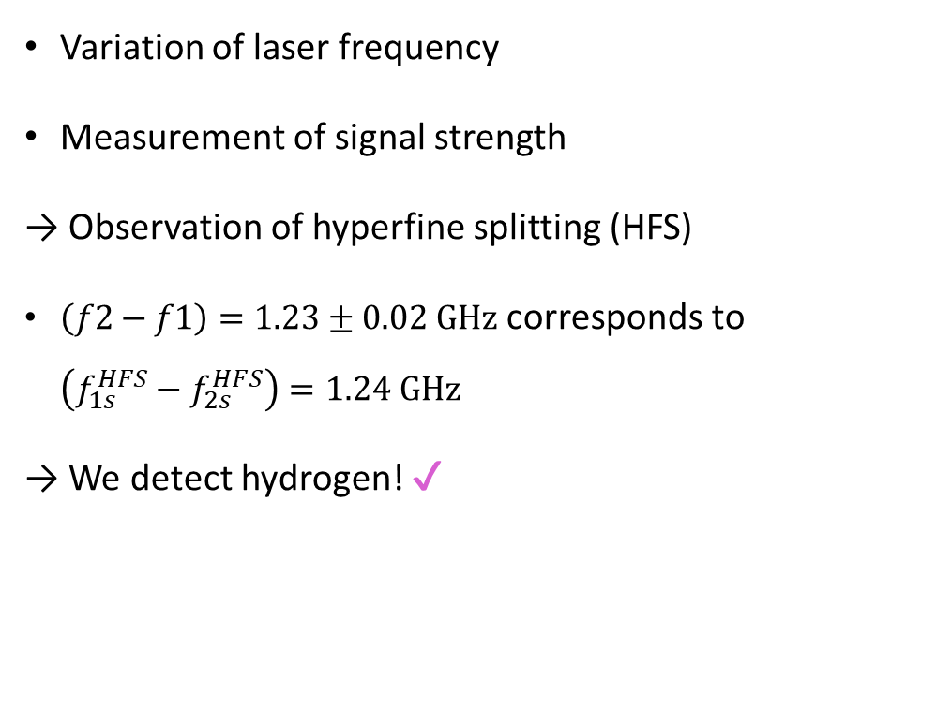
Test of hydrogen detection
Variation of laser frequency
Measurement of signal strength
→ Observation of hyperfine splitting (HFS)
$\left(f2−f1\right)=1.23±0.02 GHz$ corresponds to $\left(f_{1s}^{HFS}−f_{2s}^{HFS}\right)=1.24 GHz$
→ We detect hydrogen! ✔
The frequency values on the abscissa correspond to the measured frequency of the seeder laser fundamental, shifted by 230MHz (outdated wavelength meter calibration) and multiplied by a factor of 8 (two SHG processes, two photon excitation). This was done to to match the absolute literature values [3]. Figure taken from [4].
[3] C.G. Parthey, et al., Improved Measurement of the Hydrogen 1S - 2S Transition Frequency. Phys. Rev. Lett. 107, 203-001 (2011). https://doi.org/10.1103/PhysRevLett.107.203001. arXiv:1107.3101 [physics.atom-ph]
[4] Killian, C. et al. GRASIAN: towards the first demonstration of gravitational quantum states of atoms with a cryogenic hydrogen beam. Eur. Phys. J. D 77, 50 (2023). https://doi.org/10.1140/epjd/s10053-023-00634-4
Notes:
But how do we now that we actually detect atomic hydrogen?
frequency sweep while measuring the signal.
able to observe the Hyperfinesplitting
The two peaks of the data point were fitted and their difference calculated.
It corresponds to the difference of the groundstate hyperfine splitting and the hyperfinesplitting in the 2s state and
agrees well with the theoretical value.
So it is save to say that we do detect atomic hydrogen!

Slide 8
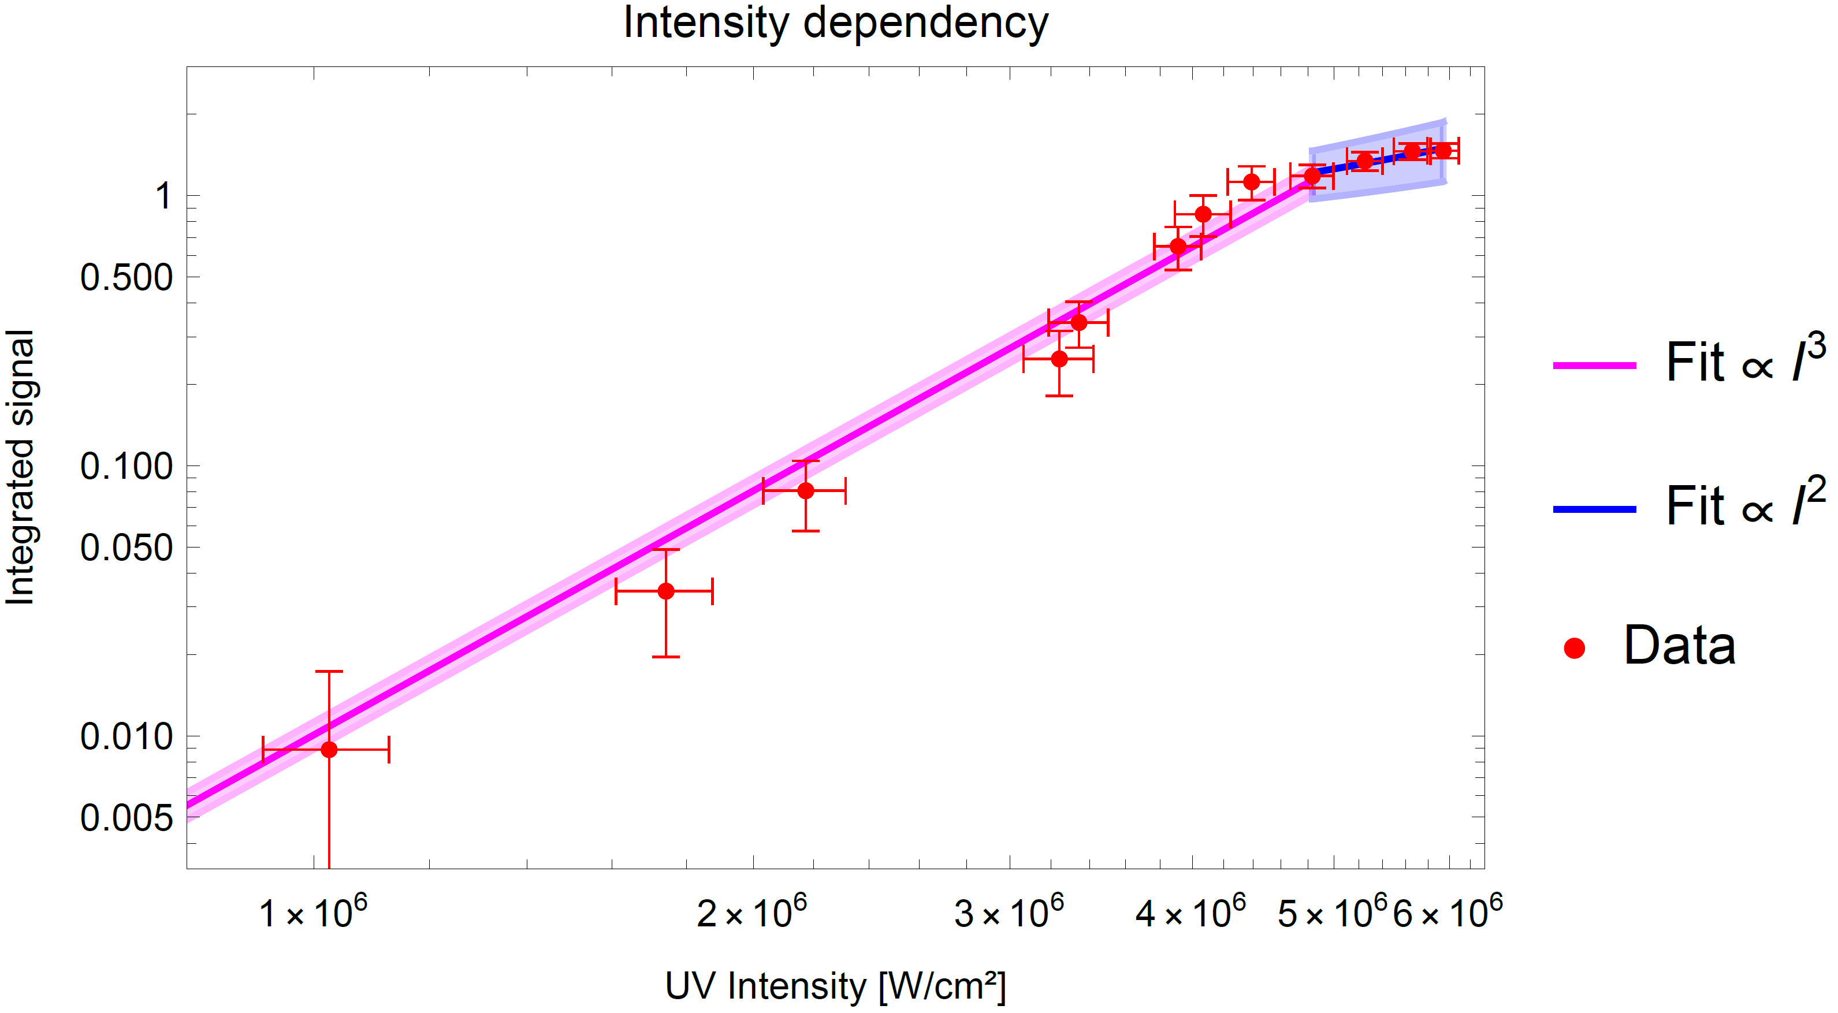
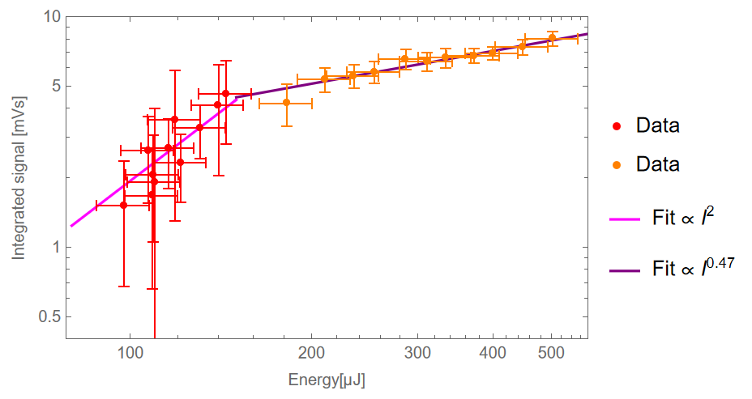
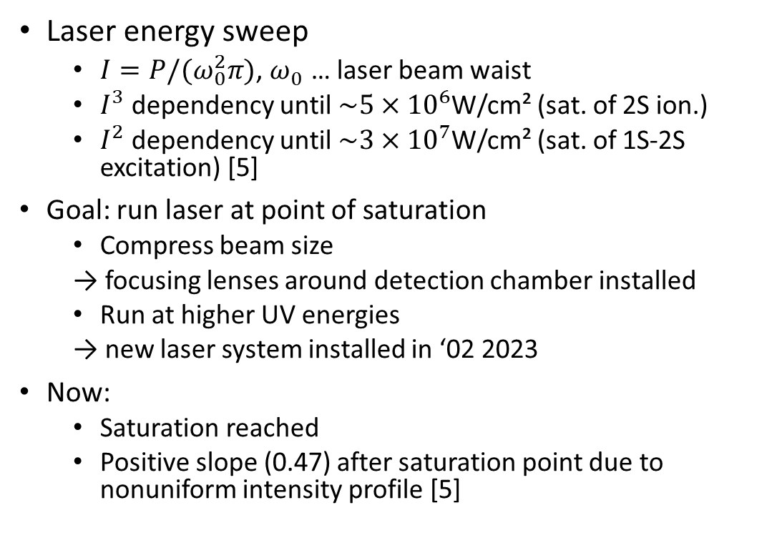
Intensity dependency
Laser energy sweep
  $I=P/{(ω}_{0}^{2}π)$, $ω_{0}^{}$… laser beam waist
  $I^{3}$ dependency until $\sim 5×{10}^{6}$W/cm² (sat. of 2S ion.)
  $I^{2}$ dependency until $\sim 3×{10}^{7}$W/cm² (sat. of 1S-2S excitation) [5]
Goal: run laser at point of saturation
  Compress beam size
  → focusing lenses around detection chamber installed
  Run at higher UV energies
  → new laser system installed in ‘02 2023
Now:
  Saturation reached
  Positive slope (0.47) after saturation point due to nonuniform intensity profile [5]
Figure taken from [4].
preliminary
[5] S.W. Downey, R.S. Hozack, Saturation of three-photon ionization of atomic hydrogen and deuterium at 243 nm. Opt. Lett. 14(1), 15–17 (1989). https://doi.org/10.1364/OL.

Slide 9
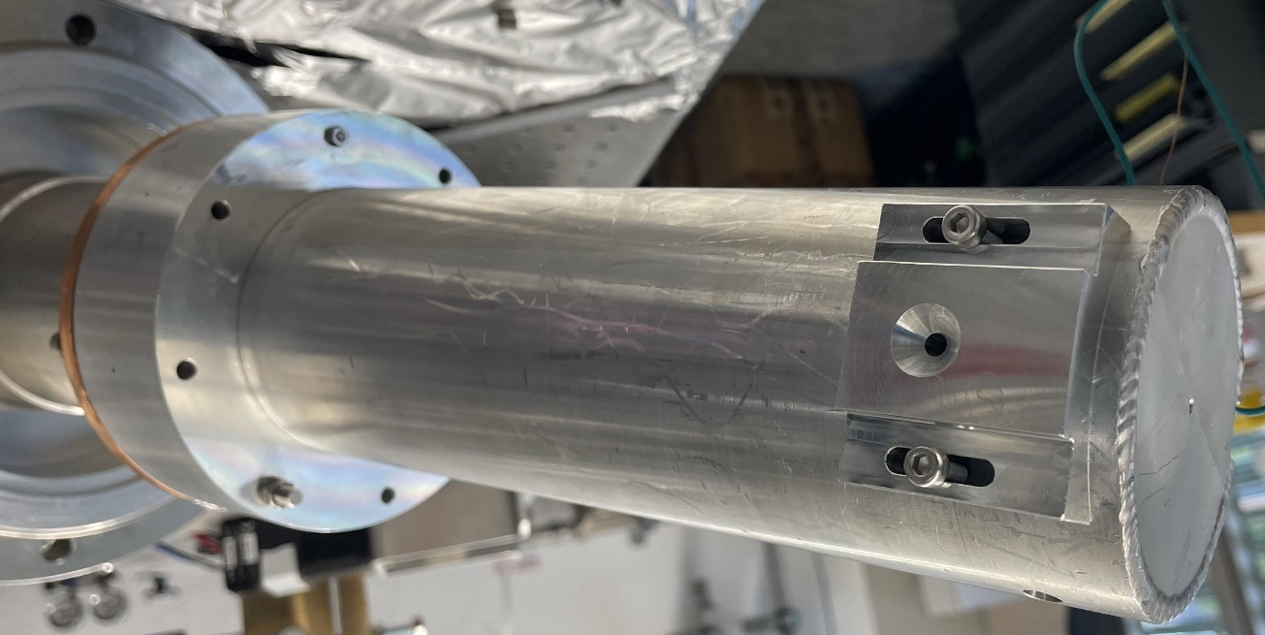
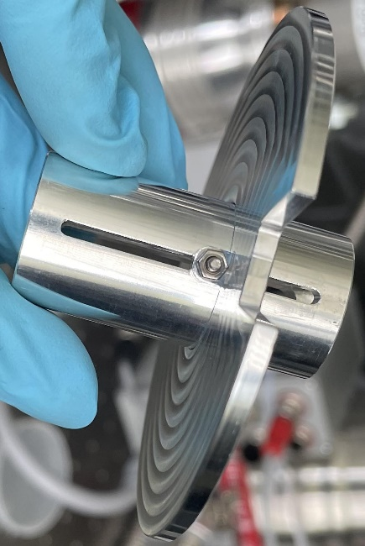
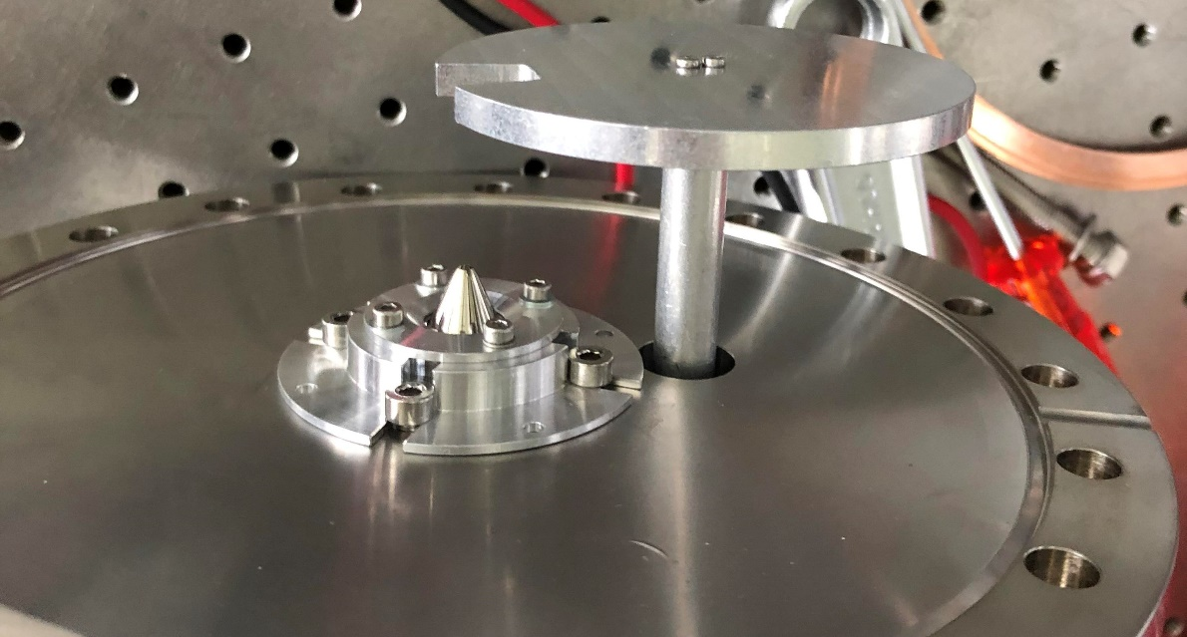
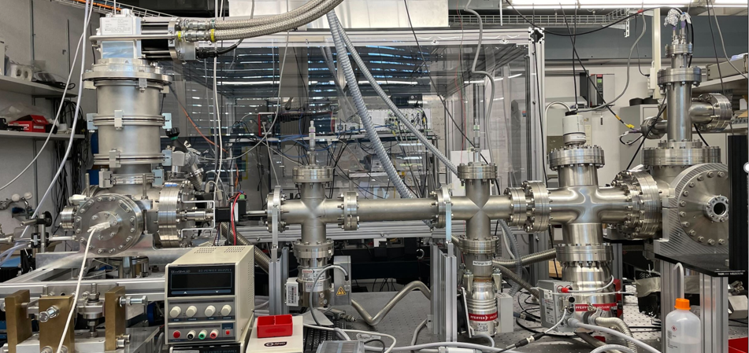






Requirement #2:
Low background (BG)
Added 4 differential pumping stages
  3 new turbo pumps
  Skimmer in cryo chamber
  2 height adjustable apertures
  1 pinhole
Improved pumping of hydrogen
  Turbo pumps as backing pumps for turbo pumps in cryo- and detection chamber
Brought chopper wheel ~1mm close to skimmer
Pinhole on heatshield
Coldhead
Heatshield + 4mm pinhole
$$p_{3}$$
Chopper + “hat”
Slit 1
Slit 2
Skimmer
~1 cm pinhole
$$p_{1}$$
Detection
chamber
H-Bottle
MW
discharge
cavity
$$p_{6}$$
$$p_{4}$$
$$p_{5}$$
$$p_{2}$$
Turbo 2
Turbo 3
Turbo 1
Turbo 4
Turbo 5
BT 2
9
BT 1
BP1
BP2

Slide 10
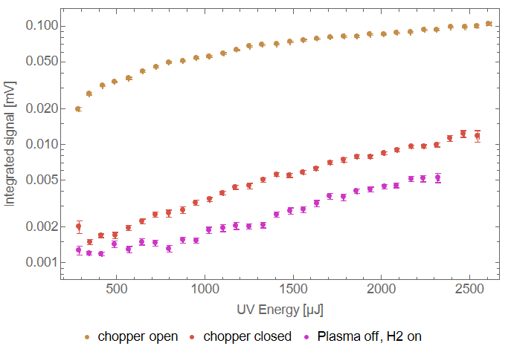
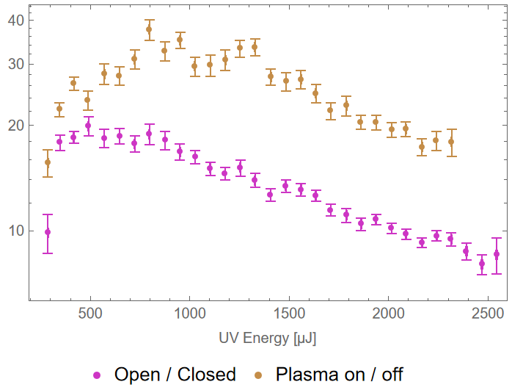
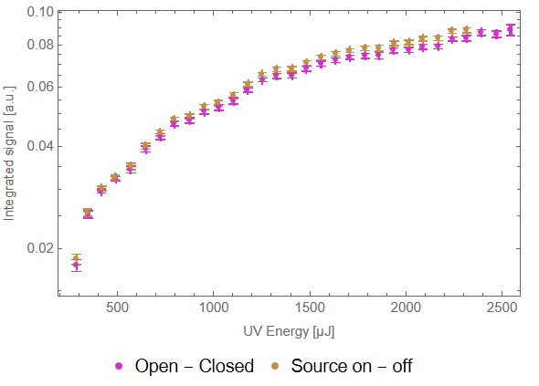
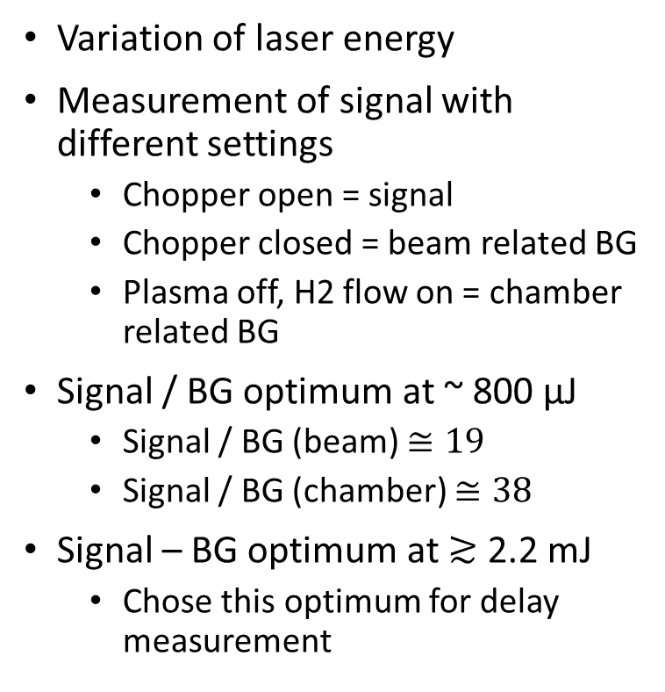
BG measurements
preliminary
Variation of laser energy
Measurement of signal with different settings
  Chopper open = signal
  Chopper closed = beam related BG
  Plasma off, H2 flow on = chamber related BG
Signal / BG optimum at ~ 800 µJ
  Signal / BG (beam) $≅19$
  Signal / BG (chamber) $≅38$
Signal – BG optimum at $≳$ 2.2 mJ
  Chose this optimum for delay measurement
preliminary
preliminary
10

Slide 11
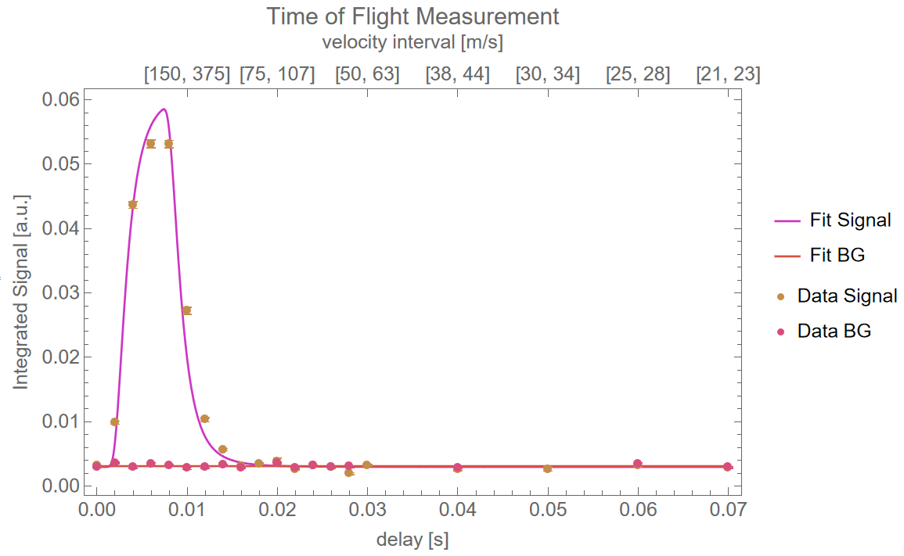
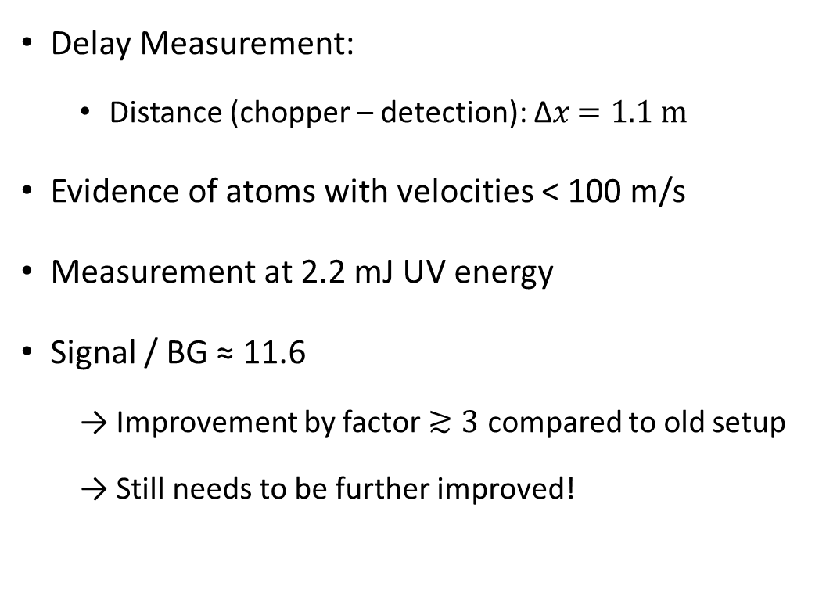
Requirement #3:
(Very) cold hydrogen beam (50-100 m/s)
Delay Measurement:
  Distance (chopper – detection): ∆𝑥 $=1.1 m$
Evidence of atoms with velocities < 100 m/s
Measurement at 2.2 mJ UV energy
Signal / BG ≈ 11.6
  → Improvement by factor $≳3$ compared to old setup
  → Still needs to be further improved!
preliminary
Notes:
need a hydrogen beam with a sufficient amount of low velocity atoms.
coldhead cools the beam down to 6.5 K
in theory there should be atoms present with velocities below 50 m/s.
To experimentally validate, we performed a delay measurement
the time between the chopper opening and the firing of the laser, hence the detection, was varied.
So a time of flight measurement.
The recorded datapoints you can see on the lower plot. With a distance of 80 cm between the chopper and the detection, the time a 50 m/s atom would take is 16 ms. And as you can see, there is clear evidence of atoms with velocities less than 50 m/s.

Slide 12
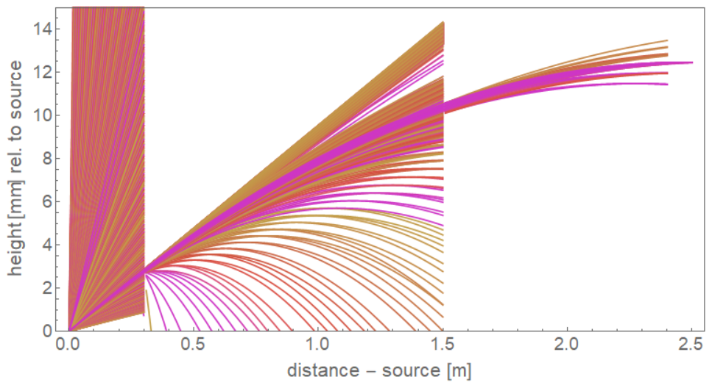
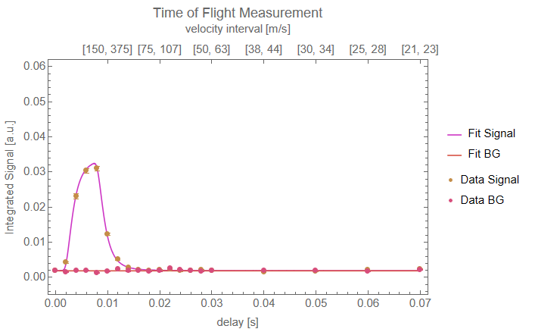
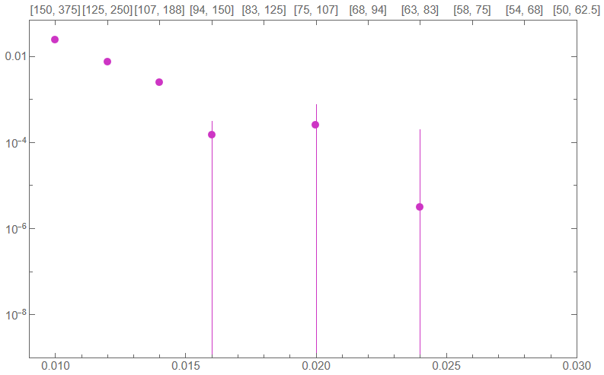
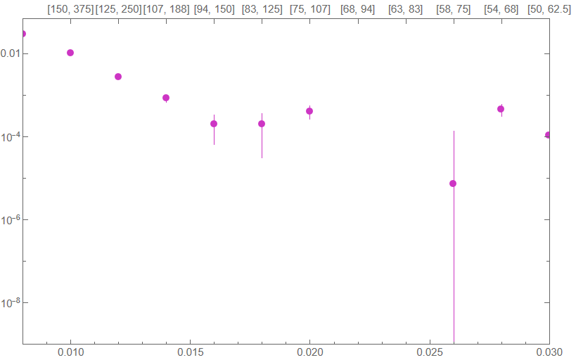

Velocity selection aperture
Two height adjustable slits (1 mm)
Selection of specific velocity with adjustment of slit-heights
Selection of velocity components: $v_{z}\left(GQS−Region\right)=0$
First test: all slits on axis (left) vs. slit 2: +1 mm (right)
preliminary
preliminary
12

Slide 13
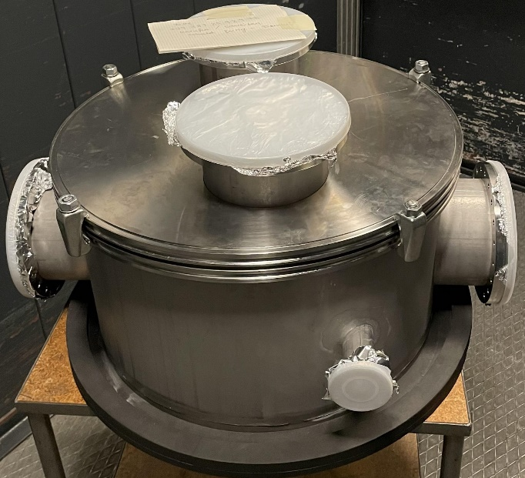
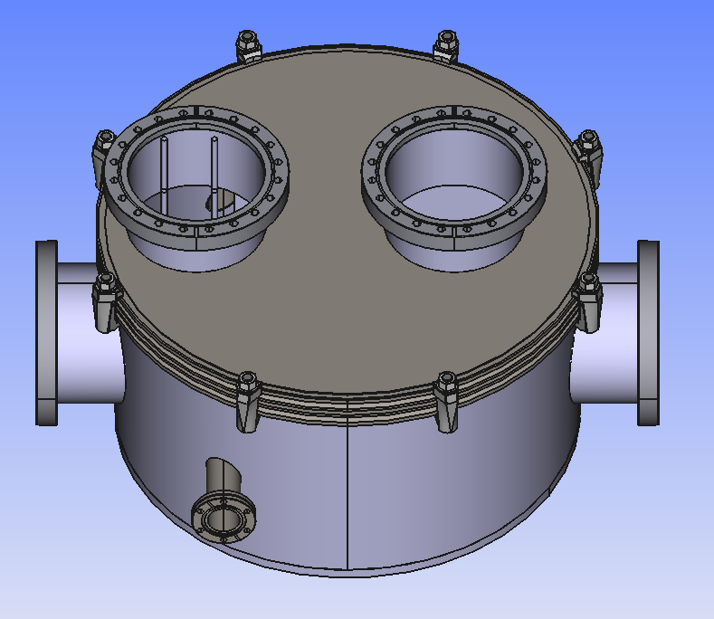
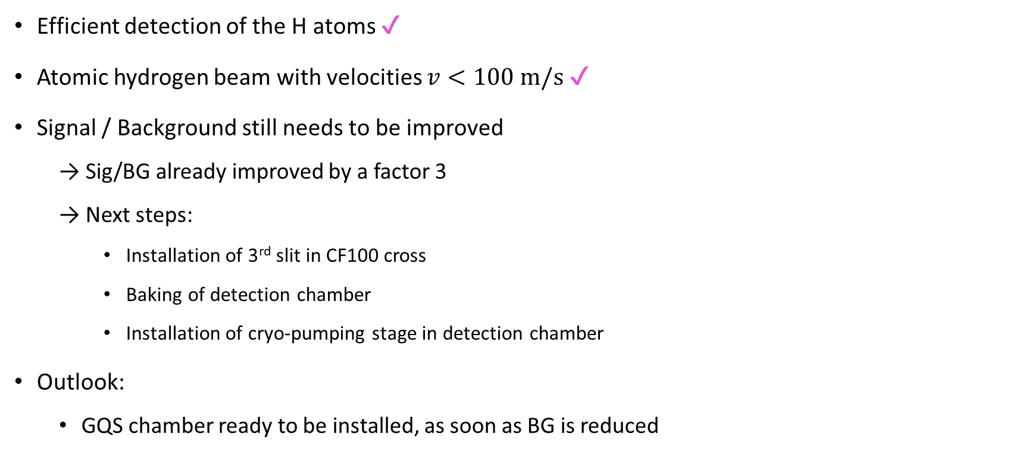
Summary and outlook
Efficient detection of the H atoms ✔
Atomic hydrogen beam with velocities $v<100 m/s$ ✔
Signal / Background still needs to be improved
  → Sig/BG already improved by a factor 3
  → Next steps:
    Installation of 3rd slit in CF100 cross
    Baking of detection chamber
    Installation of cryo-pumping stage in detection chamber
Outlook:
  GQS chamber ready to be installed, as soon as BG is reduced

Slide 14
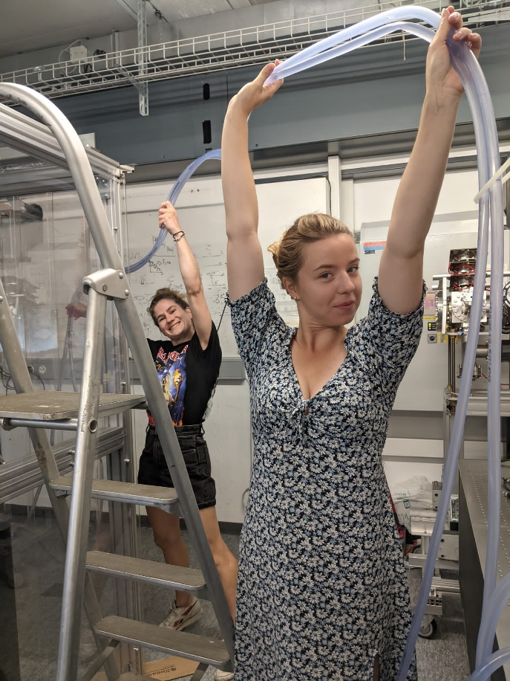
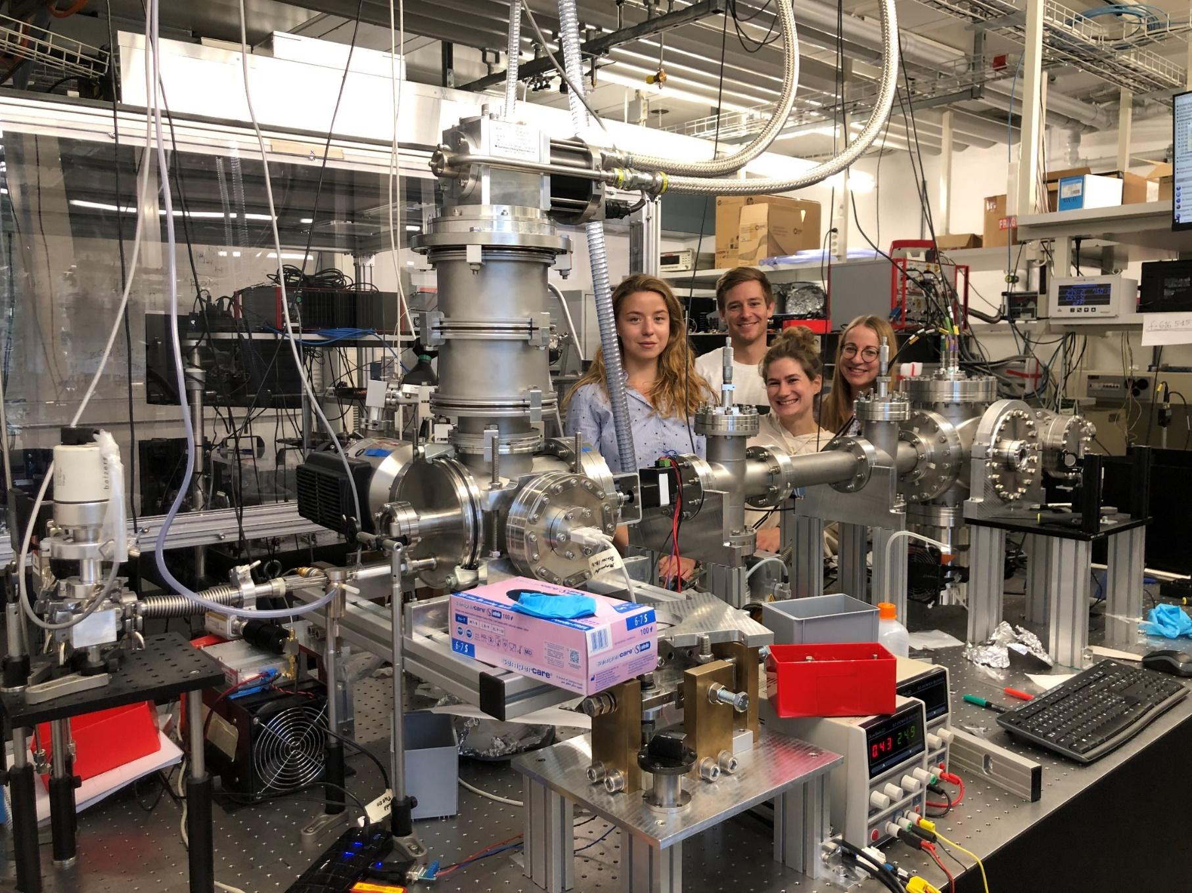
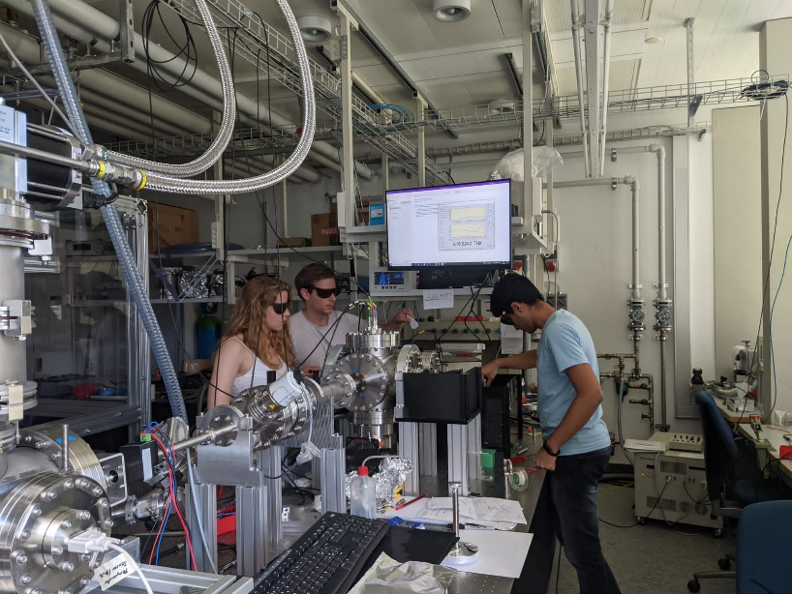
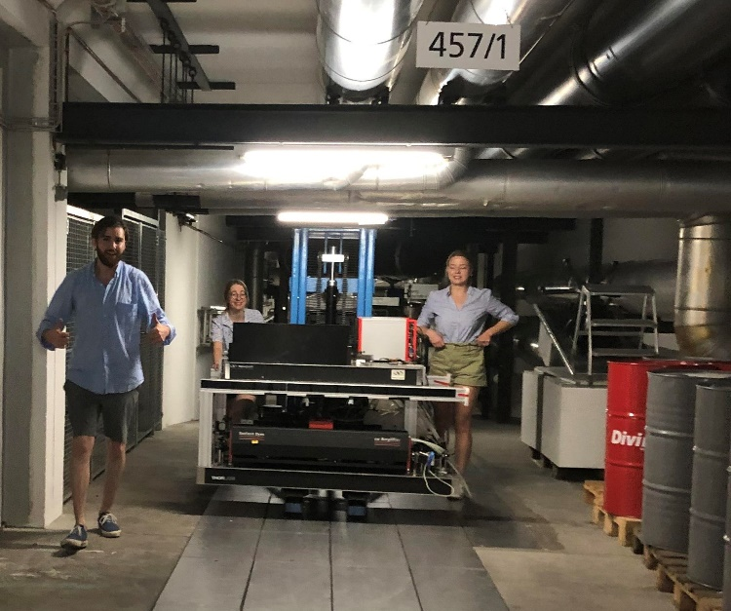
Thank you for your attention!

Slide 15
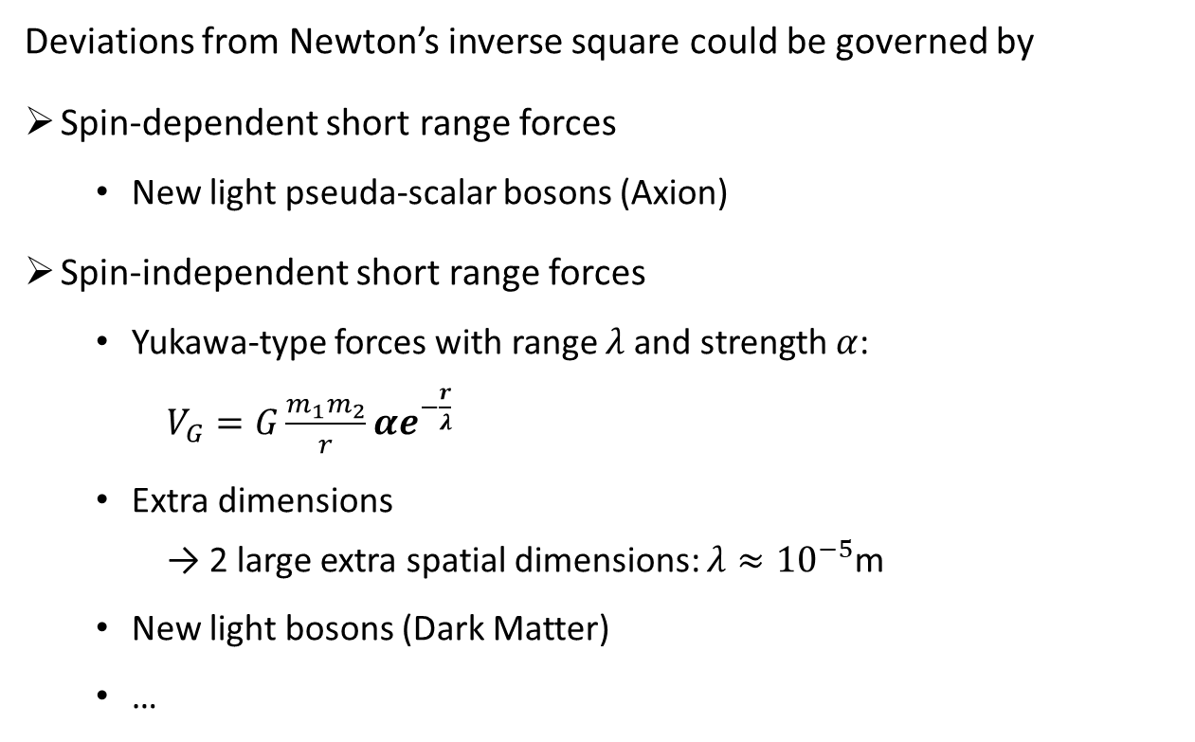
Motivation for Gravity tests on small scales
Deviations from Newton’s inverse square could be governed by
Spin-dependent short range forces
  New light pseuda-scalar bosons (Axion)
Spin-independent short range forces
  Yukawa-type forces with range $λ$ and strength $α$: $V_{G}=G\frac{m_{1}m_{2}}{r}αe^{−\frac{r}{λ}}$
  Extra dimensions → 2 large extra spatial dimensions: $λ≈{10}^{−5}$m
  New light bosons (Dark Matter)
  …
UCN GQS
Exclusion plot for new spin-independent interactions [2]
1,2: short-range gravity in torsion balance
4,12,13: Extra forces on top of Casimir and v.d.W interactions
5: neutron Gravitational Quantum States (GQS)
6: neutron whispering gallery effects
7: neutron scattering on nuclei
8: precision measurements of exotic atoms
15: low mass bosons from the sun in a high-purity germanium detector
[2] Antoniadis, Ignatios & Baessler, S. & Büchner, M. & Fedorov, Valery & Hoedl, Seth & Lambrecht, Astrid & Nesvizhevsky, V.V. & Pignol, Guillaume & Protasov, K. & Reynaud, Serge & Sobolev, Yu. (2010). Short-range fundamental forces. Forces fondamentales à courte portée.

Slide 16
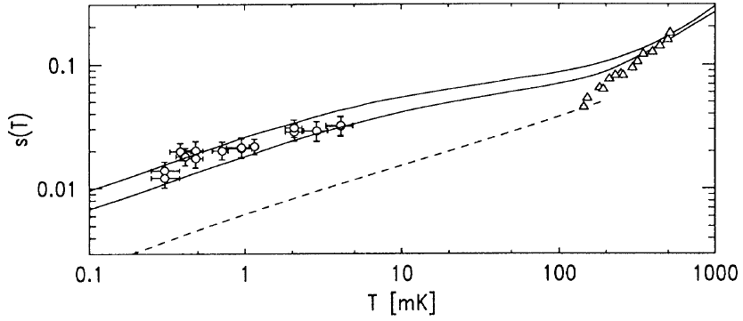
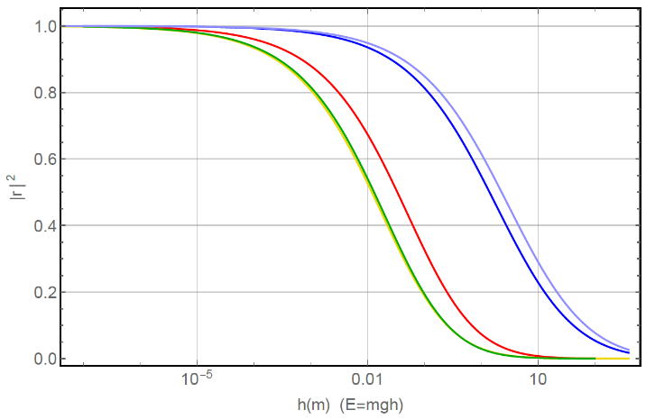
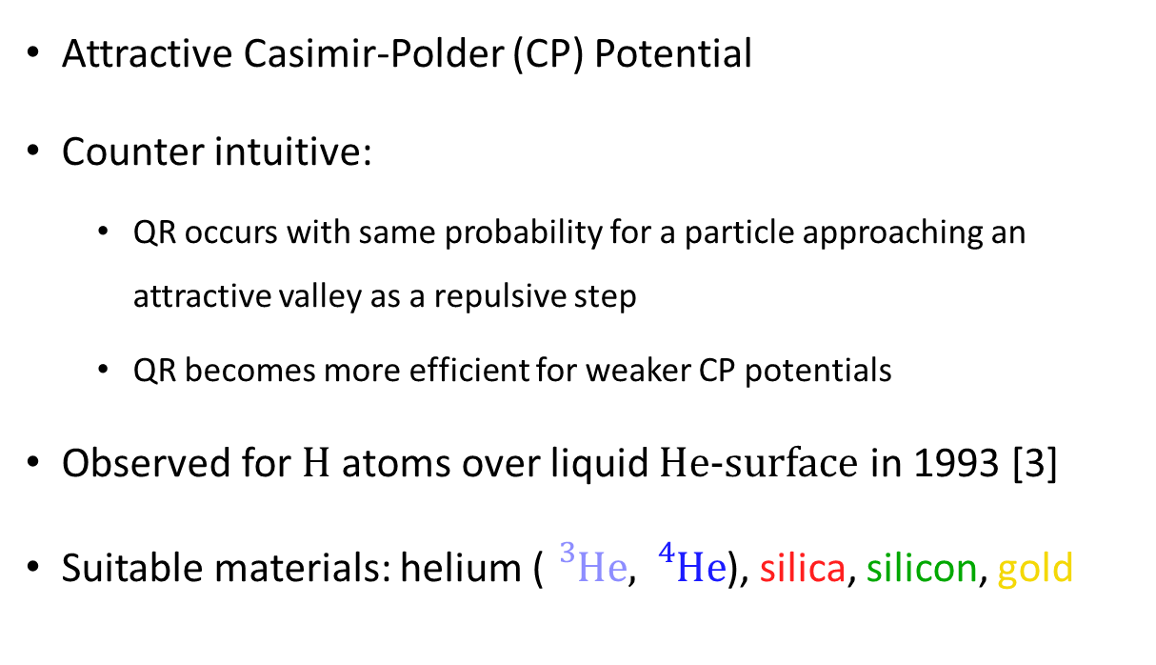
Quantum Reflection (QR)
Attractive Casimir-Polder (CP) Potential
Counter intuitive:
  QR occurs with same probability for a particle approaching an attractive valley as a repulsive step
  QR becomes more efficient for weaker CP potentials
Observed for H atoms over liquid He-surface in 1993 [3]
Suitable materials: helium (${}_{}^{3}{He},{}_{}^{4}{He}$), silica, silicon, gold
Sticking probability of H on thick He film. Taken from [3].
Quantum reflection probability for antihydrogen as a function of the free fall height of the atom h (∝ energy E = mgh) for different materials: 3He (light blue), 4He (dark blue), silica (red), silicon(green) and gold (yellow).
Taken from [4].
[3] Ite A. Yu, John M. Doyle, Jon C. Sandberg, Claudio L. Cesar, Daniel Kleppner, and Thomas J. Greytak. Evidence for universal quantum reflection of hydrogen from liquid 4He. Phys. Rev. Lett., 71:1589–1592, Sep 1993.
[4] Crépin, P.-P. and Kupriyanova et al. Quantum reflection of antihydrogen from a liquid helium film. EPL 119, 1286-4854 (2017). http://dx.doi.org/10.1209/0295-5075/119/33001
Notes:
Which brings me to my quick excurs to quantum reflection.
The CP potential is an attractive potential, so classically, one would expect a particle to be accelerated towards an attractive potential and to be reflected from it.
But according to the reciprocity theorem, quantum reflection occurs with the same probability when a particle moves towards a repulsive potential step as when a particle approaches an attractive potential valley, as indicated within the upper figures.
Another counter intuitive property of QR is, that it gets more and more efficient, the weaker the CP potential gets.
And as th CP potential is material dependent, also the probability of QR is material dependent. As you can see on the lower figure, helium 3 turns out to be most suitable.
But, eventhough QR works, the effect of the presence of the CP potential has to e taken into account

Slide 17
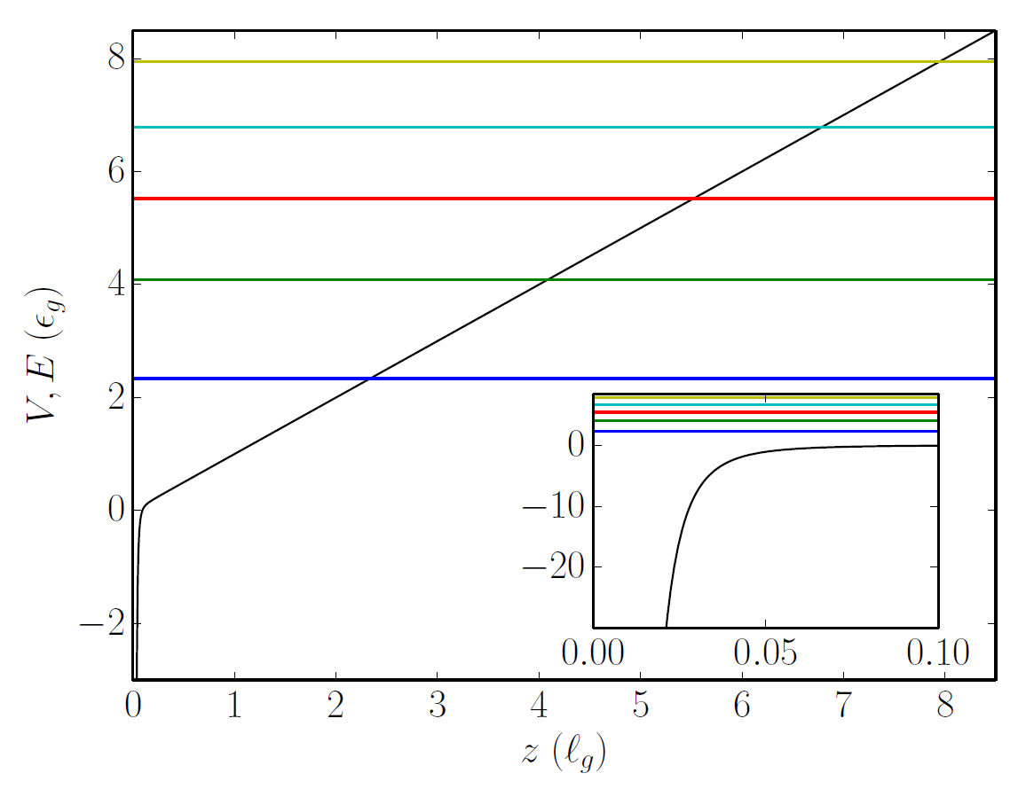
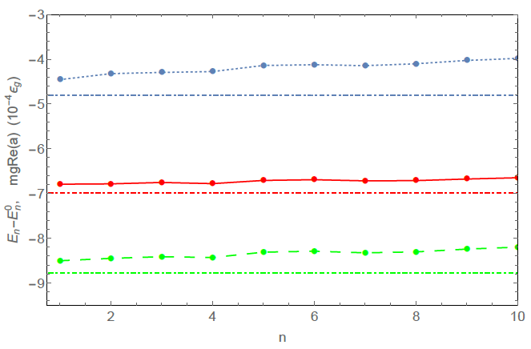
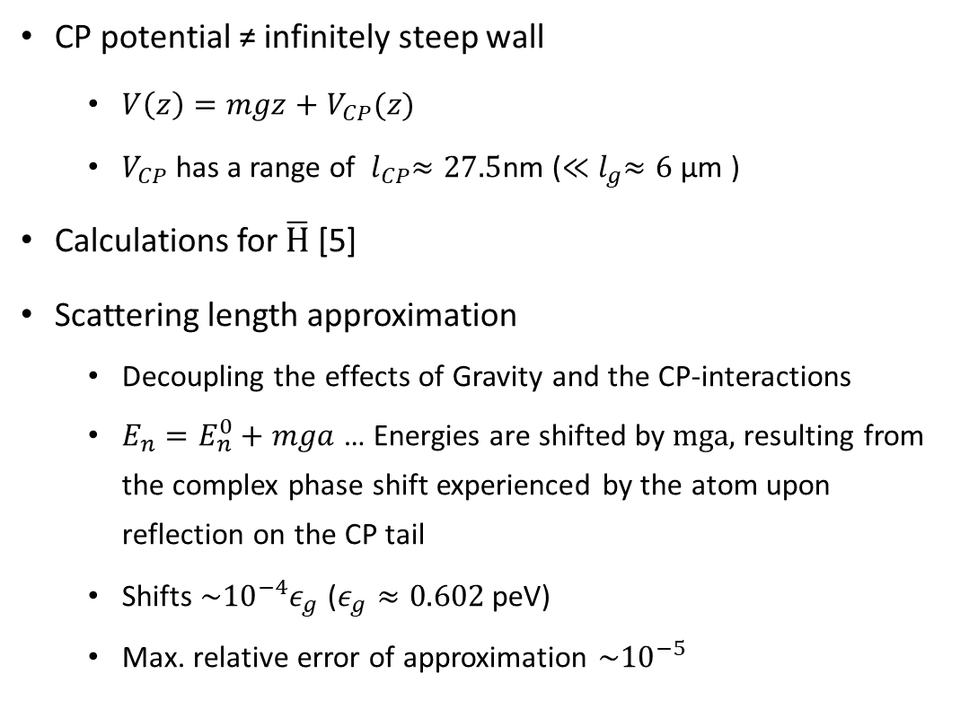


CP – shifts
  ${V\left(z\right)=mgz+V}_{CP}\left(z\right)$ (black curve) above a silica bulk. Horizontal lines correspond to energies of an ideal quantum bouncer. Taken from [5].
CP potential ≠ infinitely steep wall
  ${V\left(z\right)=mgz+V}_{CP}(z)$
  $V_{CP}$ has a range of ${ l}_{CP}≈27.5$nm ($≪{ l}_{g}≈6$ µm )
Calculations for $\overline{H}$ [5]
Scattering length approximation
  Decoupling the effects of Gravity and the CP-interactions
  $E_{n}=E_{n}^{0}+mga$ … Energies are shifted by mga, resulting from the complex phase shift experienced by the atom upon reflection on the CP tail
  Shifts $\sim {10}^{−4}ε_{g}$ ($ε_{g}≈0.602$ peV)
  Max. relative error of approximation $\sim {10}^{−5}$
Energy shifts for antihydrogen interacting with a perfect mirror (blue), a silicon bulk (green) or a silica bulk (red), in units of ${10}^{−4}ε_{g}$. The shift corresponding to the real part of mga is
represented by the horizontal lines.
Taken from [5].
[5] P.-P. Crépin, G. Dufour, R. Guérout, A. Lambrecht, and S. Reynaud. Casimir-polder
shifts on quantum levitation states. Physical Review A, 95(3), mar 2017.
Notes:
As it leads to the CP-shifts in the eigenenrgies of the GQS.
The CP potential is not a perfect infinitly stepp wall, so it has to be added to the potential term in the schrödinger equation. But the good thing is, that the CP potential has a short range in the order of nano meters compared to the range of the gravitational states.
So the application of an effective range approximation is valid, and this has been done by the group of Serge Reynaud. They calculated the shifts of the eigenenergies of the GQS due to the CP-potential with an maximal relative error of 10^-5. The shifts are in the order of 10^-4 $ε_{g}$ ($ε_{g}≈0.602$peV), which means that the shifts are around 60 atto-electronvolts!
With this accuracy of the calculation, it is save to assume that a measurement of the eigenenergies of the gqs of hydrogen would make sense and would be a valid tool to search for new physics.

Slide 18




Measurement of GQS with ultra cold neutrons
2002: First demonstration of GQS with ultra cold neutrons (UCNs) [1]
UCNs pass through slit Δ𝑧 between mirror and absorber
Measurement of neutron transmission $N$ as function of Δ𝑧
  Stepwise increase predicted for GQS (steps at $z=z_{n}$)
  Slit only becomes transparent, when $Δz≥z_{1}$
Absorber
Neutron
detector
Collimator
Bottom mirrors
$$z=z_{1}$$
$$z=z_{2}$$
$$z=z_{3}$$
0
1
.
)
1
–
s
0
.
0
s
1
t
n
u
o
c
(
N
–
1
3
0
0
1
0
2
0
3
0
4
0
A
b
s
o
r
b
e
r
h
e
i
g
h
t
(
m
)
First demonstration of GQS ith UCNs: The neutron throughput vs. the absorber height Δ𝑧 and experimental setup. Figures taken from [2].

Slide 19



Ionization Efficiency
Simulation of ionization efficiency by solving optical Bloch equations
Transition matrix element for 2 photon transition $β=\text{3.68111}×\text{10}\text{−5} \frac{Hz m²}{W}$
Beam waist $≈0.5 mm,$ Pulse Energy $≈1.5 mJ,$ Pulse duration $≈10 ns$ → $ε_{ion}≈71\%$
Simulated ionization efficiencies for different Laser pulse energies and beam waists.
Evolution of states during a 10 ns pulse of 1.5mJ with a beam waist of 0.5 mm.

Slide 20


Detection of Hydrogen - MCP
Microchannel plate (MCP)
  (Single) particle detection
    Single Ion: ~5.5 mV signal height
  Amplification via secondary emission
  Grid -50-300 V
  Front/Back/Anode -2200/-244/GND
Read out of signal: Oscilloscope
Grid
Micro-channel
plate
Anode
Laser
H+
Signal

