Slide 1
Grant opportunities in EU
Dominika Vyštejnová, FZU - Institute of Physics of the Czech Academy of Sciences
30.5.2023

Slide 2
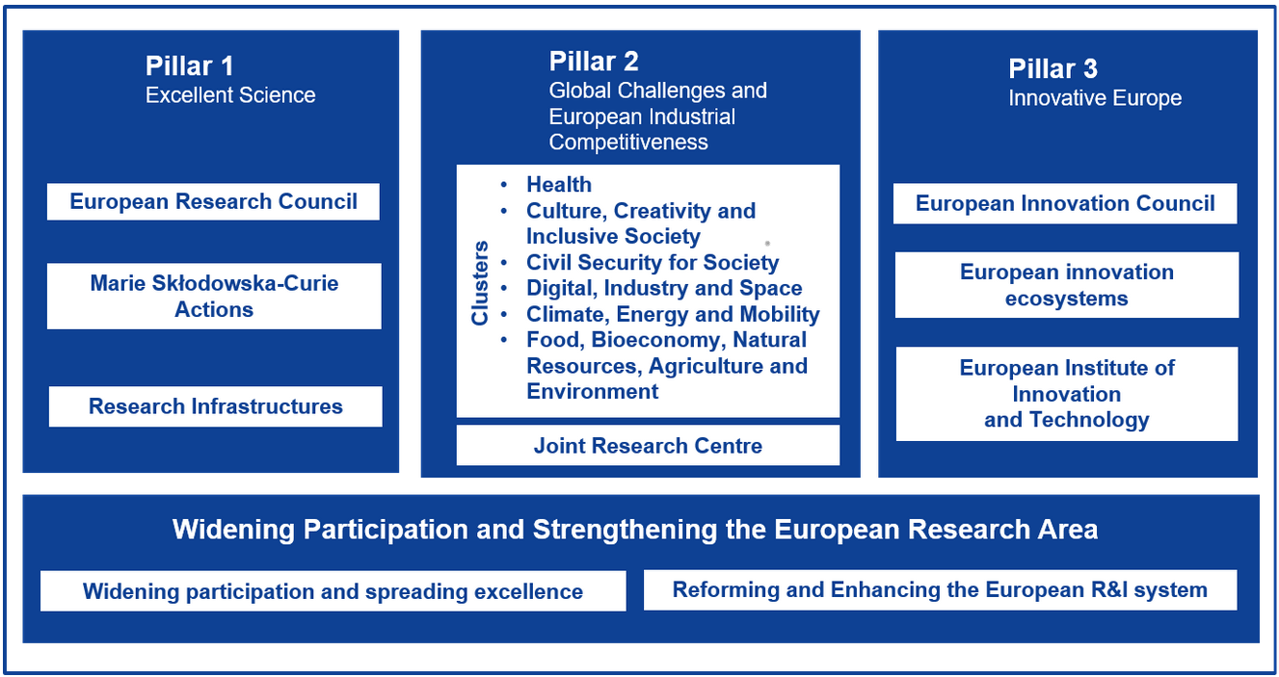
Horizon Europe

Slide 3
Horizon Europe

Slide 4
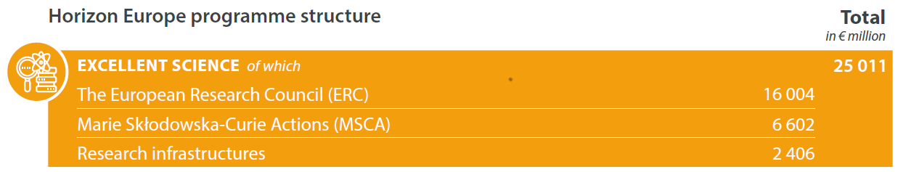
Horizon Europe
BUDGET OF EUR 95.5 BILLION

Slide 5
? ?
?
? Roles of a scientist ?
? ? ?
? ?

Slide 6
Researcher Science communicator
Excellent communicator
Roles of a scientist
Educator Leader
Collaborator
Manager Open Science Practitioner
Data Steward

Slide 7
MSCA Postdoctoral Fellowships
Supporting excellent researchers with up to eight years experience in research (from the date of the award of their PhD degree) who wish to acquire new sets of skills through training
European Postdoctoral Fellowships
For coming to or moving within Europe.
Duration between 12 and 24 months.
Global Postdoctoral Fellowships
Funding the mobility of EU nationals or long-term residents outside Europe.
12 to 24 months in a non-associated Third Country, followed by a mandatory return phase of 12 months in EU or Associated Country.
Bottom-up approach
Focus on 3i – international, interdisciplinary, intersectoral
Mobility rule – international aspect
Secondments – supporting interdisciplinarity and intersectorality
Industrial placements – on top of the fellowship, involvement of the industrial partners

Slide 8
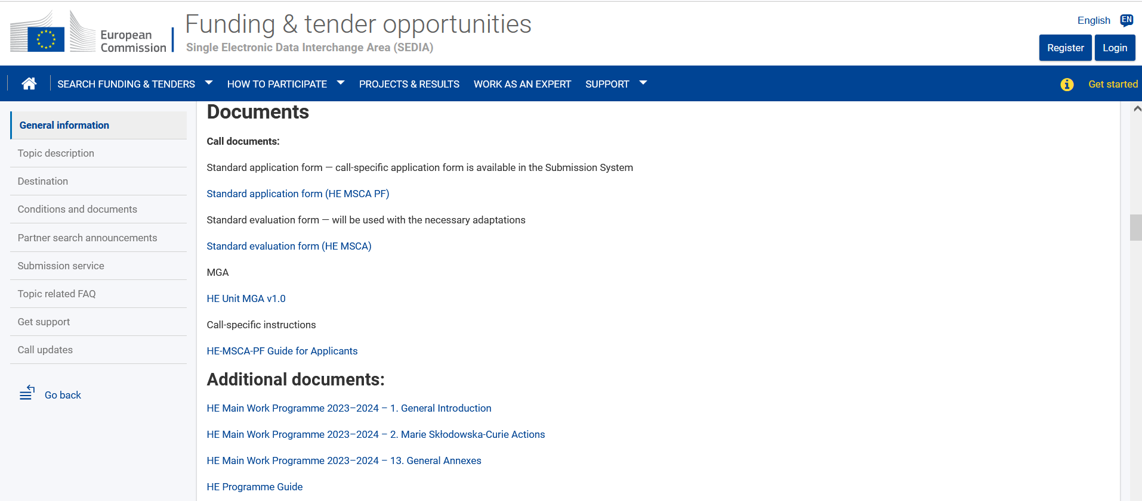
MSCA Postdoctoral Fellowships (PF)
2023 call: read the call and check all relevant documents
Application form
Guide for Applicants
Work Programme 2023 – 2024 MSCA
HE Programme Guide (Open Science, Gender, Do No Significant Harm Principle, etc.)

Slide 9
MSCA PF: 2022 call statistics
7 044 applications were submitted into the 2022 call.
The European Commission will distribute €257 million among 1 235 postdoctoral researchers.
Success rate was 17,5 %.
11,6 % of funded proposals were submitted to physics panel.
Cut-off score for physics panel was 92,4.
Upcoming deadlines: 13.9.2023 and 11.9.2024

Slide 10
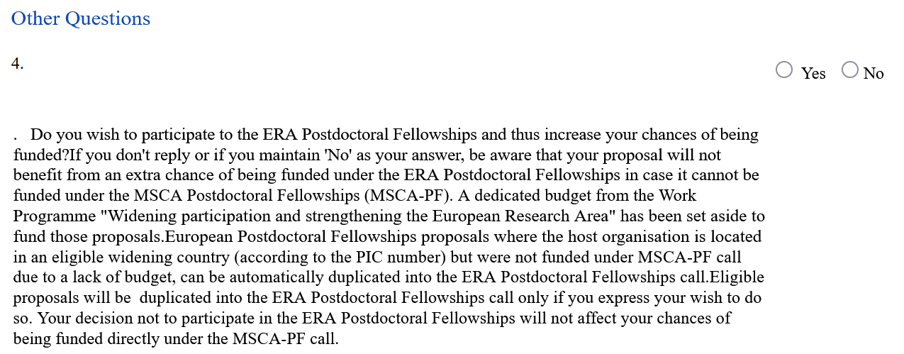
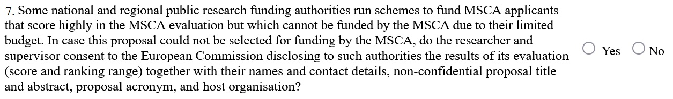
MSCA PF: additional funding possibilities
ERA Fellowships
If applying with a host organisation located in a Widening Country.
Funded by EC.
OP JAK: MSCA Fellowships CZ
For project proposals submitted to HE MSCA PF calls scoring more than 70 % but not being financed.
Funded by MEYS.
Be sure to fill in the administrative part A correctly when applying for MSCA Postdoctoral Fellowship

Slide 11
MSCA COFUND
Co-funding regional, national and international programmes for training and career development and spreading the MSCA’s best practices by promoting high standards and excellent working conditions.
All responsibility lies with the national, regional or international programmes: evaluation and selection process, training, career development.
Each programme has its own eligibility criteria, call deadlines, application conditions.
Follows the rules of MSCA PF calls in terms of mobility rule, non-discrimination rule, bottom-up approach and 3i aspects.
2 programme types: COFUND Doctoral Programmes and COFUND Postdoctoral Programmes.

Slide 12
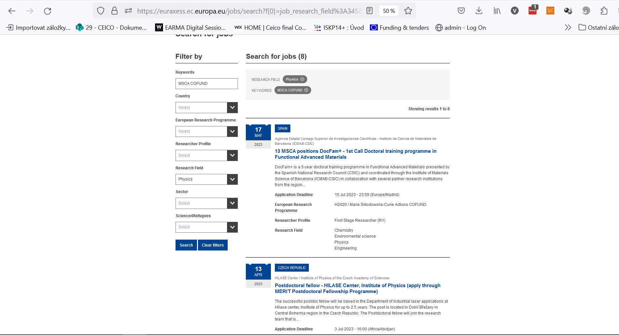
MSCA COFUND: Search tools
1) EURAXESS
https://euraxess.ec.europa.eu/jobs/search

Slide 13
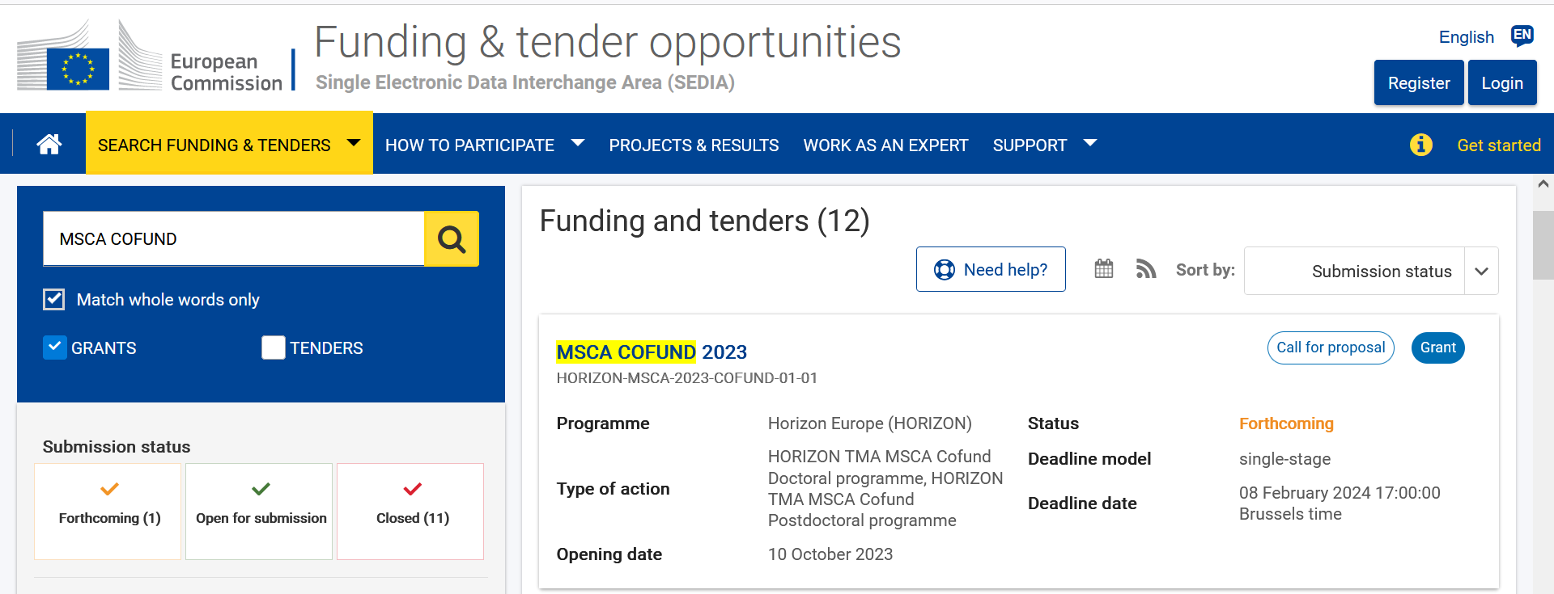
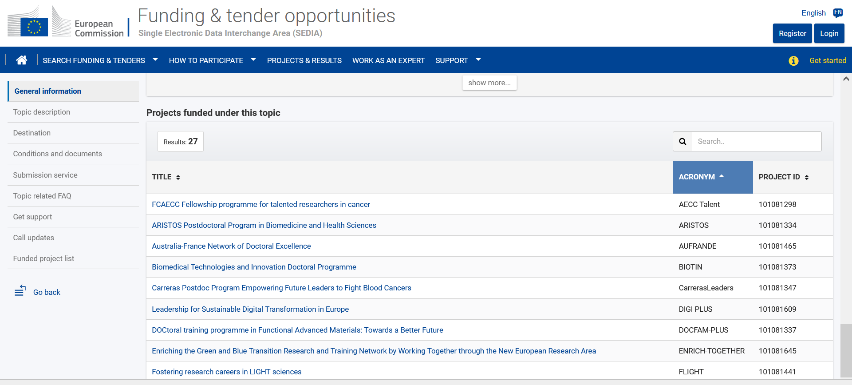
MSCA COFUND: Search tools
2) Funding & tender opportunities portal
https://ec.europa.eu/info/funding-tenders/opportunities/portal/screen/opportunities/topic-search

Slide 14
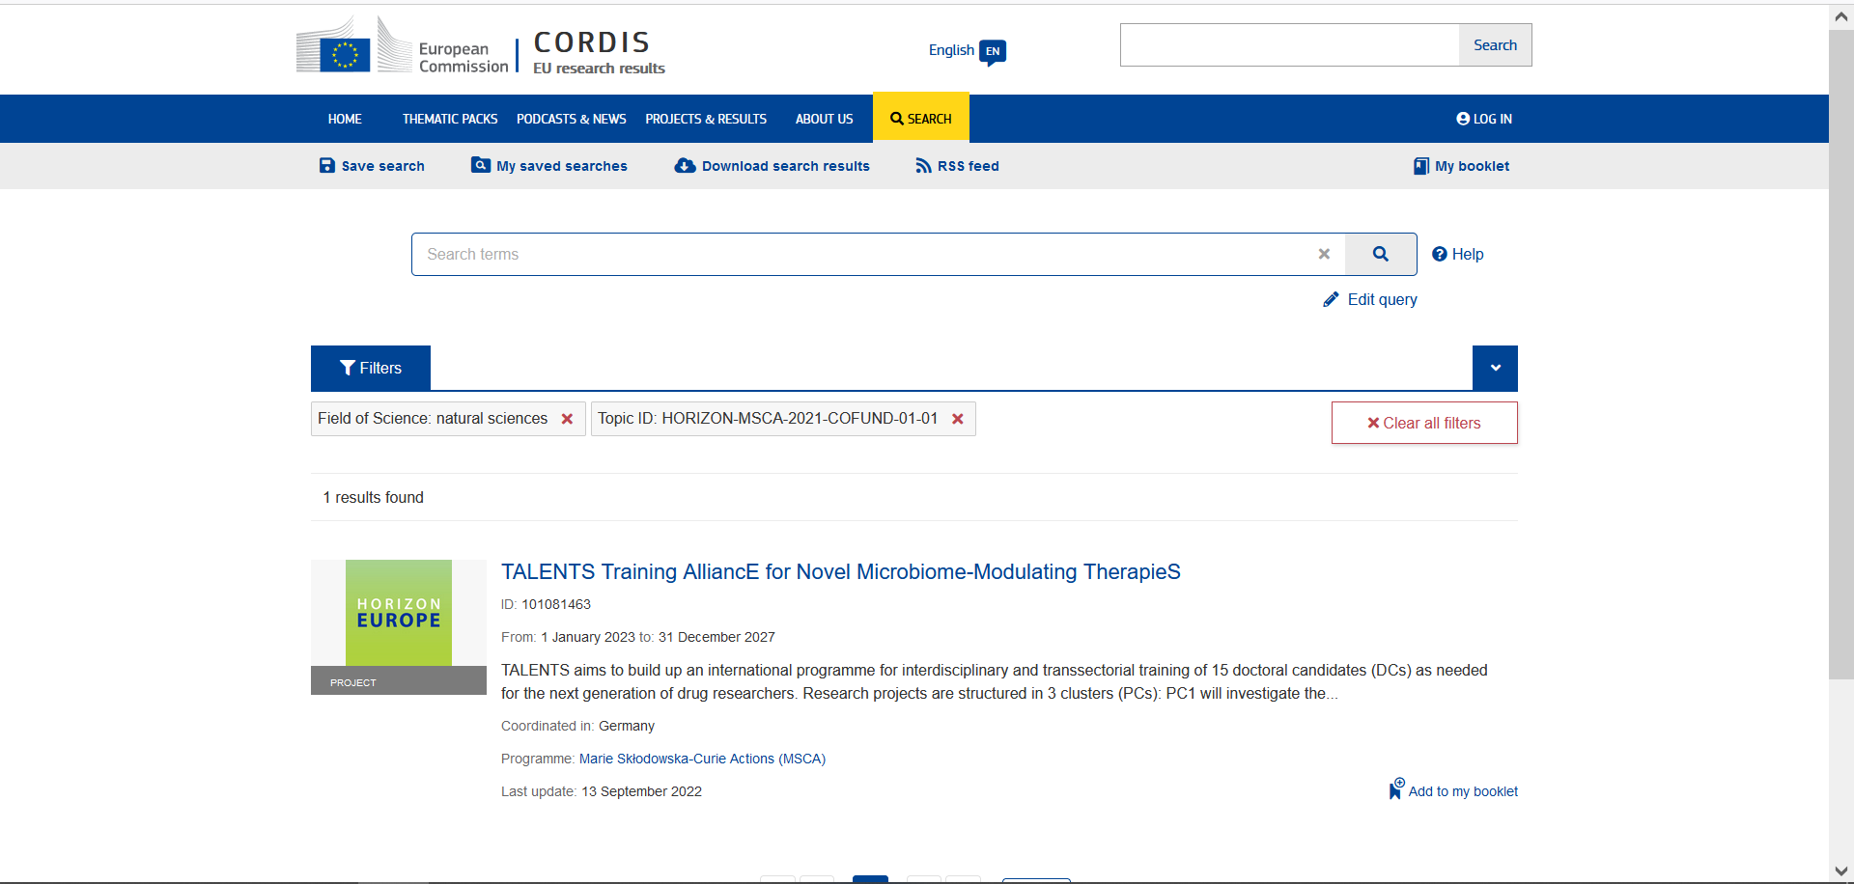
MSCA COFUND: Search tools
3) CORDIS
https://cordis.europa.eu/search/en
Topic ID: HORIZON-MSCA-2021-COFUND-01-01

Slide 15
Next career step: ERC
ERC Starting Grant
Up to 1.5€ million for 5 years
For promising early-career researchers with 2 to 7 years experience after PhD
ERC Consolidator Grant
Up to 2€ million for 5 years
For promising early-career researchers with 7 to 12 years experience after PhD
ERC Advanced Grant
Up to 2.5€ million for 5 years
For established research leaders with a recognised track record of research achievements
You can also apply for national equivalents of ERC grants such as Junior Star (CZ) or NWO Talent Programme Veni, Vidi, Vici (NL)

Slide 16
European fellowships
Postdoctoral fellowships
CERN: https://careers.smartrecruiters.com/CERN/graduates
Fermilab: https://www.fnal.gov/pub/forphysicists/fellowships/index.html
Humboldt Research Fellowship: https://www.humboldt-foundation.de/en/apply/sponsorship-programmes/humboldt-research-fellowship#h12172
Ernst Mach Grant: https://grants.at/en/
DESY Fellowship: https://particle-physics.desy.de/education__career/fellowship/index_eng.html
ETH Zurich Postdoctoral Fellowships: https://ethz.ch/en/research/research-promotion/eth-fellowships.html
NWO Talent Programme: https://www.nwo.nl/en/researchprogrammes/nwo-talent-programme (next calls: (i) Veni, pre-announcement 5.9.2023, full proposal 30.1.2024; (ii) Vidi, pre-announcement 2.11.2023, full proposal 26.3.2024)
Doctoral fellowships
CERN: https://www.smartrecruiters.com/CERN/743999904265806-doctoral-student-programme
The Bavarian-Czech Academic Agency: https://www.btha.cz/en/
Barrande Fellowship Programme: https://www.ifp.cz/cz/veda-a-univerzity/stipendia-a-financovani/stipendia-pro-doktorandy/#/

Slide 17
European fellowships: where to look
Funding & tender opportunities
Euraxess
National liaison offices in Brussels
Czech Liaison Office for Education and Research in Brussels (CZELO)
Embassies in the Czech republic
Technology Centre Prague

Slide 18
Thank you

