Slide 1
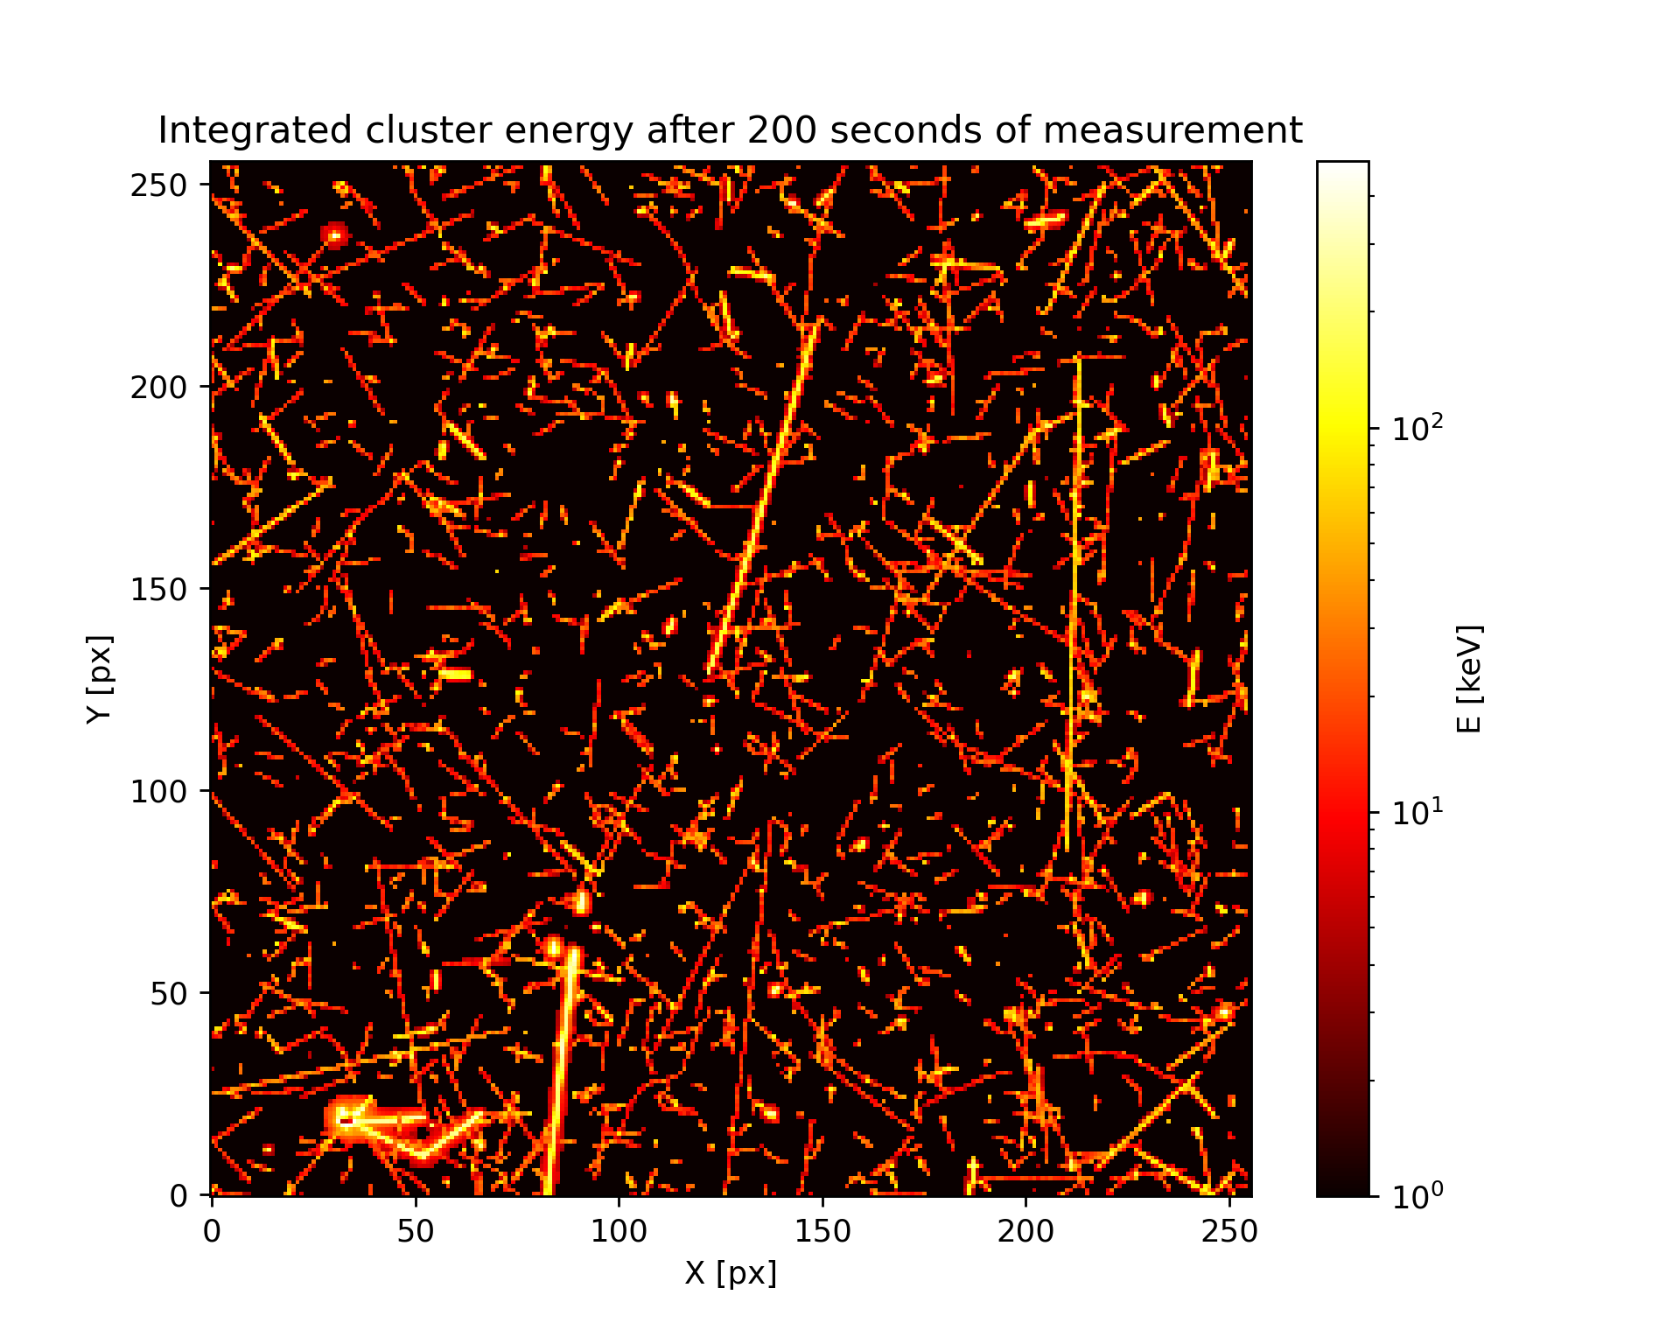

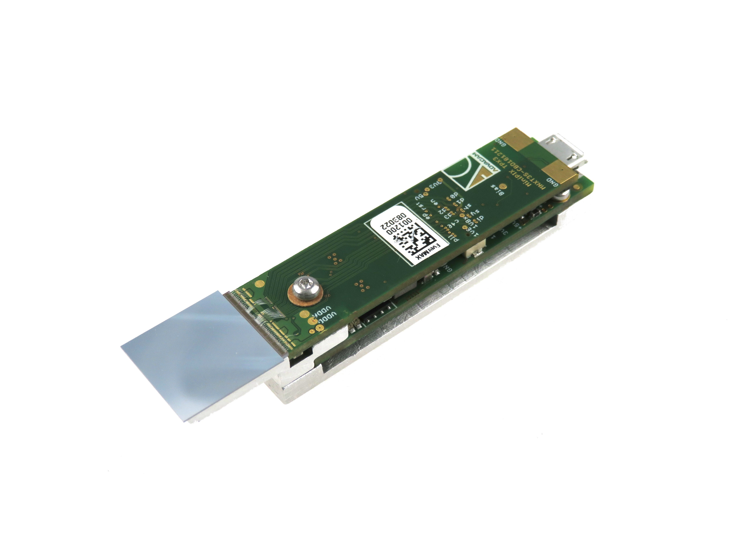
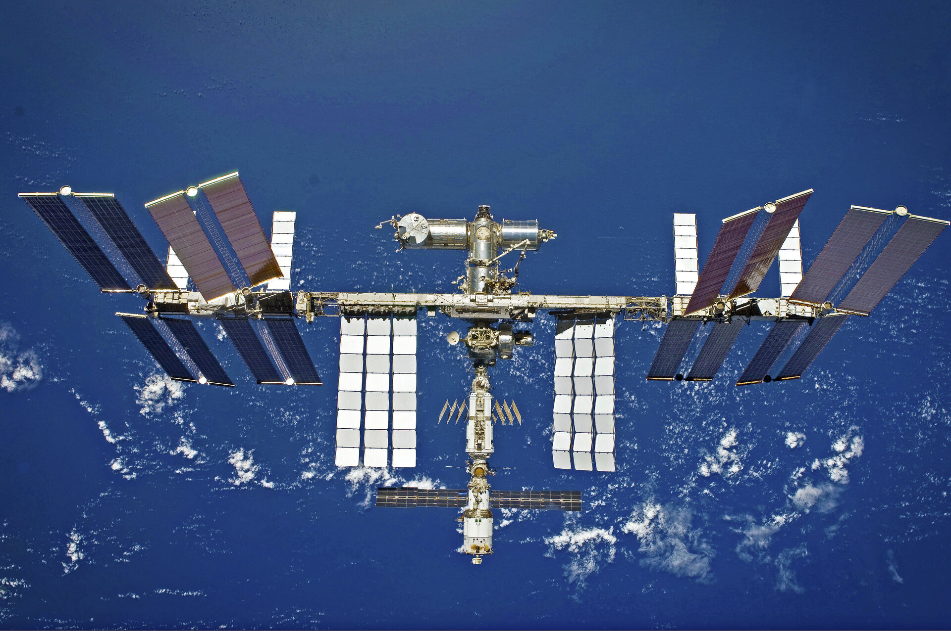
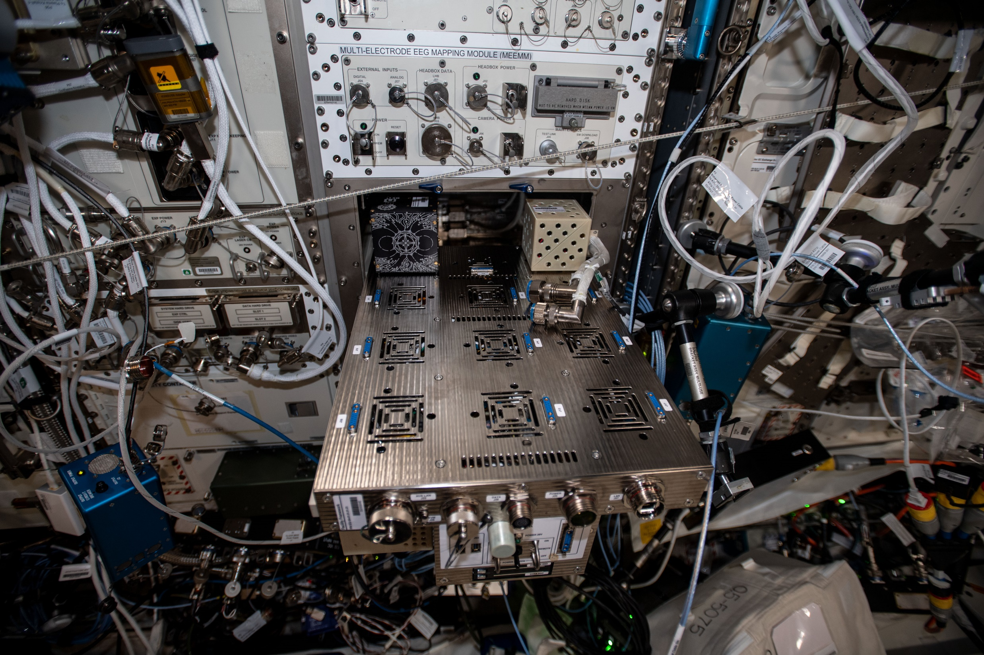
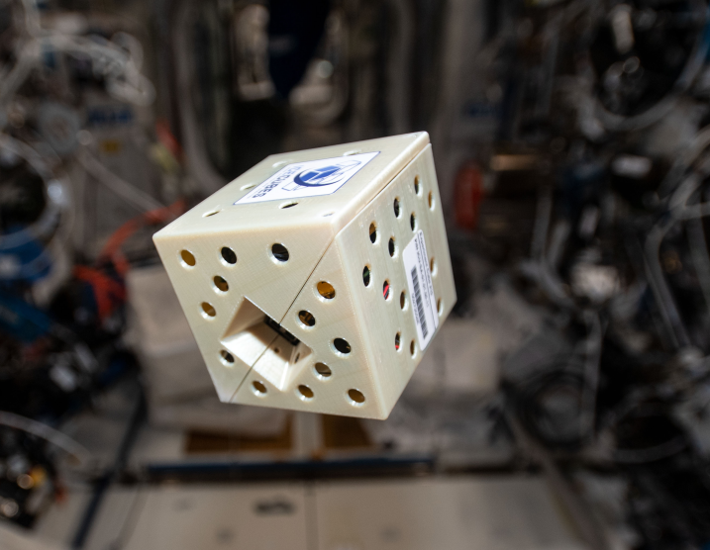
TPX3 ON INTERNATIONAL SPACE STATION
Installation of detector Minipix TPX3 on International Space Station
Educational and research purposes
Columbus module
AI Box

Slide 2
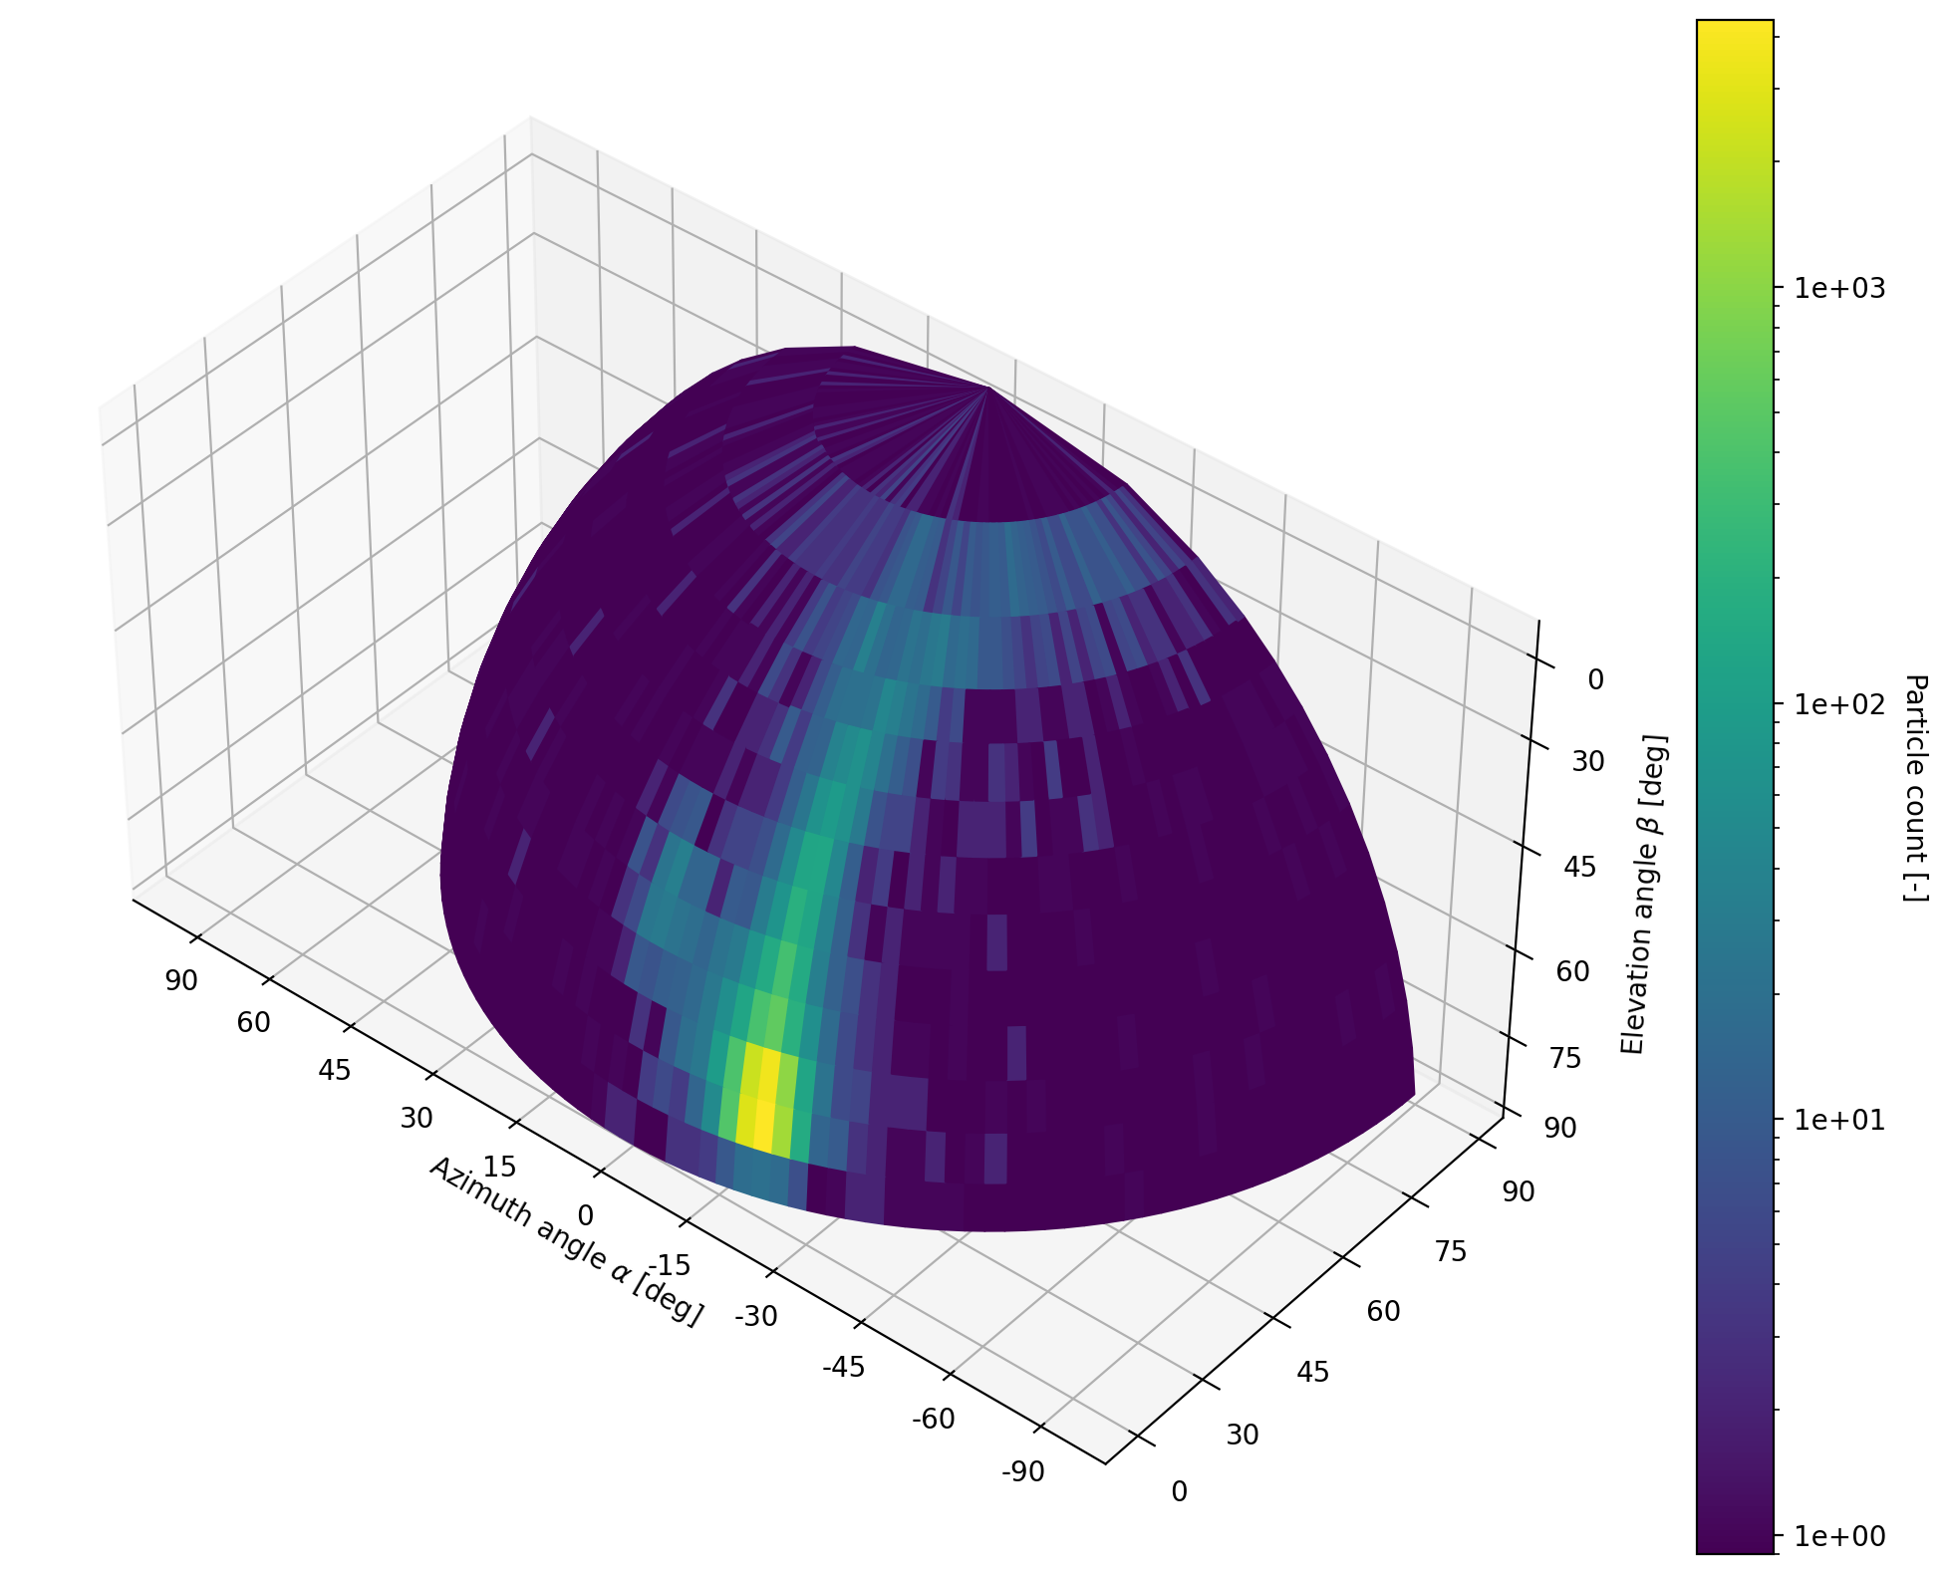
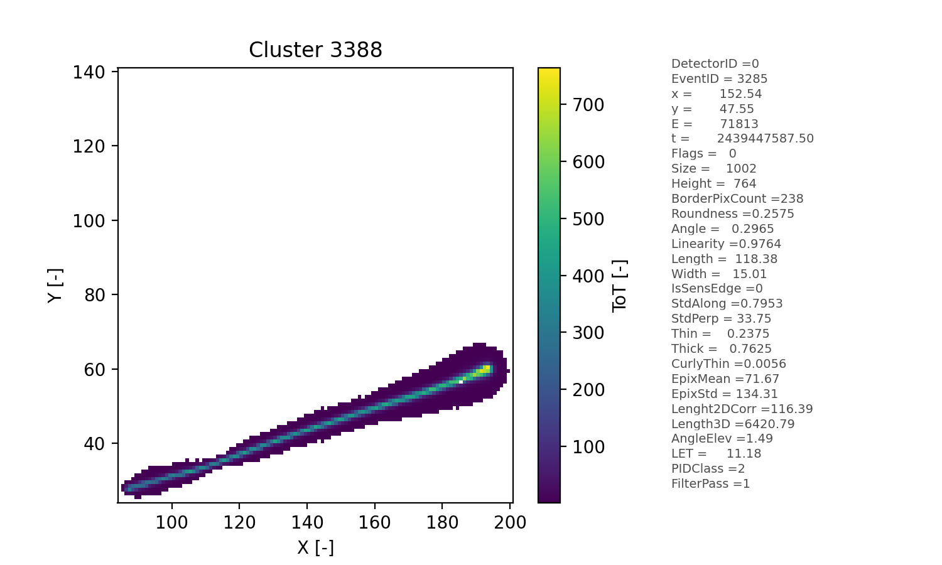
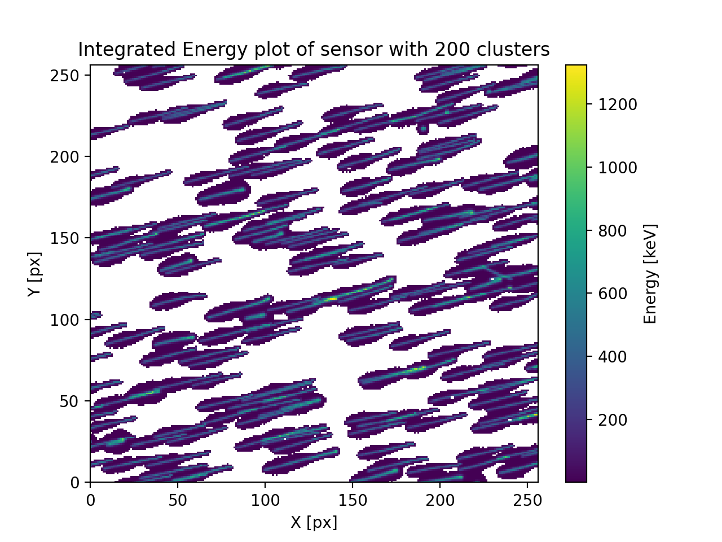
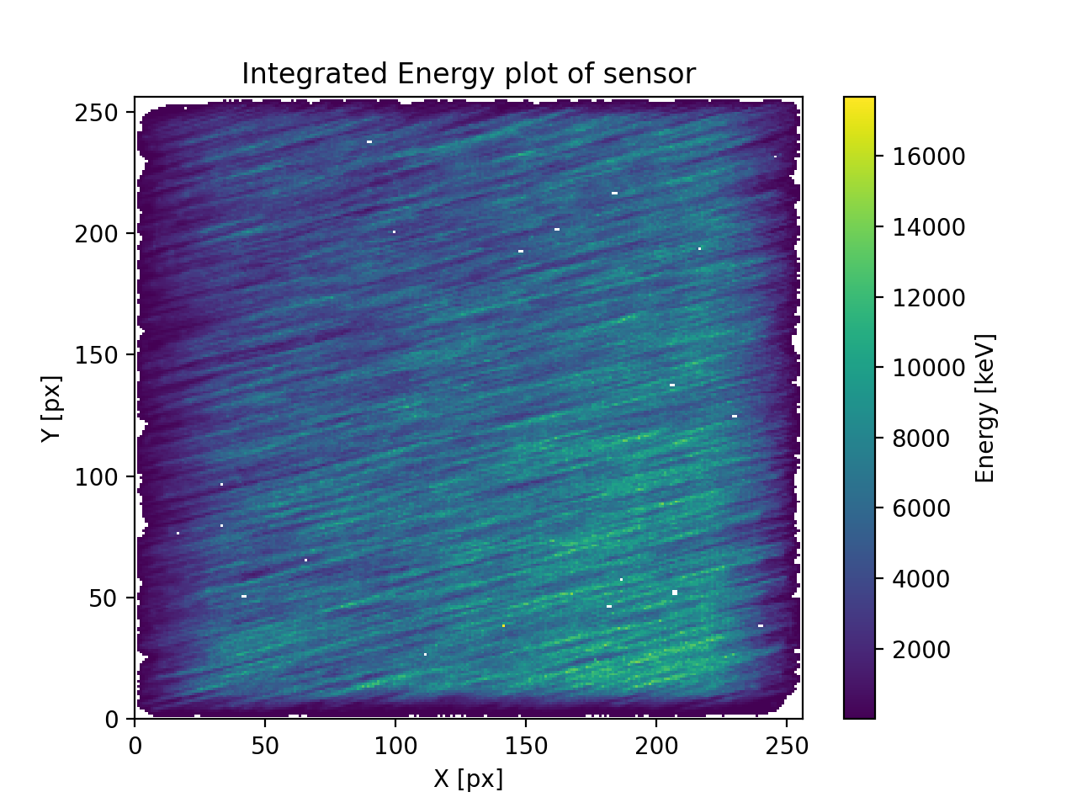
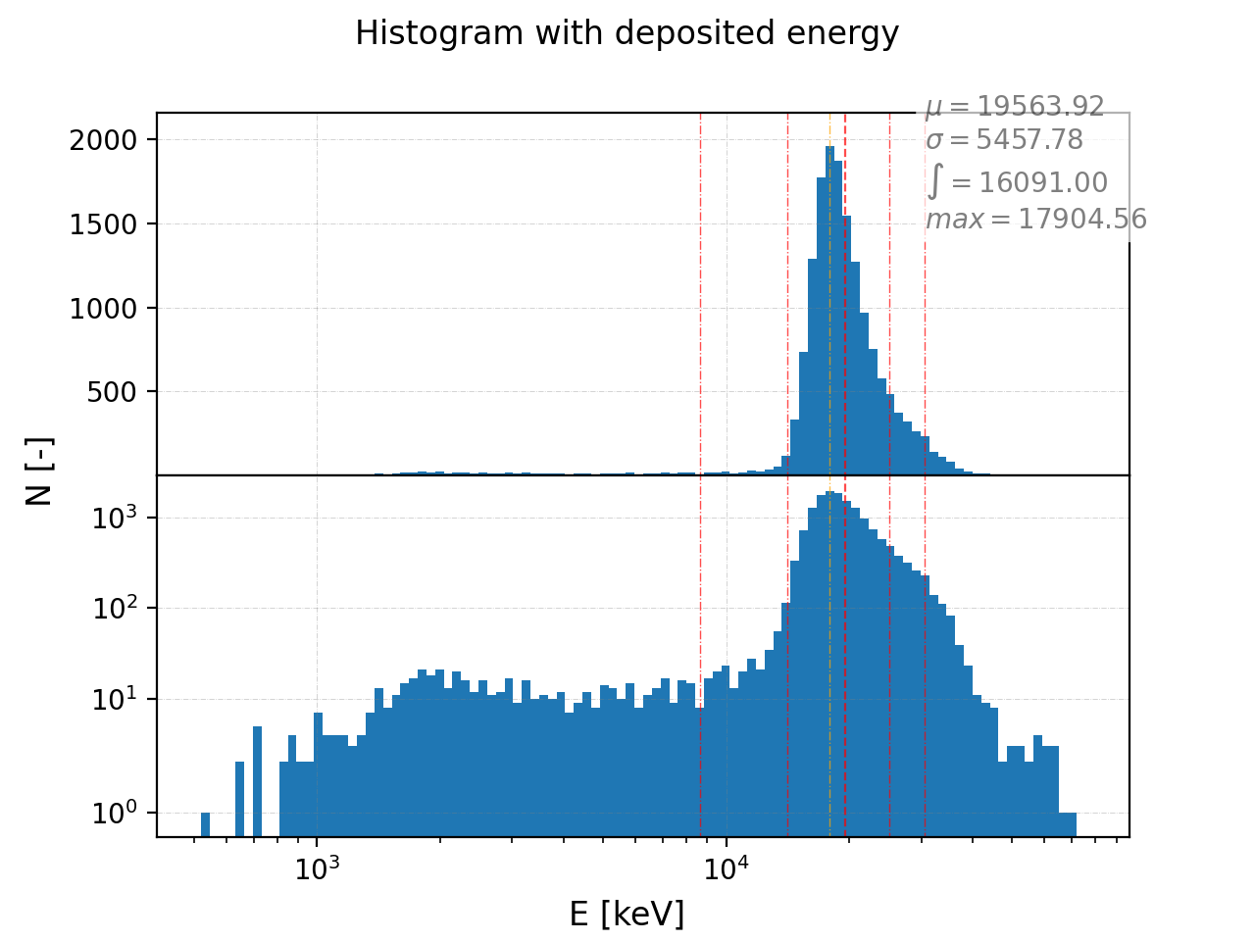
Individual track plots and list of parameters
DPE - DATA PROCESSING ENEGINE
Solved within ESA project
Goal - data analysis tool for processing of data from Timepix (TPX, TPX2, TPX3) detectors
Motivation:
Consolidation of complex data analysis under one engine (radiation field recognition, particle classification, Compton cam, etc.)
Creation of database with reference data (calibration and mixed field data)
Tested, proved and reliable tool
User friendly – graphical interface (web portal)
Usable by broad group of users (non experts)
Integrated energy sensor plots with 100 particles
Integrated energy sensor plots

Slide 3
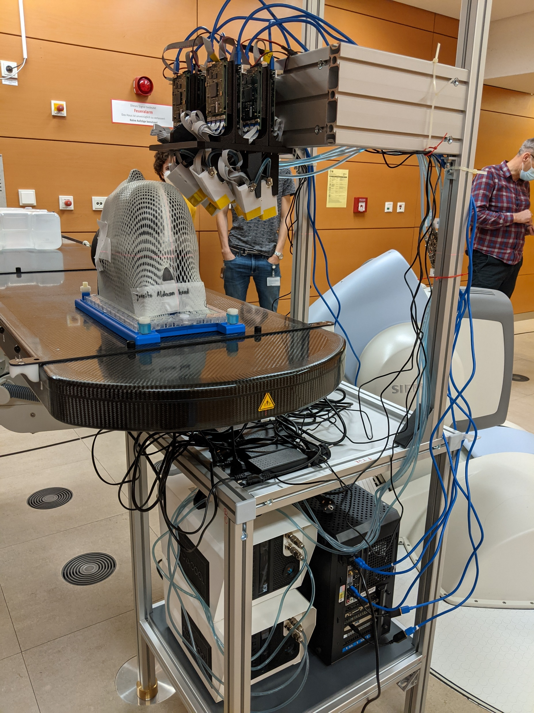
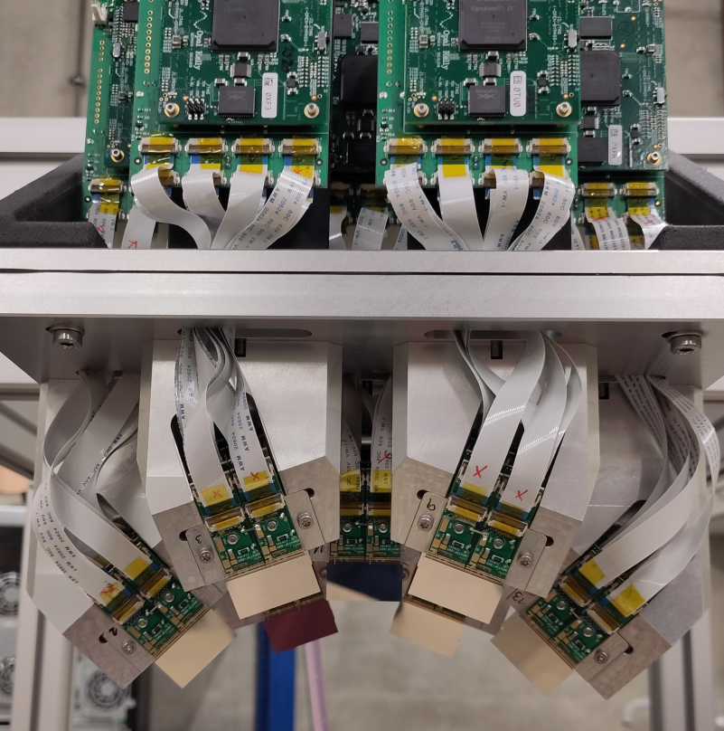
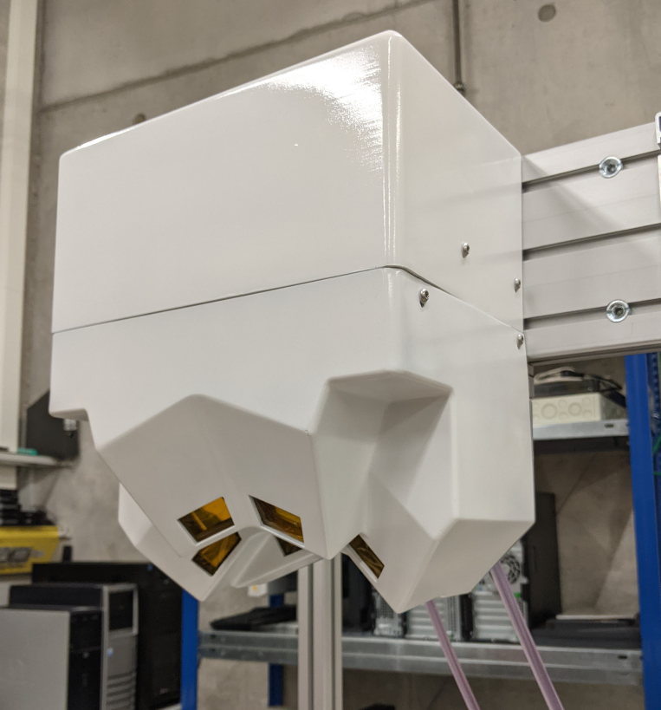
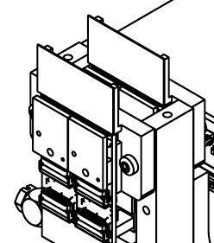
HEIDELBERG/DKFZ – CARBON ION THERAPY tracker
Tracker from 7x quad TPX3 devices – 28 TPX3 chips
Improvement of beam monitoring during carbon ion radiotherapy
Preliminary testing of detector
Beam
Final detector installation

