Slide 1



Review on Electron Cloud simulation tools @ CERN
G. Rumolo
in CERN-GSI Workshop on Electron Cloud
Monday 07.03.2011
Acknowledgments: G. Arduini, G. Bellodi, E. Benedetto, J. Crittenden, O. Dominguez, W. Fischer, G. Franchetti, U. Iriso, K. Li, K. Ohmi, E. Shaposhnikova, F. Zimmermann

Slide 2
Outline
General considerations on electron cloud simulations:
  Beam induced build up
  Effects on the beam
CERN tools
  ECLOUD
    Model and numerical parameters
    Sensitivity to physical parameters
  HEADTAIL

Slide 3
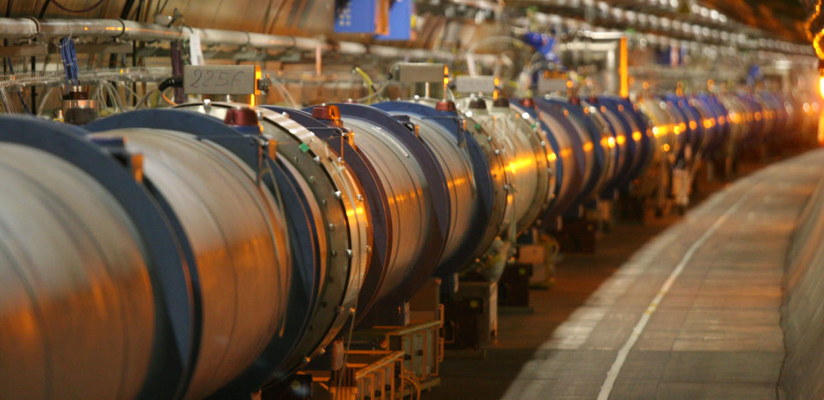
The electron cloud physics problem
Accelerator
Focus on a (usually) 1m long section
Multi-bunch beam
s

Slide 4
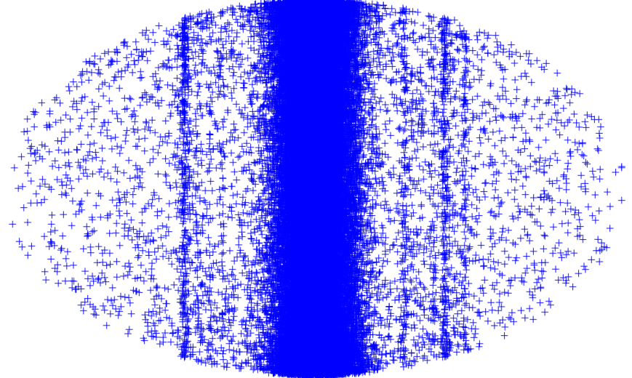
Flow chart of the e-cloud physics problem
s
Multi-bunch beam
Primary and secondary electron production, chamber properties
Noise
Equations of motion of the beam particles
E-cloud build up
x
y

Slide 5
Splitting the problem…
s
Multi-bunch beam
Primary and secondary electron production, chamber properties
Noise
Equations of motion of the beam particles
E-cloud build up
x
The instability problem
y
The build up problem

Slide 6
In summary
Coupled bunch electron cloud instability naturally needs a self-consistent solution of the electron cloud problem
  Too broad range of time scales to cover
So we choose to simulate the two branches separately:
  Electron cloud build up
    Multi-bunch
    Usually single passage, single turn
  Electron cloud instability
    Single bunch
    Multi-turn, or even multi-kick multi-turn
Build up simulation
Instability simulation
Information on how many electrons interact with a bunch:
central density
detailed distribution

Slide 7
Simulation of e-cloud build up
Existing codes
Electron cloud build up codes:
  ECLOUD (CERN, Zimmermann, Bellodi, Brüning, Crittenden, Rumolo, Schulte, Xiang)
  POSINST (LBNL, Furman, Pivi)
  CLOUDLAND (BNL-SLAC, Wang)
  CSEC (BNL, Blaskiewicz)
  PEI (KEK, Ohmi)
  FAKTOR2 (CERN, Bruns)

Slide 8
Main ingredients of ECLOUD
Multi-bunch passage, dipole/field-free/solenoid sections, clearing voltage
3D electron kinematics
Transverse beam-electron forces
Transverse electron space charge effects
Circular/elliptical/rectangular chamber
Perfectly conducting walls

Slide 9
ECLOUD simulation
General principle
focus on a beam line section (1m for ex.)
Beam pipe
slice bunch and interbunch gaps
+
+
represent e- by macroparticles: create and accelerate e- in beam and image fields
if the macroelectron hits the wall create secondaries by changing its charge and/or splitting into more macro-electrons

Slide 10
Dependence on numerical parameters
Electron cloud build up simulations are sensitive to a significant number of numerical parameters
  Time steps:
    During the bunch passage
    During the inter-bunch gap
  Number of macro-electrons launched per bunch
  Maximum number of macro-electrons allowed in the simulation
    Macro-electrons are not just produced all the time through the primary and secondary generation mechanisms
    A ‘clean’ subroutine always reduces the number of macro-electrons back to the maximum allowed, when exceeded, and the “cleaned” charge is redistributed
  Limit charge for macro-electron splitting and maximum number of macro-electrons into which a macro-electron that has ‘gained’ too much charge can be split
  Number of mesh points for space charge calculation
  Multi-seed simulations for statistics
CPU times of typical electron cloud build up simulations range from few hours to several days, depending on the choice of the parameters above (determined by the problem)

Slide 11
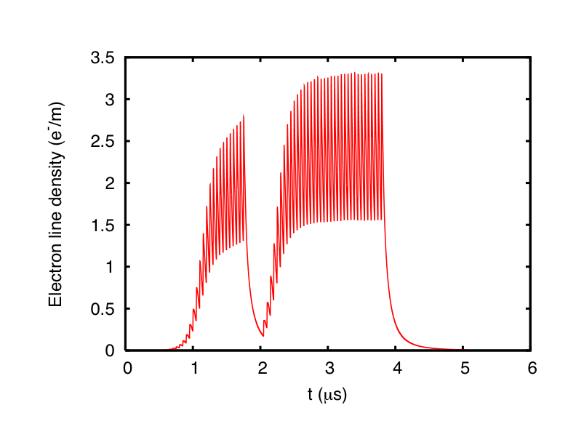
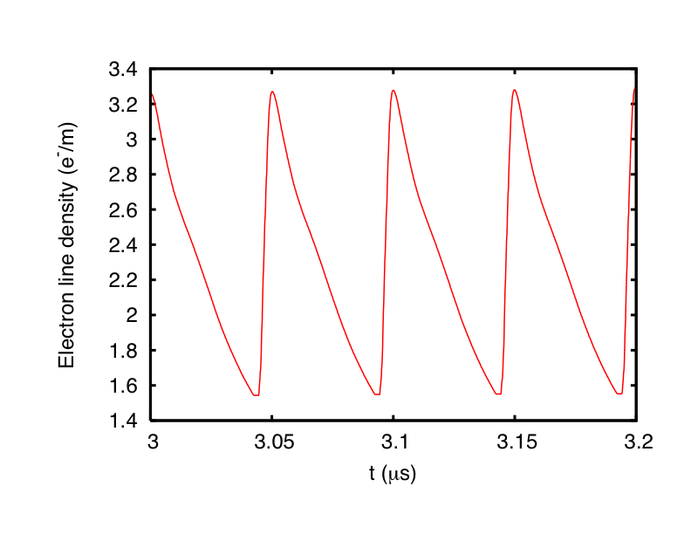
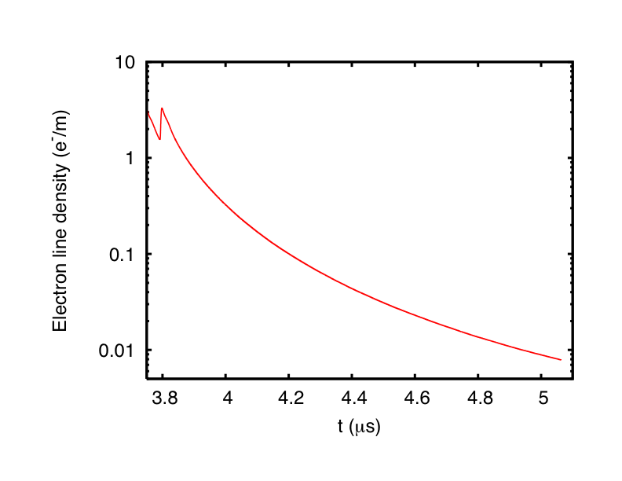
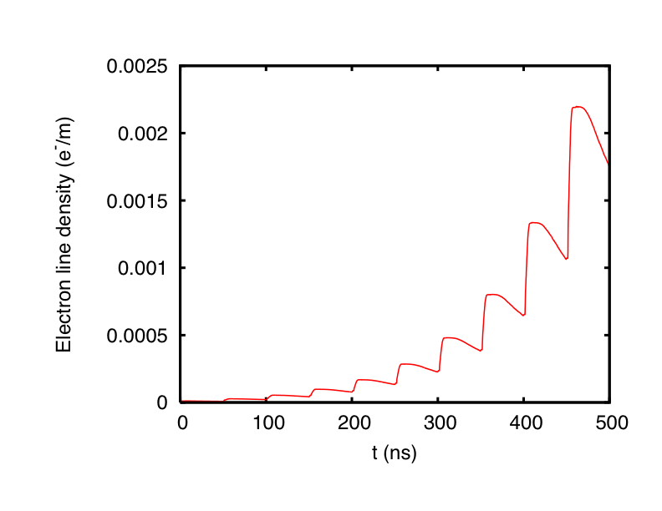
ECLOUD sample result
Saturation
x 10⁹
Exponential rise
Decay
Example of electron cloud build in LHC arc with two trains with 36 bunches of 50ns beam

Slide 12
Dependence on physical parameters
Electron cloud build up depends on a significant number of parameters in a non-monotonic and non-trivial way
  Primary mechanism of electron generation
    Gas ionization or beam loss (hadrons)
    Photoemission (positrons, LHC)
  Surface properties:
    Maximum SEY (δ_{max}) and energy at which it occurs (E_{max})
    Probability of reflection at zero energy (R₀)
    Existence and model of re-diffused electrons
  Bunch spacing and bunch length
  Beam pipe radius and shape
  Magnetic field (field-free, dipole, quadrupole)
  Beam transverse sizes
  Beam current (number of particles per bunch)

Slide 13
Dependence on physical parameters
Electron cloud build up depends on a significant number of parameters in a non-monotonic and non-trivial way
  Primary mechanism of electron generation
    Gas ionization or beam loss (hadrons)
    Photoemission (positrons, LHC)
  Surface properties:
    Maximum SEY (δ_{max}) and energy at which it occurs (E_{max})
    Probability of reflection at zero energy (R₀)
    Existence and model of re-diffused electrons
  Bunch spacing and bunch length
  Beam pipe radius and shape
  Magnetic field (field-free, dipole, quadrupole)
  Beam transverse sizes
  Beam current (number of particles per bunch)

Slide 14
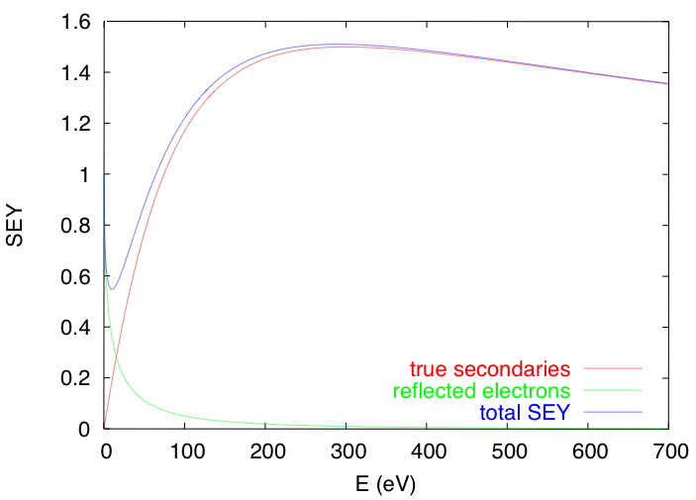


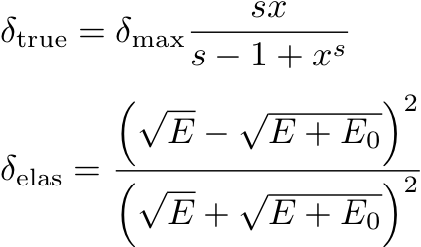
Surface model
When electrons hit the pipe wall, they do not just disappear…..
  High energy electrons easily survive and actually multiply through secondary electron emission
  Low energy electrons tend to survive long because they are likely to be elastically reflected.
Secondary electron emission is governed by the curve below (as coded in ECLOUD)
θ
E_{p}
secondaries
elastically reflected
First three parameters on which simulation results depend

Slide 15
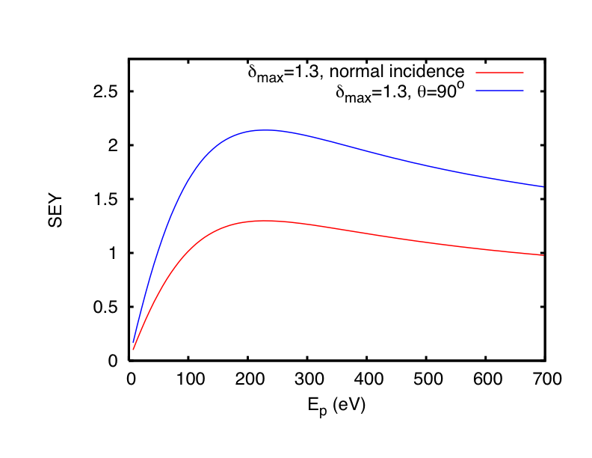

Surface model
When electrons hit the pipe wall, they do not just disappear…..
  High energy electrons easily survive and actually multiply through secondary electron emission
  Low energy electrons tend to survive long because they are likely to be elastically reflected.
Secondary electron emission is governed by the curve below (as coded in ECLOUD)
θ
E_{p}

Slide 16
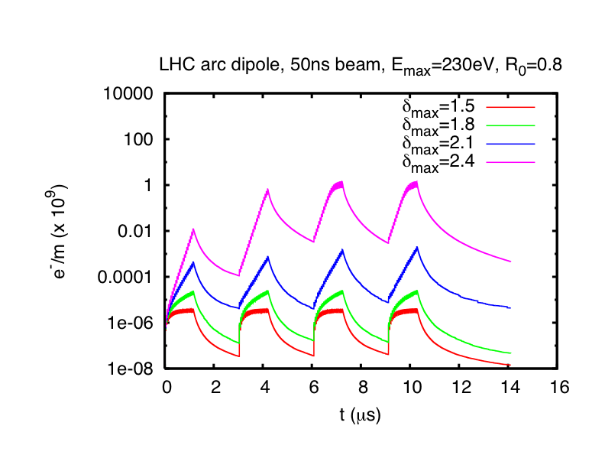
Effects on the build up
Effect of δ_{max}

Slide 17
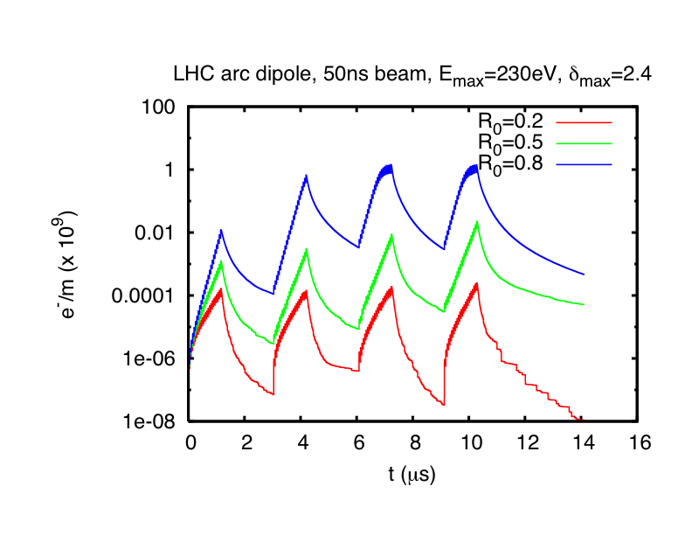
Effects on the build up
Effect of δ_{max}
Effect of R₀
Different rise times
Different decays

Slide 18
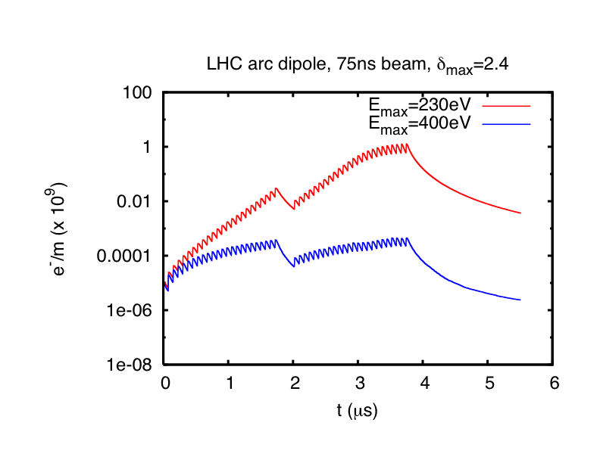
Effects on the build up
Effect of δ_{max}
Effect of R₀
Effect of E_{max}
See talks by Octavio, Ubaldo and Humberto for tuning of these numbers

Slide 19
Dependence on physical parameters
Electron cloud build up depends on a significant number of parameters in a non-monotonic and non-trivial way
  Primary mechanism of electron generation
    Gas ionization or beam loss (hadrons)
    Photoemission (positrons, LHC)
  Surface properties:
    Maximum SEY (δ_{max}) and energy at which it occurs (E_{max})
    Probability of reflection at zero energy (R₀)
    Existence and model of re-diffused electrons
  Bunch spacing and bunch length
  Beam pipe radius and shape
  Magnetic field (field-free, dipole, quadrupole)
  Beam transverse sizes
  Beam current (number of particles per bunch)

Slide 20
Dependence on bunch spacing and length
12m ~ 40ns
107ns
Be pipe
One of the former experimental regions of RHIC (PHOBOS)
Electron cloud is likely to build up, especially because in the experimental region there is a beryllium pipe (very high SEY), and the effective bunch spacing is reduced
Observation: when bunches are compressed to half length, a severe pressure rise occurs in the PHOBOS region, which later “switches off” at some stage during the store.

Slide 21

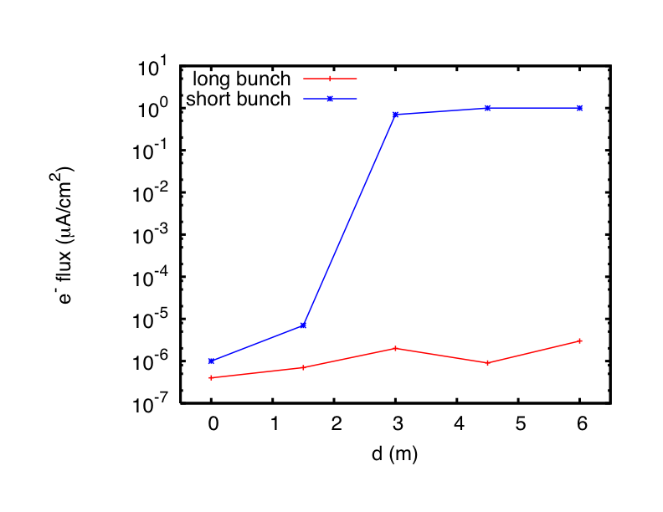
Dependence on bunch spacing and length
Beryllium pipe
Electron flux to the wall in PHOBOS, simulated with ECLOUD
IP

Slide 22
Dependence on physical parameters
Electron cloud build up depends on a significant number of parameters in a non-monotonic and non-trivial way
  Primary mechanism of electron generation
    Gas ionization or beam loss (hadrons)
    Photoemission (positrons, LHC)
  Surface properties:
    Maximum SEY (δ_{max}) and energy at which it occurs (E_{max})
    Probability of reflection at zero energy (R₀)
    Existence and model of re-diffused electrons
  Bunch spacing and bunch length
  Beam pipe radius and shape
  Magnetic field (field-free, dipole, quadrupole)
  Beam transverse sizes
  Beam current (number of particles per bunch)

Slide 23
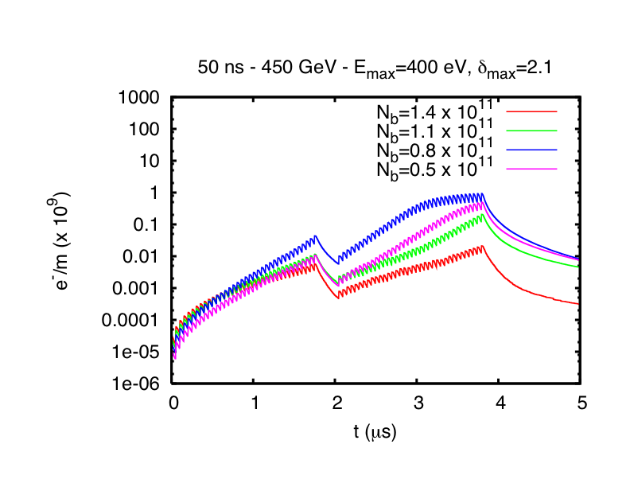
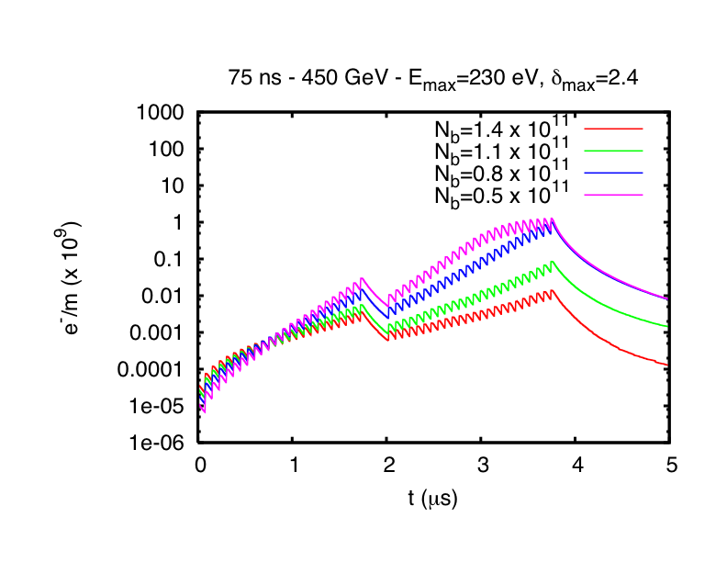
Effects on the build up
Effect of N_{b}
75ns → electron cloud decreasing function of bunch intensity
50ns → electron cloud is maximum for 8 x 10¹⁰ ppb
Non-monotonic & counterintuitive – to be experimentally verified!!

Slide 24
Simulation of e-cloud instability
Existing codes
Electron cloud instability codes:
  PEHTS (KEK, Ohmi)
  HEADTAIL (CERN, Rumolo, Zimmermann, et al.)
  QuickPIC (USC-GSI, Katsouleas, Ghalam, Rumolo, Benedetto, Beng)
  WARP-POSINST (LBNL, Vay, Furman)
  CMAD (SLAC, Pivi)

Slide 25
Main ingredients of HEADTAIL
Single-bunch effect
Multi-turn and multi-kick
Dipole/field-free/solenoid sections
  Can receive the electron distribution from ECLOUD
6D bunch description
  Several options for the type of longitudinal motion
Transverse mutual beam-electron forces
Chromaticity, amplitude detuning

Slide 26
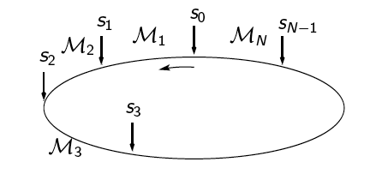
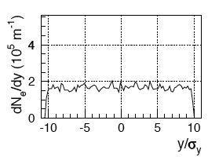
HEADTAIL simulation general principle

Slide 27
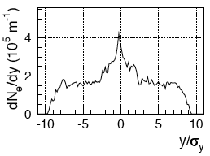
HEADTAIL simulation general principle

Slide 28
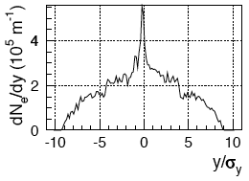
HEADTAIL simulation general principle
The effect of the electron cloud on the beam becomes visible only after many turns
The electron cloud is refreshed at every interaction point

Slide 29
Dependence on numerical parameters
Electron cloud instability simulations are sensitive to a significant number of numerical parameters
  Time steps:
    Number of slices chosen to represent the bunch
    Number of electron kicks per turn
  Number of macro-particles
    How many macro-electrons?
    How many bunch macro-particles?
    How many bunch macro-particles per bunch slice?
  Extension of the electron cloud transverse area, which is the grid to be meshed (usually a certain number of the beam transverse sigmas)
  Number of grid points for the Poisson mesh
  Type of Poisson solver (with or w/o boundary conditions on a rectangle)
CPU times for electron cloud instability simulations span from few hours to several days according to the settings

Slide 30

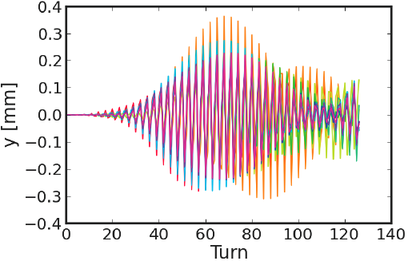
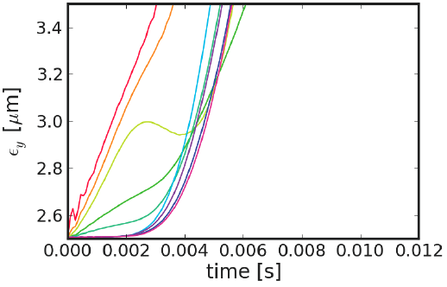
Importance of numerical parameters
Number of kicks per turn can be used
  for ‘lumping’ in a certain number of locations the action of a continuous electron cloud, or
  kicks represent real localized electron clouds in the accelerator
In case 1., if number of kicks per turn is too low, coherent motion may be turned into incoherent

Slide 31
Dependence on physical parameters
In principle both coherent instability and incoherent emittance growth could be predicted by these simulations
Evolution of a beam interacting with an electron cloud depends on a significant number of parameters in a non-trivial way
  Bunch length (longitudinal emittance)
  Beam transverse sizes (emittances and beta functions at the electron cloud location)
  Beam energy
  Beam current (number of particles per bunch)
  Chromaticity
  Magnetic field (field-free, dipole, quadrupole)
  Electron cloud density and distribution (in reality determined by many of the above parameters, but can be set independently in simulations)
See tomorrow talks by Elena, Kevin & Giuliano

Slide 32
Dependence on physical parameters
In principle both coherent instability and incoherent emittance growth could be predicted by these simulations
Evolution of a beam interacting with an electron cloud depends on a significant number of parameters in a non-trivial way
  Bunch length (longitudinal emittance)
  Beam transverse sizes (emittances and beta functions at the electron cloud location)
  Beam energy
  Beam current (number of particles per bunch)
  Chromaticity
  Magnetic field (field-free, dipole, quadrupole)
  Electron cloud density and distribution (in reality determined by many of the above parameters, but can be set independently in simulations)

Slide 33
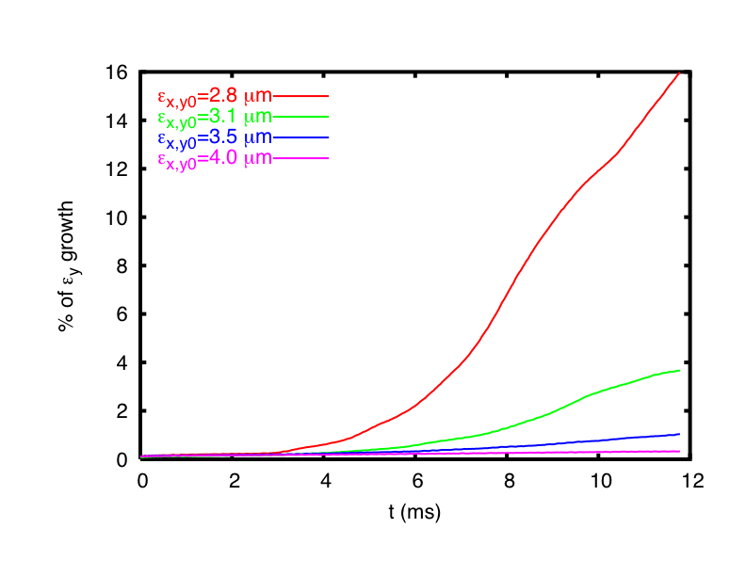
Effects on instability
Effect of ε_{x,y}
The pinch around small emittances is enhanced and makes the bunch more unstable

Slide 34
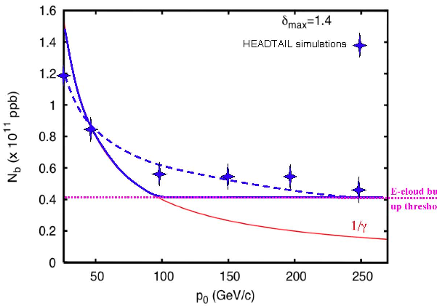
Effects on instability
Effect of ε_{x,y}
Effect of beam energy
Instability threshold decreases with energy (keeping emittances + bunch length constant)

Slide 35
Conclusions & Outlook
Electron cloud simulations are split into:
  Build up simulations
  Beam dynamics simulations
CERN tools
  ECLOUD & HEADTAIL
    Sensitive to several model and numerical parameters
    Unveiled non-trivial dependence on physical parameters
Outlook: unify build up and instability simulations in one 3D self-consistent model ??

Slide 36
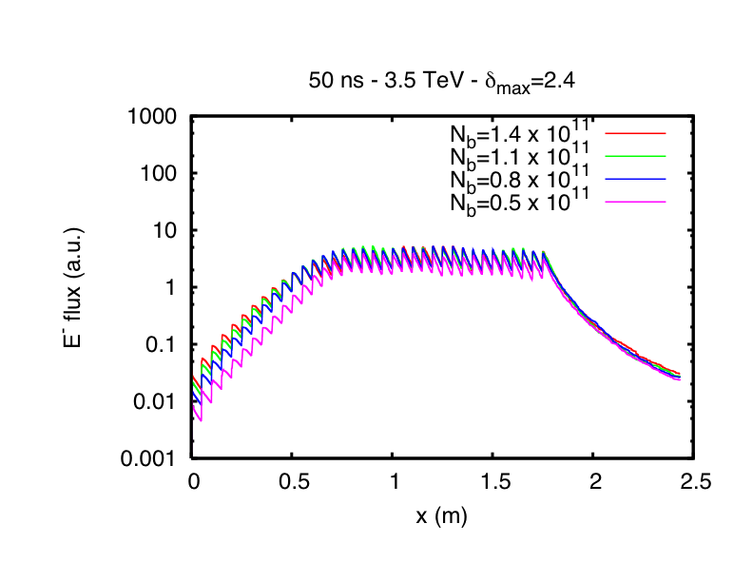
The dream of a 3D self-consistent description…
Self-consistent build up electron cloud at each kick point
We need approximately the time of (n_{turn}*n_{kick}) ECLOUD simulations plus n_{bunch} HEADTAIL simulations
E. g.
n_{kick}=1, n_{turn}=10³
n_{bunch}=10³
CPU time = 10³ x (ECLOUD + HEADTAIL)
CPU time ≈ 100d in the best case…
And memory requirements?? Unmanageable if we want to keep turn-by-turn memory of the electrons at each kick point!!

Slide 37
Conclusions & Outlook
Electron cloud simulations are split into:
  Build up simulations
  Beam dynamics simulations
CERN tools
  ECLOUD & HEADTAIL
    Sensitive to several model and numerical parameters
    Unveiled non-trivial dependence on physical parameters
Outlook: prove further & improve the reliability of our codes, develop & include more functionalities, grab the physics in our models

Slide 38
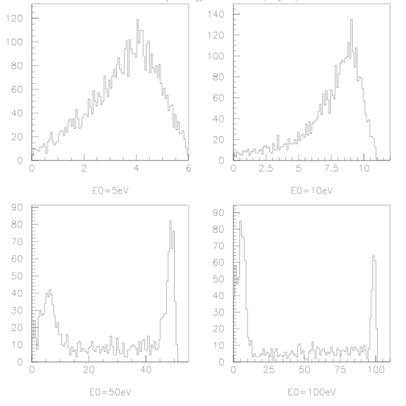
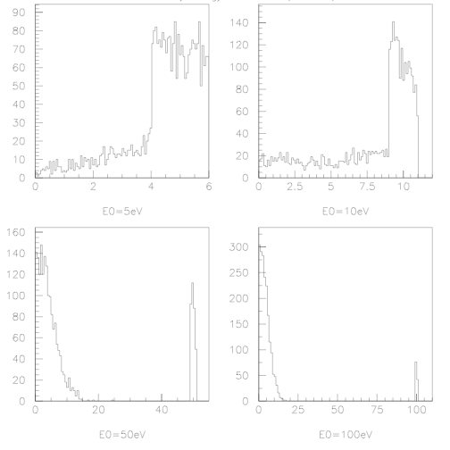
And re-diffused electrons are not included in the model…
In the present ECLOUD model, electrons are either reflected or cause secondary emission
With re-diffused (G. Bellodi)
Re-diffused electrons enhance the build up
Can impact up to a factor 2 on heat load calculations (e.g. LHC, PS2)
No re-diffused (present model)

Slide 39
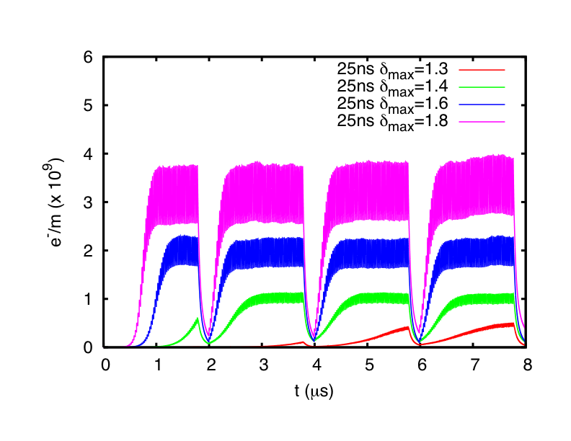
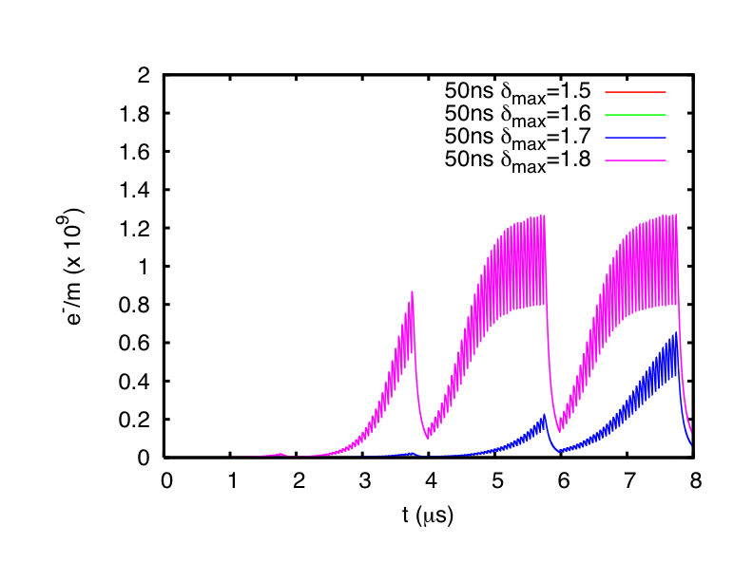
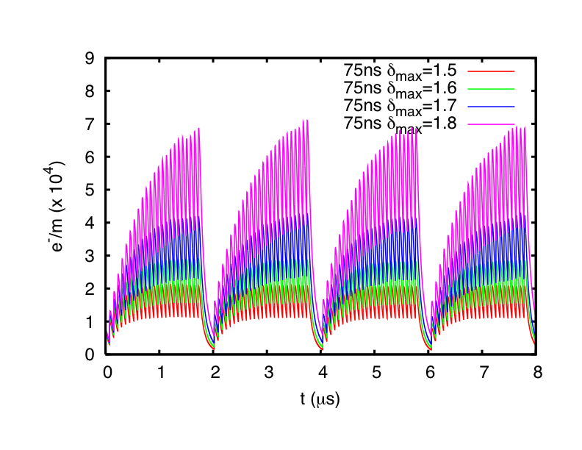
Dependence on bunch spacing
Sample results
Example of electron cloud build in an SPS MKD kicker for different kinds of beam
  25ns bunch spacing has electron cloud even for δ_{max}=1.3
  50ns bunch spacing builds electron cloud for δ_{max}>1.6
  75ns does not have electron cloud up to δ_{max}=1.8

