Slide 1
Parameter studies of the e⁻ cloud build up
C.Octavio Domínguez, Giovanni Rumolo, Frank Zimmermann
Many thanks to
all the e⁻ cloud team!!!!!!!

Slide 2

Contents
Observations. Description of the problem
Method
Results (state of the art)

Slide 3
Contents
Observations. Description of the problem
Method
Results (state of the art)

Slide 4
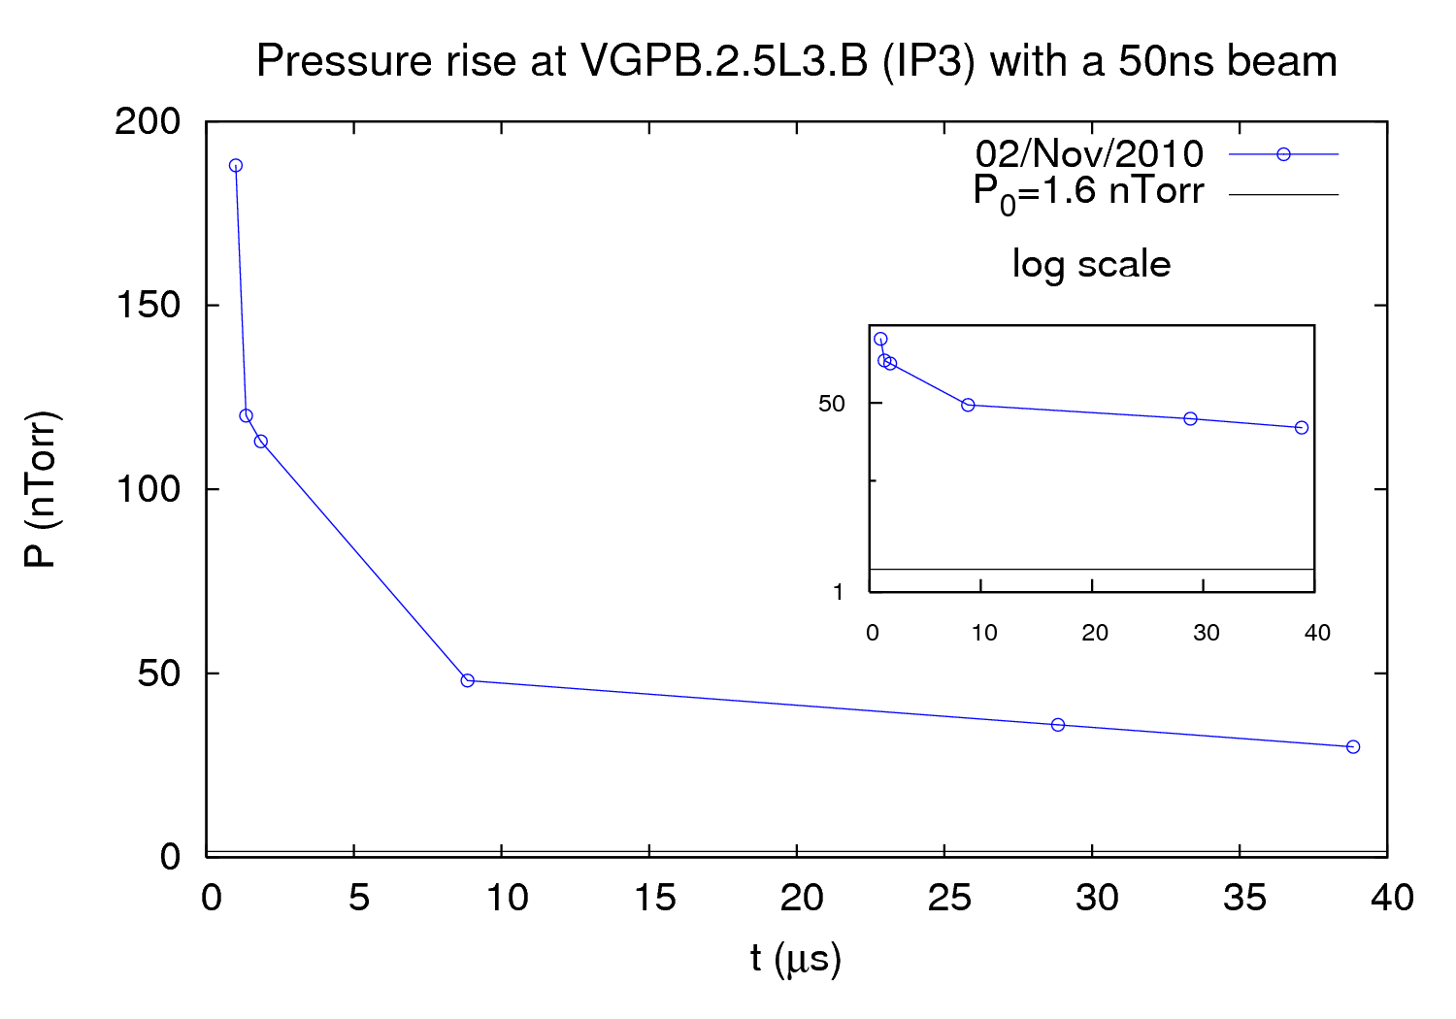
Observations
N_{b}=1.1∙10¹¹ ppb
24bunches+24bunches
450 GeV (Injection)

Slide 5
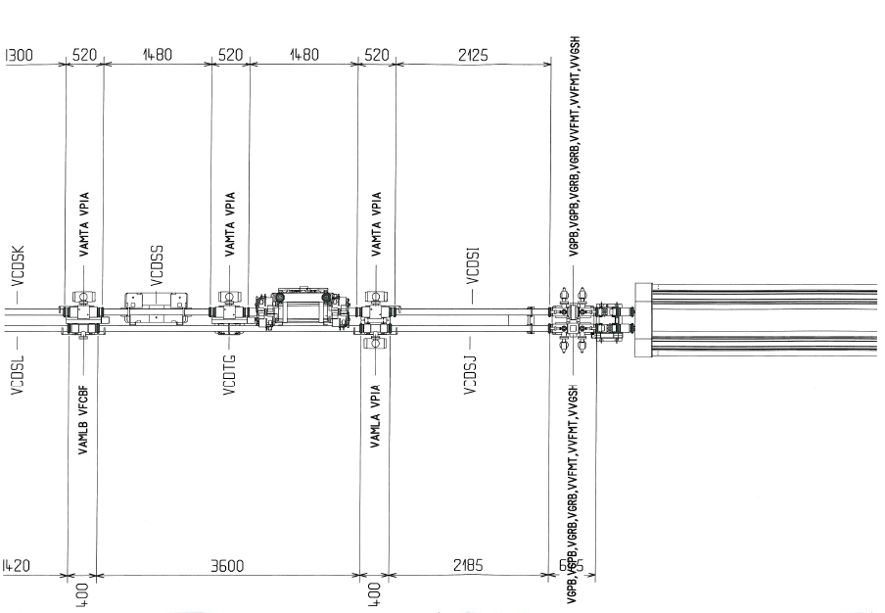
IP3 Geometry
BPMWE0008
VGP3.2.5L3.B pressure gauge

Slide 6
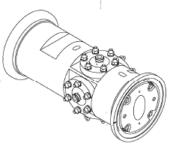
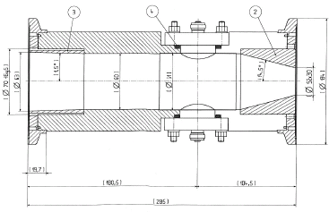
IP3 Geometry
BPMWE0008
Round section: Worst case
Elliptical section

Slide 7
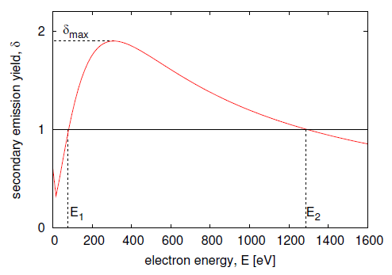
Parameters
The players of the game…
δ_{max}: Maximum secondary electron yield
ε_{max}: Electrons’ energy at which the δ_{max} is reached
R: Reflection coeficient
P: Pressure rise due to e⁻ cloud
… so let’s play!!!
ε_{max}
Courtesy U. Iriso

Slide 8
Contents
Observations. Description of the problem
Method
Results (state of the art)

Slide 9
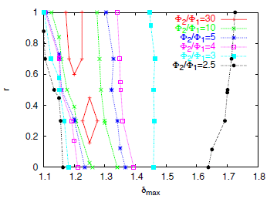
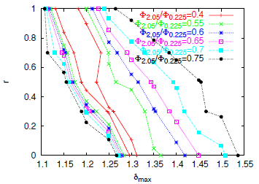
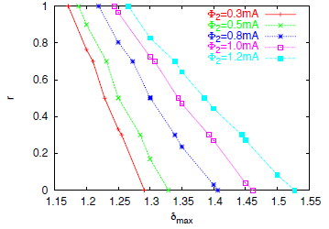
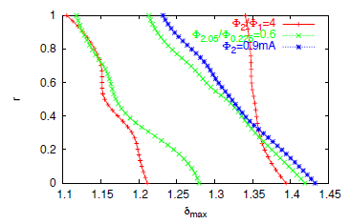
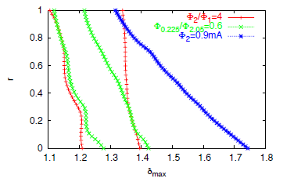
Method
D. Schulte et al., “Electron cloud measurements in the SPS in 2004,” Proc. Particle Accelerator Conference (PAC 05), Knoxville, Tennessee, 16-20 May 2005, pp 1371, 2005
p_{y}>10 eV

Slide 10
Method
φ_{1turn}
P₀=Static pressure
η_{e}=electron induced molecular desorption coefficient
k=Boltzman’s constant
T=Temperature
2L=Distance between two gauges
2S=Pumping speed
c=Specific molecular conductance
In LHC: We measure pressure (P)
In ECLOUD: We get the flux (φ)
Spacing [μs] | P at VGPB.2.5L3.B [nTorr] | ΔP_{i}/ΔP_{1μs}
38.85 | 30 | 0.153
28.85 | 36 | 0.185
8.85 | 48 | 0.250
1.85 | 113 | 0.597
1.35 | 120 | 0.637
1 | 188 | 1.00
P₀=1.6 nTorr

Slide 11
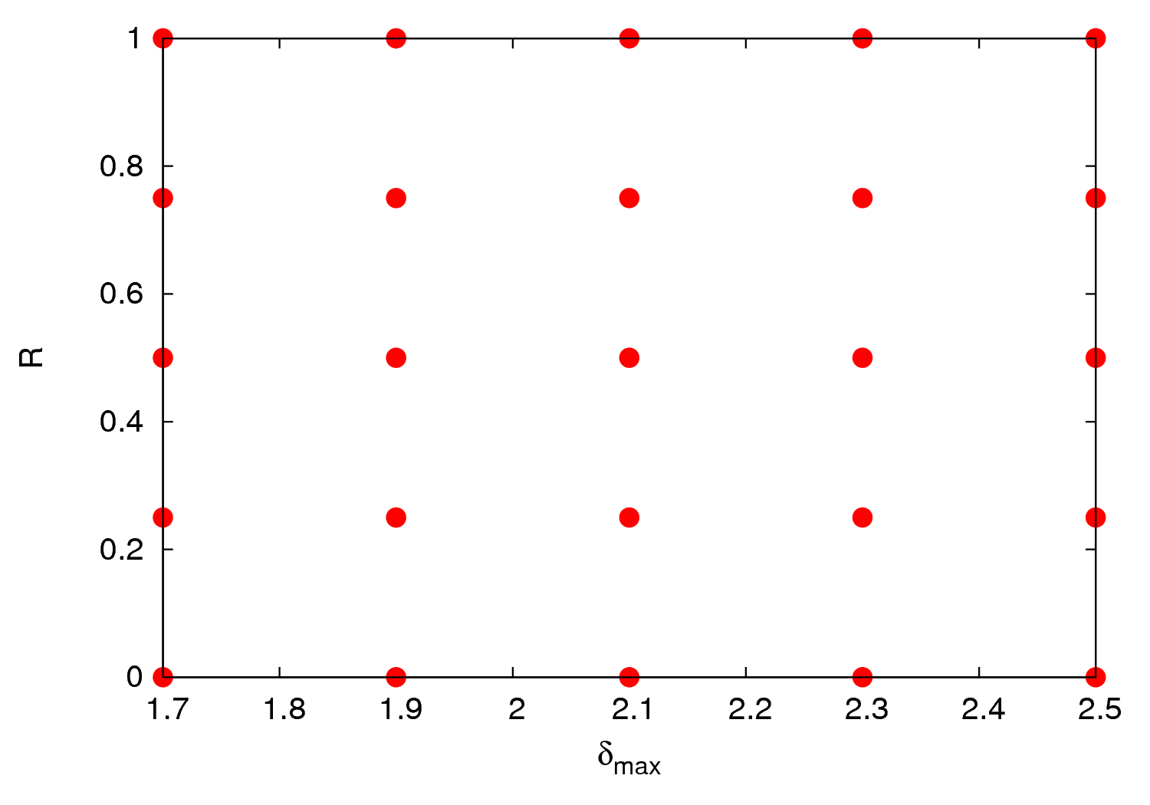
Method

Slide 12
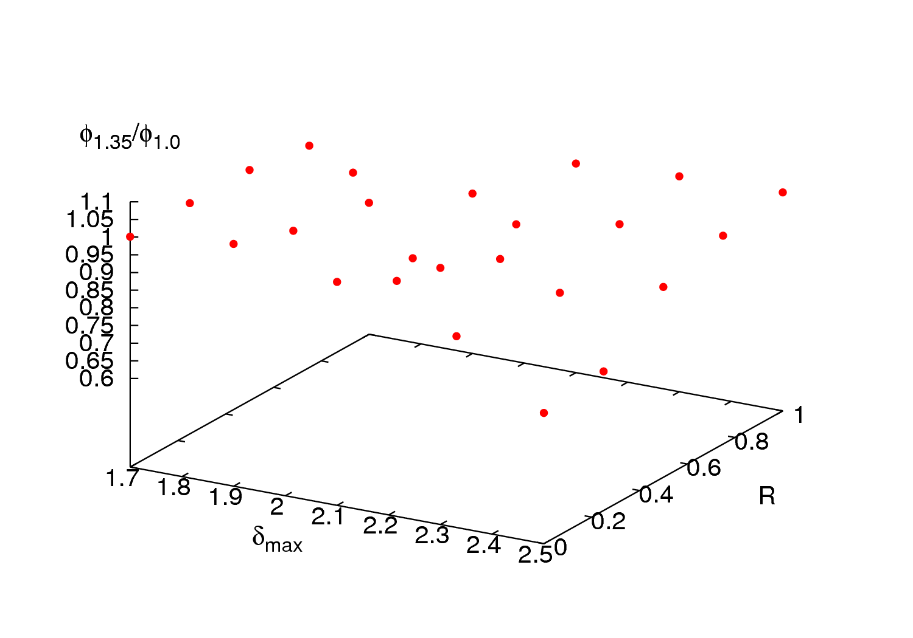
Method

Slide 13
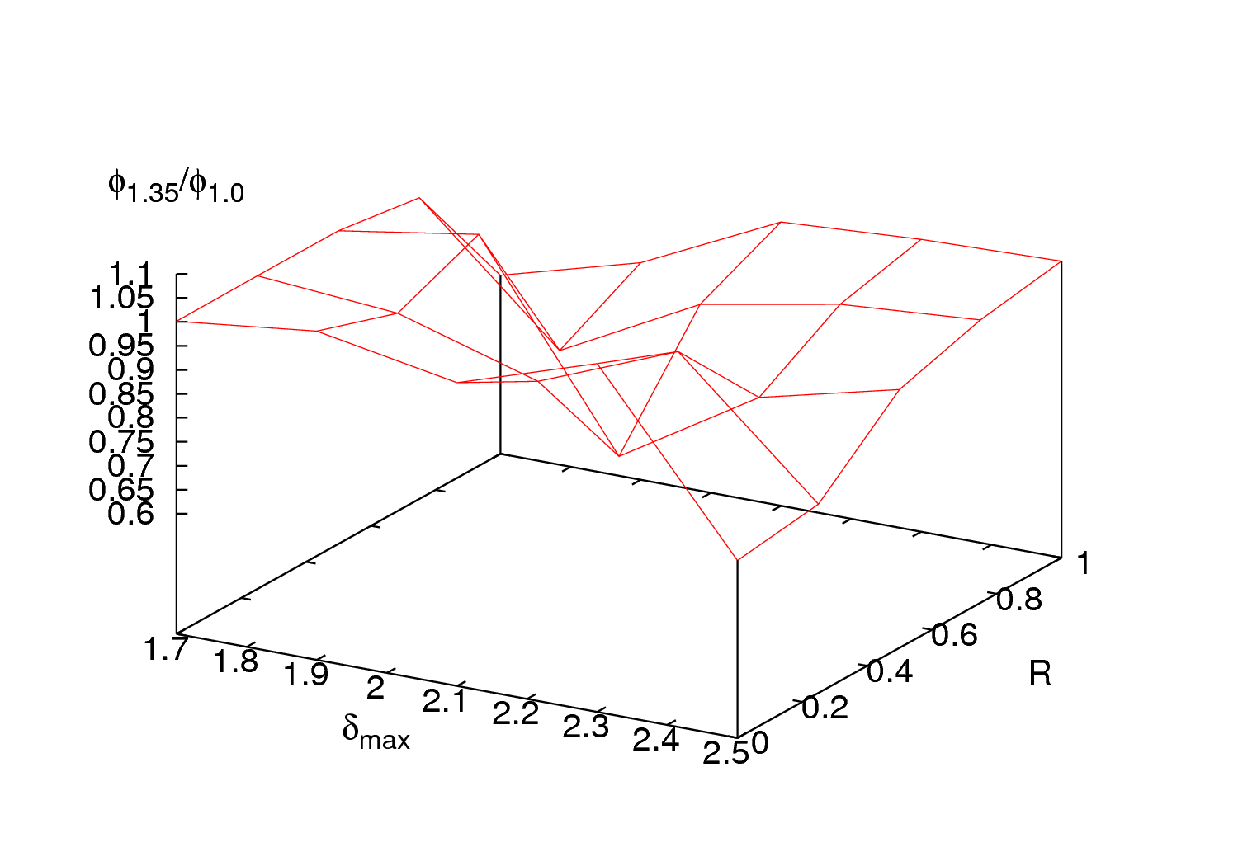
Method

Slide 14
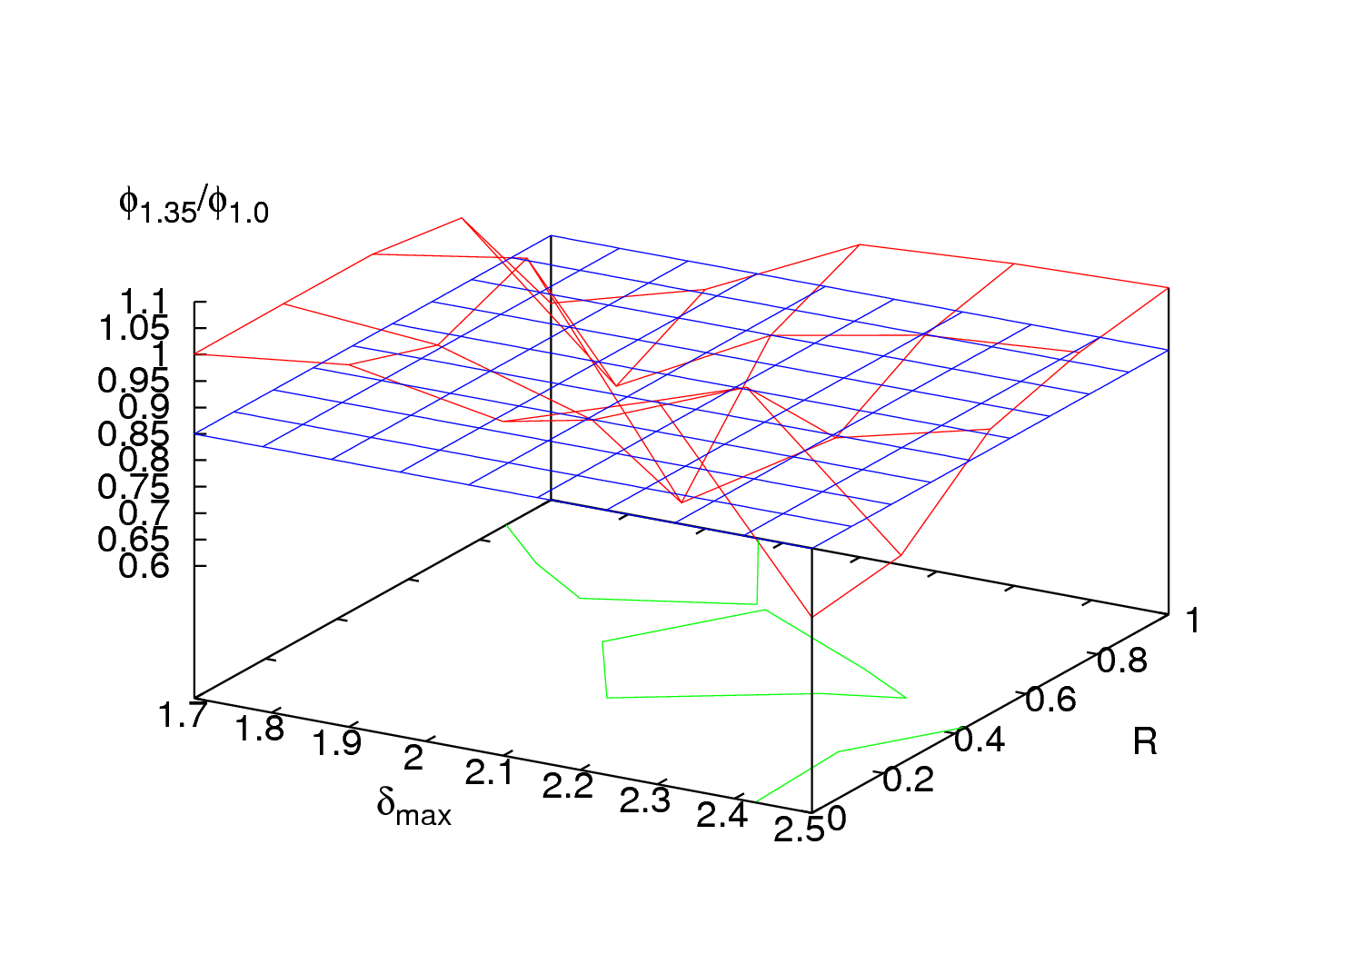
Method

Slide 15
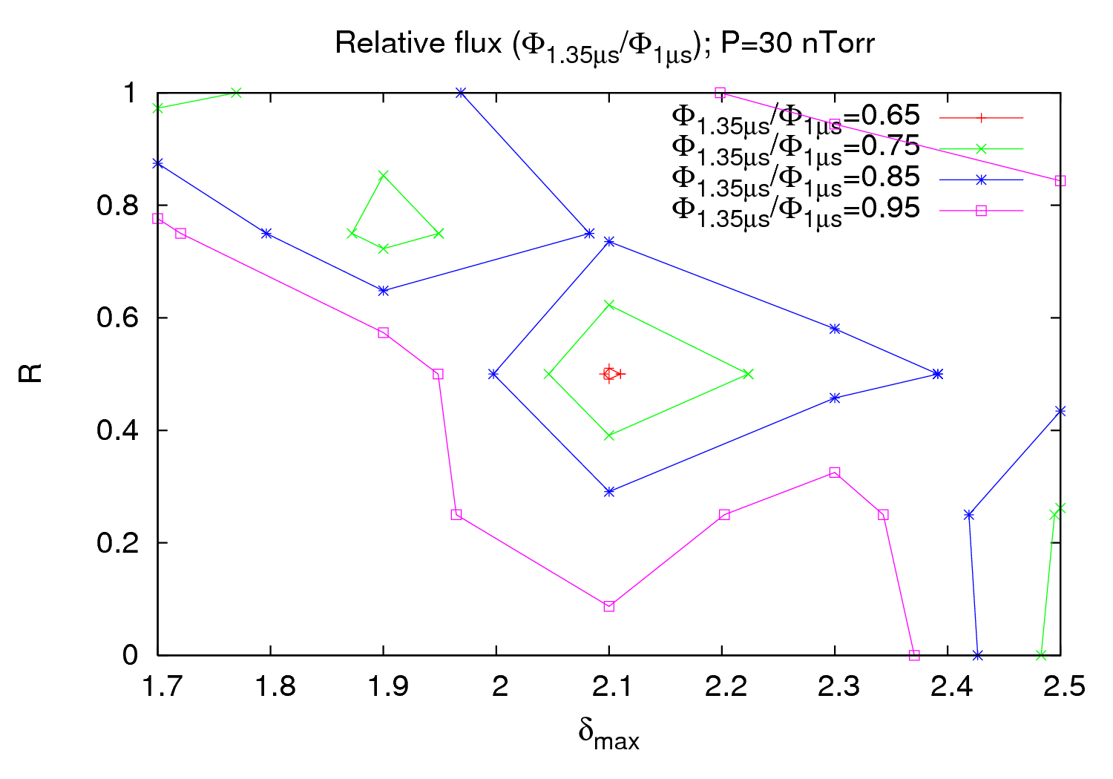
Method

Slide 16
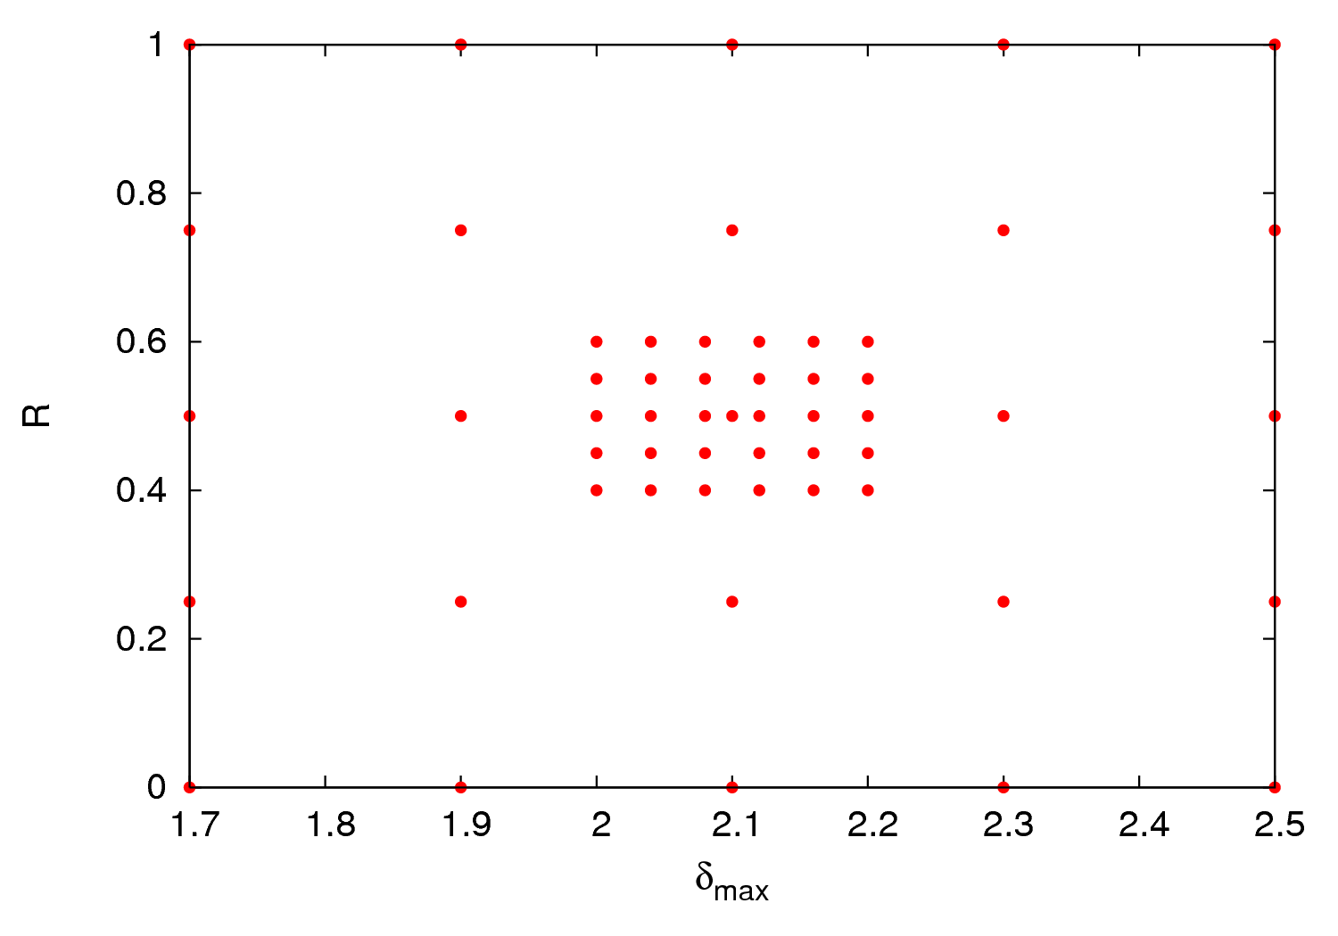
Method

Slide 17
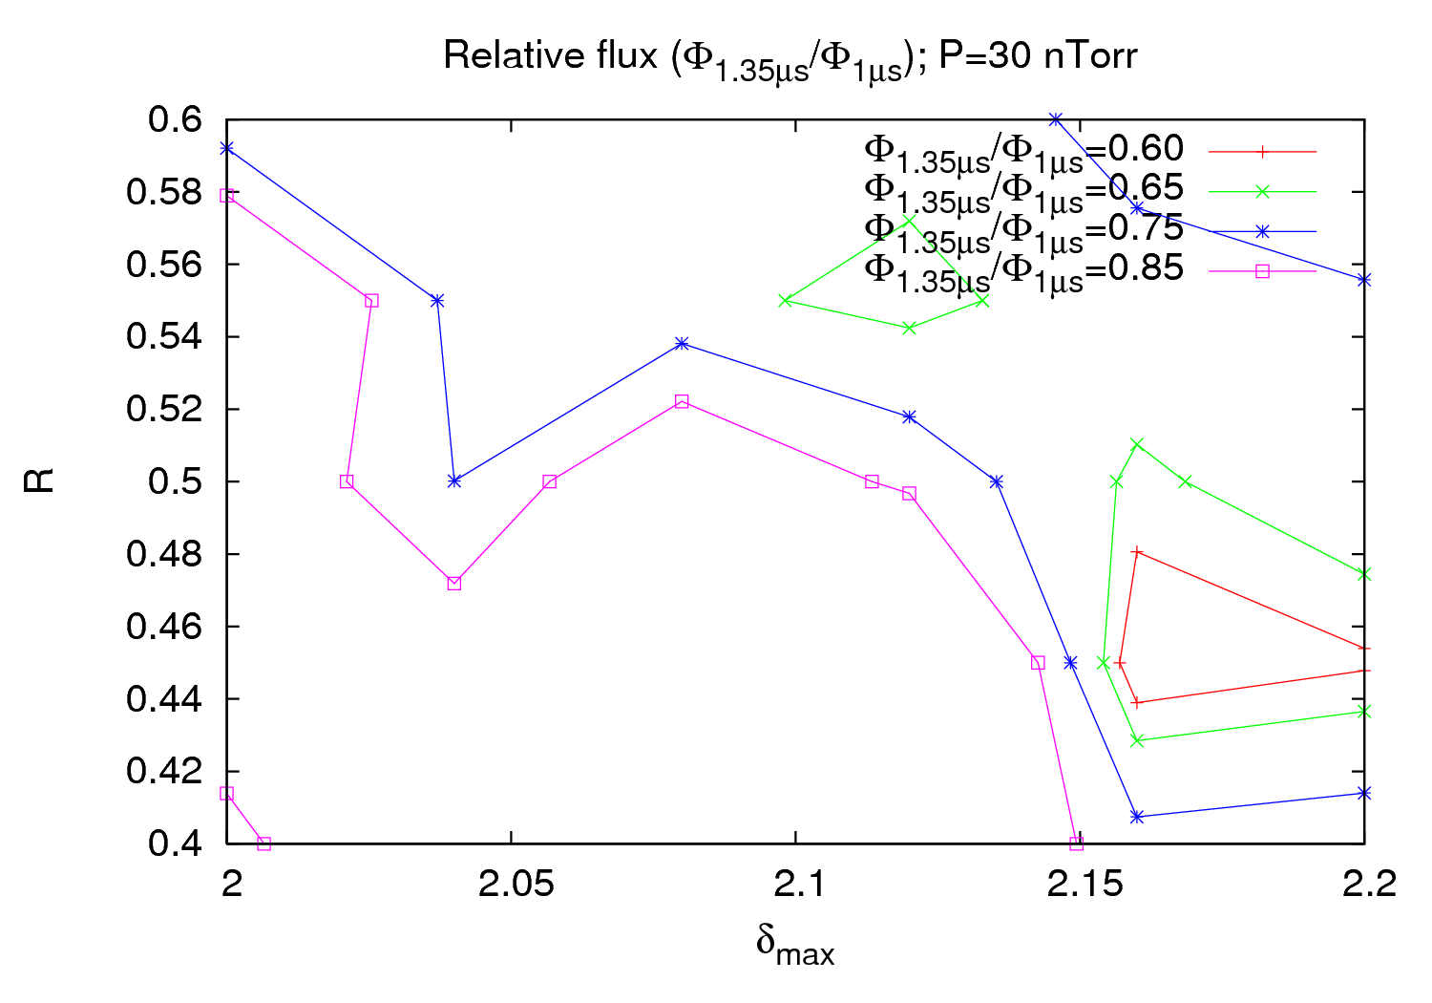
Method

Slide 18
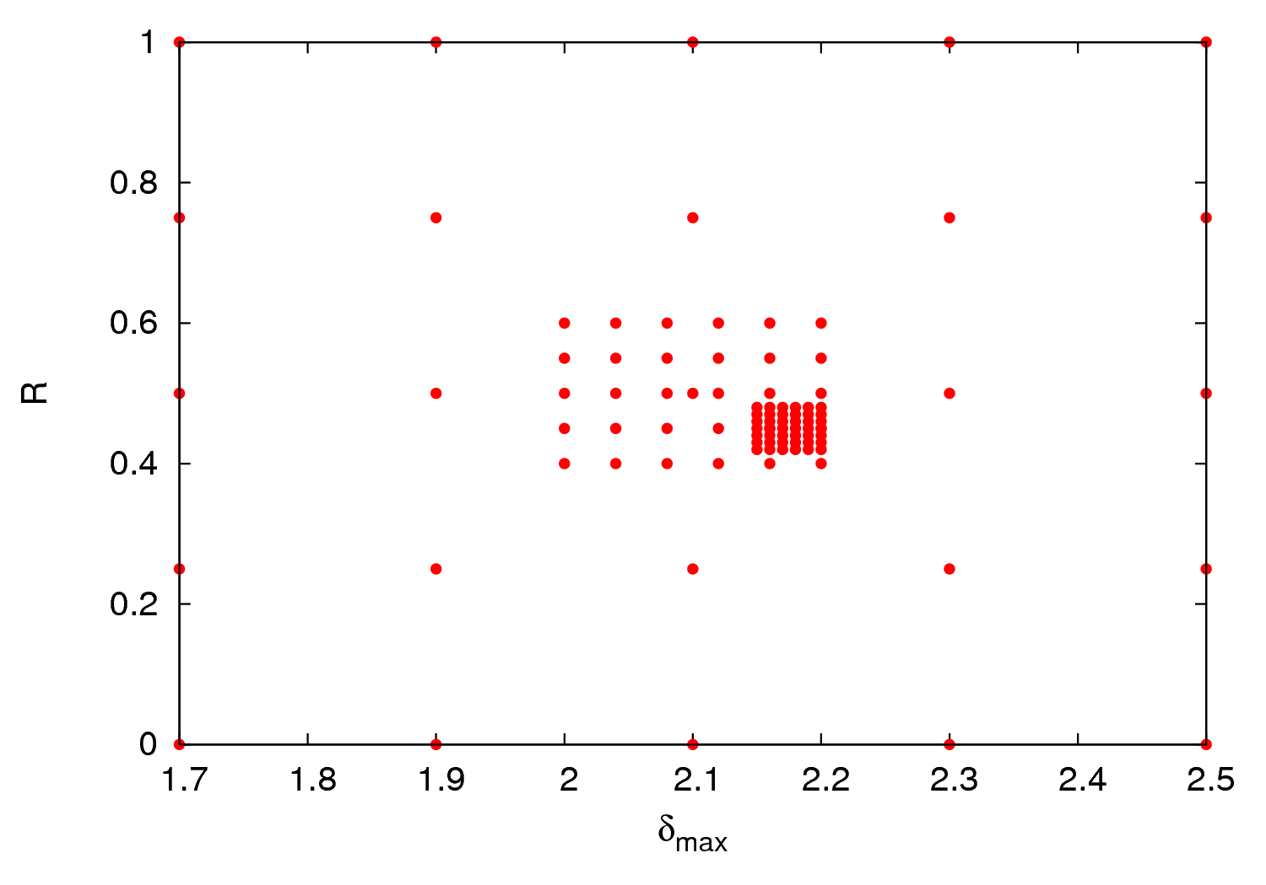
Method

Slide 19
Contents
Observations. Description of the problem
Method
Results (state of the art)

Slide 20
Results
Nice in the theory but in practice…
Working with 4 parameters is not easy
Small variations in one parameter can change your results significantly
That can lead to completely different conclusions/strategies

Slide 21
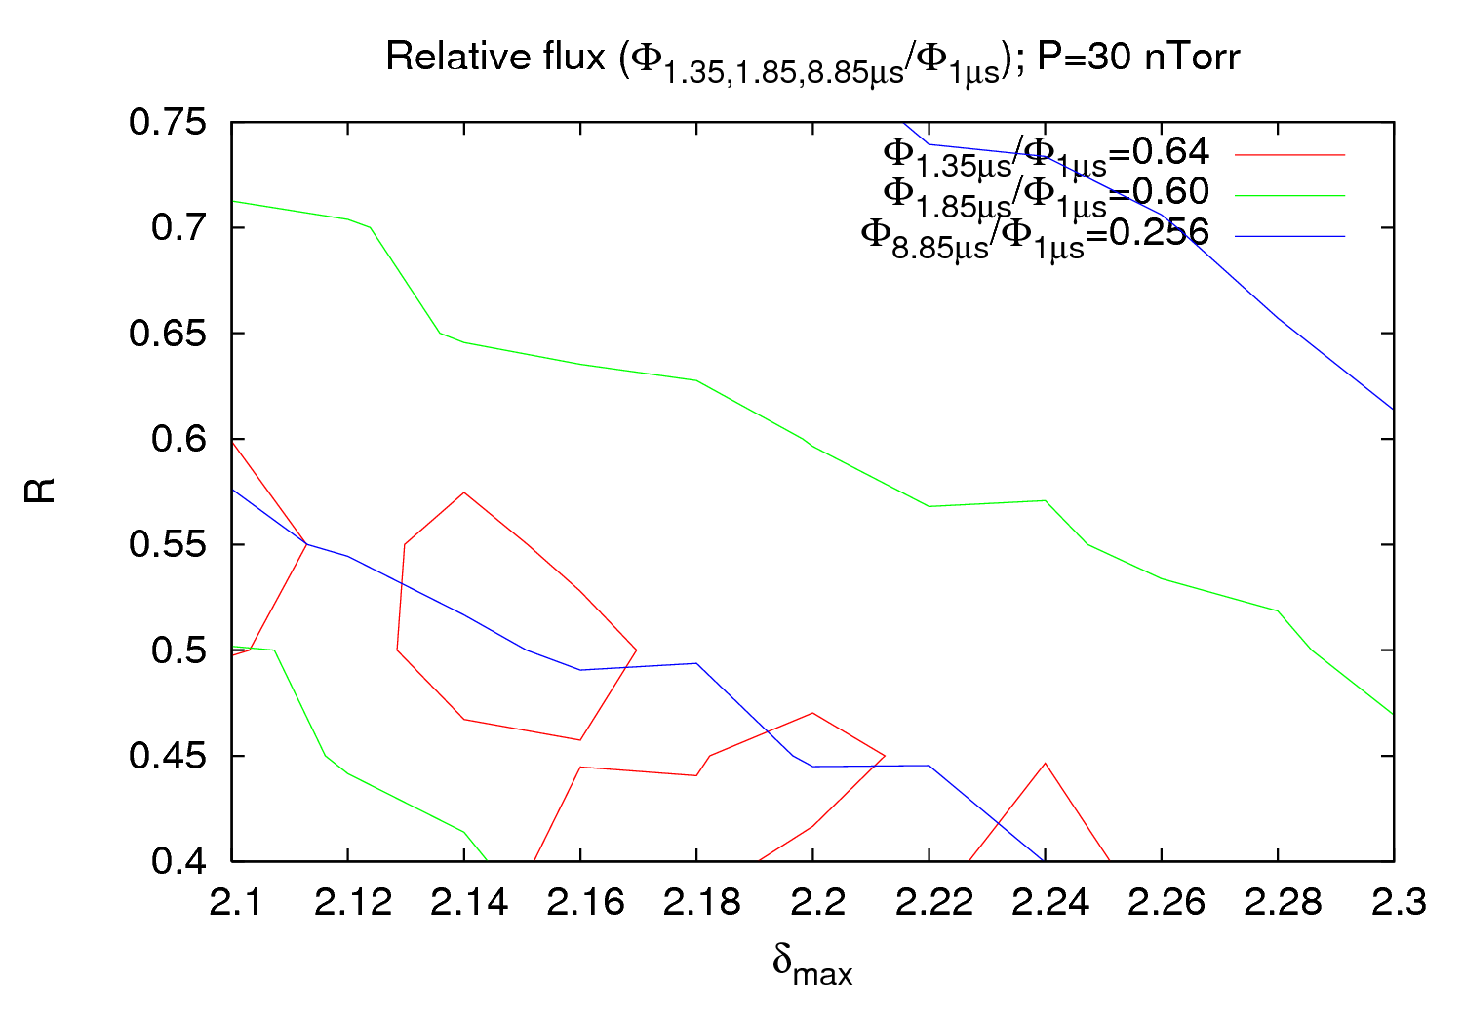
Results

Slide 22
Results
The pressure rise is due to the multiturn effect → each simulation should have the measured pressure as seed pressure (input in ECLOUD)
Need to “open” the zoom
Big dependence on the number of grid points → Finer grids required

Slide 23
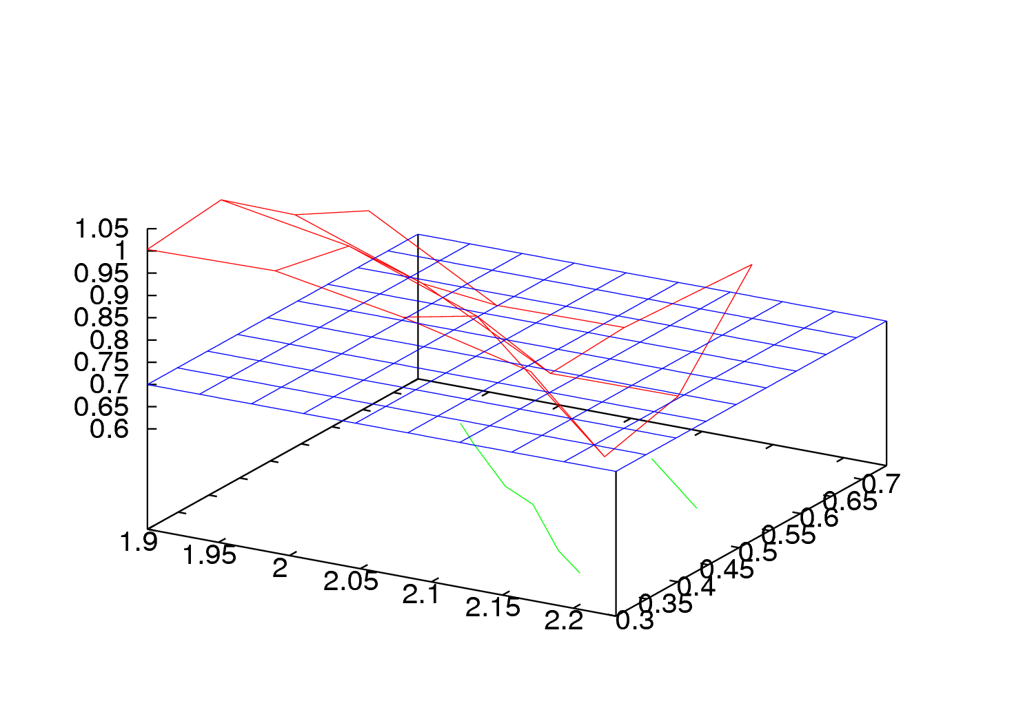
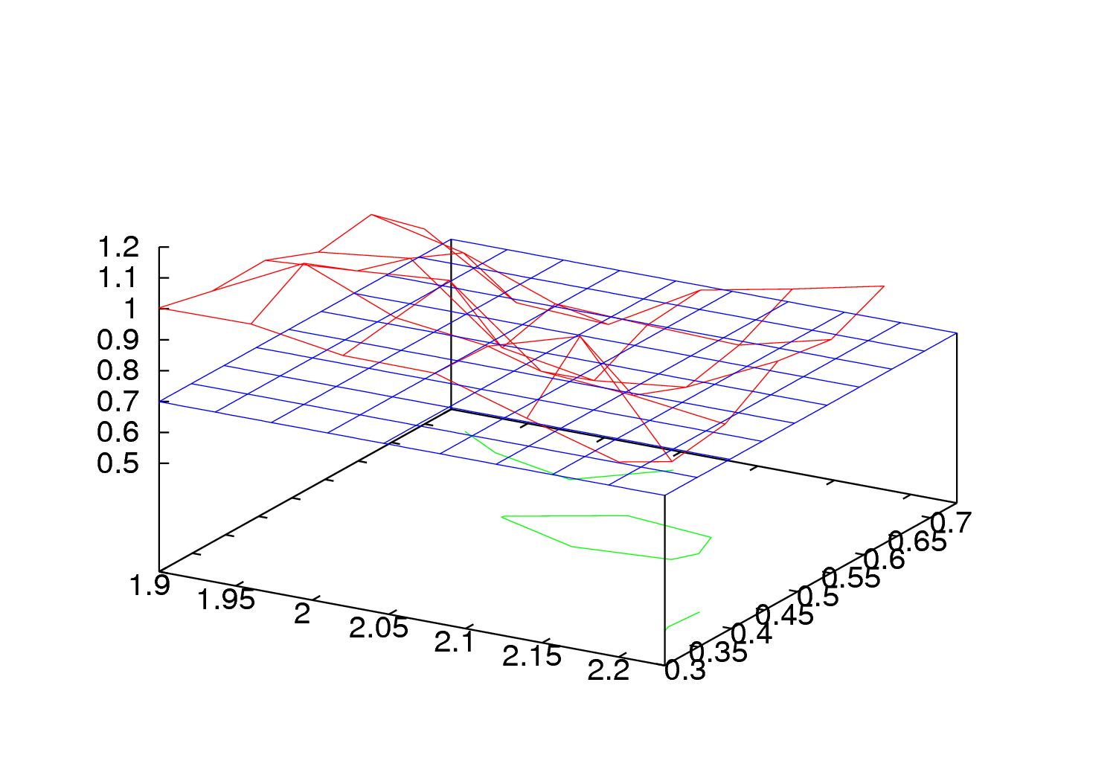
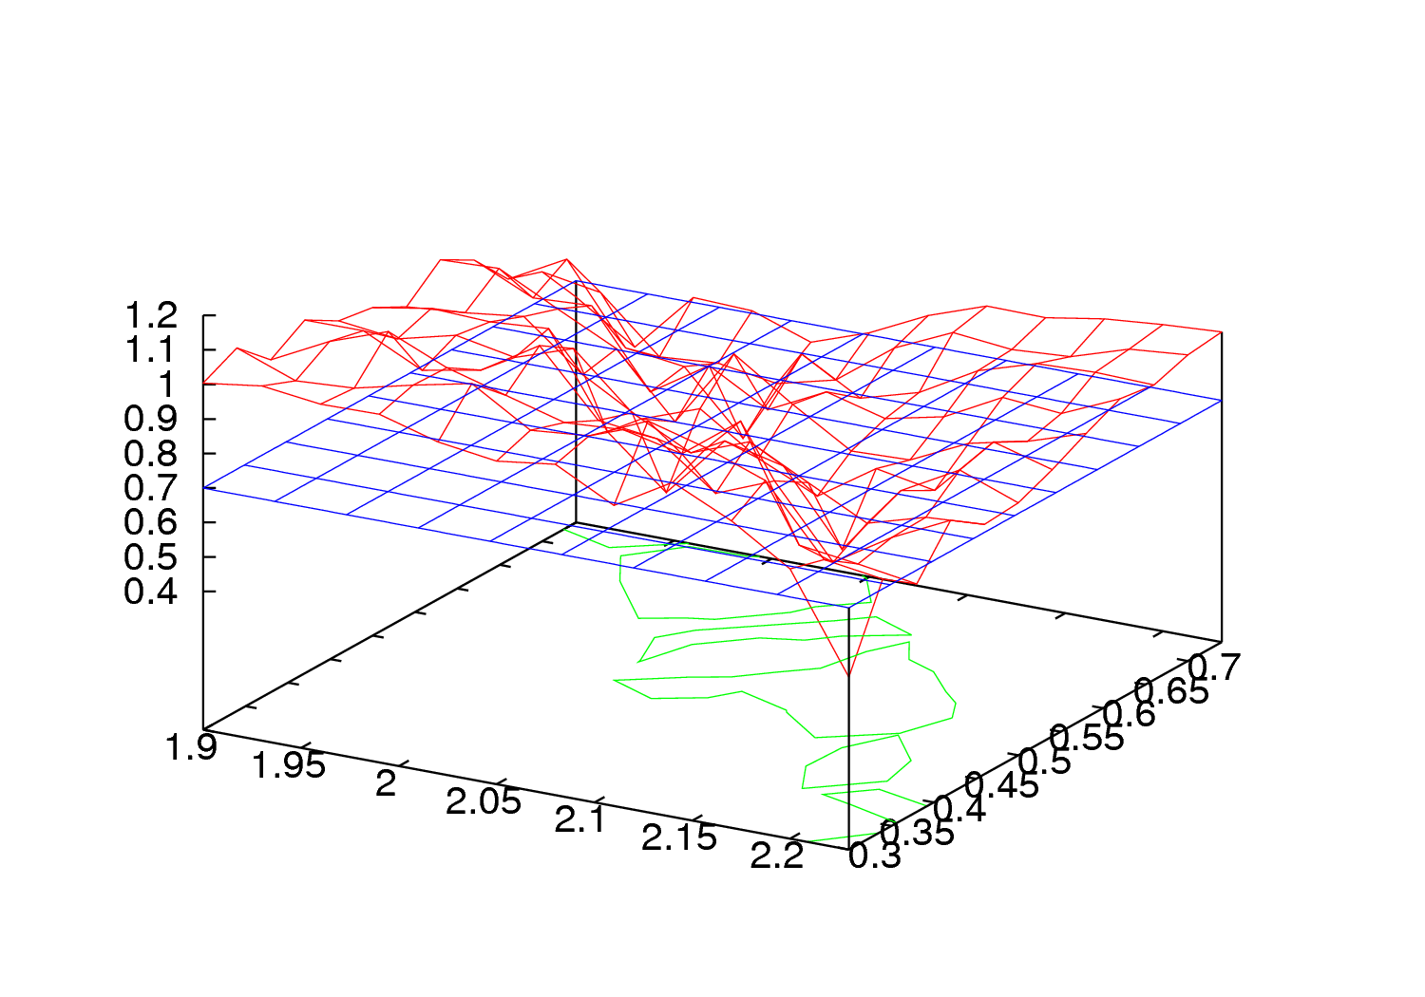
Results
4x4 grid
6x6 grid
12x12 grid

Slide 24
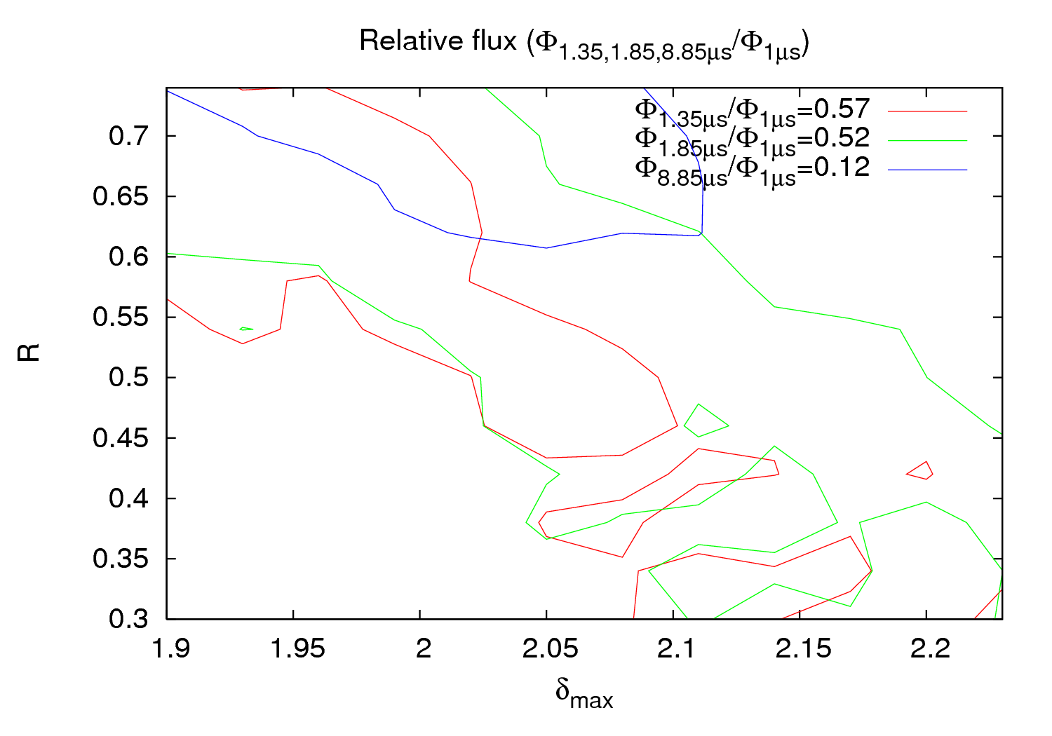
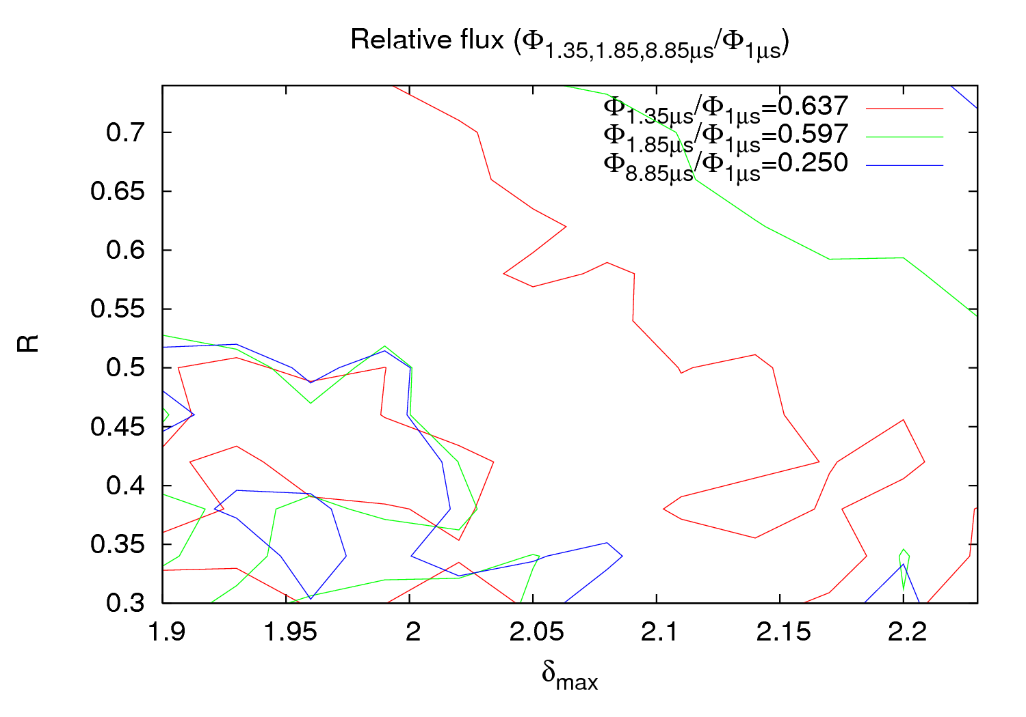
Results
ECLOUD input seed pressure → P_{i}

Slide 25
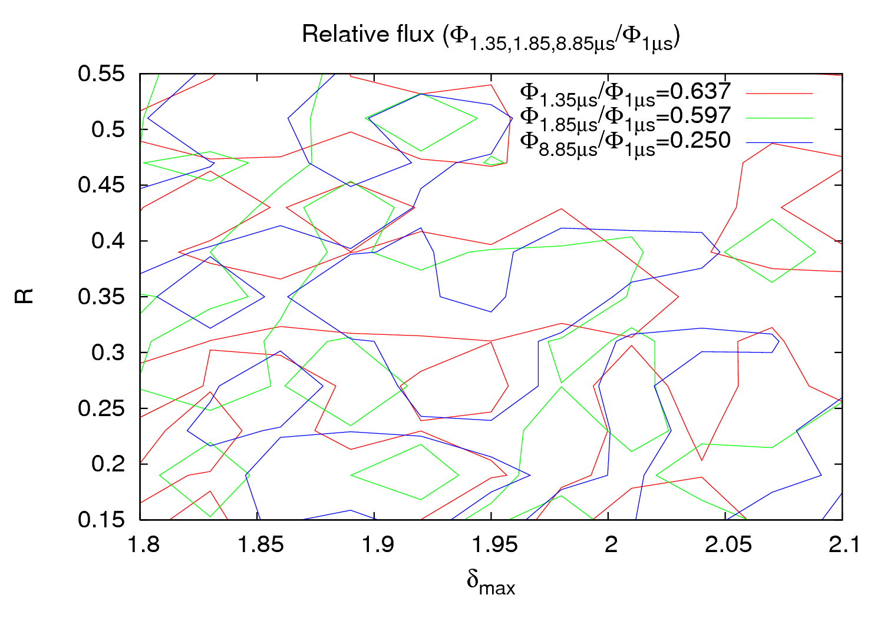
Results
ECLOUD input seed pressure →P_{i}- P₀

Slide 26
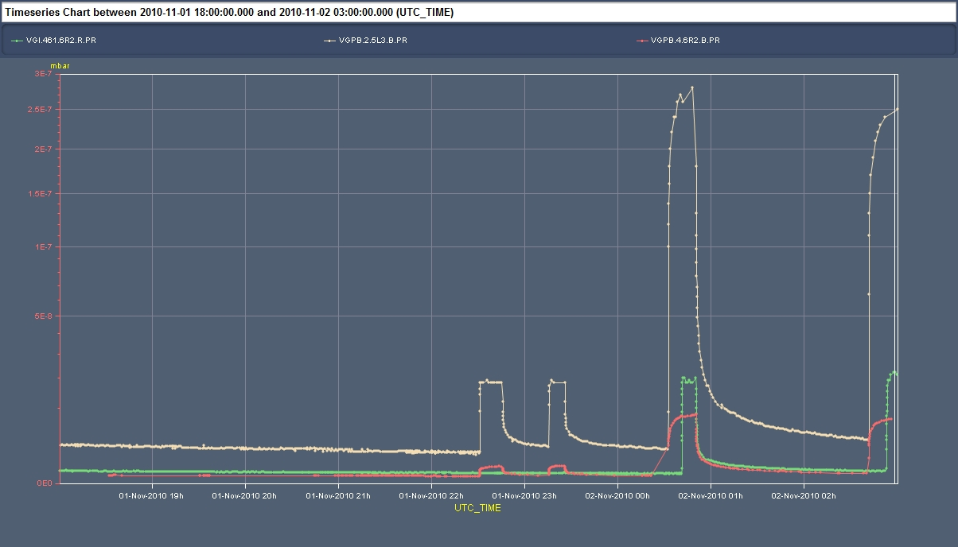
Results
197nTorr
1.1x10¹¹ p/bunch
0.8x10¹¹ p/bunch
0.6x10¹¹ p/bunch
13.5nTorr
1.6nTorr
Courtesy G.Arduoni

Slide 27
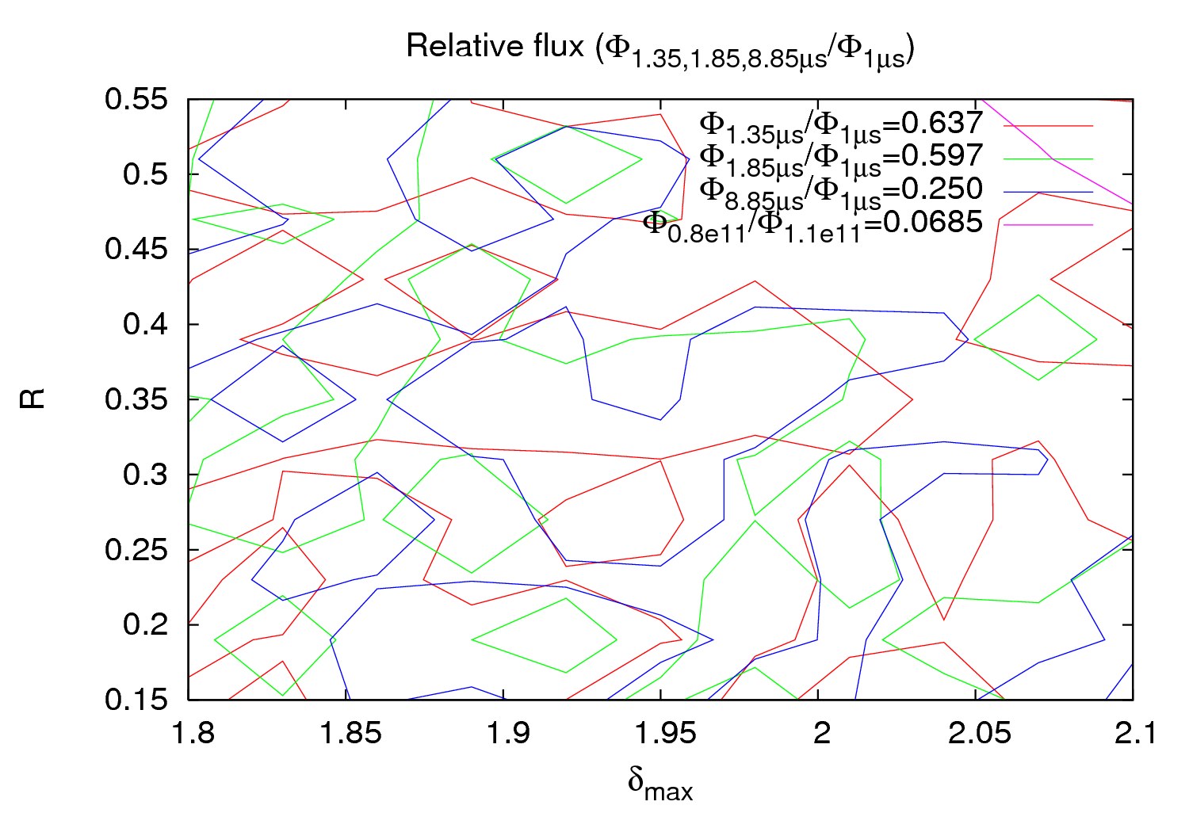
Results

Slide 28
Results
Conclusions
Parameter studies are taking place to characterize the IR3
4 parameters have been chosen to describe the surface properties
Significant impact on searched parameters with a small variation in the input
The number of grid points become important too
No good agreement yet. Possible reasons:
  The assumption of the geometry is not optimum
  Pressure at z≠0 (from gauge) varies more than expected (ratios might change!)
  Need to explore the ε_{max} parameter (set to 230 eV for all present simulations)
Need to explore other IPs

Slide 29
Thank you for your attention

