Slide 1
Measurement of the energy loss through the synchronous phase shift
E. Shaposhnikova (CERN/BE)
CERN-GSI Electron Cloud Workshop 2011
Thanks to G. Hagmann, P. Baudrenghien, A. Butterworth, T. Mastoridis , G. Arduini, W. Hofle, L. Tavian + LHC operation shift (V. Kain)

Slide 2
Synchronous phase shift
Energy loss of the beam should be compensated by the RF system
In the absence of acceleration the synchronous phase
sinφ_{s} = W_{n}/(e V),
where W_{n} is energy loss per turn and per particle and V is the voltage amplitude
Measurement of φ_{s} can be used for evaluation of energy loss due to
  synchrotron radiation
  resistive impedance (broad-band and narrow-band)
  e-cloud

Slide 3
Synchronous phase shift
Single bunch effects:
  synchrotron radiation
  broad-band resistive impedance
  → Phase shift is the same for all bunches
Multi-bunch effects:
  narrow-band resistive impedance
  e-cloud
  → Phase shift is different from bunch to bunch

Slide 4
Synchronous phase shift in LHC
Measurements of the average synchronous phase shift
(phase loop error)
∆φ_{s} = ∑ ∆φ_{s} /n_{b}=W/(e V N)
For power of 1 kW, voltage V = 3.5 MV and N =10¹³ (100 nominal bunches) → ∆φ_{s} = 0.9 deg
First preliminary measurements done in 2010
Bunch-by-bunch measurements are possible and planned for 2011 (in collaboration with OP Group)
Effect is smaller for higher voltage (in absence of dependence on the bunch length):
→ twice smaller shift for 6 MV in 2011 (3.5 MV in 2010)

Slide 5
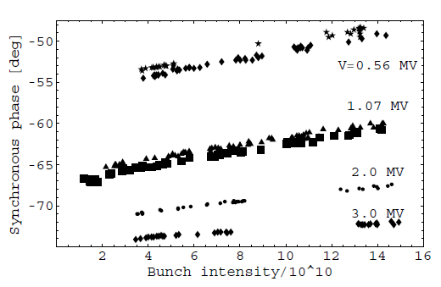



Synchronous phase shift due to energy loss of a single bunch in the SPS
Raw data, 26 GeV/c
Energy loss /turn and particle
the loss factor for the Gaussian bunch
Energy loss of a single bunch in the CERN SPS, EPAC’04

Slide 6
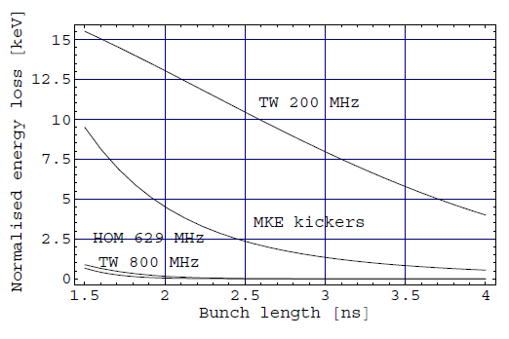
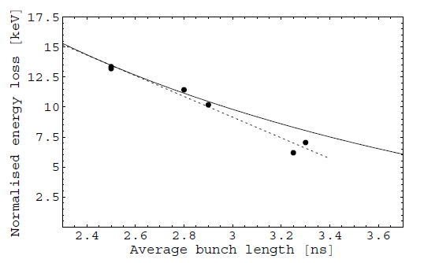
SPS: energy loss from resistive impedance budget
Contributions to energy loss U/(N/10¹⁰)
Comparison with measurements
calculated
→ good agreement between calculated and measured energy loss as a function of bunch length for a single bunch
→ 70 keV energy loss for single bunch with length of 3.5 ns

Slide 7
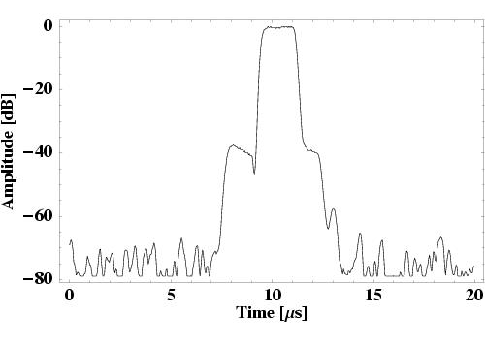
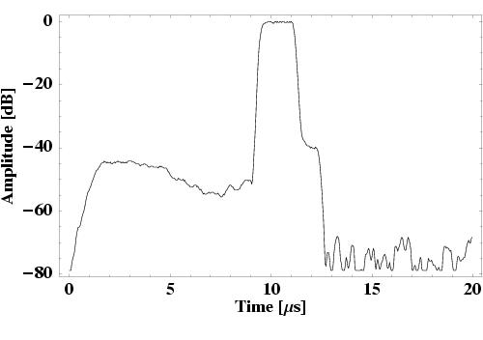
SPS: uncaptured beam motion the 200 MHz signal
Injection
A few seconds later
→ Energy loss due to e-cloud and impedance?

Slide 8
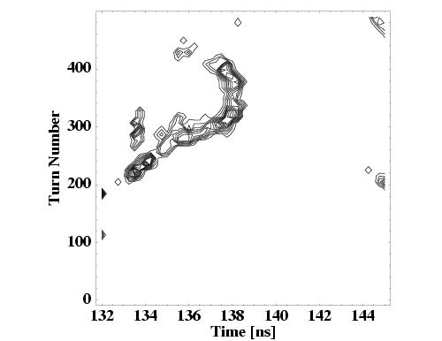
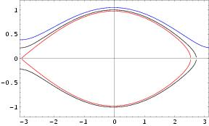
SPS: accelerating bucket on the flat bottom
Bucket: φ_{s}=1.8 deg, α=U/(eV)=0.03
U=60 keV, V=2 MV , hole ~2√πα =0.6
Measured density plot: particles lost at injection → φ_{s} ≠0
Capture loss of the LHC beam in the CERN SPS, EPAC’04

Slide 9
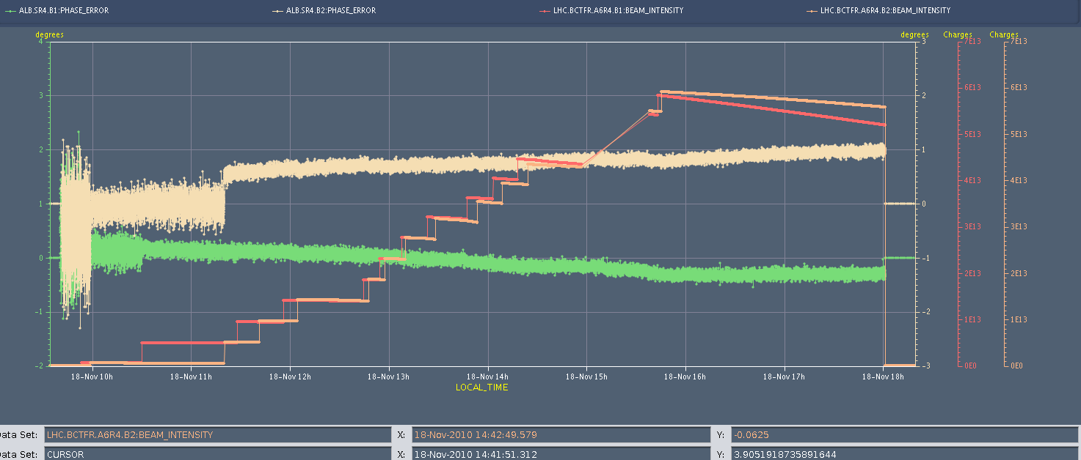
LHC: first measurements with 75 ns beam
(on 18.11.2010) N=6x10¹³
Beam1: phase shift ∆φ_{s}=0.4 deg, no/small drift
Beam2: Continuous drift, different slopes

Slide 10
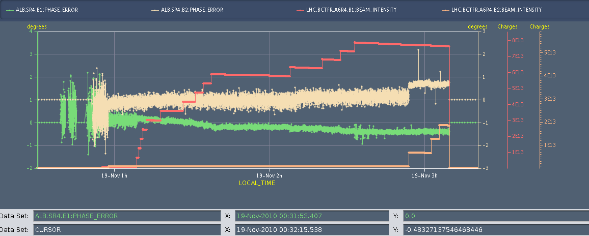
Phase shift for a 75 ns beam
(on 19.11.2010) N=8x10¹³
Beam 1: phase shift ∆φ_{s}~0.6 deg
Beam 2: phase drift (noisy pilot)

Slide 11
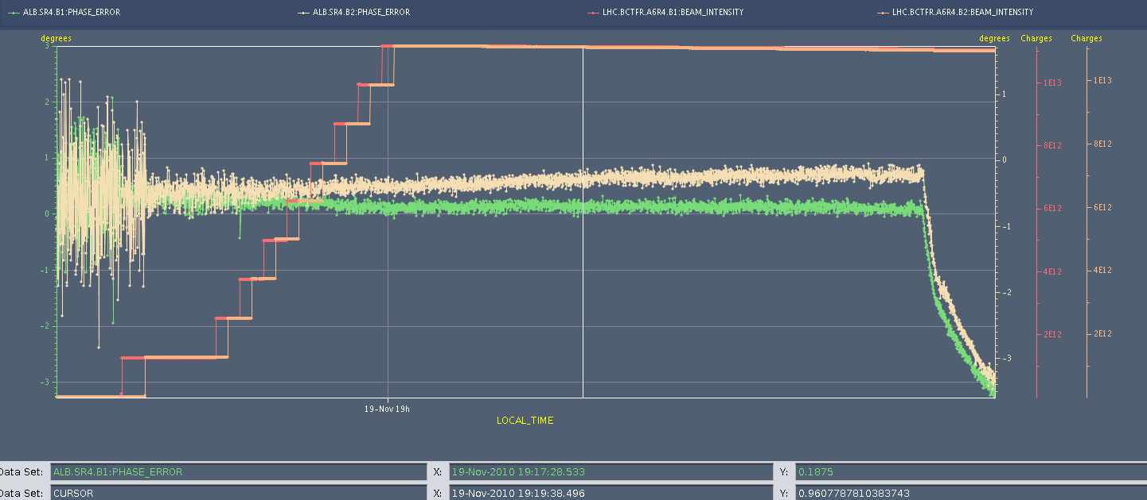
50 ns beam with energy ramp
(18:30-20:00 on 19.11) N=1.1x10¹³
ramp starts
Beam 1: phase shift ∆φ_{s}=0.2 deg
Beam 2: continuous phase drift (~2 deg)

Slide 12
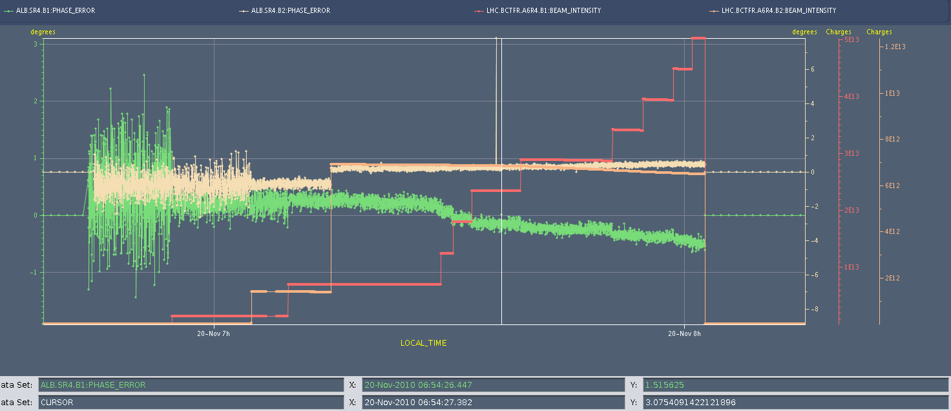
The last fill with 50 ns beam
(6:30-8:00 on 20.11) N=5x10¹³
Beam 1: ∆φ_{s}=0.8 deg, increases faster for N > 10¹³
Beam 2: phase drift

Slide 13
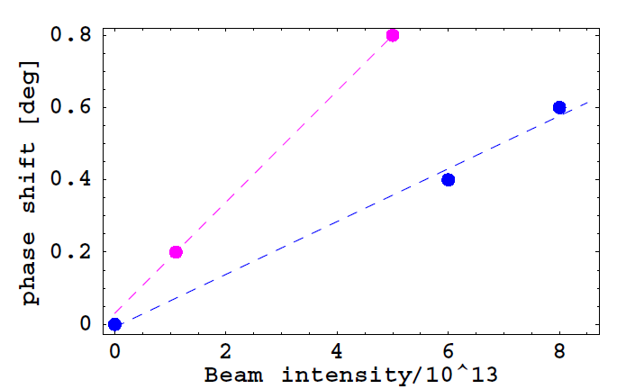
Summary of 2010 stable phase measurements for Beam1
50 ns beam
75 ns beam

Slide 14
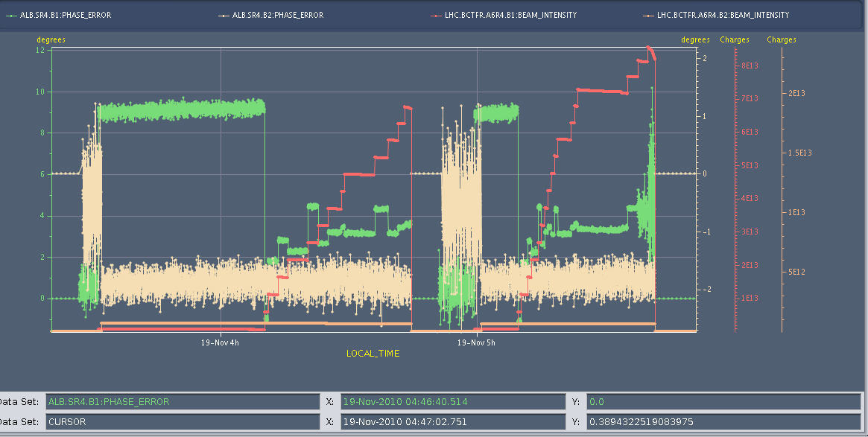
Last fills with 75 ns beam
visible drift for Beam1
- different phase drift during night and with/without beam
- large steps in phase due to the filling scheme (1.005 μs gaps)

Slide 15
Summary and future steps
First observations show visible phase shift for Beam1:
  phase shift is larger with 50 ns spacing than with 75 ns for even smaller beam intensity
  nonlinear dependence of phase shift on total beam intensity both for 75 ns and 50 ns bunch spacings → threshold
  more data is available, for 150 ns spacing also
Need calibration/understanding vs cryogenic measurements
Precision of measurements can be increased by data post-processing (now) and by using filter (in future) – P.B.
Beam2 phase drift should be investigated, systematics for Beam1 also
Measurements in the SPS for beam with different spacings

