Slide 1
2023 Schedule (May-July)
Cool-down to 2K by May 2 (before wk 18)
RF conditioning: Wk 18-19, LLRF setup: Wk 20-21
MD#1: May 31 (8h-18h): high intensity feedback setup
MD#2: Jun 7 (8h-18h): instability study
  Alternative slot Jul 3 (tbc)
MD#3: June 19 (before TS): Amplitude noise
Start warm up - Wk 30 (TBC)

Slide 2
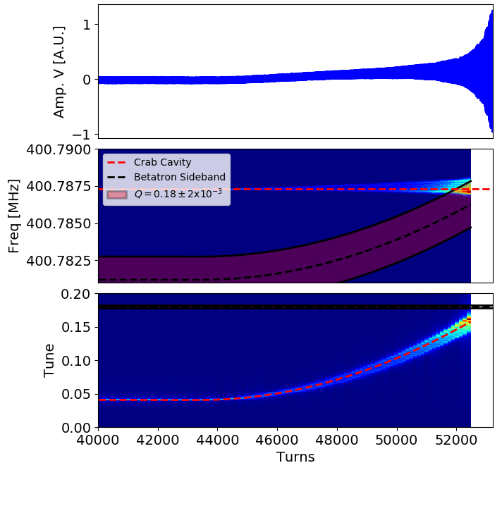
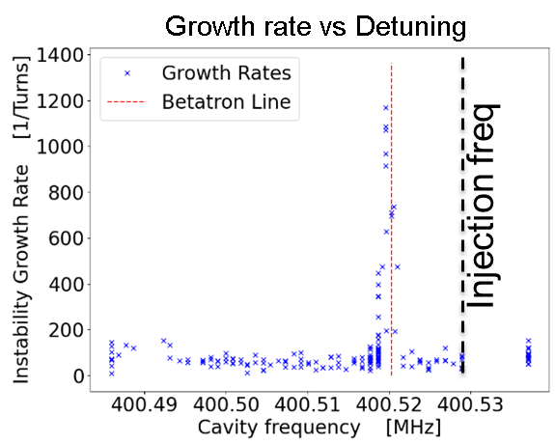
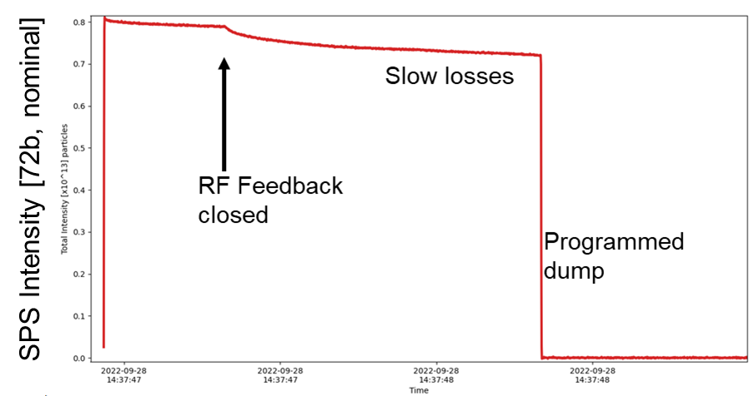
Three Scenario
RF-OFF, instability probe
RF-ON, resonant excitation
RF+FB ON, Slow losses

Slide 3
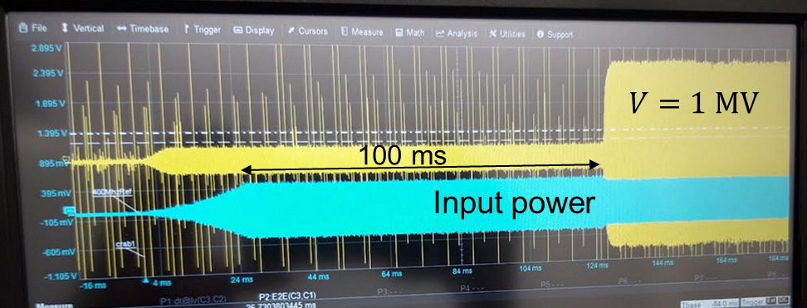
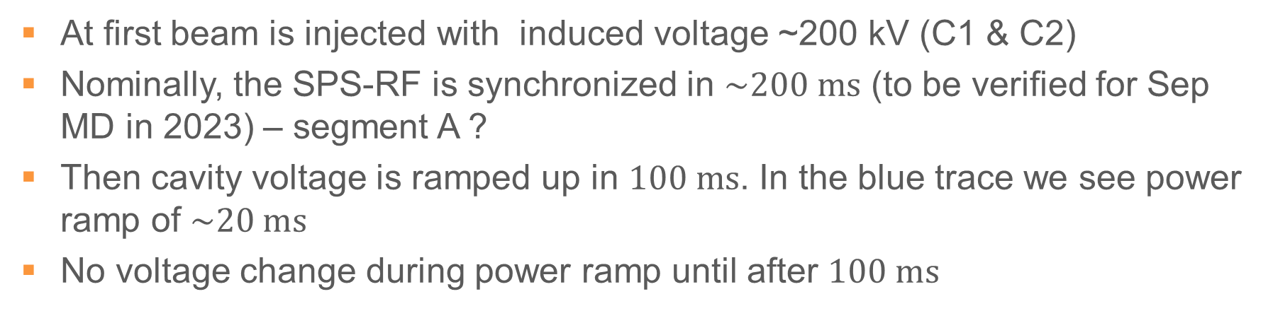
RF ON + Feedback Closure
Input power & cavity voltage
A
B
C
At first beam is injected with induced voltage ~200 kV (C1 & C2)
Nominally, the SPS-RF is synchronized in $\sim 200 ms$ (to be verified for Sep MD in 2023) – segment A ?
Then cavity voltage is ramped up in $100 ms$. In the blue trace we see power ramp of $\sim 20 ms$
No voltage change during power ramp until after $100 ms$

Slide 4
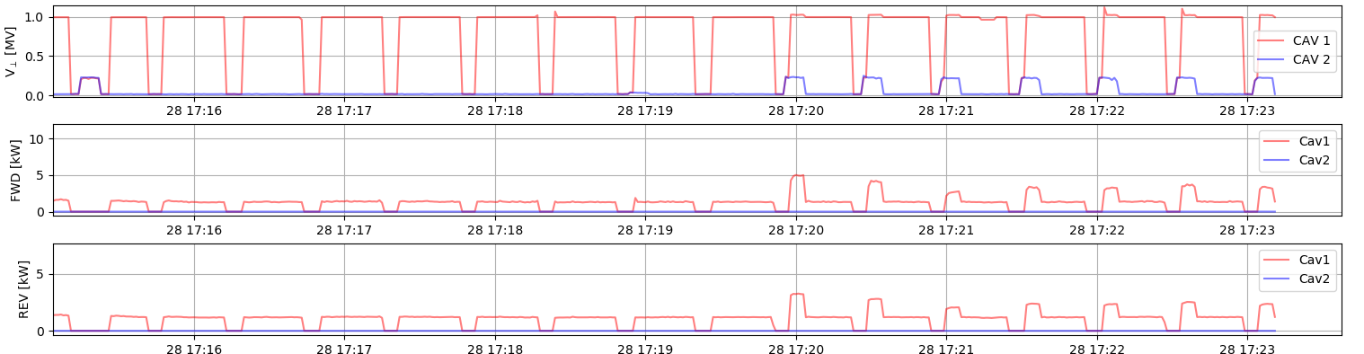
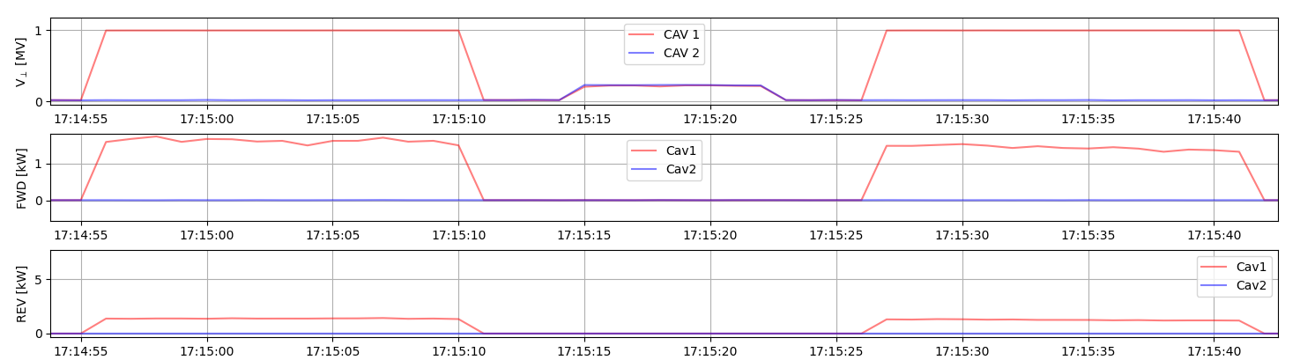
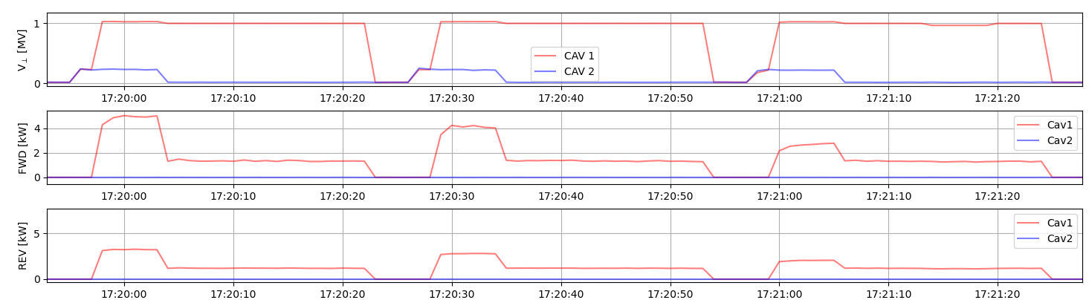

Looking with a different system (1 sec acquisition)
RF OFF (~200 kV C1 & C2)
Beam induced voltage in Cav2
No beam
Power transient
RF OFF (~200 kV C1&C2)
Measured power is $< 1 W$

Slide 5
What to do for MD#1
Identify that re-phasing is complete before RF-ON
Check beam centering in the cavities (orbit bumps)
  RF-ON with no beam for 1 MV cavity setup
  RF-ON with beam centered & not centered (scope measurements)
Measurements with RF-ON+FB with single bunch with increasing bunch intensities to understand the power transient

