Slide 1








ISAB Annual Meeting:
Crowd4SDG
This project has received funding from the European Union’s Horizon 2020 research and innovation programme under grant agreement No 872944

Slide 2
Crowd4SDG Mission
The Crowd4SDG project aims to explore and assess how crowdsourcing can contribute to the tasks of:
tracking progress towards the SDGs
generating grassroots innovation that enable such progress

Slide 3
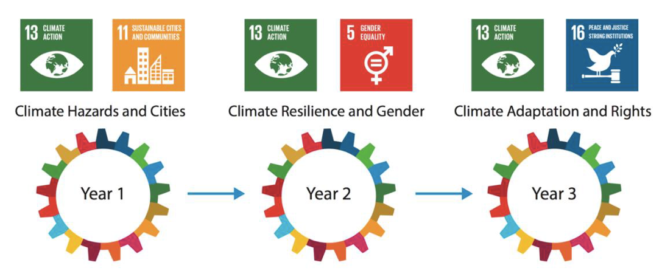
Timeline : 3 GEAR Cycles (2020-23)

Slide 4

Crowd4SDG Methodology: GEAR cycle
GATHER
Selecting with Goodwall
100 applicants, August-September
M1
REFINE
Sharing at Geneva Trialogue
2 teams, 4 days
March
EVALUATE
Coaching with Open 17
12-15 teams, 5 x 2hrs
October-November
M9
M3
M6
ACCELERATE
Prototyping with CBI Workshop
4-5 teams, 10x4hrs, December-February

Slide 5
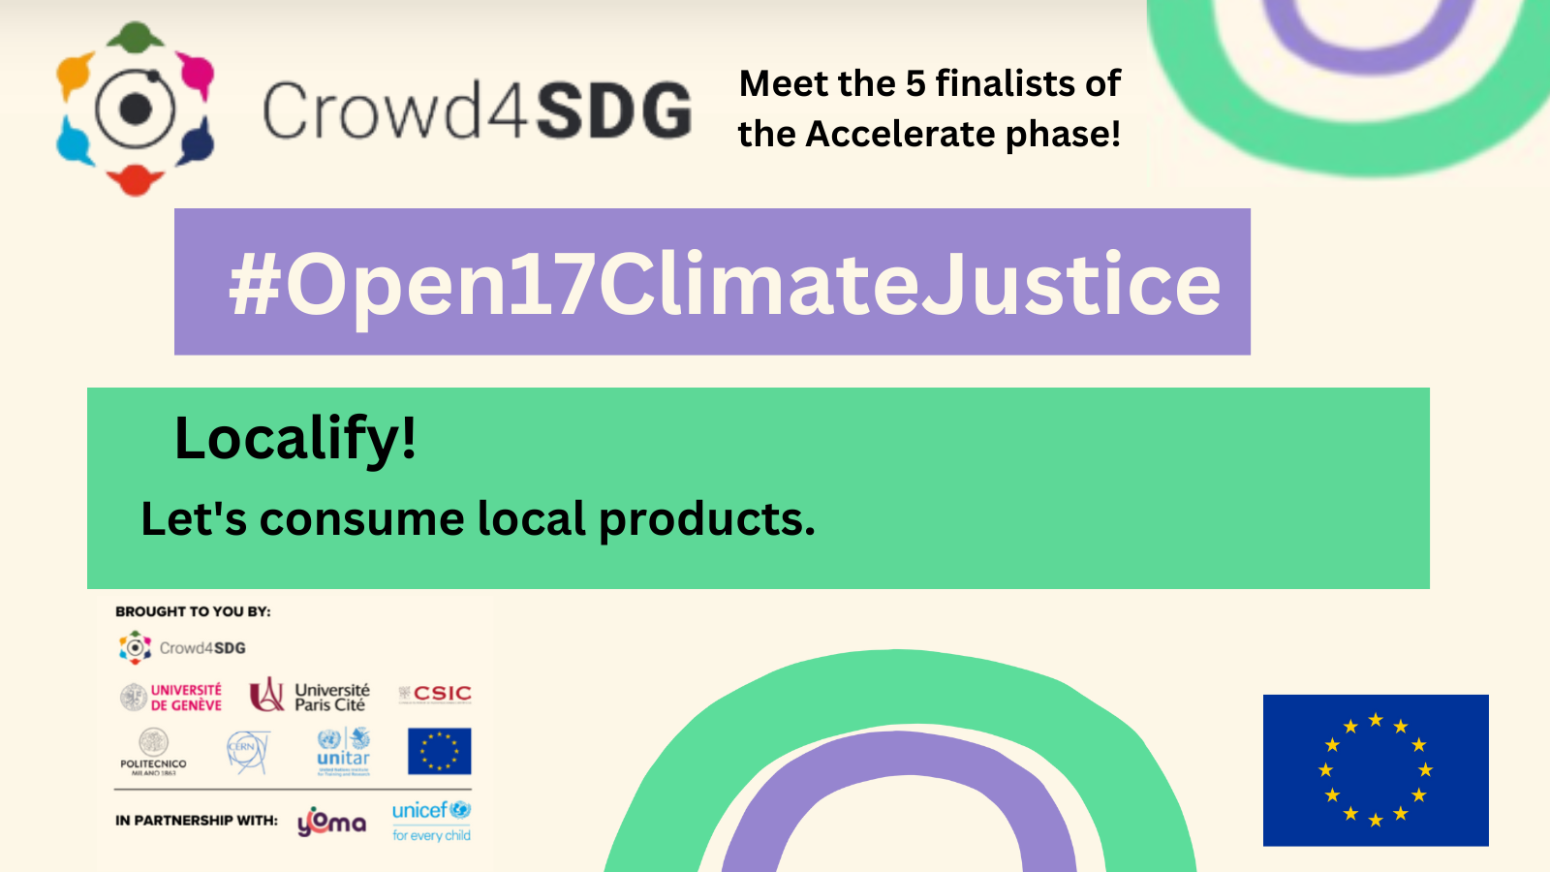
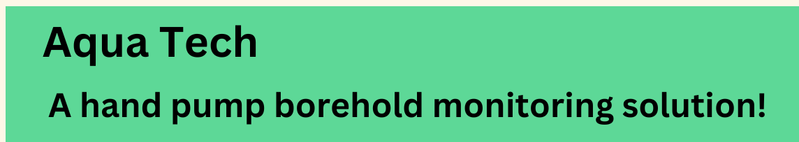
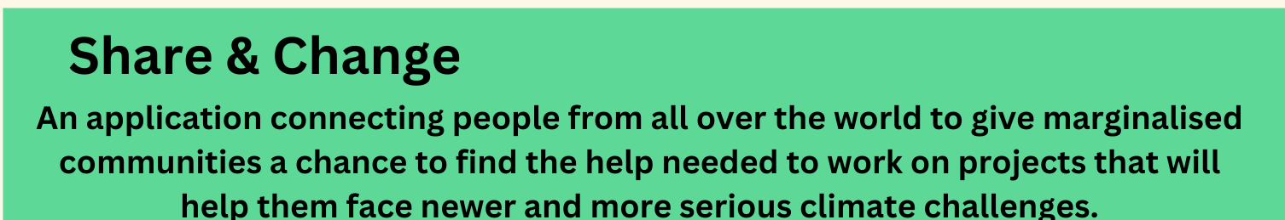
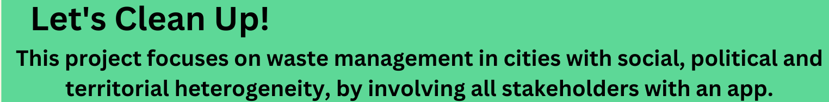
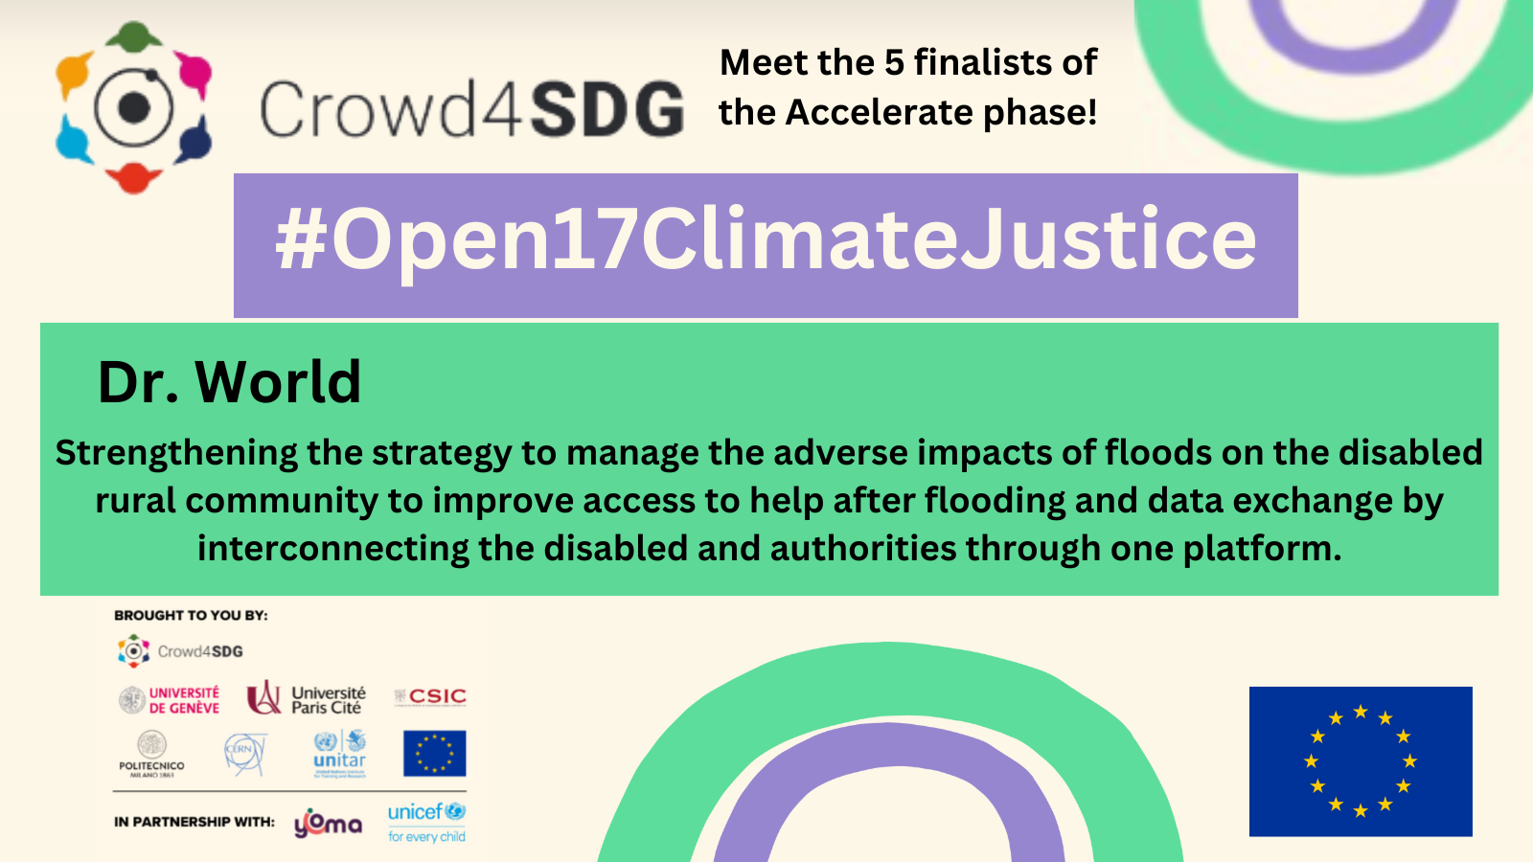
GEAR Cycle 3 finalist teams

Slide 6
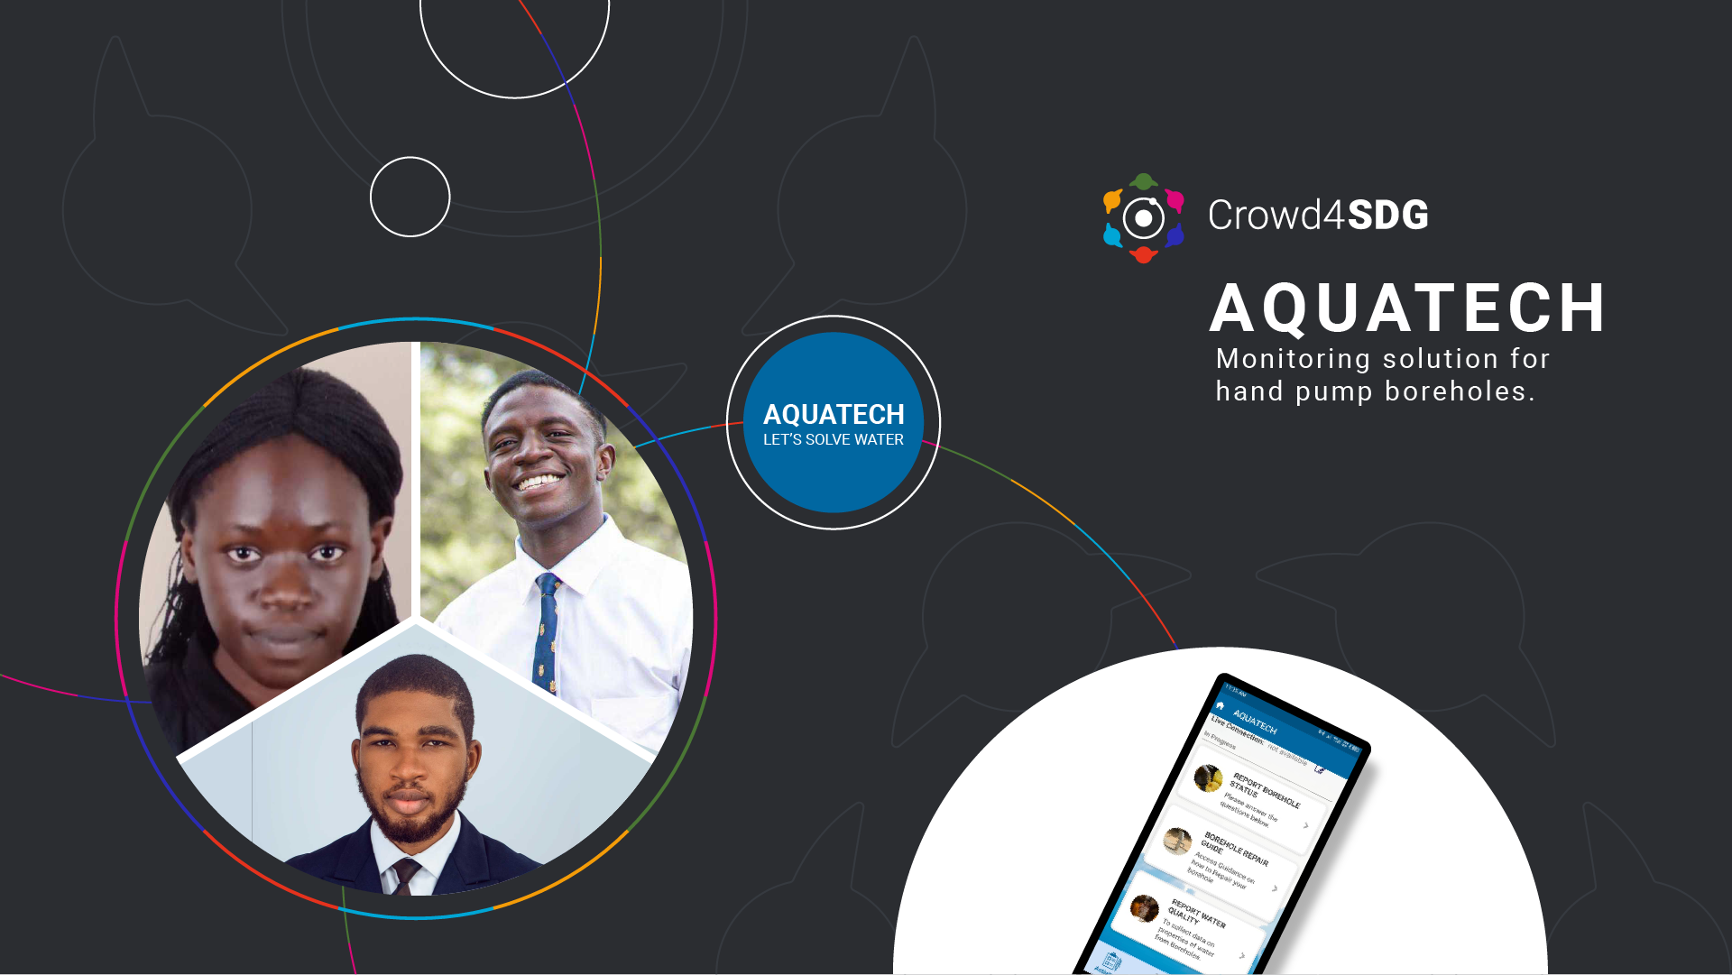
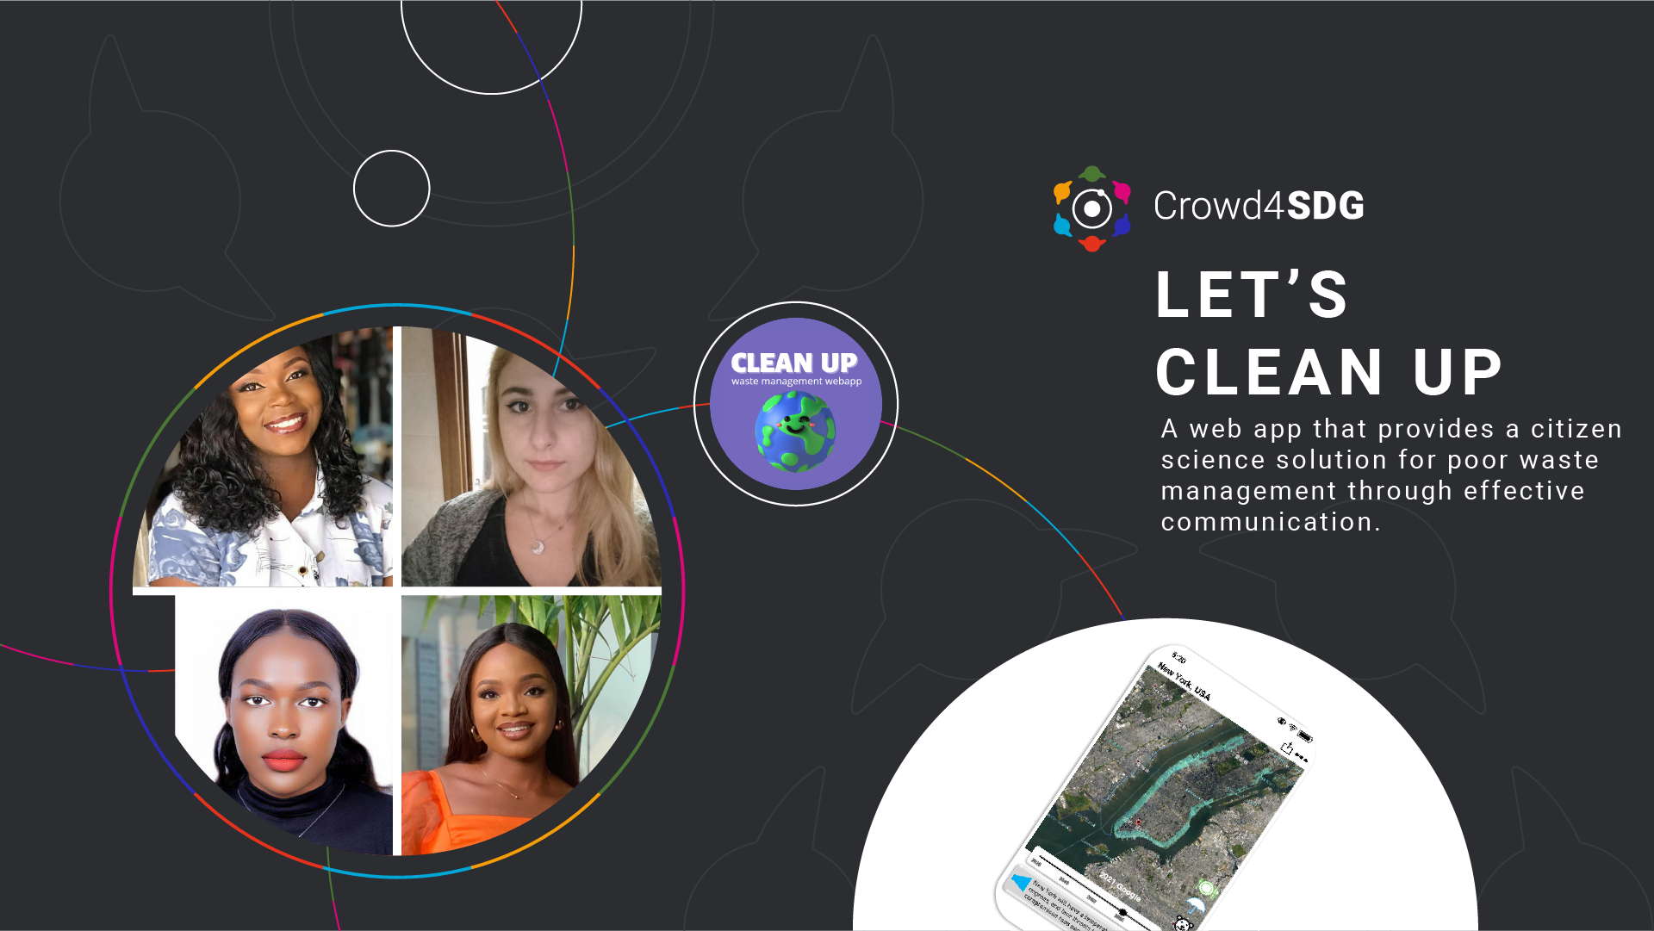
GEAR Cycle 3 finalist teams

Slide 7
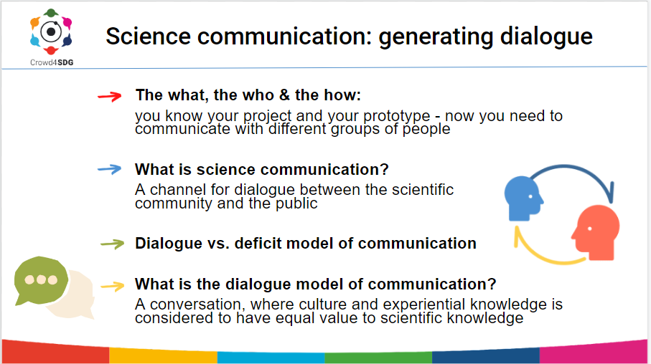

Took place during the Accelerate phase
Introduction into the theory behind science communication
Featured case studies highlighting success with mobilising citizen scientists to collect data
Workshop: engaging and communicating with citizen scientists

Slide 8
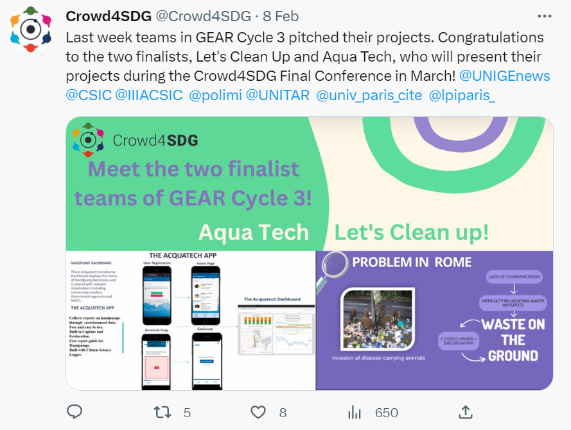
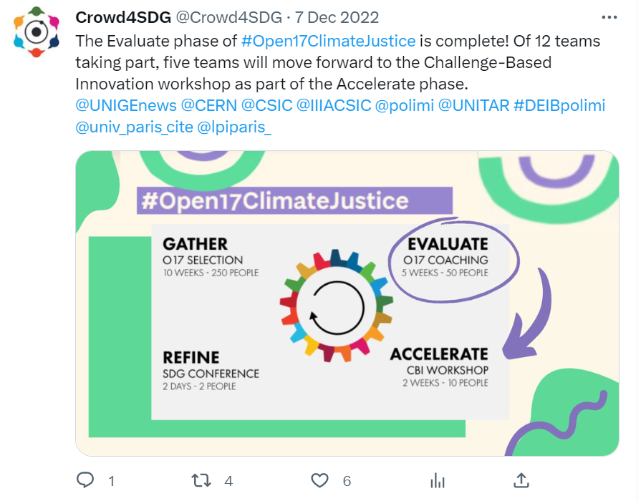
Social media campaign

Slide 9
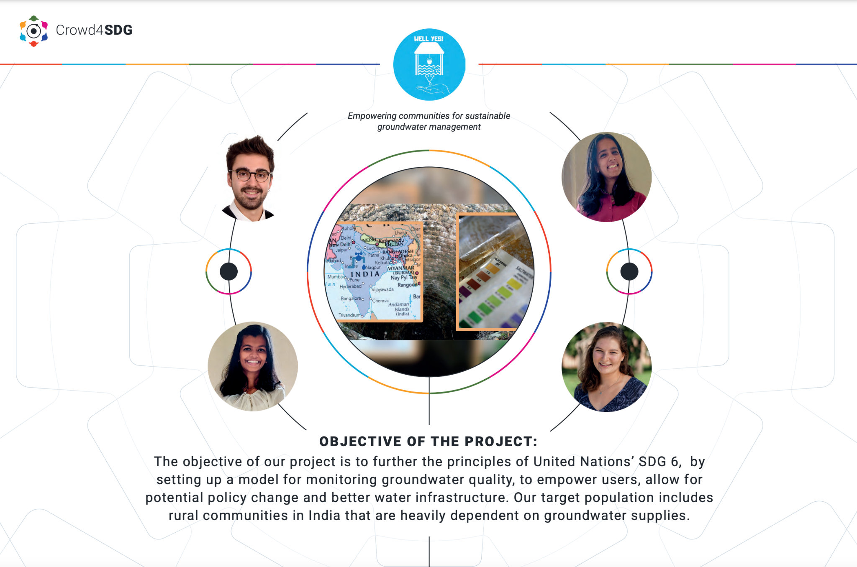
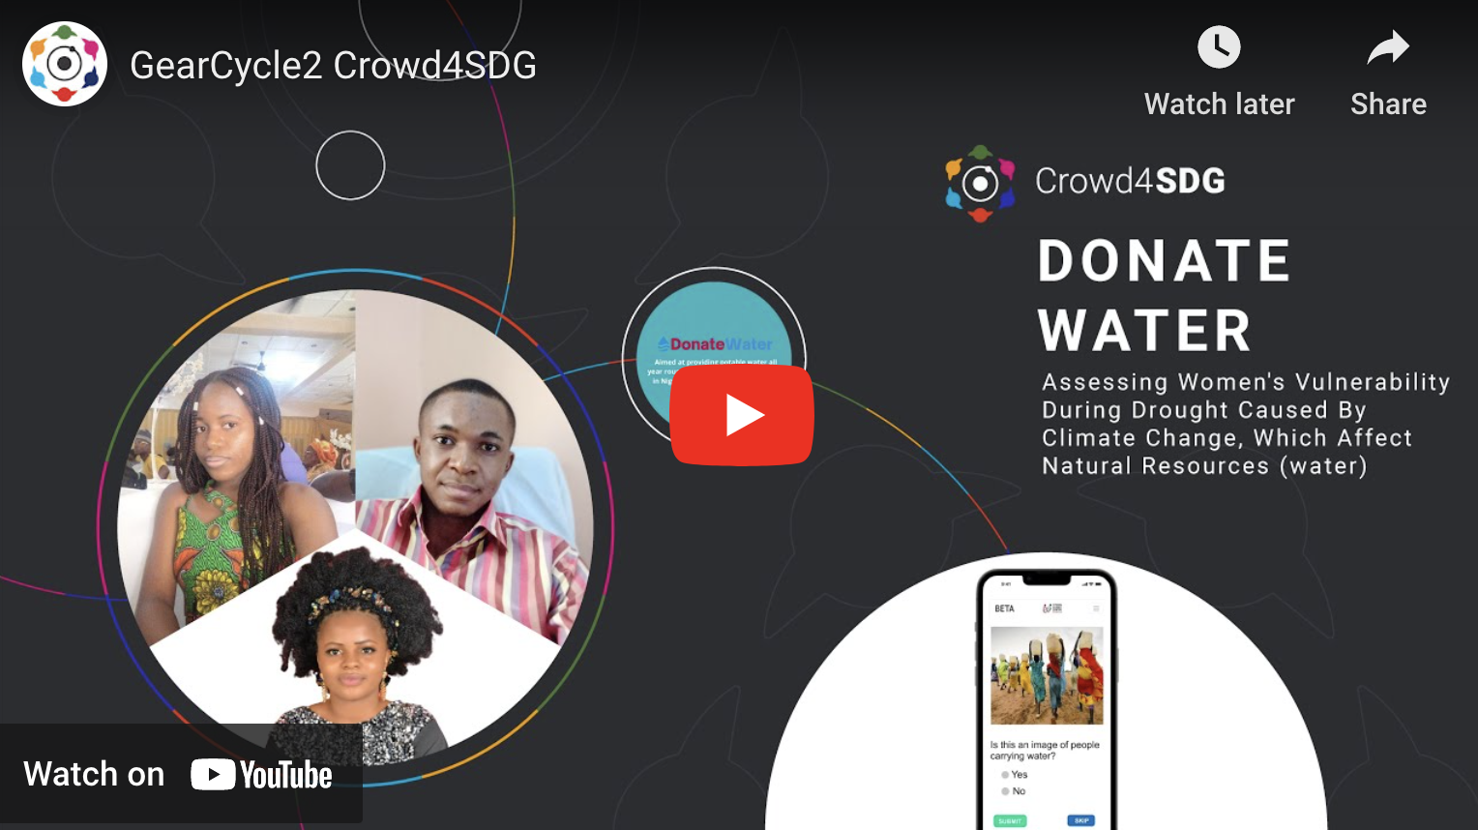
Project Material

Slide 10
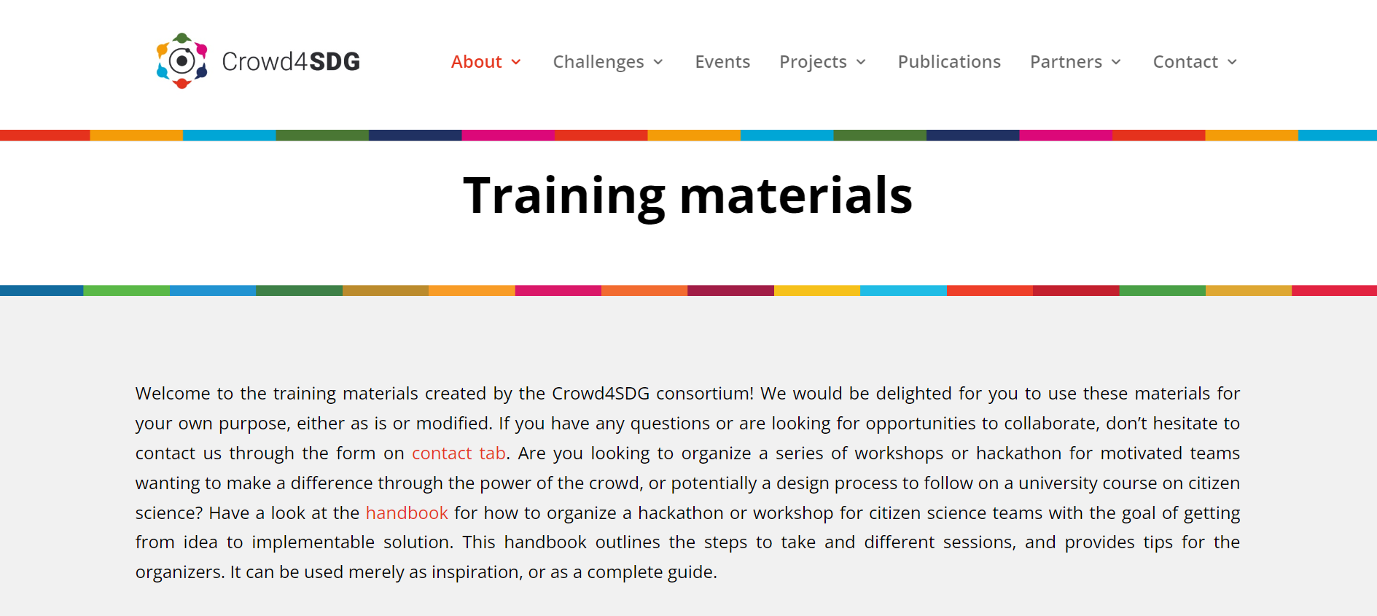
Handbook available on website
Training materials created across all three GEAR Cycles

Slide 11
Crowd4SDG Final Conference
Former teams invited to follow up on their projects:
FloodFinder (GEAR Cycle 1)
WOMER (GEAR Cycle 2)
DonateWater (GEAR Cycle 2)
AquaTech (GEAR Cycle 3)
Let’s Clean Up! (GEAR Cycle 3)

Slide 12

Geneva Trialogue - 16 March
Organised by UNITAR
Held at CERN - Globe and IdeaSquare
Crowd4SDG consortium attendance
Highlighting achievements of Crowd4SDG through presenting projects across all three GEAR Cycles

Slide 13
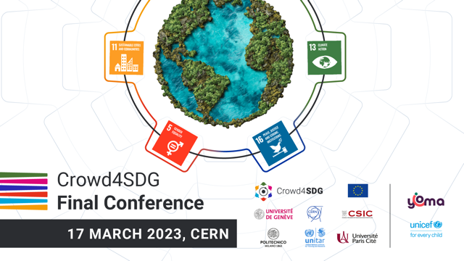
Crowd4SDG Final Conference - 17 March

Slide 14
Crowd4SDG Final Conference programme
9:00 - 12:00 - two Keynotes and two panels moderated by Trine Schmidt, SDG Lab,
Part 01
Welcome François Grey, UNIGE
EU and citizen science Gabriella Leo, Citizen Science Policy Officer, European Commission (online)
Keynote - Citizen science data for tracking progress towards sustainable development Dilek Fraisl, IIASA
Panel discussion: Citizen science for monitoring the SDGs with participation of UNITAR, CSGP AND PoliMi
Coffee Break and poster session with student projects and citizen science tools
Part 02
Keynote - How to mobilise disenfranchised youth for climate action Camilla Haux, RLabs
Panel discussion: Mobilising youth for citizen science and climate action with participation of UNOG, UZH, Goodwall and presentations of former participants of Crow
A message from the European Commission, Katherina Buse, Project Advisor

Slide 15
Crowd4SDG Final Conference agenda: hackathons
14:00 - 19:00 - Hackathons at IdeaSquare
Hackathon 1: How can online public deliberation tackle climate change? The case of transportation in International Geneva.
Hackathon 2: Using crowdsourcing tools and digital currencies to transform public participation in climate resilience research.
Hackathon 3: Leveraging citizen science for data-driven policies on sustainable development.

Slide 16
https://indico.cern.ch/event/1224762/

Slide 17
Crowd4SDG Final Conference - 17 March
By invitation and registration (semi-public)
Presentation and panel discussions at the Globe:
Objective: delivering the results of Crowd4SDG to the key actors and plans for dissemination and follow-up
Hackathons in IdeaSquare:
Objective: involve public and key actors in hands-on experience related to the results of Crowd4SDG for visibility and potential uptake

Slide 18
Gather consent forms, photos of participants and information on projects to create one pagers for each team’s project
Covered the CBI workshops on social media, including thanking the jury members and highlighting each project
One pagers created for each team and published on the Crowd4SDG website and social media channels
Creation of 3 minute video highlighting the two finalist projects - to be published on YouTube and promoted on social media in March
Communication activities for GEAR Cycle 3 Accelerate phase

