Slide 1
CERN IdeaSquare Journal of Experimental Innovation (CIJ)
2022 Status Report
Saku Makinen, Valeria Brancolini

Slide 2
Editorial activity

Slide 3
Editorial workflow

Slide 4
Article Title | Issue | Date Published | Abstract Views | Total Downloads
Resuming research in post-COVID settings | Vol. 6 No. 1 (2022) | 30/06/22 | 119 | 64
Experiencing emotions in design thinking: How positive and negative affects play their part in the innovation process | Vol. 6 No. 1 (2022) | 22/03/22 | 400 | 261
Experimenting with policy design: fostering reshoring in Emilia Romagna region | Vol. 6 No. 1 (2022) | 22/06322 | 315 | 198
The push and pull between innovation and feasibility: reflections on an ideation process during a CERN IdeaSquare Summer School | Vol. 6 No. 1 (2022) | 30/06/22 | 287 | 124
 |  |  | 1121 | 647
Co-creating the future through design-based education in innovation hubs | Vol. 6 No. 2 (2022): Special Issue "Future Innovators: building capabilities to collaborate and innovate in higher education settings" | 21/12/22 | 122 | 74
Looking beyond your own speciality: student and faculty perceptions of collaboration opportunities | Vol. 6 No. 2 (2022): Special Issue "Future Innovators: building capabilities to collaborate and innovate in higher education settings" | 21/12/22 | 70 | 37
Building team research targets and capacity in innovation hubs | Vol. 6 No. 2 (2022): Special Issue "Future Innovators: building capabilities to collaborate and innovate in higher education settings" | 21/12/22 | 135 | 41
Future-ready skills development through Experiential Learning: perceptions from students working in multidisciplinary teams | Vol. 6 No. 2 (2022): Special Issue "Future Innovators: building capabilities to collaborate and innovate in higher education settings" | 21/12/22 | 104 | 71
Understanding engineering students' perceptions of their curiosity, diligence, and perseverance and assessing its impact on their creativity | Vol. 6 No. 2 (2022): Special Issue "Future Innovators: building capabilities to collaborate and innovate in higher education settings" | 21/12/22 | 99 | 45
Design-driven entrepreneurship: a cooking exercise to integrate effectuation and design thinking | Vol. 6 No. 2 (2022): Special Issue "Future Innovators: building capabilities to collaborate and innovate in higher education settings" | 21/12/22 | 114 | 98
Are you an Alien Organization? Dare to take the test! | Vol. 6 No. 2 (2022): Special Issue "Future Innovators: building capabilities to collaborate and innovate in higher education settings" | 21/12/22 | 42 | 22
 |  |  | 686 | 388
Work-related stress in agricultural industry: a preliminary investigation | Articles in press | 26/12/22 | 137 | 28
Comparing differences of trust, collaboration and communication between human-human vs human-bot teams: an experimental study | Articles in press | 22/12/22 | 62 | 19
Investigation on the future of work: the impact of innovative strategies in a post pandemic scenario | Articles in press | 14/11/22 | 82 | 43
 |  |  | 281 | 90
2022 articles

Slide 5
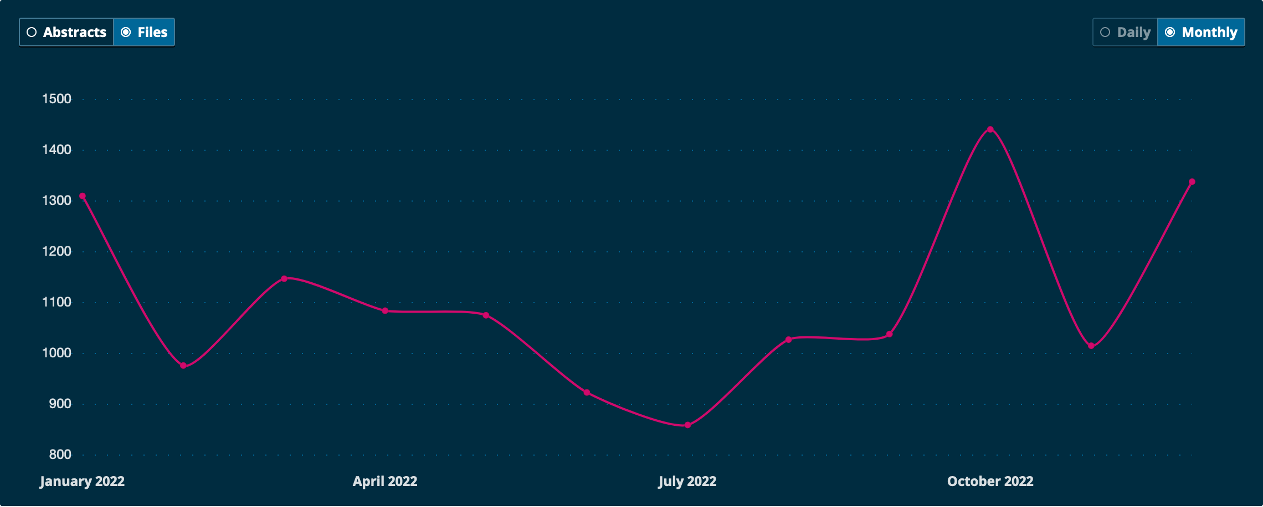
Articles’ downloads/month in 2022 (all articles)

Slide 6
Articles’ downloads/month over the years (all articles)

Slide 7
10 MOST DOWNLOADED ARTICLES OF ALL TIMES
ID | Article Title | Issue | Date Published | Abstract Views | Total PDF Downloads
799 | Designing and building a 3D printed low cost modular Raman spectrometer | Vol. 2 No. 2 (2018) | 21/12/18 | 1501 | 5153
1054 | Cultural tourism development and the impact on local communities: a case study from the South of Italy | Vol. 4 No. 2 (2020) | 28/12/20 | 763 | 3698
746 | Smart work centers as “creative workspaces” for remote employees | Vol. 2 No. 1 (2018): Special issue: "Designing creative spaces to support Experimental Innovation" | 02/07/18 | 1973 | 1798
544 | Organizational experiments and the change of meaning | Vol. 1 No. 2 (2017): Special Issue: "Experiments in an organizational context" | 22/12/17 | 786 | 1666
920 | Closing the gap: reinventing organizations for innovation and the disruptors who drive it | Vol. 3 No. 2 (2019) | 24/12/19 | 1584 | 1437
459 | Experimentation and innovation: purpose, possibilities and preferred solutions | Vol. 1 No. 1 (2017): Special Issue: "Experimenting in Innovation" | 30/06/17 | 754 | 1122
1287 | Can challenge-based learning be effective online? A case study using experiential learning theory | Vol. 5 No. 1 (2021): Special issue: "Experimenting with Challenge-Based Innovation" | 30/06/21 | 1325 | 904
873 | Customized servitization as an innovative approach for renting service in the fashion industry | Vol. 3 No. 1 (2019) | 01/01/70 | 766 | 767
882 | Improving plastic management by means of people awareness | Vol. 3 No. 1 (2019) | 01/01/70 | 1033 | 763
997 | Designing services for employees' wellbeing: principles for an improved employee experience | Vol. 5 No. 2 (2021) | 21/12/21 | 1032 | 721

Slide 8
10 MOST CITED ARTICLES OF ALL TIMES
 |  |  | <2017 | 2017 | 2018 | 2019 | 2020 | 2021 | 2022 | 2023 | total
Document Title | Volume | Issue | 0 | 4 | 6 | 12 | 20 | 38 | 34 | 8 | 122
Applying physical science techniques and CERN technology to an unsolved problem in radiation treatment for cancer: The multidisciplinary ‘VoxTox’ research programme | 1 | 1 | 0 | 1 | 2 | 3 | 2 | 3 | 4 | 1 | 16
Smart work centers as ⇜creative workspaces⇝ for remote employees | 2 | 1 | 0 | 0 | 0 | 0 | 2 | 2 | 4 | 1 | 9
The implications of entrepreneurship education on the careers of PhDs: Evidence from the challenge-based learning approach | 5 | 1 | 0 | 0 | 0 | 0 | 0 | 1 | 4 | 0 | 5
How does organizational space help organizations cope with the challenges of ambidexterity and continue to innovate? A space reorganization experiment in a transitioning organization | 2 | 1 | 0 | 0 | 0 | 2 | 2 | 1 | 0 | 0 | 5
Co-creating an idea lab: Lessons learned from a longitudinal case study | 2 | 1 | 0 | 0 | 0 | 2 | 3 | 0 | 0 | 0 | 5
Can challenge-based learning be effective online? A case study using experiential learning theory | 5 | 1 | 0 | 0 | 0 | 0 | 0 | 2 | 2 | 0 | 4
The 3 T's framework of social innovation labs | 3 | 1 | 0 | 0 | 0 | 0 | 1 | 0 | 2 | 1 | 4
Designing and building a 3D printed low cost modular Raman spectrometer | 2 | 2 | 0 | 0 | 0 | 0 | 0 | 1 | 2 | 1 | 4
How experiments in the fuzzy front end using prototyping generates new options | 1 | 1 | 0 | 1 | 0 | 1 | 0 | 2 | 0 | 0 | 4
Open hardware as an experimental innovation platform: Preliminary research questions and findings | 1 | 1 | 0 | 1 | 1 | 1 | 1 | 0 | 0 | 0 | 4
Notes:
Data from Scopus

Slide 9
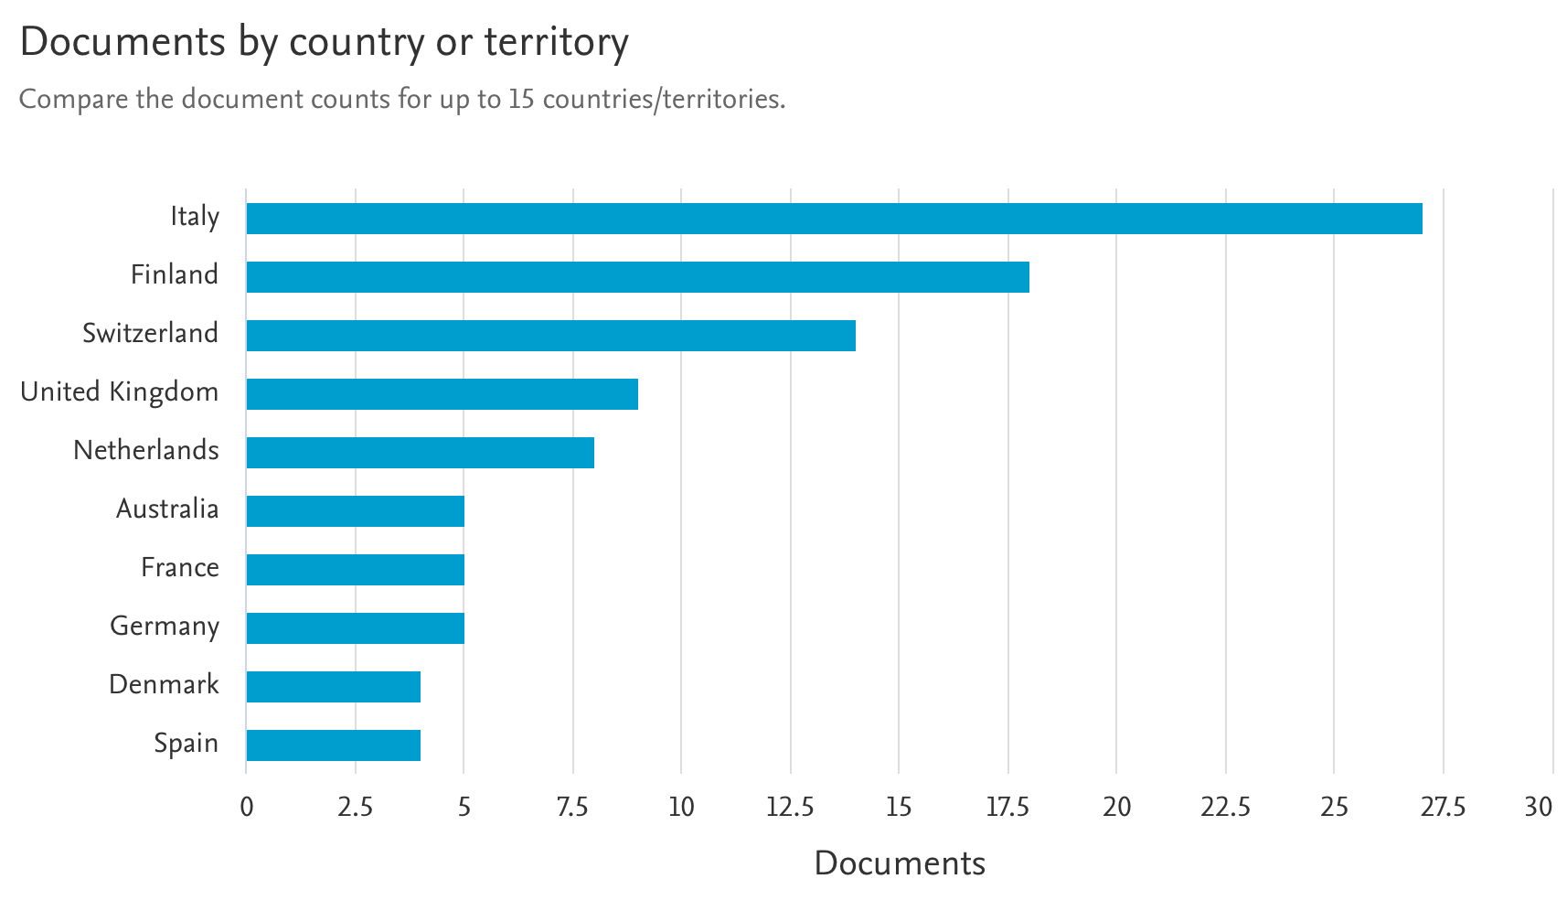
Notes:
Data from Scopus

Slide 10
Promotion through IdeaSquare social media outlets

Slide 11
Indexing
CIJ is indexed in DOAJ since 2019
CIJ is indexed in Scopus since 2019
WoS rejected our application in August 2019:
’The journal did not meet the following requirements at the EDITORIAL TRIAGE step:
Publication Volume: The volume of scholarly articles published annually is expected to be within ranges appropriate to the subject area (at least 20 articles per year)’

Slide 12

Strategic actions
Increase the number of papers published
  Publish papers from the ATTRACT projects
  Reach out to all communities involved in CERN IdeaSquare innovation projects (designers, economists, engineers/managers), through the appointment of 2 co-editors in the relevant fields
  Set up new special issues

Slide 13
News: Changes in the Editorial Board
Co-editors: Matteo Vignoli and Jonathan Wareham
New Senior Editors: Dilek Cetindamar and Katharina Holzle
New Associate Editors: Christine Thong and Clio Dosi

Slide 14
News: Other changes
New Aims and Scope and CIJ Manifesto
Three issues starting in 2023
New sections launched in 2023: Methodological Note and Data

Slide 15

Our Manifesto
[BOLD]
Outlet for unconventional, early-stage, thought- provoking experimental research. New innovation methodologies, tools, educational approaches and experiments to push the boundaries of creativity to drive societal innovation.
[INTEGRATIVE]
Multi-disciplinary journal, orchestrated by business, design and engineering teams and guided by the principles of open science and open innovation.
Photo by Hunter Harritt on Unsplash

Slide 16

Our Manifesto
[OPEN]
Open access to its content on the principle that making research freely available to the public supports a greater global exchange of knowledge.
[CONNECTING]
Interested in empirical investigations and in understanding the impact that knowledge can produce within science and society. Taking in learnings from real experiences to inform future researchers and practitioners alike.
Photo by Clint Adair on Unsplash

Slide 17

Our Manifesto
[EXPERIMENTAL]
Authors are invited to take different angles to their research, presenting solutions, innovations, design models and methods involving individuals, team or organizational experiences.
[USEFUL]
CIJ encourages replication studies and remains as a resource center for researchers and scientists that wish to further develop previously collected data and learnings. At CIJ, authors are urged to consider the applicability and relevance of their outputs for future research.
Photo by Susan Wilkinson on Unsplash

Slide 18

Our Manifesto
[MISFIT]
CIJ is a place where high-risk high-gain research is welcome and encouraged. Research that doesn't fit in any existing discipline either because they are between—or simply beyond—disciplines. Everything that challenges the status quo and could inspire future generations in the true spirit of scientific curiosity.
Photo by 愚木混株 cdd20 on Unsplash

Slide 19
What are we looking for?
Taking in the scientific spirit of CERN, CIJ is focused on experimental approaches to innovation and education.
Beyond commonly used methods such as surveys, questionnaires and case studies.
Applicable and relevant studies that are able to take into consideration complex and interactive networks.
“Experiment” as an overarching technique that allows the researcher or innovator to challenge or validate a certain hypothesis.
Range from laboratory to field to natural experiments and the studies might employ quantitative and/or qualitative methods.

Slide 20
Our scope
original research articles including conceptual/theoretical, empirical and experimental articles;
preliminary results of innovation experiments;
case-study of innovation experiments;
coffee papers;
replication studies;
data sources.

Slide 21
New sections launched in 2023
Methodological Notes
  Short article: no more than 3 authors, 1000 words long, no abstract, no IMRAD structure,1 table or figure, max 15 references.
  It should describe the less known methods replying to the questions: 1) What is it about? 2) What is it good for? 3) How to use it? and contain a good reference list to show how the method was applied in the past.
  Ideally 1/issue.
Data
  Articles (format yet to be defined) describing experimental data with the possibility to deposit/publish the actual data on a public repository (for example Zenodo)

Slide 22
2023 Pipeline
Apr. 2023
Special Issue on ‘Using Science for greater Good’
Aug. 2023
Normal Issue
Dec. 2023
Special Issue on post-COVID and how the pandemic influence experimental education (leveraging on the Attract academy work)

