Slide 1
Verry brief utrecht update

Slide 2
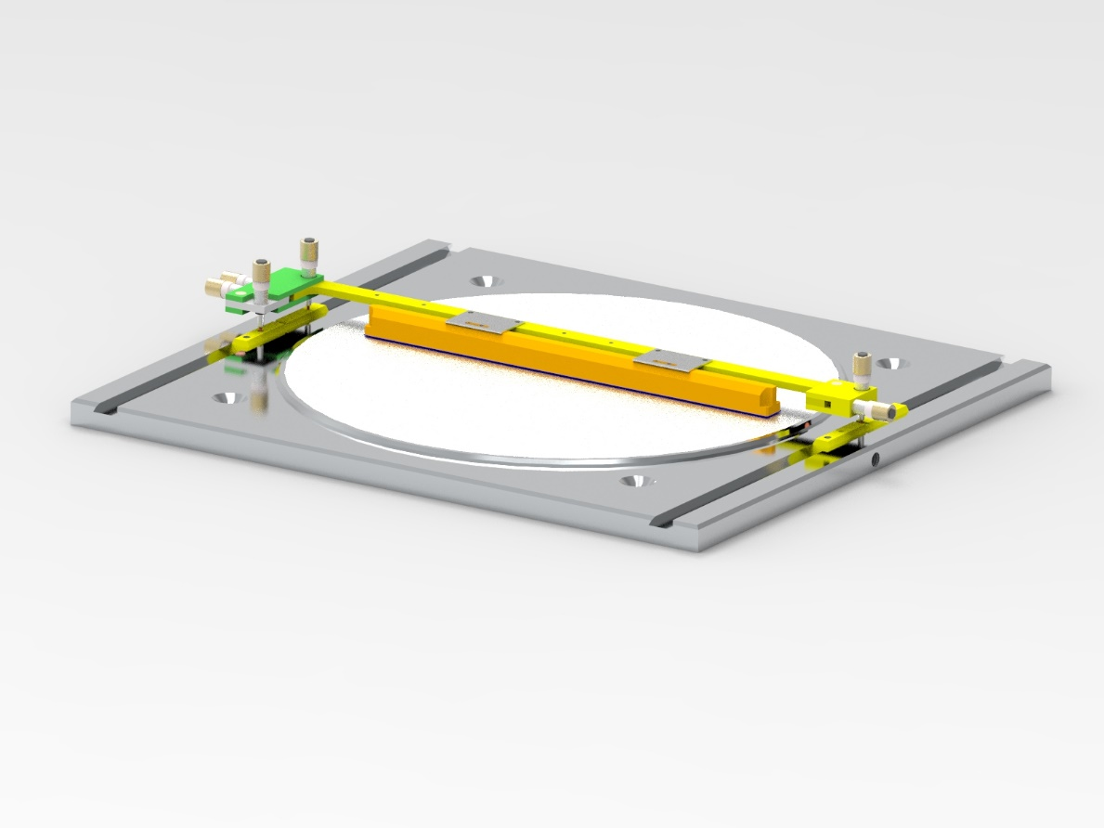
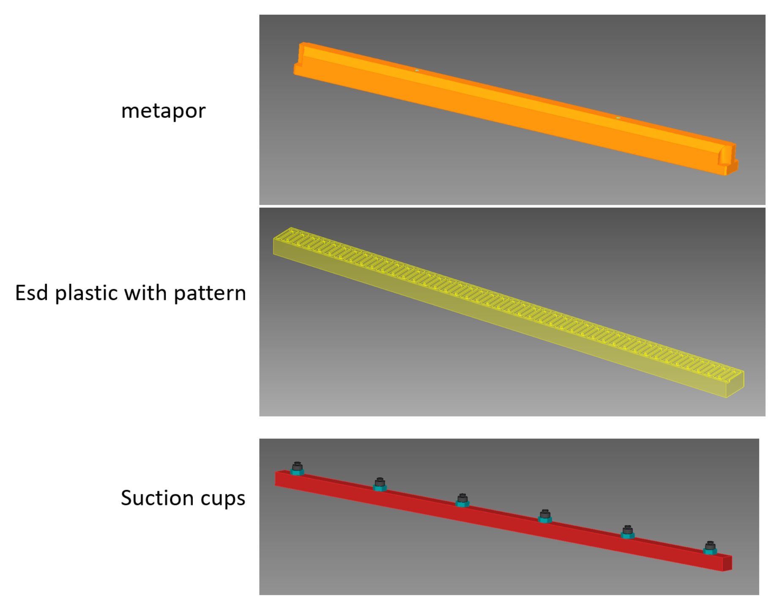
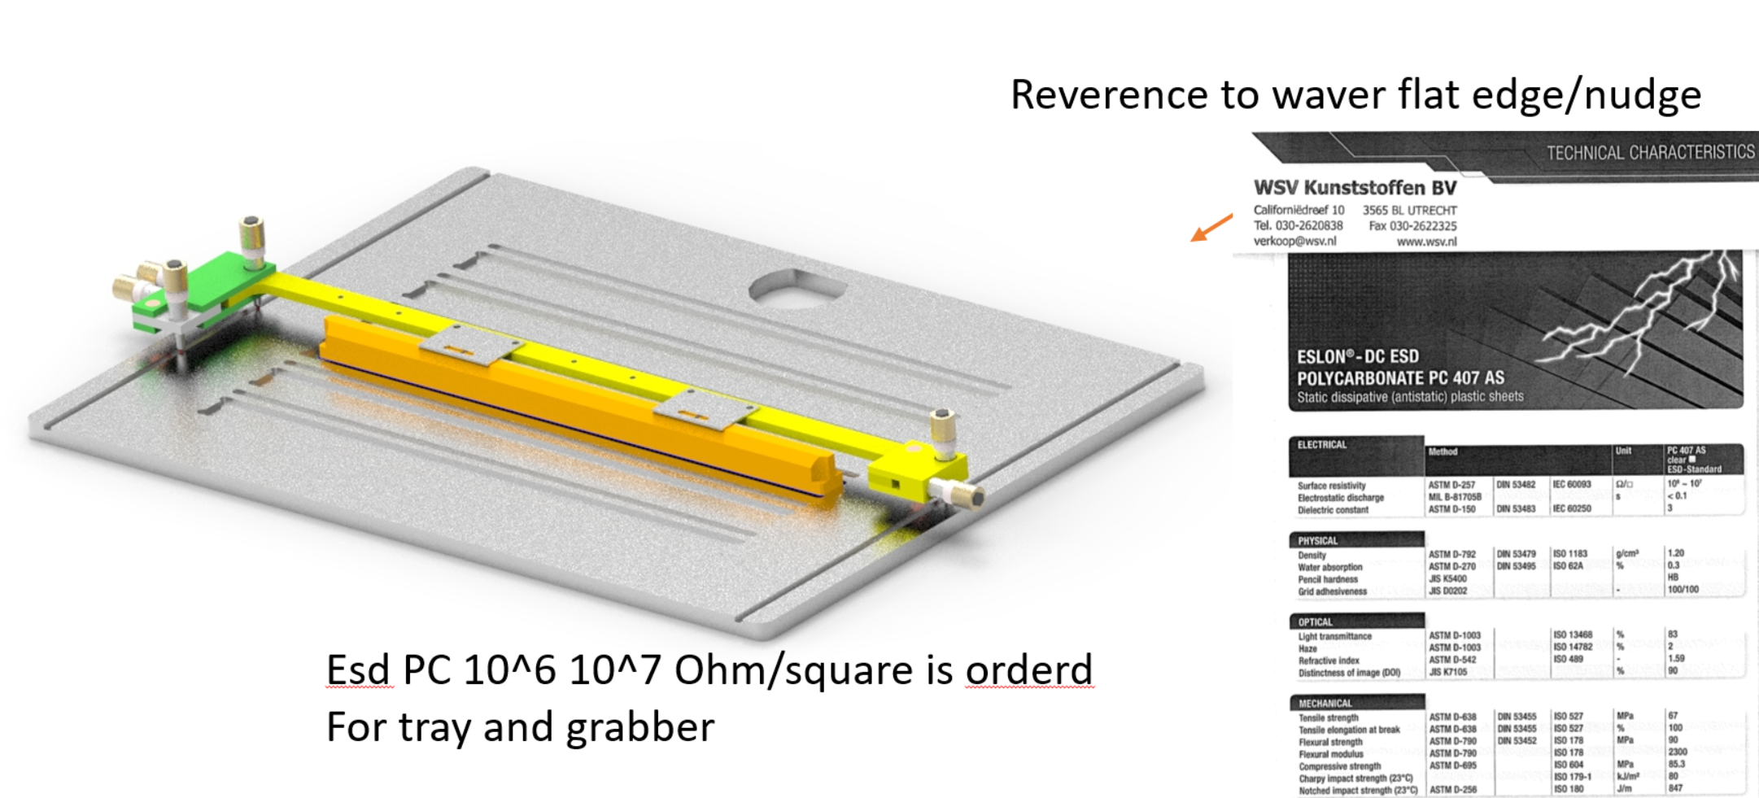
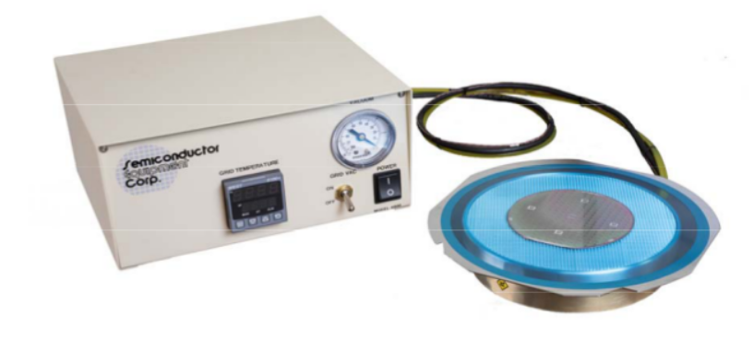
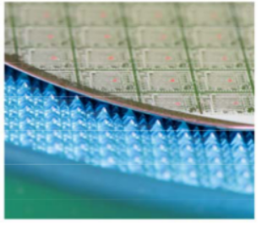
In principle wp2/3 MOST handling tools. Some developments might be useful for Big Chip handling
From utrecht metaphor grabbing table and 6dof positing/lifting tool + a couple vacuum holders
storage
@CERN “pin” table

Slide 3
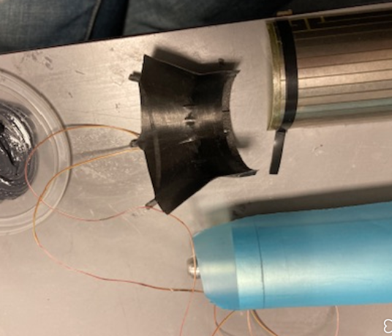
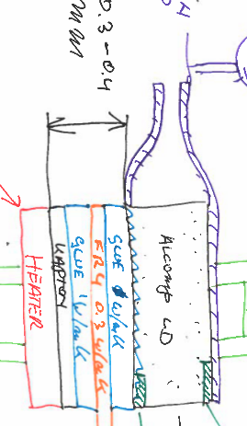
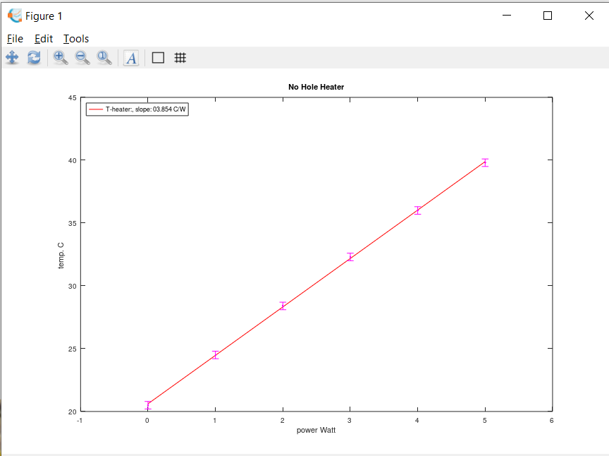
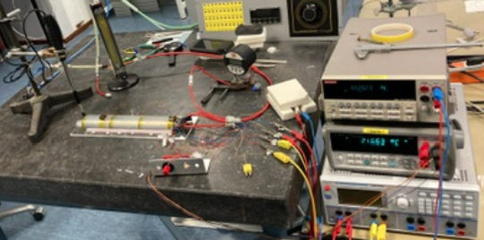
Judith finished her thesis (success!)
Summary: No Hole Foam cooling 4 °C/W
@ aprox 4m/s on matrix
Note heater to foam gluing went a bit bad so is about 0.4mm glue/fr4 e.t.c. expect room for improvement see next slide

Slide 4
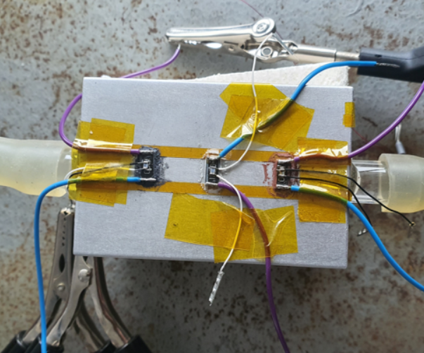
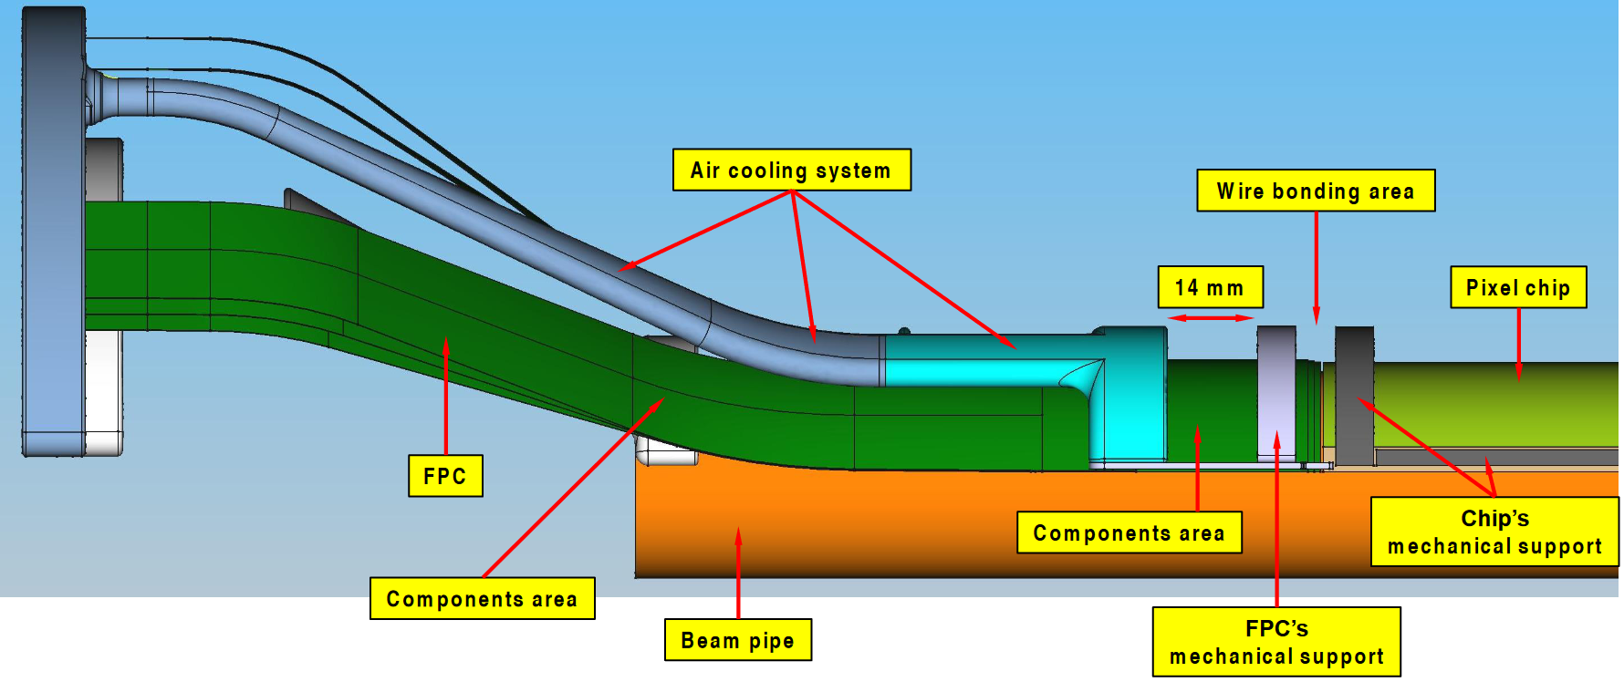
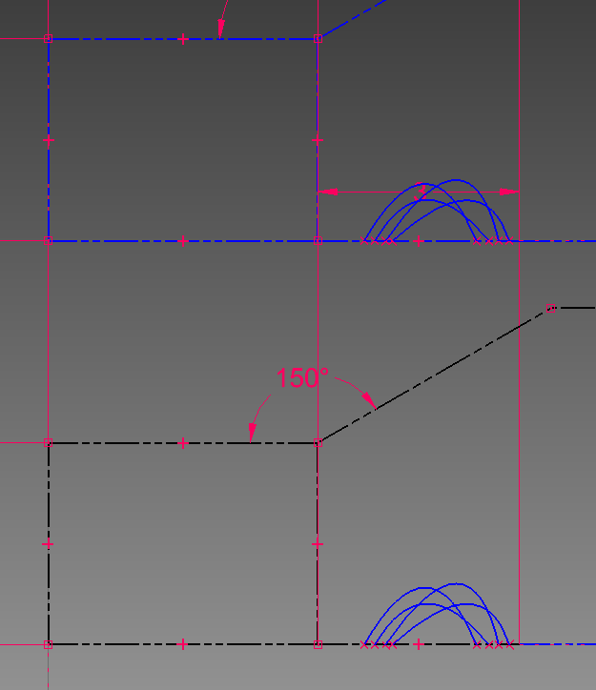
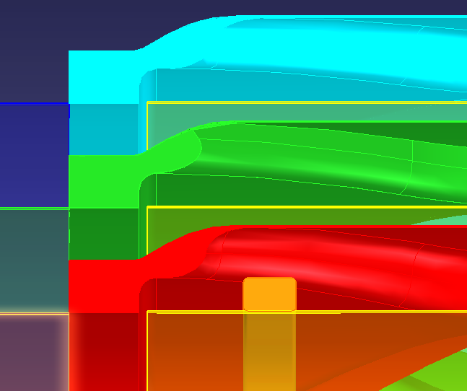
New student just started. Aim to build L0-L1-L2 No-Hole cooling
Testing glue (so far nothing above 1w/mK) orderered some more hope to start
Soon on small test with carbon foam then move to L0
Aim to add space according to latest bonding design (need to stretch a bit in z to keep printing time reasonable)

Slide 5
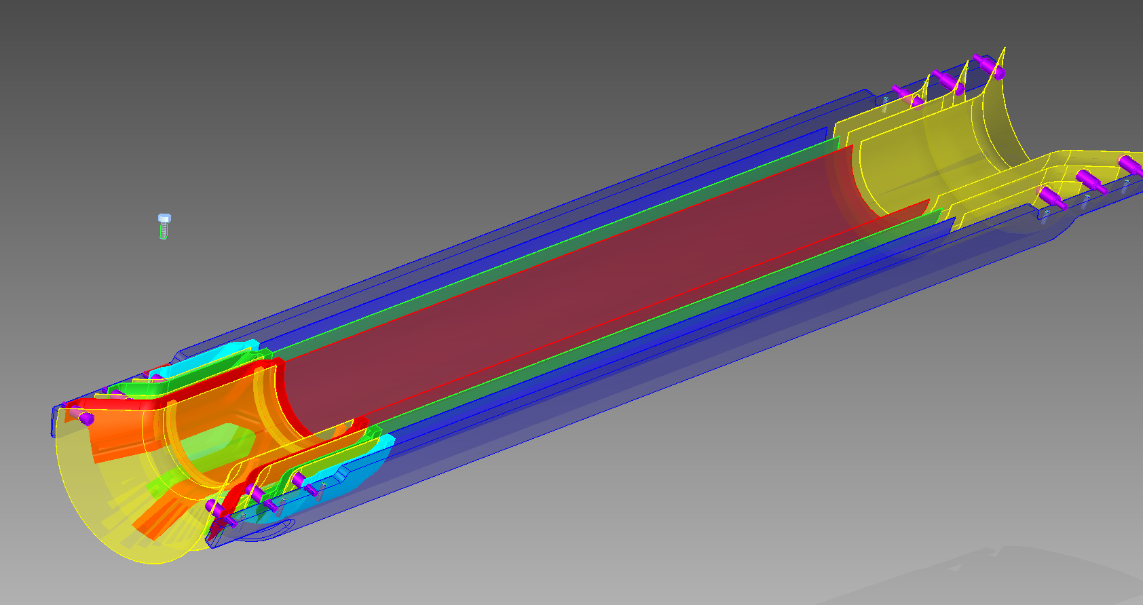
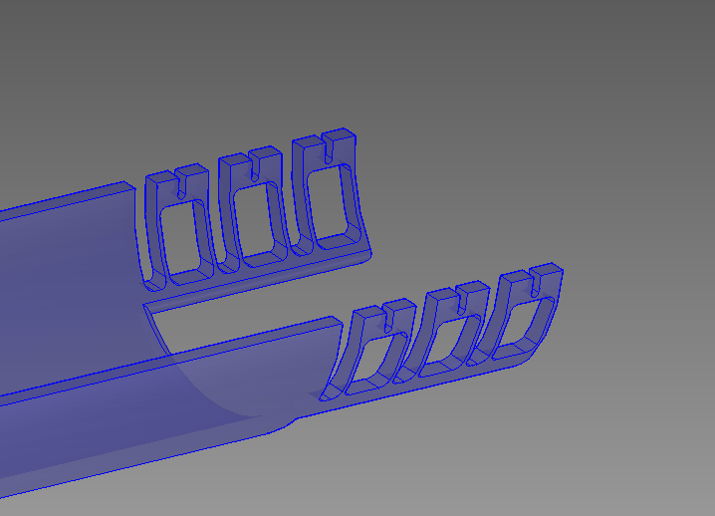
For ease of access to temperature sensors we need separate layers wil ad proposal for
Mounting and fixing constrains leaving some room for thermal expansions

