Slide 1



Self-supported ITS 3 modules with bent thin sensors and cold gas cooling
G. Feofilov , V. Zherebchevsky, S. Igolkin, N. Maltsev
Saint-Petersburg State University
Reported by G.Feofilov
ITS3 Upgrade WP5 (Mechanics and Cooling) meeting 14.02.2023
https://indico.cern.ch/event/1253461/

Slide 2

Layout
Introduction
Conceptual design, Assembly procedure
Ultraligthweight self-supported mechanics
Prototyping
First tests of self-supported
module with bent thin sensor for ITS 3
Low-speed gas cooling of large area thin pixel sensors
Conclusion

Slide 3
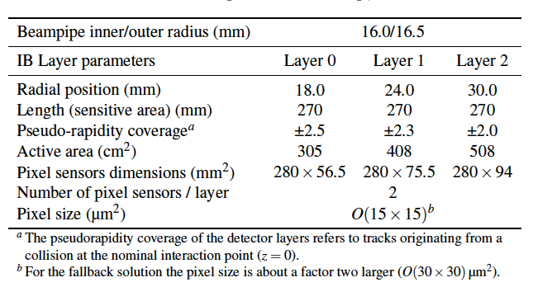
Geometrical parameters of the ITS-3[1]
Power: 20 mW/cm2 in active area
and >140 mW/cm2 in peryphery side
Challenges: extremely low material budget,
thermo-mechanical stability,
Possible Assembly/dissasembly procedure
[1] ALICE-PUBLIC-2018-013

Slide 4
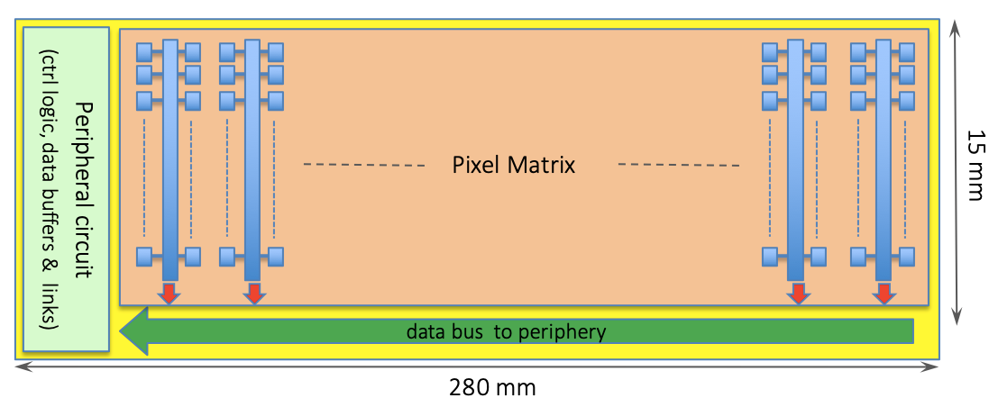
ITS-3 pixel sensor
power density below 140mWcm⁻²
power density below 20mWcm⁻²
Diagram of stitched sensor in one direction (horizontal and vertical dimensions not to scale). Stitching in the vertical direction is also possible.[1]
[1] ALICE-PUBLIC-2018-013
We consider the underpressure liquid cooling as the feasible solution for power density 140mWcm⁻²
Low-speed cold gas is proposed to cool large are thin pixel sensors in order to minimize vibrations

Slide 5
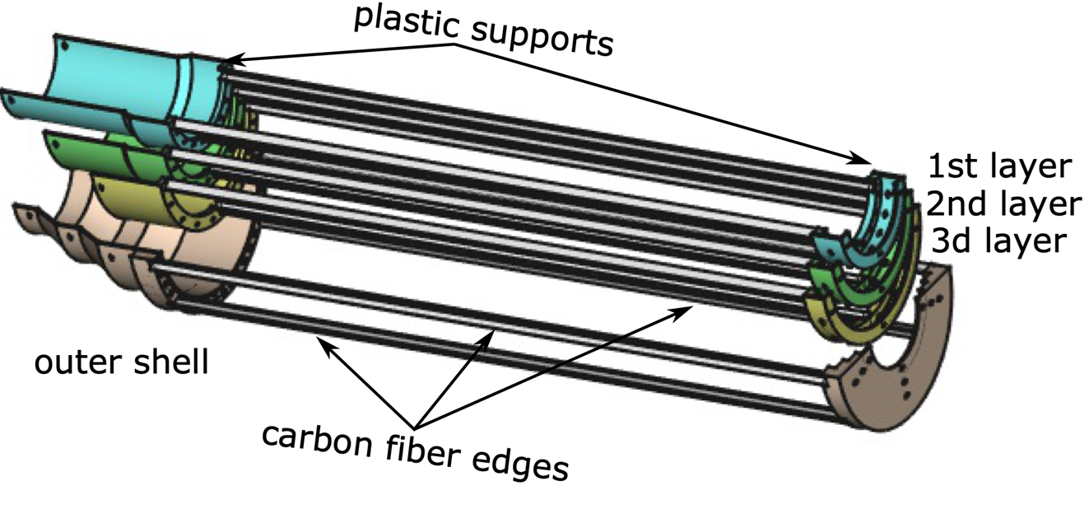
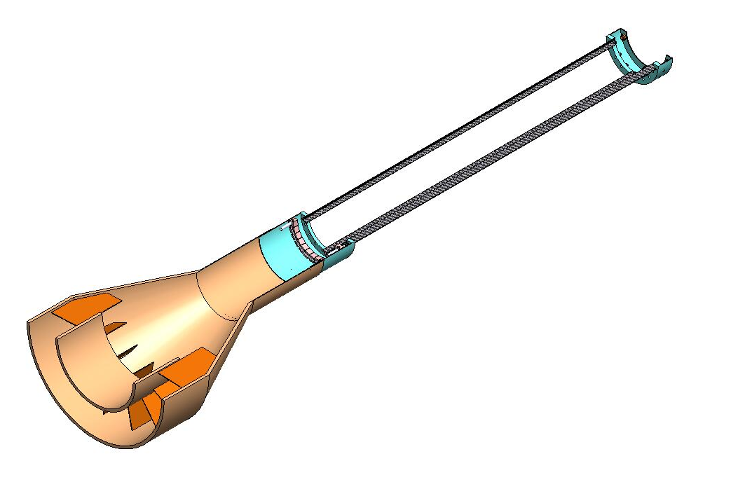
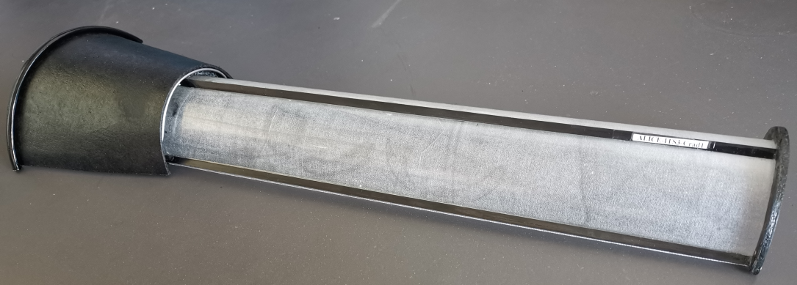
Conceptual design
We proceed from the 1st conceptual design, May 2022, presenetd at ITS3-WP (https://indico.cern.ch/event/1158834/ ) to self-supported independent CF modules for bent Si-sensors, including all services: FPCs and cooling ducts for water and cold gas supply.

Slide 6
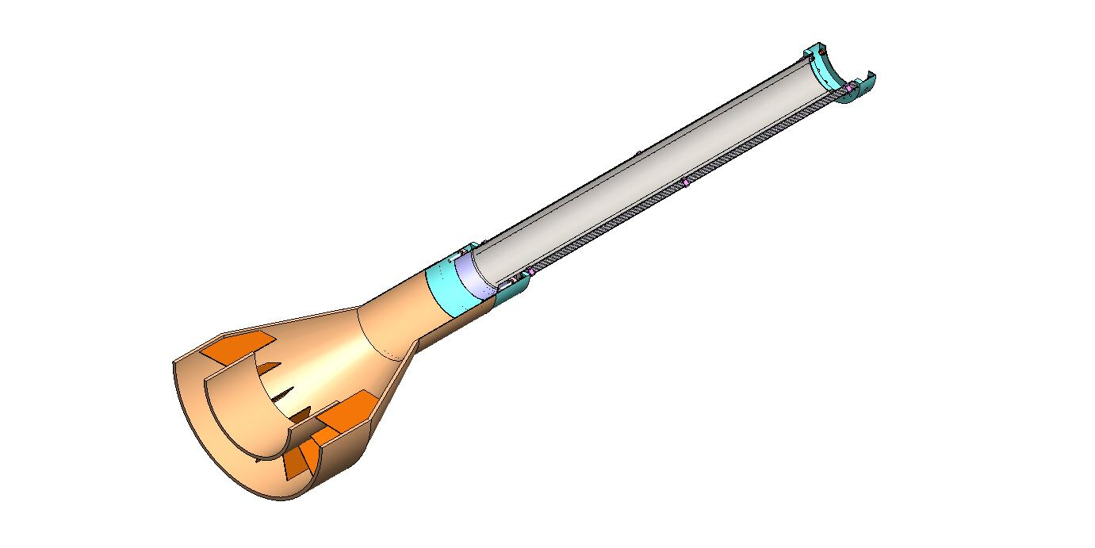
Conceptual design
Bent Si-sensor inside the CF supporting cradle
CF half-ring
CF composite longerons
Miniature water cooling system
CF composite +ROHACELL foam service half-cone
with FPCs and cooling ducts
(water and cold gas supply)

Slide 7
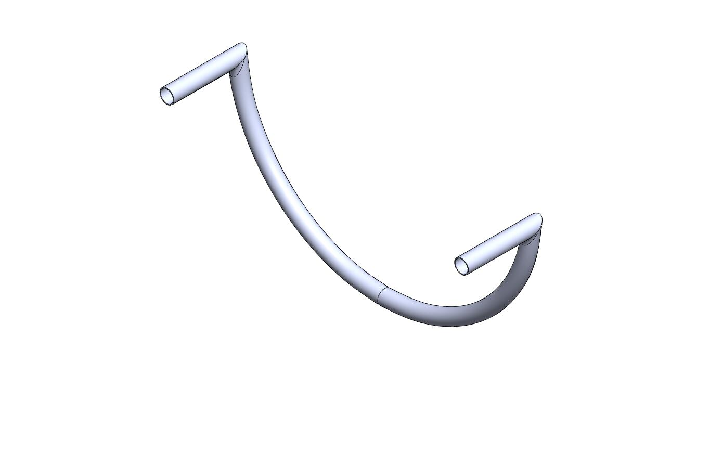
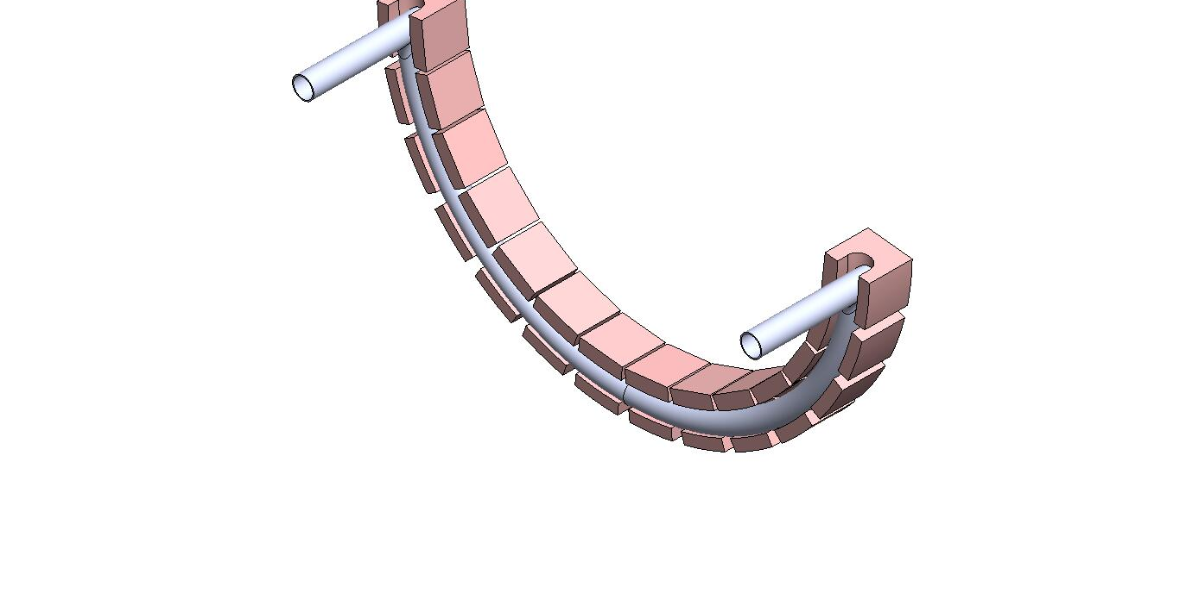
Miniature water cooling system of the digital periphery region of bent sensor:
1 mm diam. pipe placed inside Pyrolytic Graphite blocks
All services: FPCs and cooling ducts (water and cold gas supply tubes) are located and fixed at the inner surface of the service cone
The bonding (connection) of the FPCs signal lines to the bent Si-sensor readout electronic pads is performed after sensor positioning inside the CF support cradle (not shown here).

Slide 8
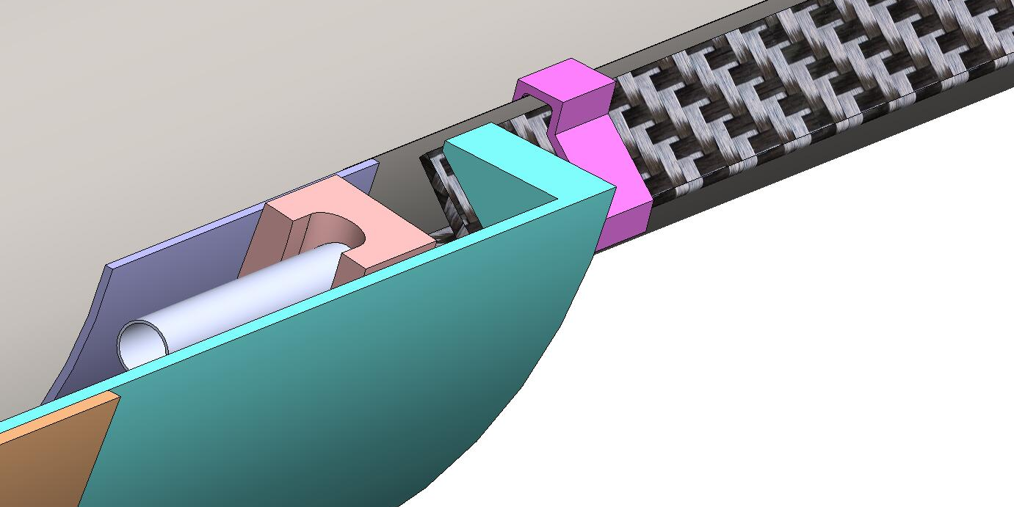
Conceptual design, Assembly procedure
Clip
Miniature
water cooling system
Digital periphery region
of bent sensor

Slide 9
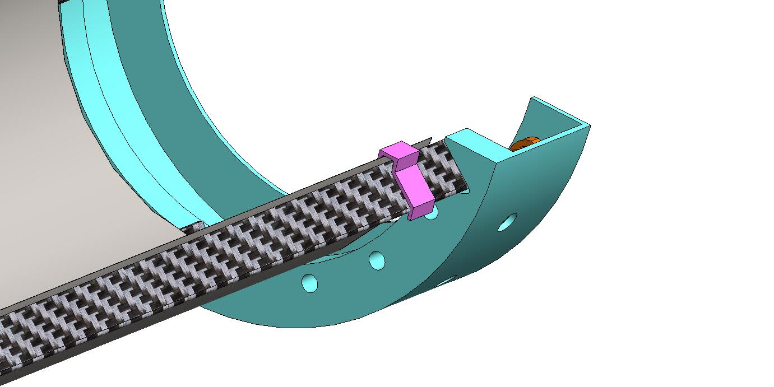
Conceptual design, Assembly procedure
Clip
CF half-ring
CF composite longeron

Slide 10
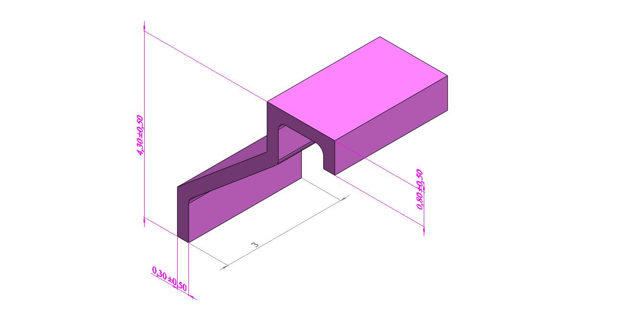
Conceptual design, Assembly procedure: clip

Slide 11
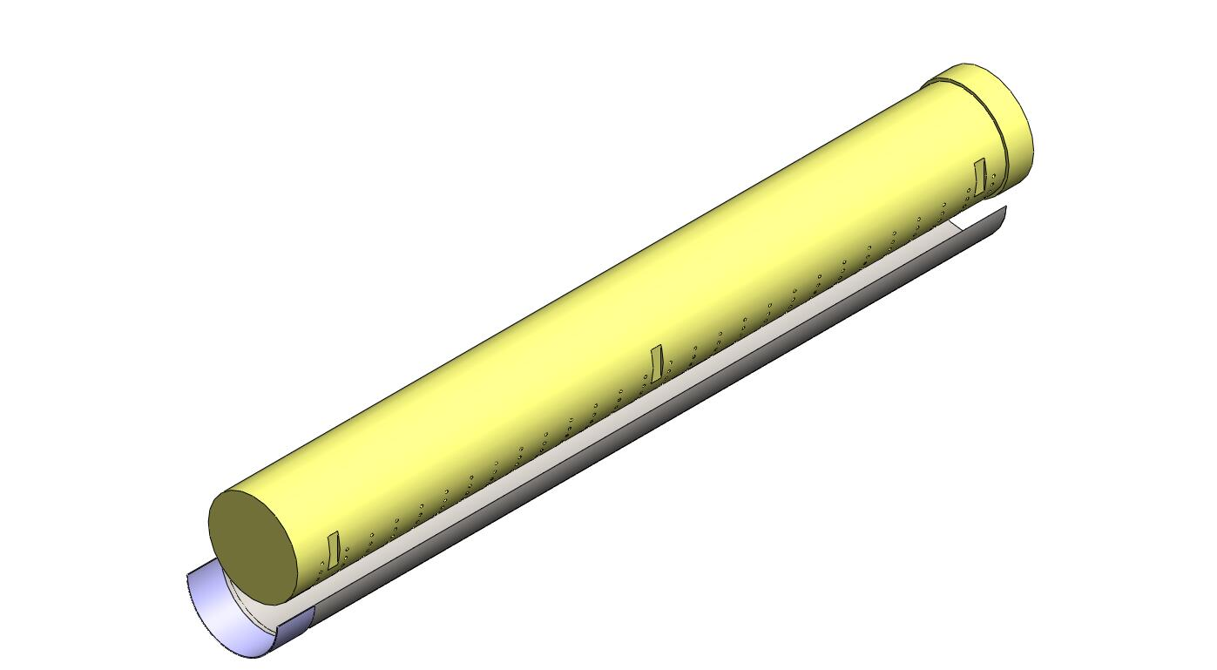
Assembly procedure

Slide 12
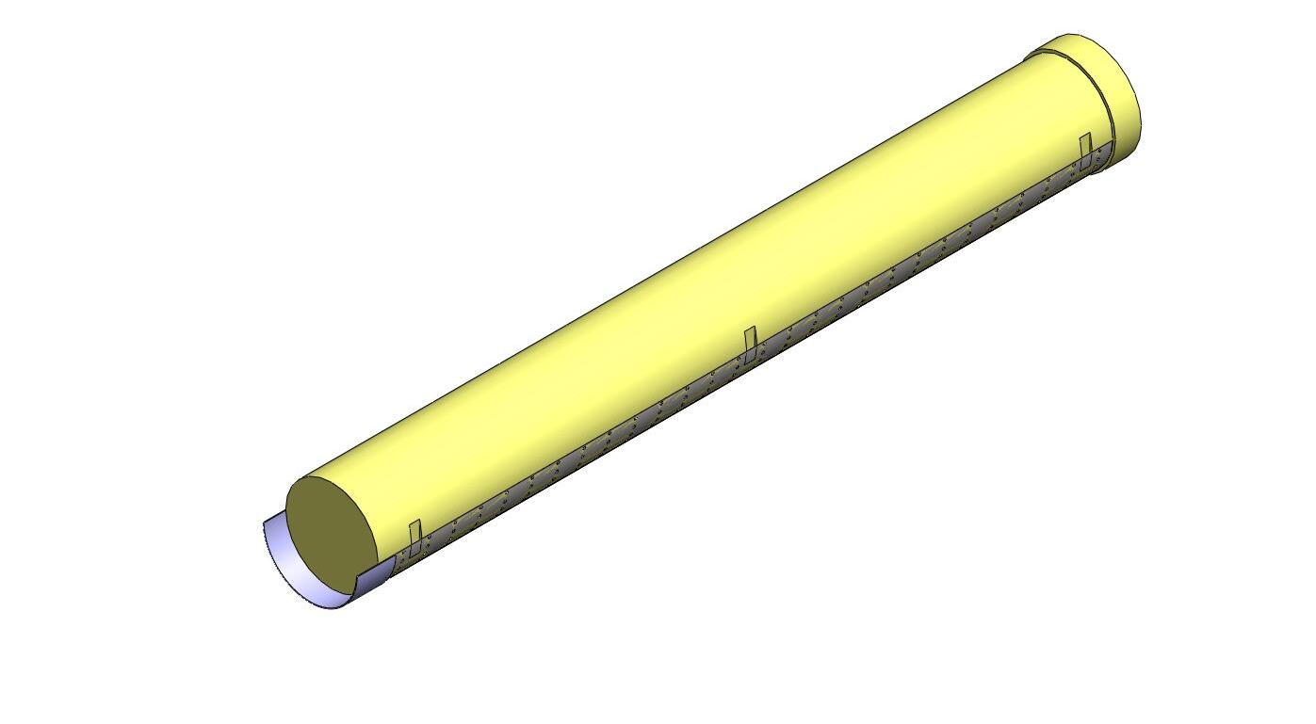
Assembly procedure

Slide 13
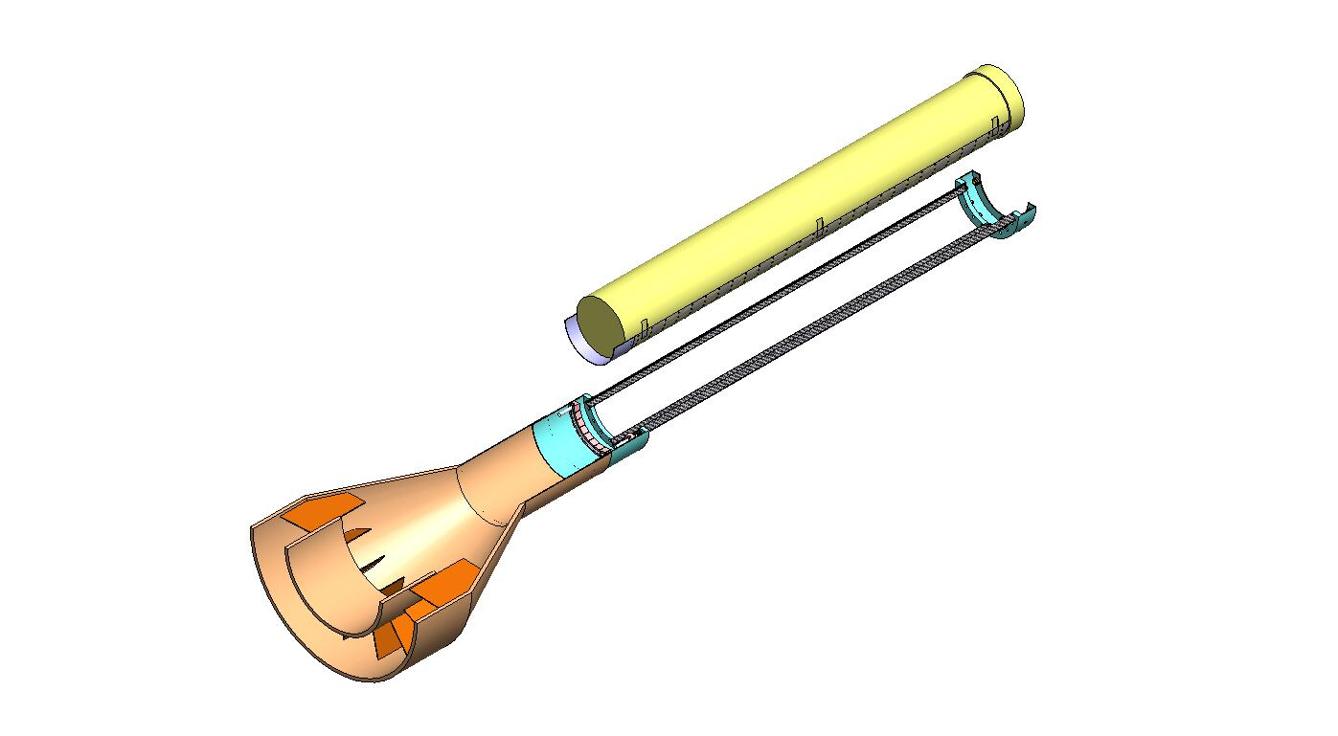
Assembly procedure

Slide 14
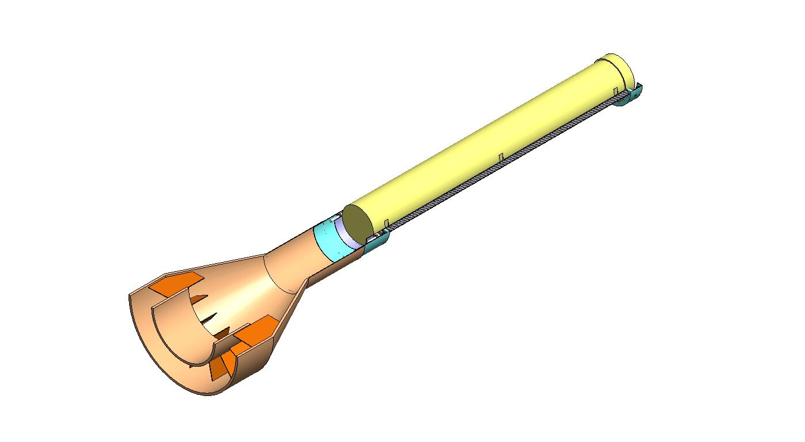
Assembly procedure

Slide 15
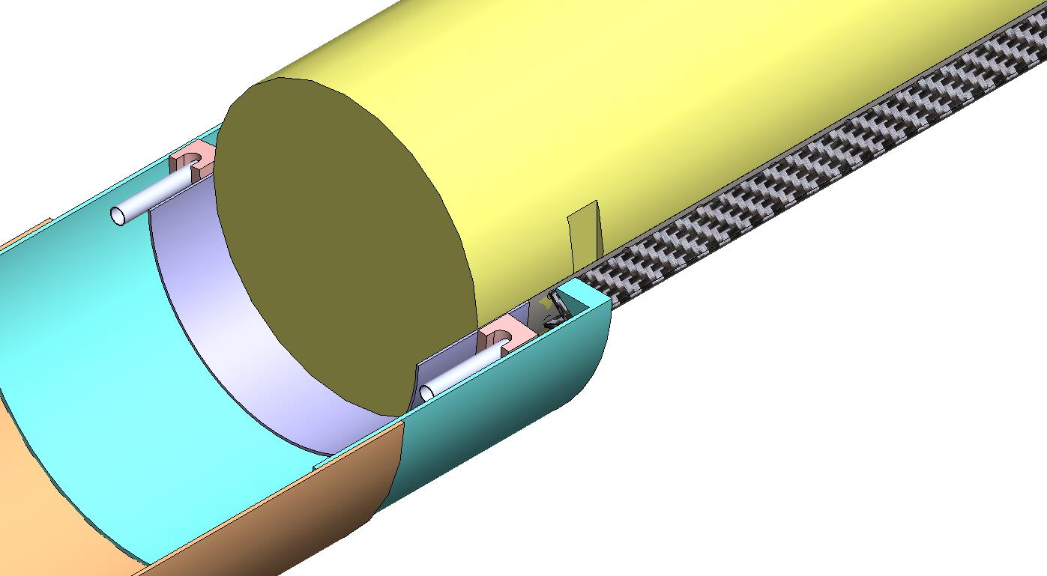
Assembly procedure

Slide 16
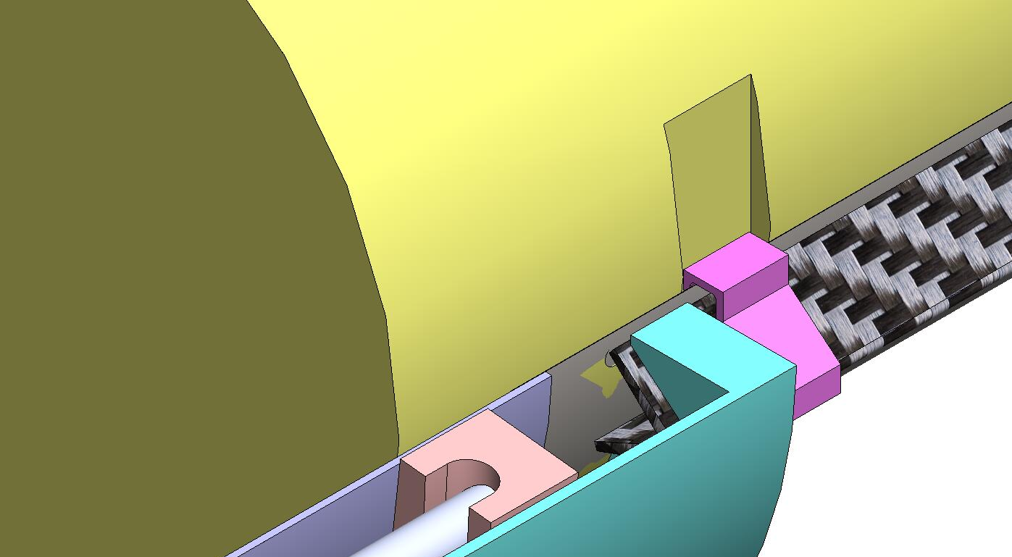
Assembly procedure
Clip is positioned
and glued
to the CF longeron

Slide 17
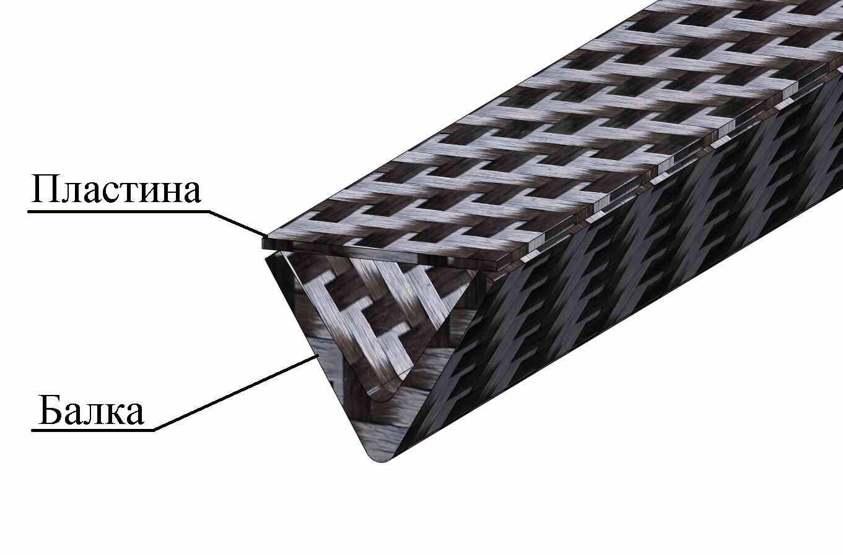
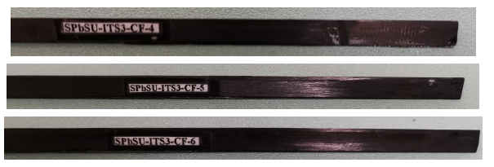

New technology was tested in SPbSU for longerons using the available CF prepreg
CF longeron + CF fleece panel
CF rib, L=300 mm
Longerons with CF prepreg NIICAM: sagging under central load
CF longeron + CF fleece panel could be a more stable option useful for gluing

Slide 18
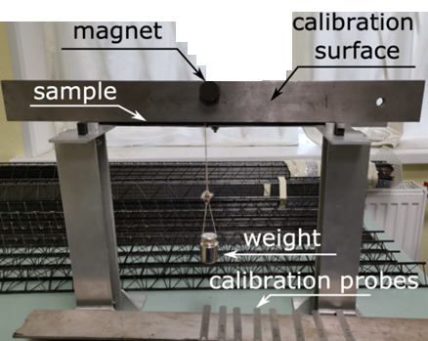
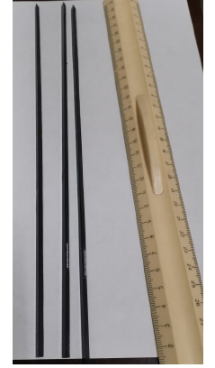
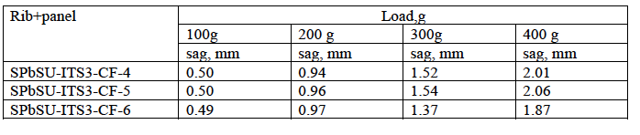
Deformation of 30 cm V-shaped
NIICAM CF longerons + CF panel
Prepreg: NIICAM
Tests with central load at SPbSU
Results could be improved by using the high performance carbon fiber like (THORNEL X1100 or TORAYCA® T1100G Tensile Strength ~7,000 Mpa) instead of NIICAM .

Slide 19
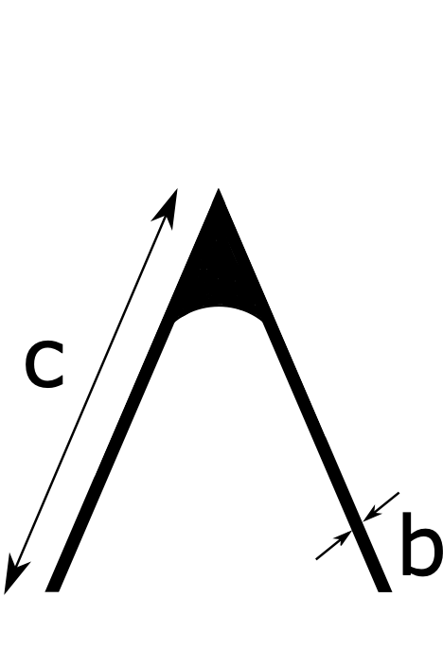
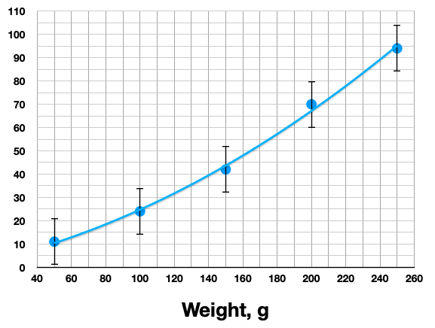
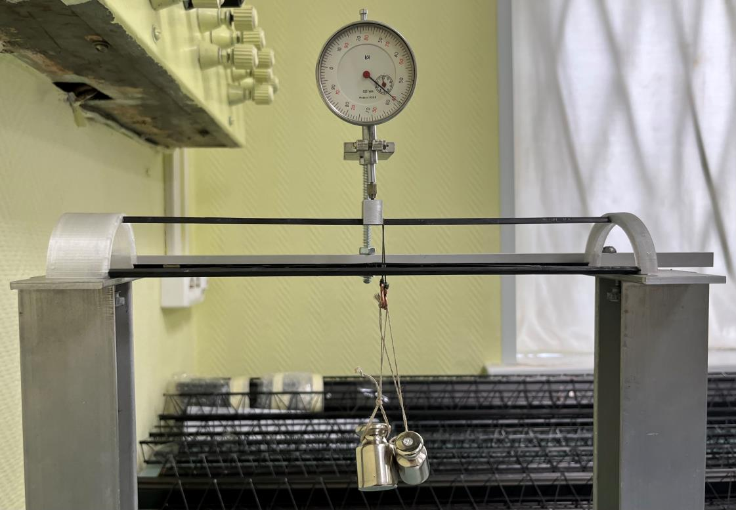
Deformation value of V-shaped CF longerons
under the influence of different weights
Longerons with high performace carbon fiber TORAYCA M55J
Deformation value, mkm
Longerons with TORAYCA M55J : very nice rigidity!

Slide 20
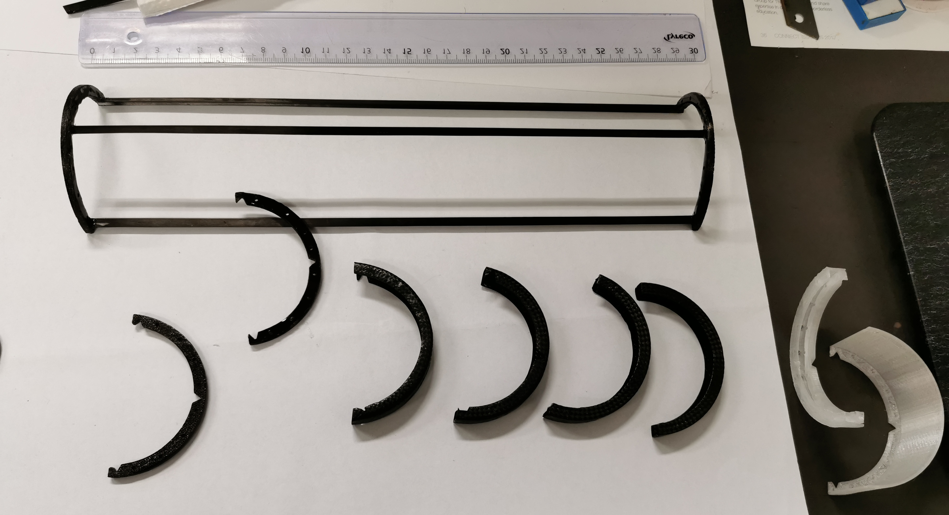
Tests at CERN:
CF samples - prepreg NIICAM

Slide 21
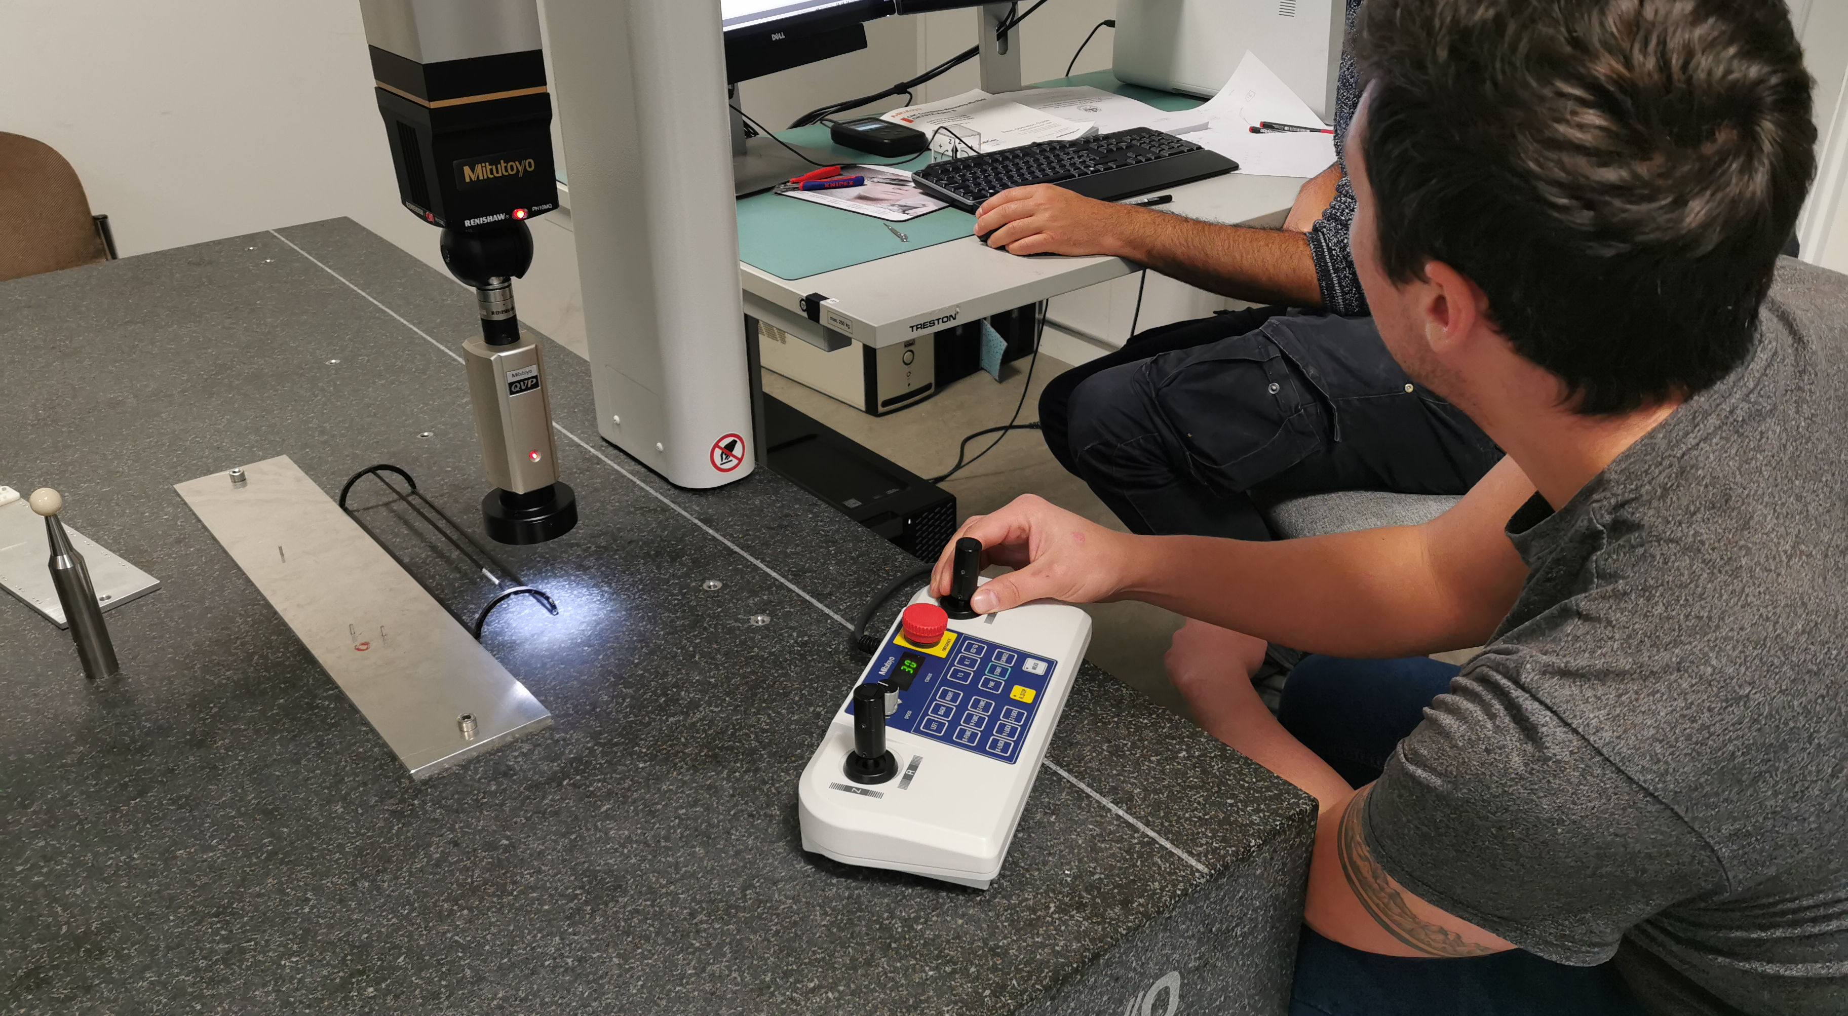
Tests at CERN – see report by Vladimir Zherebchevsky (today)

Slide 22
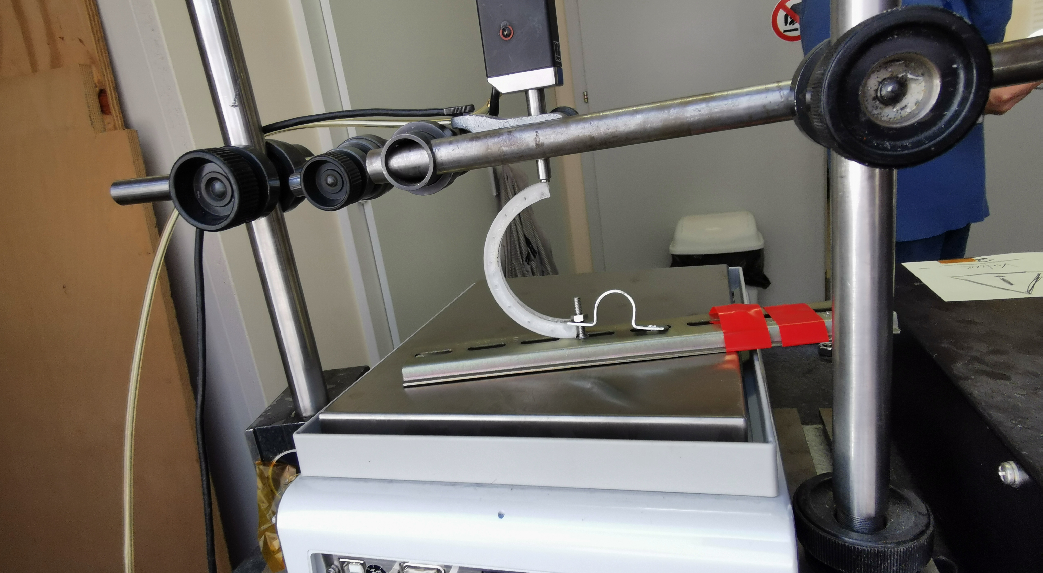
Tests at CERN

Slide 23
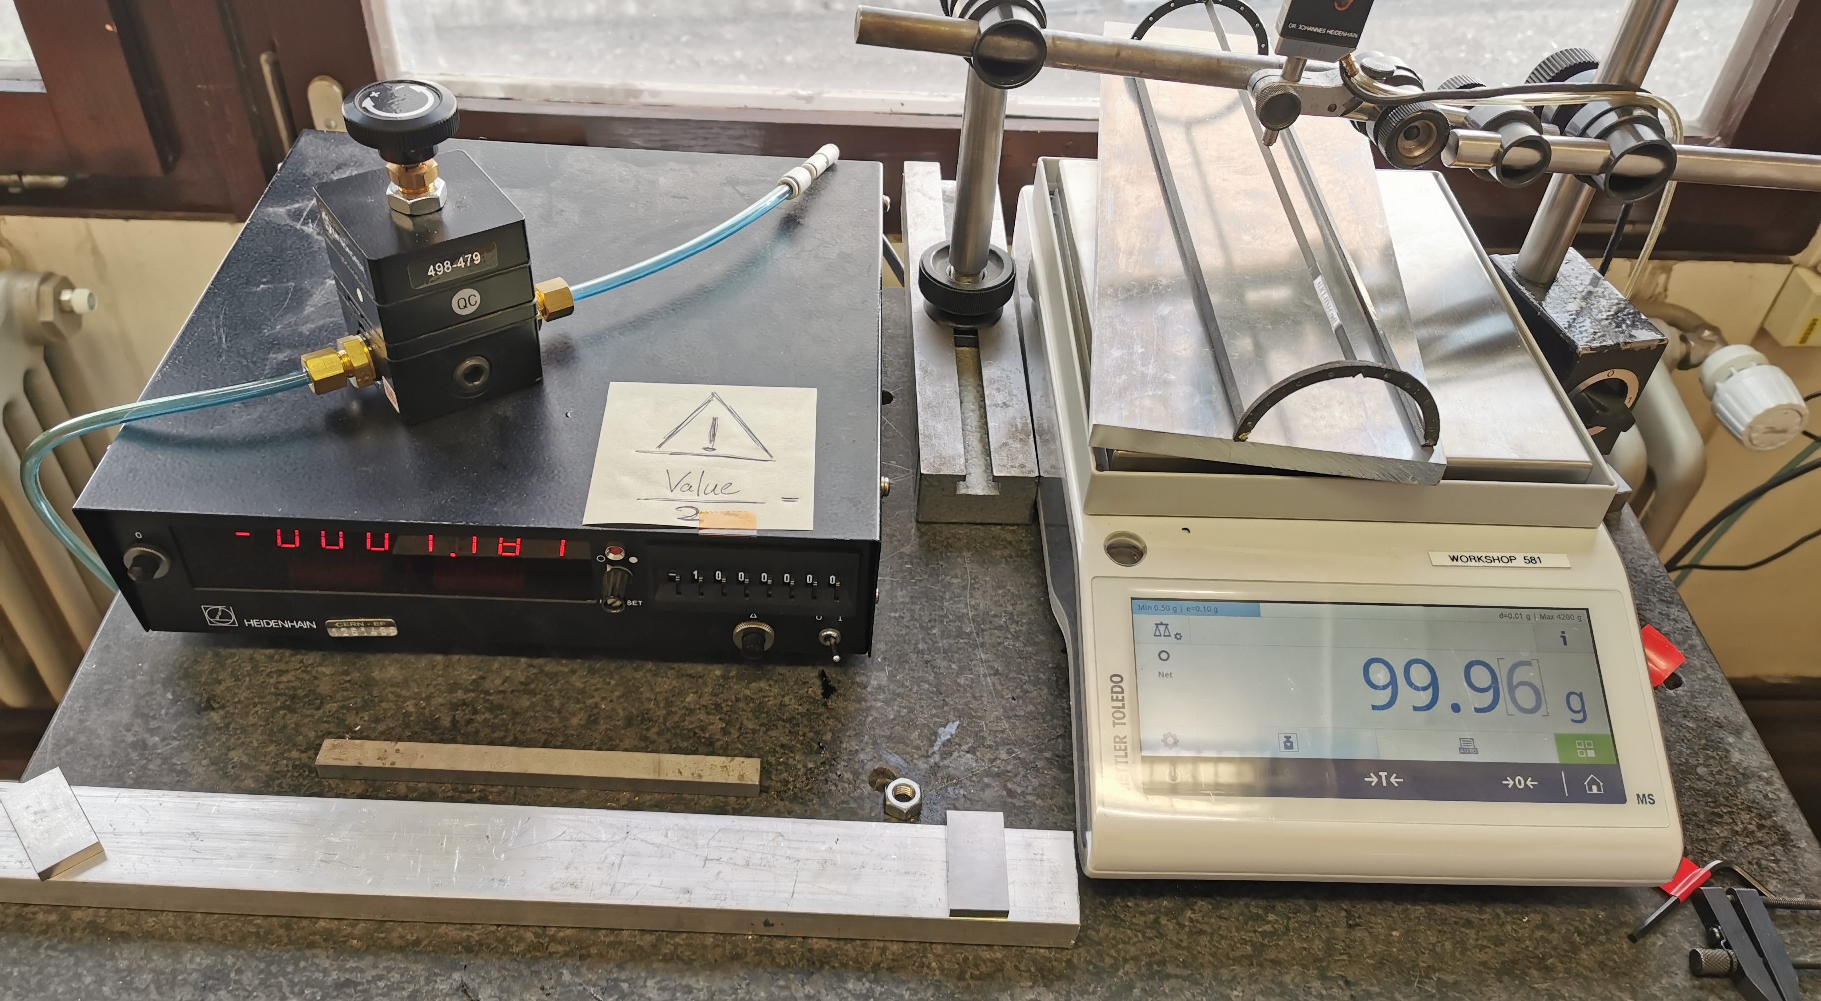
Tests at CERN

Slide 24
Summary of test at CERN :
The CF composite technology for production of low-mass longerons and carbon fiber supporting semi-rings was developed in SPbSU and tested at CERN.
The carbon fiber semi-rings with CF low-mass longerons could be used to form a cradle to support thin large area Si-sensors.
The low mass CF composite cradle has sufficient rigidity and thermo-mechanical stability to house thin large area Si detector sheets. Stiffness could be improved further by using the longerons produced with higher modulus carbon fibers.

Slide 25
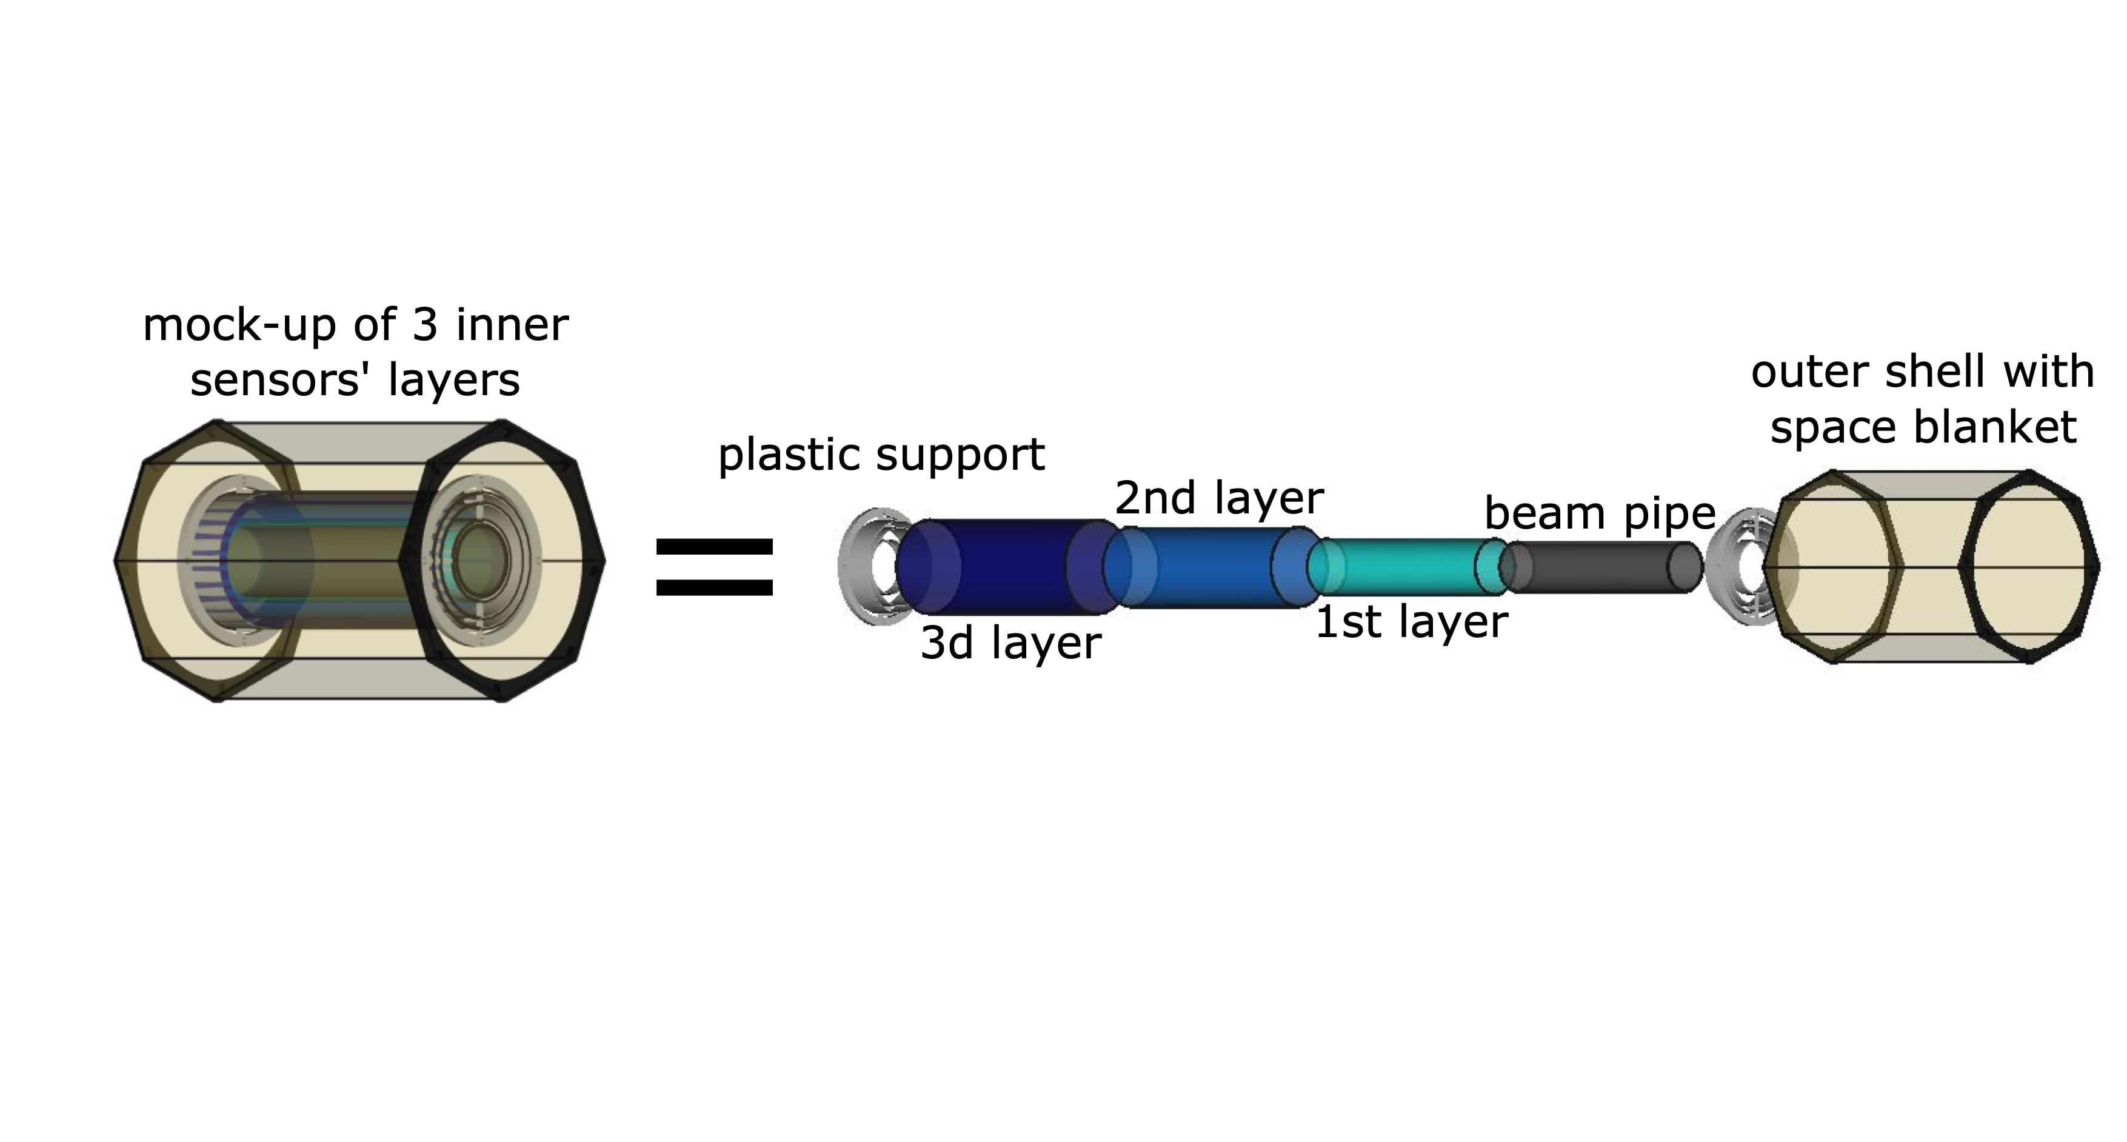
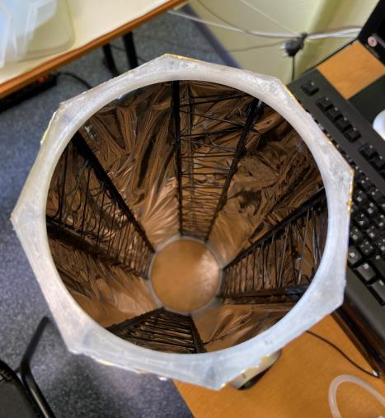
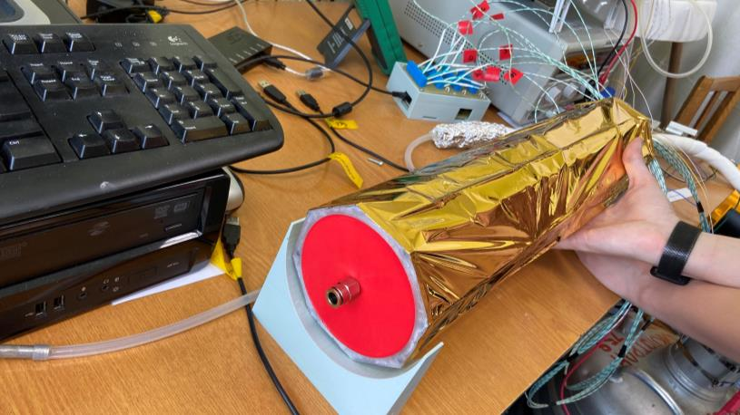
Gaseous cooling of self-supported ITS 3 modules
Scheme of cooling system with mock-up of 3 silicon cylinder layers and
outer shell with space blanket (in dimensions of the Table 1, slide 3)
ITS-upgrade WP5 meeting, 10 May 2022, 16:00 → 17:35 Europe/Zurich
https://indico.cern.ch/event/1158834/

Slide 26
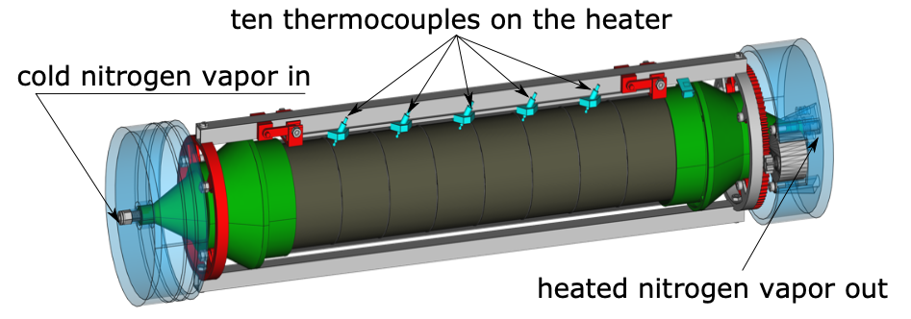
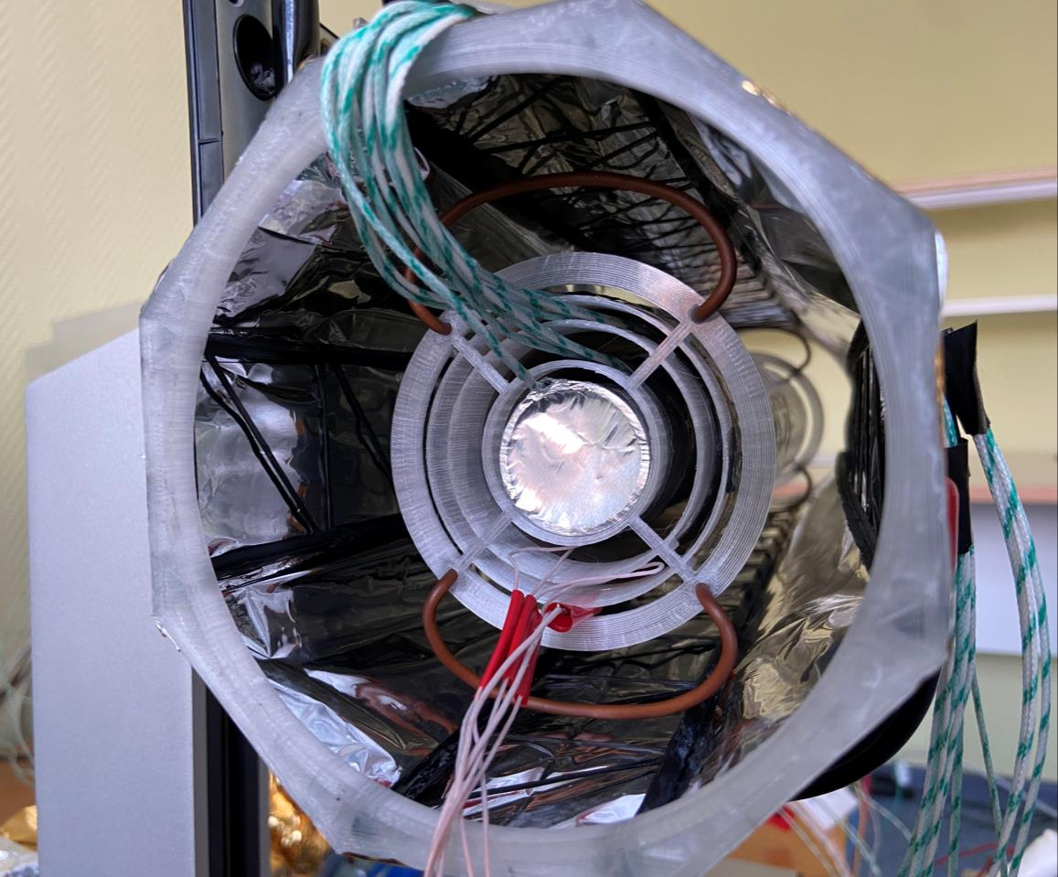
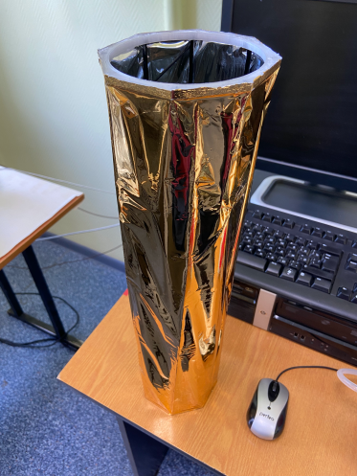
Space blanket isolated ITS-3 mock-up barrel.
V.I. Zherebchevsky, G.A. Feofilov et al.
ITS3 Upgrade WP5 (Mechanics and Cooling) meeting 06.07.2021
Notes:
Left: photo of self-supported outer shell with space blanket. It consists of low-weight rigid CF bars, space blanket and plastic support ring.
Right: a scheme of cylinder Layer 2 mock-up with heater and nitrogen cooling system

Slide 27
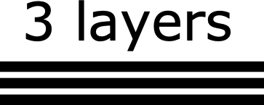
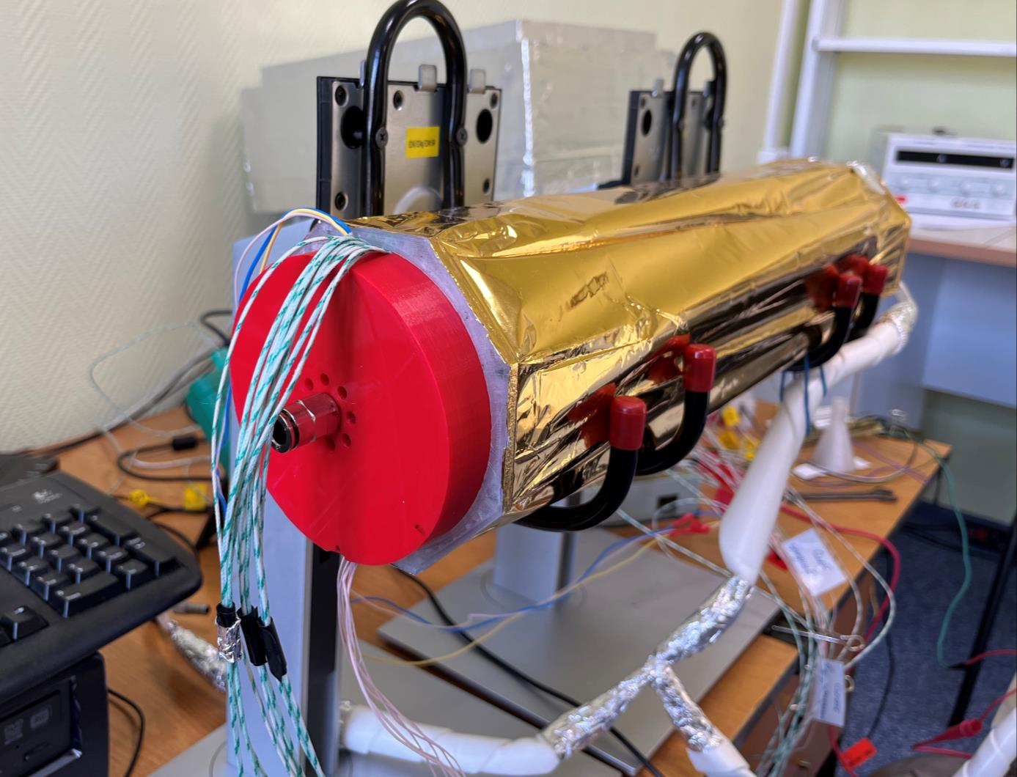
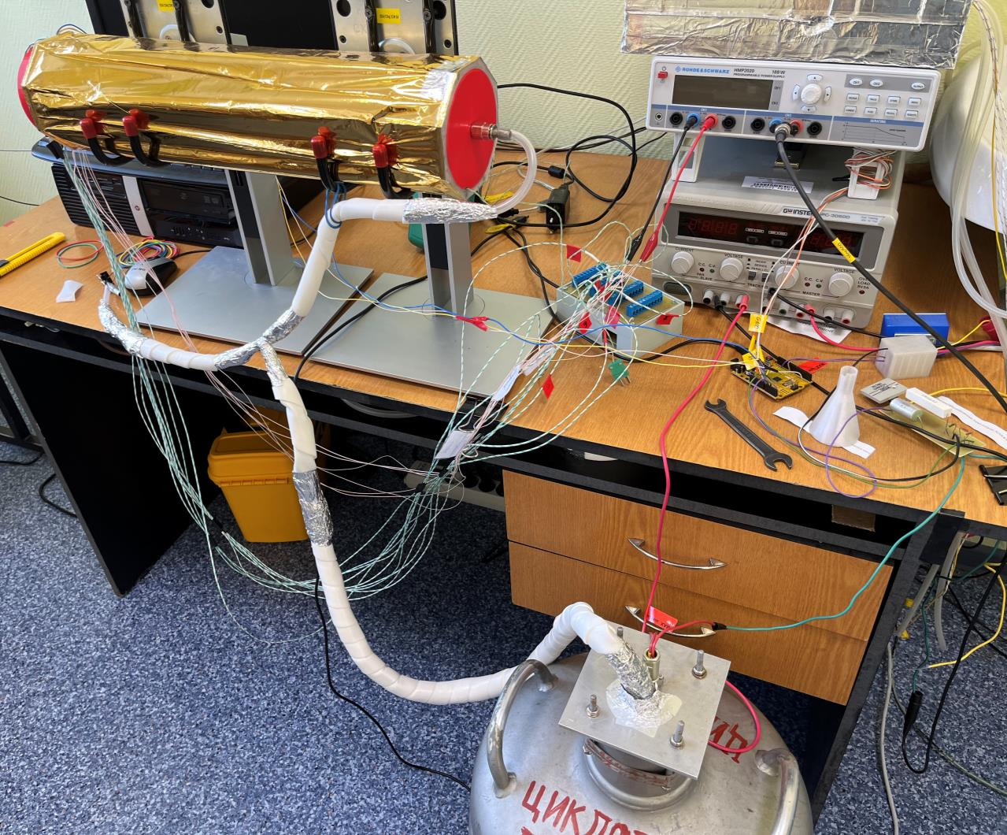
The 3d layer
The 2nd layer
Space blanket outer thermal shell
New cold nitrogen supply system
The experimental set-up was modernized
The 1st layer
The beam pipe
mock-up
Notes:
Left: a general view
Right: view of the interior
of the space blanket shell

Slide 28



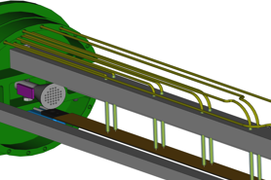
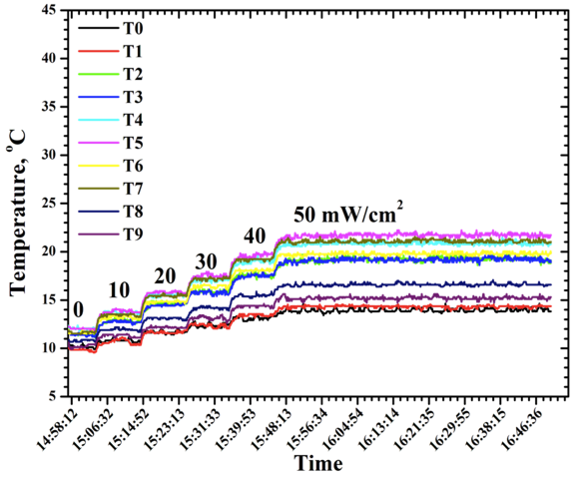
Thermal tests
with ~ zero-flow cold Nitrogen
Heat power up to 50 mW/cm²
Ten double thermocouples: T0,T1…T9
30 cm stave
with 10
thermocouples
(T0,T1…T9)
mounted along the heater
The first results are good:
Temperature<25 ºC for all heat loads
Speed of N₂ gas flow ~0
28
Notes:
28

Slide 29
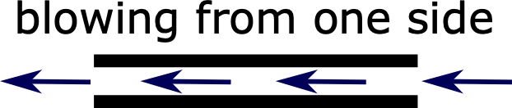
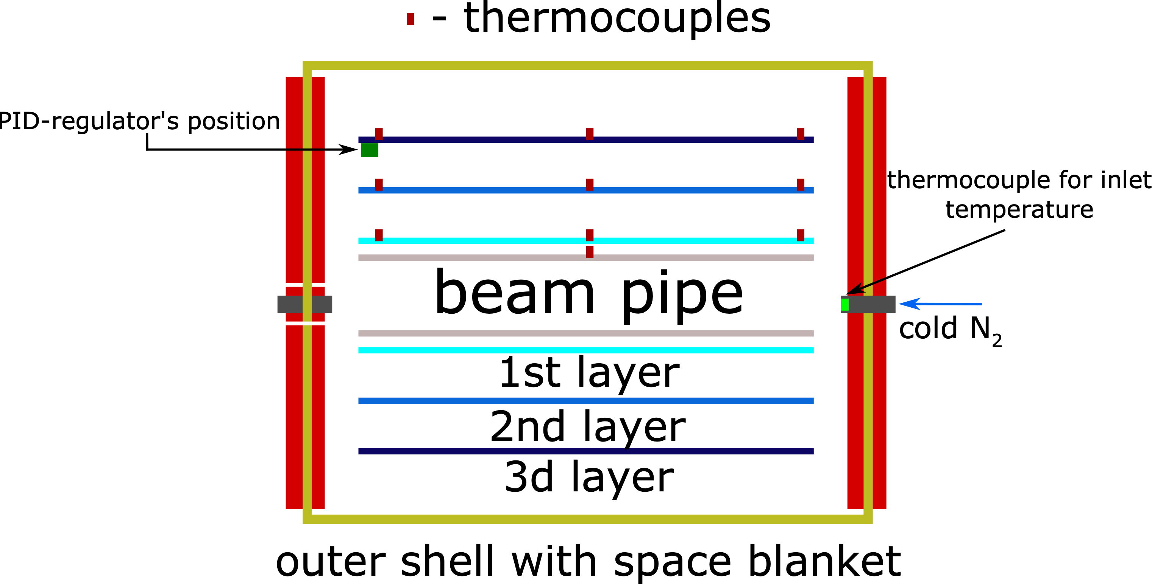
Return to previous configuration without special spreaders.
PID-regulator on exit, so we control of the outlet nitrogen temperature

Slide 30
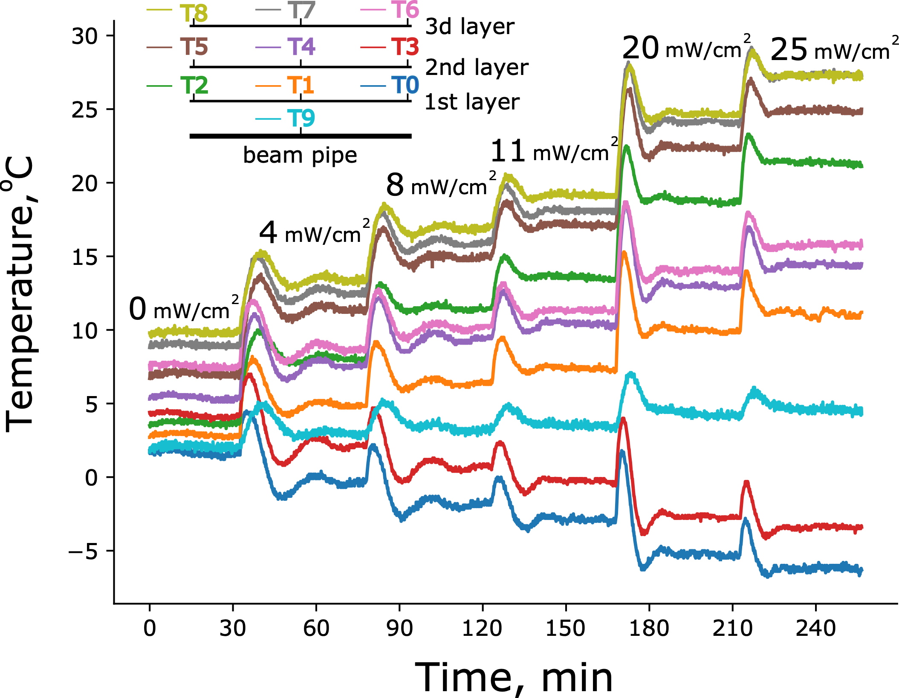
Results of temperature distributions measured
at different heat loads with cold nitrogen
Gas flow from from one side
Control of the outlet temperature at 15º C
Density of power is the same for each layer.
Temperature of the beam pipe is ~ +5º C

Slide 31
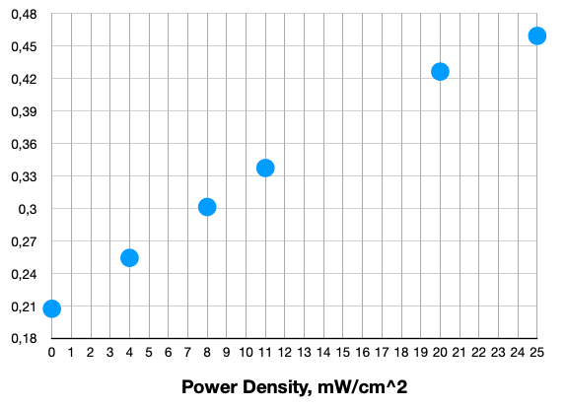
Nitrogen consumption vs. density of power
for mock-up of 3 silicon cylinder layers
N2 consumption, g/sec
at 25 mW/cm^2
the nitrogen consumption
is ~1653g/hour
ITS-upgrade WP5 meeting, 10 May 2022, 16:00 → 17:35 Europe/Zurich
https://indico.cern.ch/event/1158834/
31

Slide 32
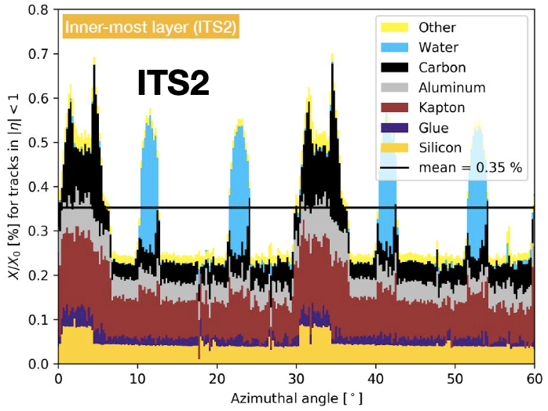
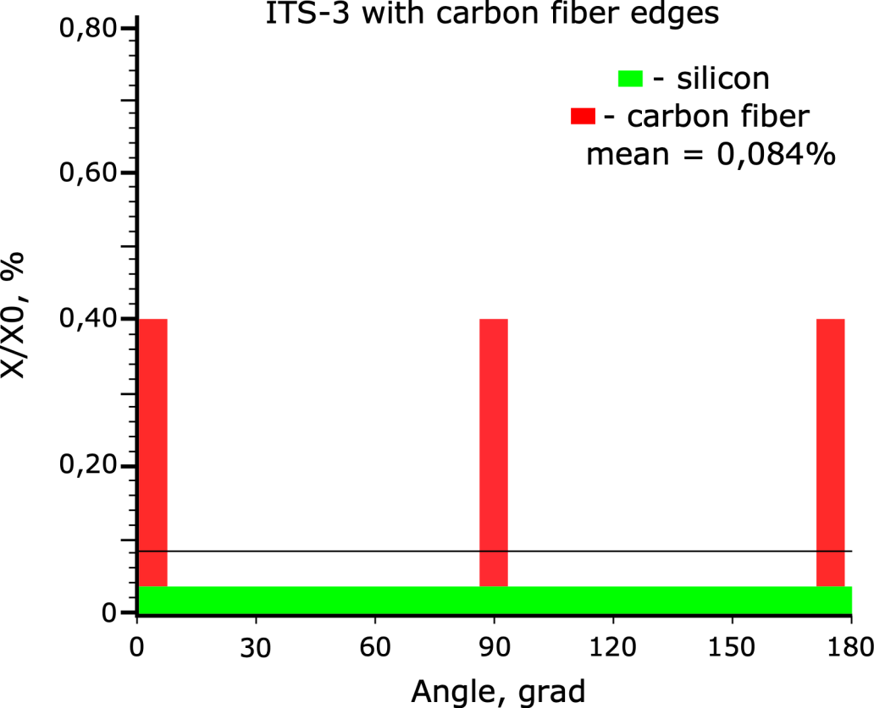
Radiation transparent design of ITS 3 layer
with bent Si sensors and carbon fiber longerons
ITS3
Red spikes in the right are due to the CF longerons (Note different scale in X axis)
The thickness of CF V-shaped longerons might be decreased by applying the high stiffness, high tensile strength and low weight THORNEL X1100 or TORAYCA® T1100G (Tensile Strength ~7,000 Mpa)

Slide 33
Conclusions
Feasibilty of the concept of self-supported ITS 3 modules with bent Si- sensors positioned inside carbon fiber composite cradle is tested using the mechanical and low speed cols gas cooling mock-ups
Th ultraligthweight self-supported mechanics for ALICE ITS-3 modules is based on the ITS 1 and ITS 2 carbon fiber ALICE technology
New technological exercises were successfully performed for production of CF composite semi-rings and CF longerons, using available carbon fiber.
Thickness of CF V-shaped longerons, holding the bent-Si sensors and the outer shell, might be further decreased.
All ITS 3 LO, L1 and L2 modules and the outer space blanket thermal shell are self supported.
Self-supported mechanics may allow to use, before the overall ITS 3 assembly, the individual operations for mounting and characterization of each LO, L1 and L2 modules of bent MAPS sensors.
The overall ITS 3 assembly/disassembly will not require any gluing/ungluing of modules.
The performance of low-speed gas (nitrogen)cooling of the full scale mock-up of three layers of the ITS 3 was demonstrated.
Further work is planned for optimization of distribution of low-speed gas (nitrogen) flow between layers.
The space blanket instead of thermally well isolated barrel works perfectly well
(no any signs of water vapor condensation were noticed)

Slide 34

Thank you for your attention!
Notes:
34

Slide 35
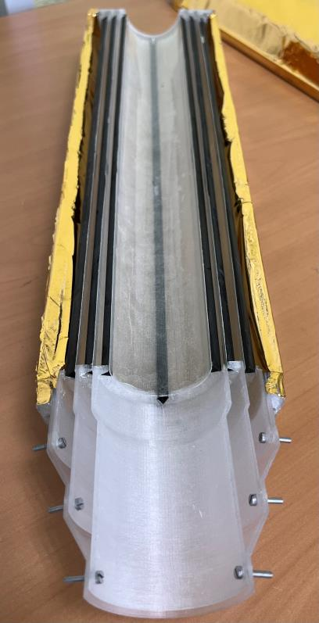
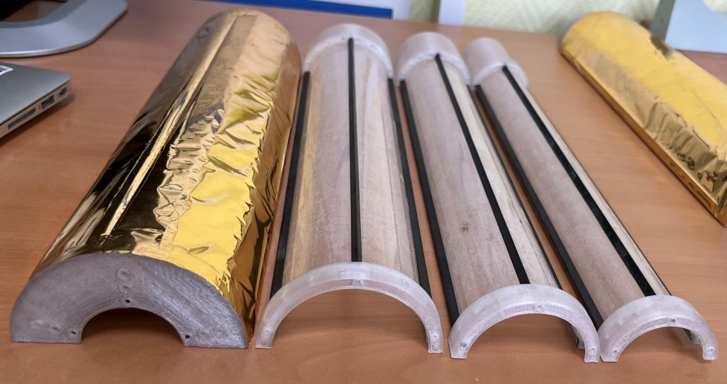
Assembling of mechanical mock-up of ITS-3
We use a fiberglass plate as a suitable mock-up of silicon thin sensors. The stiffness was estimated to be similar to ~30μ Si plate.

