Slide 1
All you ever wanted to know about Magnet Evaluation Board (MEB)
A personal recollection
Massimo Giovannozzi
30 January 2023

Slide 2

Let us start for the beginning (of my memories)
Once upon a time, there was a pleasant Swiss countryside with vineyards in which strange blue cylinders were scattered.
These objects were to be installed in a cold, dark tunnel dug deep into the earth.
A group of wise men had been given the task of discovering the properties of these strange cylinders, to assess whether they were worthy of being transported in the tunnel, and to define the most appropriate position for each object...
The Magnet Evaluation Board was born!

Slide 3
Approximative timeline
2002: Start of activities
2007: End of first round of installation
2008-2009: Back again for repairing…
2011: nMEB, the successor of MEB for routine magnet activities, mainly focusing on Long Shutdown magnet replacements
2015: Luca Bottura -> Sandrine Le Naour
2023: MAB (note the change of name…)

Slide 4
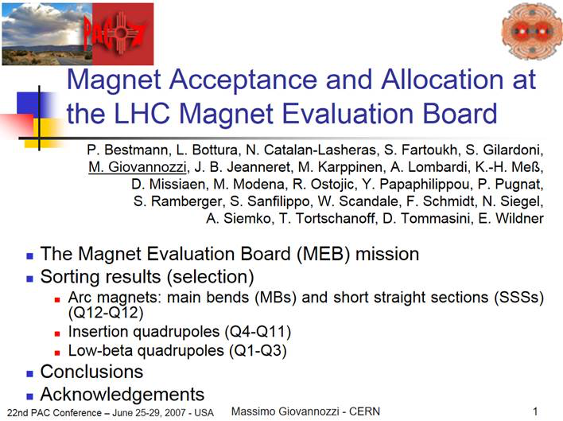
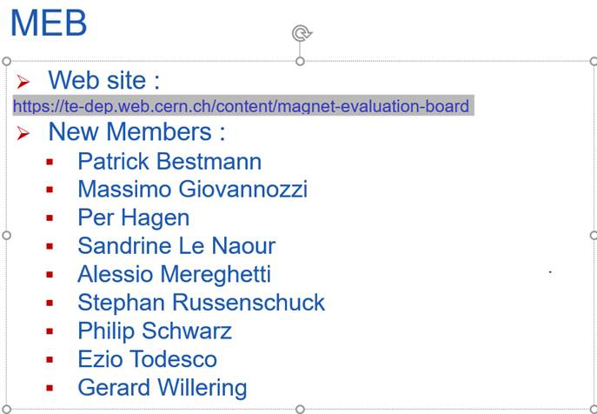
Composition
MEB
nMEB
Find who is still in MAB…

Slide 5
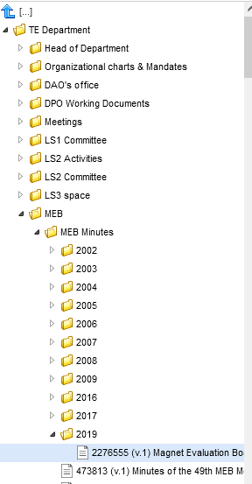
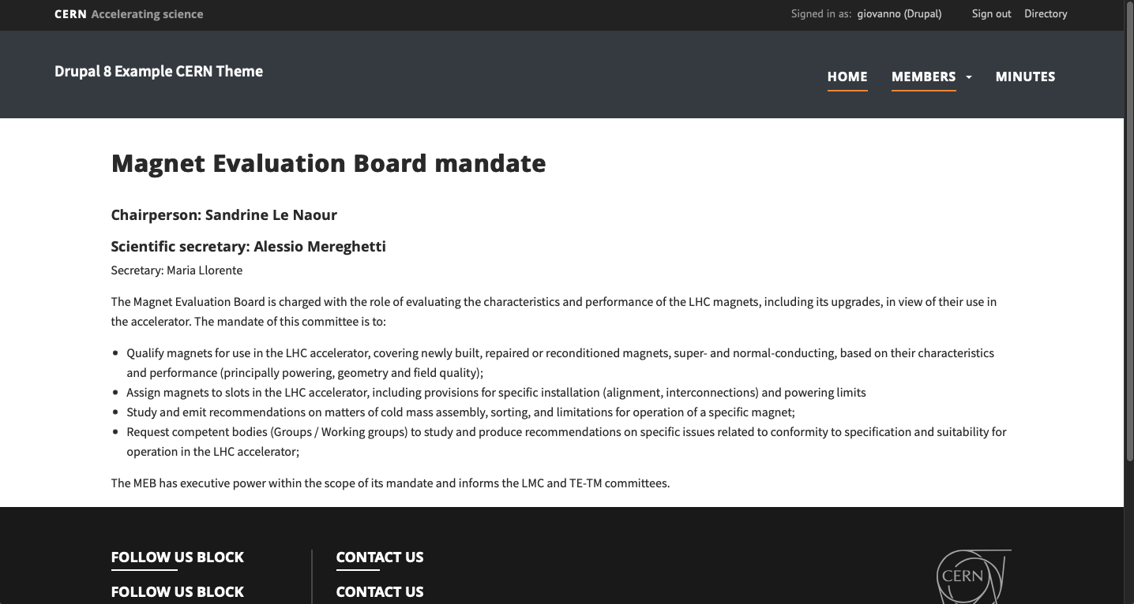
Where to find the traces of the activities
Minutes are available in EDMS under TE Department/MEB/MEB
On the other hand, other links are partially broken, like
  https://te-dep-meb.web.cern.ch
Or broken, like
  https://te-dep.web.cern.ch/content/magnet-evaluation-board

Slide 6
Roles - I
Each member had the responsibility for a specific aspect of the evaluation process:
  L. Bottura,: Chair and global overview
  ABP team (sorting of various magnet families):
    S. Fartoukh: team leader and dipoles
    S. Gilardoni: dipoles
    M. Giovannozzi: scientific secretary, insertion magnets
    J. B. Jeanneret: beam aperture
    A. Lombardi, Y. Papaphilippou: arc quadrupoles
    F. Schmidt: triplet quadrupoles
  Geometry and fiducialisation:
    P. Bestmann , D. Missiaen, W. Scandale, E. Wildner

Slide 7
Roles - II
Each member had the responsibility for a specific aspect of the evaluation process:
  Hardware responsible: K.-H. Meß, N. Siegel
    Main dipoles:
      M. Modena, D. Tommasini,
    Main quadrupoles:
      T. Tortschanoff,
    Insertion quadrupoles:
      N. Catalan-Lasheras, M. Karppinen
    Triplet quadrupoles and separation dipoles:
      R. Ostojic
    Warm quadrupoles
      S. Ramberger

Slide 8
Roles - III
Each member had the responsibility for a specific aspect of the evaluation process:
  Magnetic measurements:
    P. Pugnat, S. Sanfilippo
  Quench performance
    A. Siemko

Slide 9
Modus operandi
The ID card of each magnet had a central role in the evaluation process. No evaluation was official until the ID card was in final form and approved by each expert.
The ID cards were filled in automatically for most of the magnet families (large series families) and manually for the so-called US magnets, i.e. triplet quadrupoles and separation dipoles.
Each expert was commenting the magnet performance (using also additional data, not in the ID cards, e.g. training behaviour) and expressing acceptance of the magnet.
Acceptance: only considerations of fundamental hardware performance (e.g. electrical insulation, quench performance) would have justified a rejection of the magnet, not field quality.
ABP was proposing the slots, based on the geometry and field quality data.

Slide 10
The new Magnet Acceptance Board
The scope of MEB and nMEB was different (the first dealt with the LHC installation, a much bigger job than the second one) but the modus operandi was the same.
MAB is similar to nMEB, with the addition of HL-LHC magnets to be approved and allocated to appropriate slots. This seems to justify keeping the same modus operandi.
The ABP contribution is being discussed internally and in the context of WP2, in close contact with WP3.
The appropriate software infrastructure should be set up
  EDMS
  Indico
  Databases of geometry and magnetic data
  ID card generation

Slide 11
Thanks a lot for your attention

