Slide 1






An overview of WP3 magnets
E. Todesco
CERN, Magnet Assessment Board - 13 February 2023

Slide 2
List of contributors (from East to West)
KEK: T. Nakamoto, M. Sugano, K. Suzuki, N. Kimura et al.
IHEP: Q. Xu, Y. Wang, D. Ni, W. Wu, L. Li, Q. Peng, et al.
FREIA: K. Pepitone, R. Ruber, et al.
INFN-LASA: M. Statera, M. Sorbi, M. Prioli, S. Mariotto, et al.
INFN-Genova: P. Fabbricatore, S. Farinon, B. Caiffi, A. Bersani, R. Cereseto, et al.
CERN: S. Izquierdo Bermudez, E. Gautheron, G. Kirby, A. Foussat, J. Carlos Perez, F. Rodriguez Mateos, N- Lusa, E. Ravaioli, M. Bednarek, J. Ferradas Troitino, F. Mangiarotti, M. Bajko, A. Devred, H. Felice, D. Perini, G. Willering, S. Ferradas Troitino, H. Prin, A. Milanese, J. Ferradas Troitino, E. Takala, R. Principe, A. Ballarino, D. Tommasini, B. Bordini, J. Fleiter, C. Barth, S. Hopkins, F. Savary, D. Duarte Ramos, Y. Leclercq, M. Struik, L. Fiscarelli, S. Russenschuck, C. Petrone, G. de Rijk, L. Rossi, P. Fessia, S. Riebe, H. Garcia Gavela, L. Carlos, S. Fleury, G. Vandoni, L. Quain Solis, A. Dallocchio, P. Moyret, S. Sgobba, A. Moros, M. Crouvizier, B. Bulat, M. Guinchard and its team, et al.
CEA: H. Felice, D. Simon, et al.,
CIEMAT: F. Toral, C. Martins Jardim, J. Garcia Matos, et al.
AUP: G. Ambrosio, S. Feher, R. Carcagno, G. Apollinari, B. Ahia, P. Joshi, K. Amm, M. Yu, A. Nobrega, J. Schmalzle, M. Anarella, A Vouris, G. Chlachidze, S. Stoynev, R. Bossert, M. Baldini, P. Ferracin, D. Cheng, S. Prestemon, G. L. Sabbi, L. Cooley, V. Lombardo et al.,
In red: management at CERN and in collaborations

Slide 3
CONTENTS
Layout, deliveries, sharing of the work
Acceptance
Sorting

Slide 4
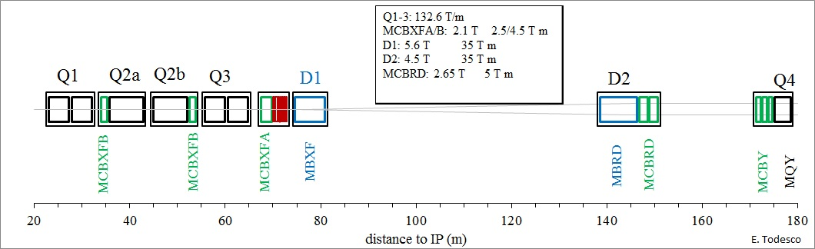

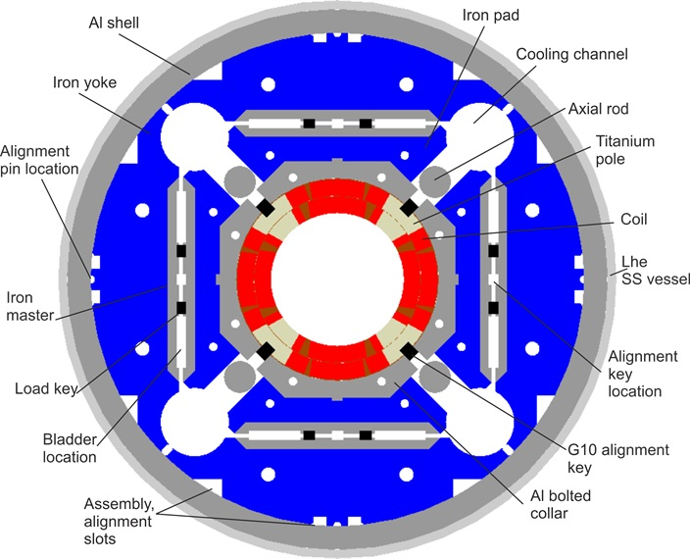
Interaction region magnets: from LHC to HL-LHC
Triplet: Nb₃Sn quadrupoles, Q1/Q3
8 for installation, 2 spares
Cold mass contains: 2 MQXFA magnets
US delivers cold masses assembled in the cryostat, and tested horizontally
  CERN will re-test the first to check transport, and another one for making the transfer function calibration
MQXF cross-section

Slide 5
Interaction region magnets: from LHC to HL-LHC
Triplet: Nb₃Sn quadrupoles, Q2
8 for installation, 2 spares
Cold mass contains: 1 MQXFB magnet and one short nested corrector MCBXFB
CIEMAT delivers the corrector magnet, that is vertically tested at CERN
MQXFB magnet is manufactured at CERN, cold mass and cryostating at CERN as well
All cryomagnets tested at CERN, in H position
MQXF cross-section

Slide 6
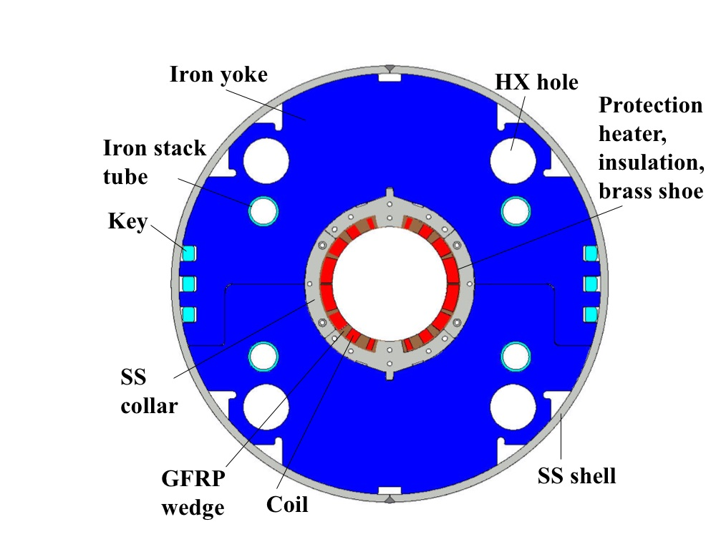
Interaction region magnets: from LHC to HL-LHC
Separation dipole: Nb-Ti dipole, D1
4 for installation, 2 spares
Cold mass contains: 1 MBXF magnet
Hitachi makes (KEK steering) the MBXF magnet and integrates in the cold mass
KEK test the magnet vertical, and delivers the cold mass
Cold mass is cryostated at CERN
All cryomagnets are tested at CERN, in H position

Slide 7
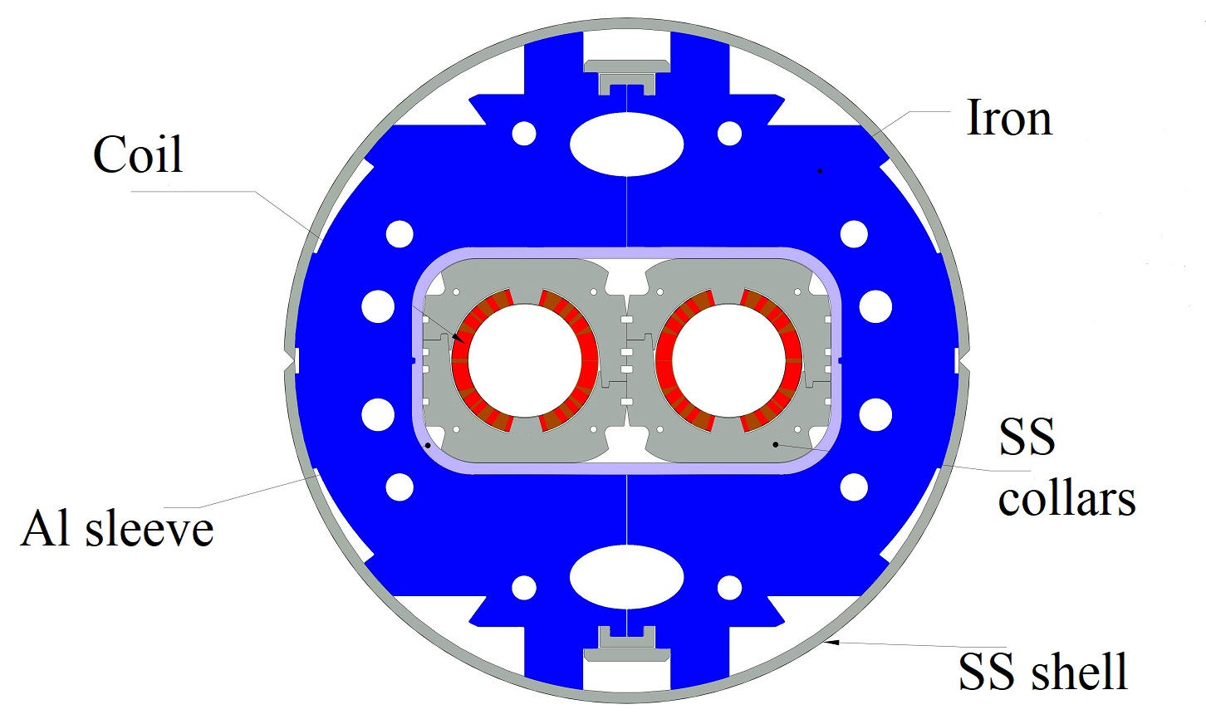
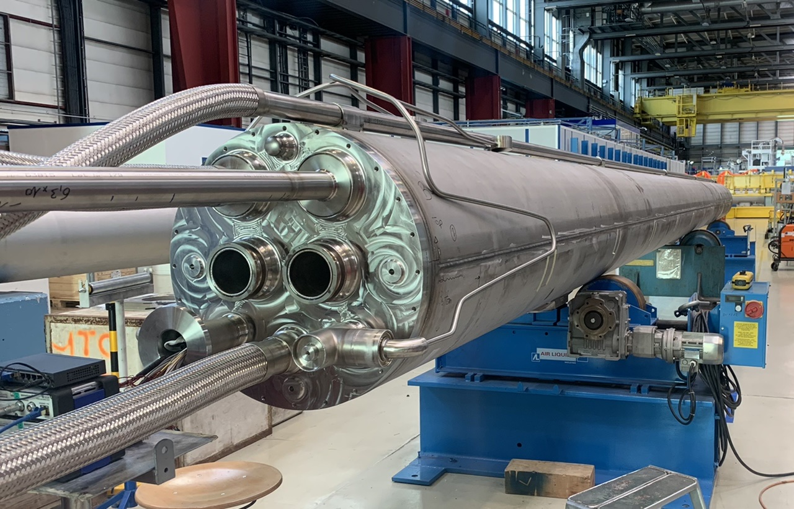
Interaction region magnets: from LHC to HL-LHC
Recombination dipole: Nb-Ti dipole, D2
4 for installation, 2 spares
Cold mass contains: 1 MBRD magnet and 2 correctors MCBRD
MBRD magnet made in ASG (INFN steering), INFN delivers the magnet
Cold mass manufacturing and cryostating at CERN
All cryomagnets tested at CERN, in H position

Slide 8
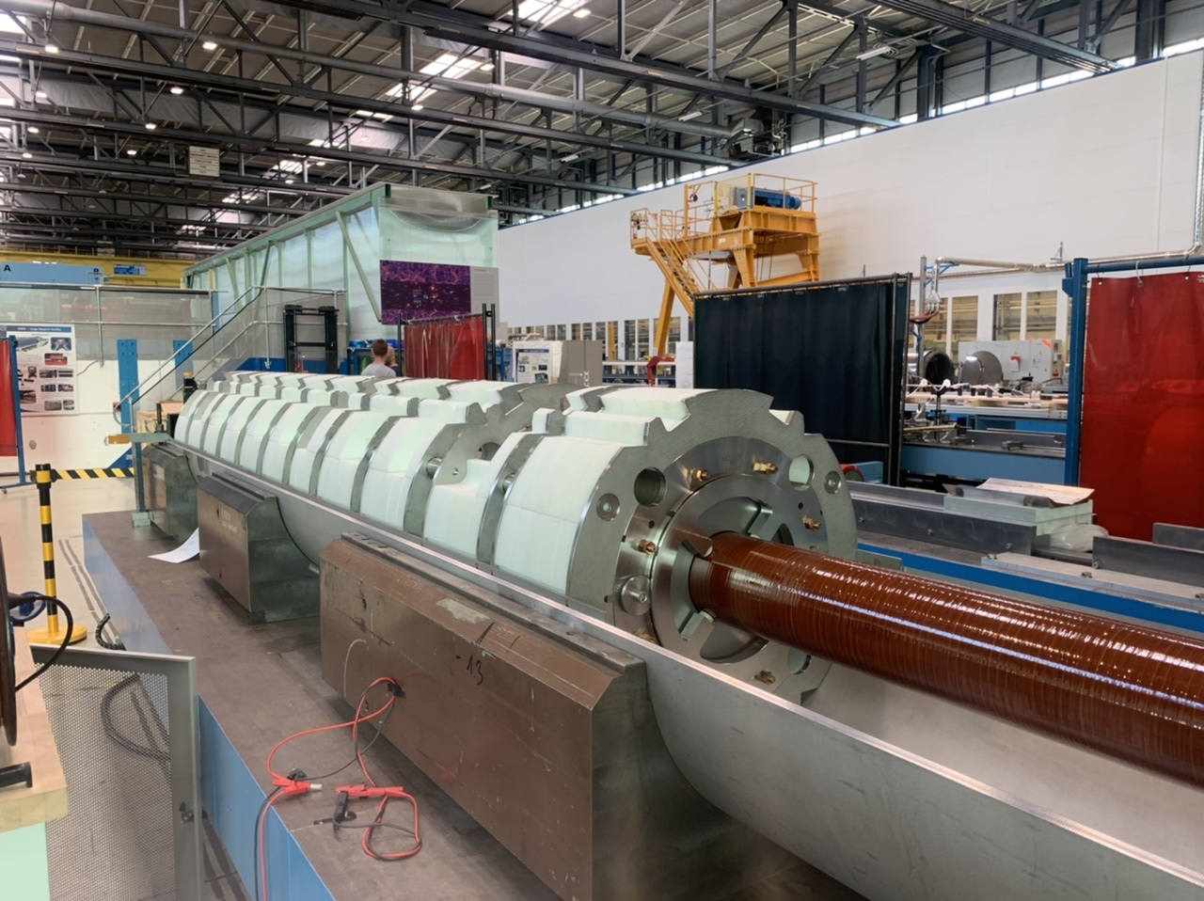
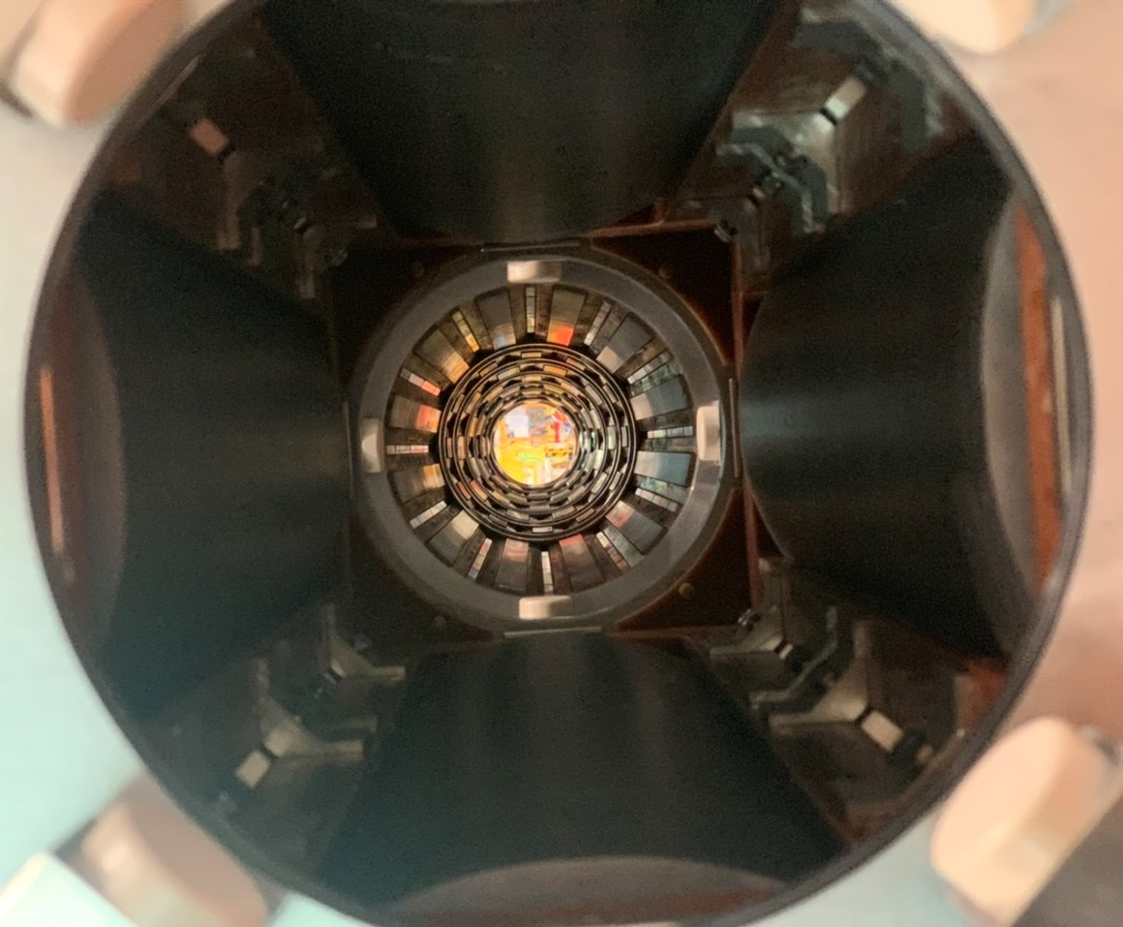
Interaction region magnets: from LHC to HL-LHC
Corrector package
4 for installation, 1 spare, 1 unit not assembled in cold mass
Cold mass contains: Nested long corrector MCBXFA, skew quadrupole, normal and skew sex oct dec dod
HO correctors magnet made in SEAS-RIAL (INFN steering), INFN tests the magnet at 4.5 K and delivers the magnet
Nested corrector magnet made in Elytt (CIEMAT steering), CIEMAT delivers the magnet , test at 1.9 K at CERN
Cold mass manufacturing and cryostating at CERN
All cryomagnets tested at CERN, in H position

Slide 9
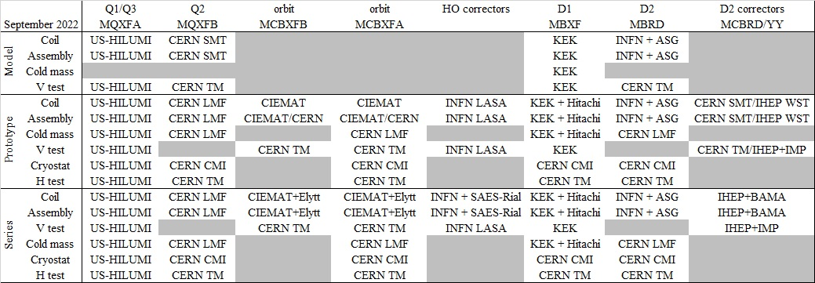
Summary of collaborations and who does what
EDMS 1952778

Slide 10
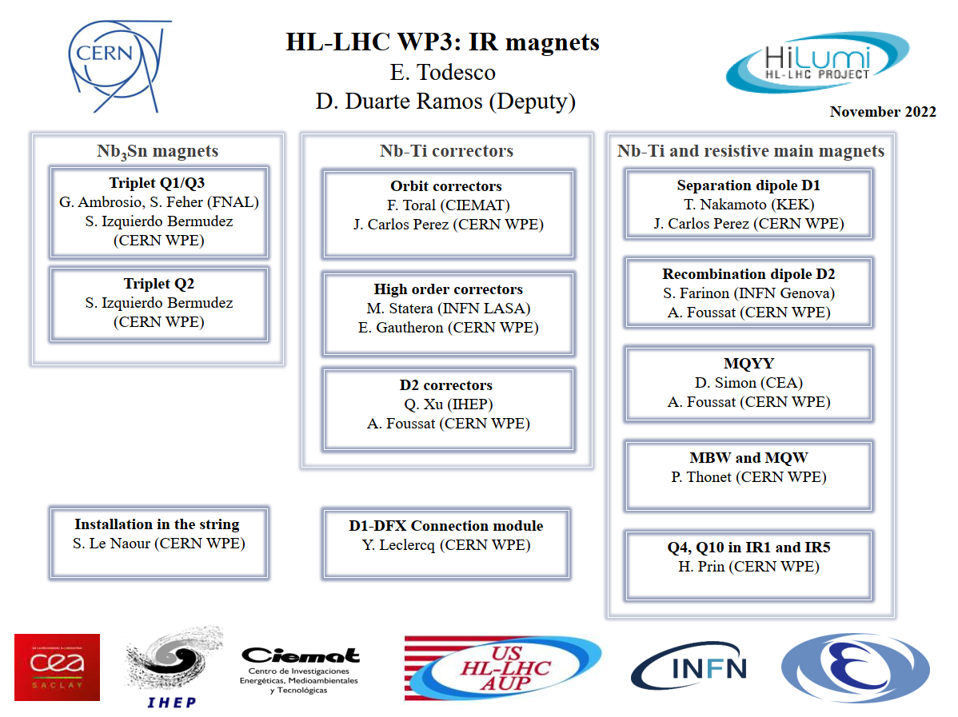
Structure and management
EDMS 1865349

Slide 11
CONTENTS
Layout, deliveries, sharing of the work
Acceptance
Sorting

Slide 12
ACCEPTANCE CRITERIA LINK
Q1/Q3 magnets, US-AUP (EDMS link, released)
Q1/Q3 cold mass and cryoassembly, US AUP (EDMS link , released)
D1 cold mass, KEK (EDMS link, released)
HO correctors, INFN-LASA (EDMS link, released)
MCBXF magnet, CIEMAT (EDMS link, released)
D2 magnet, INFN-Genova (EDMS link , released)
MCBRD magnet, IHEP (EDMS link, released)

Slide 13
ACCEPTANCE CRITERIA
Definition: nominal current is for 7 TeV, ultimate for 7.5 TeV
OPERATION:
  MQXF Ability to reach nominal+300 A
    All magnets also tested at 4.5 K
  All Nb-Ti: ability to reach ultimate
TRAINING:
  No criteria on virgin training
  All magnets tested after thermal cycle
  Requirement on training is only after thermal cycle:
    For main magnets (MQXF, D1 and D2) maximum of ≤3 quenches, no requirement at ultimate
    For correctors, maximum of ≤1 quenches, no requirement at ultimate

Slide 14
ACCEPTANCE CRITERIA
FIELD QUALITY
Tables are agreed with WP2, based on average and sigma
This is a target, that is achieved via field quality iterations
A reference tolerance of uncertainty + plus random is taken, if the individual magnets goes out a corrective action is taken
For MQXF, a magnetic shimming is used to correct non allowed multipoles when they go out of the tolerance range

Slide 15
ACCEPTANCE CRITERIA
FIELD QUALITY fine tuning: 7 actions taken
On MQXFA and MQXFB to re center b₆ around 0 units (it was 4 units) – only two MQXFA magnets have the «old» b₆ (MQXFA03 and MQXFA04, installed in the first cold mass for HL LHC) – see EDMS 2019517
On MCBRD to change the key material to correct b₃ from >15 units to <10 units – only first prototypes MCBRDP1 and MCBRDP2 have this
3 actions on D1, all on the coil cross-section to minimize b3 and b5
  Change from MBXFS1 to MBXFS2/3 (within short models)
  Change from MBXFS2/3 to MBXFP1 (from short model to prototype)
  Change from MBXFP1 to MBXF1 (from prototype to series, EDMS 2612909)
  We could plan recovering the prototype as an additional spare, in this case b3 and b5 will be around 5 units (TBC via measurements at CERN in summer 2023)
2 actions on D2, all on the coil cross-section to minimize b3 (and b5)
  Change from MBRDS1 to MBRDP1 (from short model to prototype, EDMS 2472430)
  Change from MBRDP1 to MBRD1 (from prototype to series, foreseen in 2023)
  We do not plan to use the D2 prototype as spare (VT, NC on protuding cables in cold bore)

Slide 16
ACCEPTANCE CRITERIA
Many other aspects are taken in consideration
For the US document, the template of the acceptance used for MQXA was reused
For all the Nb-Ti magnets, a new document was issued, organized in
  Documentation
  Integrated field
  Training
  Alignment
  Field quality
  Mechanical interface
  Cooling
  Protection
  Electrical test
  Instrumentation
  Pressure vessel (when applicable)
  Busbar (when applicable)
  Operation requirements (radiation dose and maximum ramp rate)
  Long-term requirements (informative)

Slide 17
CONTENTS
Layout, deliveries, sharing of the work
Acceptance criteria
Sorting

Slide 18
SORTING
A first discussion on sorting possibilities was done in August 2022
This triggered the initiative to delay PhaseII cryostating to allow more posibilites for sorting, see EDMS
Second discussion in HL-LHC meeting in Uppsala September 2022
Main features seen so far:
  Even though Q1 and Q2a have 30% lower heat load, no need to make sorting since the temperature margin of the magnet is much larger than what required from operation (2-2.6 K w.r.t. 0.35 K)
  Sorting of MQXFA magnet to couple them in a cold mass is excluded
  There is an automatic correction of systematic a4 and b3 due to the layout
  Most severe constraint is the coupling of Q2a and Q2b to minimize the integrated TF difference
  One could think about coupling

