Slide 1
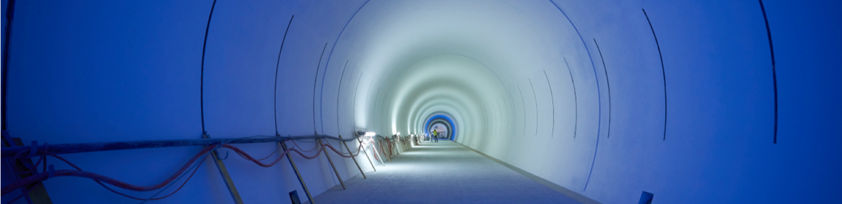
HL-LHC - status of preparation
Mike Lamont
LHCP
7th June 2024

Slide 2
HL-LHC - goals
Prepare machine for operation beyond 2025 and up to ~2040
Operation scenarios for:
  Total integrated luminosity of 3000 fb⁻¹ in around 10-12 years
  An integrated luminosity of ~250 fb⁻¹ per year
  Nominal: levelled luminosity of 5 x 10³⁴ cm⁻²s⁻¹ (events/crossing ~130)
  Ultimate: levelled luminosity of 7.5 x 10³⁴ cm⁻²s⁻¹ (events/crossing ~200)

Slide 3
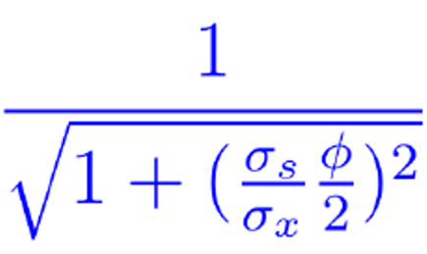

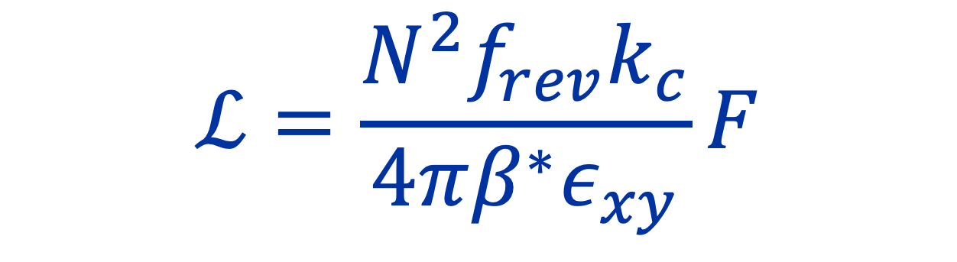
Higher Intensity
Increase bunch population
Increase F
Crossing angle reduction factor
Shorter bunches, smaller crossing angle, crab cavities
$$ℒ=\frac{N^{2}f_{rev}k_{c}}{4πβ^{∗}ε_{xy}}F$$
Smaller $β^{∗}$
Reduced emittance
Smaller beam size at IP

Slide 4
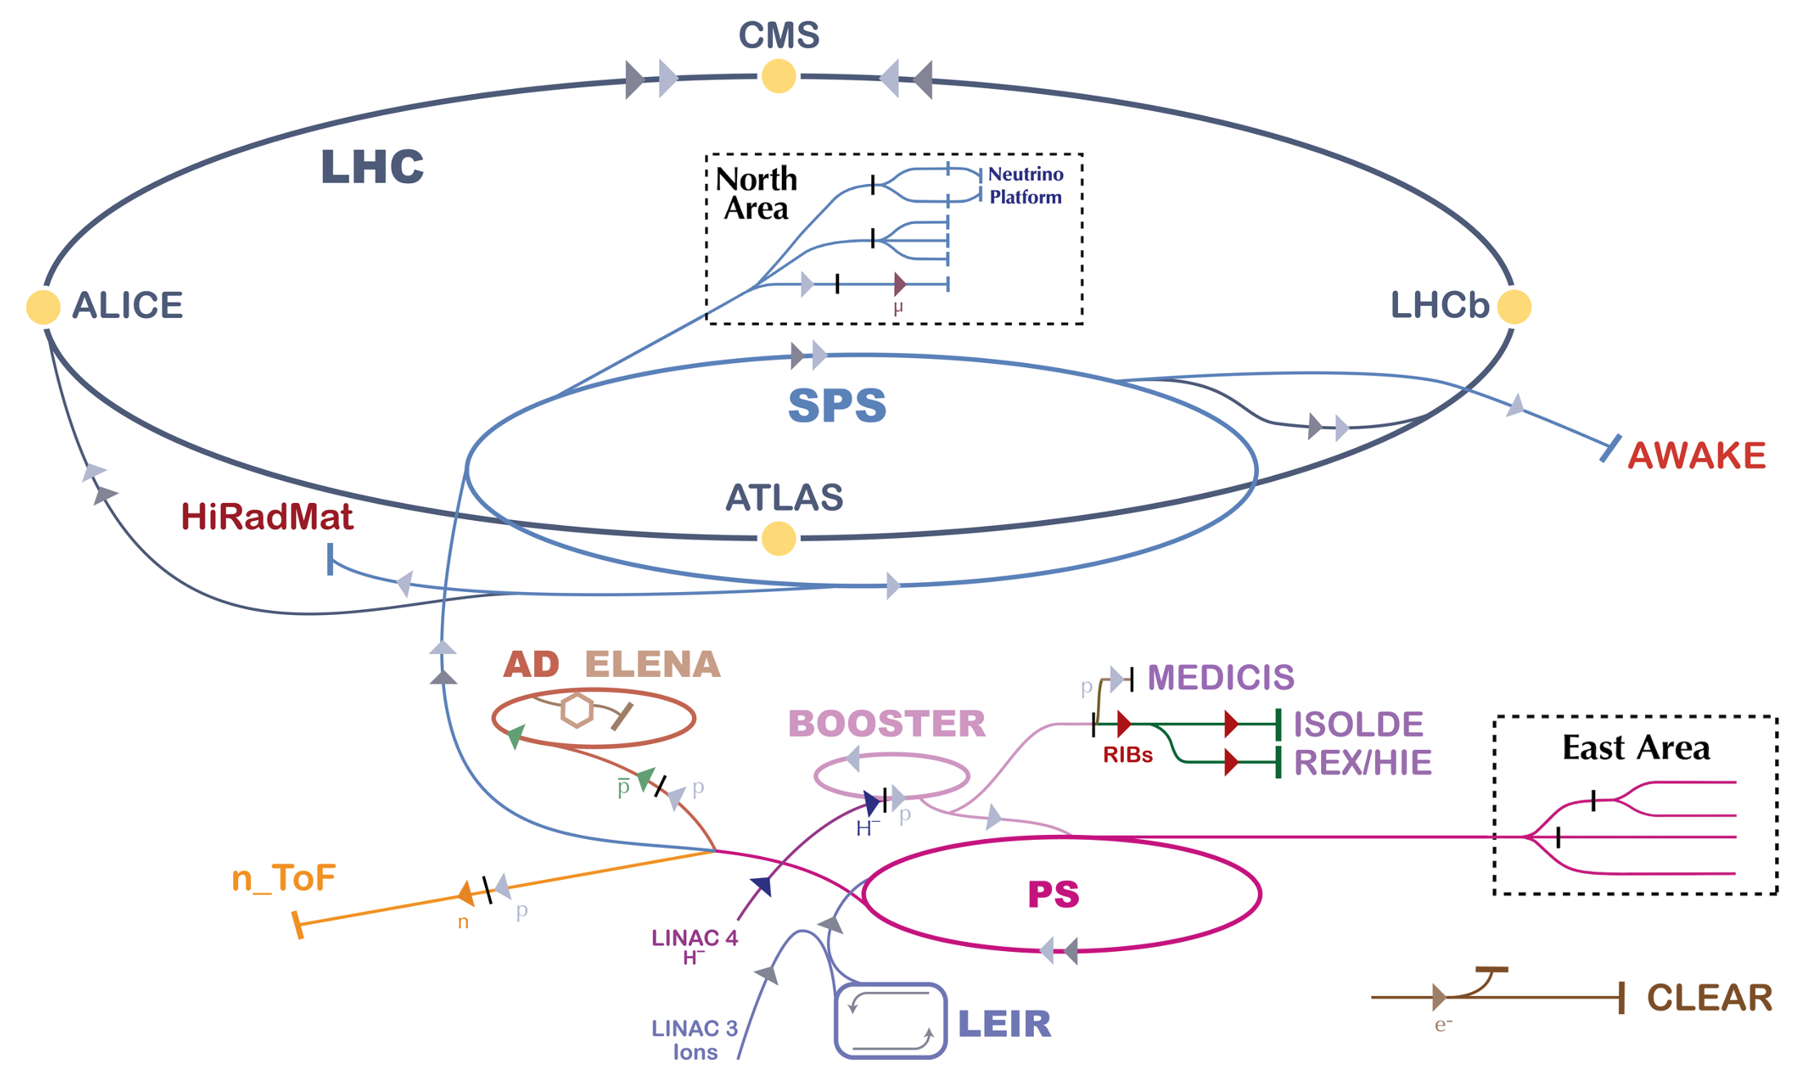
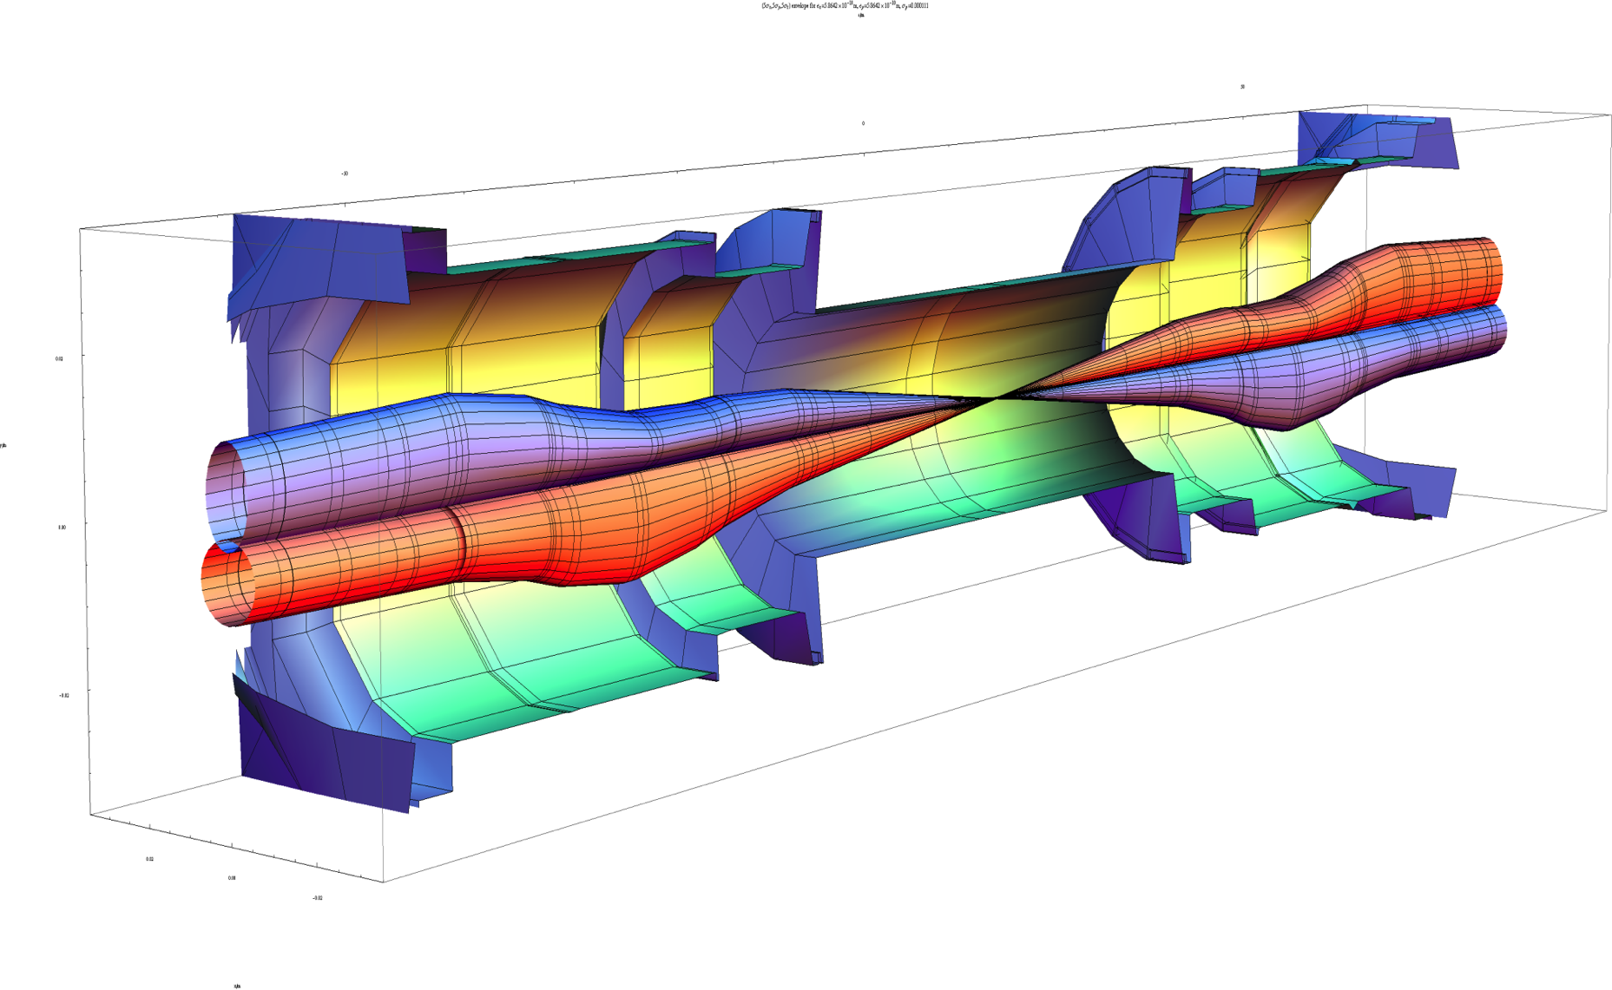
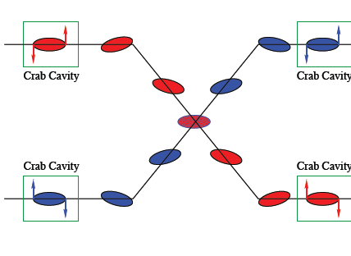
Interaction region upgrade (beta*)
Injector upgrade (bunch population, emittance)
Crossing angle compensation (crabs)
Operate in a high luminosity regime

Slide 5
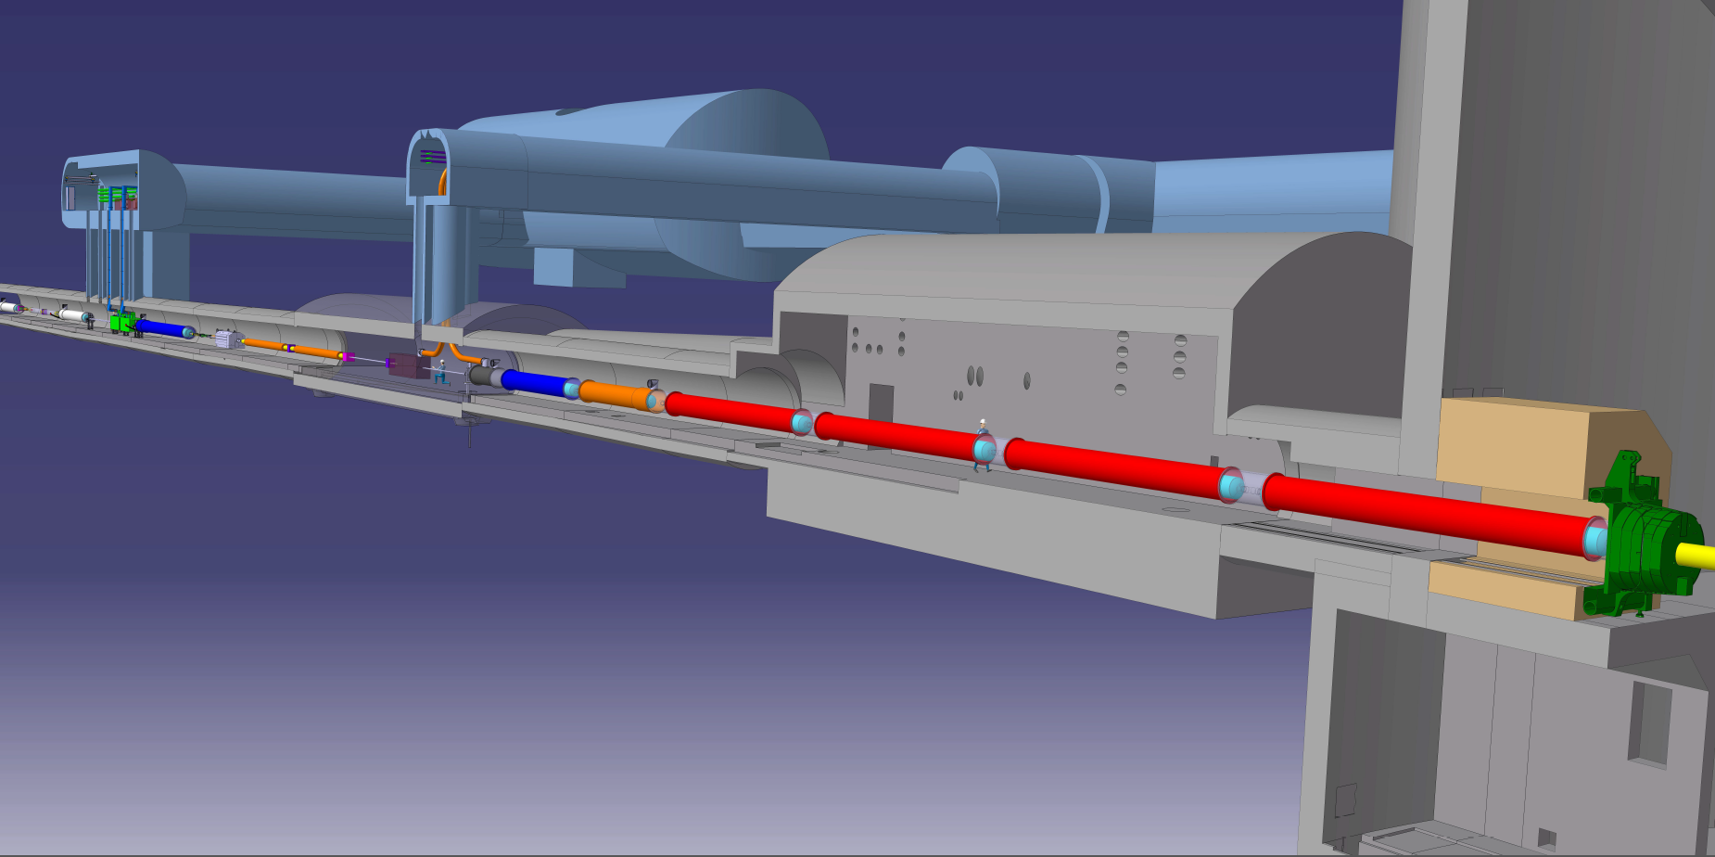








The realization of HL-LHC as a truly international collaboration
Connection to LHC (UL)
Service gallery (UR)
UA Gallery
Service cavern
DQHDS
DFHX
DFHM
Q4
Collimators
SC Links
D2
Crab cavities
D1
CP
Q3
TAXN
DFM
DFX
Q2b
Q2a
Q1
TAXS

Slide 6
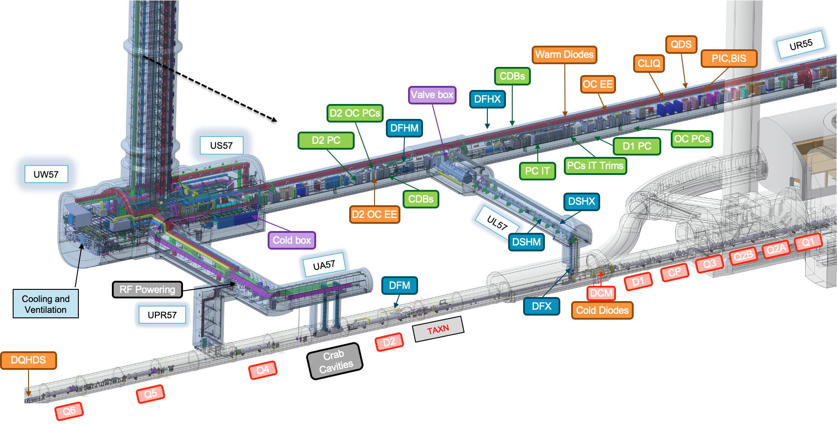

Slide 7
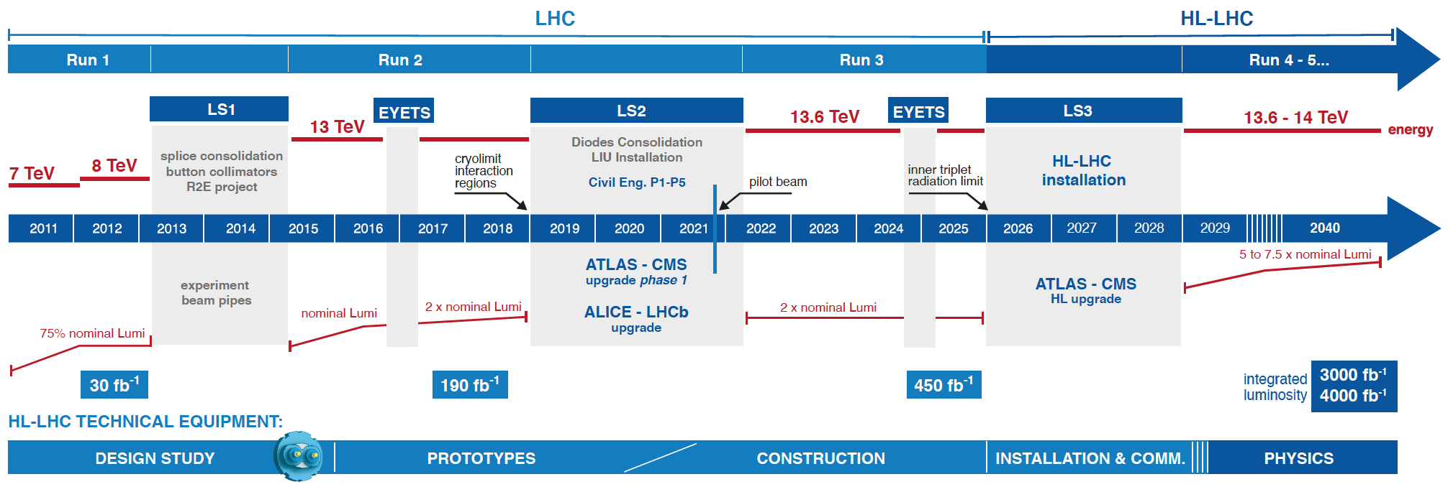
High Luminosity LHC (HL-LHC)

Slide 8
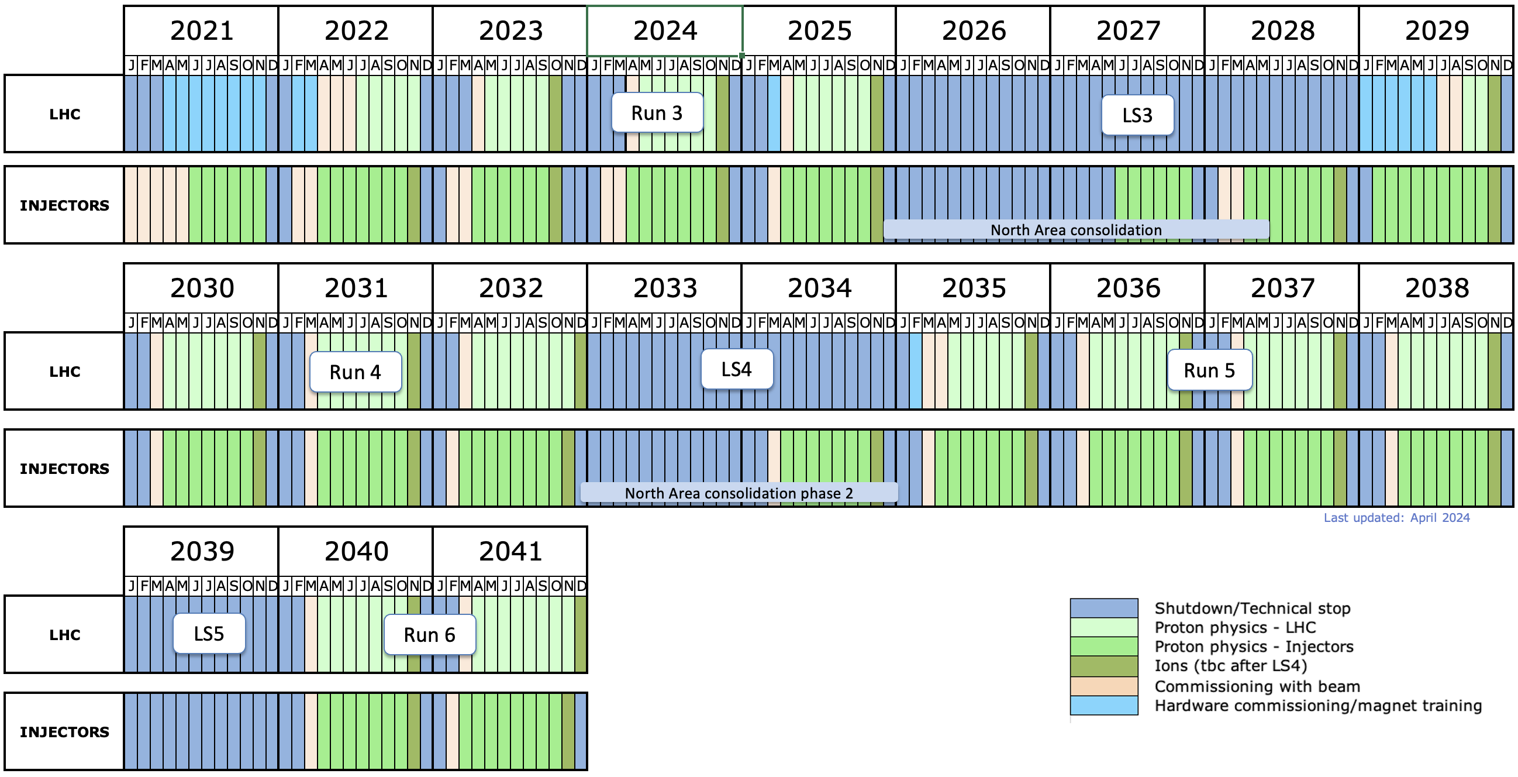
HL-LHC era - indicative timeline
LS3: HL-LHC installation
LHCb-II, ALICE3 upgrades (tbc)

Slide 9
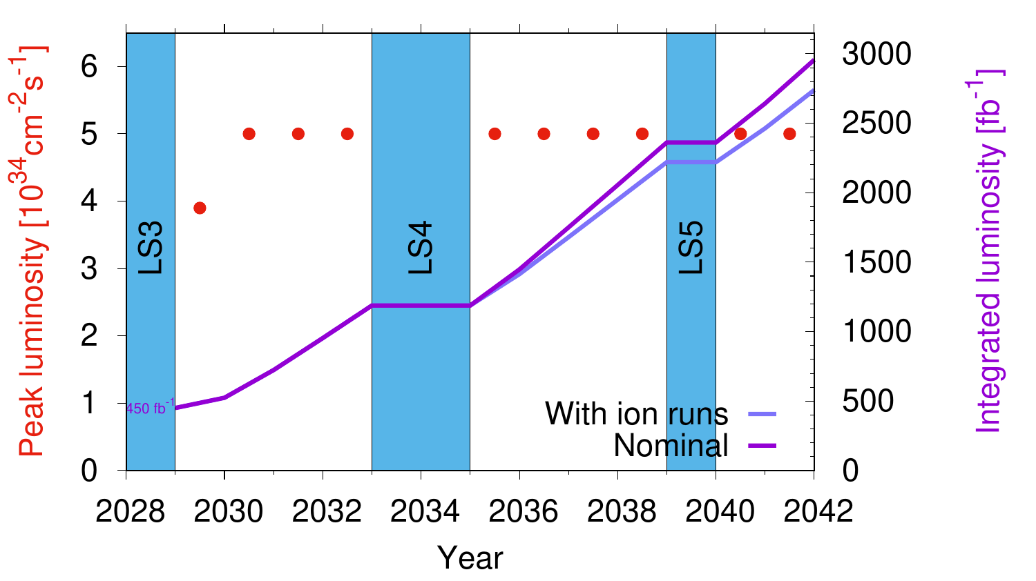
And then another miracle occurs…

Slide 10

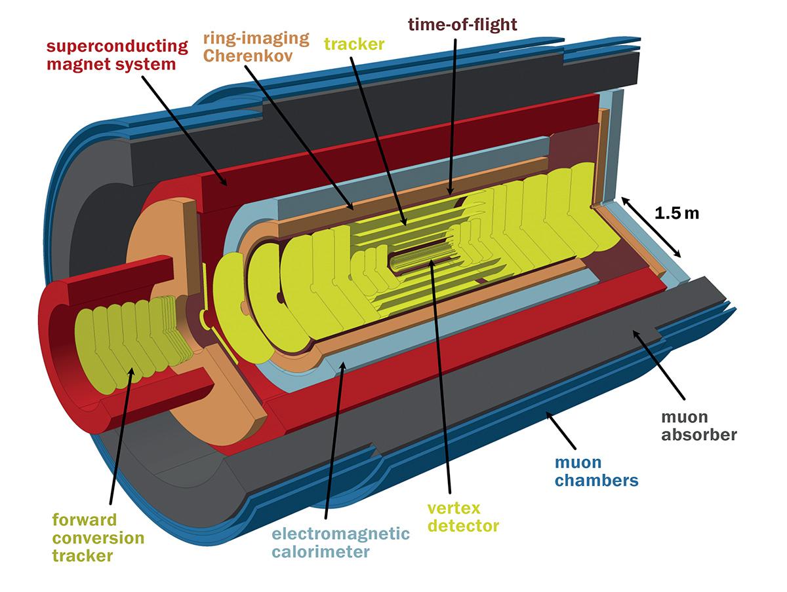
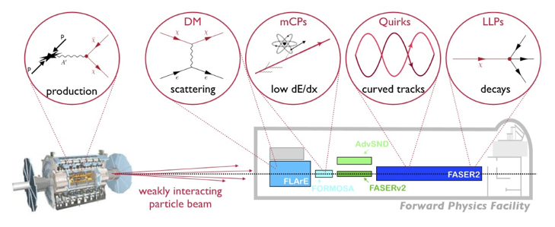
A diverse physics programme
ALICE 3 proposed for LS4
LHCb Upgrade II proposed for LS4
Forward physics
  Precision Proton Spectrometer II (PPS II)
Neutrinos
  SND, FASERnu, AdvSND, Forward Physics Facility (FPF)
Long Lived Particles/FIPS
  GPDs, FASER, SND, MoEDAL, milliQan, FPF, CODEX-b, MATHUSLA, (pro)ANUBIS
Fixed target
  SMOG-2@LHCb, LHCspin, TWOCRYST (Λc⁺ MDM/EDM)

Slide 11
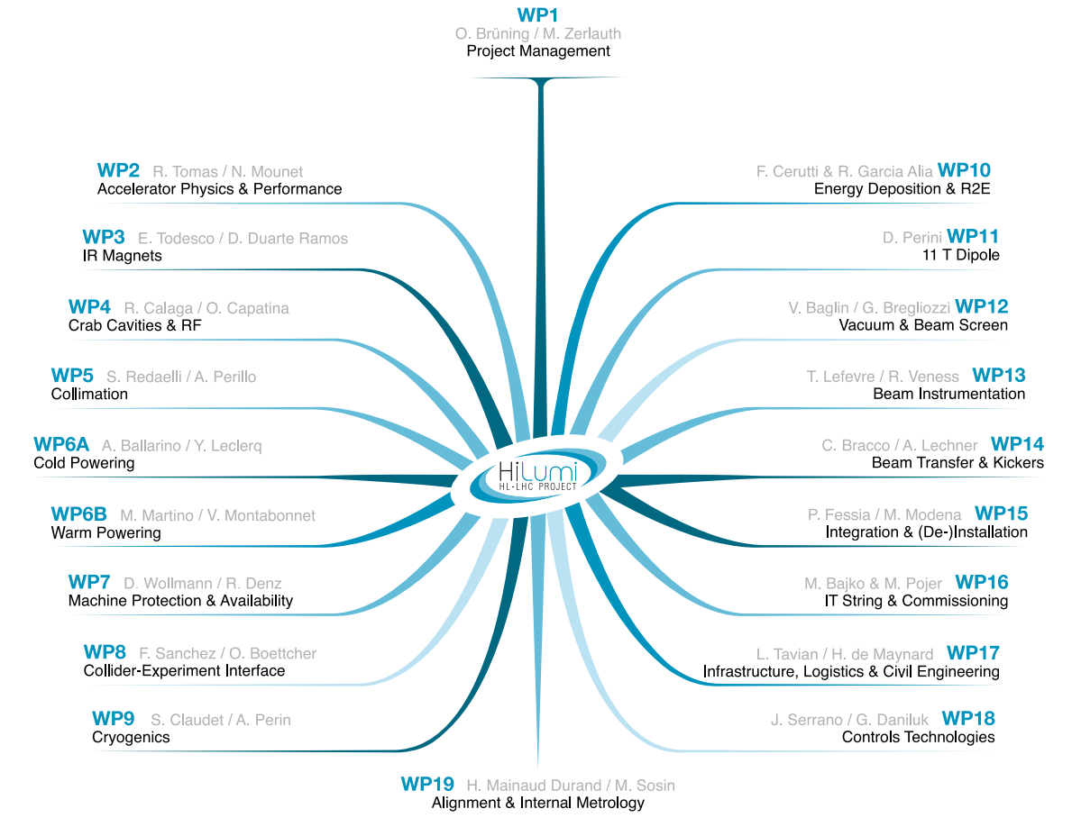
HL-LHC Work Packages

Slide 12
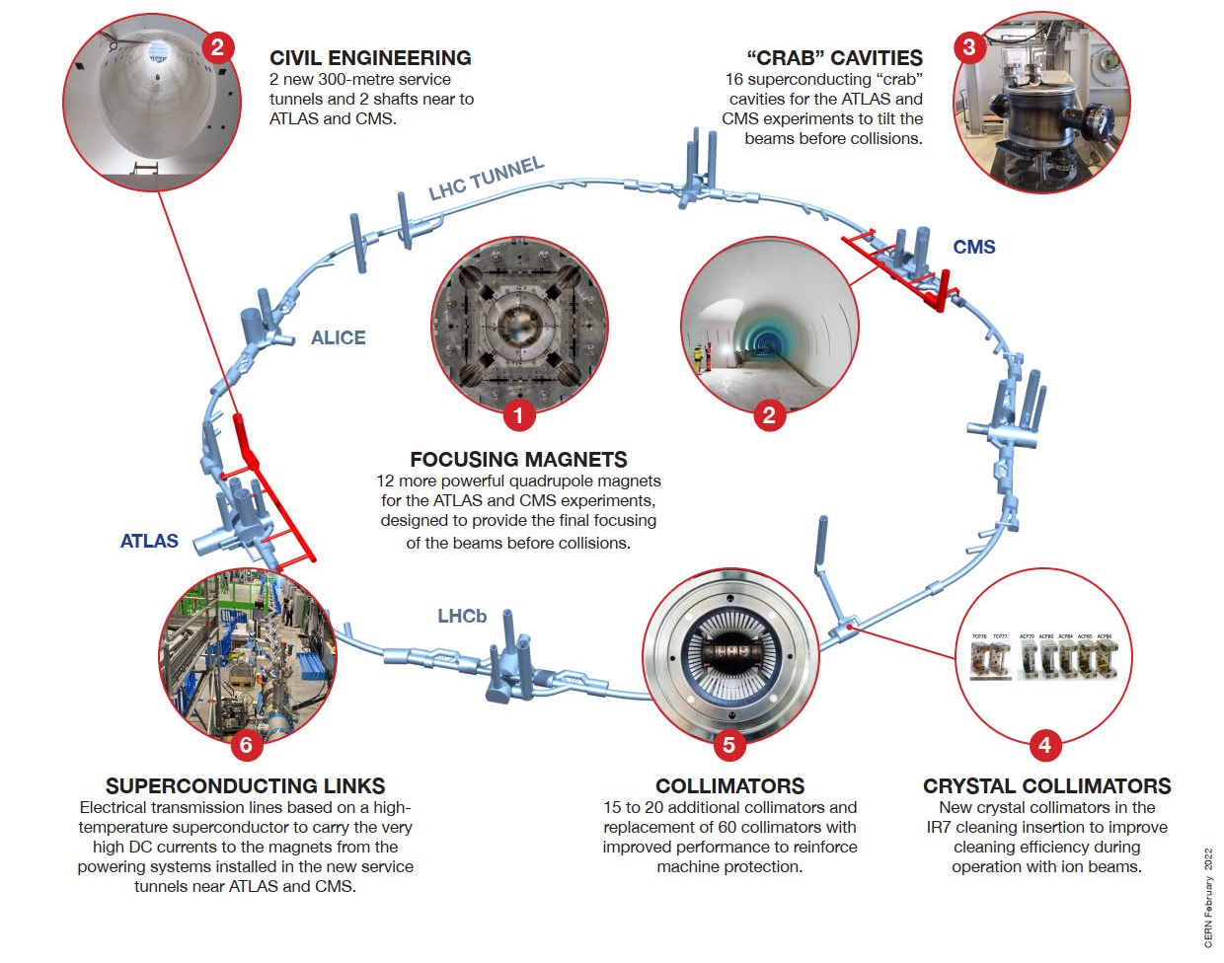
HL-LHC technology landmarks
Series production in Industry well underway
Finished in 2023
Fully validated in 2023 and first magnets ready for installation
HL-LHC has many challenging novelties covering a broad technology spectrum
Technology intensive project!
Finished in 2023
Successfully deployed in 2023 Pb-Pb run
Complete Prototype System installed in SM18 and tested
½ system already installed for Run 3

Slide 13
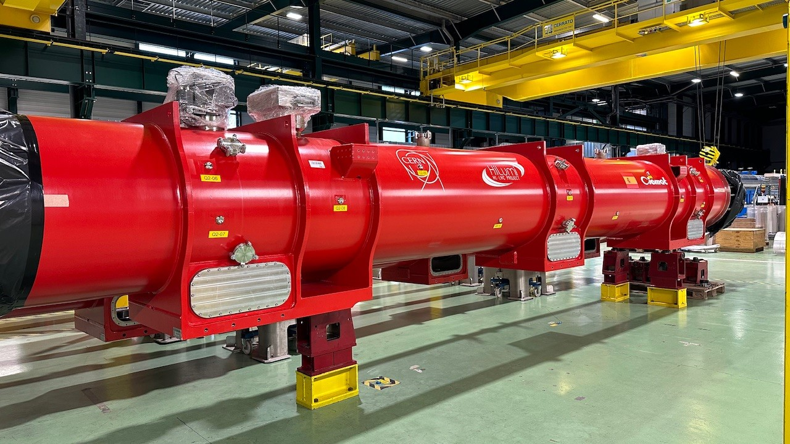
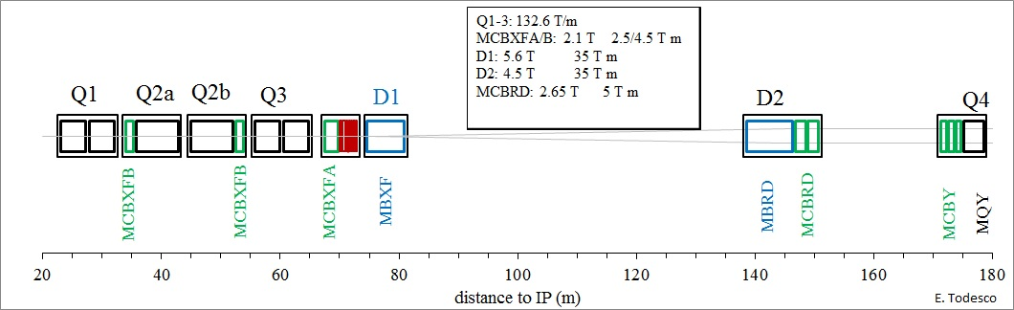
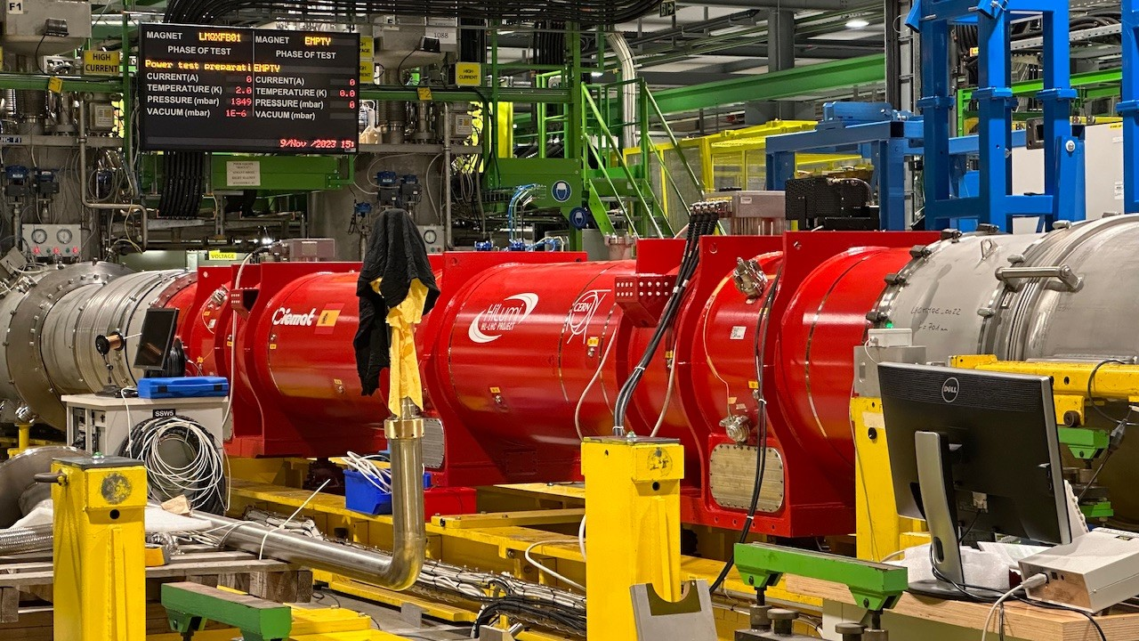
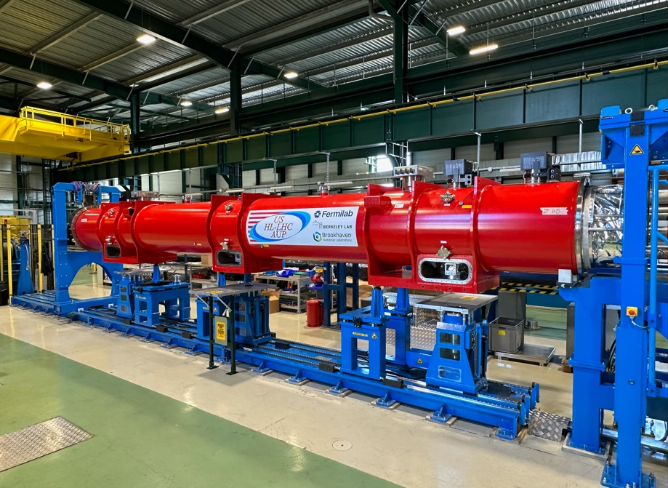
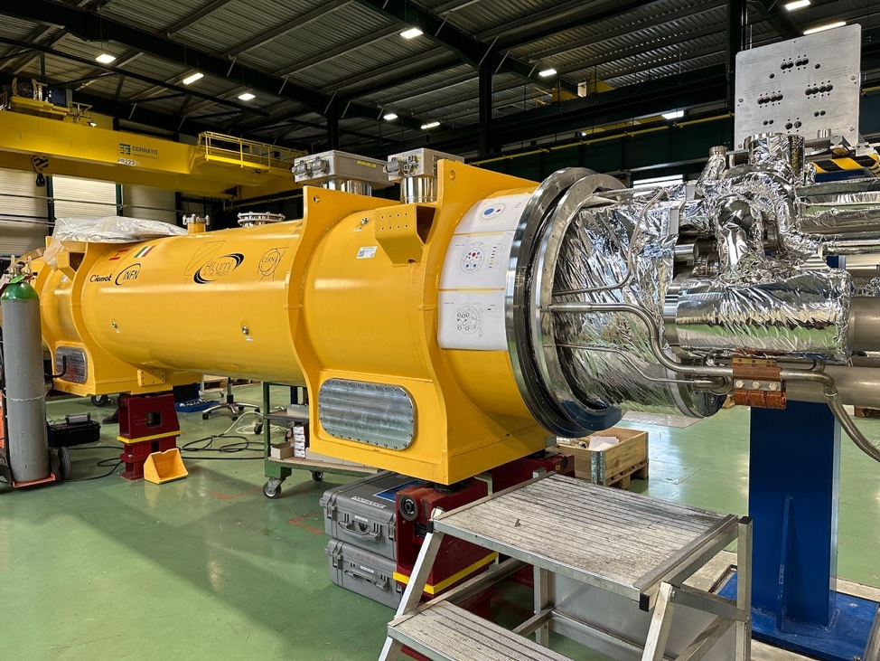
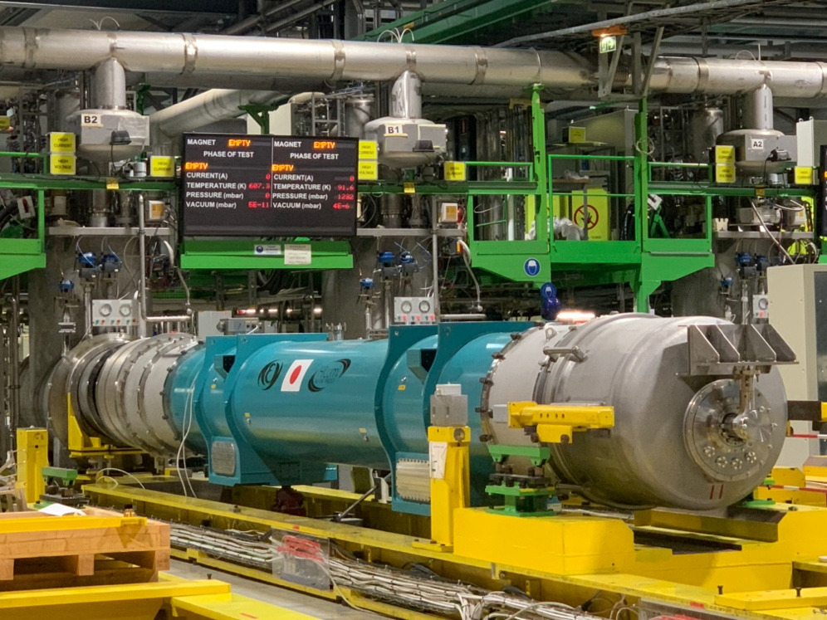
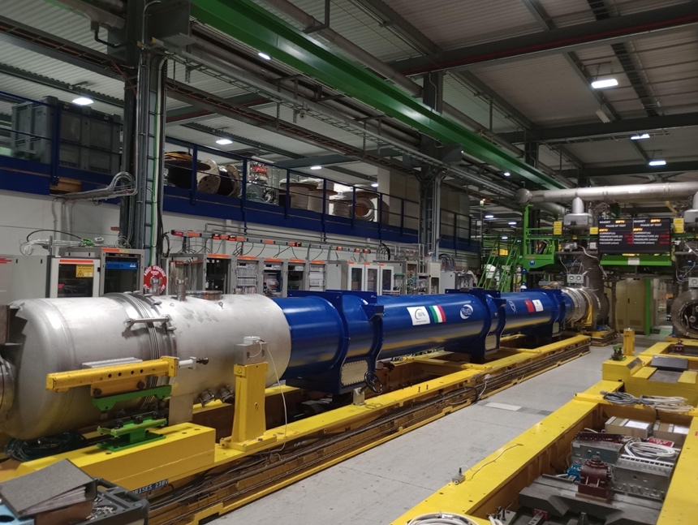
Magnets

Slide 14
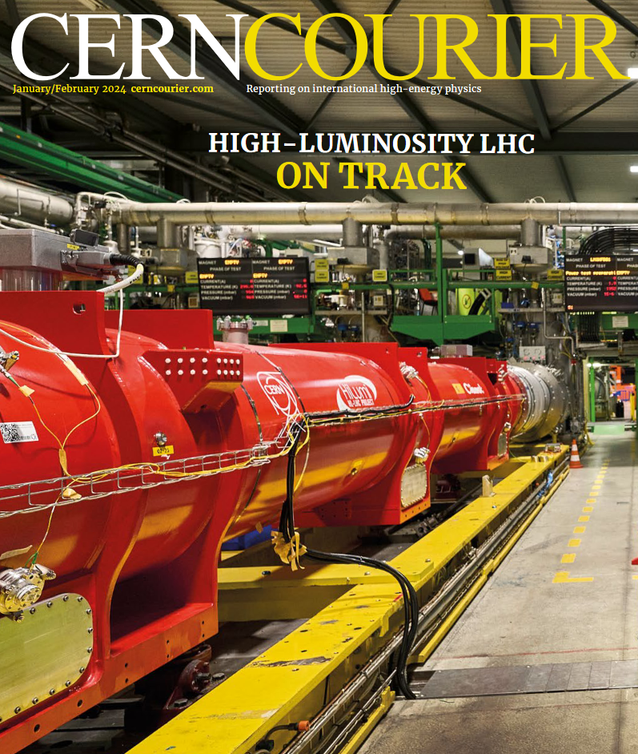
Magnets
This year will be a crucial year for qualifying
HL-LHC magnets and the cold powering system
repeatability of CERN Nb₃Sn quadrupole performance – confirmed (April)
test of first complete cold powering system
electrical robustness of cryomagnets and cold powering system
horizontal test bench upgrade to be completed

Slide 15
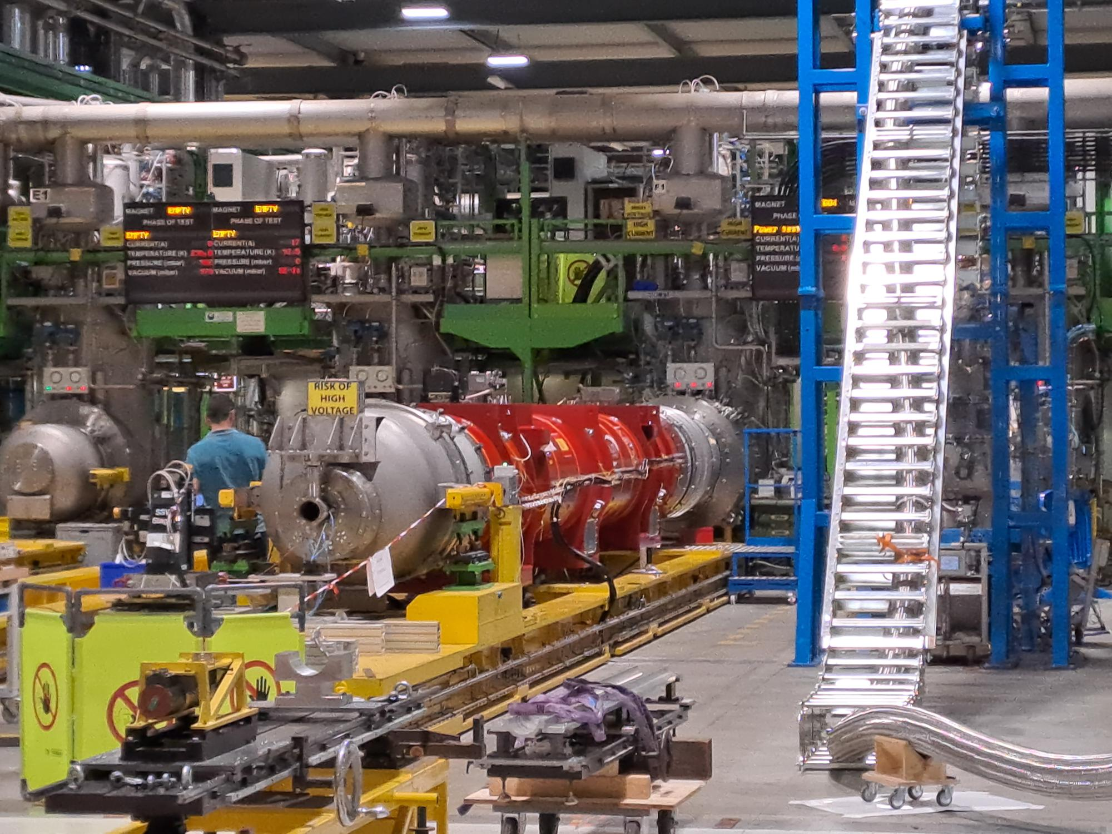
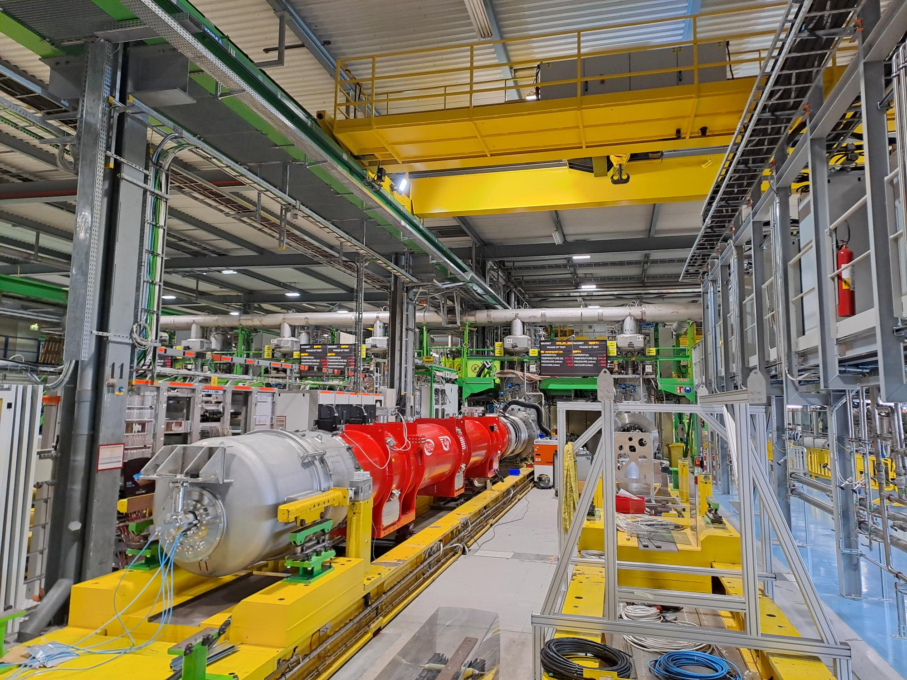
SM18 – this week
MQXFB04 successfully completed test program
LQXFA01 (Q3 in IT String) placed on bench for cold tests

Slide 16
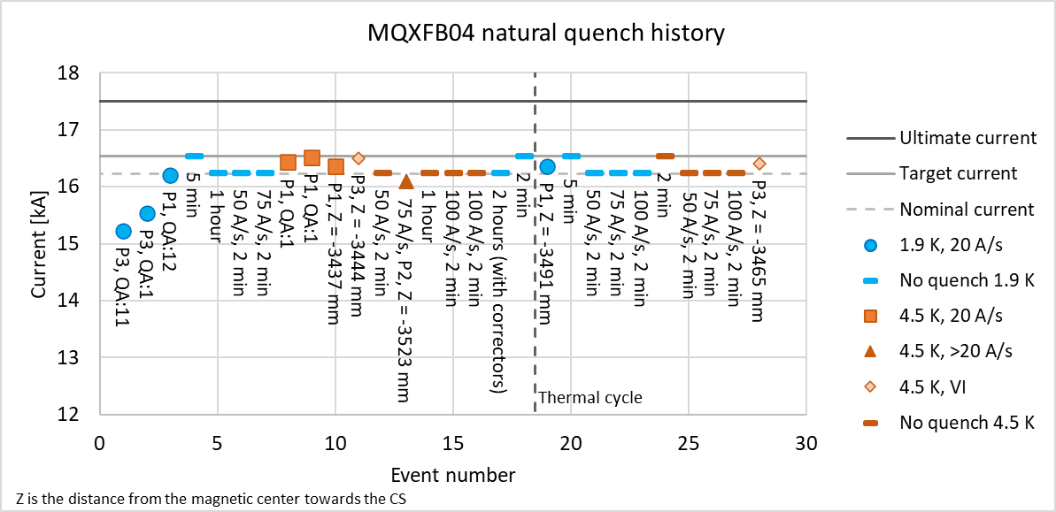
Latest series CERN inner triplet quarupole (QXFB)
Increased magnetic field at coil → shift from niobium-titanium to niobium-tin (Nb₃Sn)
However, Nb₃Sn is brittle – some issues with degradation at prototype phase

Slide 17
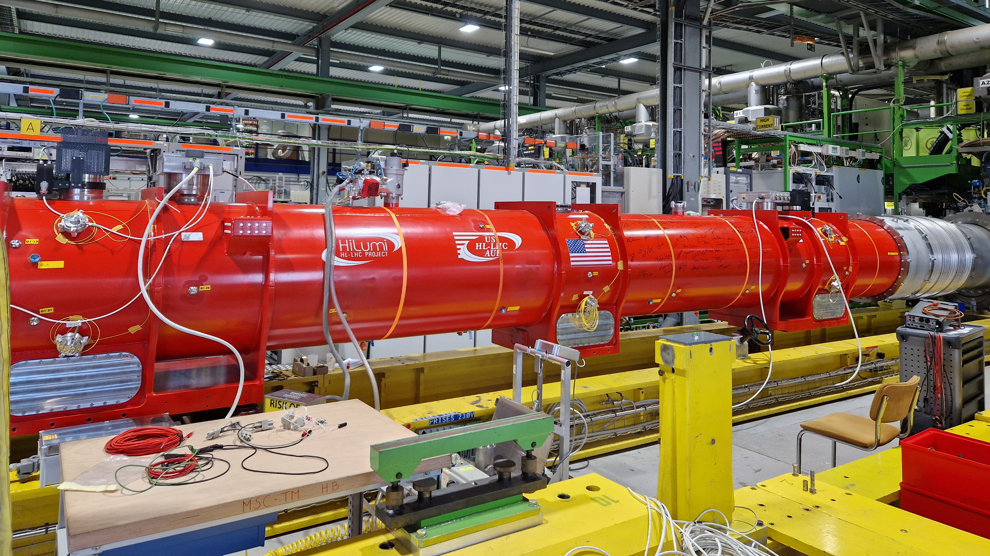
LQXFA01 AKA Q1/Q3 – FIRST QUADRUPOLE CRYO-ASSEMBLY PRODUCED IN THE US BEING TESTED IN SM18

Slide 18
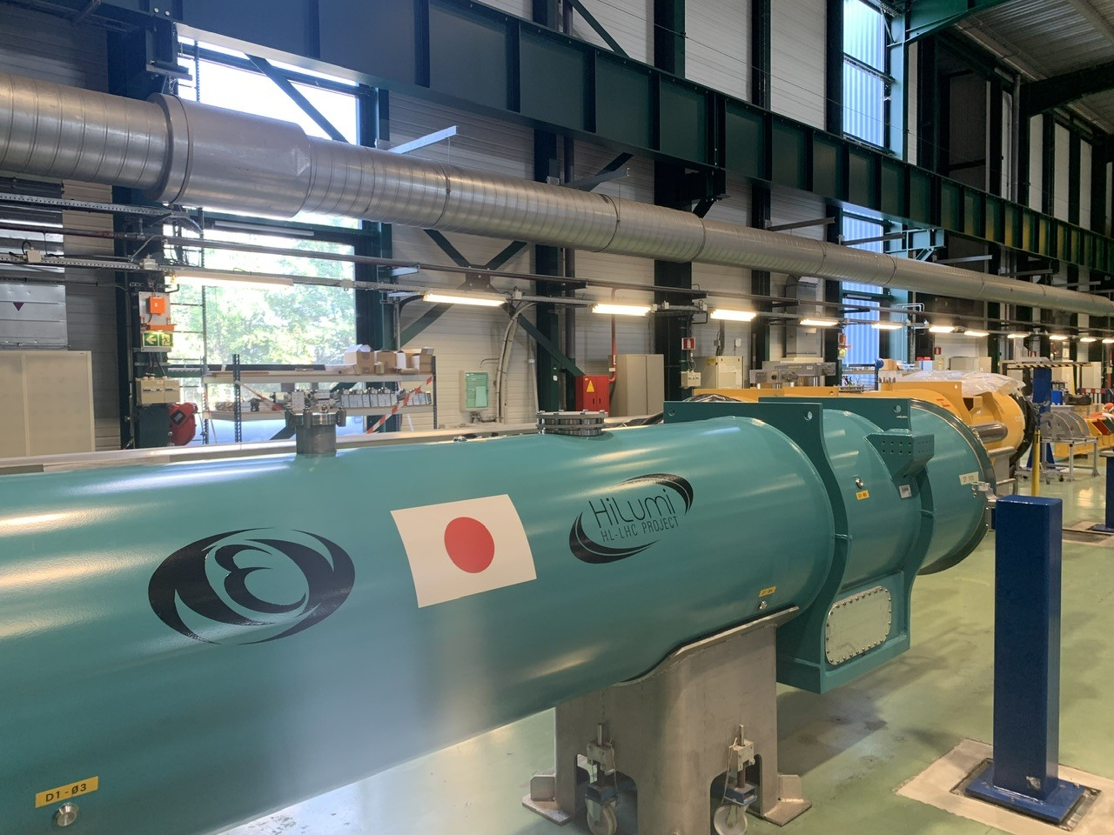
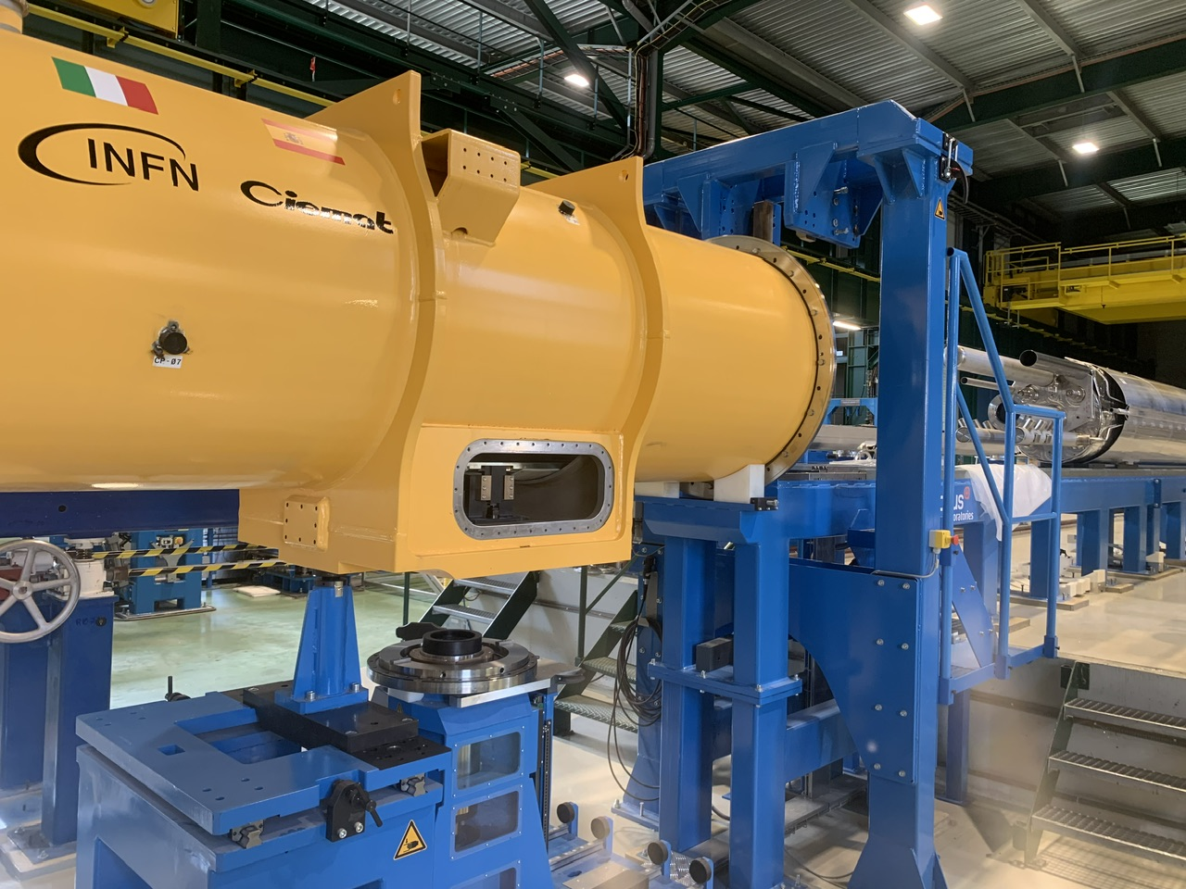
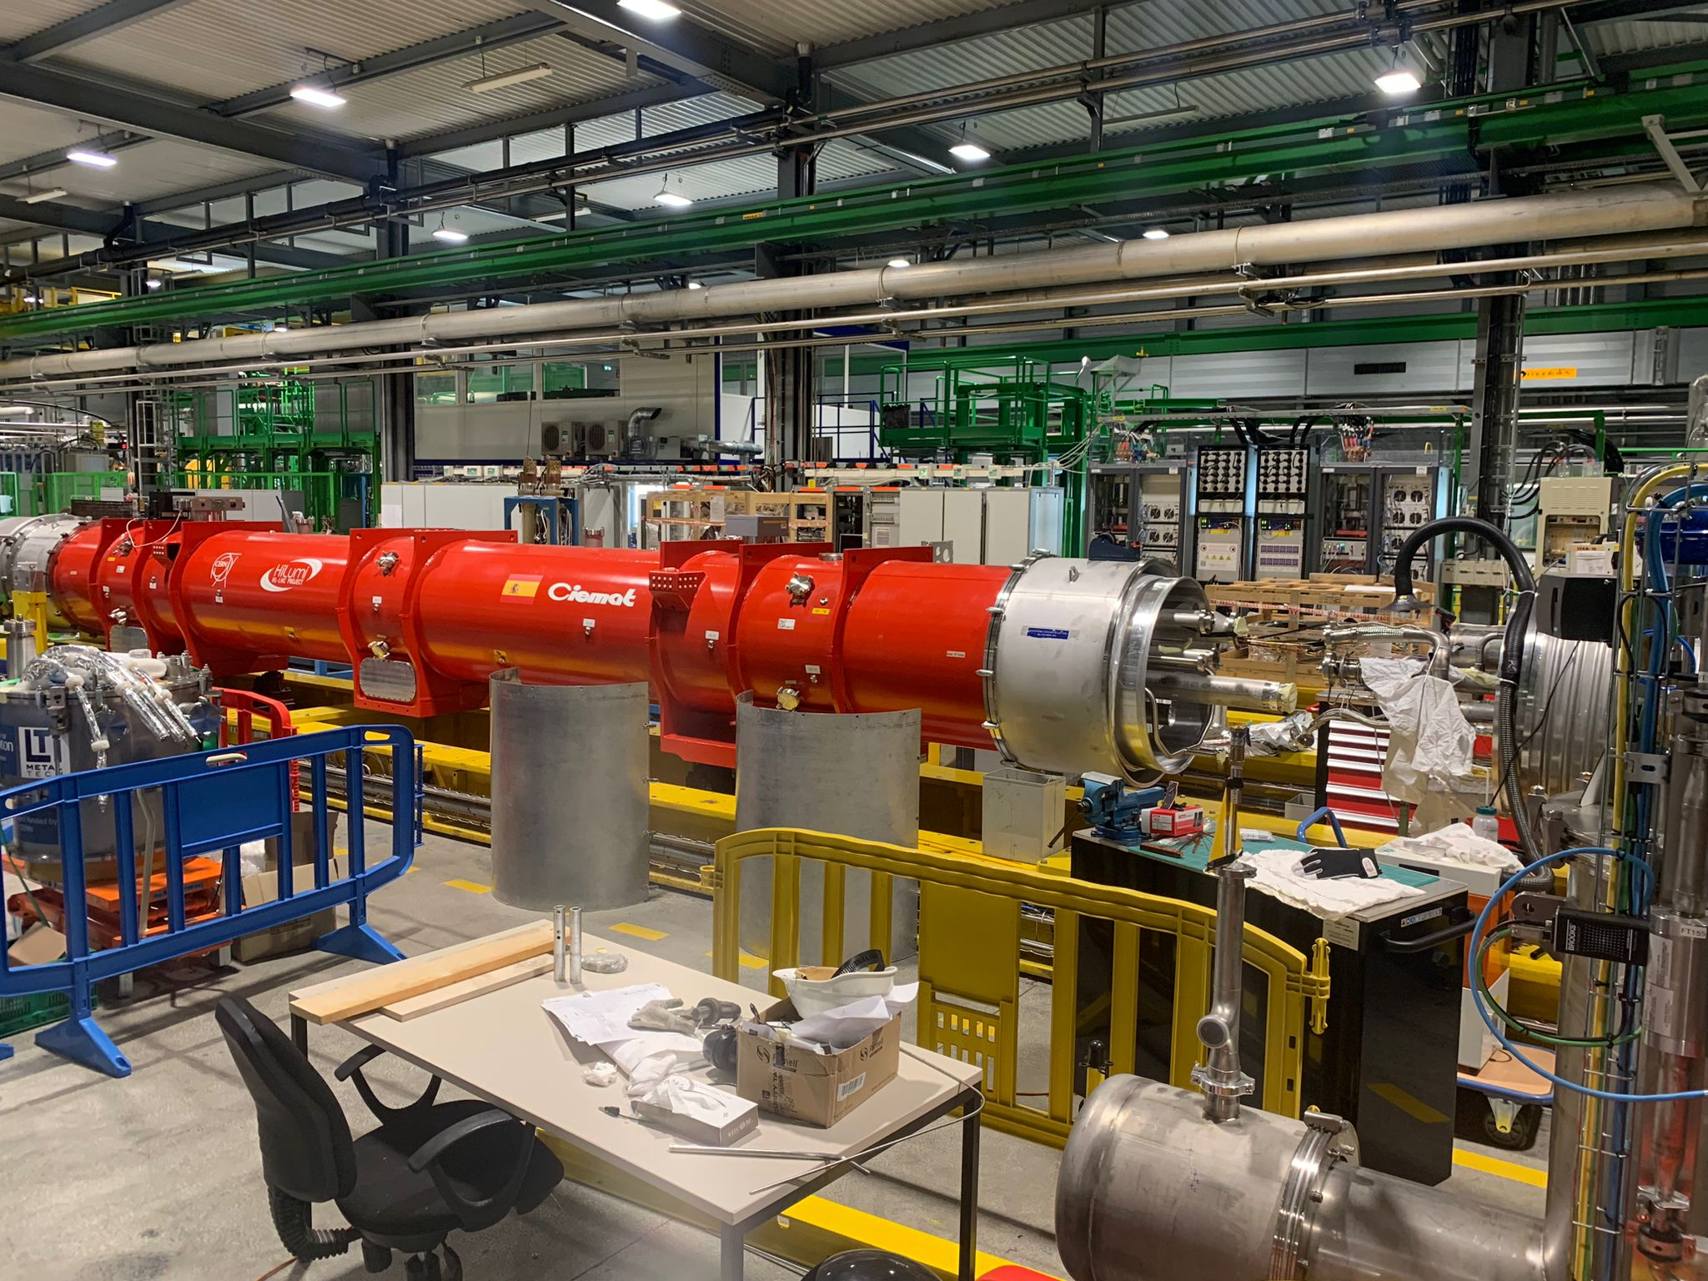
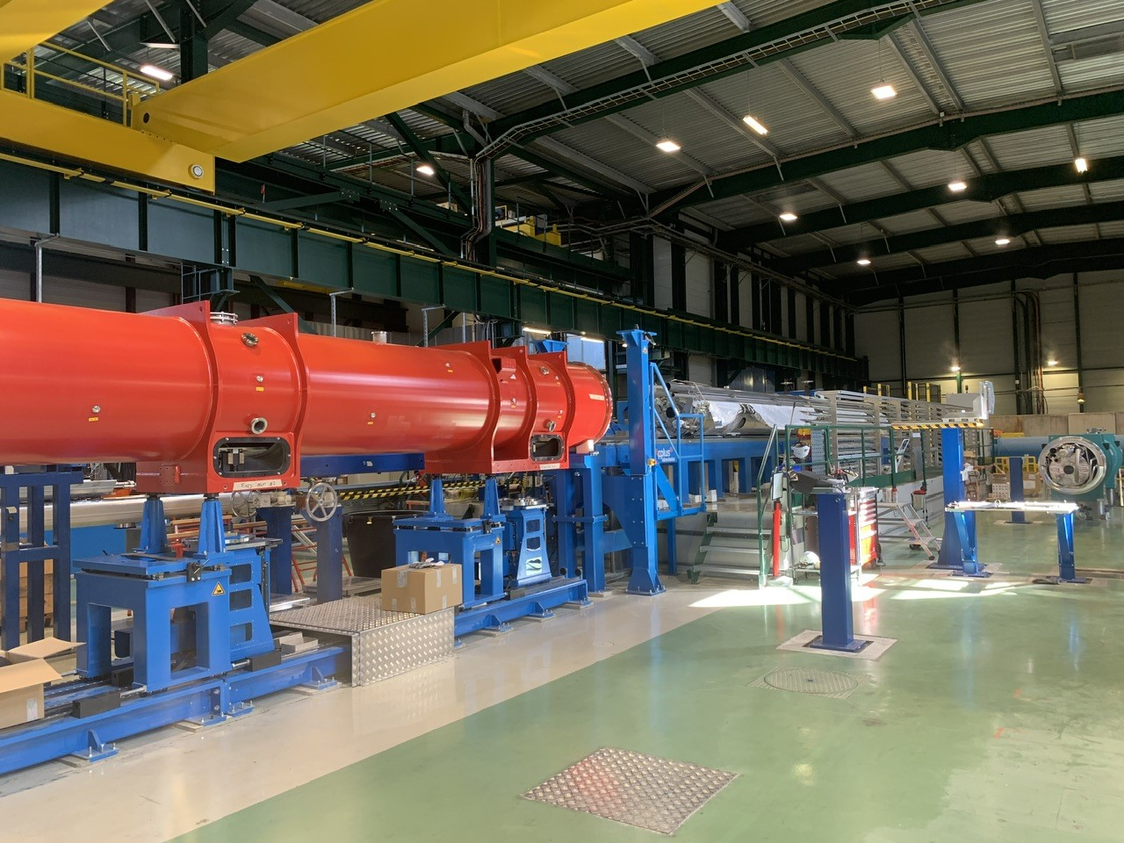
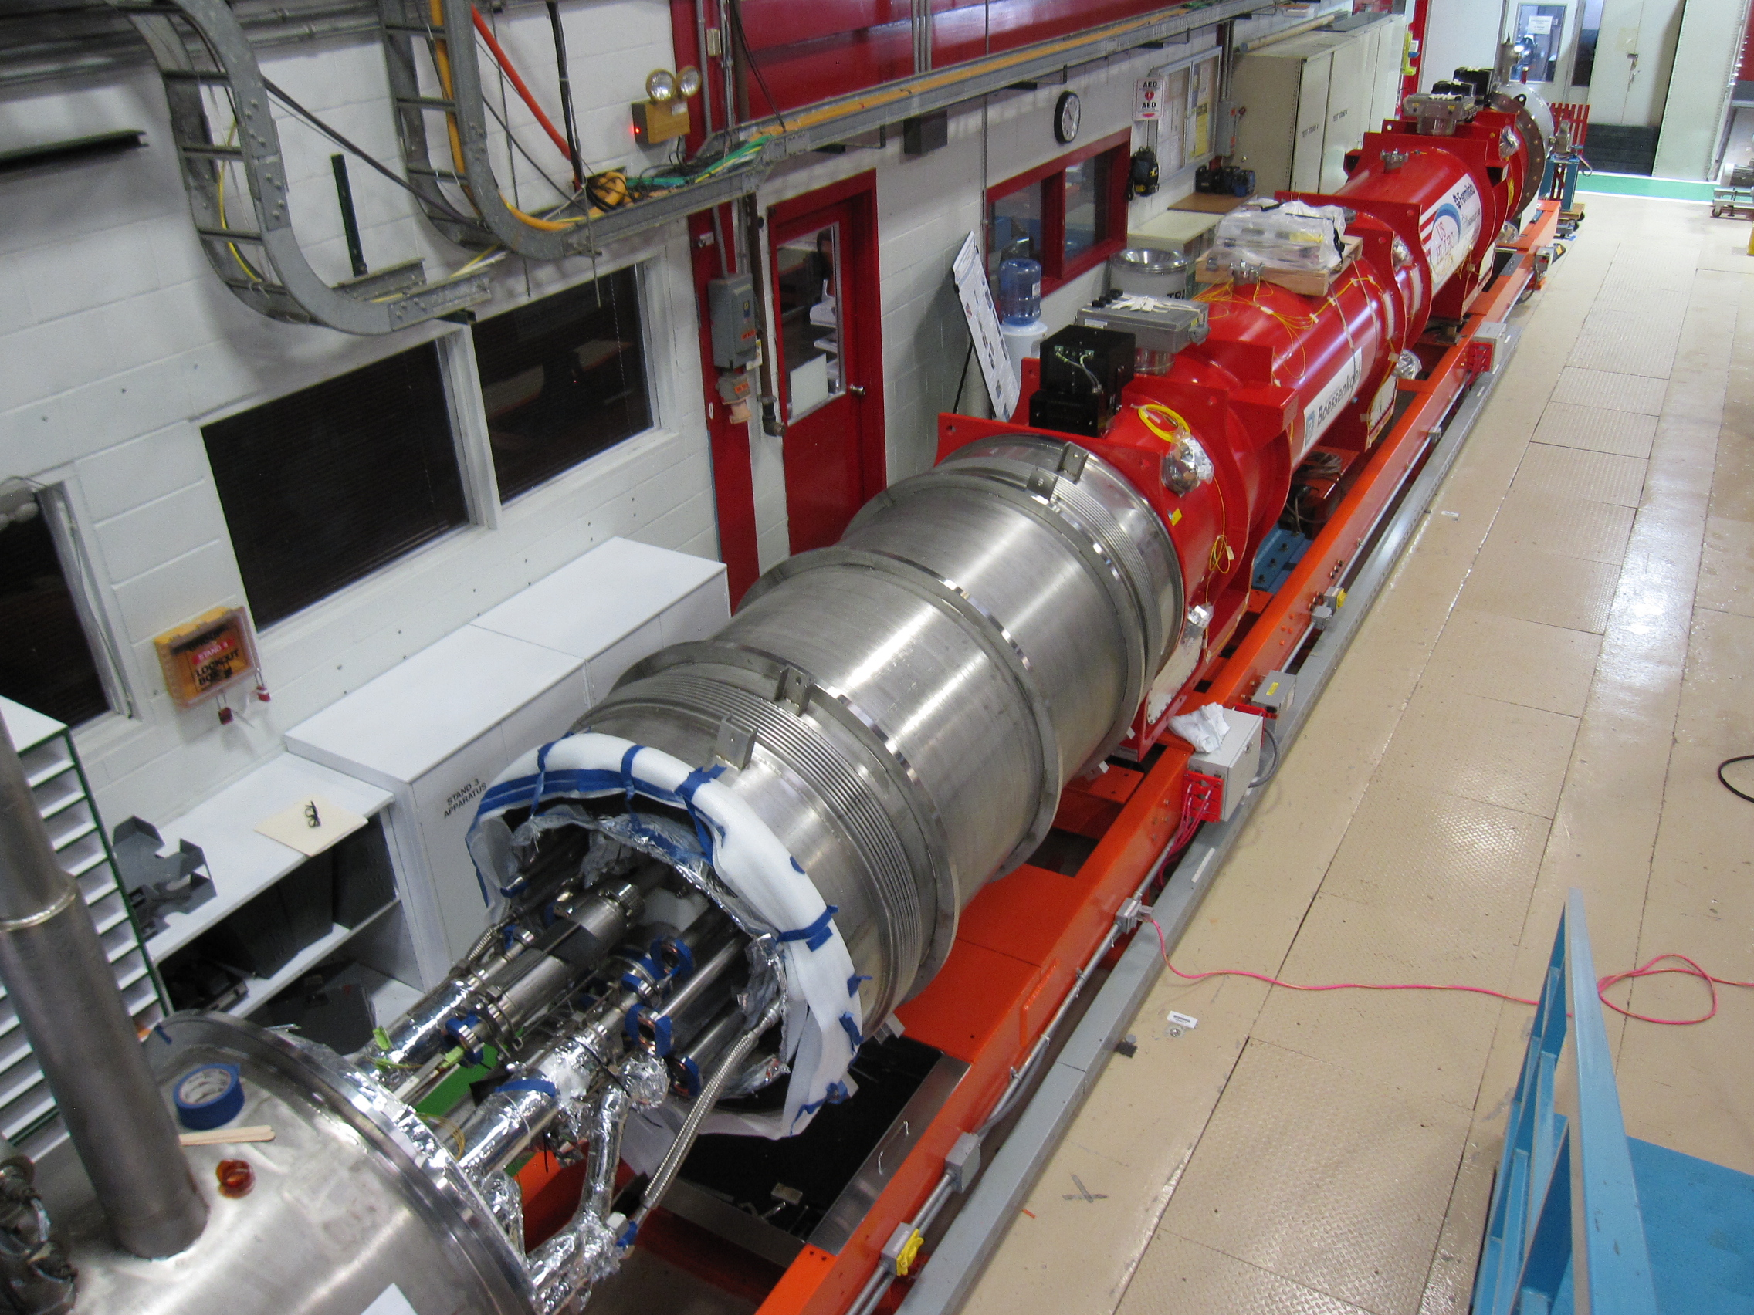
Inner Triplet (IT) String components in preparation
  Q1: magnet cold mass being welded → Available in September 2024
  Q2a: MQXFBP2b completed → On SM18 Testbench → Available April 2024
  Q2b: MQXFBP3b completed → Available for Testbench Jan. → April 2024
  Q3: magnet being prepared for shipment to CERN → Available July 2024
  CP: cryostating Phase II ongoing → Available August 2024
  D1: cryostating completed → Available for Testbench → Available March 2024
D1
(in SMI2)
CP
CP
(SMI2)
Q2b
In SM18
Q2a
(in SMI2)
Q2b
(in SM18)
Q3
(in FNAL)
Notes:
To be updated by Ezio’s PSM presentation

Slide 19
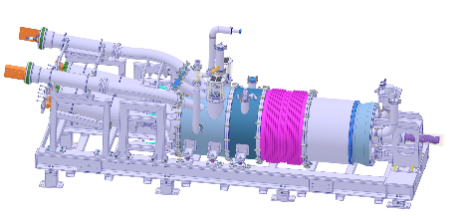
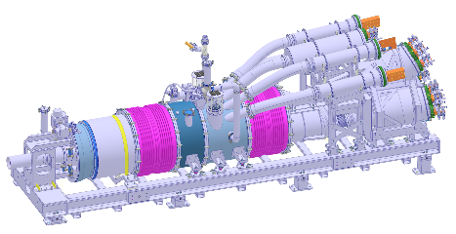
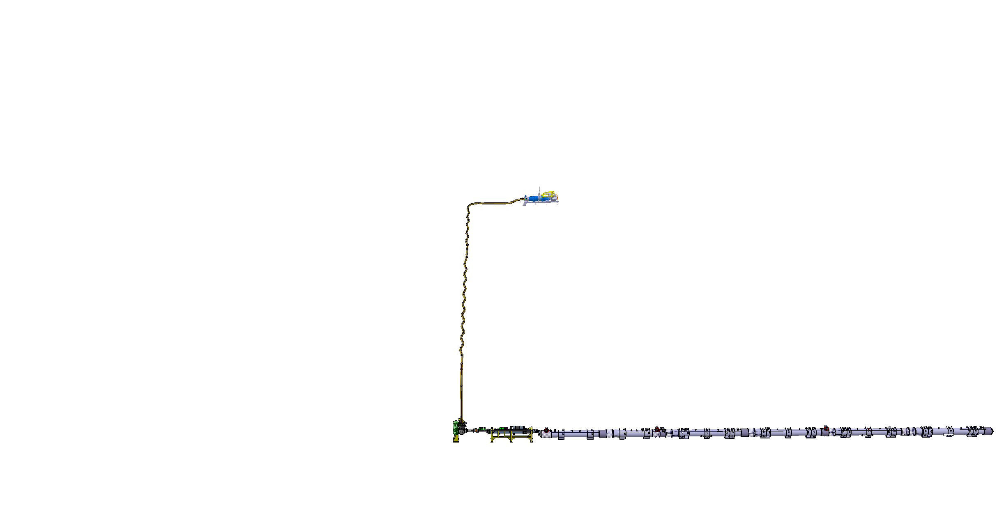
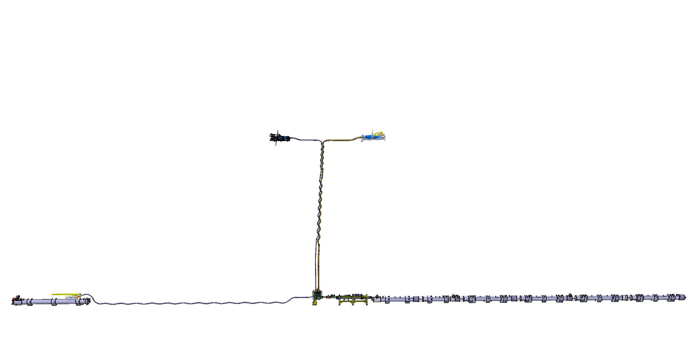
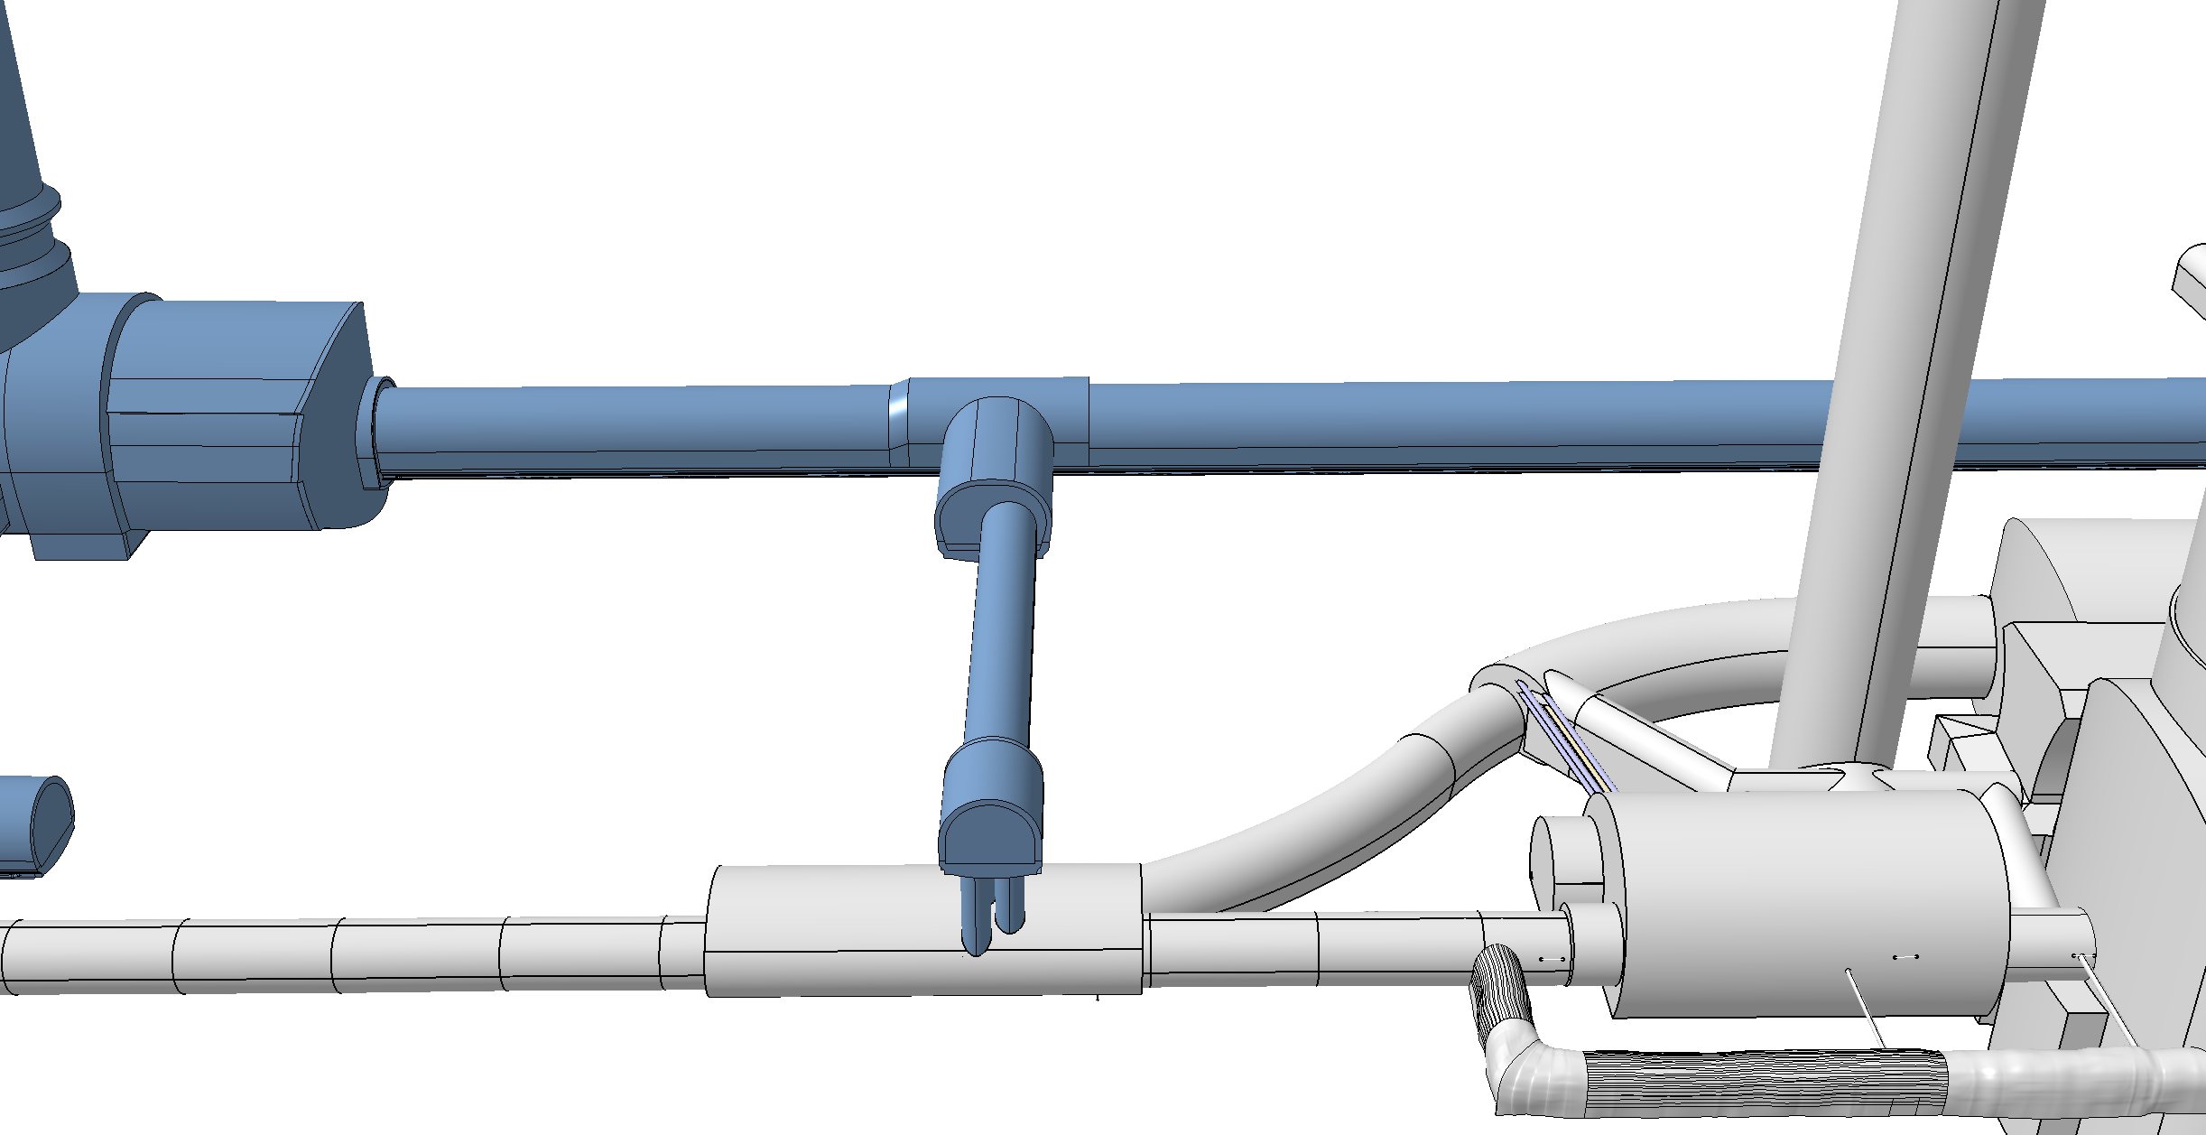
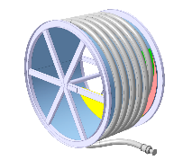
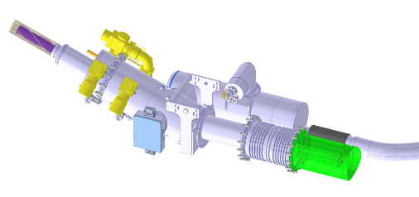
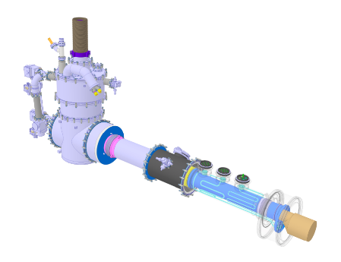
Cold Powering System
DFHM
DFHX
Power converters: (18, 0.6) kA
Power converters: (18, 7, 2) kA
DSHM
DSHX
140 m
89.5 m
Power converters: (60, 120, 200) A
D2
DCM
D1
CP
Q3
Q2B
Q2A
Q1
DFM
DFX

Slide 20
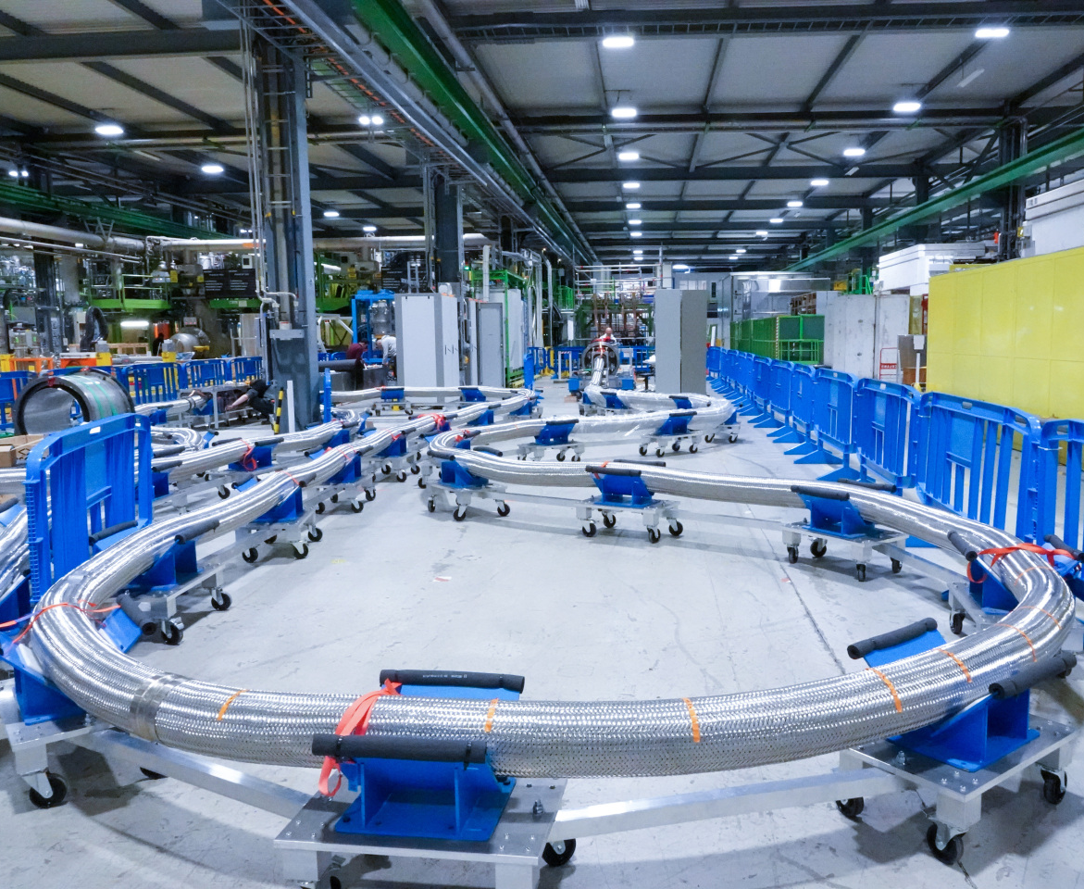
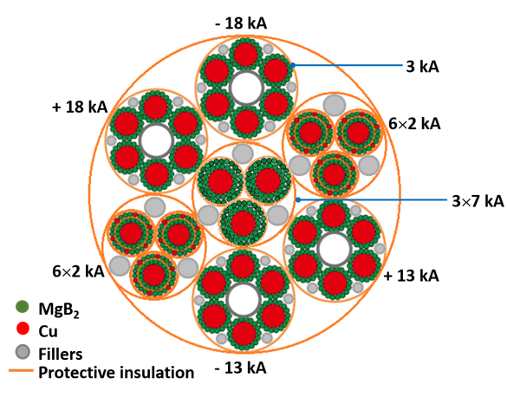
Superconducting link
The flexible, double-wall, corrugated cryostat comprises 19 MgB₂ superconducting cables in a single assembly, twisted together to form a compact bundle. These 19 superconducting cables can transfer altogether a DC current of about 120 kA at ~20 K.

Slide 21
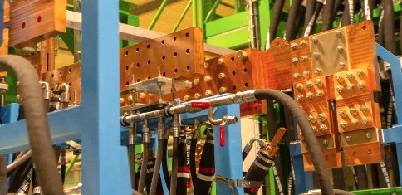
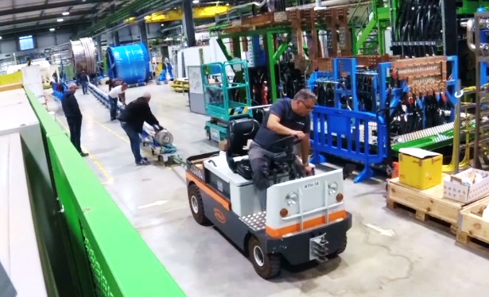
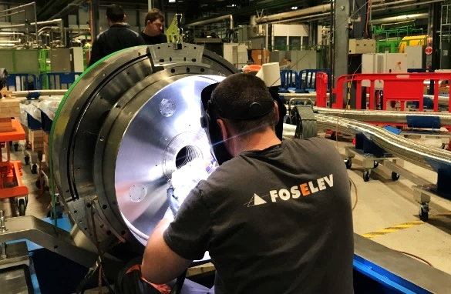
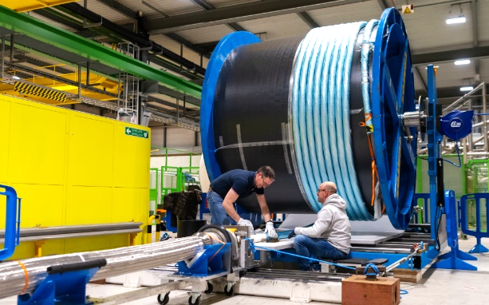
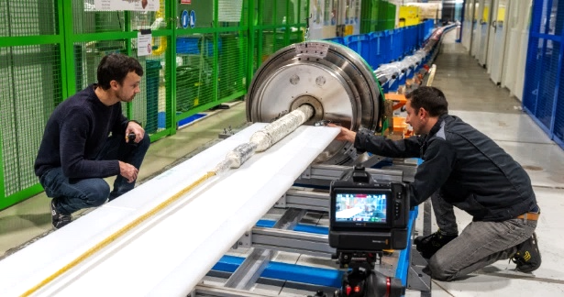
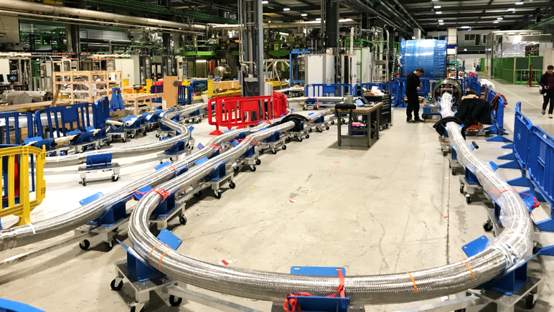
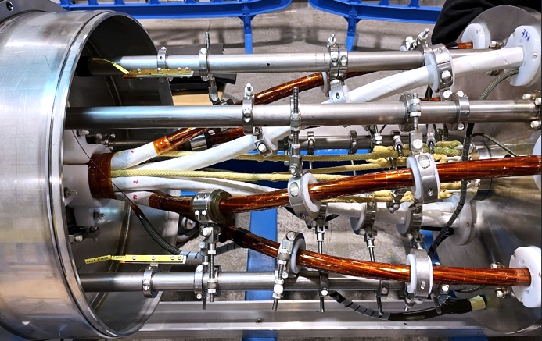
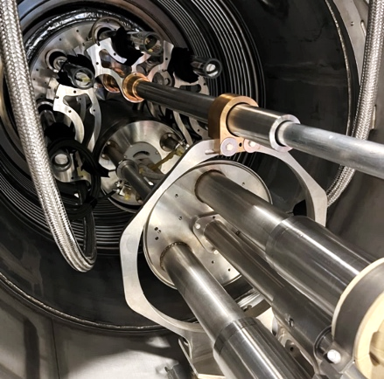



SC-Link-DFHX assembly in pictures
Complete system test of full SC link now complete

Slide 22


Slide 23






Crab Cavity series production well underway
First two series DQW cavities (CERN + RI)
reached performance beyond specification!
  RFD cryomodule assembled in UK at CERN
  DQW Dressed Cavity
  RFD pre-series 1 and 2
  RFD series fabrication launched at Zanon since May 2023

Slide 24













UK Crab Cavity Cryomodules

Slide 25

RFD cryomodule assembled in UK and being tested in
M7 bunker (SM18-CERN) before installation in SPS

Slide 26


HL-LHC LS3 Schedule
Q4 2025
LS3 Schedule – TCC October 2023
Warm-up and related tests
LSS dismantling after cryo lockout
Cabling dismantling
Core excavation (LHC side)
Plus
Injector Complex
North Area Consolidation
ECN3
Experiments (+CO2 cooling)
…
Cabling installation
LSS installation
Cool-down, related test and HWC
Long Shutdown 3 (LS3) is going to be very busy!
Q3 2029

Slide 27

Conclusions
Civil Engineering Work Completed
Nb₃Sn Technology validated
Repaired
MB Dipole
MQXFBP3
Superconducting Link demonstrated
Crab Cavity Operation and Production demonstrated
MQXFB02
D1
proto
CP
”The project is on track for installation during LS3 starting in 2026”
Stay tuned for completion of the
IT-String installation in 24 and operation @ cold as of 2025
1st Part of Collimation Upgrade completed
All magnet production on a good track
STILL A LONG WAY TO GO…

Slide 28


