Slide 1

Novel triggering strategies
at High Luminosity LHC
Marco Zanetti
University of Padova and INFN

Slide 2

“Classical” Trigger systems
Target a set of predefined signals/topologies, run online algorithms that select them, reducing the event rate to disk to an amount manageable by offline computing and analysis
temporary storage
permanent storage
10011101010111...

Slide 3
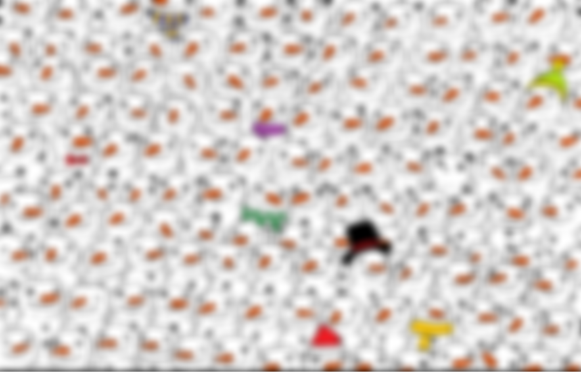
“Classical” Trigger systems
Target a set of predefined signals/topologies, run online algorithms that select them, reducing the event rate to disk to an amount manageable by offline computing and analysis
temporary storage
permanent storage
10011101010111...
The main constrains:
Latency: delay between the start of a process and the arrival of its results
Throughput: the rate at which the process can start over

Slide 4
“Classical” Trigger systems
Target a set of predefined signals/topologies, run online algorithms that select them, reducing the event rate to disk to an amount manageable by offline computing and analysis
temporary storage
permanent storage
10011101010111...
Typically “layered”: 2 or more levels dealing with decreasing rate and increasing granularity/resolution

Slide 5
Leveraging Technology Advancements
Trigger systems have been and will be profiting from sensational advancements in Telecom, Computing, Electronics, Algorithms
NETWORKING
high speed – high capacity optical links of hundreds of Gbps
ALGORITHMS
complex Machine Learning models for classification, data compression, anomaly detection
MEMORY
fast access – high density memories allowing deep buffering (longer latencies)
PROCESSING
still improving CPUs; GPUs as boosted by AI revolution; FPGAs as new standard for high performance accelerator/processing unit; distributed computing
USER FRIENDLINESS
convenient tools, large communities, common standards: enabling development and deployment

Slide 6
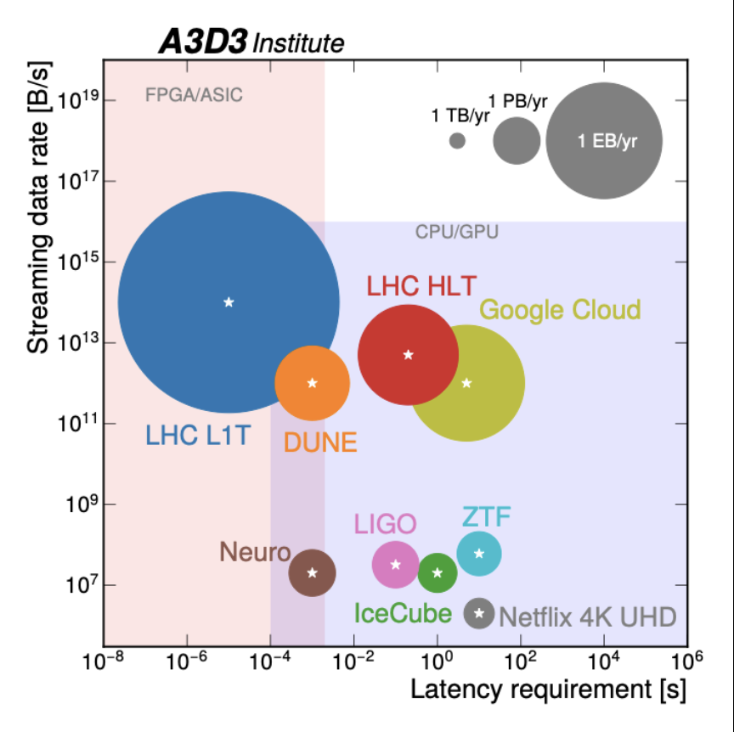
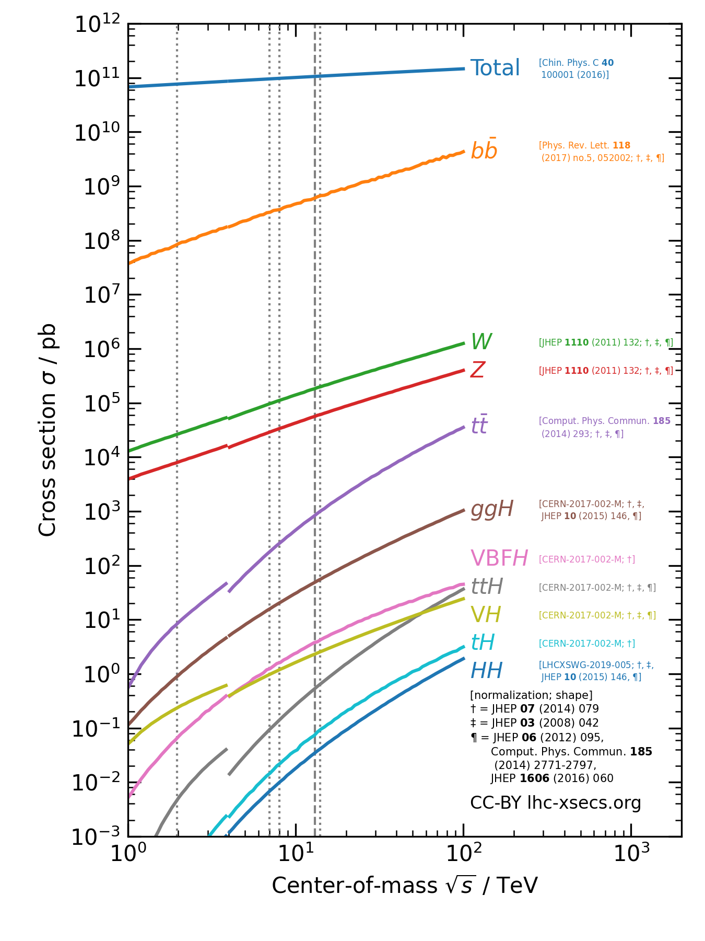
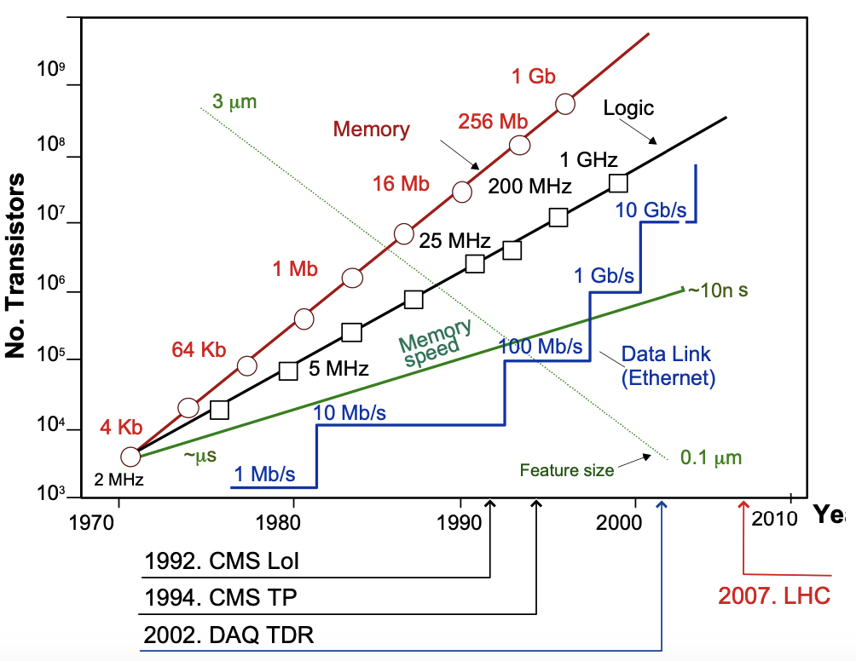
A word of caution
10+ years of LHC running ahead, may projections lead to reconsider the need of a trigger system?
Trigger will evolve, but at least for omni-purposes experiments, it will still be playing a crucial roles
  Among the biggest players (~50 TB/s), also considering commercial activities
  We know a large portion of events are little interesting
  Accurate Monte Carlo samples (with weight <1) corresponding to full stat impossible to produce
CMS DAQ TDR (2001)
Notes:
if we could, would we store “everything”?

Slide 7

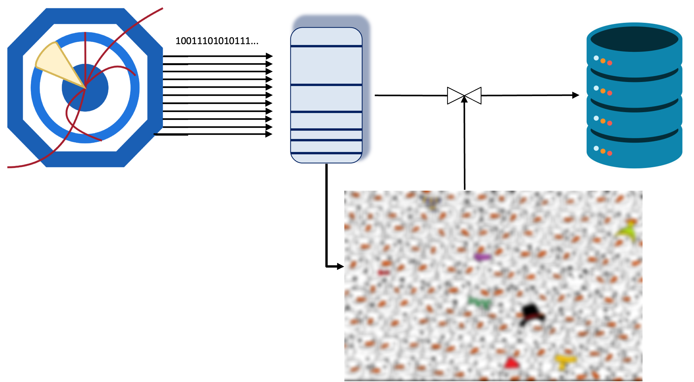
Objectives
New Trigger strategies are key to empower physics reach of experiments. That will especially the case for HL-LHC
More efficient selection for target signals/topologies
Reduce the bias! Deal with the unexpected (anomalies)
Extend phase space for interesting topologies (low p_{T})

Slide 8
Strategies
Get a better “classical” trigger system
  More detectors participating to the trigger
  Increase latencies
  More complex offline-like algo, both in hardware and software: Machine Learning!
  Get rid of the hardware level
  Higher rate (of raw data) on disk
Profit from the event reconstruction / data reduction done by the trigger system
  Permanent store reconstructed objects, trading event size with event rate
  Enabled by fast online calibration procedures
  “Real Time Analysis” both online (producing aggregated results) and offline

Slide 9
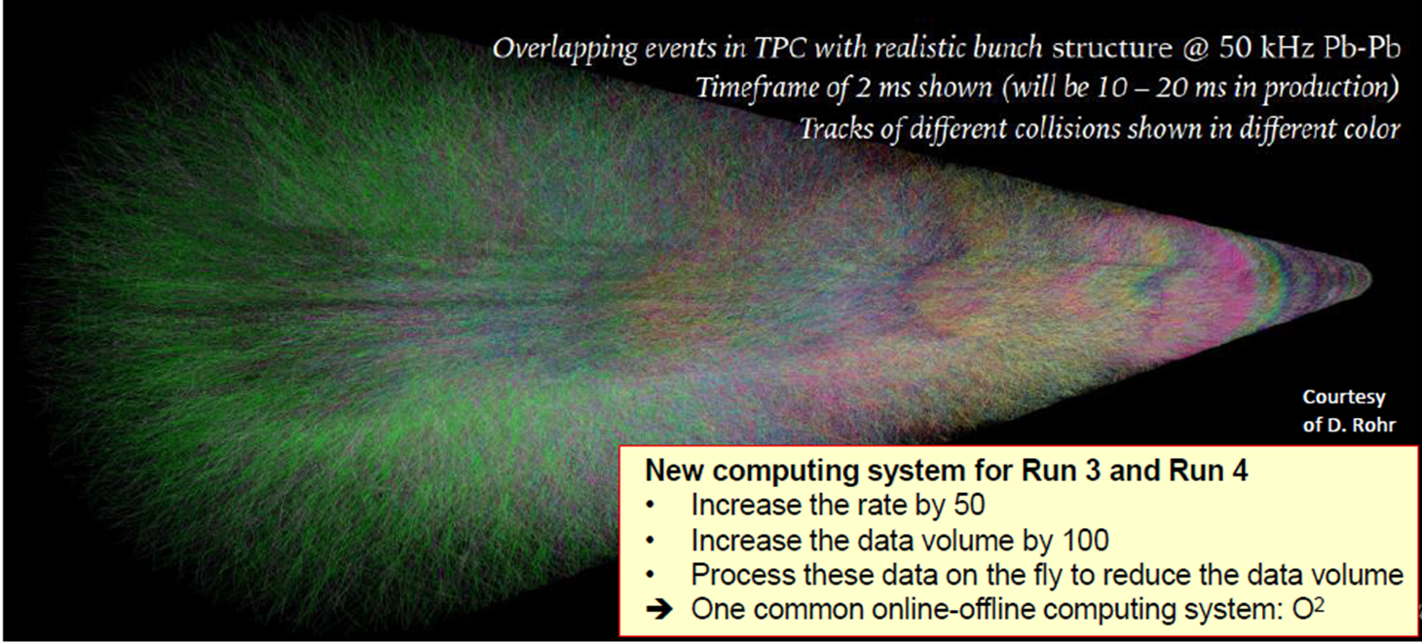
ALICE continuos reading
Heavy-Ions program entails very low S/B, online selection is essentially impossible → need large statistics!
LHC will provide 50 kHz of min-bias Pb-Pb collisions (x100 w.r.t. run 2)
Continuous read-out of all detector data, with reduced data volume to disk

Slide 10
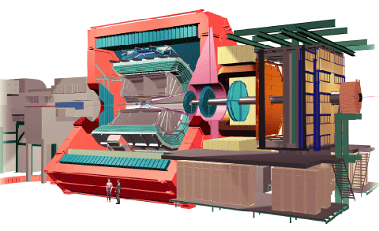
ALICE continuos reading
Heavy-Ions program entails very low S/B, online selection is essentially impossible → need large statistics!
LHC will provide 50 kHz of min-bias Pb-Pb collisions (x100 w.r.t. run 2)
Continuous read-out of all detector data, with reduced data volume to disk
ALICE O² system
(common online-offline system)
3.5 TB/s
raw data
Baseline correction + zero suppression:
Data reduction by cluster finder.
Compression factor ~6.6
Data reduction by tracking.
Only reconstructed data to storage.
Compression factor 5.5
Permanent storage.
(60PB/y)
0.5 TB/s
100 GB/s
Analysis facilities
asynchronous event reco w/ full calibration

Slide 11
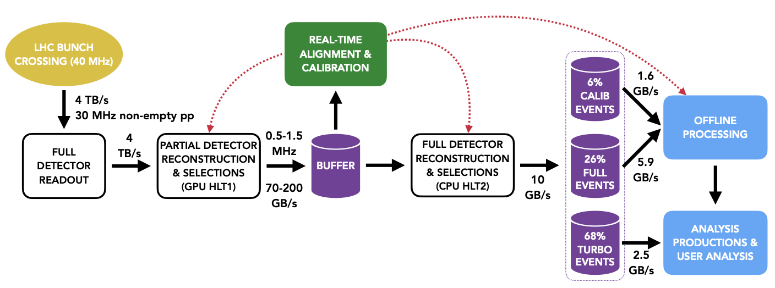
LHCb Real Time Analysis
Hardware-based L0 would not allow profiting from higher luminosity → full detector readout (4 TB/s) + 2 levels of software-based trigger
HLT1
performs a fast reconstruction to identify inclusive beauty and charm signatures as well as high p_{T} muons at 30 MHz
partial event reconstruction (tracking) on GPUs hosted in the event-building servers
select events with 2-tracks vertices, displaces single tracks, muons (configurable)
Output rate ~1 MHz onto a ~30PB disk buffer (80h)

Slide 12
LHCb Real Time Analysis
Hardware-based L0 would not allow profiting from higher luminosity → full detector readout (4 TB/s) + 2 levels of software-based trigger
HLT2
provided with real-time computed calibration constants, performs full event reconstruction on CPU and possibly on accelerators
run O(1000) algorithms selecting relevant signal events and a few inclusive topologies
outputs 10 GB/s, split into dedicated streams (majority to “Turbo”, with high level event content)

Slide 13
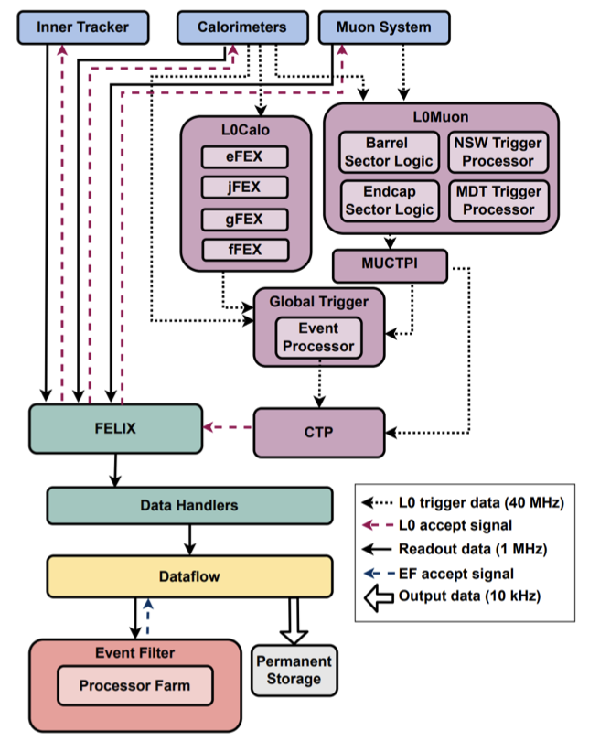
ATLAS TDAQ for HL-LHC
L0
40MHz → 1MHz, latency of 10 μs
Full granularity data from Calorimeters
Data from all muon detectors
Global Trigger: offline-like algorithms to combine/refine regional candidates running on farm of common HW
Event Filter Trigger
1MHz → 10kHz
Full event building dealing with throughput of 5 TB/s
Farm of heterogeneous commodities processors running offline-like algos on accelerators too (GPU/FPGA)

Slide 14
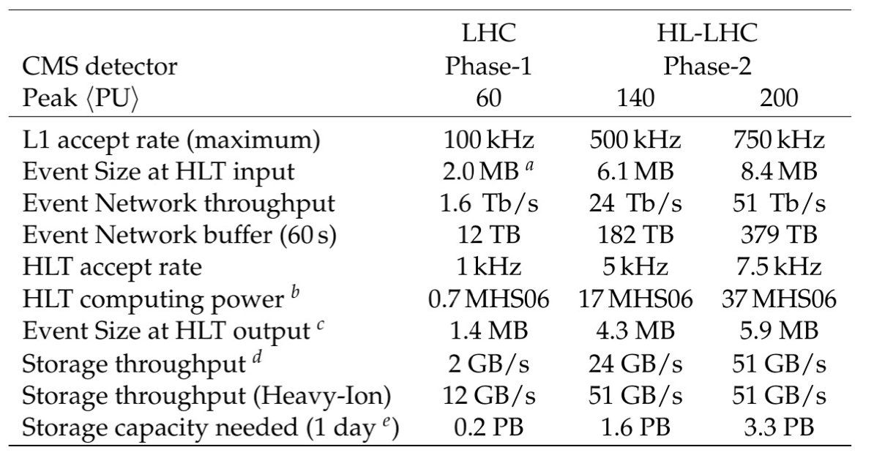
CMS Trigger for HL-LHC
Maintain the 2 levels structure:
  L1: custom FPGA boards (ATCA)
  HLT: farm of servers with CPUs and GPUs
Updated figures for rates, throughput, latency

Slide 15
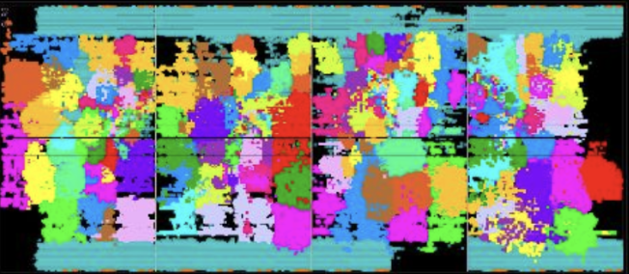
CMS Trigger for HL-LHC
400 algos on 1 FPGA
Major upgrade of the L1 system → all detectors (but silicon-pixel detector) participating in providing primitives!
Information from subsystems combined in an offline-like fashion by the Trigger Correlator:
  Particle Flow, PU mitigation; ubiquitous usage of ML
Physics objects quality comparable to those of HLT/offline

Slide 16
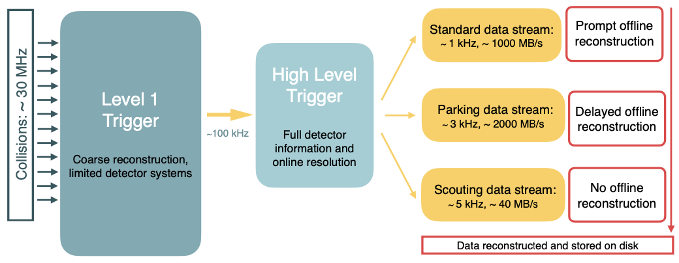
Enriching the Physics Program
Software-based trigger layers provide physics objects with accuracy comparable to offline → exploit those to extend phase space to regions filtered out by online selections
Store dedicated data streams with high level info only
Several measurements performed and published both by ATLAS and CMS

Slide 17
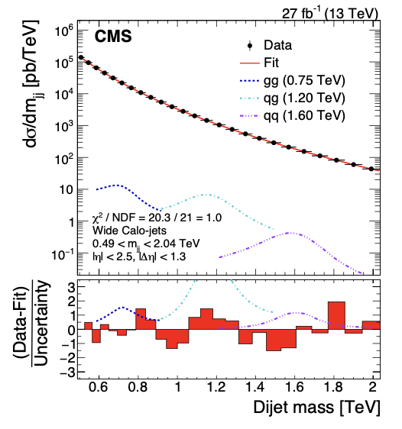
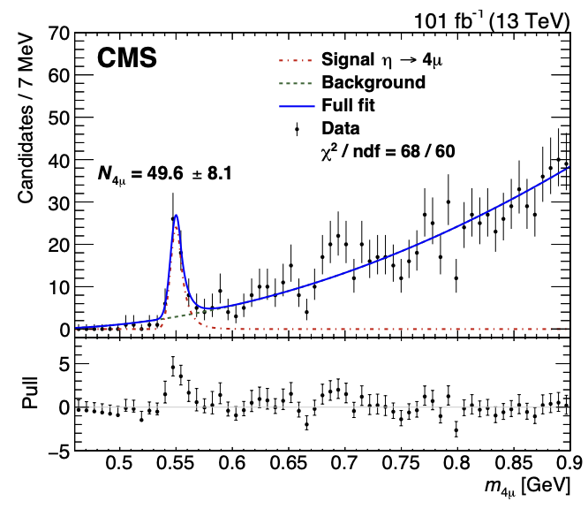
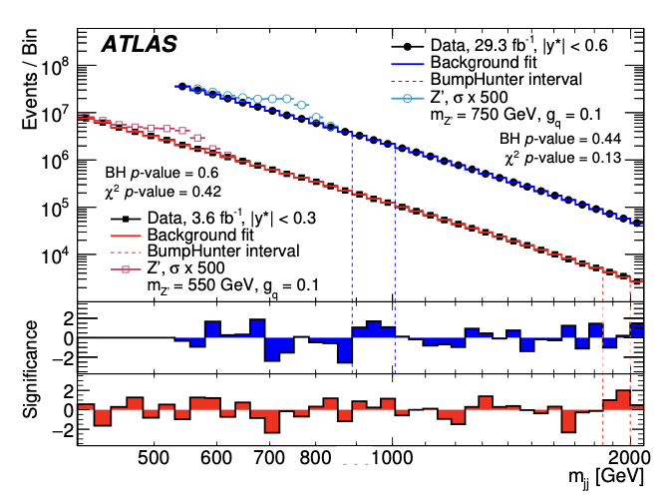
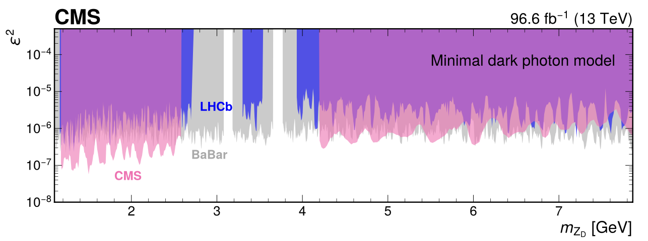
Enriching the Physics Program
Software-based trigger layers provide physics objects with accuracy comparable to offline → exploit those to extend phase space to regions filtered out by online selections
Store dedicated data streams with high level info only
Several measurements performed and published both by ATLAS and CMS
Phys. Rev. Lett. 121, 081801
CMS review submitted to Phys. Rept.

Slide 18
CMS L1 Scouting
Push further this by gathering @ 40MHz L1 objects and use them for physics analysis → potentially unprescaled Zero Bias sample
Tradeoff between rate and resolution. Proof of principle now in production
  Interesting analyses could be addressed anyhow, e.g. dijet resonances
Full potential of the system expected for HL-LHC w/ high resolution L1 objs
Address both extensions to inaccessible topologies (e.g. H→φφ→4K, W→3π) and fully unbiased anomaly searches
  Correlation with other bunch crossing also possible (looong lived particles)

Slide 19
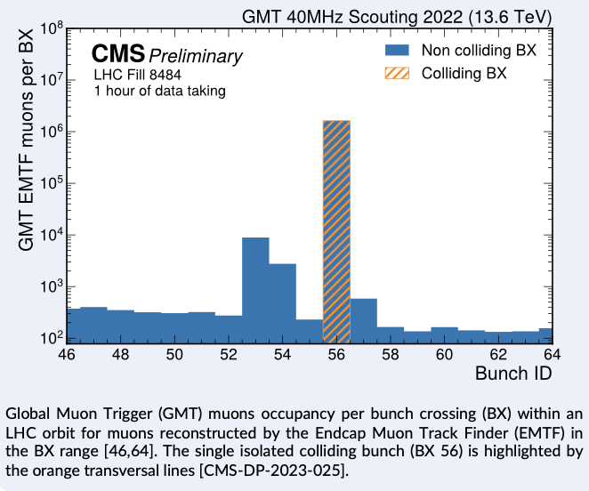
CMS L1 Scouting
Push further this by gathering @ 40MHz L1 objects and use them for physics analysis → potentially unprescaled Zero Bias sample
Tradeoff between rate and resolution. Proof of principle now in production
  Interesting analyses could be addressed anyhow, e.g. dijet resonances
Full potential of the system expected for HL-LHC w/ high resolution L1 objs
Address both extensions to inaccessible topologies (e.g. H→φφ→4K, W→3π) and fully unbiased anomaly searches
  Correlation with other bunch crossing also possible (looong lived particles)

Slide 20


Anomaly Detection, Data Compression
Courtesy of G. Grosso

Slide 21

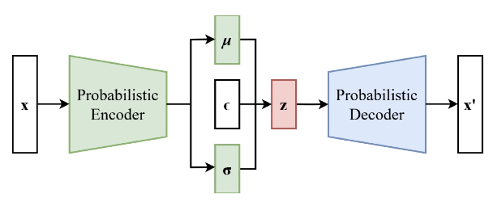

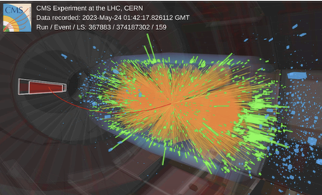
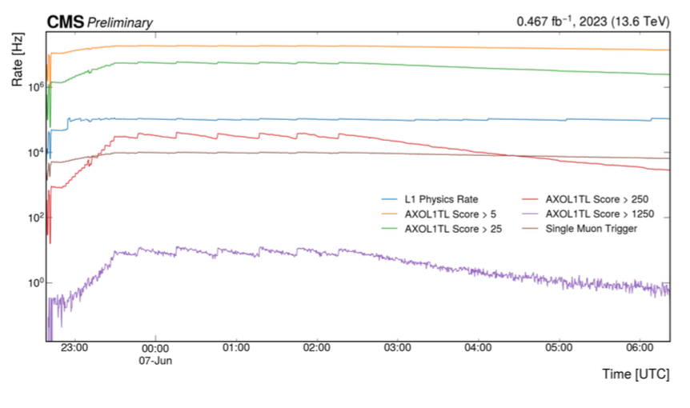
Anomaly Detection (& Data Compression)
Variational AutoEncoders used to “compress” input into a latent space; such representation can be used as metric to classify standard vs anomalous data
AXOL1TL: use VAE to trigger on anomalous events
reconstruction
latent representation
Train the model on L1 objects in a large Zero Bias datasets
It results that μ is the enough to discriminate anomalous events.
In production at CMS since a couple of weeks!

Slide 22
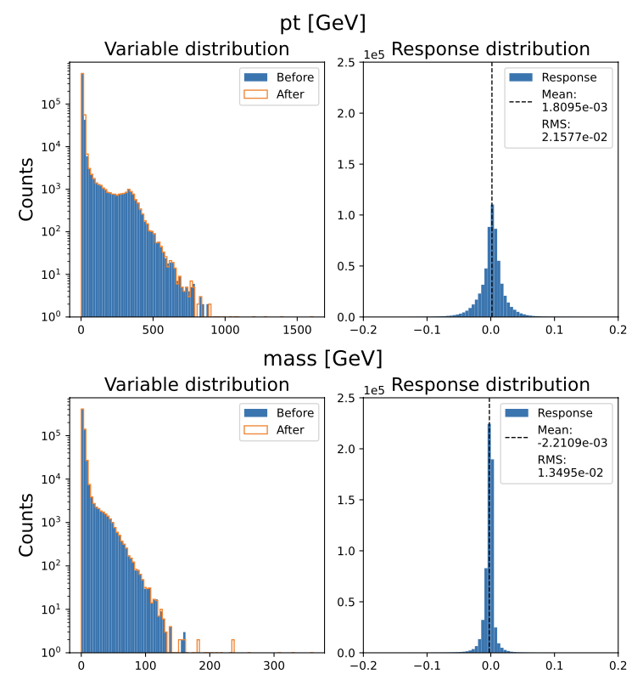
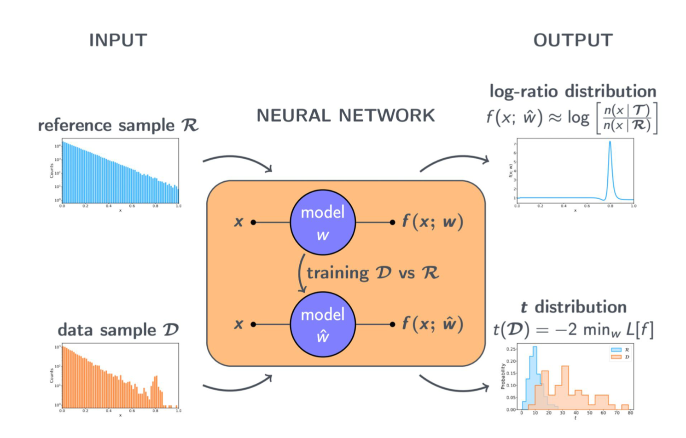
Anomaly Detection (& Data Compression)
The (lossy) compression provided by VAE could be used as an efficient way to gain bandwidth to disk
Attempts to evaluate faithfulness of the method are ongoing (e.g. Baler)
In addition to seeking single anomalous events, statistical anomalies can be addressed
Run anomaly detection algos on batches of data online (e.g. NPLM), storing statistics parameters to let potential anomalies building up

Slide 23
Summary
Trigger systems are critical enablers of the LHC experiments’ physics programs at the incoming High Luminosity phase
Tremendous technological advancements in telecom, electronics, algoritms will allow processing huge data flows with offline-comparable accuracy
Boost in sensitivity for most targeted signals, several ideas being developed for being prepared for the unexpected

