Slide 1




milliQan and FORMOSA
In Run 3 And Beyond
Ryan Schmitz (UCSB), 6/5/2024
On behalf of the milliQan and FORMOSA collaborations

Slide 2
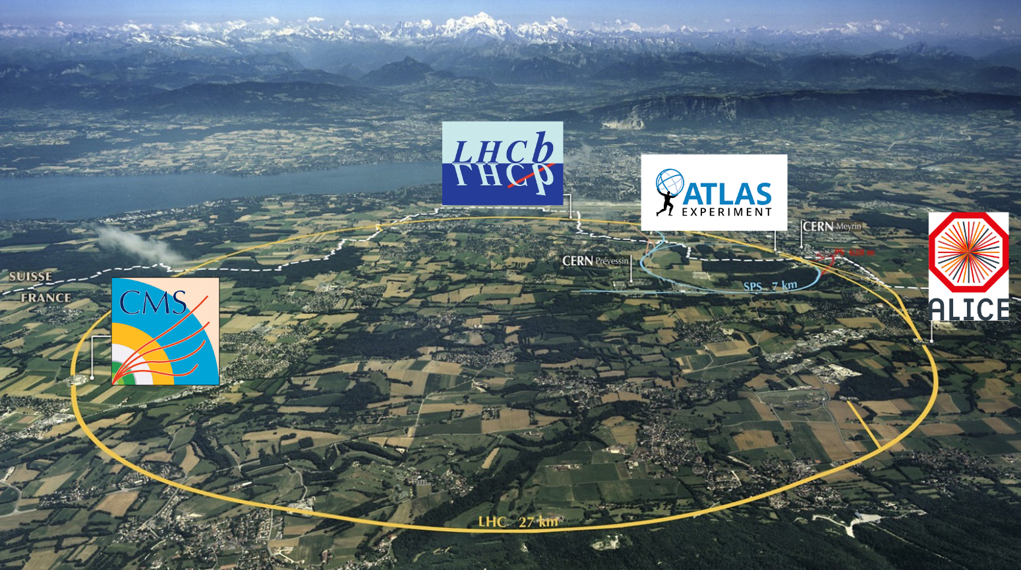
Dark Matter in a Hidden Valley
No sign of new
physics seen at
the LHC (yet)
Where could it
be hiding?
Dark matter gives biggest clue– many SM extensions include a dark or hidden sector

Slide 3
Dark sector mixing
e = size of electron’s charge
Strength: e
γ
γ*
Strength: e’ ≈ e
Electron
Dark Electron
Photon
Dark photon
Since the photon and dark photon are U(1), they can interact via kinetic mixing

Slide 4
Dark sector mixing
e = size of electron’s charge
Strength: e
γ
γ*
Strength: e’ ≈ e
Electron
Dark Electron
Photon
Natural strength:
α/π = ~1/1000
Dark photon
Since the photon and dark photon are U(1), they can interact via kinetic mixing
How strong is this interaction? We know the answer for the standard model: around 1/1000!

Slide 5
Dark sector mixing
The charge is just the strength of the two connections together. So these dark electrons have charge of 1/1000; millicharged particles!
e = size of electron’s charge
Strength: e
γ
γ*
Strength: e’ ≈ e
Electron
Dark Electron
Photon
Natural strength:
α/π = ~1/1000
Dark photon
Since the photon and dark photon are U(1), they can interact via kinetic mixing
How strong is this interaction? We know the answer for the standard model: around 1/1000!
Let’s use a millicharged particle detector to search for these!

Slide 6
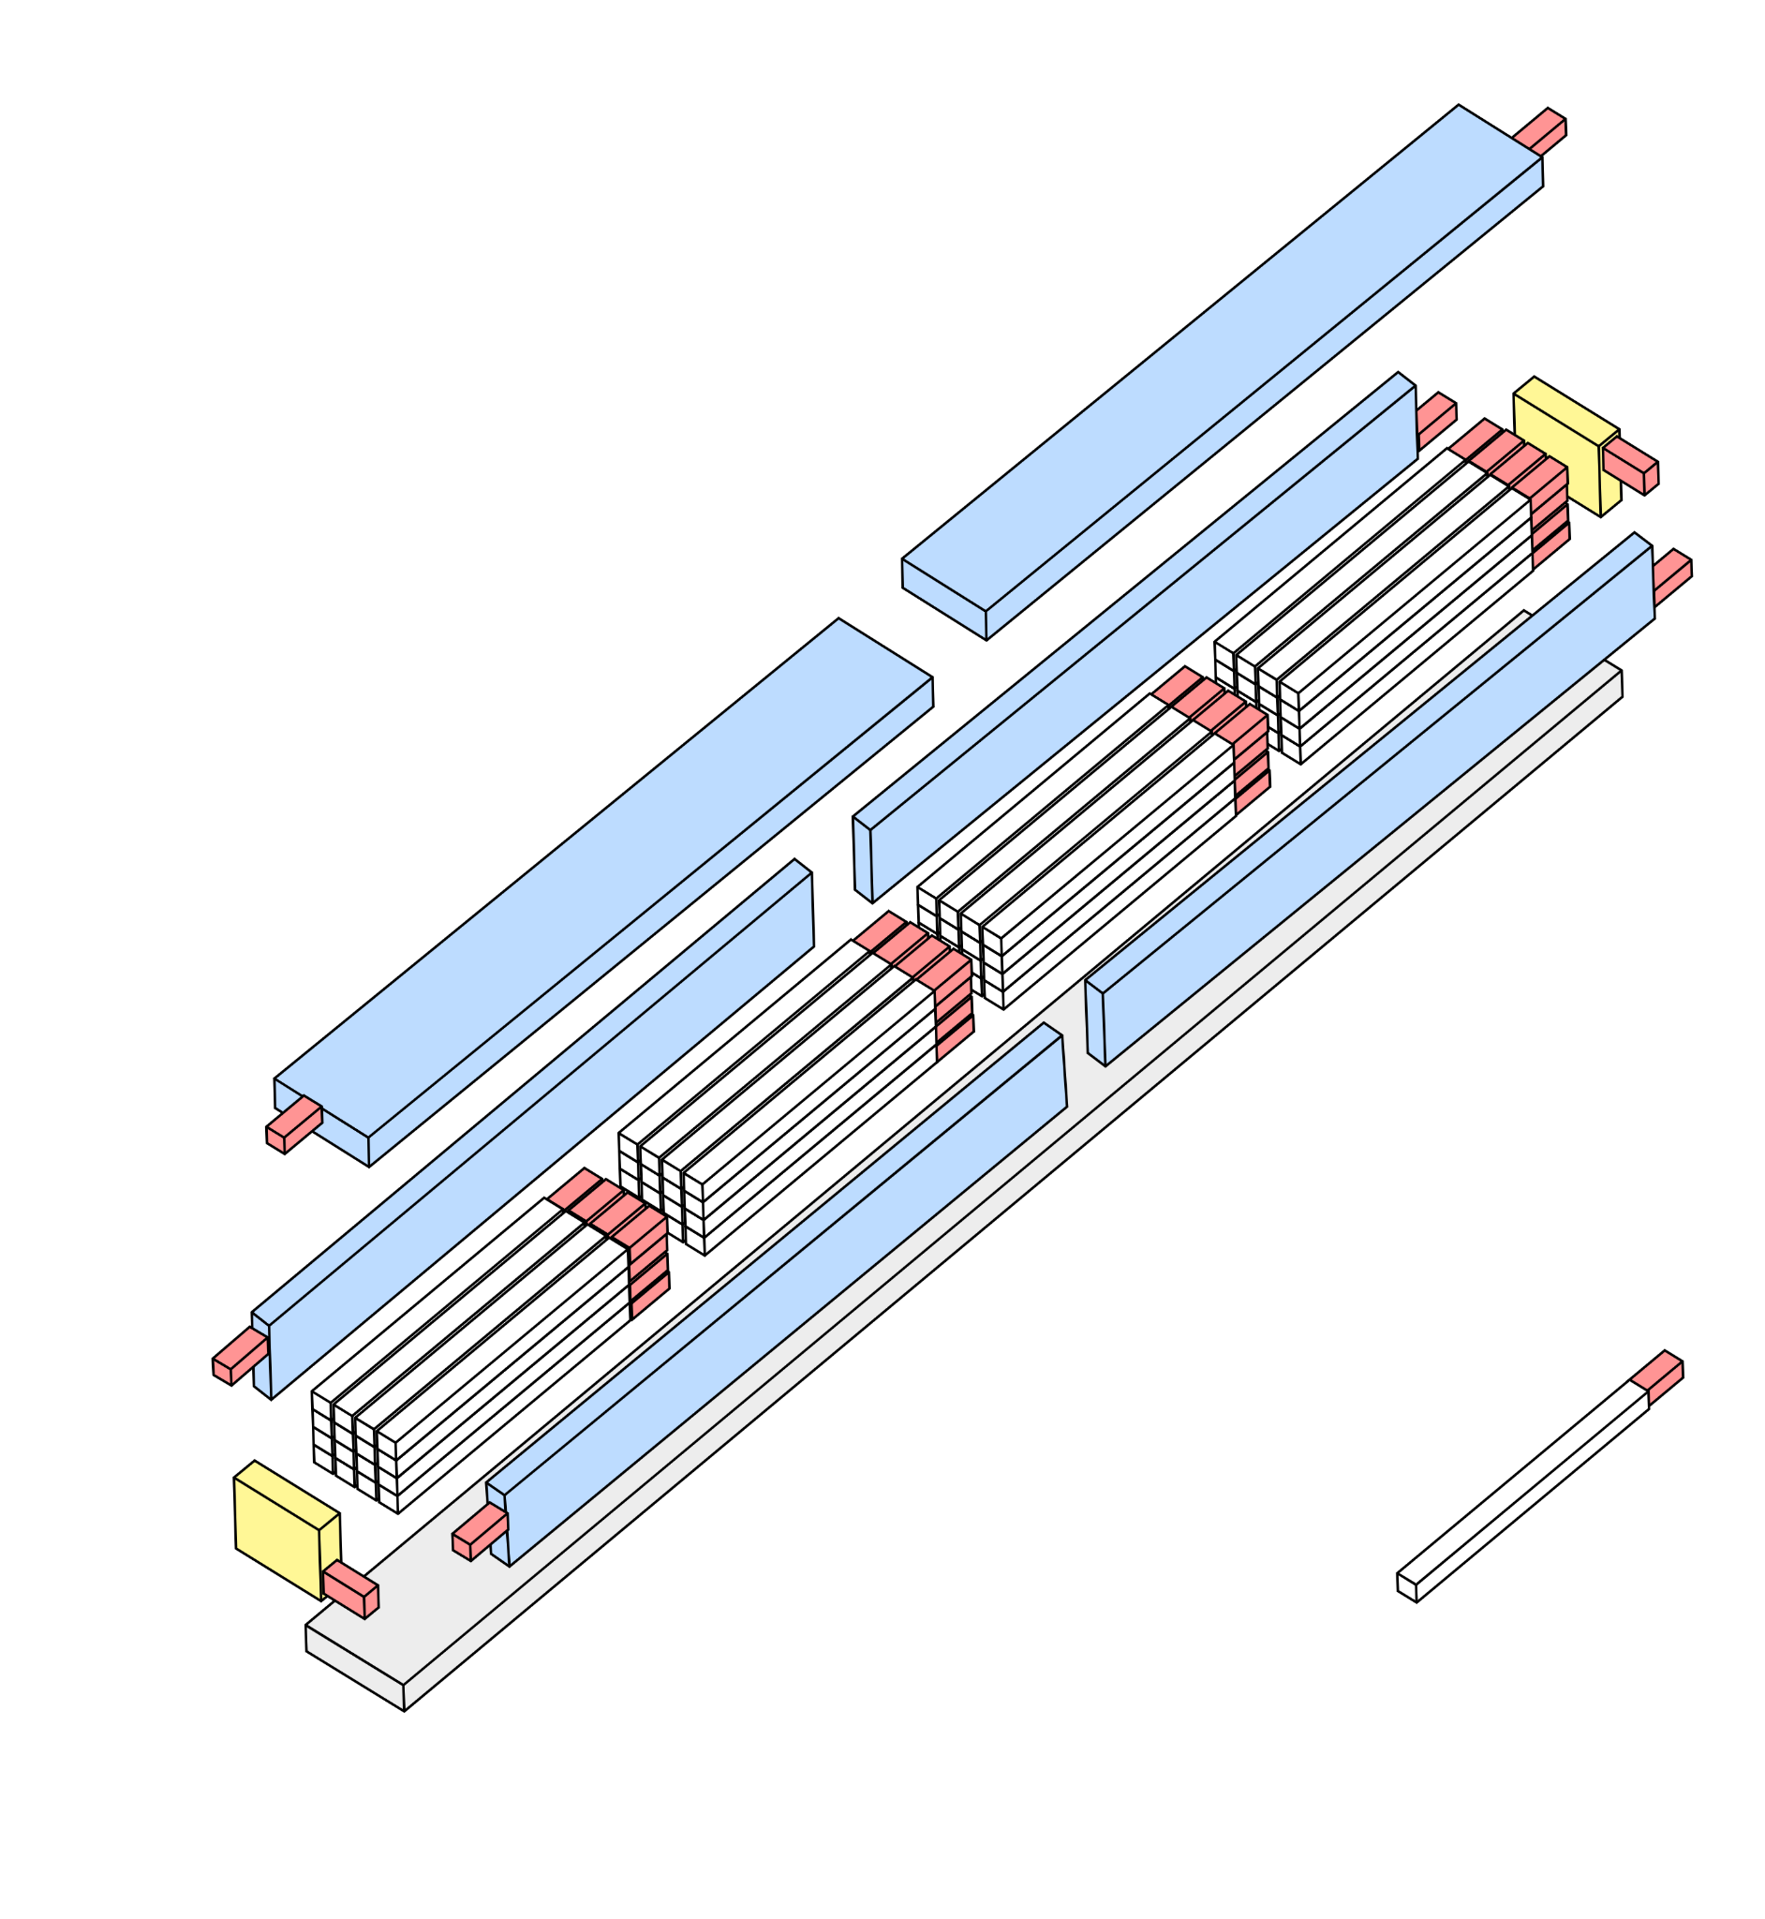
milliQan Run 3 Bar Detector
Basic design:
64 scintillator bars (60 x 5 x 5 cm) attached to PMTs arranged in 4 layers, pointed at CMS IP
6 Veto slabs on top and sides of detector to reject external backgrounds
  Provide active and passive shielding
2 Veto panels on front and back of detector
  Used to tag throughgoing muons

Slide 7
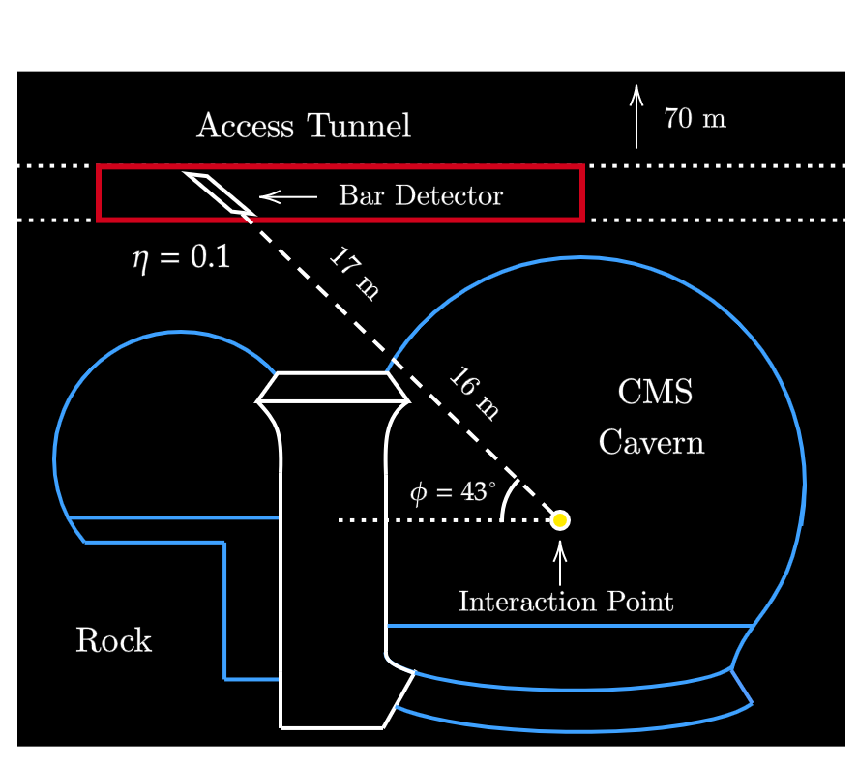
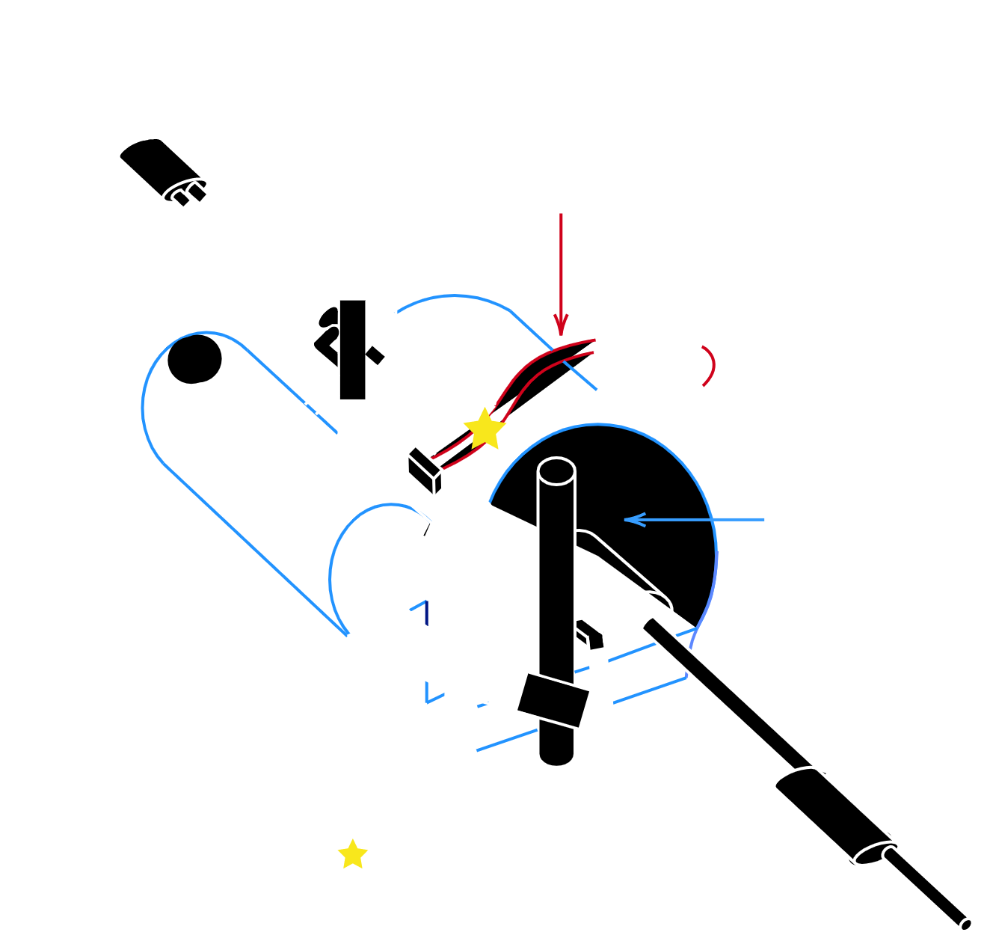
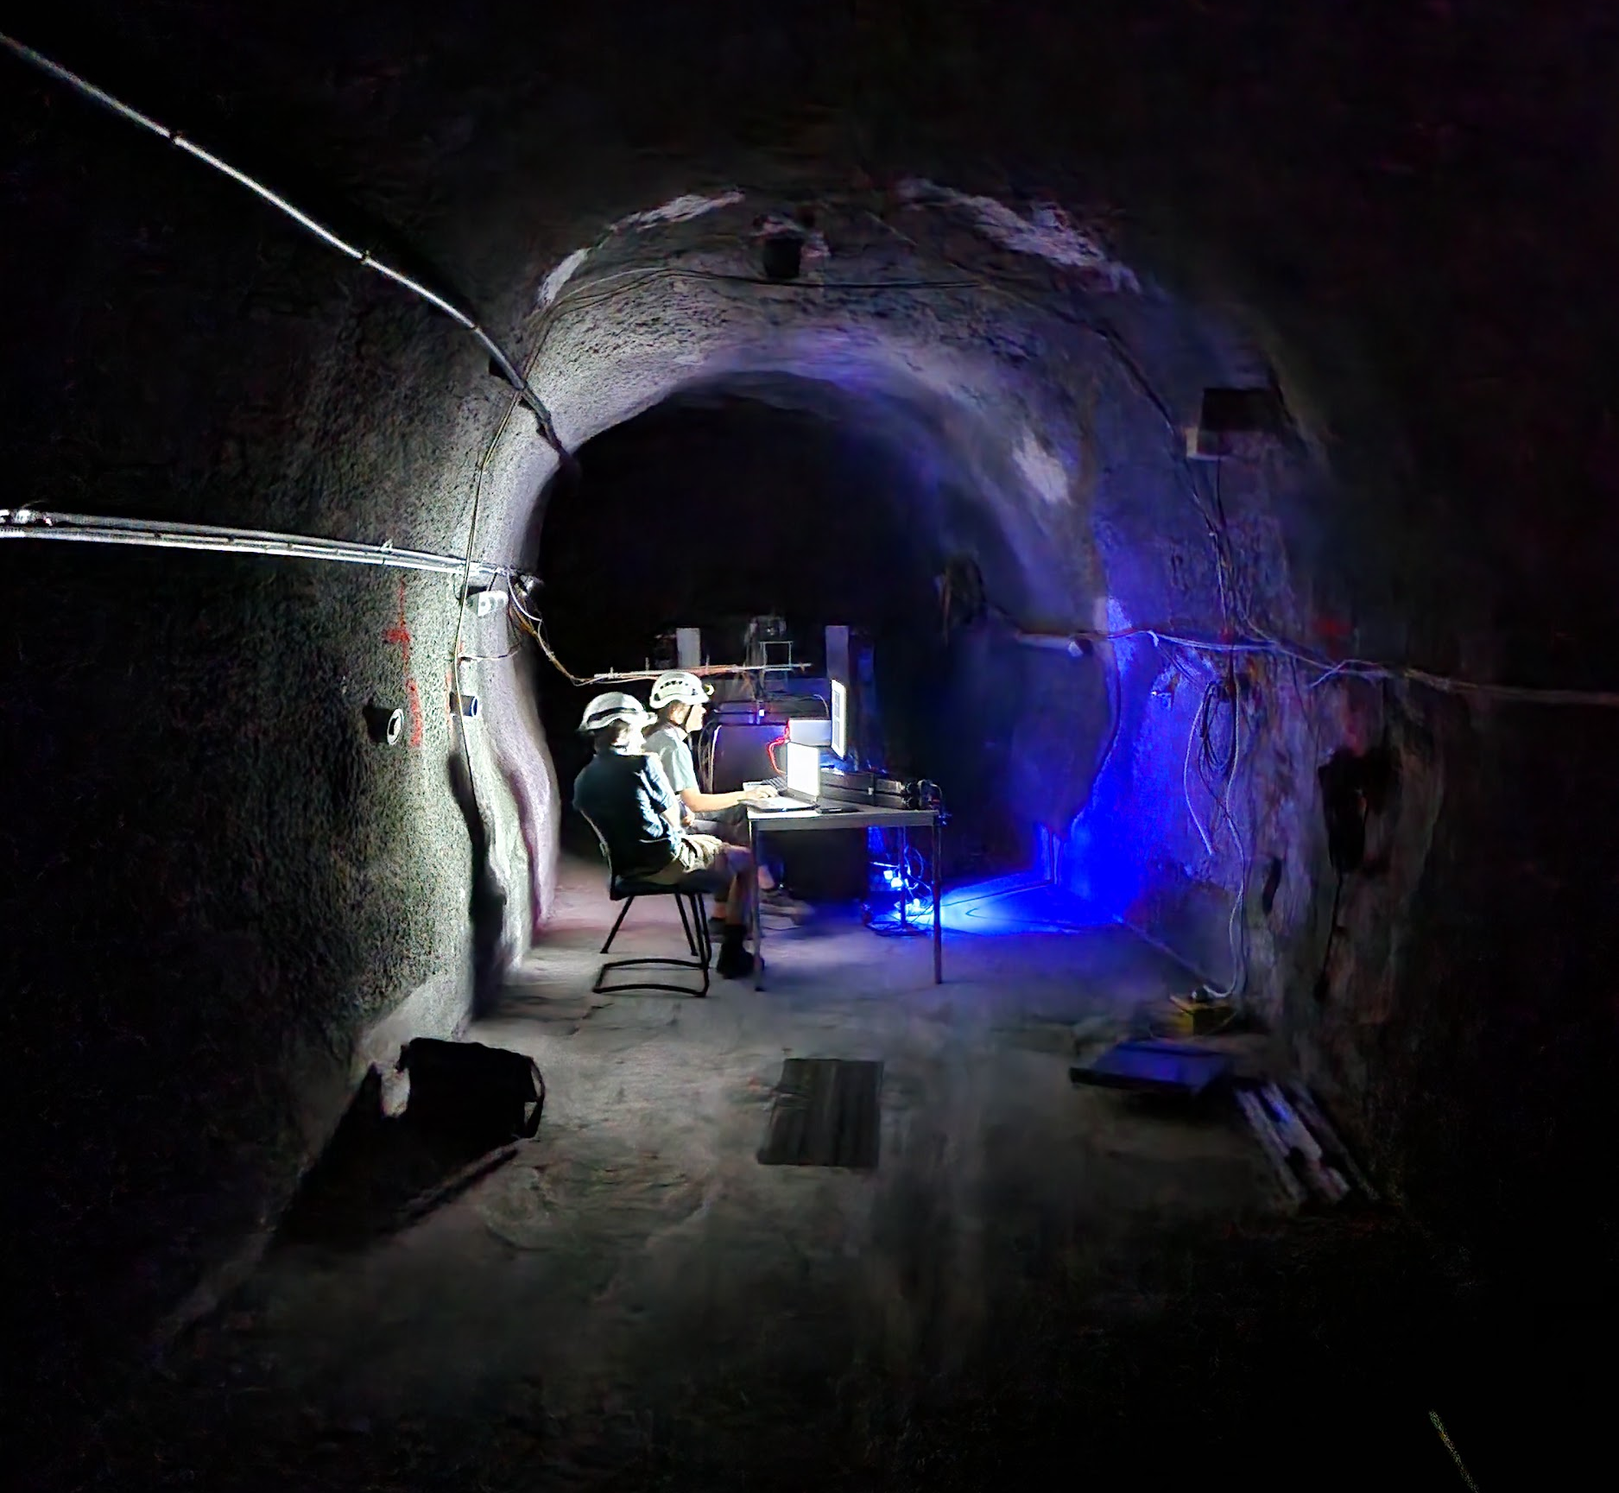
Detector Positioning
milliQan is located 80m underground
at η ~ 0.1, Φ = 43°,
r = 33m relative to the CMS collision point

Slide 8
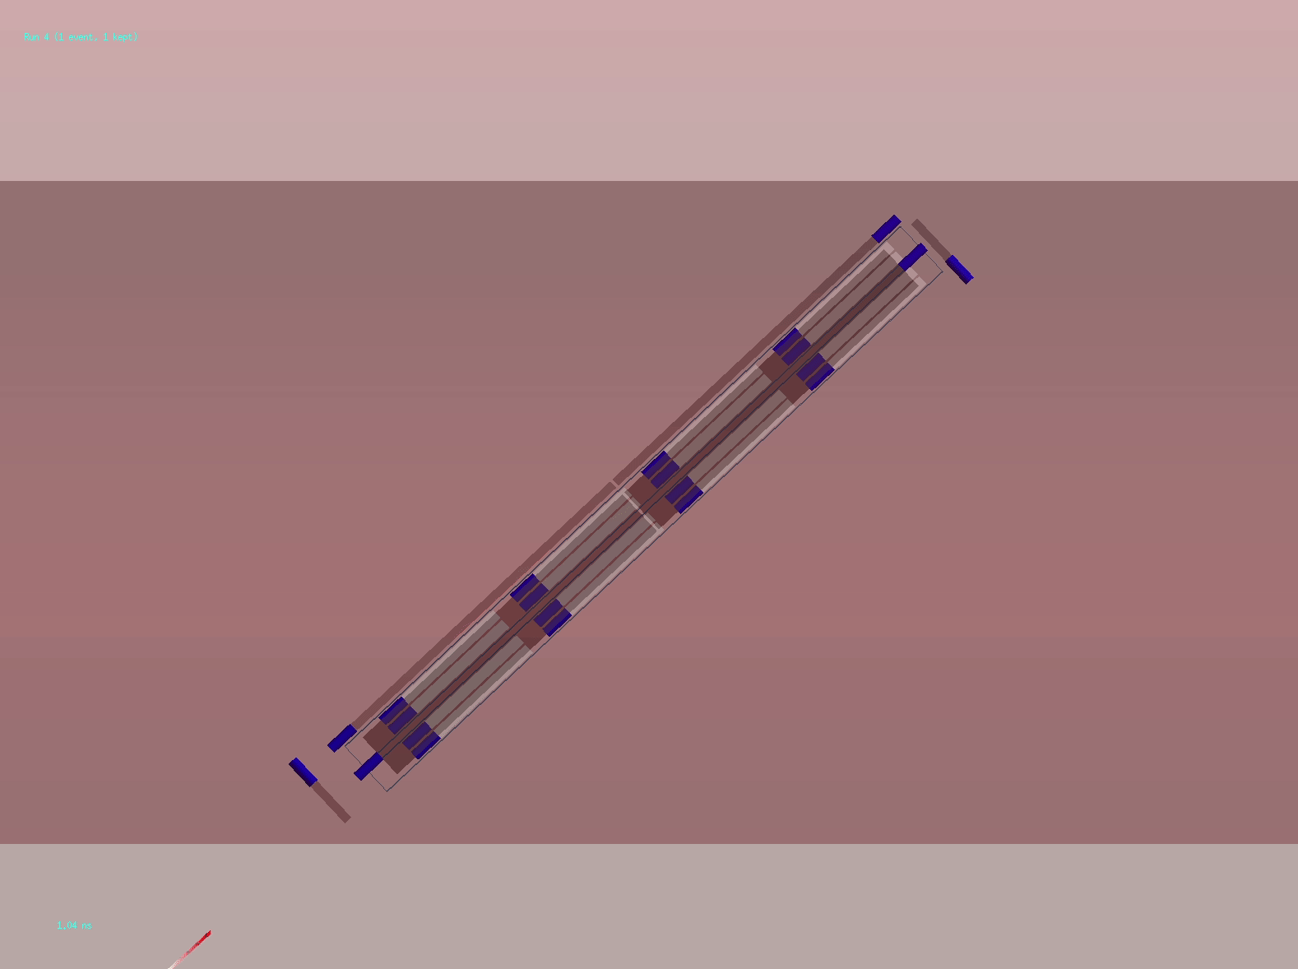
Beam Muon
Legend: μ, γ, mCP, e⁻, optical photon
Q = e
When a charged particle passes through scintillator, it produces light, which we can detect

Slide 9
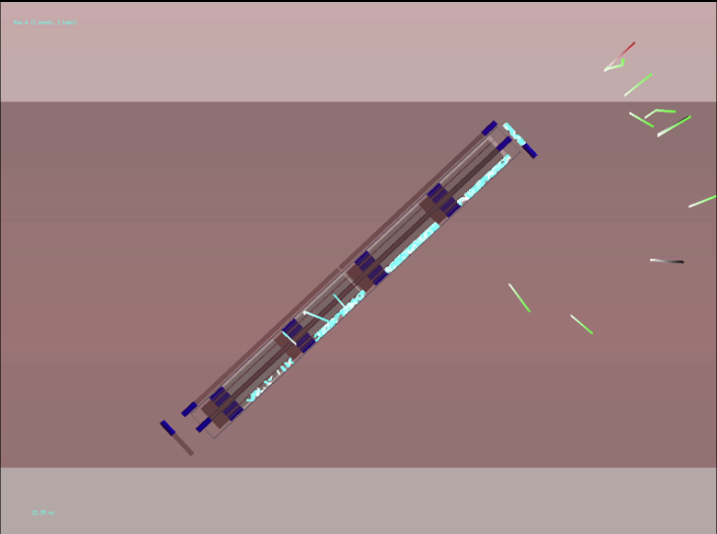
Beam Muon
Legend: μ, γ, mCP, e⁻, optical photon
Q = e
When a charged particle passes through scintillator, it produces light, which we can detect

Slide 10

mCP Signal
Legend: μ, γ, mCP, e⁻, optical photon
Q = 0.01e
When a charged particle passes through scintillator, it produces light, which we can detect
Challenge: With e.g. Q = 0.01e, we see 10,000x less light than usual. So, we need to be able to detect individual photons to be sensitive to millicharged particles

Slide 11
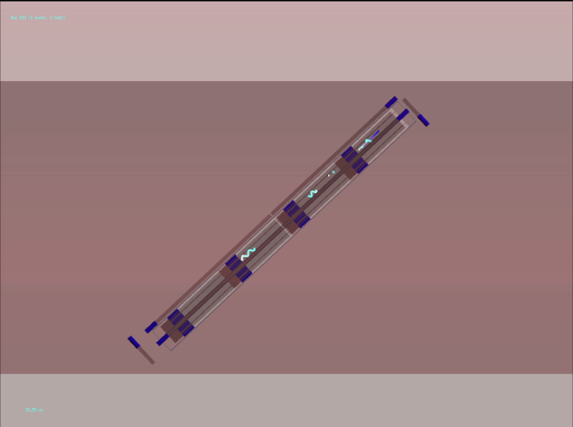
mCP Signal
Legend: μ, γ, mCP, e⁻, optical photon
Q = 0.01e
When a charged particle passes through scintillator, it produces light, which we can detect
Challenge: With e.g. Q = 0.01e, we see 10,000x less light than usual. So, we need to be able to detect individual photons to be sensitive to millicharged particles

Slide 12
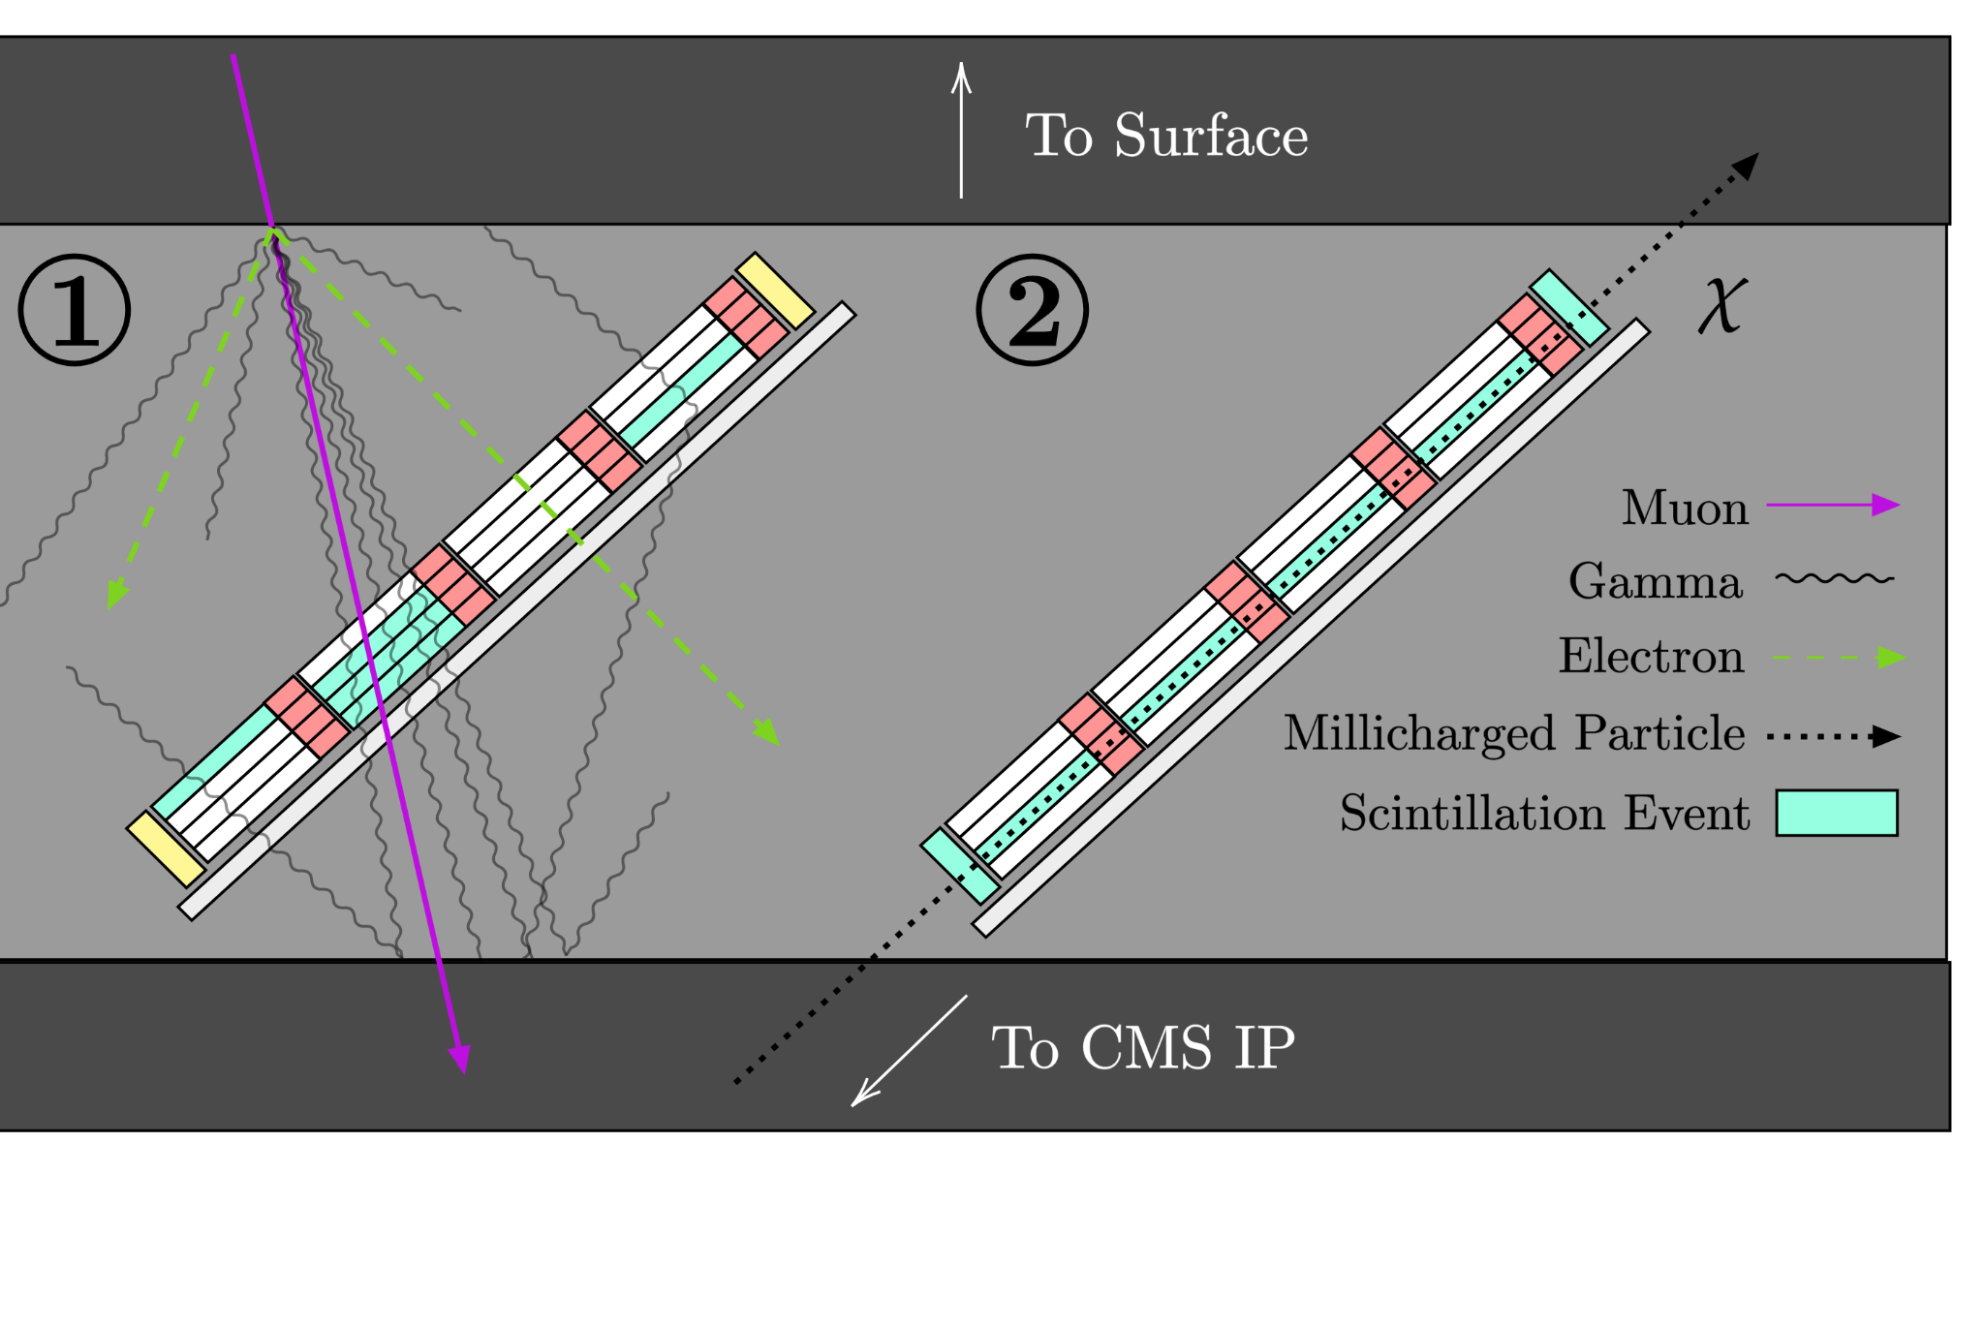
Backgrounds
Signal: ~few photons in one bar in each layer within 15ns, and no other activity
Backgrounds: Cosmic showers, PMT dark rates (~1 kHz per PMT)
Simulations of the milliQan detectors have shown that with this signal selection, cosmic background rates are negligible (see arXiv:2104.07151)

Slide 13
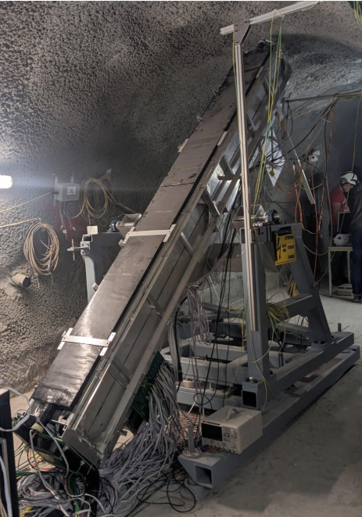
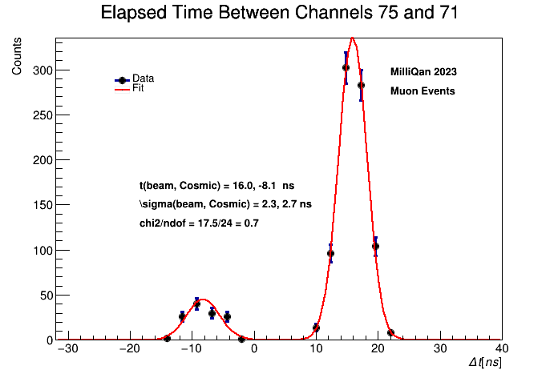
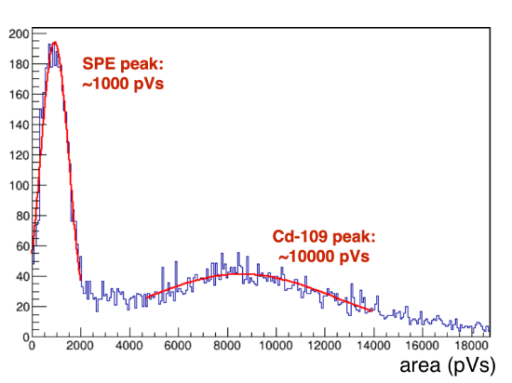
Bar Detector Status
Construction and response/timing calibration completed
last year
Studies using beam and cosmic muon backgrounds ongoing
All bars calibrated with sources!
Muons passing through all layers are used for timing calibration
Comparing SPE and Cd109 peaks gives PMT response

Slide 14
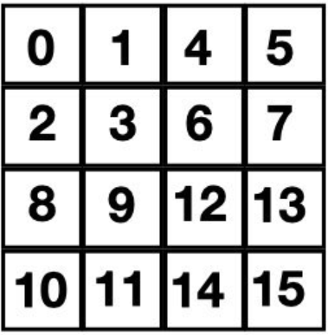
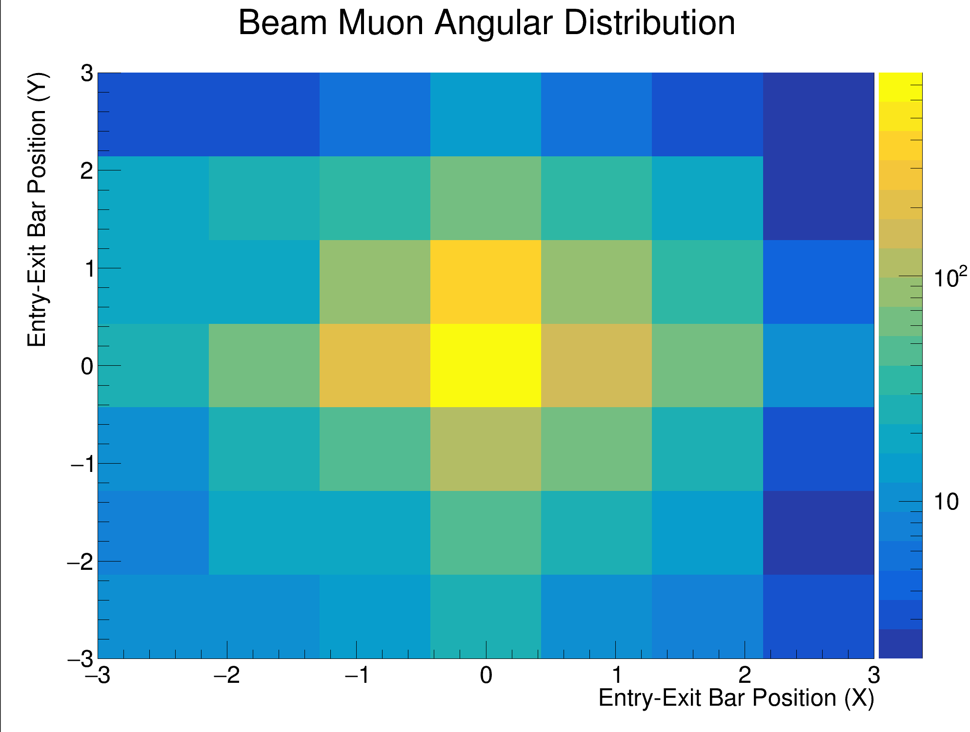
Beam Muon Validation: Alignment
Y
X
Muons (and mCPs) don’t always follow a straight path through the detector. We can measure their paths!
Measuring the tracks of beam muons allows for estimates of detector alignment and angular distributions

Slide 15
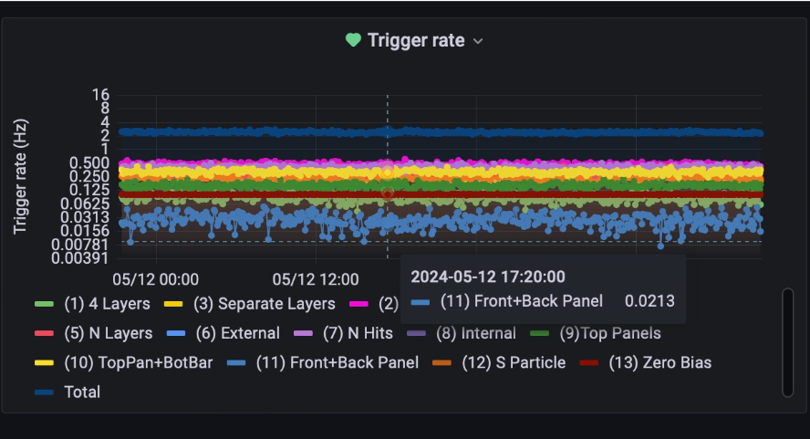
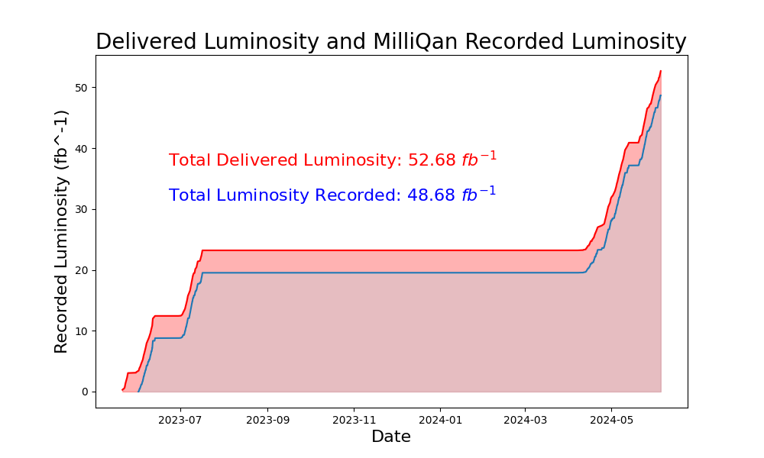
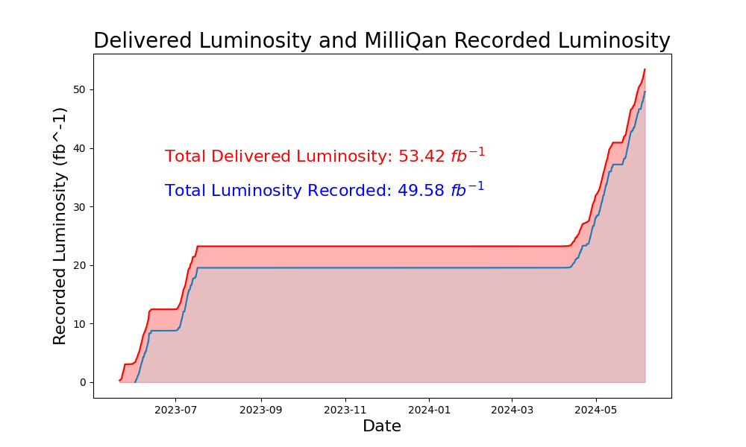
Data and Monitoring
Currently taking physics data since June 2023!
Web based monitoring and remote to help with remote shifting
Recorded 50 fb⁻¹ of collision data so far from LHC Run 3 and still running!
Web-based monitoring system allows for smooth datataking and early diagnosis of any problem
With high luminosity targets for 2024, will exceed 100 fb-1 later this year

Slide 16
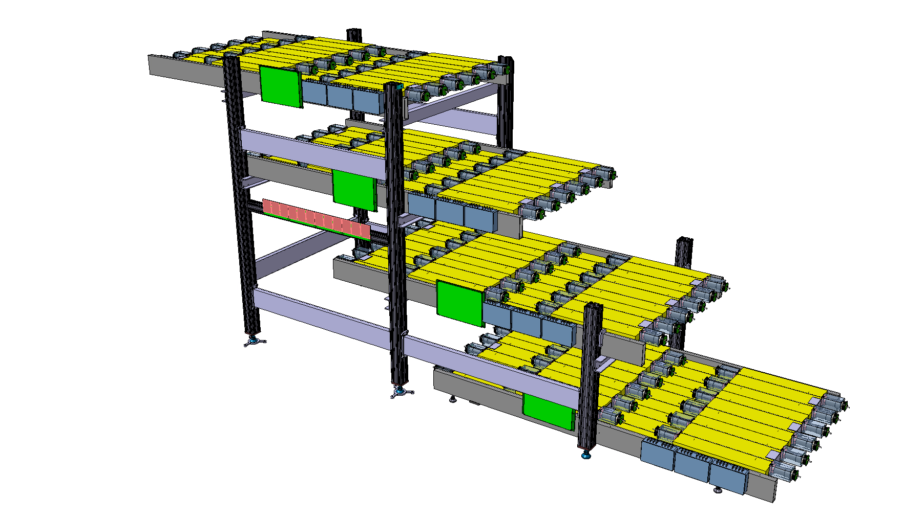
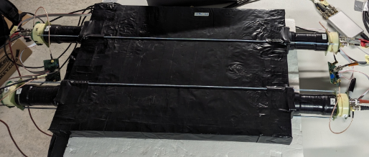
Slab Detector Status
Above 1.4 GeV, mCP production is rarer;
acceptance is limiting factor
“Slab Detector” uses four layers of twelve 40 x 60 x 5 cm plastic scintillator slabs
  Surface area equivalent to
  ~1100 5 x 5 cm bars!
Significantly improves acceptance for Q > ~0.01e

Slide 17
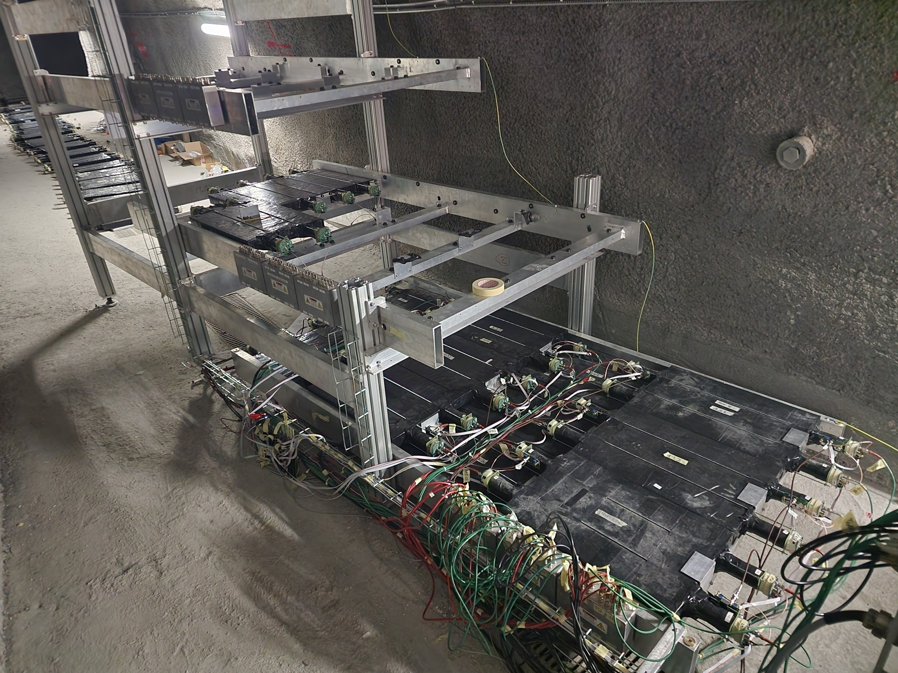
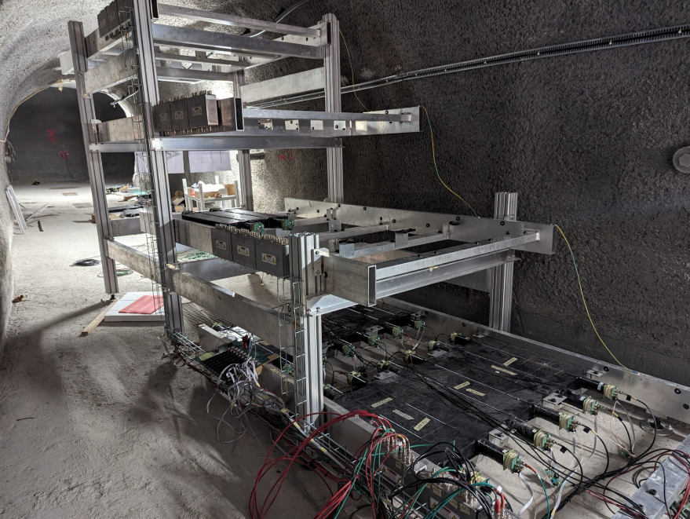
Slab Detector Commissioning
All slabs calibrated and ready for installation
DAQ system, ~half of
slabs installed
  Commissioning data already being collected
Installation of remaining
layers happening now!
  Targeting full installation, physics data by end of June → Very soon!
Nov 2023

Slide 18
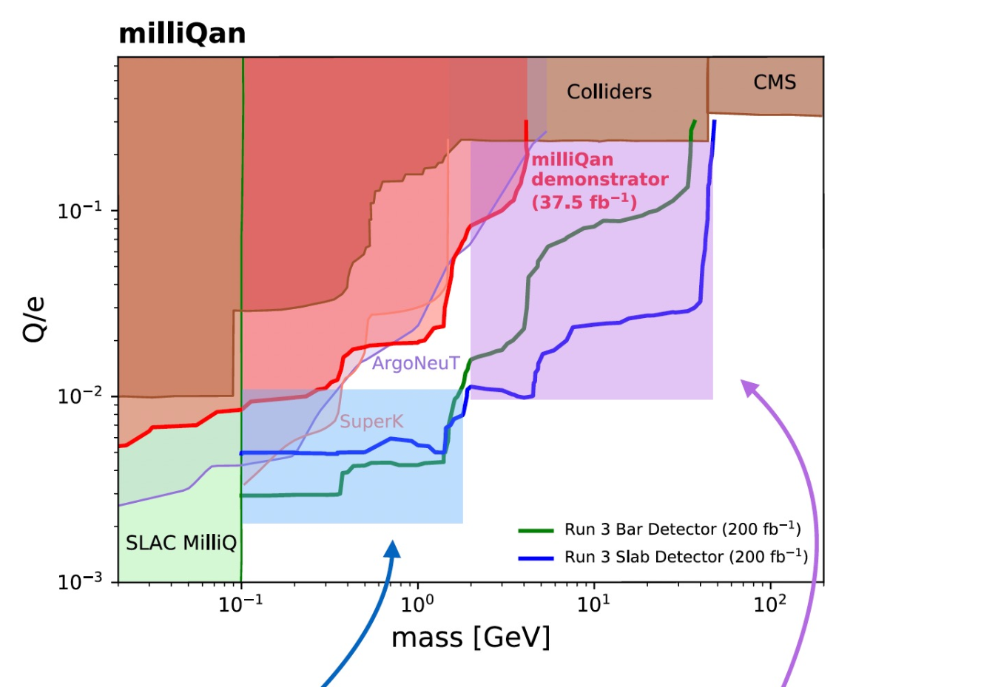
milliQan Signal Sensitivity
Bar detector → targets charge limited region
Slab detector → targets acceptance limited region
Expected combined sensitivity:
  Charges ~0.001-0.1 e
  Masses ~0.1-45 GeV
Full projections published in PhysRevD.104.032002
Charge limited region:
very high mcp flux but low efficiency
Acceptance limited region:
high efficiency but mcp flux is low

Slide 19
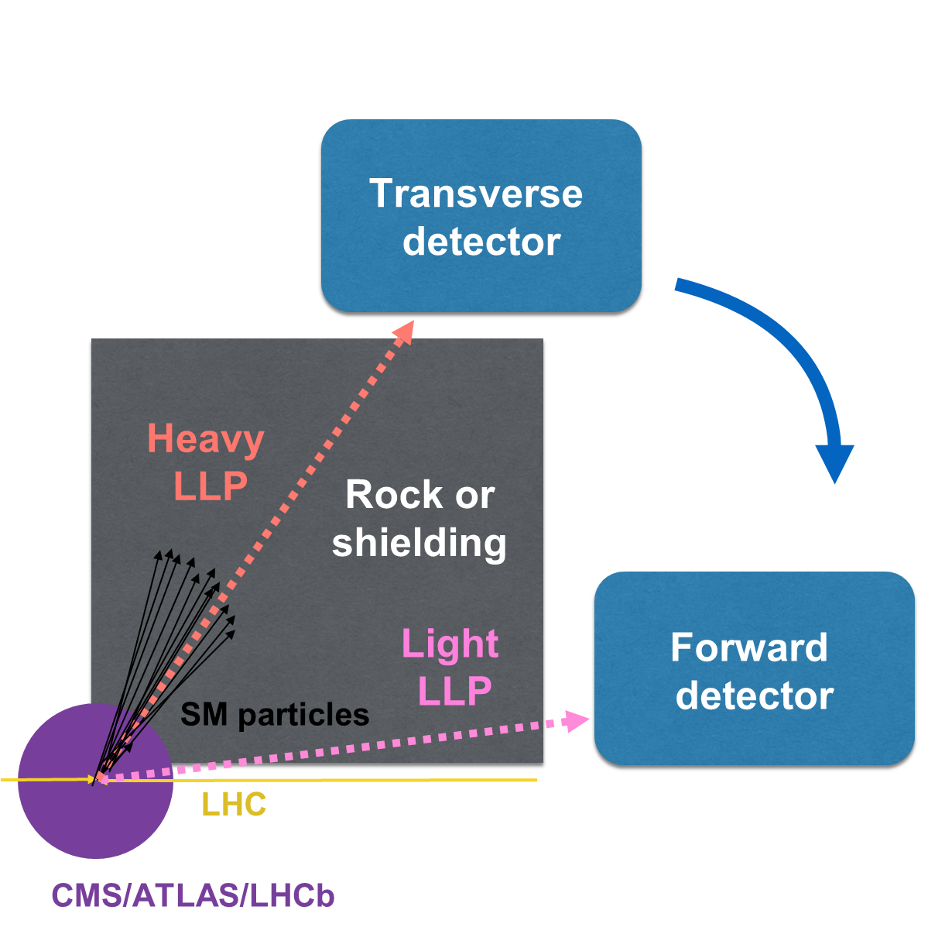
What’s next?
mCP flux over
~250 times larger
in forward region!

Slide 20
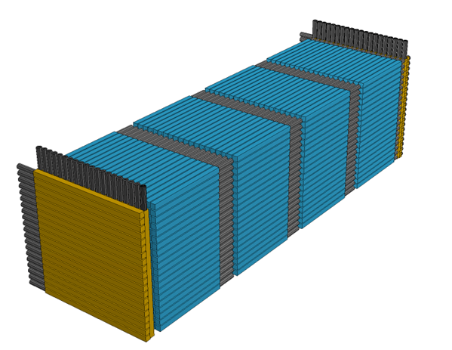
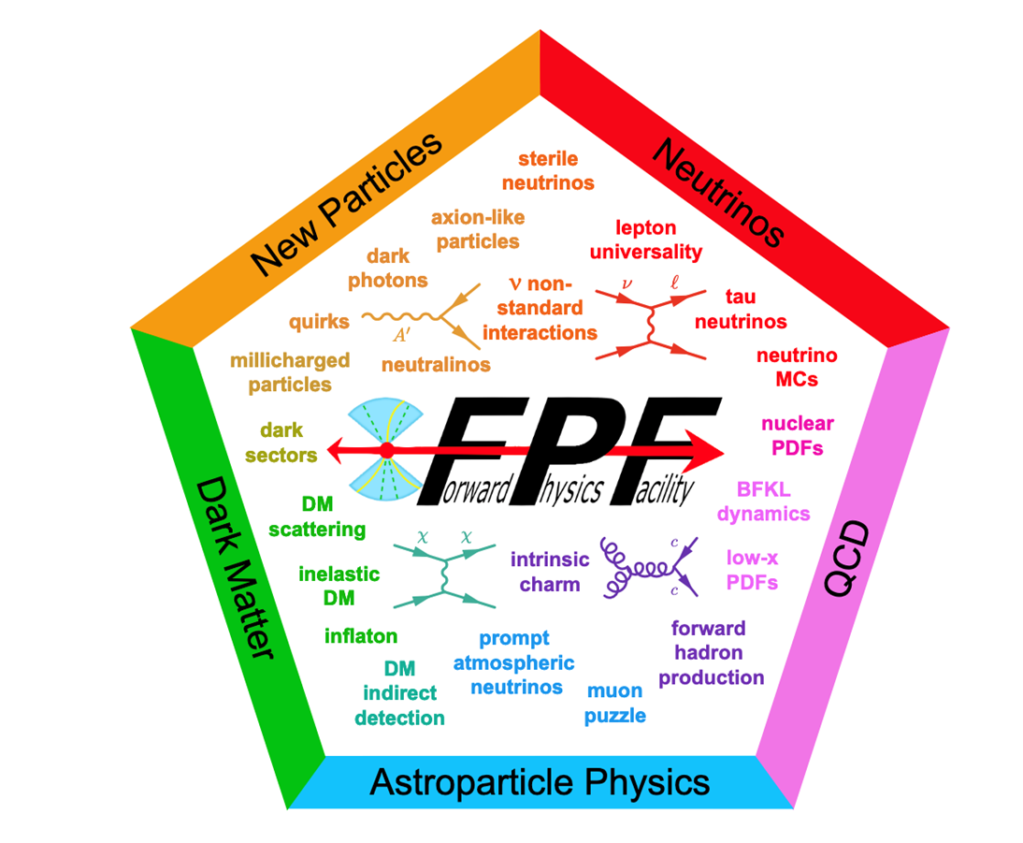
What’s next?
mCP flux over
~250 times larger
in forward region!
Let’s look forward for greatly increased production of light mCPs!

Slide 21
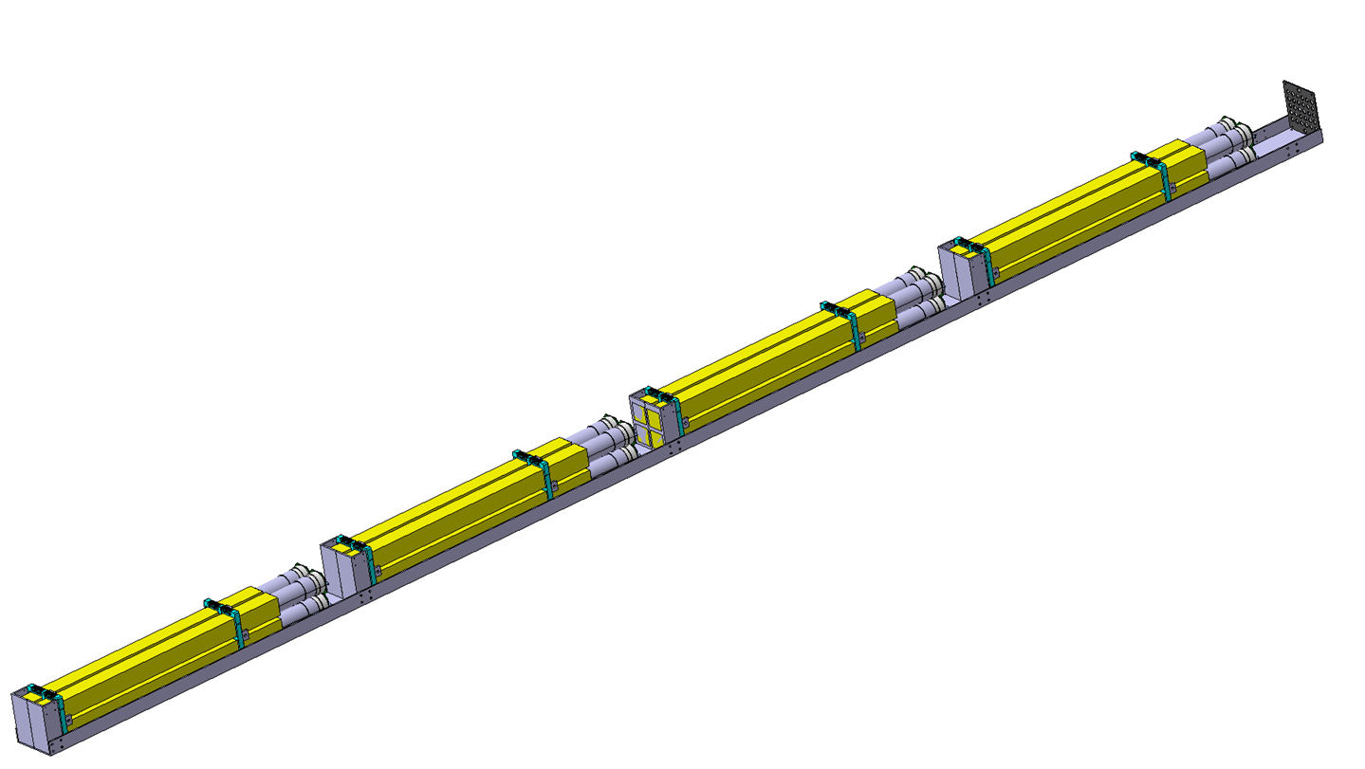
FORMOSA Detectors
For FPF: Four 20 x 20 layers of scintillating bars coupled with PMTs, pointed to ATLAS IP
Segmented beam-muon veto panels on front and back
Right now: “FORMOSA Demonstrator” gives opportunity to prove concept and target new phase space
Full detector is a 20x20 array of scintillator bars
Demonstrator is a 2x2 array:
a quarter-scale
of milliQan

Slide 22
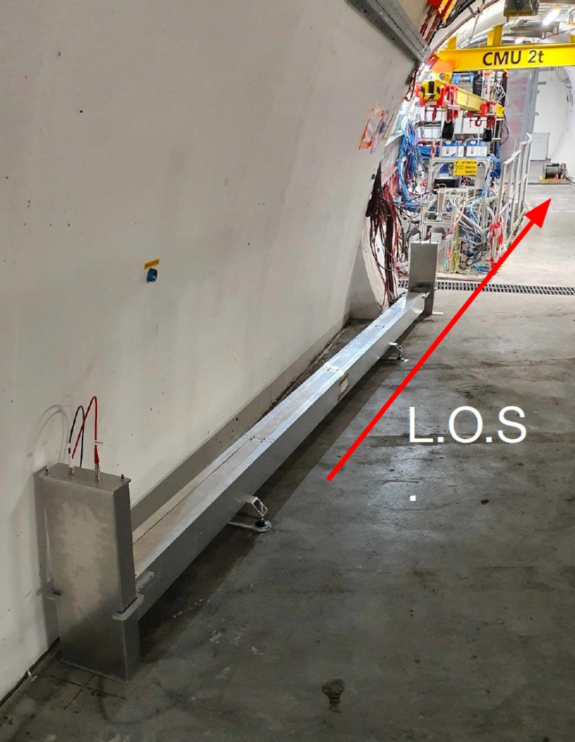
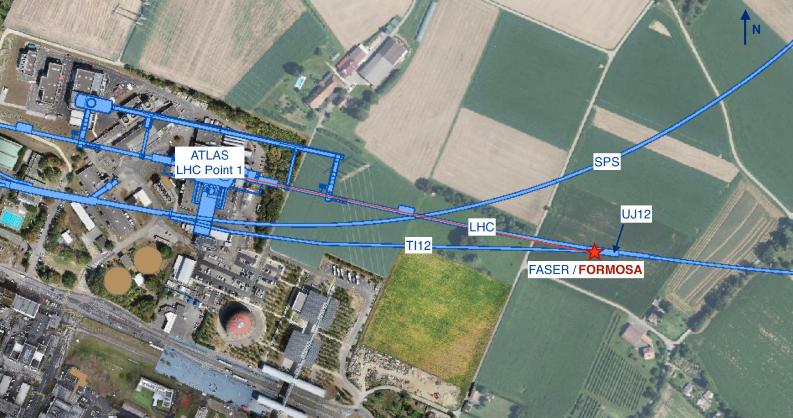
FORMOSA Demonstrator Installation
Installation completed in early Feb
LHC tunnel closed for Run 3 operations → Remote running and commissioning ongoing

Slide 23
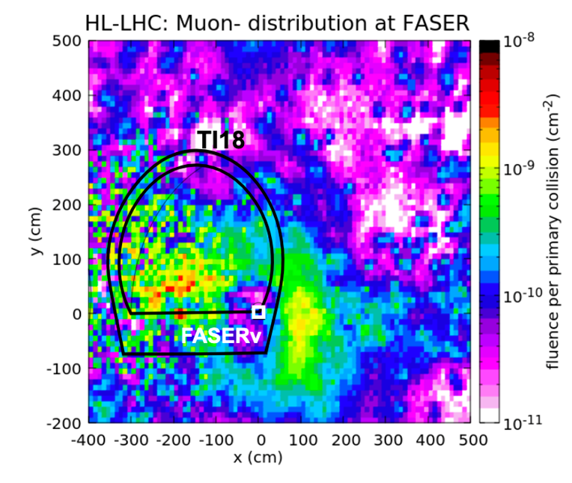
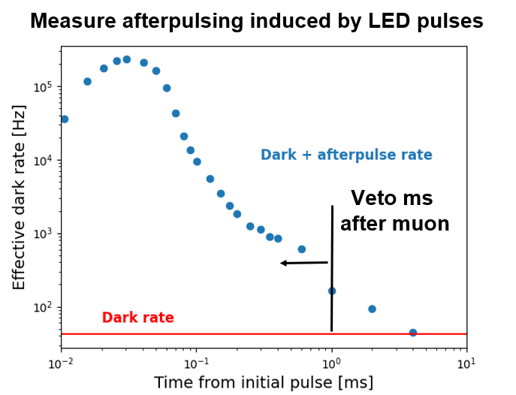
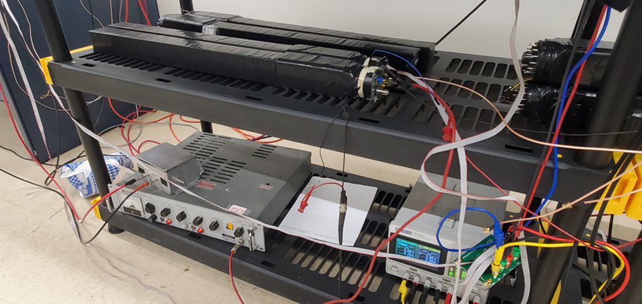
Background
Beam muons are dominant background:
Through-going flux of ~1 Hz/cm²
Causes frequent afterpulses
  Can veto by cutting on time relative to initial pulse
New challenges! Can prove feasibility with demonstrator
Can devote a ms of deadtime to cool down following a beam muon. But muons are frequent (~100Hz for demonstrator), so can’t wait too long

Slide 24
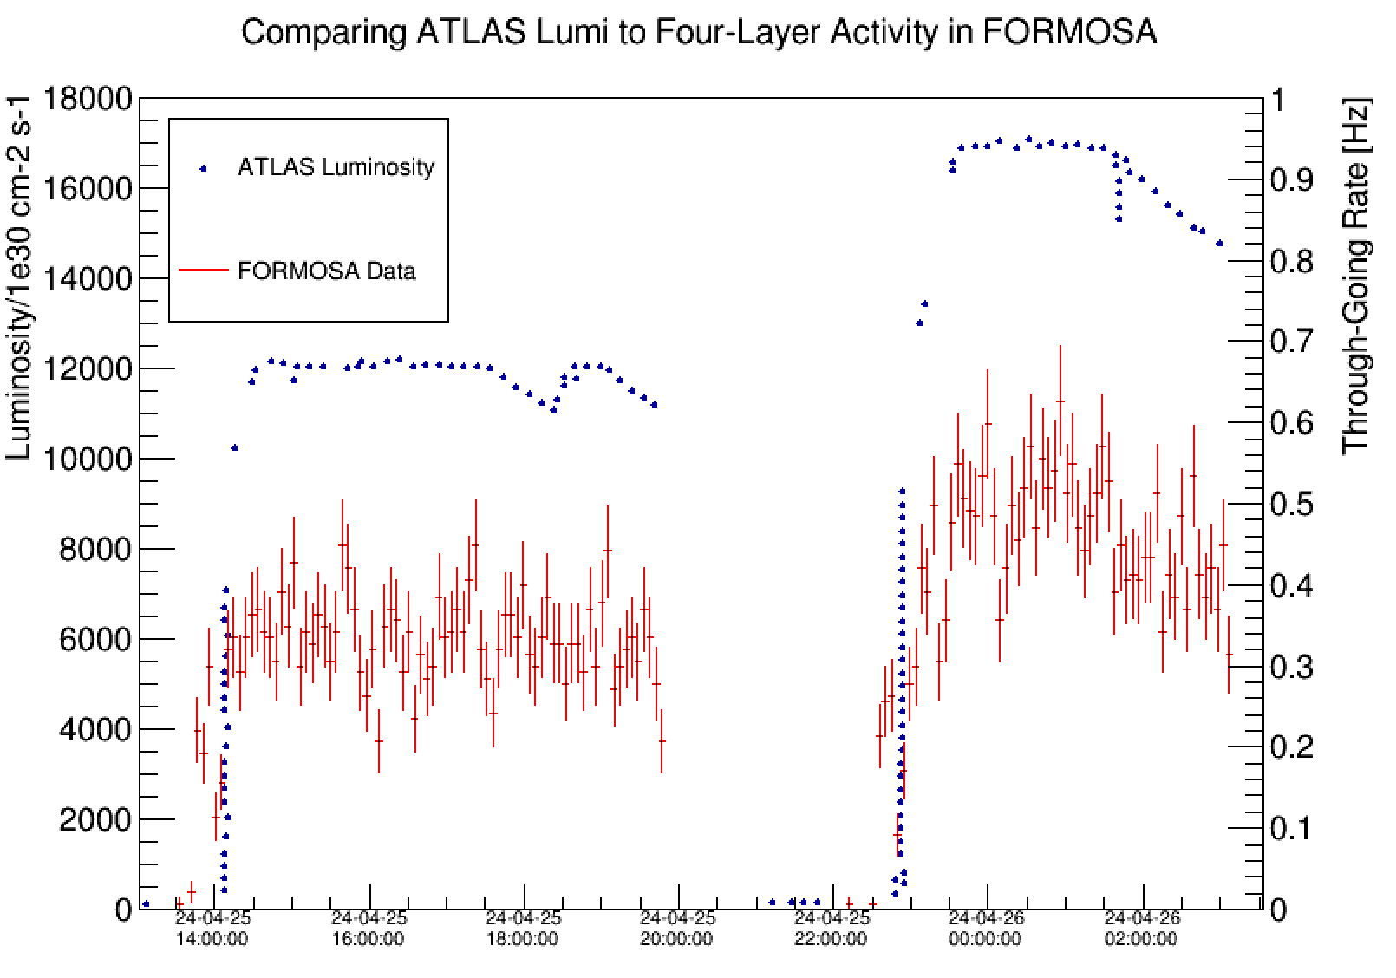
First look at data
We see the increased activity in FORMOSA when beam circulates regardless of type
The 4-layer rate aligns with beam conditions

Slide 25
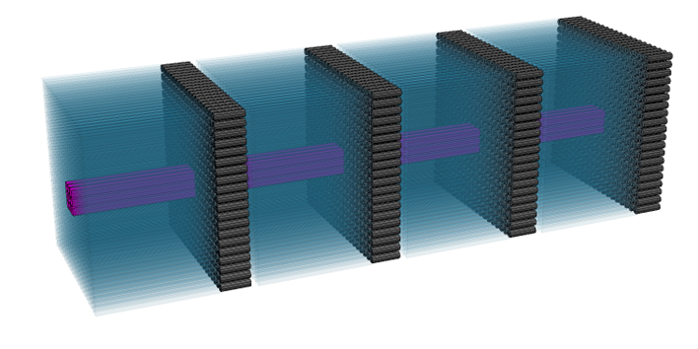
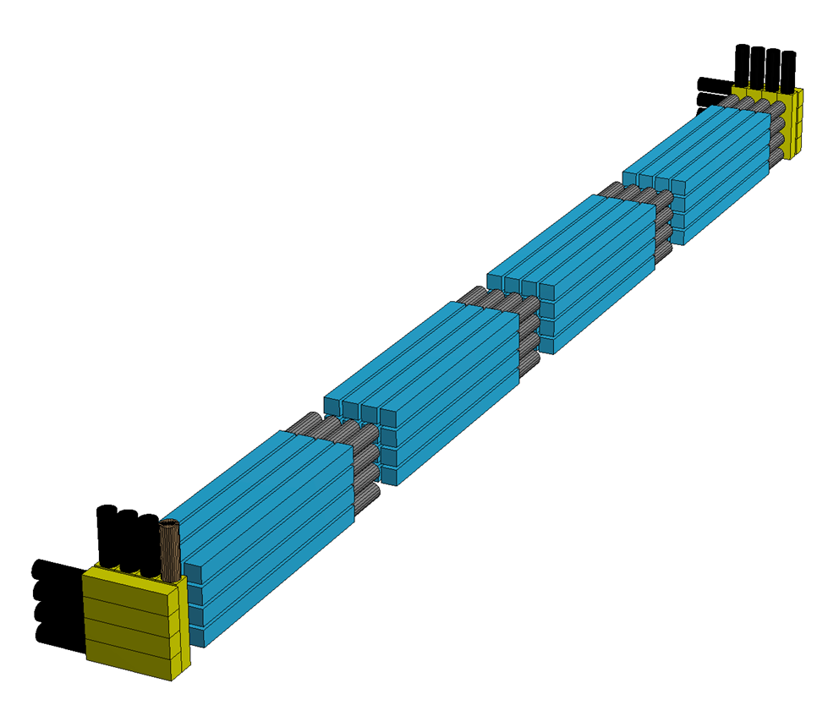
Looking Forward for FORMOSA
Expand over time to full size FORMOSA detector
  Learn from smaller iterations to optimize final form
  2x2 → 4x4 → 20x20
Consider smaller subdetector using CeBr3
  Provides up to factor of ~4 improvement in low charge sensitivity (below Q/e = 10⁻⁴!)
CeBr3
2025
HL-LHC

Slide 26
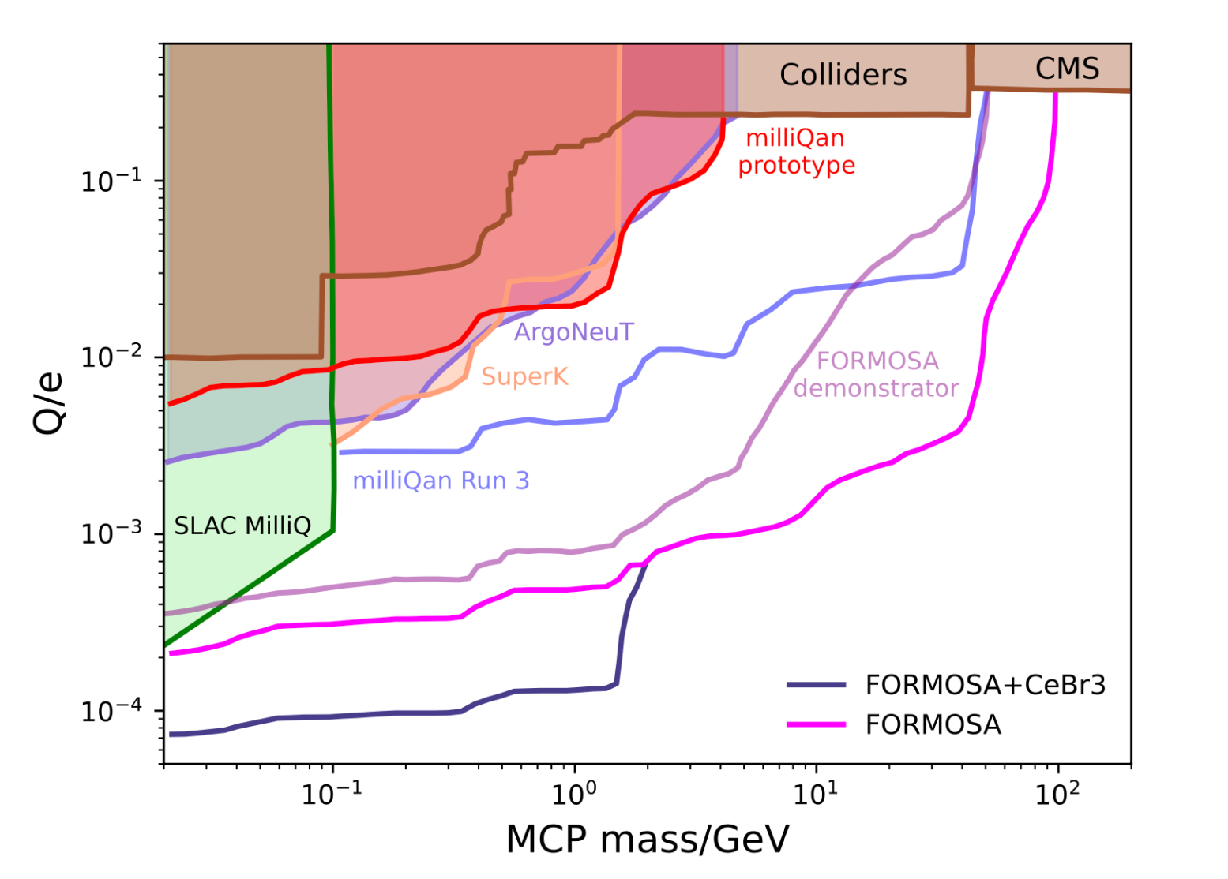
Expected Sensitivity
More details in initial paper: PhysRevD.104.035014
FORMOSA projections are very promising, even at the demonstrator level
  Full FORMOSA can reach ~10⁻⁴ charge!
Need to prove feasibility to achieve these projections. But much potential!
(4x4)

Slide 27
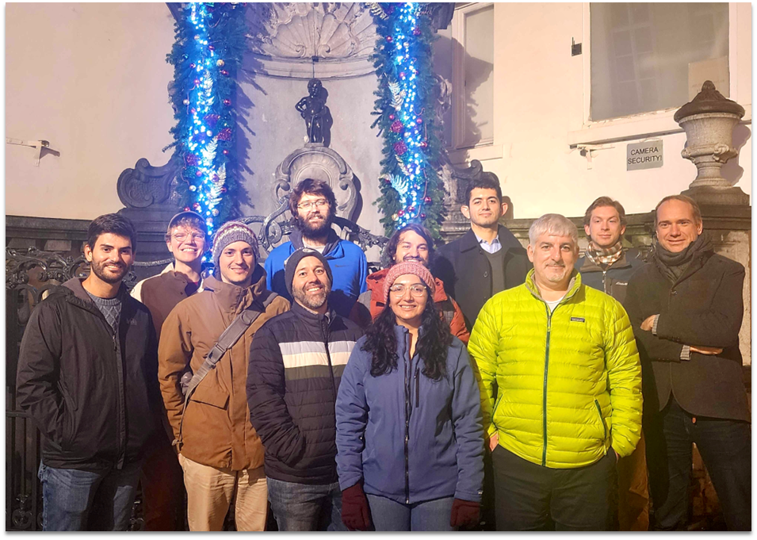
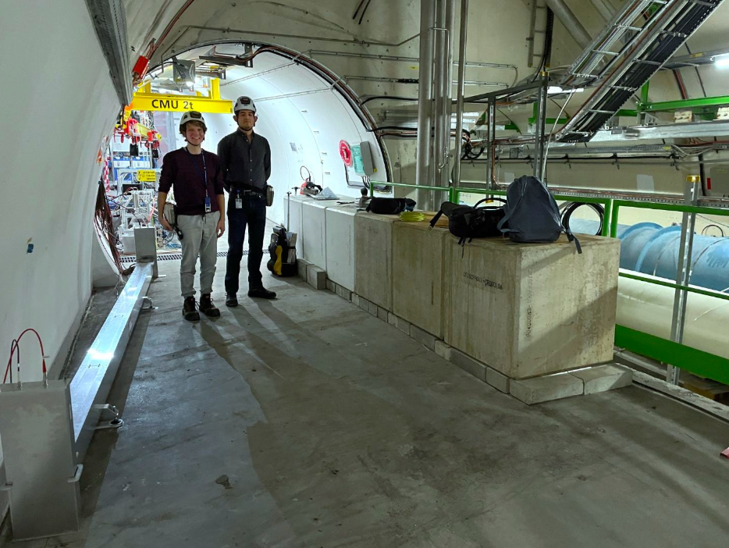
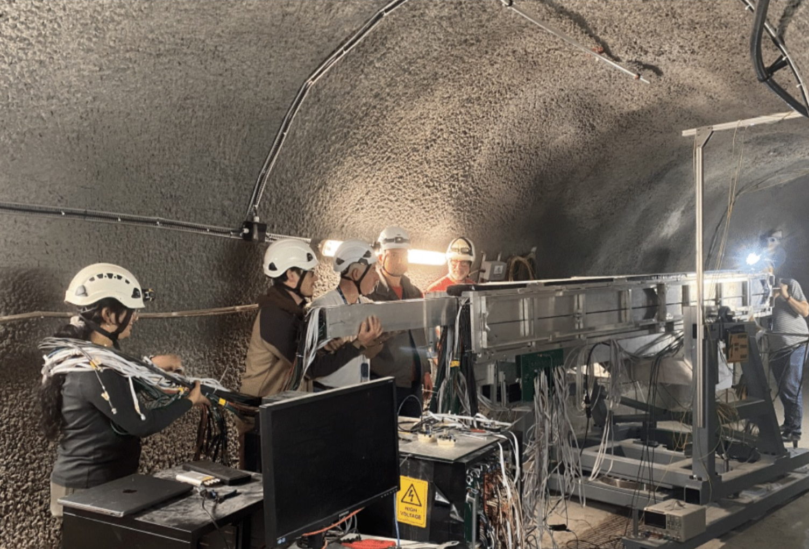
Outlook
milliQan bar detector is on its way to 100 fb⁻¹ of data this year
milliQan slab detector and FORMOSA demonstrator will achieve first physics data soon
Complementary approach yields stronger results and leading sensitivity in both the near and far future

Slide 28
Backups

Slide 29
Beam Muon Validation: Timing Calibration
To study timing performance, we measure the time difference between the first and last layer in beam muon events
We can use this to calibrate the times for each layer and to set the width of the timing window for signal
Beam
Cosmic
This plot confirms we can see beam activity! The beam distribution also drops to zero when the beam is off, a good diagnostic tool

Slide 30
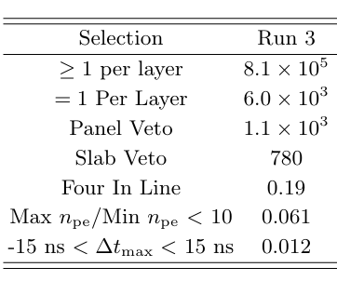
Background Prediction
Backgrounds were evaluated using this GEANT4 simulation, calibrated and validated against the four layer demonstrator, using selections motivated by the Run 2 demonstrator search
Together, these requirements reject backgrounds while maximizing signal efficiency
Cosmic Backgrounds
Key features of milliQan signal selections:
Exactly one bar hit per layer, in a line pointing towards the IP
Vetoing on muons + high energy background
Energy deposits consistent with a mCP
Detection timing consistent with a mCP originating from the IP
Dark Rate
0.05
1.4

Slide 31
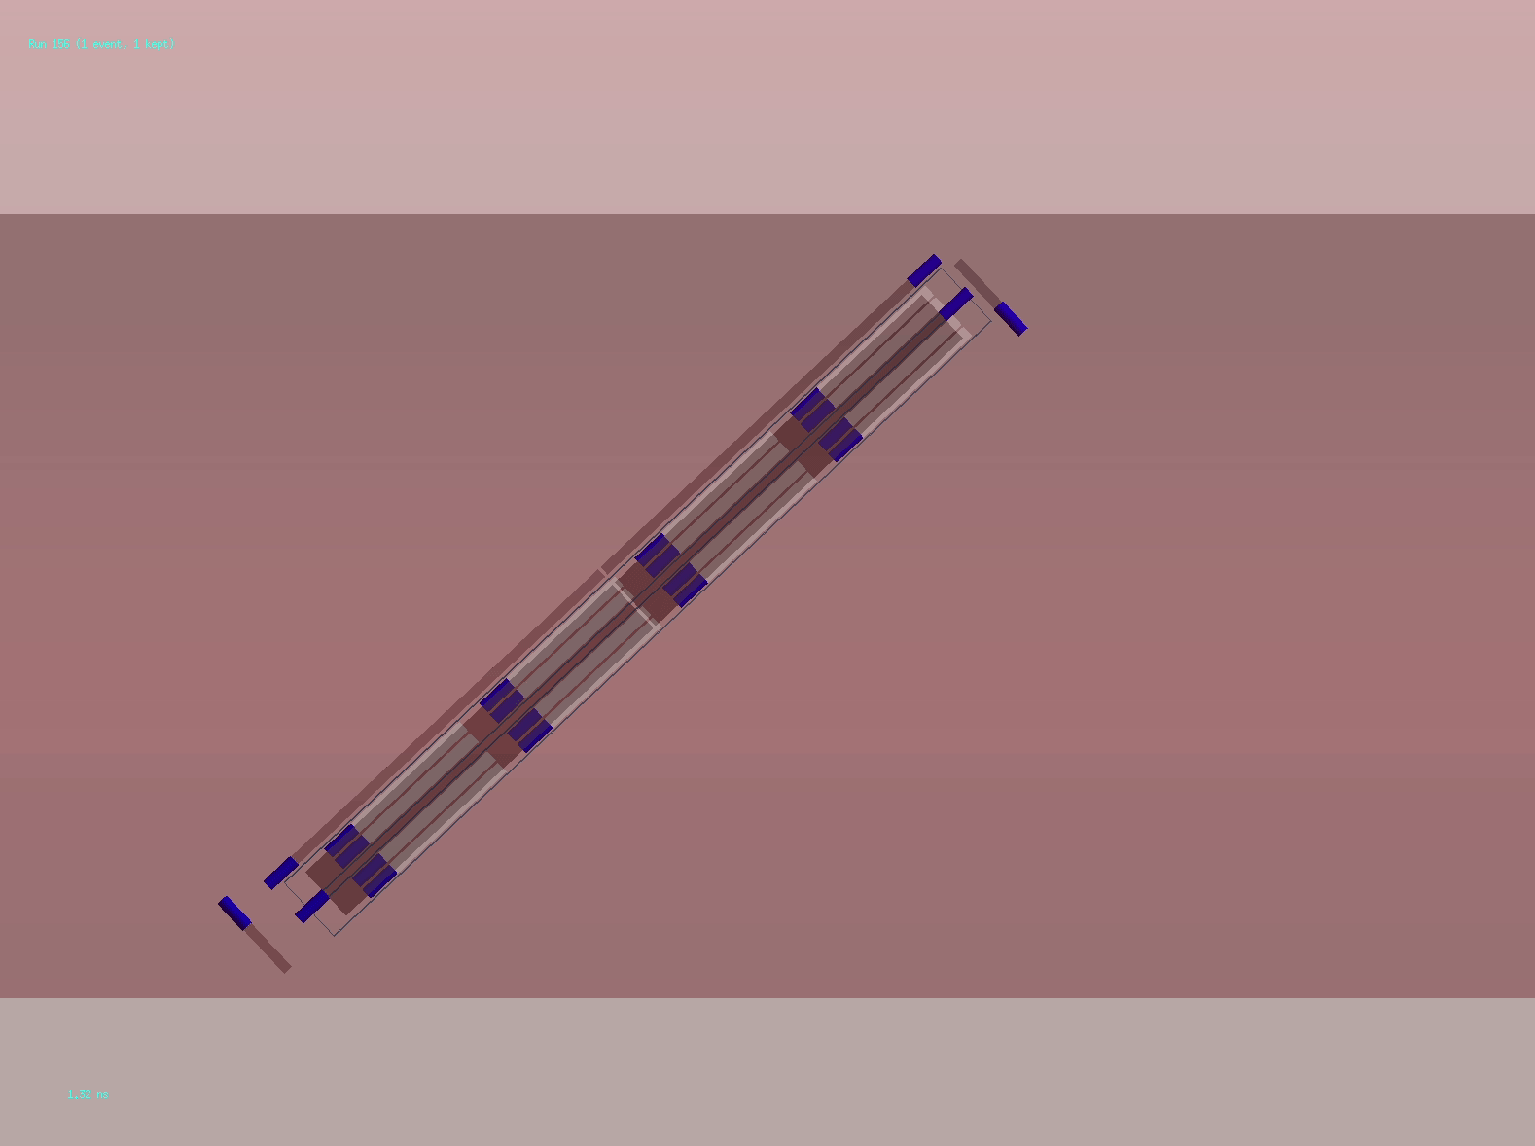
Cosmic background animation
Secondary EM showers from cosmics entering into the cavern generate gammas and electrons
Electrons are vetoed by panels, but gammas can penetrate and possibly look like signal
Selections made cause backgrounds from cosmics to become negligible for bar detector

Slide 32

milliQan Simulation Animations
Beam muon
Cosmic shower
mCP (q=0.01e)

Slide 33
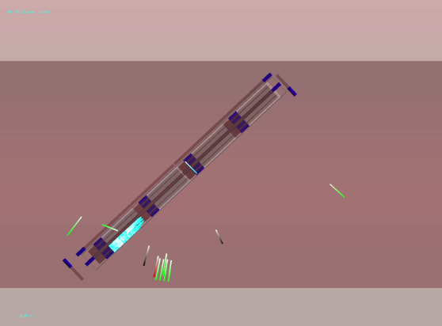
milliQan Simulation Images
Beam muon
Cosmic shower
mCP (q=0.01e)

Slide 34
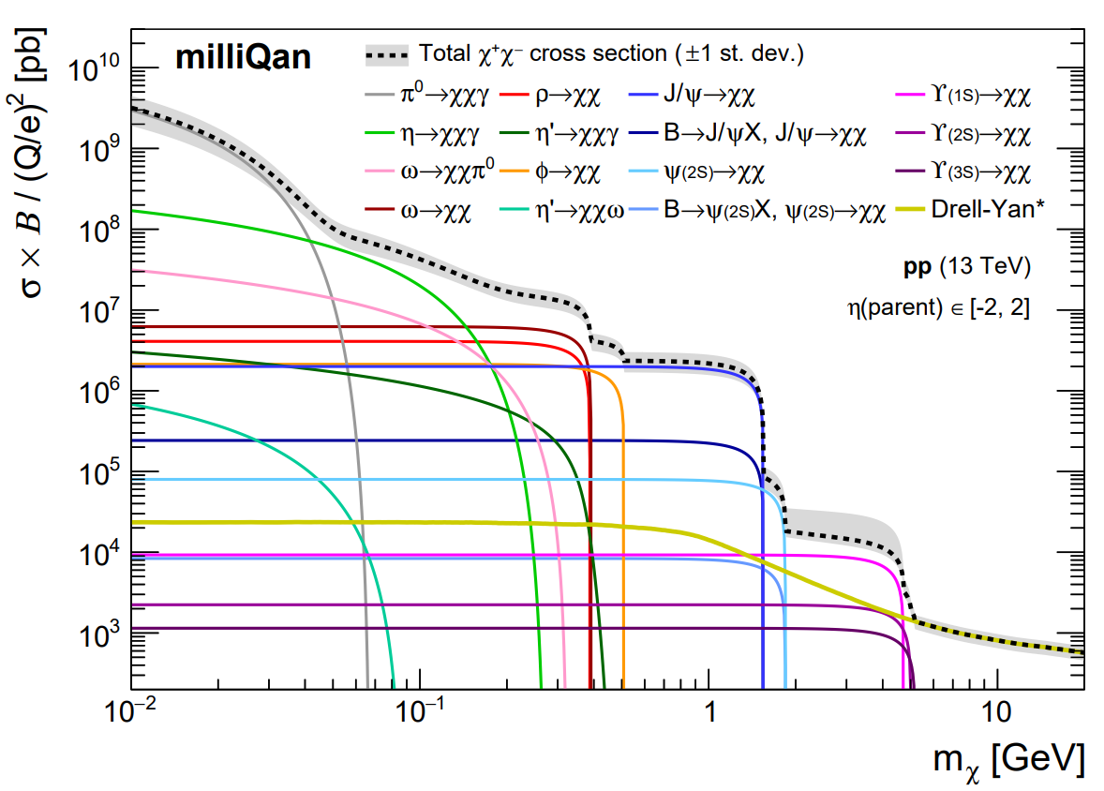
Limits on the phase space of mCPs
So, we’d like to look for millicharged particles (mCPs). How are they produced?
Every process that produces dilepton pairs (like two electrons, or two muons) can produce mCPs for the same reasons that cause mCPs have small charge

Slide 35
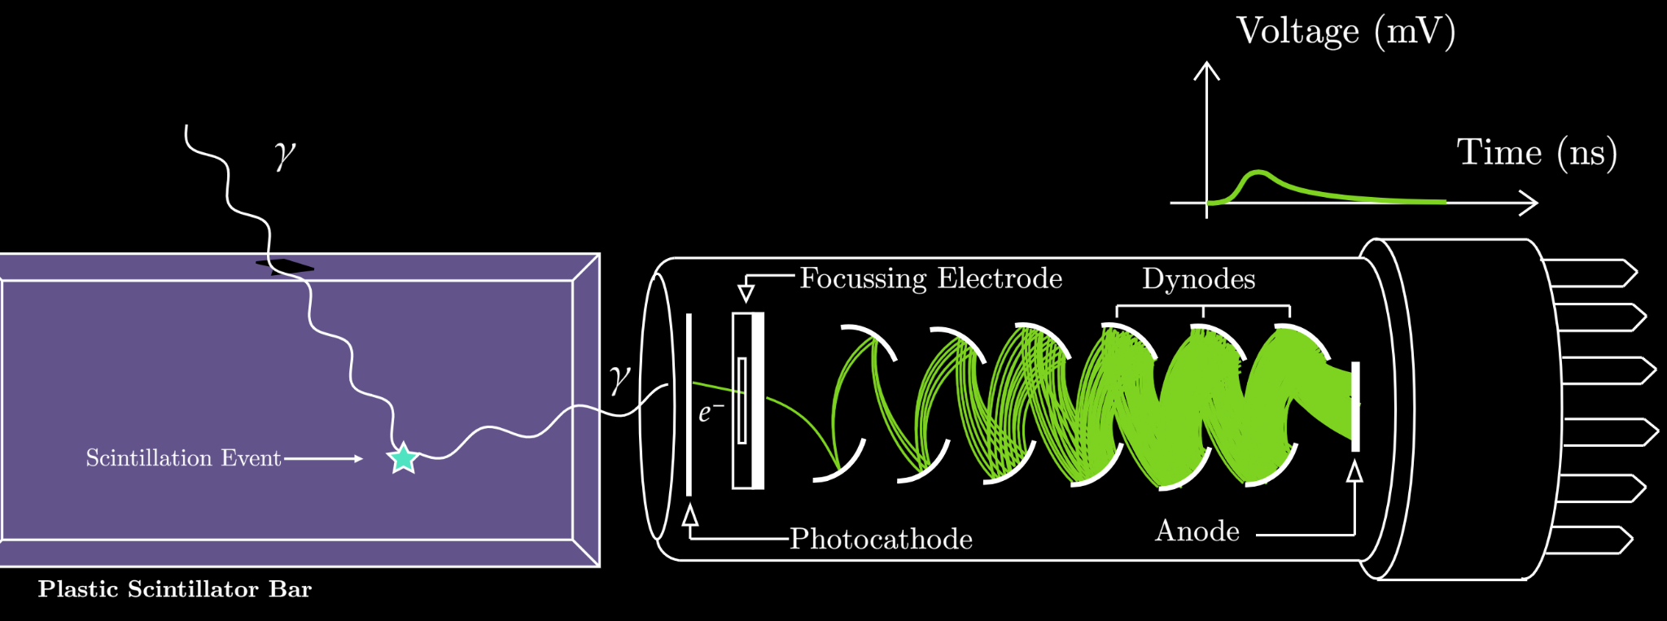
Single photon detectors
Photomultiplier Tube
When scintillation photons strike a photomultiplier tube (PMT), the a process called the photoelectric effect absorbs the photon and emits an electron
The PMT has internal plates that are charged to a high voltage (1.5kV in milliQan). The electron accelerates to a plate, strikes it, and that collision ejects a few more electrons. The process is then repeated until a huge current arrives at the end of the tube. This way, we detect single photons!

Slide 36
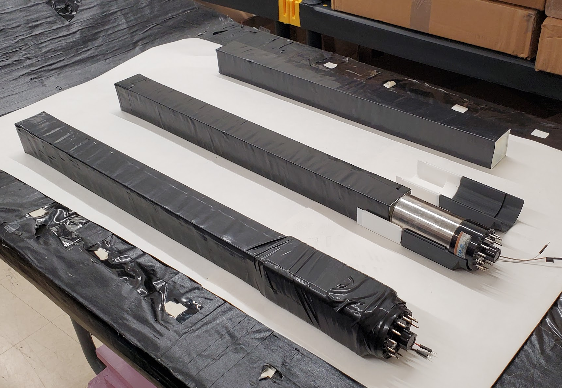
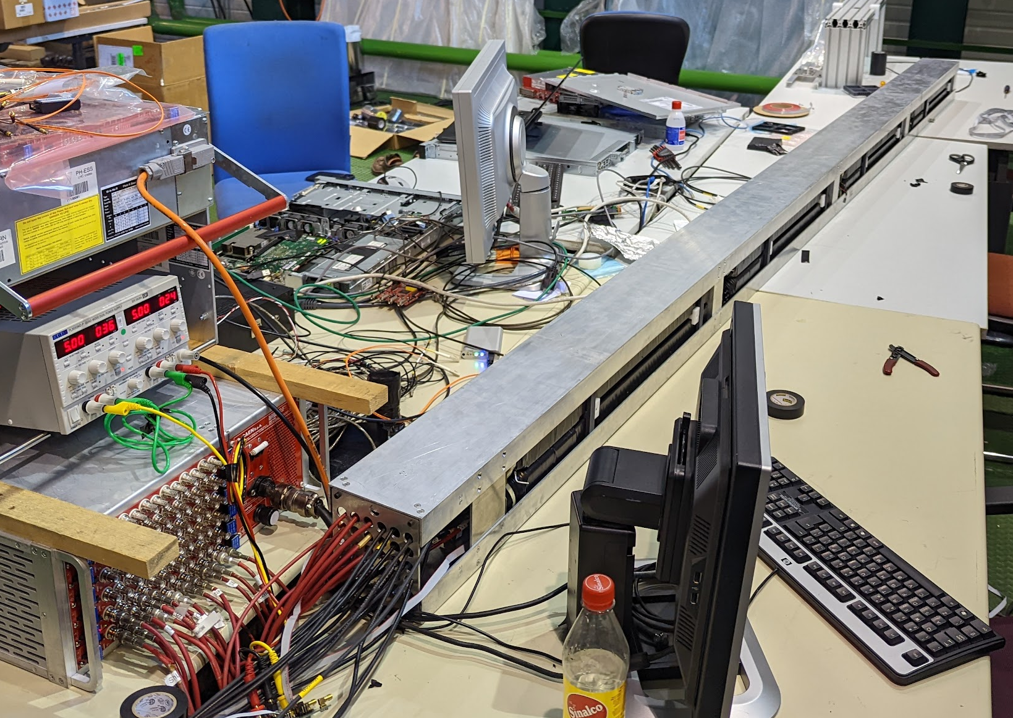
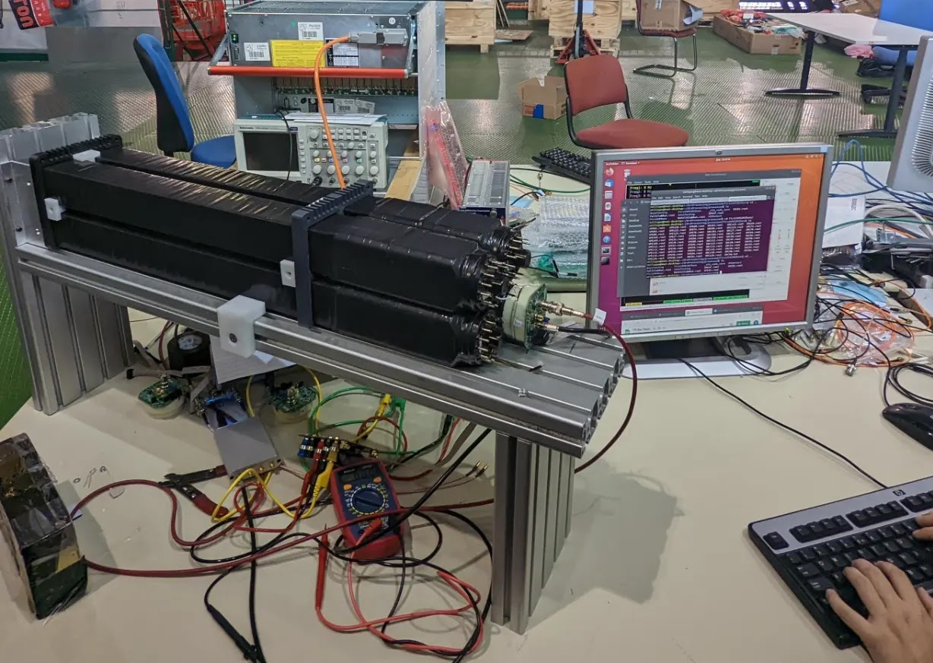
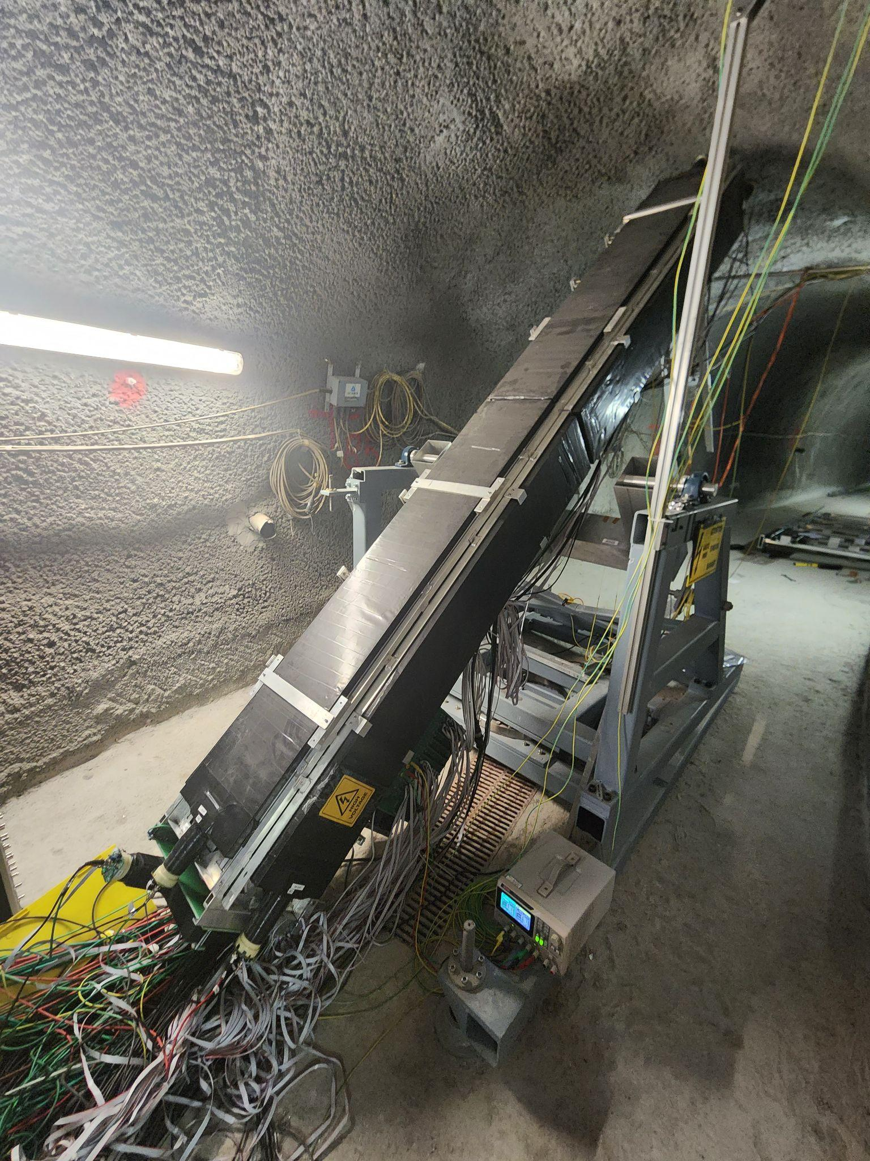
Detector construction process
4 units make one supermodule, which is then re-tested.
Supermodule
4 supermodules are placed into a structure, and make up the core of the detector
Bar
x4
x4
x4
Unit
Detector
4 bars make one unit, which is then re-tested.
Extra shielding to block out cosmic ray backgrounds are added to the sides. Completed detector!

Slide 37
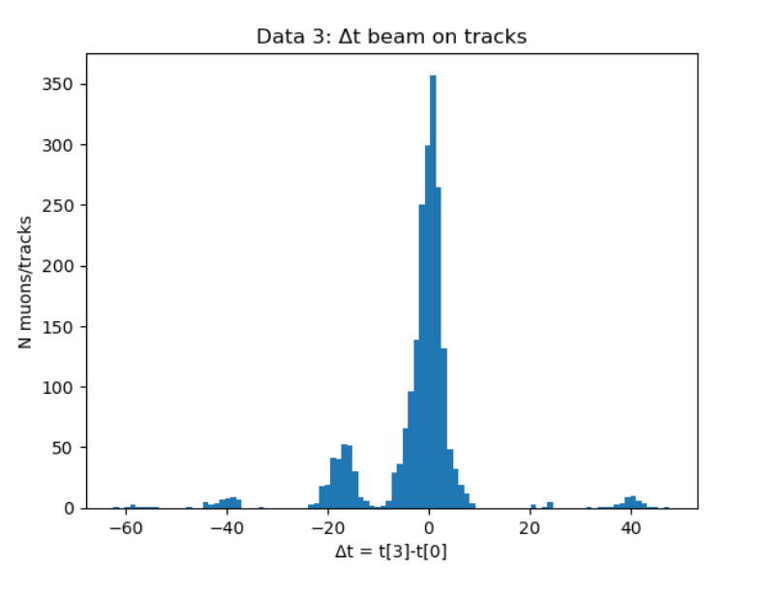
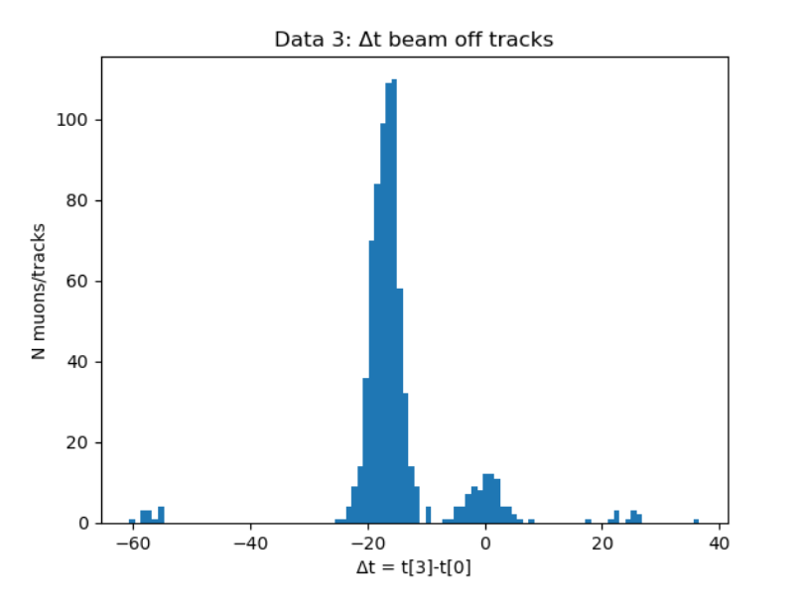
Beam on vs beam off, muon timing
We can see beam muons appear with calibrated timing around zero when beam is on, and near -20 when the beam is off. So, we’re seeing beam activity! This particular plot has a bug shifting some values by +/-30 ns, causing other clusters further out. The beam off sample may also have slight beam contamination

Slide 38
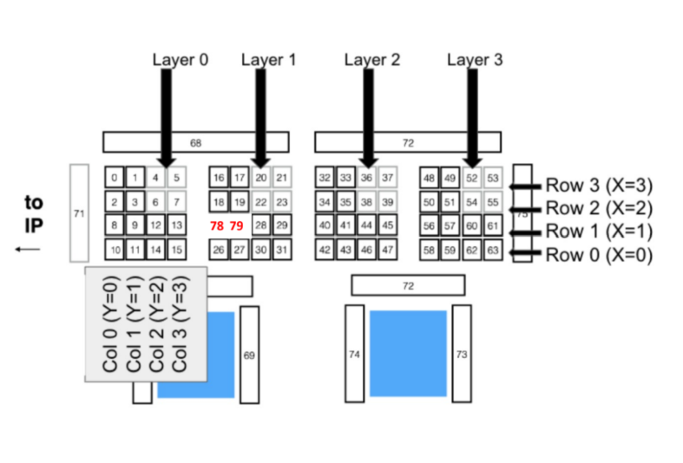

Muon Tracking Methodology
Track: a cluster at each of the detector’s 4 layers, the centroid of which cannot move by more than one unit (in x and y direction)

Slide 39




Why millicharged particles?
Standard motivation: Introduce new, hidden U(1) with a massless field A', a “dark photon” that couples to a massive “dark fermion” ψ’
Ψ’ has mass and charge under the new U(1) of e'
Gauge transformation of introduces coupling
Conclusion: Coupling arises between dark fermion and SM photon of
charge . mCP parameters are entirely defined by their mass and charge
A
A’
massless “dark photon”
“dark fermion” with mass M_{mCP} , charge e’
mixing term

