Slide 1



Predicted e+e- cross sections for neutral scalars from LHC indications
A. Kundu, A. Le Yaouanc, P. Mondal, G. Moultaka, F. Richard
Calcutta-Orsay-Montpellier collaboration
Direct discovery potential working group (WG1-SRCH) of the ECFA Higgs Factory Study
April 2023

Slide 2
Introduction
The choice of the next e+e- machine heavily relies on LHC results, in particular on the presence or absence of extra scalars
So far, no single analysis has provided for a 5 s.d. evidence, but there are however several indications at the ~3 s.d. local level with compatible masses which reveal significant indications
Can we understand these results and predict the cross sections in e+e- ?
The answer seems to be yes, but this requires extending the available phenomenology

Slide 3
LHC inputs for our work
We choose to select > 4 s.d. global significance with the exception of h151 which results from an unofficial combination of CMS & ATLAS data
This keeps 4 neutral scalars and one pseudo scalar
No change of significance after a CMS update of h(95)->2γ with RUN1 and RUN2 after some cleaning against Z->e+e-

Slide 4
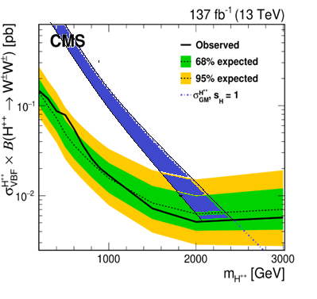

The unitarity constraint
The large VBF cross section H(650)->WW observed by CMS is violating a general rule which is imposed by the preservation of unitarity for W⁺ W⁻ -> W⁺ W⁻
Haber et al. in P.R.D 43 (1991) 904-912 have shown a way to restore unitarity by introducing a cancelling u-channel exchange of a doubly charged H - - (see also 1202.1532 )
From the measured WW couplings of h125 ~SM=gmw and H650 ~0.9gmw, one predicts a large g_{W+W+H− −} coupling
In absence of a signal in W+W+ at LHC, one predicts a heavy mH++ but one should take into account the possible opening of H+W+ which could reduce BR(W+W+) well below 1

Slide 5
The Georgi Machacek model ?
This model has one iso-doublet plus two iso-triplet and passes the ρ ∼1 rule at tree level
It predicts H++ as belonging to a custodial 5-plet H5,H5+,H5++ , not necessarily mass degenerate in an extended GM, e-GM1 2111.14195
The neutral H5 component of GM does not allow to interpret the pattern of decays followed by H(650) which dominantly decays into W+W-
We have therefore elaborated a further extension of GM, e-GM2, with an additional doublet which does the job, H(650) becoming a mixed state of the two doublets
This extension also allows to include H(320), an additional scalar observed by ATLAS in the reaction A(420)->H(320)Z

Slide 6
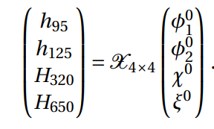
The neutral sector in an e-GM
e-GM comprises two doublet fields φ1 , φ2 with v1 and v2 and two triplet fields χ, ξ with the same v.e.v. u
For the neutral sector one writes:
where the matrix is 4X4 unitary real (no CPV) with 16-4-6=6 free parameters requiring the unitary vectors to be orthogonal
In total there are 6+3 (v1, v2, u) free parameters and 14 observables from LHC measurements
One needs to choose between various Yukawa coupling patterns and we find that type I (all fermions having the same coupling) gives an agreement with the data

Slide 7
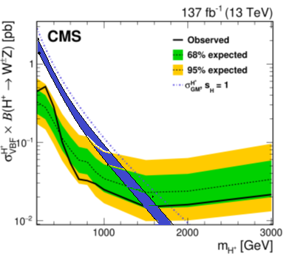

Type I result
Non-trivial result since it allows to predict 5 couplings and all ZZ/WW signs relevant for the second sum rule
W⁺W⁻ -> Z Z
There is a cancellation which allow to ~accommodate mH5+=375 GeV
Predicts Γ_{H320->ZZ}~10 GeV, excluded by the 4 lepton search unless Γ_{tot}~100 GeV
Appears plausible if H(320) is predominantly coupled to hh as indicated by the ATLAS result A->ZH(320)->Zbbbb

Slide 8
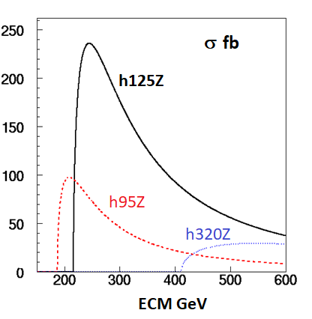
Predicted cross sections
Large x-sections allowing very precise measurements
Access to H(320)hh self-coupling ‘easy’ ~200 times larger than SM hhZ

Slide 9
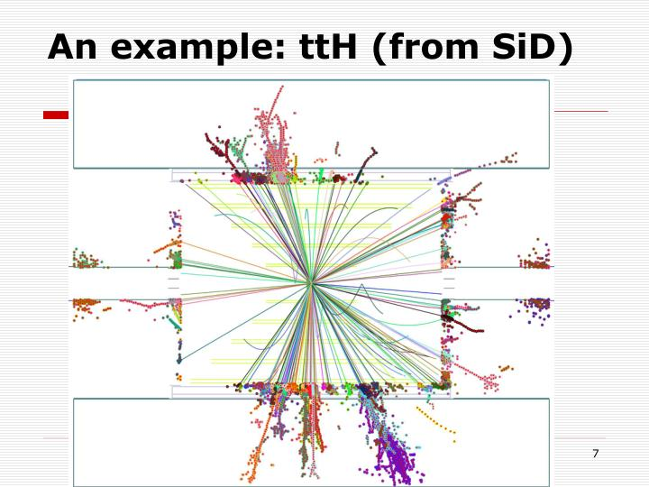
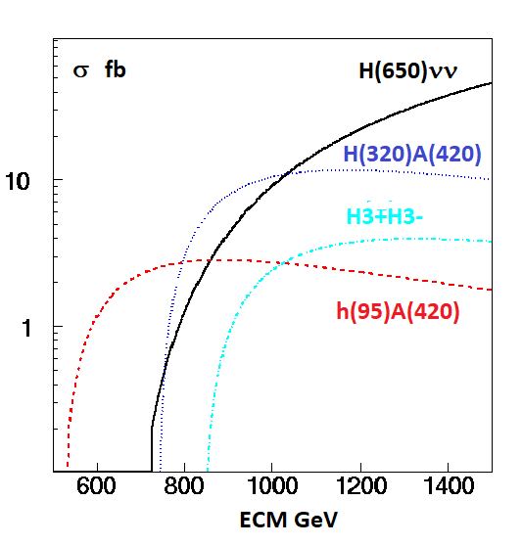
TeV collider reach
ILC provides 8000 fb-1 at 1 TeV
Mass degeneracy inside GM triplet mH3+=mA=400 GeV was assumed
The final states are complex modes (~ttH) requiring the highest L and an almost ideal detector
H(650) mainly produced through VBF (beam polarisation allows a factor ~2 gain, not included)
Using a e-e- collider one could also produce H ⁻ ⁻ through VBF

Slide 10
CONCLUSIONS
We propose a consistent description for the most significant observations of neutral scalars at LHC with a simple extension of the GM model, referred to as e-GM2
This allows for a plausible, but not unique, prediction for the e+e- cross sections at future colliders
At a LC reaching a centre of mass energy of ~1 TeV, almost all these states are measurable, except perhaps H++ which should be observed at HL-LHC, illustrating the complementarity of the two colliders
An e+e- LC would allow to probe the triple scalar couplings, an essential ingredient to establish the model
The complexity of the heavier final states and their low cross-section will be challenging even for an e+e- machine operating in an easy environment
Within this scenario, HL-LHC and a TeV LC offer a great discovery potential

Slide 11
Previous presentation

Slide 12
1st indication : H->ZZ into 4 leptons
The cleanest channel for discoveries
From a combination of published histograms done in 1806.04529 with 113.5 fb⁻¹ from CMS (2/3) and ATLAS (1/3) one observes a peak at M_{H}~660 GeV Γ_{H}~100 GeV, ~90 fb with s/b=42/14 ~3.75 s.d. local significance
With 139 fb-1 ATLAS a ~3.5 s.d. effect at the same mass 2103.01918
With 139 fb-1, with sequential cuts, an excess is observed at the same mass, s/b=9/2 ~2.1 s.d., for VBF->H(660)->ZZ ~30 fb (~2 times smaller with a MVA analysis less contaminated by ggF) 2009.14791
The VBF cross section is below the inclusive cross section ~90fb implying a dominant ggF contribution
CMS analyses into four leptons, ggF nor VBF, are not yet published
These results call for a combination of both analyses before one can draw a valid conclusion
Could stop here but…

Slide 13
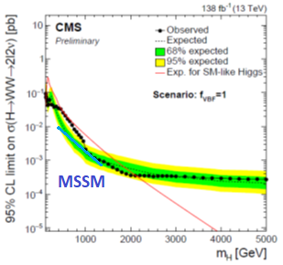
Evidence for VBF->H(650)->W+W- ->ℓℓvv
Large top background even after b-jet vetoing
Wide signal with ±50% mass resolution
VBF->H(650)->ℓℓvv (µµ, ee and µe) favoured with 3.8 s.d. local (2.6 global) significance
The VBF cross section ~160±50 fb, close to SM, is >5 times larger than ZZ, inconsistent with GM which predicts for the scalar H5 WW/ZZ=0.5 !
Within 2HD, h(125)WW from CMS gives sin²(α−β)~0.97±0.09 meaning that H(650)WW~cos²(α−β)~(0.03± 0.09)SM
2HD 2 s.d. upper limit shown by the blue line
Both interpretations are inconsistent !
An attempt from ATLAS does not reach the same sensitivity (only µe) ATLAS-CONF-2022-066

Slide 14
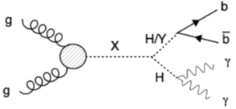
Evidence for gg+VBF->H(650)->Y(90)+h(125)->bb+γγ
3.8 s.d. for mH=650 GeV and mY=90 GeV shown at ICHEP22
Mass resolution on Y does not allow to distinguish between Z and h(95) which is by now a “good old friend”
CP says that bb cannot come from Z->bb but could be h(95) which is another strong candidate seen in 3 channels 2203.13180 +1 (2302.07276 )
The cross section is dominant over all other indications ~200 fb
HIG-21-011

Slide 15
Interpretations
H(650) cannot be accommodated within 2HD nor the genuine GM model
Requires an extension of GM with an extra doublet where H(650) is a mixed state of doublets and triplets, under construction by our group
Combining indications from H(650), one gets 6.7 s.d. using P=Nbins*Π Pi and 5.8 s.d. with a conservative approach
The channel H(650)->h(95)h(125) provides a reinforced evidence for h(95) 2204.05975
Initial evidences for A(400)->ττ and Zh from ATLAS not confirmed, nor progress on A->tt from CMS
But new evidence for A->ZH(320)->Zhh->Zbbbb from ATLAS at 3.8 s.d. ATLAS-CONF-2022-043 which also requires e-GM
See 2208.00920 and 2112.00921 for alternate interpretations of H(650)

Slide 16
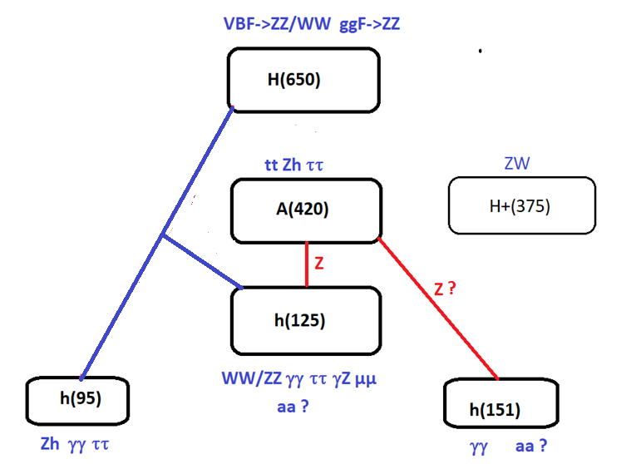
SUMMARY OF BSM CANDIDATES

Slide 17
References
Global interpretation of LHC indications within the Georgi-Machacek Higgs model, Talk presented at the International Workshop on Future Linear Colliders (LCWS2021).
François Richard (IJCLab, Orsay)(Mar 22, 2021)
e-Print: 2103.12639 and ref therein
Searches for scalars at LHC and interpretation of the findings Anirban Kundu (Calcutta U.),
Alain Le Yaouanc (IJCLab, Orsay), Poulami Mondal (Calcutta U.), François Richard (IJCLab, Orsay)
Contribution to 2022 ECFA Workshop on e+e- Higgs/EW/TOP factories
e-Print: 2211.11723

Slide 18
References
Global interpretation of LHC indications within the Georgi-Machacek Higgs model, Talk presented at the International Workshop on Future Linear Colliders (LCWS2021).
François Richard (IJCLab, Orsay)(Mar 22, 2021)
e-Print: 2103.12639 and ref therein
Searches for scalars at LHC and interpretation of the findings Anirban Kundu (Calcutta U.),
Alain Le Yaouanc (IJCLab, Orsay), Poulami Mondal (Calcutta U.), François Richard (IJCLab, Orsay)
Contribution to 2022 ECFA Workshop on e+e- Higgs/EW/TOP factories
e-Print: 2211.11723

Slide 19
Acknowledgements
Contributions from Gilbert Moultaka are gratefully acknowledged.
This work has benefitted from discussions with Sven Heinemeyer and Howard Haber through various workshops.
Thanks to Pawel Jan Klimek for providing useful infos about ATLAS results.

Slide 20
Missing slides & additional slides (lack of lime)

Slide 21
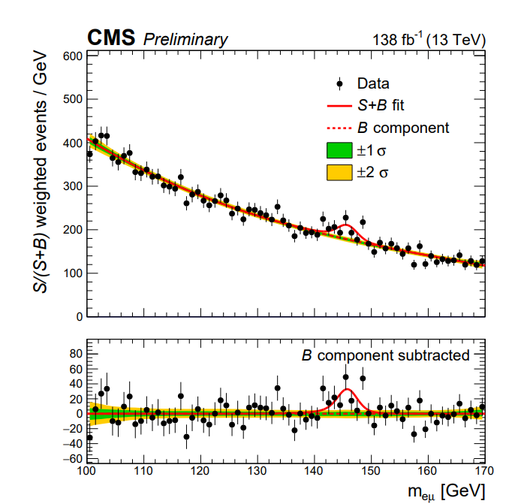
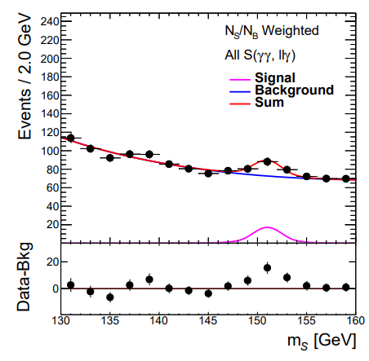
Compatibility h->µe and h->γγ

Slide 22
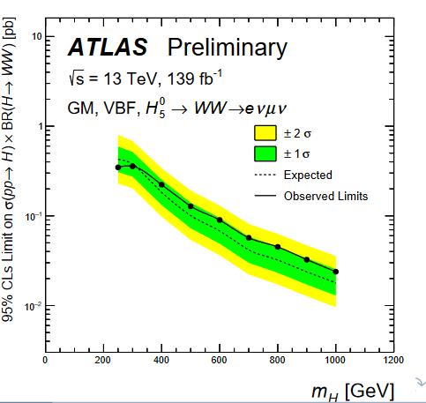
H->WW->µevv from ATLAS
ATLAS has provided a preliminary result (PISA) on VBF->H5->WW in µevv (not µµ nor ee) ATLAS-CONF-2022-066
Like CMS, ATLAS sees a wide excess around 650 GeV but with only at the 1 s.d. level
ATLAS can set a 200 fb 2 s.d. limit for
σ(pp->H)xBR(H->WW)
This limit is compatible with the observation of CMS 160±50 fb
ATLAS has a smaller efficiency as compared to CMS (retain only µe)

Slide 23
Predictions from the sum rules
For H+5->WZ the blue band is closer to the limit from CMS and one cannot exclude mH5+=375 GeV, as indicated by ATLAS and CMS
The blue band, obtained assuming BR(W+W+)=1, will decrease with the opening of H++-> H3+W+, H3+H3+ and H5+W

Slide 24
A(420)->ZH(320)->Zh(125)h(125)
Local (global) significance of 3.8σ (2.8σ)
hh into 4b using mass constraint to improve resolution
Requires e-GM for H(320)
Note that A(420)->ZH(320) is close to threshold, meaning that the true width of H(320) could be larger than indicated by the plot
ATLAS-CONF-2022-043

Slide 25
Complex events

Slide 26
GM model issues

Slide 27
Georgi-Machacek for pedestrians
Allows I=2, H++, without violating ρ=M²w/Mz²cos²θw=1 at tree level
Is achieved by combining 1 isospin doublet (v_{φ}) + 2 triplets, one real the other imaginary, with the same vacuum expectations :
=1 with v_{χ}=v_{ξ}=u
Predicts a 5-plet of physical states H5++ H5+ H50 H5- H5– Fermiophobic only produced by VBF
+ 3-plet H3+ H30 (CP-odd) -> A(400)
Mass degeneracy inside multiplets usually assumed but unnecessary for ρ=1 see 2111.14195
+ Singlets h(125) and H mixing angle α

Slide 28
Yukawa coupling schemes in 2HDM
Yukawa couplings in 2HDM offer a wide range of possibilities 2104.03275
In most 2HDM models each type of fermion (u,d,ℓ) is coupled to only one scalar doublet φ₁ or φ₂ hence no FLV
In type III they can be coupled to both hence FLV at tree level 1612.01644
The preferred mass region is for mh<2Mw

Slide 29
The GM model for advanced
GM is constituted by one doublet φ and two triplets, one complex χ and one real ξ, with the same vacuum expectations to get ρ=1
Y=1/2 T=1/2 vφ Y=1 T=1 vχ Y=0 T=1 vξ
Only φ couples to fermions
They form the following physical states, dominantly triplet
H1 and H1’ have following composition
The physical states are
The mixing angle α has to be small to avoid altering the doublet properties of the SM h(125)
E.g. sin α=-0.15 & sH=0.5, vφ=213 GeV for the doublet, vξ=vχ=43.5 GeV for the triplets

Slide 30
SGM: a SUSY version of GM
1308.4025
GM does not necessarily mean compositeness
SGM provides all the “goodies” of SUSY
Perturbativity, computability
EWSB naturally triggered
Mh predicted with less “tension” on stop masses with extra contributions to RC
Two doublets as needed to interpret H320 and the ZZ/WW decays of H(650)
DM candidate
Complex/rich world with ~20 Higgs scalars

Slide 31
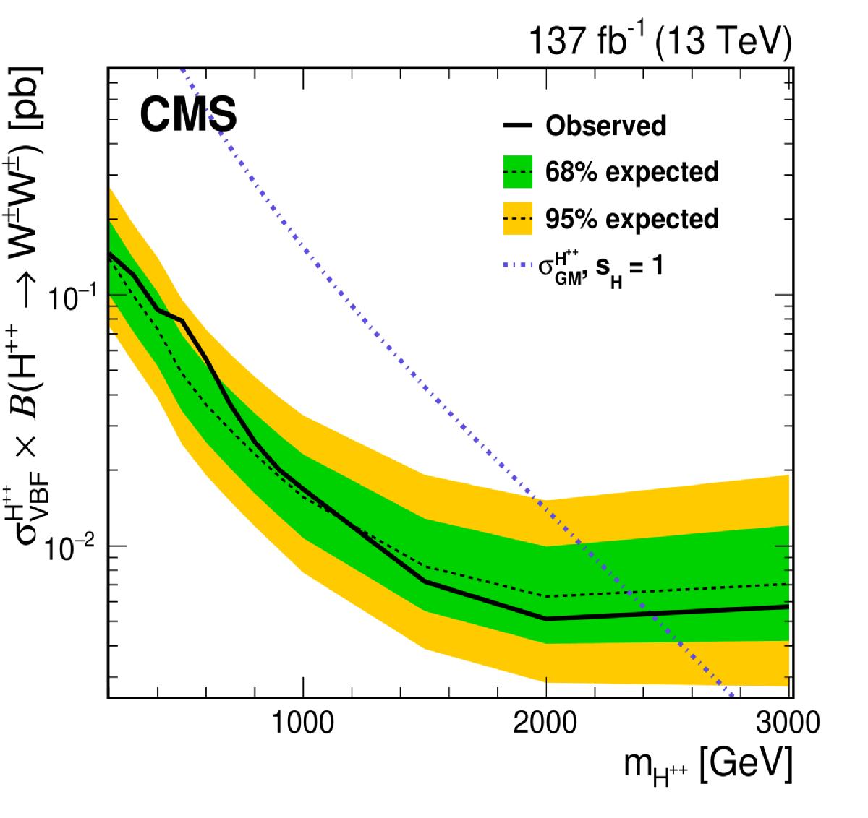
What about H5+ and H5++ ?
2104.04762
ATLAS-CONF-2022-005
CMS cross sections assume s_{H}=1 are divided by 4 for s_{H}=0.5
If H3+ is light H3+Z and H3+W+ become dominant and these resonances become wide
Coincident excess at mH5+~375 GeV for ATLAS (2.8sd) & CMS while naïve GM predicts 650 GeV
Not excluded in eGM 2111.14195

Slide 32
e+e- Colliders

Slide 33
LUMINOSITY at 1 TeV
In reference 1903.01629 a running scenario of ILC at 1 TeV collecting 8000 fb-1 has been envisaged
Beneficial for Higgs self-coupling measurement
Discoveries at LHC would boost these studies at ILC and CLIC
Convert ILC into an ERL 2105.11015 and 2203.06476

