Slide 1
Sustainability in the Back of the Envelope
  Pablo Garcia Tello
  CERN EU Office/IdeaSquare

Slide 2

As cool as we think we are, the reality is that we all should go back to school.
Because each one of us got an F in Sustainability.
So, roll your sleeves up, take your pen and pencil and do it!

Slide 3
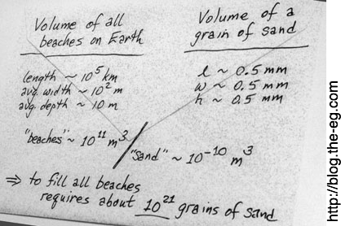
Welcome to Sustainability 101 folks !!!
Where we start discussing impact meaningfully and not pub-style.
Sustainability
in the
Back of an Envelope

Slide 4
Easy Exercises
(It is not necessary to explain almost any concept)
(examples)

Slide 5

Is Solar Energy a Sustainable Solution Globally?

Slide 6
The Surface of the Sahara is ~10¹³ m². Imagine we cover it with solar panels of 1 m² each one. Let us take a reasonable efficiency/ solar panel ~ 15%. This will give 10¹² W or ~ 10⁹ kW.
Since the world population is ~10¹⁰ people, the entire Sahara would give us ~0.1 kW/person), assuming we transport the energy without any loses and that the panels work 24/7/365.
The primary energy consumption ~58 kWh person/day. If a day has 24 h, it means 2.5 kW/person.

Slide 7
Is Wind Energy a Sustainable Solution Globally?

Slide 8
The Earth’s surface is ~10¹⁴ m². Imagine we totally cover it with wind mills. Let us take an optimistic efficiency ~4 Watts/m² independently of how the wind blows and any other factors and assuming that the mills work 24/7/365.
The entire Earth would generate then ~10¹⁵ W ~ 10¹² kW.
Since the World population is ~10¹⁰ people, it will give ~ 100 kW/person.
The primary energy consumption ~58 kWh person/day. If a day has 24 h, it means 2.5 kW/person.

Slide 9
Are Electric Cars a Sustainable Solution Globally?

Slide 10
The amount of Lithium in a battery of an electric car is ~8 Kg/car. Global Lithium reserves are estimated ~2 10¹⁰ Kg.
The number current globally cars is estimated ~2 x 10⁹ (including only passenger private and public commercial cars).
This means that if tomorrow we will turn all cars into electric we would be depleting all the existing Lithium.
Reflection: Would it change significantly anything if we would reduce the amount of Lithium to 1 Kg or 0.5 Kg?

Slide 11
Mid-level exercises
(it is necessary to explain a simple concept)
(examples)

Slide 12
IPAT: A good starting equation to play with Impact
We are living in exponential times…
…but what does it really mean?
IPAT is a formula describing the impact of human activity on the environment.
I = P x A x T
I represents
the magnitude of the environmental impact you want to consider. It may be expressed in
terms of resource depletion or waste accumulation.
P represents the size of the impacting human population.
A stands
for affluence.
It represents
the level of consumption
by that population.
T stands for technology. It represents the processes used to obtain resources and transform them into useful goods and
wastes.
P.R. Ehrlich, J.P. Holdren,(1971). "Impact of Population Growth". Science. 171 (3977): 1212–1217.

Slide 13
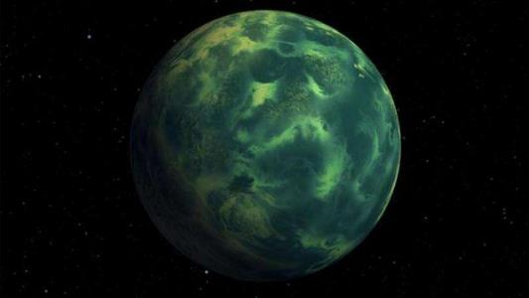
3179/R-C08 and Scalability: A (real?) example
We are living in exponential times…
…but what does it really mean?
The IdeaSquare Cosmic Preservation Unit (IS-CPU), received recently, and thanks to our sophisticated quantum communication technology (that we will not show you today), a message from planet 3179/R-C08.
Its inhabitants are extremely concerned because they want to maintain their environmental impact levels constant for 2060 and they are not sure what kind of constraints that imposes in their technology development.
Based on the message annexes the IS-CPU has made the following assumptions they consider to be accurate about 3179/R-C08:
Its population will increase 35% in 2060.
Its global GDP will experiment an annual growth rate of 3.5%.
Note: Growth at 3.5%, when compounded for forty years, means that the global economy in that planet will be 4 times larger.

Slide 14
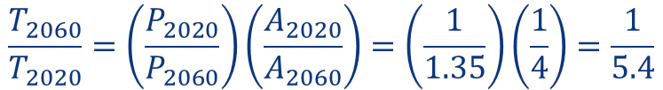
3179/R-C08 and Scalability: A (real?) example
We are living in exponential times…
…but what does it really mean?
Using IPAT, IS-CPU has reached the following conclusion:
If the inhabitants of 3179/R-C08 want I₂₀₂₀= I₂₀₆₀ then…
$$P_{2060}A_{2060}T_{2060}=P_{2020}A_{2020}T_{2020}$$
WOW!!!
Their technology will need to reduce impact above a factor of 5 !!!!
$$\frac{T_{2060}}{T_{2020}}=\left(\frac{P_{2020}}{P_{2060}}\right)\left(\frac{A_{2020}}{A_{2060}}\right)=\left(\frac{1}{1.35}\right)\left(\frac{1}{4}\right)=\frac{1}{5.4}$$

Slide 15

Kaya: A close cousin of IPAT
The Kaya identity is a useful equation for quantifying the total emissions of the greenhouse gas carbon dioxide (CO₂) from human sources.
It states the total emission level of CO₂ as the product of four factors:
$$F = P\left(\frac{GDP}{P}\right)\left(\frac{E}{GDP}\right)\left(\frac{F}{E}\right)$$
F = Global CO₂ emissions from human sources
P = Global population
E = Energy consumption
GDP= Gross Domestic Product
Kaya, Yoichi; Yokoburi, Keiichi (1997). Environment, energy, and economy : strategies for sustainability. Tokyo [u.a.]: United Nations Univ. Press.

Slide 16
Kaya: A real example
The IPCC estimates that we have about 7-8 years left until a global warming between 3-4 degrees happens (not going to explain why that is crucial..).
To have a fair chance at avoiding this oven-like scenario we must halve CO₂ emissions by 2030, according to the global scientific community.
$${CO}_{2} emissions = Population\left(\frac{GDP}{Population}\right)\left(\frac{Energy intensity of global economy}{GDP}\right)\left(\frac{{CO}_{2} emissions}{Energy}\right)$$
What we must achieve is CO₂/2. So…take your pick:
First question:
    Should we halve population?
    Should we halve global GDP?
    Should we halve the intensity of the Global Economy?
    Should we halve the emissions of our Economy?
Second question: Are we capable of doing it?
Third question: What systemic consequences it will bring?

Slide 17

The Jevons paradox: When technology backfires!!
It may happen that our technology is so good in increasing the efficiency of use of a certain resource, that it triggers an increase in its consumption.
Example: Booming of Social Media
In 2010, it was estimated that there were about 2 billion cat pictures on the internet. Today, that number is expected to be more than 6.5 billion.
R. York, Ecological Paradoxes: William Stanley Jevons and the Paperless Office, Human Ecology Review, Vol. 13, No. 2, 2006.

Slide 18
The Jevons paradox: When technology backfires!!
Data-driven Extinction?
Let’s take Facebook.
Facebook generates 4 x 10¹⁵ bytes of data per day. Let us assume they store it all and add redundancy and backup for safety.
This is ~ 2 x10¹⁷ bytes/month.
They build a new data center approximately every six months. Let us suppose that it is because they reach their storage limit. This means ~10¹⁸ bytes/data center.
Today we generate ~ 10²² bytes of info.
The projection for 2024 ~2 x 10²² bytes.
If we wanted to store all the data produced in 2022, we would need 10⁴ data centers. Today, the number of data centers is estimated in ~10⁴, so not bad at all for this crude estimation! It means also that we are approximately storing all the data we are generating globally.
Today, we globally emit around 5 x10¹³ Kg of CO₂e (CO₂ equivalents) each year.
Currently, the global carbon footprint in CO₂ equivalents (CO₂e) for all the data centres accounts for ~ 2% the global carbon emissions
It means ~10⁷ Kg emitted by the 10⁴ data centers following the estimation.
If data centers would account for all the CO₂ emissions, we would need ~10¹⁰ of them. It means storing a total of 10²⁸ bytes (6 orders of magnitude compared to what is stored today).
If in 2 years the progression of data produced and stored doubles, following the figures above, then it takes 5 years to become ten times more (one order of magnitude). Thus, it will take ~60 years to reach 10²⁸ bytes.
Climate Change models predict that with the current policies, the temperature of the Planet will increase an average of ~3 C by 2100. According to these estimations, even if all other emitting sources keep the same levels as today, data centers alone will make the emissions doubling in ~60 years. If emissions double, the average temperature could increase even close to 5 C with devastating consequences.
        https://kinsta.com/blog/facebook-statistics/
        https://www.datacenterknowledge.com/data-center-faqs/facebook-data-center-faq
        https://www.idc.com/
        https://www.usitc.gov/publications/332/executive_briefings/ebot_data_centers_around_the_world.pdf
        https://www.climateneutralgroup.com/en/news/carbon-emissions-of-data-centers/#:~:text=Worldwide%2C%20it%20is%20estimated%20that,as%20the%20entire%20airline%20industry.
        https://www.nature.com/articles/d41586-020-01125-x
        https://agupubs.onlinelibrary.wiley.com/doi/full/10.1029/2019RG000678

Slide 19
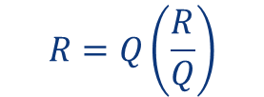
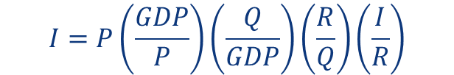
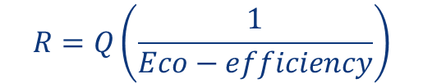
Let’s go back to IPAT…
Let Q be the quantity of goods and services delivered (within a given time period) to people.
Let R be the quantity of resources consumed in order to deliver those goods and services.
Then the IPAT equation can be rewritten as:
Resource
intensity
→
$$I=P\left(\frac{GDP}{P}\right)\left(\frac{Q}{GDP}\right)\left(\frac{R}{Q}\right)\left(\frac{I}{R}\right)$$
$$R=Q\left(\frac{R}{Q}\right)$$
Impact
created
per unit of resource
consumed
The inverse of resource intensity is called eco-efficiency, thus:
$$R=Q\left(\frac{1}{Eco−efficiency}\right)$$
Resources consumed are equal to goods and services delivered divided by eco-efficiency

Slide 20
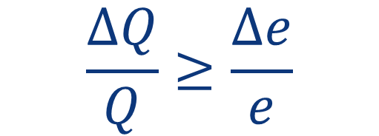
Scaling again…and back to Jevons!
Whether or not gains in eco-efficiency yield genuine savings in resources and lower environmental impacts depends on how much, over time, society consumes of a given product or service (the relative eco-efficiency gain Δe/e).
Rule of thumb:
$$\frac{∆Q}{Q}≥\frac{∆e}{e}$$
If
we have backfire
Q = quantity of goods and services delivered (within a given time period) to people.
e= eco-efficiency.
M.R. Chertow, (2000). "The IPAT Equation and Its Variants". Journal of Industrial Ecology. 4 (4): 13–29.

Slide 21
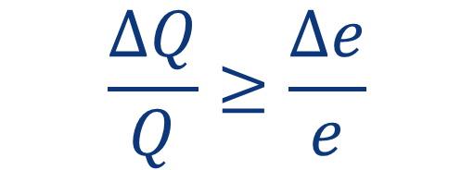
Scaling again…and back to data centers!
Rule of thumb:
$$\frac{∆Q}{Q}≥\frac{∆e}{e}$$
If
we have backfire
Q = quantity of goods and services delivered (within a given time period) to people.
e= eco-efficiency.
$$quantity of goods consumed≥eco−efficiency$$
Clearly, data centers, due to our eagerness of storing EVERYTHING, backfire.
M.R. Chertow, (2000). "The IPAT Equation and Its Variants". Journal of Industrial Ecology. 4 (4): 13–29.

Slide 22
“High-level” exercises
(A secondary school /undergrad Physics Concept is required to be explained)
(example)

Slide 23
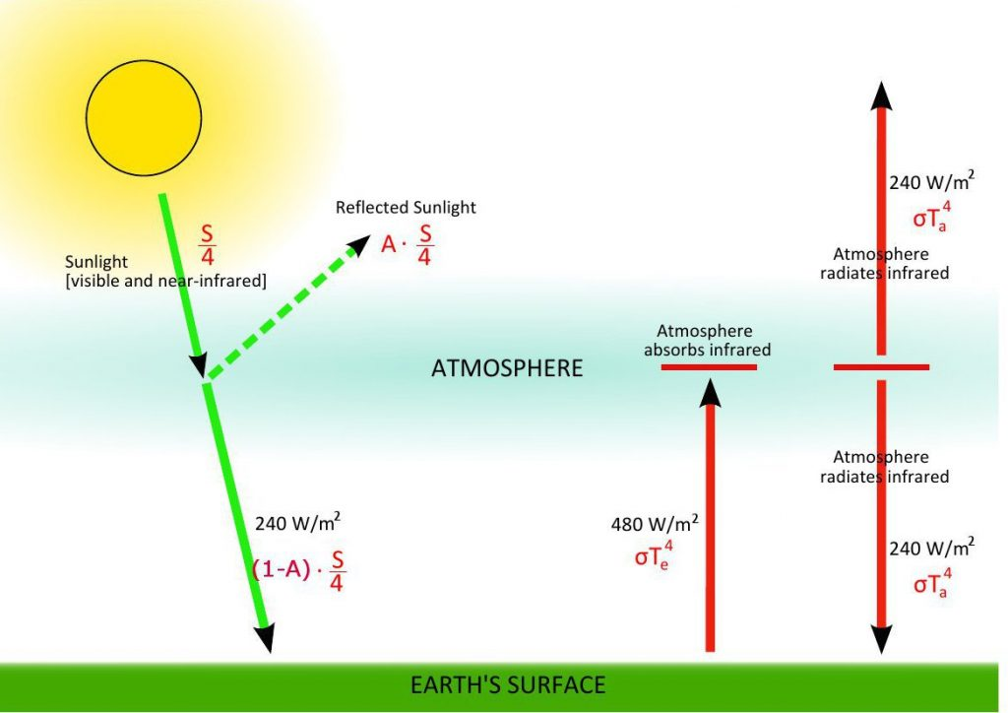
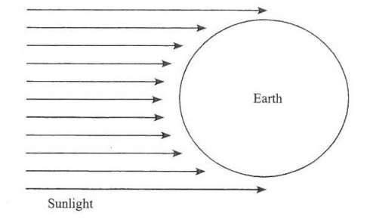






Example: Understanding the Green House Effect
Concept: Stefan-Boltzmann’s Law. The amount of radiation, E, emitted by a (black) body per unit area, A, is directly proportional to the fourth power of the temperature, T.
$$E=σT^{4}$$
$$con σ\sim 6 x {10}^{−8} W/m^{2}K^{4}$$
1. Solar radiation, S [W/m²] is entering the atmosphere. A fraction A, called the albedo, is reﬂected back. Thus, a fraction (1-A) heats the Earth.
1. Now we add the atmosphere. So, our original 𝜎𝑇⁴ (radiation out) is broken into:
$${Sun radiation}_{in}={Sun radiation}_{out}$$
$S\left(1−A\right)πR^{2}=σT^{4}$4 $πR^{2}$
$$σT^{4}=σT_{e}^{4}−εσT_{a}^{4}$$
The Sun is far away so it is a circle of area 𝜋𝑅².
4𝜋𝑅² is the surface of the Earth sphere that gets irradiated.
$$\left(1−A\right)\frac{S}{4}\frac{1}{σ\left(T_{a}^{4}−T_{e}^{4}\right)}=\left(1−ε\right)$$
$$\left(1−A\right)\frac{S}{4}=σT^{4}$$
If we double the concentration of CO₂ in the atmosphere, a simple model predicts that the emissivity increases from ε=0.78 to ε=0.80. The surface temperature would increase by 1.2 K.

Slide 24
Innovation
What we don’t know
Paradigms
(Transformative Innovation)
Breakthroughs
(Radical Innovation
…sometimes)
Facts
(No Innovation)
Possibles
(Incremental Innovation)
What we know
That we know
That we don’t know

Slide 25
Thanks!
Any questions?

