Slide 1
On the electrical parameters of a depolarizer
Ivan Koop, Egor Bedarev, Alexei Otboev and
Yury Shatunov
BINP, 630090 Novosibirsk
EPOL zoom meeting
16.03.2023

Slide 2
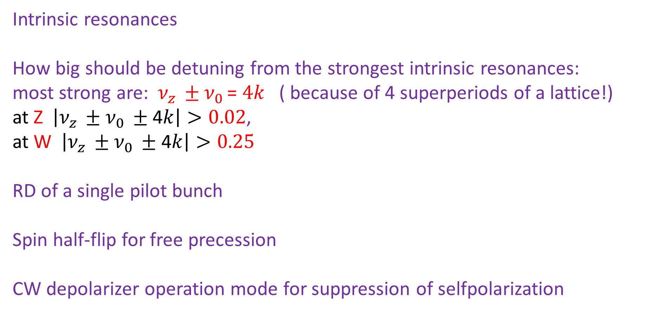
Outline
Intrinsic resonances
How big should be detuning from the strongest intrinsic resonances:
most strong are: $ν_{z }±ν_{0 }$= $4k$ ( because of 4 superperiods of a lattice!)
at Z $\left|ν_{z }±ν_{0 }±\text{4}k\right|>0.02$,
at W $\left|ν_{z }±ν_{0 }±\text{4}k\right|>0.25$
RD of a single pilot bunch
Spin half-flip for free precession
CW depolarizer operation mode for suppression of selfpolarization

Slide 3
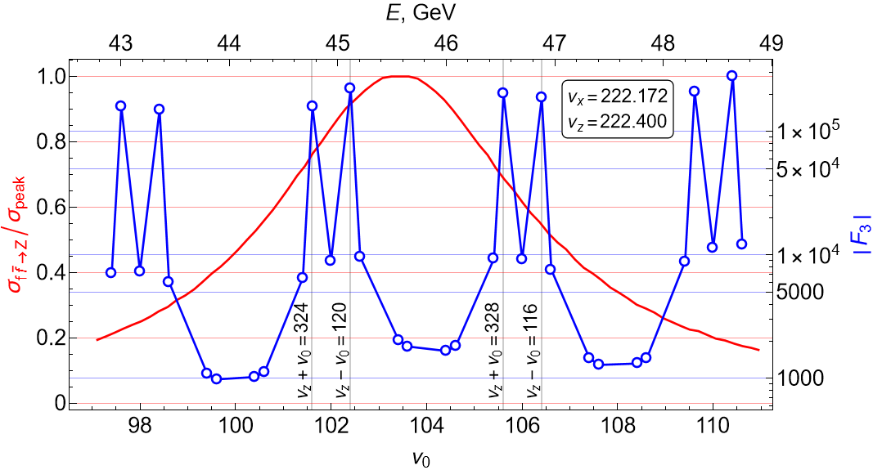
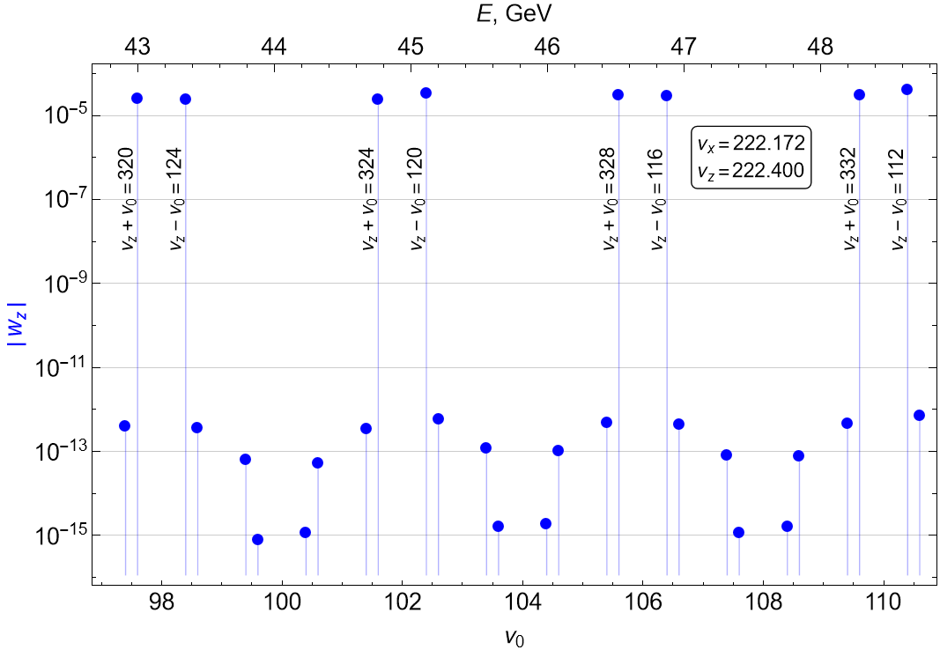

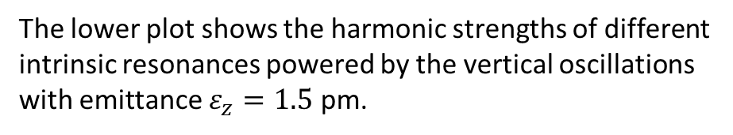
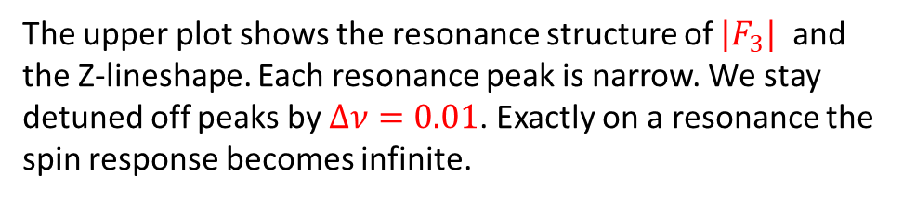
Intrinsic Spin Resonances structure at Z
The lower plot shows the harmonic strengths of different intrinsic resonances powered by the vertical oscillations with emittance $ε_{z}=1.5$ pm.
The upper plot shows the resonance structure of ${|F}_{3}|$ and the Z-lineshape. Each resonance peak is narrow. We stay detuned off peaks by $∆ν=0.01$. Exactly on a resonance the spin response becomes infinite.

Slide 4
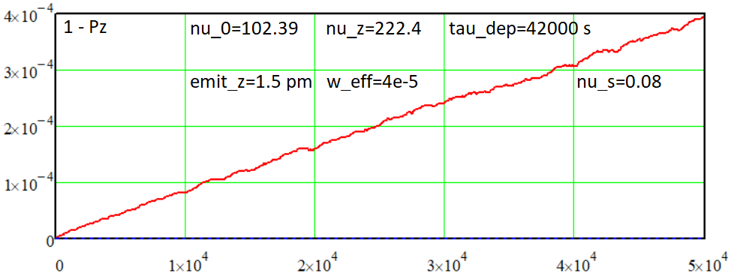
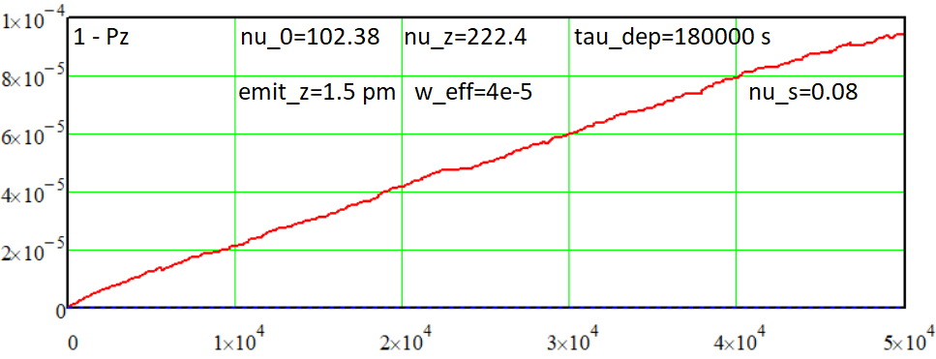
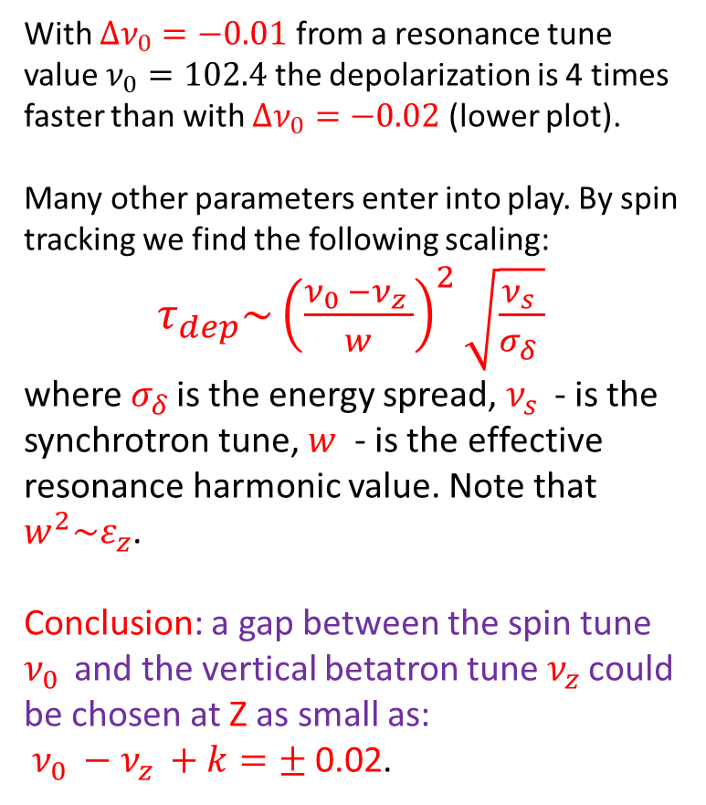
Beam depolarization by the intrinsic spin resonance at Z
With $Δν_{0}=−0.01$ from a resonance tune value $ν_{0}=102.4$ the depolarization is 4 times faster than with $Δν_{0}=−0.02$ (lower plot).
Many other parameters enter into play. By spin tracking we find the following scaling:
$τ_{dep}\sim {\left(\frac{ν_{0 }−ν_{z }}{w}\right)}^{2}\sqrt{\frac{ν_{s }}{σ_{δ }}}$
where $σ_{δ }$is the energy spread, $ν_{s }$ - is the synchrotron tune, $w$ - is the effective resonance harmonic value. Note that $w^{2}\sim ε_{z}$.
Conclusion: a gap between the spin tune $ν_{0 }$ and the vertical betatron tune $ν_{z }$could be chosen at Z as small as:
$ν_{0 }−ν_{z }+k=±$0.02.

Slide 5
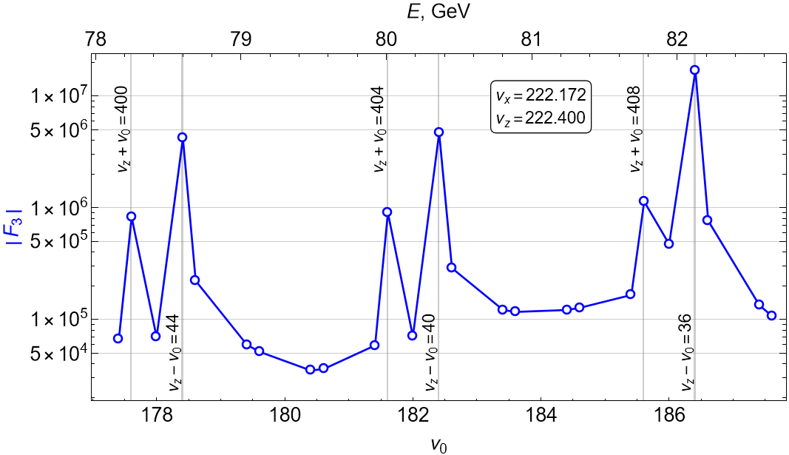
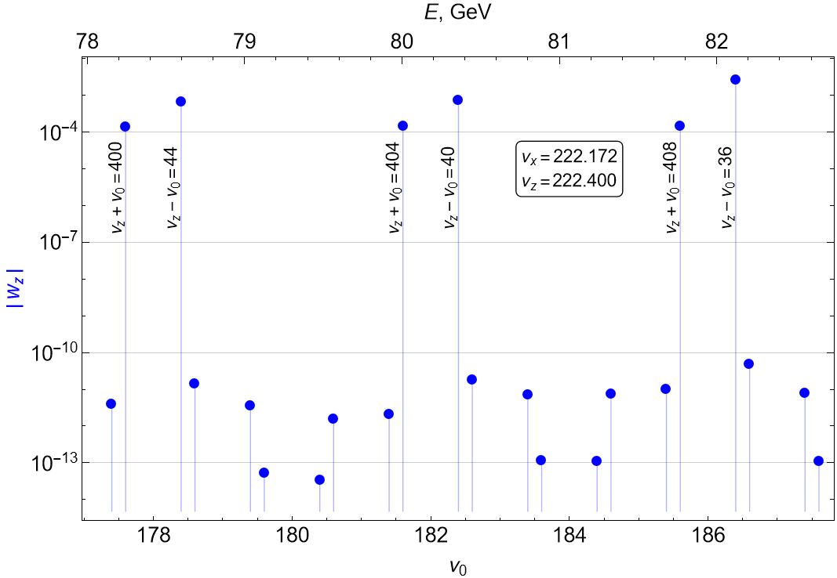
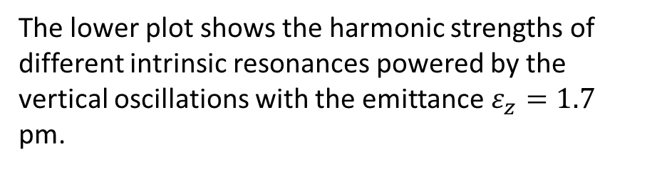
Spin Resonances structure at W energy range
The lower plot shows the harmonic strengths of different intrinsic resonances powered by the vertical oscillations with the emittance $ε_{z}=1.7$ pm.
The difference between the resonances strengths of resonances 4*k with all others is about 8 orders of magnitude!

Slide 6
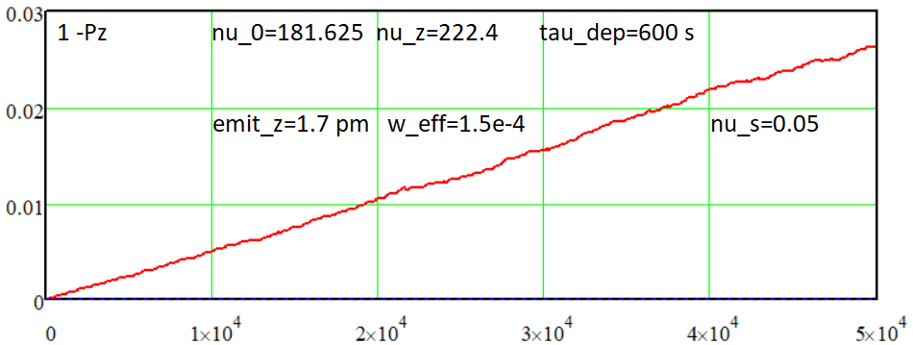
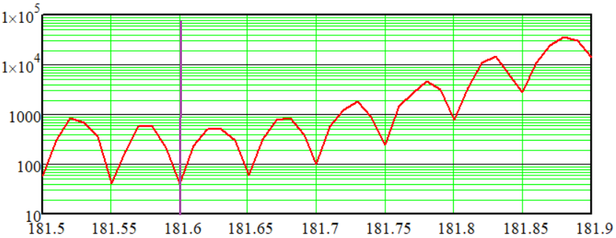
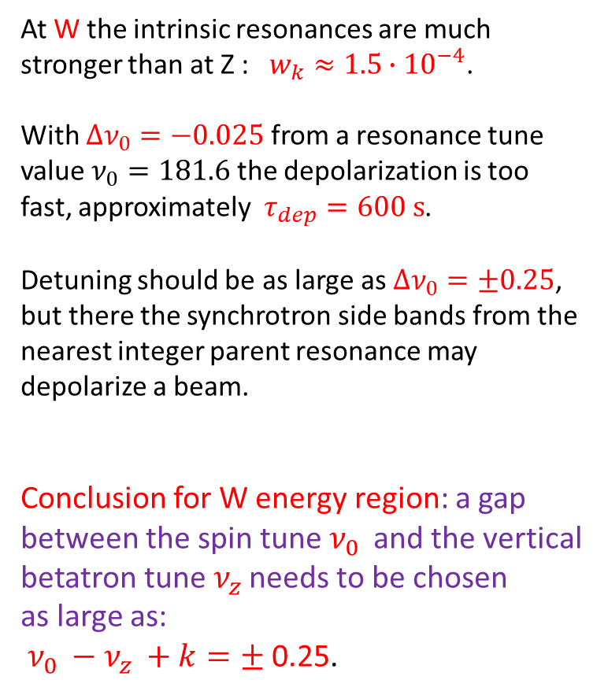
Beam depolarization by the intrinsic spin resonance at W
At W the intrinsic resonances are much stronger than at Z : $w_{k}≈1.5∙{10}^{−4}$.
With $Δν_{0}=−0.025$ from a resonance tune value $ν_{0}=181.6$ the depolarization is too fast, approximately $τ_{dep}=600 s$.
Detuning should be as large as $Δν_{0}=±0.25$, but there the synchrotron side bands from the nearest integer parent resonance may depolarize a beam.
Conclusion for W energy region: a gap between the spin tune $ν_{0 }$ and the vertical betatron tune $ν_{z }$needs to be chosen
as large as:
$ν_{0 }−ν_{z }+k=±$0.25.

Slide 7
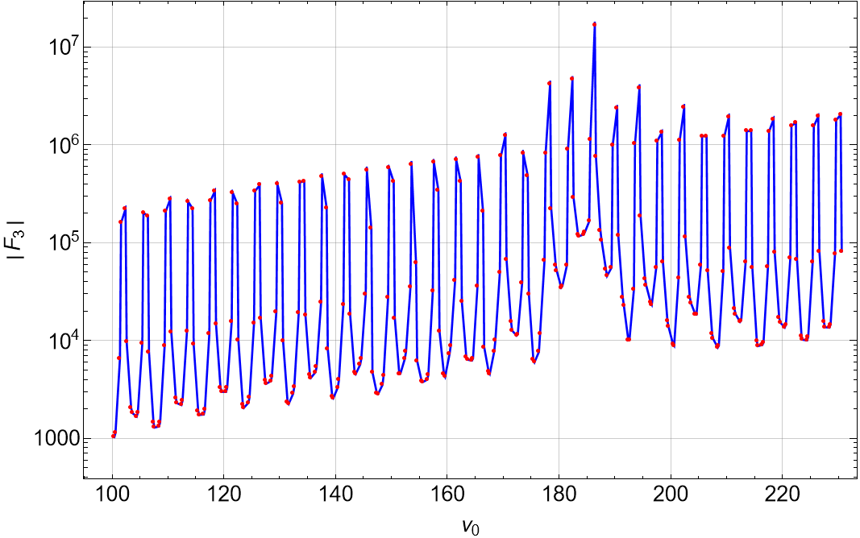
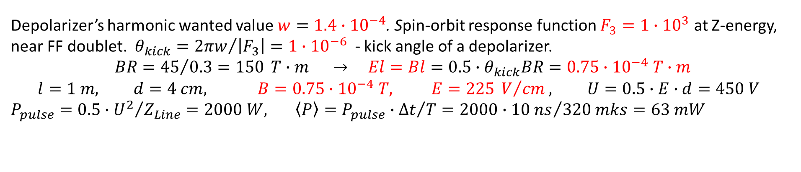
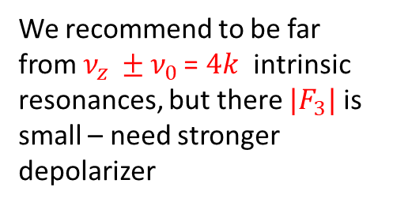

Input/Output parameters for RD of a single bunch
Depolarizer’s harmonic wanted value $w=1.4∙{10}^{−4}$. Spin-orbit response function $F_{3}=1∙{10}^{3}$ at Z-energy, near FF doublet. $θ_{kick}={2πw}/{\left|F_{3}\right|=1∙{10}^{−6}}$ - kick angle of a depolarizer.
$$BR={45}/{0.3=150} T∙m → El=Bl=0.5∙θ_{kick}BR=0.75∙{10}^{−4} T∙m$$
$$l=1 m, d=4 cm, B=0.75∙{10}^{−4} T, E=225 V/{cm}, U=0.5∙E∙d=450 V$$
$P_{pulse}=0.5∙{U^{2}}/{Z_{Line}}=2000 W, \left\langle P\right\rangle =P_{pulse}∙{∆t}/T=2000∙{10 ns}/{320 mks}=63 mW$
We recommend to be far from $ν_{z }±ν_{0 }$= $4k$ intrinsic resonances, but there ${|F}_{3}|$ is small – need stronger depolarizer
Strip Line sketch:
d
$$\vec{E}$$

Slide 8
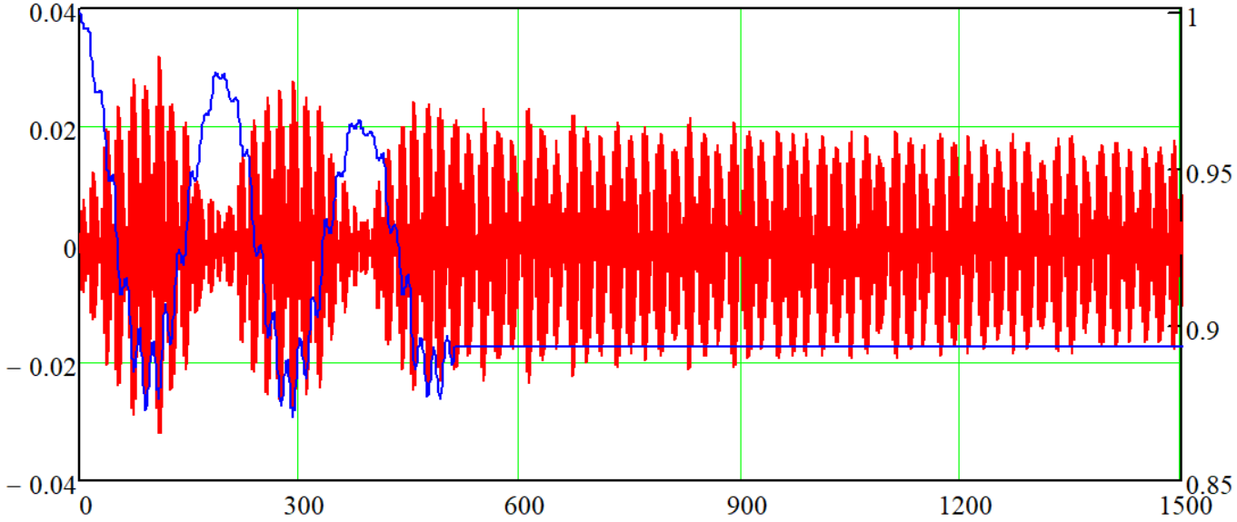
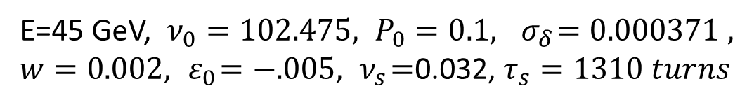
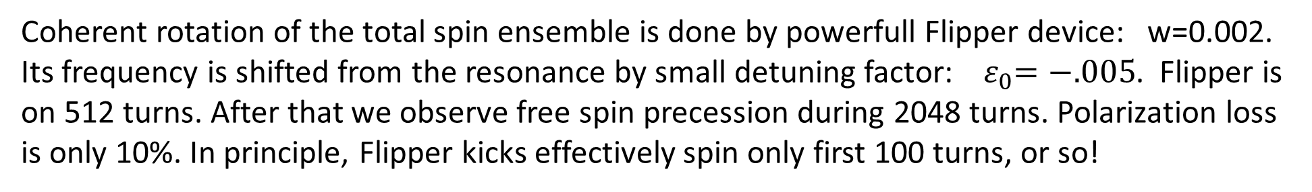



Excitation of the coherent spin precession at Z by Flipper
$$P_{Long}$$
E=45 GeV, $ν_{0}=102.475, P_{0}=0.1,{ σ}_{δ}=0.000371 ,$
$w=0.002,{ ε}_{0}=−.005, { ν}_{s}=$0.032, $τ_{s}=1310 turns$
$$\frac{P_{Vert}}{P_{0}}$$
$$h=\sqrt{ε^{2}+w^{2}}$$
ε
w
Spin precession in resonance frame
Track spin of Np=400 particles with initial polarization $P_{0}=0.1$
Coherent rotation of the total spin ensemble is done by powerfull Flipper device: w=0.002. Its frequency is shifted from the resonance by small detuning factor: ${ ε}_{0}=−.005$. Flipper is on 512 turns. After that we observe free spin precession during 2048 turns. Polarization loss is only 10%. In principle, Flipper kicks effectively spin only first 100 turns, or so!

Slide 9
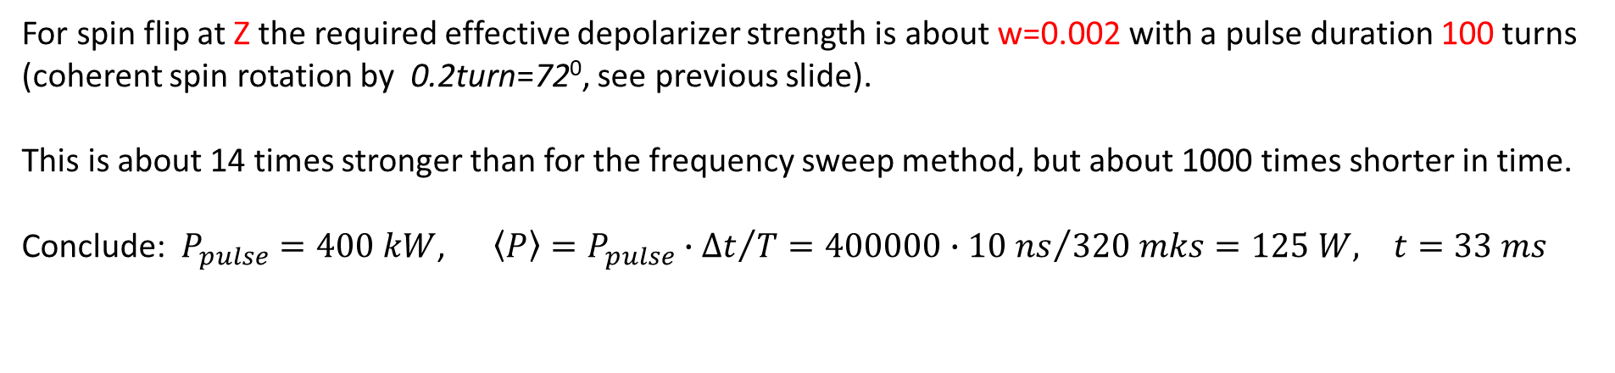
Parameters for spin flip of a single bunch
For spin flip at Z the required effective depolarizer strength is about w=0.002 with a pulse duration 100 turns (coherent spin rotation by 0.2turn=72⁰, see previous slide).
This is about 14 times stronger than for the frequency sweep method, but about 1000 times shorter in time.
Conclude: $P_{pulse}=400 kW$, $\left\langle P\right\rangle =P_{pulse}∙{∆t}/T=400000∙{10 ns}/{320 mks}=125 W, t=33 ms$

Slide 10
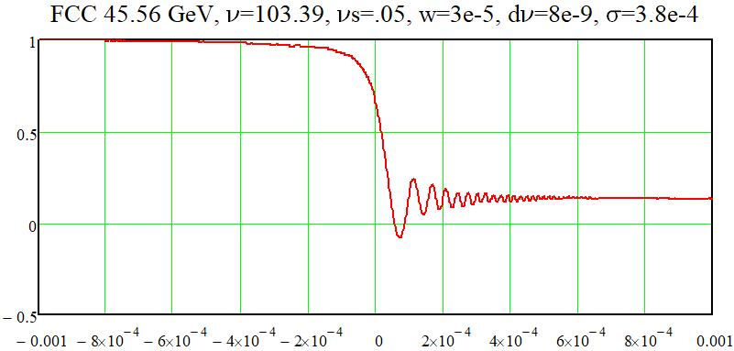
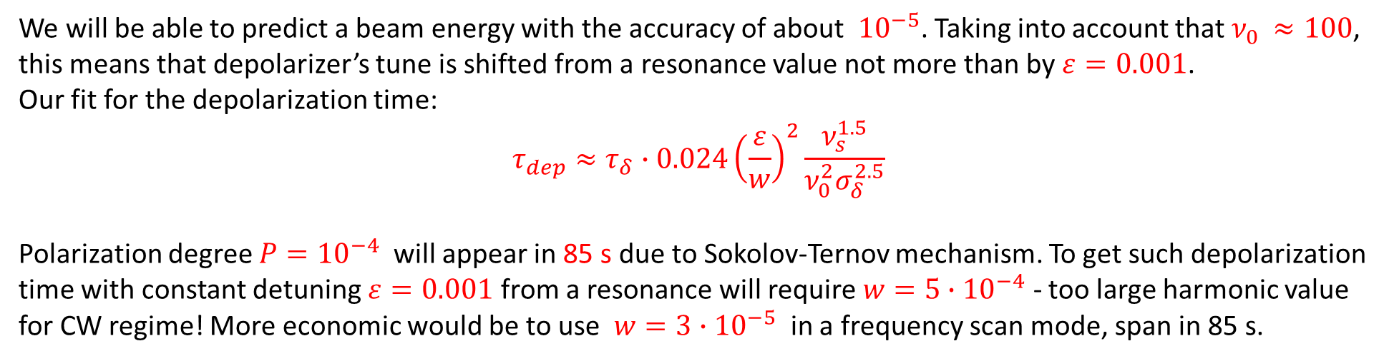
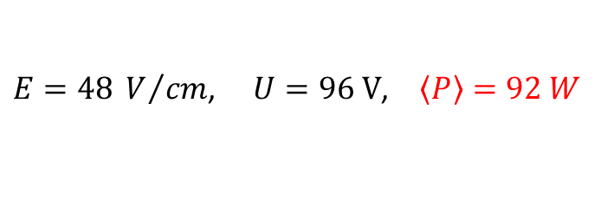
CW regime to depolarize colliding bunches
We will be able to predict a beam energy with the accuracy of about ${10}^{−5}$. Taking into account that $ν_{0 }≈100$, this means that depolarizer’s tune is shifted from a resonance value not more than by $ε=0.001$.
Our fit for the depolarization time:
$$τ_{dep}≈τ_{δ}∙{0.024\left(\frac{ε}{w}\right)}^{2}\frac{ν_{s}^{1.5}}{ν_{0}^{2}σ_{δ}^{2.5}}$$
Polarization degree $P={10}^{−4}$ will appear in 85 s due to Sokolov-Ternov mechanism. To get such depolarization time with constant detuning $ε=0.001$ from a resonance will require $w=5∙{10}^{−4}$ - too large harmonic value for CW regime! More economic would be to use $w=3∙{10}^{−5}$ in a frequency scan mode, span in 85 s.
$E=48 V/{cm}$, $U=96 V$, $\left\langle P\right\rangle =92 W$

Slide 11
Conclusion
There are many uncertainties due to strong dependence of spin response function F3 from the betatron and spin tunes. F3 varies by many orders of magnitude when spin tune changes its integer part.
Most safe is to operate far from the strong intrinsic resonances: integer multiples of 4. Our calculations show that the needed depolarizer power is in the order of 100 W. It is sufficient to depolarize a beam in all modes of operation.
Selectivity also is important ingredient of a system. Needs to be developed.

