Slide 1
Prototyping workshop on a Saturday morning
Dina Zimmermann @ CERN IdeaSquare

Slide 2
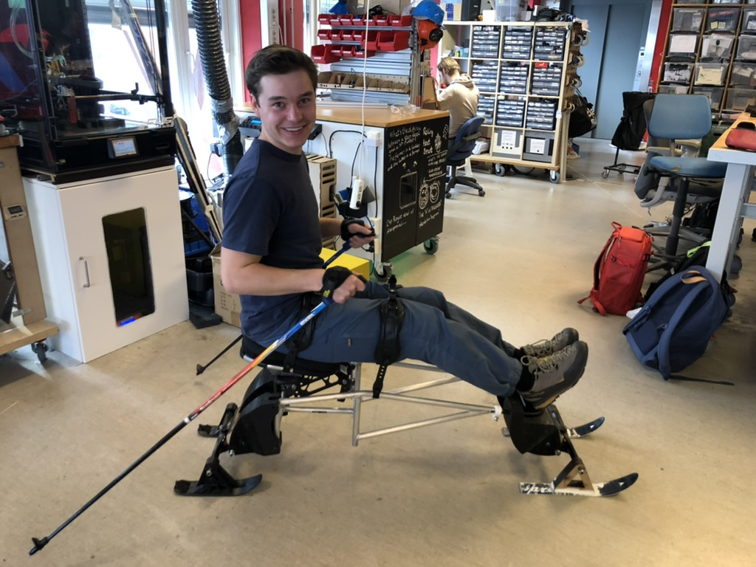
The power of prototyping

Slide 3
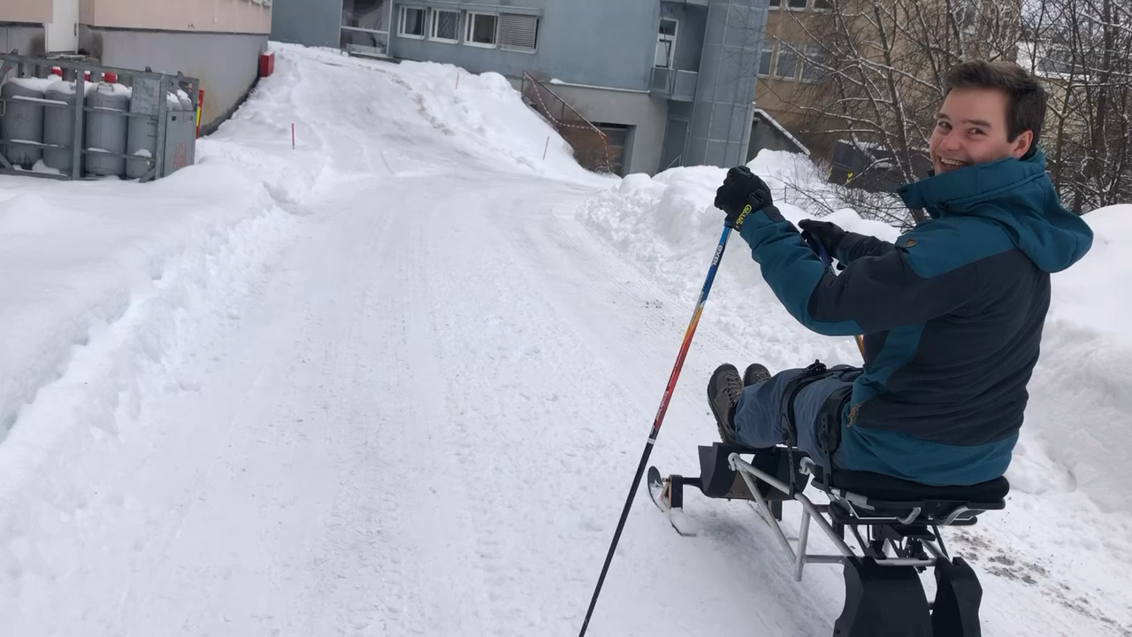
The power of prototyping

Slide 4
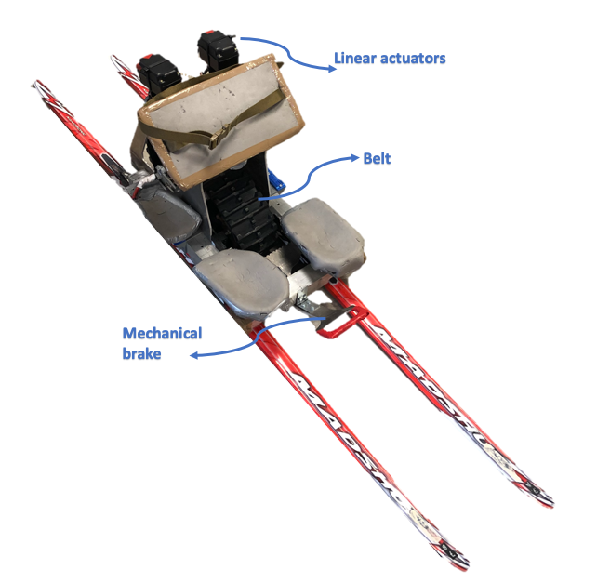

Slide 5
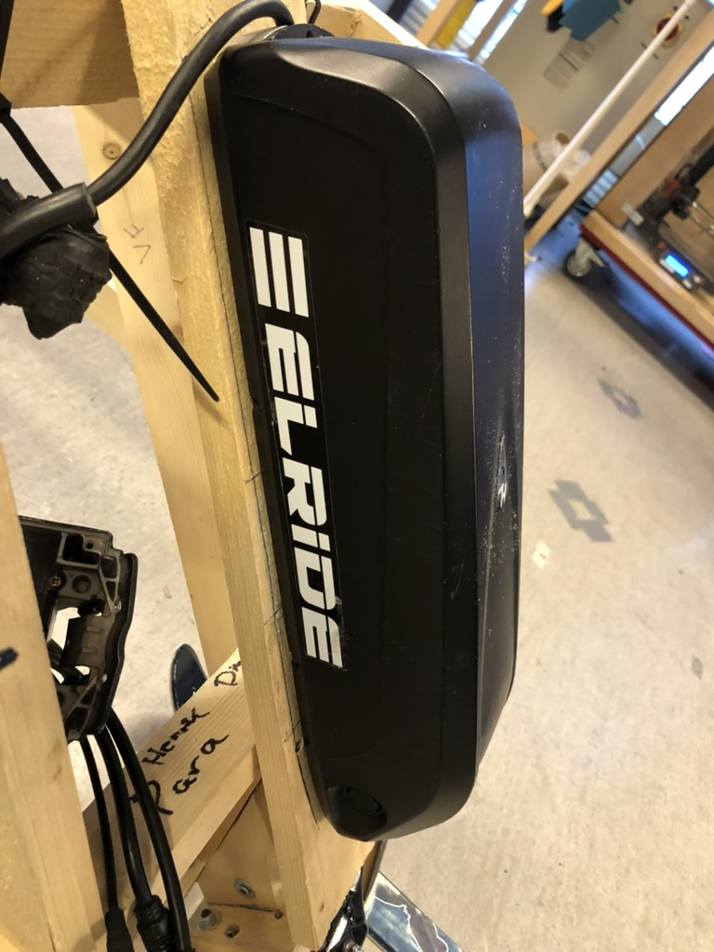
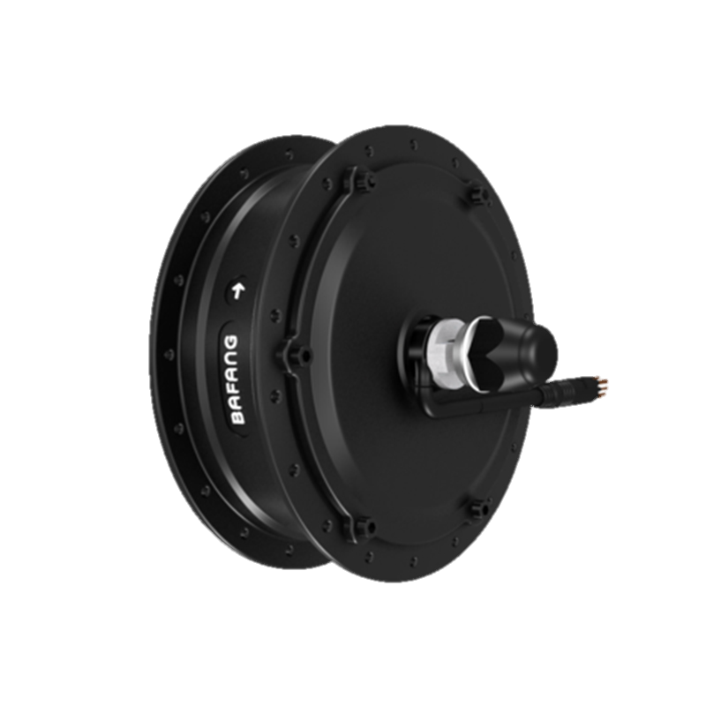
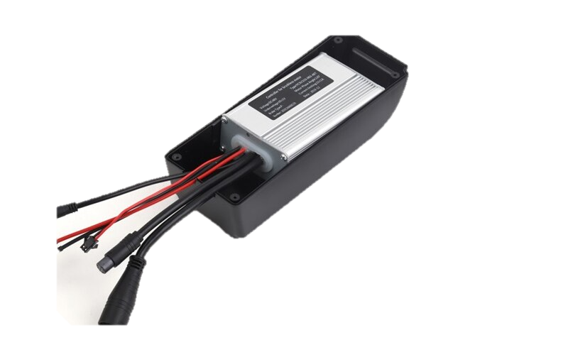
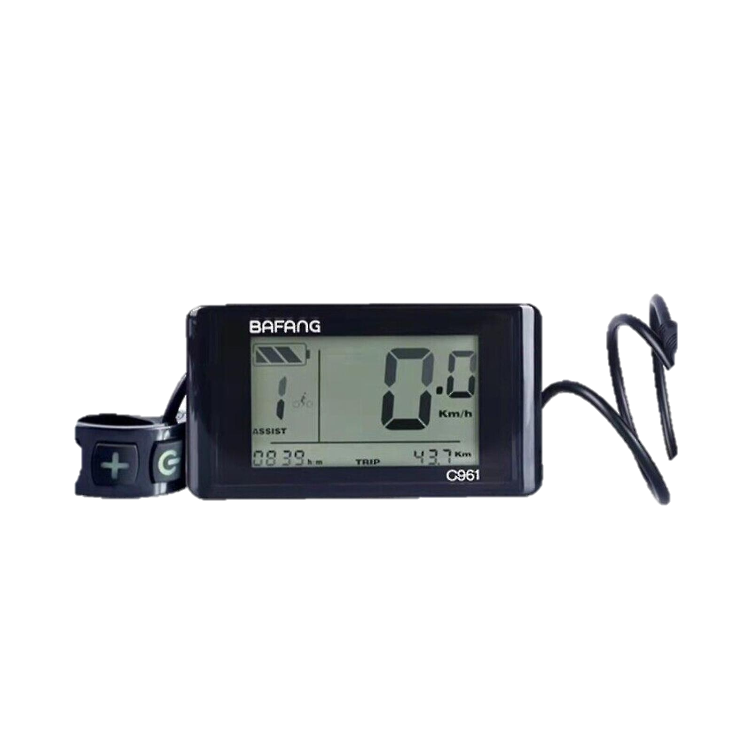
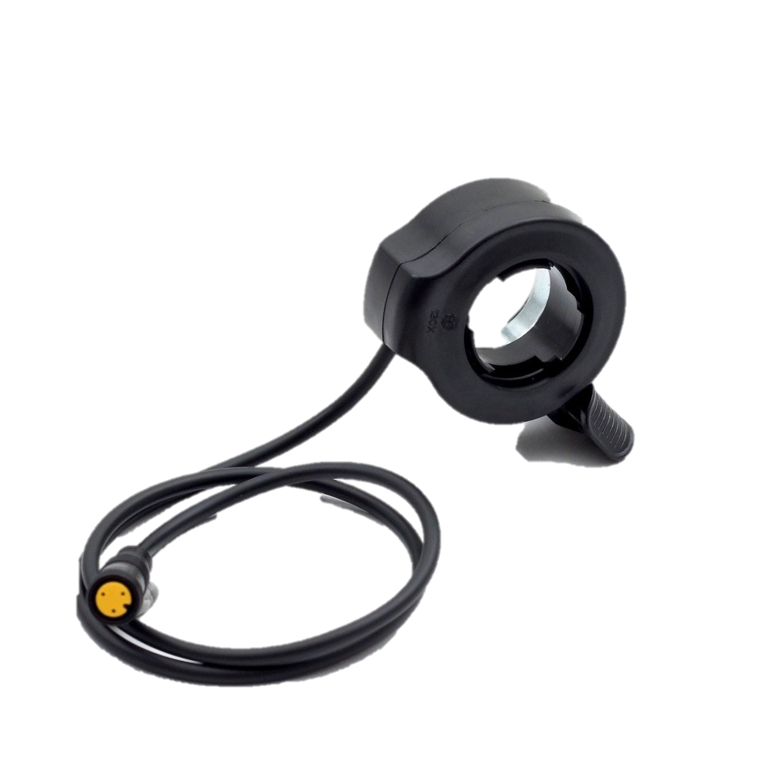

Slide 6
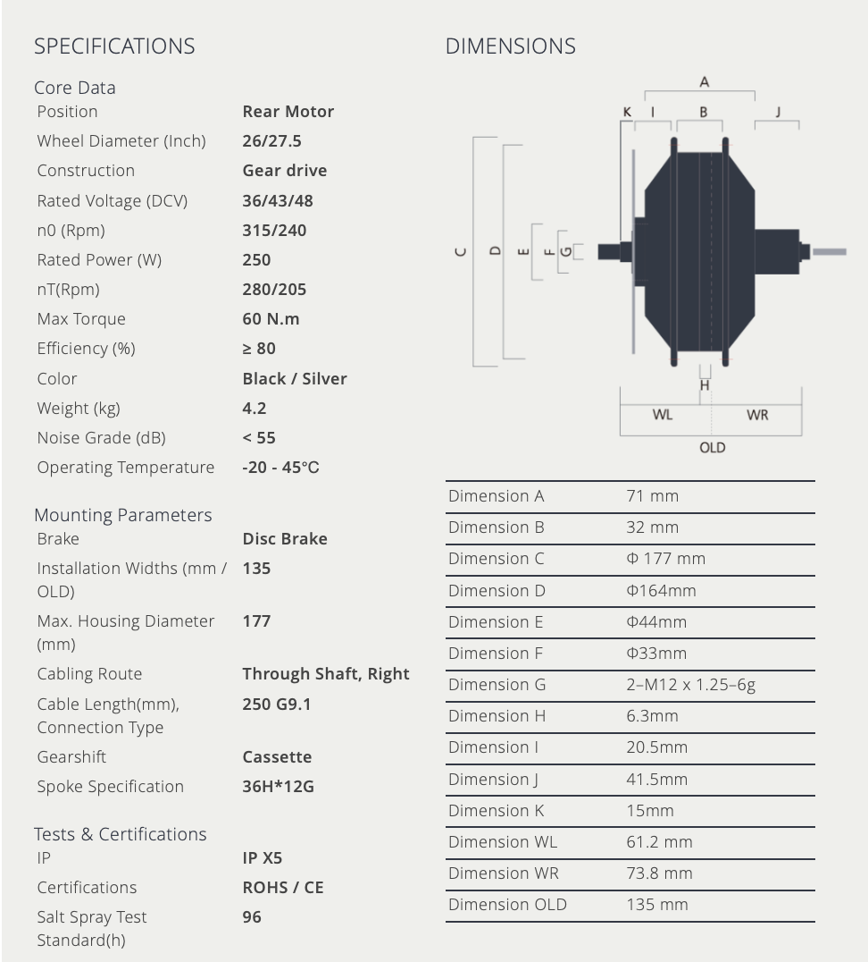
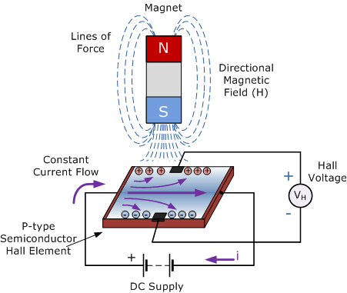
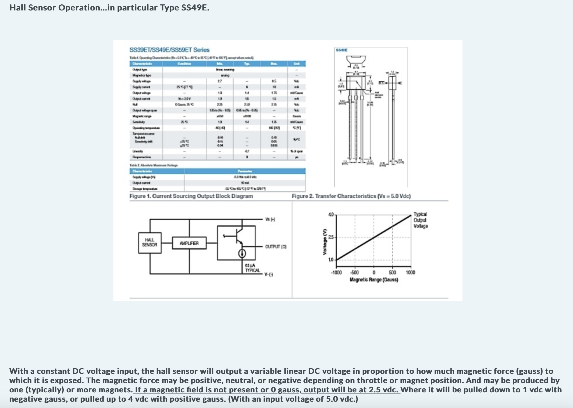
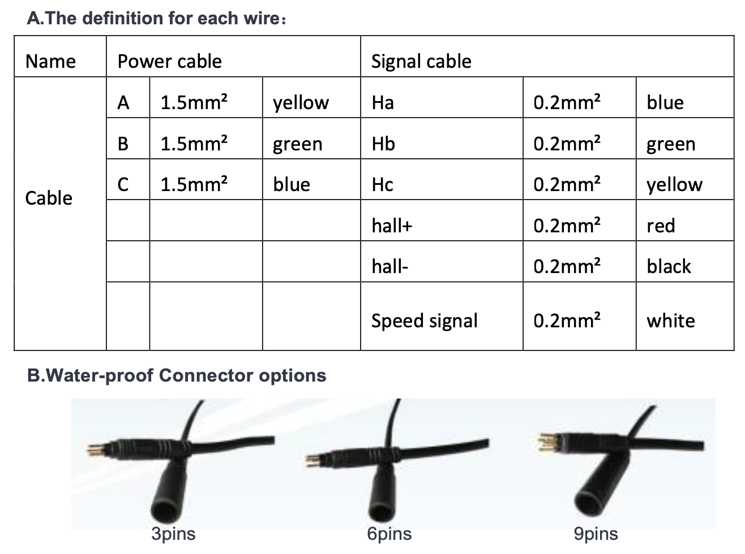
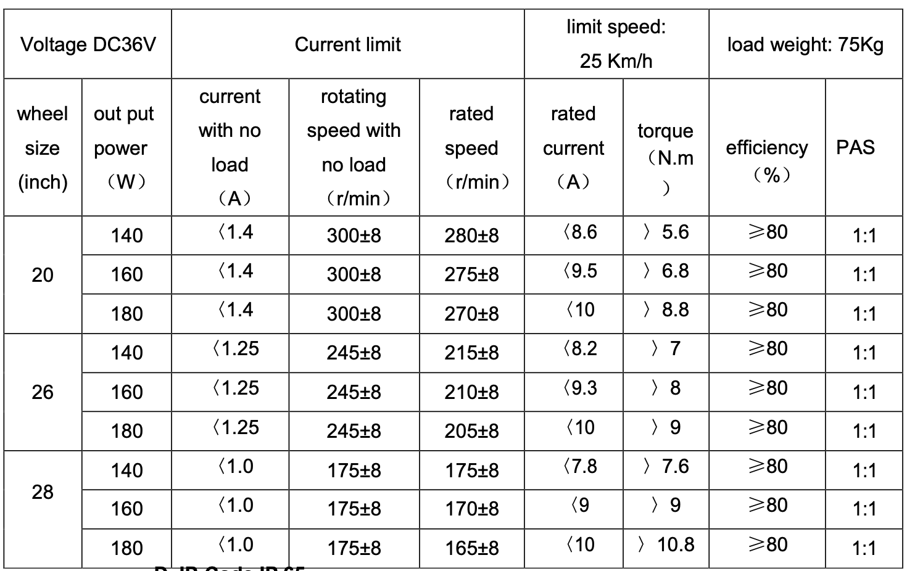
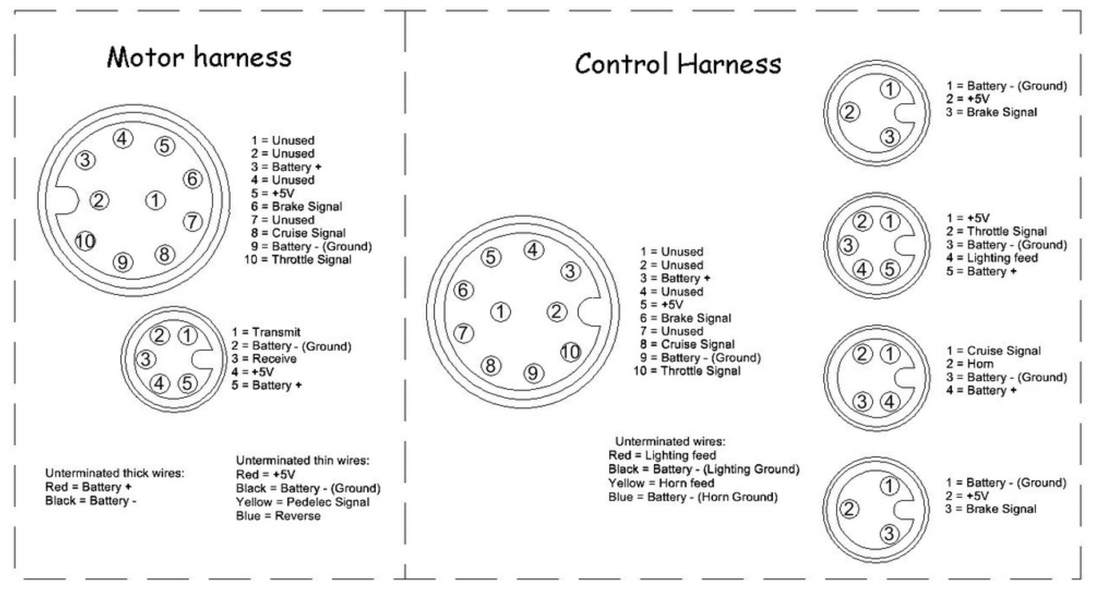

Slide 7
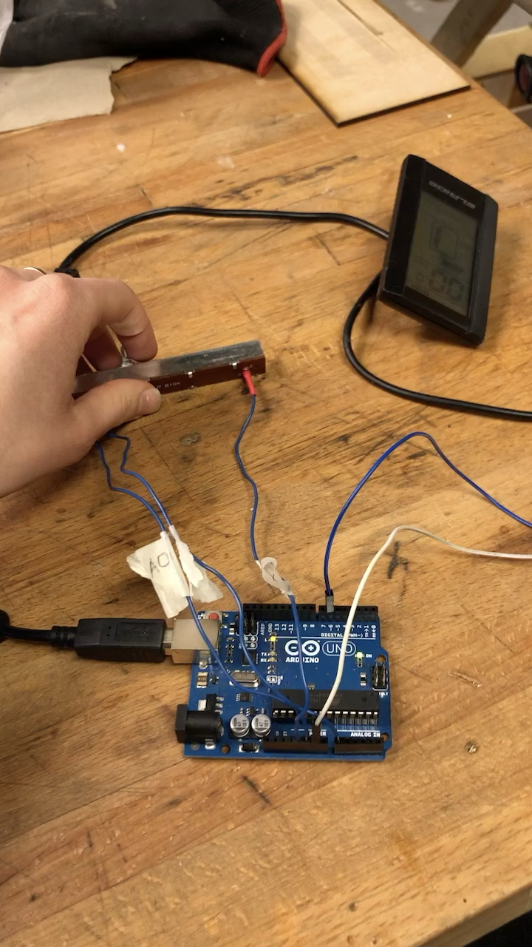

Slide 8
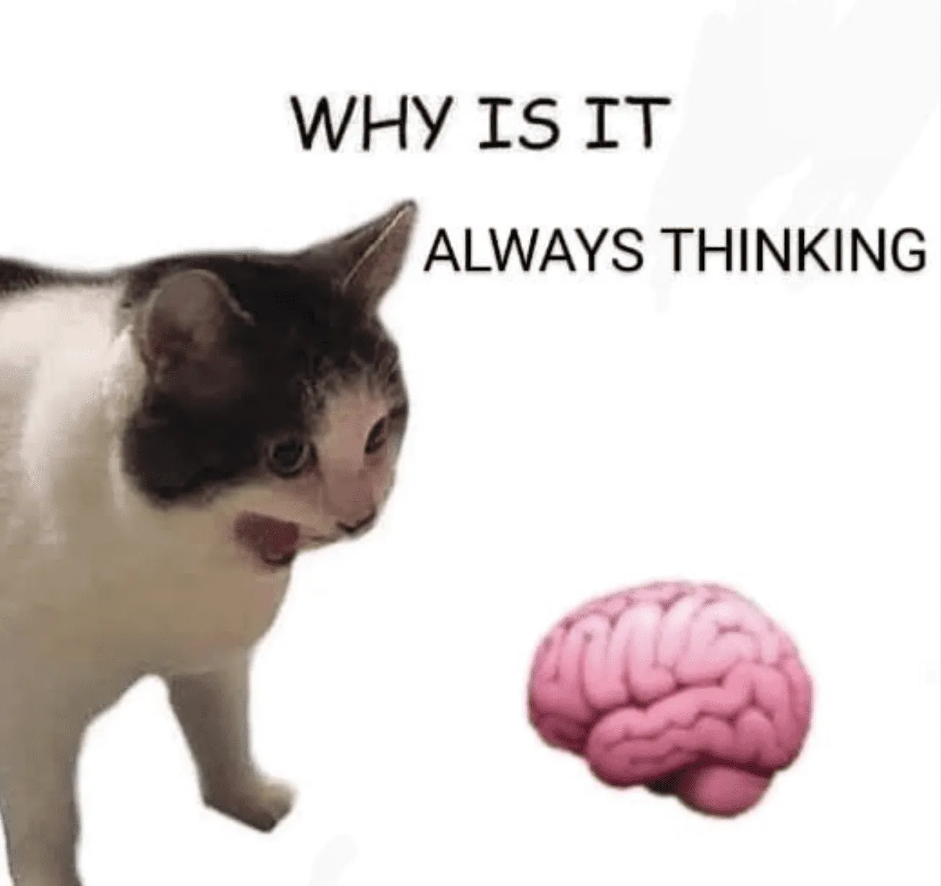
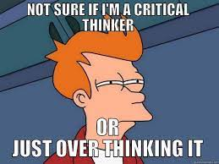

Slide 9
What is prototyping?
If something helps you communicate, test, validate, interact, or explore your idea and make it tangible - it is a prototype.

Slide 11
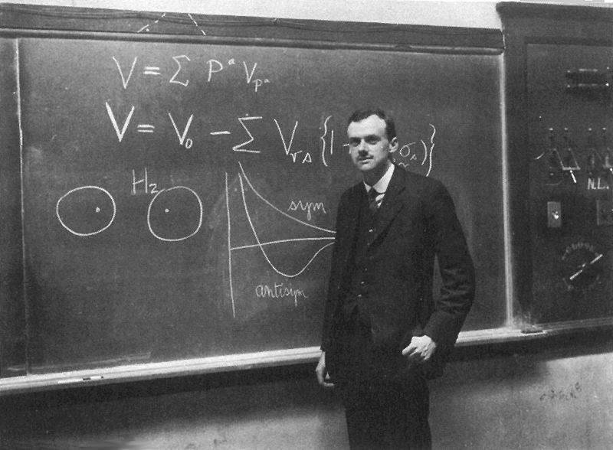
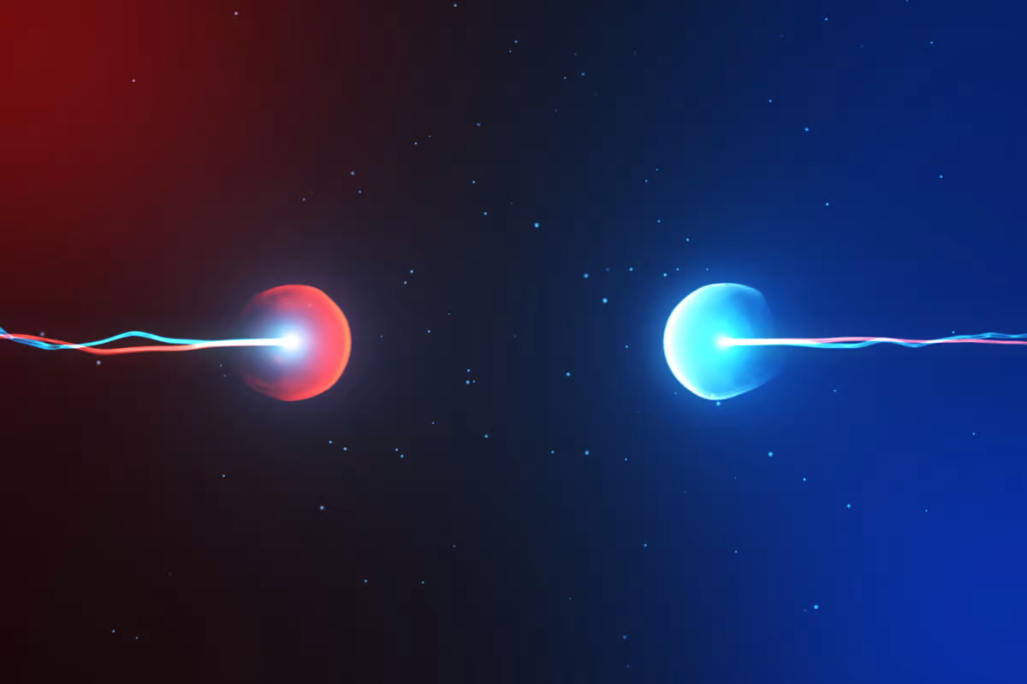
Notes:
Paul Dirac – equation in 1928 that won the Nobel prize in 1933. Proposed both positive and negative energy and Dirac interpreted it as there existing matching particles with opposite charge.

Slide 12


Slide 13
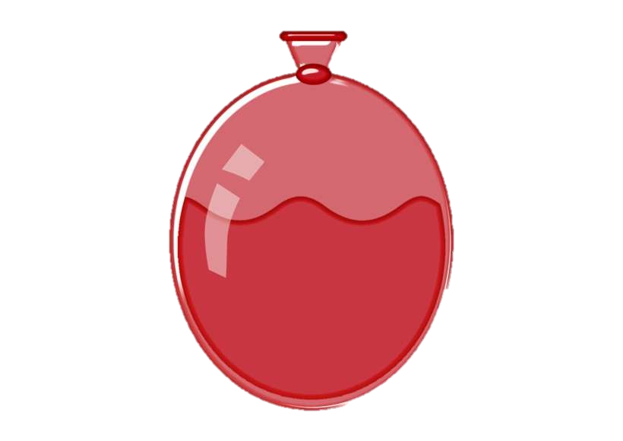

Antimatter
You have 10 minutes to build the Antimatter Anti-Annihilator
3 m
Matter

Slide 14
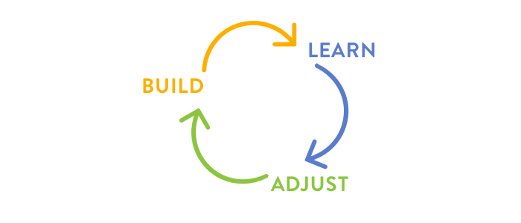
Iterating, iterating, iterating
5 minutes to improve/rebuild your prototype

