Slide 1


1) Doppler-shift, Michelson interferometer
2) Optical nm-resolution sensor, superresolution
4th EPS TIG Hands-on Event for Science, Technology and Interfaces
14.10.2023, Idea², CERN
Marie Andrae, Lucia Perez-Ramirez, Mathieu Chevrot, Stefan Kubsky Synchrotron SOLEIL and CEA, France

Slide 2
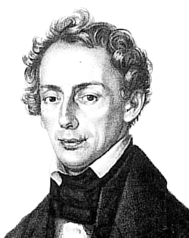
1) Michelson Interferometer: Doppler shift
What role played the discoverer of the Doppler effect ?
In 1842, Christian Doppler (1803-53) formulated the hypothesis, that the color observable in starlight stems from a changing distance – wich is not the case.
However, soon afterwards, thanks to the advent of steam engine powered locomotives, the acoustic Doppler-effect was experimentally verified and named after him.

Slide 3
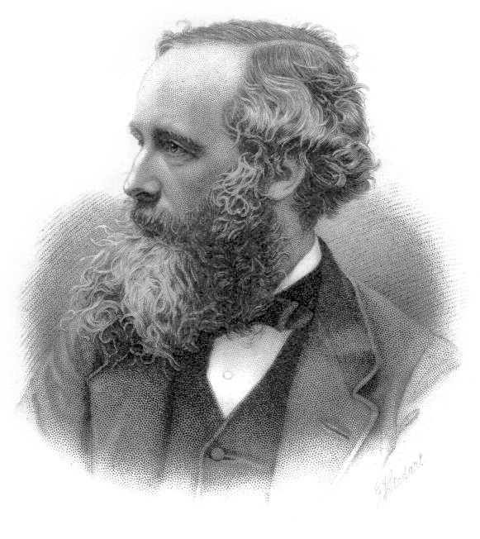
1) Michelson Interferometer: Doppler shift
Where is the connection to light and « modern » physics ?
James Clerk Maxwell (1831-79) delivered his famous set of equations after a thourough study of the existing knowledge of the time (Faraday, Kelvin, Ampère…) in 1864, concluding:
  “This velocity is so nearly that of light, that it seems we have strong reason to conclude that light itself (including radiant heat, and other radiations if any) is an electromagnetic disturbance in the form of waves propagated through the electromagnetic field according to electromagnetic laws.”
However, Maxwell was of the opinion that electromagnetic waves need a medium to propagate, called « Ether ».
It was an experiment and a theory that proved ethers’ non existence … about 20 and 40 years later, respectively… you know which ?

Slide 4
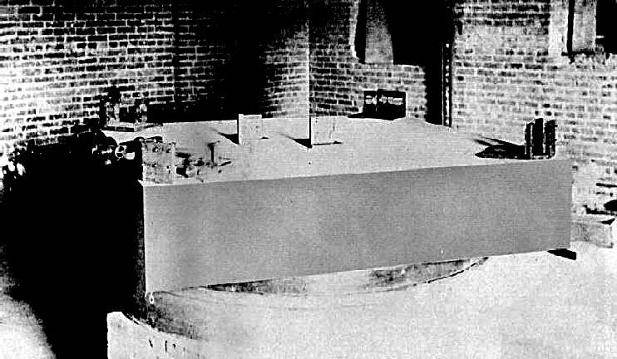
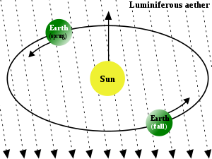

1) Michelson Interferometer: Doppler shift
What happened during the time when new physics concepts arose ?
In 1881 in Potsdam, Albert Michelson and in 1887 together with Edward Morley in Cleveland, the « Michelson experiment » prooved the non existence of the Ether – against all their hope !
  Predicted: 0,4 fringes of displacement with 11m long arms, using white light !
Since then, the velocity of the sun and the milky way have been taken into account and results yield: 0
-> « most famous failed experiment in history »
In 1905, Albert Einstein delivered the special relativity theory, …

Slide 5
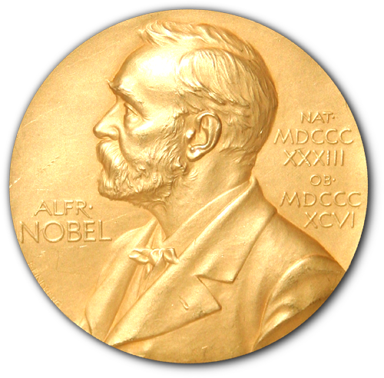
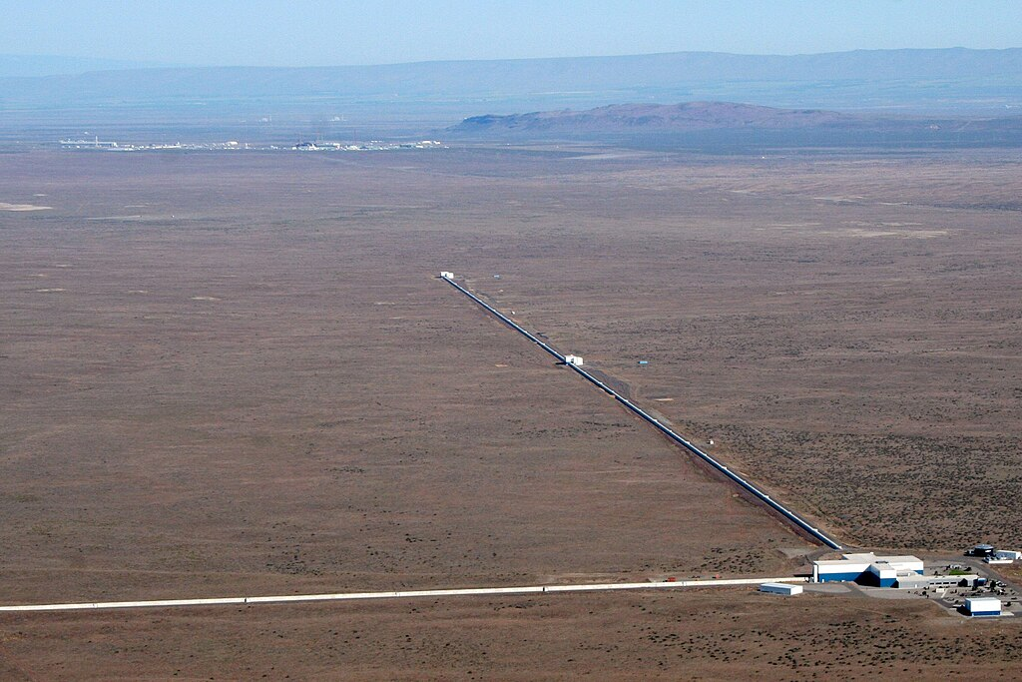
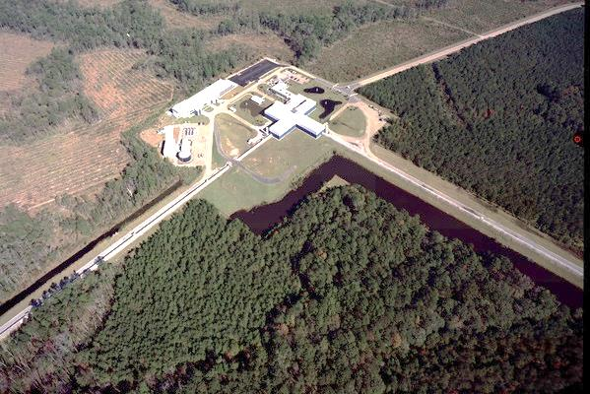
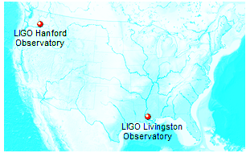
1) Michelson Interferometer: Doppler shift
Why is a Michelson Interferometer a iconic piece of instrumentation today ?
2017 Nobel prize in Physics
for Rainer Weiss, Barry C. Barish and Kip S. Thorne
for “decisive contributions to the LIGO detector and the observation of gravitational waves“
Hanford
3000kms ~ 10ms
Livingston

Slide 6

1) Michelson Interferometer: Doppler shift
And now ? -> We’re building one in a couple of hours…from scratch and some knowledge:
Photodetector ( + data acqusition, not shown) → yields beat signal of f₂ and f₁ from which speed of the moving mirror can be deduced
Static reference partial reflector
Back-reflected
light with f₂ and f₁
Back-reflected
light with f₂ and f₁
Moving mirror ( full reflector)
Schulungen - Umgebung
Schulungen in T1 durchführen;
Prototyp 1 in wird T1 abspeichern,
V
Schulungen - Umgebung
Schulungen in T1 durchführen;
Prototyp 1 in wird T1 abspeichern,
Laser light
with frequency f₁
Laser
Beamsplitter
( e.g. 50/50)
Mirror ( or more general an object) is moving in the direction of a laser beam with speed v

Slide 7
1) Michelson Interferometer: Doppler shift
And now ? -> We’re building one in a couple of hours…from scratch and some knowledge:
Tasks for the « Doppler » experiment:
Assemble the interferometer (mechanics, optics, detection, electronics, data retrieval, data analysis and interpretation) -> Yeah !
How to know about the actual speed of the moving mirror ?
Estimate by calculating the interference fringes passing with respect to the Doppler effect (?!)
Record interference when one mirror moves ->
Develop a clear, educated path to present your findings on Sunday !

Slide 8
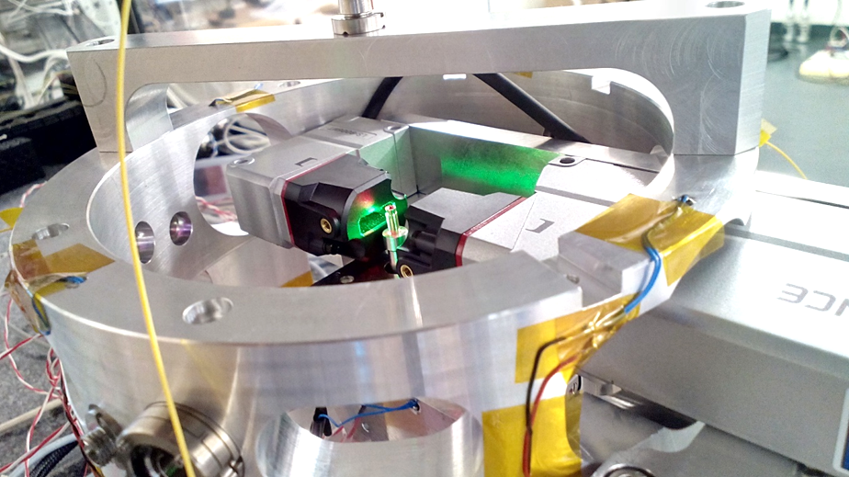
2) Optical nm-resolution sensor, based on superresolution
Why and where would one need nm-resolution ?
Scientific and engineering disciplines dealing with « small » objects (10µm-> sub-nm) need:
Reproducible interaction with the object and a « probe » in an experimental or production situation
  Needs to be nm-precise (semiconductor industry is at ~5nm « structure size »)
  The more dimensions – the better
  « Absolute » readout - calibration takes time
  Time resolution (fast)
  « Rugged » -for use in hostile environments (hot, cold, magnetic field, vacuum)
  Compact for integration
  Affordable

Slide 9
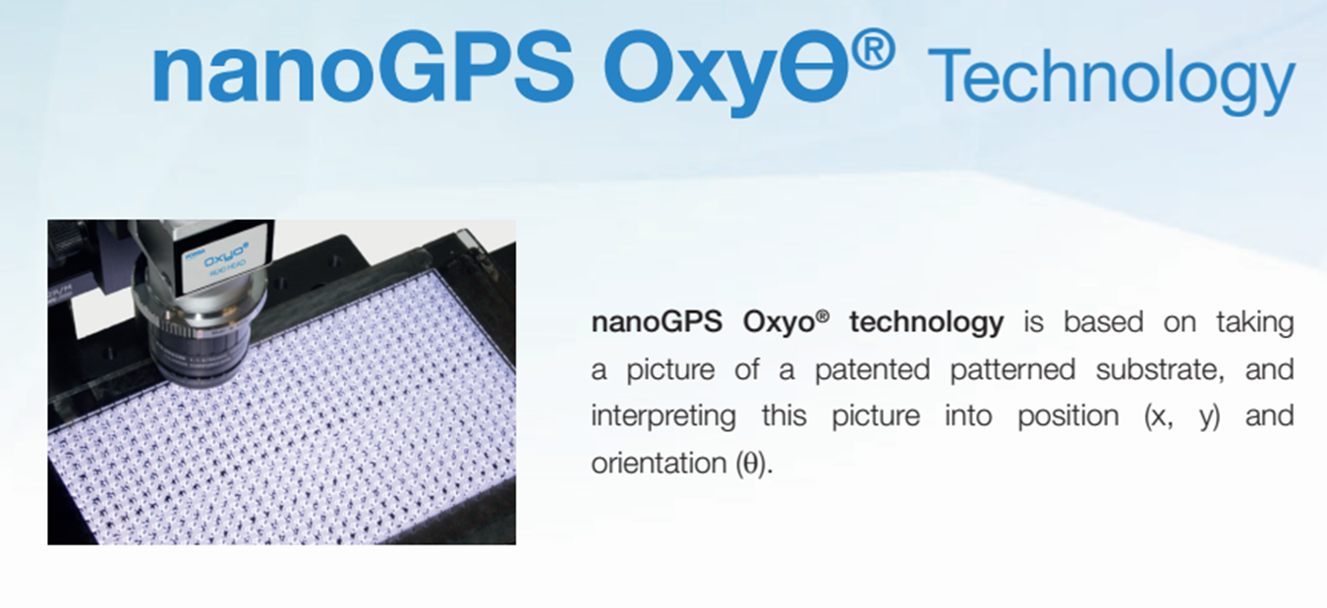
2) Optical nm-resolution sensor, based on superresolution
What ?
  Horiba’s « OXYO » System satisfies the above conditions – Introduction by one of the inventers – Olivier Acher from Horiba
  Identify components of the system, please: What do you see ? What sizes approximately ?

Slide 10
2) Optical nm-resolution sensor, based on superresolution
Project: You enter the nanoworld now – and measure : How ?
  Construct an OXYO position readout system
  Move the fiducial with nm-fine precision, record, analyse and present the trajectory
  Compare the OXYO-based measurement to classical strain gauge measurement
  Make observations on measurement errors and uncertainties (thermal drift, vibration) estimate their impact
  Present the results (~20 mins presentation on sunday)

Slide 11
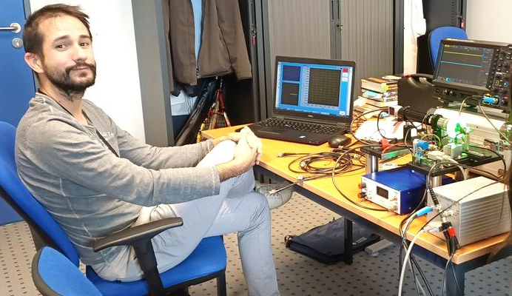
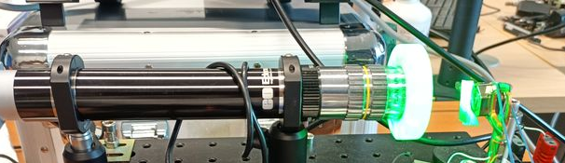
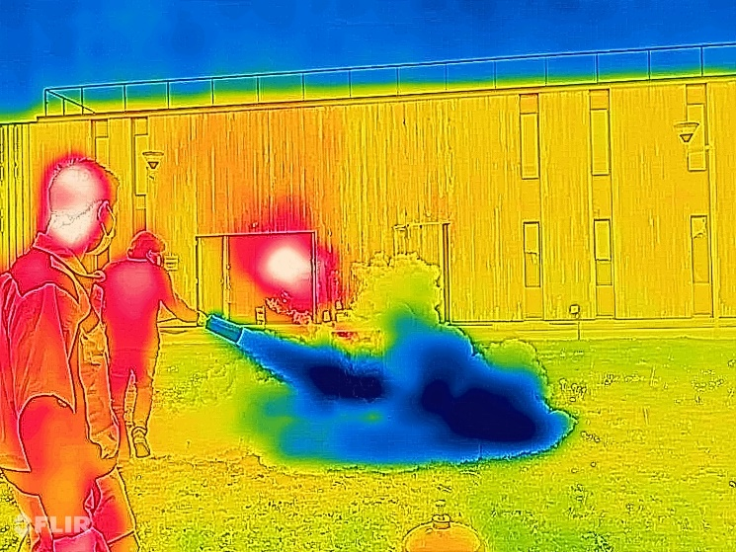
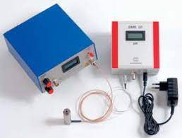
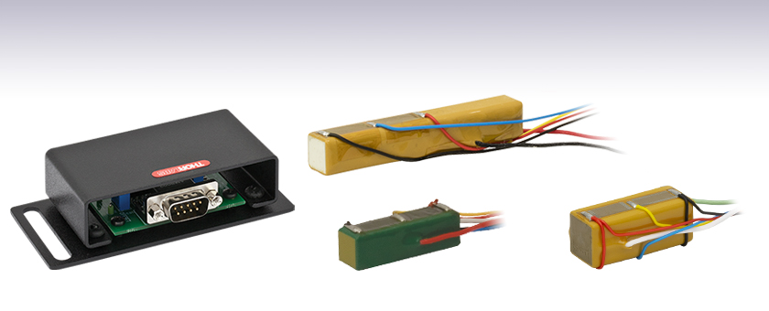
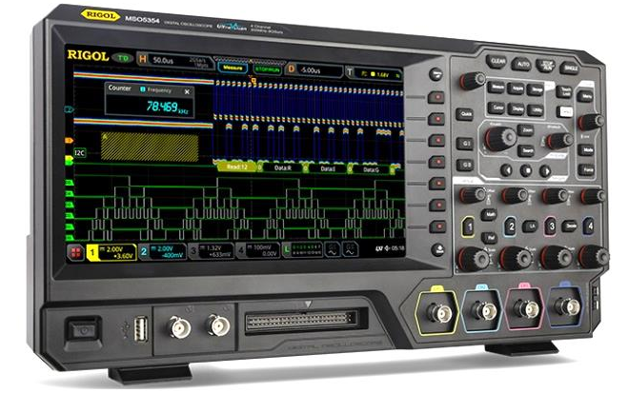
Optical nm-resolution sensor, based on superresolution
Please ask for help when you’re unsure on how to proceed !

Slide 12
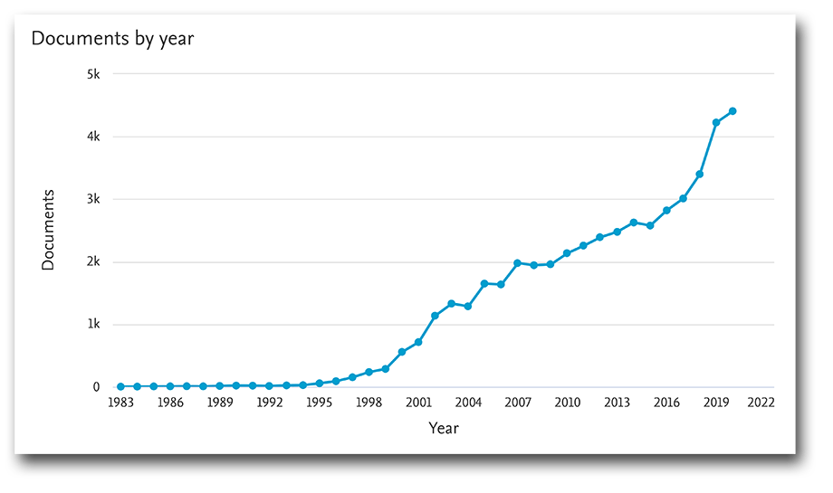
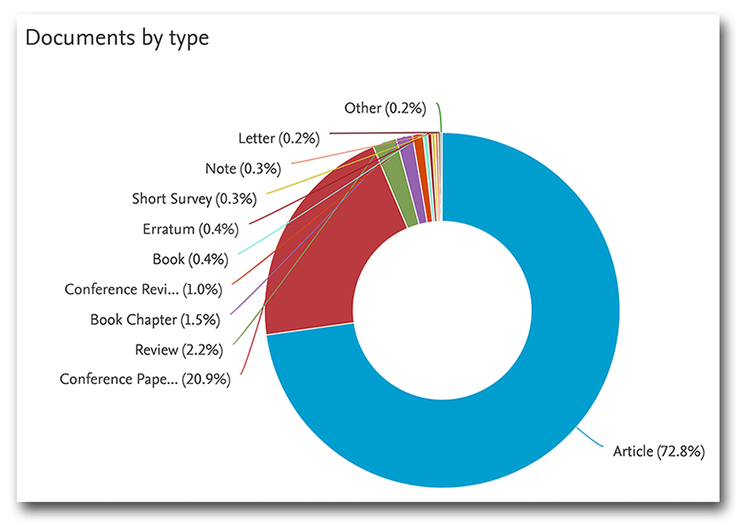
Quantum Computing
Why ?
  Ultimate computation speed
  Optimization as a problem class is a key application: financial trading, defense, logistics, cryptography and communication
  Research on QCs is a globally active field²
  Textbooks are scarce³

Slide 13
Quantum Computing
How ?
  Many physical objects exist, fulfilling the requirements for qubits inside a QC^{4,} each having advantages and disadvantages, research for appropriate systems is ongoing
  Key problems for implementation⁵:
    Physically scalable to increase the number of qubits
    Qubits that can be initialized to arbitrary values
    Quantum gates that are faster than decoherence time ( typ. between ns and s)
    Universal gate set
    Qubits that can be read easily
  Qubits are very sensitive to their environment. This can also inversely be exploited as a feature: Quantum sensing
⁴ see e.g. https://en.wikipedia.org/wiki/Quantum_computing
⁵ DiVincenzo, David P. (13 April 2000). "The Physical Implementation of Quantum Computation". Fortschritte der Physik. 48 (9–11): 771–783. arXiv:quant-ph/0002077. Bibcode:2000ForPh..48..771D. doi:10.1002/1521-3978(200009)48:9/11<771::AID-PROP771>3.0.CO;2-E.

Slide 14
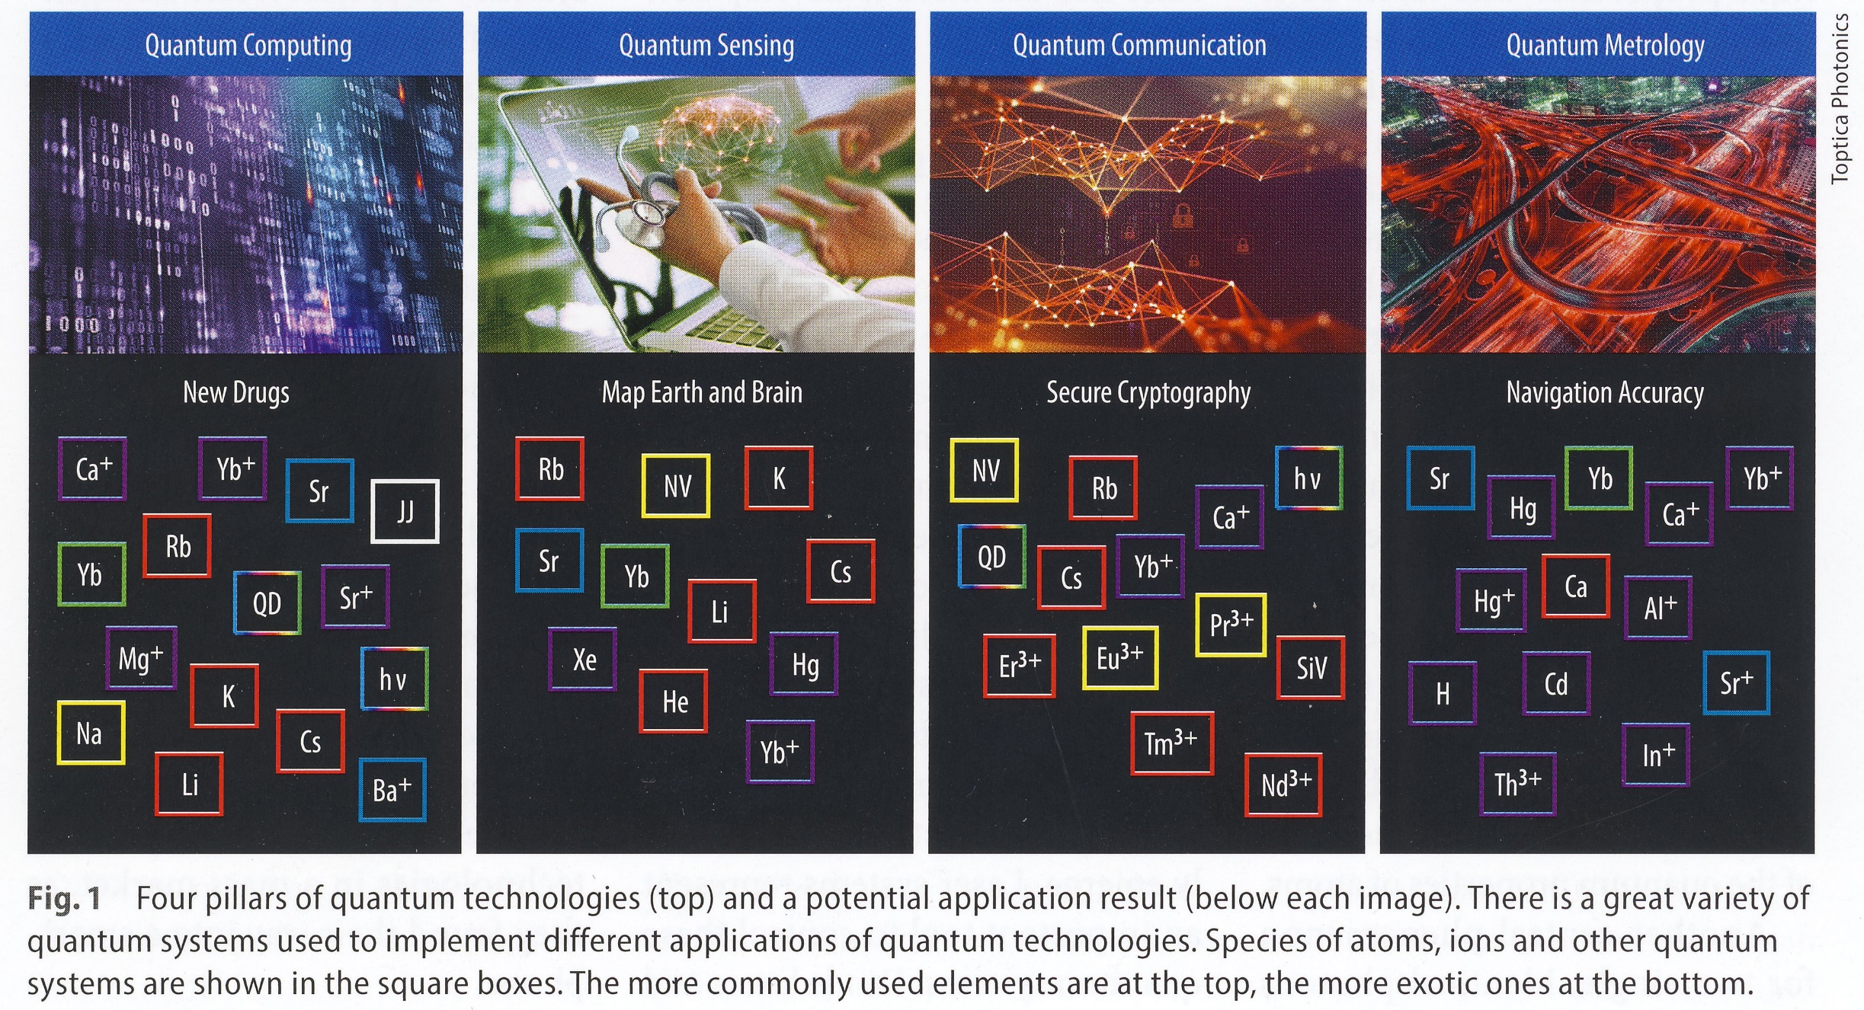
Quantum Technologies - Pillars
From Physics’ Best April 2022, p9

Slide 15
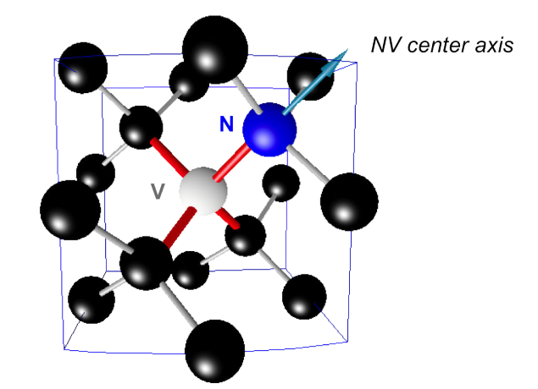
Quantum Sensing with NV- centers in Diamond
NV- centers in Diamond are point defects within the diamond crystal lattice (fcc). One nitrogen atom N is on a lattice position and one adjacent lattice–site is vacant V⁶ :
Two charge states can exist: NV⁰ and NV⁻. NV⁻, has one more electron, the total configuration has a spin of S=1. The NV⁻ centers are discussed here.
⁶ from Margarita Lesik. Engineering of NV color centers in diamond for their applications in quantum information and magnetometry. Quantum Physics [quant-ph]. École normale supérieure de Cachan -
ENS Cachan, 2015. English. ﬀNNT : 2015DENS0008ﬀ. ﬀtel-01158995, https://tel.archives-ouvertes.fr/tel-01158995 and refs therein. Thanks to Prof. J.-F. Roch.

Slide 16
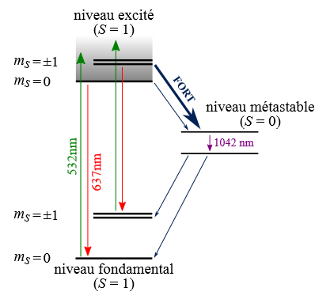
Quantum Sensing with NV- centers in Diamond
NV- centers’ electronic structure⁷
Optical pumping from the S=1 ground state triplet populates the excited state.
Relaxation occurs optically at 637nm or non radiatively via S=0
Optically allowed transitons are spin-conserving, therefore the metastable level is dark.
Pump cycling can achieve population of the m_{s}=0 states, which could be exploited to initialise a quantum state for use within a QC.
External magn. Field (=Zeeman splitting on m_{s}=+-1) does not affect zero spin levels
n.b. : The energy levels and transition-probabilities are furthermore influenced by electrical fields, crystal strain and temperature.
Transition energies between these many more levels lie in the Microwave region and permit to prepare and read electrically a population configuration of the NV- center: towards a QC @RT.
⁷ From LoicToraille: Utilisation de centres NV comme capteurs de champs magnétiques à haute pression dans des cellules à enclumes de diamant. Physique [physics]. Université Paris Saclay (COmUE), 2019. Français. NNT: 2019SACLN056. tel-02429177v2; https://tel.archives-ouvertes.fr/tel-02429177v2

Slide 17
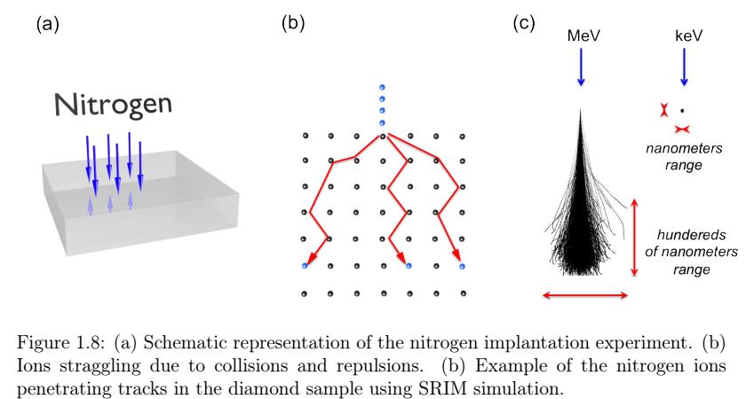
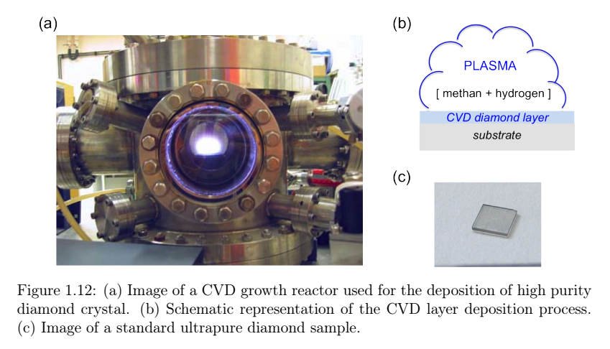
NV- centers in Diamond: how to make them ?
Different paths to obtain NV- centers in diamond, from [6]:
Spin coherence time is one of the key parameters for quantum computation, surface proximity (<2nm) makes NV- centers spins more fragile to external perturbations. At RT, 2ms have already been reported.

Slide 18
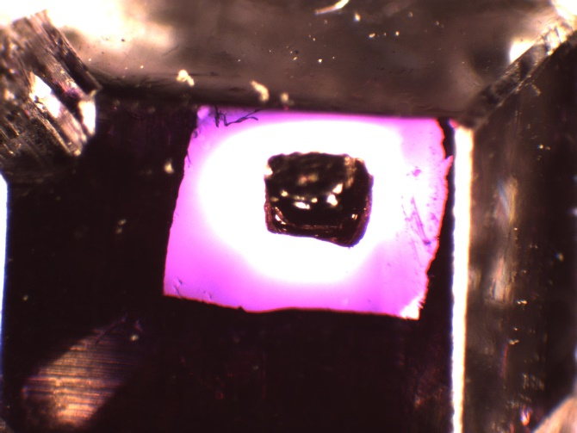
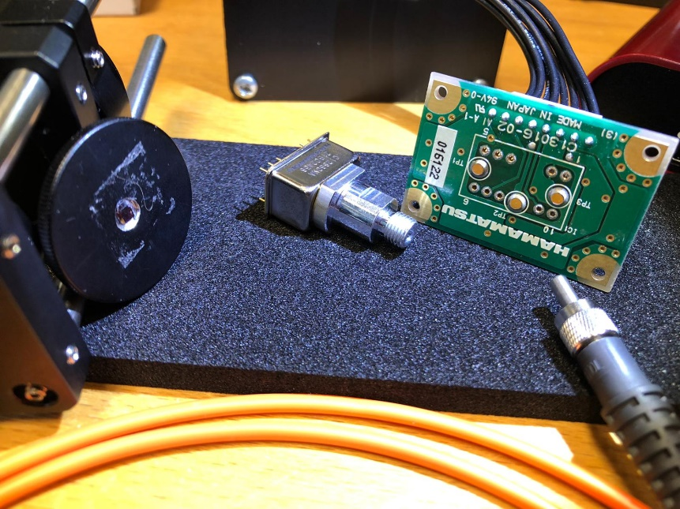
Hands-on quantum magnetometer
Quantum magnetometer: exploit PL influenced by external magnetic field
Experimental requirements (your part):
  Need NV- centers in diamond (by Quantum Technologies, Leipzig)
  Green light source (532nm)
  Optical excitation setup
  Optical read-out concept (consider spectral range versus readout speed)
  Detector(s)
  Magnet to produce magnetic field
  PC and software -> data acquisition and interpretation
  Ion implantation simulation to obtain NV-Centers
  Presentation of results

Slide 19
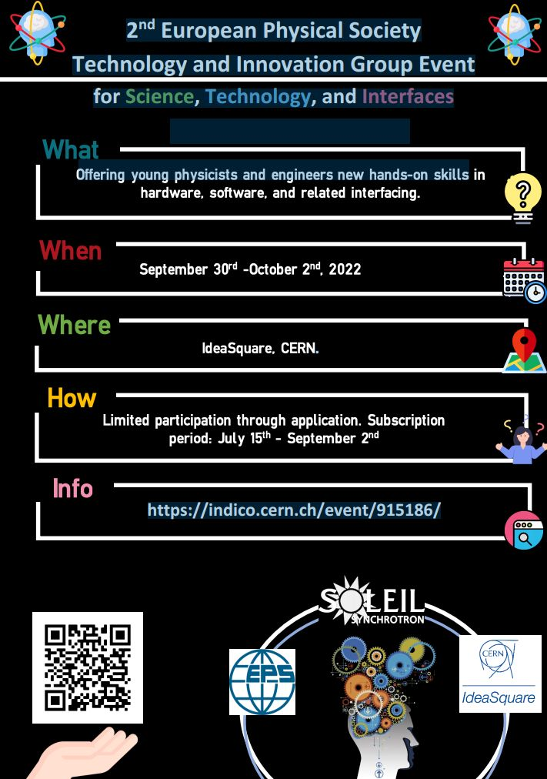
Want More hands-on experience ?
Apply and come to CERN:
More insight into NV- centers in diamond from NATURE⁸:
https://www.youtube.com/watch?v=VCT0wDLyvSs
⁸ Link: thanks to Mathieu Chevrot !

