Slide 1
Accelerator
SC dipole magnet

Slide 2
Concept
Attempt to use uniform technology through the collider complex
  HTS windings (for robustness)
  High current density (for cost reasons)
  Operation at high temperature (for energy efficiency)
Simplify magnet design, profiting from the small aperture (30 mm x 100 mm)
Adapt coil geometry

Slide 3
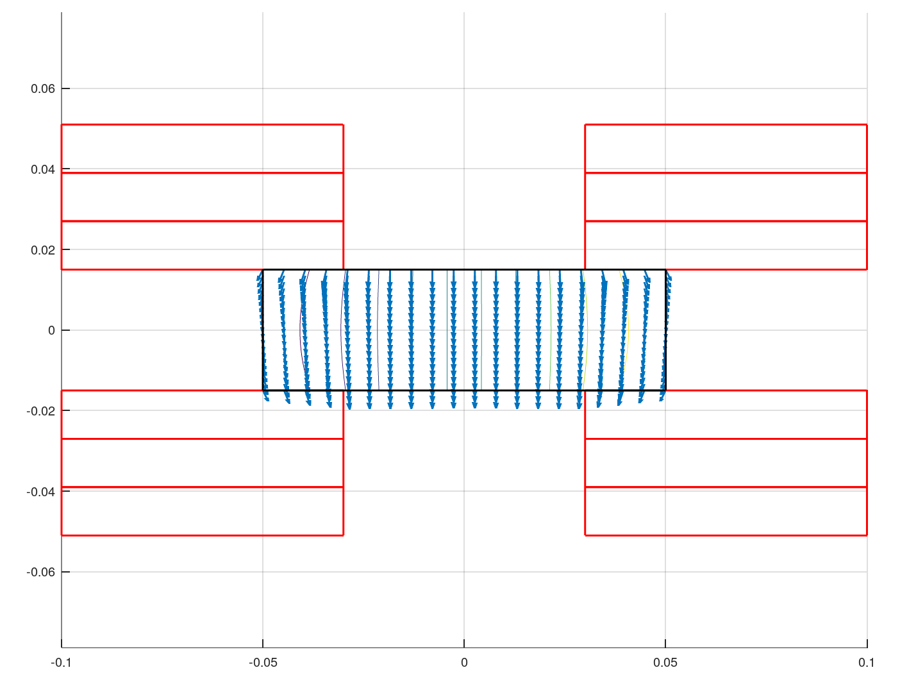
Coil
Flat racetracks
12 mm tape
J_{E} = 650 A/mm²
B = 10 T

Slide 4
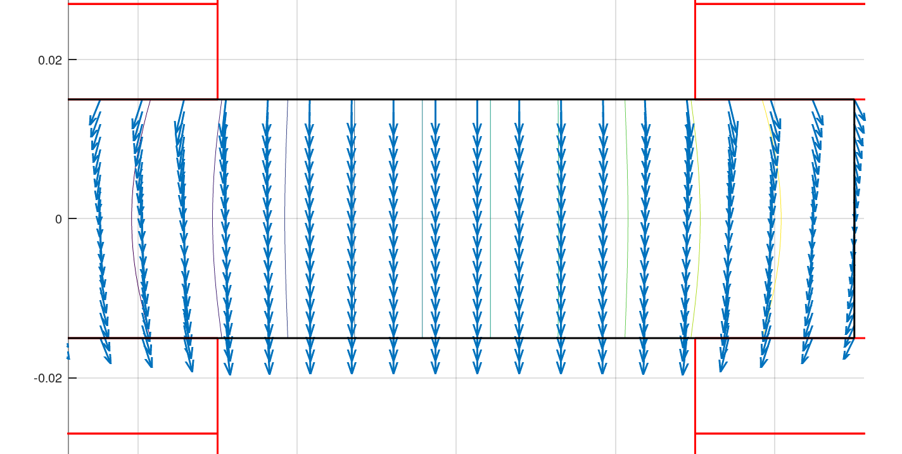
Field quality (no iron)
Calculations at Rref = 10 mm
B1 = 10.355
b3 = -7.2 units
b5 = -1.4 units
b7 = -0.03 units

