Slide 2
LHC re-commissioning
M.Solfaroli, J.Wenninger

Slide 3
Outline
A few updates from the YETS period
2023 operation and re-commissioning plan
Info on 2023 run
LHC re-commissioning

Slide 4
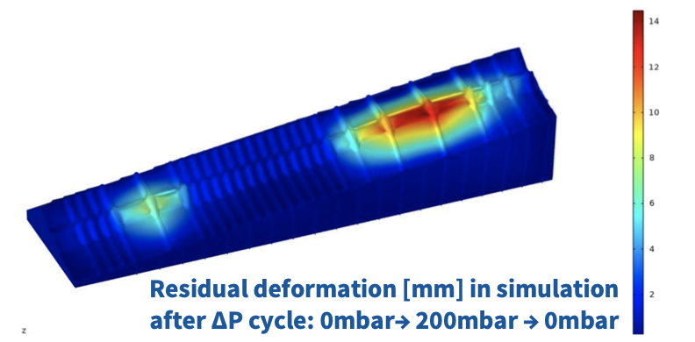
LHCb VELO incident
The evaluation of the impact of the VELO vacuum incident on the LHC machine and VELO operation is still in progress
Current status:
The deformation should not be a problem for beam injection (aperture)
  Aperture checks around IR8 to be done with beam for confirmation
No problem expected in terms of impedance and heating
To define limits on VELO closure, the edge of VELO must be reconstructed with beam tomography, possibly completed by beam aperture scans
  LHCb is investigating what can be determined parasitically to beam operation using SMOG
LHCC open session - 8th March 2023

Slide 5
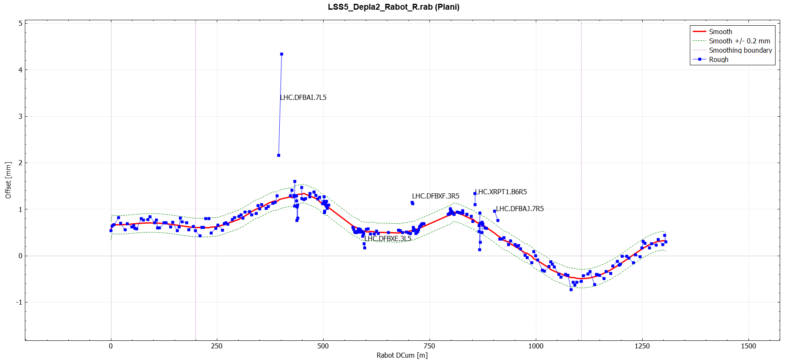
CMS radial IP shift
At the end of 2022 run, CMS requested a radial shift of the beamline by 1.1 mm to center the beam spot within the CMS pixel.
In order to limit the mechanical stress on the HW components, it was decided to separate the correction:
50% by beam line movement
50% by introduction of a magnetic bump
Today:
LSS5 beam line was shifted by 0.5 mm radially
It was estimated that the magnetic bump would induce ~10% increase of radiation to the triplet magnets ➔ IT task-force recommended to not apply this correction
J.F. Fuchs
LHCC open session - 8th March 2023

Slide 6
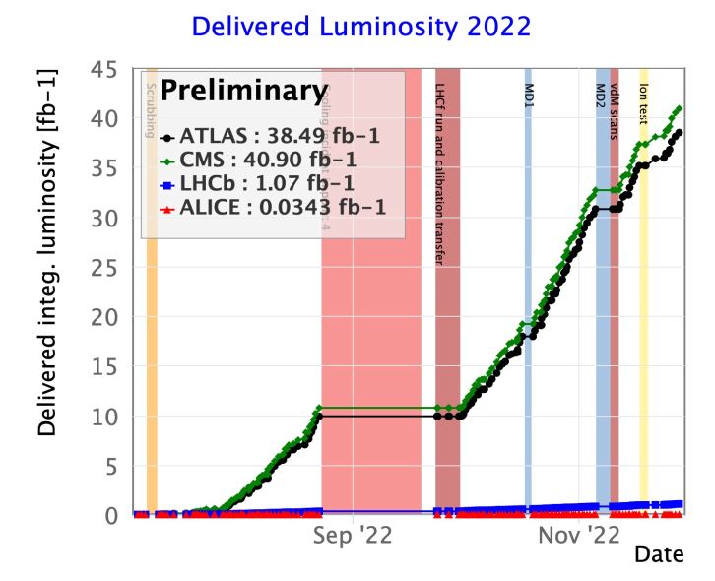
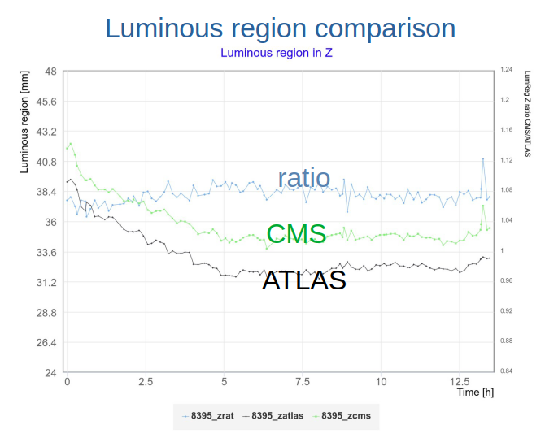
ATLAS luminosity scale
ATLAS recently corrected their 2022 luminosity scale down by 5.4%
After update of the visible X-section from vdm scans
The lower ATLAS lumi is in agreement with the observed difference of luminous region. This could be explained by a ~10 microrad larger half-Xing angle in ATLAS than in CMS
Some indications of such a difference visible on the DOROS BPM data, but it’s at the edge of the BPM accuracy
We will feed this information into the 2023 setup ➔ Collisions at injection might be used to reconstruct the luminous regions to guide the machine setup at 6.8 TeV
Examples of reconstruction of Xing angle with DOROS BPM data
LHCC open session - 8th March 2023

Slide 7
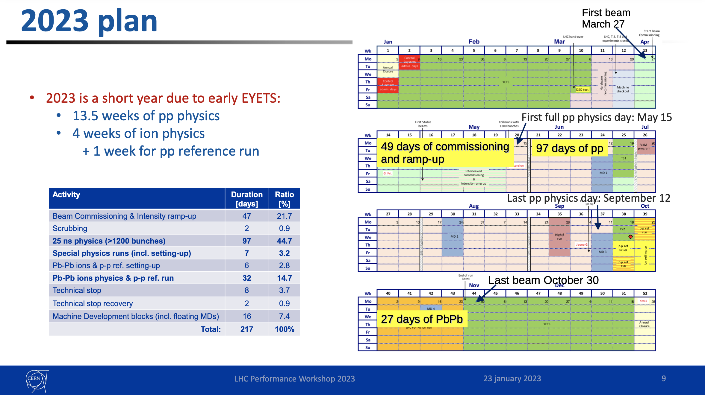
LPC @Chamonix
LHCC open session - 8th March 2023

Slide 8
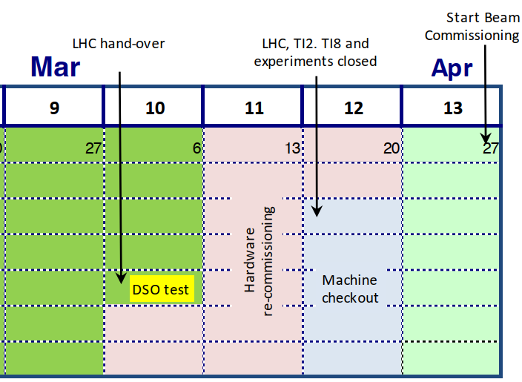
Plan to re-start
With the Departmental Safety Officer (DSO) tests, BE-OP takes over LHC machine coordination from EN-ACE on March 10th
DSO tests
Global safety tests, including access system and EiS (Element Important de Securite)
Preparation for the tests on Thursday 9th end of the day - LHC and experimental caverns closed & patrolled @4pm
Full day tests on Friday 10th - LHC and experimental caverns closed & patrolled until completion
Powering tests
10512 tests to prepare sc circuits for 6.8 TeV operation
First low current tests 6th - 9th March – evenings only
11 days period bet 11th – 22nd March – NO access in LHC, access possible in the experimental caverns
Start individual equipment checkout in parallel to powering tests
LHCC open session - 8th March 2023

Slide 9
Plan to re-start
5-day period of global machine checkout
Start delayed by 24-36 hours (LHCb) ➔ 23rd March
LHC machine and experimental caverns patrolled & closed on 22nd March 2023
If delay limited to 24 hours and no issue encountered
  Three days should be sufficient (provided powering test are completed)
  ➔ we should be able to stay on track to get beam during weekend 25th – 26th March
At the end of check-out we plan a Transfer Lines test:
Beam extraction from SPS until downstream dumps at the end of the TI2 and TI8 transfer lines
Fundamental activity that allows testing the full extraction chain, anticipating problems
Tentatively scheduled on Friday 24th March in the evening
LHCC open session - 8th March 2023

Slide 10
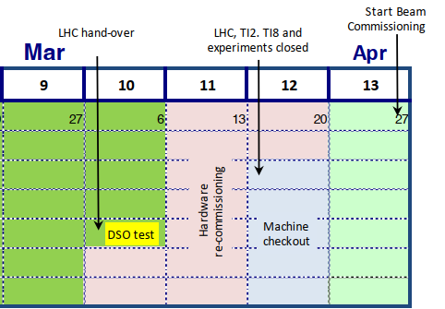
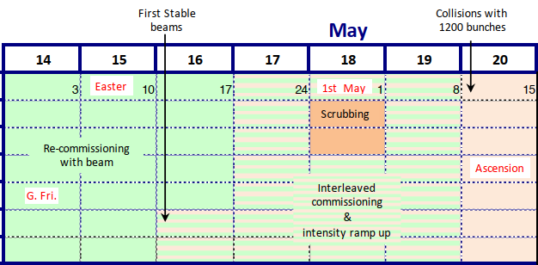
Beam commissioning
3.5 weeks of re-commissioning with beam
Mostly commissioning on machine side, in preparation for physics production
Some activities concerning experiments will also be carried out (next slides)
2-3 days allocated for reconditioning of the vacuum chamber for e-cloud (scrubbing) - advanced wrt schedule (place-holder): end of week 16, beginning of week 17
LHCC open session - 8th March 2023

Slide 11
Beam commissioning - experiments
Some activities have been agreed with LPC:
Dedicated splashes around day 3-4 of beam commissioning
First stable beams at injection, planned to happen before Easter weekend
A few stable beams shifts during Easter weekend to help cover the 4-day long weekend
ATLAS request for horizontal muons ➔ after Easter, before first stable beams at 6.8 TeV
Gas injection in IP8 (LHCb SMOG) to perform parasitic VELO foil tomography
First stable beams at 6.8 TeV: expected on schedule during week 17
LHCC open session - 8th March 2023

Slide 12
Machine configuration for pp production
time
Ramp&Squeeze
β* = 1.33/10/1.33/2 m
(IP1/2/5/8)
Squeeze to
β* = 0.6 m in IP1&5
Establish and optimize collisions
Stable Beams and β*
levelling down to
0.3 m in IP1&5
2022
Injection
Ramp&Squeeze
β* = 2/10/2/2 m
(IP1/2/5/8)
Xing-Sep planes rotation in IP8
Squeeze to
β* = 1.2 m in IP1&5
Establish and optimize collisions
Stable Beams and β*
levelling down to
0.3 m in IP1&5
Injection
Main differences for experiments between 2022 and 2023 cycles:
IP8 rotation to provide same full crossing angle for any LHCb polarity – confirmed by LHCb
Much longer β* levelling from 1.2 m to 0.3 m (2022: 60-30cm) to maximise integrated luminosity - Tuned for bunch intensities of 1.8E¹¹ ppb
LHCC open session - 8th March 2023

Slide 13
Machine configurations for special runs & ions
In parallel to setting up the nominal pp configuration, we hope to use beam commissioning periods (mostly nights and week-ends) to pre-commission other 2022 configurations
Vdm: based on 2022 settings
  Expect a quick recommissioning, mainly orbit and collision point optimization
High-beta 120m, high beta 6km: brand new de-squeezes
  Bring probe beams to end of de-squeezes, if time permits first look at optics
Ions: energy has been defined to be 6.8Z TeV, optics available
  If time permits, bring probe beams to end of squeeze, first look at optics
  Such strategy proved to be very effective in the past to prevent diverting some shifts of pp production to those tasks and to timely identify possible issues
LHCC open session - 8th March 2023

Slide 14
Intensity ramp up
Intensity ramp up (to ~1200 bunches) during ~3 weeks
Similar steps to 2022, possible optimization is under discussion
Start with ~1.5E¹¹ ppb (bunch intensity used in operation at end of 2022)
Insert 8b4e train early on, from ~300-600b
LHCC open session - 8th March 2023

Slide 15
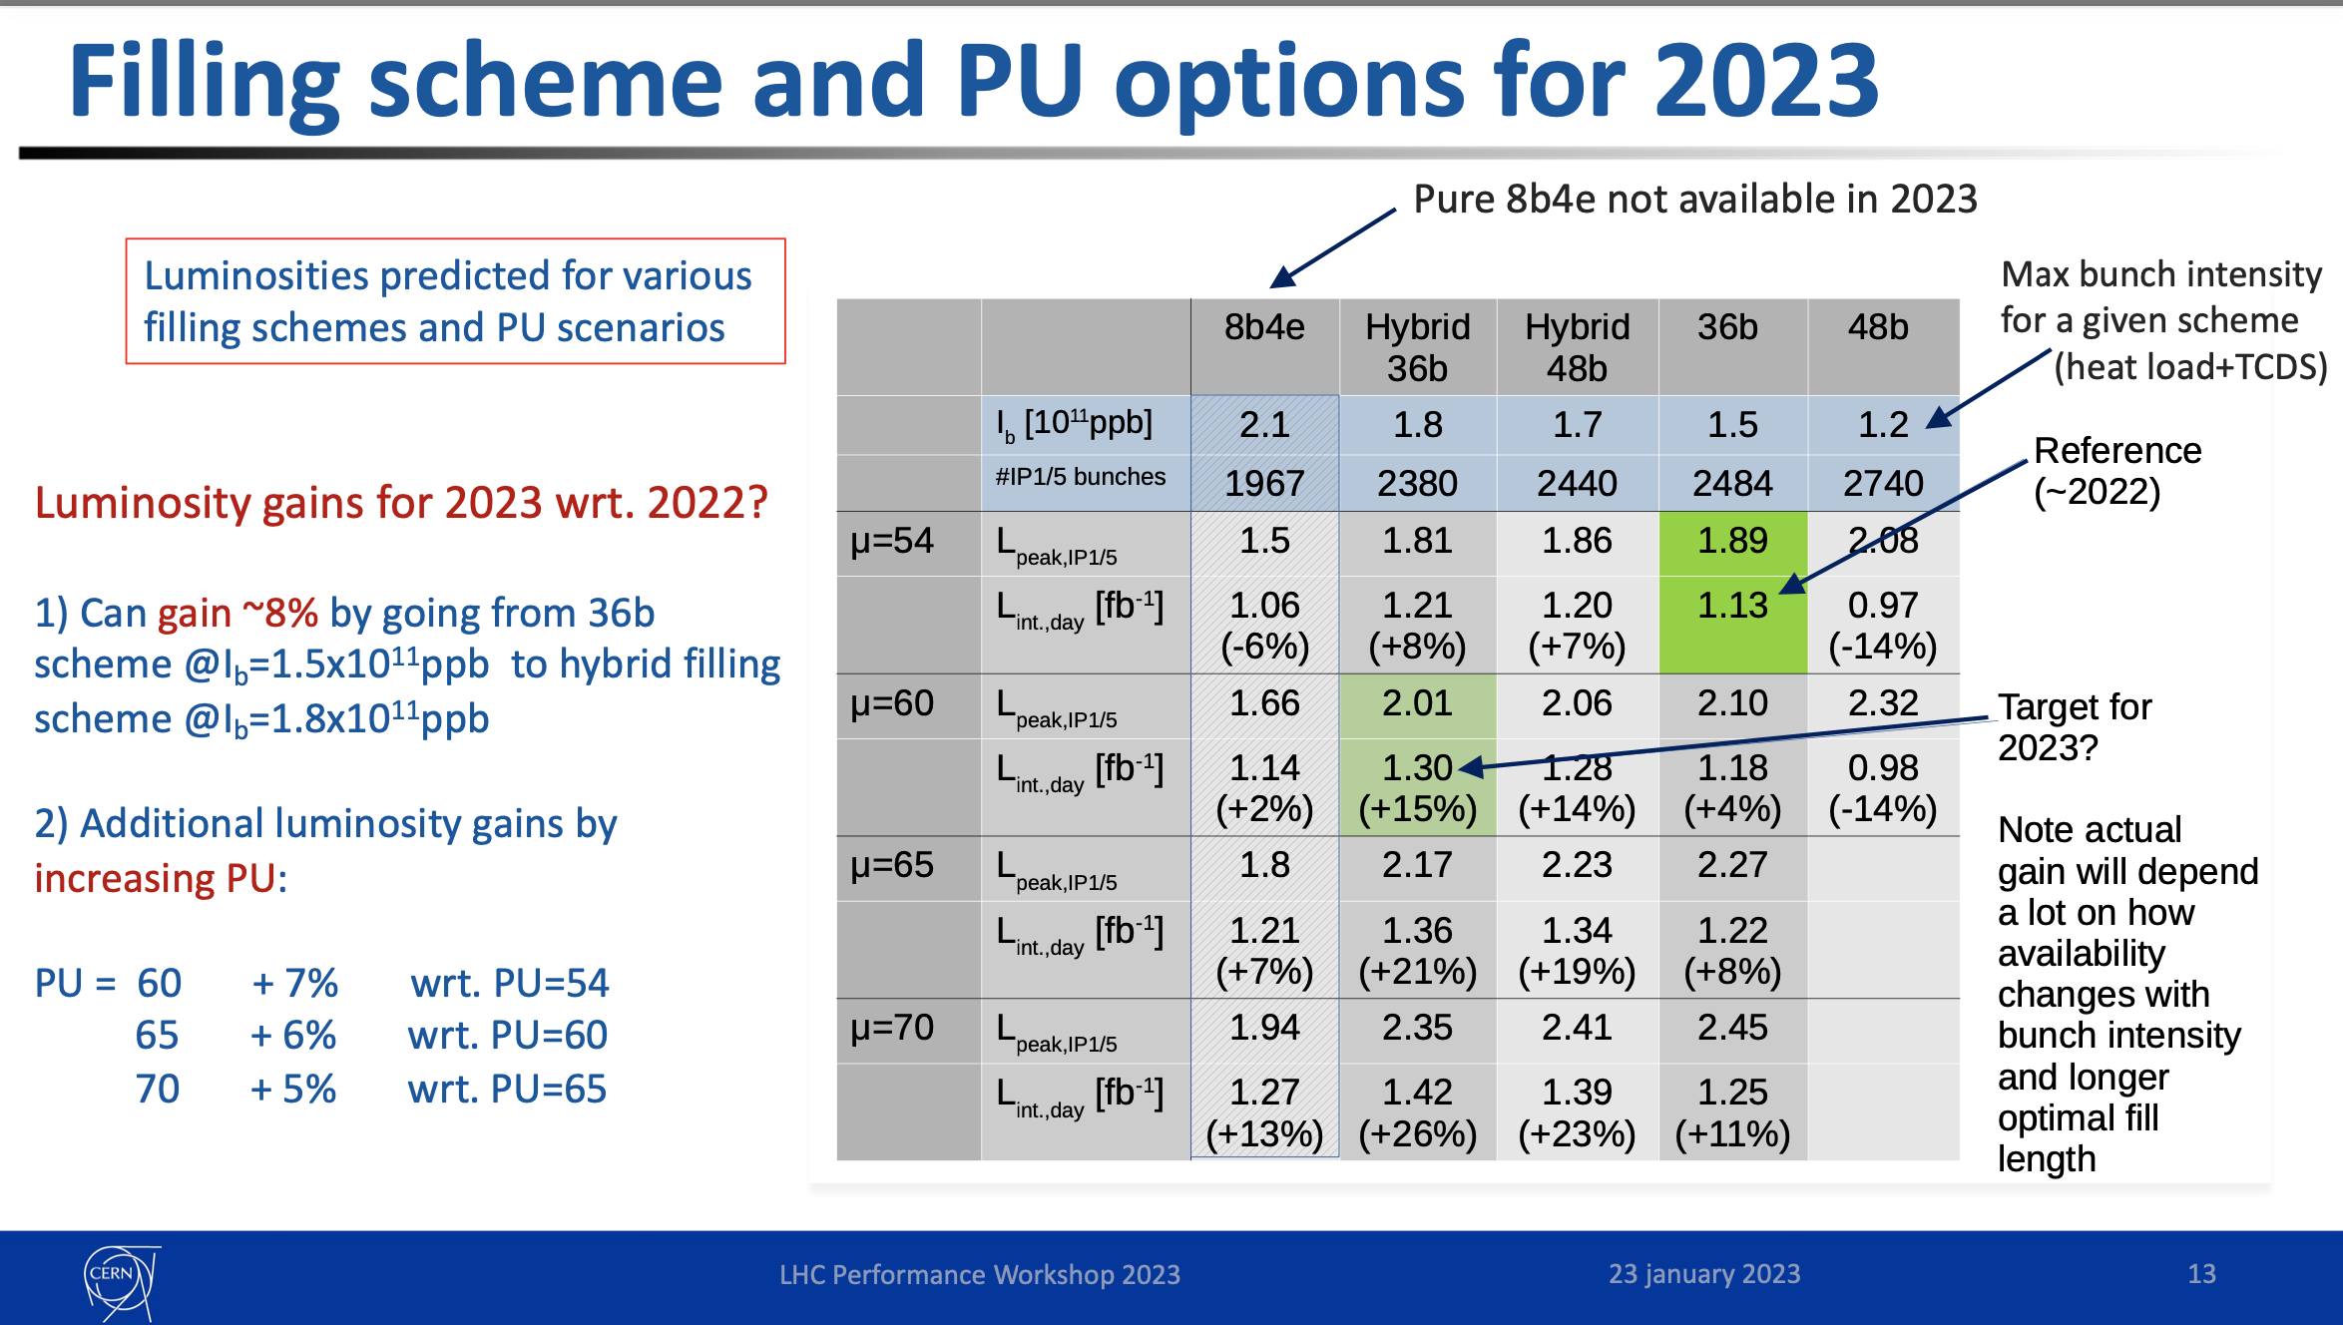
LPC on 27th February 2023
CONFIRMED
LHCC open session - 8th March 2023

Slide 16
Conclusions
An intense phase of re-commissioning of the LHC for 2023 run is about to start
  BE/OP will take over the LHC activity coordination on coming Friday 10th March
All activities are on schedule and NO showstopper is identified
First Stable Beams @6.8 teV planned to happen sometimes in week 17
LHCC open session - 8th March 2023

