Slide 1

The construction of the prototypes and series of the HOCM
Marco Statera and Marco Prioli
on behalf of the LASA team
INFN Milano - LASA
LASA – Feb 17th 2022

Slide 2
OUTLINE
Scope: the High Order correctors magnets
Highlights from EM and mechanical design
Highlights of prototypes and series production
Selected results
Conclusions

Slide 3
SCOPE - High Order Correctors
The INFN-LASA follows the design, construction and test of the 5 prototypes of the High Order (HO) corrector magnets for the HL interaction regions of HL-LHC. KE2291
The INFN-LASA follows the series production of the 54 HO corrector magnets for the HL interaction regions of HL-LHC. KE3085
INFN delivers the magnets, the vertical test of all magnets, and collaborates to the integration in the cold mass by CERN

Slide 4
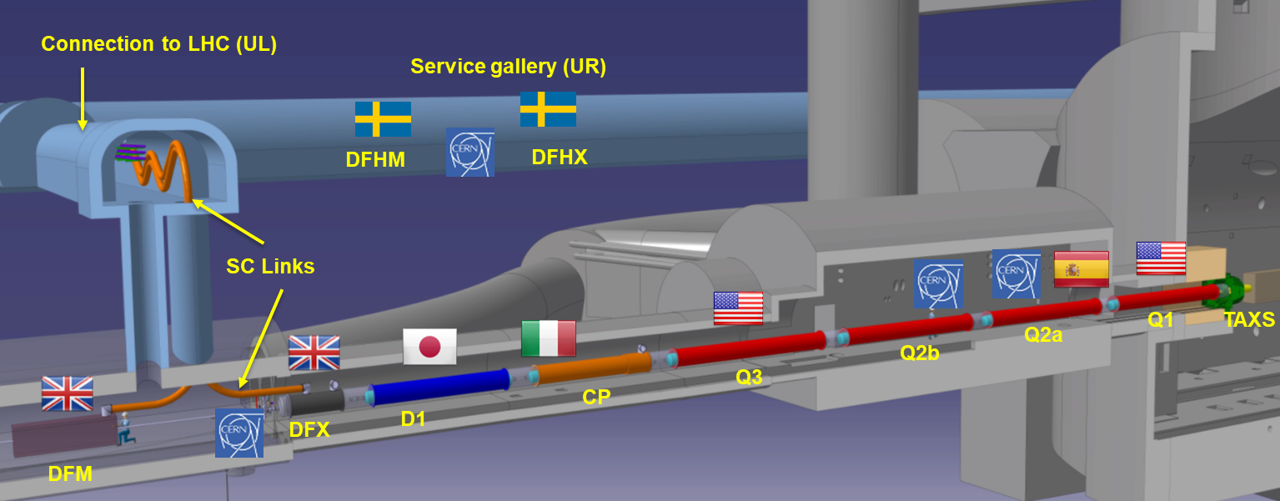



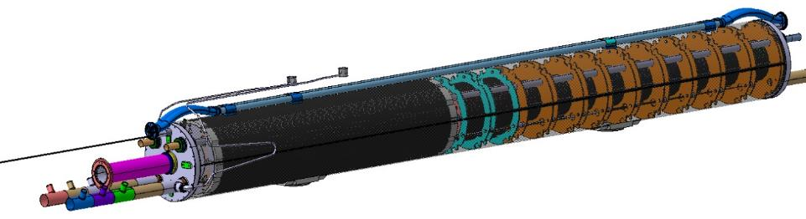

THE LOW BETA SECTION and the High Order Correctors
~70 m
a4
a3
a6
a5
b3
a2
b6
b5
b4
By H. Prin

Slide 5
SUPERFERRIC DESIGN
First superferric magnets in a high energy accelerator
NbTi coils
Racetrack
Insulation by S2 glass reinforced material
Superferric design
Compact and modular
Strong contribution of the iron poles
Field quality influenced by the shape of the poles
Quench protection
No energy extraction (but 4P)
60% margin @ 1.9 K
magnet | Integrated strength | Ic @ 4.2 K | Margin @4.2 K | Margin @1.9K
4P S | 0.700 Tm | 315.5 A | 42.3 % | 57.1 %
6P | 0.095 Tm | 225.5 A | 53.4 % | >60 %
8P | 0.069 Tm | 230.2 A | 54.4 % | >60 %
10P | 0.037 Tm | 255.7 A | 58.9 % | >60 %
12P N | 0.086 Tm | 232.6 A | 54.9 % | >60 %
12P S | 0.017 Tm | 230.2 A | 54.4 % | >60 %
Longitudinal dimension
Quench protection
Small dimension: 84 kN series production mass (54 magnets)
constraints

Slide 6
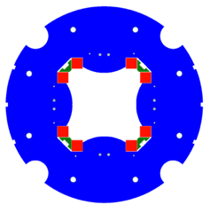
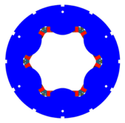
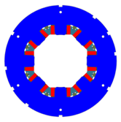
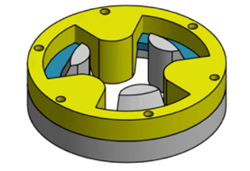
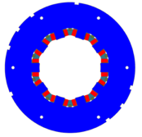
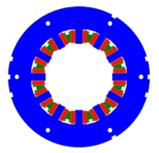
HO Corrector Magnets Zoo
MQSXF
MCSXF
MCOXF
Design
Construction & Test
5 prototypes
54 series magnets
6P 8P 10P +50% Bdl
OD320
OD460
a3
b3
a4
b4
a2
MCDXF
MCTXF
Prototypes tested 2016-2020
Geometrical lengths:
200 mm - 265 mm
12P, S4P: 540 mm – 580 mm
a5
b5
a6
b6
Round Coil Superconducting Magnet
MgB₂demonstrator

Slide 7
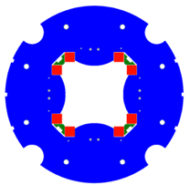
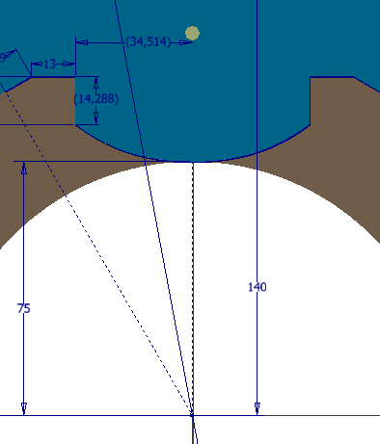
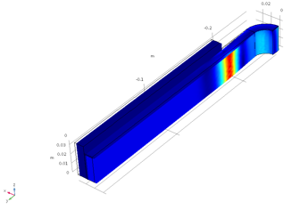
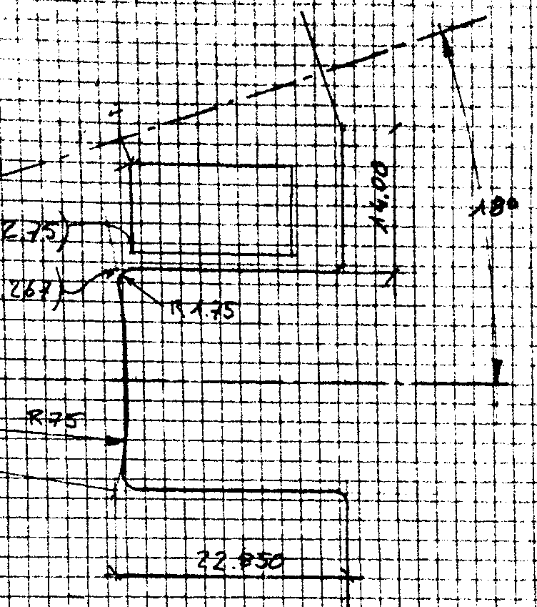
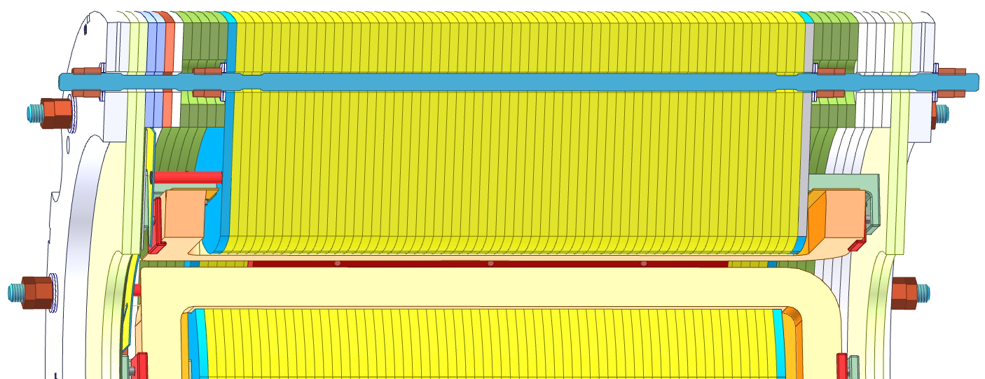
MECHANICS
pole shape
coils
modifed ideal n= 2; 3
Wedges prestress
Avoid movements/falling
1D model
ideal shape
ARMCO
iron
non magnetic
wedges
maximum area n > 3
wedge
coil
flux return plates
pole
a.u.
3D modelling of the coils for stress managenment
Racetrack coils
sketch by G. Volpini

Slide 8
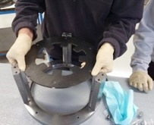
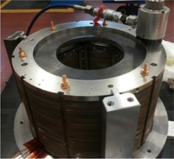
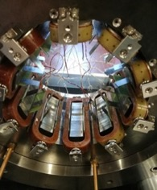
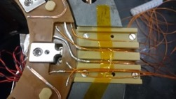
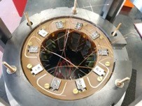
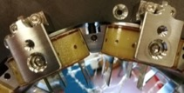
ASSEMBLY
lamination
Procedure developed at LASA on prototypes
6P, 8P, 10P assembled at LASA
12P and 4P assembled in industry
Pole laminations
Inner CuBe rods-loading
Coils centering and fixing
Connections
Final laminations
Outer CuBe rods-loading
alignment frame
upper PCB
PCBs fixing
coil
bridge
lower PCB
CuBe rods
Longitudinal support
wedge

Slide 9
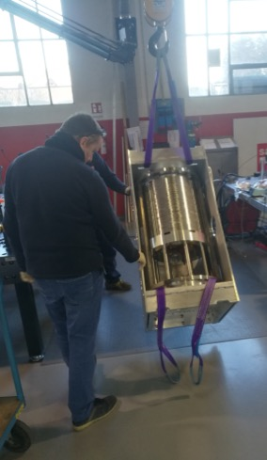
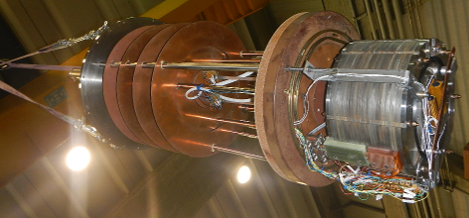
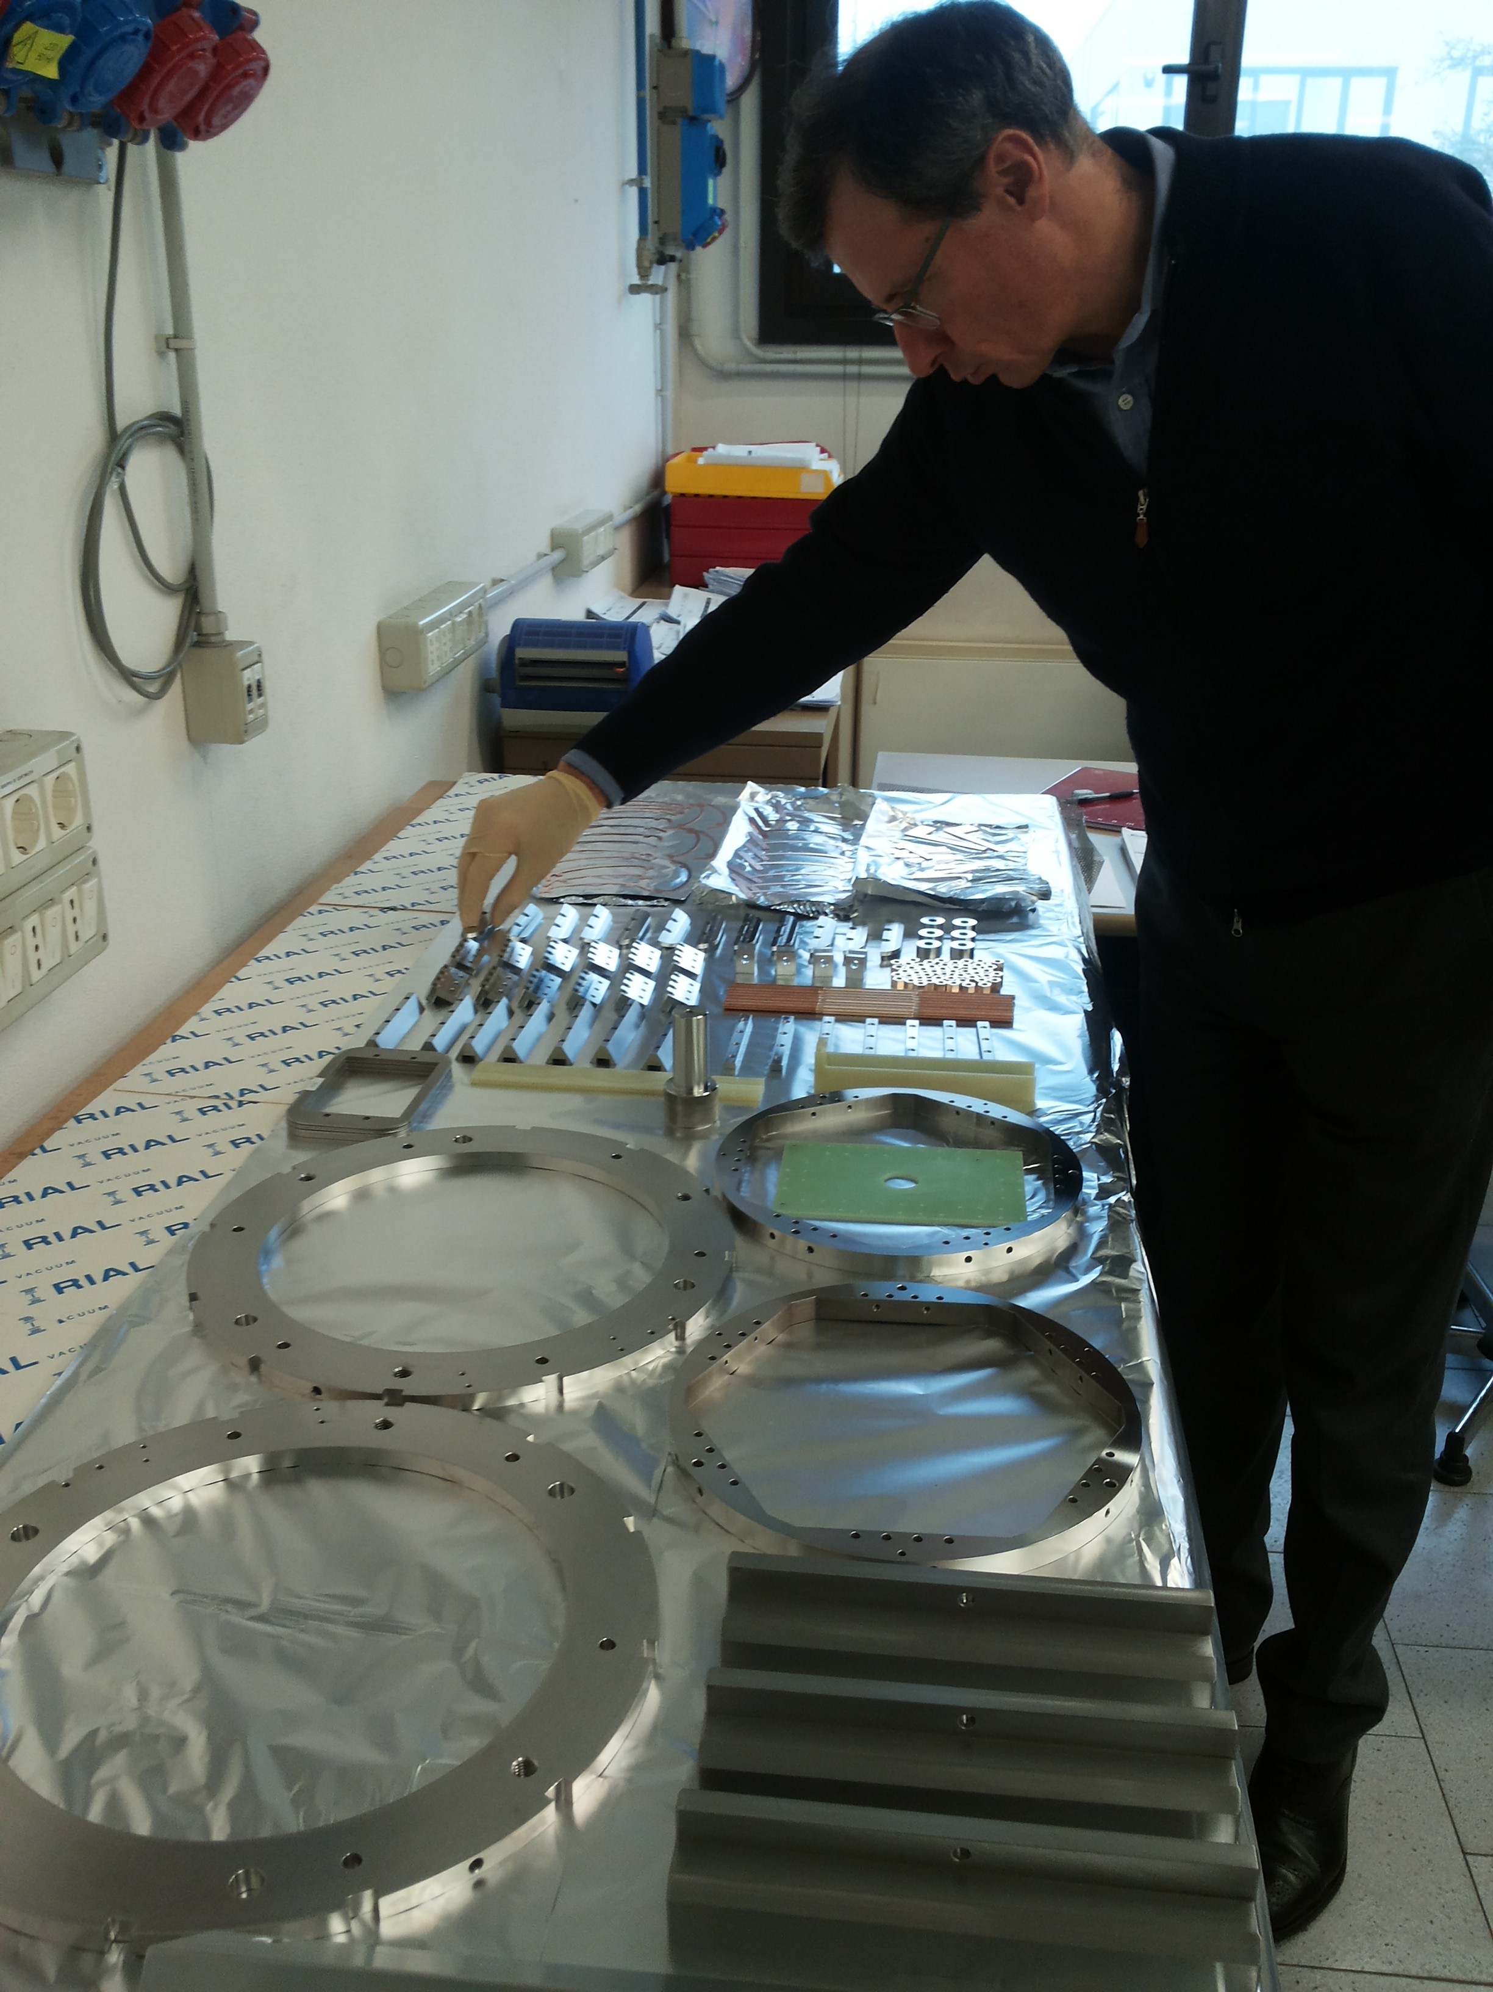
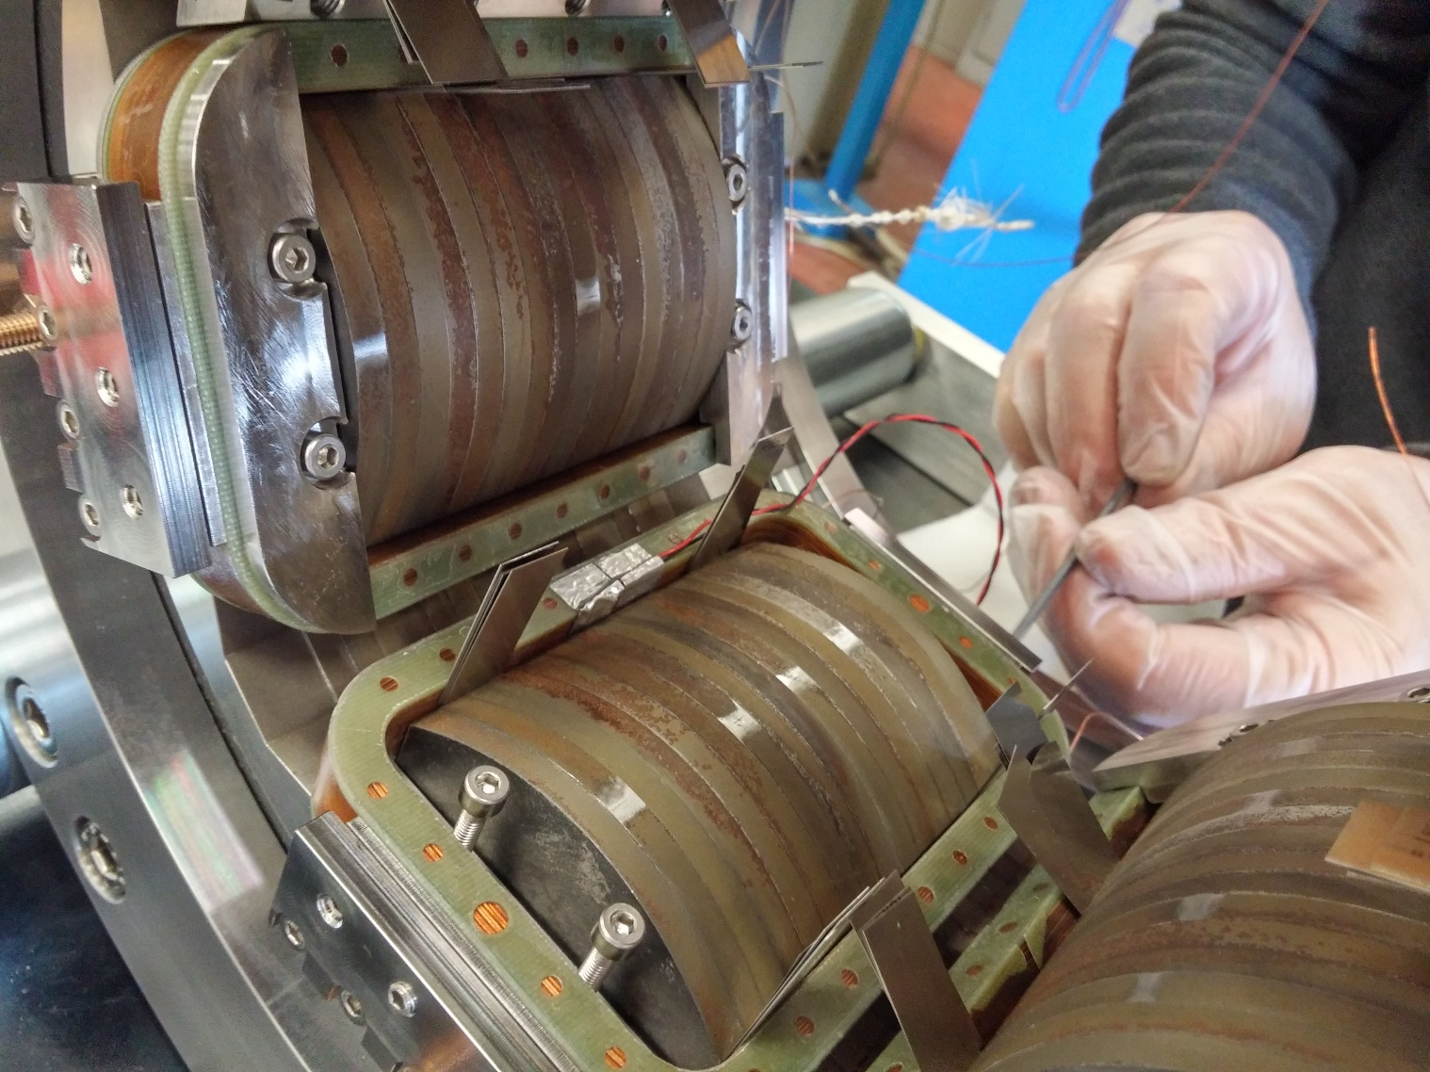
Prototypes
Sextupole Octupole and Decapole
Coils production and assembly at LASA
Normal Dodecapole and skew Quadrupole
Coils production and assembly in SAES Rial Vacuum
8P test
First components QC
Sextupole assembly
Skew Quadrupole handling in SRV

Slide 10
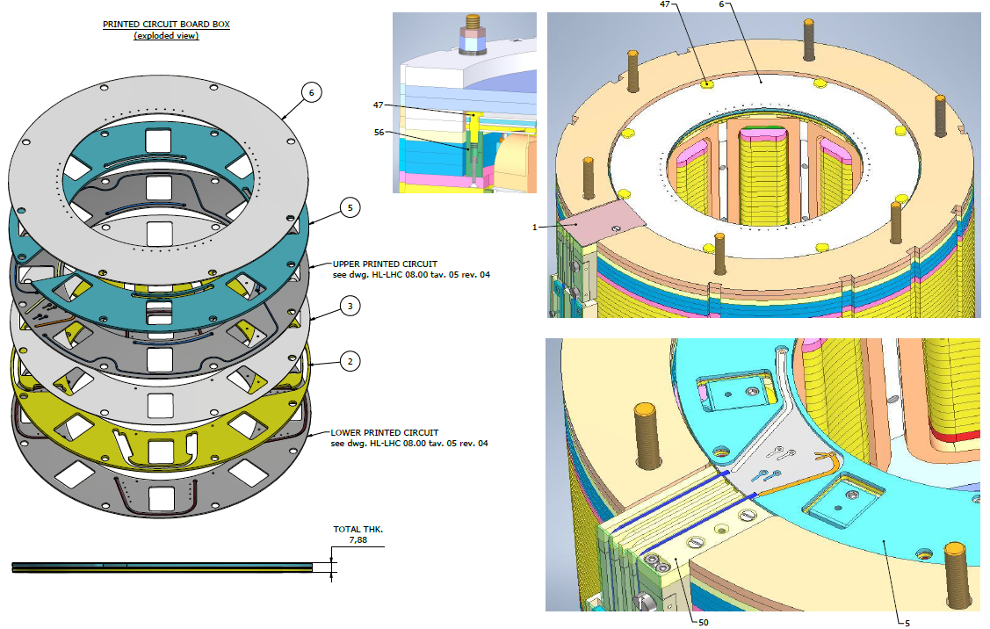
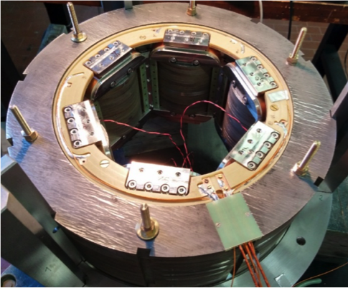
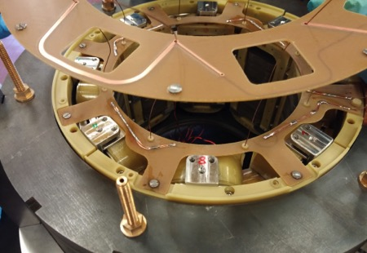
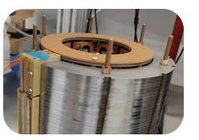
The Electrical Connections
The coils are connected in series
Duratron support disk
Printed Circuit Boards
Thin Cu on PCBs
PCB box
On duratron columns
Duratron disks
copper thick laminations (1 mm)

Slide 11
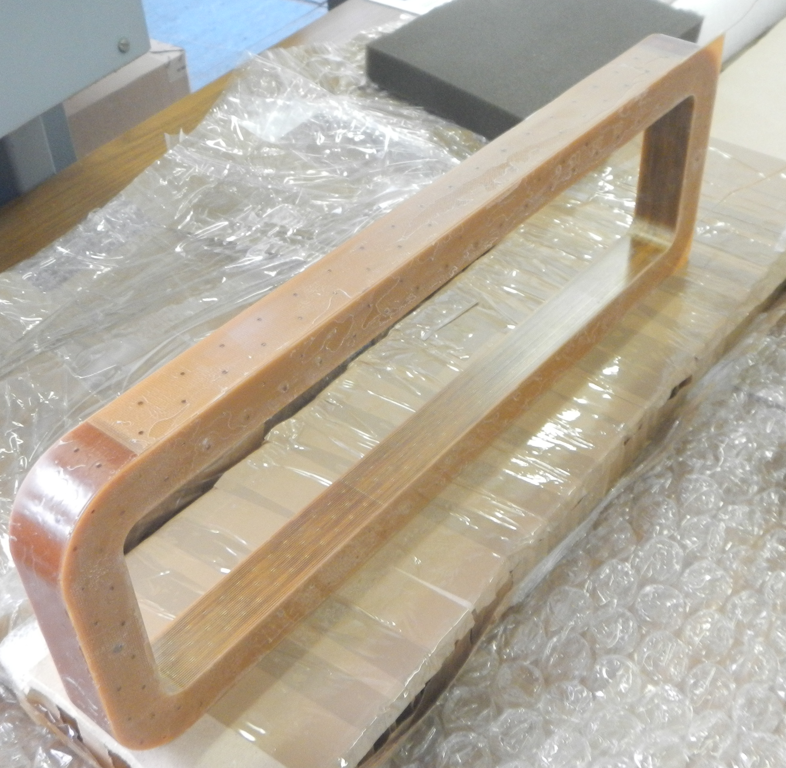
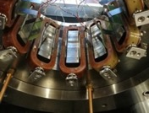
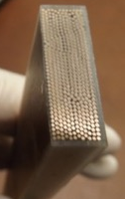
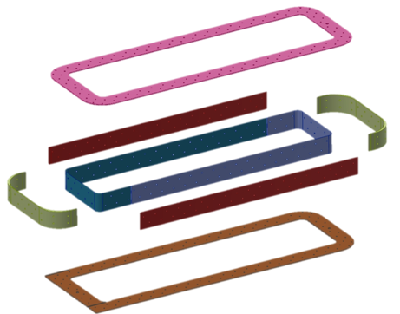
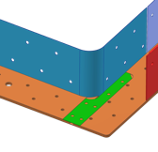
Coils
Racetrack, same design, but 6 families
Single wire up to 750 turns
External S2 reinforced material
Production learning curve in industry
QA at in industry during production
457 mm
130 mm
Machined from bulk
0.15 mm
sheet
498 mm
1.0 mm
1.5 mm
insert
out
in

Slide 12
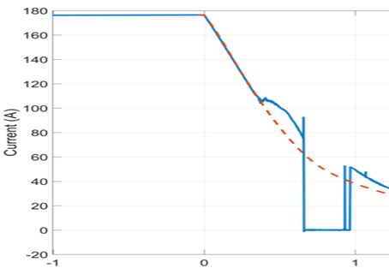
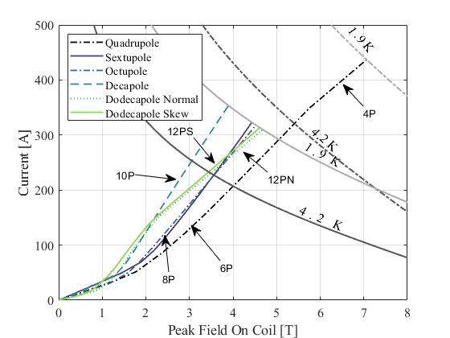
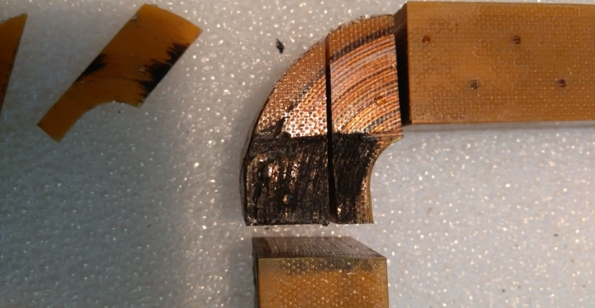
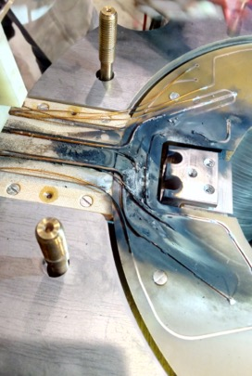
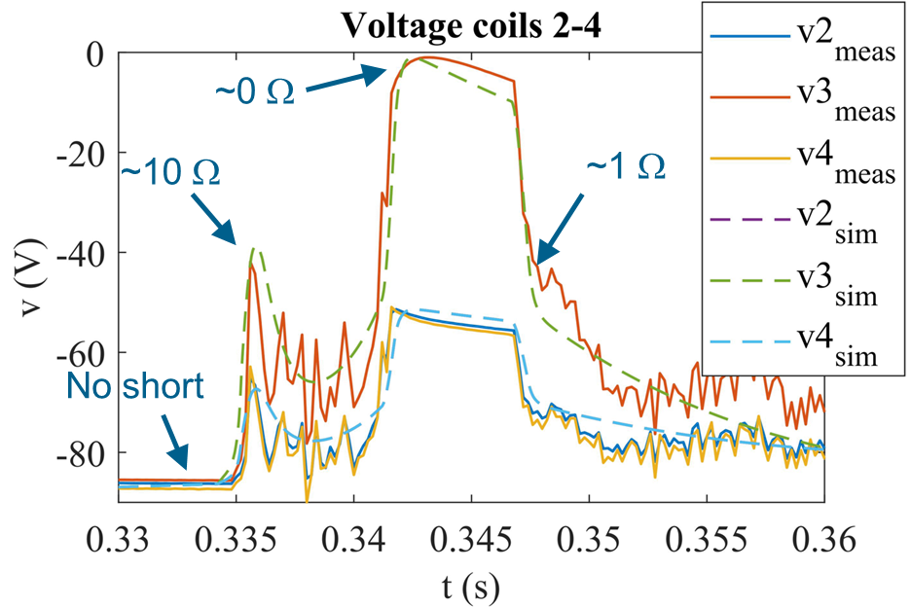
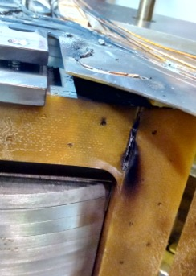
The Load Lines
What happens if something goes wrong?
Working point
4P working point
6P, 8P and 10P may be installed as normal or skew
Many designs, one wire
Different designs, same protection scheme
Except for the skew quadrupole
Analysis by Sorbi-Prioli-Mariotto
Mitigation: input wire additional protection layer

Slide 13
COILS
Racetrack, same design, but 6 families
Single wire up to 750 turns
External S2 reinforced material
Production learning curve in industry
QA at in industry during production
457 mm
498 mm
130 mm

Slide 14
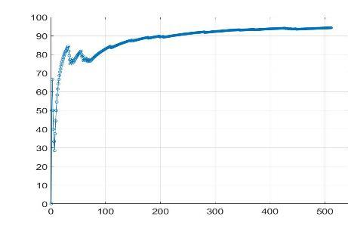
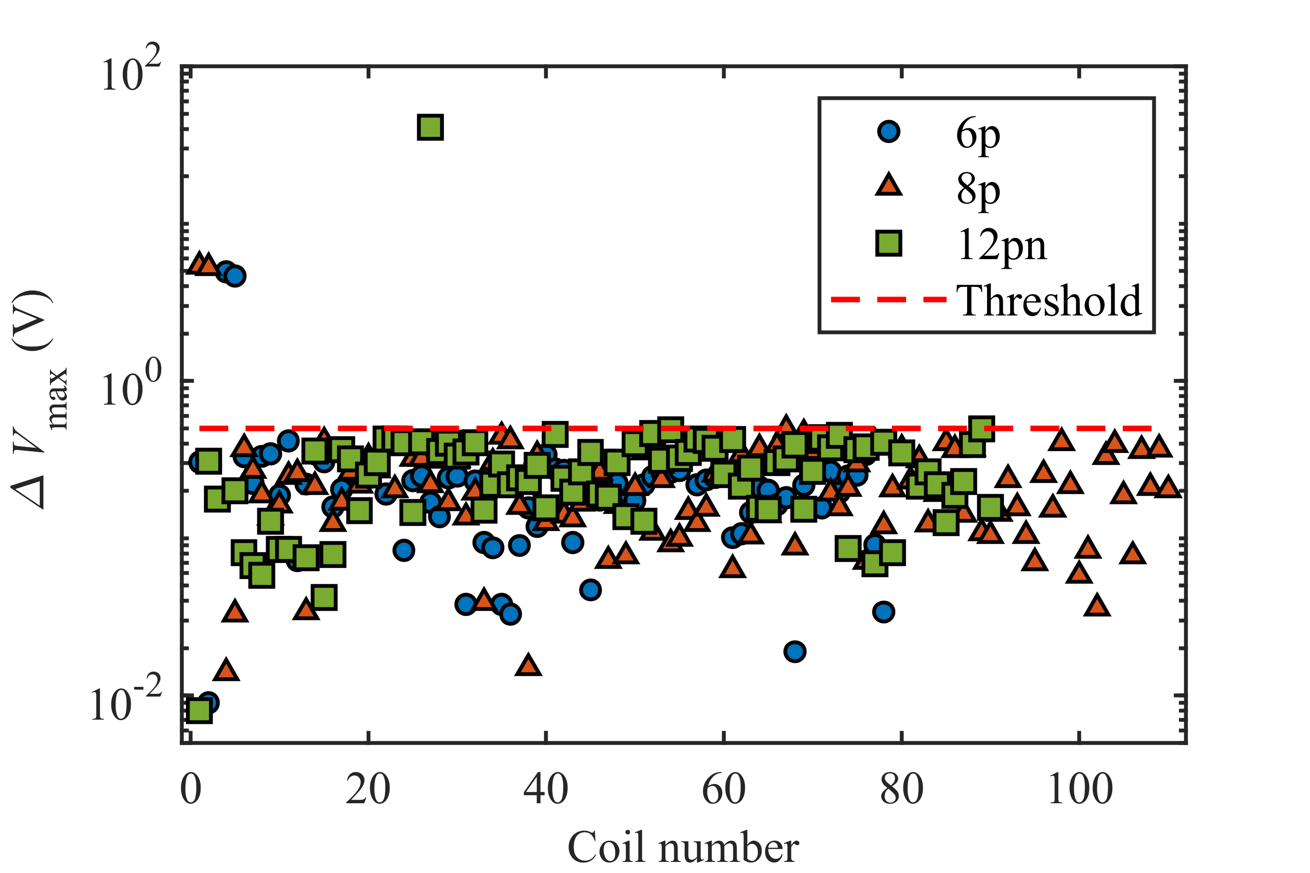
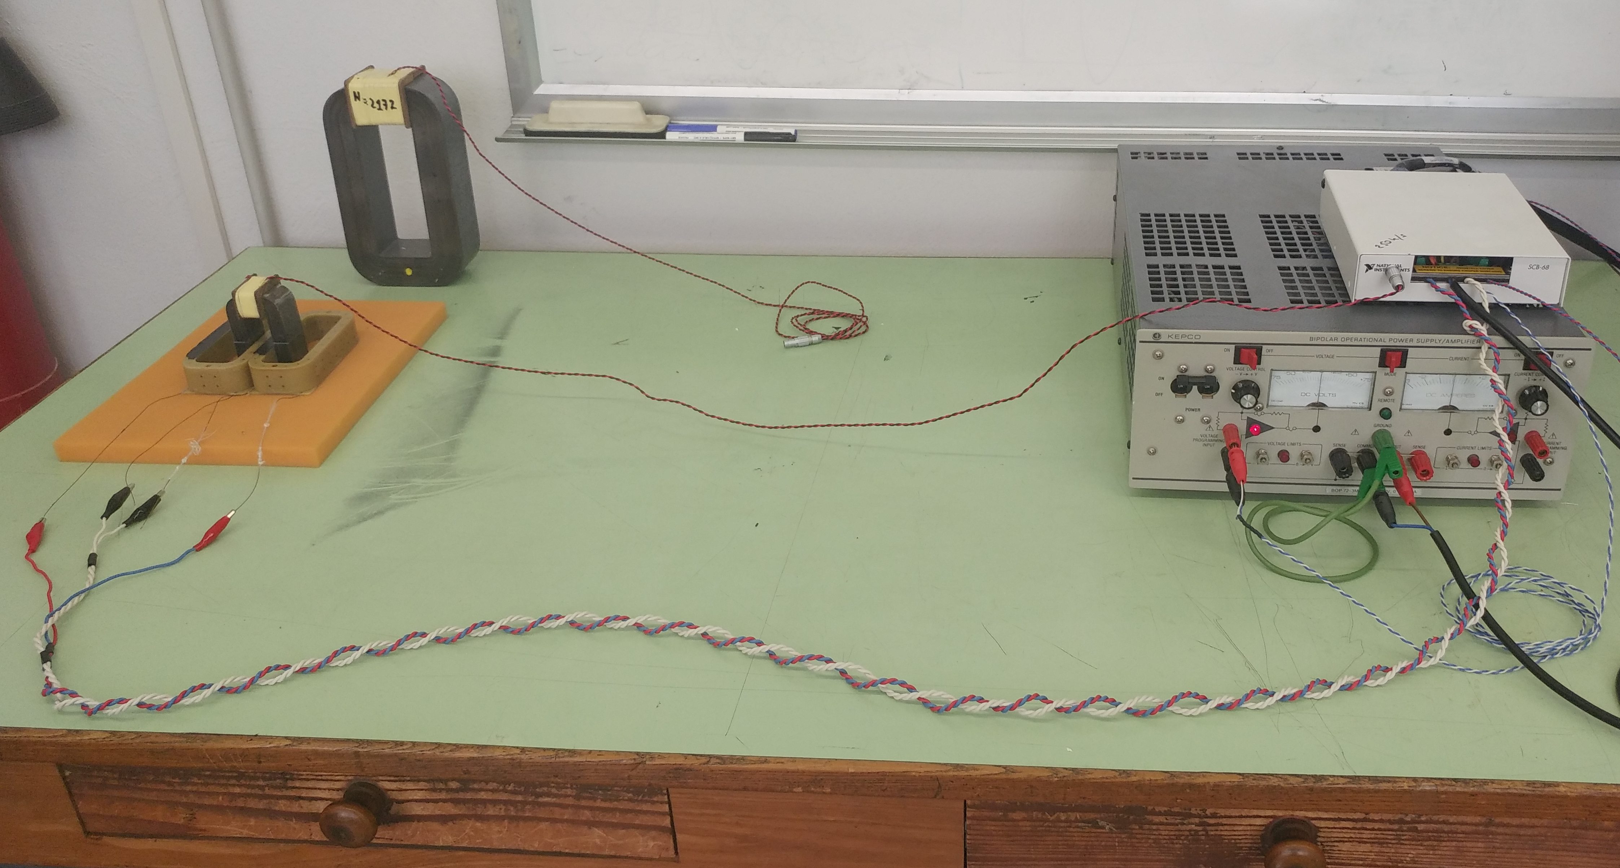
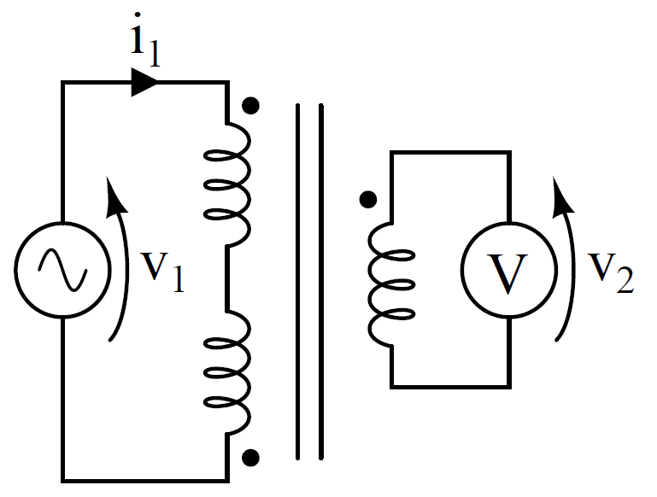
QC coils
Produced coils 508
29 NC (6%)
QC developed by LASA
Measurements in industry
The number of turns is checked through a custom measurement setup
Surge test at V₀ = 2 kV to detect internal insulation defects
Voltage to ground tests
Mechanical dimensions
Learning curve
Percentage of conform coils vs produced coils
Inter-turn short
One turn less

Slide 15
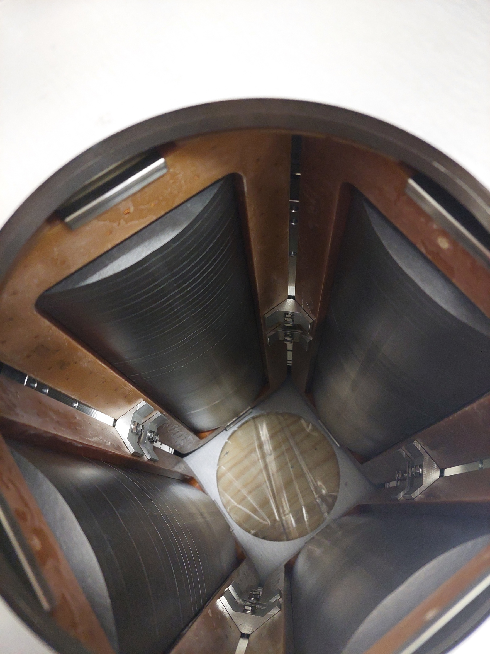
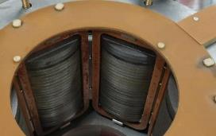
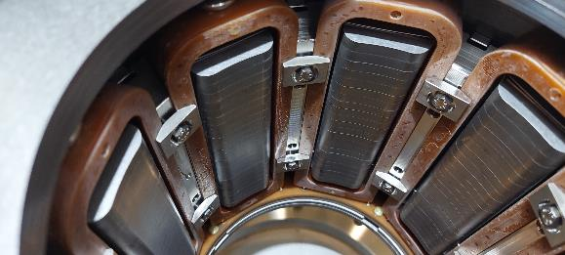
Major Design iterations
Wedges additional supports fixed by spring washers to improve wedges stability in octupoles and quadrupoles 4P and 8P
Splices mechanical protection box

Slide 16
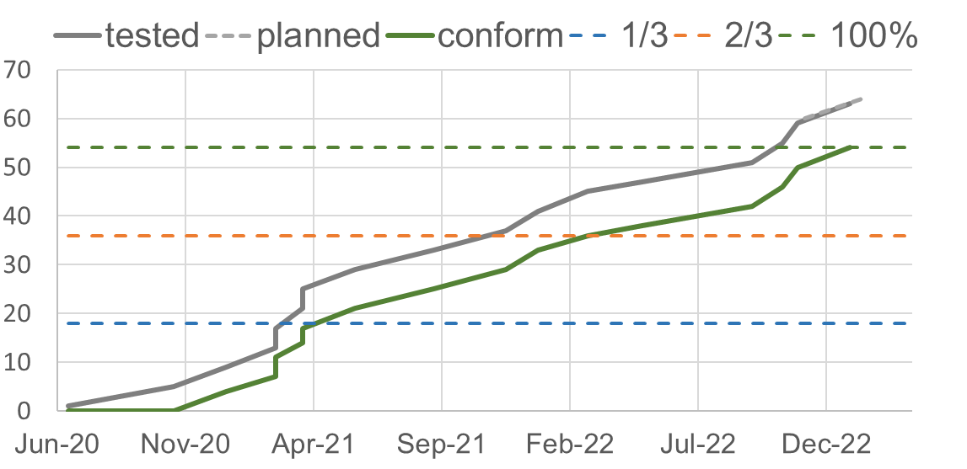
Status of Production and test (magnets)
Legend
done/tested
Test ongoing
re-assembly
Coils produced at SAES Getters Lainate (Milano, I)
Last coils delivered in July 2021
Magnets Assembled at SAES Rial Vacuum (Parma, I)
Last 10 produced magnets delivered to LASA in Oct 2021
End of tests Feb 2023
Produced magnets
100%
½ production
1 batch

Slide 17

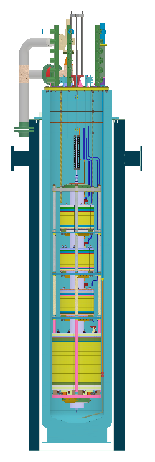
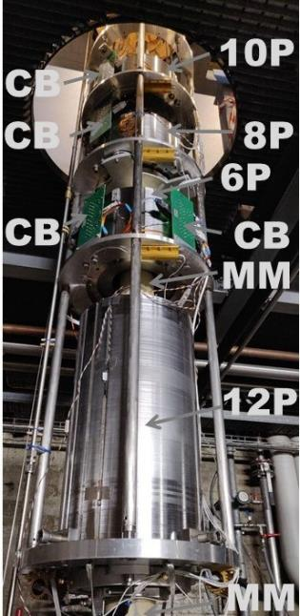
The test station at LASA
Four HO correctors cooled at 4.2 K
  Each magnet powerd individually
  Magetic Measurements
Power converter 600 A
  Dump resistance 1 Ω or 1.5 Ω
  IGBT polarity switch by LASA
  IGBT for quench protection
Field probe for the series by CERN
  Each magnet measured individually
  No cross talk

Slide 18
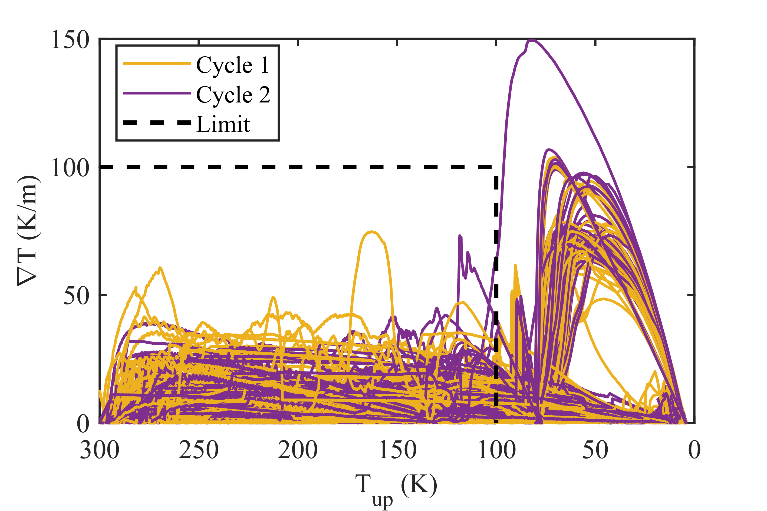
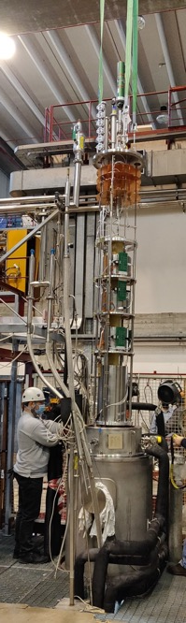


Test results
Powering (M. Prioli)
Training (both polarities)
Endurance test 1h at ultimate
Magnetic field measurement
(E. De Matteis, S. Mariotto)
Field integral 1% to 3% wrt simulations
Field integral reproducibility <0.1%
Field quality high reproducibility
Transfer function very good agreement with simulations, high reproducibility
Quenched coil recostruction via Magnetic Measurements (S. Mariotto)
96 Thermal cycles
Round Coil Superconducting Magnet
2 MgB₂ coils
Reached 230 A (1.5 I_{nom})
See 3LOr2B-02
S. Mariotto
By R. Valente

Slide 19





















Training in last 12 months

Slide 20



Magnetic Measurements Example
Calculated
Reproducibility 0.2%
Allowed harmonics 100 U
Integrated field repeatibility 0.1% at nominal current
Second assembly repeatibility 0.05%(measured)
Integrated field simulated vs measured 2% or lower for all HO correctors
The measurement of the 12p was a challenge

Slide 21

Quenched Coil(s) Measurement
Superconductors get magnetized during operation due to the Persistent Screening Currents in the filaments of the conductors
Transition to normal resistive state cancel the magnetization
Quenched coils will not have residual magnetization
Post quench fourier analysis of the remnant magnetic field
S. Mariotto and M. Sorbi. SuST, 35(1):015006, nov 2021.
1
4
The system is able also to localize quench coils in multiple ways:
Shape of Flux is different
Harmonics Amplitude depends by:
  Number of quenched coils.
  Position of the coils.
Harmonic Phase combination reconstruct uniquely the different quenched coils
Multiple coils quench in quadrupole observed

Slide 22


Integration
46 HO Correctors
delivered to CERN
9 correctors alligned
beampipe
Mechanical integration
Assembly in building 180, CERN by H. Prin
Alignment measurement by C. Petrone
More in next presentation by E. Gautheron
by E. Todesco

Slide 23


Integration
MCDXF01 first test in Jul 2020
46 HO Correctors delivered to CERN
9 correctors alligned
beampipe
by E. Todesco
Mechanical integration
Assembly in building 180, CERN by H. Prin
Alignment measurement by C. Petrone
More in next presentation by E. Gautheron

Slide 24
CONCLUSIONS
The HL-LHC corrector design is solid
Construction of 54 HO Correctors in industry
All HOC are powered at cold, 54 magnets have been successfully tested
Magnetic Measurements are performed
The results are very reproducible for each family with a good agreement with simulations
An innovative quench recostruction method has beed developed
The integration in the first cold mass started
First superferric magnets in a high energy collider

Slide 25



LASA team
F. Broggi, E. De Matteis, S. Mariotto, A. Paccalini, A. Pasini, D. Pedrini, A. Leone, A. Palmisano, M. Prioli, M. Sorbi, S. Sorti, M. Statera, M. Todero, R.U. Valente
CERN
E. Gautheron, A. Musso, E. Todesco
SAES Getters and SAES Rial Vacuum
F. Gangini, P. Manini, C. Santini,
M. Canetti, M. Campaniello, A. Zanichelli
THANK YOU

