Slide 1
Fabrication of the High Order Corrector Magnets for Hi-Lumi LHC
Experience from the Industry Production
P. Manini, M. Campaniello, C. Santini, F. Veronelli (SAES Getters)
M. Canetti, L. Corradini, F. Gangini (SAES RIAL Vacuum)
HIGH ORDER CORRECTORS END OF PRODUCTION
NFN LASA (Feb 17 2023)

Slide 2
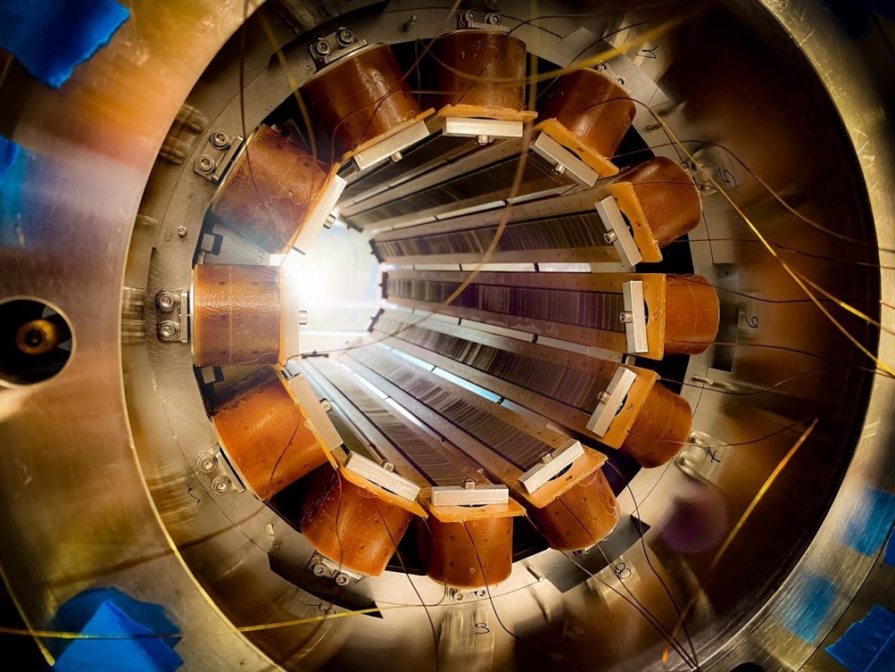
Outline
  SAES Group
  High Order Corrector Magnets for Hi-LUMI LHC – Context:
    Design by INFN LASA
    Fabrication by SAES (Coils) and SAES RIAL Vacuum (Magnets)
  Challenges
  Magnets production:
    Components fabrication
    Magnet assembly
  Magnets cryo-test (@LASA)
  Lessons learned and Conclusions

Slide 3
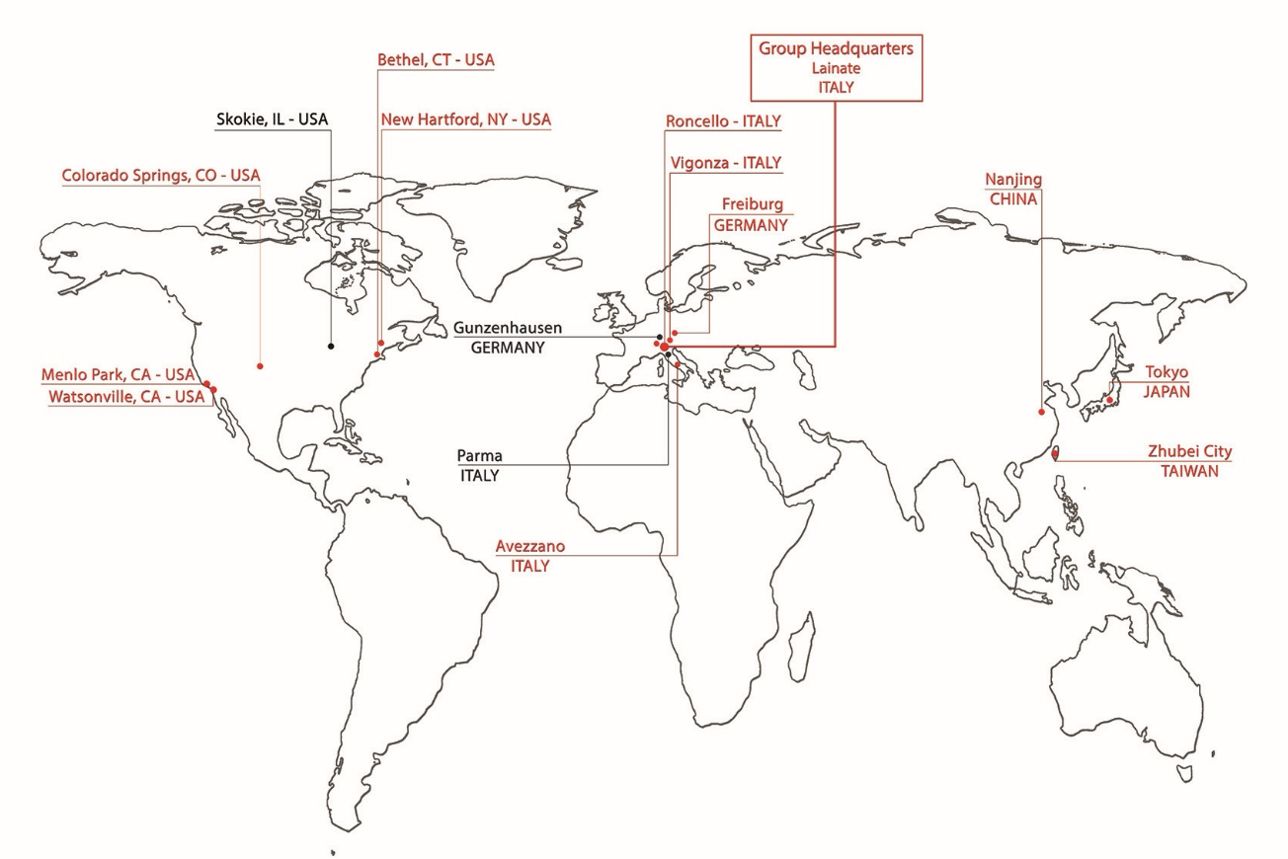
Quick introduction to SAES Group and the High Vacuum Division
SAES® is an Italian Company, which develops and produce engineered solutions (components and systems) for many industrial and scientific applications: Getters components and pumps, Nitinol based components, Shape memory devices, composite materials and coated films.
Founded in 1947
10 Production Site WW, HQ in Milano
>1100 employees
Total revenues 220M€ (2022)
≈ 10% revenues allocated to R&D activity every year
The High Vacuum Division is specifically focused on providing products and solutions to the accelerator community through :
SAES getters : NEG solutions for high and ultra-high vacuum applications
SAES RIAL Vacuum : vacuum chambers, components & systems
CINEL : monochromators, mirror systems, front end, beamlines and scientific instrumentations.

Slide 4
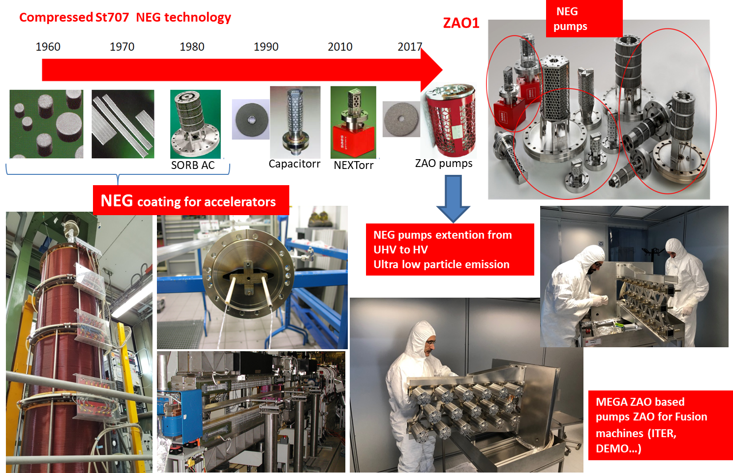
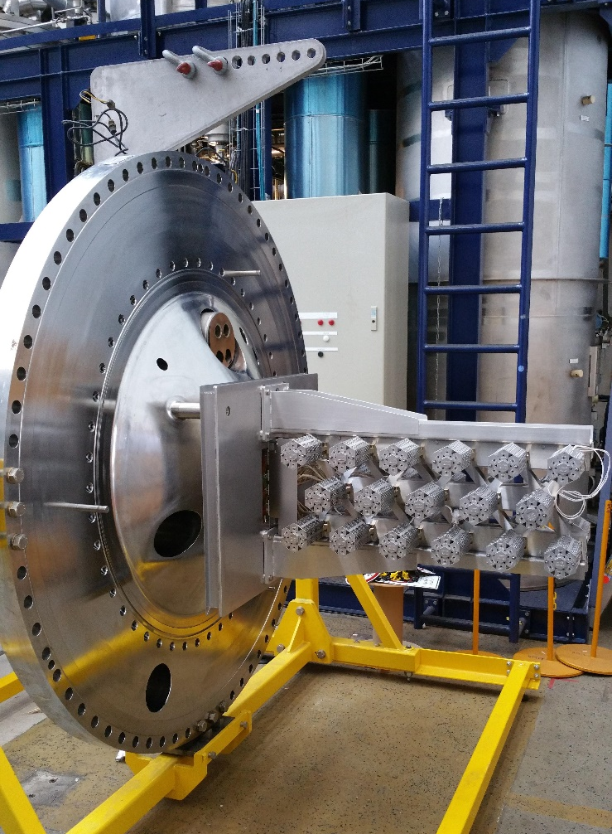
SAES Getters : NEG solution for accelerators & research
St172
Small scale prototype (1:20 ) of the pump delivered to SPIDER ion source @RFX (ITER project)

Slide 5
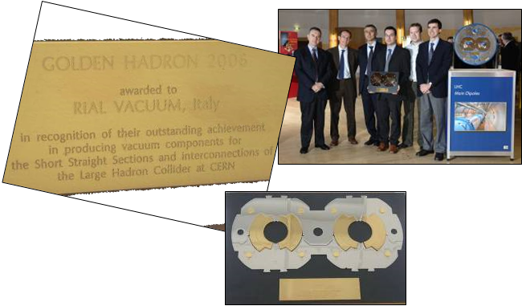
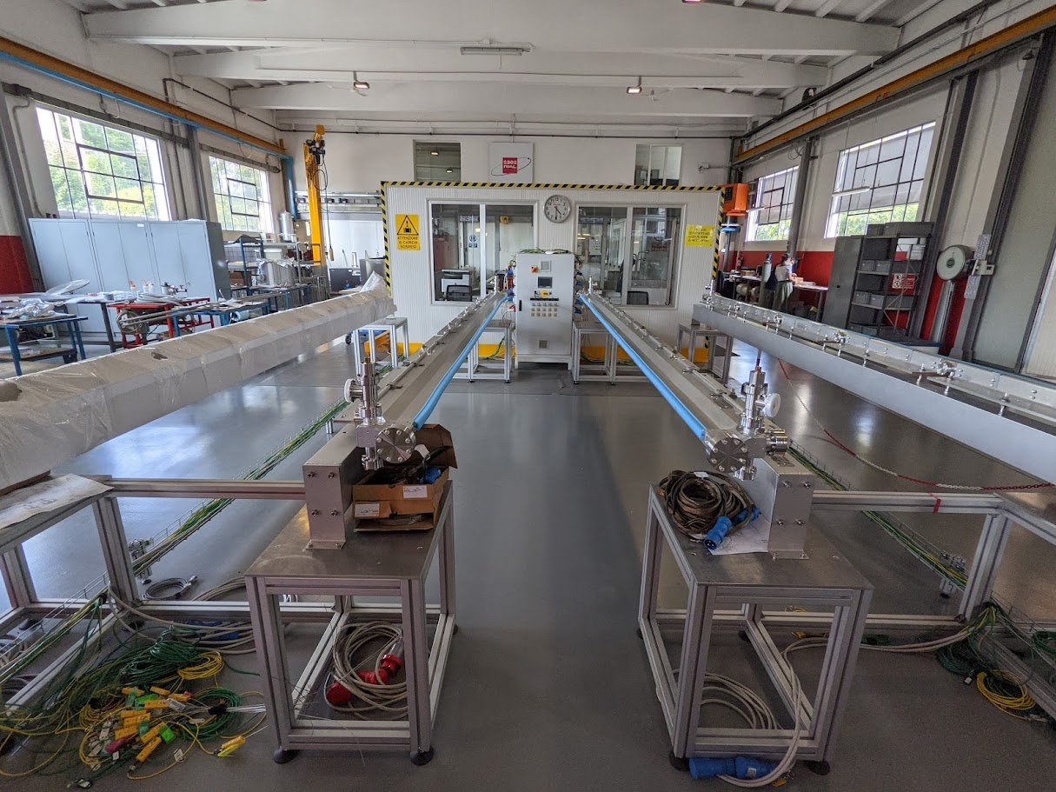
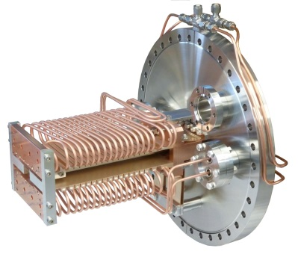
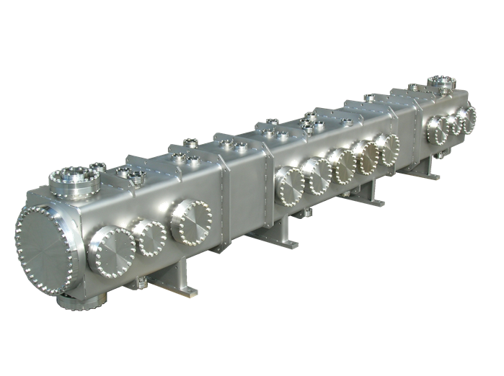
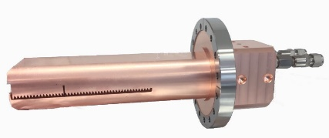
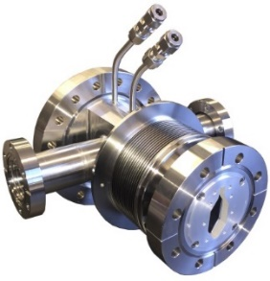
SRV : vacuum chambers & components
SAES RIAL Vacuum (SRV) was established in 2015
Since May 2022 is 100% part of the SAES Group
30 employees
7M€ Turnover (2022)
HQ in Parma
RIAL VACUUM has been recipient of the GOLDEN HADRON from CERN as a recognition for quality excellence in the supply of UHV products

Slide 6
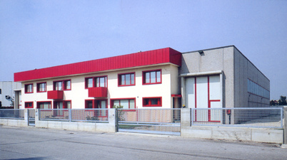
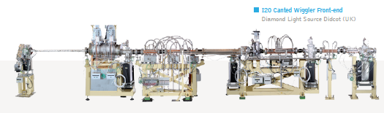
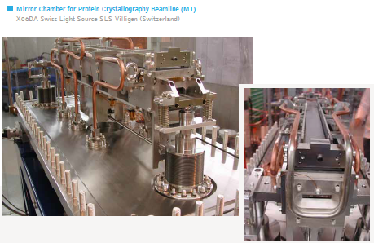
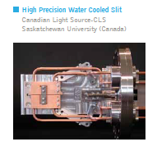
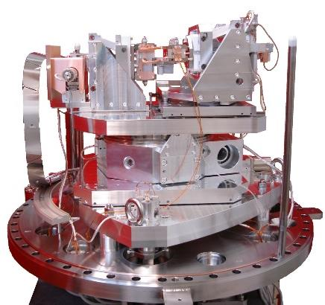
Cinel : BL and instrumentation for synchrotrons
CINEL was established in 1970
Since July 2021 is 100% part of the SAES Group
35 employees
6 M€ Turnover (2022)
HQ in Vigonza

Slide 7



High Vacuum Division for the accelerator community
MISSION: create a technological Italian pole able to work for and support the international accelerator and research community
Vacuum chambers
Beamlines
Vacuum chambers
Beamlines
NEG pumps
NEG pumps
Technological competences
Engineering & Design
Production capacity, manufacturing equipment
NEG pumps, NEG coating, instrumentation R&D, physical modeling
Financial solidity,
Entrepreneurial vision

Slide 8

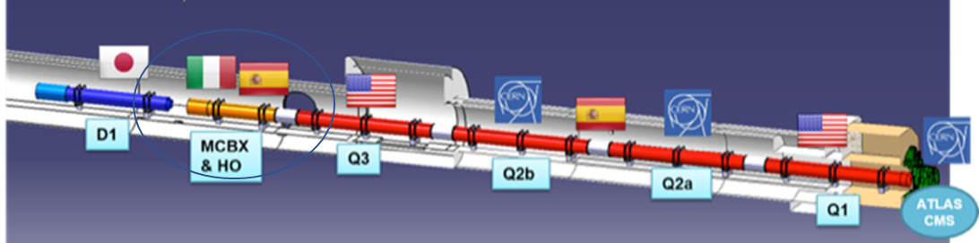
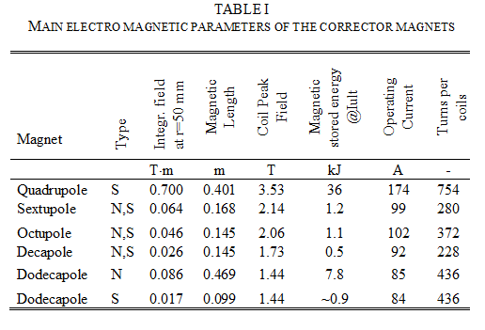
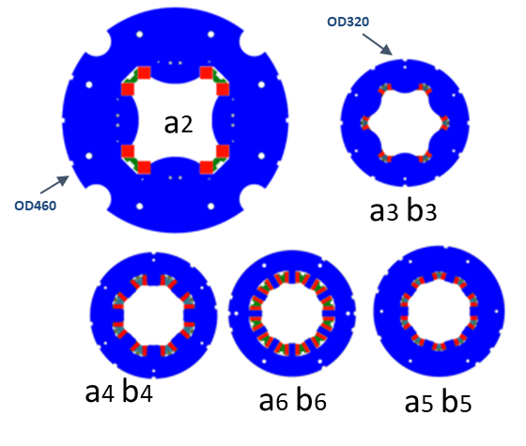
Corrector magnets for the Hi-Lumi LHC upgrade: INFN LASA
The Project: INFN-LASA in kind contribution to LHC upgrade:
  Design, construction and test of 5 different prototypes
  Series production of 54 High Order Correctors:
  12 Sextupoles, 12 Octupoles, 12 Decapoles, 6 Skew Dodecapoles, 6 Normal Dodecapoles, 6 Quadrupoles
Magnets specification and challenges:
  NbTi superconducting coils
  superferric design (first time in LHC)
  150 mm bore
  60% margin @ 1.9 K
  200 mm - 600 mm length
  Radiation hardndess: 15 MGy
INFN –LASA has vast competences in magnets design, prototyping and testing. Serial production of magnets is not the core activity of INFN which has rather the mission to transfer technology to the industry, beside fundamental research.
Since 2015 INFN looked into the market for an industrial supplier.

Slide 9
A bit of history…
  2015: SRV produced the mechanical components of the Sextupole and Octupole prototype magnets.
  2017: SRV won the tender for the manufacturing of the prototype of the Quadrupole and the Normal Dodecapole magnets and for the development of the winding & impregnation special tools.
    SRV role: machining and EDM mechanical cutting of components, magnet assembling and testing
    SAES role: production of the SC coils, leveraging on core expertize in precise handling of SMA wires
  2018: Winding/impregnation tools developed. Both prototypes manufactured and successfully tested with expected performances.
  2019: SRV won the tender for the series production (54 high order corrector magnets)
  The manufacturing activity started in the second half of 2019 and finished on October 2021.

Slide 10
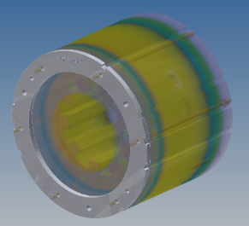
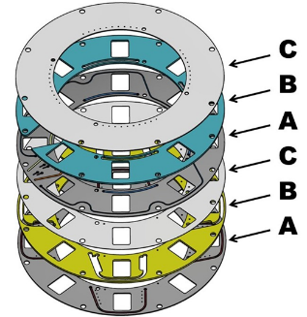
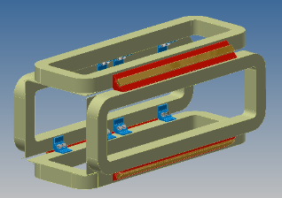
Some Challenges: Project Starting
  During the first 6 months after the project’s start, several design changes were required by INFN/CERN to improve the magnets reliability and mechanical features
    Closing Plate – tighter tolerances for the cryostat and beampipe interface required.
      Closing Plate re-designed by INFN with the collaboration of SRV and Rodofil (feasibility study)
      After finalization the solution was re-tested and qualified.
    PCB Box – need to protect the brazed components on the PCB board against shorts caused by metallic chips coming from LHC cryostats.
      Box designed by INFN with SRV support.
      First PCB Box (M10) produced and tested at SRV. Excellent mechanical features but insufficient electric design.
      Identified and qualified a different fluxant Mob-39, which ensured adequate insulation.
    Wedges additional supports quadrupole – Added to increase magnet robustness and avoid coils movement.
      Prototype modified and tested
      Resulting design implemented in the serial production.

Slide 11
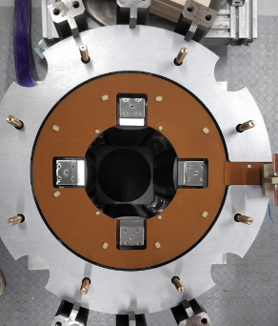
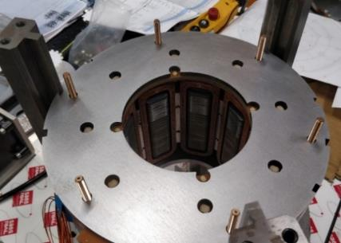
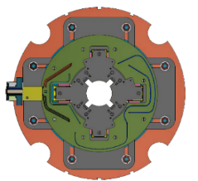
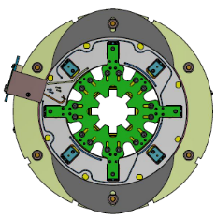
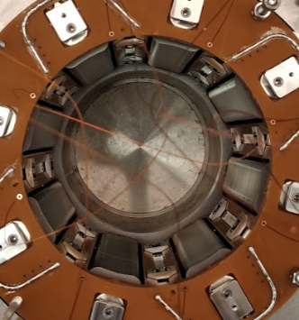
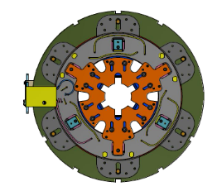
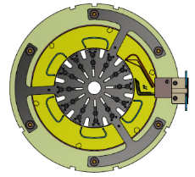
Some Challenges: Project Ongoing
Magnets Assembly
  The soldering process can bend the PCB boards. This may cause a gap between the PCB Box layers once tightened with Duratron screws.
    Supporting structures designed and realized for each magnet to ensure PCB boards being properly supported during soldering.
    Duratron M4 bolts added in the PCB Box to make the closing pressure more uniform in order to close the gap between layers (SRV feasibility study).
  Problems during magnet closing. The Duratron screws that fix the PCB box interfere with the “closing sheet” during the magnet tightening.
    Closing sheets machined with holes to avoid mechanical interference with the Duratron screws
Cryogenic tests
  The wedges move after the cryogenic trials on Octupoles and Dodecapoles magnets.
    The tightening torque is increased
      First batch magnets returned to SRV for reworking, cleaning and tightening with higher torque. Intrinsically critical operation due to the risk of damaging SC wires and coils.
    Added counter wedges in Octupoles

Slide 12
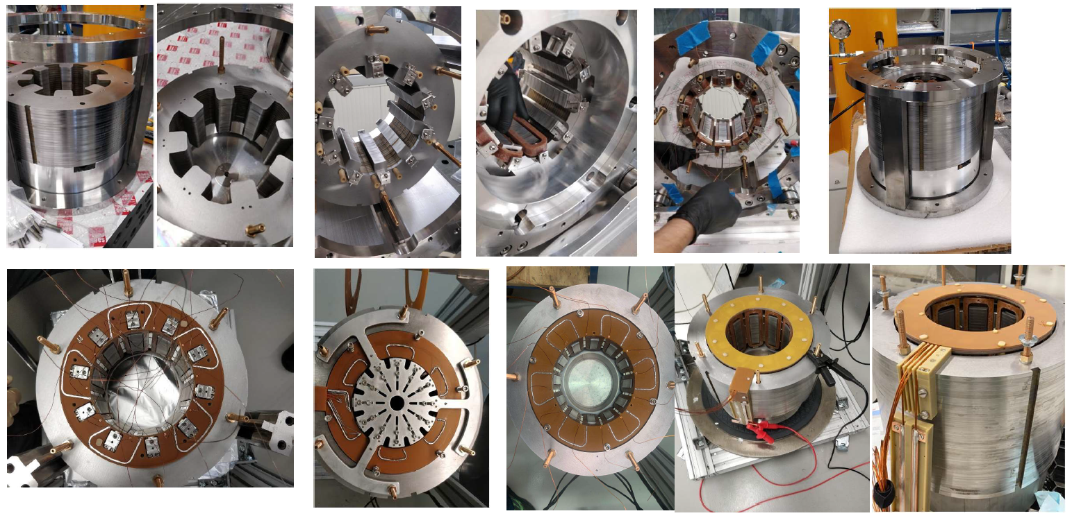
Magnets Series Production
    Components fabrication
    Coils
    Laminations
    Mechanical parts
    Electrical/Insulation parts
    Magnet assembly
    Cores Assembling
    Coils Insertion
    SC Cables Soldering
    Magnets Closing
    Magnets Testing
    Magnets Shipping

Slide 13
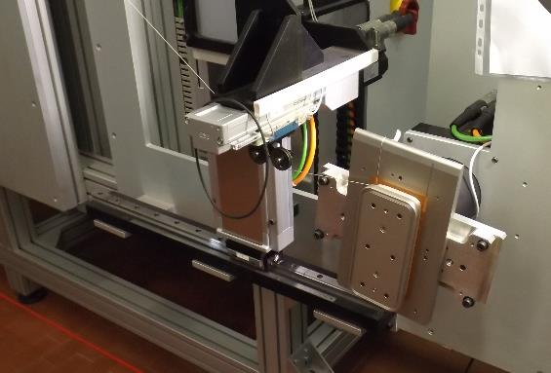
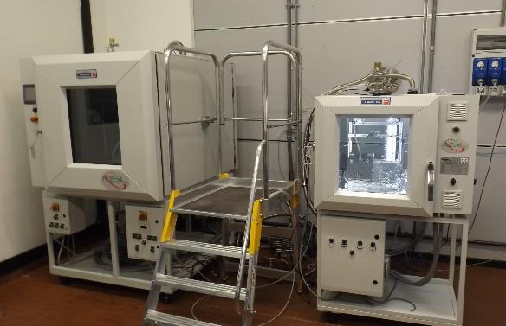
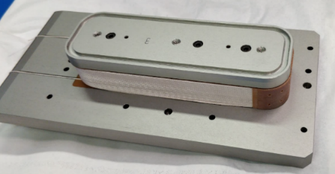
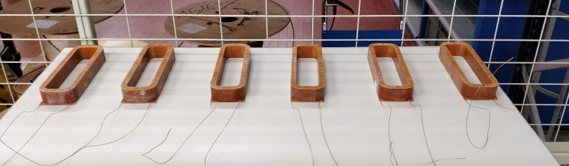
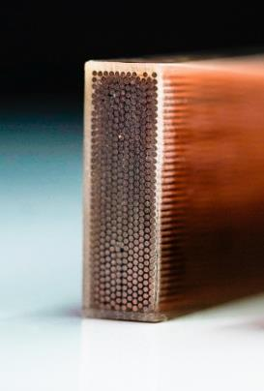
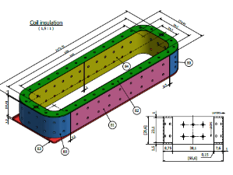
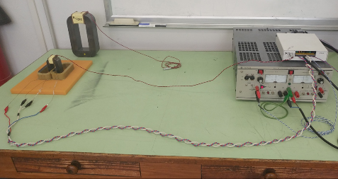
Components: NbTi Coils
SAES Getters realized more than 500 superconducting coils within six families of different geometrical dimensions and winding number using two NbTi wires dimensions: 0.5 mm and 0.7 mm
Internal electrical isolation was guaranteed by a S2 fiberglass on the wire while dedicated inserts of BT-S2 guarantees the ground insulation. The mechanical stability of the coils was obtained by the impregnation and curing of a high performance epoxy resin for
cryogenic and radiation applications (CTD-101K). A dedicated set of molds were internally designed and realized to obtain the specific geometrical dimensions and the required tolerance.
The main process steps of the coils production including the winding of superconductive wire, the impregnation of the coils and the quality control: visual inspection, coil dimensional check, coil ground and internal insulation measure and coil electromagnetic comparison to verify the number of winding.

Slide 14
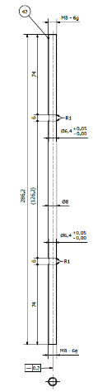
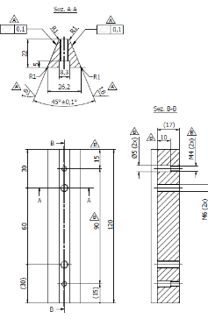
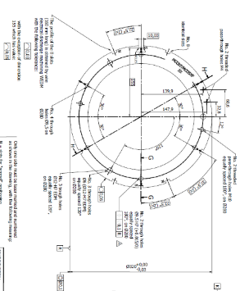
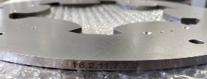
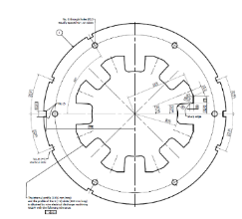
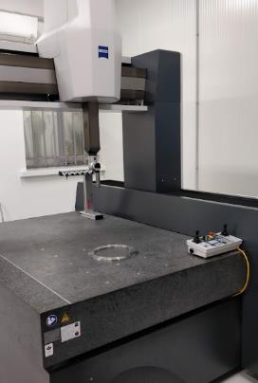
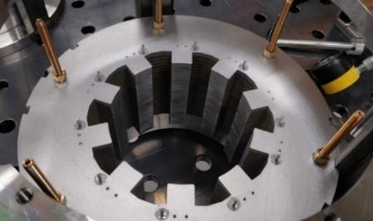
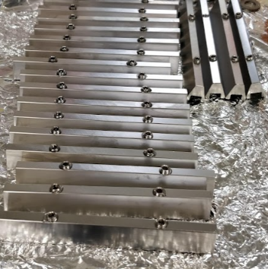
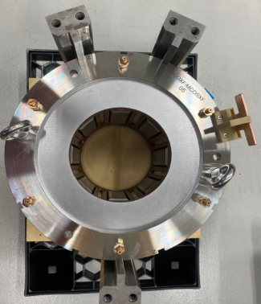
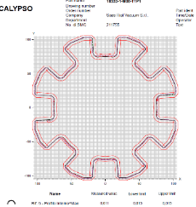
Components: Mechanical Parts
Laminations (ARMCO)
With a combination of water jet cutting, for the raw parts, milling and EDM cutting SRV realized more than 3000 high precision ARMCO Pure Iron laminations that have been controlled with CMM machine to validate the high tolerance required (0,03mm shape tolerance on the internal figure and assembling and positioning slots).
Tie Rods (Copper Beryllium)
This component, redesigned partially by SRV to facilitate the tightening operations, is fundamental to hold in place (longitudinal compression) the core and the final magnet.
Wedges (SS 316)
Important component to fix the coils in the core: to have the required straightness value, SRV proceeded with thermal treatment and a subsequent final milling. CMM control after this phase was required.
Closing plate (SS 316)
High precision turning components (0.03mm shape tolerances on internal and external circumferences and positioning slots). These are the boundaries between the magnets and the cryo system at CERN. This component was CMM controlled before assembling.

Slide 15
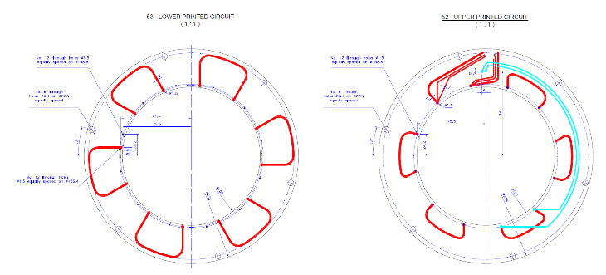
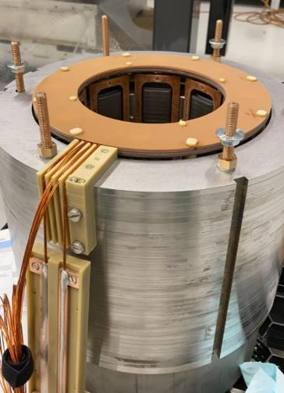
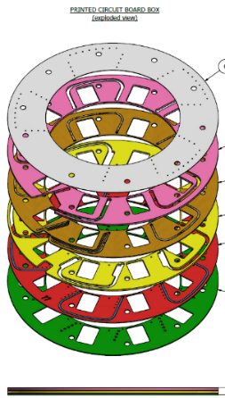
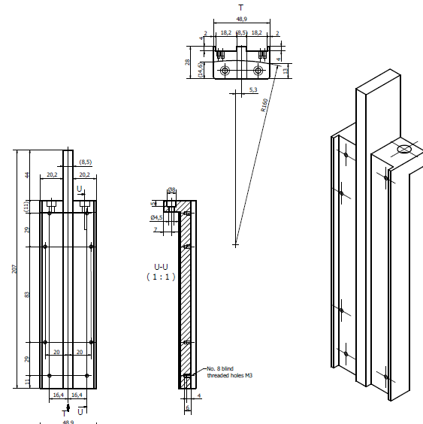
Components: Electrical/Insulation Parts
Printed Circuit Board and PCB Box (Arlon, Copper)
  PCB production on Arlon disks to have the path to solder all the SC wire connection close to the coil’s ends.
Insulation Components (Arlon, DURATRON)
  To prevent accidental shorts during operation, a system called PCB Box was designed and produced to cover with Arlon layers the PCB once soldered.
  DURATRON raw material have been worked (milled and turned) to obtain parts close to the electrical connections. With this material SRV produced bolts and nuts (M4 and M6) separator washers and structures to accommodate magnets’ electrical exits.

Slide 16




Magnet Assembly: Core
  One lamination at time was carefully added to the piling alignment structure and checked on the database (each lamination had a specific code). Every 5 laminations added the procedure called for a check for straightness (done closing the upper part of the structure). Finally, the core was pressed with a hydraulic pump and closed tightening the CuBe tie rods with CuBe nuts and washers.

Slide 17






Magnet Assembly: Coils Insertion
Once the core passed the CMM control, it was inserted in the rotating structure to allow the coil insertion. Handle with care and introducing the wedges (tight with low range precise torque wrench) to hold everything in place.
SRV designed and produced a ring device to help holding coils and wedges in position during assembly.
Coils and wedges positions needed to be checked measuring the gaps (0.1mm tolerances).

Slide 18






Magnet Assembly: Cables Soldering
This was a very sensitive phase. Wires in the holes of the PCB and solder. For Octupoles, Decapoles and Dodecapoles magnets a pair of PCB was needed to have enough space for soldering. NbTi cables are very fragile and delicate. This operation had to be done with no mistakes at the first try.

Slide 19



Magnet Assembly: Dimensional Control
  In this final assembly phase, the last electrical connection and laminations were inserted in the structure before the closing plate installation and tie rods final tightening.
  The very last assembling phase before shipment was the testing.
  The first control was the dimensional one: a final CMM to insure slots positions accuracy.

Slide 20




Magnet Assembly: Electrical Tests
The second important control was the electrical one carried out with High Potential Test (done with a Megger machine): pushing magnets (Coils VS Ground) to 1500V and 2000V, the insulation was verified (never exceeded 0.1 µA).

Slide 21






Magnet Assembly: Shipping
SRV designed wooden crates to ensure safe shipments with no damages to the finished magnets.
Shock indicators and accelerometers were added for extra safety reasons and to collect data regarding the shipment’s shock history (threshold 5g).

Slide 22



Cryo-Testing and Project Status
4 magnets cooled each test (2 thermal cycles), powered individually
  Full characterization: training , quench memory, field quality and transfer function
46 magnets succesfully cryo tested at LASA and 8 at CERN
Quadrupole
Dodecapole

Slide 23
Lessons learned and Conclusions
High Order corrector SC magnets are complex objects.
  Several modifications of the magnets design were required to finalize the serial production.
  Design changes were also introduced during the manufacturing activity to improve specific technical features
  These changes had to be addressed, tested and finalized under time pressure.
The goal was achieved thanks to the close cooperation between INFN and SRV/SAES.
  SRV/SAES : High flexibility and willingness to deploy resources to address new requirements
  INFN : Openness to understand and accommodate our needs in term of financial and planning schedule
After an initial period (“learning curve”) the manufacturing efficiency significantly improved with very low defectivity rates.
The expertize gathered on SC magnets has opened to SAES/SRV the possibility to explore new business opportunities and to increase the technology portfolio.
Through the collaboration, INFN has disseminated information and know how to the industrial partners, which is also one of the statutory missions of this Research Institute. Several scientific papers published on the subject.

Slide 24
Thank you for your attention!

