Slide 1
The HL-LHC Plan
Oliver Brüning – CERN – Project Leader
On behalf of the HL-LHC project
Ceremony for the delivery of the last High Order Corrector Magnet by INFN to CERN for the HL‐LHC project,
LASA February 17th 2023

Slide 2
Reminder of the HL-LHC Goals
From FP7 HiLumi LHC Design Study application in 2010
Goals in a nutshell:
Extend the LHC lifetime by 15+ years
Prepare the machine for producing in that period 10 times more data as compared to the nominal LHC operation period
The main objective of HiLumi LHC Design Study is to extend the LHC lifetime by another decade and to determine a hardware configuration and a set of beam parameters that will allow the LHC to reach the following targets:
A peak luminosity of L_{peak} = 5×10³⁴ cm⁻²s⁻¹ with levelling, allowing:
An integrated luminosity of 250 fb⁻¹ per year, enabling the goal of L_{int} = 3000 fb⁻¹ twelve years after the upgrade. This luminosity is more than ten times the luminosity reach of the first 10 years of the LHC lifetime.
Transition from Prototype tests to Series production!!!
And preparing for installation work
Ultimate performance established 2015-2016. With same hardware and same beam parameters, by using engineering margins:
L_{peak ult} ≅ 7.5 10³⁴ cm⁻²s⁻¹ and Ultimate Integrated L_{int ult} ∼ 4000 fb⁻¹
LHC should not be the limit, would Physics require more than nominal

Slide 3
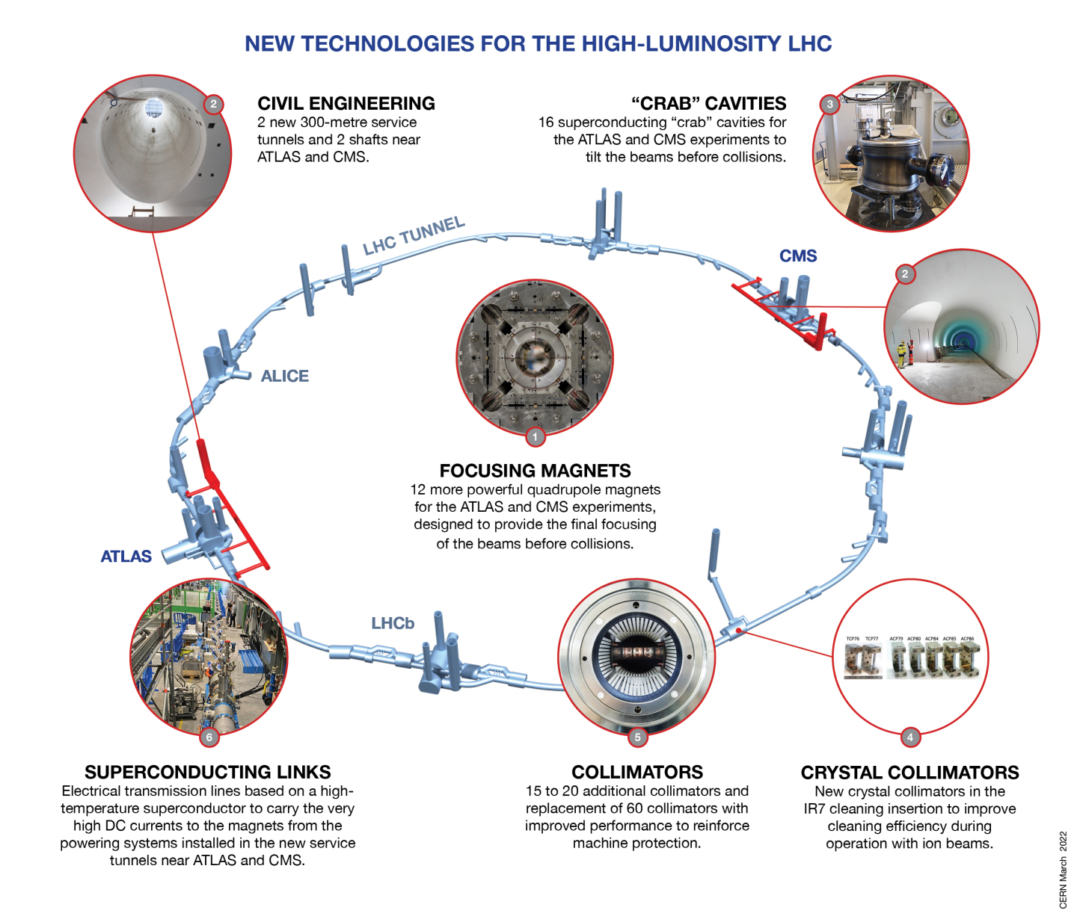
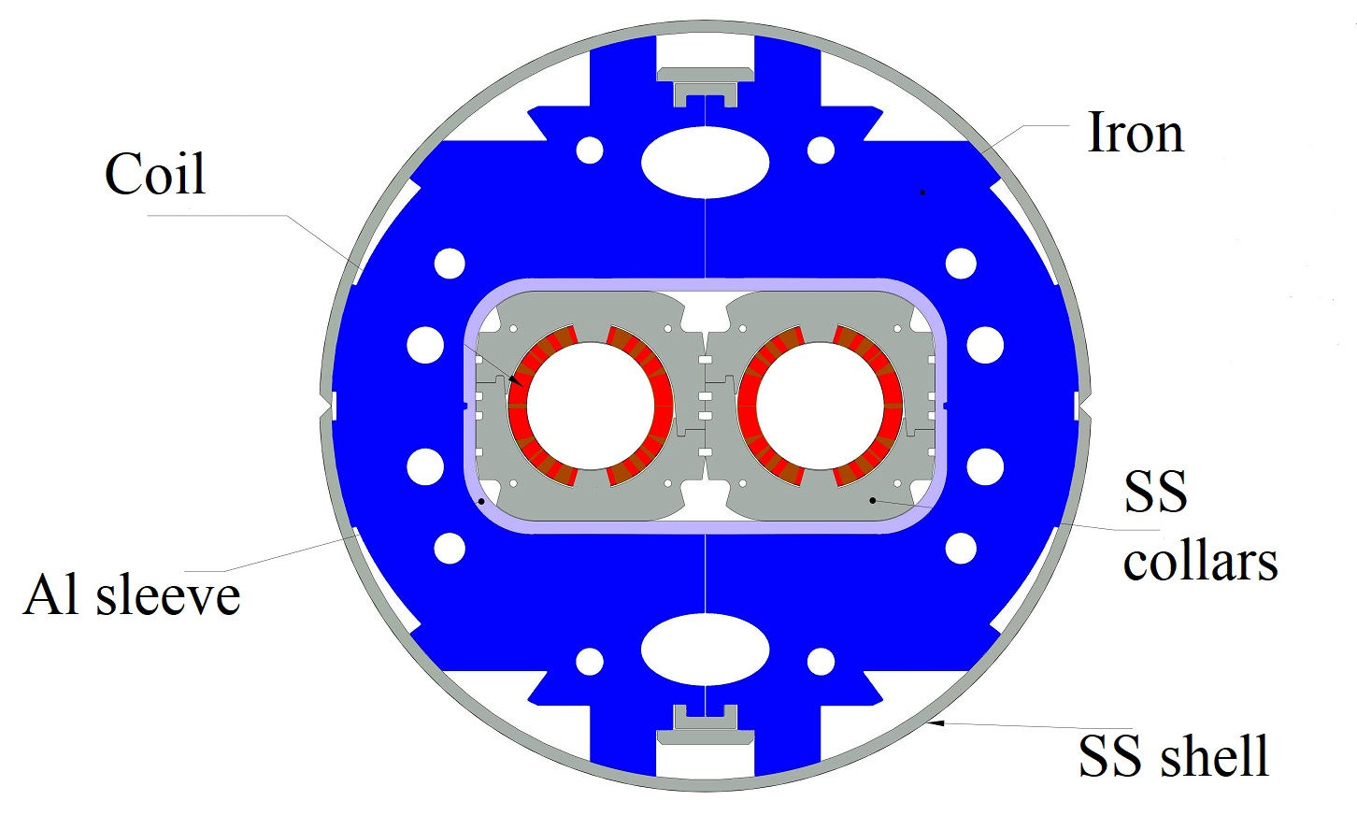
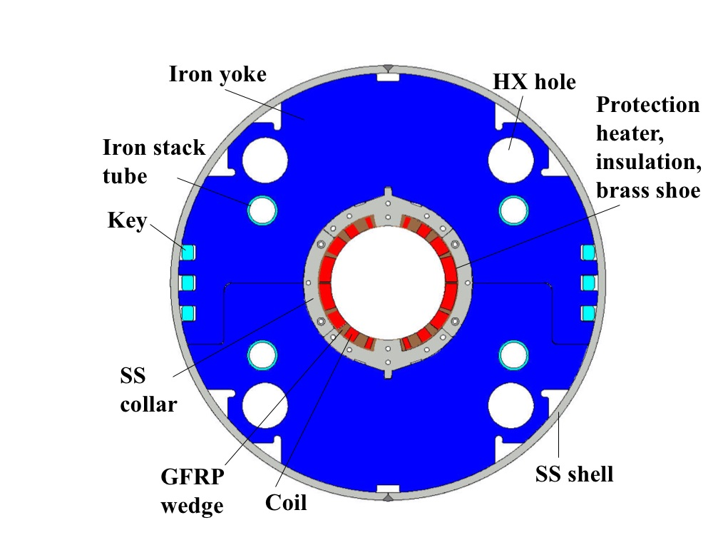
Technology
Landmarks
Separation / Recombination
dipole magnets: D1 & D2

Slide 4
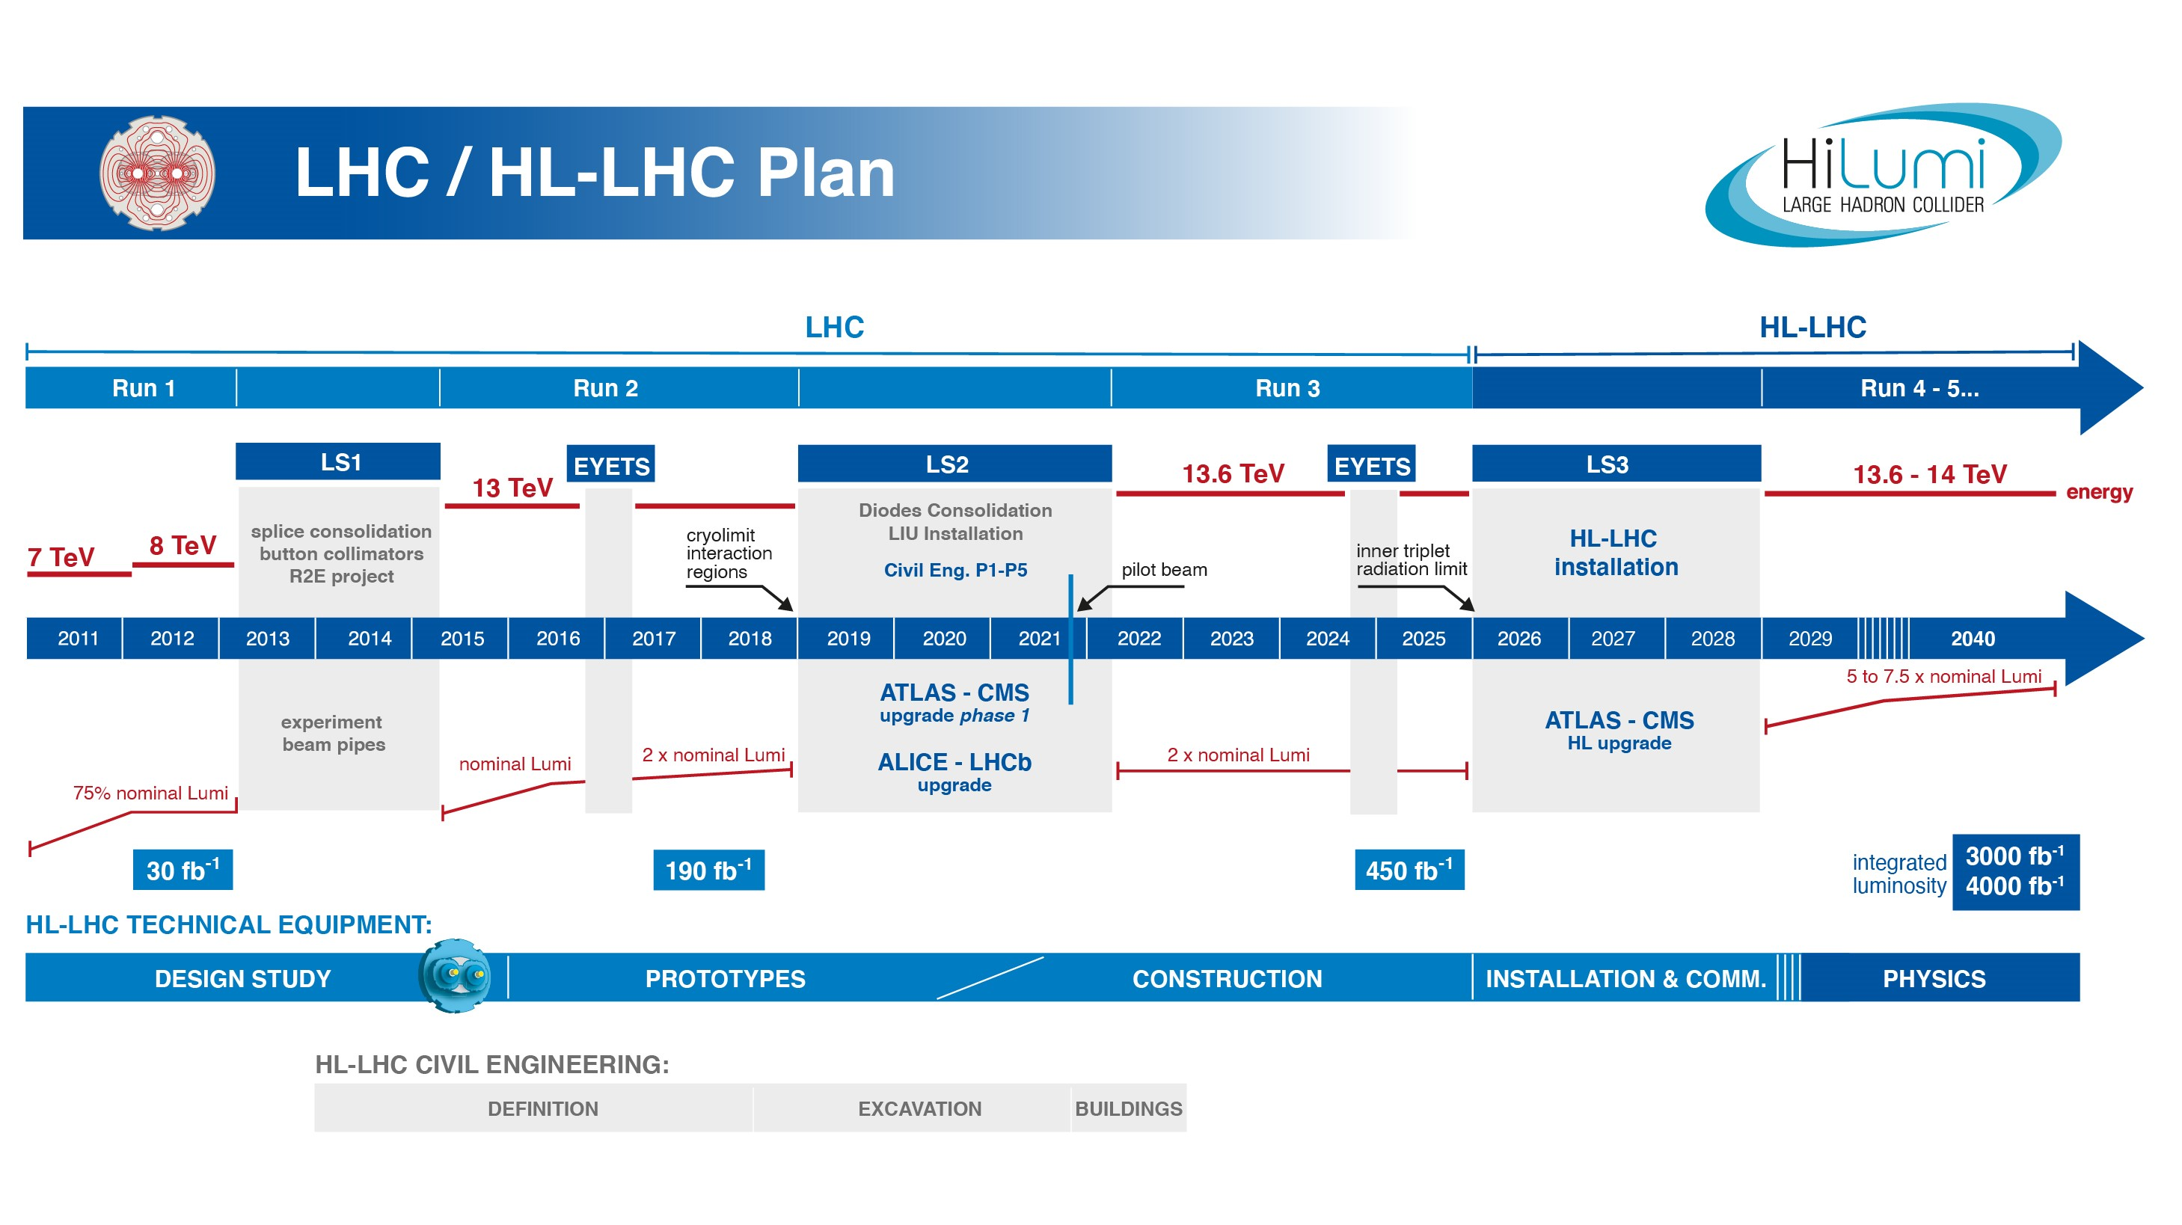
EU funded HiLumi
Design Study
Approval of
HL-LHC Project
We are here
HL-LHC Operation
Run3 operation
Ca Half Way!
6 years since project approval
6 years until start Run4
Transition from Prototype development to
Series production is well underway!

Slide 5
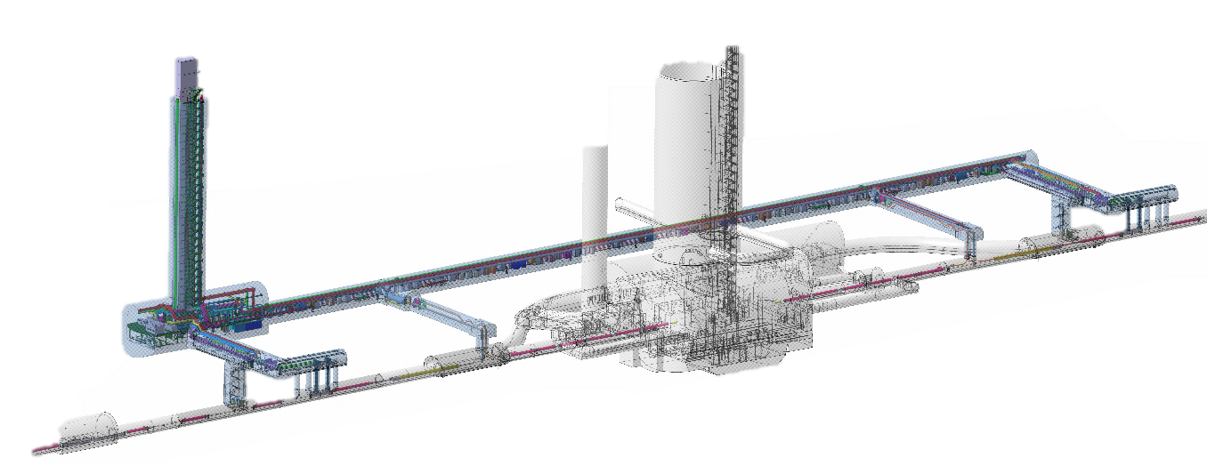
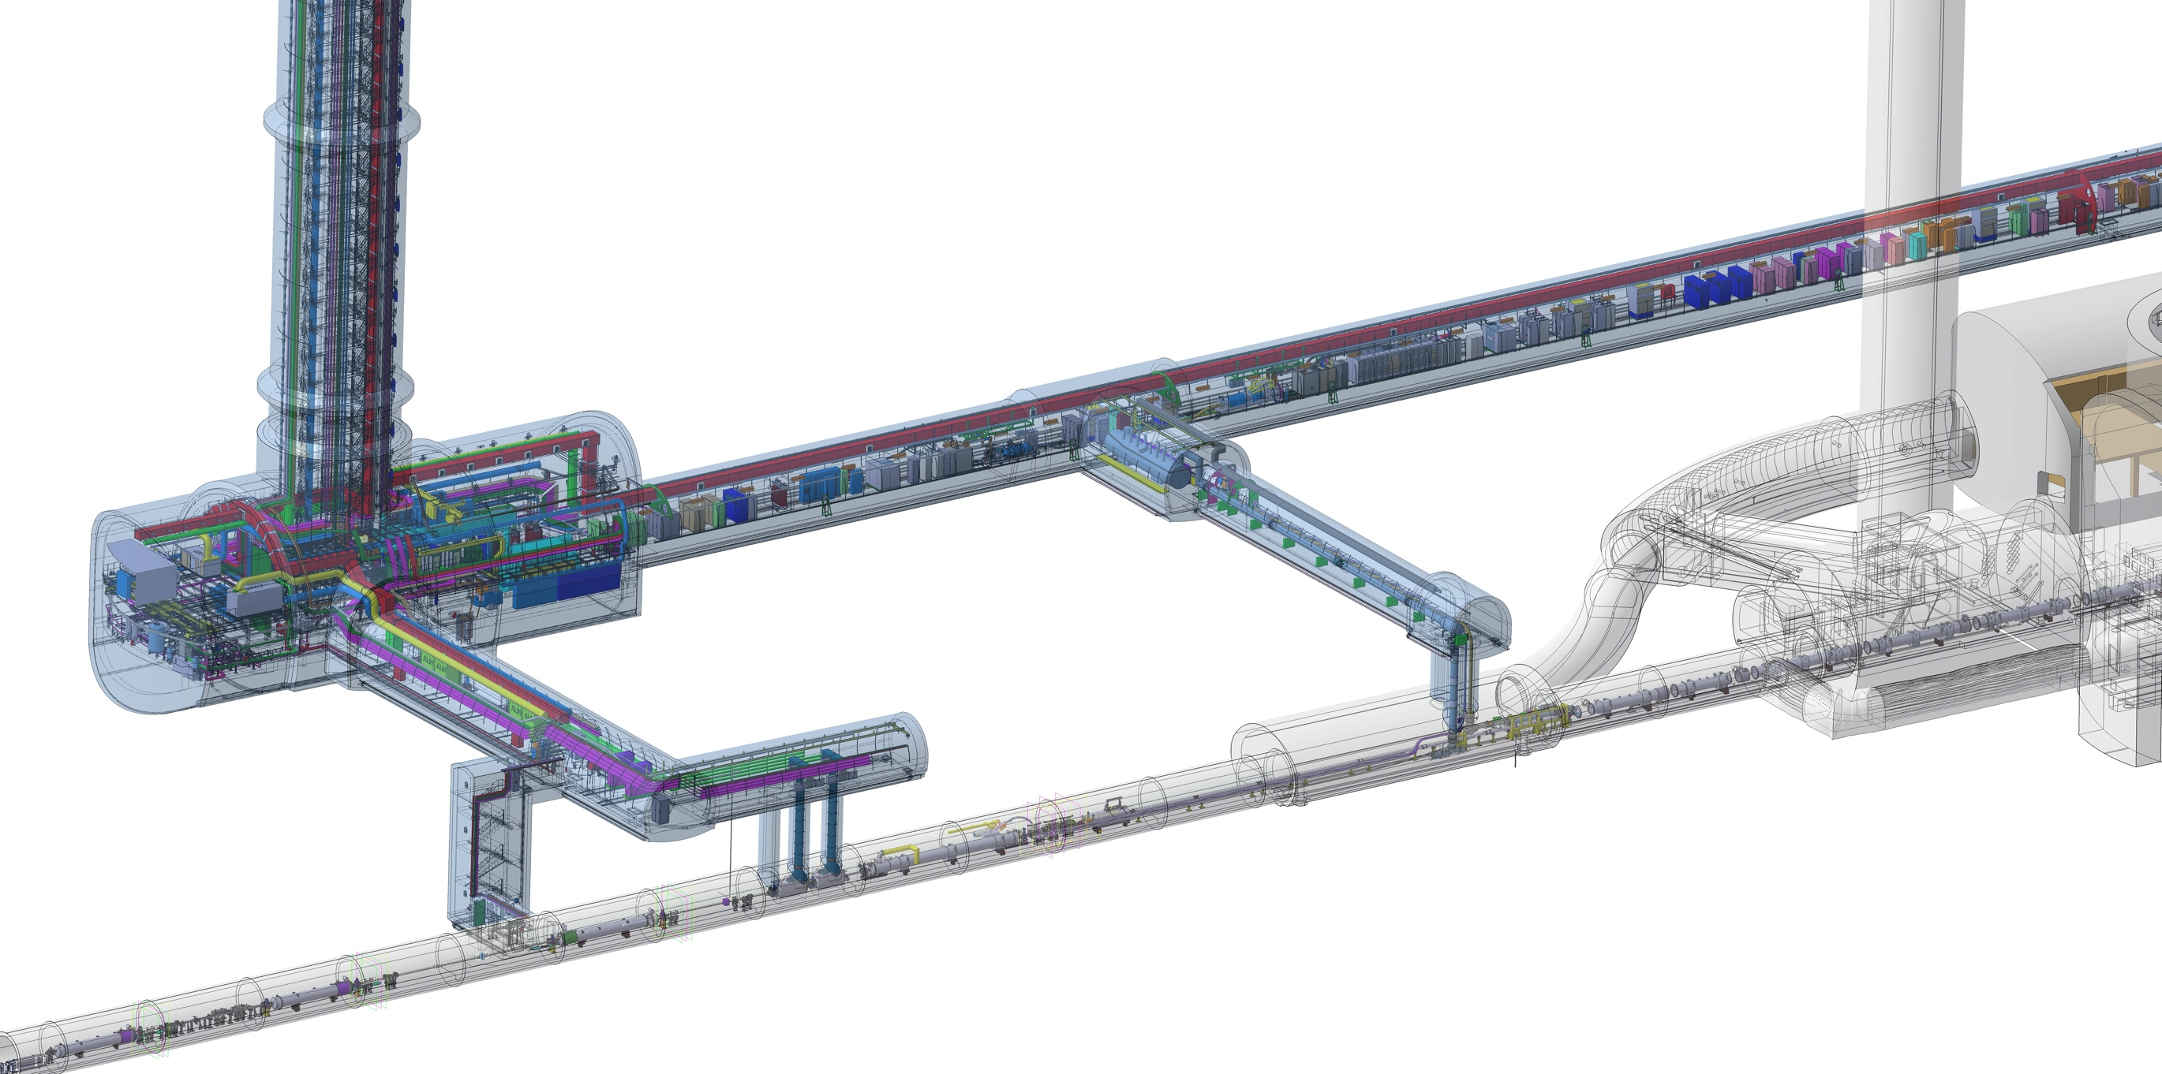
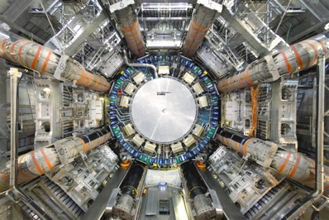
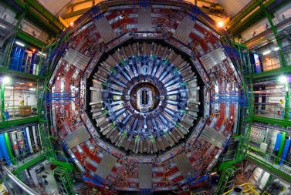
HL-LHC Scope in 1R and 5R
QDS
UR55
Warm Diodes
CLIQ
PIC,BIS
CDBs
OC EE
Valve box
DFHX
D2 OC PCs
DFHM
US57
D2 PC
D1 PC
OC PCs
UW57
PC IT
PCs IT Trims
CDBs
DSHX
D2 OC EE
UL57
Cold box
DSHM
UA57
D1
CP
Q3
Q2B
Q2A
Q1
RF Powering
DFM
DCM
Cooling and Ventilation
DFX
UPR57
Cold Diodes
TAXN
D2
DQHDS
Crab
Cavities
Q4
Q5
Underground Civil Engineering Excavation work was completed during LS2!
Q6

Slide 6
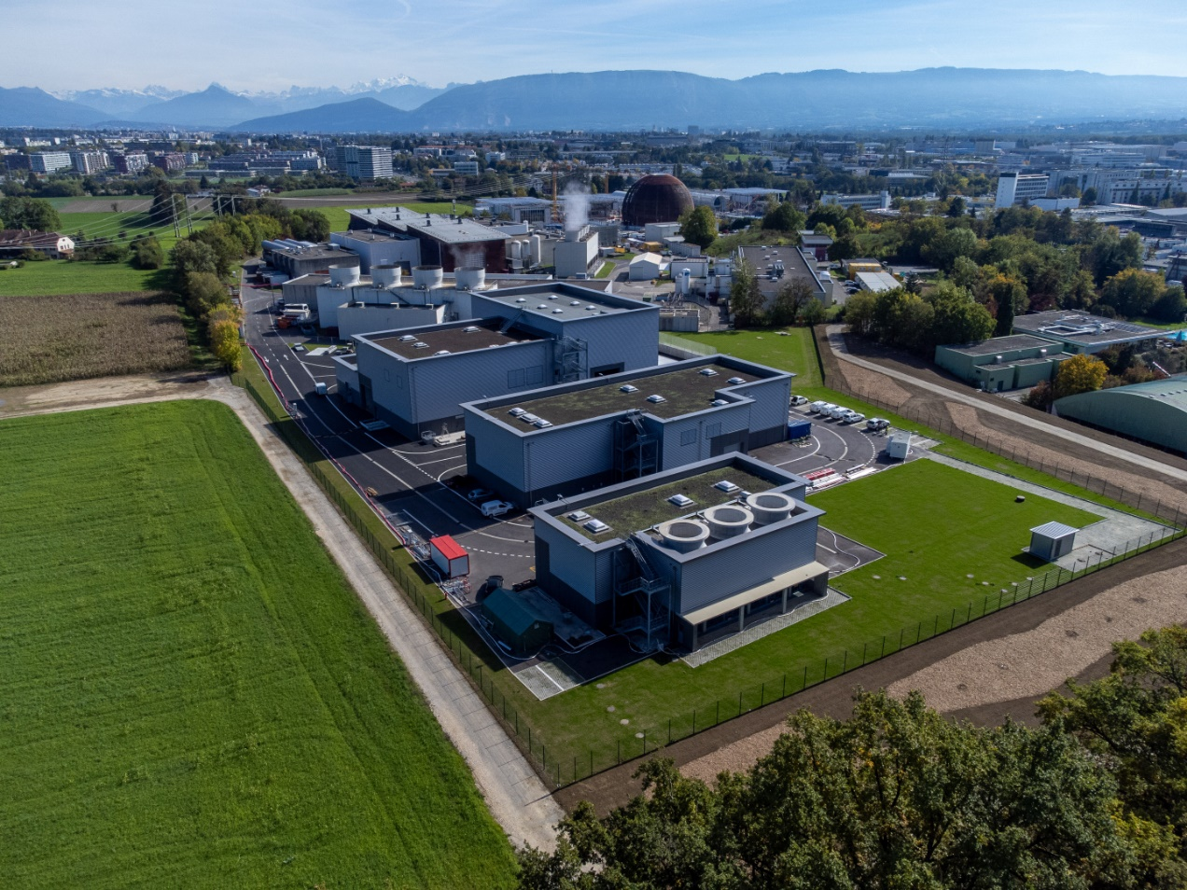
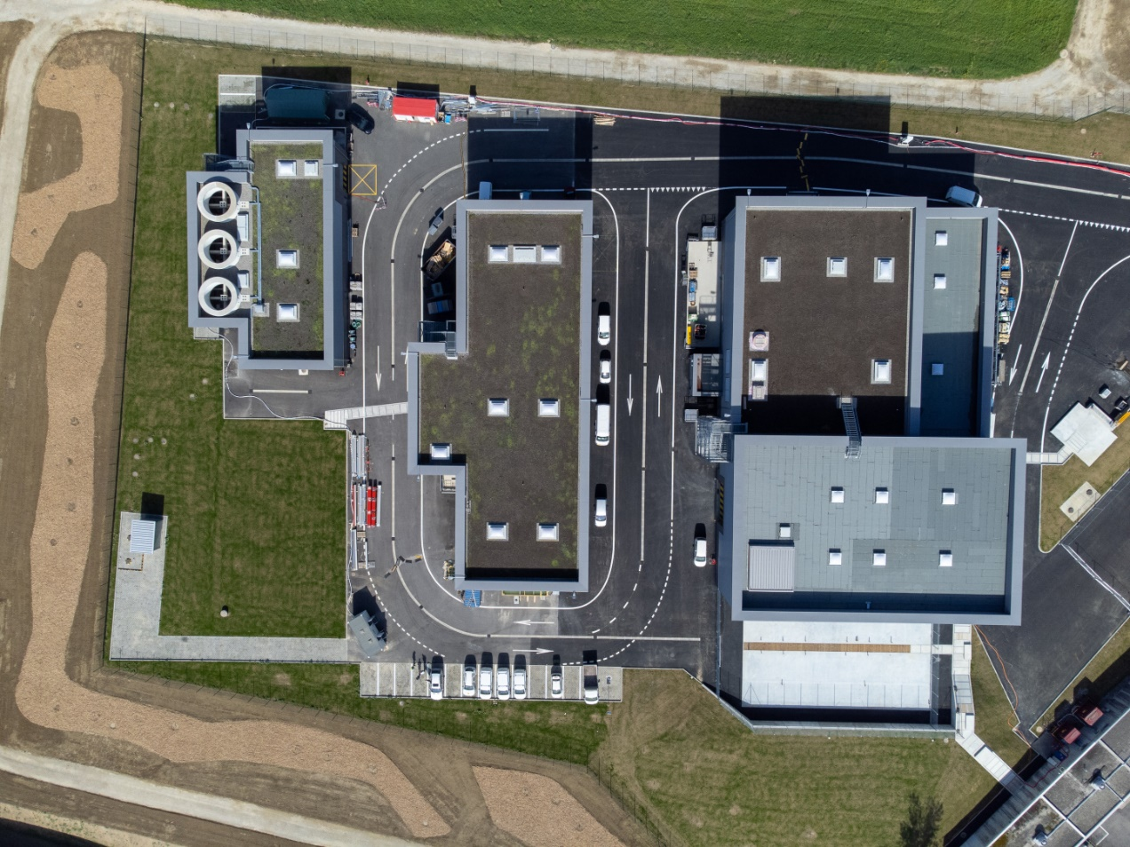
Completion of the civil engineering works
SF17
SU17
SE17
SHM17
SD17
Example Point 1

Slide 7
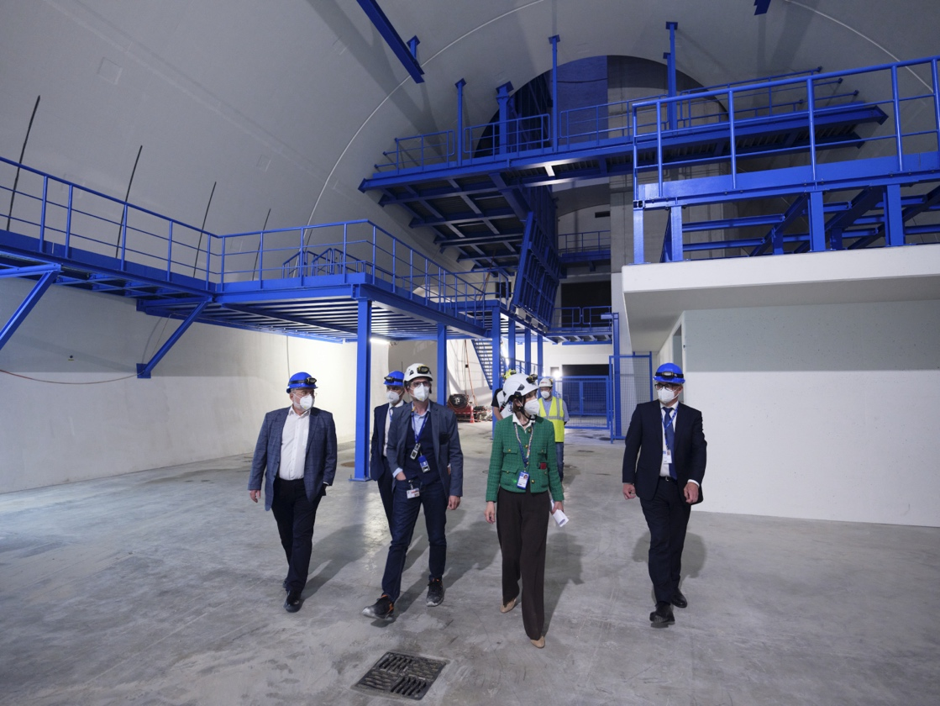
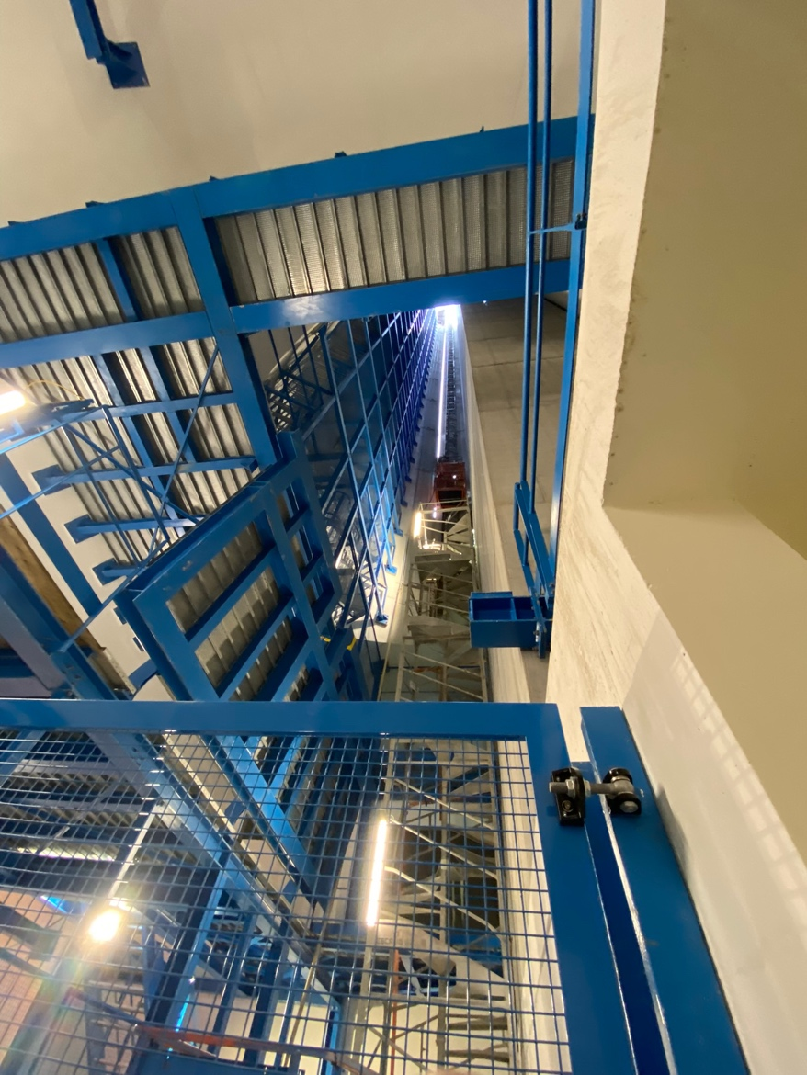
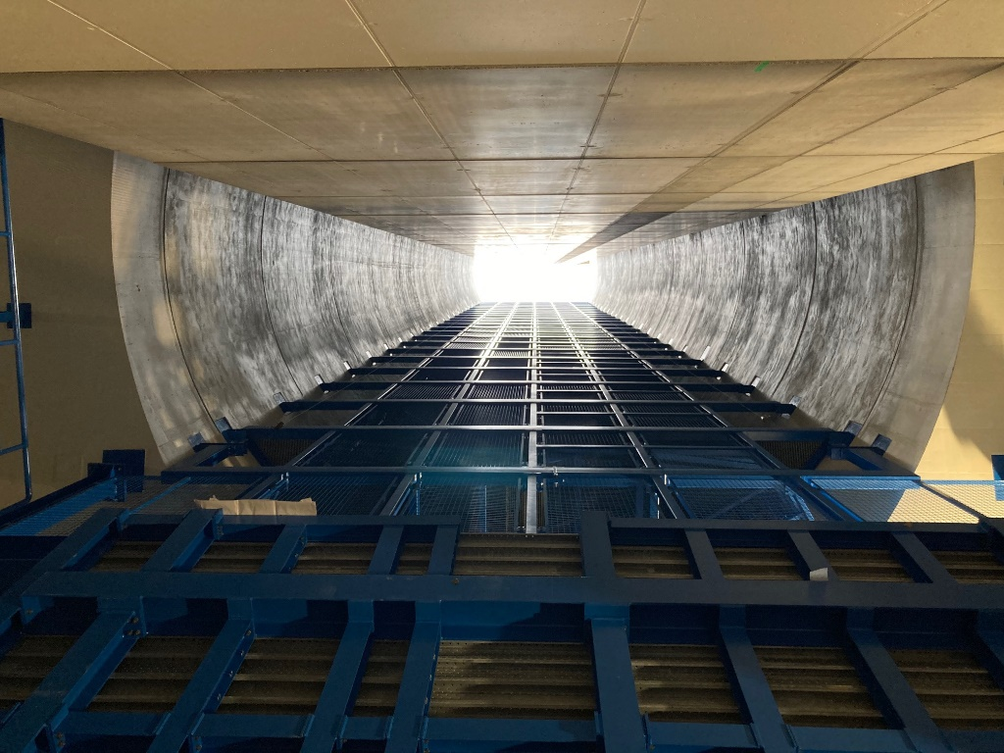
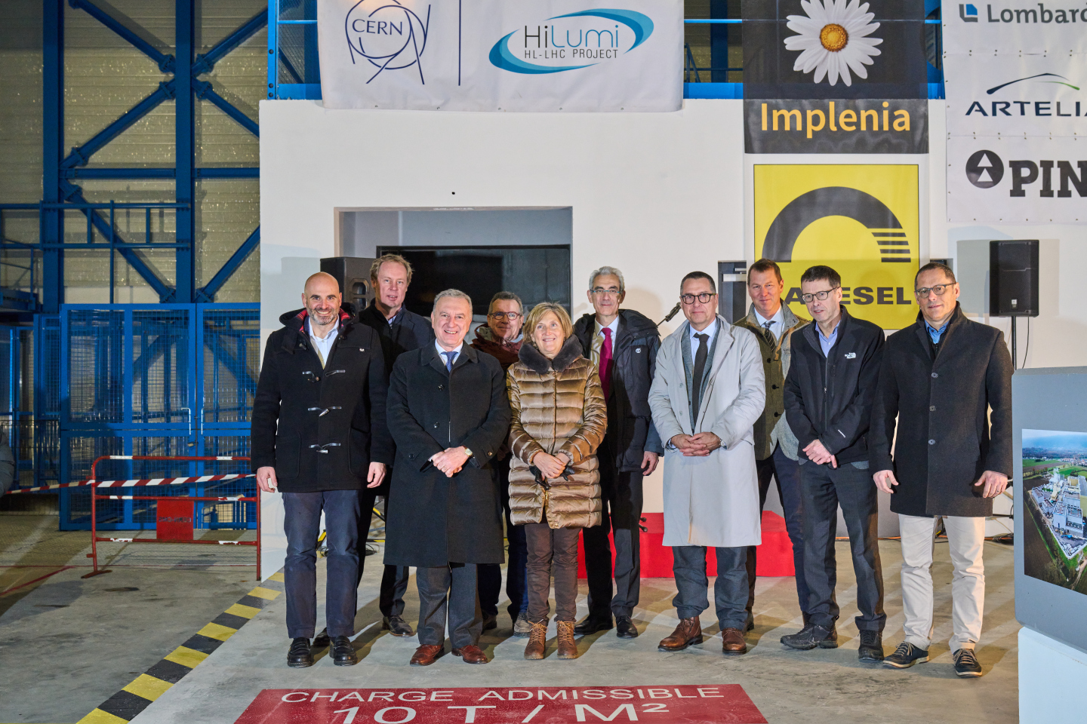
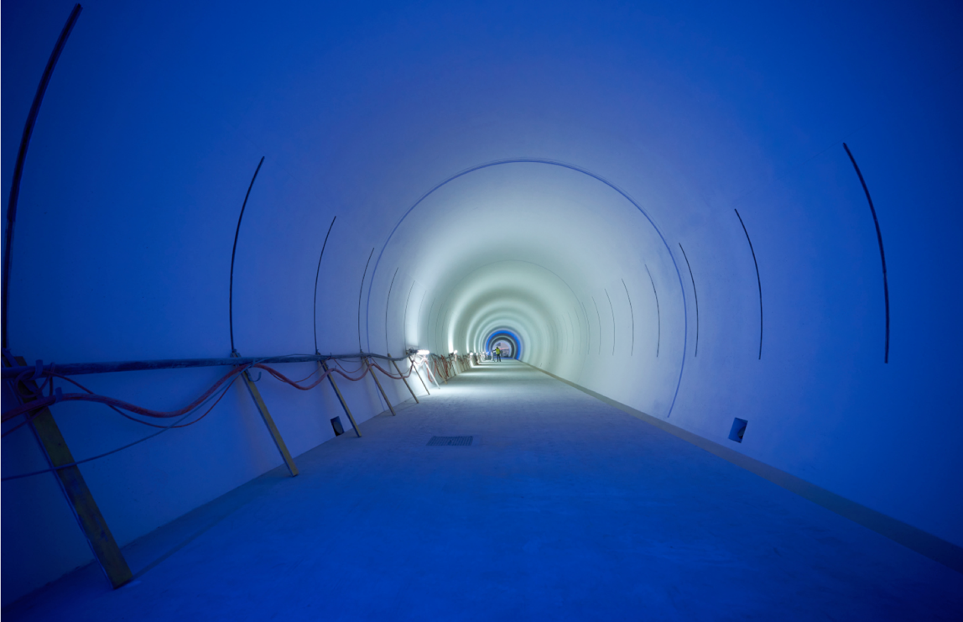
Ceremony for completion of CE on January 20th 2023
Notes:
To be updated with latest plans for Ceremony

Slide 8
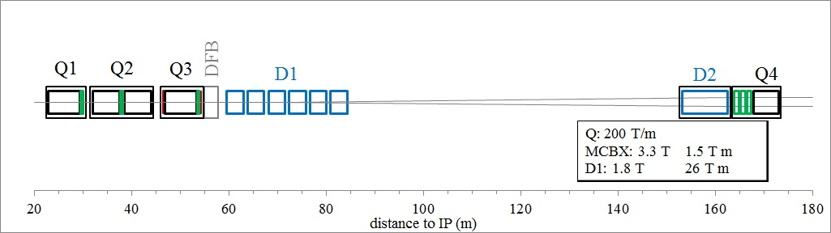
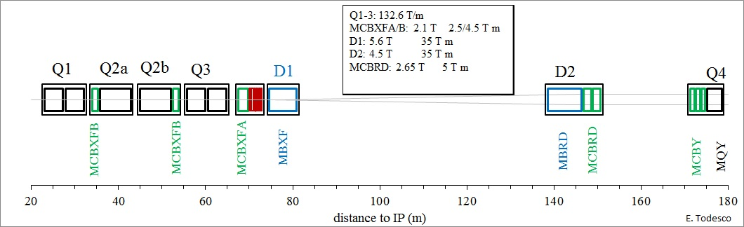
New HL-LHC Triplet Layout:

Slide 9
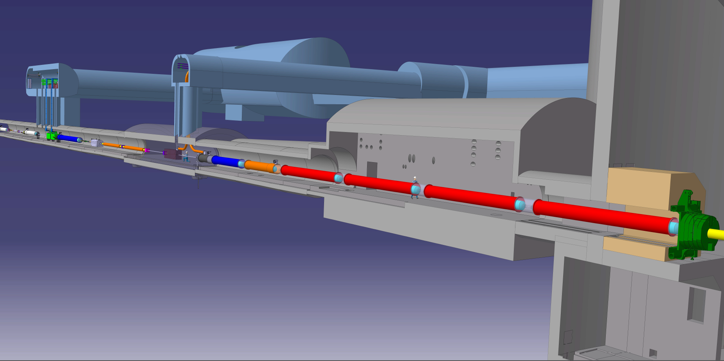




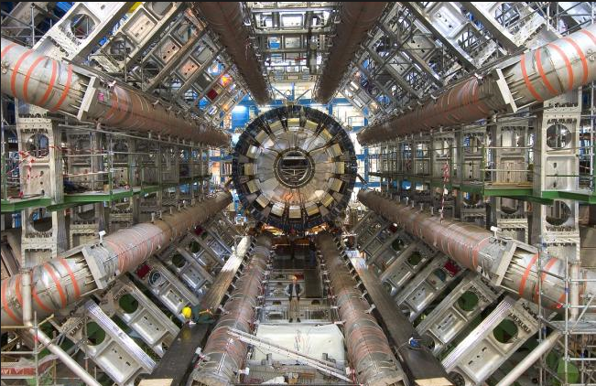


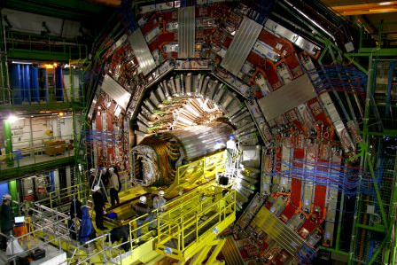
The Insertion Region (up to Q4)
Connection to LHC (UL)
Service gallery (UR)
UA Gallery
Service cavern
Q4
Collimators
SC Links
D2
Crab cavities
D1
CP
Q3
TAXN
DFM
DFX
Q2b
Q2a
Q1
TAXS

Slide 10
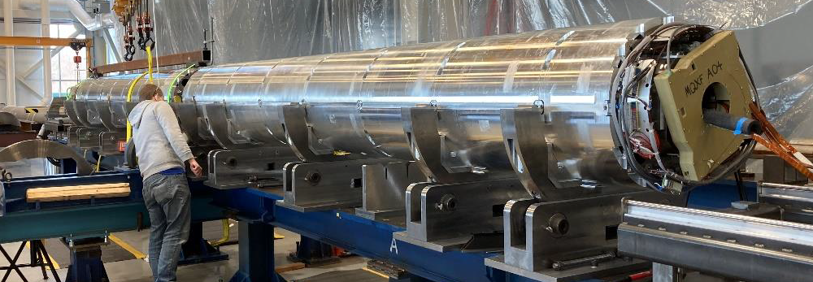
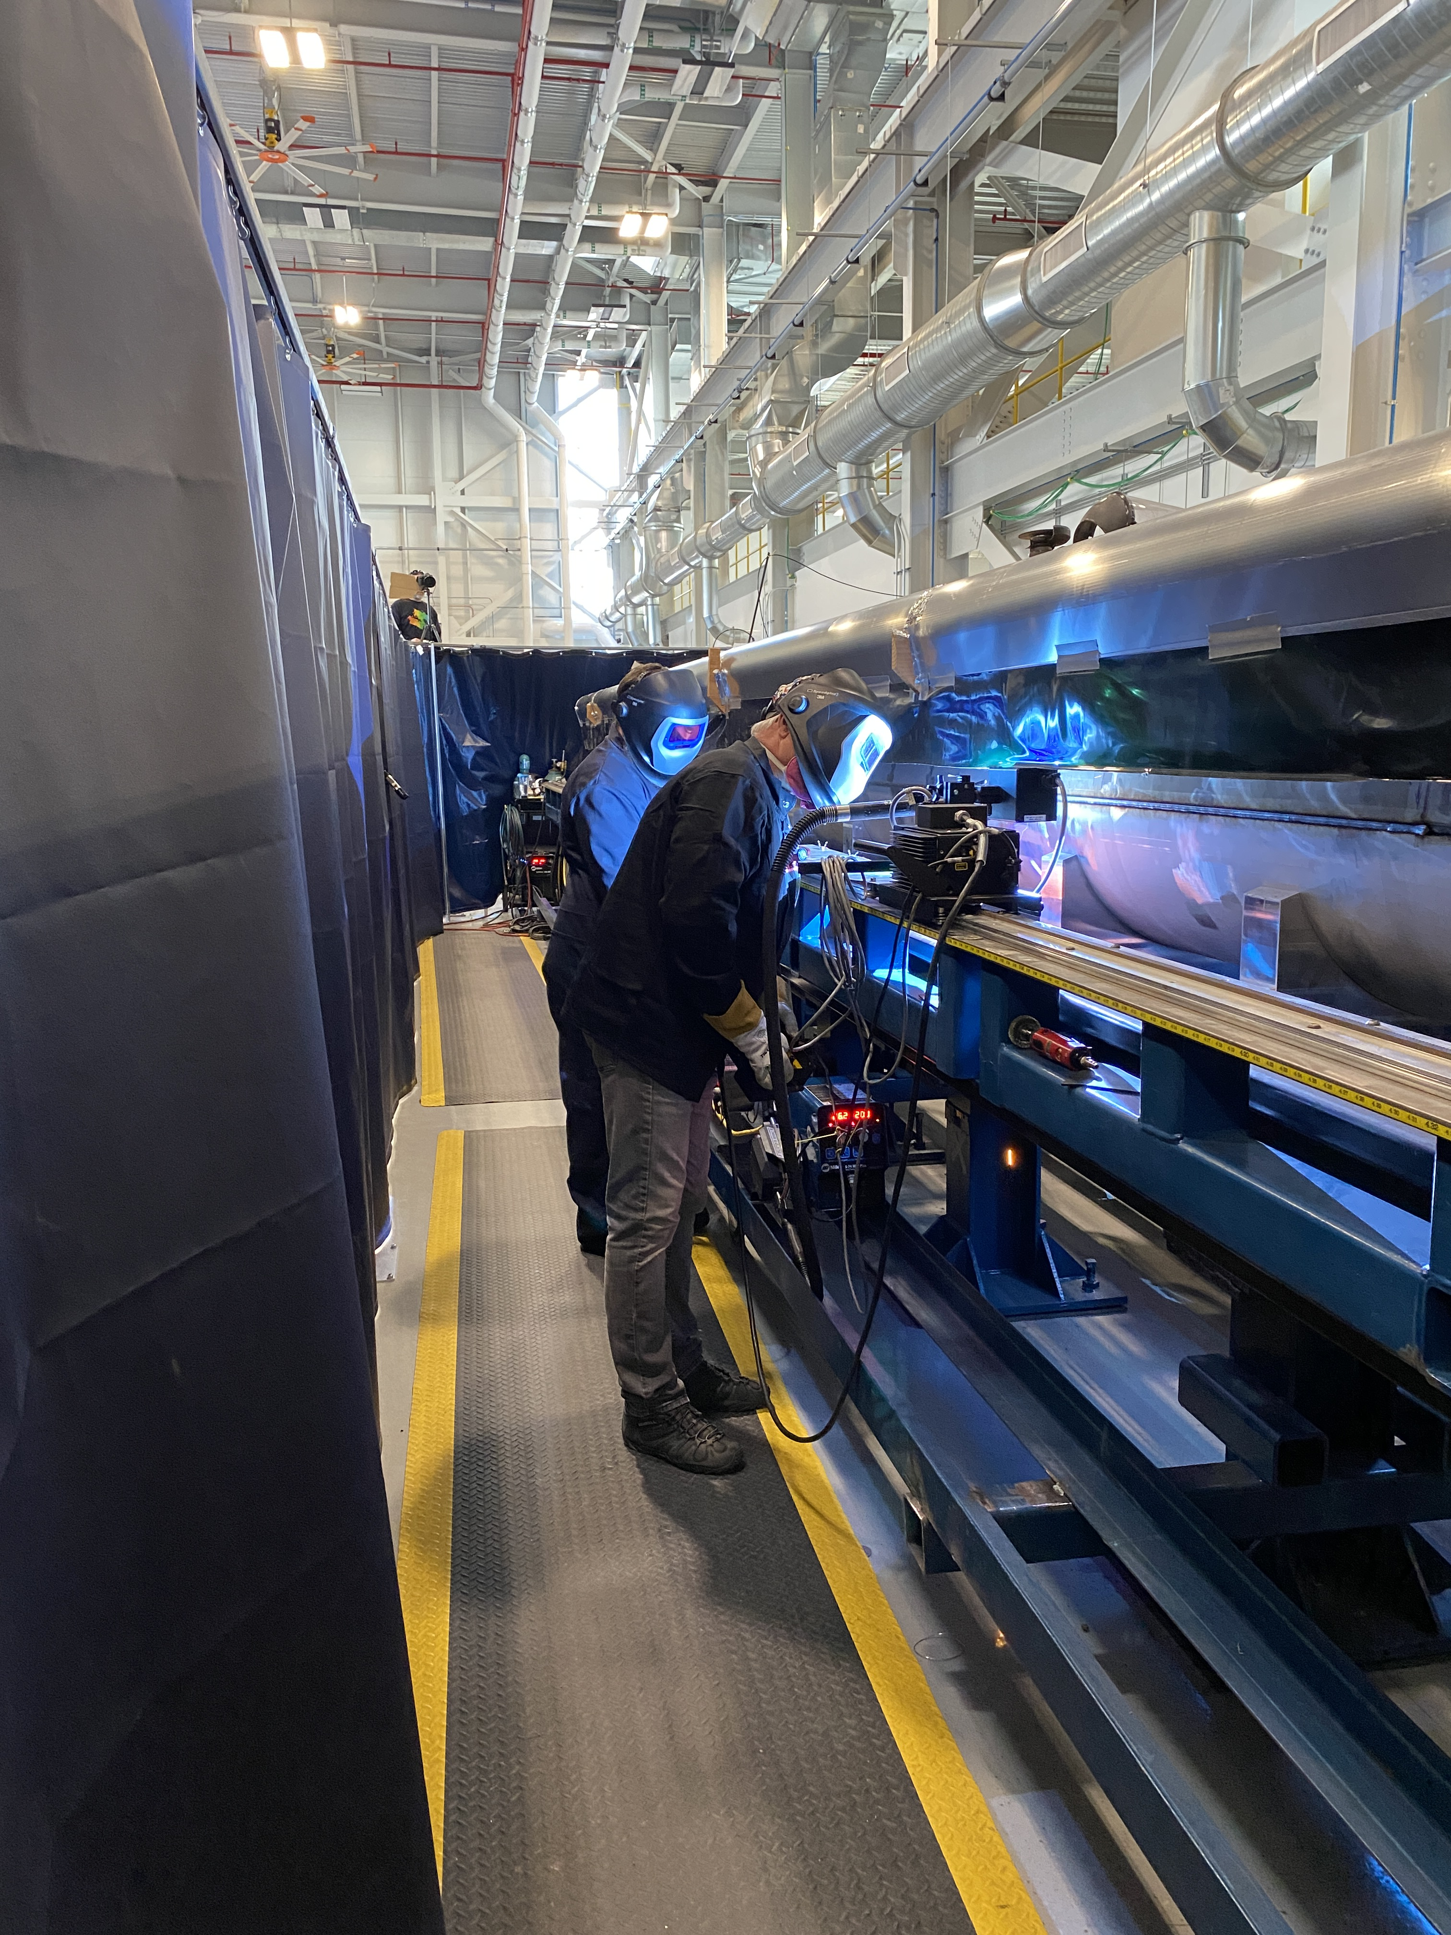
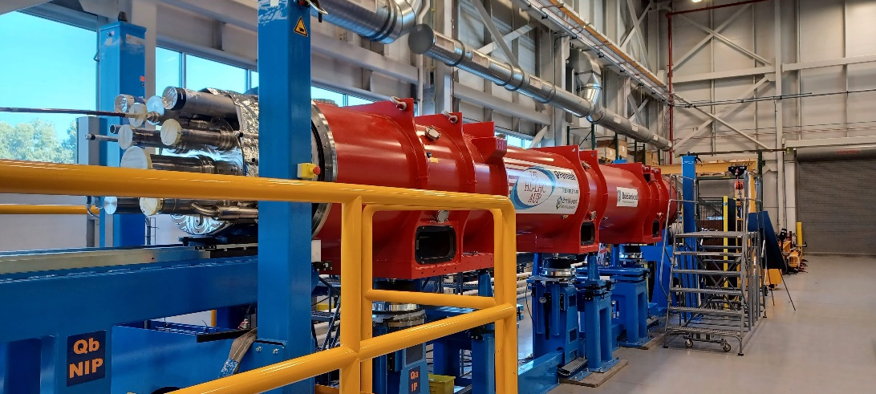
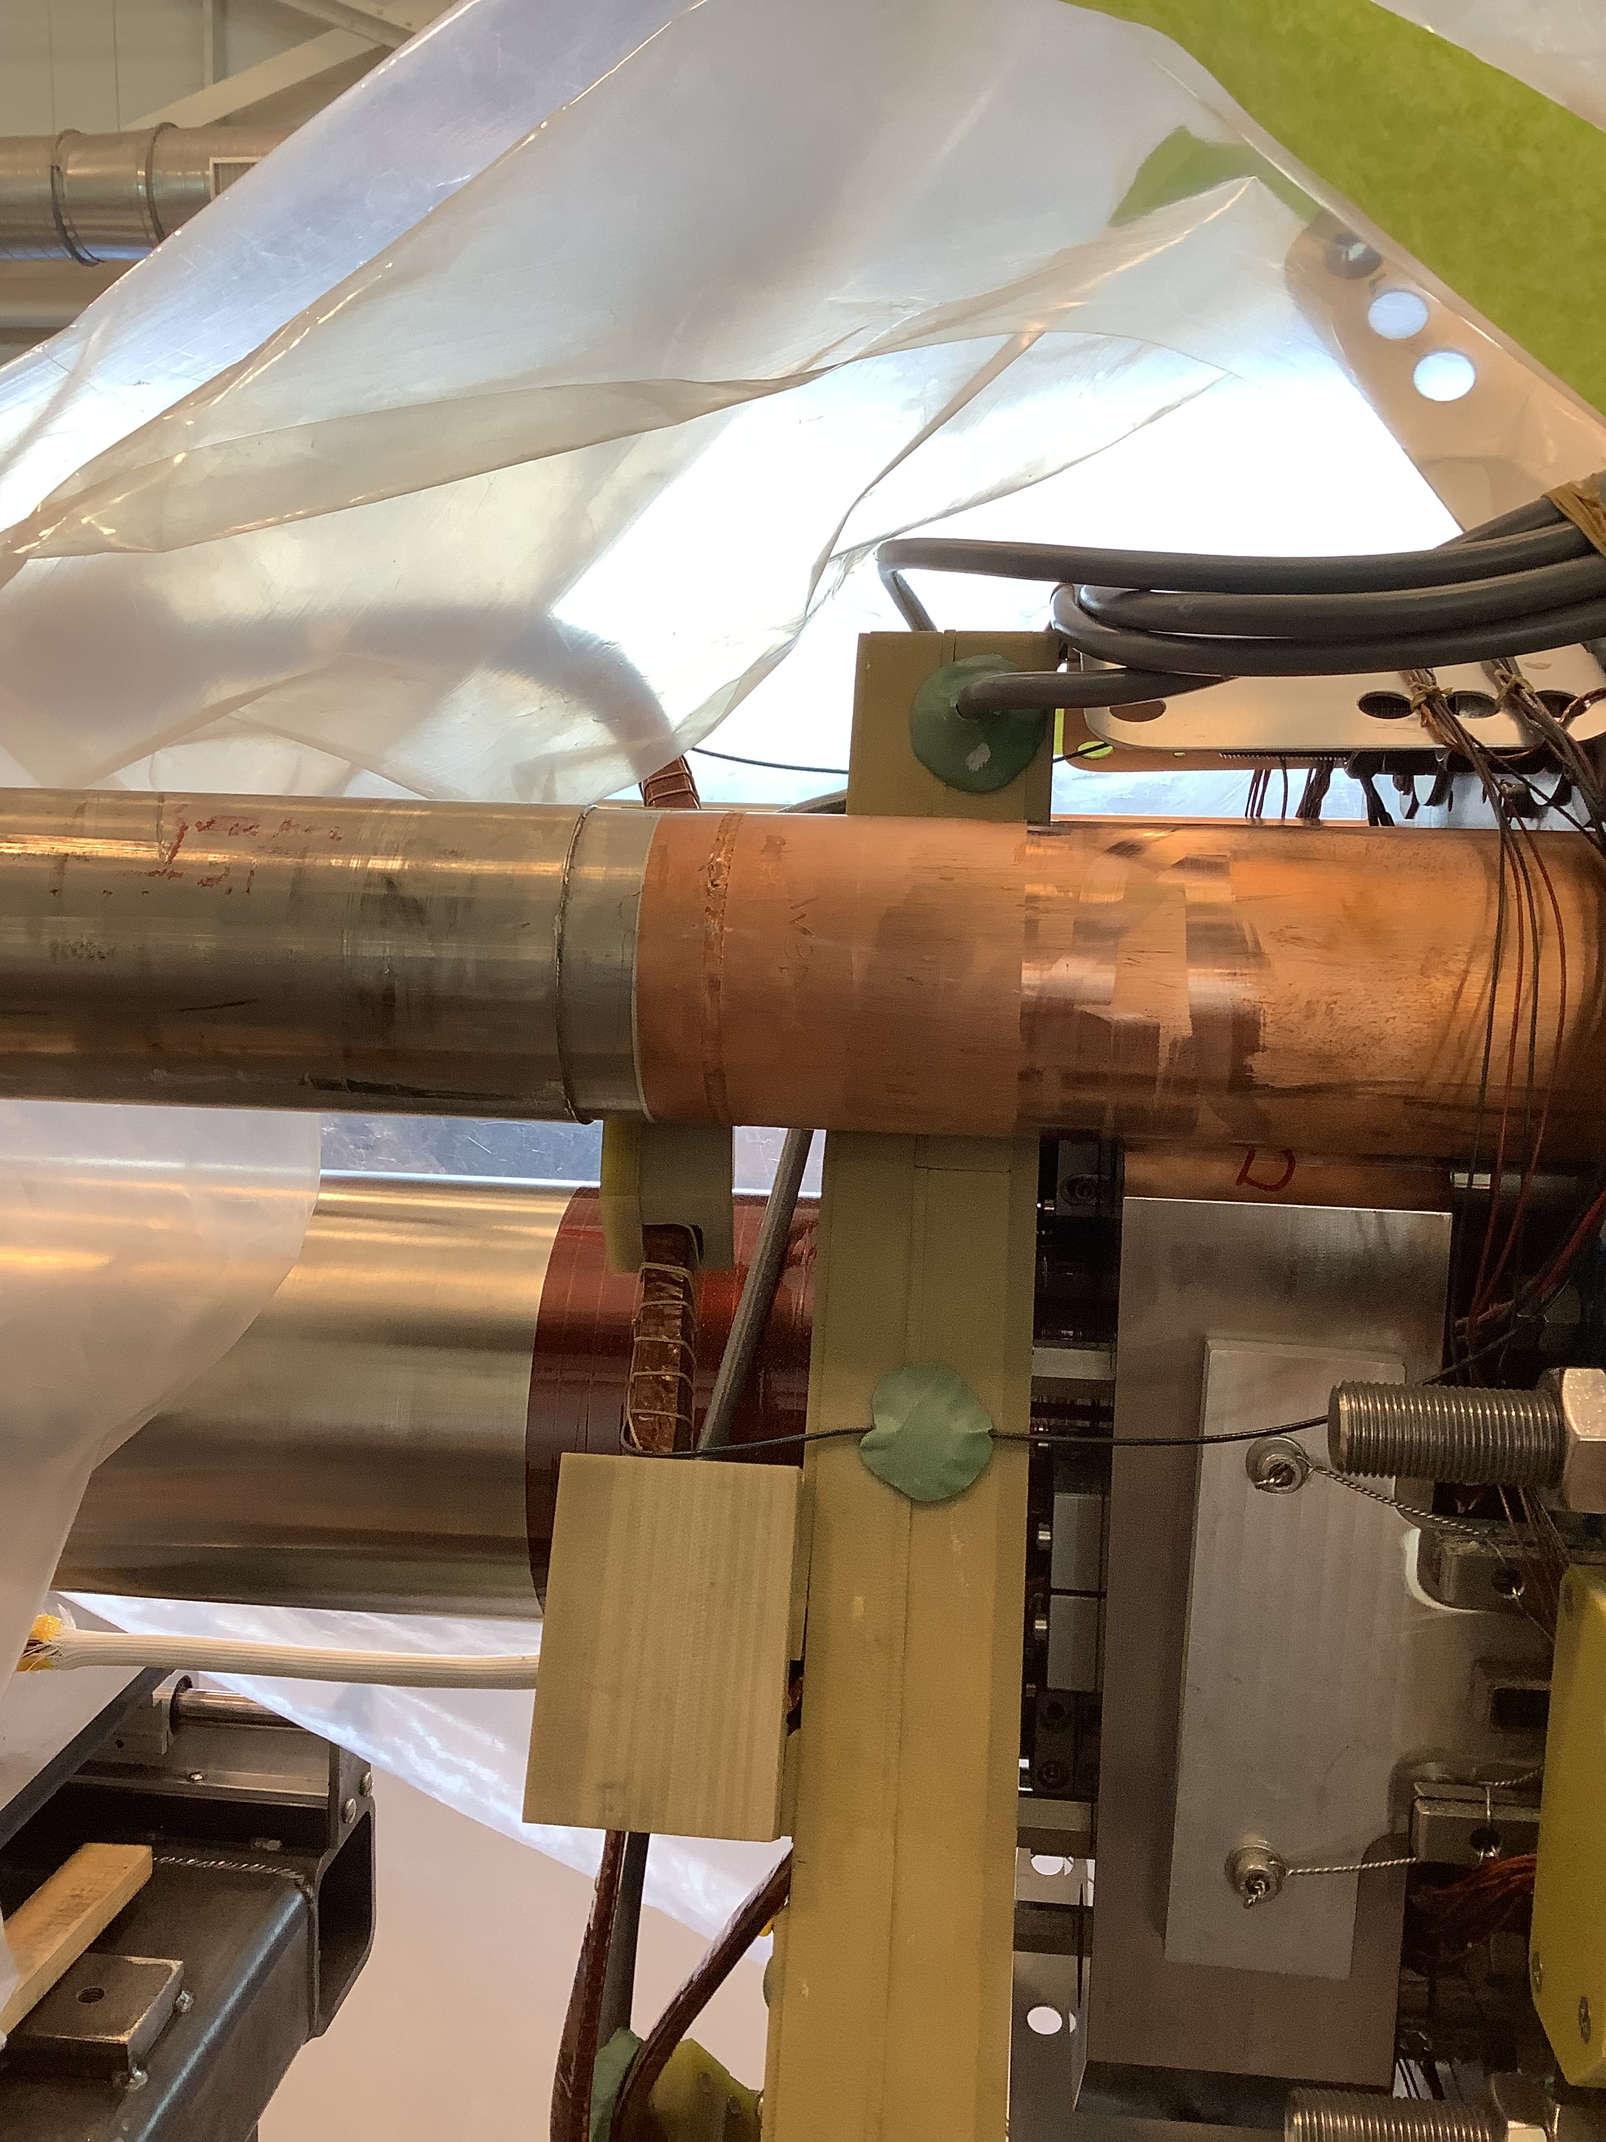
Update on MQXFA – Q1 & Q3: Cryo-Module Assembly in the USA
6 magnets constructed and validated ➔ ready for Coldmass construction [2 / Coldmass]! ✓
May 2022: Endurance Test on MQXFA05: 50 quenches, 5 TC ➔ magnet remains @ nominal! ✓
Magnet Pair Alignment
Cryostated Assembly LMQXFA-01
Shell Longitudinal Seam Welding
Heat Exchanger Installation
First AUP horizontal test ➔ spring 2023
Cryostated Assembly @ FNAL

Slide 11
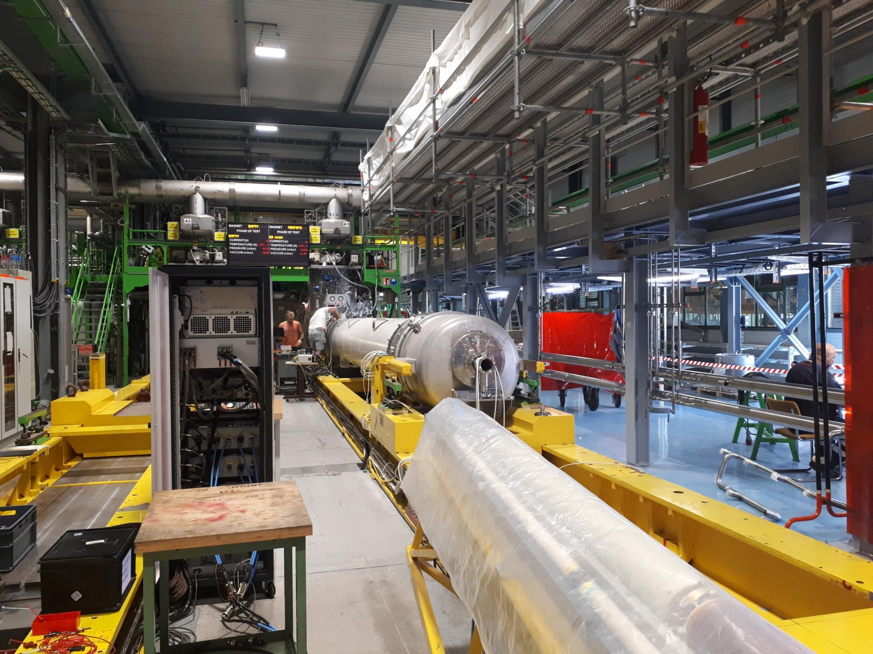
Update on MQXFB – Q2: Cryo-Module Assembly at CERN
MQXFBP3 test at CERN ➔ nominal + 300 and TC ✓
MQXFB02 test @ CERN ➔ nominal +300A and TC – still ongoing ✓
P3 and MQXFB02 satisfy the CERN acceptance criteria ✓
Limitation @ 4.5K, but Temperature margins compatible with nominal operation:
P3 & 02 reached nominal +300A,
P3 went through
3 TC without degradation;
MQXFB02 through 2 TC -
tests ongoing
Notes:
To be updated in time

Slide 12
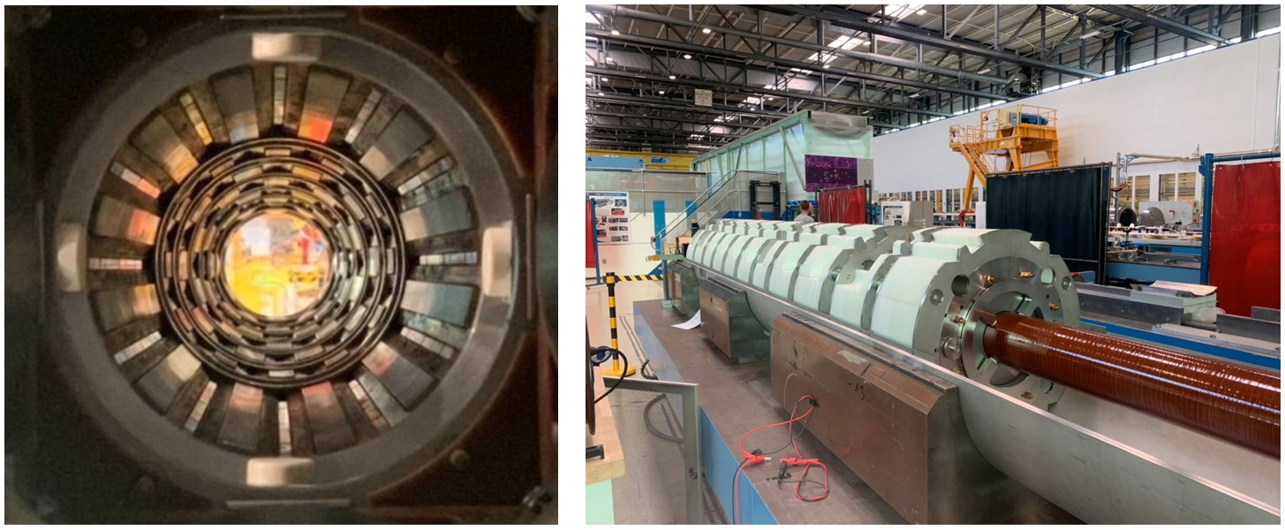
Corrector Package Production
November 2021: HO corrector manufacturing and assembly completed ✓
Excellent performance of the delivered magnets!!!
The last High Order Corrector Magnet by INFN has been delivered to CERN for the HL‐LHC project

Slide 13
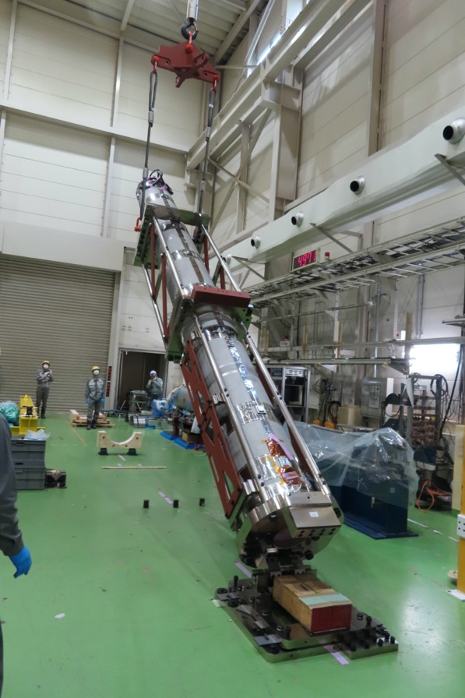
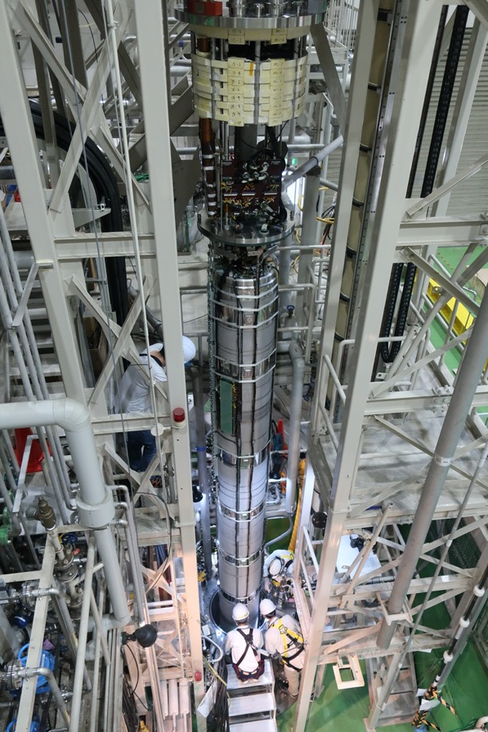
D1 Prototype at KEK
Lifting up the D1 magnet
Insertion into vertical cryostat
Prototype passed acceptance criteria and is now on its way to CERN

Slide 14
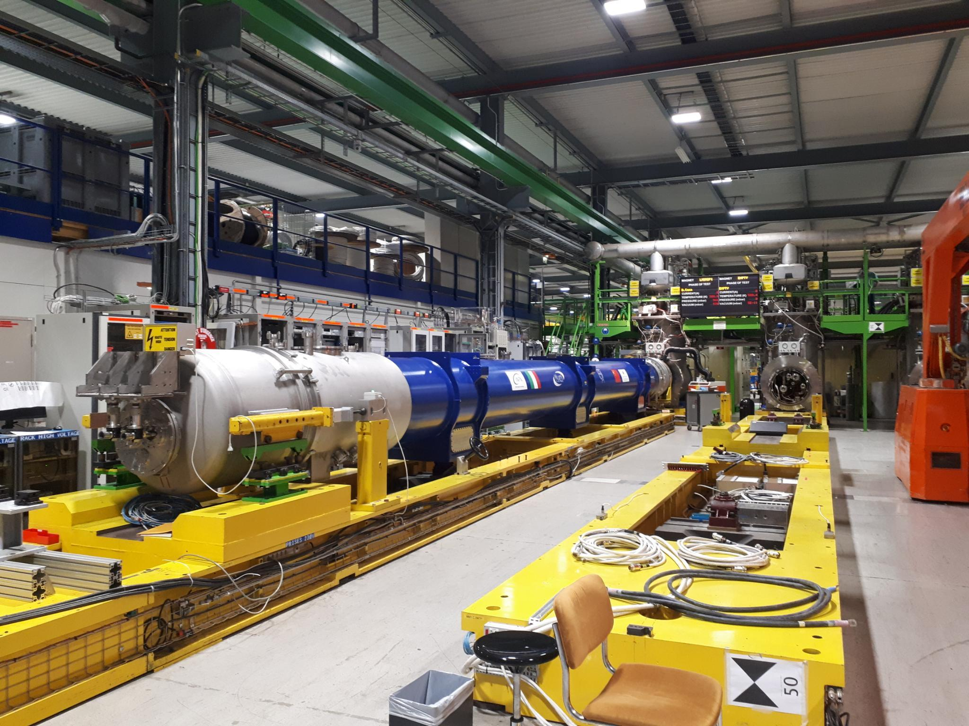
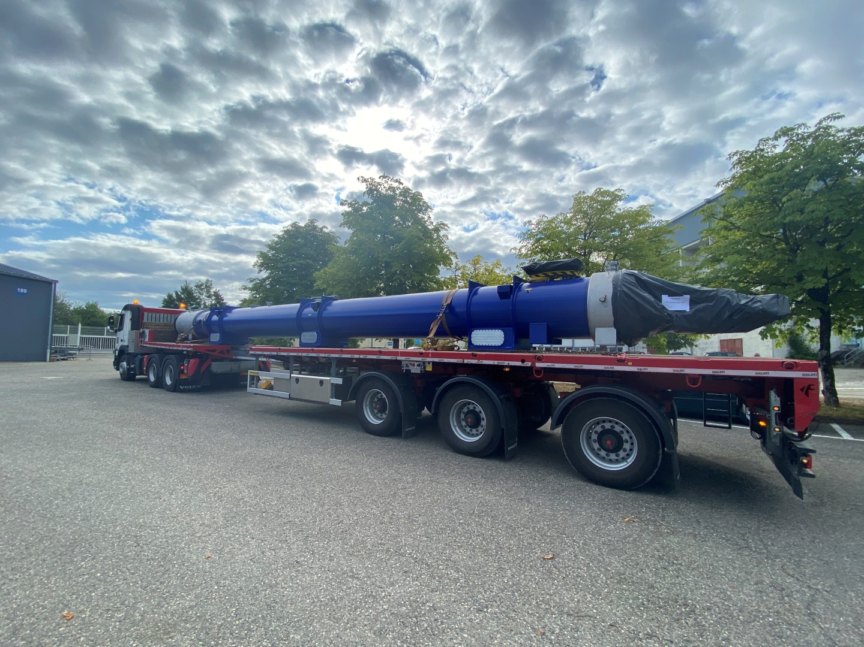
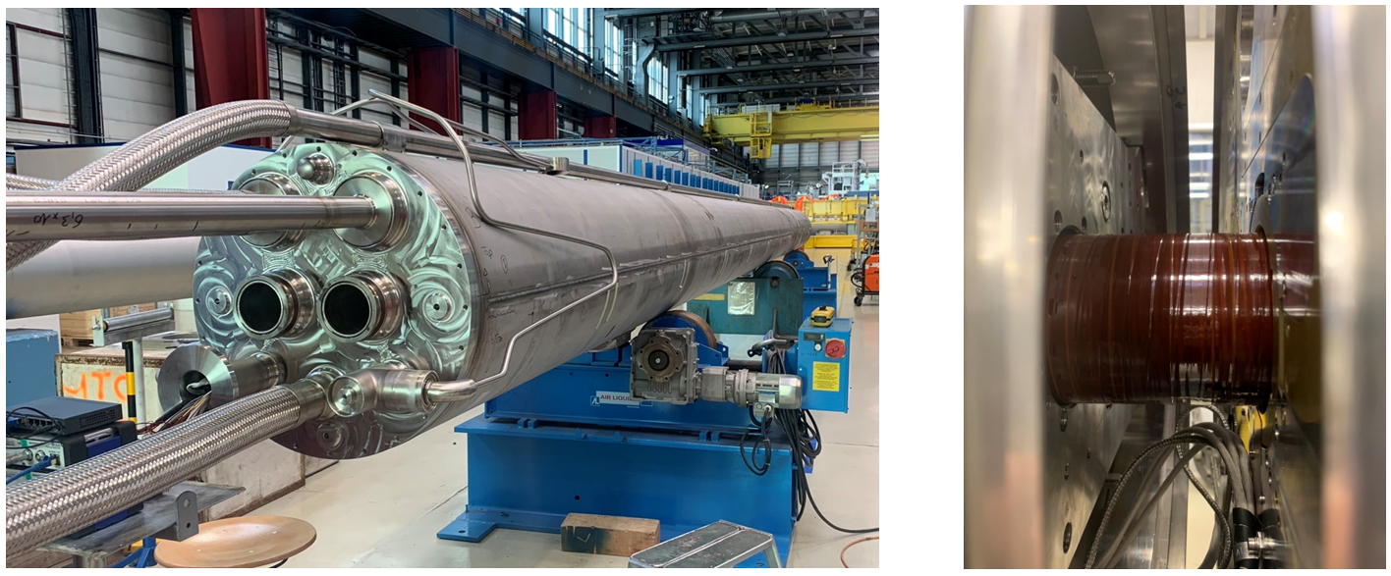
D2 Cold-Mass Assembly
D2 Prototype on the test bench in SM18: reached ultimate current after TC without quench
Cryogenics by-pass
D2 Prototype Cold-Mass @ CERN in Hall 180

Slide 15
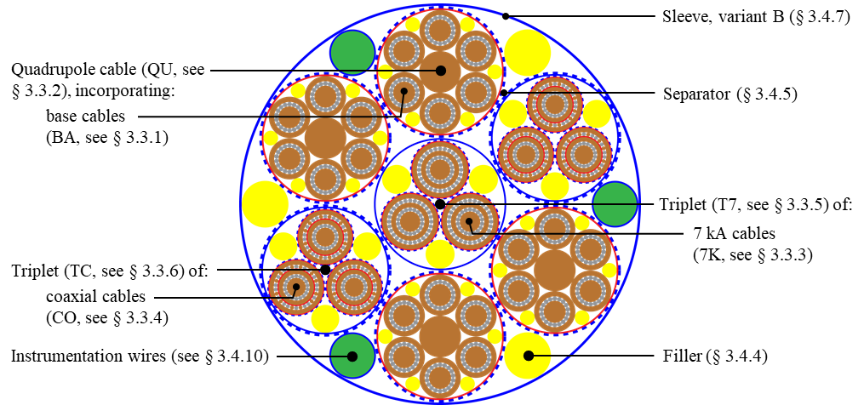
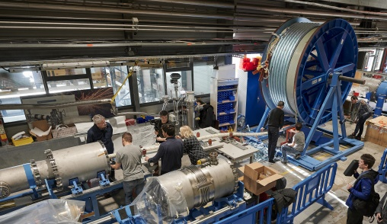
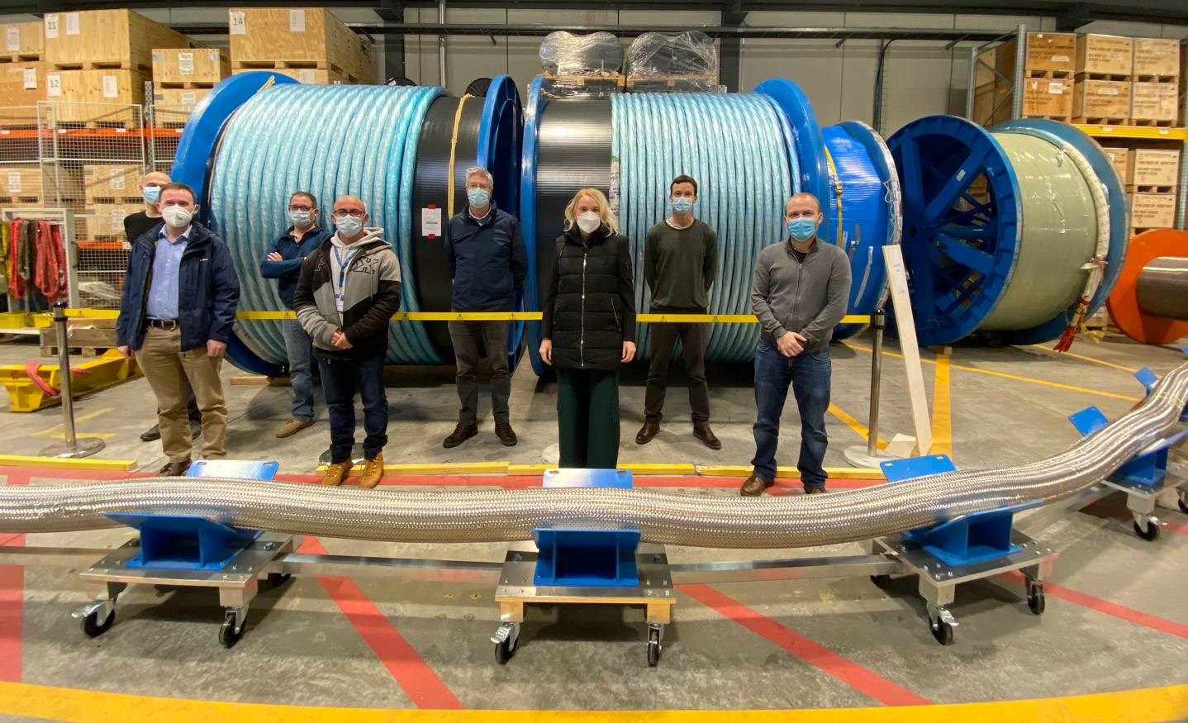
Flexible MgB₂ superconducting links
Demonstration of 2 x 20kA +
2 x 7kA in June’20
in MgB₂ @ 30K
in flexible cryostat
over 60m [54kA total]
MgB₂ cable:
Φ ∼ 90 mm
|Itot| > 100 kA @ 25 K
Φ∼ 90 mm
MgB₂
L= 60 m

Slide 16
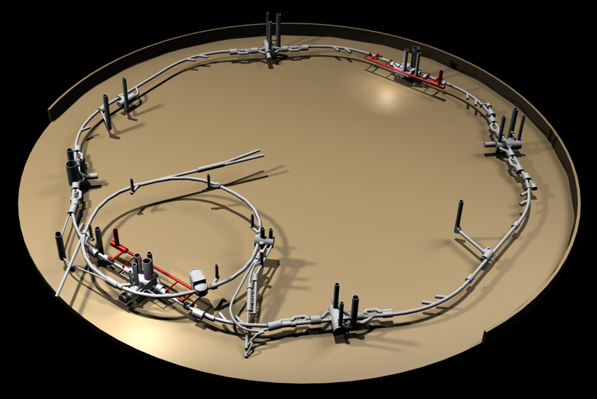
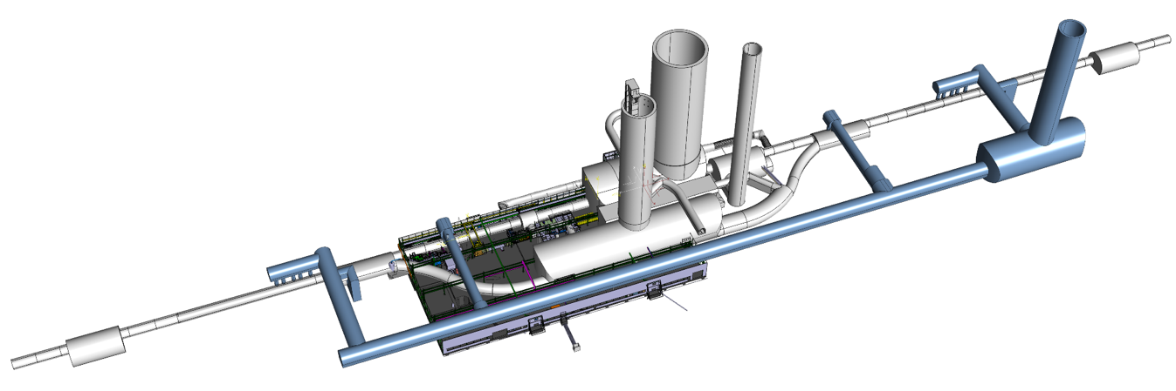
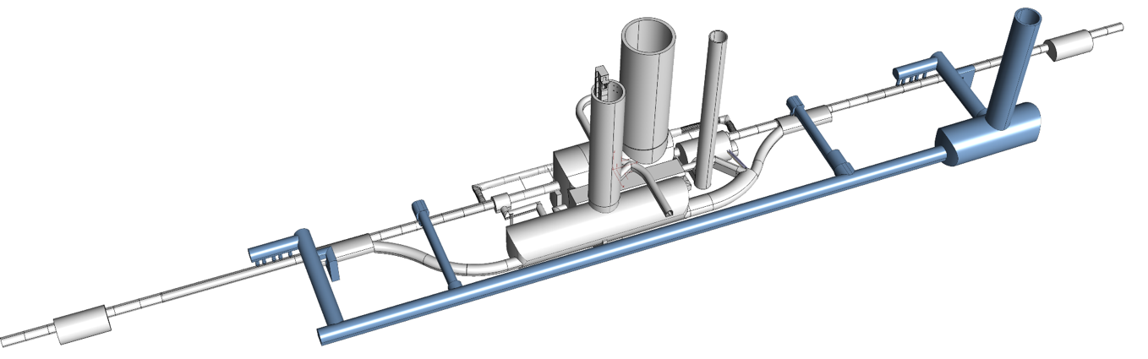

Next Milestone: HL-LHC IT STRING: P5L
P4
P5
P5
P3
P2
HL-LHC
P6
P5R
SPS
P7
P1
P5L
P8

Slide 17
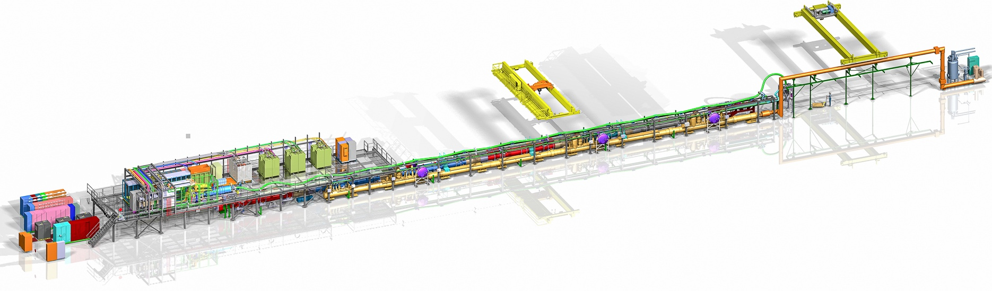
The IT STRING Scope
The scope of the IT STRING is to represent, as best as reasonably achievable in a surface building, the various operation modes to STUDY and VALIDATE the COLLECTIVE BEHAVIOUR of the different systems of the HL-LHC’s IT zone (magnets, magnet protection, cryogenics of the magnets andof the superconducting link, magnet powering, vacuum, alignment, interconnections between magnets, and the superconducting link itself).
Installation of IT-String started and will proceed throughout 2023
and will continue in 2024. Hardware Commissioning to start in 2024
The IT STRING will deliver the first complete experience of installing and operating the IT zone

Slide 18
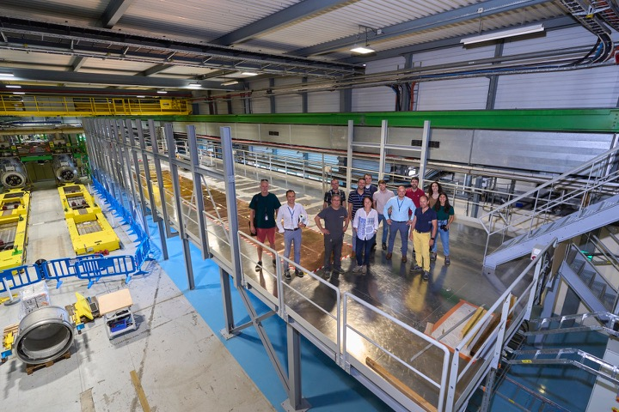
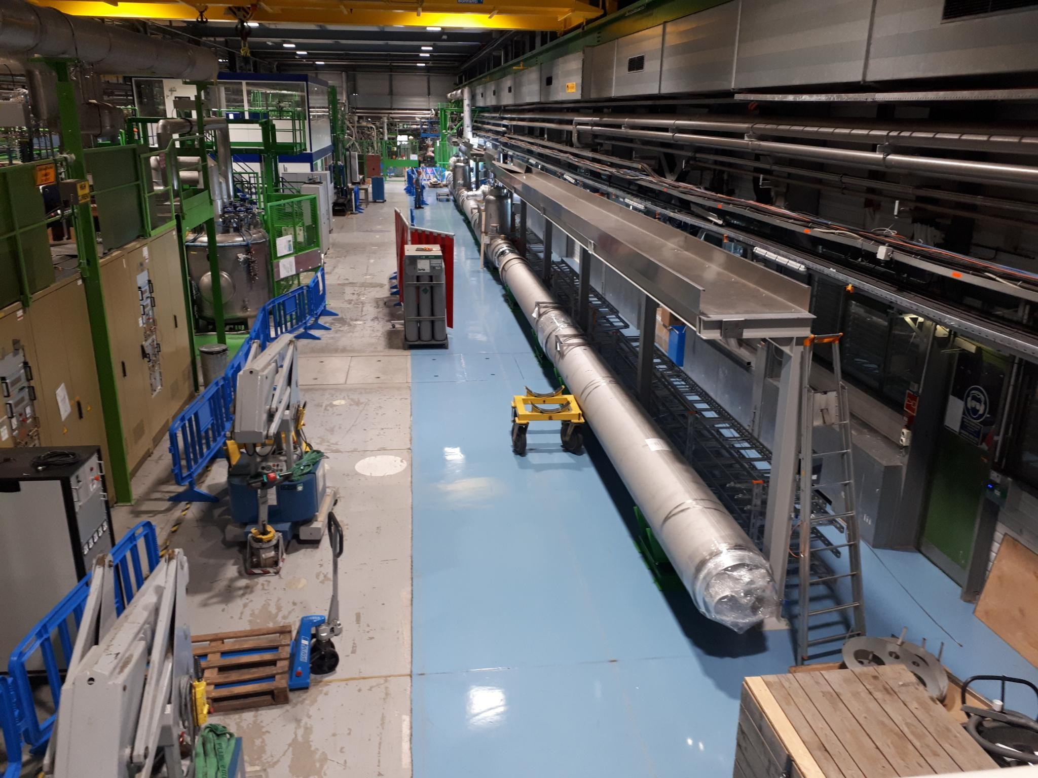
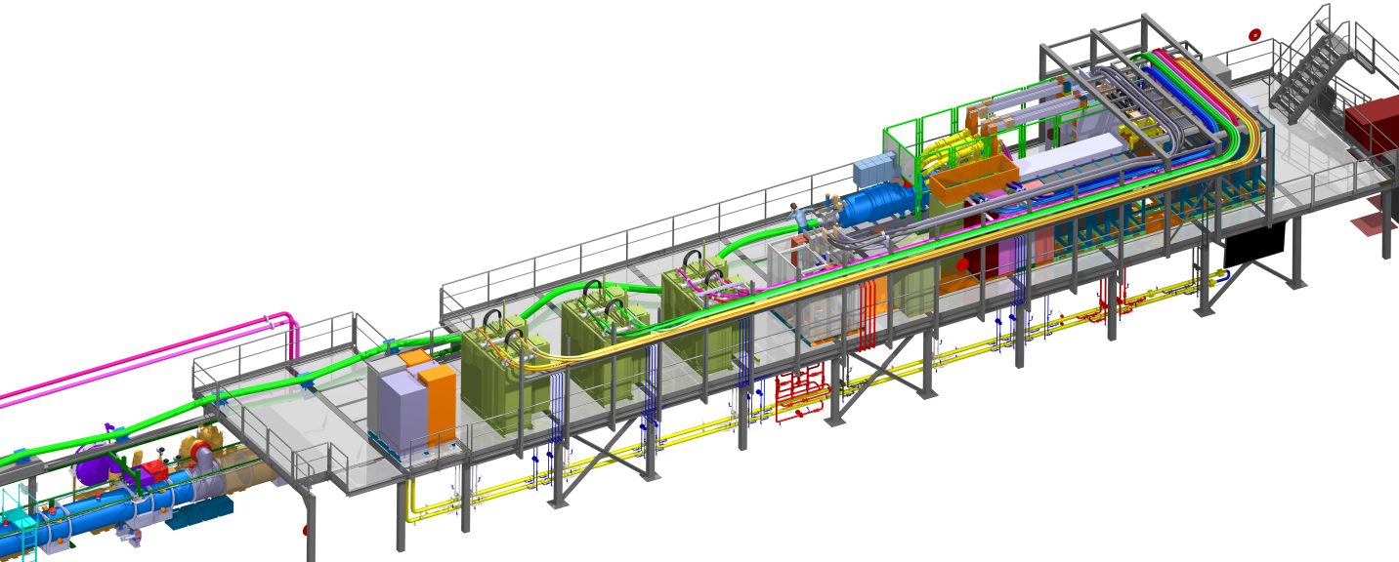
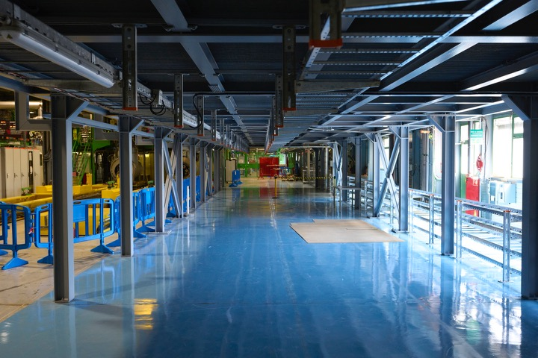
Status in pictures
On top of the metallic structure
Under the metallic structure

Slide 19
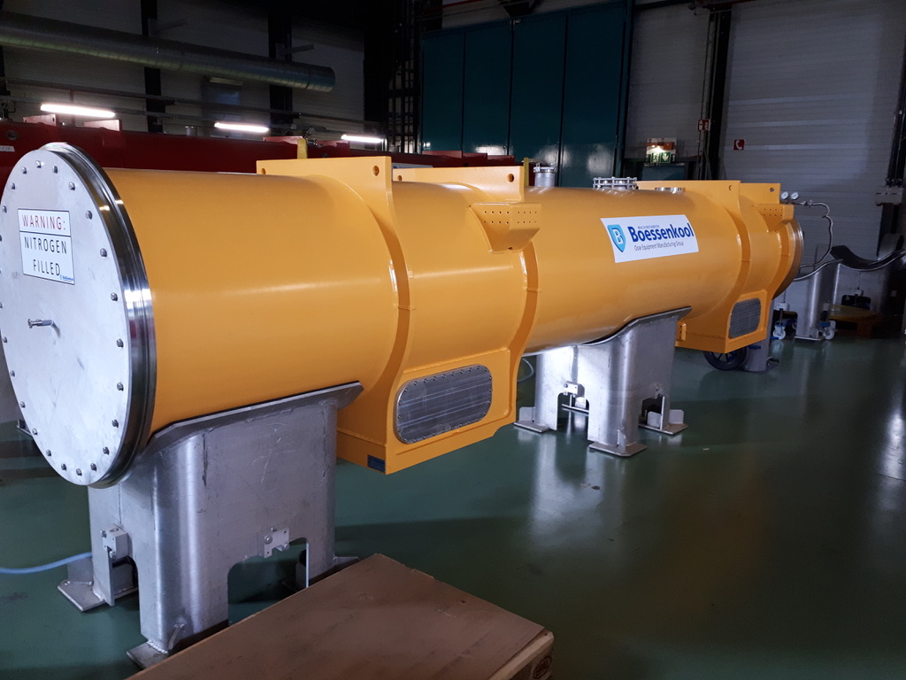
HL-LHC is ready for Series production of most components We are getting ready for installation: ➔ IT-String
LASA the first to finish magnet production!!!

Slide 21
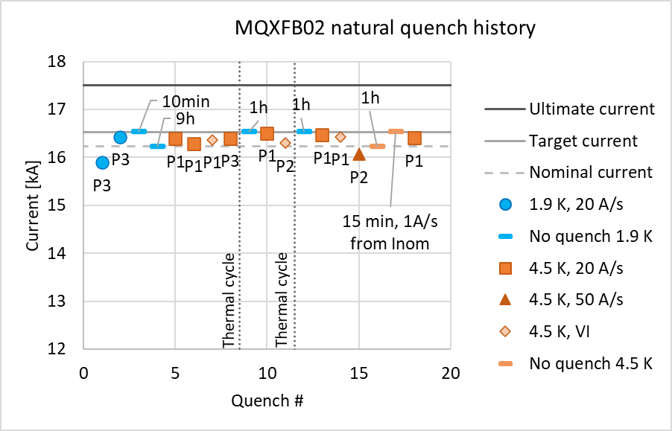
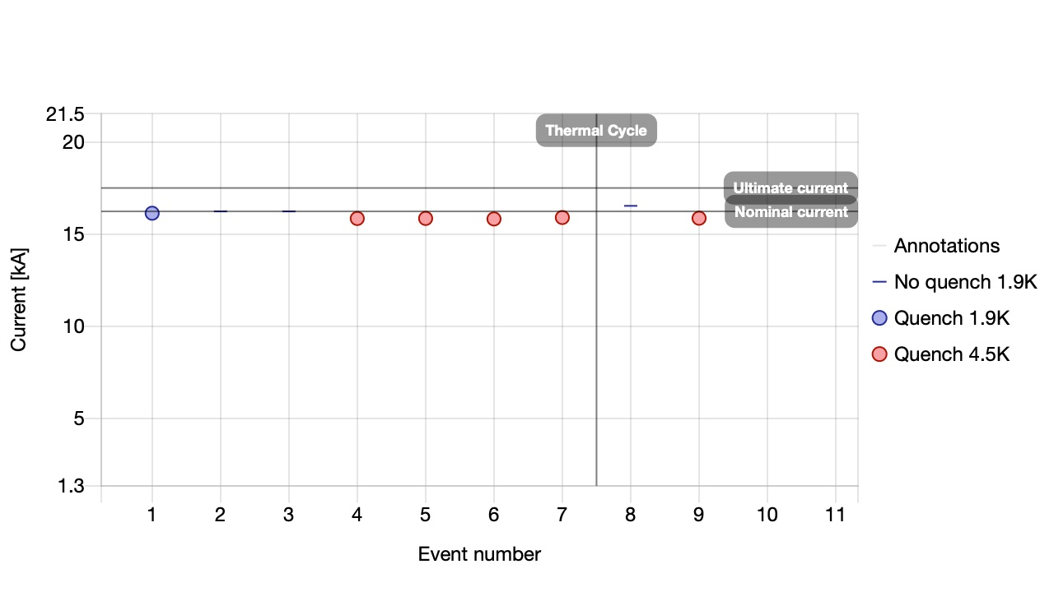
Update on MQXFB – Q2: Cryo-Module Assembly at CERN
MQXFBP3 test at CERN ➔ nominal + 300 and TC ✓
MQXFB02 test @ CERN ➔ nominal +300A and TC – still ongoing ✓
P3 and MQXFB02 satisfy the CERN acceptance criteria
Limitation @ 4.5K But Temperature margins compatible with nominal operation:
P3 & 02 reached nominal +300A,
P3 went through
3 TC without degradation;
B02 through 2 TC -
B02 tests ongoing
Notes:
Pictures and updates to be implemented

Slide 22
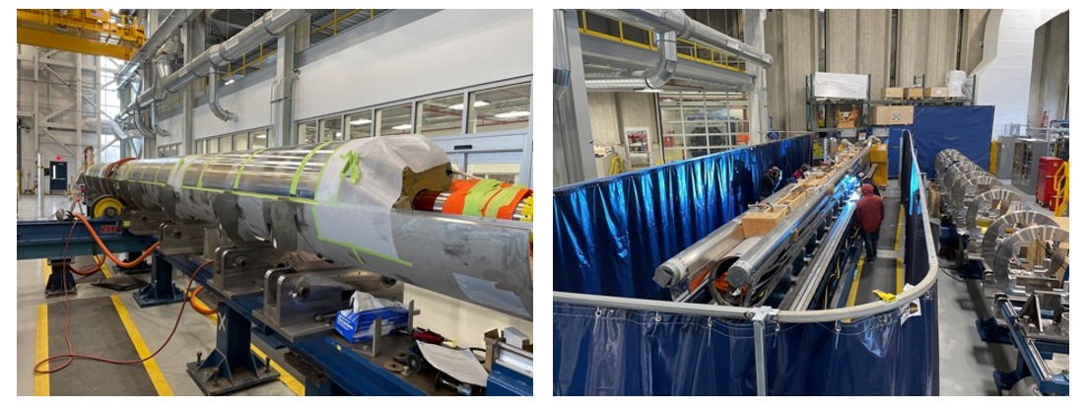
Update on MQXFA – Q1 & Q3: Cryo-Module Assembly in the USA
6 magnets constructed and validated ➔ ready for Coldmass construction [2 / Coldmass]! ✓
Cryogenics by-pass
May 2022: Endurance Test on MQXFA05: 50 quenches, 5 TC ➔ magnet remains @ nominal! ✓
Coldmass assembly of long magnet [2 of the 4.2 meter long magnets] ongoing @ FNAL
Fitting of bottom SS shell and longitudinal welding

Slide 23
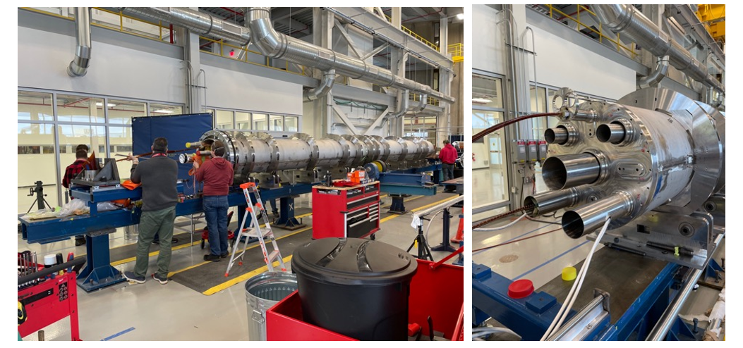
Update on MQXFA – Q1 & Q3: Cryo-Module Assembly in the USA
Cryogenics by-pass
Integration of the Cold-Mass components and installation of end plates and pipes
23

Slide 24
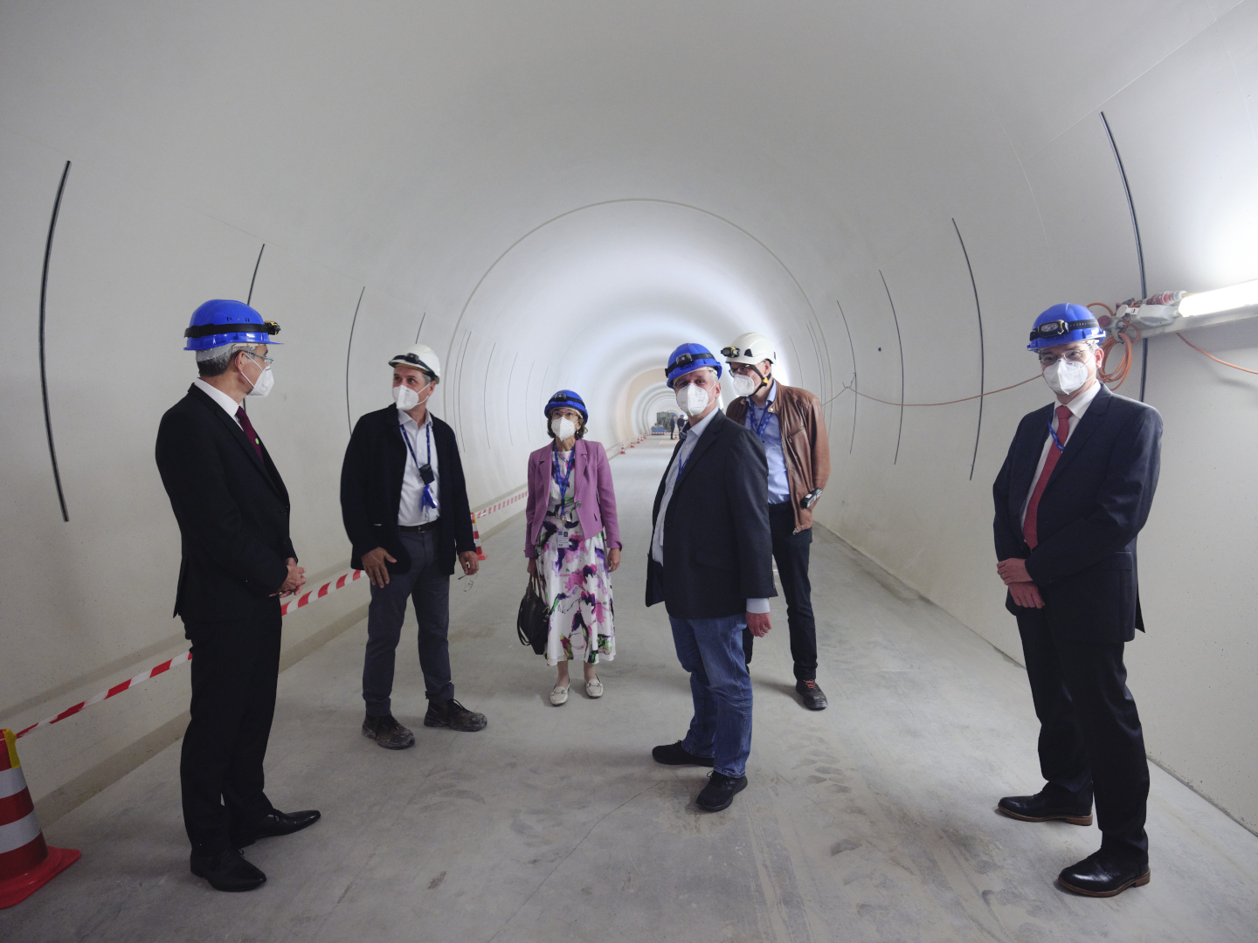

Main civil engineering work at Point 1 (ATLAS)
UR15
US17

Slide 25
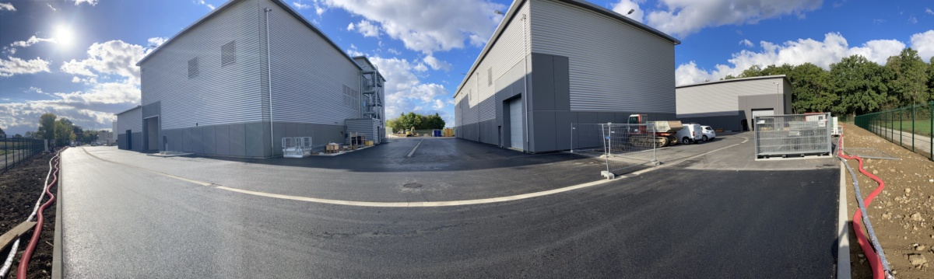
Main civil engineering work at Point 1 (ATLAS)
SD17
SF17
SHM17
SE17
SU17

Slide 26

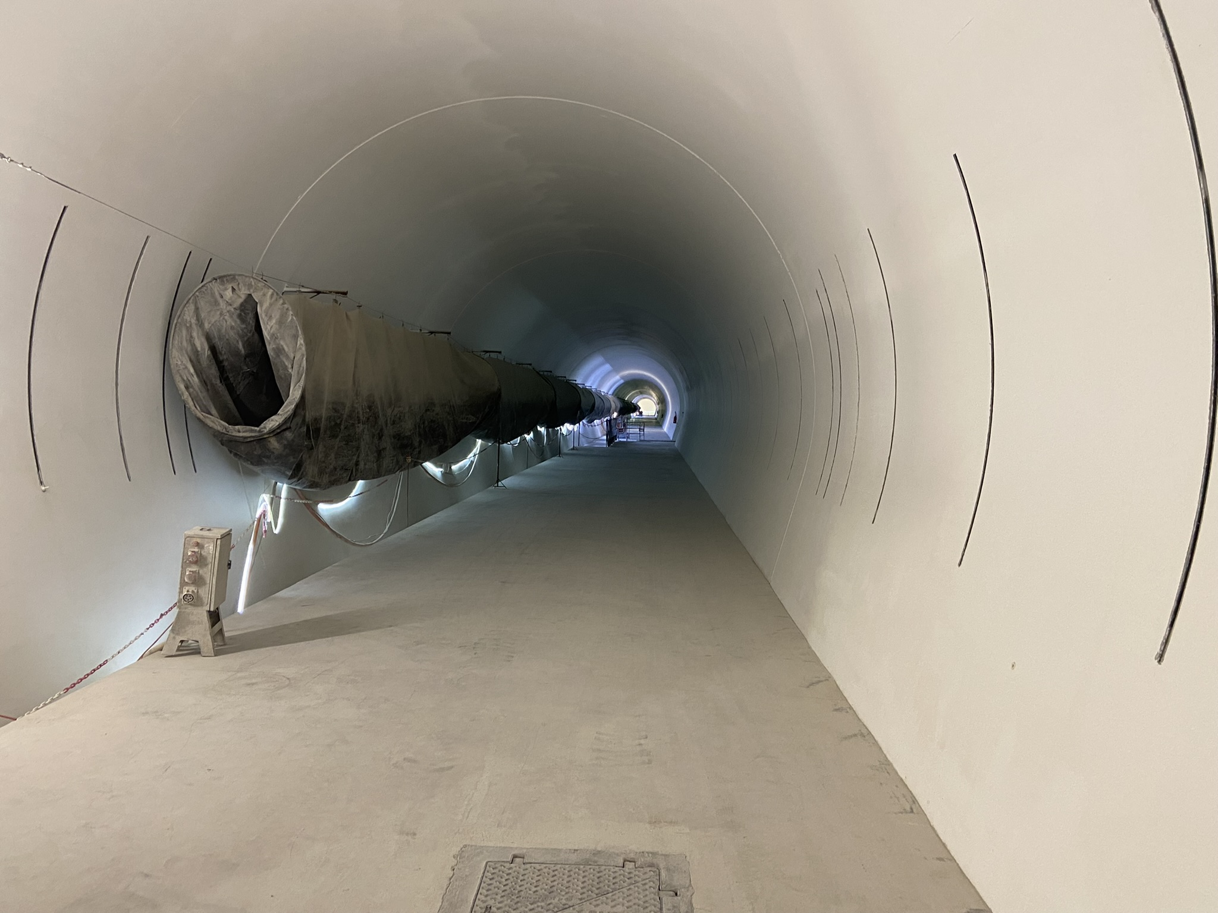

Main civil engineering work at Point 5 (CMS)
PM57
UR55
US57

Slide 27
Main civil engineering work at Point 1 (ATLAS)
Underground
(Fully completed on 25 Oct’21)
Surface
SF17
SU17
SE17
SHM17
SD17
Fully completed and delivered by Sep’22
(+ ~1 months w/r to the initial contractual date)

Slide 28

Main civil engineering work at Point 5 (CMS)
Underground
(fully completed on 25 Feb’22)
Surface
SF57
SHM57
SE57
SD57
SU57
Fully completed and delivered by Jan’23
(+ ~2 months w/r to the initial contractual date)

Slide 29


Main civil engineering work at Point 5 (CMS)
SF57
SHM57
SU57
SE57
SD57

Slide 30



Technical infrastructures in the delivered buildings
Sectional doors
Cranes
Cable trays
Lighting
Ventilation system
Primary water system
SHM57
SL172
SF57

Slide 31
Cryostat Preparation @ CERN

Slide 32
International Collaboration
Connection to LHC (UL)
Service gallery (UR)
DFHM
DFHX
SC Links
Q2a
Q1
TAXS
Q2b
Q3
CP
DFX
D1
DFM

Slide 33














Personnel!
DOE Nb3Sn R&D
2000
LARP
generic
FP6
CARE
Nb3Sn
2005
CERN-KEK R&D
LARP
HiField quads
FP7 sLHC PP
(INJ)
FP7
EuCARD
HiField Dip
2010
Project DS started
KEK D1 design and construction
LARP
Demo
sLHC INJ implem.
FP7 DS Hi-Lumi LHC
M
2015
Crystals, …?
TRIUMF CC cryostat
IHEP
CCT corrector
Injector
upgrade
HL-LHC Construction
today
HL-LHC install.& comm.
2024

