Slide 1
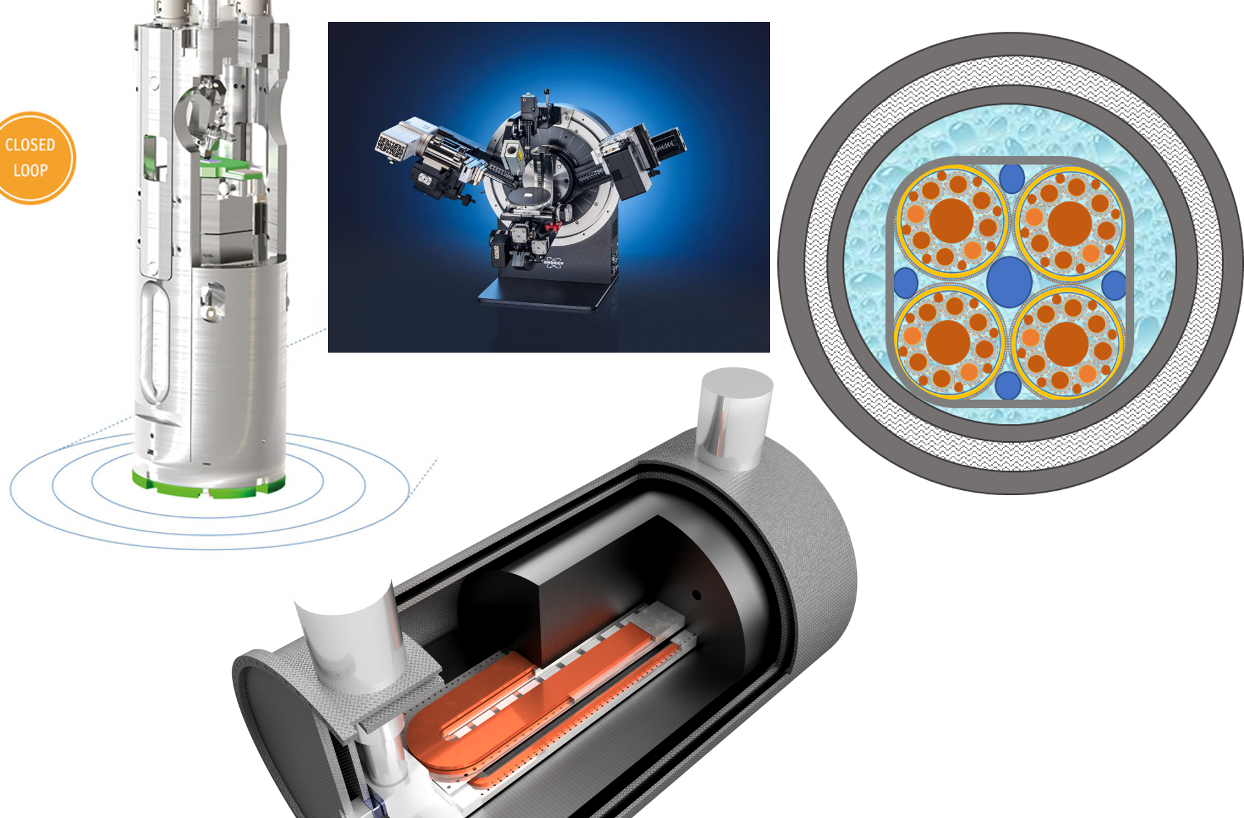
SC from paprticle Physics to societal applications :
IRIS
Lucio Rossi
Università di Milano
& INFN – sezione di Milano
Laboratorio LASA
17th of February 2023

Slide 2
The Program IRIS
Response to a call by the Ministry for Research under the “Recovery Funds” (PNRR)
To form a new distributed infrastructure in applied superconductivity (AS) in Italy by mutualizing existing infrastructures, competences, skills and by expanding them with new laboratories
6 poles for the new or renewed infrastructures: Frascati (INFN), Genova (INFN, CNR-Spin, Unige), Milano (INFN, Unimi – LASA lab), Napoli (Unina), Salento (Unisalento) e Salerno (INFN e Unisa)
  LASA (Milano) is the hub and coordinates the activity

Slide 3
Scope of IRIS
→ contribute to Fundamental Physics instrumentation (particle accelerators for post-LHC era) and to Societal Applications for green energy and medicine.
Superconductivity has been instrumental for the discovery of the Higgs boson and its development will be critical for future accelerators and we need of adequate infrastructure to sustain this. But the infrastructure will be devoted also to societal applications. In the domain of energy will be fundamental for a future green economy but also will allow a step toward sustainable infrastructure for fundamental physics.
Method: trying to cluster applied physicists with material scientists and magnet engineers. Therefore, we have also teams working on basic science and materials.
Industry are not allowed to be partner, rather they must be contractors.

Slide 4
IRIS timeline
Avviso MUR n. 3264 del 28-12-20221
Application on 25 February 2022
Negotiation phase with MUR: 10 June 2022 (resubmission new proposal : 17 June 2022)
Decree of approval: n. 124 of 21.06.2022
Start date of the project: 1 November 2022 (however early expenditure may be admissible for reimbursement)
End of project: 28 February 2025
→ 6 month extension to 30 October 2025 (mentioned in the call)

Slide 5
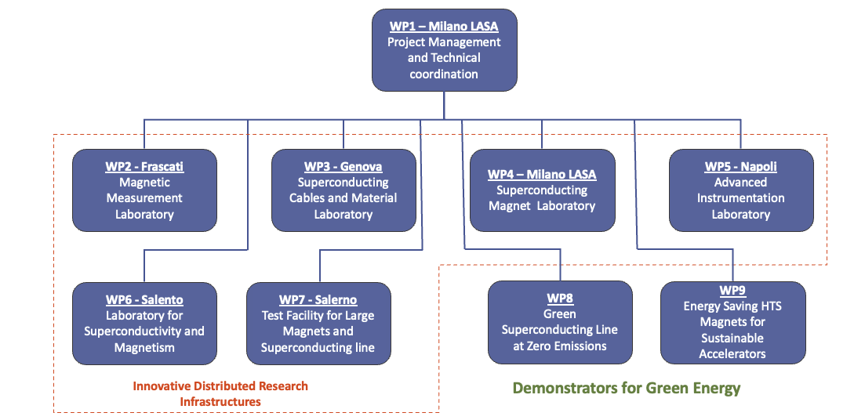
IRIS Structure

Slide 6
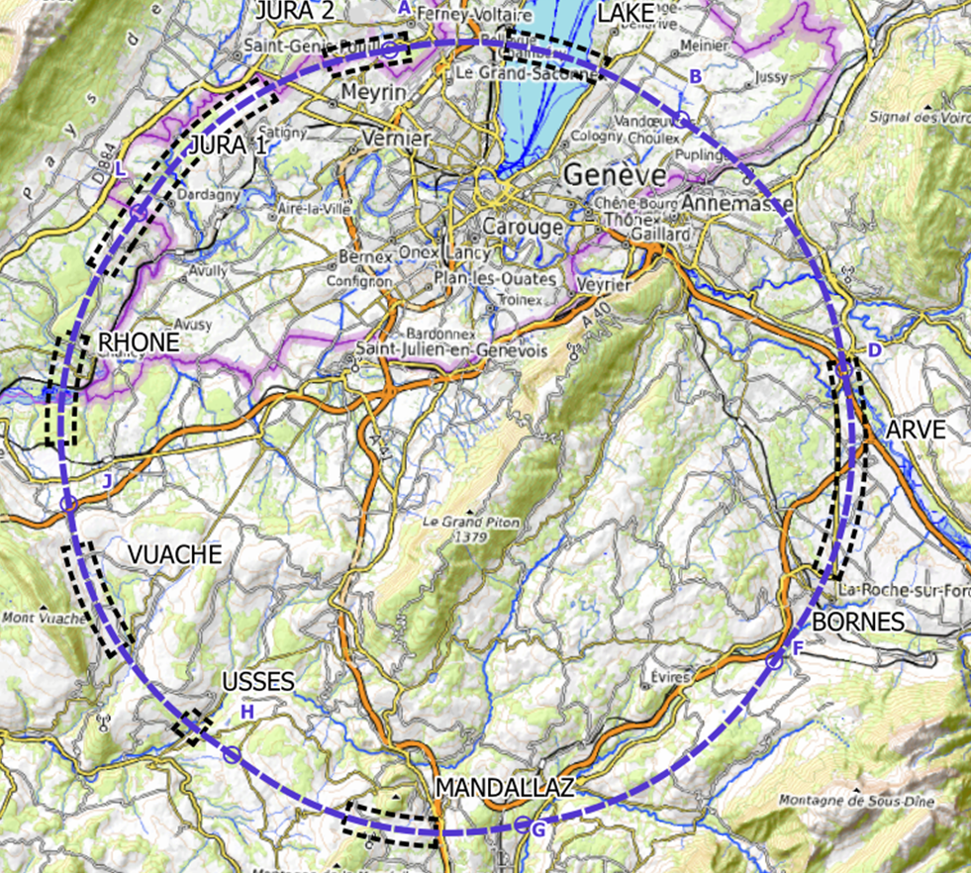
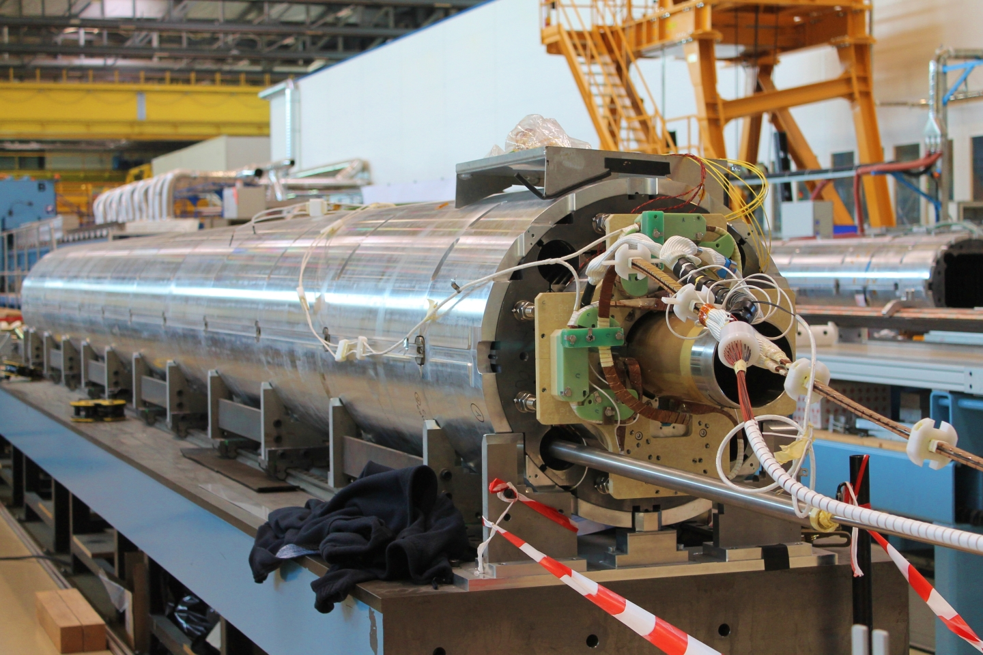
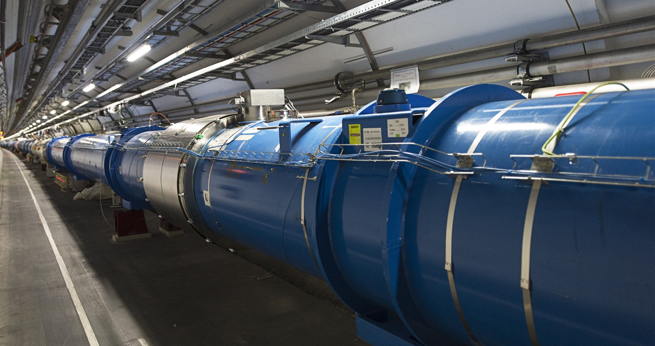
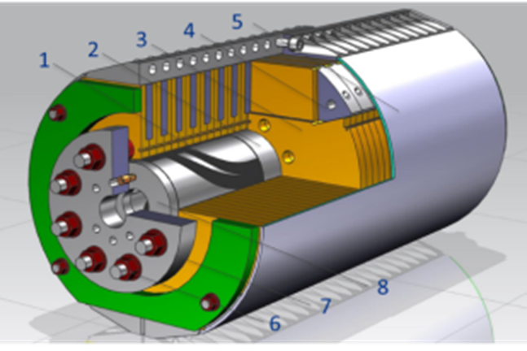
IRIS project scope -1
Fundamental Physics instrumentation
Superconductivity has been instrumental for the discovery of the Higgs boson and its development will be critical for future accelerators and we need of adequate infrastructure to sustain this.
LHC dipoles (8 T) in the tunnel
HiLumi MQXF quad (12 T)
FCC (12-16 T)

Slide 7
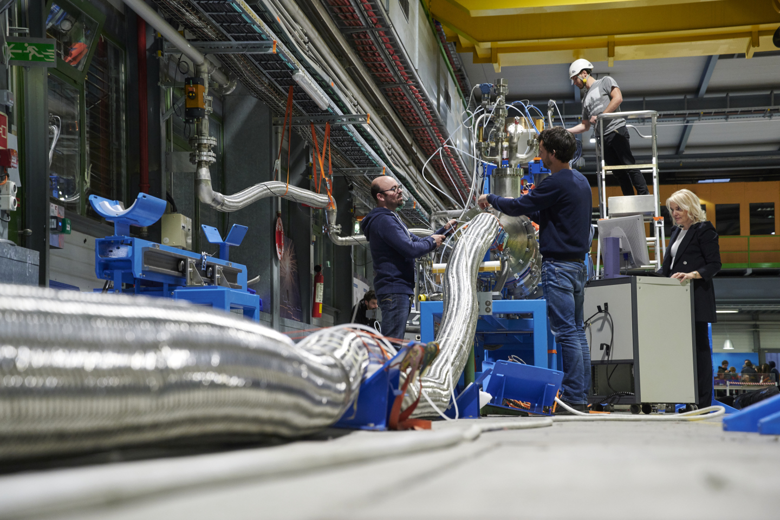
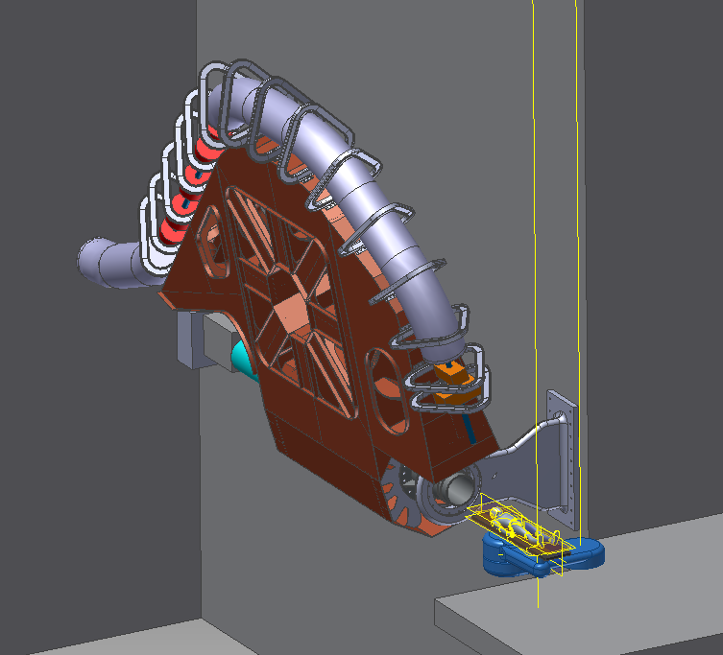
IRIS project scope -2
Societal Applications
Green Energy and Medical
Green : energy transport at zero emission and energy saving magnets.
  important for society but also for the sustainability of our research infrastructure
Medical: Superconductivity could play a key role in heavy ion therapy by enabling a rotatable gantry
Courtesy A. Ballarino - CERN
Courtesy M. Pullia (CNAO –Italy)

Slide 8
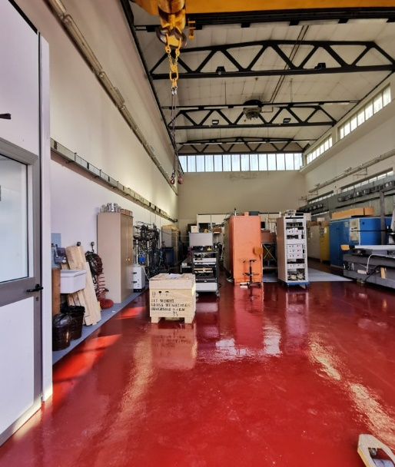
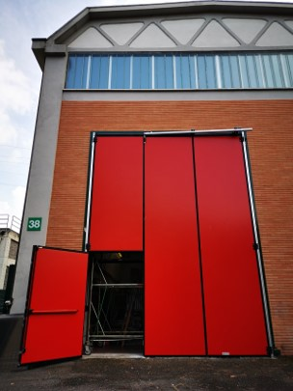
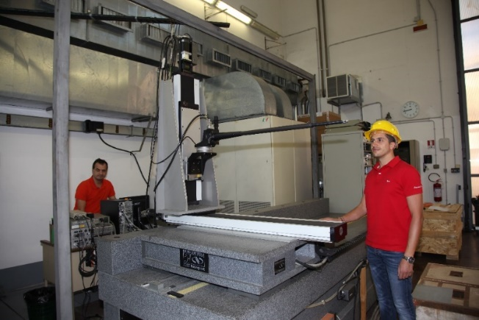
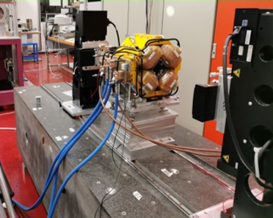
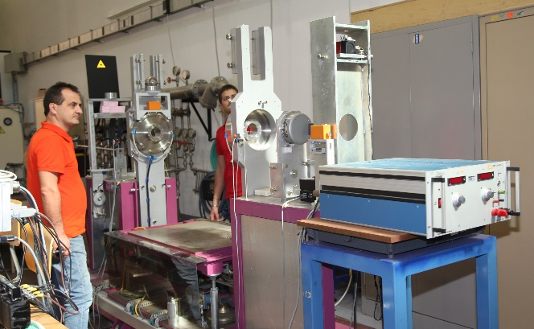
WP2 – Frascati
INFN-LNF
WP2- Magnetic Measurements Laboratory @ LNF
The INFN-LNF magnetic measurements laboratory, about 200 m², with 15 T crane has already :
a Hall effect digital teslameter with a 5-axes movement device on a granite bench;
a stretched wire bench for integral measurements of fields and mechanical fiducialization;
a rotating coil multipole measurement system; an NMR teslameter.
Several other ancillary instruments are available, such as gaussmeters, integrators, etc…
Hall probe mounted on the coordinatometer
Stretched wire bench
Rotating coil bench

Slide 9
WP3 – Genova INFN, CNR-SPIN, UNIGE-DIFI
Collaboration among the three Insitutes ha sbeen formalized (ante-IRIS) with a new Joint Research Lab : LabCoR
INFN
  Characterization of very high current cable
  Design of SC magest for accelerators and Detectors
  Industrial Folow-ip of the SC magnets Construction
  R&D on future Magnets
CNR-SPIN
  Study of Sc materia for application
  Development of SC wires
UniGe – Phsics Dept.
  Research on SC material

Slide 10
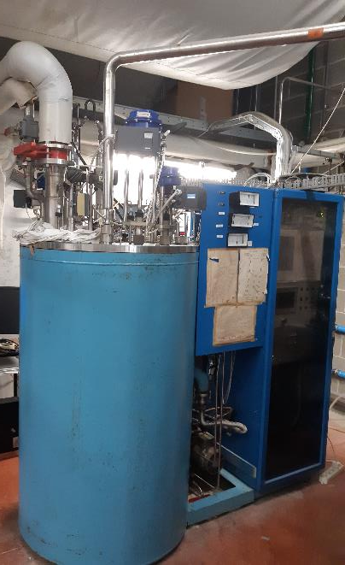
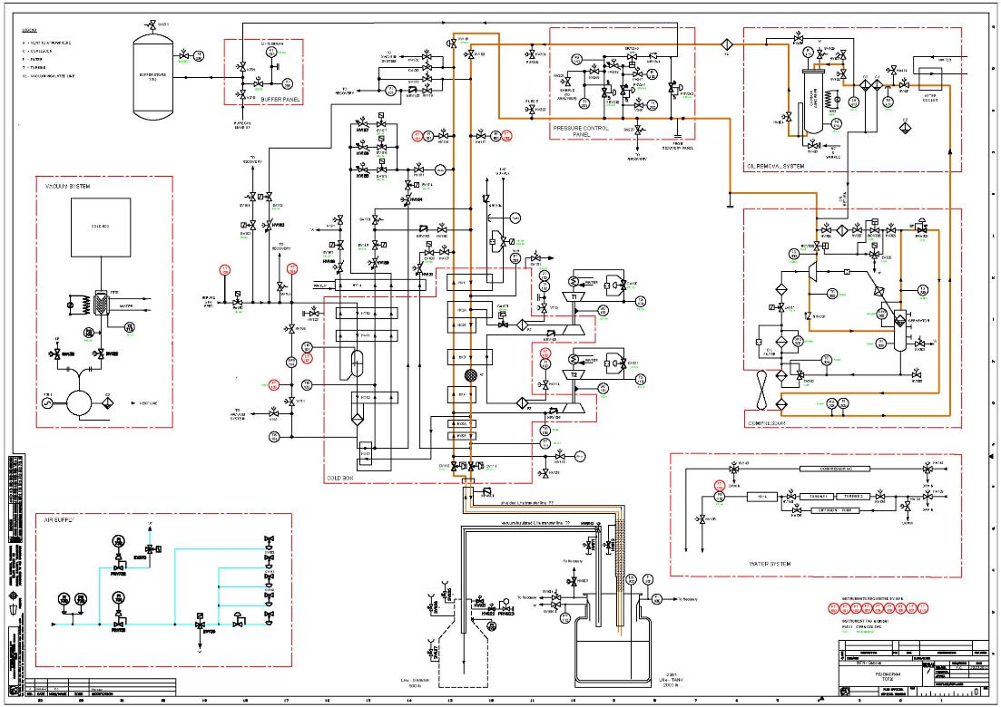
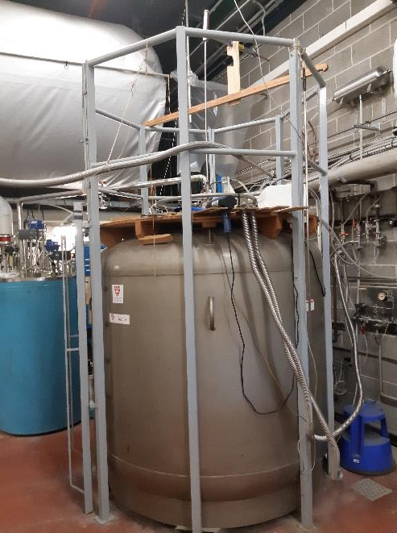
INFN-GE lab LHe plant
Pressure control panel
Buffer
Compressor
T1
T2
Purifier
Cold box
Storage
dewar

Slide 11
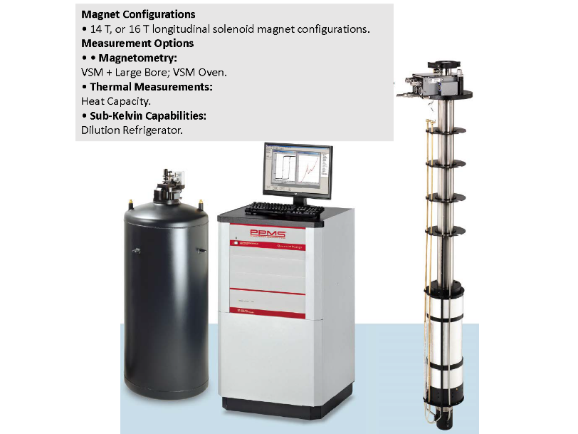
Unige - DIFI
UNIGE Physics Department:
Renewal of cryogenic plant (He gas recovery abd LN distribution)
New test station fo thermal capacity measurements in high magnetic fields for research of new SC materials

Slide 12
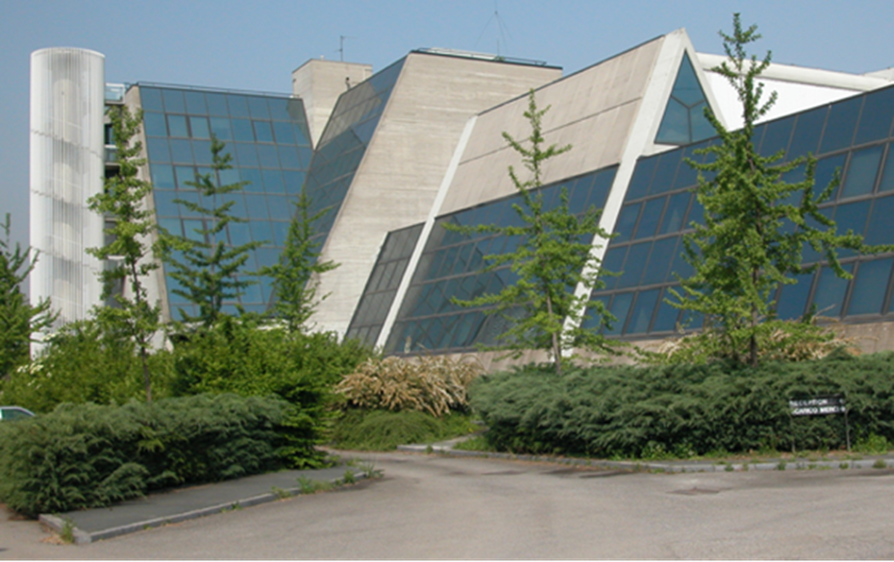
WP4 – Milano LASA - INFN-Milano, UNIMI-DIFI
Laboratorio Acceleratori & Superconduttività Applicata
  SC magnets and SRF cavities
Also photocathodes and other activities (BriXino, radionuclides studies)
(old) LHe plant to be renewed in the next 2 years
About 25 people active in applied superconductivity
It is “only” a building, not an Institution: it belongs to Unimi, co-managed by INFN-Milano and Unimi-DIFI
It is National R.I. as INFN infrastructure (in the list of PNIR as medium priority)

Slide 13
Main activity WP4
Re-vamping of the exiting equipment in the main hall for SC magnet test
  (INFN) Revamping of the existing SC magnet test facility (for bare magnets) up top 20+ kA
  (INFN) Addition of VTI for magnet tests, new power lines, etc…
(DIFI) New building for a Superconducting Magnet Laboratory open to other labs and Industry to support new projects (FCC, MuCol, other) and novel ideas
(DIFI) Metal AD equipment to support prototypal activity
(INFN) A complete set of new equipment for manufacturing small/medium size SC magnet

Slide 14
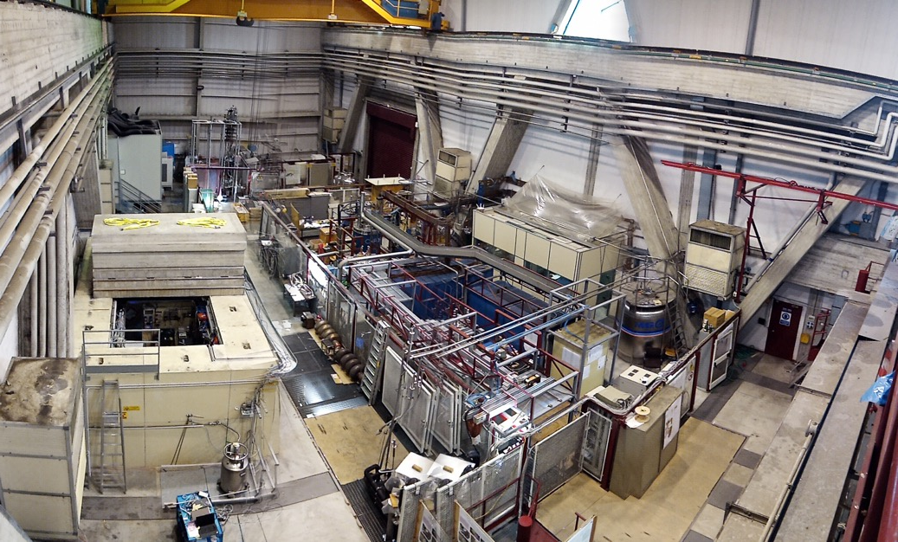
LASA Hall
High field solenoids
SC wire testing area
High current PS
Test Station for long magnets & High Current

Slide 15
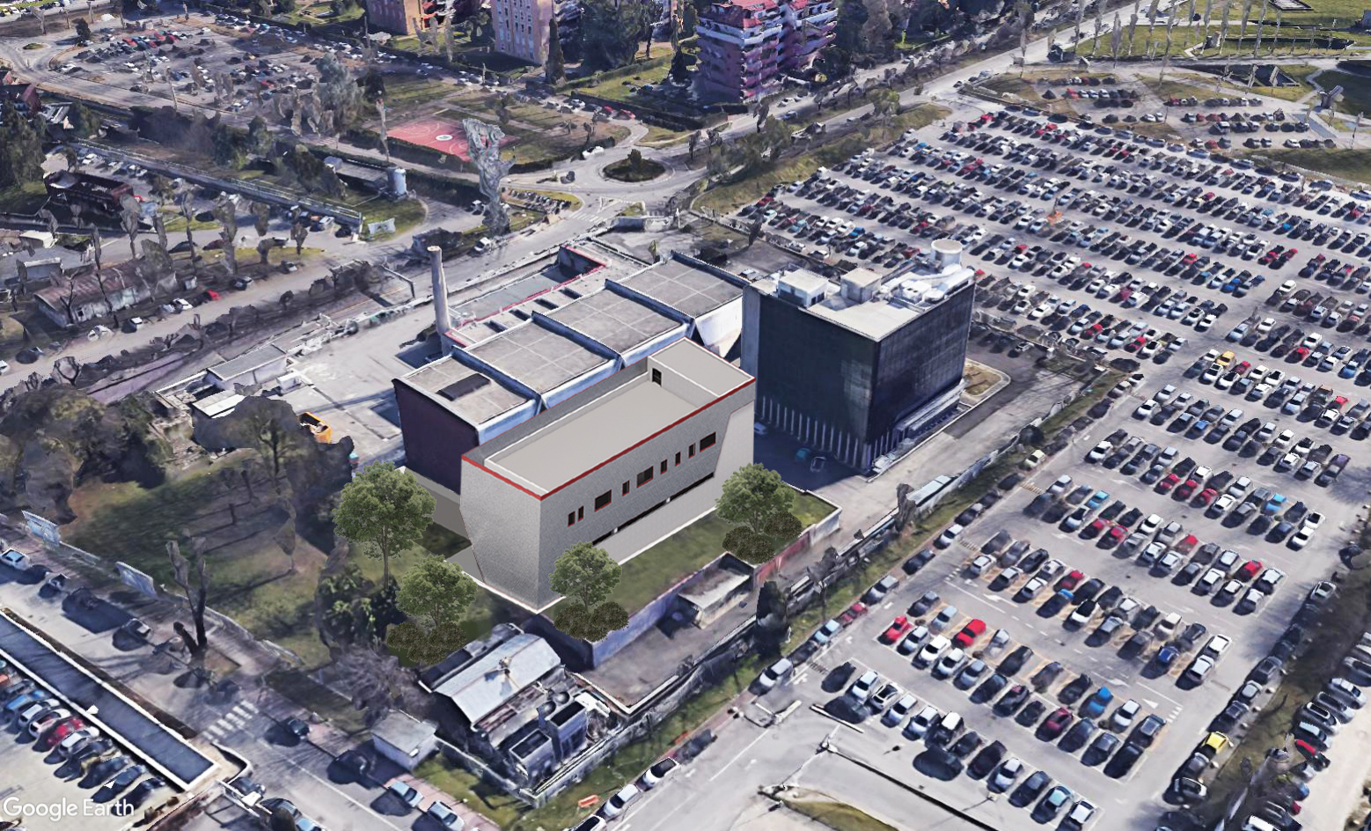
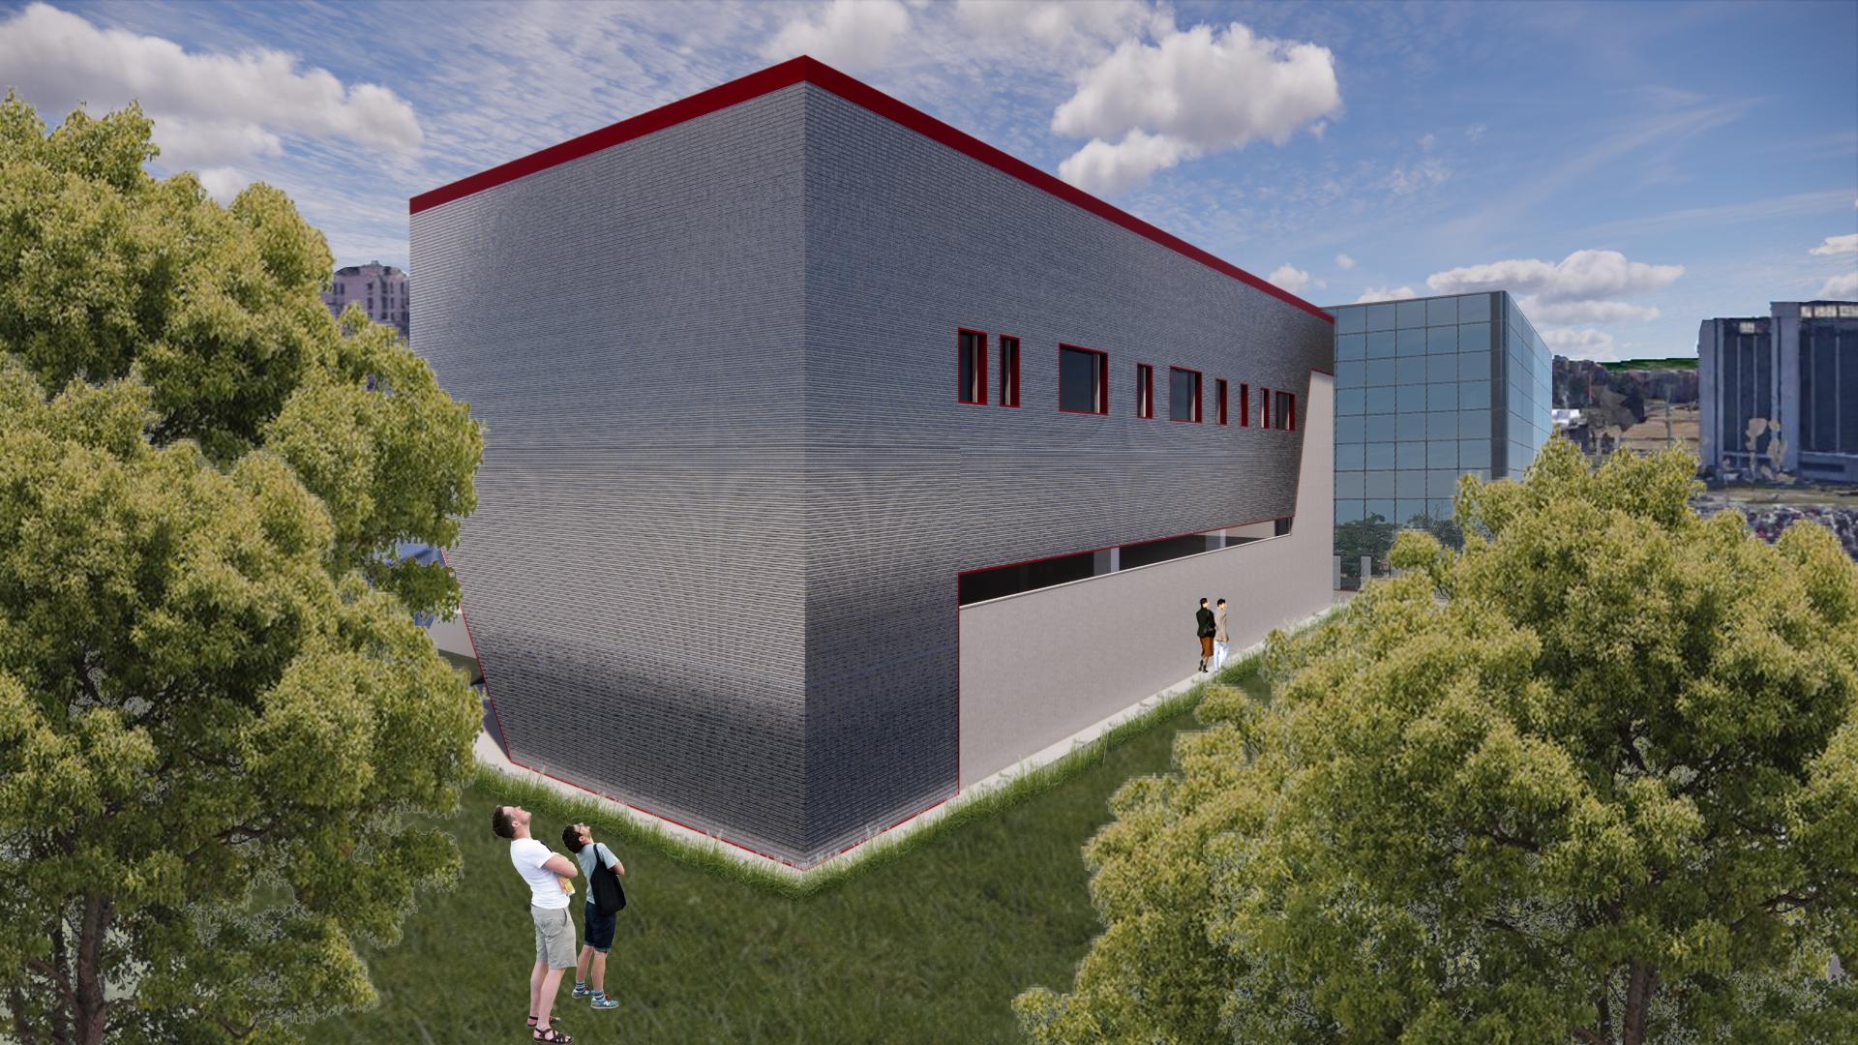
400 m2 surface building
2 floors (+ underground bunker)

Slide 16




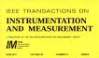
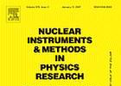

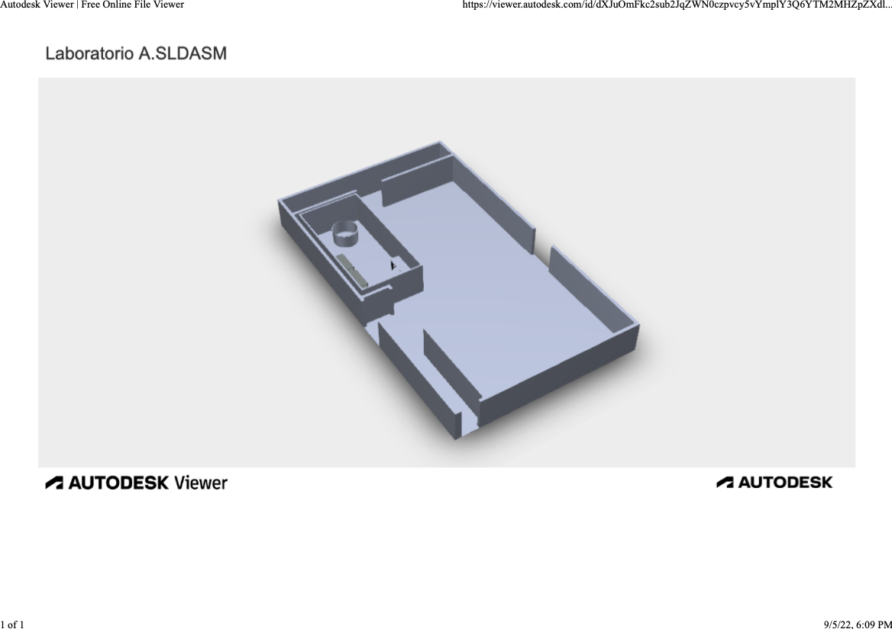
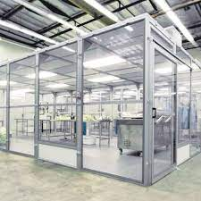







WP5 – Napoli – CIRMIS IMPALAB expertise
Magnetic measurements
Measurements on superconducting cables
Cryogenics
Aims new lab
  Extend the current instrumentation and measurement procedure for superconducting magnets and cable
  Improve the metrological feature of the measure
  Develop new procedures for facing the state of the hard challenge for LTS and HTS
2x
3x
2x
3x
7x
17.6 m
11.4 m
13x

Slide 17
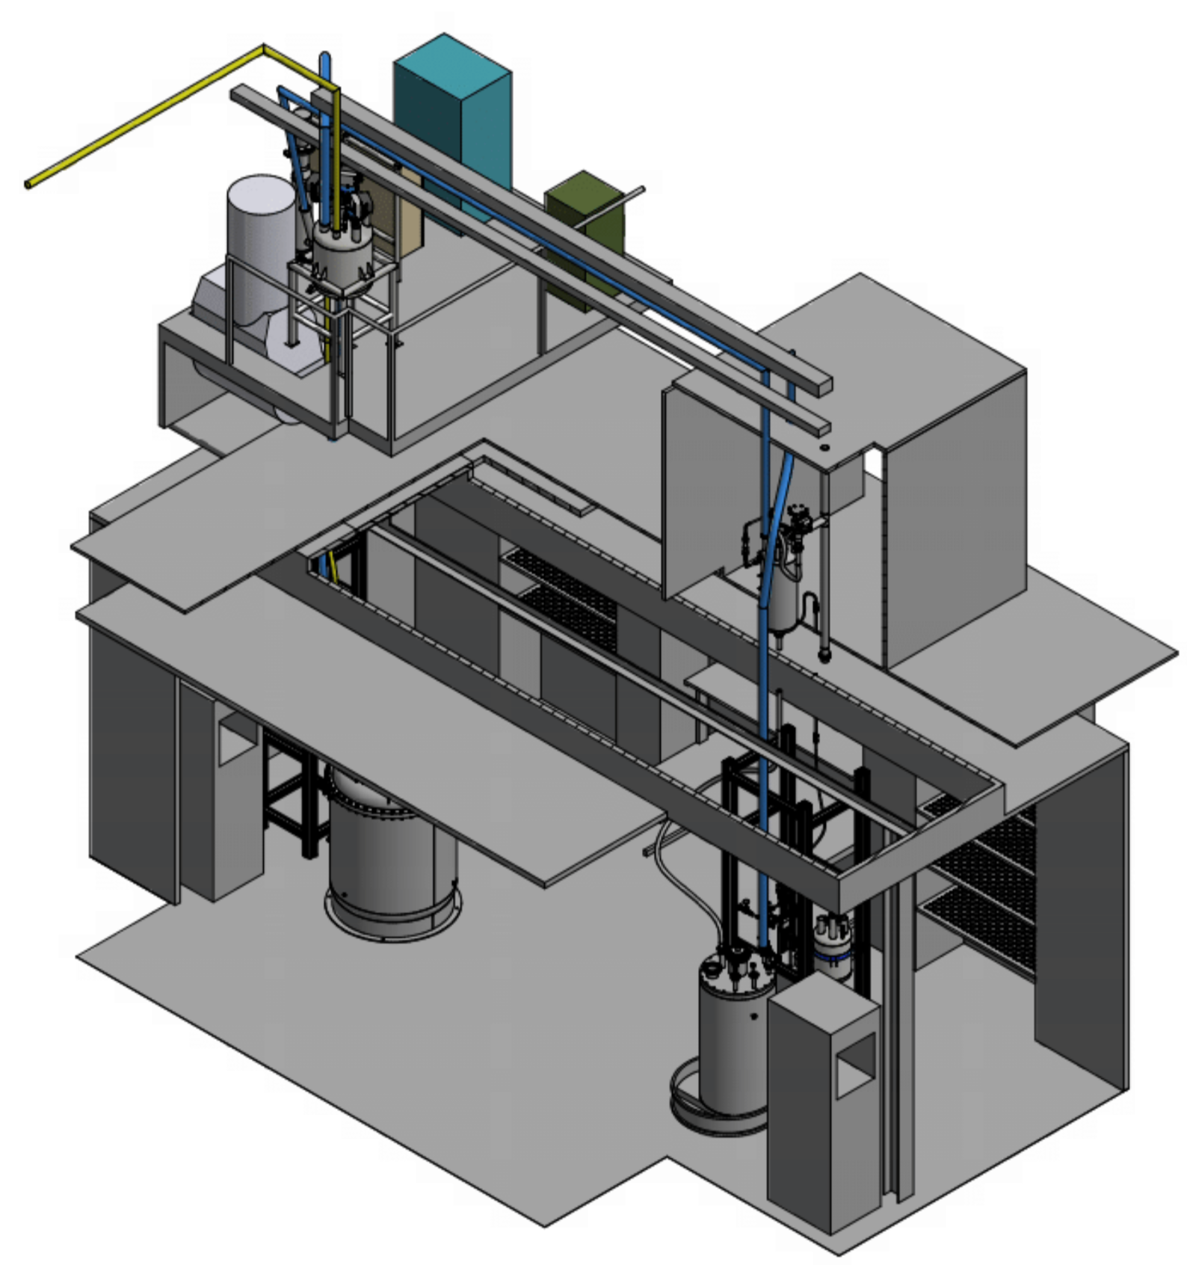
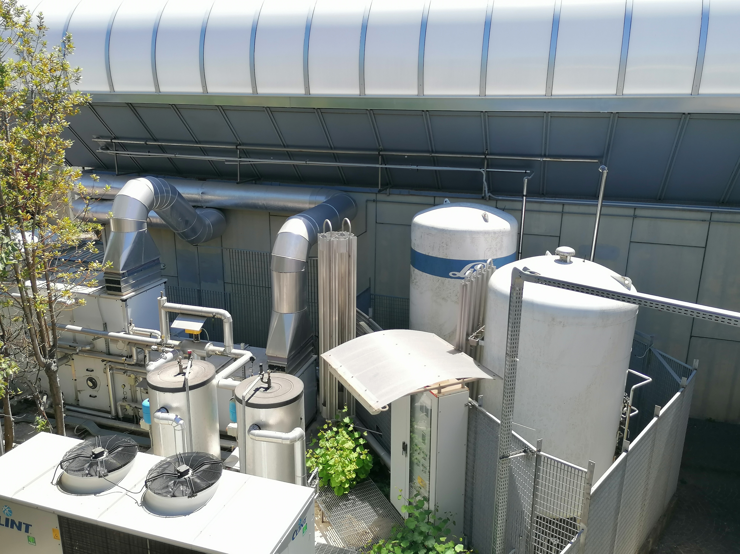
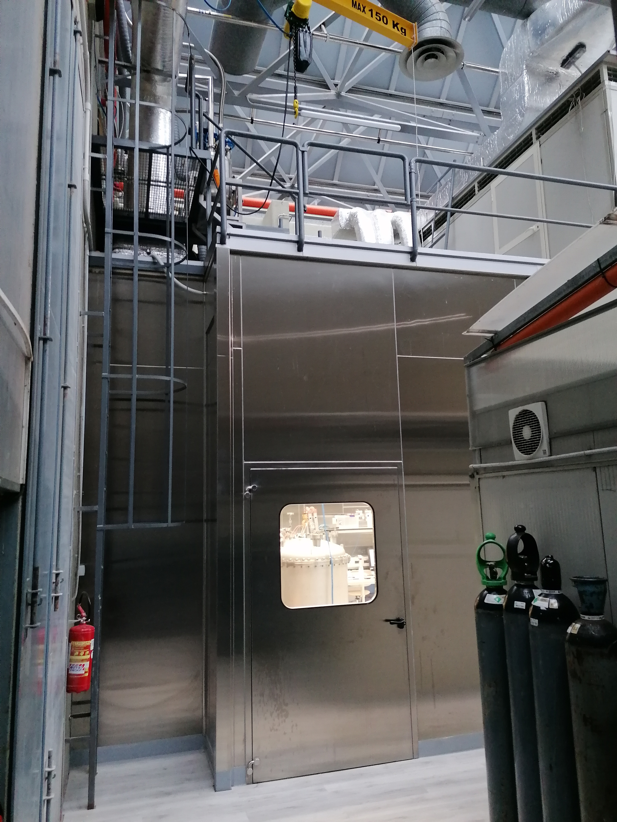
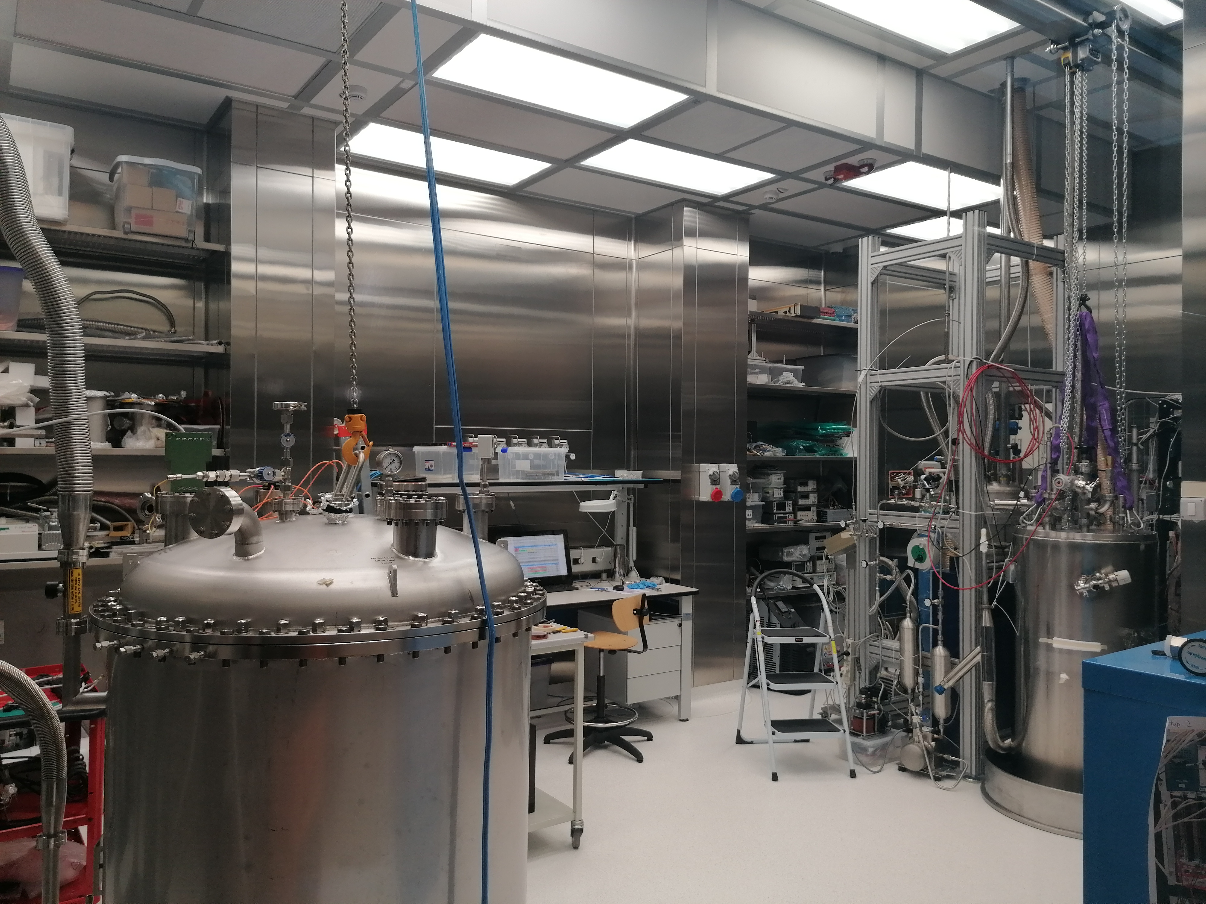
WP5 – Naples CRYOLAB
Light Detectors Test
Stand alone cryo system
Vacuum and cryogenic equipment
New
  Clean area for vacuum system and material deposition (Hardwall clean room approx. 6x4 m2)
  Liquid nitrogen cryostat
  Cryoprobe
  Low-temperature calibration system
  Dry system for low-temperature characterisation
Cryogenic liquids storage

Slide 18
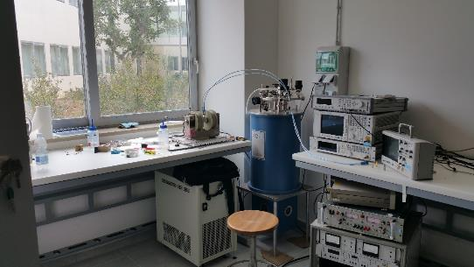
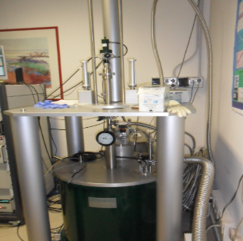
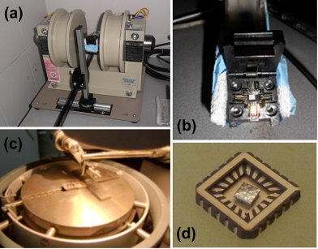
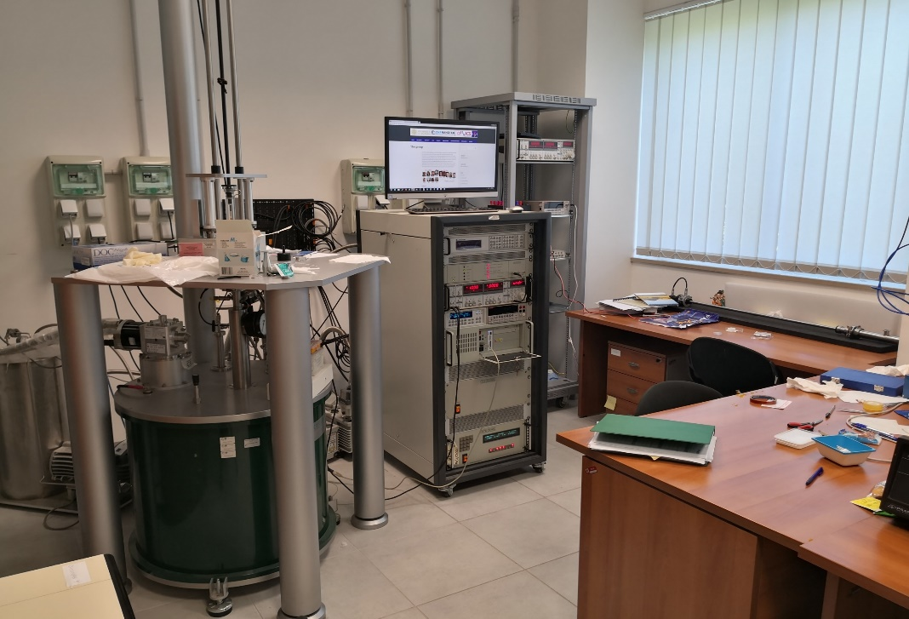
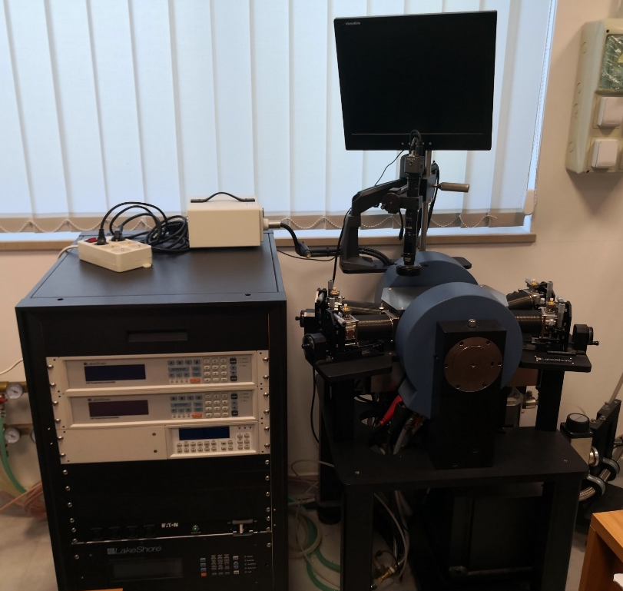
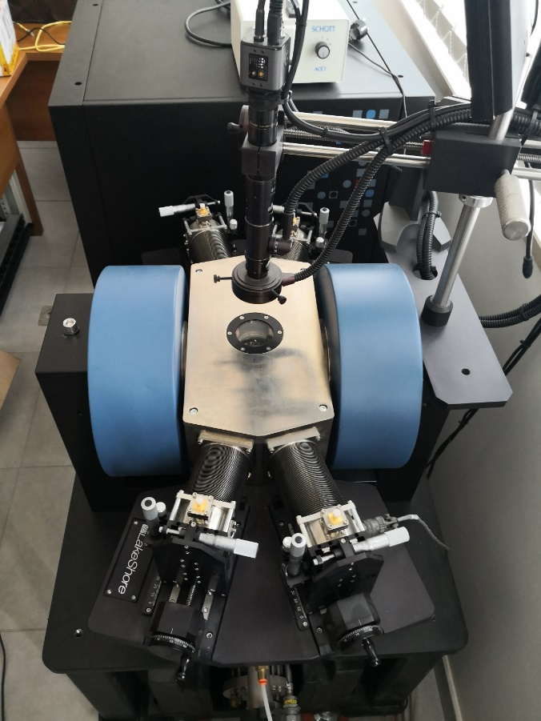
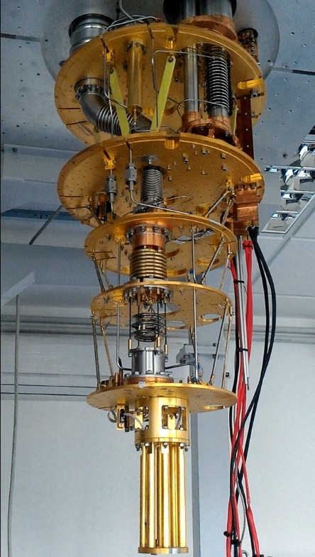
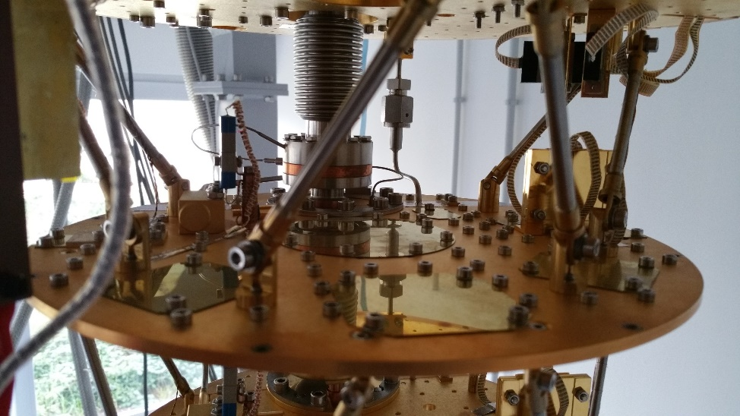
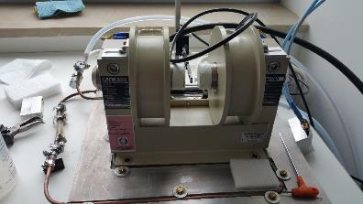
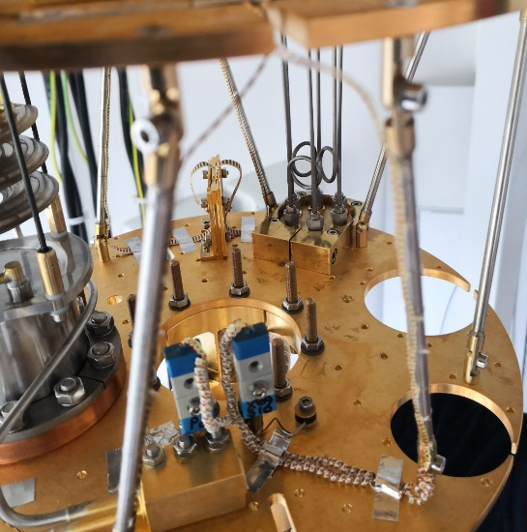
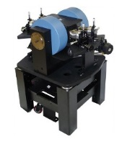

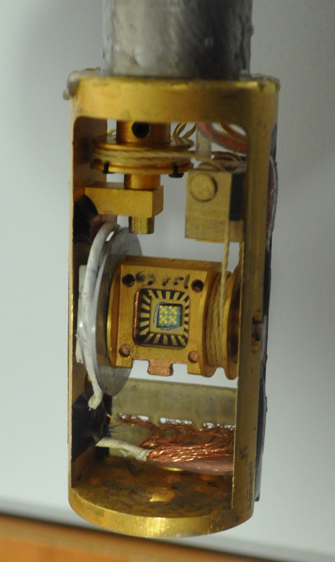
WP6 - Laboratorio di Superconduttività e Magnetismo -LECCE
Cryogenic superconducting magnet (10.5 T, 0.3-300 K)
Oxford dilution refrigerator (down to 10 mK, vector magnet 6T/1T/1T)
Lakeshore Cryogenic RF probe station (down to 8 K and up to 0.5 T and 70 GHz).
Italian node of the European Infrastructure on Magnetism EMHFL-ISABEL (funded within ISABEL project, H2020-INFRADEV-2018-2020, Grant No. 871106).

Slide 19
WP6 – Salerno
INFN-NA-G.C.Salerno, CNR-SPIN- UNISA
INFN-Salerno with UNISA has built and commissioned a new SC Magnet test facility in the last 5 year, THOR
It is used at present for testing GSI – SIS100 SC multiplets
With IRIS the INFN/Unisa facility will evolve by:
  Increasing the cryogenic power for SC magnets
  Ability to test magnets not only at Supercritical He flow and ability to test magnets of LHC/Hilumi/FCC size (however, no HEII at te moment)
  Adding a new test facility for Green SC Lines : up to 25 kV – 40 kA (1 GW),20 K He gas, with a dugout for cable as long as 140 m

Slide 20
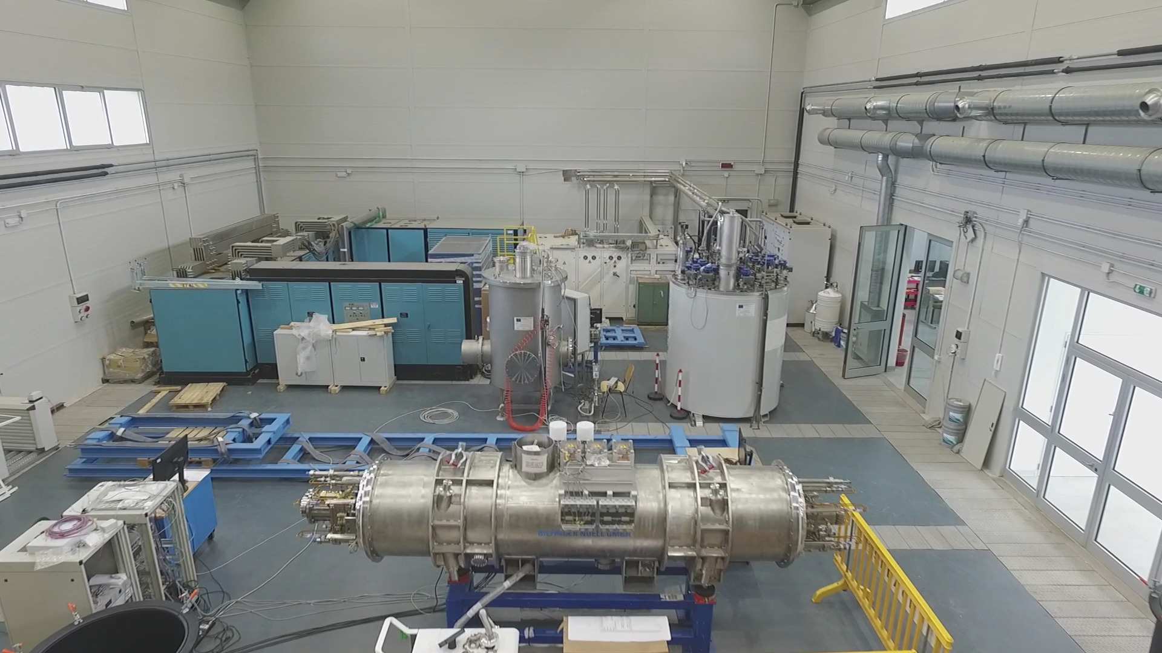
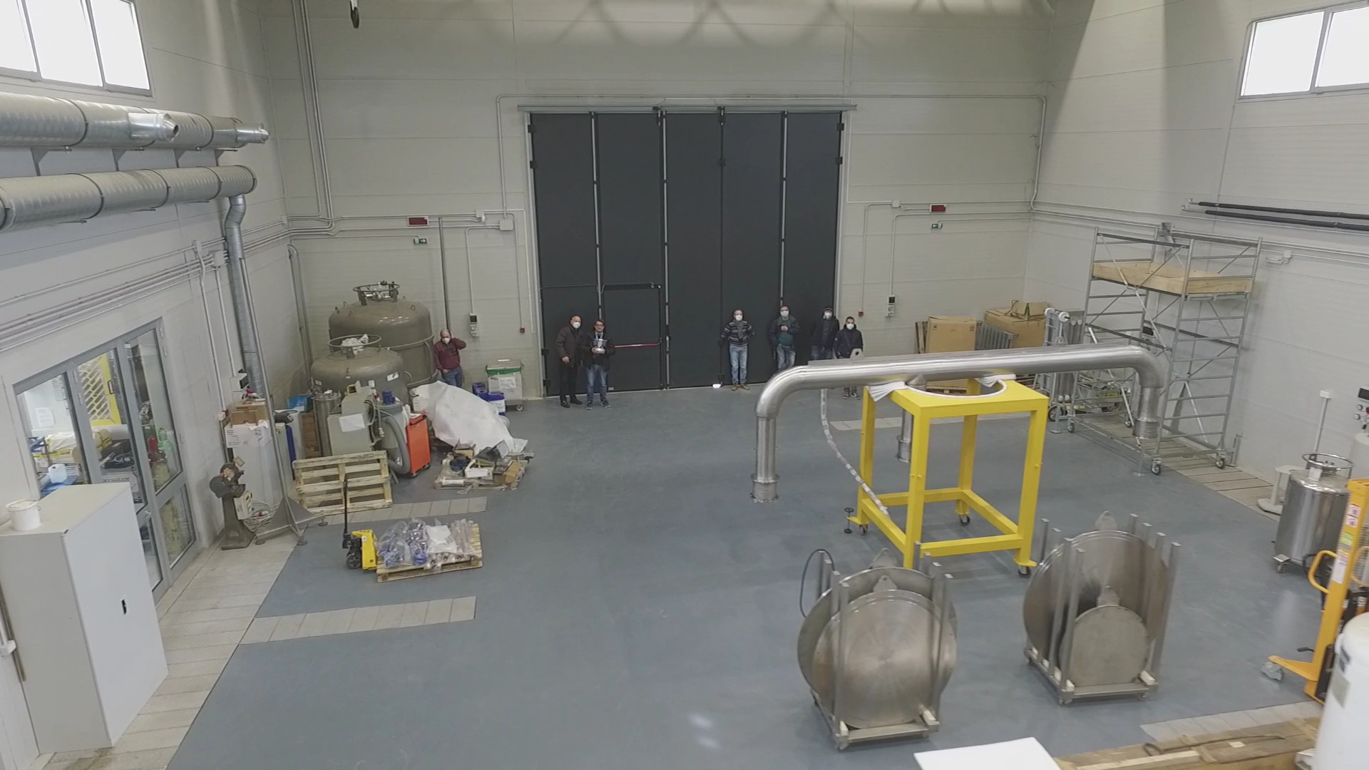
THOR Lab

Slide 21
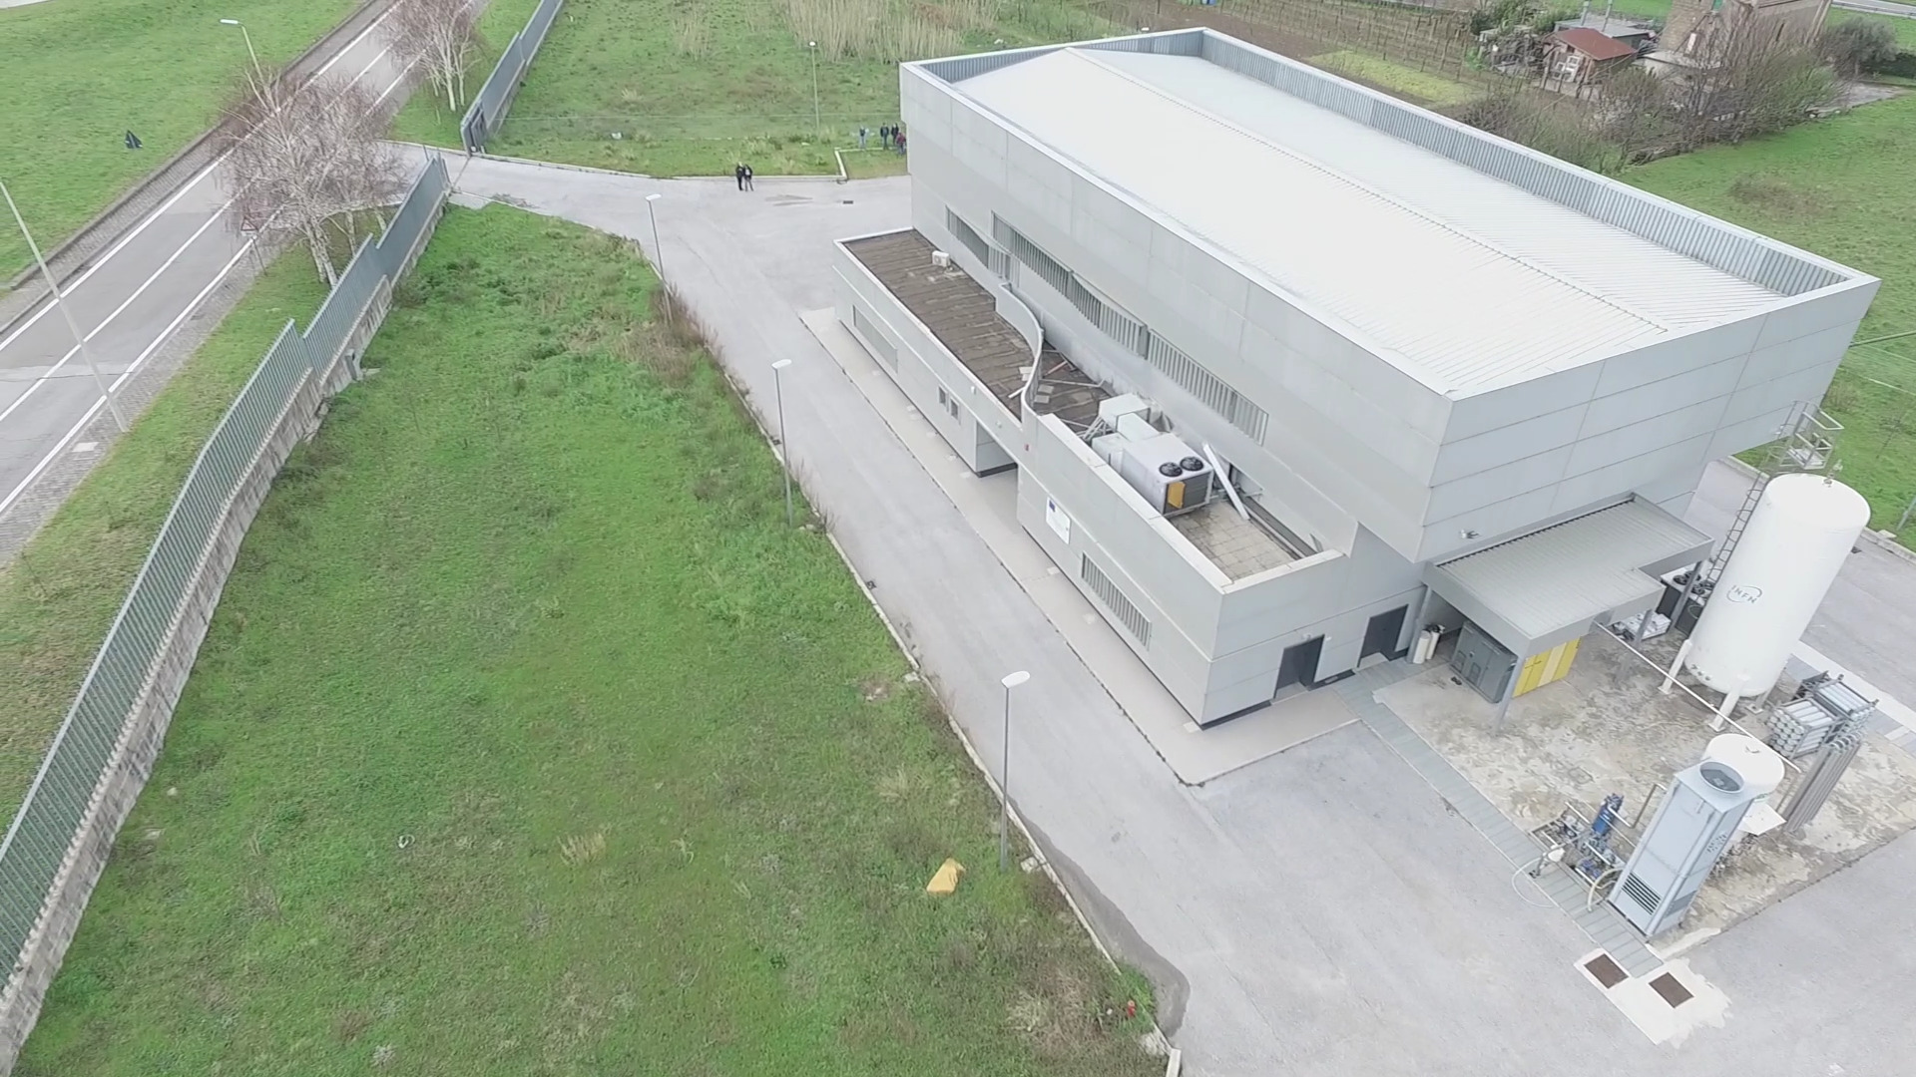
WP7 – Salerno – INFN & DIFI lab : present and IRIS extension
Present
Future with IRIS

Slide 22
We need to reduce the project in 3 days (not easy with a distributed infrastructure over 6 poles)
75 → 60 M€: keep all poles/partners, 60 M€ include taxes → 50 M€ net budget
To cope with requested reduction:
We have considered to modify part of the scope of demosntrators:
Reducing the current from 50 to 40 kA, compensated by an increase of voltage from 20 to 25 kV, which make it easier and allows for a small reduction of the budget, at constant goal of P= 1 GW
Energy saving HTS Magnets: it is a difficult goal, given the time frame. To help a budget cut we changed the scope. From 10 T - 150 mm → 8 T – 80 mm; preserving the aspect of energy saving (10-20 K)
Civil Engineering. The new constructions are in Milano and Salerno. In Milano we have re-modulated the project and considered a simple industrial building (a “hangar” ). Salerno will simplify the C.E. scope, too, with one building only instead of two.

Slide 23
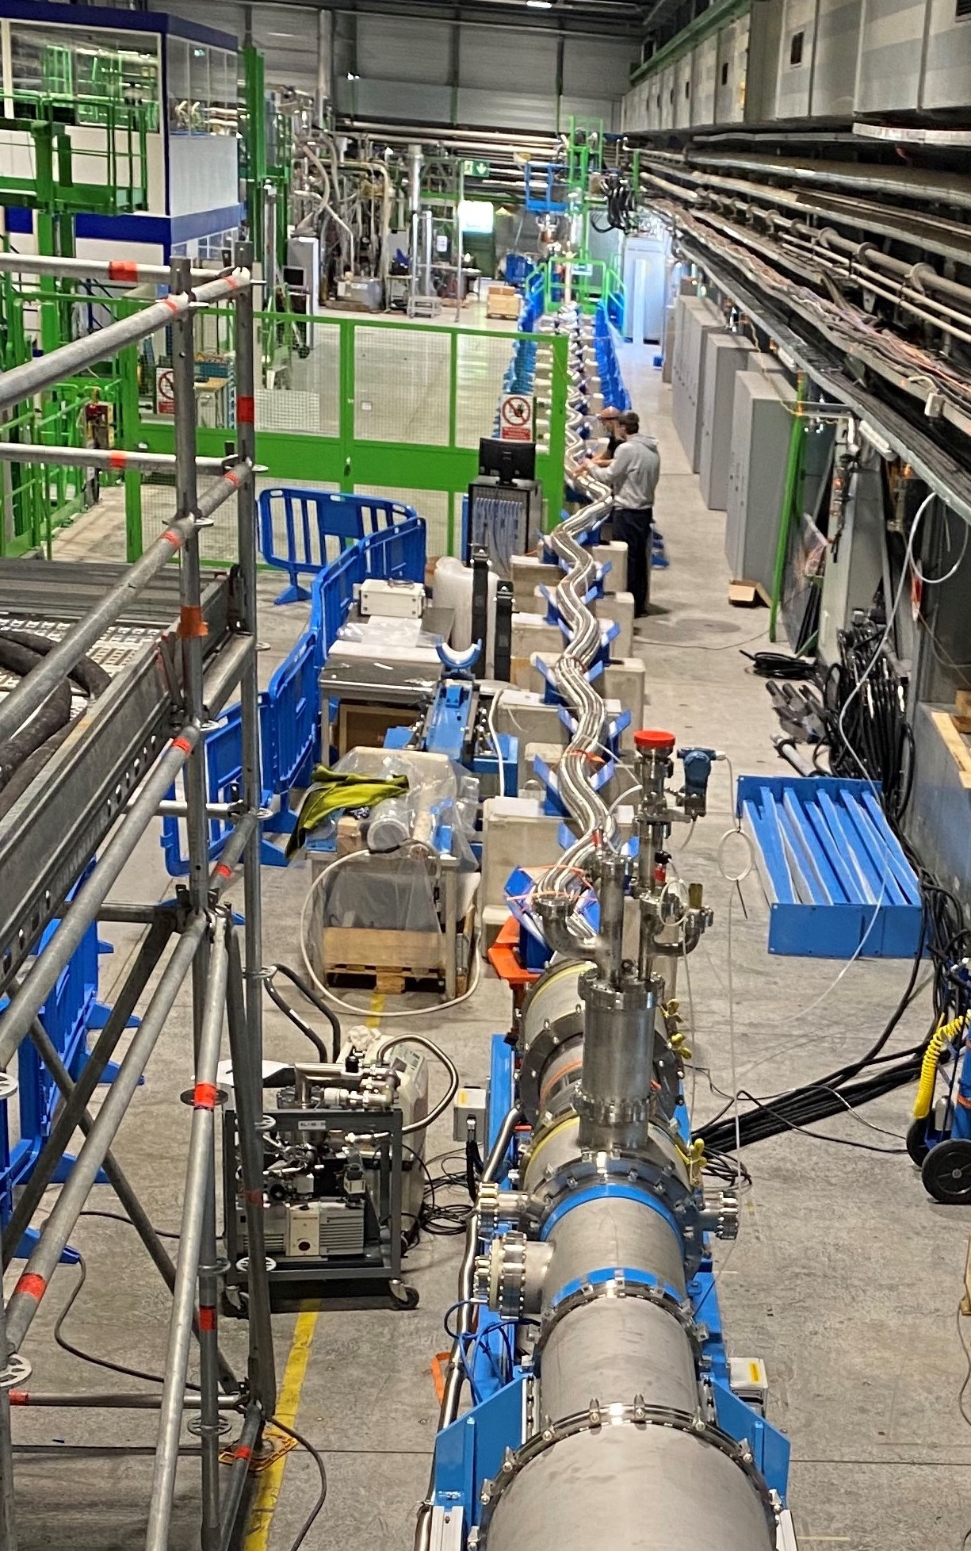
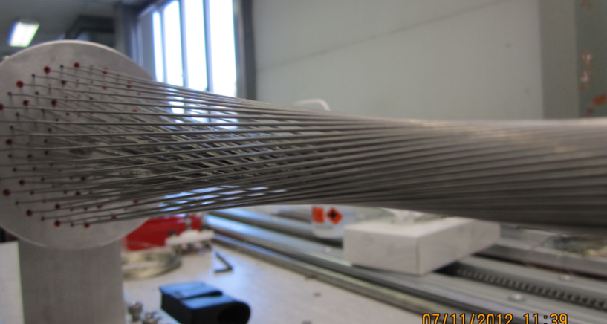
(courtesy of A. Ballarino, CERN, archive)
Left: Superconducting Line, in its flexible cryostat, 60 m , 100 kA – 3 kV, during successful test in 2020 at CERN for the High Luminosity LHC Project
Right: cabling a sub-element of a MgB₂ cable for High Luminosity LHC Project
Scope: Manufacturing a demonstrator capable of 1 GW DC, operated at 20 K and test it in “operative” conditions in a test facility that will then be available for other projects. 25 kV-40kA, 20 K; (50+ kV testing) - use of round wire MgB₂
Use: beside long-distance large electrical power transmission, significant place in the electric system for HVDC back-to-back system (study for placing the demonstrator in an Italian facility after the PNRR).
We will design the facility and this demo for cooling with He gas; however, in second stage after IRIS, compatibility with LH cooling will be investigated, too.
(courtesy of A. Ballarino, CERN, archive)

Slide 24



Iris project design: 4x40 kA -25kV 20 K
Gaz He
Cryogenic
Outer Cryogenic wall ID 198/OD 220
Inner Cryogenic wall ID 127/OD 143
Characteristics
Length (m) | 75 m
Inner envelope diameter (mm) | 127/143
Outer envelope diameter (mm) | 198/220
Bending radius (m) | 2,2 m
Expected losses | 2,5 W/m at 20K (187,5 W)
P in | 20 bar
T In/T out | 18K/20K
Expected cooling power at 18 K≈330-370 W including the 2 terminaisons, cryo ends…
Mass flow: ≈15 g/s
Pressure drop ≈ 0,4 mbar.
LN₂ required for the current leads of the terminations.
Drum for envelope maximum diameter of 4,5 m
Vacuum chamber
Low thermal conduction spacer

Slide 25
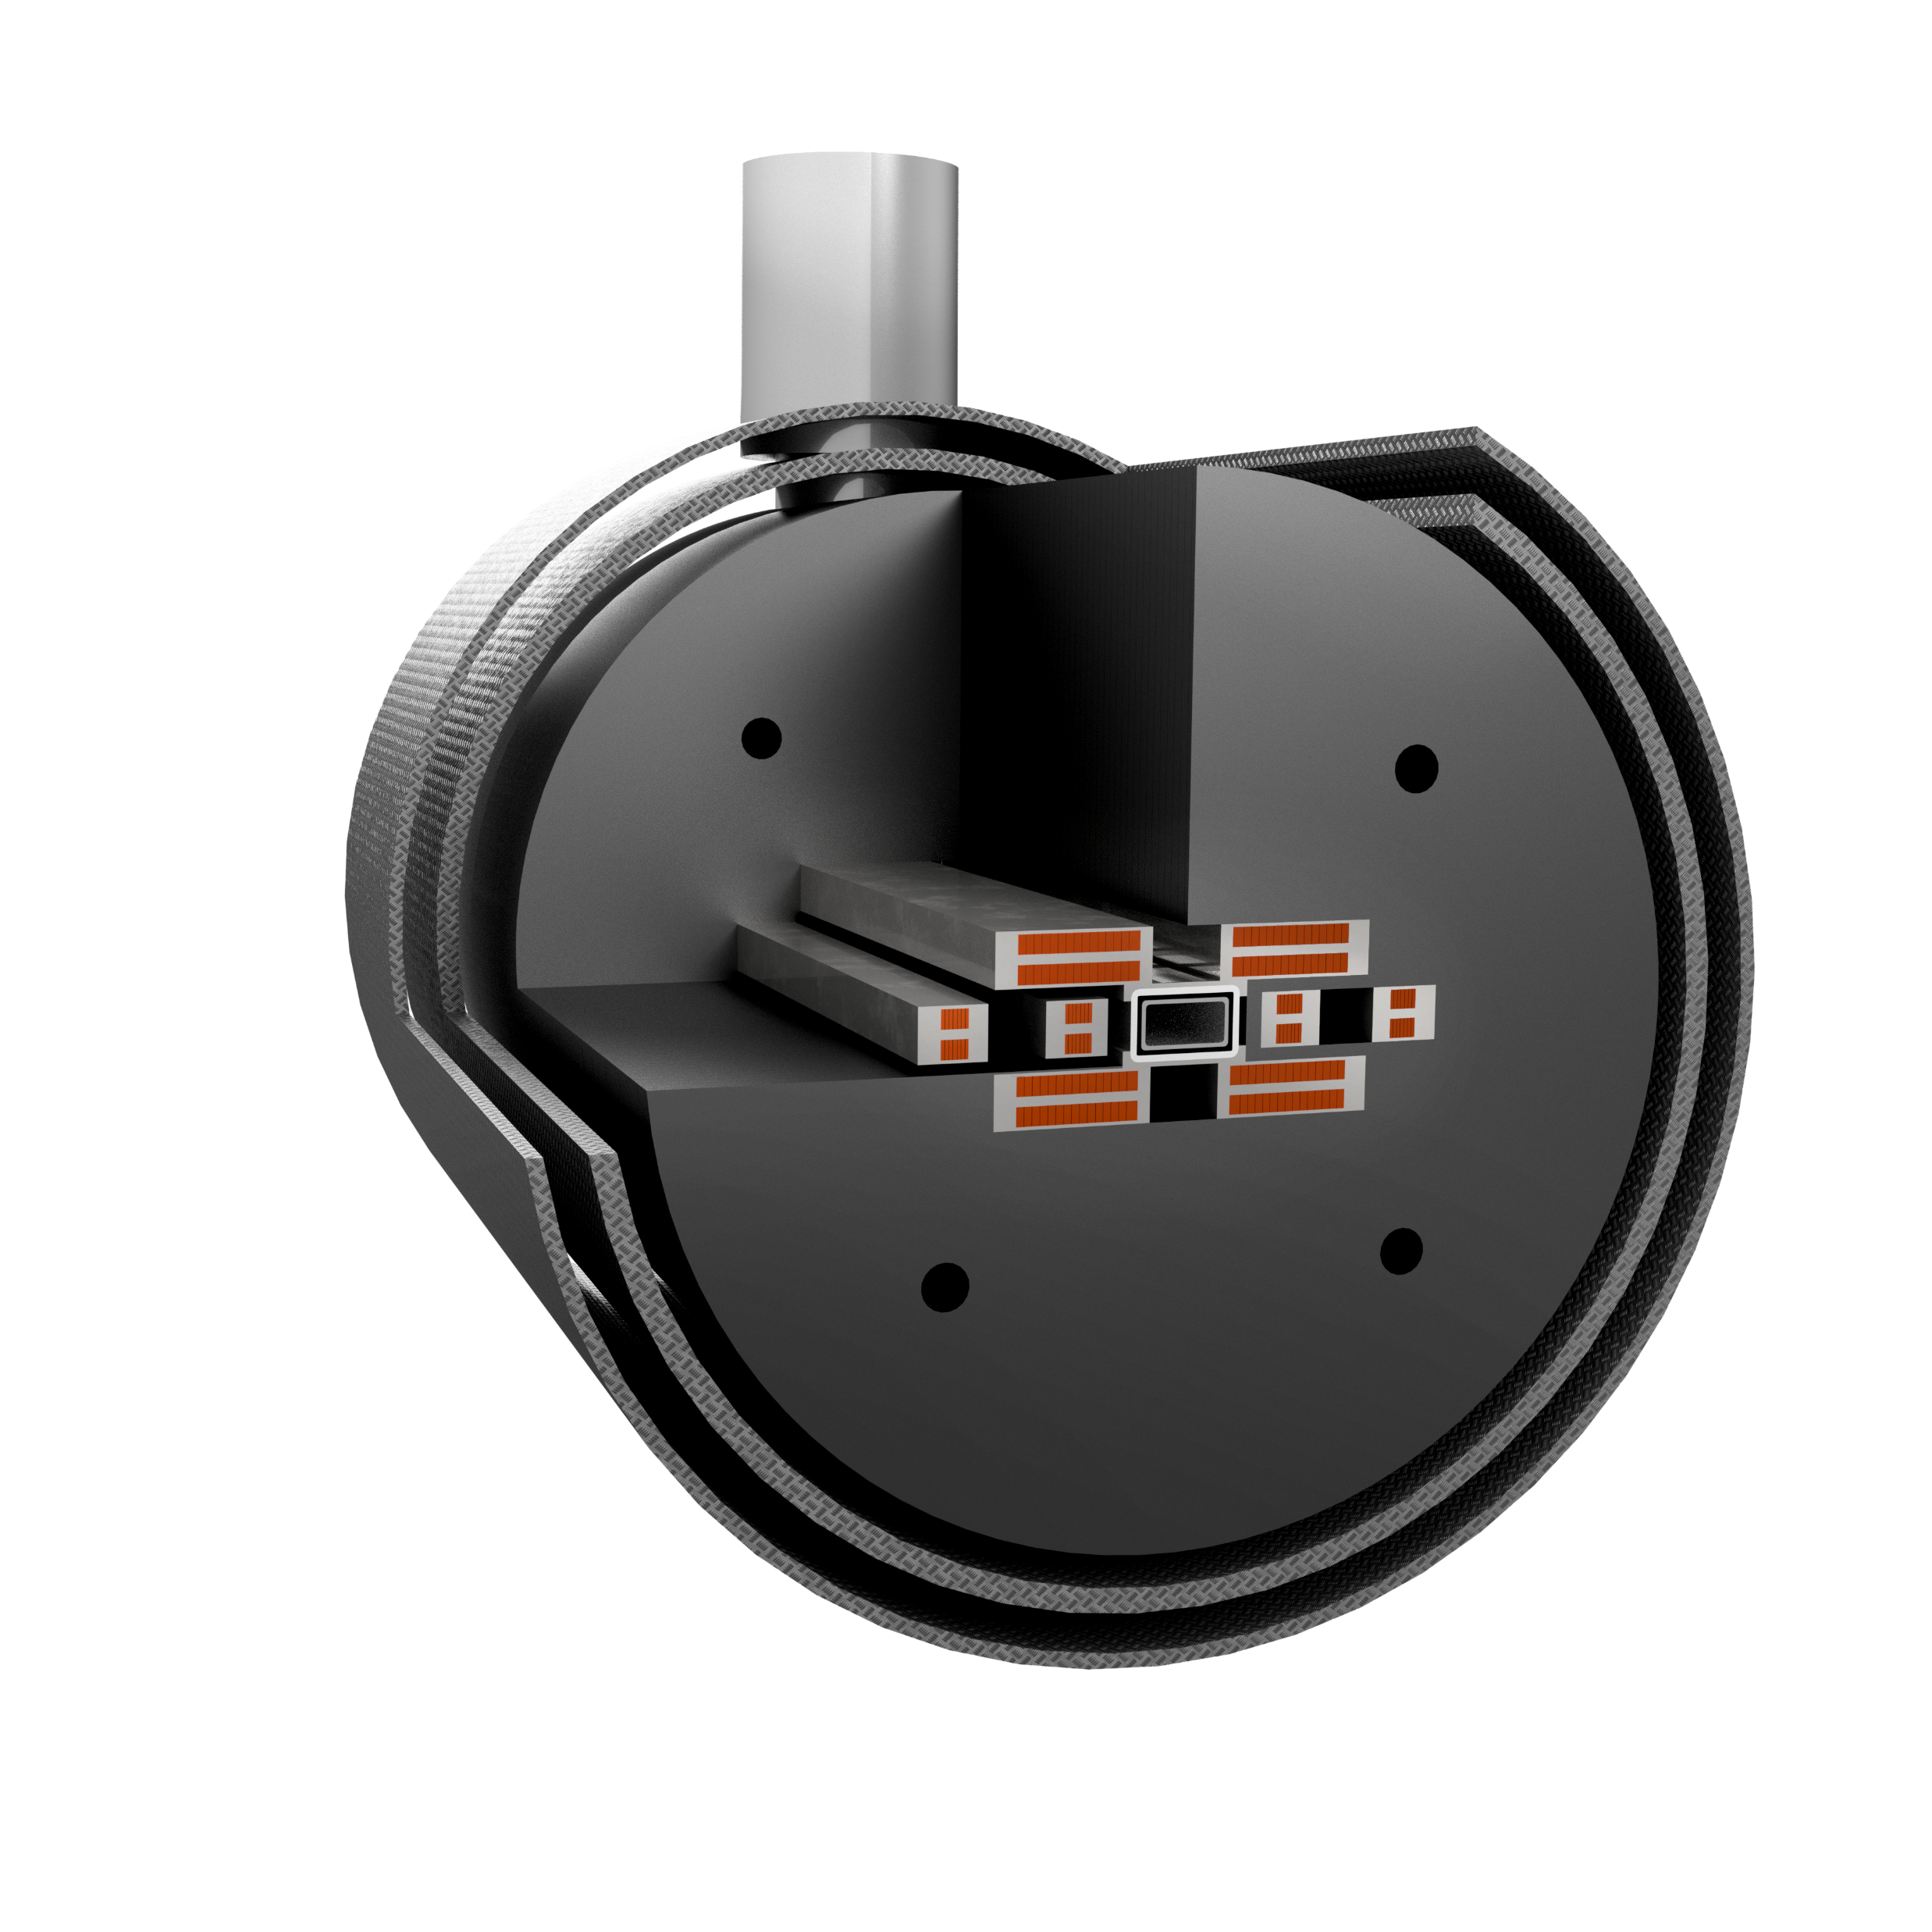
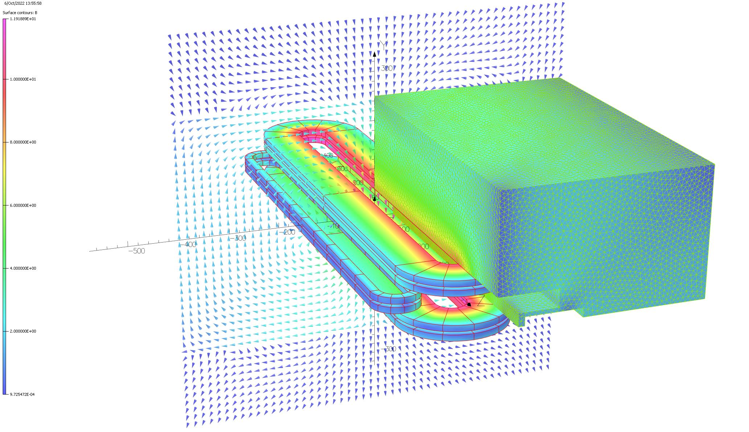
Dipole of 50x80 mm aperture, 8-10 T , used as background field for cable test:
1) operation of dipole with cryogen-free technology
2) non-insulated (better: Controlled-Insulation) technology in dipoles
The dipole will be installed in Genova – IRIS WP3 facility

