Slide 1
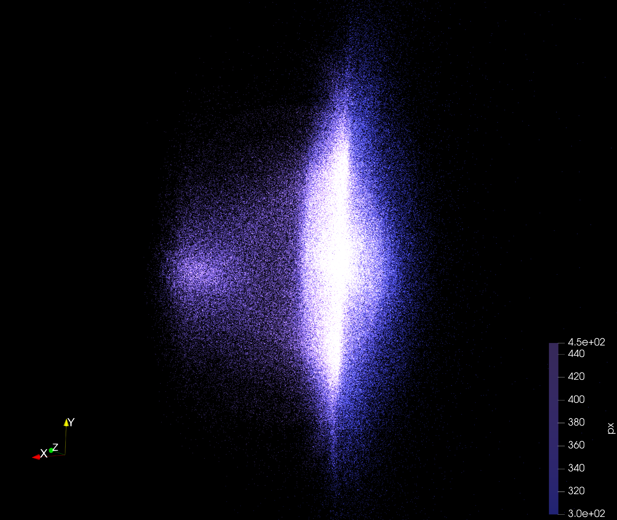

EARLI: Designing a LWFA for AWAKE
S. Marini, D. F. G. Minenna, P. A. P. Nghiem & N. Pichoff
CEA, IRFU, DACM, Université Paris-Saclay
V. Bencini, S. Doebert, J. Farmer, E. Gschwendtner
CERN
B. Cros, F. Massimo & I. Moulanier
LPGP, CNRS, Université Paris-Sud, Université Paris-Saclay
P. Muggli
Max Planck Institute for Physics
S. Bethuys, A. Jeandet, S. Ricaud & C. Simon-Boisson
Thales LAS

Slide 2
Contents
Plasma acceleration
AWAKE experiment
EARLI project

Slide 3
Plasma acceleration
1
And plasma accelerators

Slide 4
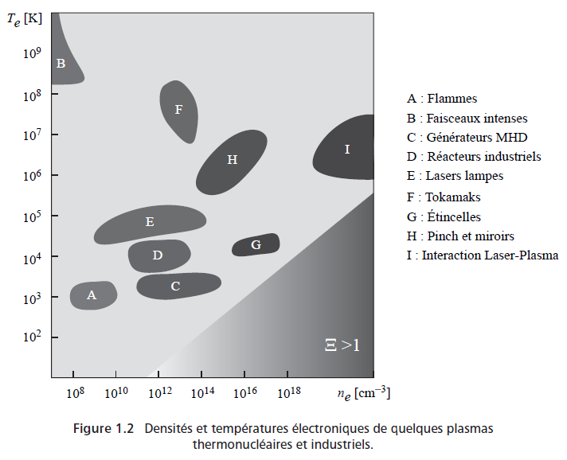
What is a plasma?
Ionised gas
Matter with a significant proportion of free charge
99% of matter (baryonic and leptonic)
Stellar interior, interstellar medium, solar wind, solar corona, magnetosphere, ionosphere, lightning, …
Plasma physics
Industry, space, astrophysics, thermonuclear, lasers ...
Rax, Physique des plasmas (2005)

Slide 5
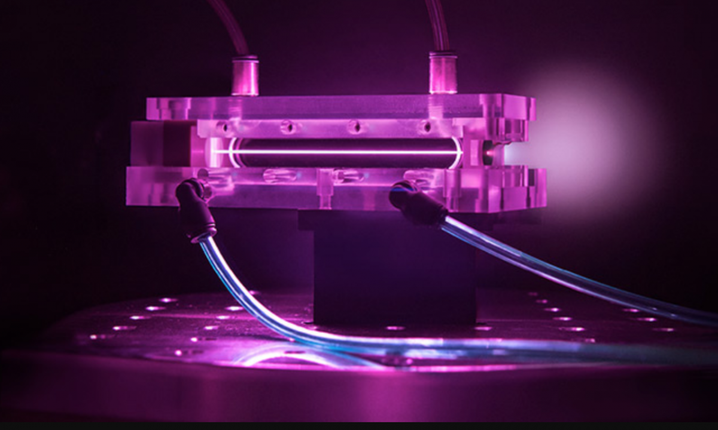
BELLA experiment
LBNL, Berkeley
7.8 GeV peak (5%)
20 cm plasma
Laser: 850 TW
Gonsalves, PRL (2019). Picture: https://science.thewire.in/

Slide 6
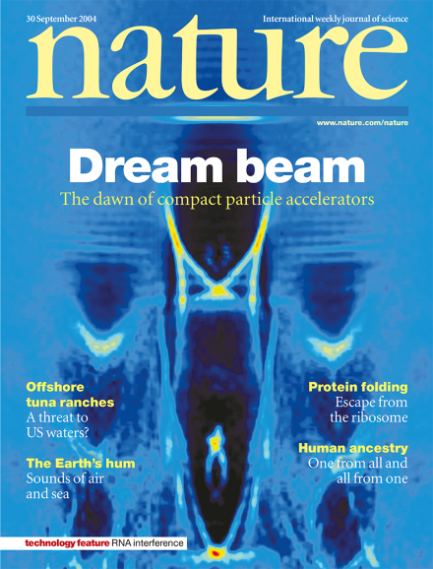
Concepts
Theoric
Laser-driven
1957: V. I. Veksler, Sov. J. Atomic Energy
1979: T. Tajima and J. M. Dawson, Phys. Rev. Lett.
Beam-driven
1985: P. Chen et al., Phys. Rev. Lett.
Experimental demonstrations
2005: Dream beam (80-180 MeV)
C. G. R. Geddes et al., Nature
S. P. D. Mangles et al., Nature
J. Faure et al., Nature

Slide 7
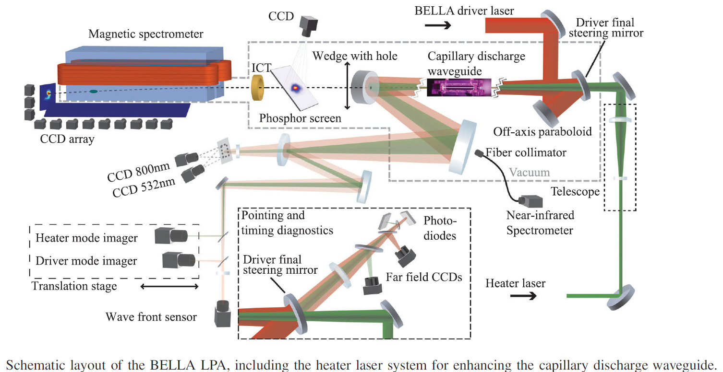
Concepts
Experimental demonstrations
2007: K. Nakamura et al., Phys. Plasmas (1 GeV)
2013: X. Wang et al., Nature Comm. (2 GeV)
2013: H. T. Kim et al., Phys. Rev. Lett. (3 GeV)
2014: W. P. Leemans et al., Phys. Rev. Lett. (4 GeV)
2019: A. J. Gonsalves et al., Phys. Rev. Lett. (8 GeV)

Slide 8
Concepts
Simulations and physics
Multi GeV
2013: B. S. Paradkar et al., Phys. Plasmas (10 GeV)
2007: W. Lu et al., Phys. Rev. STAB (100 GeV)
TeV colliders
2010: C. B. Schroeder et al., Phys. Rev. STAB (1 TeV)

Slide 9
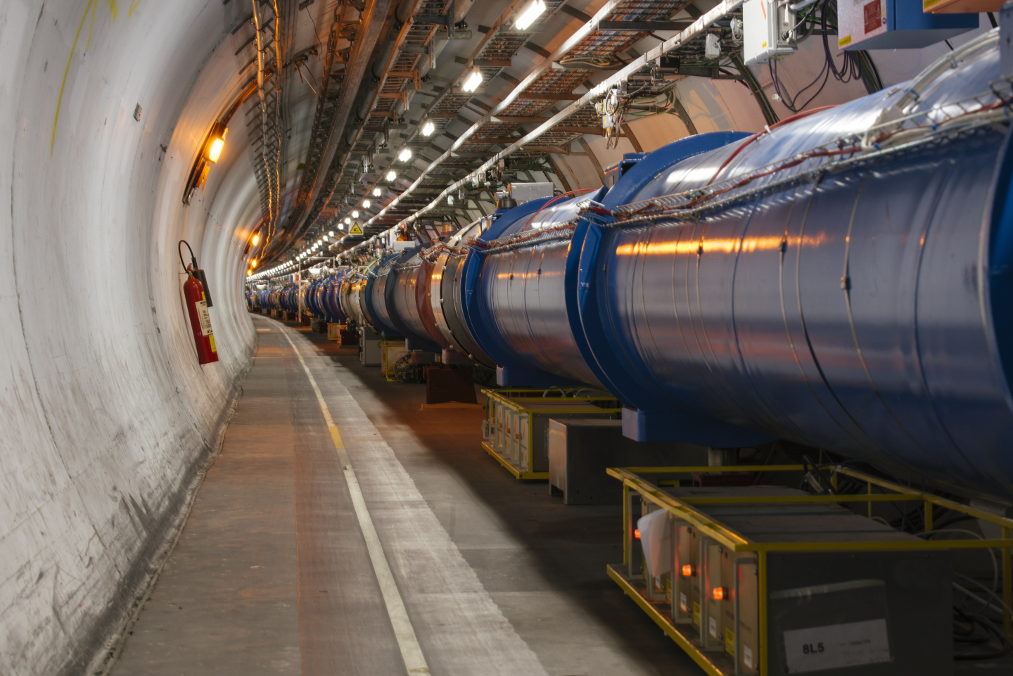

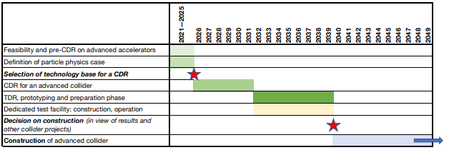
Plasma colliders
It is expected that a plasma-based collider can only become available for particle physics experiments beyond 2050, given the required feasibility and R&D work described in this report. It is therefore an option for a compact collider facility beyond the timeline of an eventual FCC-hh facility.
European Strategy for Particle Physics - Accelerator R&D Roadmap, CERN Yellow Reports (2022). Figure: R. Assmann (DESY)

Slide 10
Applications for plasma accelerator
Light sources
X-ray scanners
Particle sources
Injector for accelerator facilities
Injector for plasma facilities
Free electron lasers
Medical applications
Flash therapy (strong irradiation > 200 Gy/s)
VHEE (high energy > 100 MeV)
Future colliders (multi-stage)
High energy physics
Advantages
Disadvantages
Size & Cost
Tunable
Short pulses
Immature R&D
Low beam quality (Emittance, energy spread)
Stability and reproducibility

Slide 11
AWAKE experiement
2
and beam-driven plasma accelerators

Slide 12
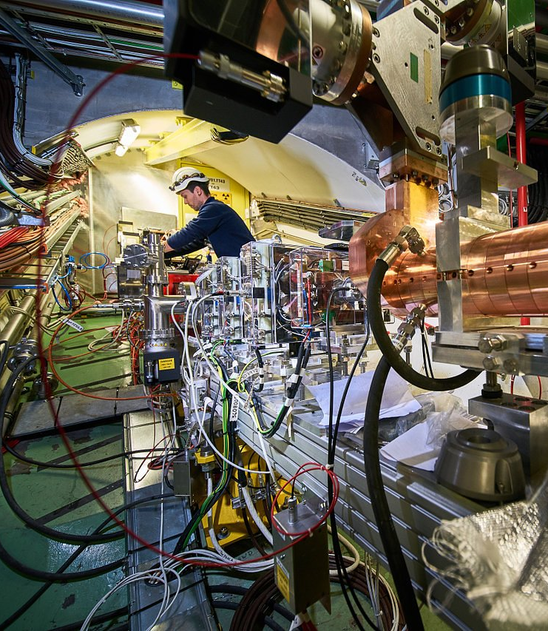
AWAKE experiement
Advanced Proton Driven Plasma Wakefield Acceleration Experiment
Accelerator R&D project (gradient of a few GV/m)
Based at the CERN Neutrinos to Gran Sasso (CNGS) facility
International scientific collaboration
23 institutes
Run1 (2016 - 2018)
Demonstrate seeded self-modulation of the proton bunch in plasma
Demonstrate electron acceleration in plasma wakefield driven by a self-modulated proton bunch

Slide 13
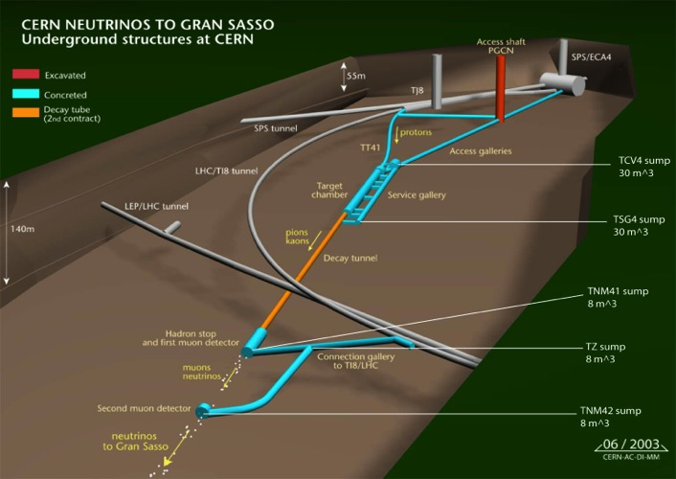
AWAKE installed in CERN underground
AWAKE
~50m
Control
room
protons
SPS
~1000m
AWAKE Run 1, 2a/b experiment < 2026
AWAKE Run 2c/d experiment >2027
LHC
~1100m
beam dump
Slide: E. Gschwendtner, CERN

Slide 14
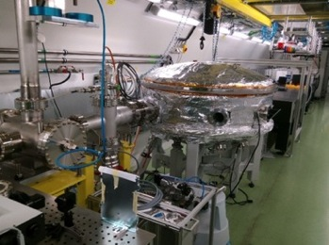
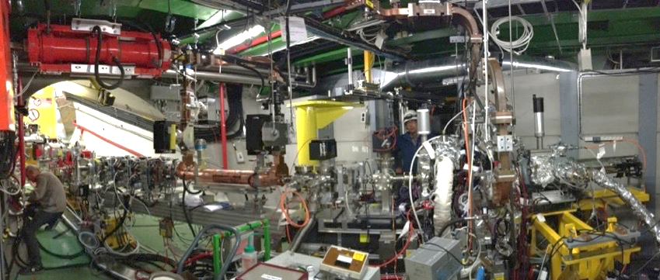
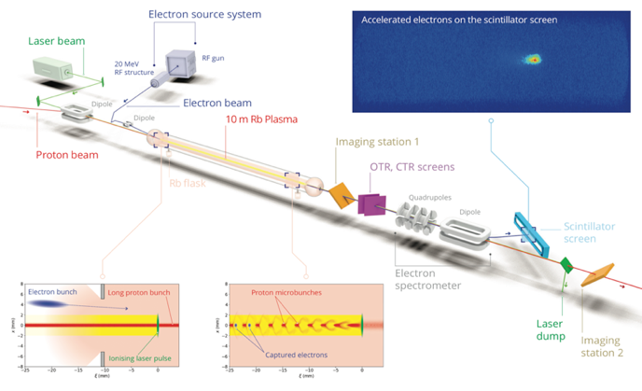
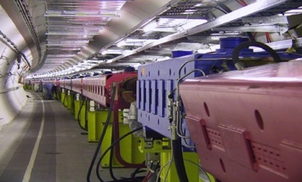
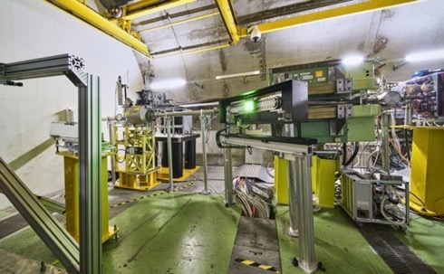
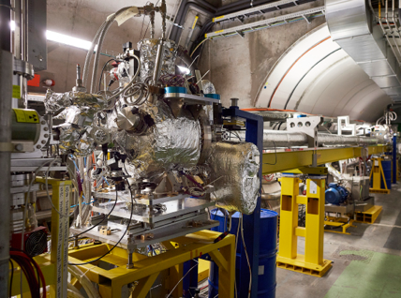
AWAKE Run1
Laser line
Transfer line
Diagnostics and booster structure
Electron source
500mJ
120fs
20 MeV
4x10⁹ e
2ps
Laser, compressor in laser room
400 GeV
3x10¹¹ p
400ps
Diagnostics
750m proton beam line
10m Plasma cell in AWAKE tunnel
Slide: E. Gschwendtner, CERN

Slide 15
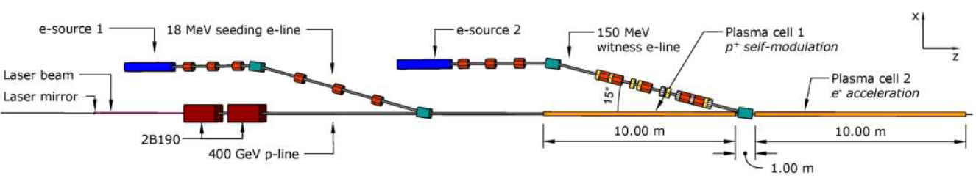
AWAKE Run2c
Run 2c
New 10 m Rb plasma source
For electron acceleration and emittance control
Demonstrate scalable plasma source technology
Need a new electron source
Plasma cell of Run1
New plasma cell for Run2c
Slide: S. Doebert, CERN

Slide 16
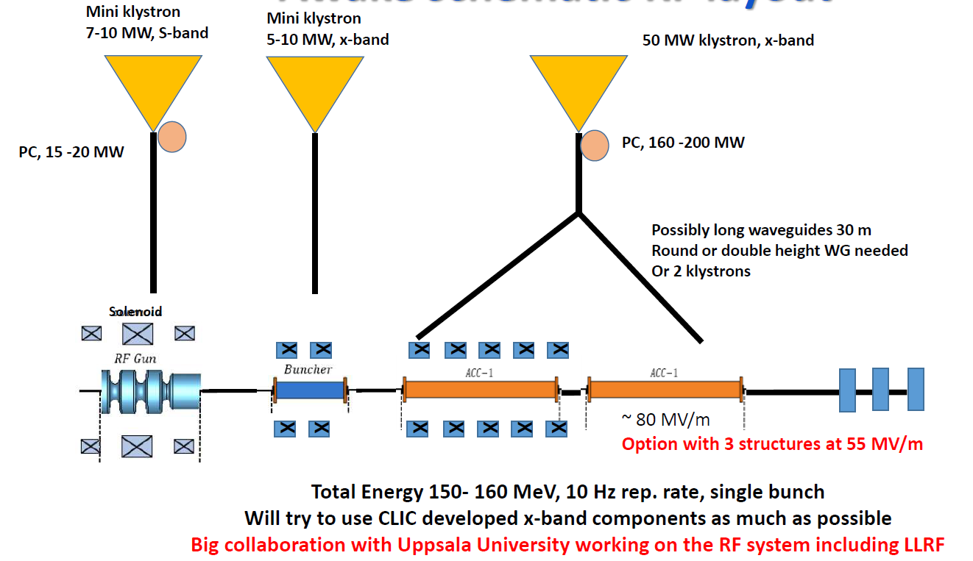
CERN electron gun
Slide: S. Doebert, CERN

Slide 17
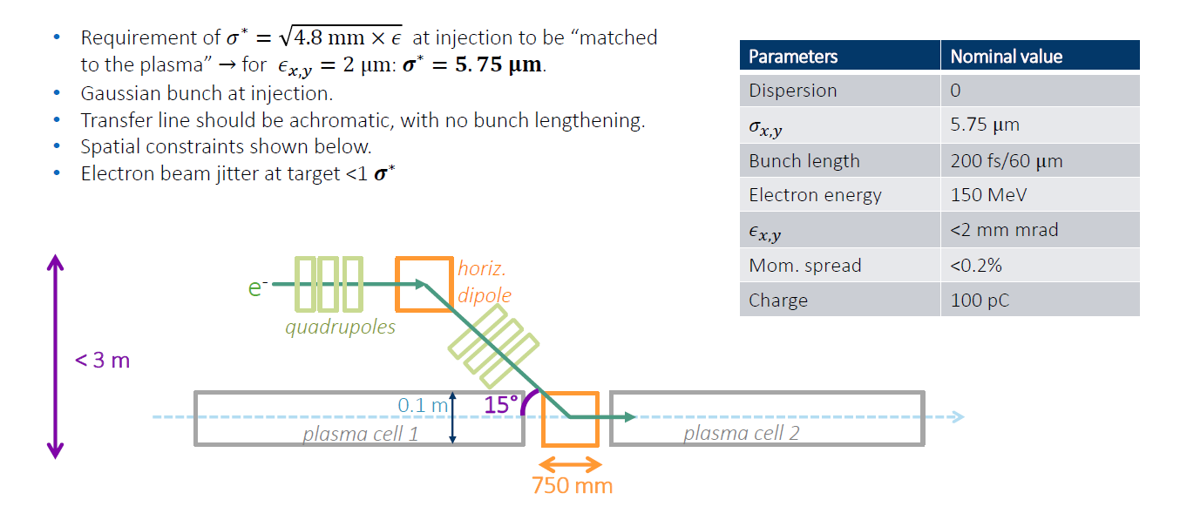
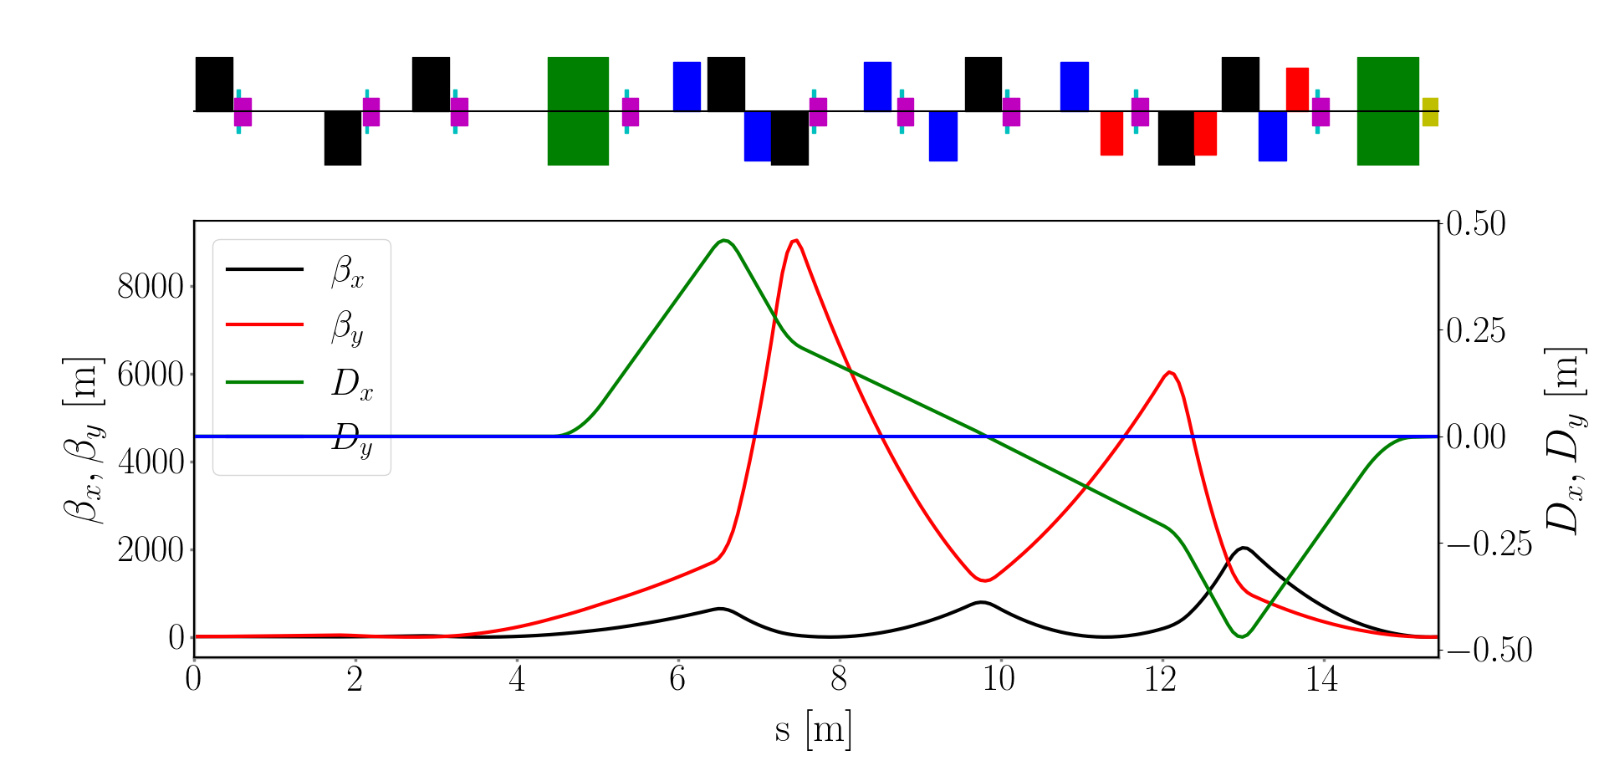
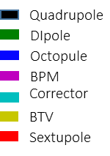
CERN transfer line
Slide: V. Bencini, CERN. CERN design by V. Bencini, R. Ramjiawan, F. Velotti

Slide 18
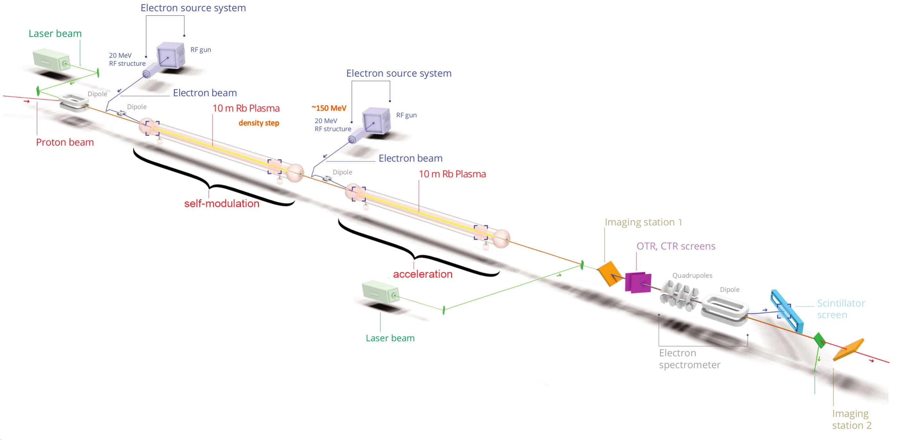
AWAKE Run2c electron source needed
Using a laser wakefield accelerator (LWFA) instead?
⇒ EARLI
(Is it feasible?)

Slide 19
EARLI project
3
A laser wakefield accelerator for AWAKE

Slide 20
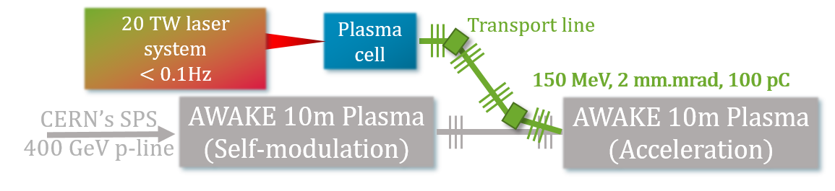
EARLI project
LWFA-based electron injector for AWAKE Run2c
Alternative to RF injector
Smaller footprint?
Reproducible, high-quality beam for 1- to 2-week runs
Include
A stable laser system 0.01 - 0.1 Hz
a plasma cell with adjustable density profiles
a transfer line with an S achromat
Using methods from conventional accelerators

Slide 21
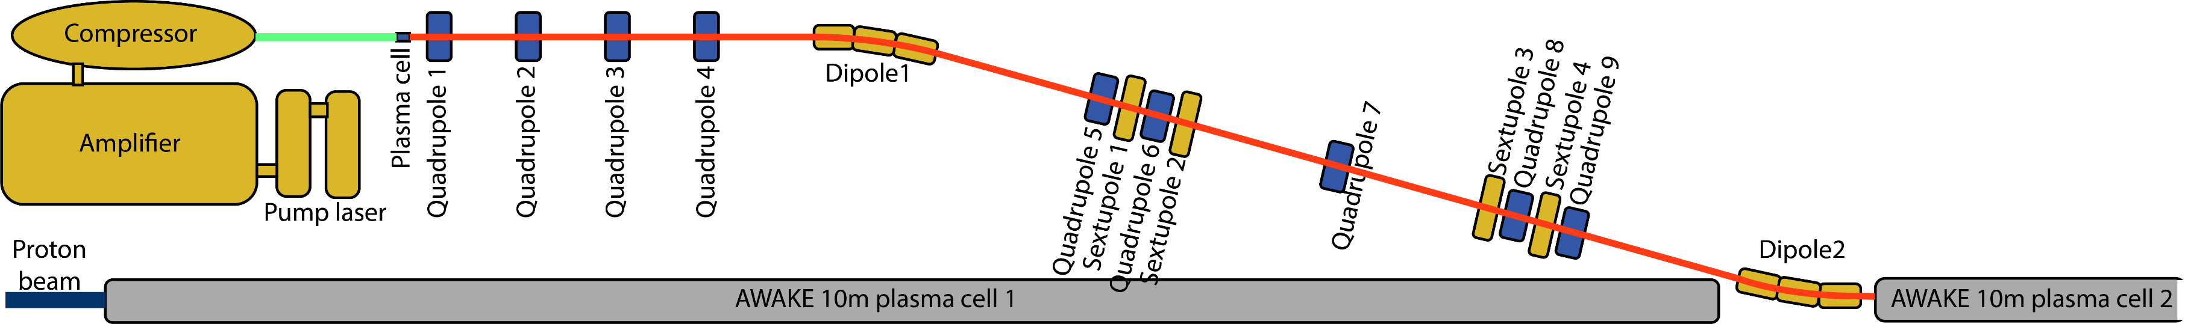
EARLI project

Slide 22
Goals
Scientific goals
Transition from lab experiments to full accelerators (for users)
Prove the reliability of LWFA for specific applications
Pave the way for future small-footprint laser-plasma-based facilities
Go toward more reliable laser technology and sustainable alternatives
Stepping stone for other projects such as AWAKE, EuPRAXIA, APOLLON, …
AWAKE goals
First LWFA accelerator at CERN
Transform AWAKE to a complete plasma accelerator where electrons are created and accelerated in plasmas only
Interesting alternative to the RF electron injector with possible smaller footprint
Tunability and upgradeability
Toward EARLI partners
Bridge the gap between experimental research and machine development and transfer knowledge
Possibility to industrialise the concept

Slide 23
Challenges
Challenges and issues that must be addressed
Beam parameters targeted for AWAKE were achieved separately. Such parameters had never been reached simultaneously
The 100 pC high charge of the beam with a low energy spread and emittance is a challenge
The repeatability of the LWFA must be achieved
The competition against the CERN photo-injector
Define an approach to design that focuses on beam physics

Slide 24
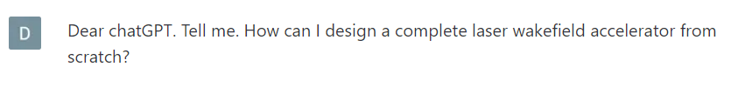
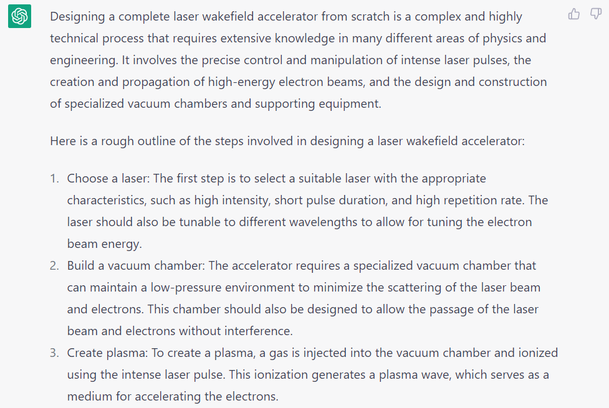
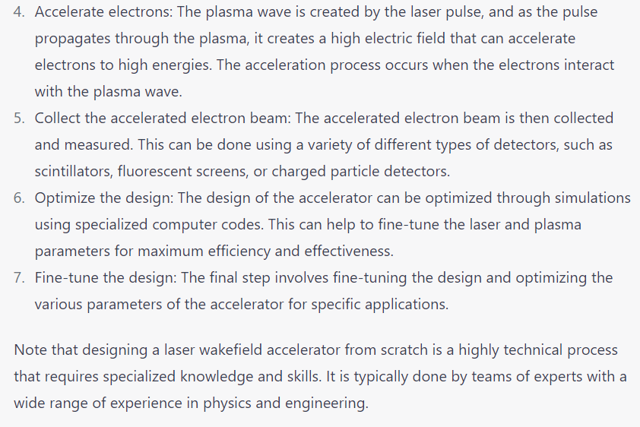
Design of a laser-plasma accelerator (asking an IA)
Choose a laser
Build a vacuum chamber
Create plasma
Accelerate electrons
Collect the accelerated electron beam
Optimize the design
Fine-tune the design
Correct way?

Slide 25
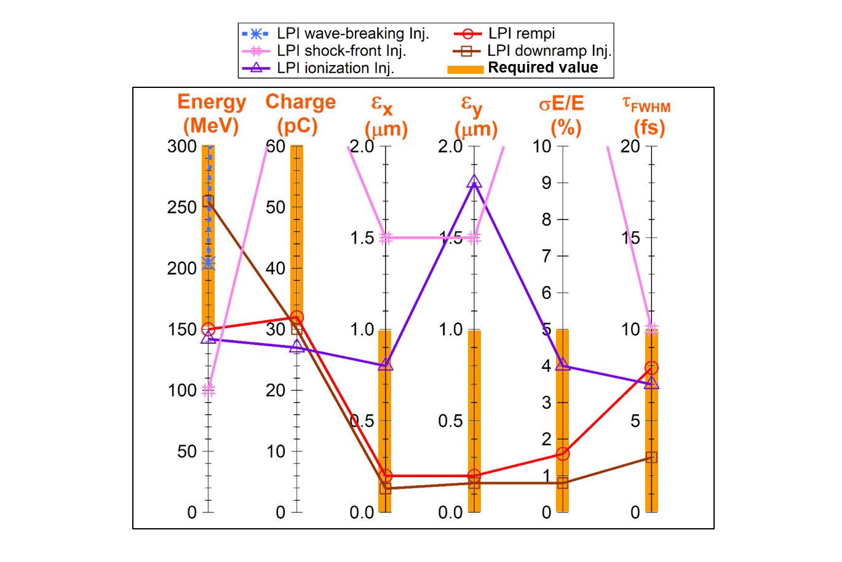
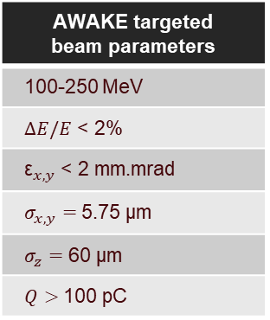
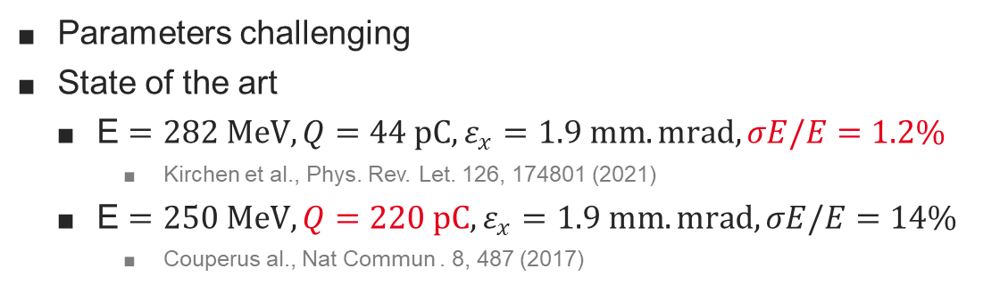
Design of a laser-plasma accelerator centered on beam physics
Example: EuPRAXIA's first optimization results
Assess the targeted beam parameters at the final user
AWAKE needs
Close to EuPRAXIA’s first LWFA stage
AWAKE targeted beam parameters
100-250 MeV
$ΔE/E$ < 2%
${\text{ε}}_{x,y}$ < 2 mm.mrad
$σ_{x,y}=$5.75 µm
$σ_{z}=$ 60 µm
$Q>$100 pC
EuPRAXIA Conceptual Design Report
Nghiem et al., PRAB (2020)
Parameters challenging
State of the art
E $=282 MeV,Q=44 pC,ε_{x}=1.9 mm.mrad,σE/E$ $=1.2\%$
Kirchen et al., Phys. Rev. Let. 126, 174801 (2021)
E $=250 MeV,Q=220 pC,ε_{x}=1.9 mm.mrad, σE/E=14\%$
Couperus al., Nat Commun . 8, 487 (2017)

Slide 26
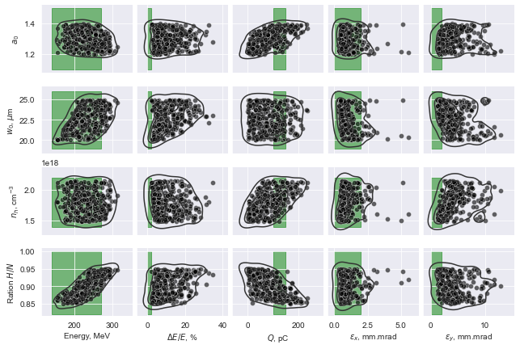
Design of a laser-plasma accelerator centered on beam physics
Explore the most promising configurations to reach these beam parameters, which can fit the available space
LWFA scheme and plasma density profile suitable for e- injection by ionisation (published data and team expertise)
Transfer line configuration with two dipoles and 8 quadrupoles
Laser configuration
Launch simulations and massive optimizations
From injection up to the final user, including plasma acceleration stage and transfer line
Exploration of parameter ranges of the 6D beam
Numerical + physics-based optimisations

Slide 27
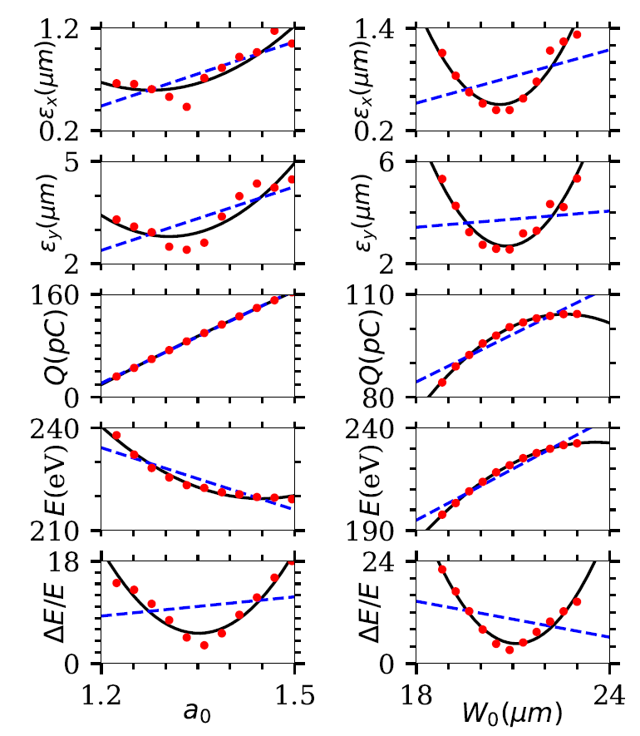
Design of a laser-plasma accelerator centered on beam physics
Estimate the reproducibility and stability, with error/tolerance analysis
Test experimental prototypes
Determine the needed beam measurements, their positions and their resolutions
Assess the feasibility
Cost, size, beam quality,…
Launch the fabrication of laser, plasma, magnetic and diagnostic components
Conduct the beam commissioning until targeted beam parameters are reached

Slide 28
Organisation
WP1 MANAGEMENT [B. CROS and D. MINENNA]
WP2 BEAM SIMULATION [CEA/IRFU]
Laser-plasma simulations
WP3 PLASMA CELL DESIGN AND TEST [LPGP/CNRS]
Plasma cell design and manufacturing
WP4 LASER SYSTEM DESIGN [Thales LAS]
Transfer line design, diagnostics and beam commissioning
Laser system design and manufacturing
Experimental tests on existing laser facilities
Laser reliability and remote control
Project management (WPs coordination, Funding)
Communications
Management of the requirements
Management of the configuration
Start-to-end beam dynamics
Steering committee from each organization
WP target?

Slide 29
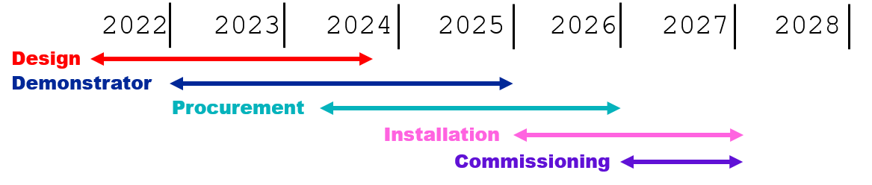
Timeline
June-August 2022
Creation of the project
First laser-plasma simulations
Preliminary design of the transfer line selected
September-November 2022
First transfer line simulations
Preliminary feasability investigation
December 2022-February 2023
First start-to-end simulations
First plasma prototypes
EARLI for AWAKE timeline

Slide 30
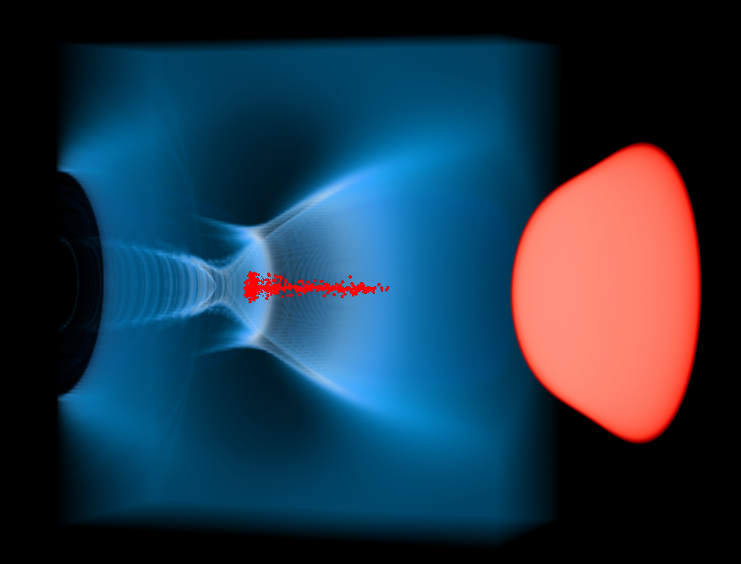
Thank you
Plasma electronic density
Electron beam
Laser
EARLI laser-plasma simulation

