Slide 1
“Innovate for Sustainable Accelerating Systems” – brief abstract
AMBITION – With the ambition to maintain the attractiveness and competitiveness of European research infrastructures and to enable Europe’s Green Deal, we propose to Innovate for Sustainable Accelerating Systems (iSAS) by establishing enhanced collaboration in the field to broaden, expedite and amplify the development and impact of novel energy-saving technologies to accelerate particles. The objective of iSAS is to innovate those technologies related to the cryomodule that have been identified as being a common core of SRF accelerating systems and that have the largest leverage for energy savings with a view to minimizing the intrinsic energy consumption in all phases of operation.
METHODOLOGY – Based on a recently established European R&D Roadmap for accelerator technology and based on a collaboration between leading European research institutions and industry, several interconnected technologies will be developed, prototyped, and tested, each enabling significant energy savings on their own in accelerating particles. The collection of energy-saving technologies will be developed with a portfolio of forthcoming applications in mind and to explore energy-saving improvements of existing research infrastructures on the ESFRI Roadmap, for example the ESFRI Landmarks HL-LHC, ESS and EuXFEL. Considering the developments realised, the new energy-saving technologies will be coherently integrated into the parametric design of a new accelerating system, a LINAC SRF cryomodule, optimised to achieve high beam-power in accelerators with an as low as reasonably possible energy consumption.
IMPACT – Through inter- and multidisciplinary research that delivers and combines various technologies, it is the long-term ambition of iSAS technologies to reduce the energy footprint of SRF accelerators in future research infrastructures by half, and even more when the systems are integrated in Energy-Recovery LINACs.

Slide 2
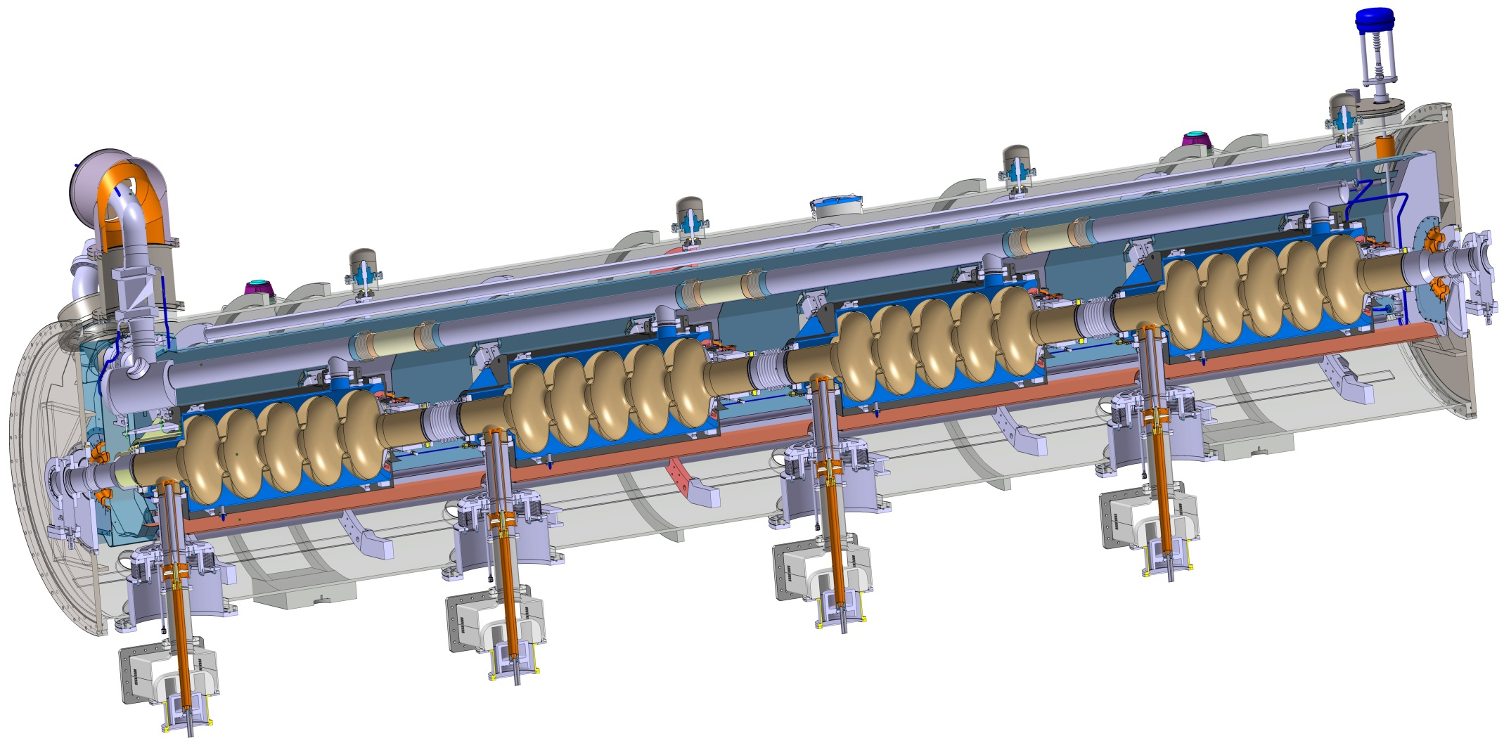
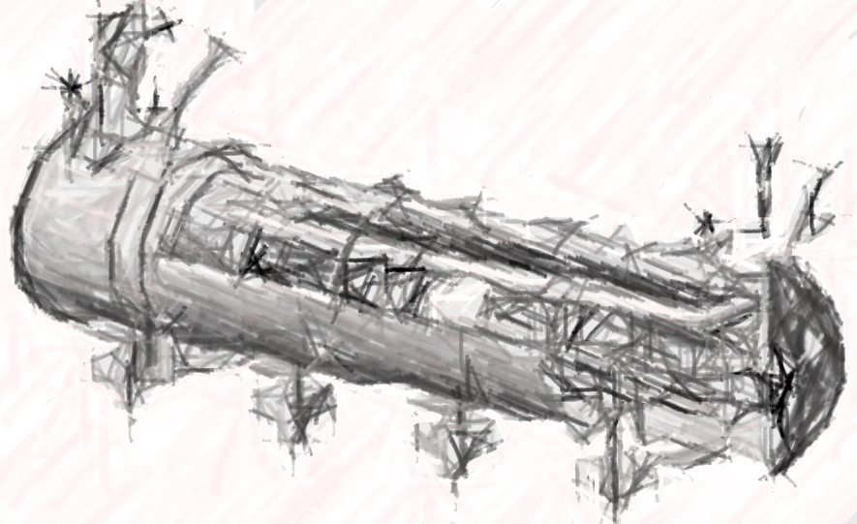
particle therapy
nanometer
semiconductors
INNOVATE TECHNOLOGIES TOWARDS
A SUSTAINABLE ACCELERATING SYSTEM
TODAY
NEW DESIGN

Slide 3
DEVELOP ENERGY-SAVING TECHNOLOGIES ESSENTIAL TO INTEGRATE IN THE DESIGN OF A SUSTAINABLE LINAC CRYOMODULE
particle therapy
nanometer
semiconductors
R&D Pathfinders for new
energy-saving technologies
TA: Technology Area

Slide 4
DEVELOP ENERGY-SAVING TECHNOLOGIES ESSENTIAL TO INTEGRATE IN THE DESIGN OF A SUSTAINABLE LINAC CRYOMODULE
particle therapy
nanometer
semiconductors
INT#1
R&D Pathfinders for new
energy-saving technologies
INTEGRATING
integrating new technologies in the design of a new sustainable LINAC cryomodule
TA: Technology Area, INT: Integration Activities

Slide 5
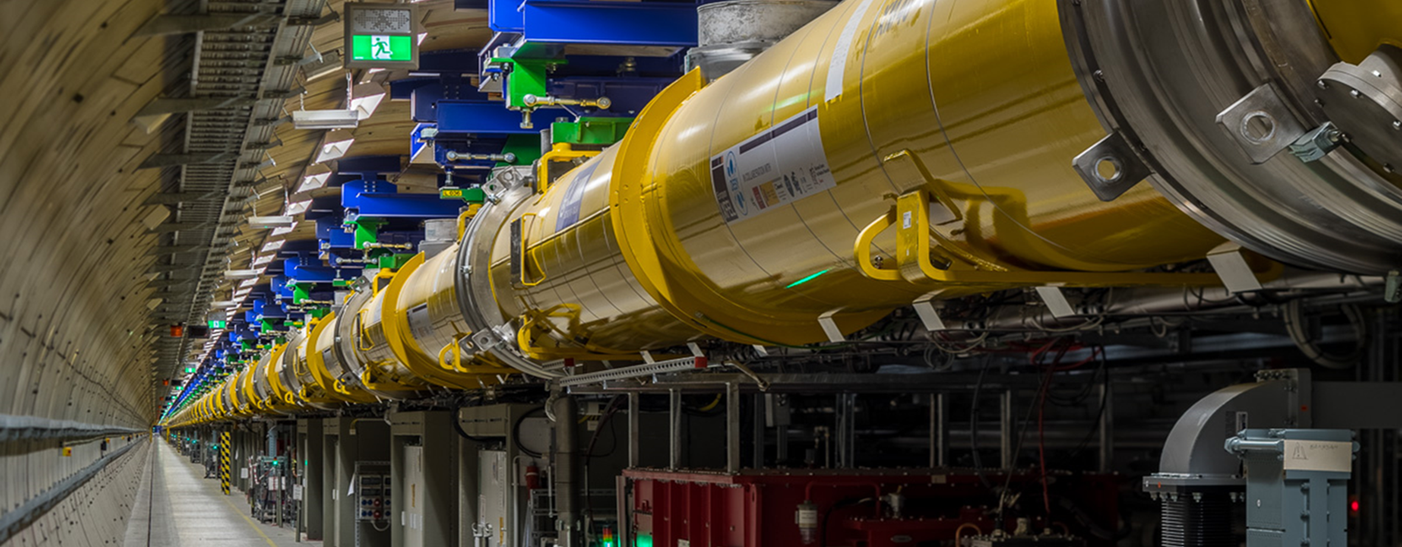
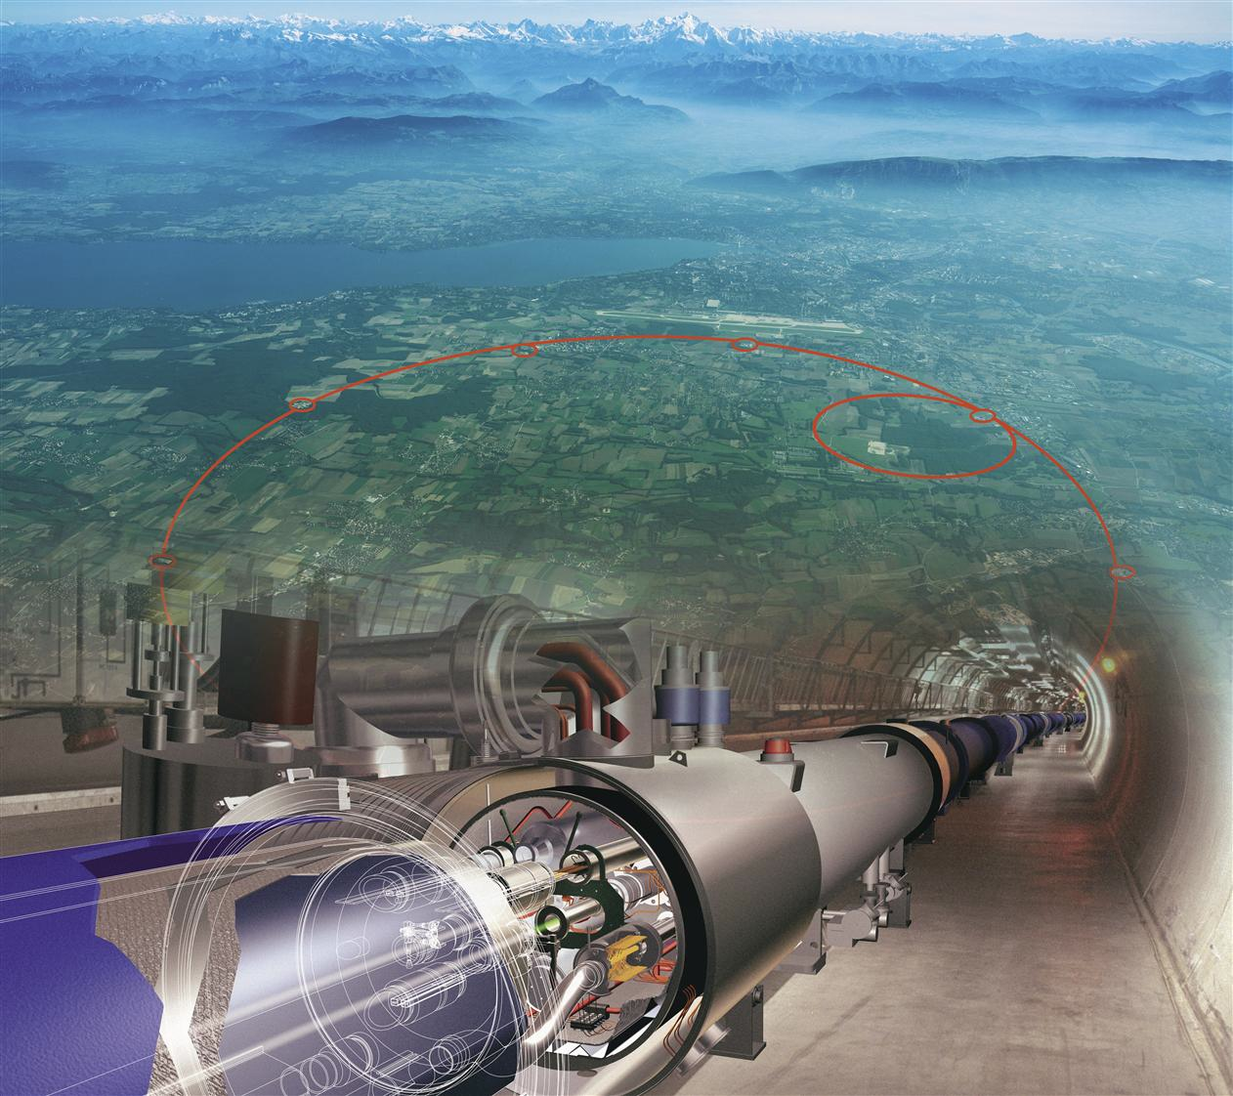
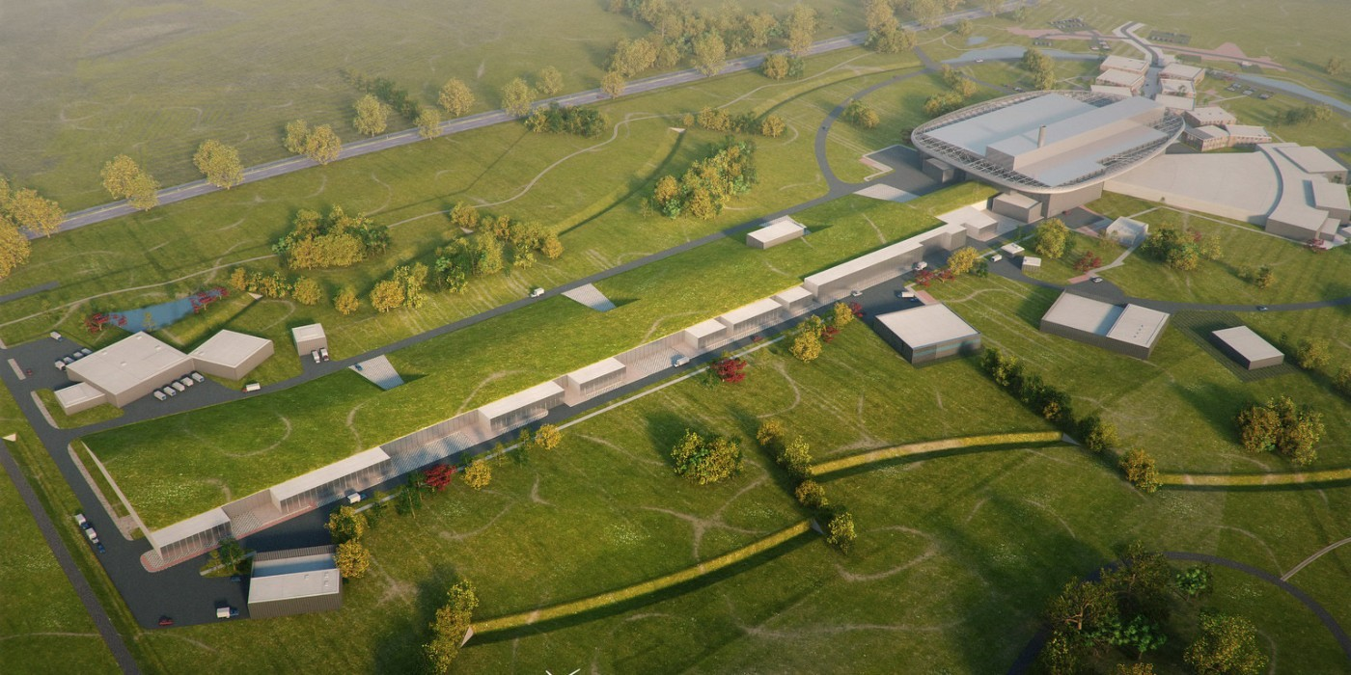
DEVELOP ENERGY-SAVING TECHNOLOGIES ESSENTIAL TO INTEGRATE IN THE DESIGN OF A SUSTAINABLE LINAC CRYOMODULE
particle therapy
nanometer
semiconductors
INT#1
R&D Pathfinders for new
energy-saving technologies
INTEGRATING
integrating new technologies in the design of a new sustainable LINAC cryomodule
SC XFELs
HL-LHC
ESS upgrade
INT#2: full deployment of energy saving in current and future accelerator RIs
TA: Technology Area, INT: Integration Activities
RIs: Research Infrastructures

Slide 6
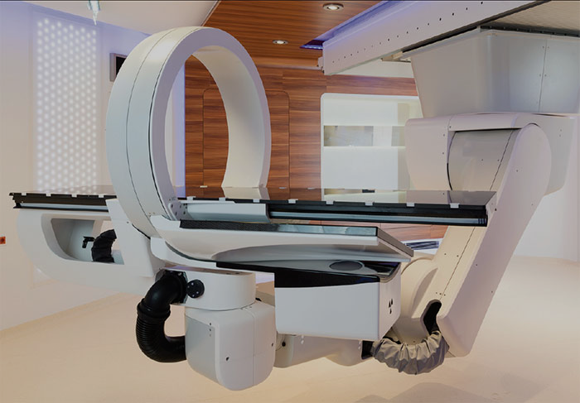

INT#3: accelerator turn-key solutions with breakthrough applications
particle therapy
DEVELOP ENERGY-SAVING TECHNOLOGIES ESSENTIAL TO INTEGRATE IN THE DESIGN OF A SUSTAINABLE LINAC CRYOMODULE
particle therapy
nanometer
semiconductors
nanometer
semiconductors
INT#1
R&D Pathfinders for new
energy-saving technologies
INTEGRATING
integrating new technologies in the design of a new sustainable LINAC cryomodule
SC XFELs
HL-LHC
ESS upgrade
INT#2: full deployment of energy saving in current and future accelerator RIs

Slide 7
iSAS Objectives – Technology Areas
TA#1: energy-savings from RF power – While great strides are being made in the energy efficiency of various RF power generators, the objective of iSAS is to ensure additional impactful energy savings through coherent integration of the RF power source with smart digital control systems and with novel tuners that compensate rapidly cavity detuning from mechanical vibrations, resulting in a further reduction of power demands by up to a factor of 3.
TA#2: energy-savings from cryogenics – While major progress is being made in reusing the heat produced in cryogenics systems, the objective of iSAS is to develop superconducting cavities that operate with high performance at 4.2 K (i.e., up to 4.5 K depending on the cryogenic overpressure) instead of 2 K, thereby reducing the grid-power to operate the cryogenic system by a factor of 3 and requiring less capital investment to build the cryogenic plant.
TA#3: energy-savings from the beam – Significant progress has been achieved in maintaining the brightness of recirculating beams to provide high-intensity collisions to experiments, but most of the particles lose their power through radiation or in the beam dump system. The objective of iSAS is to develop dedicated power couplers for damping the so-called Higher-Order Modes (HOMs) excited by the passage of high-current beams in the superconducting cavities, enabling efficient recovery of the energy of recirculating beams back into the cavities before it is dumped, resulting in energy reduction for operating, high-energy, high-intensity accelerators by a factor ten.

Slide 8
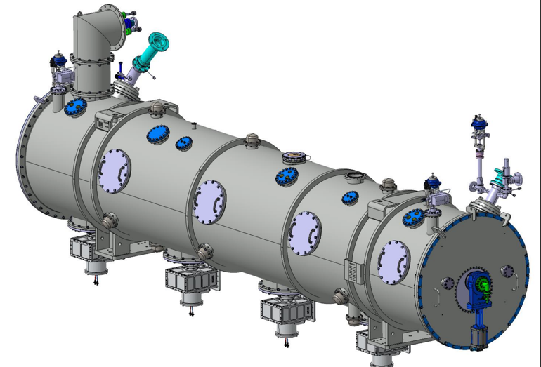
iSAS Objectives – Integration Activities
INT#1: integration into the design of a LINAC cryomodule While LINAC cryomodules are designed for specific accelerators, the objective of iSAS is to address the common engineering challenges of integrating iSAS energy-saving technologies into a parametric design of a new sustainable accelerator system.
INT#2: integration into existing RIs – While various RIs envisage upgrades, the objective of iSAS is to expedite the technical integration of energy-saving technologies by retrofitting existing accelerating systems. An existing cryomodule will be adapted, ready to demonstrate energy recovery of high-power recirculating beams in the PERLE research facility, paving the way for high-energy, high-intensity electron beams with minimal energy consumption.
INT#3: integration into industrial solutions – While iSAS technologies are emerging, the objective of iSAS is to plan for concrete co-developments with industry to expedite reaching a Technology Readiness Level (TRL) sufficiently advanced towards largescale deployment of the new energy-saving solutions at current and future RIs as well as to prepare the path for industrial applications. For many future RIs and industrial applications SRF is the enabling technology.

Slide 9
iSAS concrete Work Packages
R&D Pathfinders for three Technology Areas (TA) for energy-saving
  TA#1: energy savings from the RF power (short-term and very wide applications)
      WP.1: optimal integration of Ferro-Electric Fast Reactive Tuners (FE-FRT) to deal with microphonics (400, 800 and 1300 MHz)
      WP.2: low-level RF controls (LLRF controls incl. AI)
    TA#2: energy savings from the cryogenics (medium-term and wide applications)
      WP.3: high-temperature SRF cavities above 4.2 K (thin Nb₃Sn films on Cu)
    TA#3: energy savings from the beam (long-term and specific applications)
      WP.4: Higher-Order Mode damping and fundamental power couplers
INT#1: integrate these technologies into the design of a sustainable LINAC cryomodule
  WP.5: based on the ESS cryomodules, develop a parametric design for an optimally sustainable LINAC cryomodule, ready to be adapted and built for various future applications in industry and in accelerator RIs
INT#2: integrate these technologies into existing LINAC cryomodules at RIs
  WP.6: engineering aspects to integrate and test energy-saving iSAS technologies in a cryomodule, and verify the options to retrofit existing SRF systems at RIs, with a focus on ESS, HL-LHC, EuXFEL
INT#3: integrate towards turn-key solutions and applications in industry
      WP.7: prepare the co-developments with industrial partners such that when the new technologies and the new designed LINAC cryomodule are developed and validated, their Technology Readiness Level is sufficient such that industry can consider building them

Slide 10
iSAS cross coordination
The ambition of iSAS is to pave the way by developing common solutions for the engineering and industrial challenges to expedite the integration of energy-saving solutions.
The methodology to achieve the iSAS objectives is based on a profoundly cross-disciplinary fertilization
between different disciplines, from RF engineering to material science, electronics, mechanical engineering,
and cryogenics, with co-developments between leading research and industrial institutions.

Slide 11
iSAS develops, prototypes & validates SRF energy-saving technologies
TA#1: energy-savings from RF power
The objective is to significantly reduce the RF power sources and wall plug power for all SRF accelerators with ferro-electric fast reactive tuners (FE-FRTs) for control of transient beam loading and detuning by microphonics, and with optimal low level radio frequency (LLRF) and detuning control with legacy piezo based systems. iSAS will demonstrate operation of a superconducting cavity with FE-FRTs coherently integrated with AI-smart digital control systems to achieve low RF-power requirements.
Schematic overview to compensate detuning with new FE-FRTs avoiding large power overhead and to compensate with AI-smart control loop countermeasures via the LLRF steering of the RF amplifier the disturbances in SRF cavities that impact field stability

Slide 12
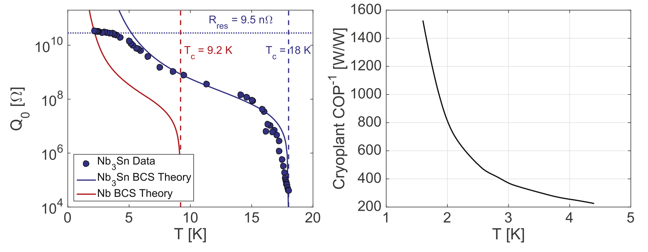
iSAS develops, prototypes & validates SRF energy-saving technologies
TA#2: energy-savings from cryogenics The objective is focused on the development of thin-film cavities and aims to transform conventional superconducting radio-frequency technology based on off-shelf bulk niobium operating at 2 K, into a technology operating at 4.2 K using a highly functionalized material, where individual functions are addressed by different layers. iSAS will optimize the coating recipe for Nb₃Sn on copper to optimize tunability and flux trapping of thin-film superconducting cavities and to validate a prototype beyond the achievements of the ongoing Horizon Europe I.FAST project.
Supercond. Sci. Technol. 30 (2017) 033004
The higher critical temperature (T_{c}) of Nb₃Sn allows for the maximum value of quality factor Q₀ for 1.3 GHz cavities to be achieved at operating temperatures of about 4 K compared to 2 K for Nb (left figure). The graph on the right shows the efficiency of a cryogenic plant (COP) as a function of temperature achieving about 3 times higher COP efficiency when operating at a temperature of 4.2 K than at 2 K. This suggests that operating a cryogenic plant at 4.2 K with Nb₃Sn SRF cavities, can lead to significant better performances and energy savings.

Slide 13
iSAS develops, prototypes & validates SRF energy-saving technologies
TA#3: energy-savings from the beam The objective is to reduce the total power deposited into the cryogenics circuits of the cryomodule of the Higher-Order Mode (HOM) couplers and fundamental power couplers (FPCs) leading to a significant reduction of the heat loads and the overall power consumption. iSAS will improve the energy efficiency of the FPCs and HOM couplers by designing and building prototypes that will be integrated into a LINAC cryomodule capable of energy-recovery operations and to be tested in accelerator-like conditions.
towards full high-power energy recovery

