Slide 1


Innovate for Sustainable Accelerating Systems
(iSAS)
Achille Stocchi
IJCLab(CNRS)/Paris-Saclay
Jorgen D’Hondt
Vrije Universiteit Brussel
Horizon Europe iSAS proposal, March 2023

Slide 2

The energy efficiency of present and future
accelerators […] is and should remain an area
requiring constant attention.
A detailed plan for the […] saving and re-use of
energy should be part of the approval process
for any major project.
European Strategy for Particle Physics 2020

Slide 3
Where do accelerators use power ?

Slide 4
Basic structures of a particle accelerator
particle production
beam preparation
beam acceleration
experiment
beam
dump

Slide 5
Basic structures of a particle accelerator
particle production
beam preparation
beam acceleration
experiment
beam
dump
cooling @ 2K

Slide 6
Basic structures of a particle accelerator
particle production
beam preparation
beam acceleration
experiment
beam
dump
∼50%
magnets ∼10%
others ∼35%
cooling @ 2K
∼5%
Typical power consumption for an electron-positron Higgs Factory
the highest priority next collider for particle physics
example FCC@250GeV

Slide 7
Basic structures of a particle accelerator
recover this
energy
reduce most of this energy
beam acceleration
particle production
beam preparation
beam acceleration
experiment
beam
dump
∼50%
∼50%
magnets ∼10%
others ∼35%
cooling @ 2K
∼5%
Typical power consumption for an electron-positron Higgs Factory
the highest priority next collider for particle physics
example FCC@250GeV

Slide 8
Power use for future HEP colliders example of Higgs Factories

Slide 9
Impact for the current designs of Higgs Factories
Linear colliders
Circular colliders
ACC
ACC
radiation
ACC
dump >99.9999% of
the beam power
FCC-ee@250 ≃ 300 MW
∼2% of annual electricity
consumption in Belgium
radiate away very quickly
the beam power
about half of this is dumped or lost due to radiation
OBJECTIVE: develop accelerator technologies that recover the beam energy with an impact of saving ∼1% of Belgium’s electricity

Slide 10
Impact for the current designs of Higgs Factories
Linear colliders
Circular colliders
ACC
ACC
radiation
ACC
dump >99.9999% of
the beam power
FCC-ee@250 ≃ 300 MW
∼4% of annual electricity
consumption in Belgium
radiate away very quickly
the beam power
Energy consumption is reducing in Europe, not excluded with ½ by 2050-2060
about half of this is dumped or lost due to radiation
OBJECTIVE: develop accelerator technologies that recover the beam energy with an impact of saving ∼2% of Belgium’s electricity

Slide 11
The enabling technology for modern accelerators is the Superconducting Radio Frequency (SRF) technology
The main energy-saving technologies for SRF systems are generally applicable
(e.g., ESS, EuXFEL, HL-LHC, …)

Slide 12

From Grid to Beam
RF power generation
GRID
cryogenics
Picture adopted from M. Seidel (IPAC 2022)

Slide 13
From Grid to Beam
RF power generation
efficiency ~30-60%
GRID
RF power load
by detuned cavities
∼ Δω²
beam power
dumped
or
radiated
cryogenics
dissipated heat
∼ 1/Q₀
efficiency
∼ T / (300K – T)
power-inefficiency

Slide 14
From Grid to Beam
improve amplifier efficiency
e.g. solid state amplifiers for oscillating power demands
RF power generation
recover the energy from the beam
e.g. ERL reaching
100% recovery
efficiency ~30-60%
GRID
RF power load
by detuned cavities
∼ Δω²
beam power
dumped
or
radiated
dealing with microphonics
e.g. Fast Reactive Tuners
cryogenics
dissipated heat
∼ 1/Q₀
mitigation with novel technologies
efficiency
∼ T / (300K – T)
operate cavities at higher T & improve Q₀ of cavities
e.g. Nb₃Sn from 2K to 4.2K ➔ 3x less cooling power needed

Slide 15
Three main iSAS Technology Areas
energy savings from the RF power
RF power generation
energy savings
from the beam
efficiency ~30-60%
GRID
RF power load
by detuned cavities
∼ Δω²
beam power
dumped
or
radiated
cryogenics
dissipated heat
∼ 1/Q₀
efficiency
∼ T / (300K – T)
energy savings
from the cryogenics

Slide 16
from the overall Accelerator R&D Roadmap
and in responds to a Horizon Europe call, we
Innovate for Sustainable Accelerating Systems (iSAS)
with focus on these three main iSAS Technology Areas (TAs) to develop energy-saving solutions for modern SRF accelerators
with support from
Enterprise Europe Network (EEN), EuXFEL GmbH, I.FAST, LEAPS, LDG and TIARA

Slide 17
“Innovate for Sustainable Accelerating Systems”
HORIZON-INFRA-2023-TECH-01-01
New technologies and solutions for reducing the environmental and climate footprint of RIs
REGULATIONS
Specific conditions
  Expected EU contribution per project: around 5M EUR.
  Consortia must include at least 3 different research infrastructures, each of them being an ESFRI infrastructure, and/or a European Research Infrastructures Consortium (ERIC) or another research infrastructure of European interest (i.e. a research infrastructure which is able to attract users from EU or associated countries other than the country where the infrastructure is located). Consortia should be built around a leading core of at least 3 world-class research infrastructures and can include a wider set of RIs.
  Other technological partners, including industry and SMEs, should also be involved, thus promoting innovation and knowledge sharing through co-development of new technical solutions for research infrastructures.
  Proposals should built on and explain any synergies and complementarities with previous or current EU grants, including those under other parts of the Framework Programmes.
Expected Outcome
Reduction of environmental impacts (including climate-related)
Optimisation of resource and energy consumption integrated through the full life cycle of research infrastructures
Increased long-term sustainability of European research infrastructures
Scope
      The aim of this topic is to deliver innovative technologies and solutions which reduce the environmental and climate footprint of RIs through the full life cycle of research infrastructures. Proposals should identify common methodologies, among the concerned RIs, to assess environmental impact and strategies to reduce it, as well as efficiency gains in the broader ecosystem.
      Proposals should address the following aspects, as relevant:
        new technologies and solutions for research infrastructures enabling transformative resource efficiency (e.g. energy consumption) and reduction of environmental (including climate-related) impacts, including, when relevant, more sustainable and efficient ways of collecting, processing and providing access to data;
        validation and prototyping;
        training of RI staff for the operation and use of the new solutions;
        action plans to deploy the new developments at wider scale and ensure their sustainability;
        measures to ensure an environmentally effective integration of the solutions in the local contexts;
        societal engagement to foster acceptance of the solutions in the local and regional communities.

Slide 18
“Innovate for Sustainable Accelerating Systems”
HORIZON-INFRA-2023-TECH-01-01
New technologies and solutions for reducing the environmental and climate footprint of RIs
A strong and broad impact with a 5M EUR EU-project
develop an impactful and well-motivated project that is also a catalyser for
the implementation of the Accelerator R&D Roadmap
Goal: develop, prototype and validate the essential energy-saving and energy-recovery SRF technologies to potentially retrofit existing Research Infrastructures and integrate in the design of a novel sustainable LINAC cryomodule with a broad portfolio of future applications in industry and at accelerator Research Infrastructures
Sustain the impactful 20th-century accelerator applications into an energy-low 21st century!
REGULATIONS
Specific conditions
  Expected EU contribution per project: around 5M EUR.
  Consortia must include at least 3 different research infrastructures, each of them being an ESFRI infrastructure, and/or a European Research Infrastructures Consortium (ERIC) or another research infrastructure of European interest (i.e. a research infrastructure which is able to attract users from EU or associated countries other than the country where the infrastructure is located). Consortia should be built around a leading core of at least 3 world-class research infrastructures and can include a wider set of RIs.
  Other technological partners, including industry and SMEs, should also be involved, thus promoting innovation and knowledge sharing through co-development of new technical solutions for research infrastructures.
  Proposals should built on and explain any synergies and complementarities with previous or current EU grants, including those under other parts of the Framework Programmes.
Expected Outcome
Reduction of environmental impacts (including climate-related)
Optimisation of resource and energy consumption integrated through the full life cycle of research infrastructures
Increased long-term sustainability of European research infrastructures
Scope
      The aim of this topic is to deliver innovative technologies and solutions which reduce the environmental and climate footprint of RIs through the full life cycle of research infrastructures. Proposals should identify common methodologies, among the concerned RIs, to assess environmental impact and strategies to reduce it, as well as efficiency gains in the broader ecosystem.
      Proposals should address the following aspects, as relevant:
        new technologies and solutions for research infrastructures enabling transformative resource efficiency (e.g. energy consumption) and reduction of environmental (including climate-related) impacts, including, when relevant, more sustainable and efficient ways of collecting, processing and providing access to data;
        validation and prototyping;
        training of RI staff for the operation and use of the new solutions;
        action plans to deploy the new developments at wider scale and ensure their sustainability;
        measures to ensure an environmentally effective integration of the solutions in the local contexts;
        societal engagement to foster acceptance of the solutions in the local and regional communities.

Slide 19
“Innovate for Sustainable Accelerating Systems” – abstract
AMBITION – Particle accelerators have become essential instruments to improve our health, the environment, our safety, and our high-tech abilities, as well as to unlock new fundamental insights in physics, chemistry, biology, and generally enable scientific breakthroughs that improve our lives. Accelerating particles to higher energies will always require a large amount of energy. In a society where energy sustainability is critical, keeping energy consumption as low as reasonable possible is an unavoidable challenge for both research infrastructures (RIs) and industry, which collectively operate over 40,000 accelerators. Based on state-of-the-art technology, the portfolio of current and future accelerator-driven RIs in Europe could develop to consume up to 1% of Germany's annual electricity demand. With the ambition to maintain the attractiveness and competitiveness of European RIs and to enable Europe’s Green Deal, we propose to Innovate for Sustainable Accelerating Systems (iSAS) by establishing enhanced collaboration in the field to broaden, expedite and amplify the development and impact of novel energy-saving technologies to accelerate particles. For many frontier accelerators superconducting RF (SRF) systems are the enabling technology. The objective of iSAS is to innovate those technologies that have been identified as being a common core of SRF accelerating systems and that have the largest leverage for energy savings with a view to minimizing the intrinsic energy consumption in all phases of operation. In the landscape of accelerator-driven RIs, solutions are being developed to reuse the waste heat produced, to develop energy-efficient magnets and to operate facilities on opportunistic schedules when energy is available. The iSAS project has a complementary focus on the energy efficiency of the SRF accelerating technologies themselves. This will contribute to the vital transition to sustain the tremendous 20th century applications of the accelerator technology in a green and energy conscious 21st century.

Slide 20
“Innovate for Sustainable Accelerating Systems” – abstract
METHODOLOGY – Based on a recently established European R&D Roadmap for accelerator technology and based on a collaboration between leading European research institutions and industry, several interconnected technologies will be developed, prototyped, and tested, each enabling significant energy savings on their own in accelerating particles. The collection of energy-saving technologies will be developed at these unique R&D Pathfinder labs with a portfolio of forthcoming applications in mind and to explore energy-saving improvements of existing RIs on the ESFRI Roadmap, for example the ESFRI Landmarks HL-LHC, ESS and EuXFEL. Considering the developments realised, the new technologies will be coherently integrated into the parametric design of a new accelerating system, a LINAC SRF cryomodule, optimised to achieve high beam-power in accelerators with an as low as reasonably possible energy consumption. This new cryomodule design will enable Europe to develop and build future energy-sustainable accelerators. The timescale to innovate, prototype and test new accelerator technologies is inherently long, in some cases longer than the typical duration of R&D projects. It is therefore essential to continue to collaborate and enhance the R&D process so that energy-sustainable technologies can be implemented without delay to avoid hampering scientific and industrial progress enabled by accelerators. Accordingly, iSAS plans to leverage operating European projects and plans for impactful co-development with industrial partners to jointly achieve a technology readiness level sufficient to enter the phase of large-scale production of the new technologies.

Slide 21
“Innovate for Sustainable Accelerating Systems” – abstract
IMPACT – While the readiness of several energy-saving technologies will be prepared towards industrialisation with impact on current RIs, iSAS is also the pathfinder for sustainable future SRF particle accelerators and colliders. Through inter- and multidisciplinary research that delivers and combines various technologies, it is the long-term ambition of iSAS technologies to reduce the energy footprint of SRF accelerators in future RIs by half, and even more when the systems are integrated in Energy-Recovery LINACs. Unlocked by iSAS, Europe’s leadership will be maintained for breakthroughs in fundamental sciences and will help enable high-energy collider technology to go beyond the current frontiers of energy and intensity in an energy-sustainable way. In parallel, the new sustainable technologies will empower and stimulate European industry to conceive a portfolio of new applications and to take a leading role in, for example, the semiconductor, particle therapy, security, and environmental sectors.

Slide 22
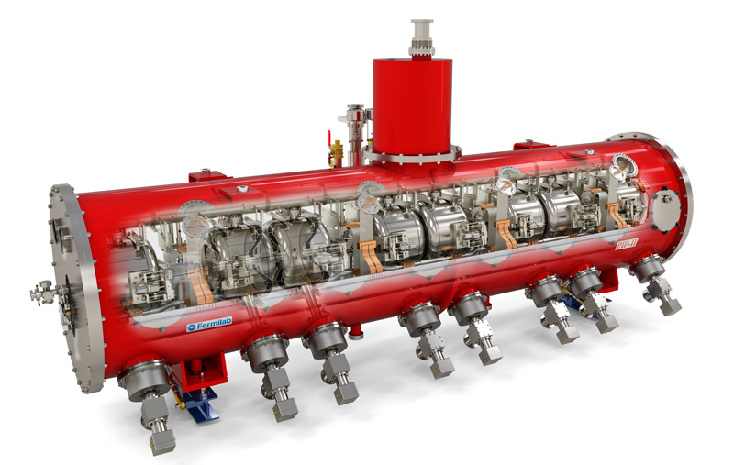
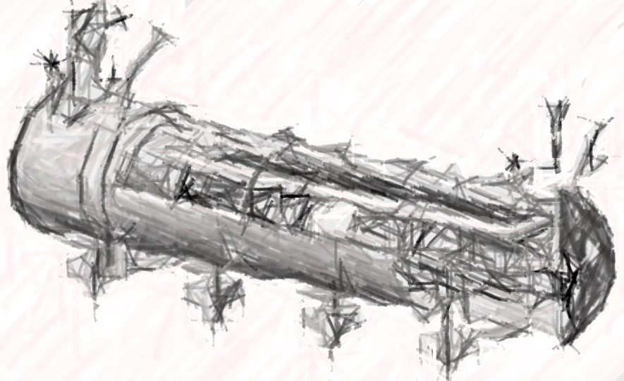
particle therapy
nanometer
semiconductors
INNOVATE TECHNOLOGIES TOWARDS
A SUSTAINABLE ACCELERATING SYSTEM
TODAY
NEW DESIGN

Slide 23
DEVELOP ENERGY-SAVING TECHNOLOGIES ESSENTIAL TO INTEGRATE IN THE DESIGN OF A SUSTAINABLE LINAC CRYOMODULE
particle therapy
nanometer
semiconductors
R&D Pathfinders for new
energy-saving technologies
TA: Technology Area

Slide 24
DEVELOP ENERGY-SAVING TECHNOLOGIES ESSENTIAL TO INTEGRATE IN THE DESIGN OF A SUSTAINABLE LINAC CRYOMODULE
particle therapy
nanometer
semiconductors
INT#1
R&D Pathfinders for new
energy-saving technologies
INTEGRATING
integrating new technologies in the design of a new sustainable LINAC cryomodule
TA: Technology Area, INT: Integration Activities

Slide 25
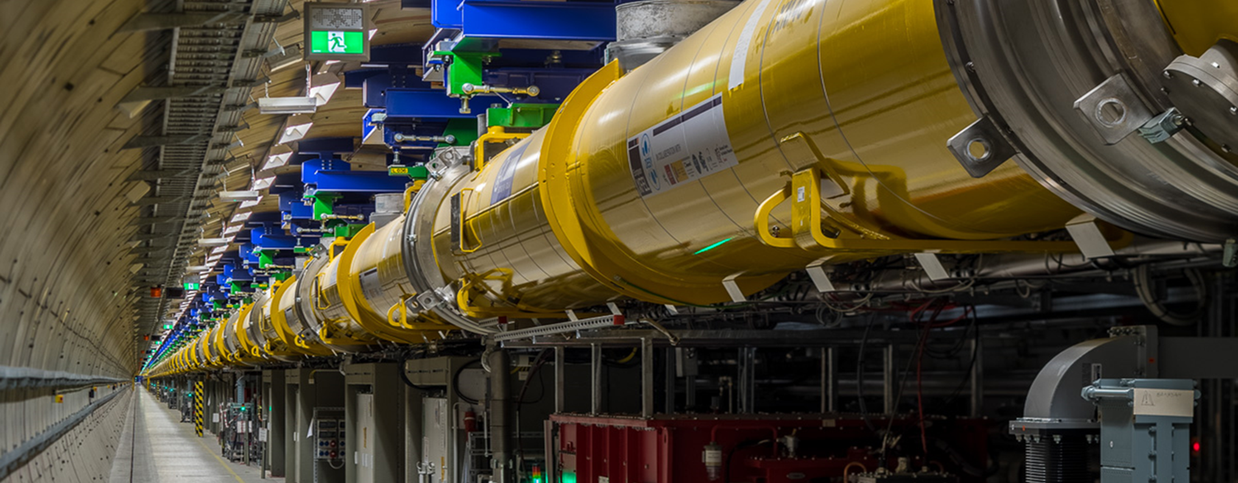
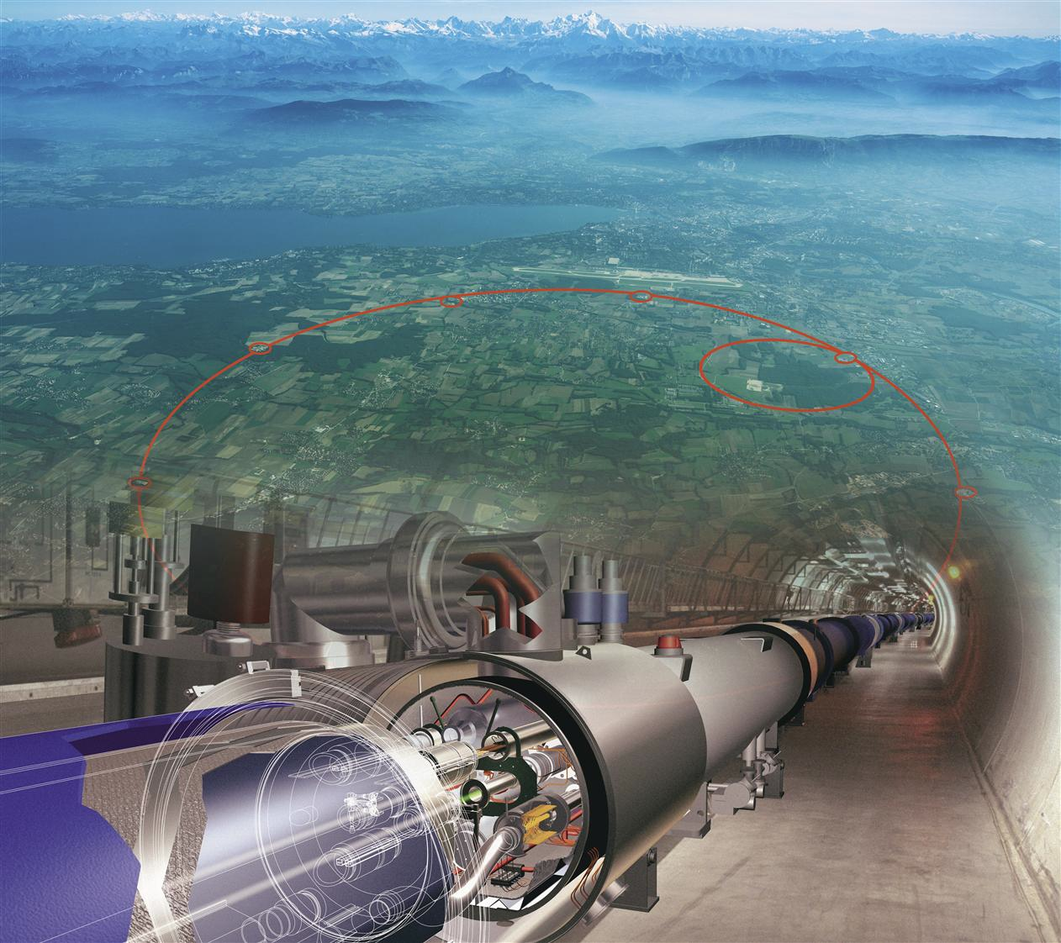
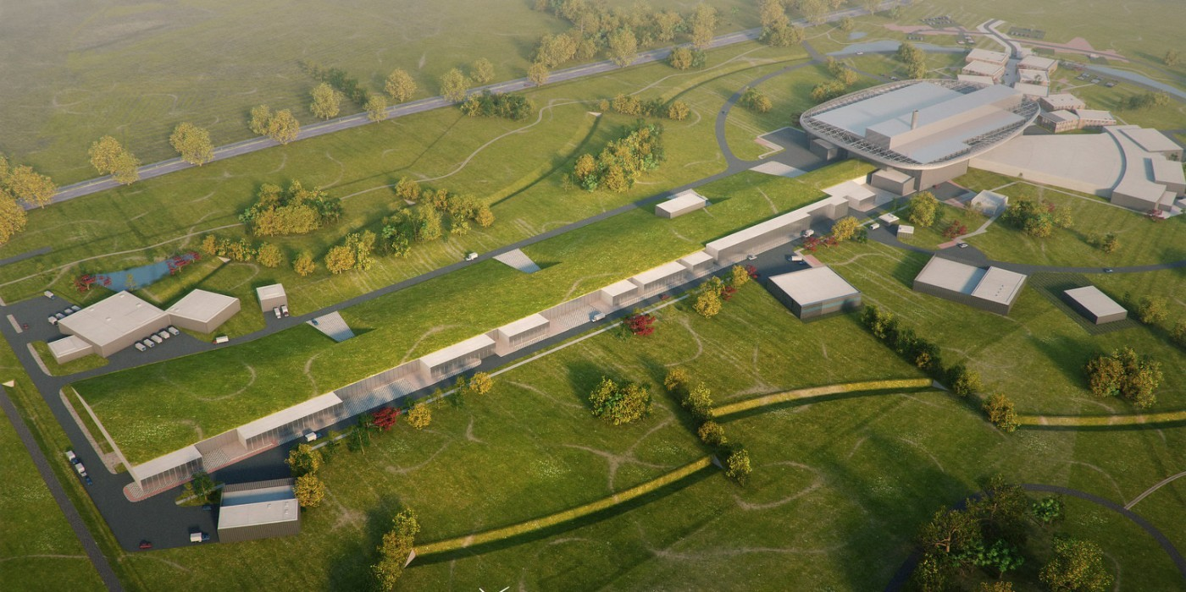
DEVELOP ENERGY-SAVING TECHNOLOGIES ESSENTIAL TO INTEGRATE IN THE DESIGN OF A SUSTAINABLE LINAC CRYOMODULE
particle therapy
nanometer
semiconductors
INT#1
R&D Pathfinders for new
energy-saving technologies
INTEGRATING
integrating new technologies in the design of a new sustainable LINAC cryomodule
SC XFELs
HL-LHC
ESS upgrade
INT#2: full deployment of energy saving in current and future accelerator RIs
TA: Technology Area, INT: Integration Activities

Slide 26
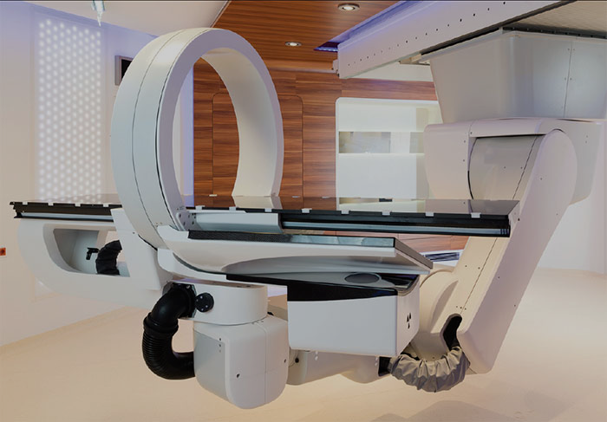

INT#3: accelerator turn-key solutions with breakthrough applications
DEVELOP ENERGY-SAVING TECHNOLOGIES ESSENTIAL TO INTEGRATE IN THE DESIGN OF A SUSTAINABLE LINAC CRYOMODULE
particle therapy
nanometer
semiconductors
INT#1
R&D Pathfinders for new
energy-saving technologies
INTEGRATING
integrating new technologies in the design of a new sustainable LINAC cryomodule
SC XFELs
HL-LHC
ESS upgrade
INT#2: full deployment of energy saving in current and future accelerator RIs
TA: Technology Area, INT: Integration Activities

Slide 27
“Innovate for Sustainable Accelerating Systems” (iSAS) – Technology Areas
TA#1: energy-savings from RF power – While great strides are being made in the energy efficiency of various RF power generators, the objective of iSAS is to ensure additional impactful energy savings through coherent integration of the RF power source with smart digital control systems and with novel tuners that compensate rapidly cavity detuning from mechanical vibrations, resulting in a further reduction of power demands by up to a factor of 3.
TA#2: energy-savings from cryogenics – While major progress is being made in reusing the heat produced in cryogenics systems, the objective of iSAS is to develop superconducting cavities that operate with high performance at 4.2 K (i.e., up to 4.5 K depending on the cryogenic overpressure) instead of 2 K, thereby reducing the grid-power to operate the cryogenic system by a factor of 3 and requiring less capital investment to build the cryogenic plant.
TA#3: energy-savings from the beam – Significant progress has been achieved in maintaining the brightness of recirculating beams to provide high-intensity collisions to experiments, but most of the particles lose their power through radiation or in the beam dump system. The objective of iSAS is to develop dedicated power couplers for damping the so-called Higher-Order Modes (HOMs) excited by the passage of high-current beams in the superconducting cavities, enabling efficient recovery of the energy of recirculating beams back into the cavities before it is dumped, resulting in energy reduction for operating, high-energy, high-intensity accelerators by a factor ten.

Slide 28
“Innovate for Sustainable Accelerating Systems” (iSAS) – Integration Activities
INT#1: integration into the design of a sustainable LINAC cryomodule – While LINAC cryomodules are designed for specific accelerators, the objective of iSAS is to address the common engineering challenges of integrating iSAS technologies into a parametric design of a new sustainable accelerator system.
INT#2: integration into existing RIs – While various RIs envisage upgrades, the objective of iSAS is to expedite the technical integration of energy-saving technologies by retrofitting existing accelerating systems. A cryomodule will be adapted, ready to demonstrate energy recovery of high-power recirculating beams in the PERLE research facility, paving the way for high-energy, high-intensity electron beams with minimal energy consumption.
INT#3: integration into industrial solutions – While iSAS technologies are emerging, the objective of iSAS is to plan for concrete co-developments with industry to expedite reaching a TRL sufficiently advanced towards largescale deployment of the new energy-saving solutions at current and future RIs as well as to prepare the path for industrial applications. For many future RIs and industrial applications SRF is the enabling technology.

Slide 29
“Innovate for Sustainable Accelerating Systems” (iSAS) – concrete Work Packages
R&D Pathfinders for three Technology Areas (TA) for energy-saving
  TA#1: energy savings from the RF power (short-term and very wide applications)
      WP.1: optimal integration of Ferro-Electric Fast Reactive Tuners (FE-FRT) to deal with microphonics (400, 800 and 1300 MHz)
      WP.2: low-level RF controls (LLRF controls incl. AI)
    TA#2: energy savings from the cryogenics (medium-term and wide applications)
      WP.3: high-temperature SRF cavities above 4.2K (thin Nb₃Sn films on Cu)
    TA#3: energy savings from the beam (long-term and specific applications)
      WP.4: Higher-Order Mode damping and fundamental power couplers
INT#1: integrate these technologies into the design of a sustainable LINAC cryomodule
  WP.5: based on the ESS cryomodules, develop a parametric design for an optimally sustainable LINAC cryomodule, ready to be adapted and built for various future applications in industry and in accelerator RIs
INT#2: integrate these technologies into existing LINAC cryomodules at RIs
  WP.6: engineering aspects to integrate and test energy-saving iSAS technologies in a cryomodule, and verify the options to retrofit existing SRF systems at RIs, with a focus on ESS, HL-LHC, EuXFEL
INT#3: integrate towards turn-key solutions and applications in industry
      WP.7: prepare the co-developments with industrial partners such that when the new technologies and the new designed LINAC cryomodule are developed and validated, their Technology Readiness Level is sufficient such that industry can consider building them

Slide 30
“Innovate for Sustainable Accelerating Systems” (iSAS) – cross coordination
The ambition of iSAS is to pave the way by developing common solutions for the engineering and industrial challenges to expedite the integration of energy saving solutions.
The methodology to achieve the iSAS objectives is centered on a profoundly cross-disciplinary fertilization
between different disciplines, from RF engineering to material science, electronics, mechanical engineering,
and cryogenics, with co-developments between leading research and industrial institutions.

Slide 31
“Innovate for Sustainable Accelerating Systems” (iSAS) – Technical objectives
TA#1: energy-savings from RF power – The objective is to significantly reduce the RF power sources and wall plug power for all SRF accelerators with ferro-electric fast reactive tuners (FE-FRTs) for control of transient beam loading and detuning by microphonics, and with optimal LLRF and detuning control with legacy piezo based systems. iSAS will demonstrate operation of a superconducting cavity with FE-FRTs coherently integrated with AI-smart digital control systems to achieve low RF-power requirements.
TA#2: energy-savings from cryogenics – The objective is focused on the development of thin-film cavities and aims to transform conventional superconducting radio-frequency technology based on off-shelf bulk niobium operating at 2 K, into a technology operating at 4.2 K using a highly functionalized material, where individual functions are addressed by different layers. iSAS will optimize the coating recipe for Nb₃Sn on copper to optimize tunability and flux trapping of thin-film superconducting cavities and to validate a prototype beyond the achievements of the ongoing Horizon Europe I.FAST project.
TA#3: energy-savings from the beam – The objective is to reduce the total power deposited into the cryogenics circuits of the cryomodule of the Higher-Order Mode (HOM) couplers and fundamental power couplers (FPCs) leading to a significant reduction of the heat loads and the overall power consumption. iSAS will improve the energy efficiency of the FPCs and HOM couplers by designing and building prototypes that will be integrated into a LINAC cryomodule capable of energy-recovery operations and to be tested in accelerator-like conditions.

Slide 32
Technology Readiness Level (TRL)
The readiness of the energy-saving iSAS technologies will be improved to prepare them towards industrialisation and cost-effective mass production for current and future RIs.
The objective of iSAS is for RIs and European industry to co-develop industrial solutions for energy-savings technologies in accelerators, delivering applications that can be implemented across various accelerator-driven research and non-research infrastructures.

Slide 33
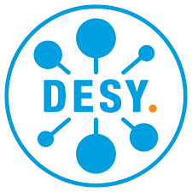










iSAS organisation
~1000 person-months of researchers and ~12.6M EUR
(of which 5M EUR is requested to Horizon Europe)
+ industrial companies: ACS Accelerators and Cryogenic Systems (France), RI Research Instruments GmbH (Germany), Cryoelectra GmbH (Germany), TFE Thin Film equipment srl (Italy), Zanon Research (Italy), EuclidTechLab (USA)

Slide 34
Governing Board
Chair: Dave Newbold (STFC)
All (associate) partner institutes
Coordination Panel
Scientific Coordinator: Jorgen D’Hondt (Uni Brussels)
Deputy Scientific Coordinators: Giovanni Bisoffi (INFN) & Jens Knobloch (HZB)
Project Coordinator and Office: Achille Stocchi (CNRS)
External Relations: Maud Baylac (CNRS)
Ex-officio: chair Governing Board & chair Advisory Board
Advisory Board
Chair: Frederick Bordry (CERN)
International experts
Integration Activities
Management WP9
Coordination & Management
CNRS team coordinated by Ketel Turzo (CNRS)
WP5 INT#1
Design new CM
Nuno Elias
(ESS)
WP6 INT#2
Existing RIs
Guillaume Olry
(CNRS)
WP7 INT#3
Industry
Giorgio Keppel
(INFN)
WP1 FE-FRT Axel Neumann (HZB)
Societal Impact WP8
WP2 LLRF Holger Schlarb (DESY)
Task#1: Training & Early Career
Task#2: Outreach & Dissemination
Task#3: Diversity & Equity
Task#4: Open Science
CNRS team coordinated by Ketel Turzo (CNRS)
Technology Areas
WP3 4K Cavity Cristian Pira (INFN)
WP4 HOM & FPC Yolanda Gomez-Martinez (CNRS)
Industry Board
Steering Committee

Slide 35
Innovate for Sustainable Accelerating Systems (iSAS)
As the main pathfinder to enable sustainable SRF accelerators, with iSAS the most impactful new energy-saving technologies will be developed, validated, and integrated towards industrial solutions with a direct and verifiable impact on current RIs and their upgrades.
The outcomes of iSAS are expected to help reshape what is feasible in the future CW SRF accelerator landscape.
In the long term, the impact of iSAS is to reduce the energy footprint of future SRF accelerators in RIs by at least half and to unlock new facilities that maintain Europe's leading position to enable fundamental science breakthroughs in an energy sustainable manner.
The new sustainable technologies will stimulate the European industry to take a leading role in building cost- and energy-efficient SRF systems for new accelerators with impact in, for example, the semiconductor and medical sectors.

